Slide 1
The UCLH Proton Beam Therapy Centre
Simon Jolly
University College London
VHEE’17, Daresbury

Slide 2


UK Overseas PBT Programme
Since 2008 NHS England has approved:
  345 Adults
  791 Children
Quality Inspections – 3 Overseas Centres
Commissioning via Evidence Based Policies
All cases reviewed by National Expert Panel
  Outcomes tracking programme
Adult:
  Base of Skull & Spinal Chordoma
  Base of Skull Chondrosarcoma
  Spinal & Paraspinal Bone and Soft Tissue Sarcomas (Non Ewing’s)
Paediatric:
  Base of Skull & Spinal Chordoma
  Base of Skull Chondrosarcoma
  Spinal & Paraspinal ‘adult type’ Bone and Soft Tissue Sarcomas
  Rhabdomyosarcoma
  Orbit
  Parameningeal & Head & Neck
  Pelvis
  Ependymoma
  Ewing’s Sarcoma
  Retinoblastoma
  Pelvic Sarcoma
  Optic Pathway and other selected Low Grade Glioma
  Craniopharyngioma
  Pineal Parenchymal Tumours (not Pineoblastoma)
  Esthesioneuroblastoma

Slide 3
NHS PBT: Recent History
2007 Cancer Reform Strategy
  Recommended Treatment Overseas and Explore Business Case UK based centre(s).
2008 Overseas Programme
  Within NHS Highly Specialised Commissioning.
2010 the ‘Trust Beauty Contest’:
  The Christie Hospital, Manchester.
  UCLH, London.
2011 Strategic Outline Case England.
Ministerial Approval.
2015 Full Business Case Approved.

Slide 4
NHS England Patient Mix
Cancers approved for proton therapy in England
(Total = 1,666)
Paediatric:
  Chordoma
  Chondrosarcoma
  Rhabdomyosarcoma
    Parameningeal
    Pelvic
    Orbit
    H&N
  Osteosarcoma
  Ewing’s
  PPNET
  Ependymoma
  Low Grade Glioma
  Optic pathway Glioma
  Craniopharyngioma
  Medulloblastoma
  Hodgkins
  Retinoblastoma
Adult:
  Choroidal Melanoma
  Ocular / Orbital
  Chordoma
  Chondrosarcoma
  Para-spinal Sarcoma
  Paranasal Sinuses
  Meningioma
  Acoustic Neuroma
  Craniospinal RT – pineal
  Teenage & Young Adult
  Atypical Cases Common Indications
Ocular (9%)
Head and Neck (20%)
Brain (16%)
Complex cases (20%)
Paediatric (17%)
Sarcoma (18%)

Slide 5
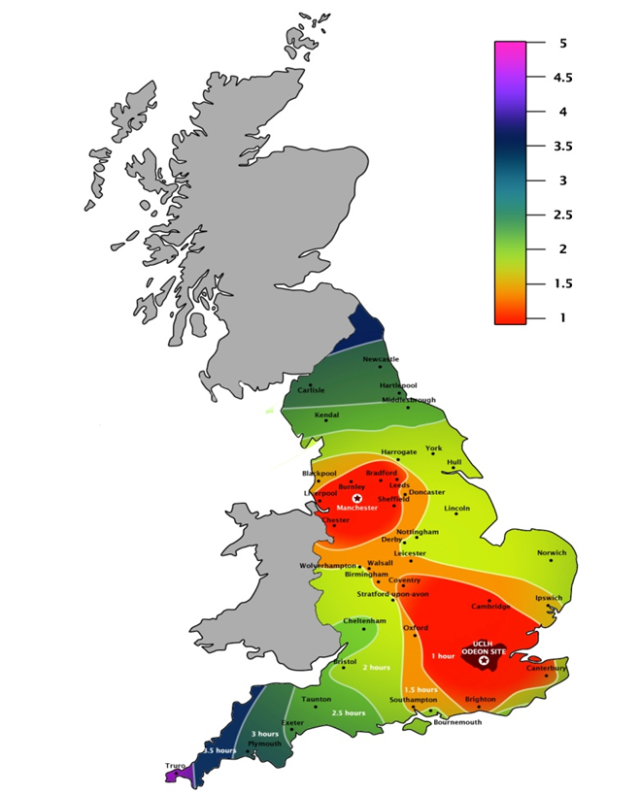


NHS England PBT Service
New national service on two sites:
  Manchester – 3 treatment rooms
  London – 3 treatment rooms
Pencil beam scanning only: 70–245 MeV.
Full 360º rotating gantries.
Joint Equipment Procurement
Christie Started building July 2015:
  Cyclotron delivery 22/06/2017
  On Track for first patient 101/08/2018
UCLH Started building December 2015:
  First patient planned for September 2020
First patients:
  Manchester: 2018
  London: 2020

Slide 6
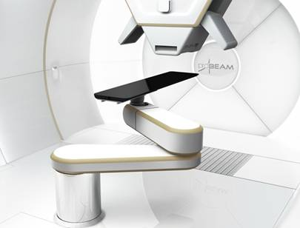
Operational Expectations
Facility opening times:
24 Hours/day
Clinical time:
  5 days per week
  14 Hours per day
Outside treatment hours:
  Quality Assurance Checks
  Maintenance Requirements
  Research

Slide 7
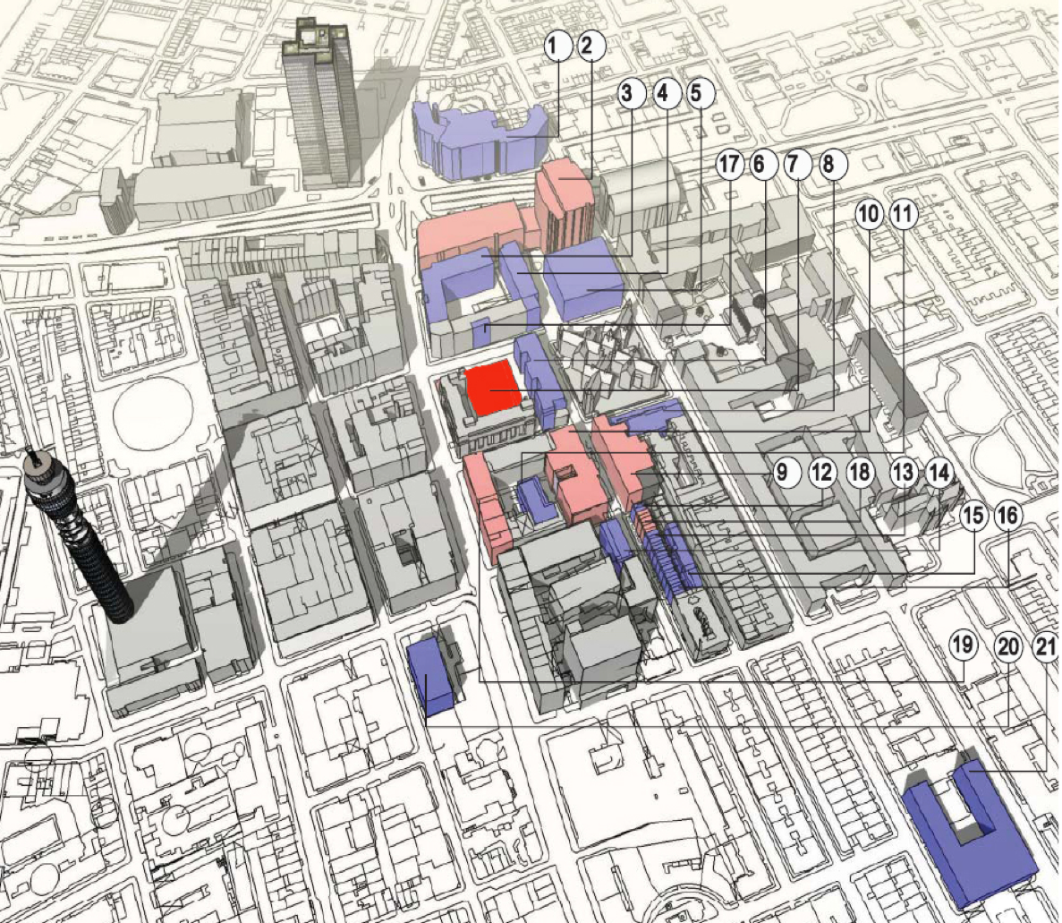
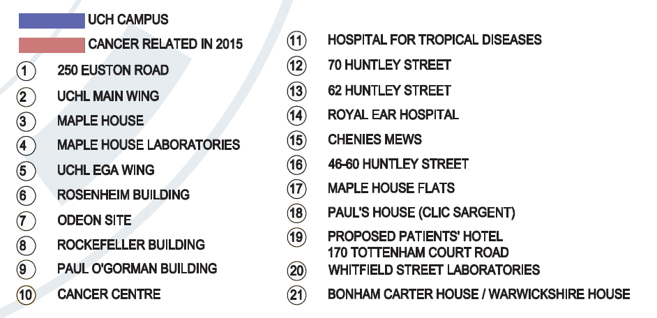
UCL Cancer Campus (2015)
UCLH CAMPUS
UCL CAMPUS
Clinical cancer
Proton centre

Slide 8
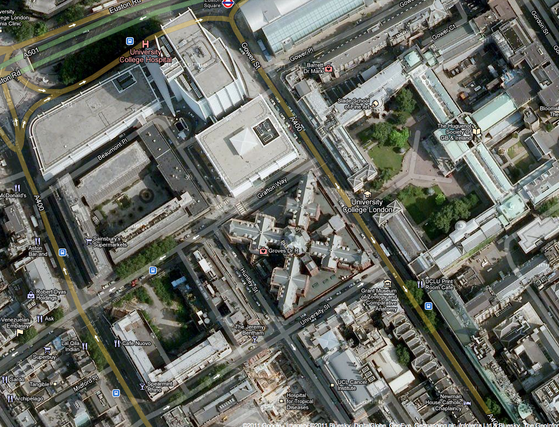
UCLH Proton Beam Therapy Site
New facility will be on existing UCLH site, next to Tottenham Court Road.
Linked to UCLH via walkways to allow easy patient transfer.
Due to open 2020 (2 years after The Christie).
Varian cyclotron and 4 360º gantries.
UCLH
Cruciform Building
UCL
Spearmint Rhino
New proton therapy site
Jeremy Bentham
Rosenheim Building

Slide 9
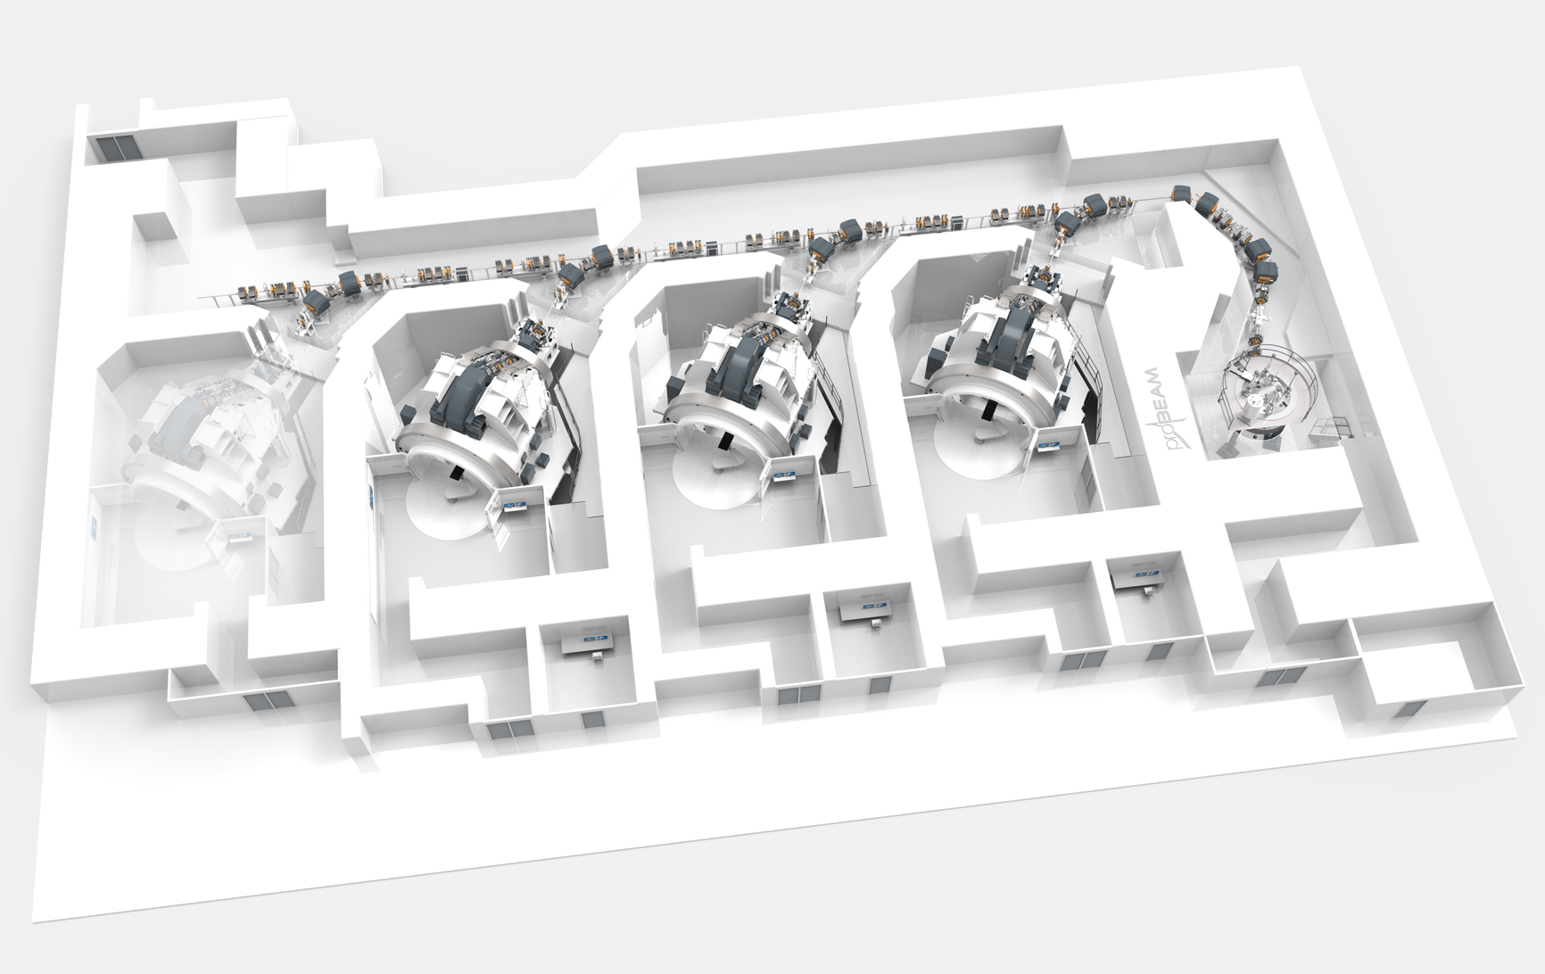
UCLH Proton Therapy Facility
Beamline Corridor
Cyclotron
Gantry
Treatment Rooms
Images courtesy of UCLH/Jan Timmer, Varian Inc.

Slide 10
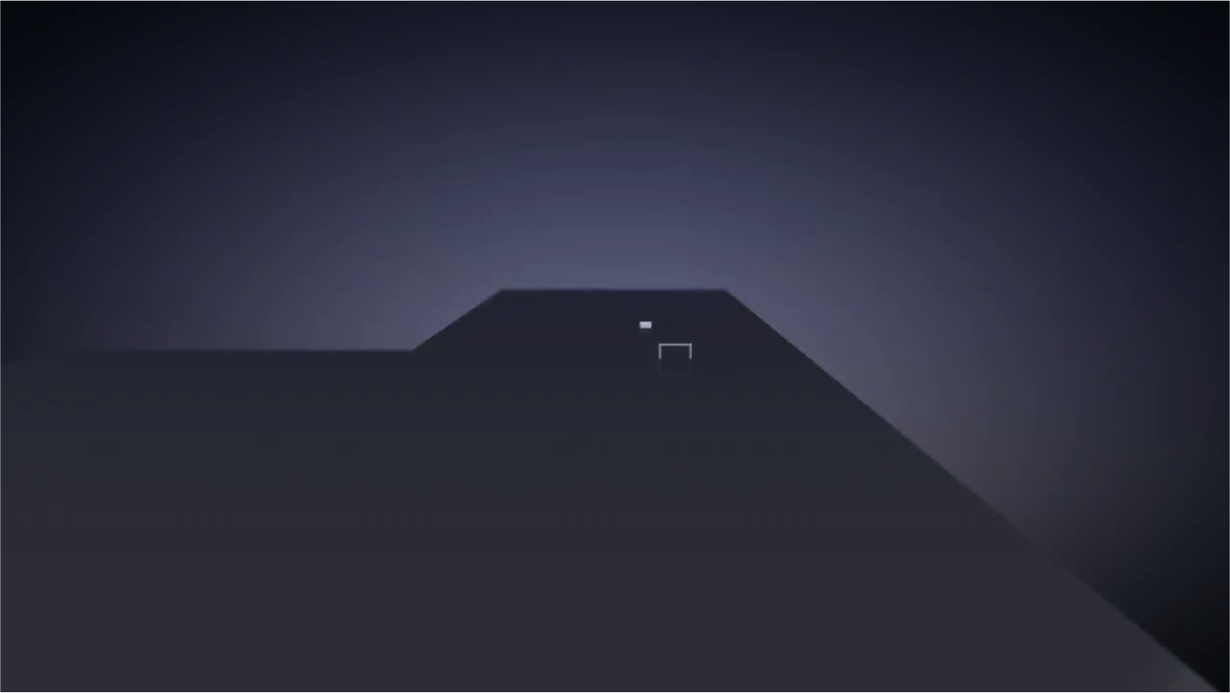
UCLH PBT Facility
https://www.youtube.com/watch?v=2MadsdvYOis&t=3m29s

Slide 11
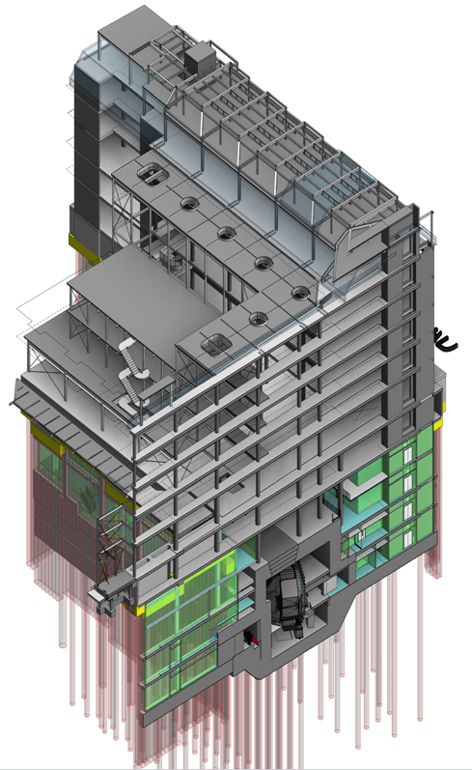
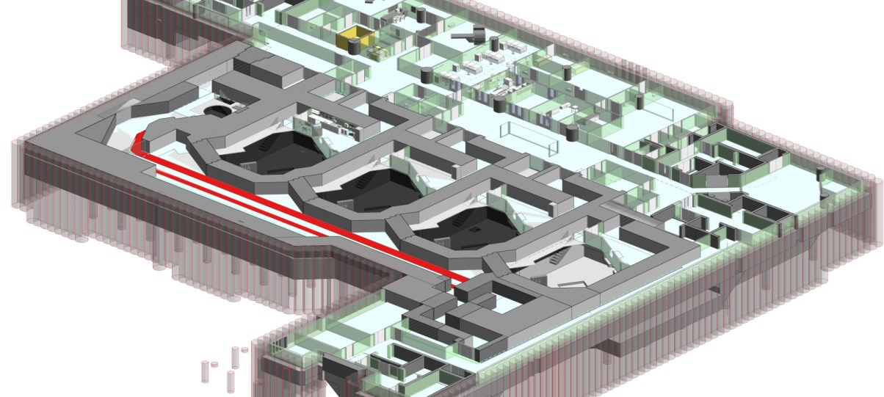
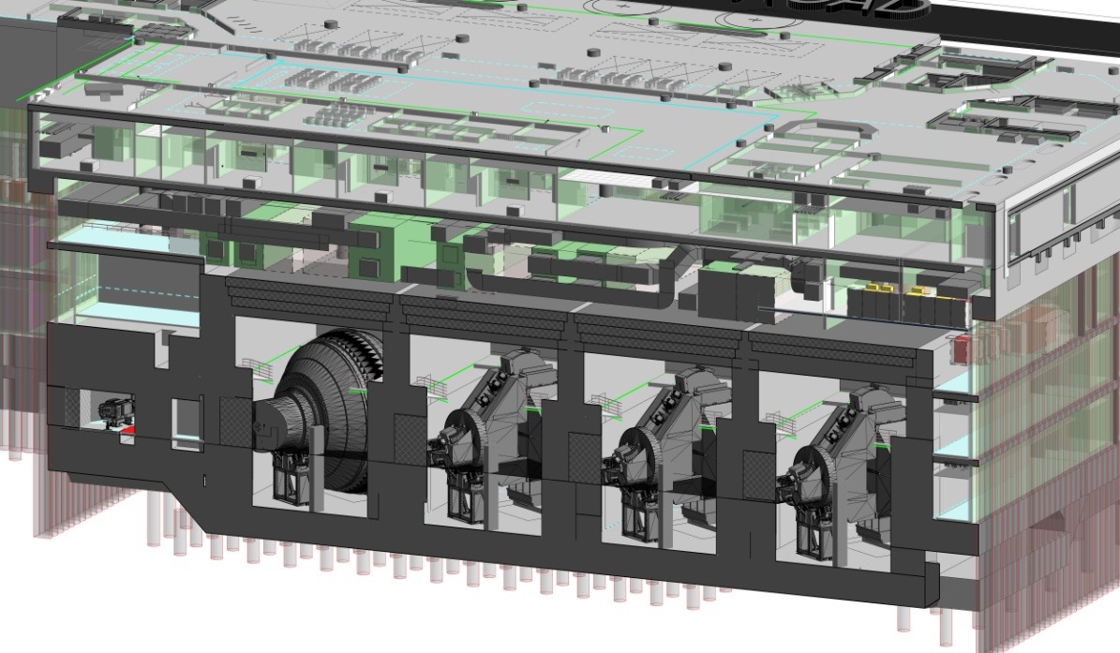
UCLH PBT Construction
P. Zakrzewska et al., Proceedings of PTCOG 54. Int J Particle Ther. 2015;2(1):331-332

Slide 12
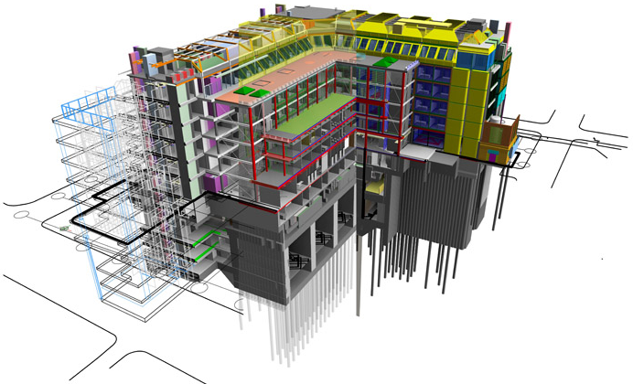
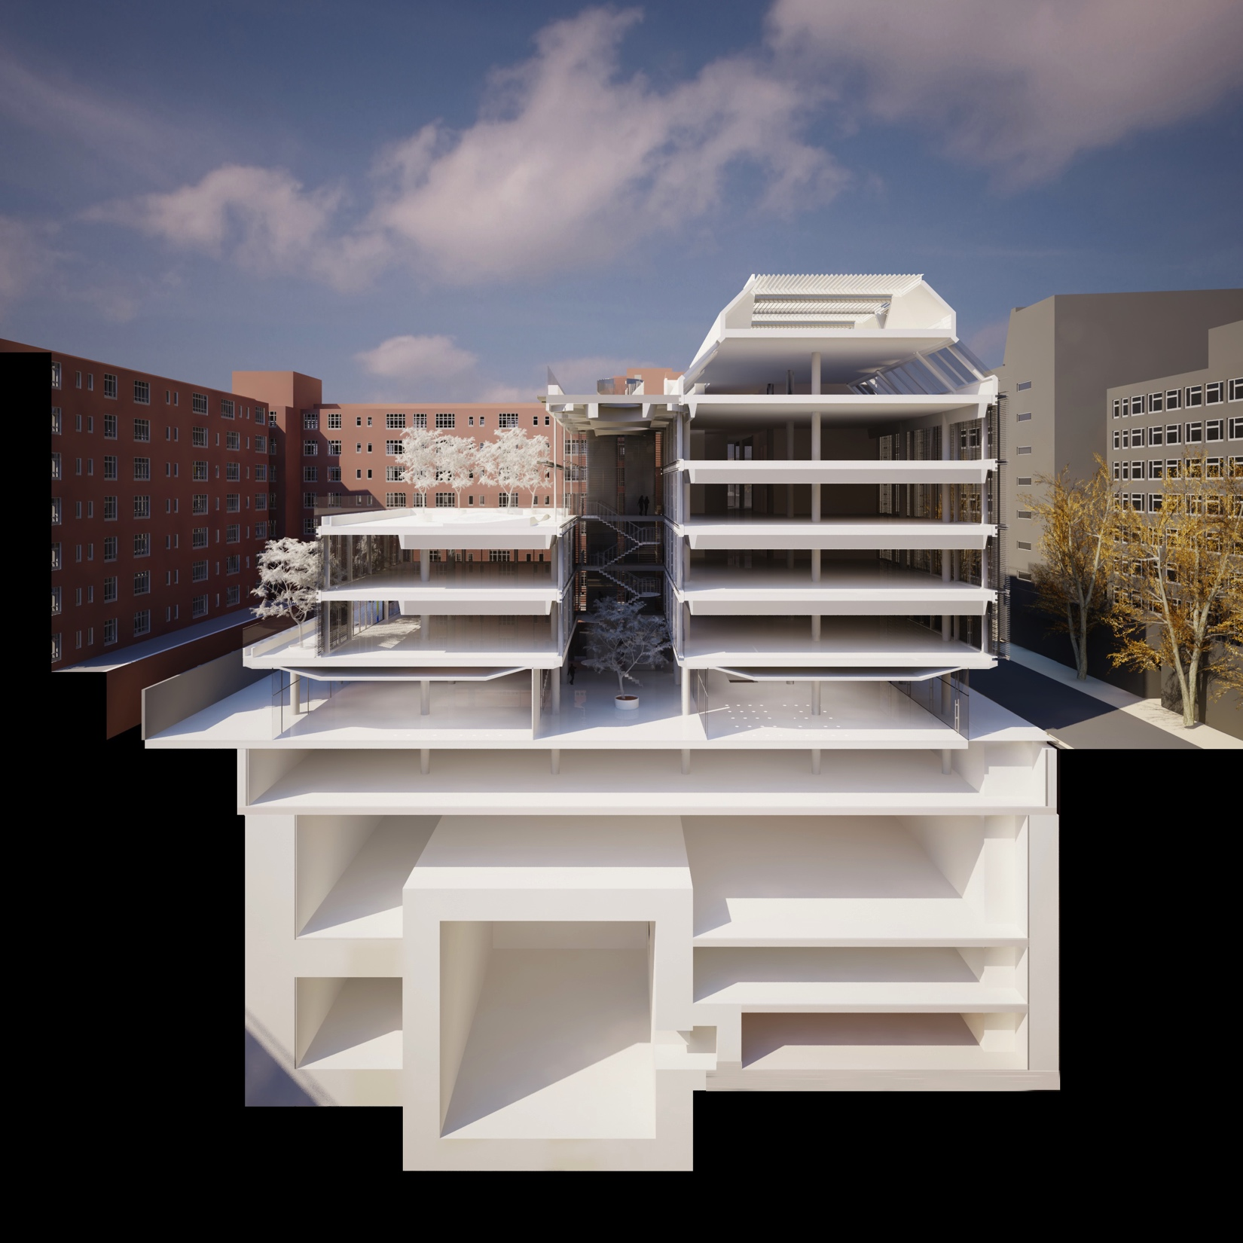
UCLH PBT Building Services
http://www.stwarchitects.com/project-information.php?c=1&p=10003

Slide 13
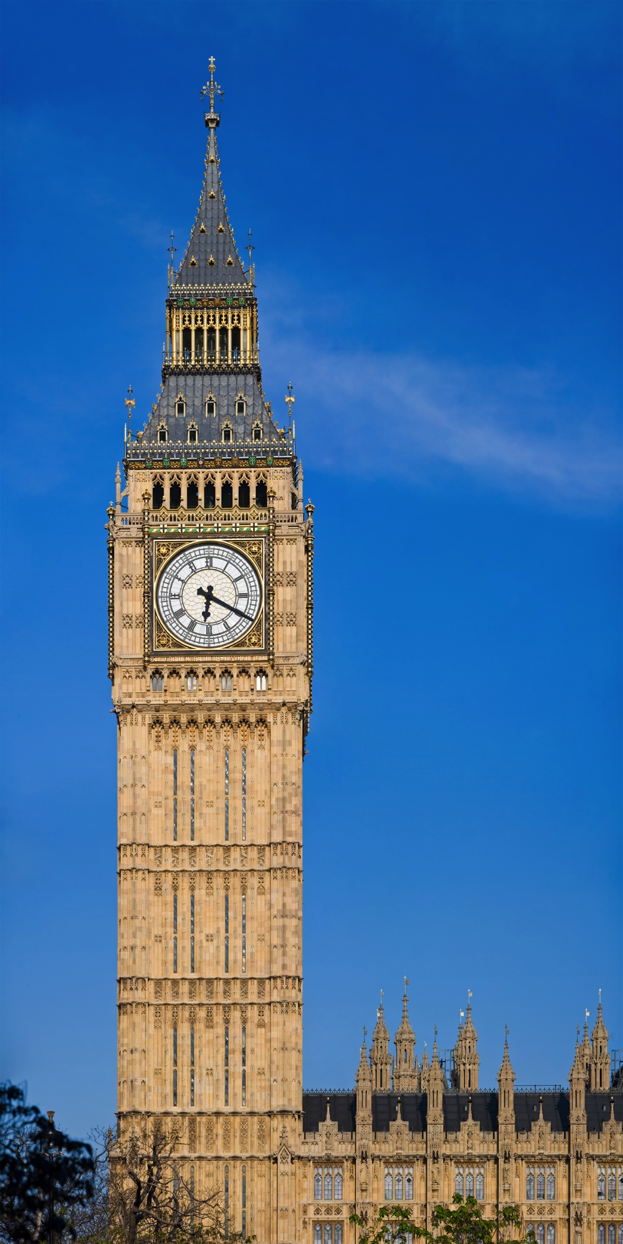
UCLH PBT Site: Facts & Figures
Site is big:
  30 m deep, 90 m wide.
  Pilings go more than 90 m deep: same as height of Big Ben!
80,000 cubic metres of earth removed:
  300 workmen on site.
  1 dump truck every 3 minutes to remove spoil.
Building 11 stories tall:
  Same height as Tower Bridge.
  PBT all underground (-2 to -5).
  Below ground also includes 8 operating theatres.
  New Haematology centre above ground (Europe’s largest).
Due to open in 2020.
https://www.youtube.com/watch?v=ttfmeSJFs3g

Slide 14
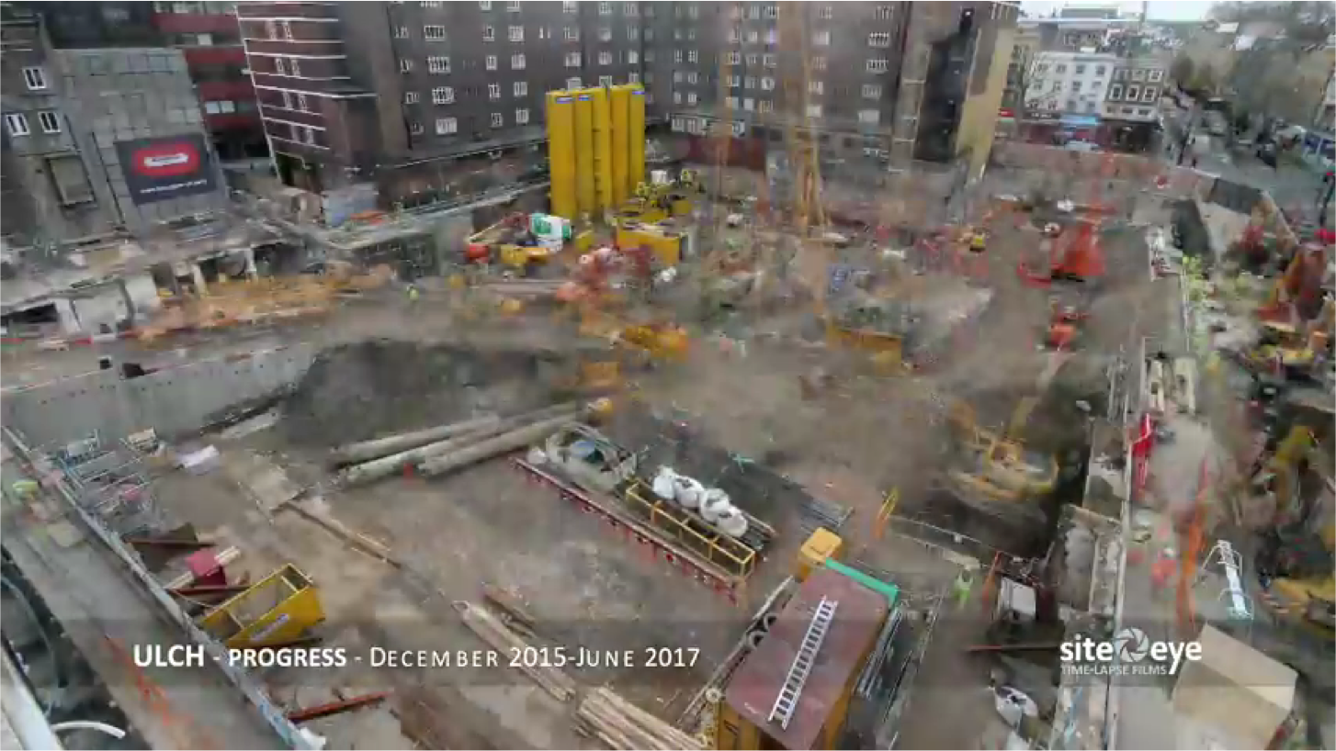
UCLH PBT Site Progress
https://www.youtube.com/watch?v=_XMJQc1qi2w

Slide 15
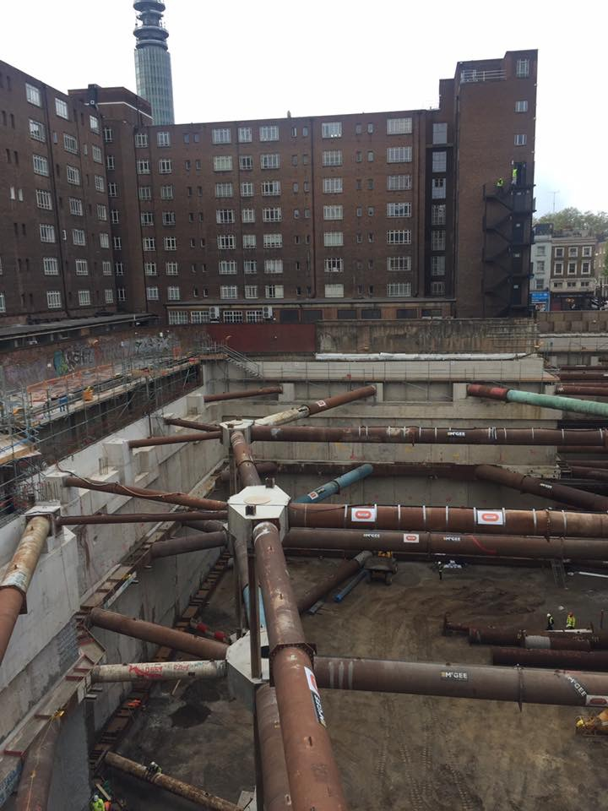
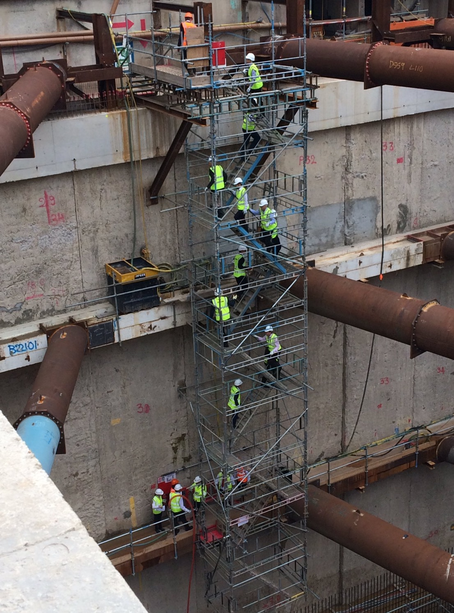
UCLH PBT: The Big Dig…
“ ‘Crater’ bigger than Royal Albert Hall excavated in central London to house pioneering cancer treatment centre.”
http://www.standard.co.uk/news/health/crater-bigger-than-royal-albert-hall-excavated-in-central-london-to-house-pioneering-cancer-a3587611.html

Slide 16
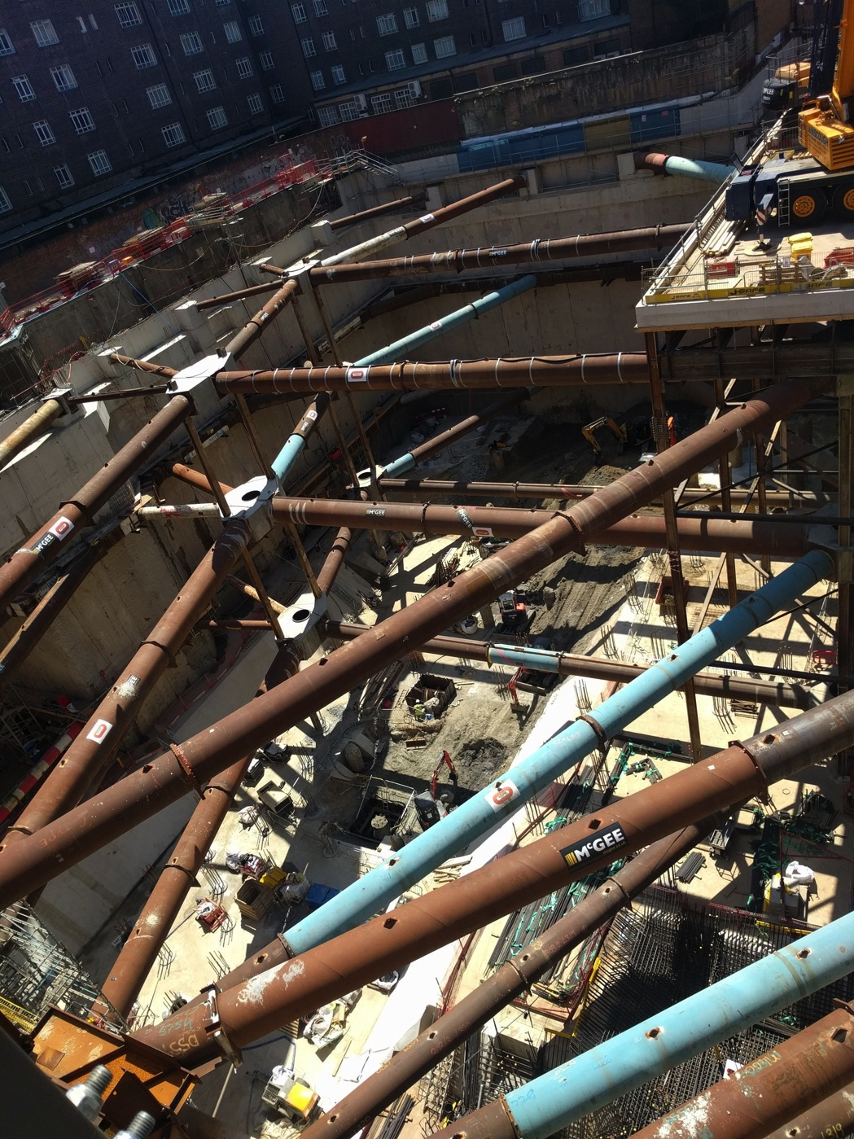
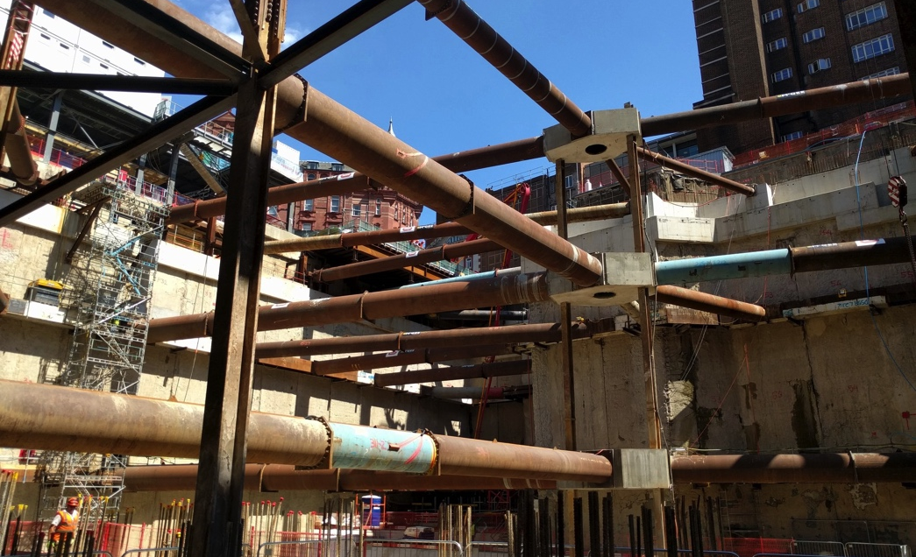
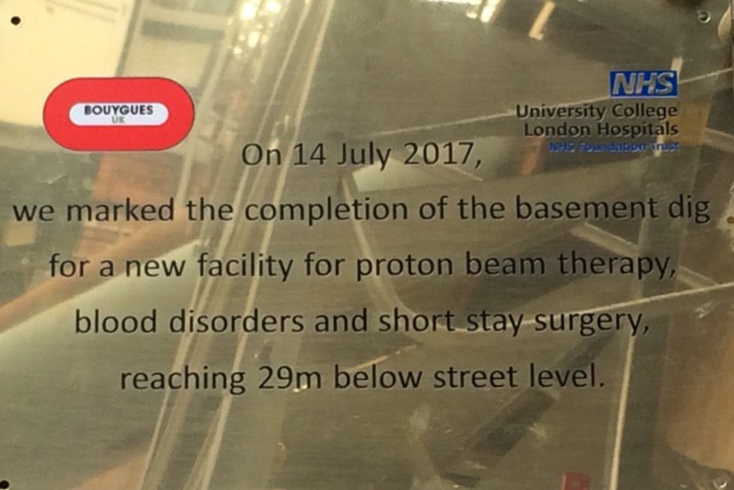
UCLH PBT: Hitting Rock Bottom…

Slide 17
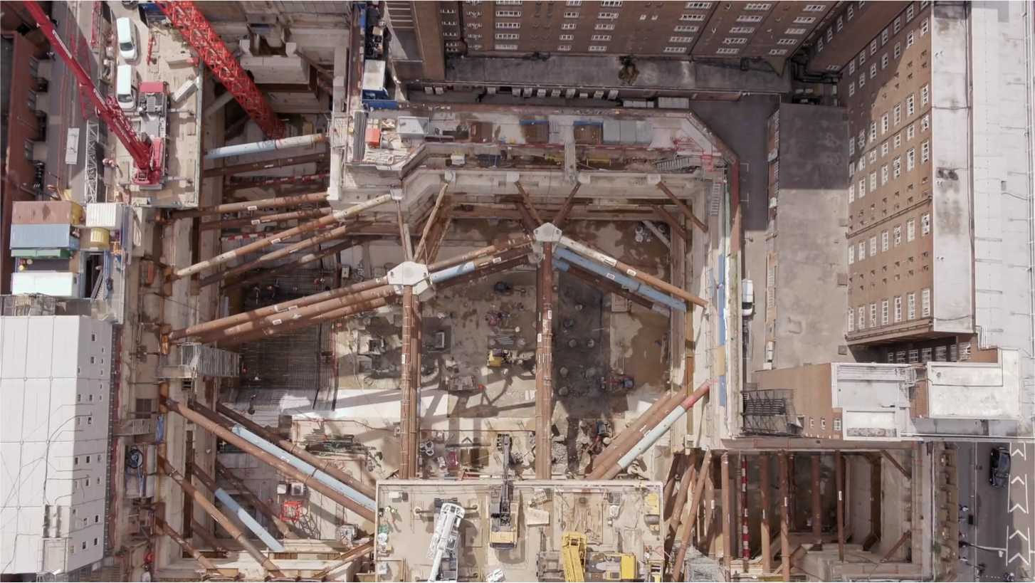
UCLH PBT Site Drone Footage
https://www.youtube.com/watch?v=PcWH_bh84Oc

Slide 18
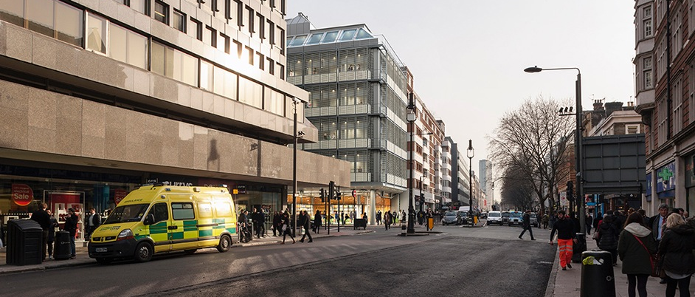
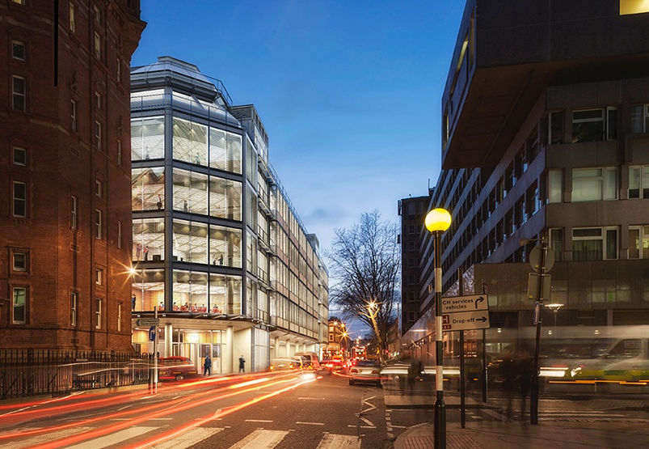
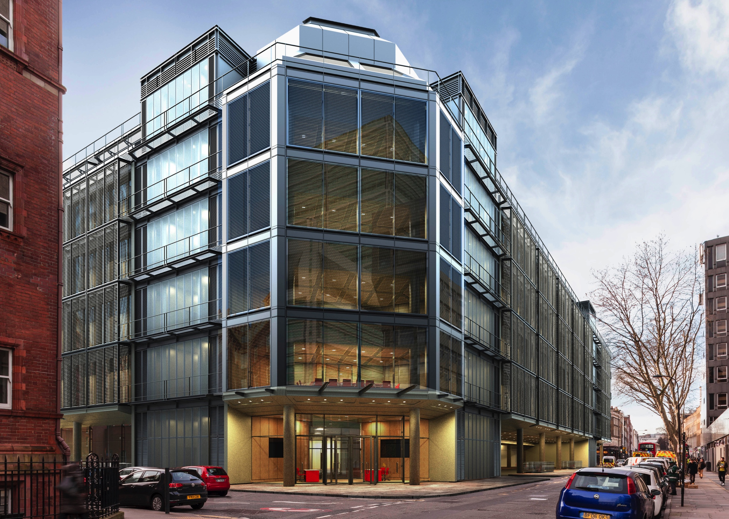
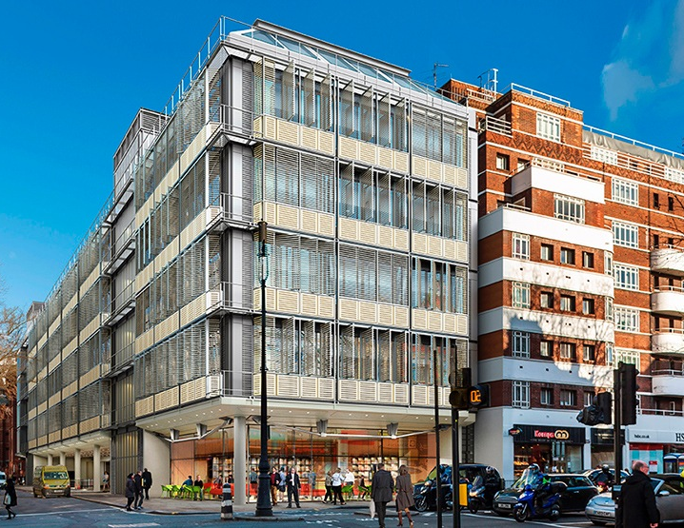
Onwards to 2020…
https://www.edwardwilliamsarchitects.com/projects/view/uclh-phase-4-and-proton-beam-therapy-unit-london-uk

