Slide 1
C++ LeCroyData Class Progress
Dan Walker
University College London

Slide 2
Recap
Load LeCroy binary data for quick and easy processing in ROOT.
Identify pile-up, calculate ADC counts for each pulse, and get it done fast. – Choose two of three.

Slide 3
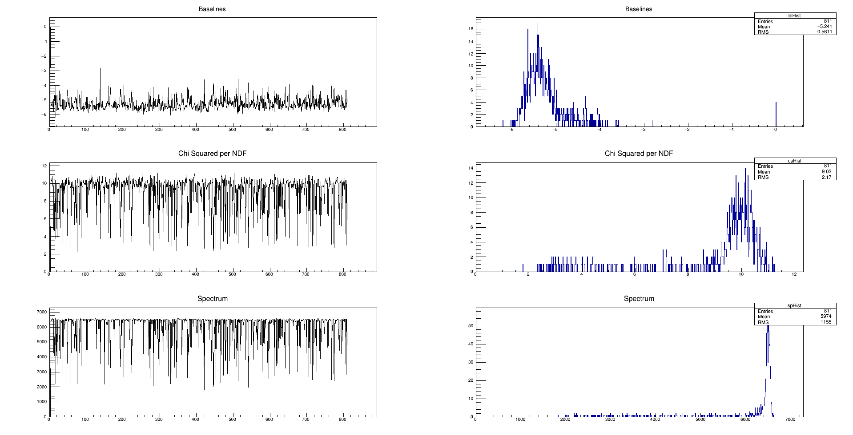
Previous Results: Analysis by function fitting, filter by Chi2/NdF
Slow, with many pulses discarded.

Slide 4
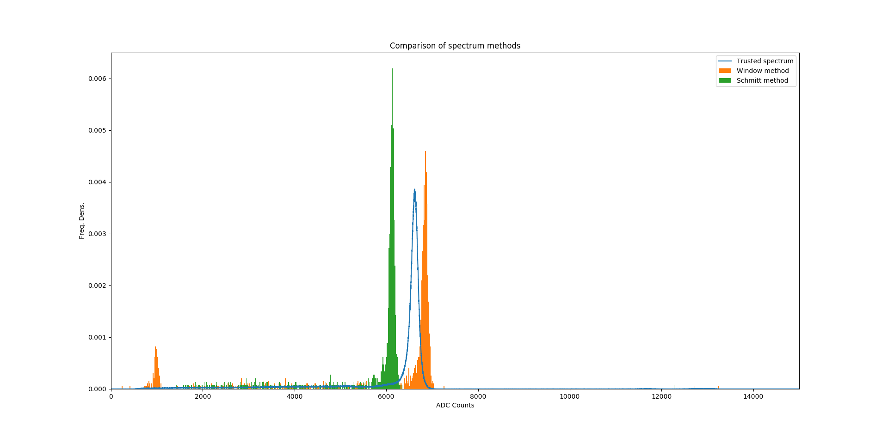
Previous Results: Custom triggers for Schmitt ‘trigger’ and time interval definitions of regions of interest in the acquisition.
Fast, retains data for many pulses (often including double pulses), fails to recreate Caen spectrum.

Slide 5
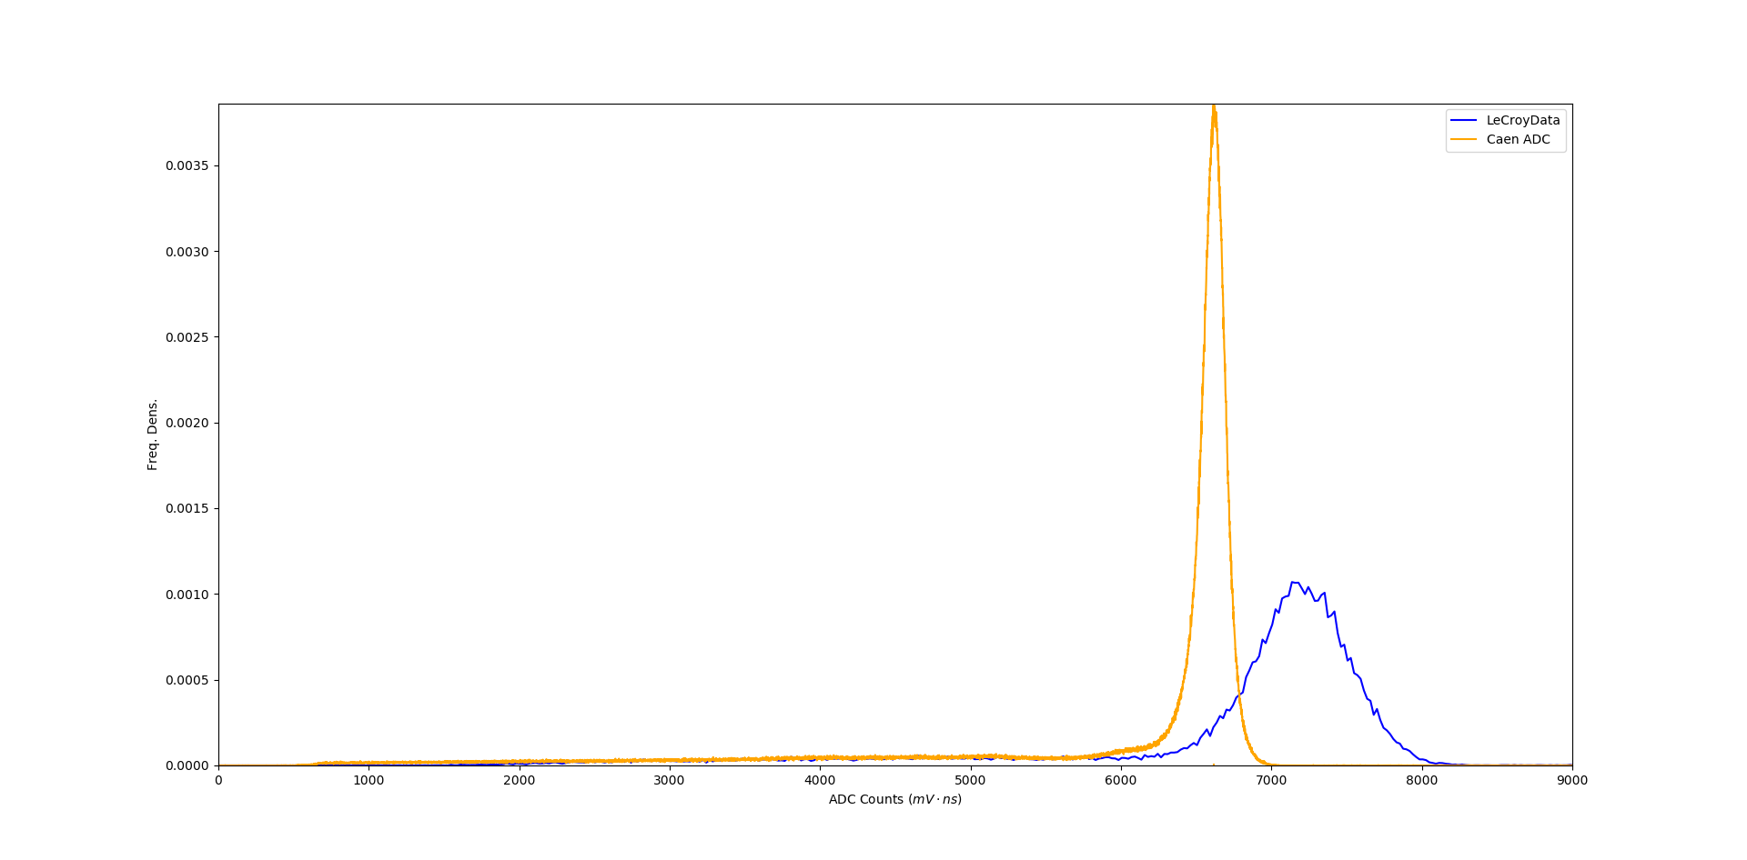
Previous Results: Integrating over the whole acquisition
Fast, but with a wide peak. Still not a good reconstruction of the trusted data.

Slide 6
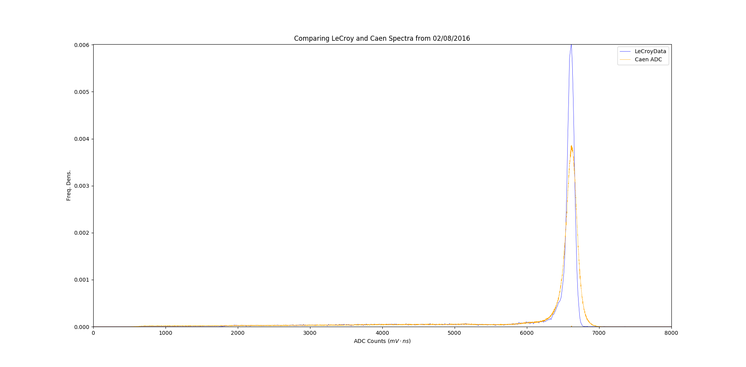
New Spectrum Results: Use the trigger from the data file, and define a region in time around that, including an offset parameter.

Slide 7
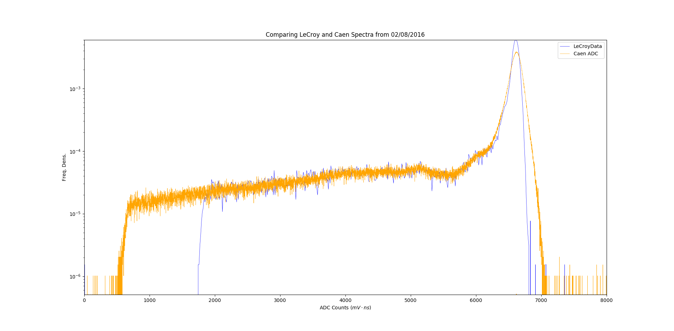
New Spectrum Results: Fast, narrow peak, reconstructs the Caen results… Mostly. (Peak ADC counts ~0.03% lower than in Caen spectrum when integration region symmetric around the trigger. Could try tweaking the offset parameter very gently to look for improvements?)
?

