Slide 1
A Scintillator-based Range Telescope for Quality Assurance in Proton Therapy
Laurent Kelleter
Department of Physics and Astronomy (HEP)
University College London
Notes:
Hello everybody. My name is Laurent Kelleter. I work at the High-Energy Physics Institute of UCL. I am very glad to have the opportunity to present to you the results of our work at UCL. So this talk is about a range telescope for range quality assurance in proton therapy. This means we want to build a detector that can measure the range of a clinical proton beam in water. This measurement is necessary in the daily quality assurance process in every proton therapy centre. The detector has to be easy to handle, precise and cheap. So I would like to talk about the range quality assurance in a proton therapy centre, about our idea for a cheap and precise detector and about the first results that we’ve got using our first detector prototype.
Let’s start with the range quality assurance proces in proton therapy.

Slide 2
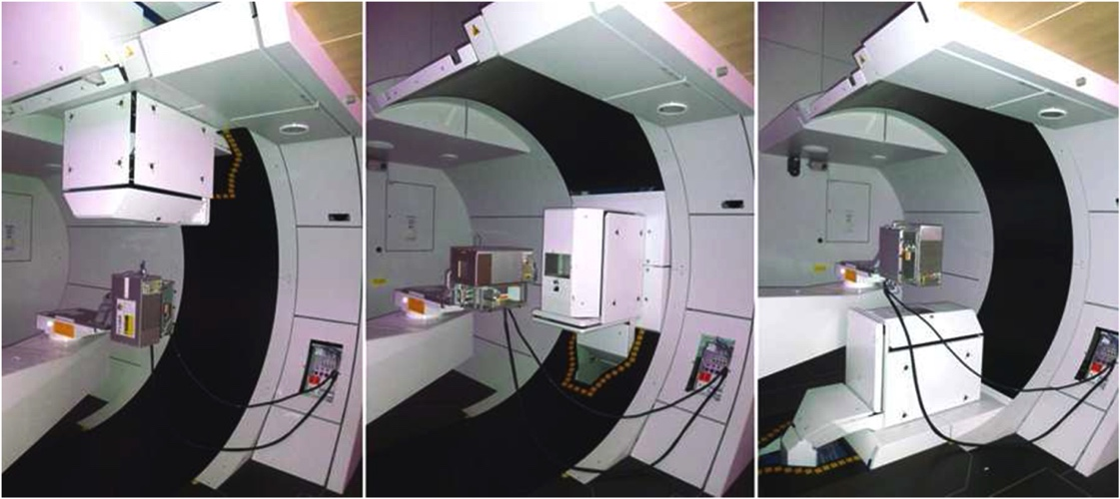
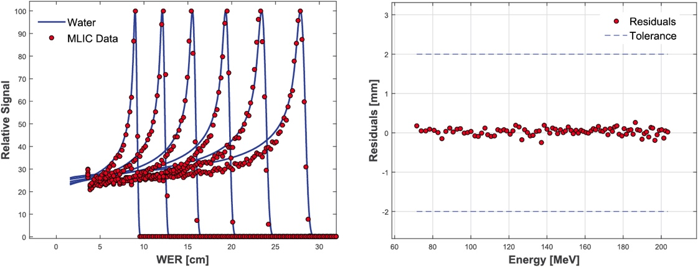
Range Quality Assurance in Proton Therapy
O. Actis et al. 2017 Phys. Med Biol. 62 1661
Notes:
The reason why we are doing this, or the problem we want to tackle is range quality assurance in proton therapy which is carried out daily in every PTC
This is an example from PSI, really nice integrated custom system, measure all energy steps, fit the range and check whether they’re within tolerance.

Slide 3
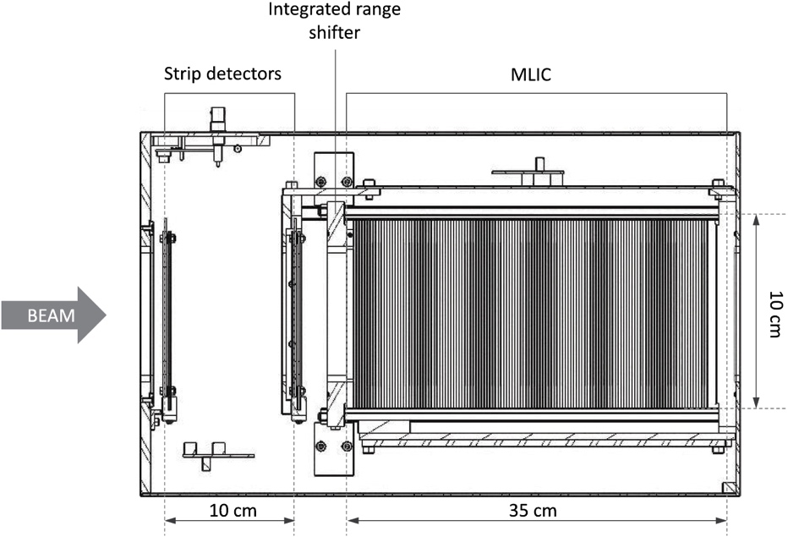
Range Quality Assurance in Proton Therapy
O. Actis et al. 2017 Phys. Med Biol. 62 1661
Notes:
The reason they’re so fast: multi layer ionization chamber. It is a stack of ionization chambers with some absorber in between the sheets which absorb the proton beam.
Really expensive
Many PTCs don’t pay for it or don’t put the effort in developing their own and do a customized solution (manual scanning with a single ionization chamber in a water tank): slow
Our idea: build a similar range telescope on the basis of cheap plastic scintillator

Slide 4
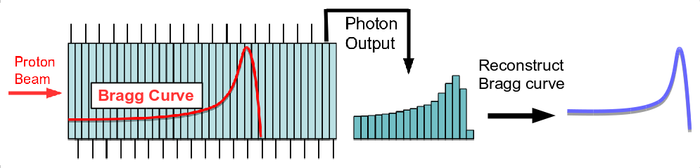
Range Telescope: Principle
Notes:
This is how our idea looks like. We have this scintillator segmented into sheets. The proton beam is fully absorbed in the scintillator stack. The light yield of each sheet of the stack is read out individually. The light output of the stack looks like a mashed-up Bragg curve because of the dependence of the quenching effect on the ionization density. Our task is now to reconstruct the pristine Bragg curve from the light output.
It is worth to mention that the plastic scintillator is nearly water equivalent with a density of about 1.02g/cm3. Therefore, only a tiny correction factor is needed to reconstruct the water-equivalent range of the protons.

Slide 5
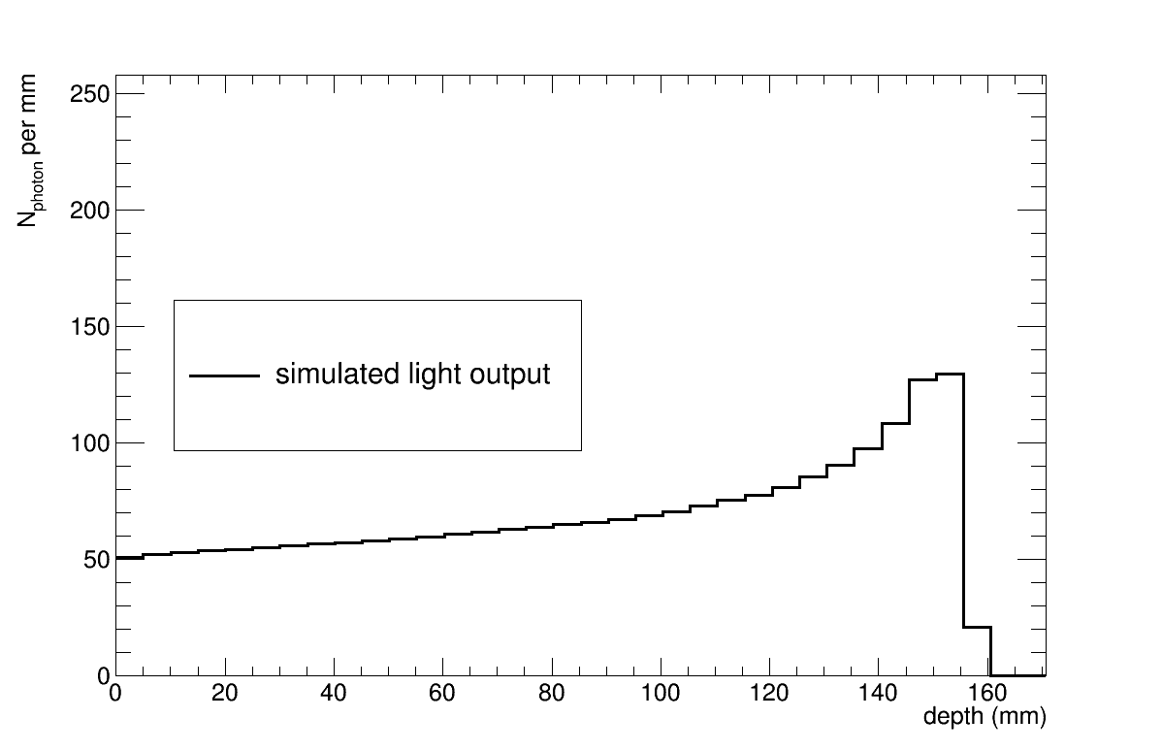
Proton Range Reconstruction
Geant4 simulation
Notes:
I did a simulation of the light output in such a segmented scintillator stack. This is what you get when you plot the light yield of each sheet against the depth in the stack. You can clearly see the Bragg peak where the protons stop, but it looks slightly mashed-up compared to a pristine Bragg curve. The work I’ve done was to develop a description of this quenched Bragg curve by combining Birk’s law with an analytical description of the Bragg curve by Thomas Bortfeld.

Slide 6
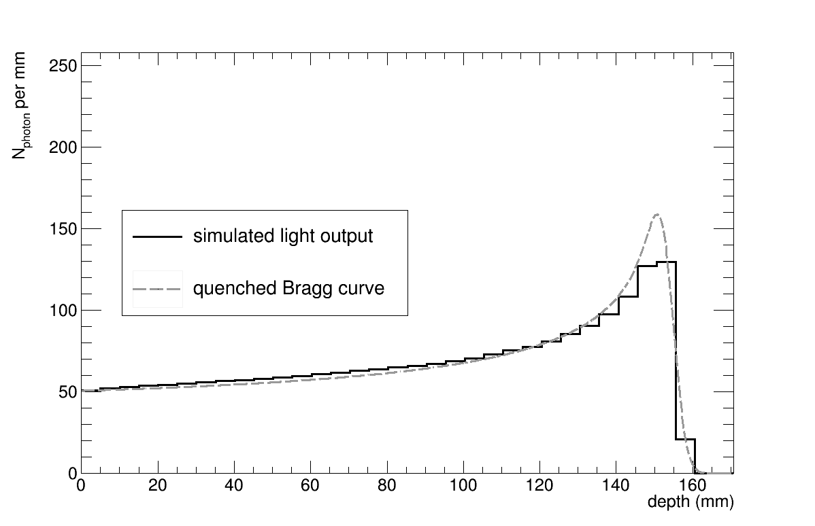
Proton Range Reconstruction
Geant4 simulation
Notes:
Here, the model of the quenched Bragg curve is fitted to the simulated light output. You can see it describes the simulation fairly well. The model has three fit parameters: a scaling factor for the height phi, the width sigma of the peak and most importantly the range. This fitted parameters can be taken from this fit and put into the formula of a pristine Bragg curve.

Slide 7
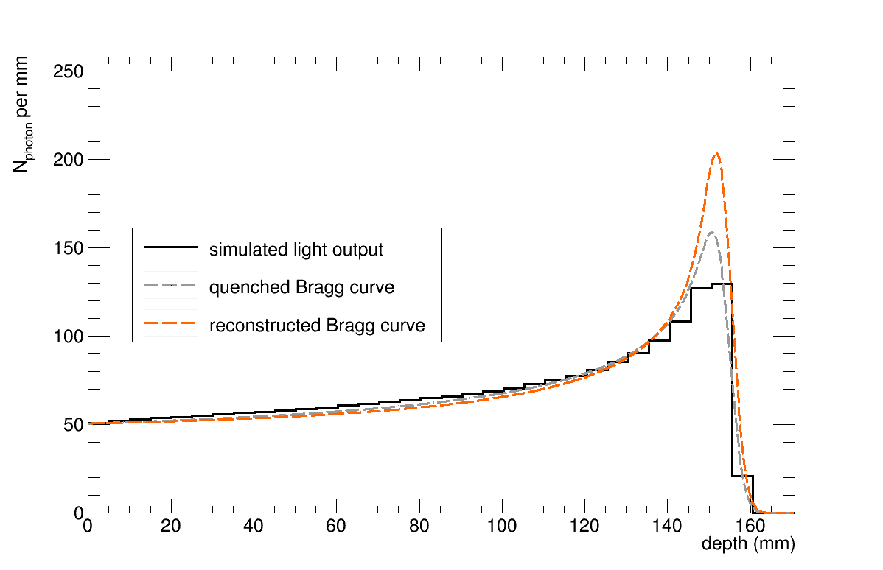
Proton Range Reconstruction
Geant4 simulation
Notes:
This is shown in this plot. The pristine Bragg curve has been reconstructed using the fit parameters from the quenched Bragg curve fit.

Slide 8
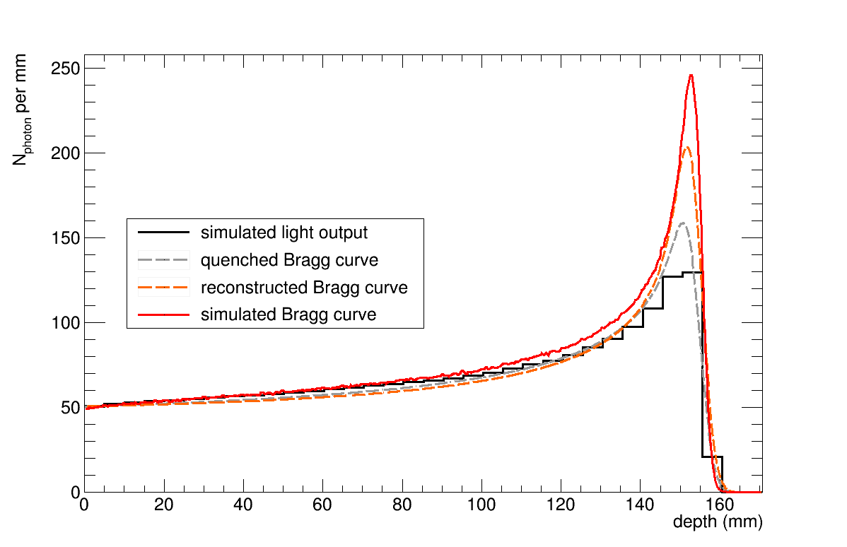
Proton Range Reconstruction
Geant4 simulation
Notes:
We can compare the reconstructed Bragg curve to the actual simulated energy deposition. We seen that they are fairly similar. The difference at the peak stems from an overestimation of the width sigma of the peak. This overestimation comes from the poor resolution of the light output, which is 5mm here.

Slide 9
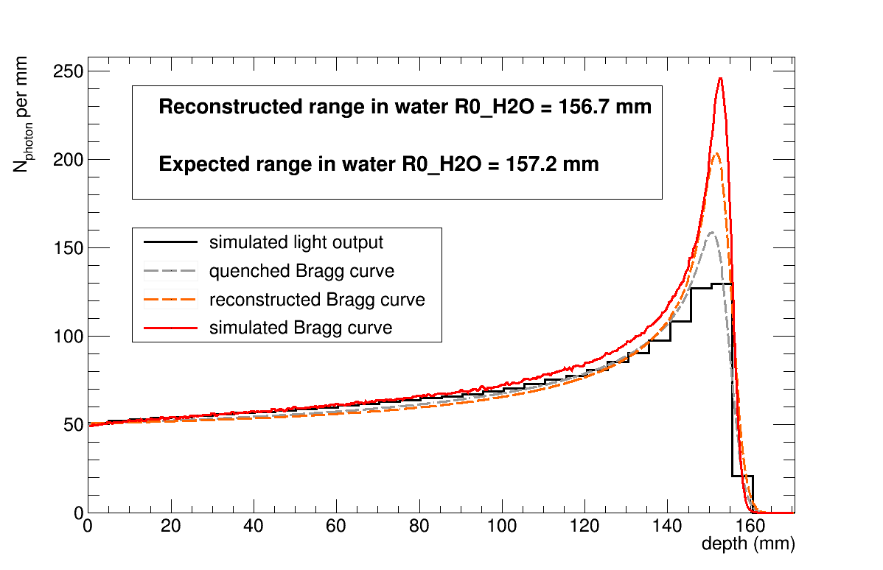
Proton Range Reconstruction
Geant4 simulation
Notes:
It is also possible to convert the range in the scintillator to range in water using simulated R(E) curves. When I compare it to the expected range in water I see that the values deviate by about 3 permille, which gives us the combined model and range reconstruction uncertainty.
So far so good, I did extensive simulations and developed a model for the range reconstruction. Now we can get on with building a prototype.

Slide 10
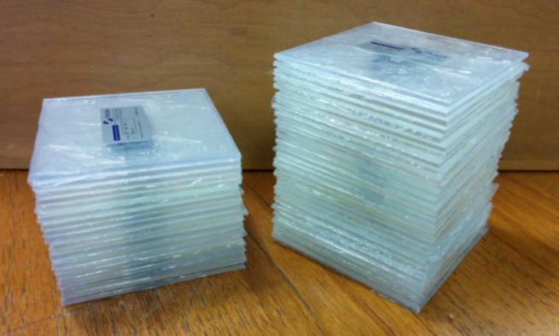
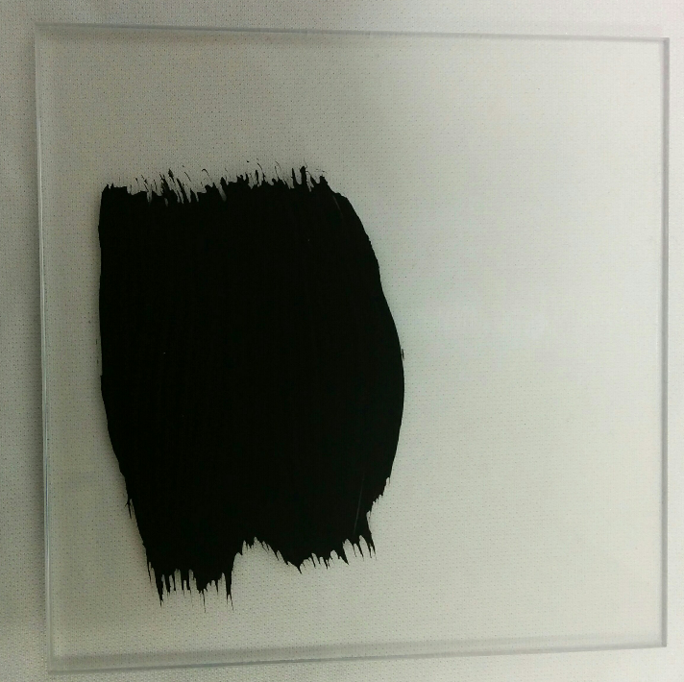
Scintillator Sheets
10 cm x 10 cm
Notes:
We use 2-3 mm thick scintillator sheets from Nuvia. They have a area of 10 by 10 cm in order to absorb the full beam and even allow some space for scanning in the xy plane. We then painted them black in order optically isolate them from each other. We left the sides unpainted where we want to do the readout of the light output.

Slide 11
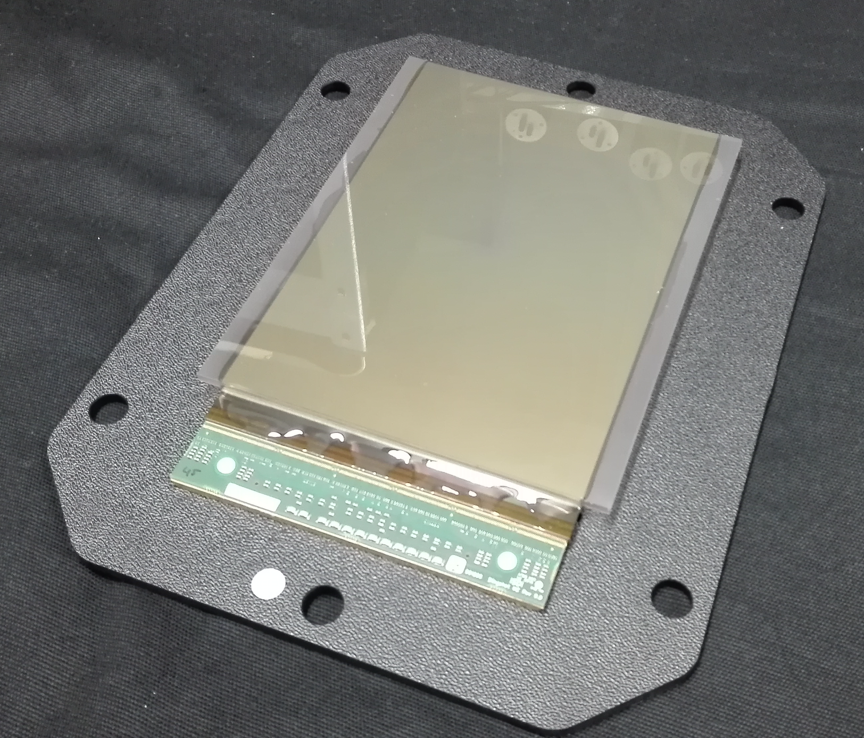
Readout: Pixel Sensor
15cm
10cm
Notes:
Our initial idea for a readout was to use photodiodes. One photodiode per sheet. Since this requires major hardware developing capacities, we decided to go for an easier option and use a 15 by 10 cm large pixel sensor. It would also be possible to use a DSLR camera. However, these cameras introduce lensing effects which is why we decided to go for the pixel sensor.

Slide 12
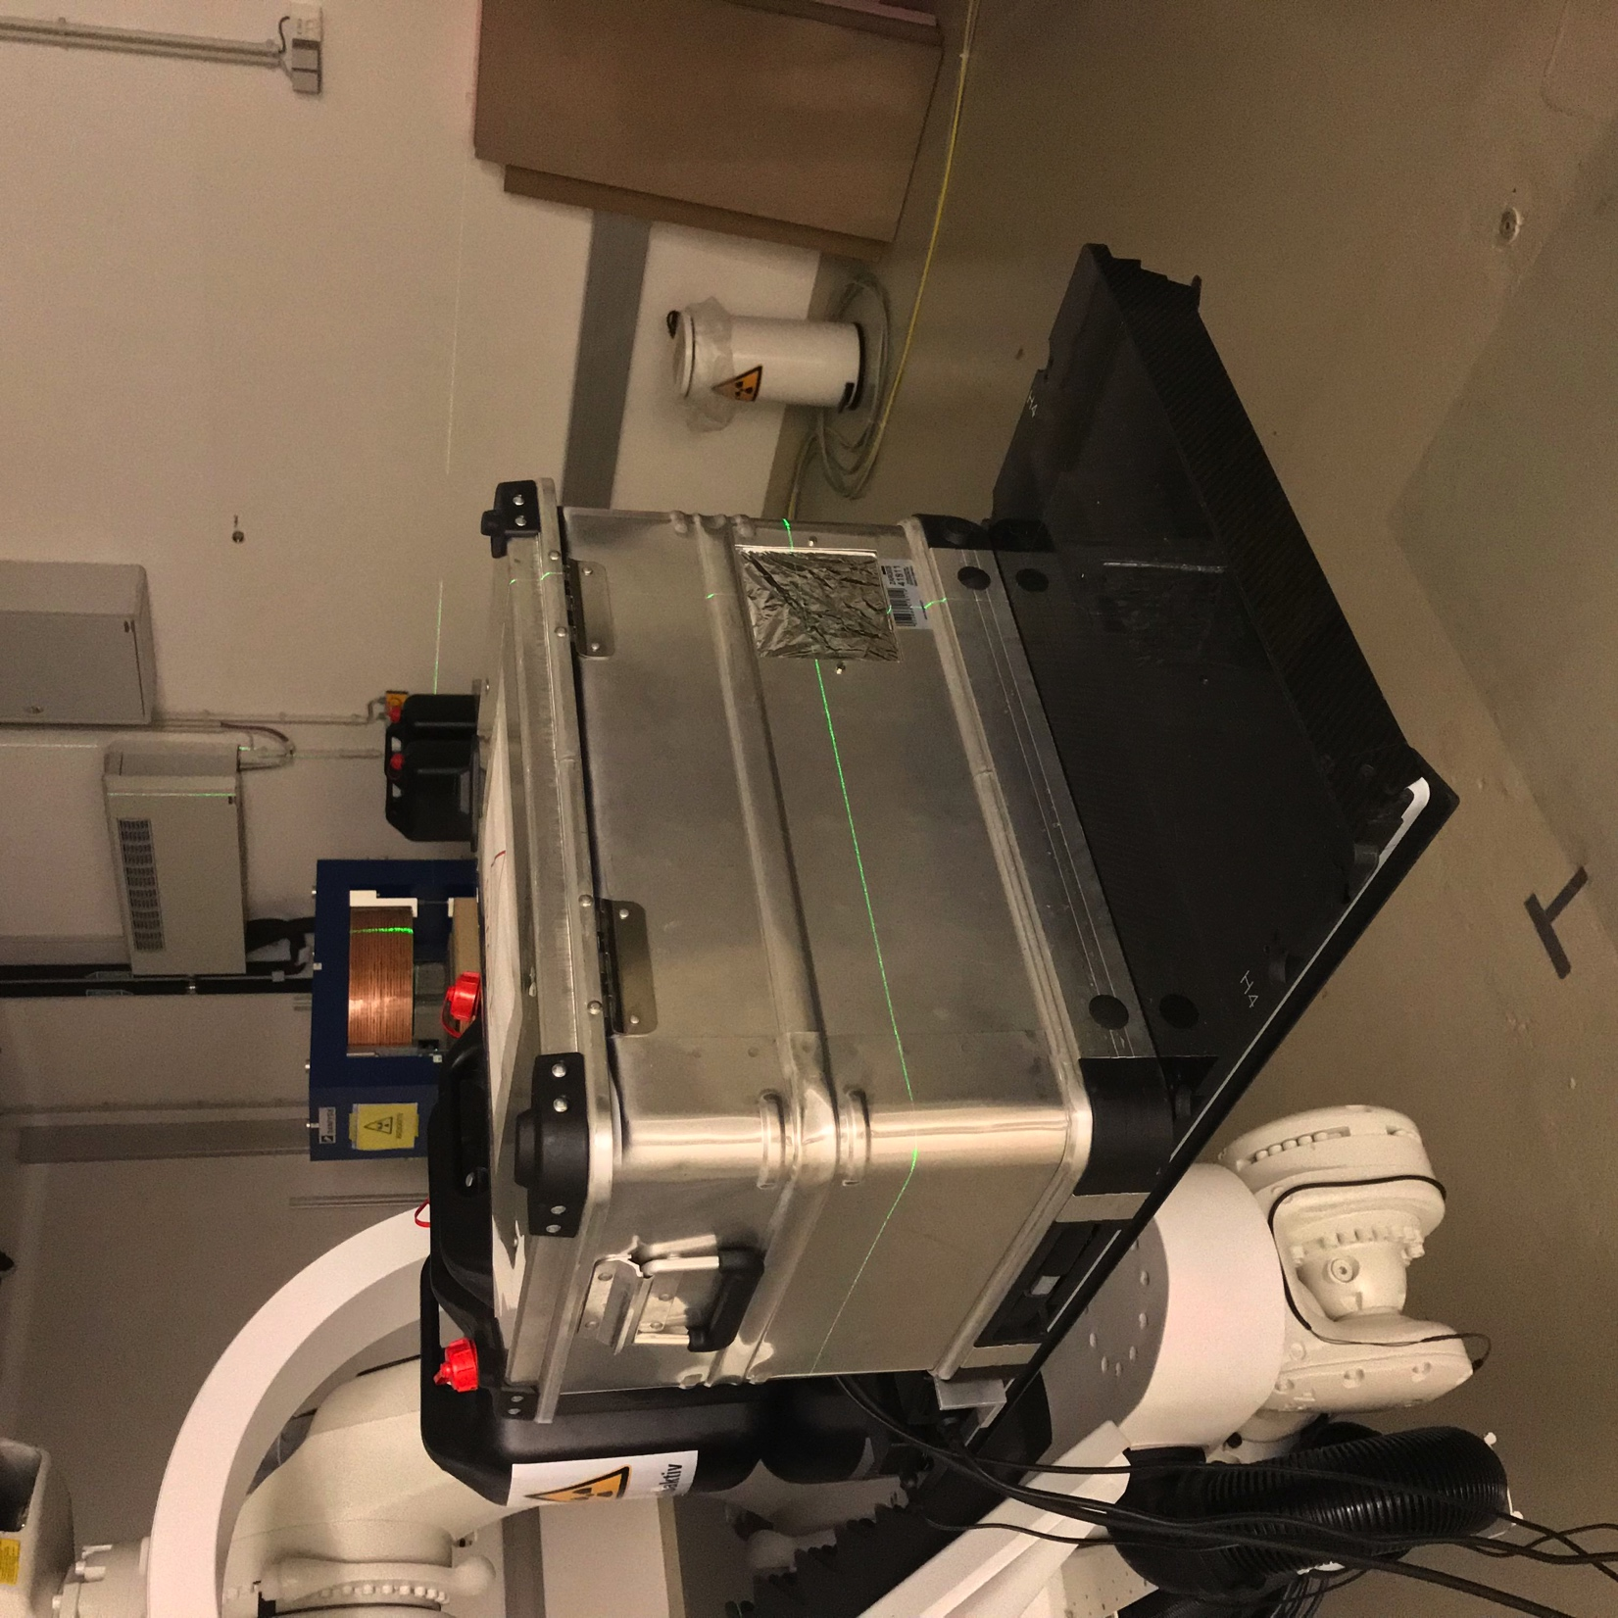
MedAustron Beam Test
Beam
Notes:
We then put our prototype in a light tight flight box. You can see it here mounted to a treatment couch. There is a beam entrance window made of Mylar on the right side.
This is how it looks when you open the box…

Slide 13
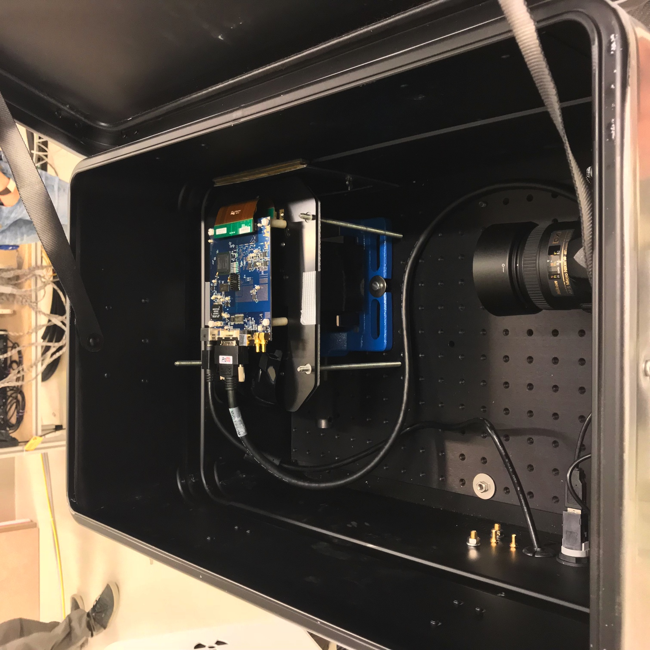
MedAustron Beam Test
Beam
Notes:
You can see the sensor here on top of the scintillator stack. The stack is fixed in a vice and sits on an optical breadboard. As you can see, we also used a DSLR camera as a backup. However, the nicer images are produced by the pixel sensor.

Slide 14
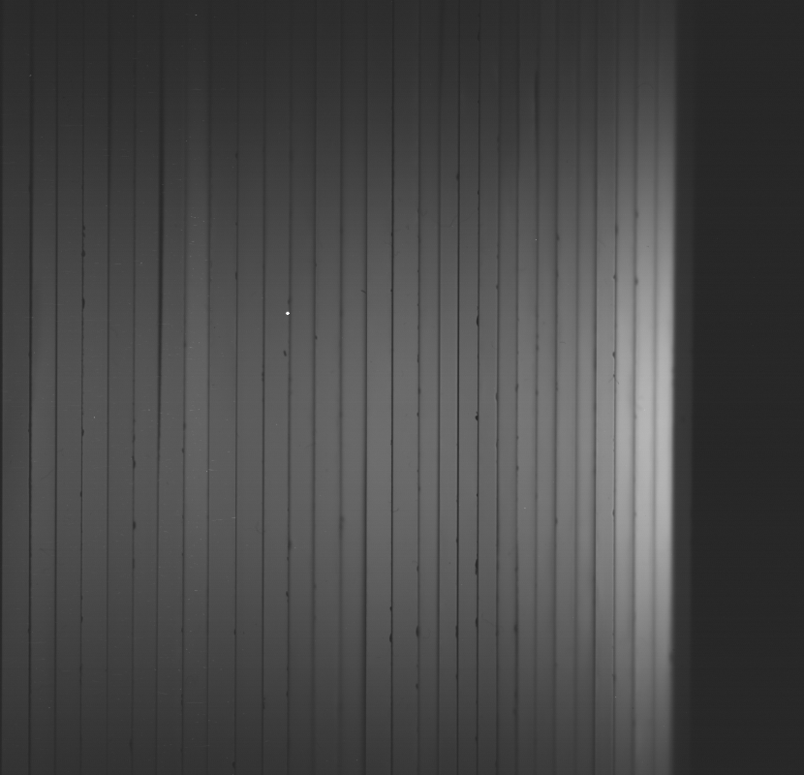
Run at 97.4 MeV
Beam
Notes:
This is what you then get for a 100MeV proton beam entering from the left side. You can see the Bragg peak on the right end. The flickering comes from the fluctuating beam current.

Slide 15
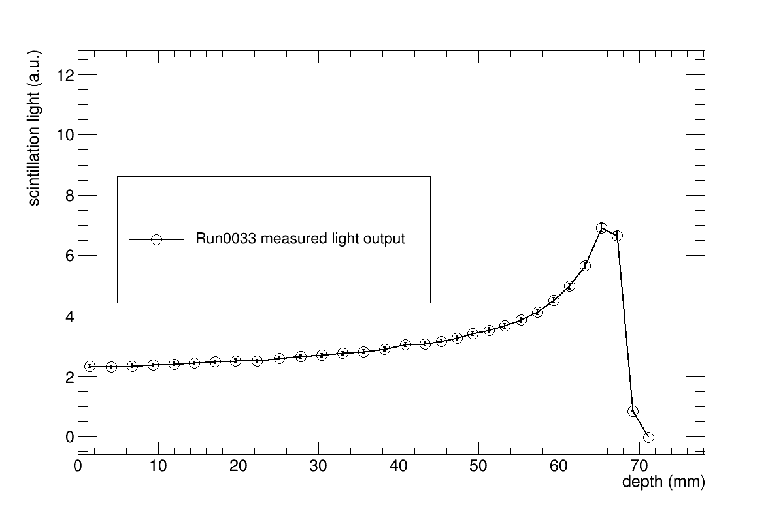
Range reconstruction
Notes:
This is the integrated light output of each individual sheet after background subtraction and calibration.

Slide 16
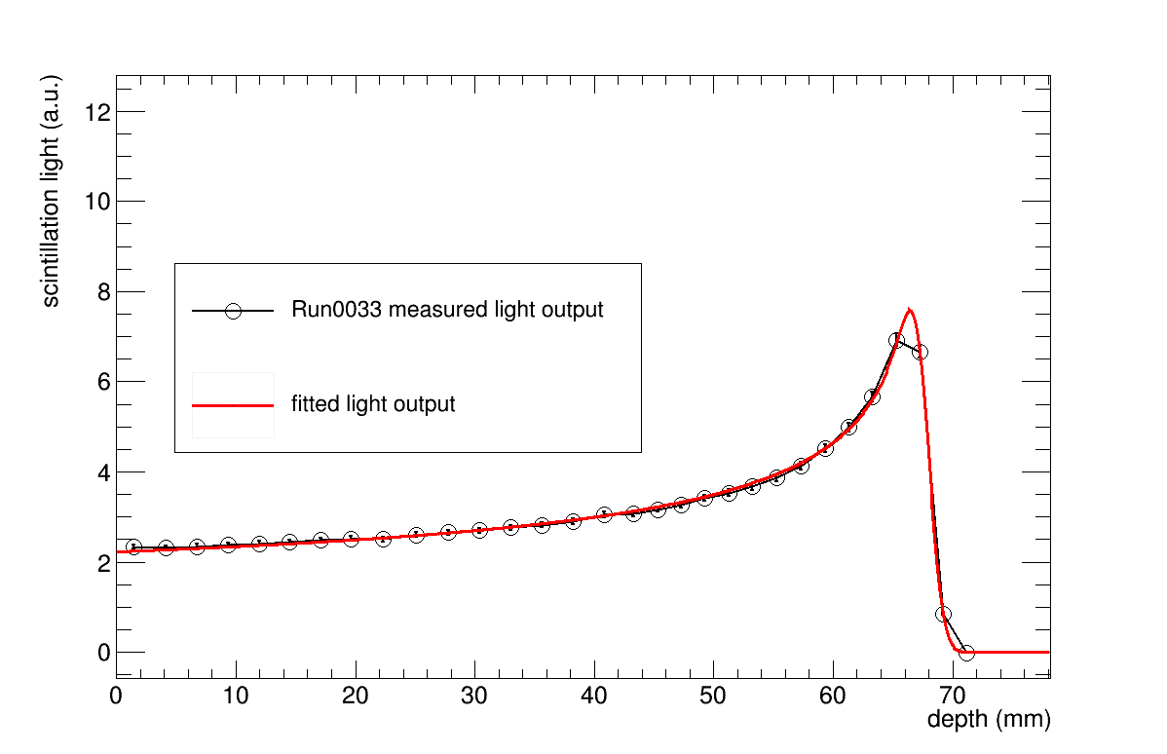
Range reconstruction
Notes:
We can fit the quenched Bragg curve to the data. Marvelous!

Slide 17
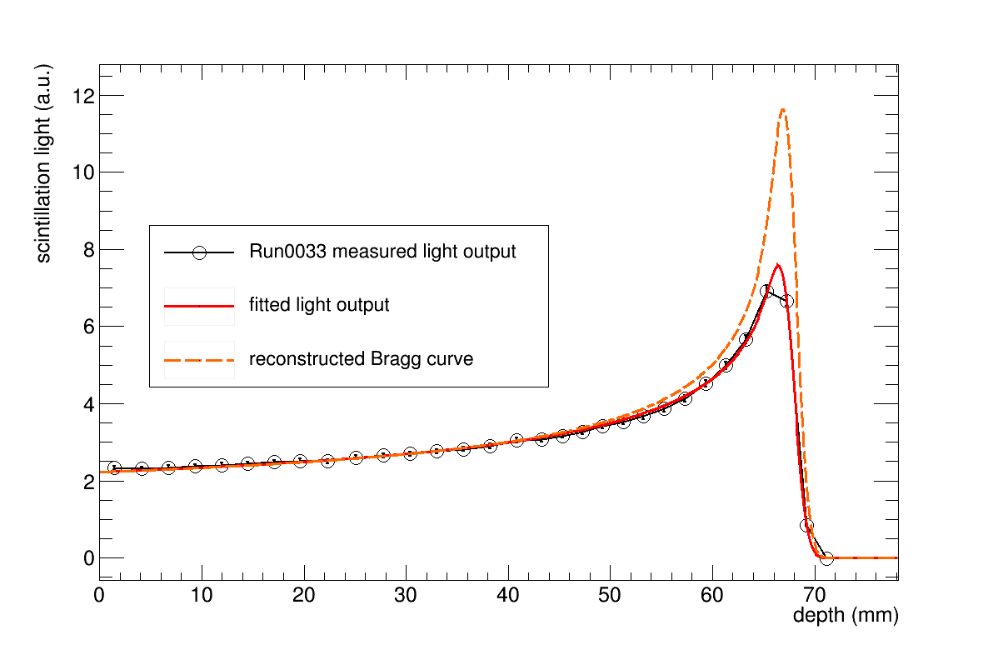
Range reconstruction
Notes:
And reconstruct the pristine Bragg curve by putting the fitted parameters from the quenched Bragg curve in the analytical formula of a pristine Bragg curve.
But we did not just one single energy or range measurement. We measured a couple of beam energies.

Slide 18
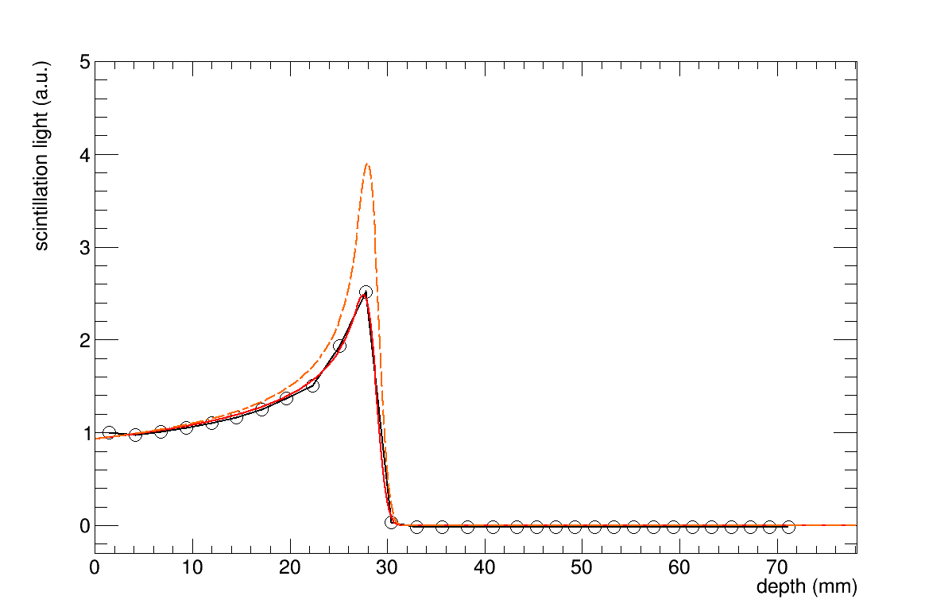
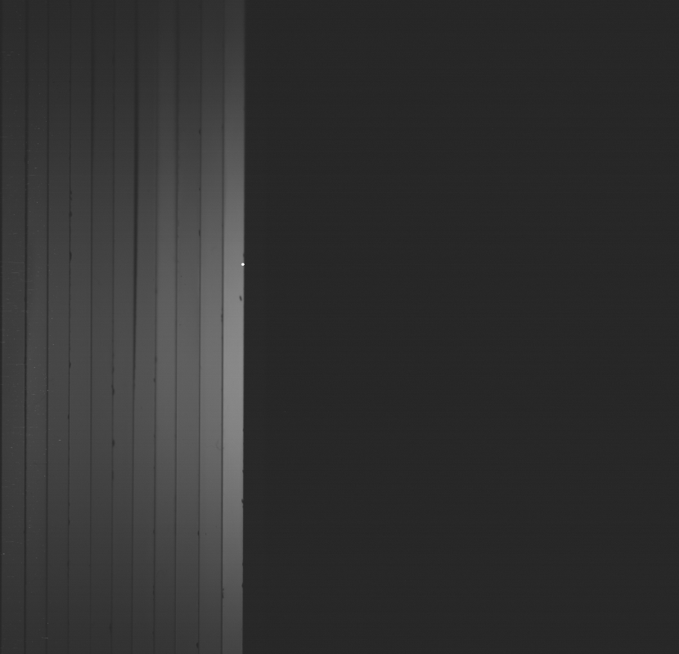
Range Scan
Notes:
And this is it. I was quite happy when it turned out to work that well.

Slide 19
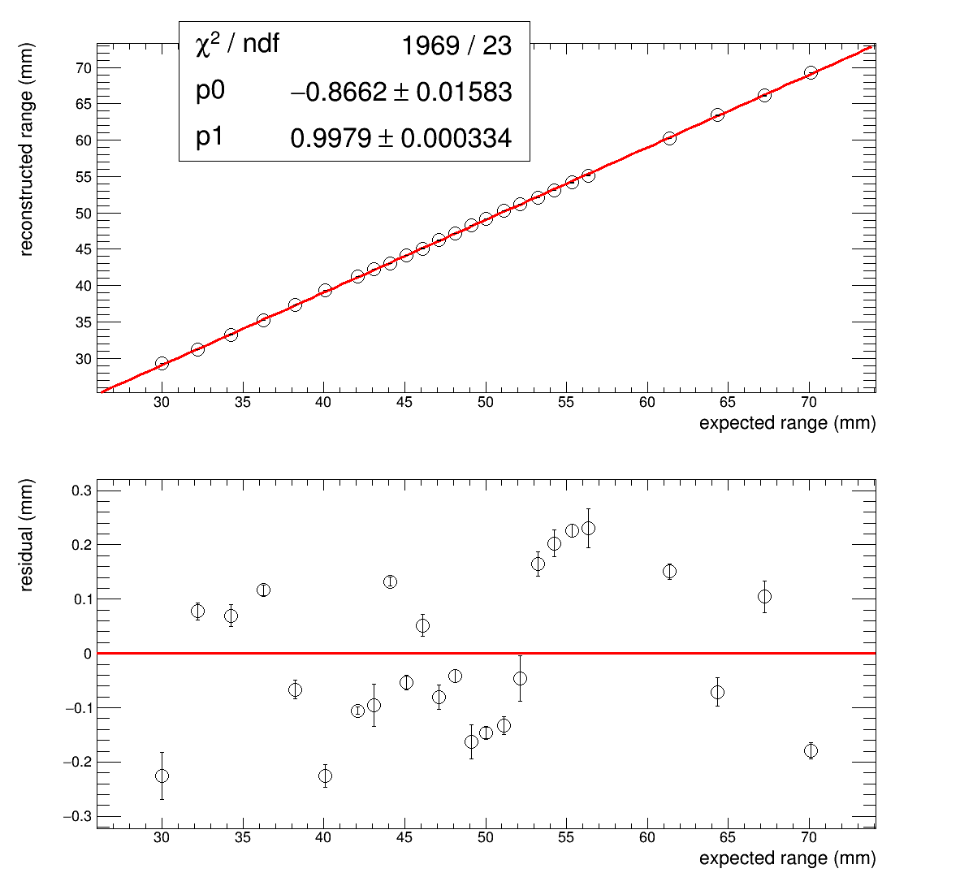
Range Scan: Range Linearity
Notes:
I then plotted the means of the reconstructed ranges vs the expected ranges that were given to us by MedAustron. The dependence is nicely linear with a slope close to one. The offset is an indicator for the water-equivalent offset between our detector and the isocentre where the official range was measured. We do also have a beam entrance window made of aluminium. You can see the values scatter nicely around the linear fit in the residuals. The scattering gives us an idea about the reconstruction uncertainty with is bout 0.15mm.

Slide 20

Clatterbridge Beam Test: Radiation Damage
Notes:
We also did some radiation damage tests during another beam test in Clatterbridge.

Slide 21
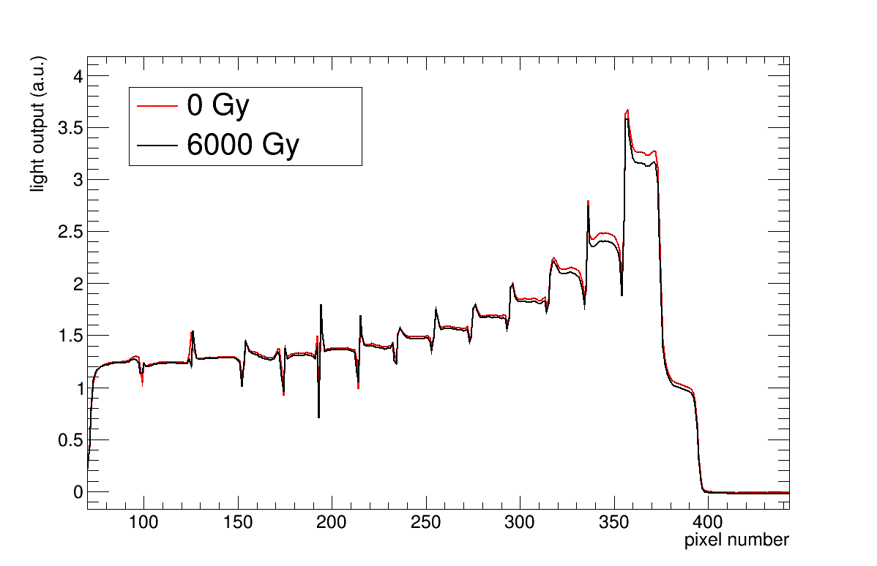
Clatterbridge Beam Test: Radiation Damage
Notes:
This is a calibrated projected image of the CMOS sensor. We delivered 6,000Gy peak dose to the scintillator, worth about 1 year of daily QA. We can see a light output reduction of about 3% at the peak.

Slide 22
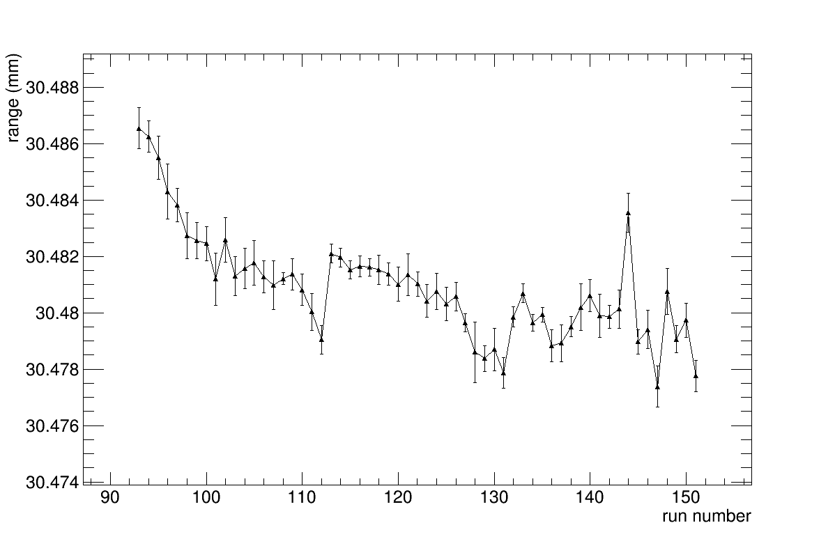
Clatterbridge Beam Test: Radiation Damage
4750 Gy
Cumulative
peak dose
1600 Gy
3160 Gy
6340 Gy
Notes:
This radiation damage has a negligible effect on the range reconstruction. However, this is only preliminary and we need to make sure we understand it well enough before we take our final conclusion.

Slide 23
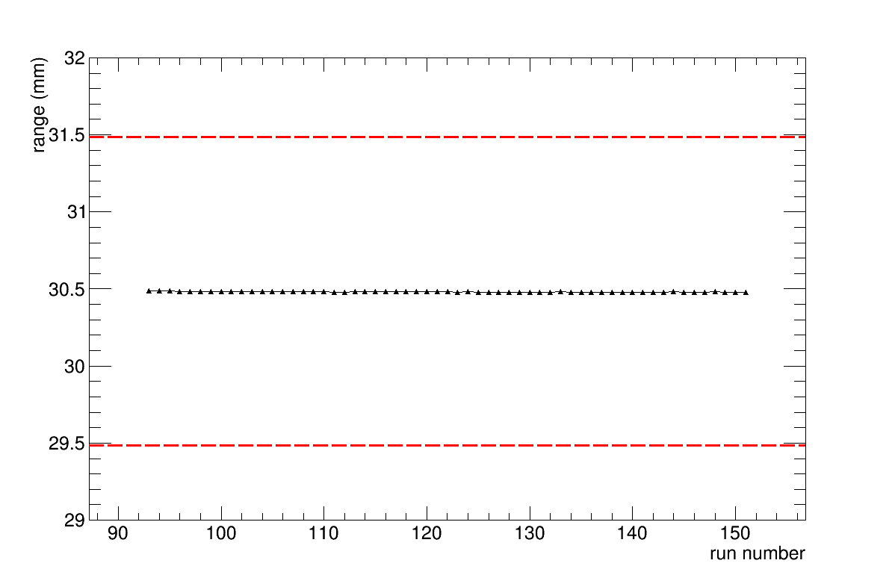
Clatterbridge Beam Test: Radiation Damage
Notes:
To put the last plot into context, here is the same plot on a larger scale, shown together with some +- 1mm tolerance lines. You can see that the range measurement is very stable.

Slide 24
Conclusion
Results
  Developed model for range reconstruction
  Build a prototype with image sensor
  Beam test results:
    Range reconstruction uncertainty ~0.15mm
    Preliminary: negligible deterioration of range reconstruction after 6,000 Gy
Outlook
  Image sensor is overkill. Build customized readout with photodiodes
  Build large prototype for full clinical proton beam range
  Open postdoctoral position in our group: Innovation Fellowship in Proton Beam Therapy Diagnostics Development. Deadline 6th July!
Notes:
To conclude, we developed and build a prototype range telescope on a scintillator basis. The range reconstruction uncertainty is about 150 micron which is competitive with other commercially available devices. The issue with quenching has been overcome and the radiation damage assessment shows that the detector is robust.
As an outlook: Since the CMOS sensor is a bit of an overkill, we want to downgrade and use a cheaper and simpler way of readout, something like photodiodes. And we also want to build a large second prototype which can cover the full clinical proton beam energy range. In order to do that, we are looking for a new postdoc in our group: the deadline for the application for the Innovation fellowship is on the 6th of July! If you are interested or you know somebody who might be, please fell free t talk to either me or Dr. Simon Jolly.

Slide 25
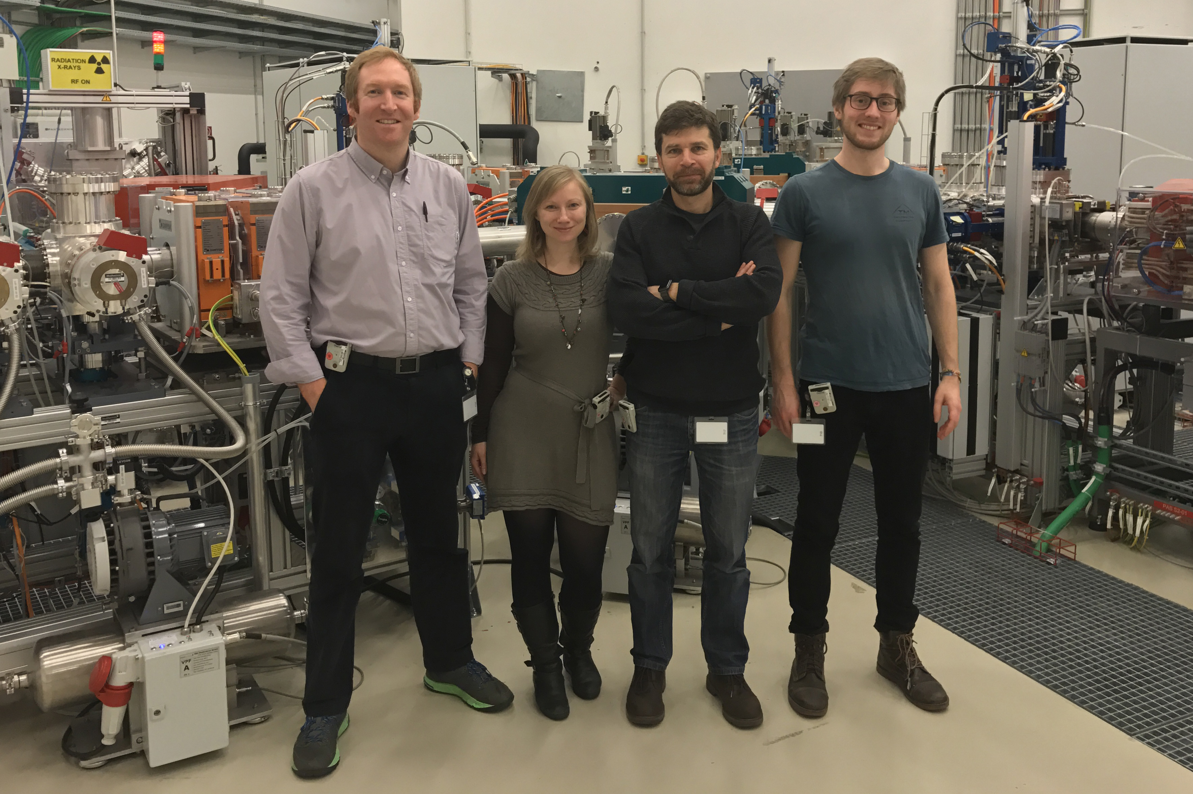
Thank you for your attention
This project has received funding from the European Union’s Horizon 2020 research and innovation programme under the Marie Sklodowska-Curie grant agreement No 675265, OMA – Optimization of Medical Accelerators.
Notes:
In the name of the whole group, thank you very much for your attention.

Slide 26
Backup

Slide 27
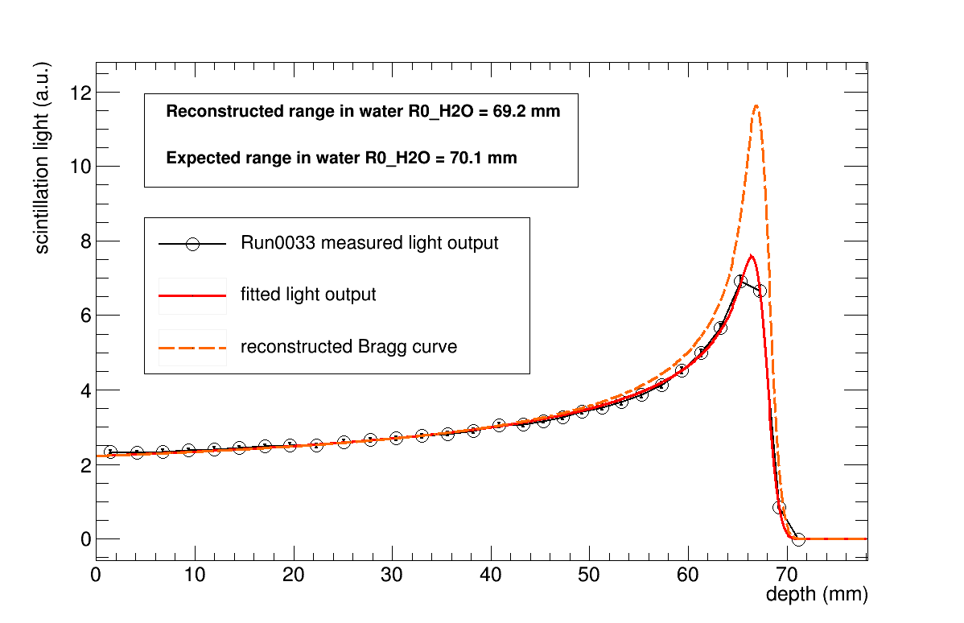
Range reconstruction

Slide 28
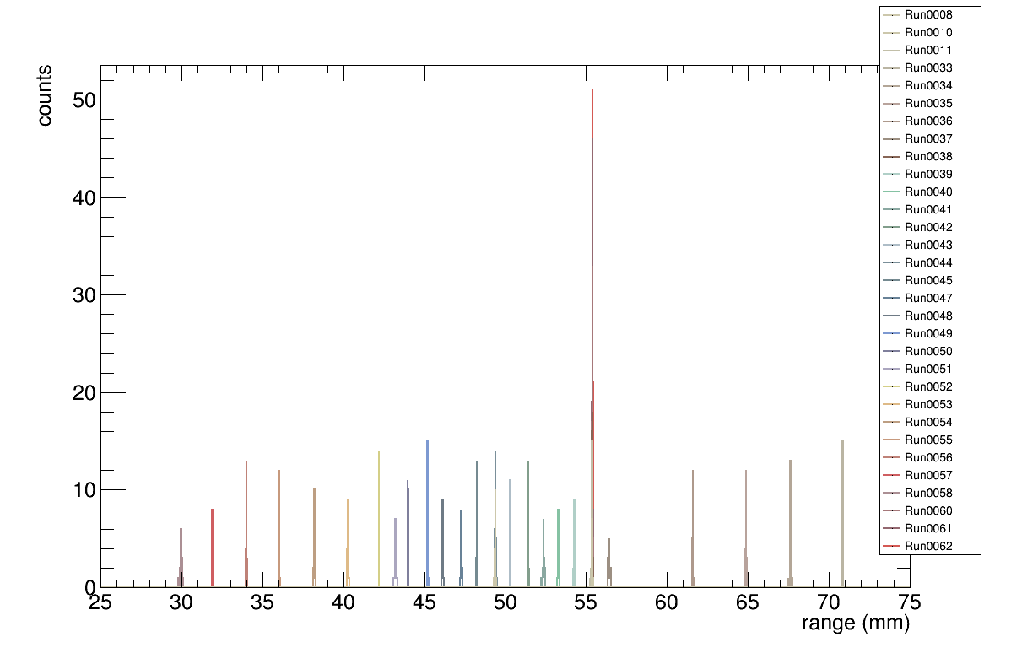
Range Scan: Reproducibility
Notes:
So each run is taken at a different energy/range. In each run there are 21 frames which are fitted individually. The reconstructed range is then plotted in a histogram which you can see here. The runs are displayed in different colours. You can see that all the runs are far apart and have well distinct ranges.

Slide 29
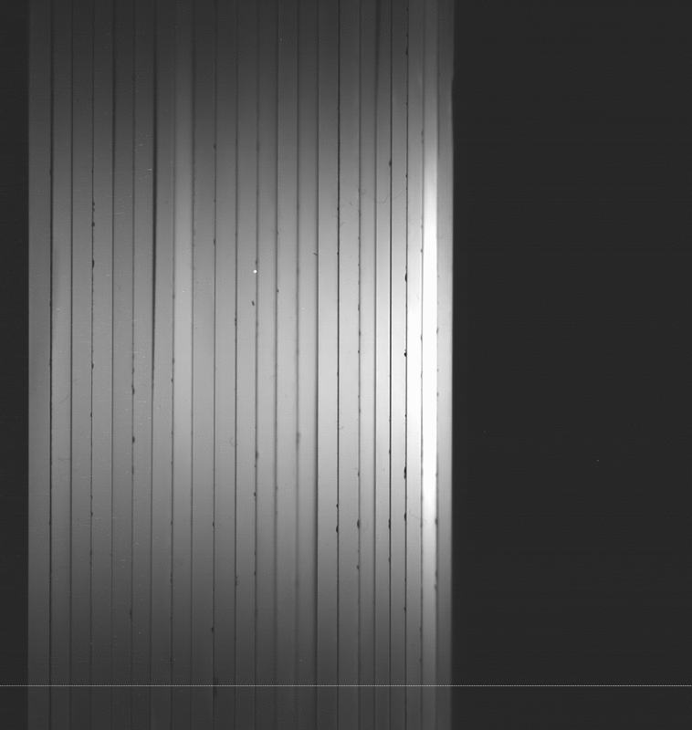
Intensity Scan
Notes:
We also did a test of different beam currents. Here you see a video of that. Remember that there might be some quenching at high beam current.

Slide 30
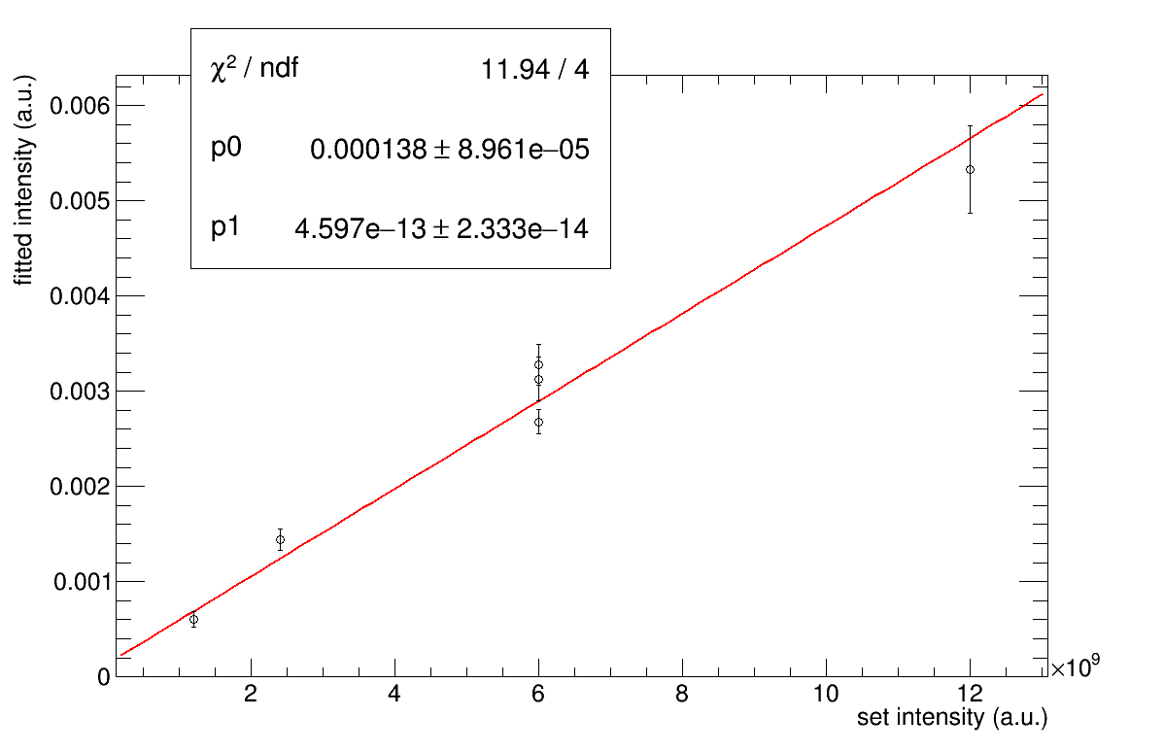
Intensity Scan
Notes:
So I plotted the height-parameter of the fit vs the set intensity in the synchrotron. Unfortunately there are not many data points. Beam current-induced quenching would manifest as a non linearity in this plot. This is not seen, so we can say that there is no additional quenching at this beam current.

Slide 31
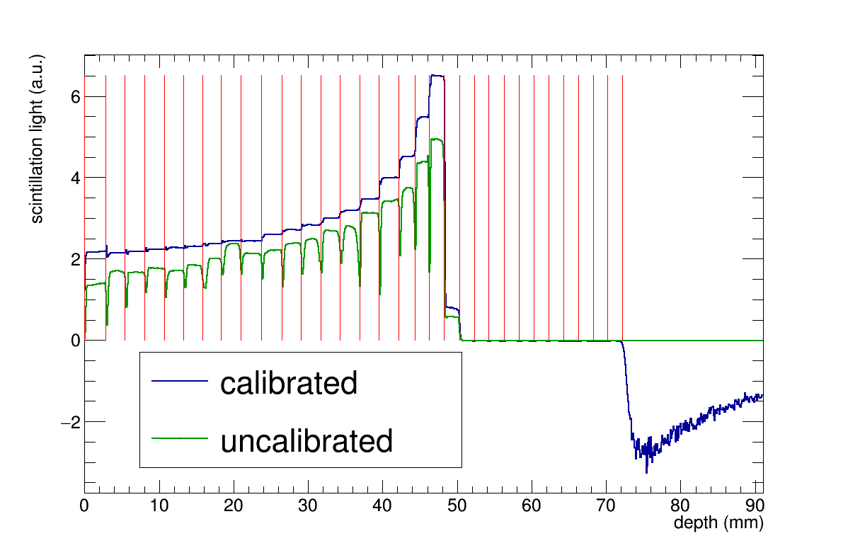
Calibration

Slide 32
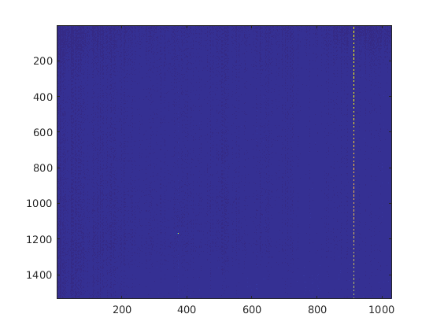
Background

Slide 33
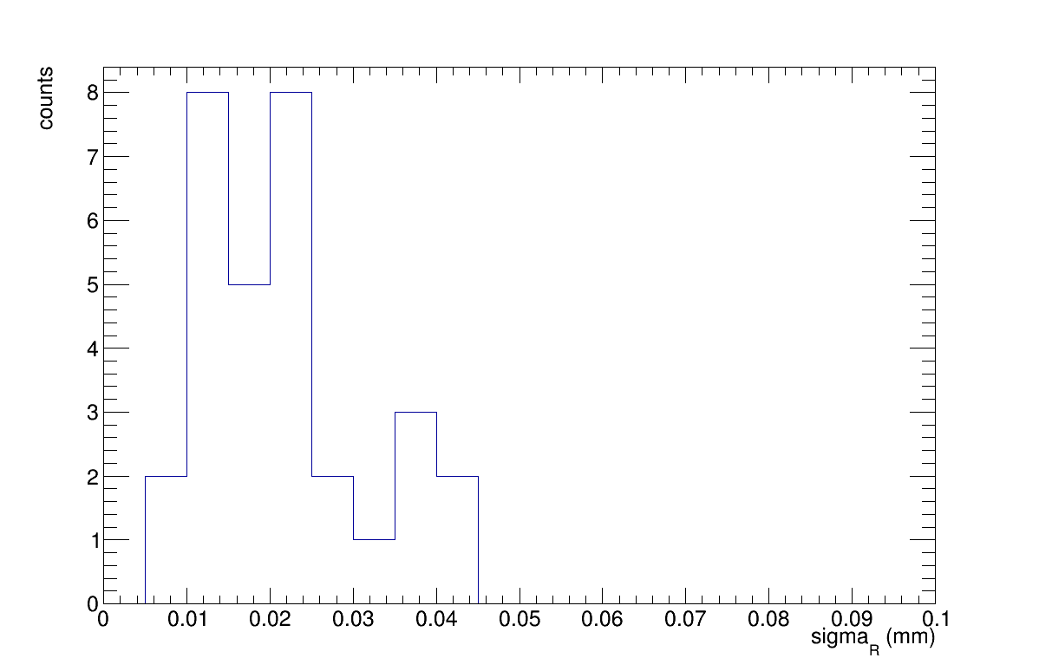
Range reconstruction Uncertainty

Slide 34
Notes:
Hello, Laurent Kelleter, OMA fellow from UCL, we,ve seen a lot of motivation for proton therapy so I just want to jump straight into my topic. wanna talk about this
Projector is not broken, what you see is a video of a proton beam in a segmented block of plastic scintillator. Beam comes from left to right, you can see the Bragg peak. The flickering is the fluctuation of the beam current

Slide 35
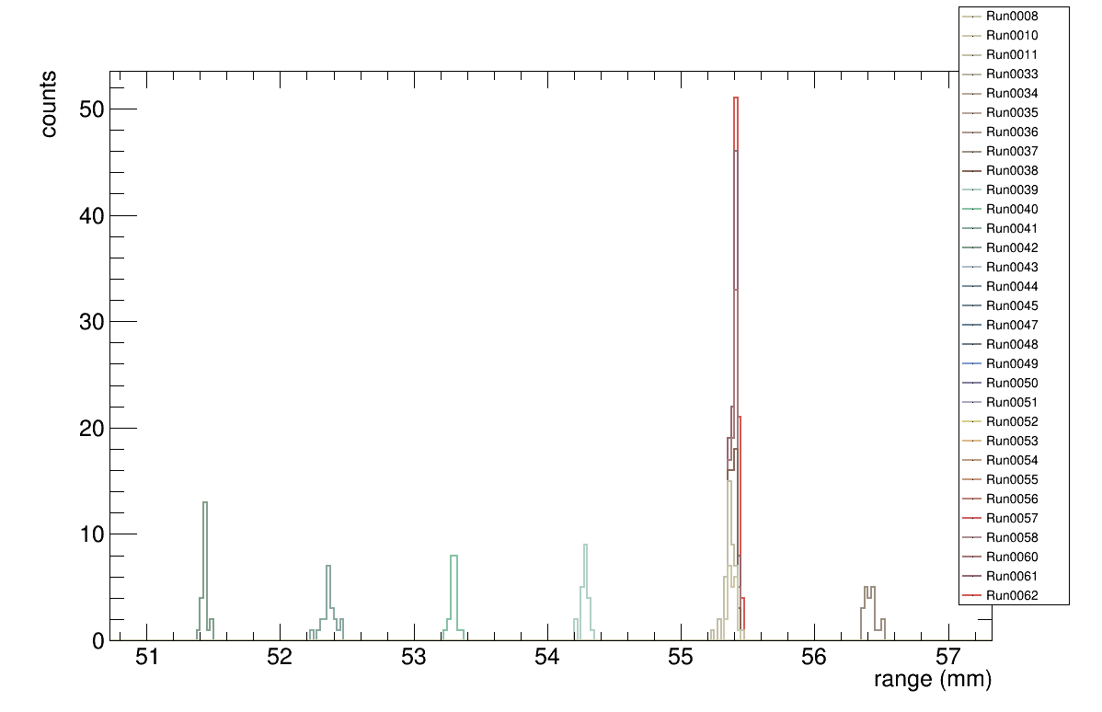
Range Scan: Reproducibility
Notes:
Here’s a zoom to the ranges around 55mm. You can see that the measured ranges form nice little Gaussians with a sigma of about 0.05mm. We also remeasured one range a couple of times and the run-to-run stbility is also remarkable.

Slide 36
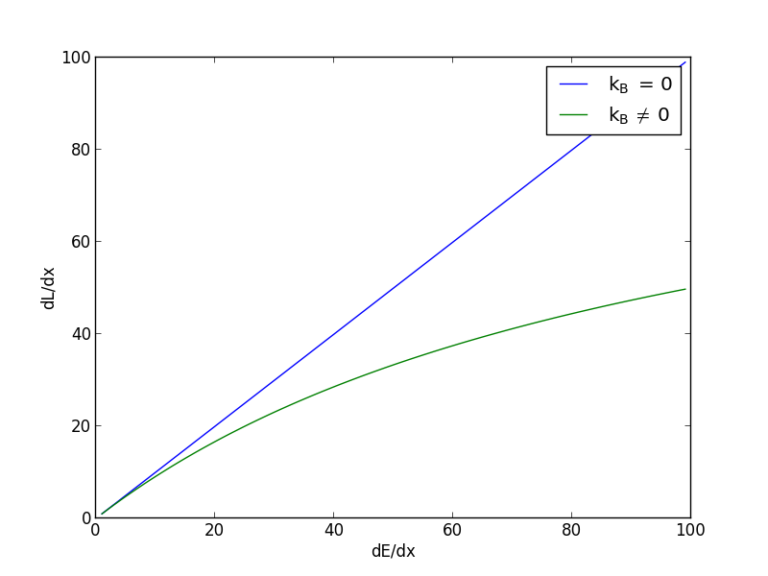
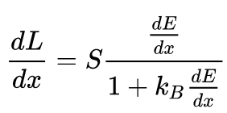
Quenching: Birk’s Law
Notes:
If the ionization density gets very high, the light output stops being linear to the energy deposition. The strength of the ionization dependence of the quenching is described by Birk’s constant.
Since protons have a comparatively large dEdx, the Bragg curve in a plastic scintillator appears mashed-up. The ionization density depends on the energy and nature of the particle and also on the beam current in case of high beam intensities. So we really need to be careful when we try to take into account quenching.

Slide 37
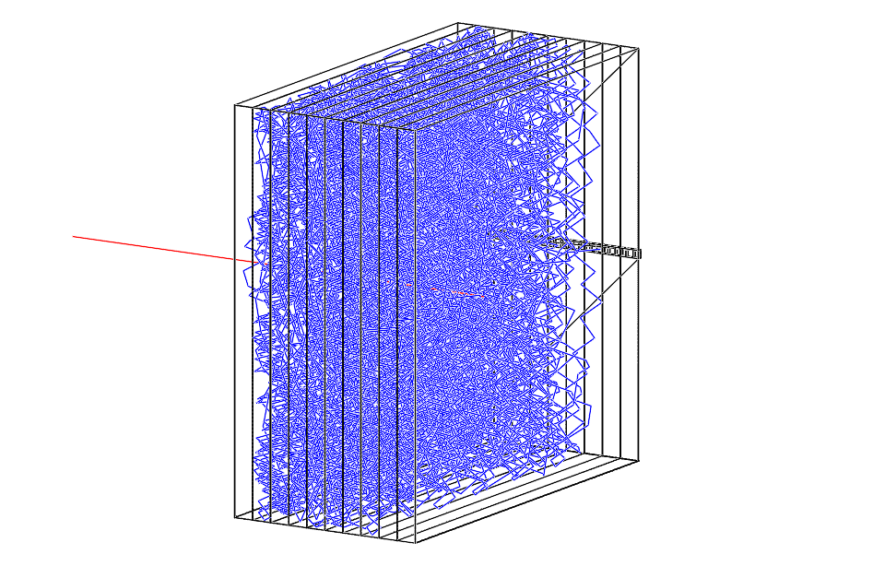
Range Telescope: Simulation
Geant4 simulation
Proton beam
Notes:
Firstly, we run a couple of simulations in order to understand how much light we expect, what the maximum sheet thickness is, etc. We were relying here on the Geant4 simulation of the SuperNEMO calorimeter. Here you can see the simulation of a proton in red entering a scintillator stack and producing optical photons in blue.

Slide 38
Range Scan
Beam
Notes:
And this is how that looks like.
We then did the analysis of the integrated light output per sheet, which brings us to my favourite slide

