Slide 1
Measurements of Scintillator sheet thickness
Jordan Silverman

Slide 2
Method
8 measurements of each scintillator sheet were taken, at the middle of each edge and at each corner. These measurements were taken using a digital caliper.

Slide 3
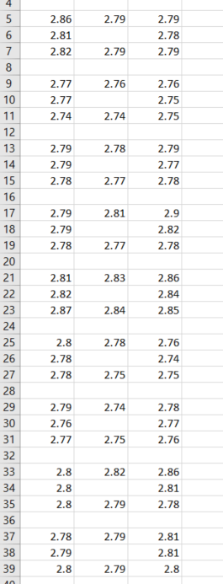
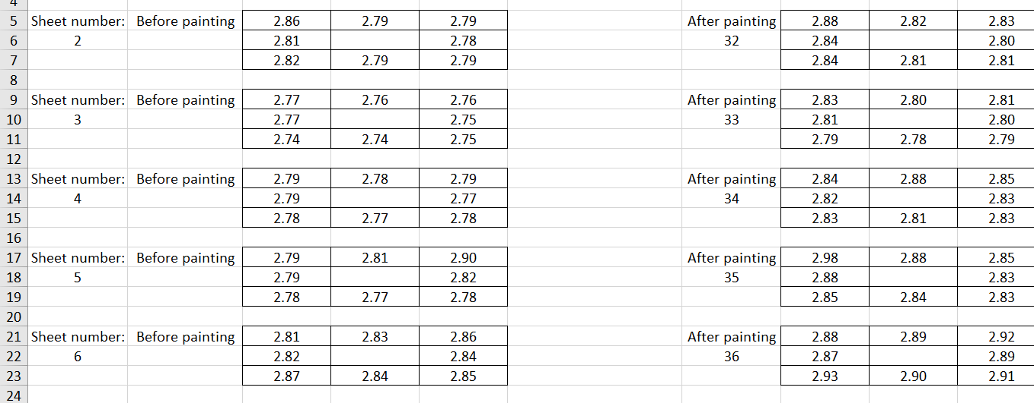
Conversion to .csv

Slide 4
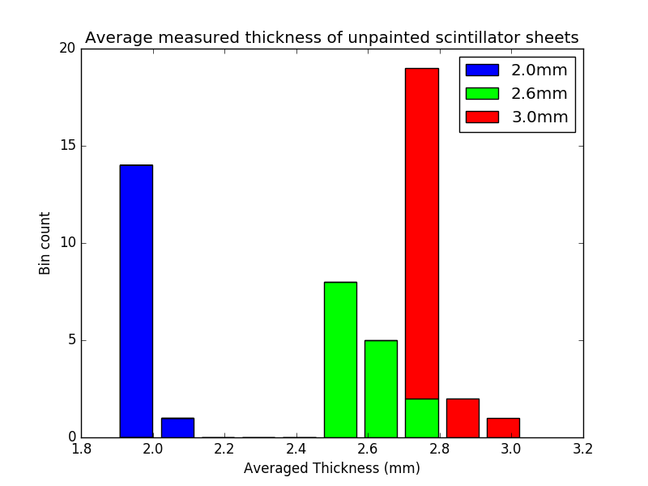
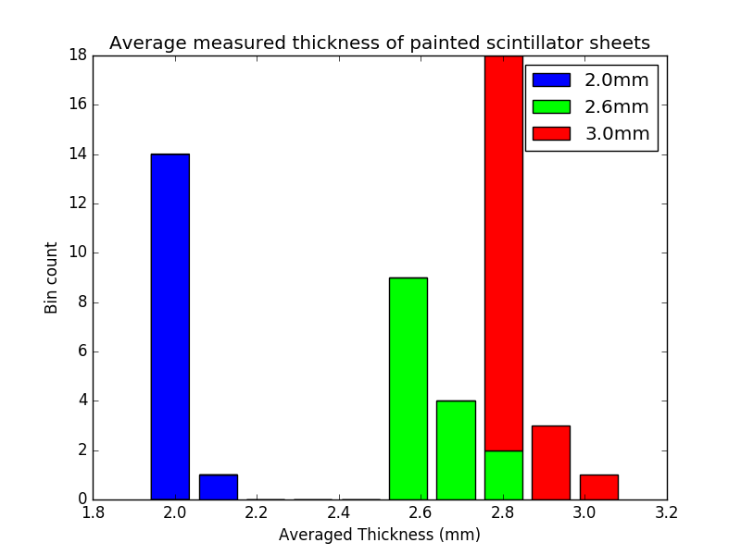
Average measured Thickness results

Slide 5
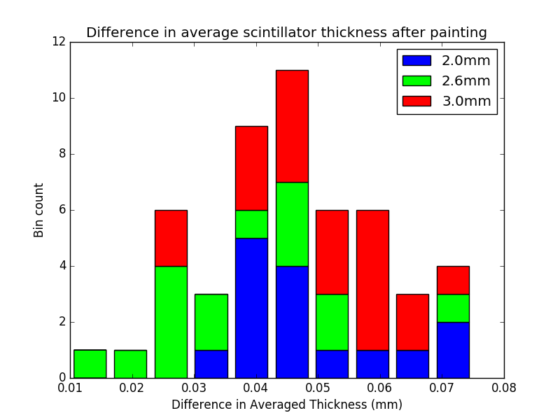
Difference in thickness results

Slide 6
Difference in thickness results
Absolute value?

Slide 7
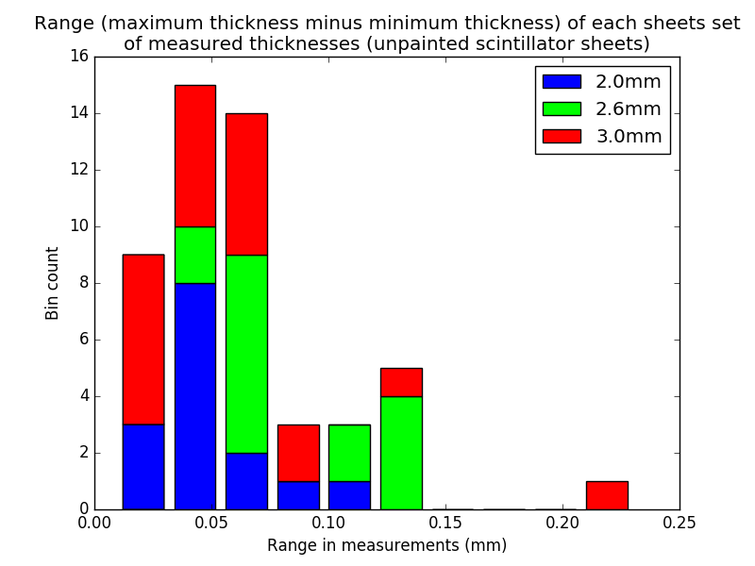
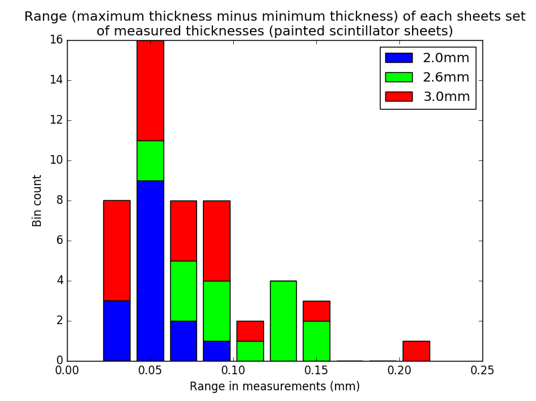
Range across sheets results
For all practical purposes, the spread in ranges does not change.

Slide 8
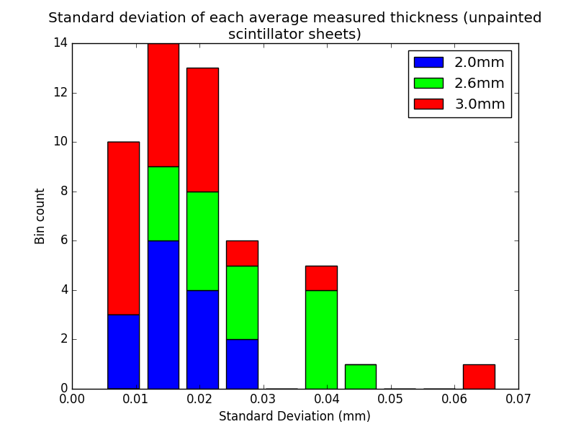
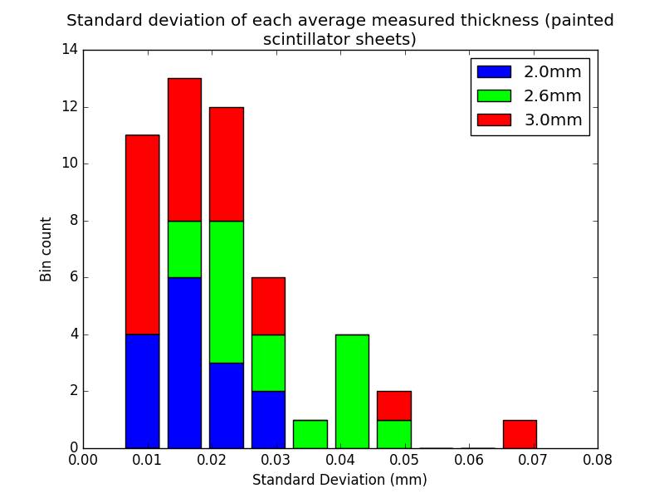
Standard deviation across sheets results

