Slide 1
Measurements of Scintillator sheet thickness
Jordan Silverman

Slide 2
Method
8 measurements of each scintillator sheet were taken, at the middle of each edge and at each corner. These measurements were taken using a digital caliper.

Slide 3
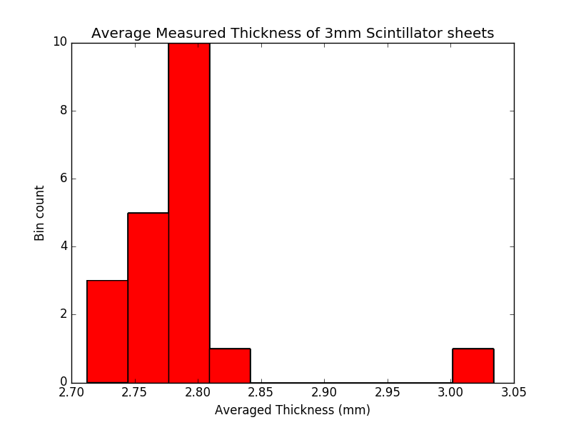
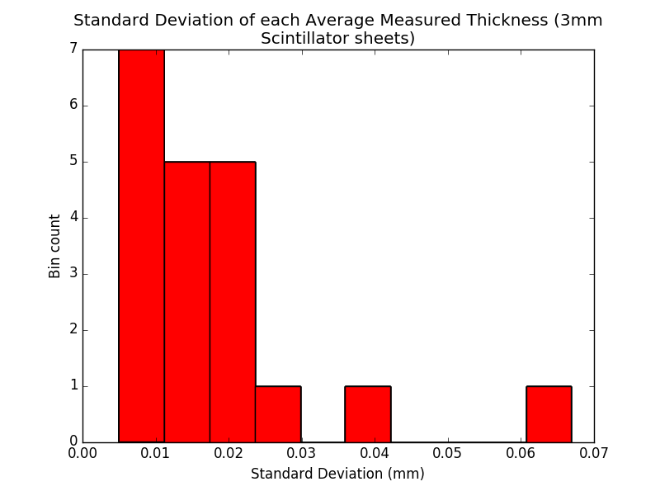
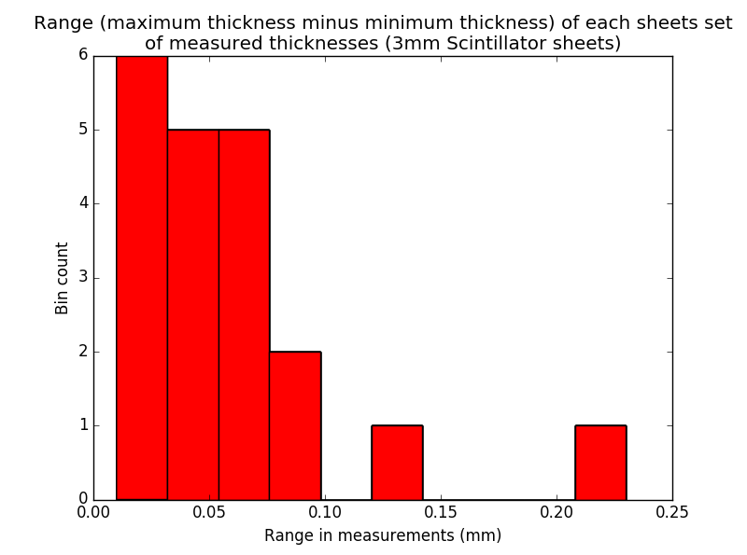
3mm sheet results
The thickness of the 3mm sheets was distributed around 2.75mm. There was a single outlier sheet with a much higher thickness.
The majority of the sheets had a standard deviation less than 1% of the measured, with 3 outliers.

Slide 4
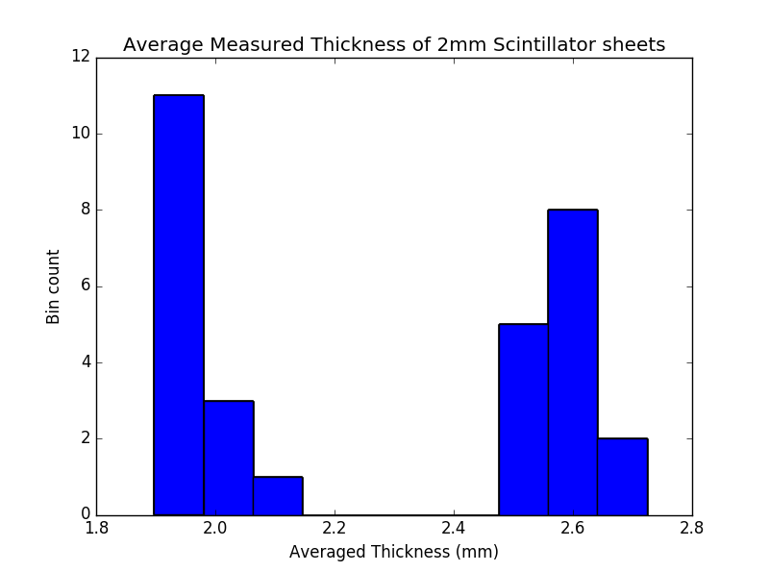
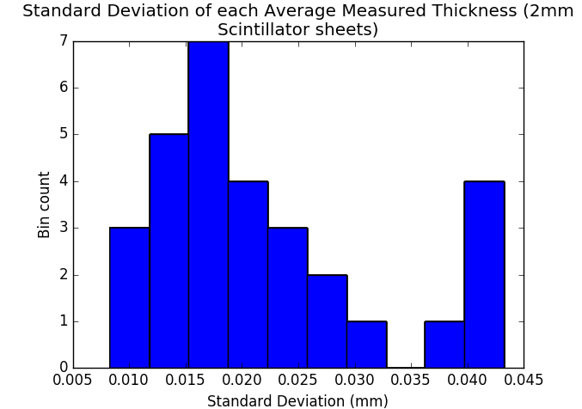
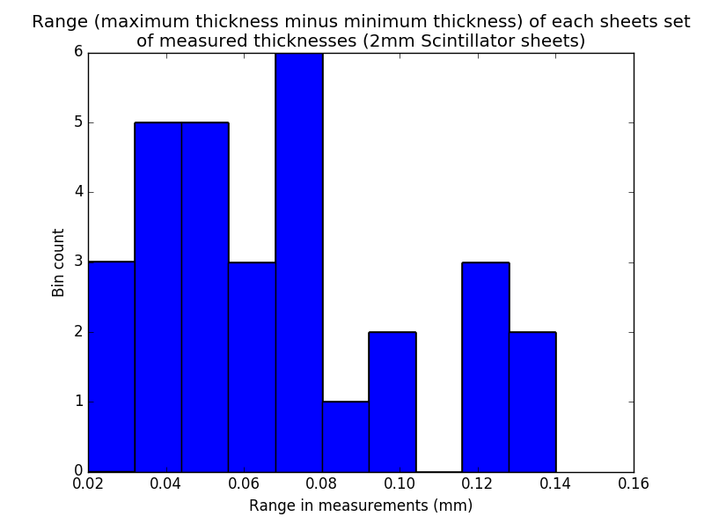
2mm sheet results
The thickness of the 2mm sheets fell into 2 regimes, ones that accurately fell around an average of 2.0mm thickness, and those that fell around 2.6mm thickness
The spread of results displayed using standard deviation and range

