Slide 1
Notes:
Hello, Laurent Kelleter from HEP, wanna talk about this
Projector is not broken, what you see is a video of a proton beam in a segmented block of plastic scintillator. Beam comes from left to right, you can see the Bragg peak. The flickering is the fluctuation of the beam current

Slide 2
A Scintillator-based Range Telescope for Proton Therapy
Laurent Kelleter
Department of Physics and Astronomy (HEP)
University College London
Notes:
We call this a range telescope. I would like to talk about what this is for, how we got where we are now and where we want to go. This work is been carried out within the European training network OMA which stands for Optimization of Medical Accelerators and is funded by the EU.

Slide 3
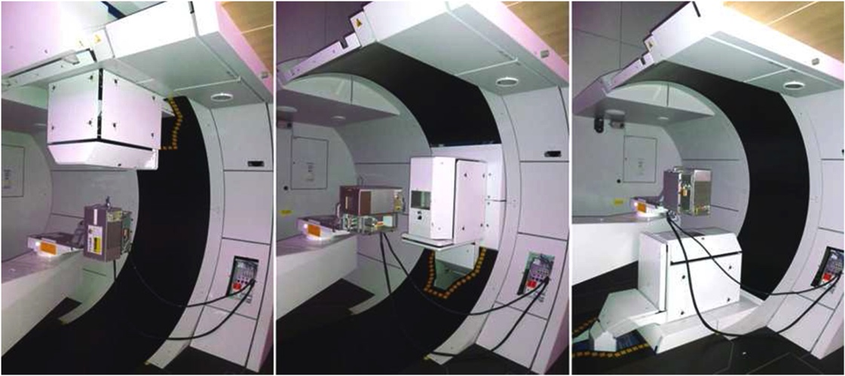
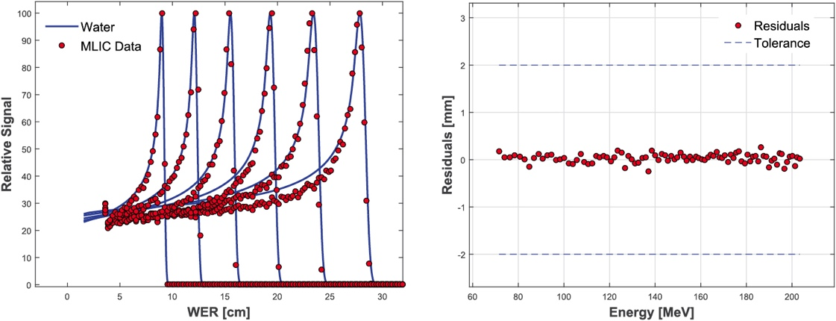
Range Quality Assurance in Proton Therapy
O. Actis et al. 2017 Phys. Med Biol. 62 1661
Notes:
The reason why we are doing this, or the problem we want to tackle is range quality assurance in proton therapy
Carried out daily in every PTC
Example from PSI, really nice integrated custom system, measure all energy steps and check whether they’re within tolerance.

Slide 4
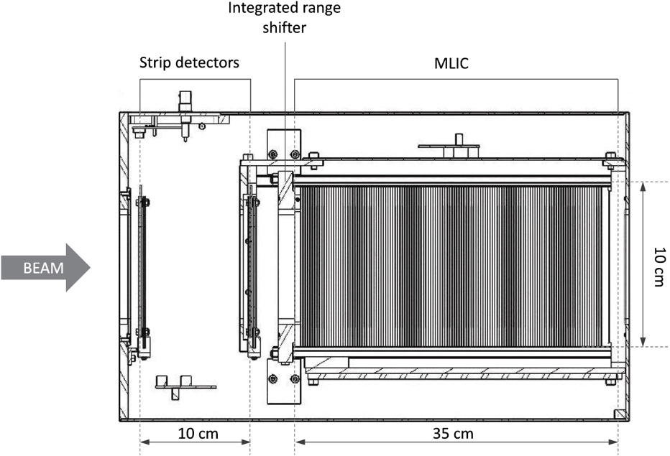
Range Quality Assurance in Proton Therapy
O. Actis et al. 2017 Phys. Med Biol. 62 1661
Notes:
The reason they’re so fast: multi layer ionisation chamber
Really expensive
Many PTCs don’t pay for it or don’t put the effort in developing their own and do a customized solution (manual scanning): slow
Our idea: build a similar range telescope on the basis of cheap plastic scintillator

Slide 5
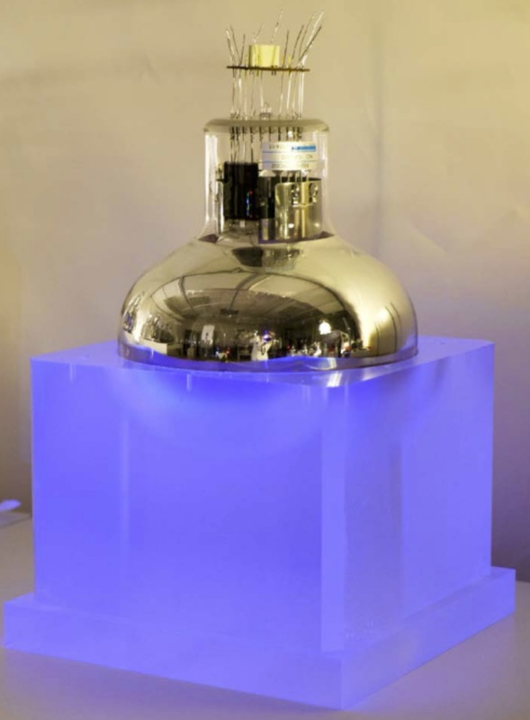
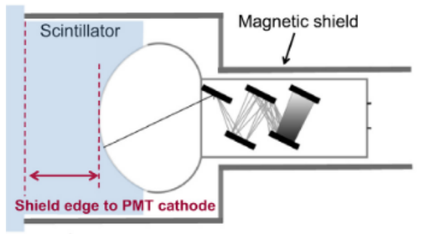
UCL HEP: SuperNEMO Calorimeter
arXiv:1707.06823 [physics.ins-det]

Slide 6
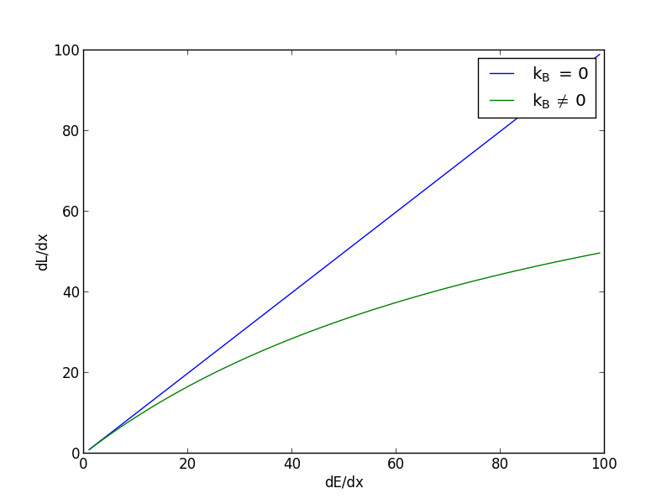
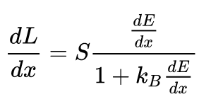
Quenching: Birk’s Law

Slide 7
Range Telescope: Principle

Slide 8
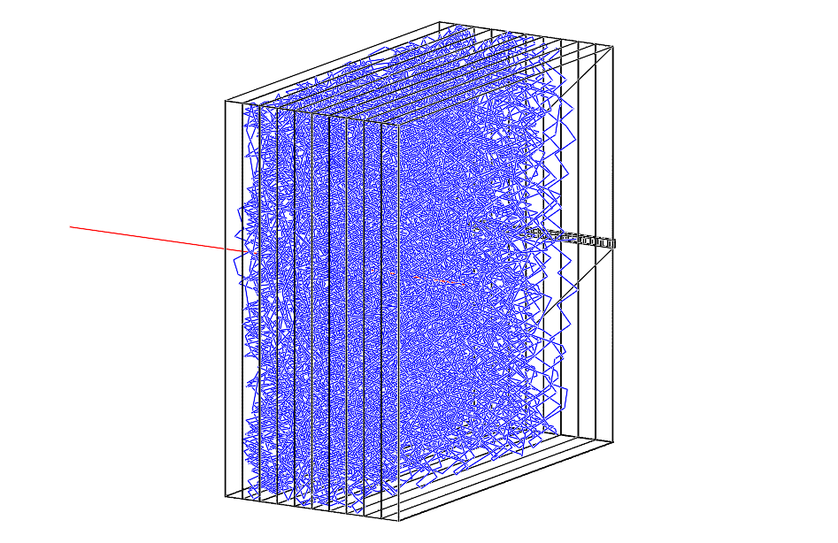
Range Telescope: Simulation
Geant4 simulation
Proton beam

Slide 9
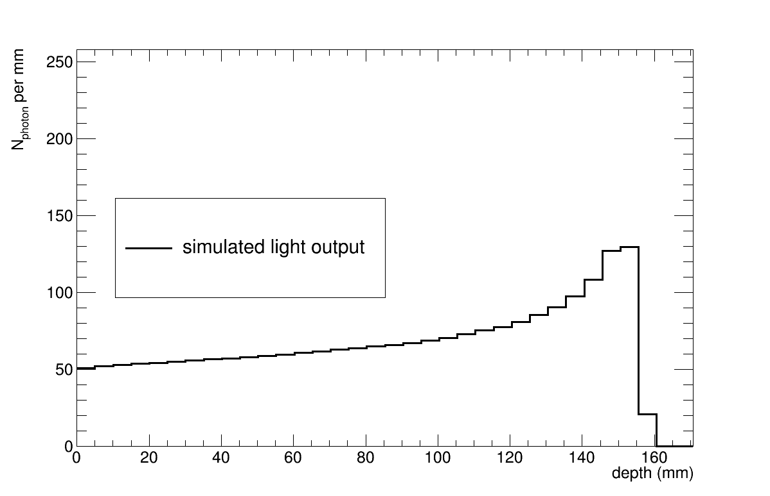
Proton Range Reconstruction
Geant4 simulation

Slide 10
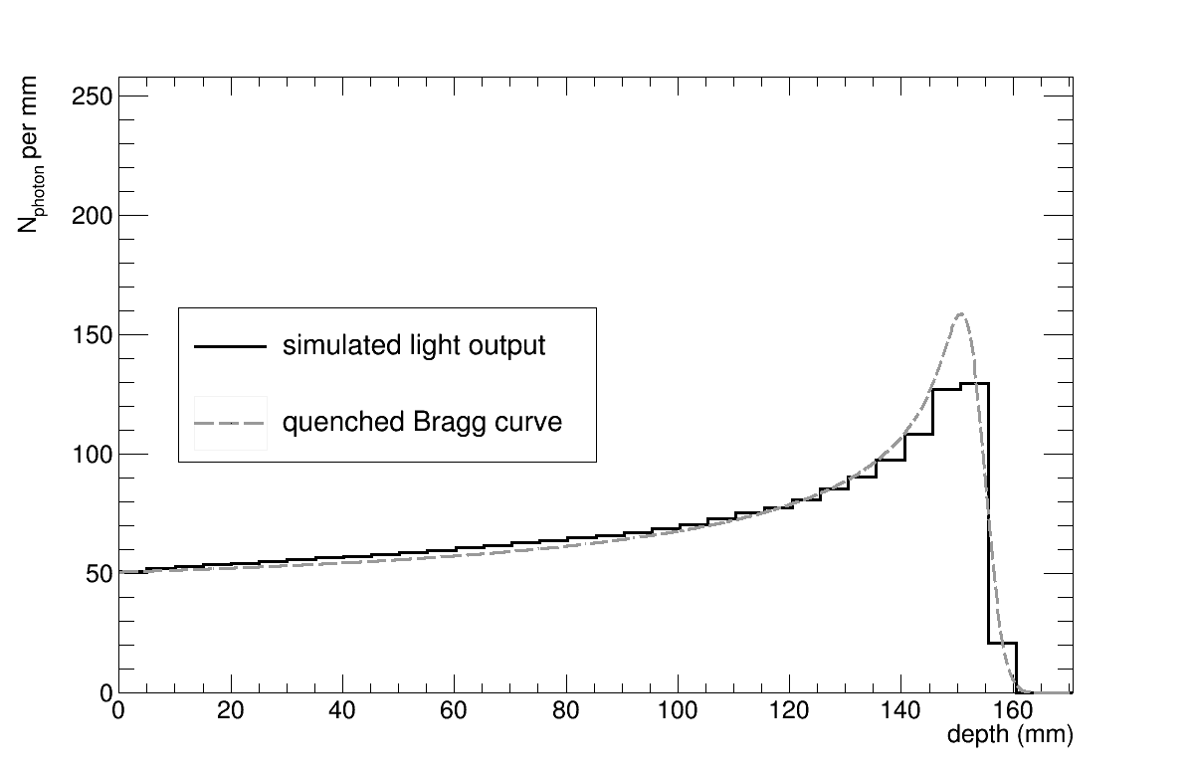
Proton Range Reconstruction
Geant4 simulation

Slide 11
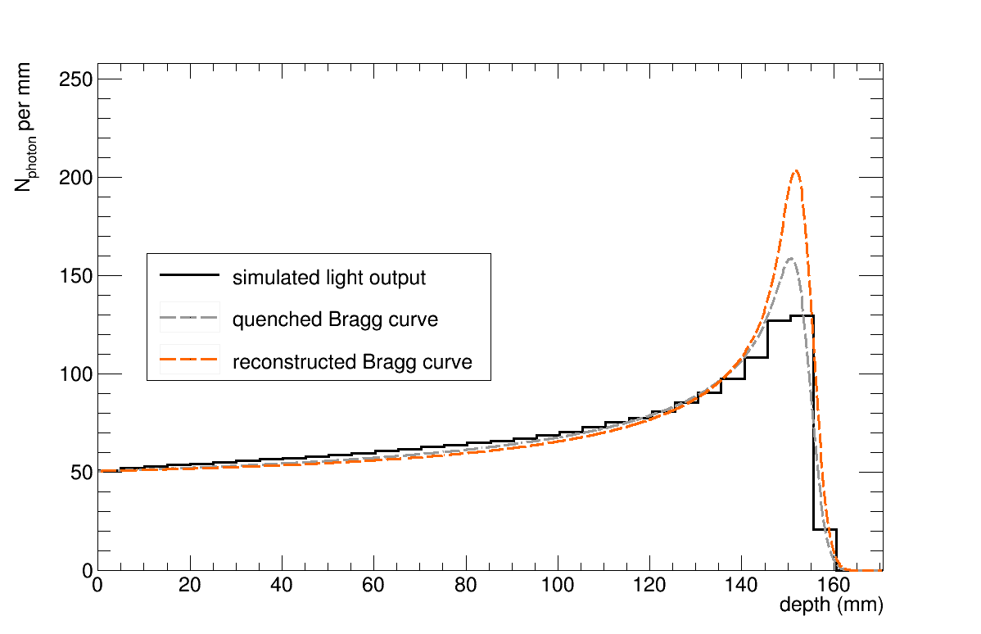
Proton Range Reconstruction
Geant4 simulation

Slide 12
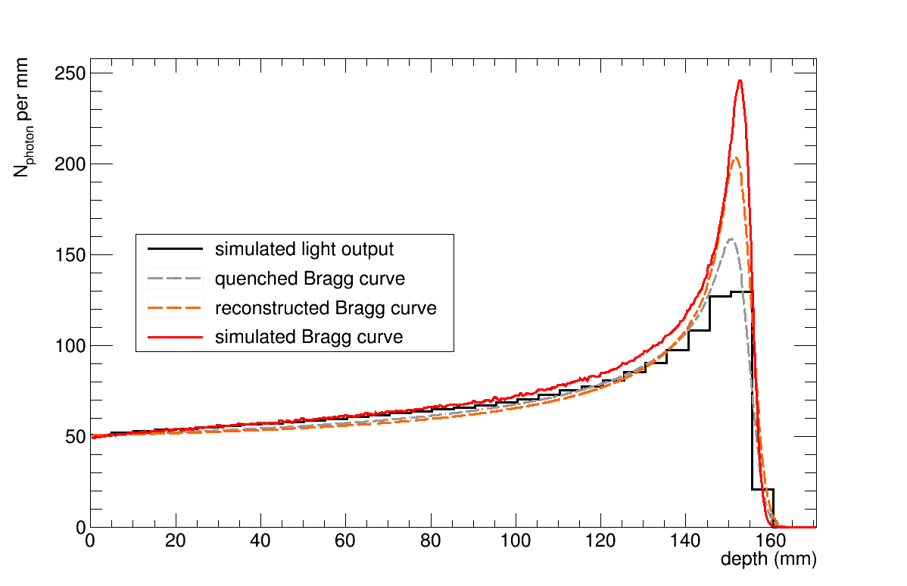
Proton Range Reconstruction
Geant4 simulation

Slide 13
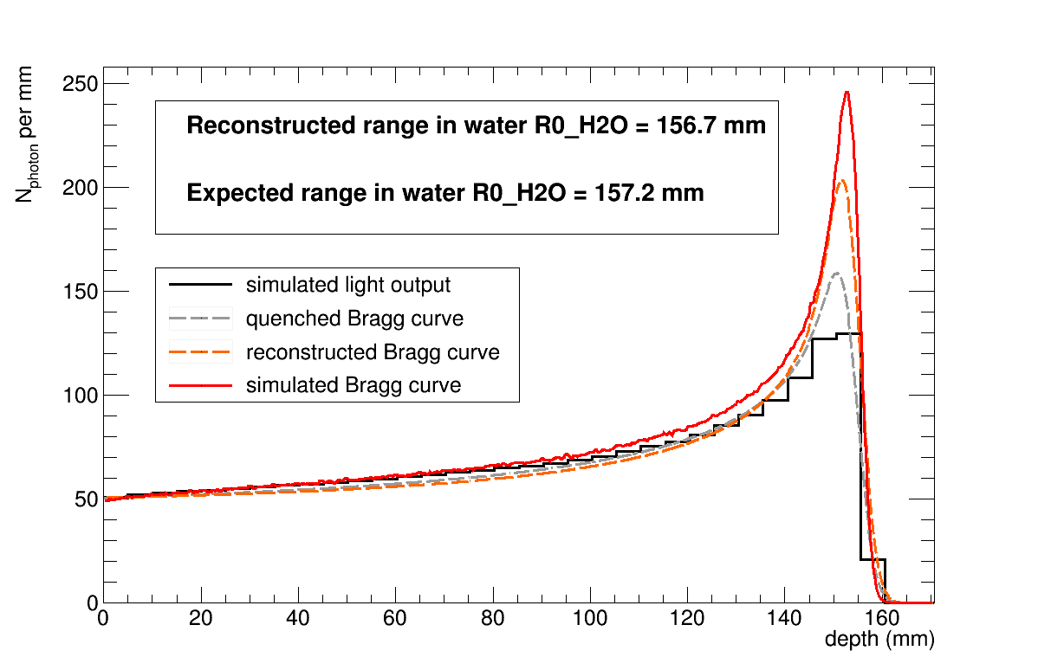
Proton Range Reconstruction
Geant4 simulation

Slide 14
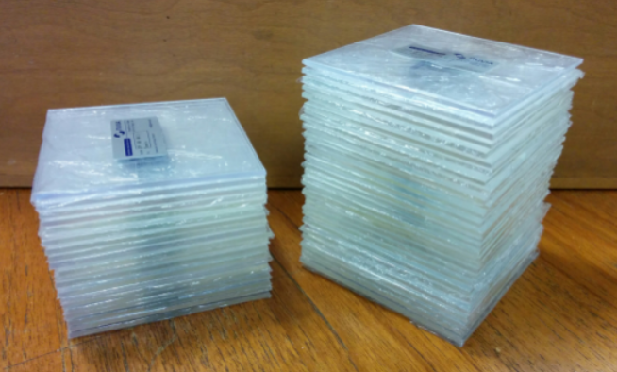
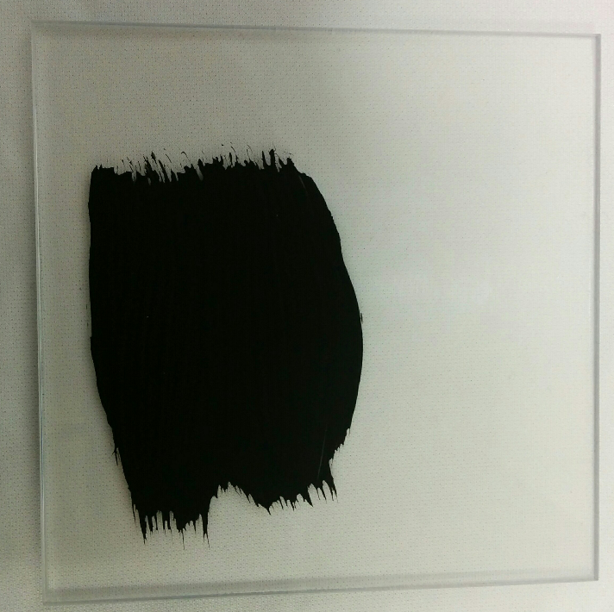
Scintillator Sheets

Slide 15
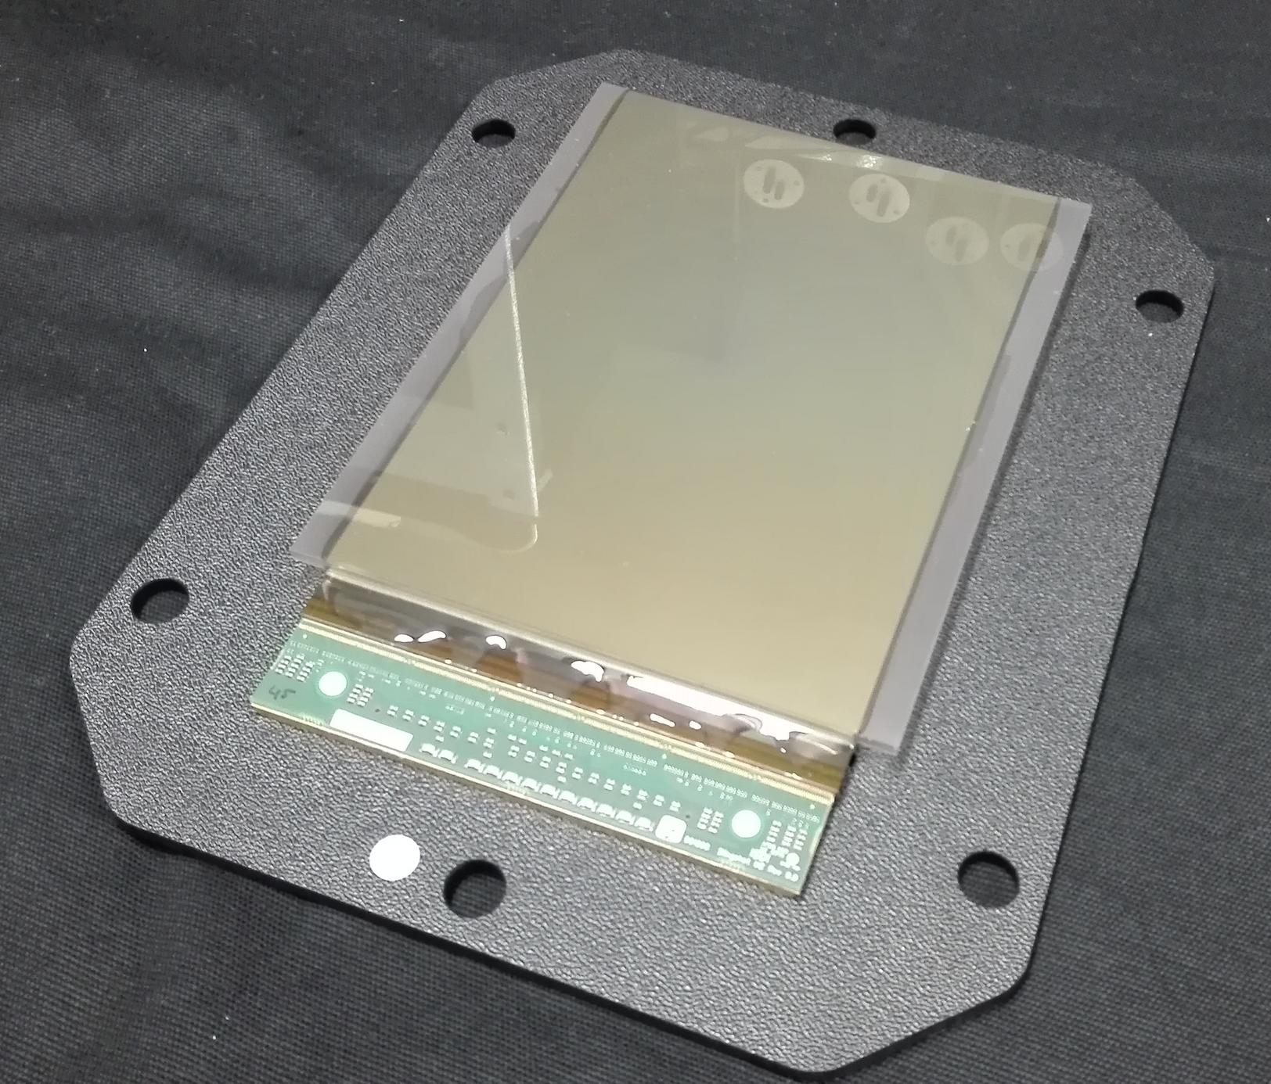
Readout: Pixel Sensor

Slide 16
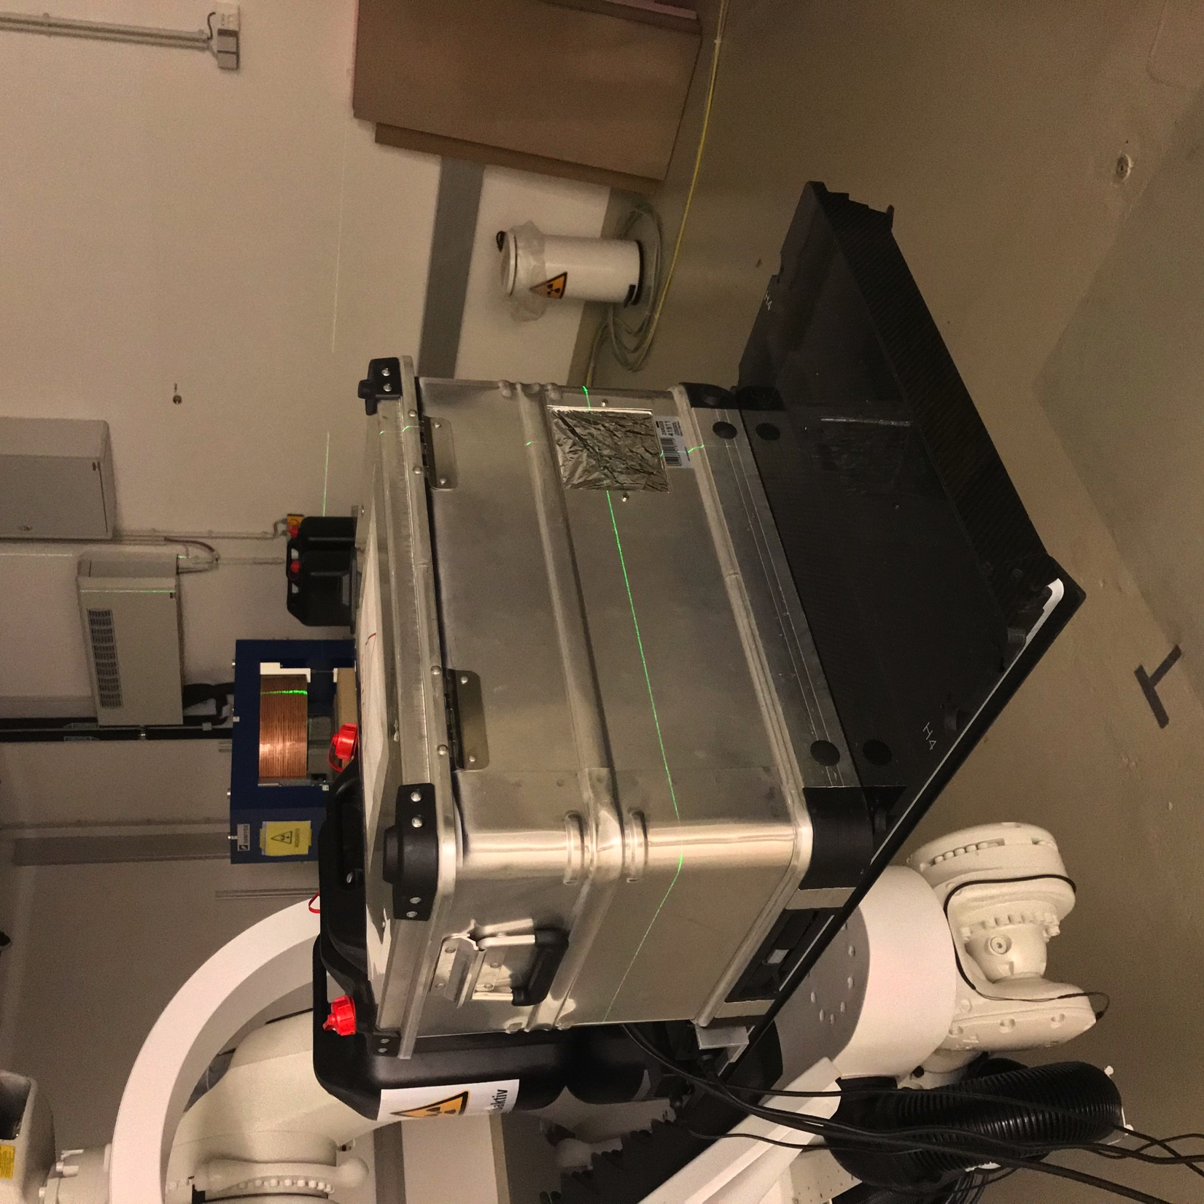
MedAustron Beam Test
Beam

Slide 17
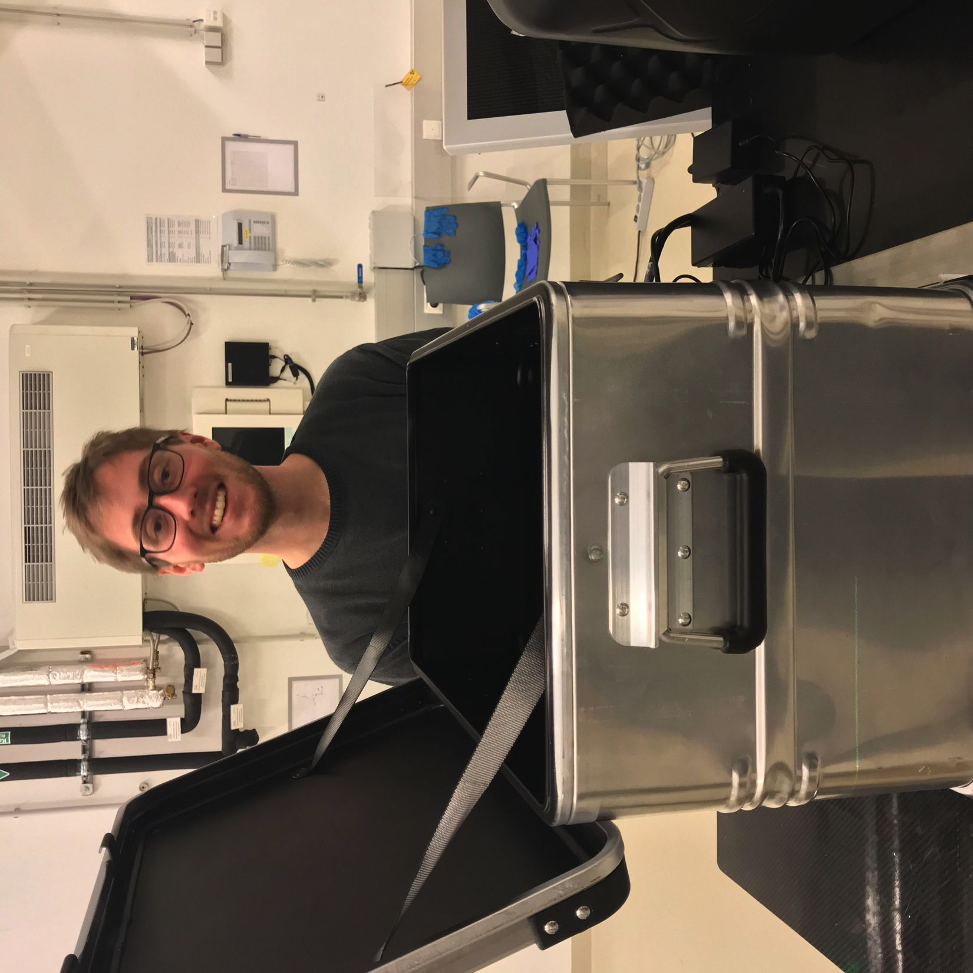
MedAustron Beam Test

Slide 18
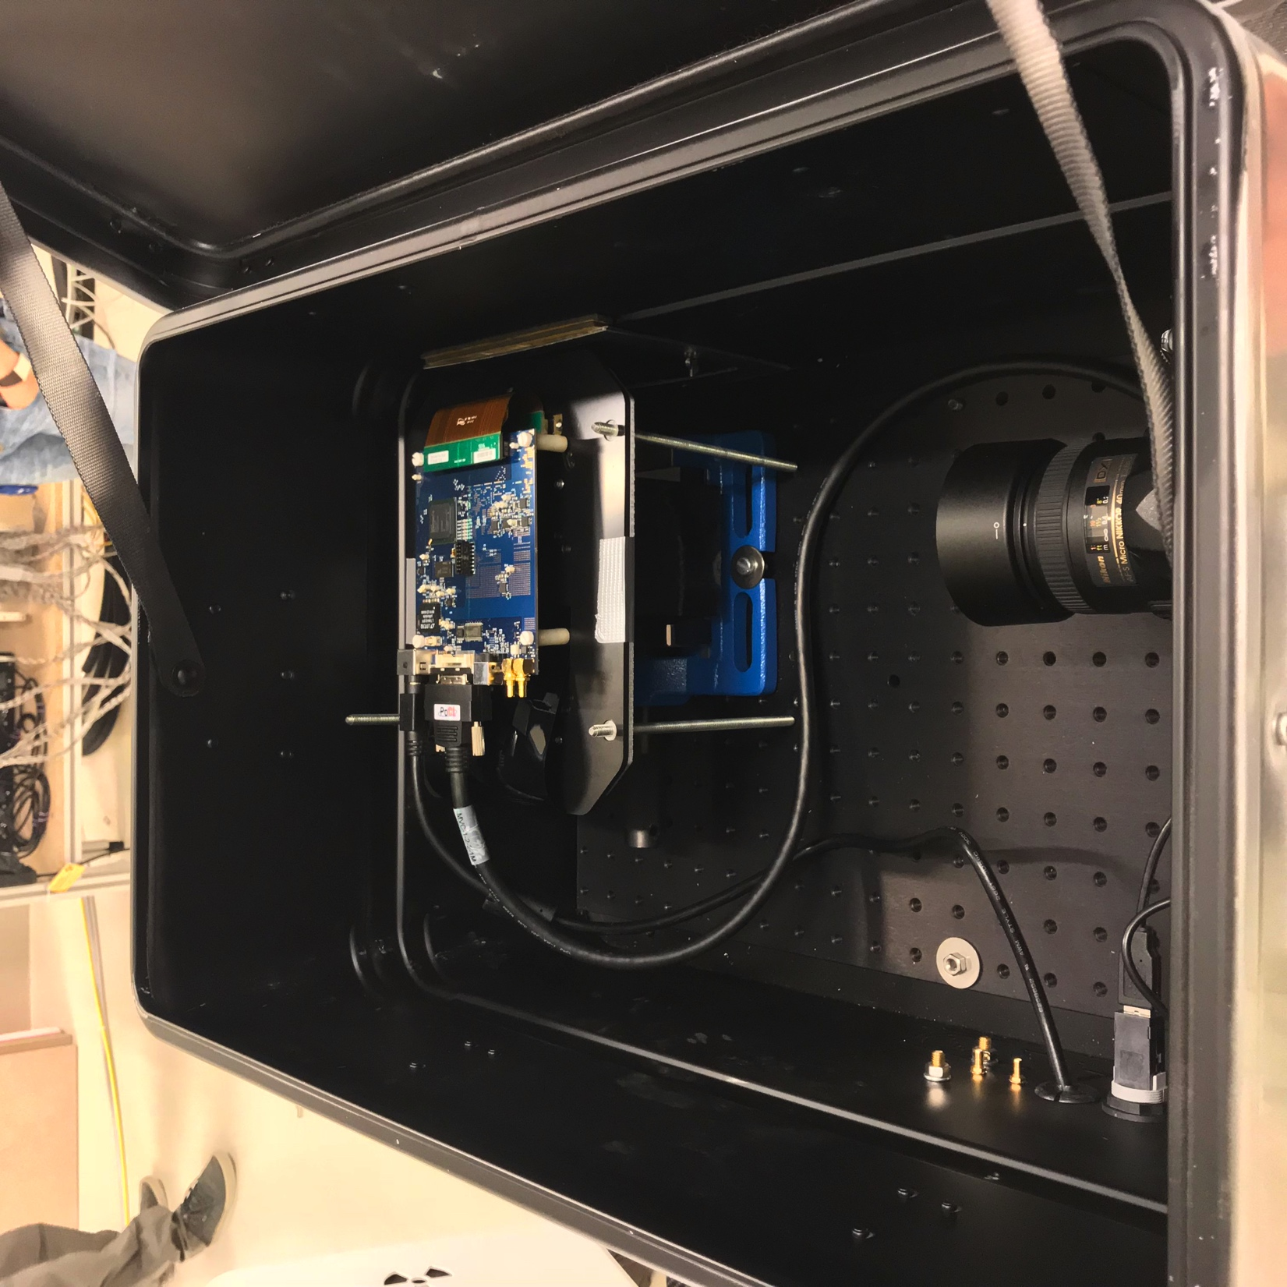
MedAustron Beam Test
Beam

Slide 19
Run at 97.4 MeV
Beam

Slide 20
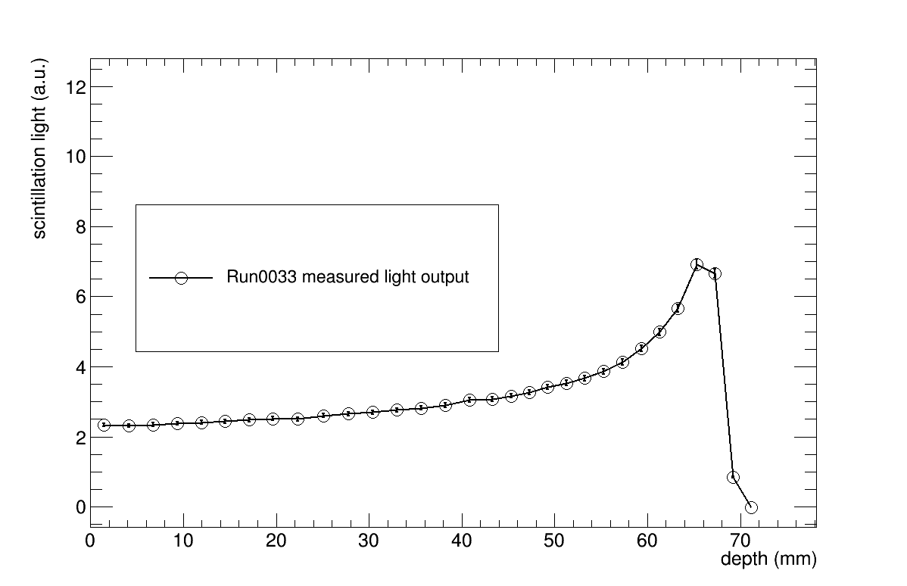
Range reconstruction

Slide 21
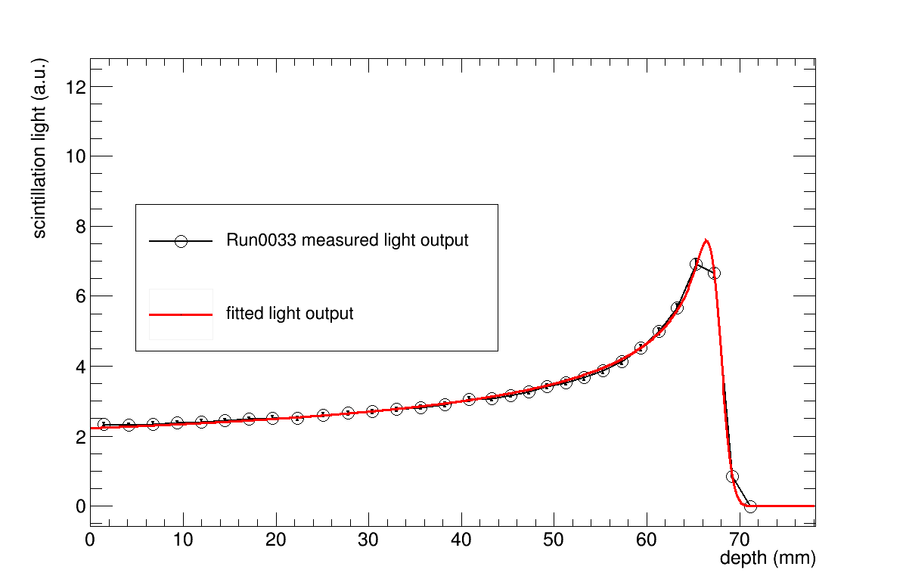
Range reconstruction

Slide 22
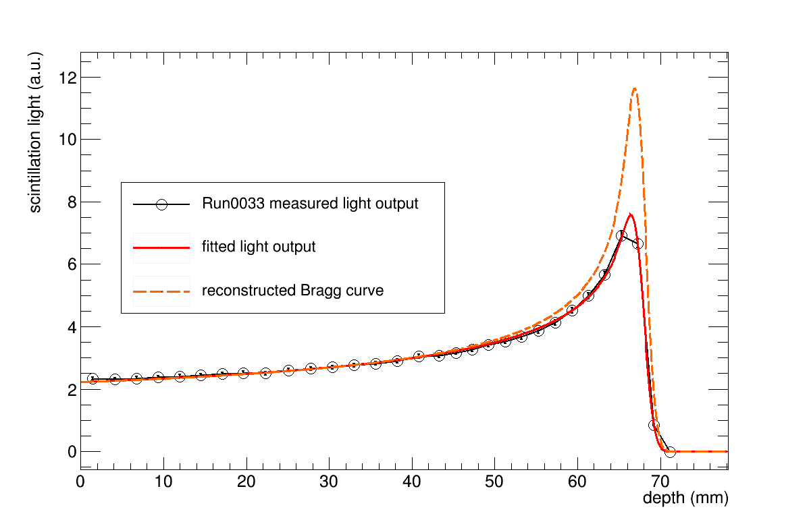
Range reconstruction

Slide 23
Range Scan
Beam

Slide 24
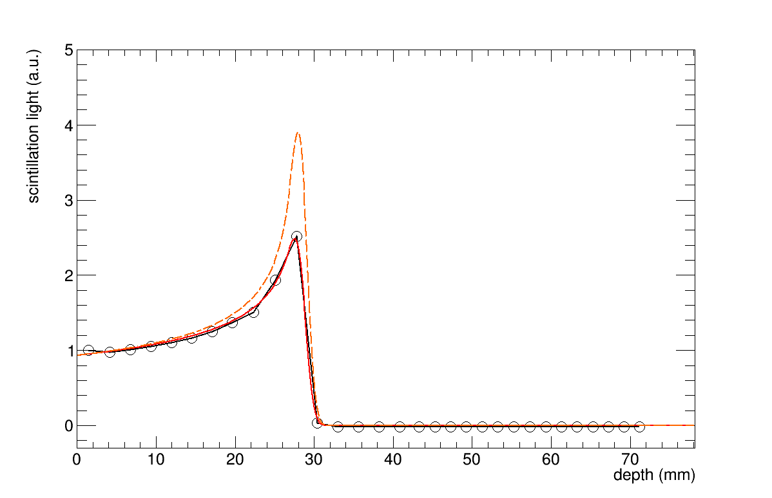
Range Scan

Slide 25
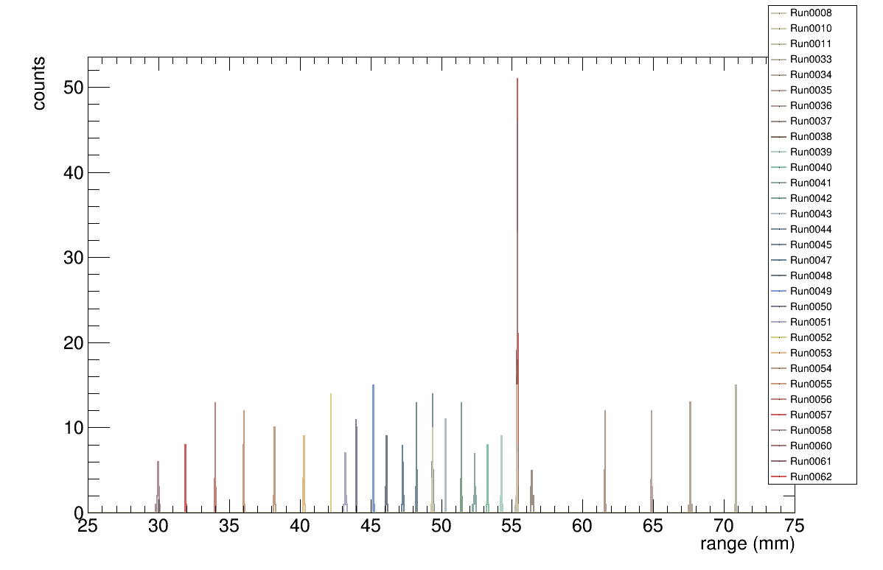
Range Scan: Reproducibility

Slide 26
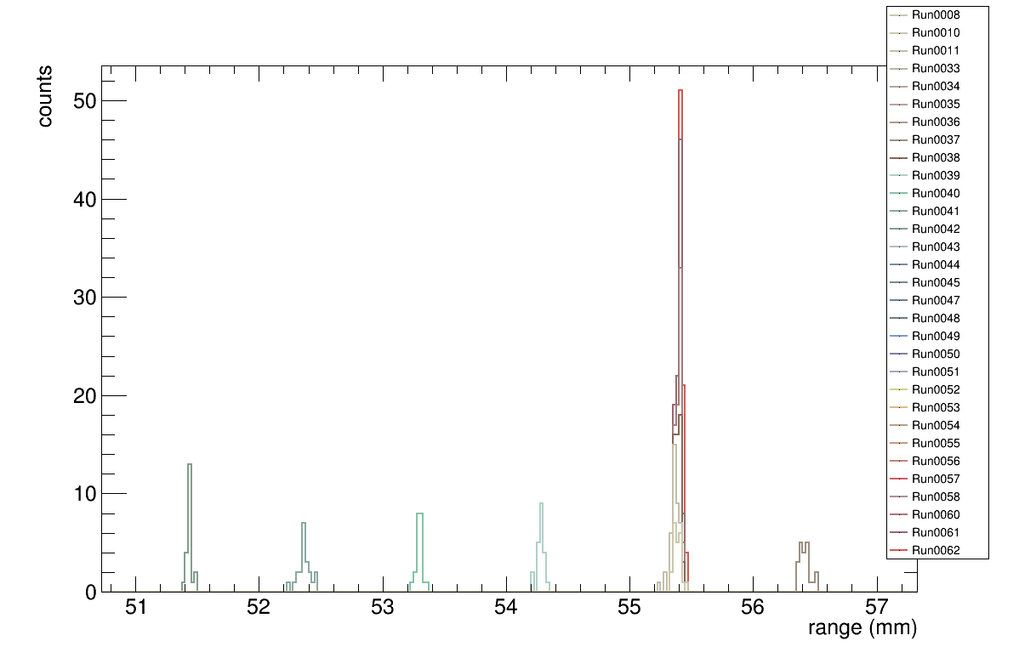
Range Scan: Reproducibility

Slide 27
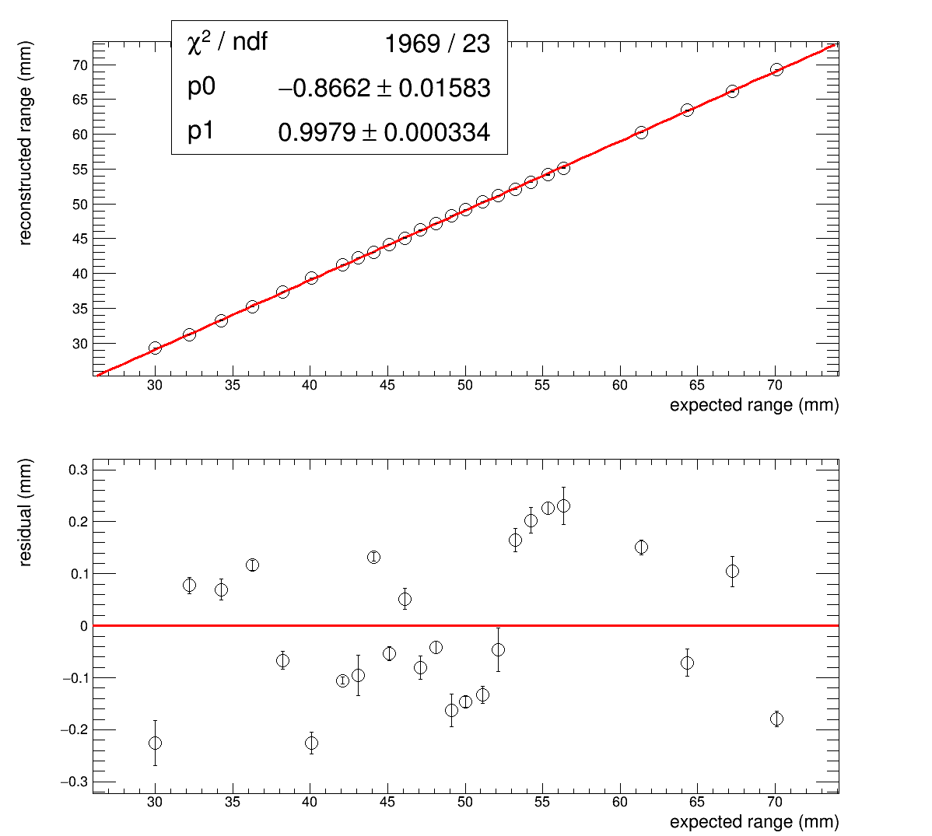
Range Scan: Range Linearity

Slide 28
Intensity Scan

Slide 29
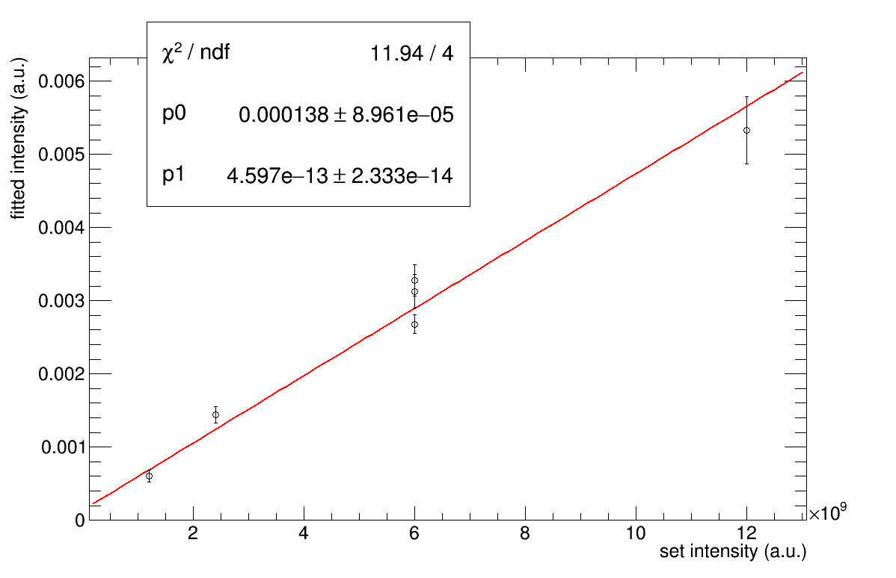
Intensity Scan

Slide 30
Clatterbridge Beam Test: Radiation Damage

Slide 31
Conclusion
Results
Extensive optimization in Geant4 simulations
Developed model for range reconstruction
Read-out solution found
Beam test results:
Range reconstruction uncertainty < 0.3mm
No intensity-induced quenching observed
Preliminary: 3% light reduction after 6,000 Gy
Outlook
CMOS sensor is overkill. Build customized readout
Build larger prototype for 250 MeV

Slide 32
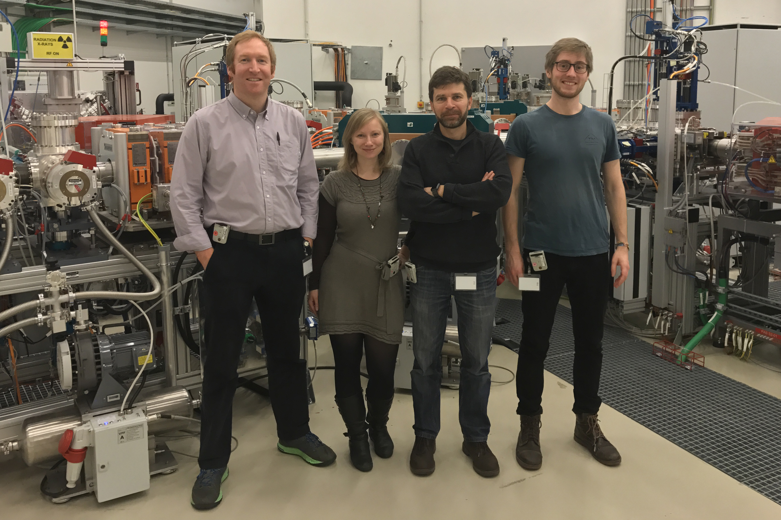
Thank you for your attention
This project has received funding from the European Union’s Horizon 2020 research and innovation programme under the Marie Sklodowska-Curie grant agreement No 675265, OMA – Optimization of Medical Accelerators.

Slide 33
Backup

Slide 34
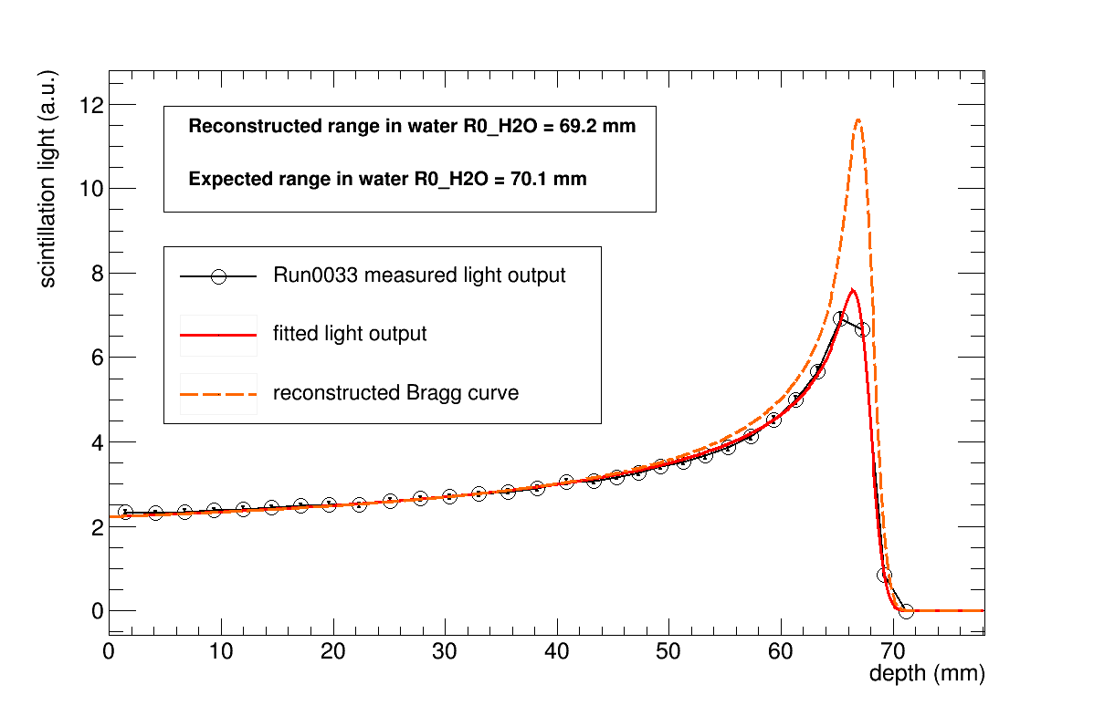
Range reconstruction

