Slide 1
Design of a Detector for Fast Treatment Plan Verification in Proton Radiotherapy
Saad Shaikh
PBT Group Meeting 22/08/18

Slide 2
Background…

Slide 3
Treatment Plan Verification (TPV)
Radiotherapy causes death of cancerous cells (and healthy cells).
Proton therapy (PT) delivers highly concentrated radiation doses to localised areas.
Minimal collateral damage, but little room for screw ups…
Need to ensure that treatment will be delivered as expected within small margin of error BEFORE treating patient.
Current methods of TPV are slow and waste time that could be used to treat patients.

Slide 4
Proposed Improvement to TPV
Couple tracker with scintillation-based calorimeter to deliver position and dose measurements of a proton beam.
Could deliver necessary info for TPV much more quickly.
UCL developing a single-module calorimeter prototype using tech from SuperNEMO.
  Scintillator block, photomultiplier tube, HV Supply, readout to LeCroy oscilloscope.
Birmingham PRaVDA group developing a tracker.
  Three silicon strips offset by 60° to provide 2D position measurements.

Slide 5
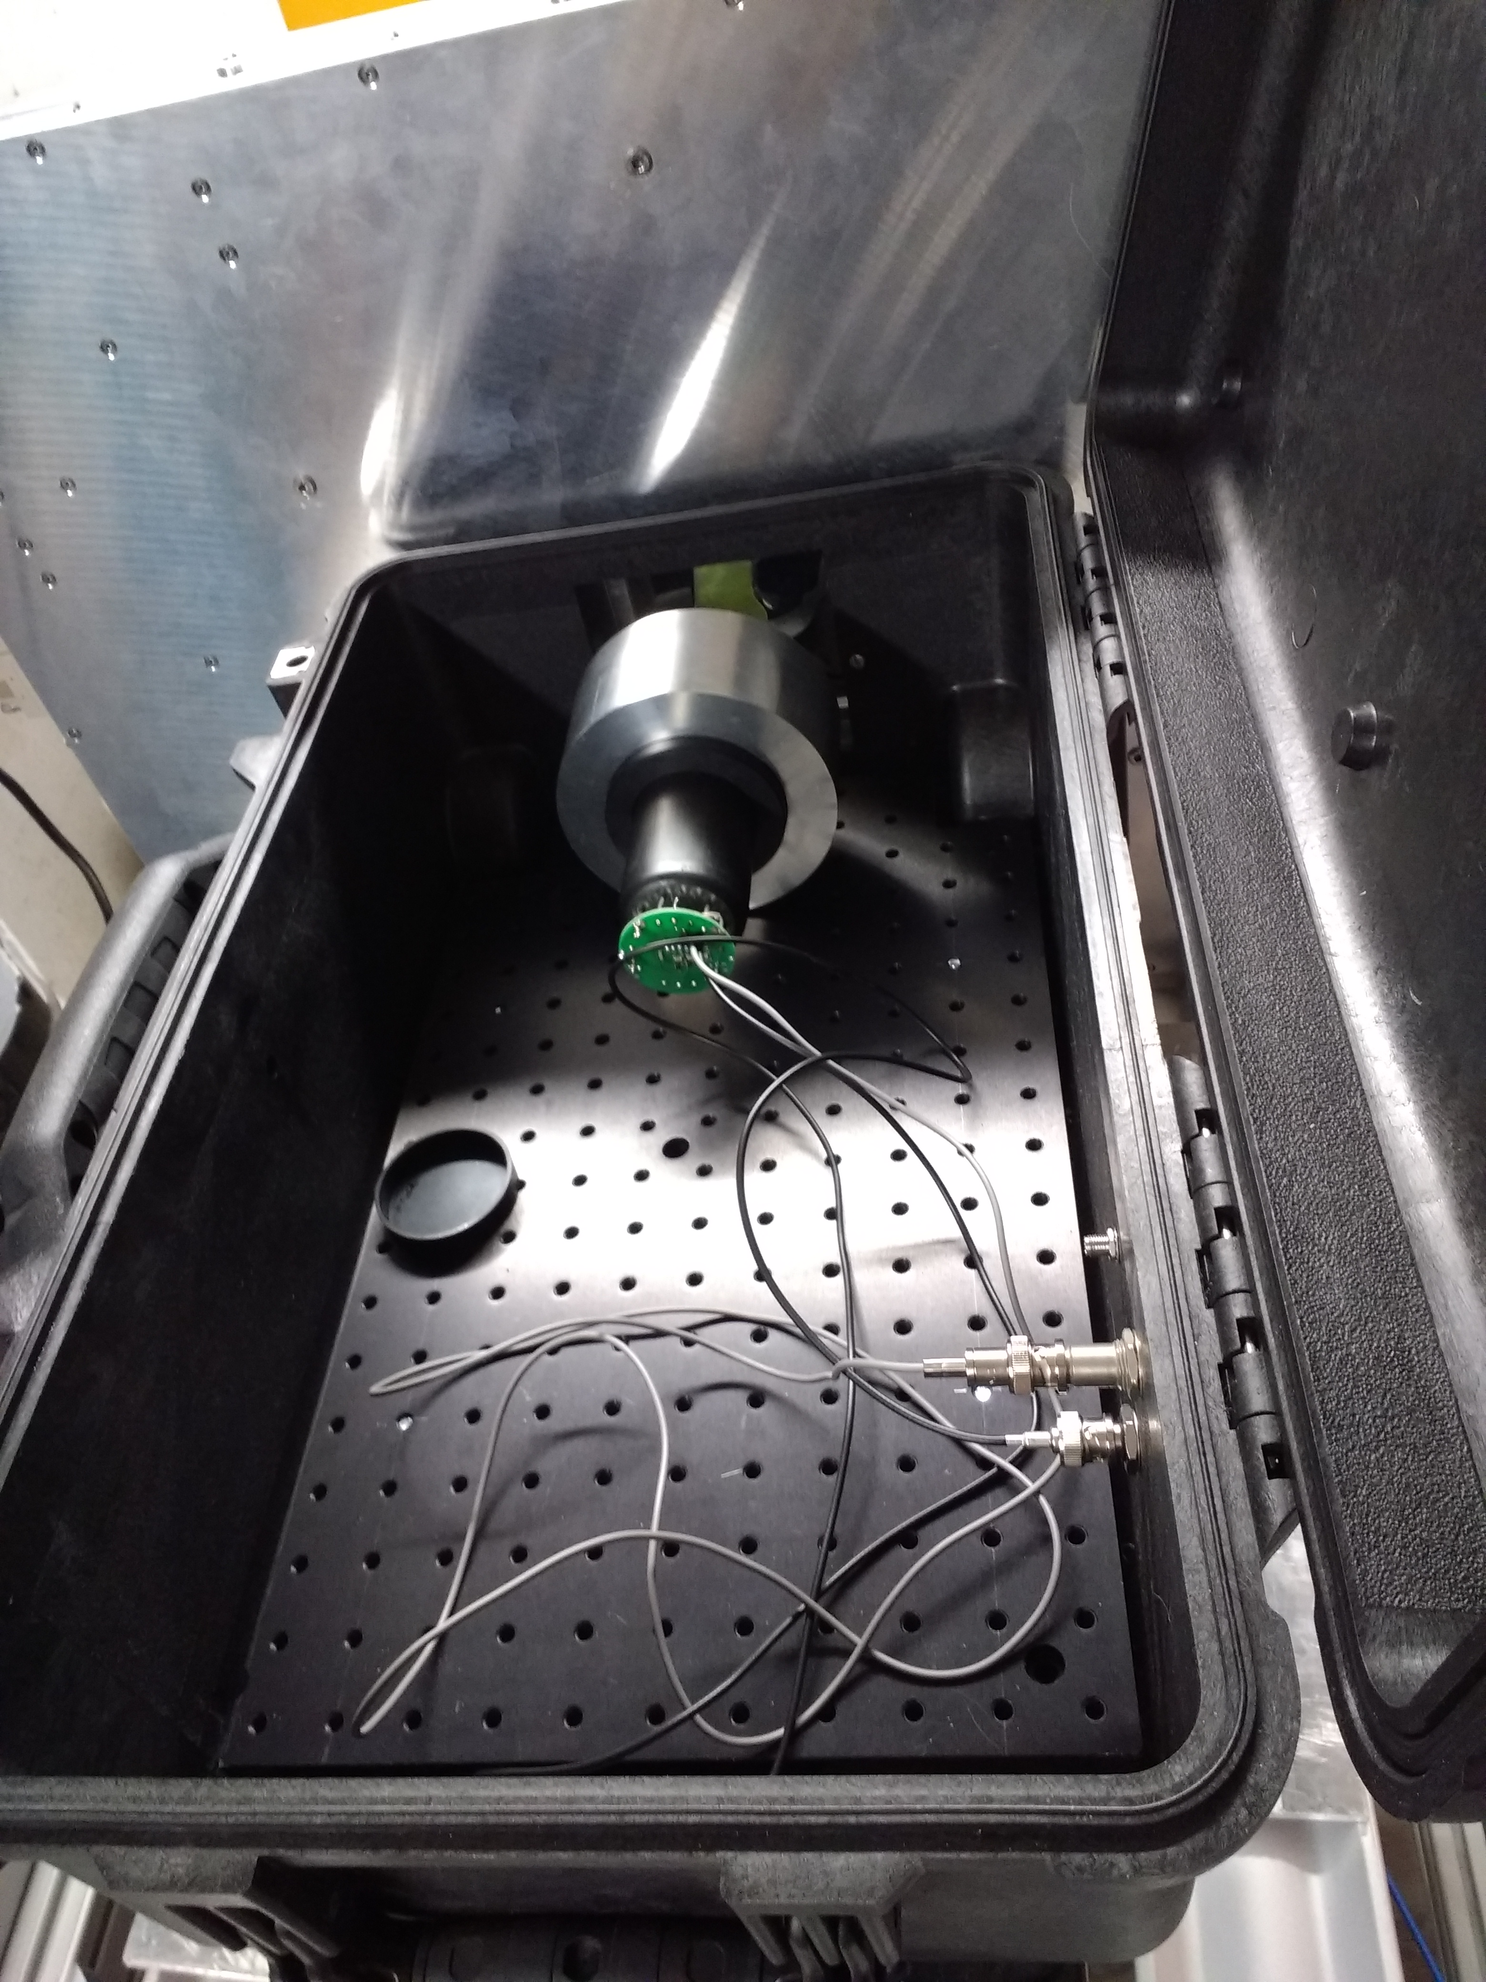
UCL Single-Module Calorimeter

Slide 6
UCL Single-Module Calorimeter
LeCroy oscilloscope operates on a trigger-based system to record pulses from calorimeter.
Pulse recorded as: potential difference against time. Integral provides ‘ADC Counts’ -> Energy!
Have developed ROOT-based analysis tools to analyse readouts from scope
  Compiled program into single executable
  Can plot raw waveforms
  Can histogram intervals between triggers
  Can histogram ADC Spectra

Slide 7
Demo of Program

Slide 8
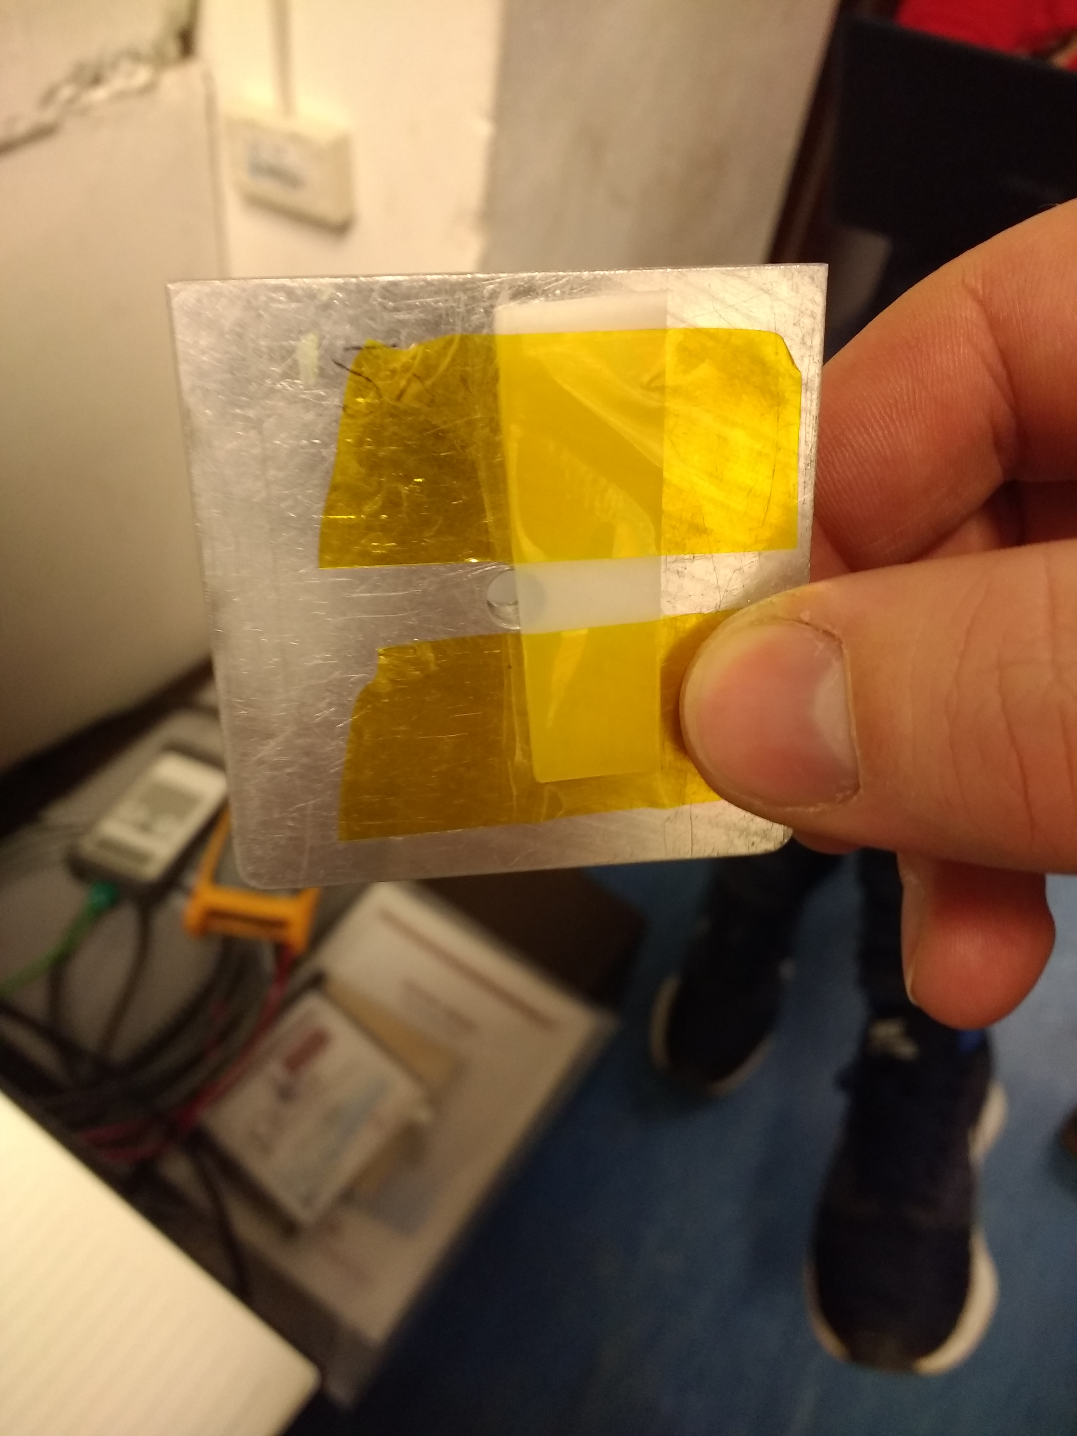
A Match Made in HEP
Experiment set up consists of tracker placed upstream of calorimeter.
Proof of principle from reproduction of shape of beam-degrading target in energy deposition profile.
Previous attempt to match measurements of tracker and calorimeter unsuccessful.
  Detectors not operating on same clock: could not match timestamps of measurements.
  Strange smearing of ADC spectra observed with detector placed upstream.

Slide 9
Birmingham II: This Time It’s Personal
Current aim is to take new measurements in October.
LeCroy scope now will be triggered externally, by the tracker itself.
LeCroy scope now will record 65000 pulses per file.
  Previously set to 1000 pulses per file.
  Minimise downtime and better synchronisation of data intake.
Preparation completed so far:
  Overhauled analysis tools for ease of use.
  Tested scope to check if it can handle a buffer of that size with high rates of data.

Slide 10
Scope Test Results

Slide 16
LED Test Results Summary
Scope behaves well for 1 kHz all the way up to 100 kHz.
Strange behaviour at 1 MHz…
  Seems to cap out at 333 kHz
  Manual states maximum frequency is 250 MHz
  Raw waveforms do not reveal much.
  Potentially of no concern as beam tests are at much lower rates?
Seem to have slightly less error for 100 kHz range.

Slide 17
Further Work
Continue to refine data analysis program
  So far program only calculates the energy of pulses.
  Incorporate functions to match tracker and calorimeter data.
  Use machine learning to produce a more sophisticated way of filtering pile-up.
Take more data at Birmingham!

