Slide 1
Proton CT reconstructions
Matthieu Hentz
28/11/2018

Slide 2
Reconstruction details
Analytic reconstruction algorithm:
  Filtered backprojection (FBP)
  Good because it’s fast
  Using Simon Rit’s implementation that uses Schulte’s Gaussian MLP estimate for proton paths
Simulation parameters:
  Multithreaded Geant4 10.4.2
  288 million proton at 200 MeV, runtime about 3.5 hours using 8 cores on 20 nodes
  Phantoms are 20 cm in diameter: Catphan CTP528 module and spiral phantom to show radial variation in spatial resolution
  720 projections, every 0.5°
  Translates to 900 protons/mm^2 per projection

Slide 3
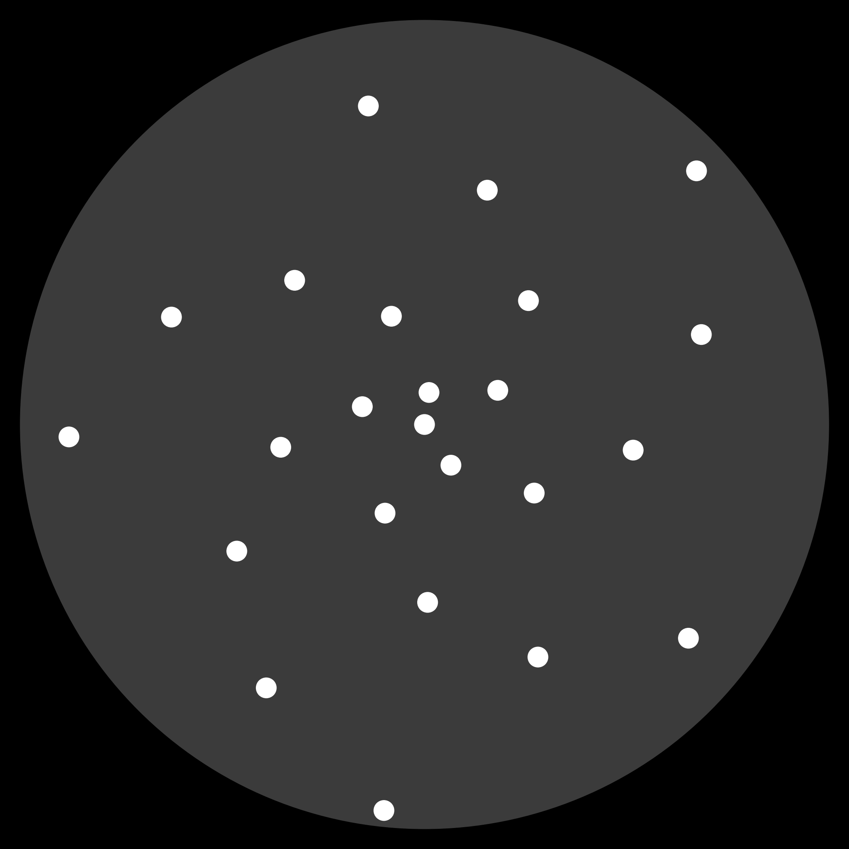
Spiral phantom
Water cylinder of radius 10 cm
Aluminium inserts, 5 mm wide
Perfect phantom →
  Evaluated using stopping power values from NIST PSTAR tables:
  S(Al, 200 MeV) = 9.520
  S(Water, 200 MeV) = 4.492
  So white inserts have value
  RSP(Al) = 9.520/4.492 = 2.120
Grey area has value: RSP(Water) = 1

Slide 4

Spiral phantom pCT
Binned at 0.5 mm intervals and then averaged
This where the MLP estimate comes in as the proton paths need to be estimated to know their position which is then used in the binning

Slide 5
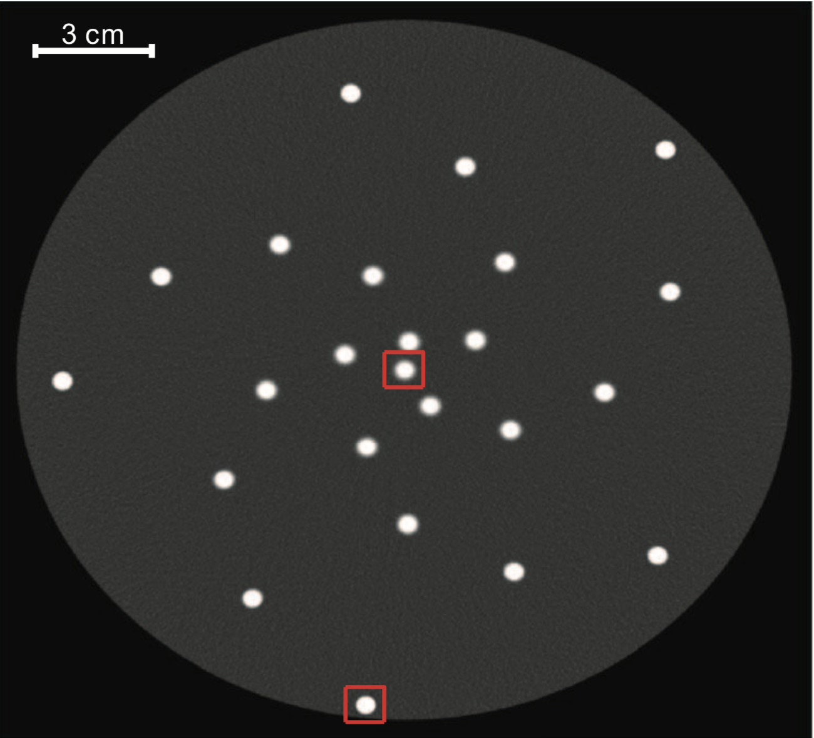
Spiral phantom comparison
Mine
Rit’s

Slide 6


Interesting observation
“Distance-driven binning”
i.e. averaging
Binned at entry detector
Binned at exit detector

Slide 7
Resolution degrades towards centre
Insert close to the surface
vs. insert close to the centre
This is attributed to the uncertainty envelope of the MLP estimate being largest at the centre of the phantom

Slide 8
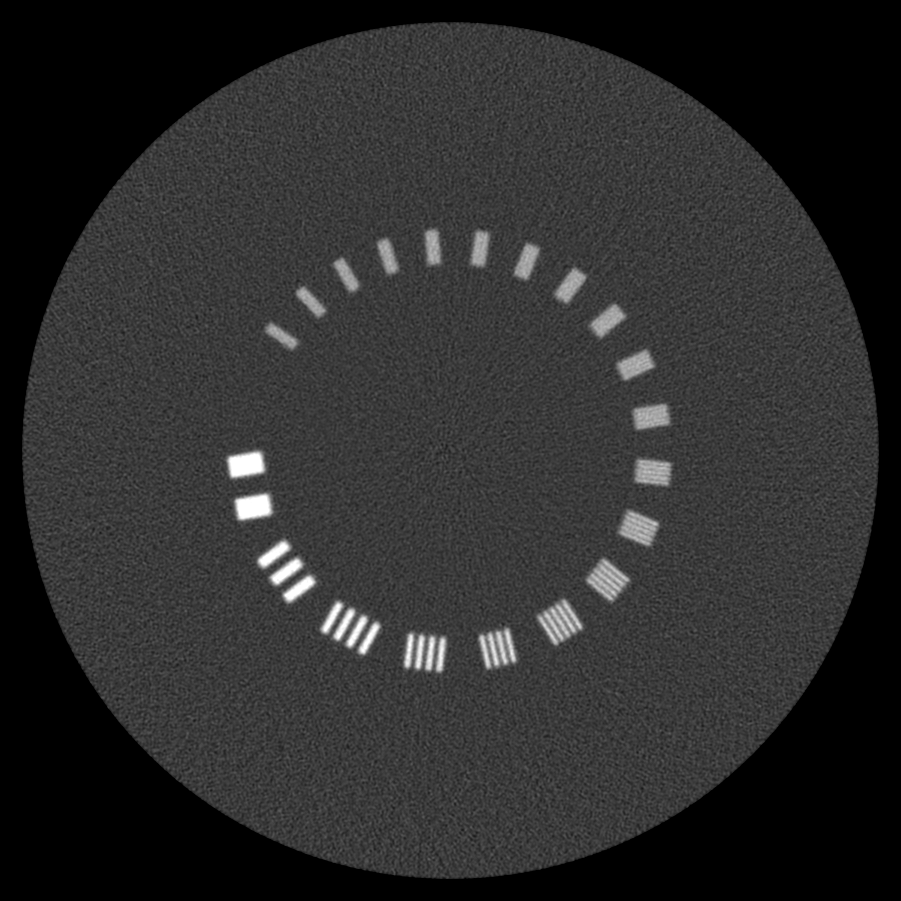
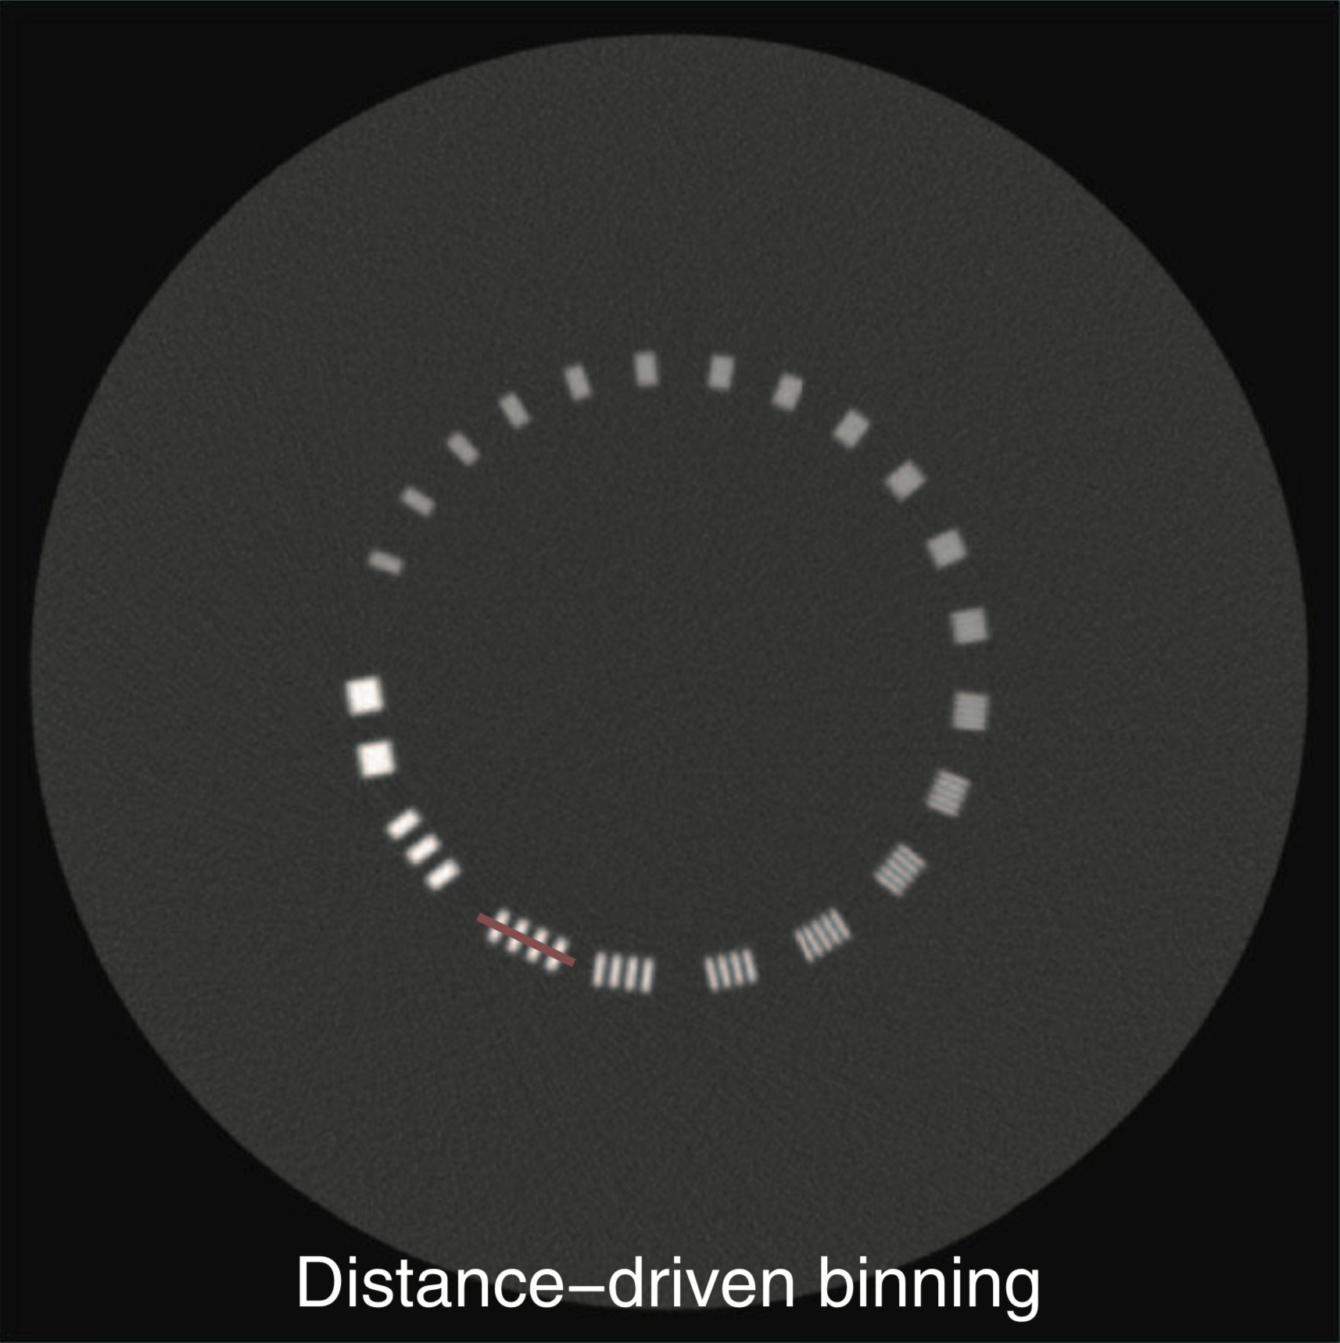
Catphan CTP528 module
Mine
Rit’s

