Slide 1
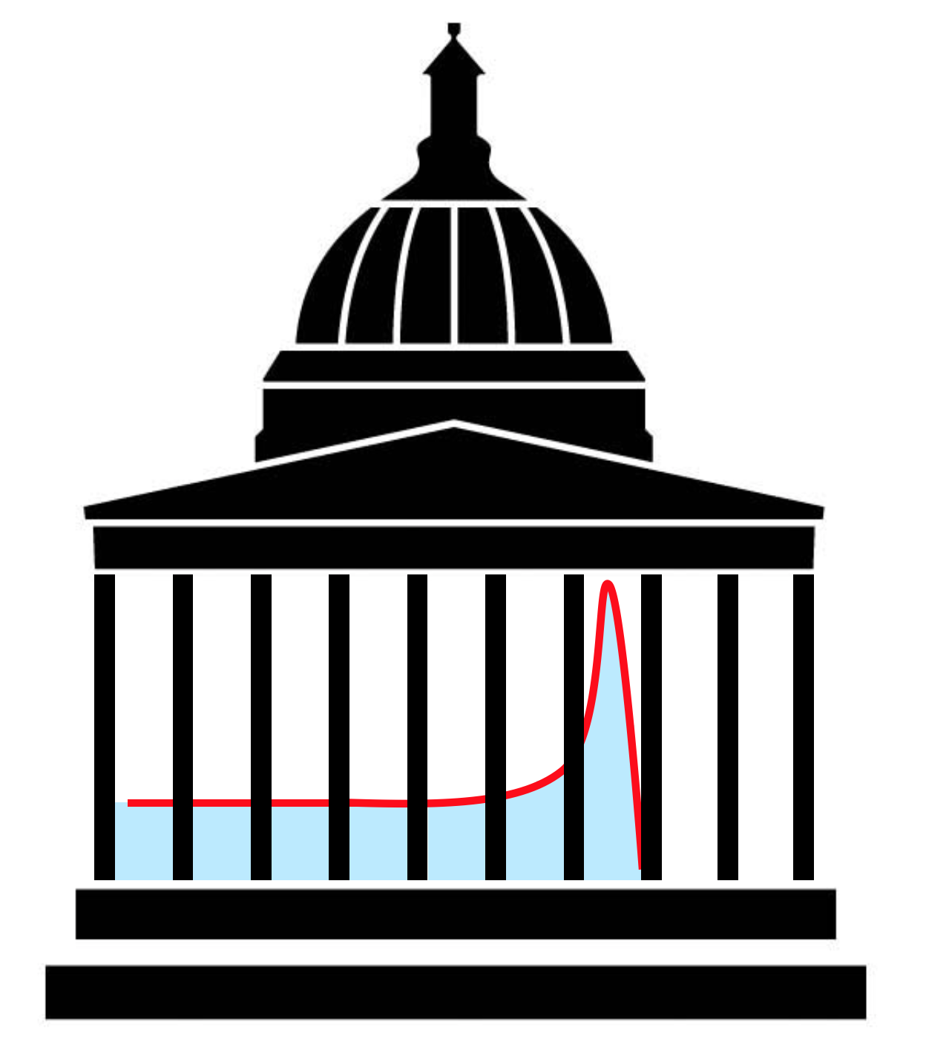
Birks’ constant measurement
Laurent Kelleter

Slide 2
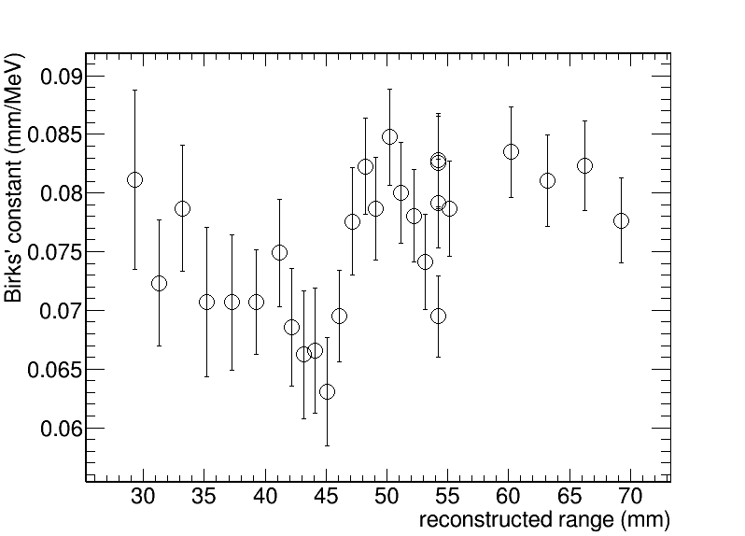
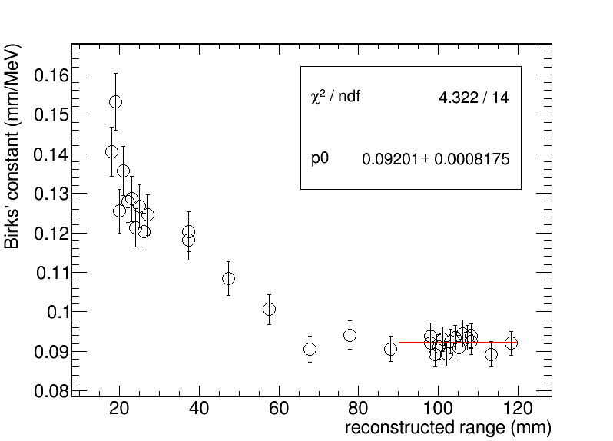
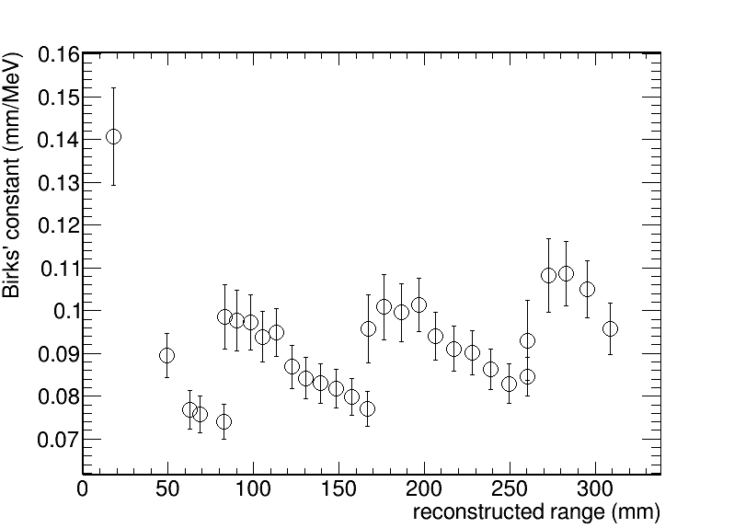
Birks constant measurement
MedAustron
HIT Nov18
HIT Apr19
Increase of Birks constant with decreasing beam energy.
Question: Why?

Slide 3
Birks constant fit
Answer: Fit is pulled up by weird data points
Next question: What causes the calibration to fail in the first few sheets?
Birks is fixed at 0.09 mm/MeV. Fit good except for first sheets
Birks is fitted and a large value is returned

Slide 4
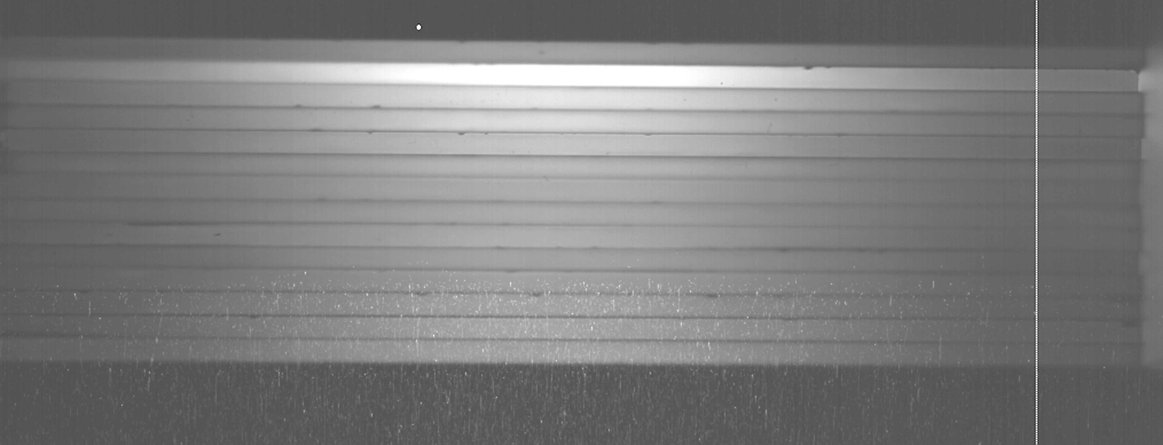
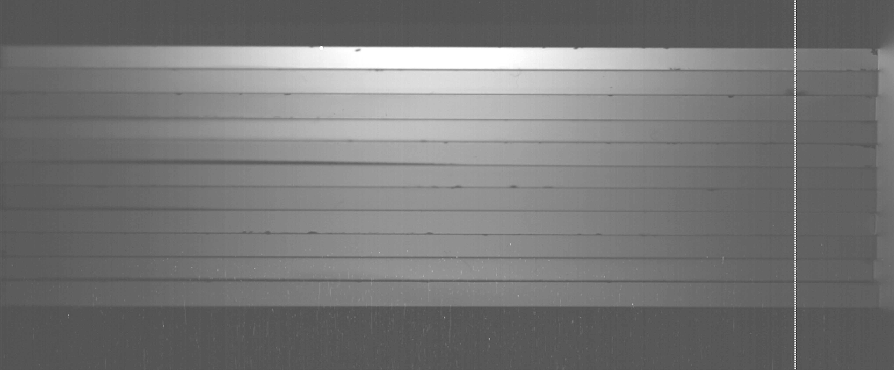
Answer: Protons hit sensor!
HIT nov18
All images are increased in brightness to make it easier to see the white pixels by direct proton hits. The images are NOT saturated at the Bragg peak!
Spot size 29.8 mm FWHM
E = 59.15 MeV
White pixels from protons that hit sensor directly
MedAustron
Spot size 21.5 mm FWHM
E = 62.4 MeV

Slide 5
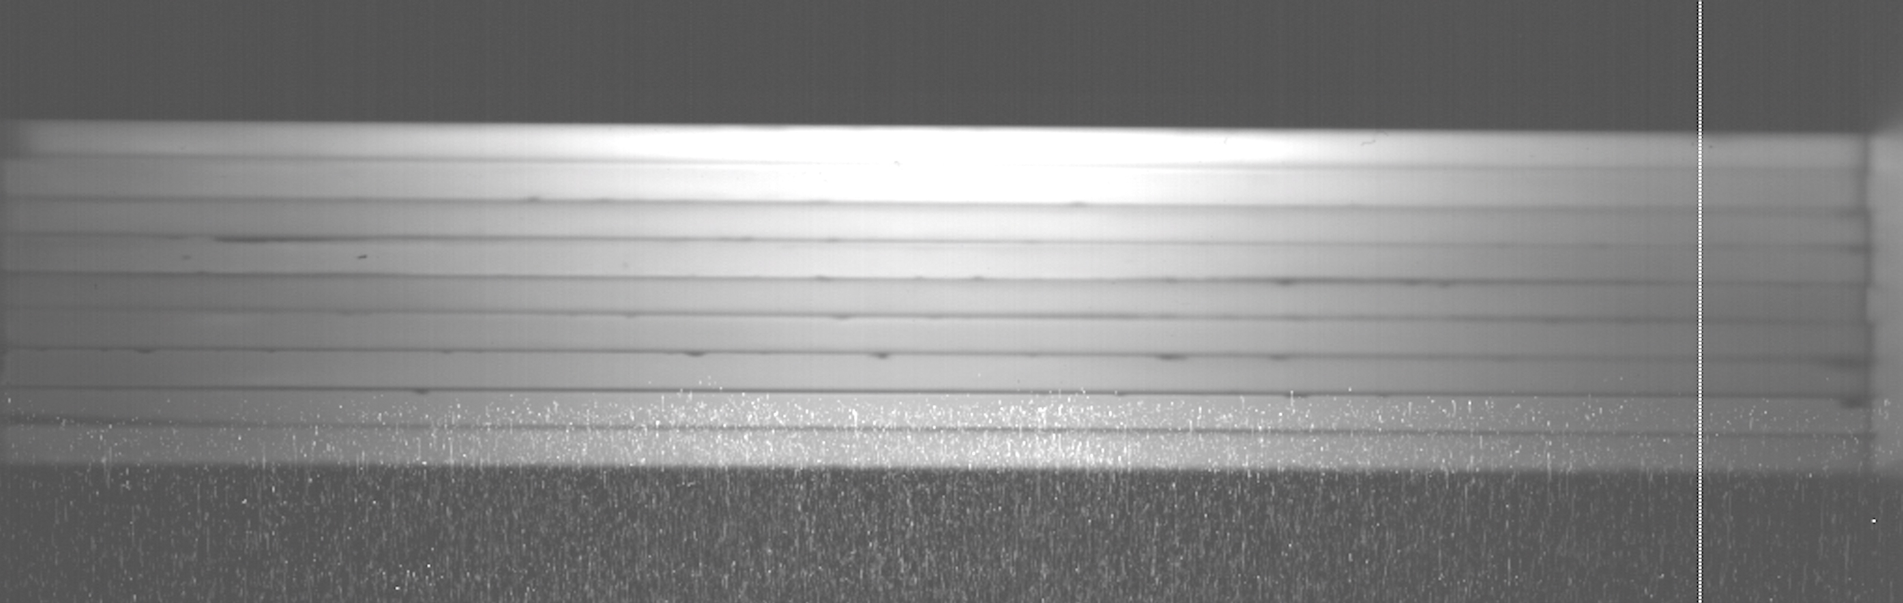
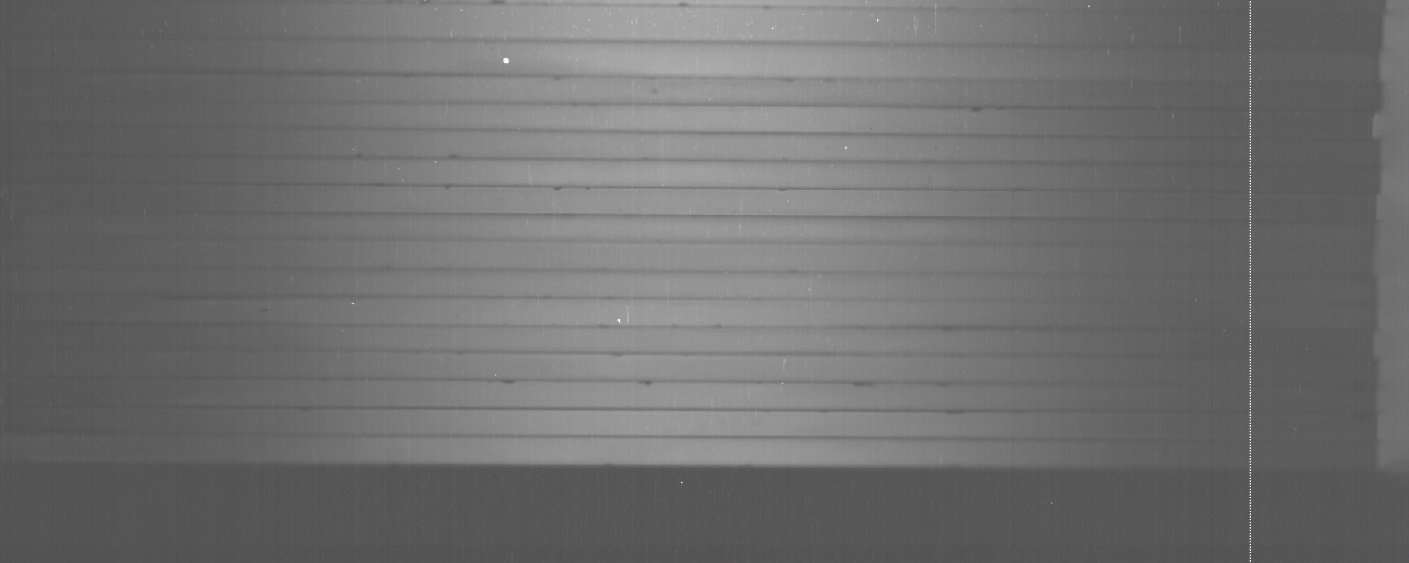
Different energies/spot sizes at HIT
HIT nov18
Spot size 32.4 mm FWHM
Protons hit sensor
E = 48.47 MeV
HIT nov18
No protons hit sensor
Spot size 13.8 mm FWHM
E = 116.39 MeV

Slide 6
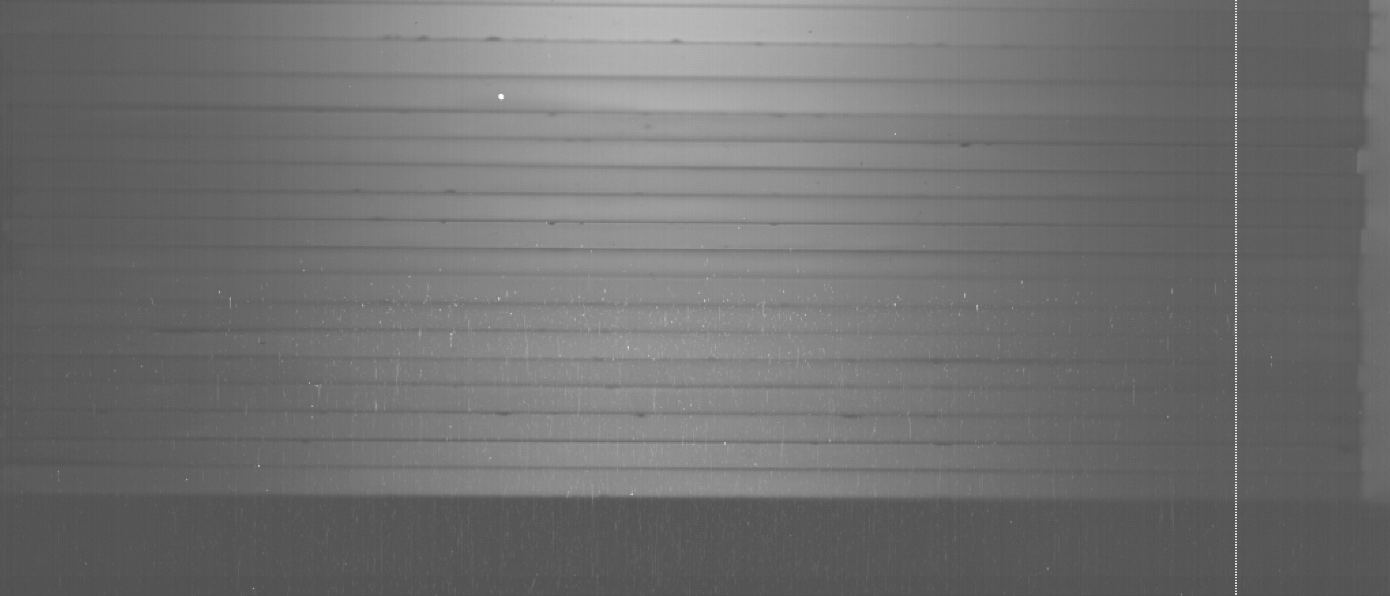
Similar spot sizes HIT/MA
HIT nov18
Spot size 20.2 mm FWHM
Protons in sensor go further because of higher energy
E = 78.87 MeV
=> Beam position in sensor is approximately the same for HIT and MA
MedAustron
Spot size 21.5 mm FWHM
Also protons in sensor, but travel less far
E = 62.4 MeV

Slide 7
Conclusion
Calibration of PDL curves fails because protons enter the sensors directly
This is due to a larger beam spot size at HIT compared with MedAustron at the same proton energy
The direct hits increase the light output in the first sheets
Which reduces the peak-to-plateau ratio
And ultimately increases the fit value of Birks constant
This effect gets stronger with decreasing beam energy because of the increasing beam spot size

