Slide 1
Using a mixed He/C beam for monitoring intrafractional motion
Lennart Volz^{1,2 *} & Laurent Kelleter^{3 *}, R. Radogna³, C. Graeff⁴, C. Schömers⁵, S. Brons⁵, S. Jolly³ and J. Seco^{1,2}
PTCOG 58
¹ Department of Biomedical Physics in Radiation Oncology, DKFZ, Hedielberg, GER
² Department of Physics and Astronomy, Heidelberg University, Heidelberg, GER
³ Department of Physics and Technology, University College London, London, UK
⁴ Gesellschaft für Schwerionenforschung GmBH, Darmstadt, GER
⁵ Heidelberg Ion-Beam Therapy Center, Heideberg, GER
* Equal contribution

Slide 2
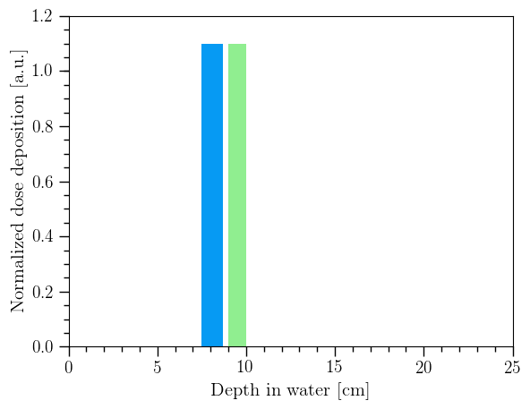
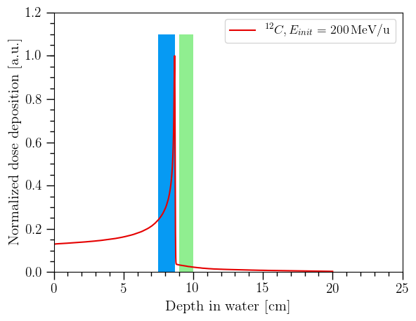
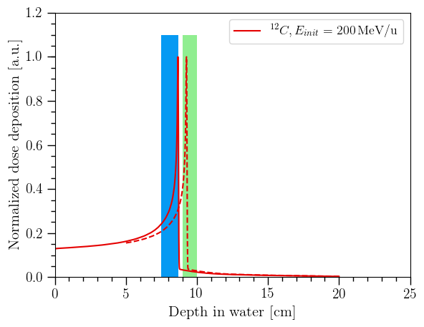


Ion-beam radiotherapy: range uncertainty
Patient
Target
Tumor
Organ at Risk
Nozzle
Organ at risk
Ideal: Prescribed dose to target, minium dose to healthy tissue
Needed: Online treatment monitoring

Slide 3
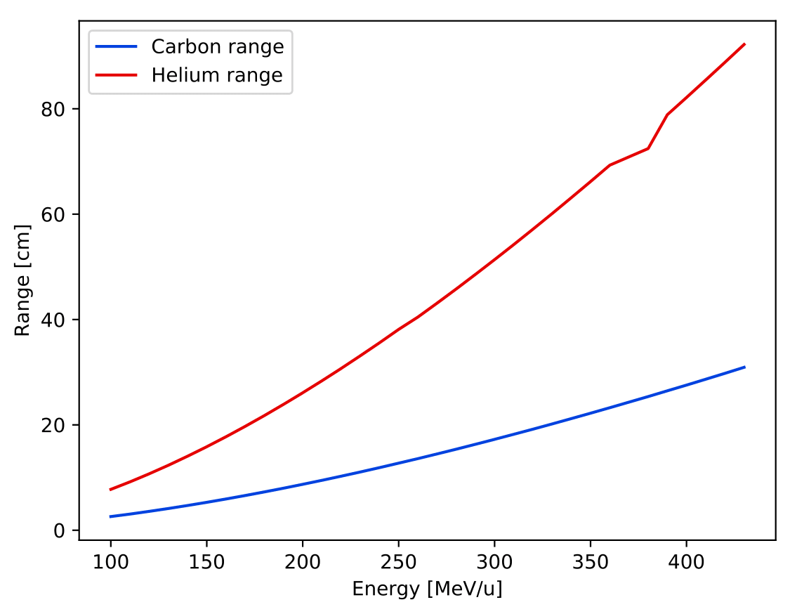
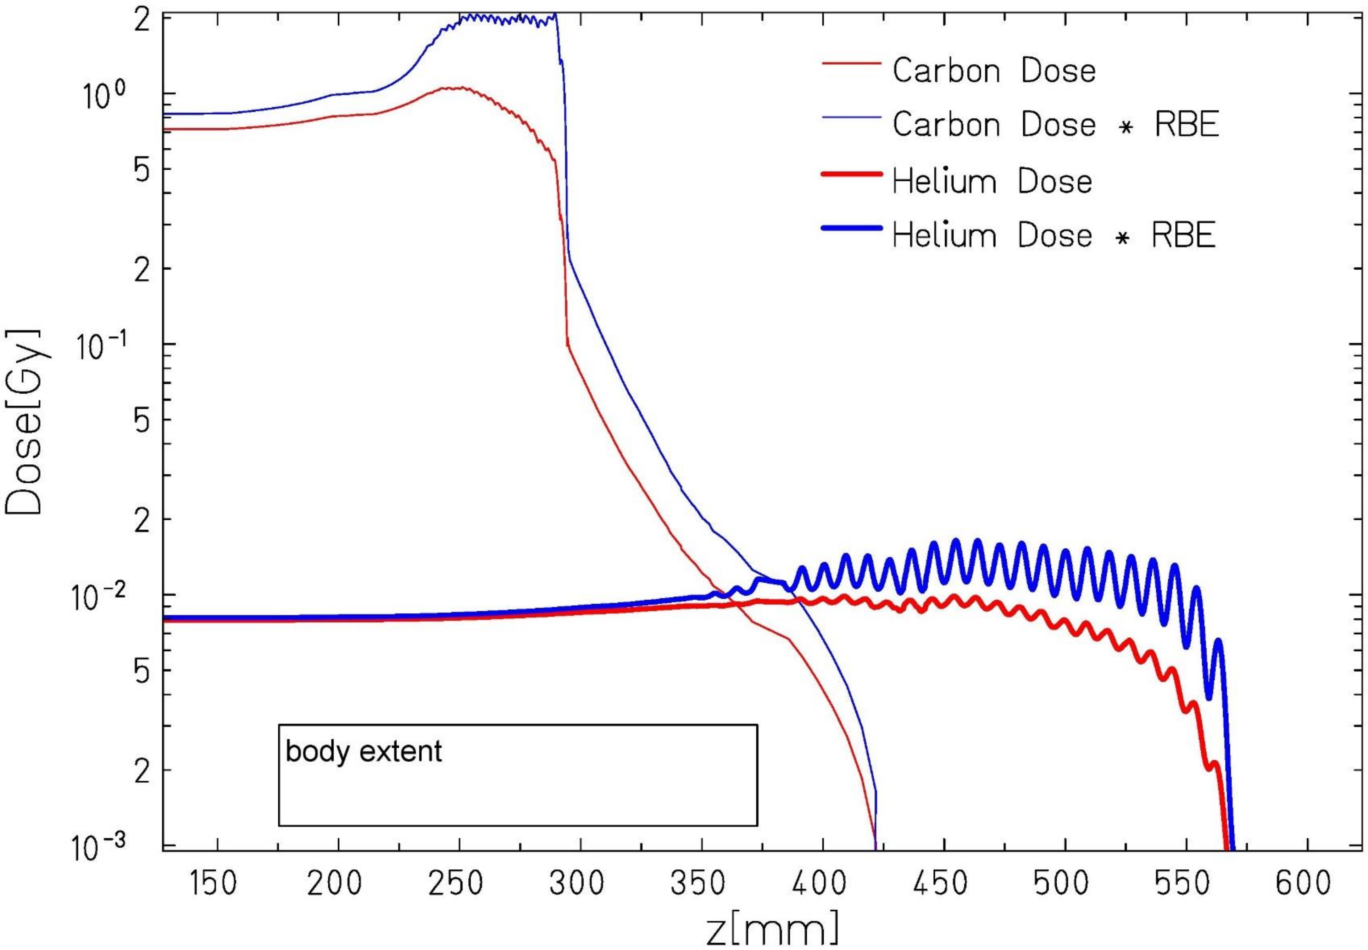
He/C mixed beam: See what you treat
⁴He²⁺ and ¹²C⁶⁺ have approx. the same A/q^{1,2}
→ Simulatenous acceleration to same velocity
Helium range ~3 times Carbon range
10% Helium less than 0.5% target RBE dose ²
Patient
Detector
RBE optimized He/C SOBP¹
log scale!
⁴He²⁺ and ¹²C⁶⁺ range at the same velocity ³
¹ Graeff et al. (2018); ²Mazzuconi et al. (2018); Lühr et al. (2011) (http://dEdx.au.dk)

Slide 4
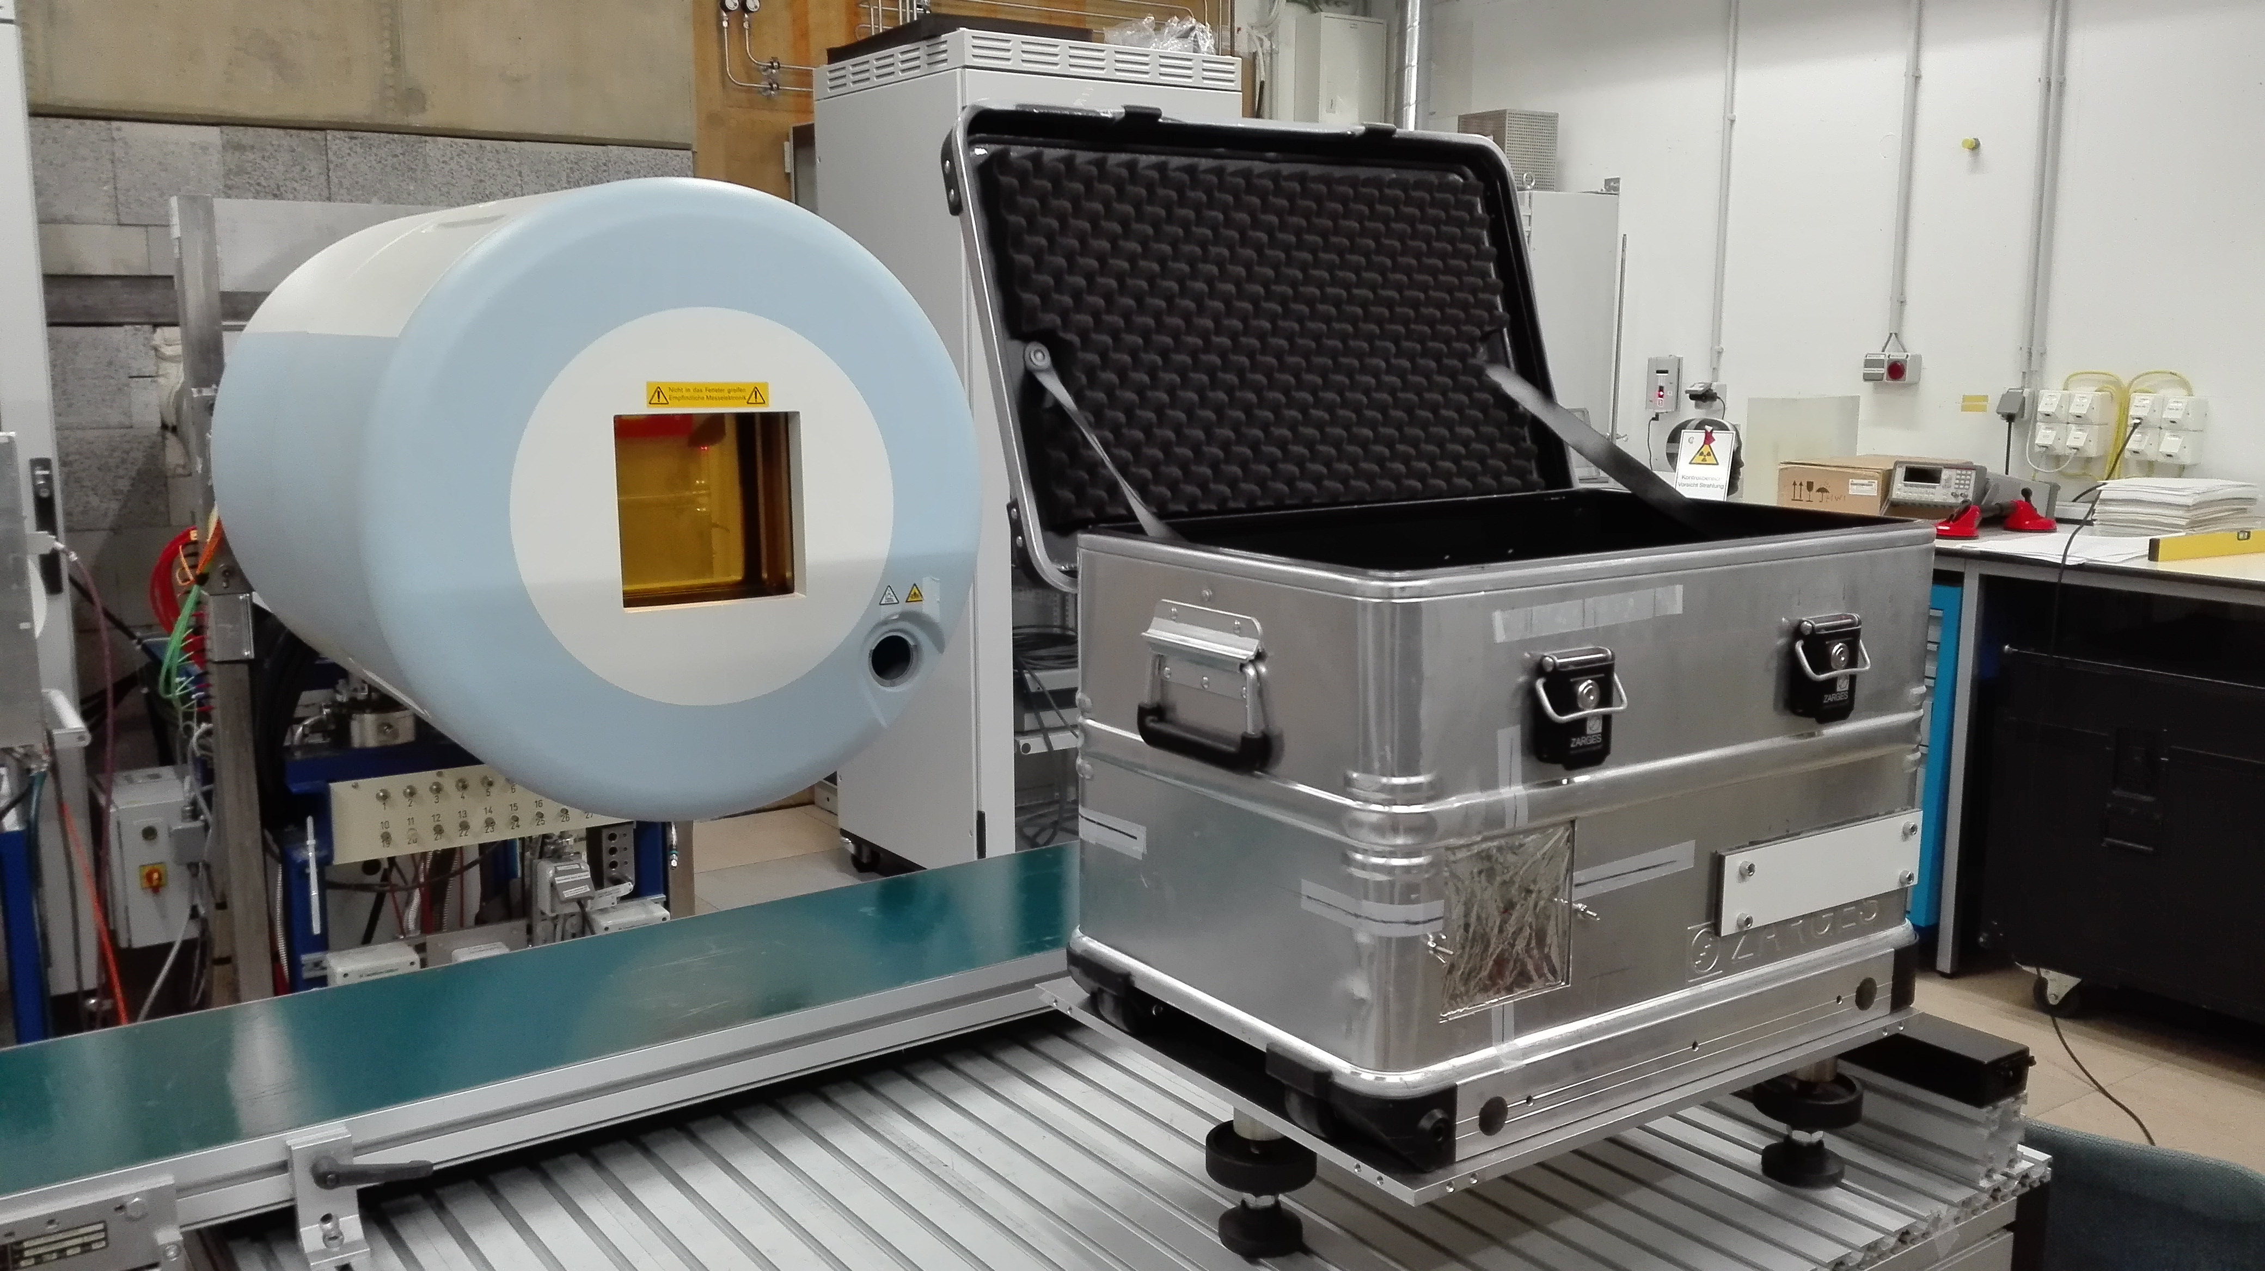
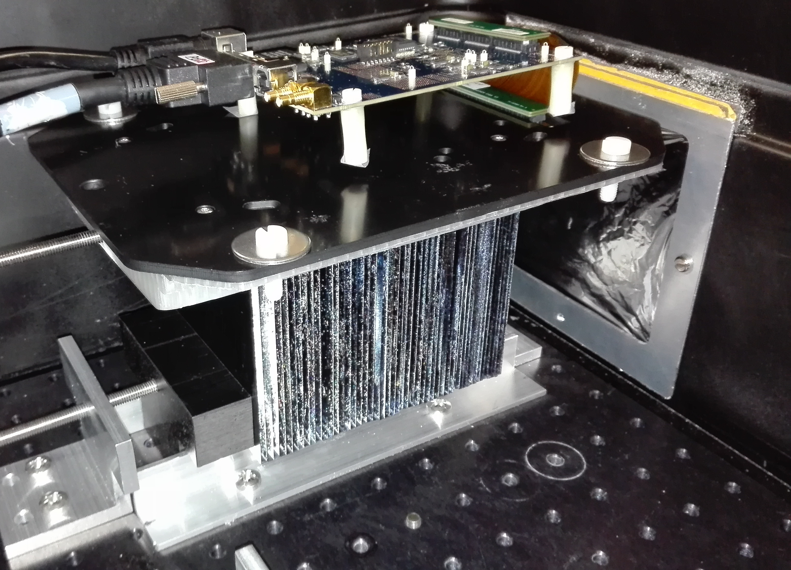
Experiments at Heidelberg Ion-Beam Therapy Center
Experiments at HIT QA cave
Separate Helium and Carbon beams
Novel range telescope developed at UCL
  12cm stack of thin 2-3mm scintillation sheets
  Read out by flat panel CMOS sensor
Geant4 simulations of the setup
Nozzle
Detector
CMOS sensor
Poster at PHY04
Mylar foil
Polystyrene sheets
UCL range telescope prototype at HIT

Slide 5
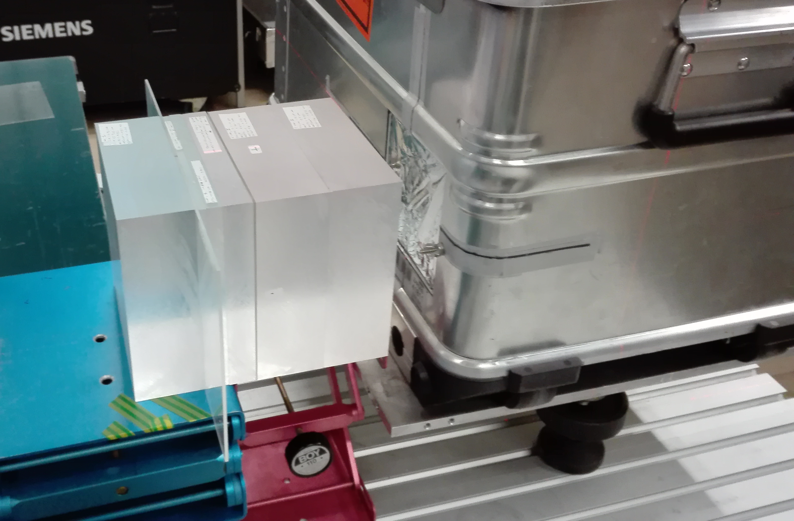
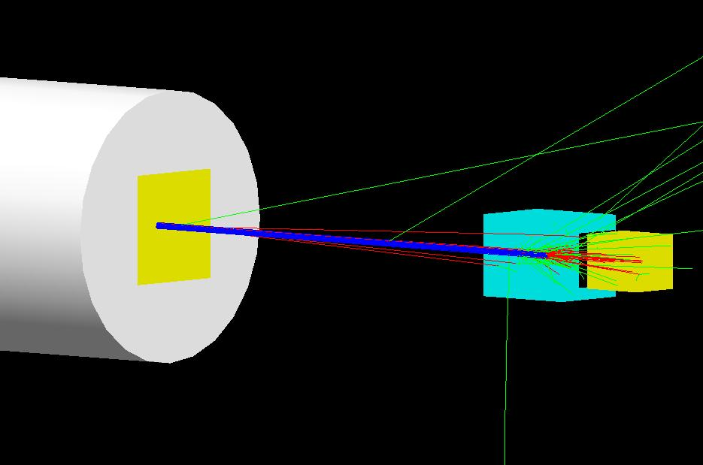
Simple PMMA geometries: Setup
Experiment
Simulation
PMMA degrader (WET ≈ 21.9 cm), different air gaps after ~5cm build up
¹²C: 219.19 MeV/u (~10cm range), ⁴He: 220.5 MeV/u (~30cm range), beam FWHM ~8mm
Experiment: Intensity 8x10⁷ particles/s

Slide 6
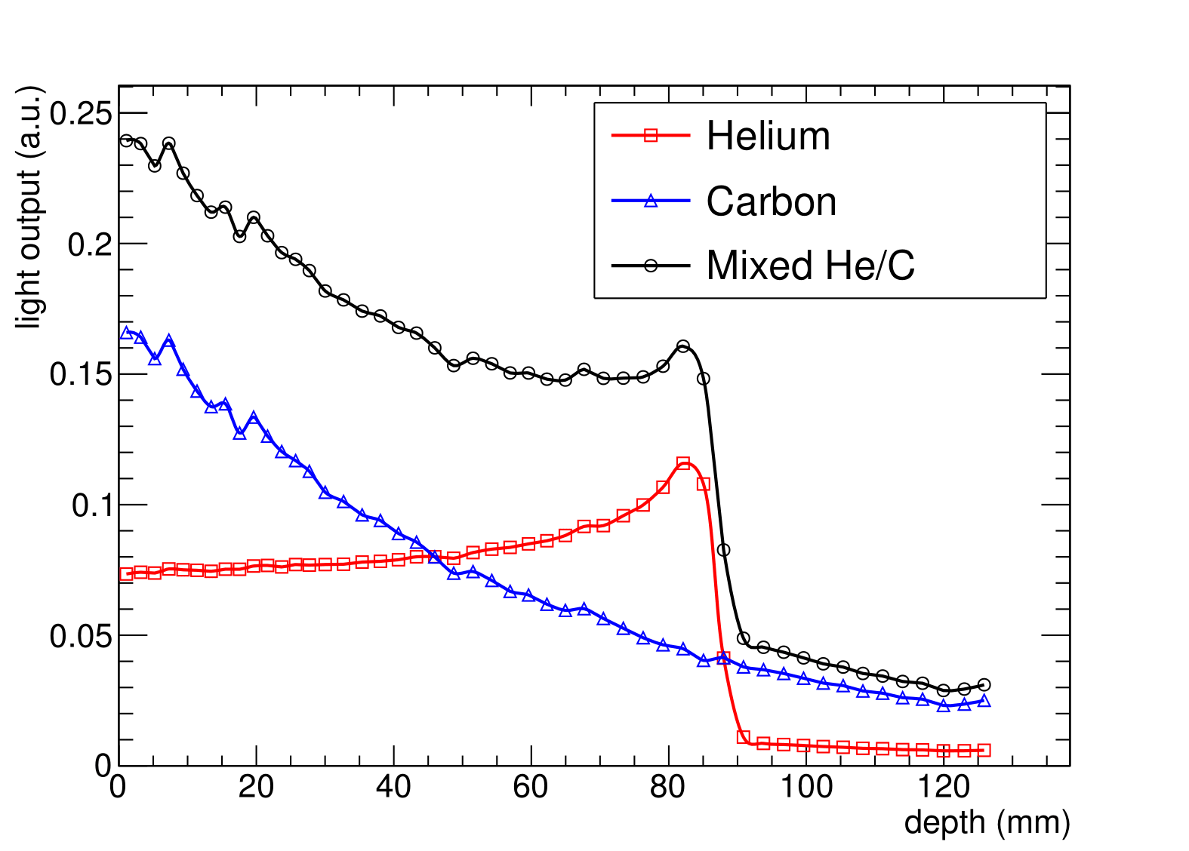
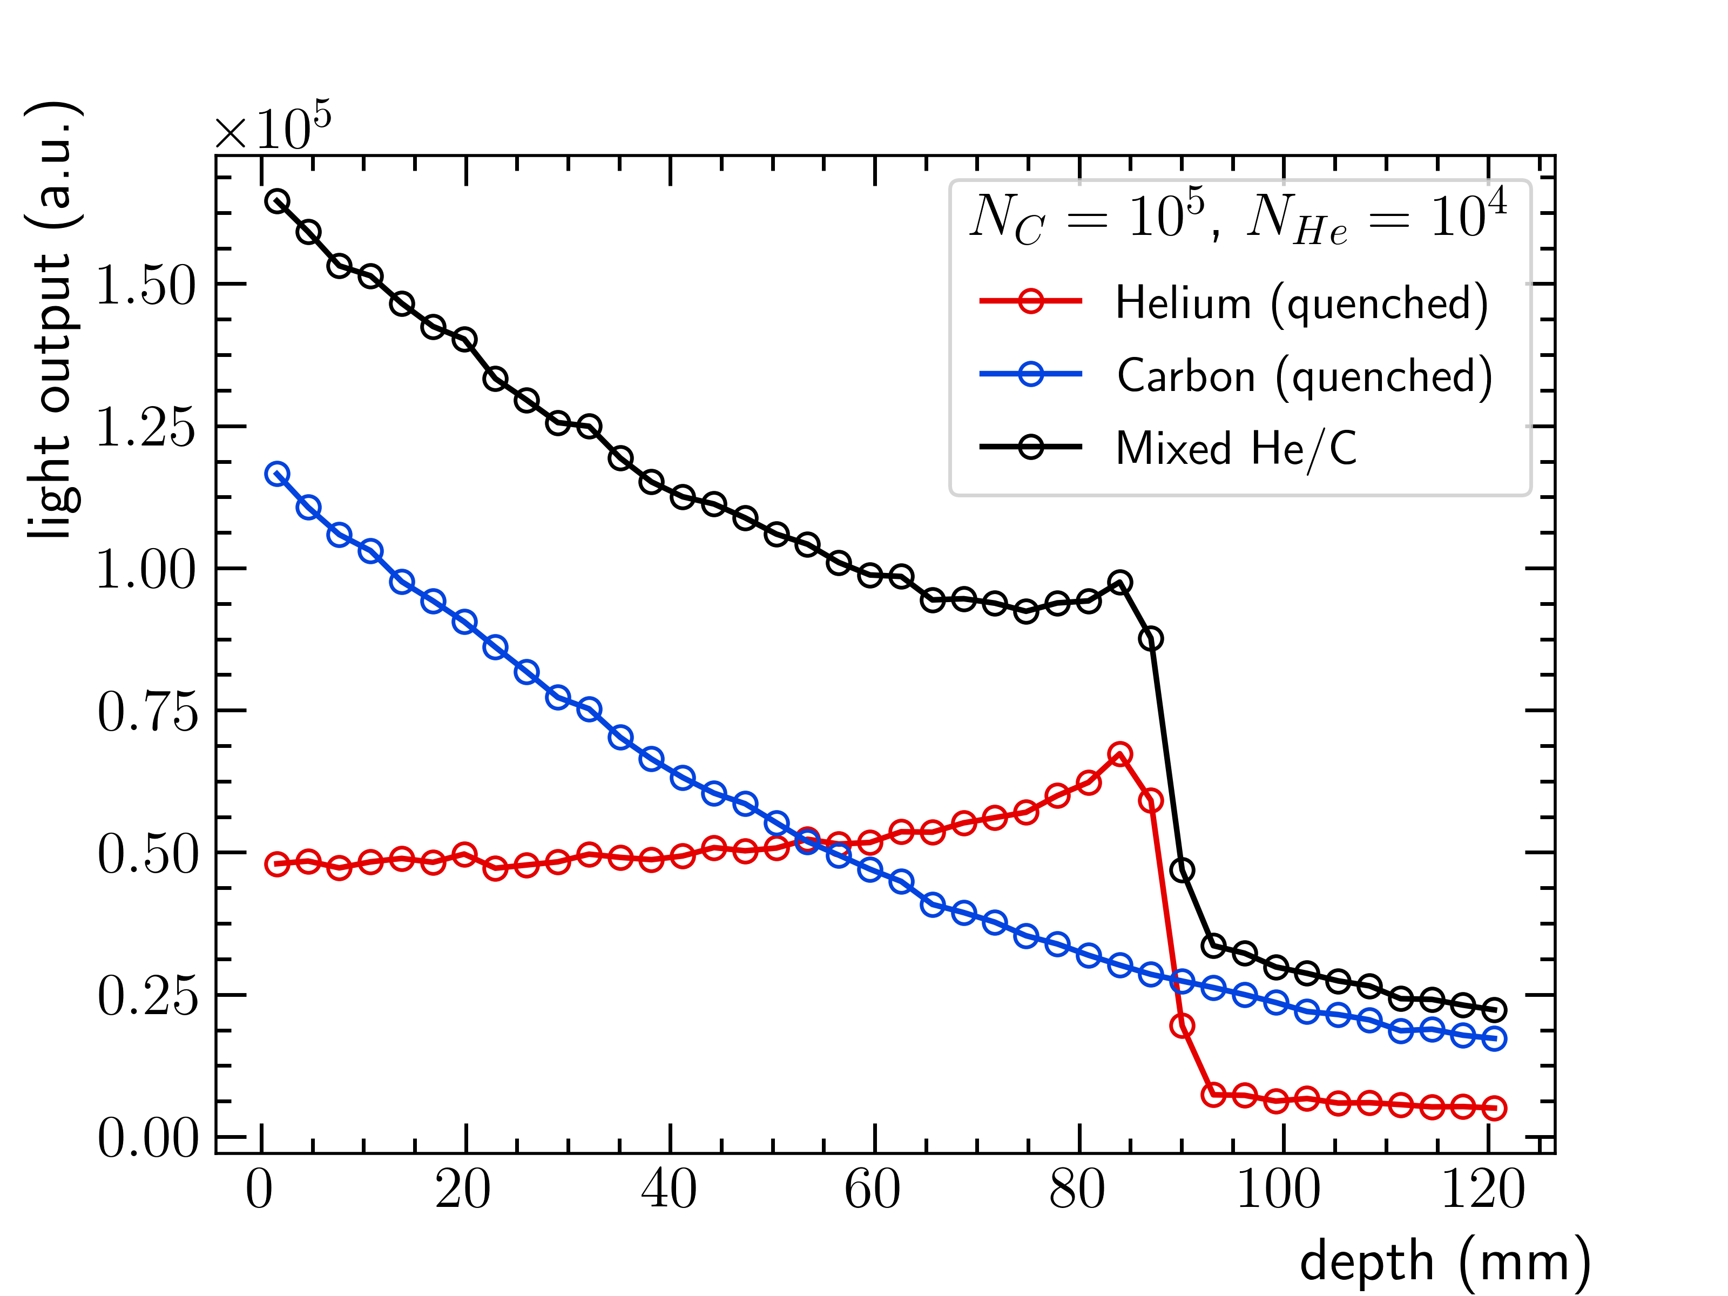
Simple PMMA geometries: Data processing
Experiment
Simulation
Quenched scintillation light output
Adding the He and C signal together (10:1 ratio)
- Preliminary

Slide 7
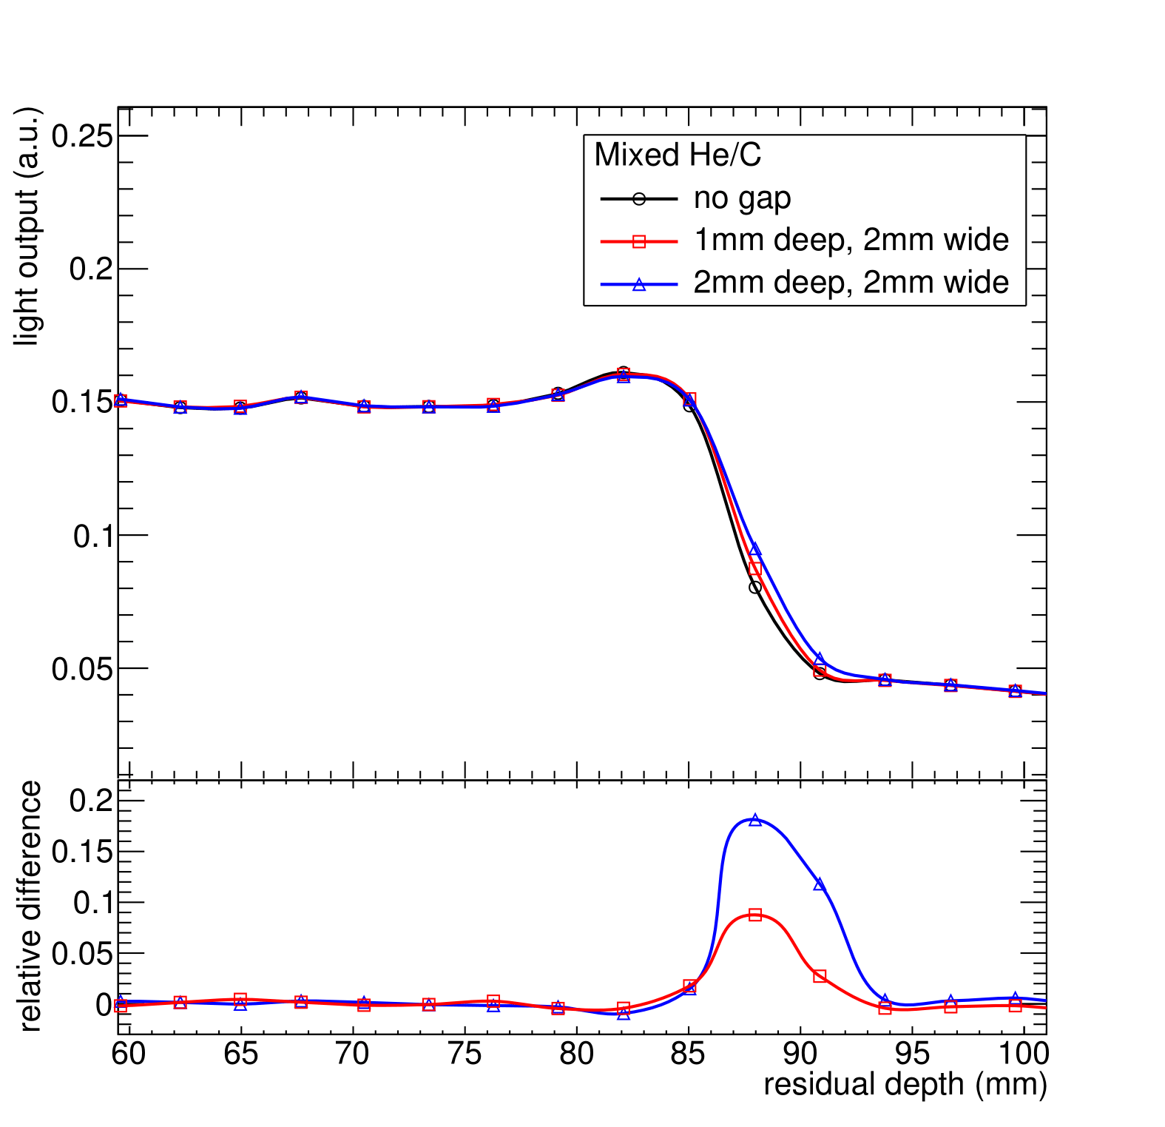
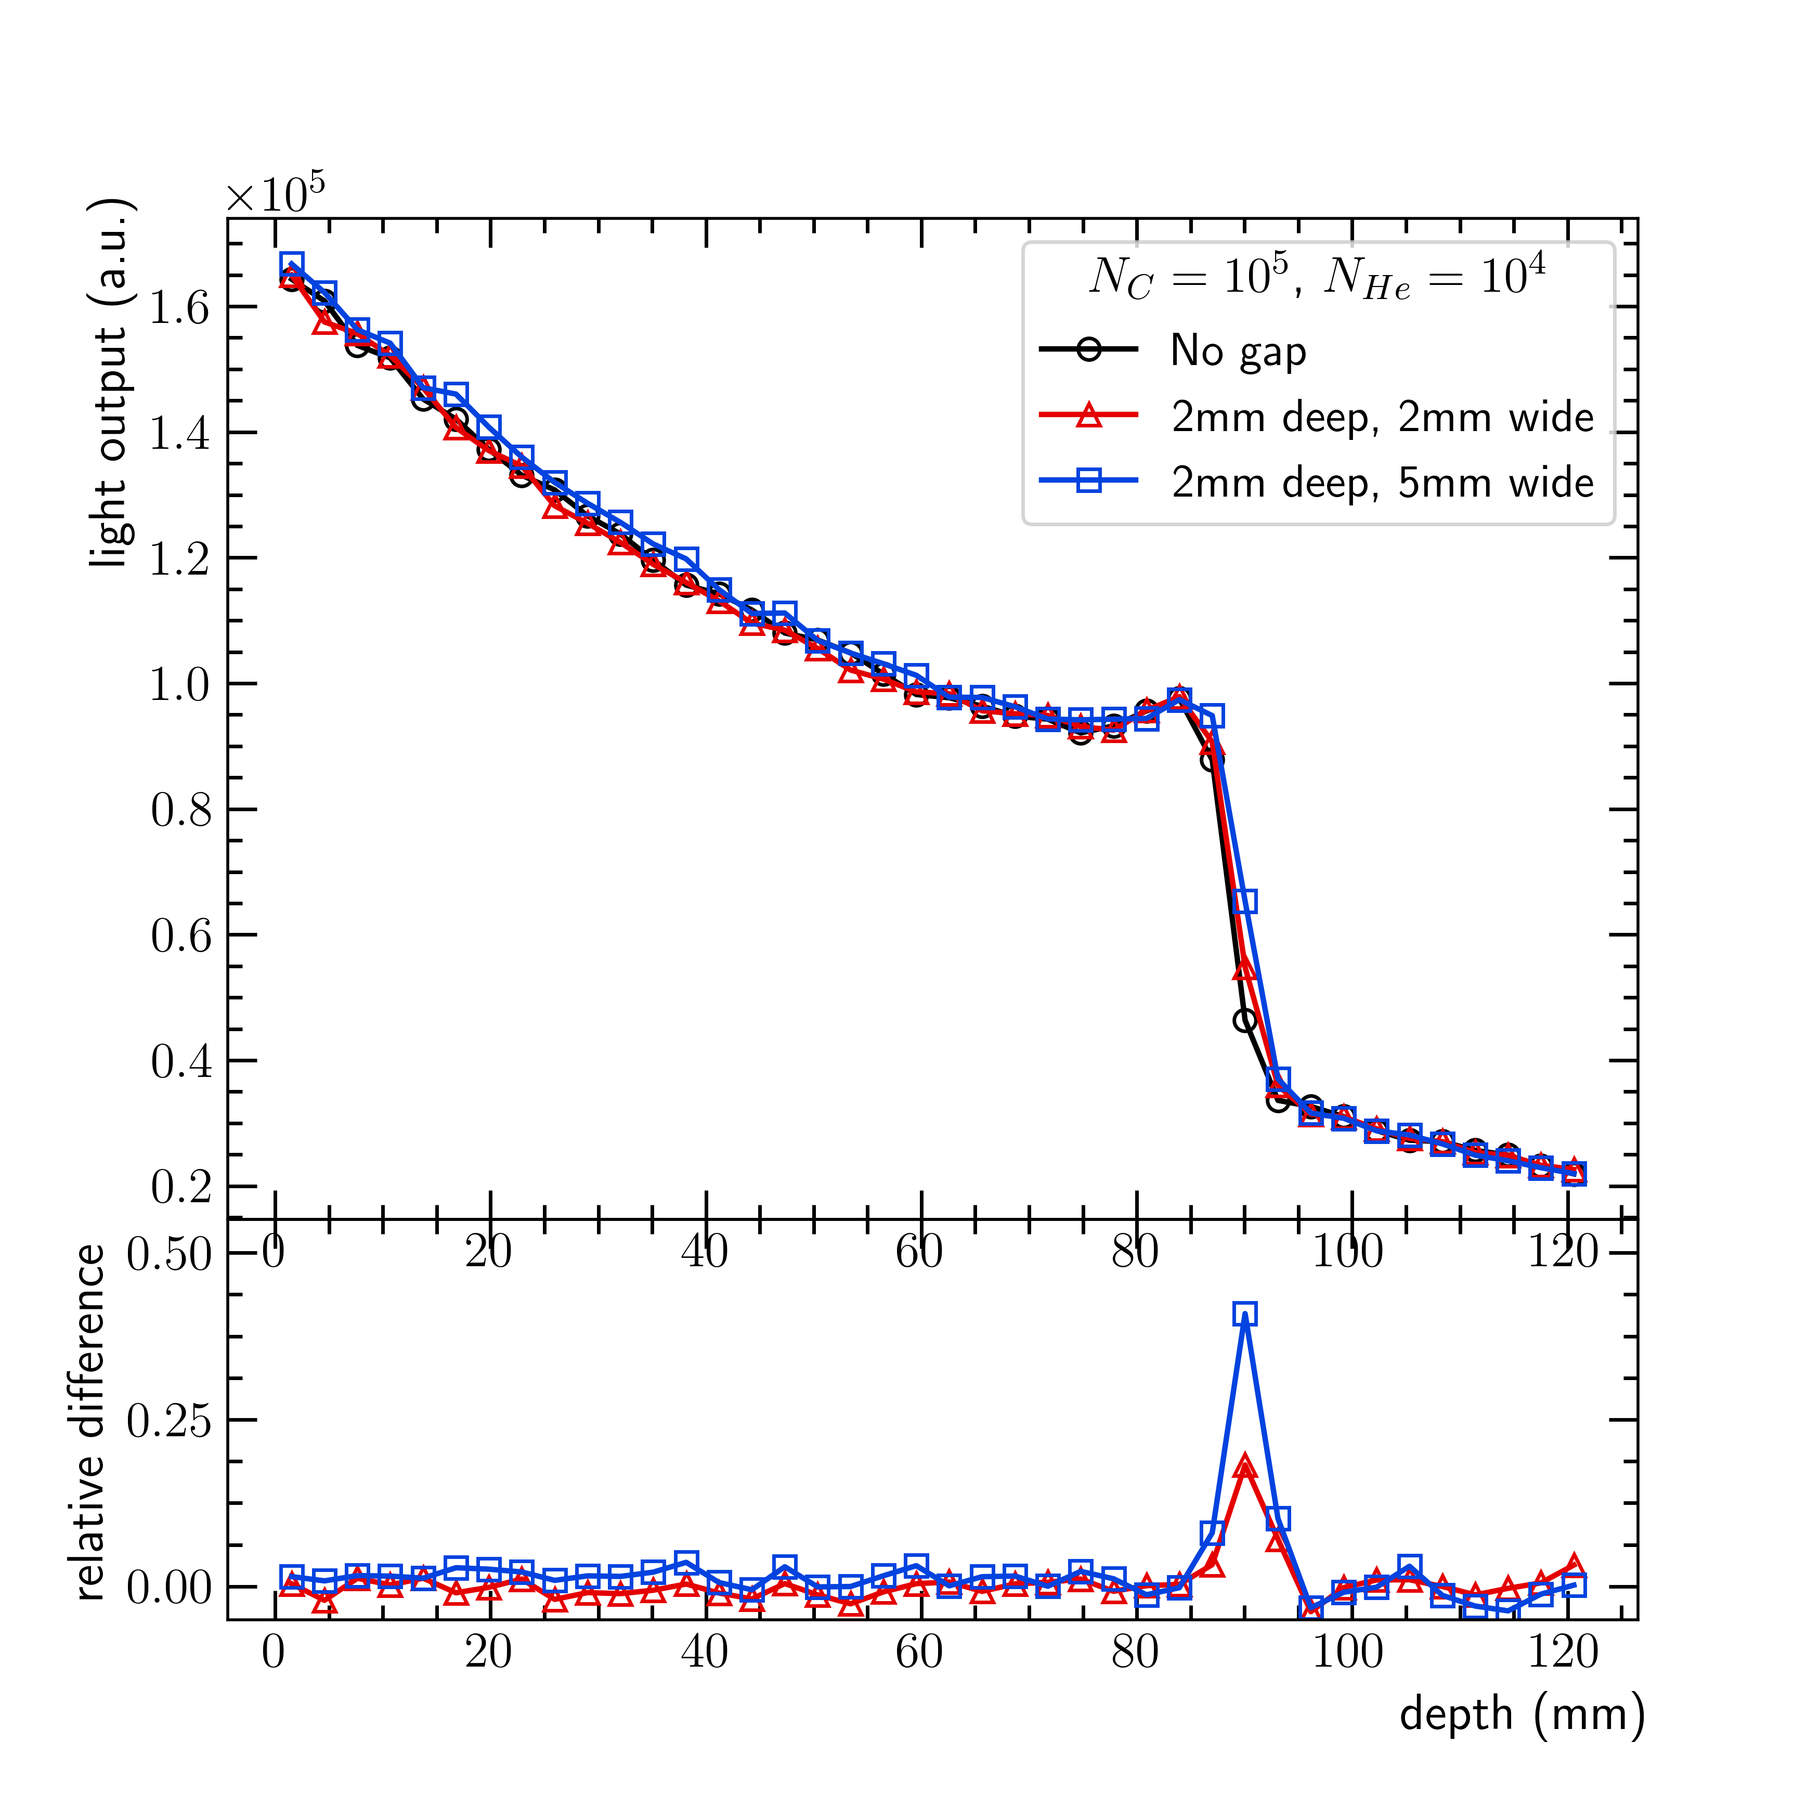
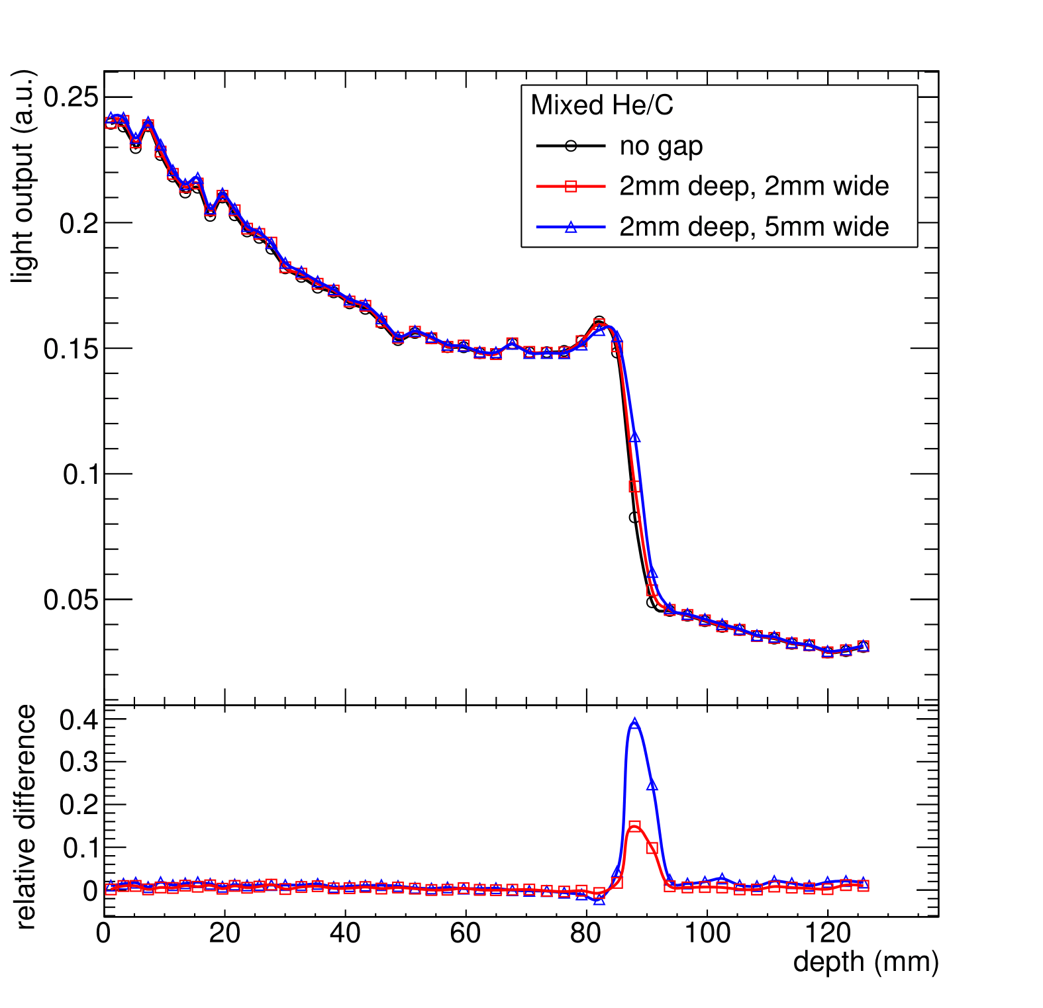
Simple PMMA geometries: How sensitive is the method?
Experiment
Simulation
2mm wide → 22% of beam
- Preliminary

Slide 8
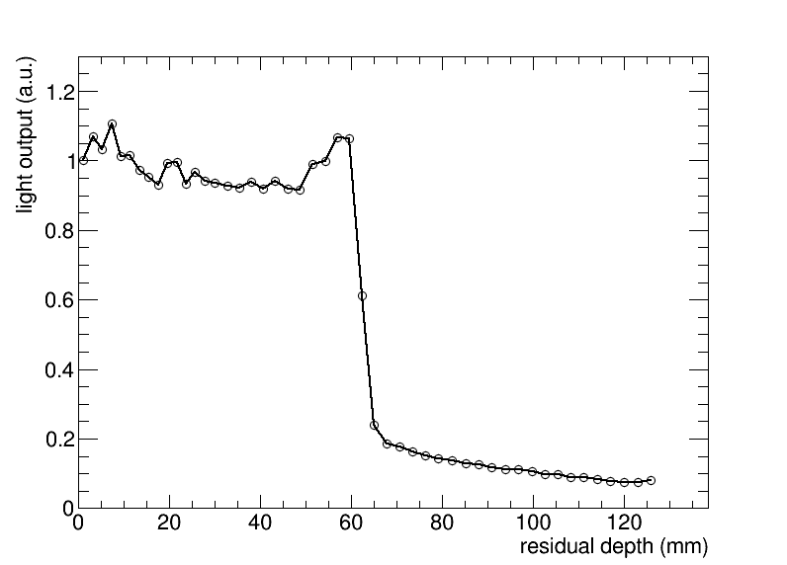
Simple PMMA geometries: online range monitoring
PMMA degrader (WET ≈ 21.9 cm)
2mm PMMA slab covering half the field after ~5cm build up
3x3cm² scanned field, ~3x10⁶ p/spot, E=210MeV/u, 8x10⁷ p/s, ~10 mm FWHM
¹²C peak
Beam
2mm
5cm
~9.1cm
- Preliminary

Slide 9
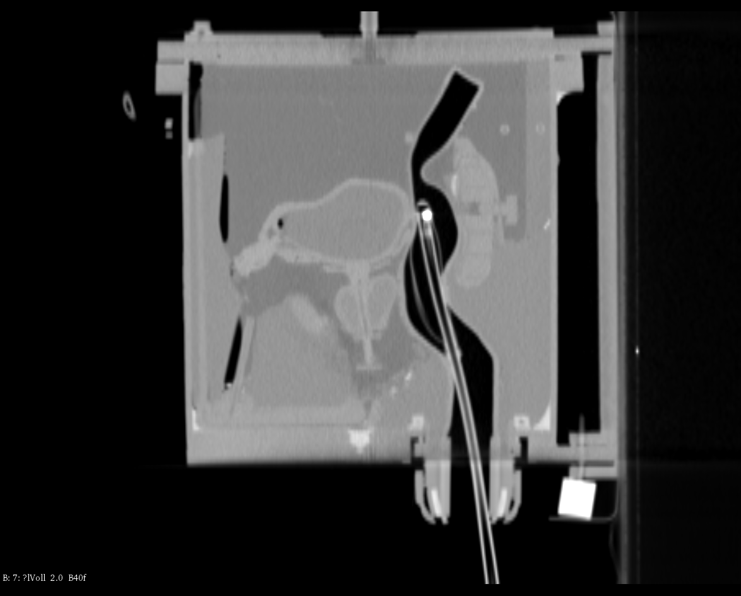
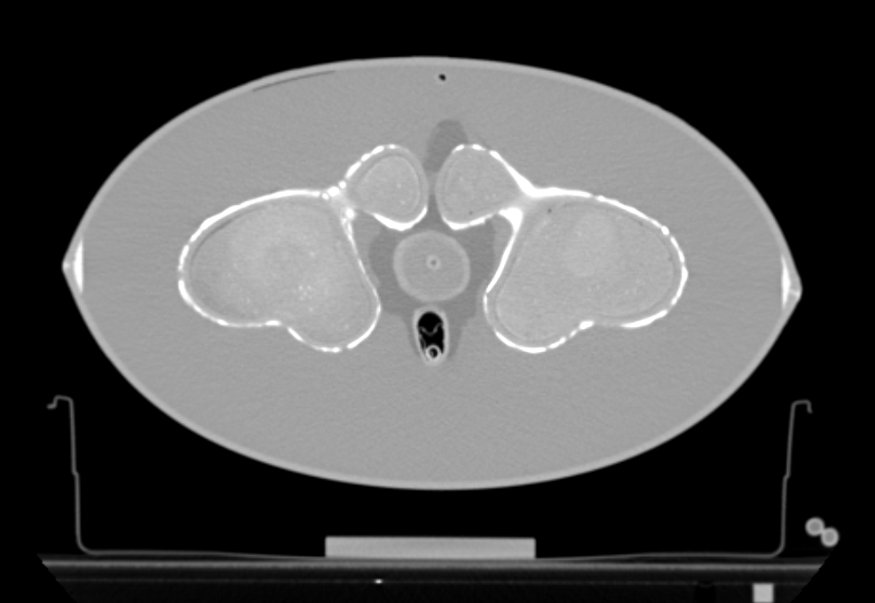
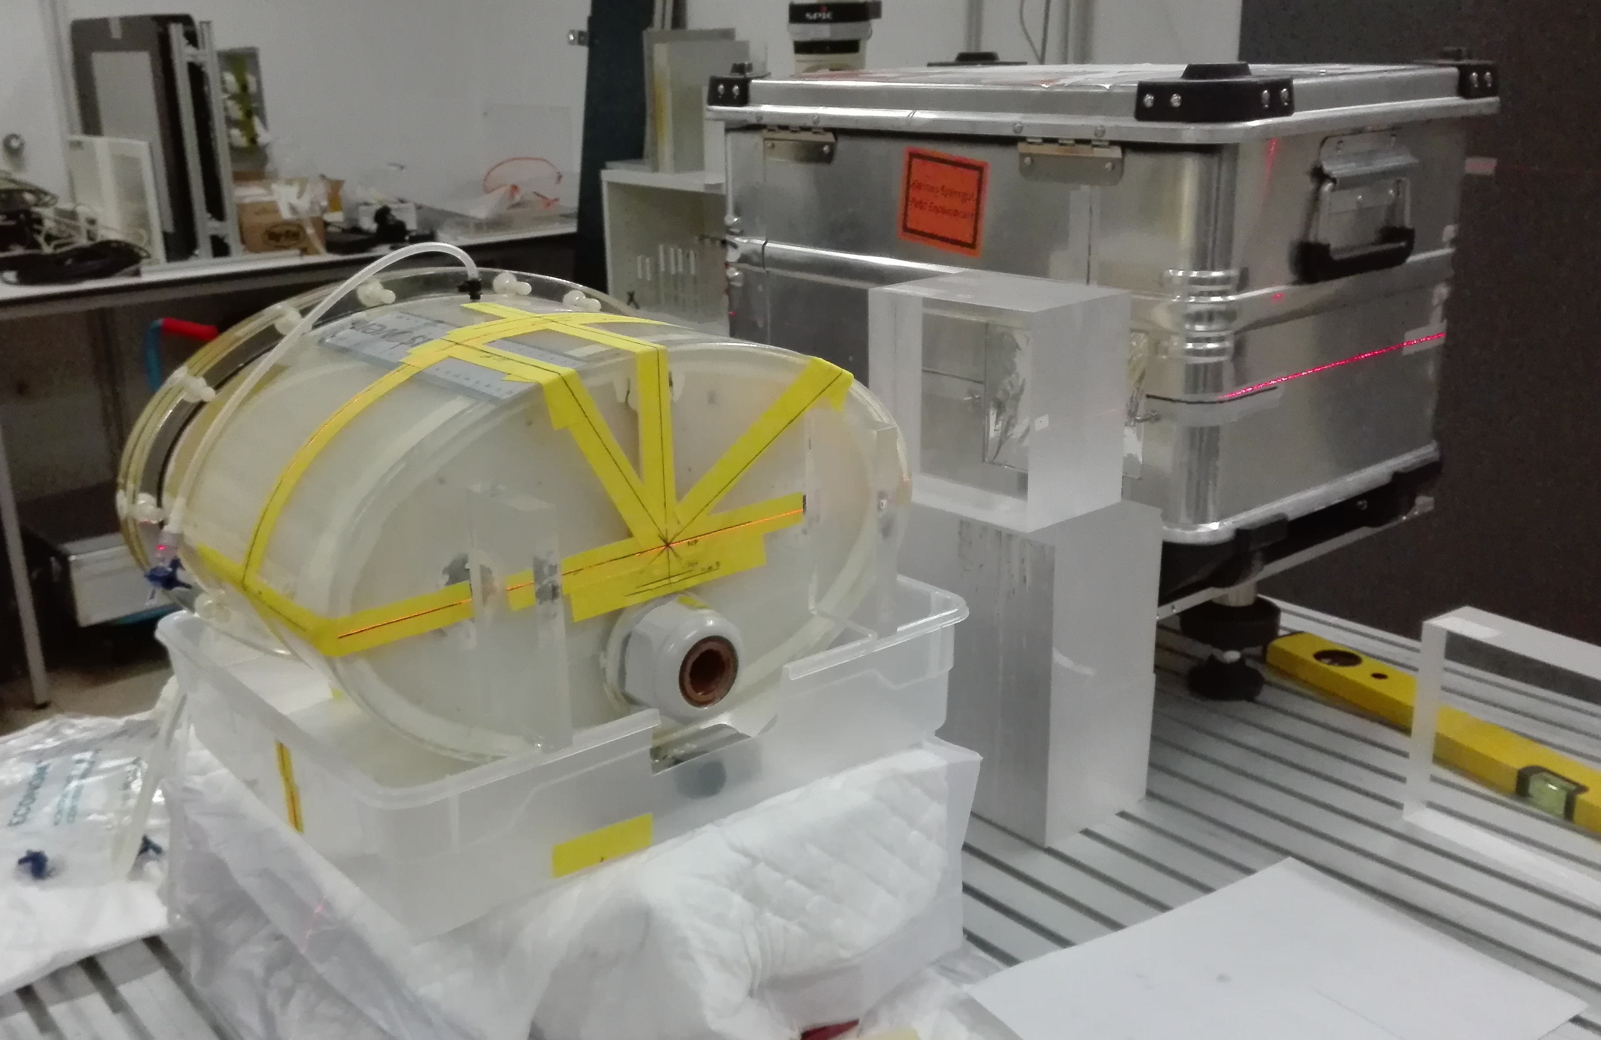
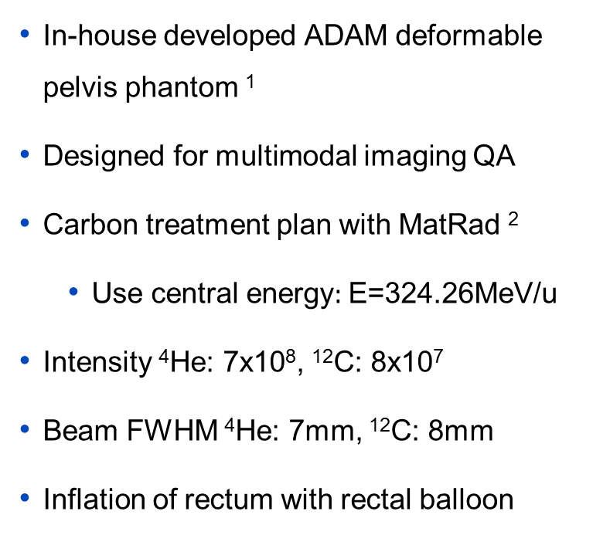
Anthropomorphic phantom: What could we use this method for?
In-house developed ADAM deformable pelvis phantom ¹
Designed for multimodal imaging QA
Carbon treatment plan with MatRad ²
  Use central energy$:$E=324.26MeV/u
Intensity ⁴He: 7x10⁸, ¹²C: 8x10⁷
Beam FWHM ⁴He: 7mm, ¹²C: 8mm
Inflation of rectum with rectal balloon
Axial
Sagittal
¹ Niebuhr et al. (2019); ² Wieser et al. (2017)

Slide 10
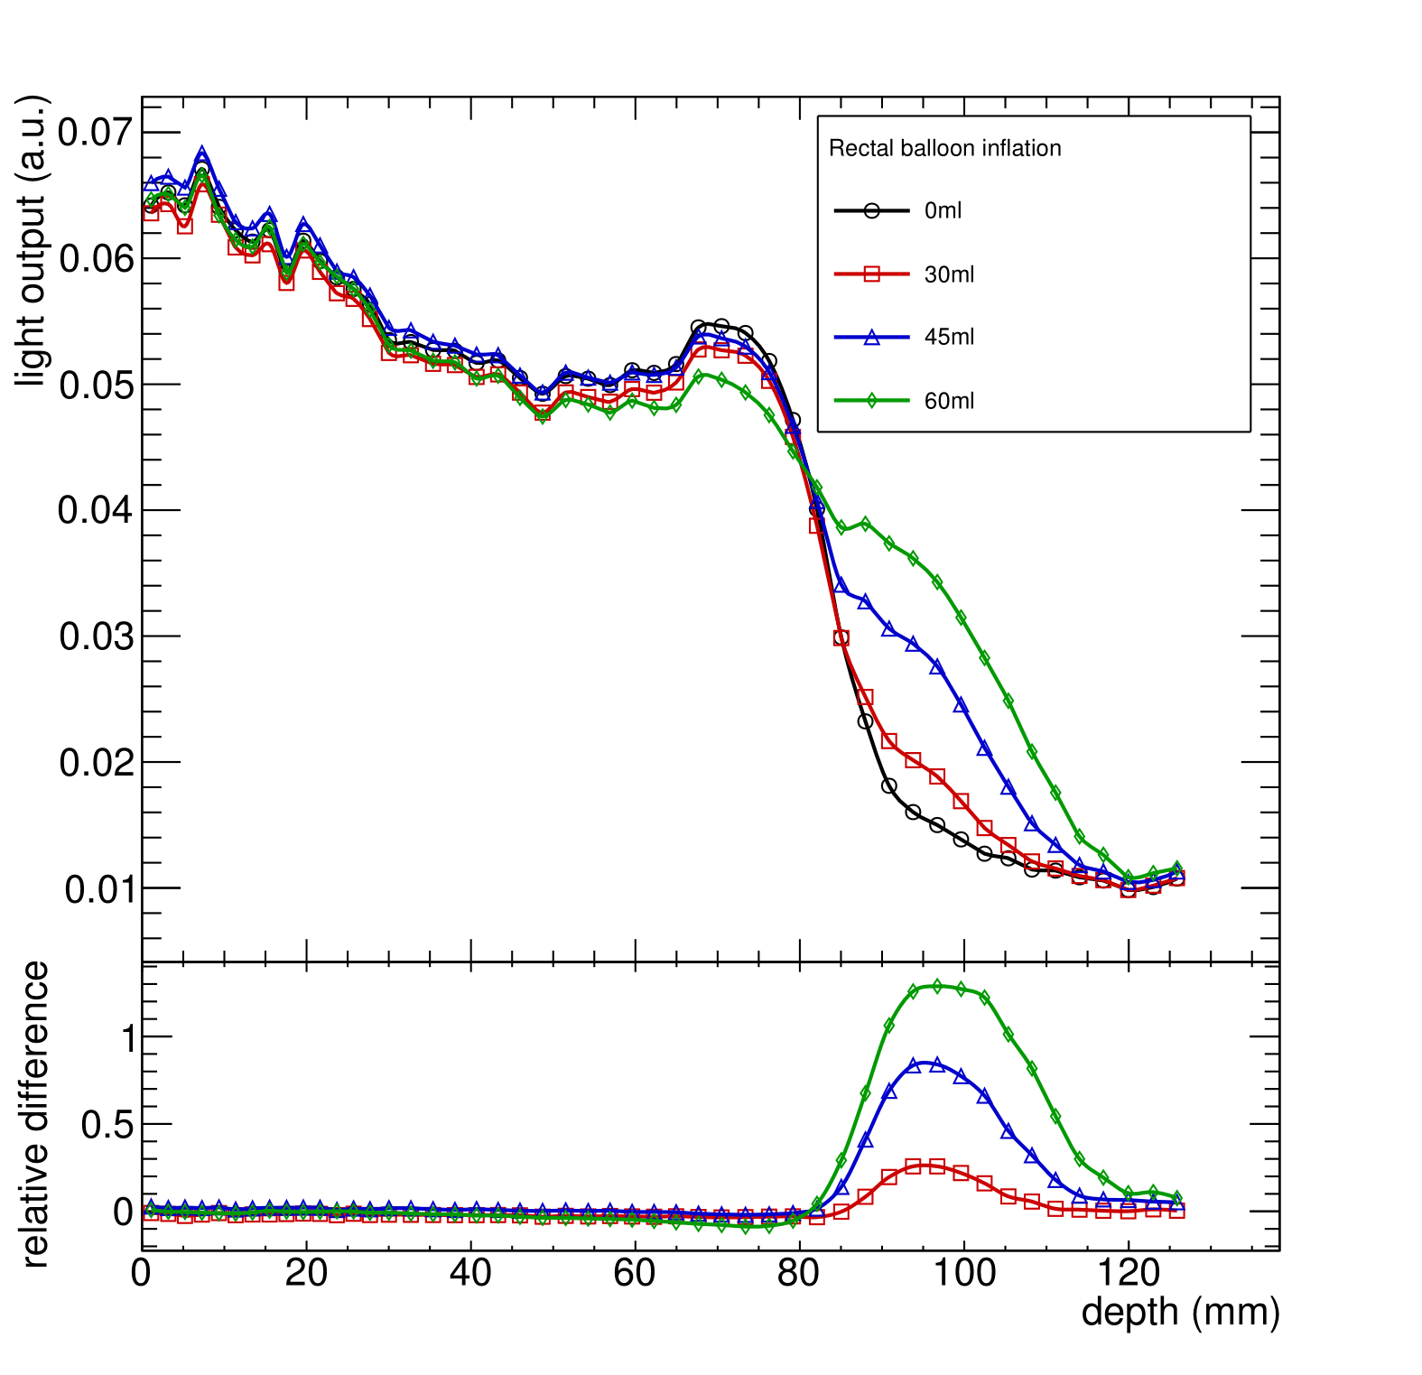
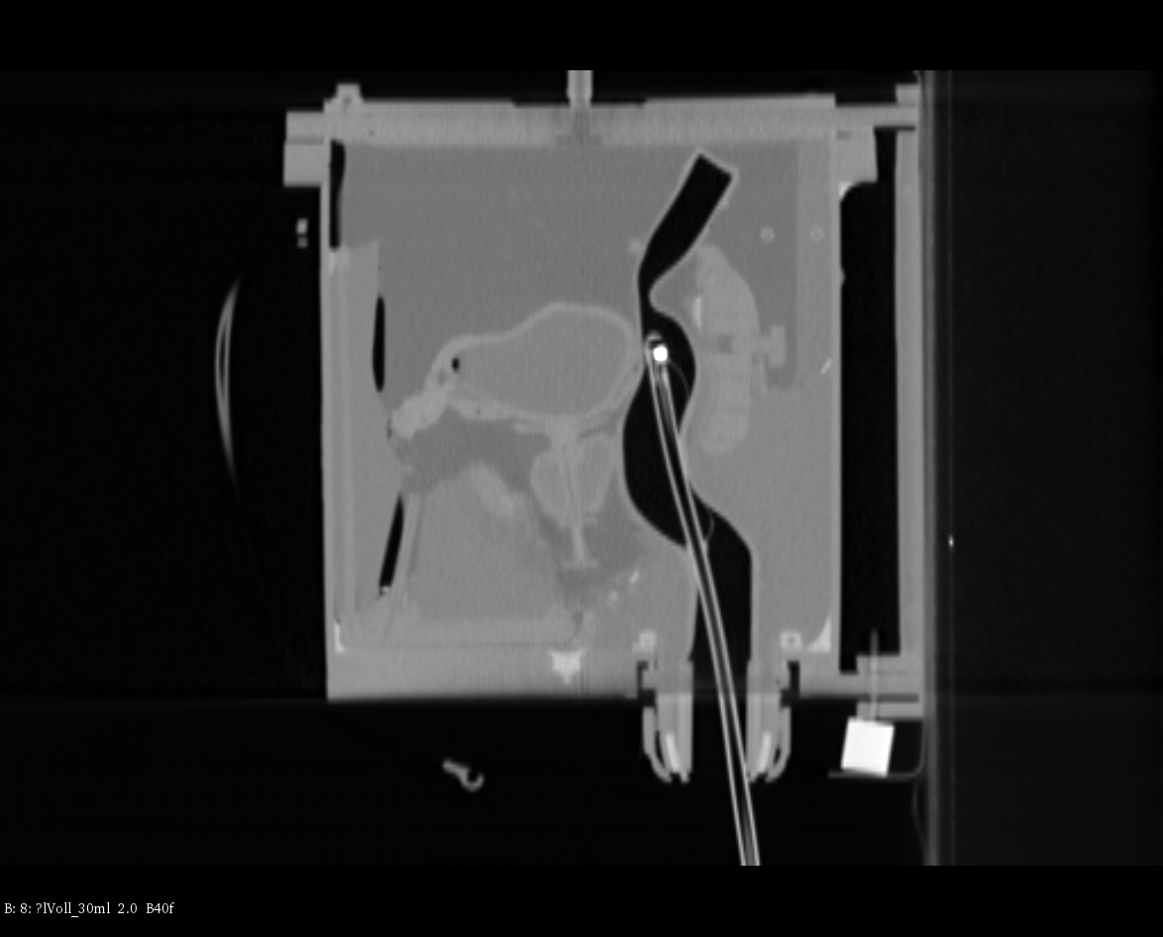
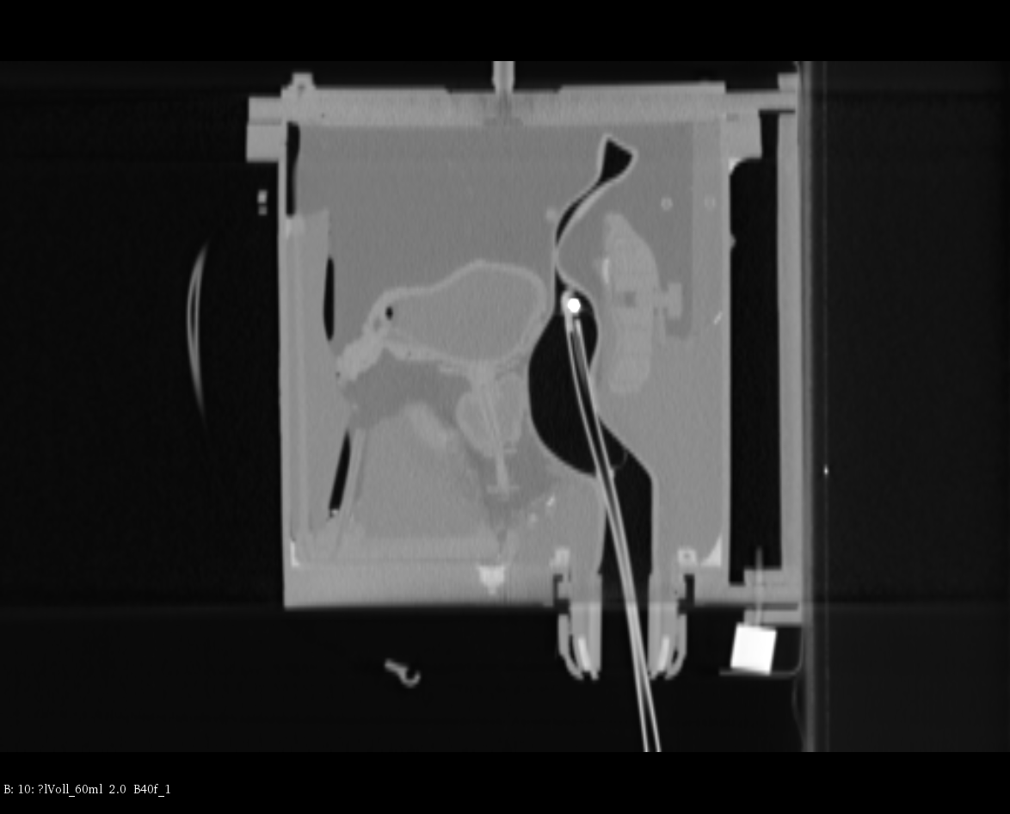
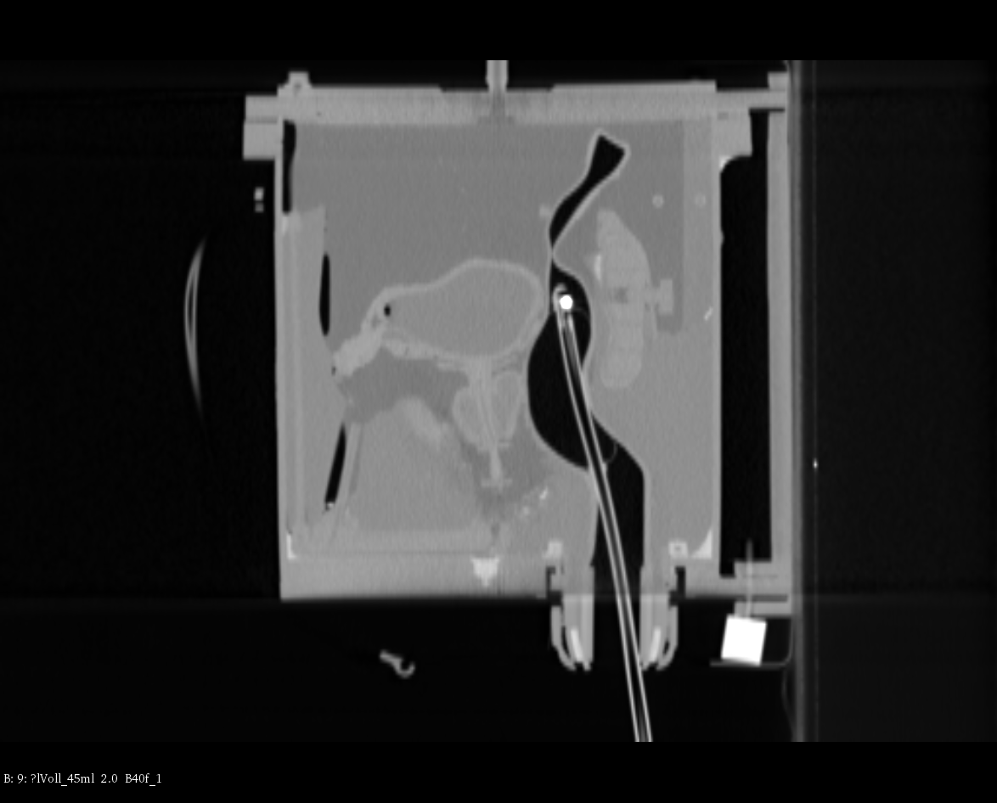
Anthropomorphic phantom: What could we use this method for?
Beams eye view
Bladder
Prostate
Rectum + balloon
- Preliminary

Slide 11
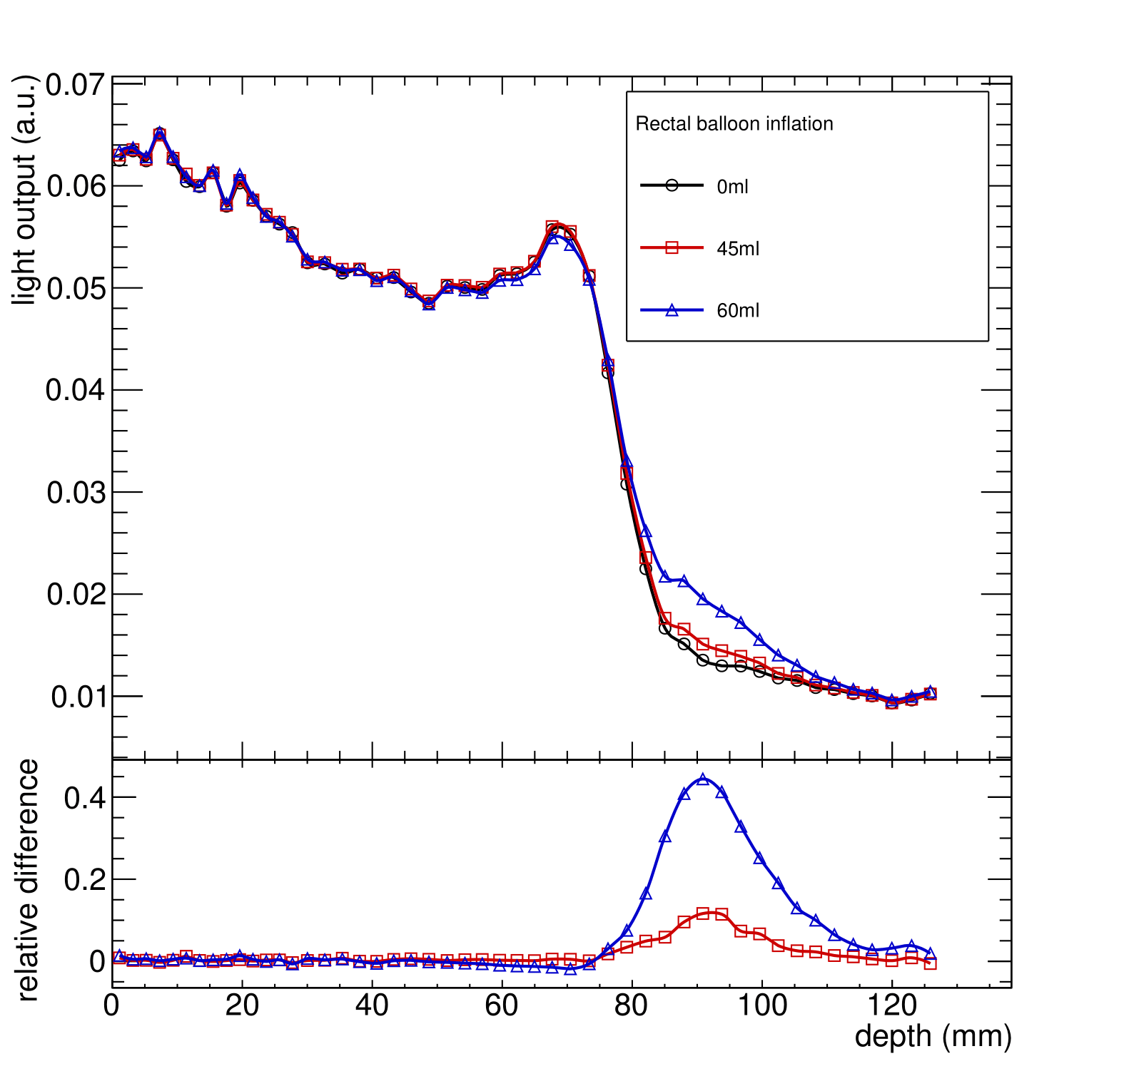
Anthropomorphic phantom: What could we use this method for?
Beams eye view
Bladder
Prostate
Rectum + balloon
- Preliminary

Slide 12
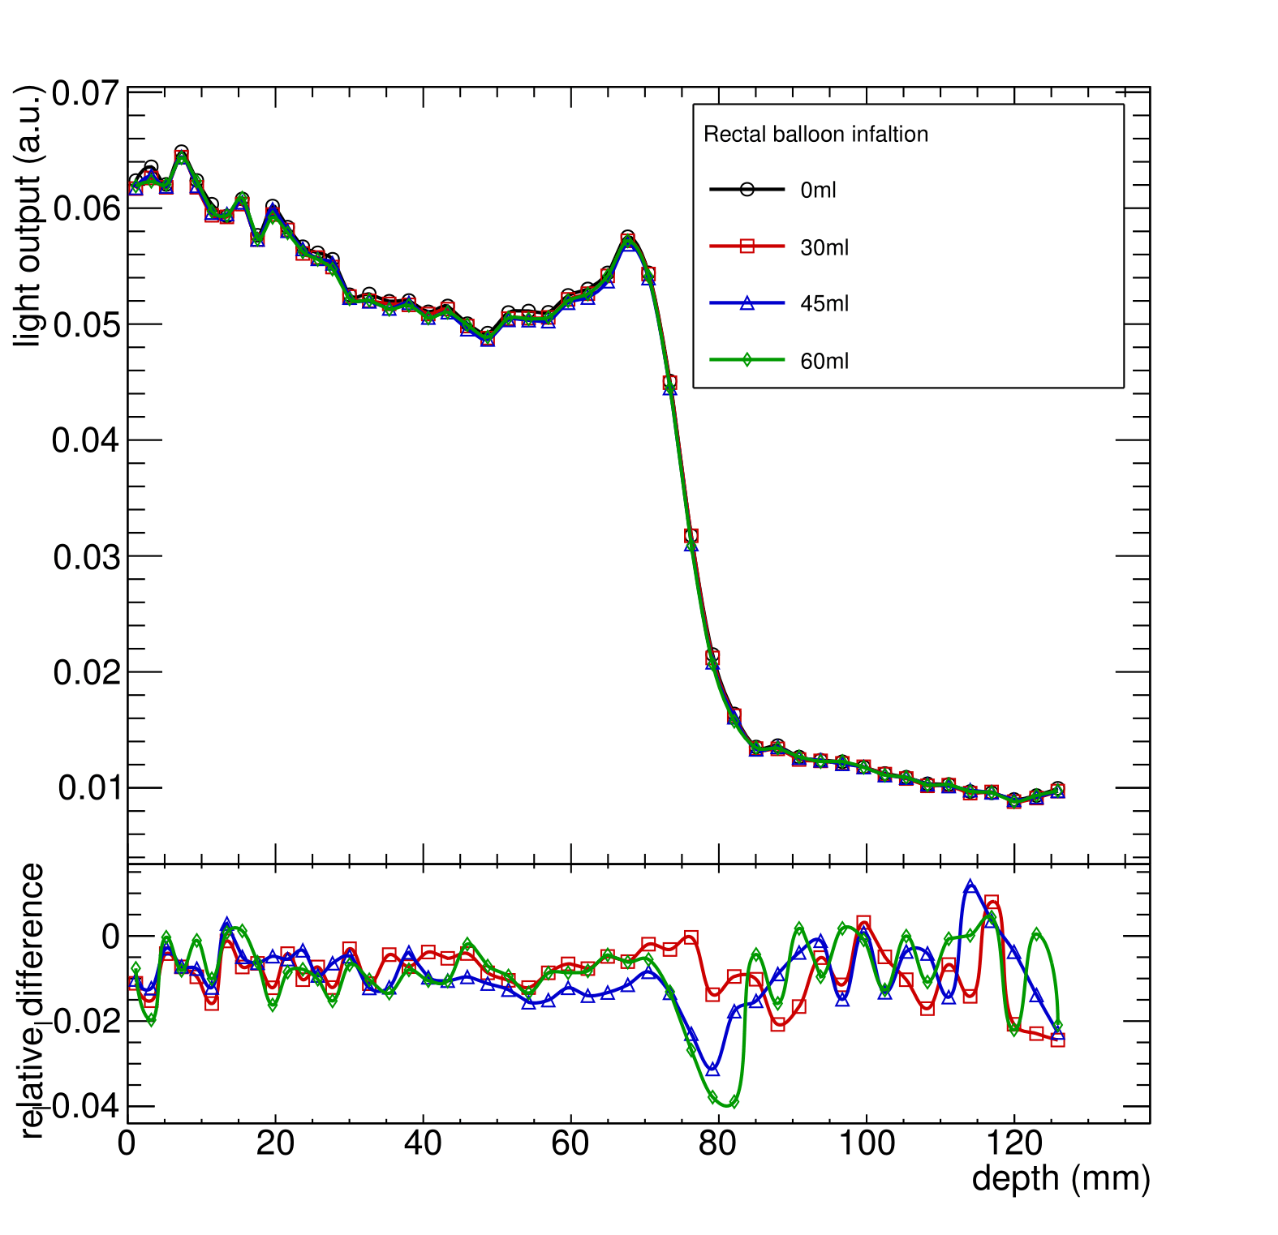
Anthropomorphic phantom: What could we use this method for?
Beams eye view
Bladder
Prostate
Rectum + balloon
- Preliminary

Slide 13
Take home message
A mixed Helium/Carbon beam offers the potential of online treatment monitoring and post-treatment QA
First experimental results further confirm previous proof-of-concept investigations
Many challenges in proving the feasibility of acceleration…
Next steps:
Currently under investigation!
How to use the additional information?
Which patients would benefit from the technique?
6/4/2019 |

Slide 14
Backup

Slide 15
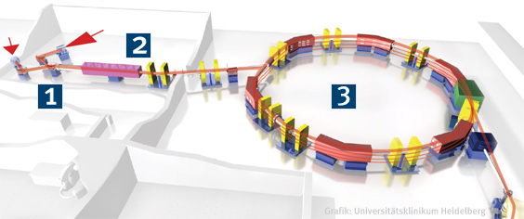
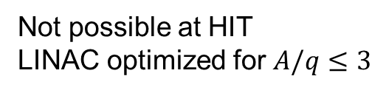
Backup: Production of a mixed beam
Extraction?
Extract ⁴He⁺/¹²C³⁺
Pre-acceleration?
Not possible at HIT
LINAC optimized for $A/q≤3$
Schematic of the HIT accelerator complex
Would in general be possible
Synchrotron?
Stable acceleration, extraction, scanning, dose rate etc..?
More investigation needed!

Slide 16
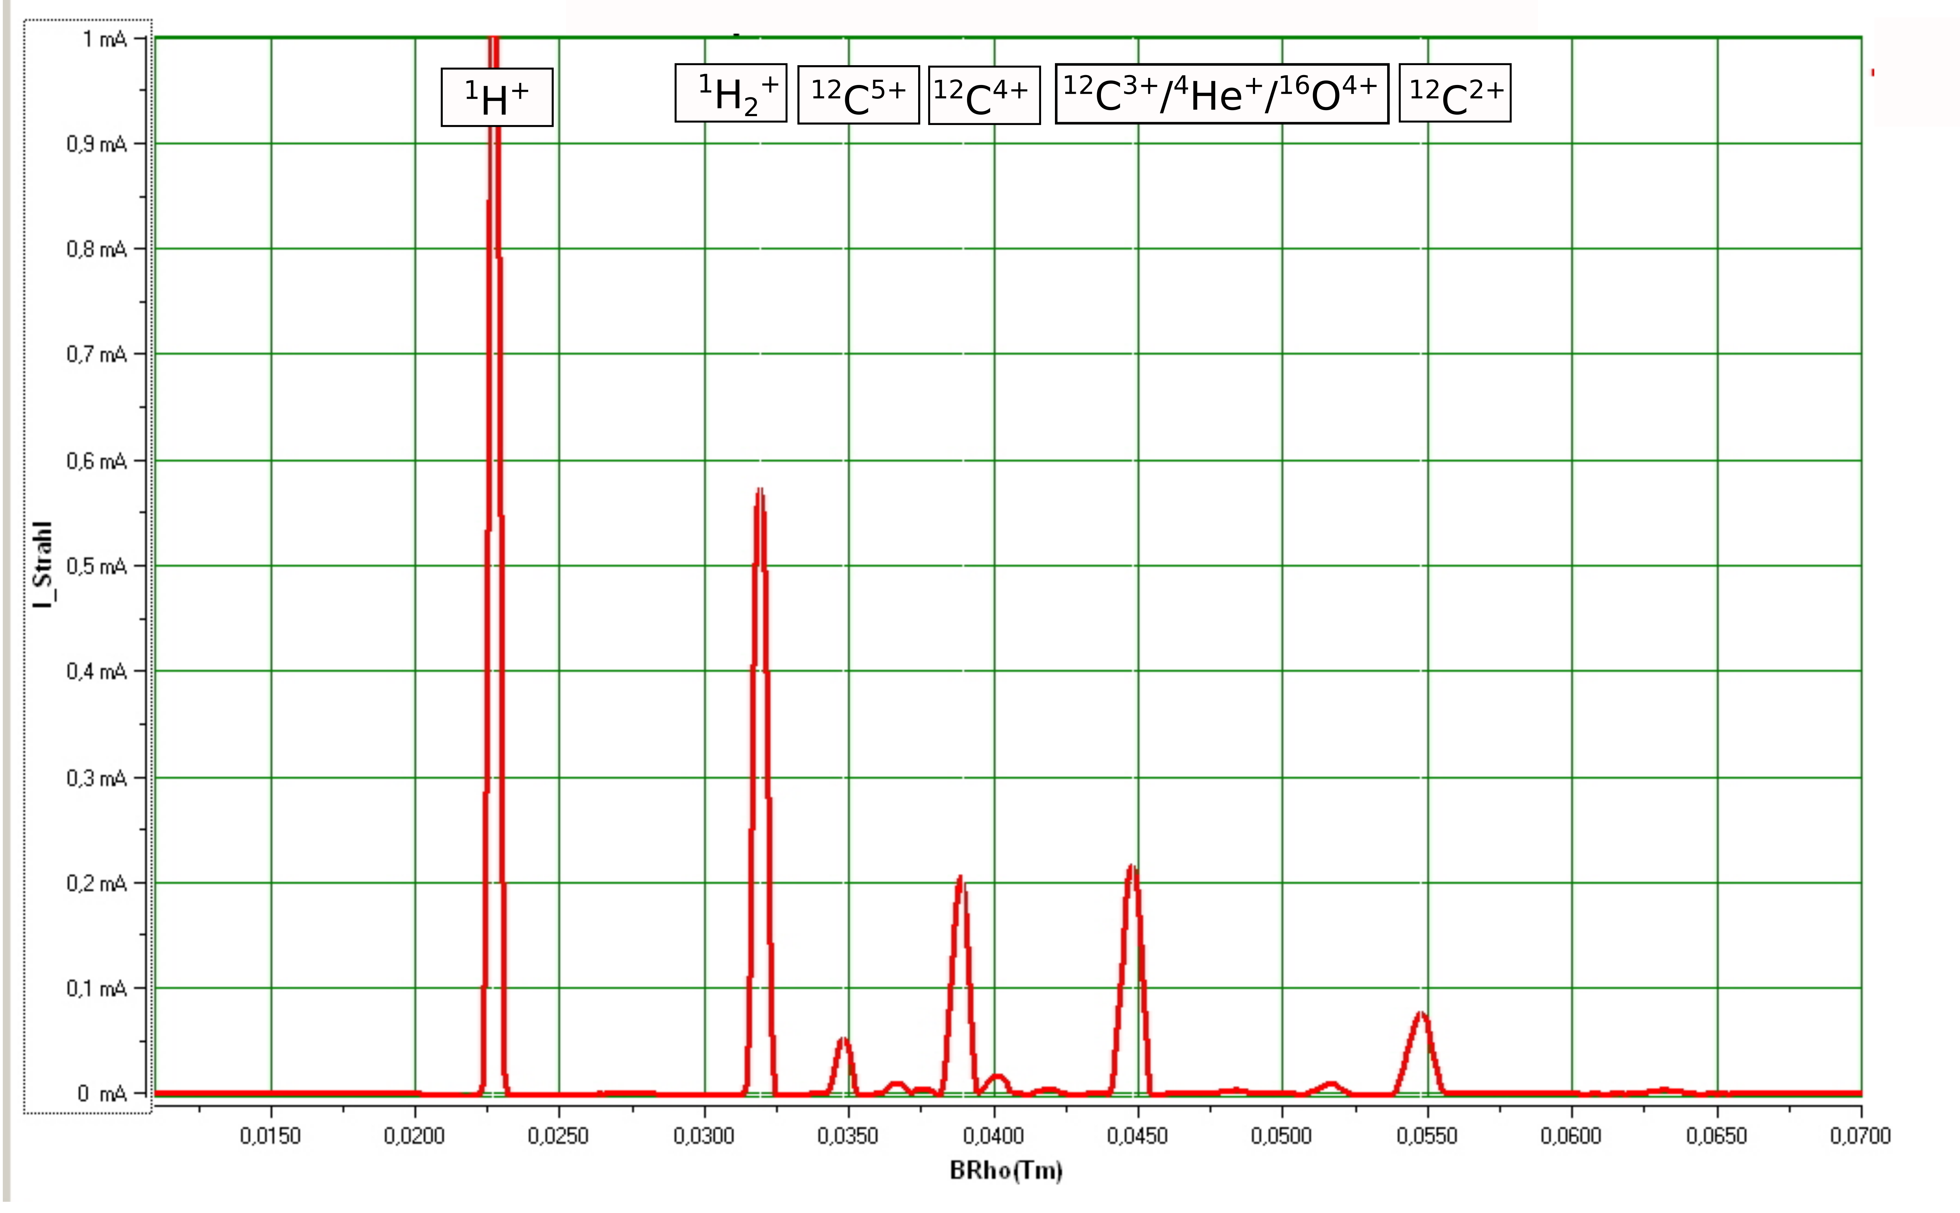
Backup: Methane source spectrum
Contamination from previous run with CO₂
- Courtesy of Tim Winkelmann (HIT)

Slide 17
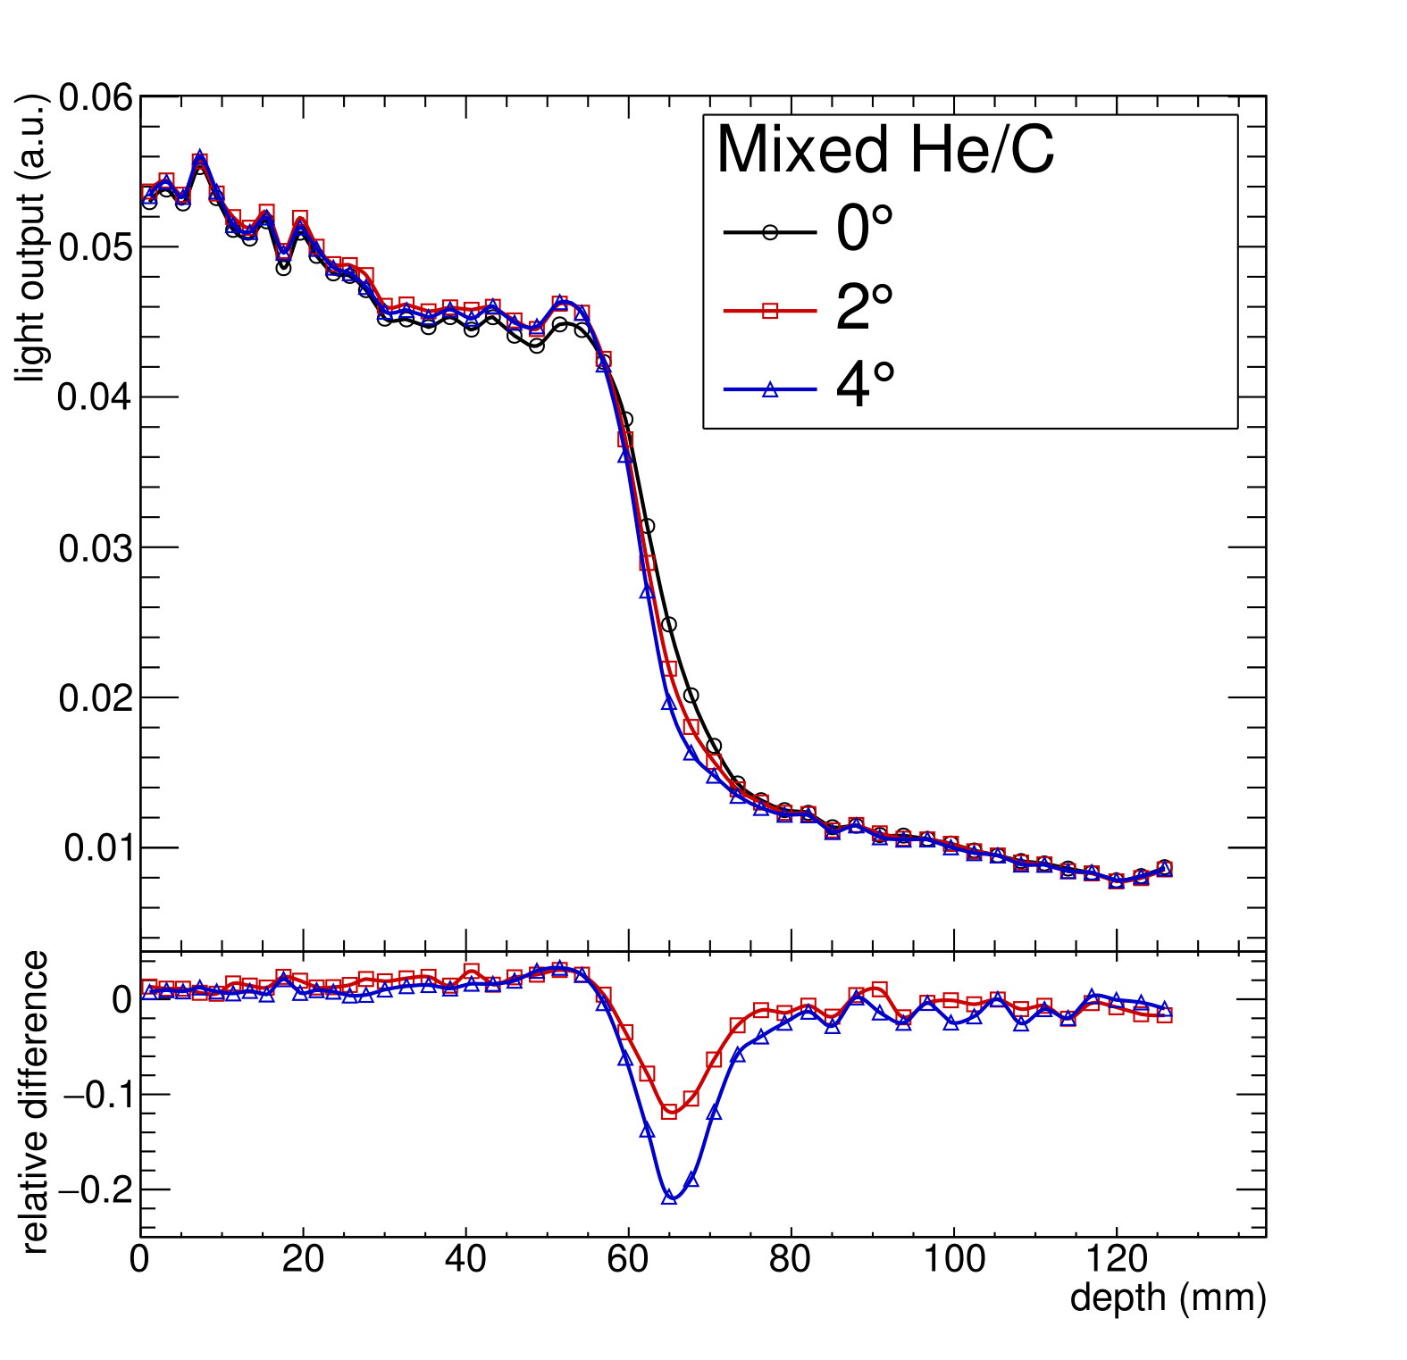
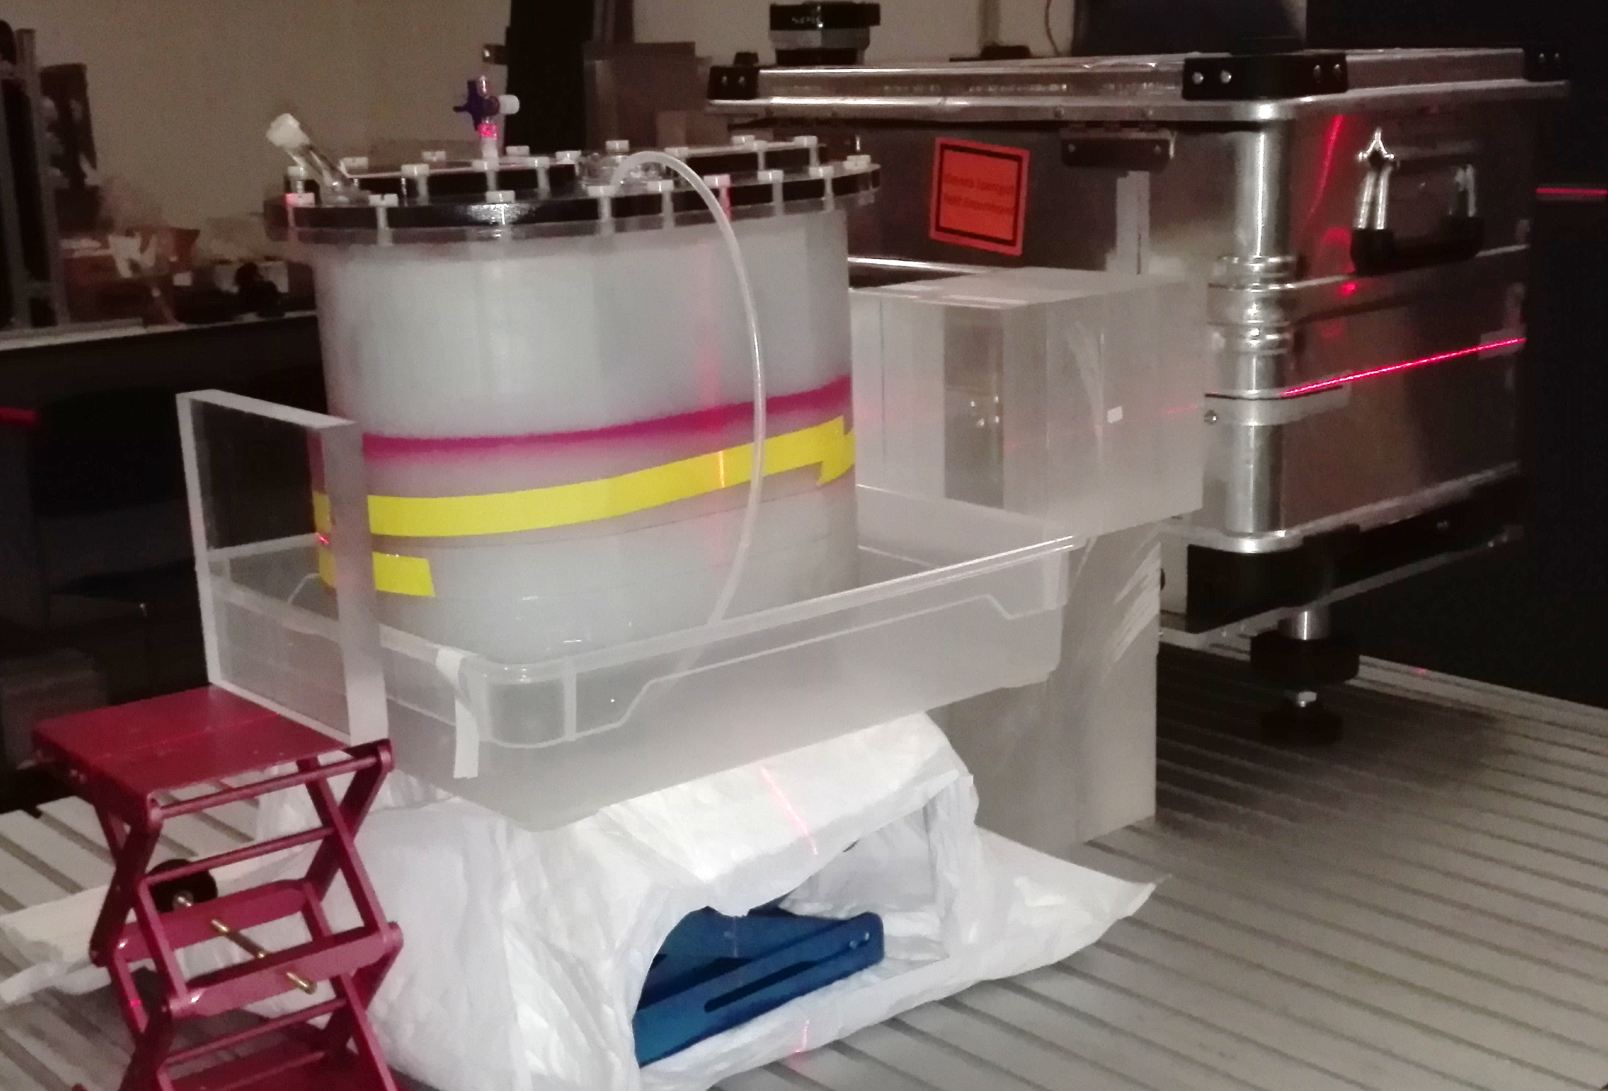
Backup: ADAM PETer rotation
Beam E=324.26
2cm PMMA degrader

Slide 18
Backup: Geant4 simulation setup
Separate Helium and Carbon beams
Geant4.10.2.p03
G4HadronPhysics_QGSP_BIC_HP, G4IonBinaryCascade, G4EmStandardPhysics_option4, G4StoppingPhysics
Birks constant k_{B}=0.126 MeV/mm
Nozzle ~2.03mm WET (G4_WATER), Nozzle-isocenter distance 1.02m
PMMA degrader density optimized to match measured degrader RSPs
CT scan loaded from HU to Density and HU to Material lookup table taken directly from CT scanner QA

