Slide 1
Enhancing Particle Therapy Through The Use Of Mixed Ion Beams
Simon Jolly¹, L. Volz², C. Graeff², L. Kelleter³, M. Pullia⁴, C. Schömers⁵, J. Stadlmann², and J. Seco³
¹University College London (UCL)
²Gesellschaft fuer Schwerionenforschung (GSI), Darmstadt
³German Cancer Research Center (DKFZ), Heidelberg
⁴Centro Nazionale di Adroterapia Oncologica (CNAO), Pavia
⁵Heidelberg Ion-Beam Therapy Centre (HIT), Heidelberg

Slide 2
Abstract
Particle beam therapy treatment with protons and light ions provides significant improvements over conventional X-ray radiotherapy due to the Bragg peak. However, the improved dose conformity of particle therapy requires a corresponding improvement in the accuracy of dose delivery to prevent underdosing of the tumour and overdosing of the surrounding healthy tissue.
In vivo measurements of dose delivery have proved challenging: real-time systems for measuring delivered dose have yet to be realised. One possibility for ion therapy systems is through Helium-Carbon mixing. By diluting the Carbon treatment beam with a small quantity of Helium ions and accelerating to the same energy per nucleon, a diagnostic signal can be obtained: with a negligible increase to the delivered dose, the Helium beam exits the patient, providing diagnostic information on the tissue being treated and thereby providing real-time information on the position and range accuracy of the delivered dose.
This talk describes the background to ion beam therapy and gives insight into experiments carried out to realise clinical Helium-Carbon mixing. The challenges for future systems are also discussed.

Slide 3
The Bragg Peak
Charged particles deliver more conformal dose due to Bragg peak: dose peak and end-of-range.
Heavier particles (He, C, O) have even tighter Bragg peak than protons: better know where they stop…

Slide 4
Non Small Cell Lung Cancer
IMRT
PBT
Zhang X, Li Y, Pan X, et al. Int J Radiat Oncol Biol Phys. 2009;77(2):357-366

Slide 5
Range Uncertainty
Range uncertainty is a major issue!
With tighter conformal dose, how do we make sure that the dose goes where we want it?

Slide 6
Online Range Monitoring
How do you know where you’re delivering the dose?
Two main areas under study for protons:
  Prompt gamma (PG).
  PET emission.
Both have drawbacks:
  Intensity of signal.
  Dose-signal correlation.
What can we do with ions?
Moteabbed et al, Phys. Med. Biol. 56 (2011) 1063 Doi: 10.1088/0031-9155/56/4/012

Slide 7
Mixed He-C Beams
Fully ionized Helium and Carbon – (nearly) same mass:charge ratio (difference of 0.065%)
Simultaneous acceleration to same velocity - range of ⁴He²⁺ ≈ 3 x range of ¹²C⁶⁺

Slide 8
Measuring a Mixed Beam
¹²C peak
⁴He peak
Beam
Patient
Detector
Carbon beam stops in tumour.
Helium beam exits patient: measured in detector.

Slide 9
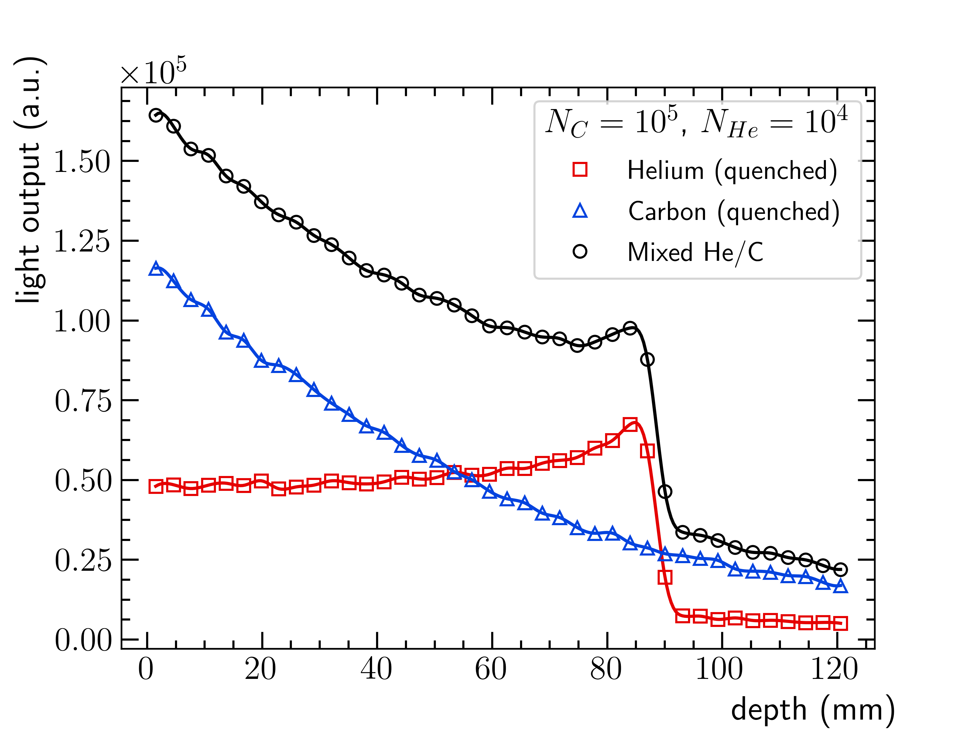
Carbon and Helium Doses
Dilute Carbon beam with 10% Helium: only 0.5% additional dose.
Helium Bragg peak gives measurable signal in residual detector.
Carbon ion fragmentation still measurable: need to subtract from Helium signal.
Simulation

Slide 10
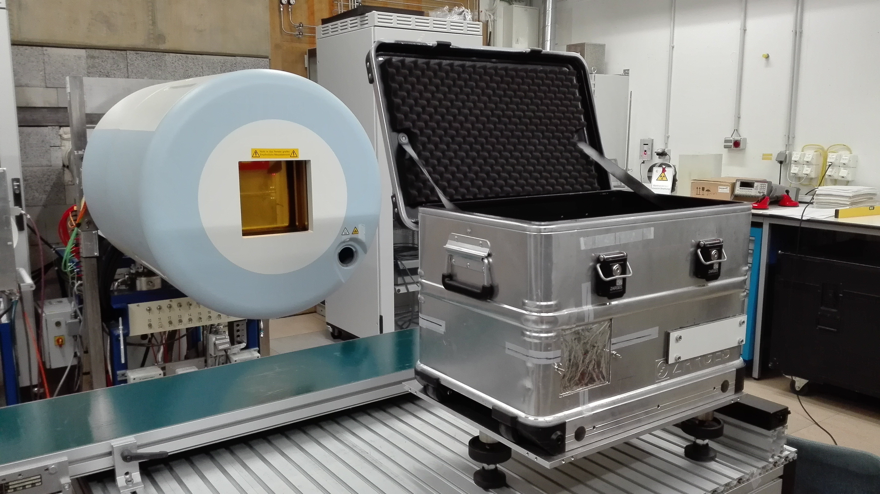
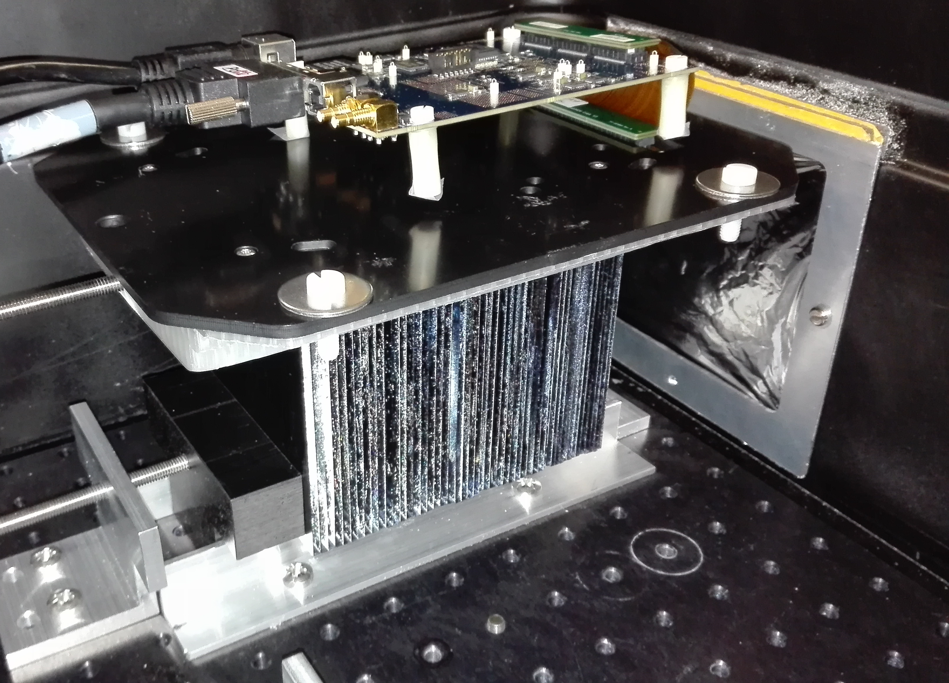
Experiments at HIT
Experiments at HIT QA cave (2019).
Deliver Helium and Carbon beams separately to detector and sum contributions.
Measure residual range with UCL scintillator range telescope:
  12 cm stack of thin 2-3 mm scintillation sheets
  Read out by flat panel CMOS sensor
Setup simulated in Geant4.
Nozzle
Detector
CMOS sensor
Mylar foil
Polystyrene sheets
UCL range telescope at HIT

Slide 11
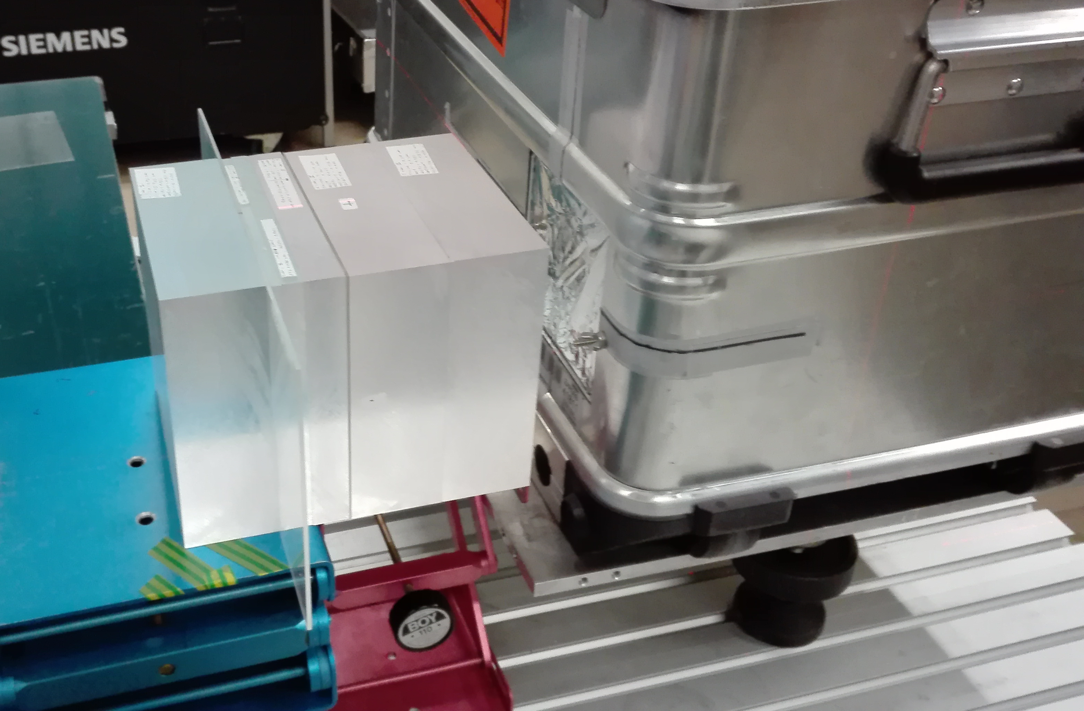
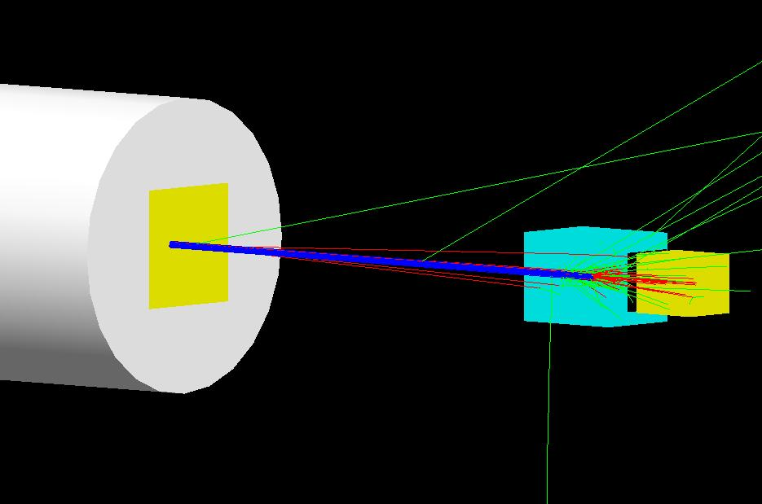
Simple PMMA Setup
~21.9cm
¹²C peak
⁴He peak
Beam
Air gap
Nozzle
Detector
5cm
~10cm
PMMA
¹²C: 219.19 MeV/u (~10cm range), ⁴He: 220.5 MeV/u (~30cm range)

Slide 12
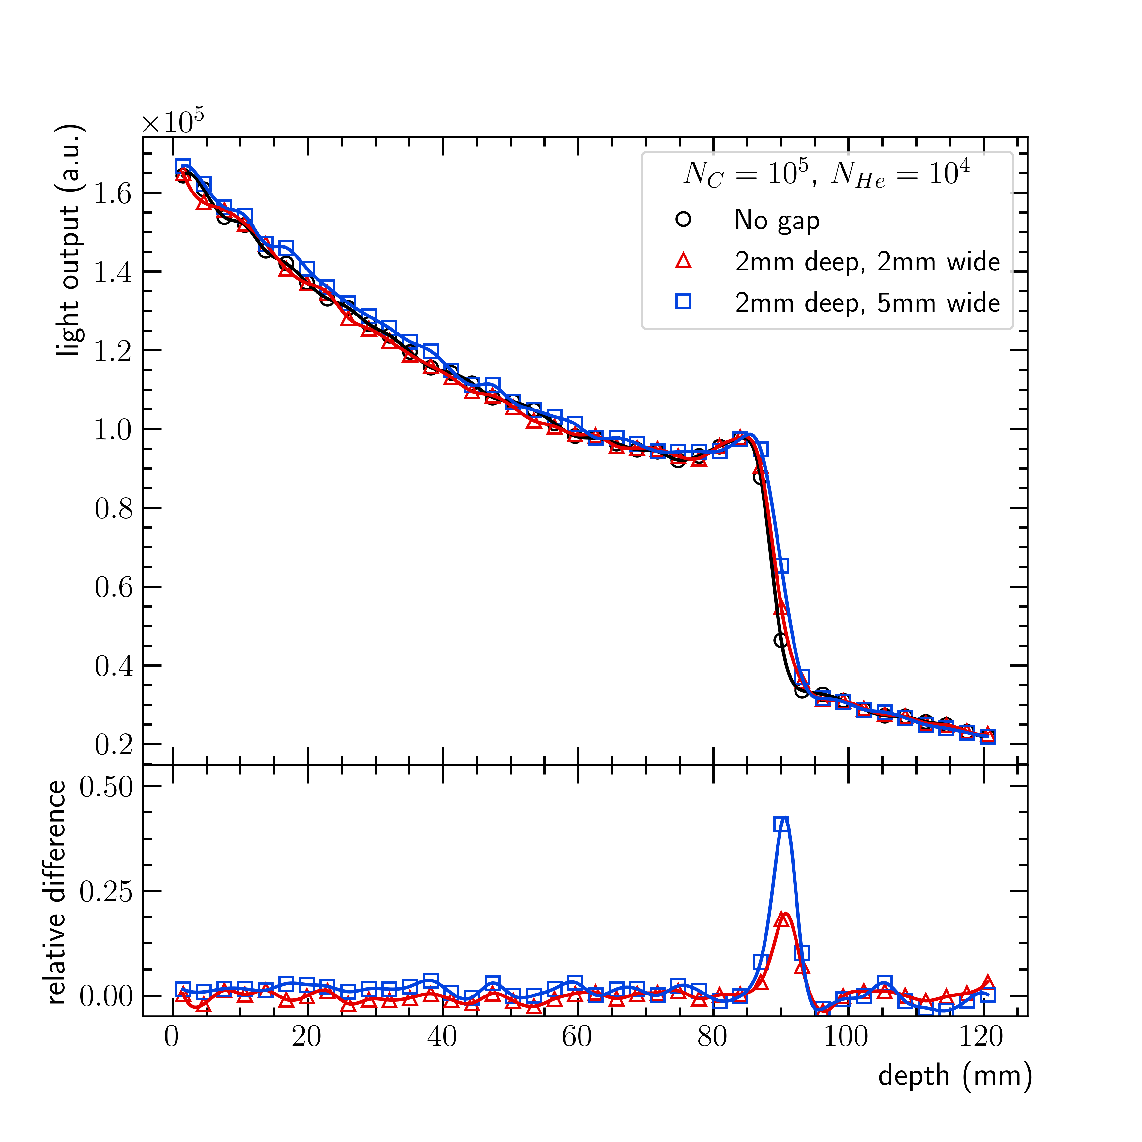
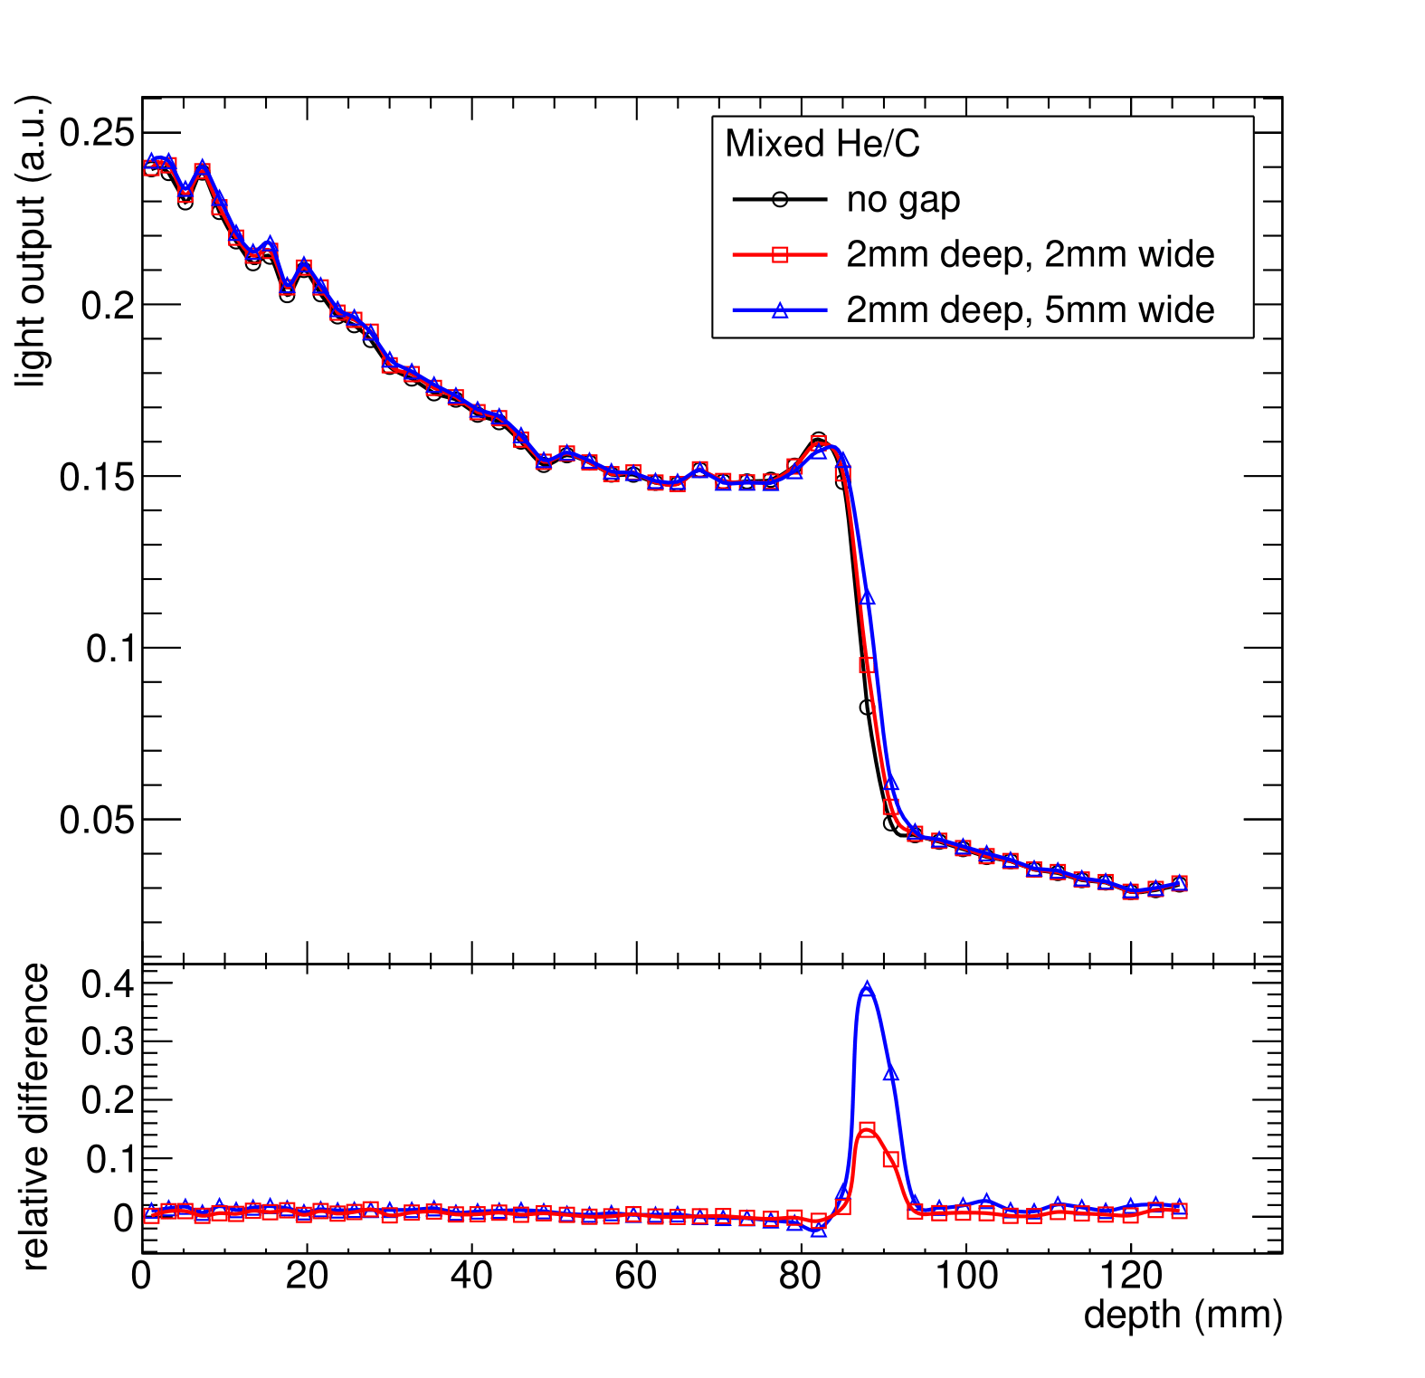
PMMA Phantom Results
Experiment
Simulation
Residual water eq.
Residual water eq.

Slide 13
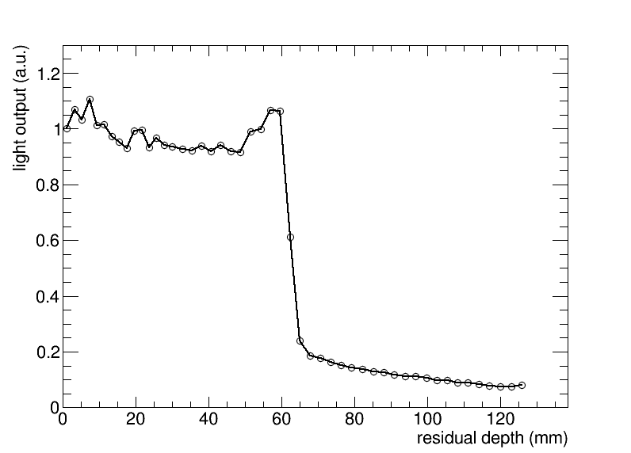
Scanned PMMA Phantom
PMMA degrader (WET ≈ 21.9 cm)
2mm PMMA slab covering half the field at ~5cm depth
10x10 spots scanned (3mm spacing), ~3x10⁶ p/spot, E=210MeV/u, 10 mm FWHM
~21.9cm
¹²C peak
⁴He peak
Beam
2mm
5cm
~9.1cm

Slide 14
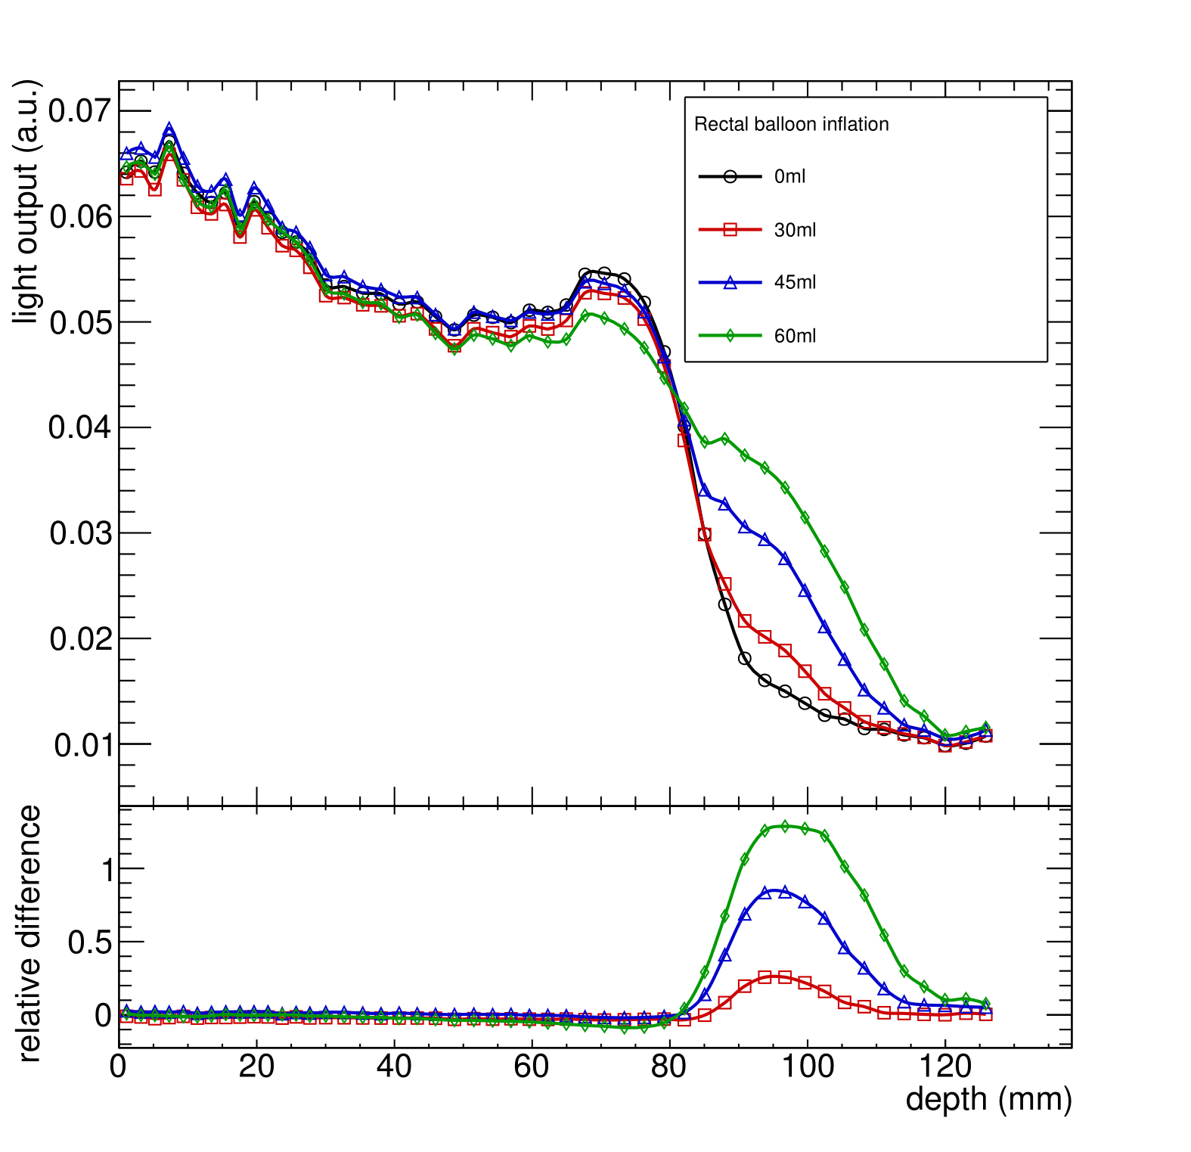
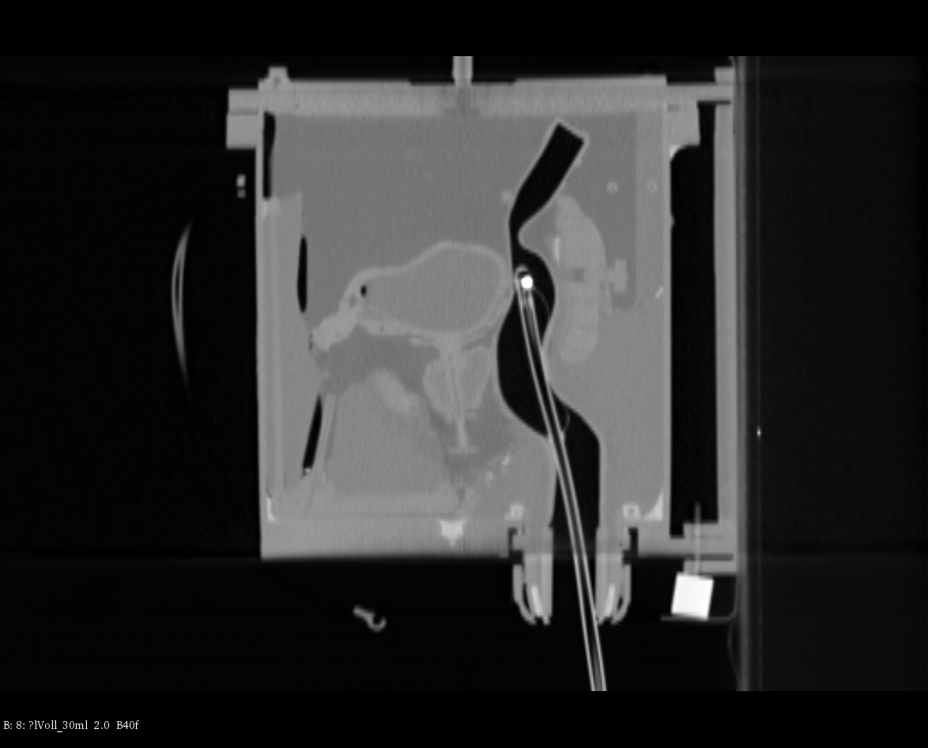
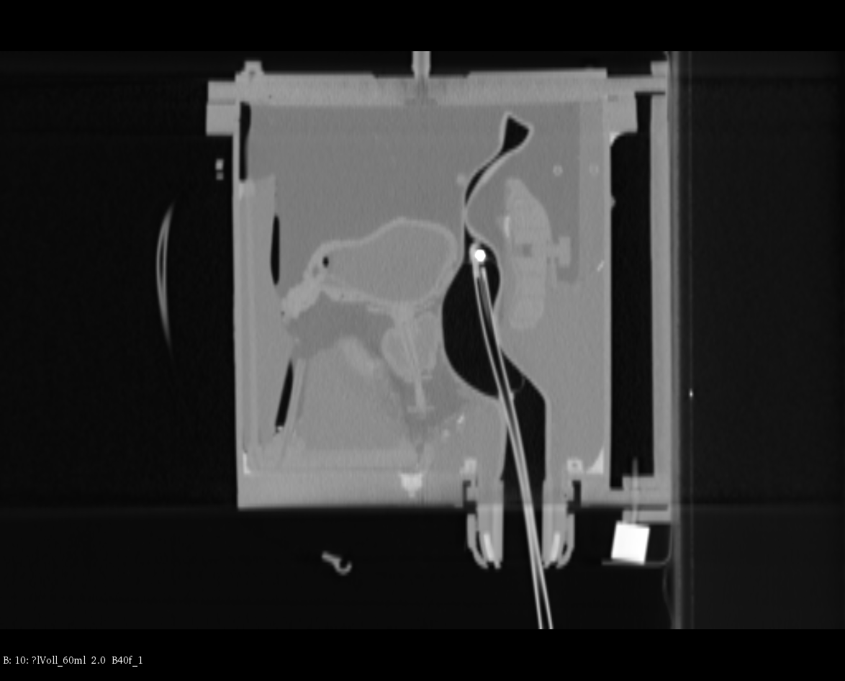
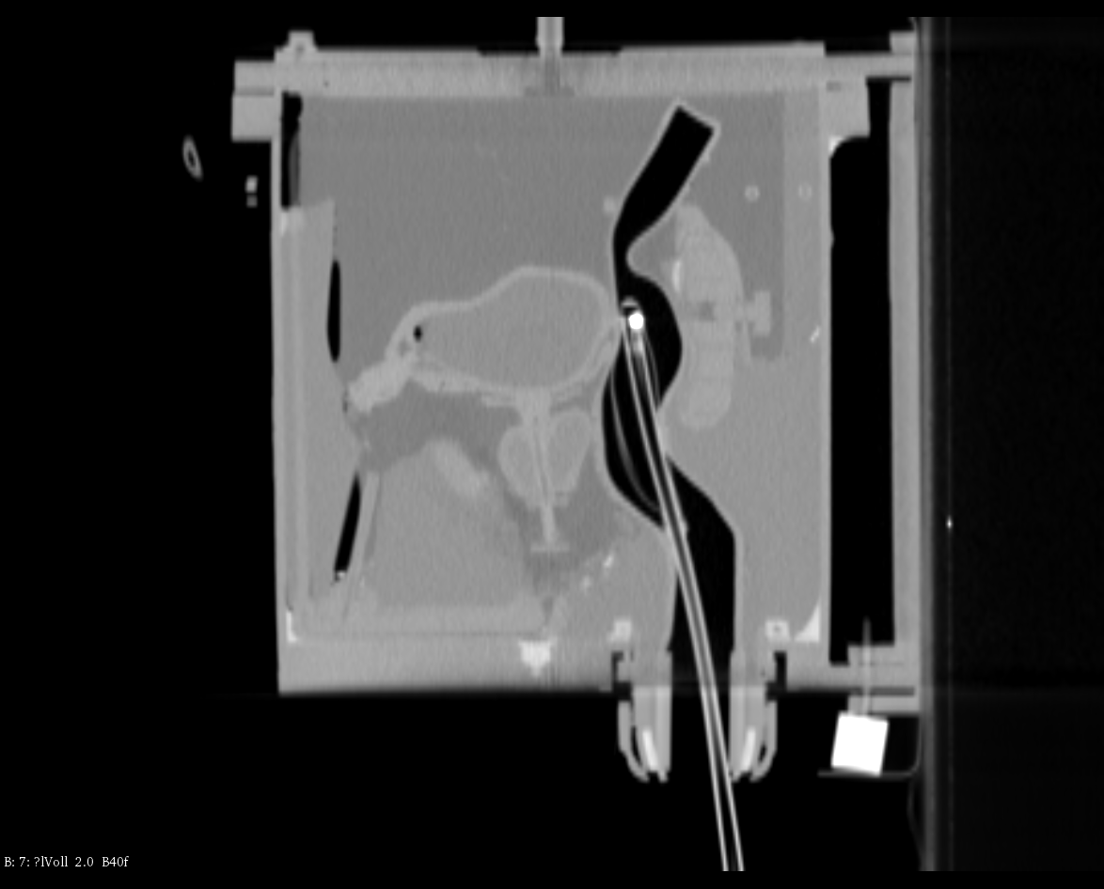
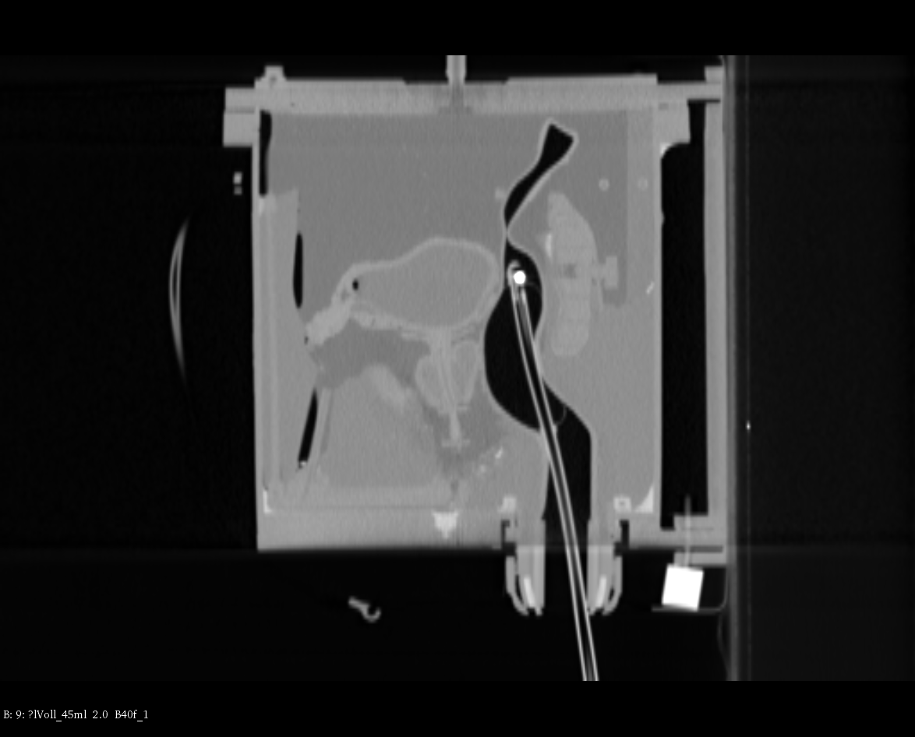
Anthropomorphic Phatnom
Beams eye view
Bladder
Prostate
Rectum + balloon
60 ml
45 ml
30 ml
0 ml
Residual water eq.

Slide 15
Can We Make Mixed Beams?
Yes! Actually produced by accident…
Horst et al observed contamination of He beam with C, N and O.
  Phys. Med. Biol. 66 (2021) 095009
  Doi: 10.1088/1361-6560/abef88
The challenge is to produce the right ions in the right quantities…
Only possible with synchrotrons: degrader in cyclotrons changes E/v ratio.

Slide 16
Ion Sources: Mixed Ions
Carbon production already mixes Carbon and Helium:
  Carbon extracted from CO₂.
  Helium used as support gas.
Cannot use fully stripped ions with A/q = 2: yield too low.
A/q = 4 possible:
  ¹²C³⁺ and ⁴He⁺.
  Same rigidity with suitable yield.
  Issues with ¹⁶O⁴⁺ contamination.
Rev. Sci. Instrum. 79, 02A331 (2008)
DOI: 10.1063/1.2823952

Slide 17
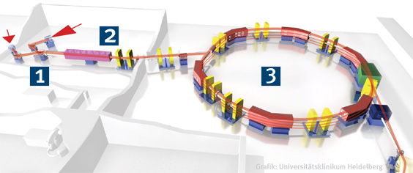
Linac Acceleration
HIT Layout:
Ion Sources
Linac
Ring
RFQ+DTL linacs in existing therapy machines currently designed to accelerate ions with A/q in range 1–3:
  Can accommodate protons, ⁴He²⁺ and ¹²C⁴⁺ but not ⁴He¹⁺ and ¹²C³⁺.
  Ions stripped at end of linac: fully stripped in ring.
  Redesign needed to allow A/q = 4.

Slide 18
Injection & Acceleration
With fully stripped ions at linac exit, ions with A/q = 4 can be injected into ring:
  With mixed beams extracted from ion source, accelerate together.
  Possible to do separate injection?
    Two bunches in ring: ⁴He²⁺ and ¹²C⁶⁺.
    Beam dynamics becomes more challenging.
Stripping at injection: stack beams?
MedAustron

Slide 19
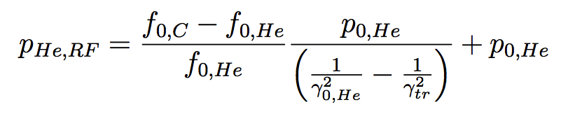
Accelerating He and C Together
Because of the slight difference in mass per nucleon (mC=12 amu, mHe=4.0026033 amu) the two species have a slightly different momentum per nucleon in order to have the same revolution frequency imposed by the RF cavity!
Where f0,He is the frequency that the helium would have to go through the nominal orbit

Slide 20
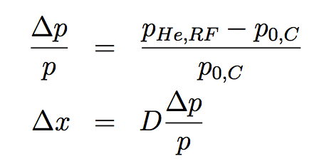
Extracting He and C
Synchrotrons normally drive beam into resonant to extract:
  RF knockout (HIT).
  Betatron core (CNAO, MedAustron).
Not clear whether resonance will affect ions in the same way:
  Can both ions be extracted simultaneously?
  Will the proportions be maintained?
For CNAO:
Betatron core pushes the beams in resonance

Slide 21
Conclusions
He-C mixing provides method of on-line beam monitoring:
  Accidental contamination already observed!
  Measurable Helium signal in residual range detector with 10% He-C contamination.
  Provides in-vivo signal, but also sensitive to downstream changes.
Challenges to be overcome:
  Requires synchrotron (or linac): cannot be achieved with cyclotron due to beam degrader.
  Beam with mixed ions possible from ion source:
    He-C ratio must be correct at ion source extraction.
    Oxygen contamination from CO₂.
  Existing linacs will need redesign to accommodate A/q = 4.
  Study needed of synchrotron resonances to allow simultaneous extraction: new extraction methods needed?

Slide 22
Thank You
This project has received funding from the European Union’s Horizon 2020 research and innovation programme under the Marie Sklodowska-Curie grant agreement No 675265, OMA – Optimization of Medical Accelerators.

Slide 23
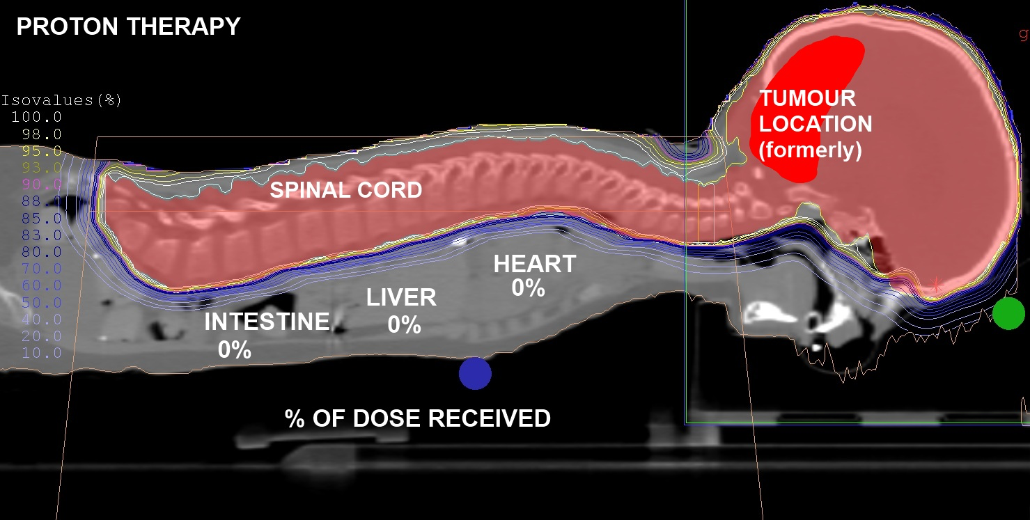
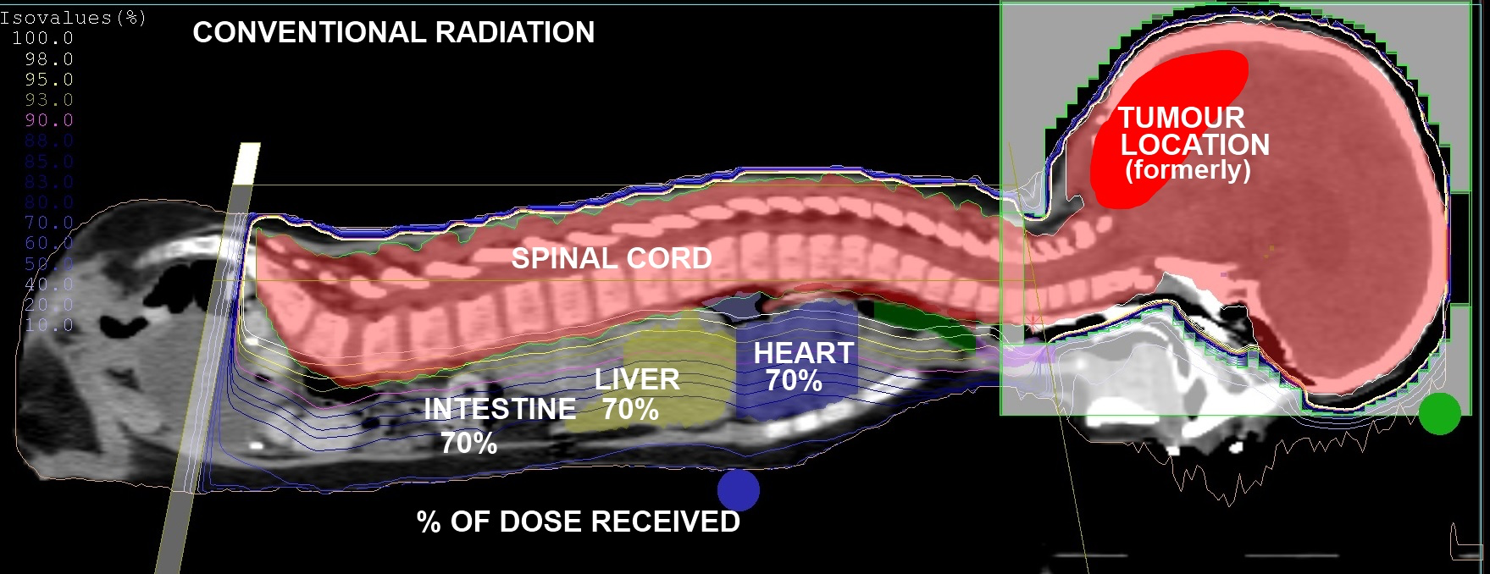
Medulloblastoma Comparison
http://www.proton-cancer-treatment.com/media/press- releases/proton-treatment-plan-for-ashya-is-ready/

Slide 24
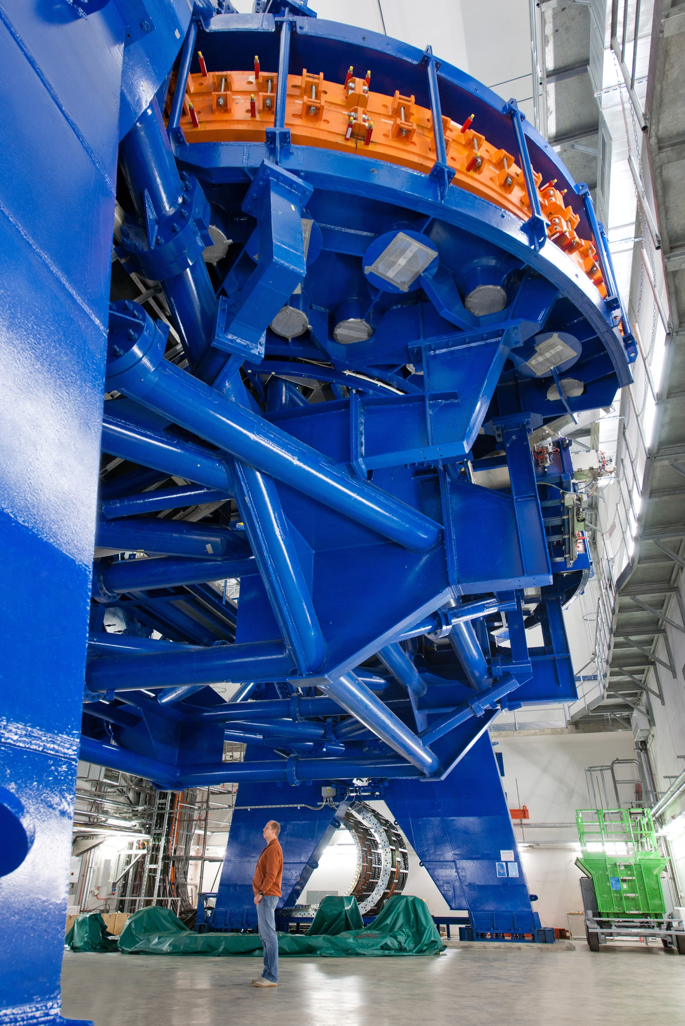
Extraction & Scanning
Synchrotrons normally drive beam into resonant to extract:
  RF knockout (HIT).
  Betatron core (CNAO, MedAustron).
Not clear whether resonance will effect ions in the same way:
  Can both ions be extracted simultaneously?
  Will the proportions be maintained?
Beam transport and pencil beam scanning more straightforward:
  Difference in Bρ of 0.065%.
  Difference in beam spot size needs study.
HIT

