Slide 1
QuADProBe: The Quality Assurance Detector for Proton Beam Therapy
Simon Jolly, Raffaella Radogna, Ruben Saakyan, Spyros Manolopoulos
University College London

Slide 2
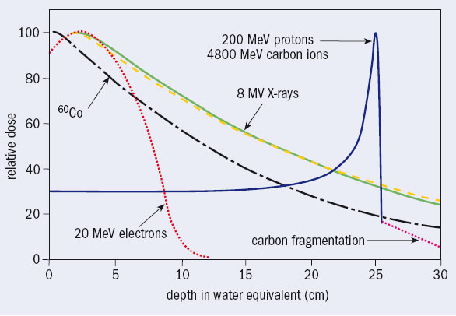
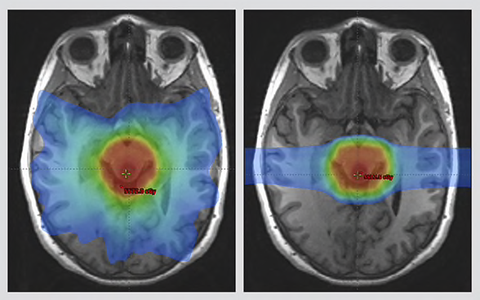
Proton Therapy Advantages
Protons
X-rays
Proton Beam Therapy (PBT) has advantages over conventional radiotherapy due to the Bragg peak:
Protons have defined stopping distance.
More dose delivered around end-of-range.
But better dose localization means accuracy of dose delivery vital:
Beam properties MUST be very accurately know to ensure accurate dose delivery.
Accurate Beam QA vital.

Slide 3
Quality Assurance in PBT
A large range of Quality Assurance (QA) processes are needed to ensure treatment is delivered correctly:
Most comprehensive checks carried out monthly and yearly.
Daily checks ensure day-to-day variation of treatment is within tolerances; no time for more comprehensive checks.
Daily beam QA measures 4 most critical beam parameters:
Beam spot size.
Beam position.
Beam range in water: Water Equivalent Path Length (WEPL).
Absolute dose.
Faster, more accurate QA enables more patients to be treated:
Reducing QA time allows more treatment time: 2–3 more patients per day per room for an hour’s saved QA time.
Make monthly/yearly measurements daily: frees up time.

Slide 4
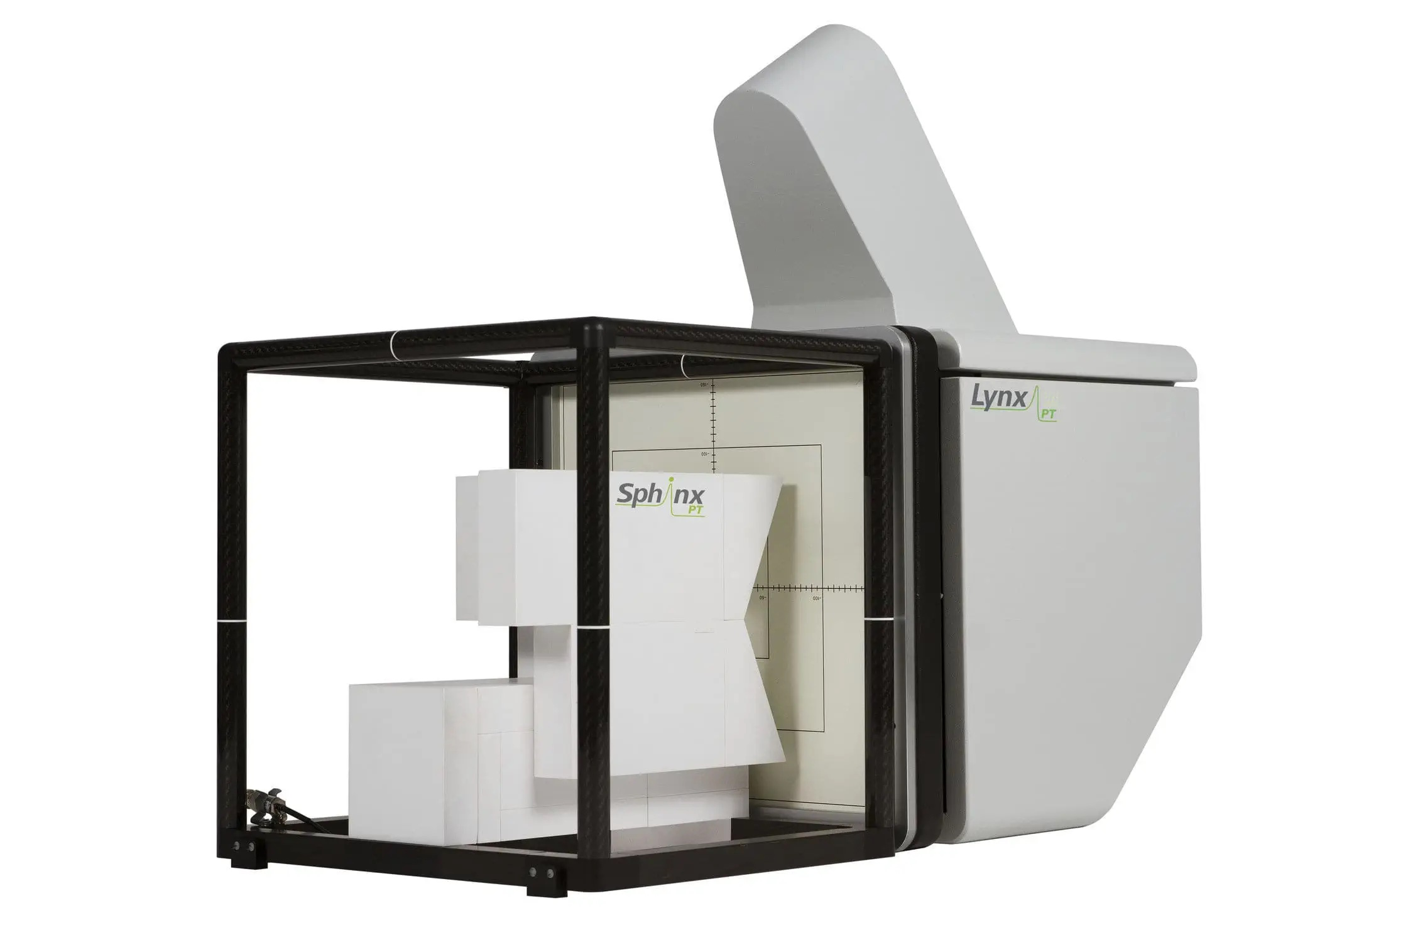
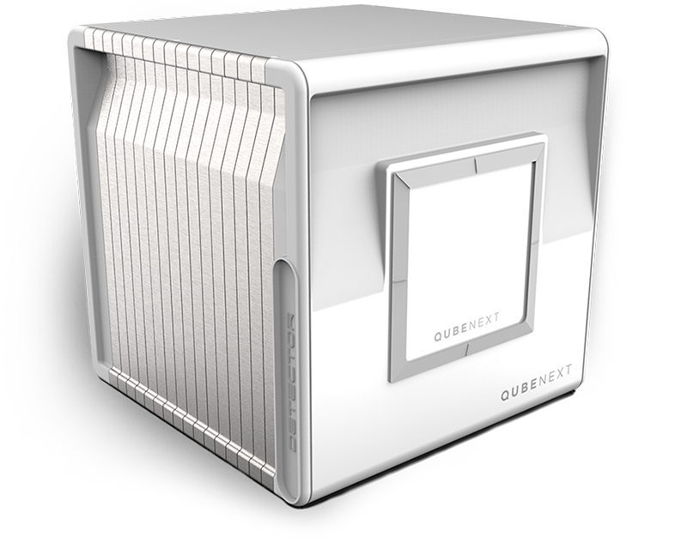
Current PBT QA Detectors
Several systems available for partial beam QA, but only 2 attempt multiple measurements.
IBA Lynx+Sphinx:
Beam spot size imaged on scintillator screen with camera after passing through Sphinx absorber.
Good for spot size measurements.
Cannot measure range: verified indirectly by measuring spot size after passing through Sphinx.
Must be verified with other detectors.
Notoriously tempremental…
De.Tec.Tor QUBENext:
2x1D strip ionization chambers measure spot size and position; Multi-Layer Ionisation Chamber measures range.
Delicate set up required due to analogue electronics.
Virtually no market penetration.
Most of detector volume does not intercept beam.
Heavy: up to 40kg!

Slide 5
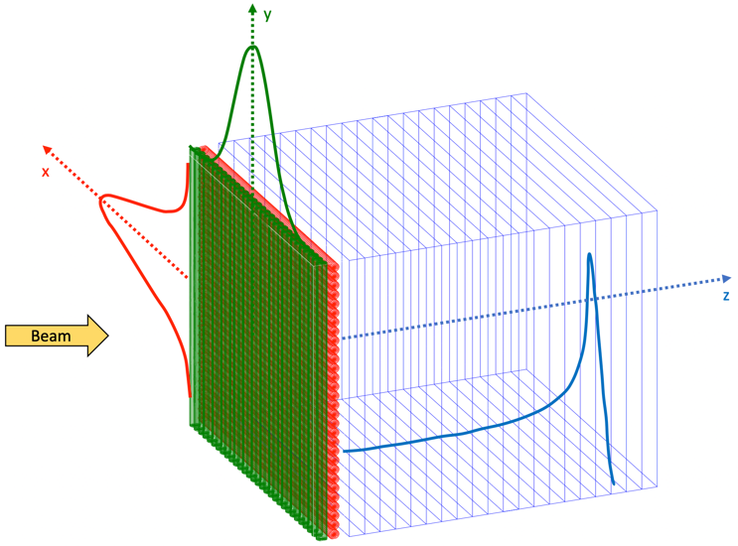
The QuADProBe
The Quality Assurance Detector for Proton Beam Therapy (QuADProBe) will provide a superior alternative to existing technology:
Spot size and position is measured with 2 x 1D scintillating fibre arrays.
Range measured with plastic scintillator range telescope (QuARC).
Builds on well-established technology:
Scintillating fibre profile monitor already demonstrated at Heidelberg.
QuARC programme already well-established at UCL, with patent recently granted.
QuARC already funded by STFC, so QuADProBe funding for 3-year programme covers profile monitor development and detector integration only.

Slide 6
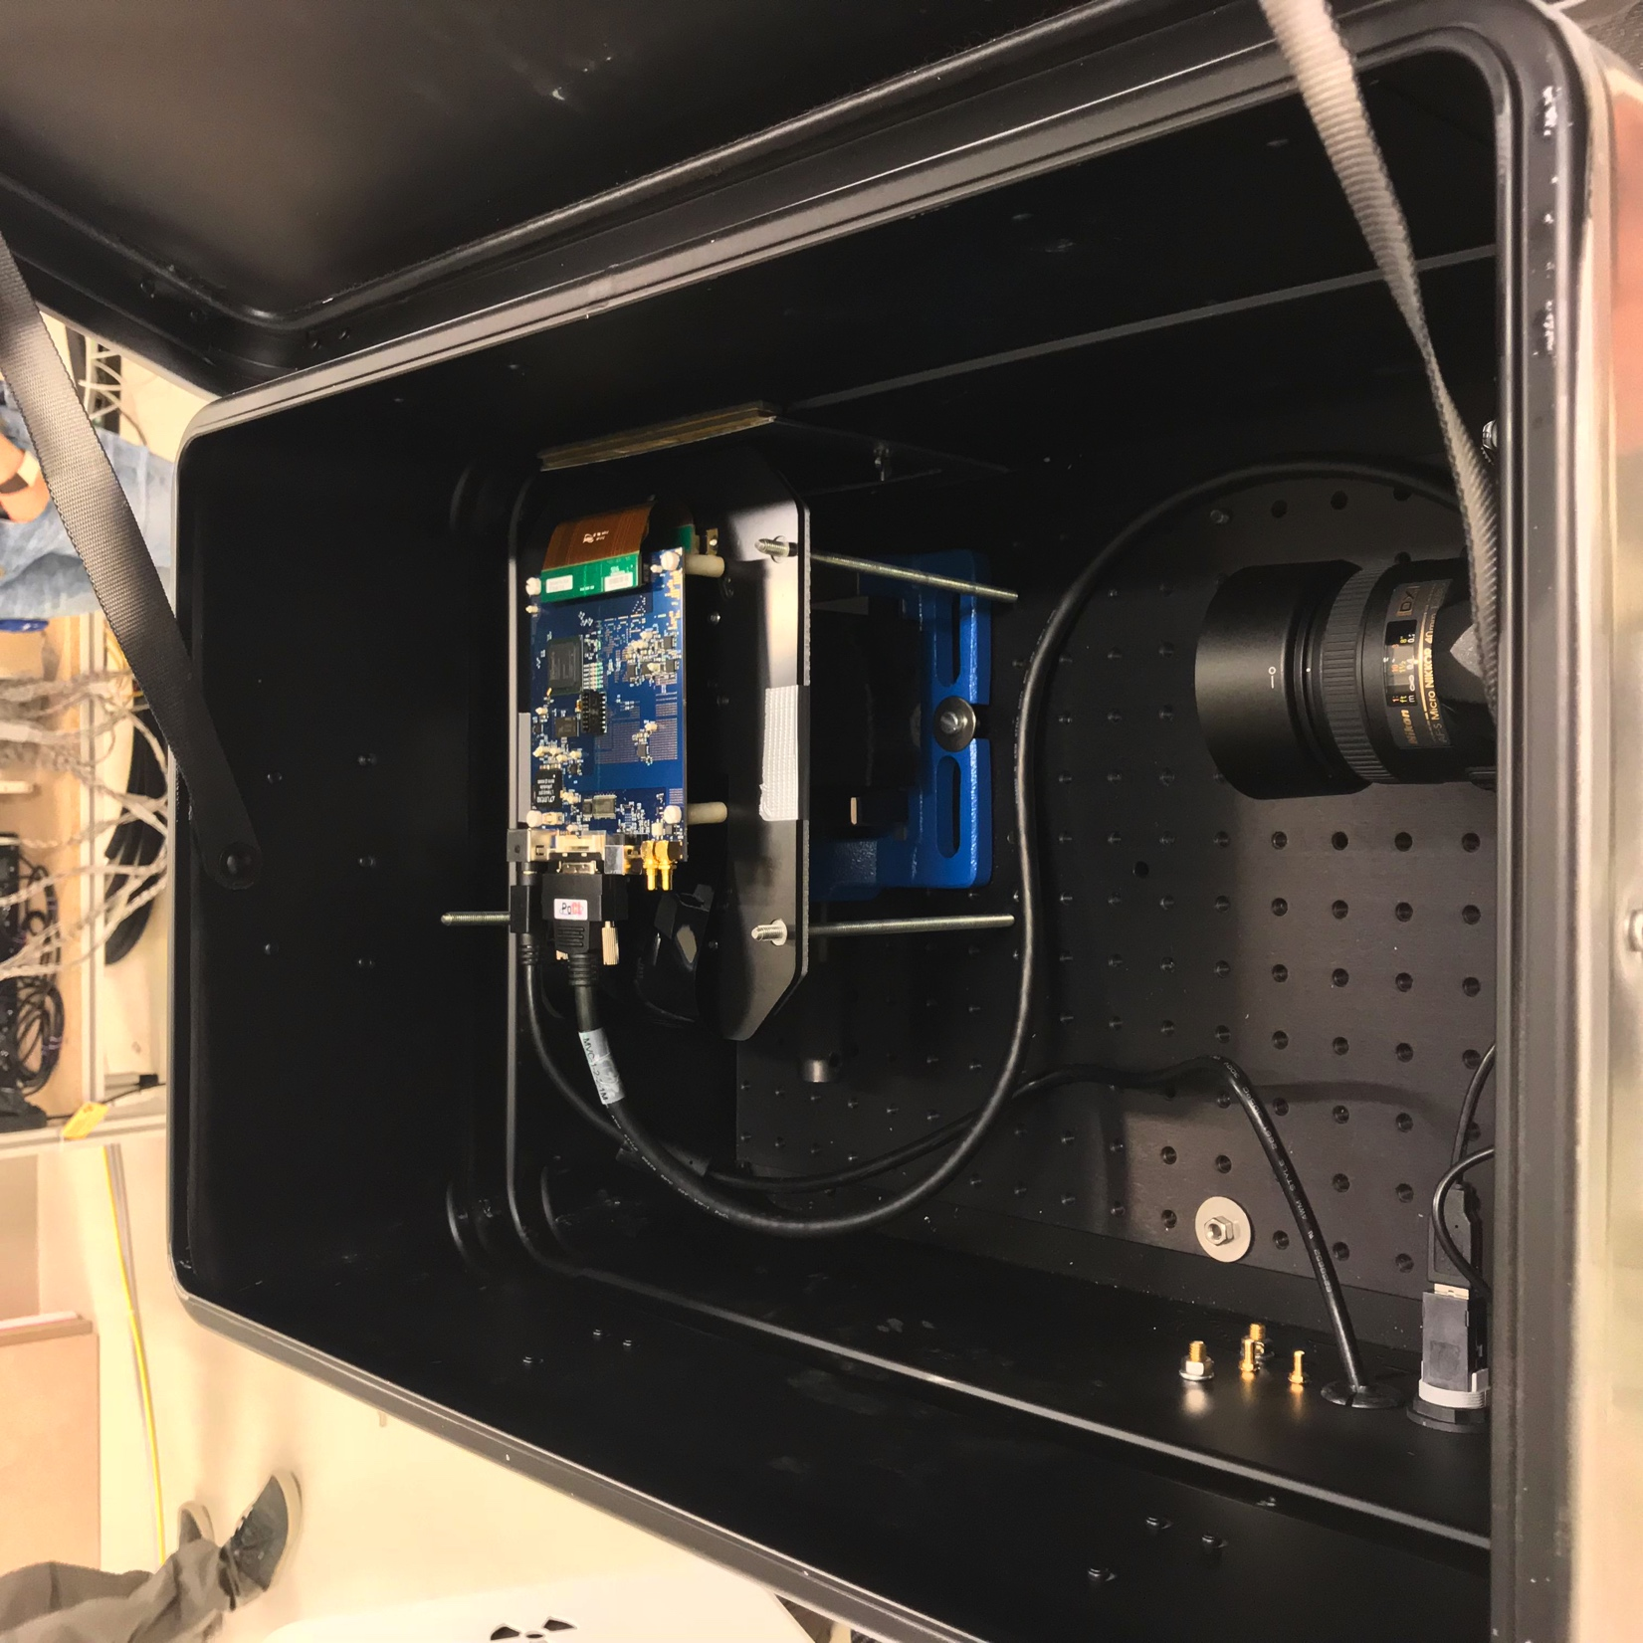
The QuARC
The Quality Assurance Range Calorimeter (QuARC) forms key part of QuADProBe.
Scintillator stack intercepts beam:
Light measured with photodiodes: upgrade from CMOS sensor.
Light output correlated with dose deposition: measure range.
STFC QuARC grant funded since Dec. 2020: already achieved excellent progress…
Patent recently granted.

Slide 7
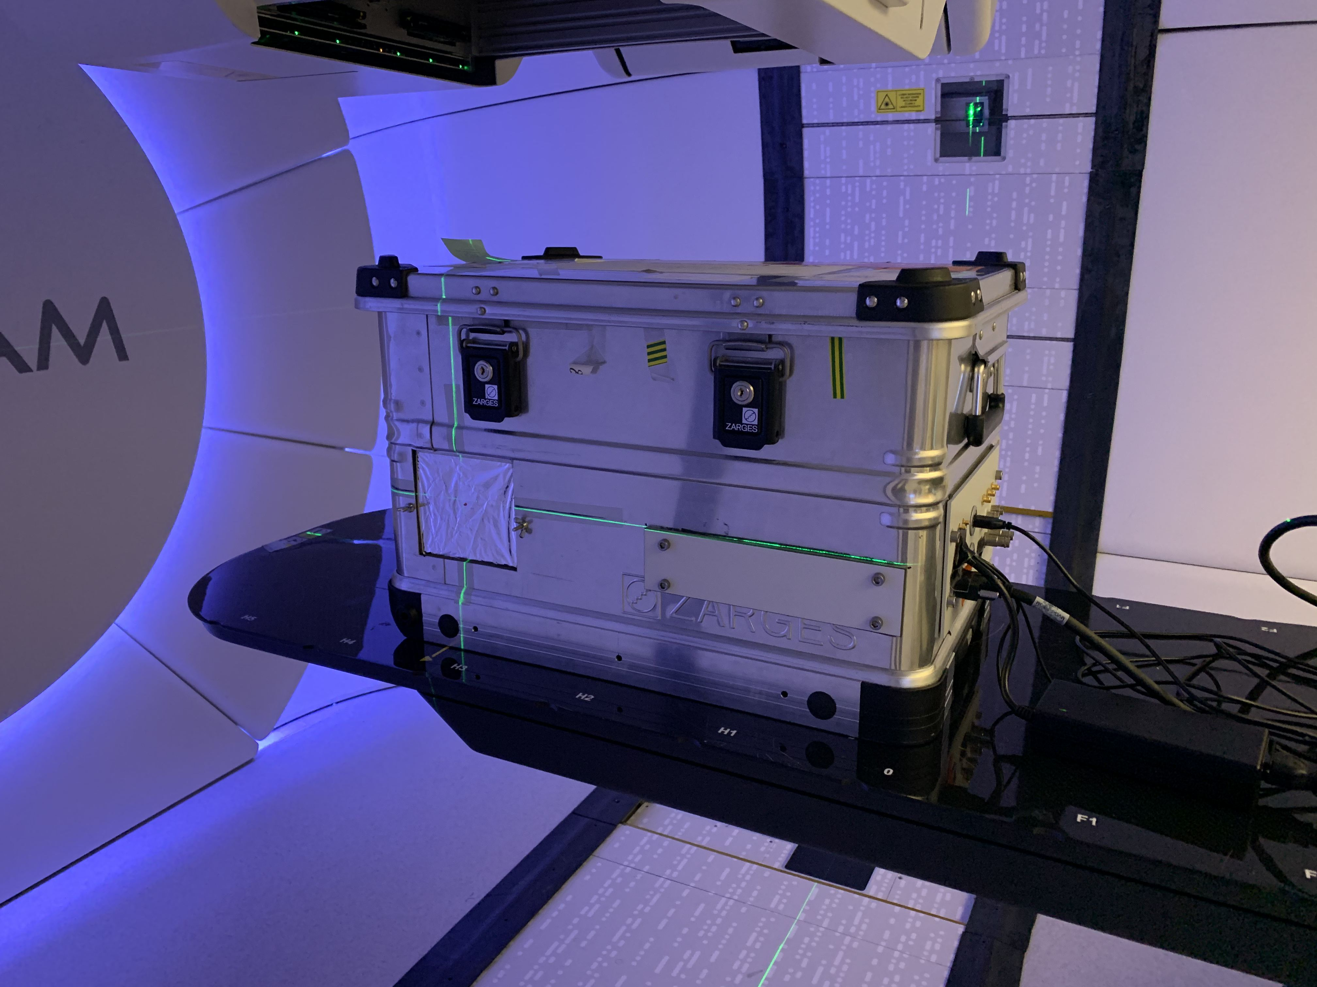
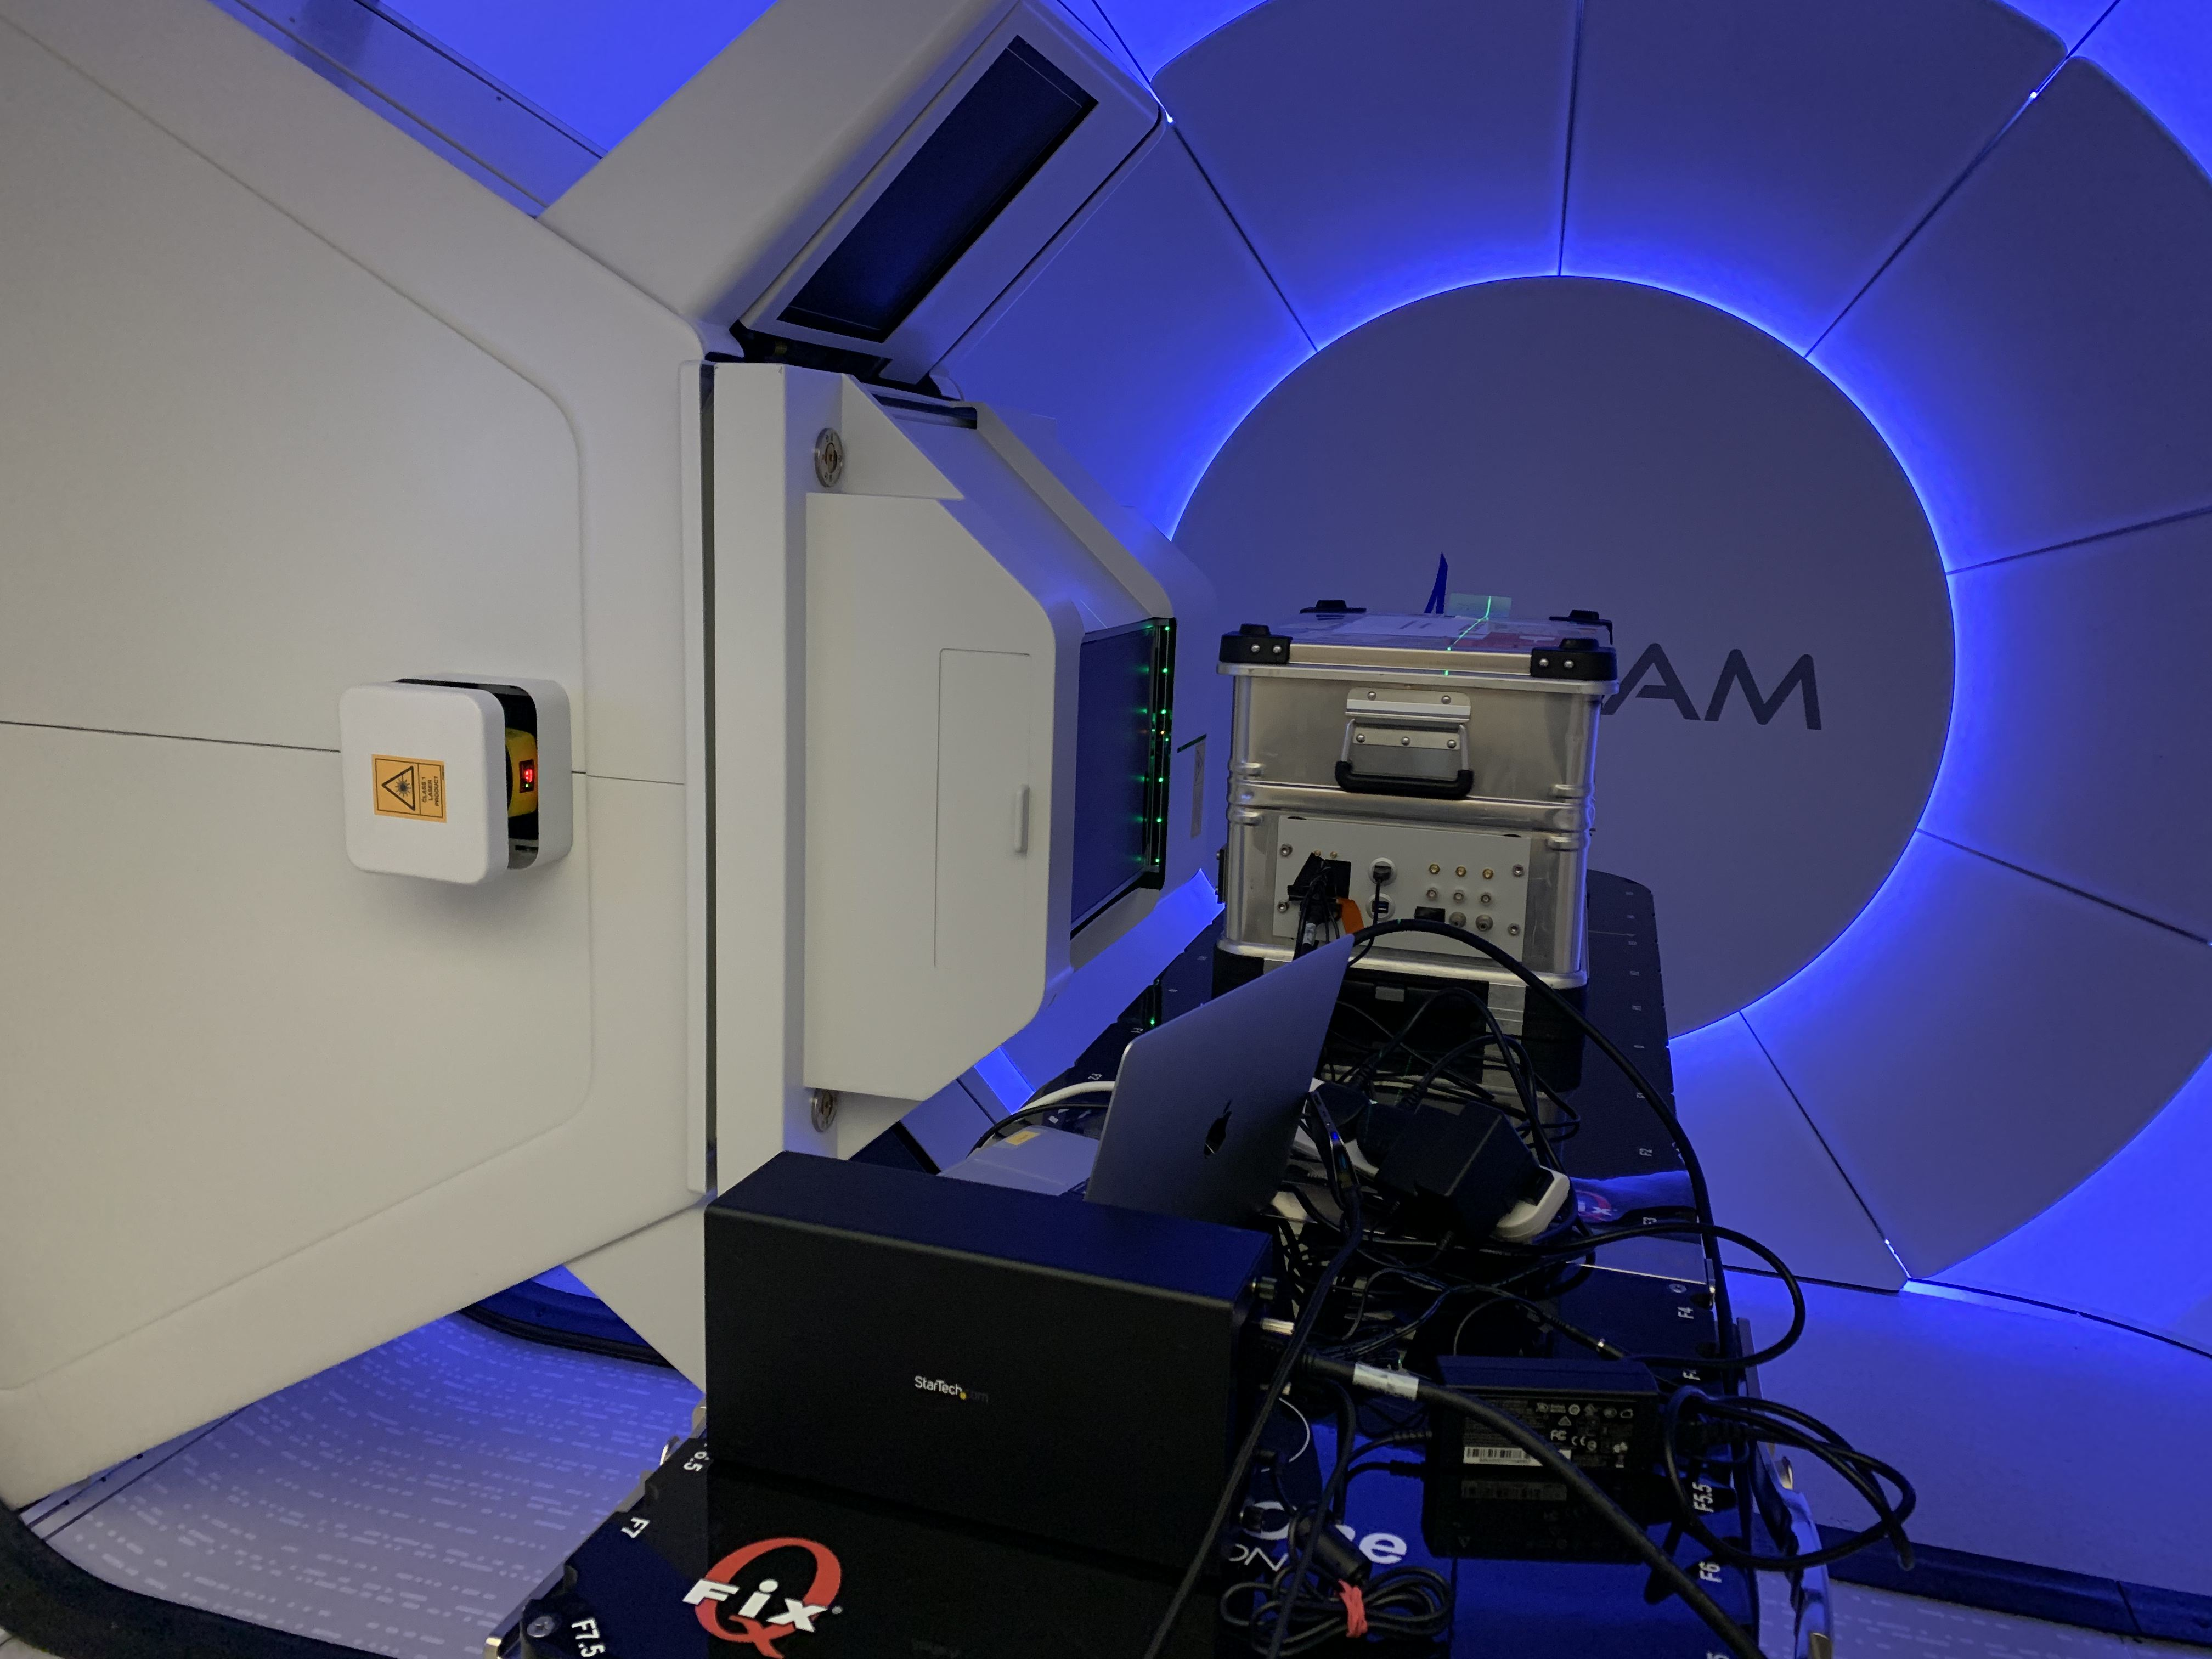
QuARC Clinical Measurements
Significant progress made since start of pandemic:
Switch to photodiode readout.
2 versions of photodiode ADC readout electronics (Cosylab).
FPGA interface with photodiode electronics.
Raspberry Pi back end detector controller.
Web-based GUI for device-independent measurements.
Range measurements were made in April using UCLH clinical beam.
First test of new DAQ chain.

Slide 8
QuARC Results
Excellent results achieved from April 2021 run despite excess noise and low light levels:
Front-end electronics improvements for rev.3.
Tests underway to improve scintillator light collection.
Web GUI gave live results as intended:
Possible to view raw and fitted output.
Live curve fitting at 50 Hz!

Slide 9
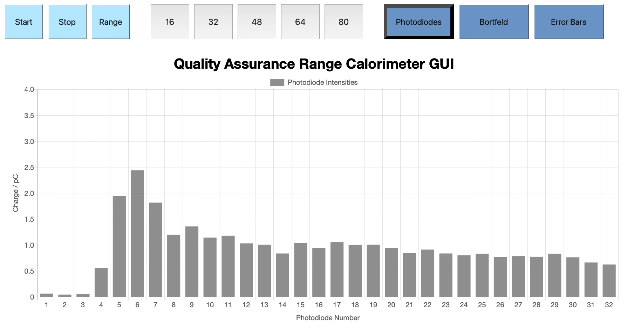
Web GUI: Raw Data

Slide 10
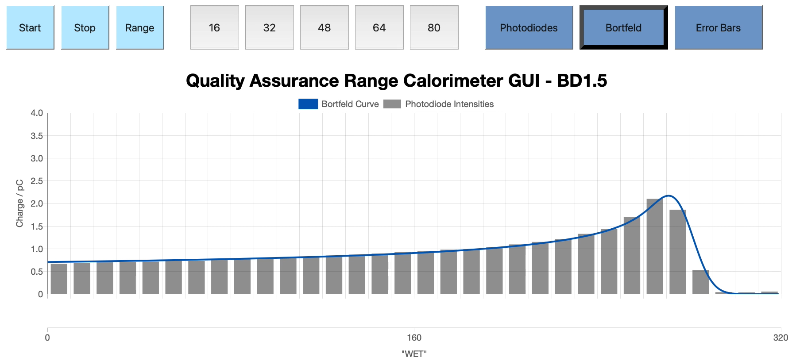
Web GUI: Quenched Fit

Slide 11
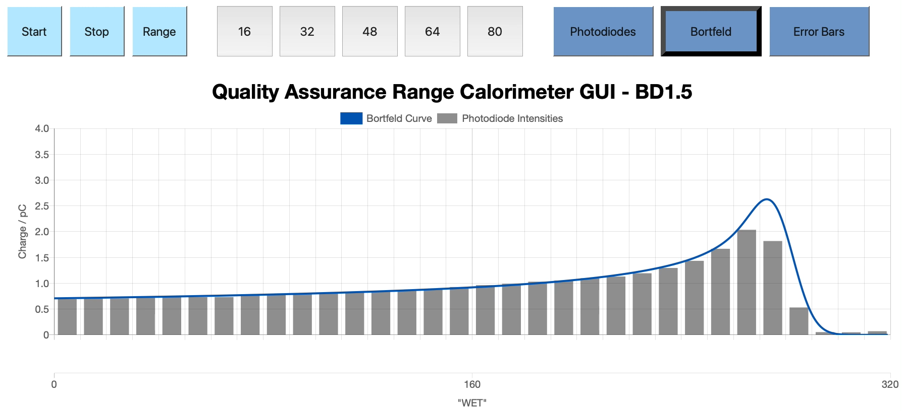
Web GUI: Bragg Curve Fit

Slide 12
Summary
Better QA allows better quality treatment for more patients.
QuADProBe detector will provide better, faster beam QA for clinical PBT systems:
Lighter, more robust detector at lower cost than existing systems.
Integrated solution.
Also FLASH capable!
Route to market through well-established relationships with commercial partners:
Cosylab.
Varian.
Interest already from clinical PBT centres.
Excellent progress already made on QuARC portion of detector despite limited manpower and funding.
Web-based software will provide device-independent control and readout for implementation in any clinical centre:
Possible to control through any web interface.
PC or tablet.

