Slide 1
Proton Beam Therapy
DEPARTMENT OF PHYSICS AND ASTRONOMY
HEP Christmas Group Meeting 2022
Sonia Escribano, Saad Shaikh, Raffaella Radogna, Fern Pannell, Ruben Saakyan, Derek Attree, Connor Godden, Simon Jolly

Slide 2
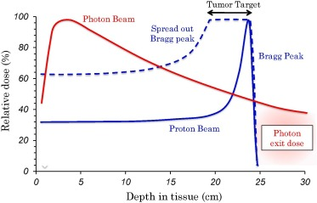
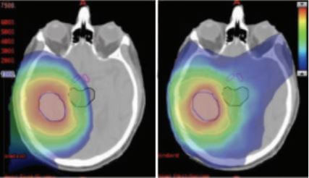
Proton beam therapy
Proton Beam Therapy (PBT) offers a highly localised depth-dose distribution, due to the well-defined range of protons in matter. Range uncertainties prevent taking full advantage of its benefits.

Slide 3
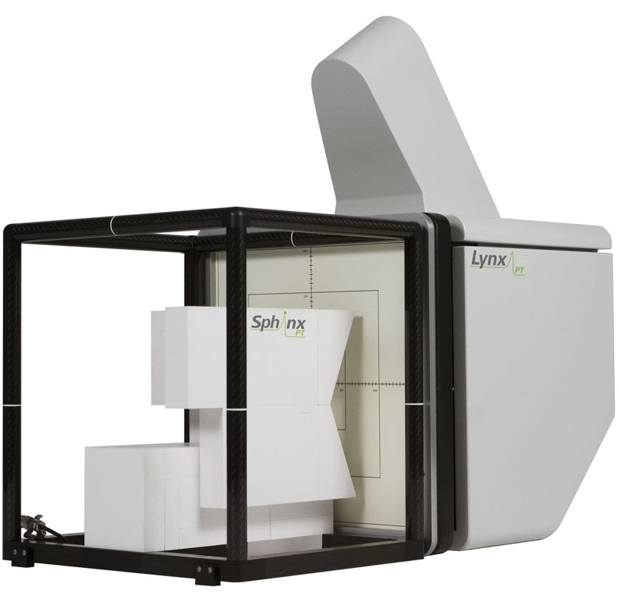
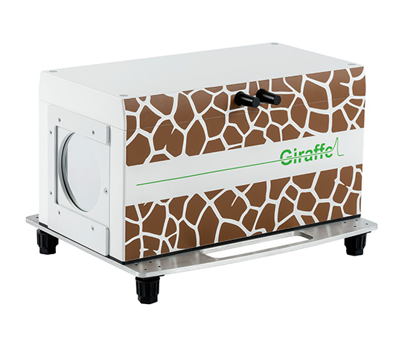
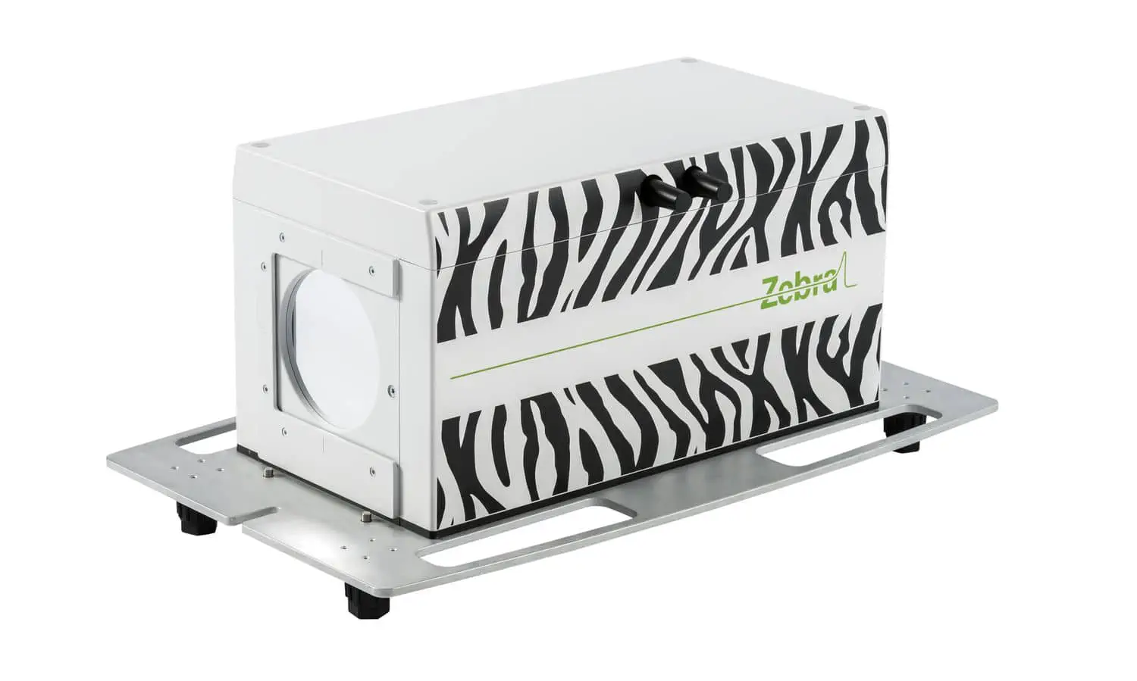
Daily Quality Assurance (QA)
To ensure accurate dose delivery in PBT, daily Quality Assurance (QA) measurements are required. These include beam range, absolute dose, spot position and size.

Slide 4
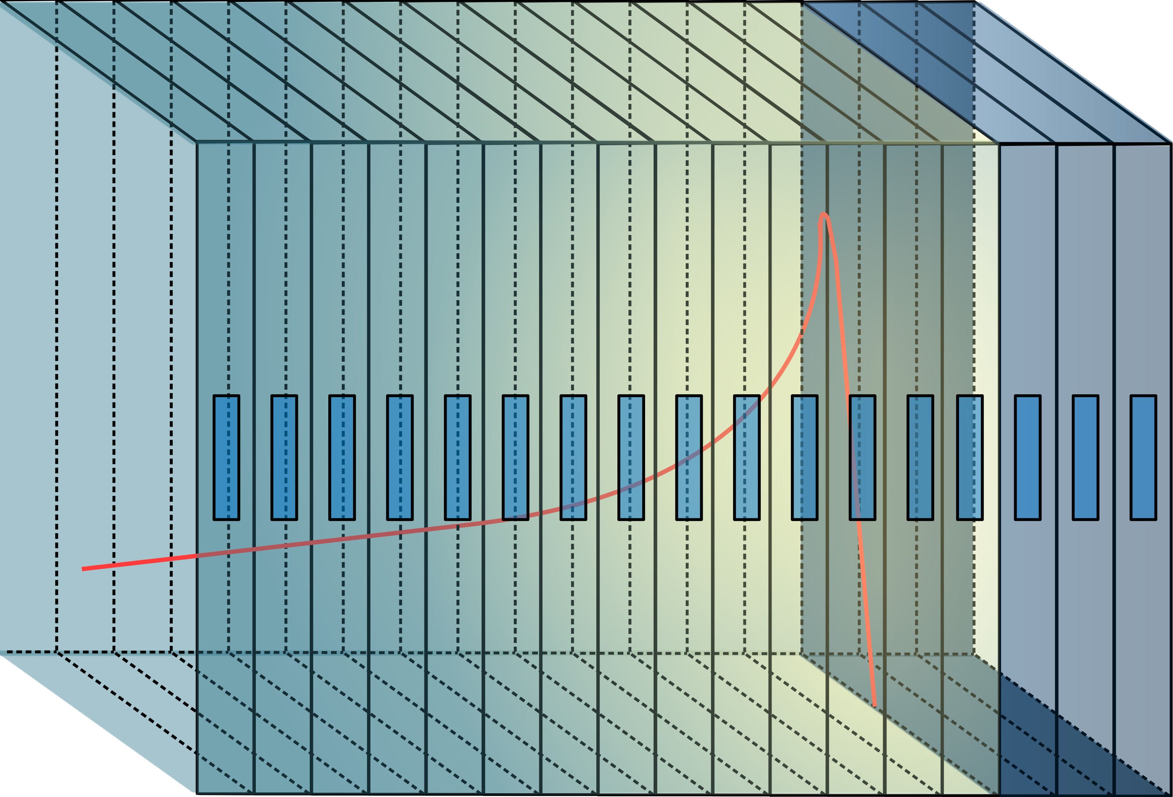
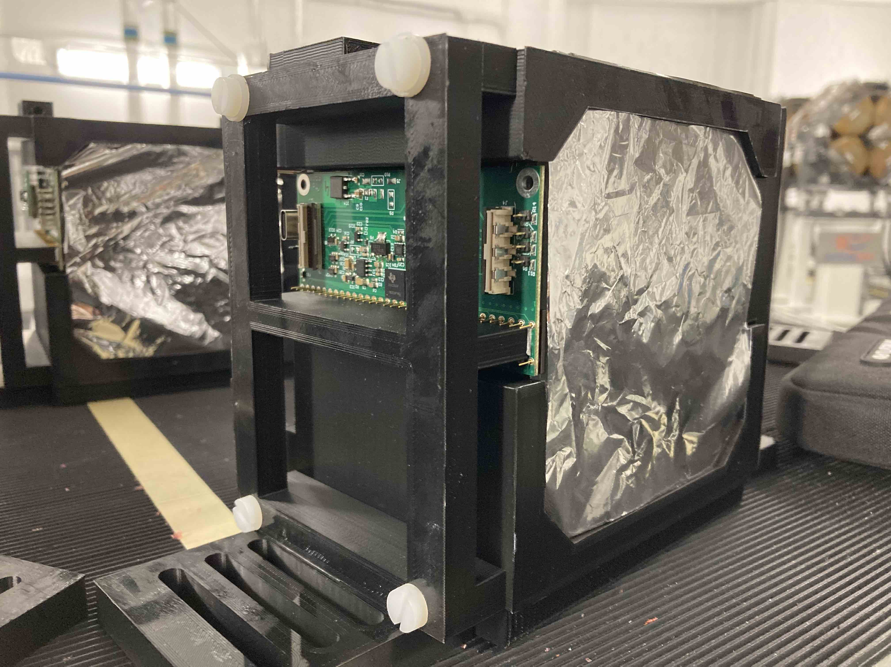
QuARC
Optically isolated polystyrene scintillator sheets of 105 mm x 105 mm x 3 mm.
Each sheet is coupled to a photodiode to measure light output. Photodiodes coupled to modular ADC converters, read-out by an FPGA.
Analytical model deployed to fit depth-light curve to reconstruct Bragg curve and recover proton range in real-time [1].

Slide 5
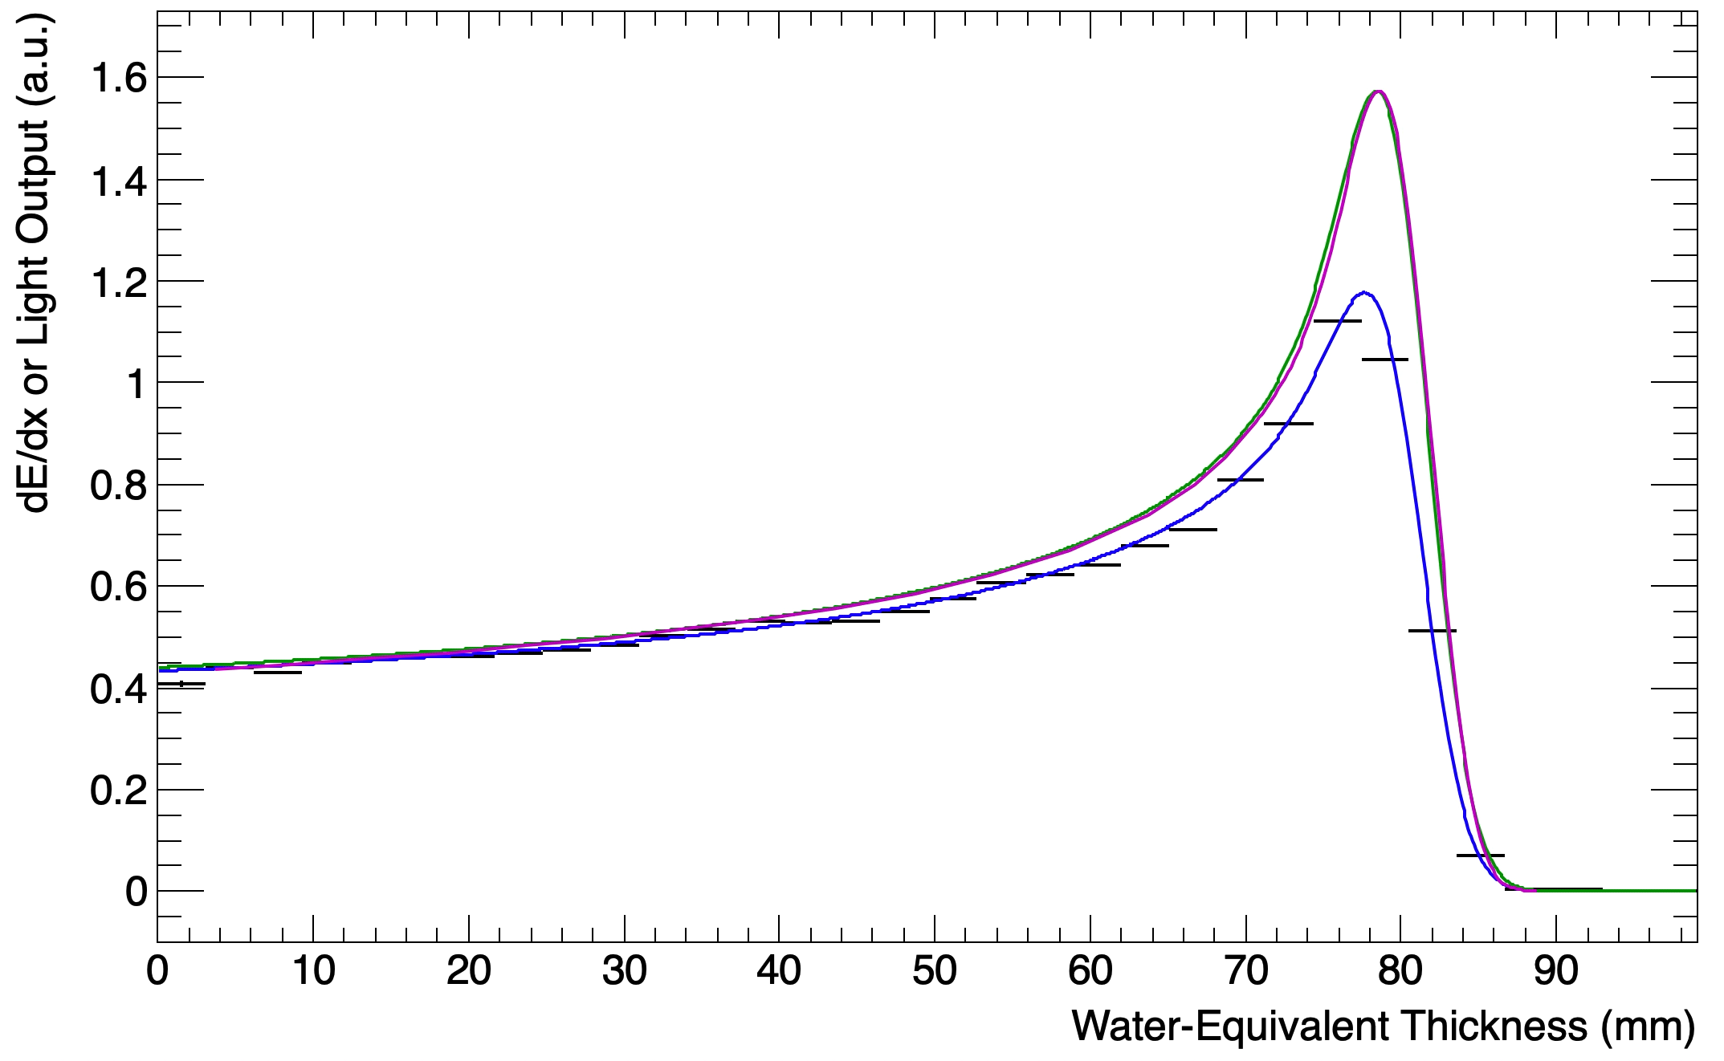
Previous results: UCLH September 22
130 MeV
Accurate to 0.1 mm in only 10 mins – including setup time
  Black: Sheet Average Light Output
  Blue: Fitted Quenched Depth-Light Curve
  Green: Reconstructed Depth-Dose Curve
  Magenta: UCLH Reference Dose Curve

Slide 6
What’s new?
New scintillator sheets: 4 production mechanisms.
New experiments at The Christie and PARTREC.
FLASH experiments: Early preclinical evidence suggests FLASH radiotherapy offers additional healthy tissue sparing effects with complete dose delivery in less than 100 ms. For FLASH proton therapy this corresponds to average currents of at least 600 nA to the patient, compared to current clinical standard of 1–10 nA [2].

Slide 7
Christie Beam Test: FLASH
Comparison of the integrated photodiode charge for clinical (18.8 nA) and FLASH (800 nA) currents for a 245 MeV proton beam. The normalised calibration ratio shows that the light output is within 1% of each other.

Slide 8
Christie Beam Test: Results

Slide 9
Christie Beam Test: Results

Slide 10
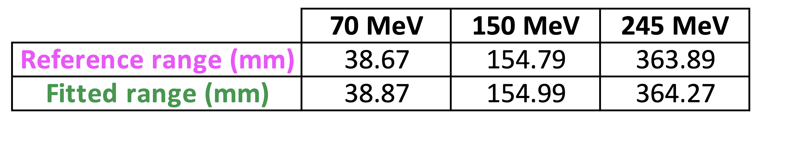
Christie Beam Test: Results

Slide 11
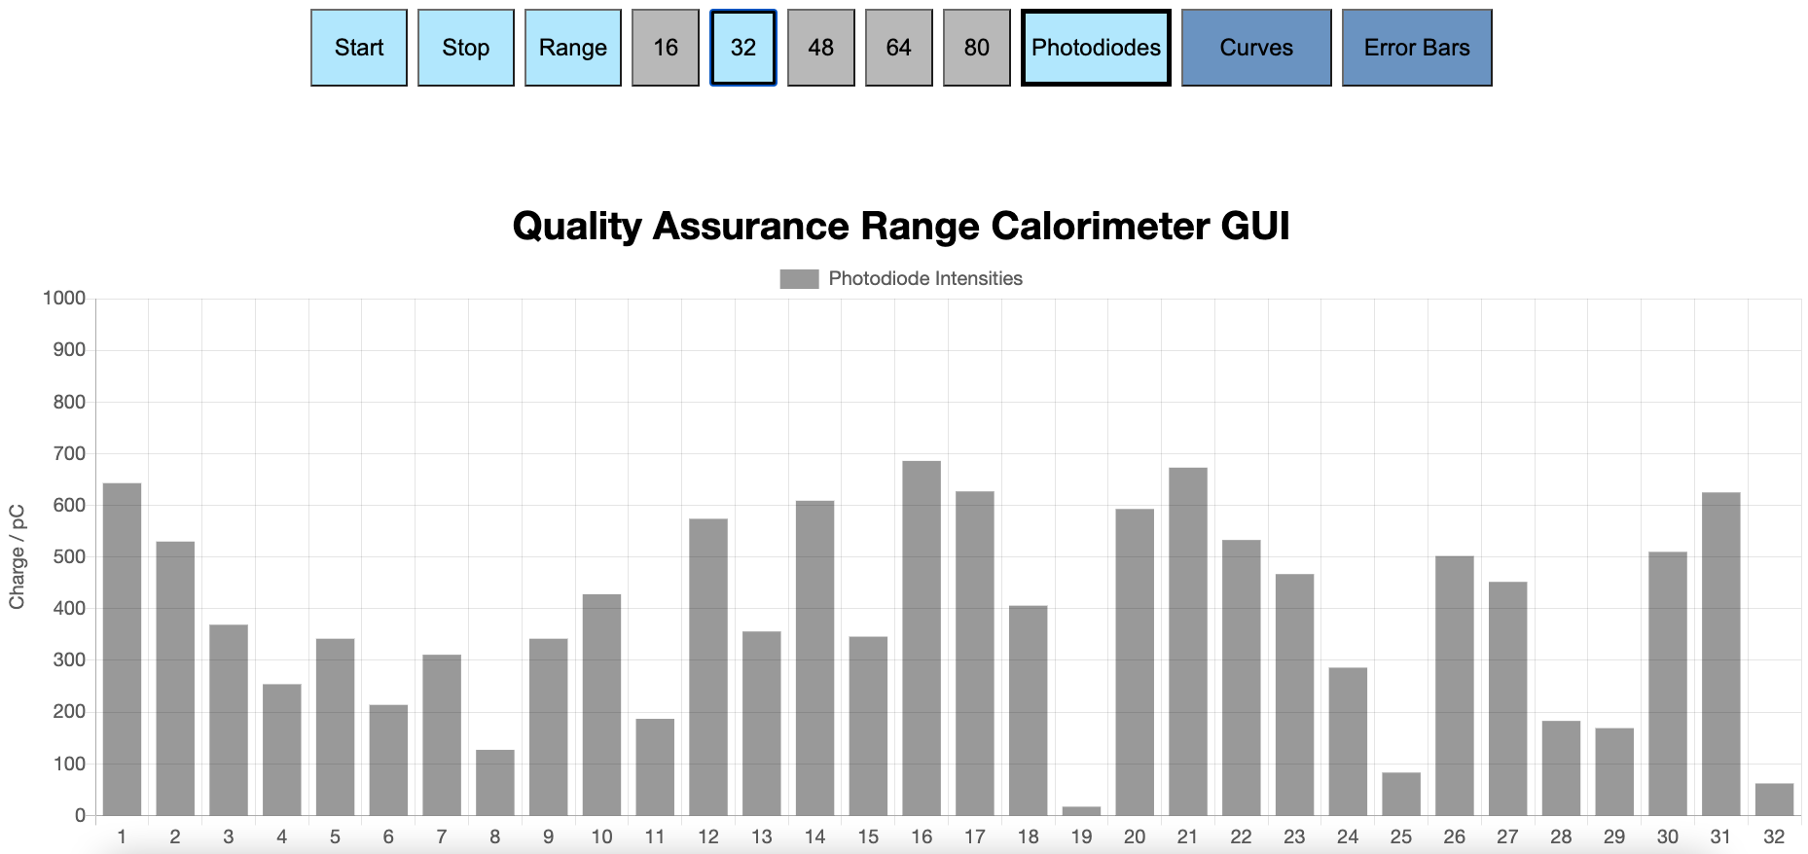
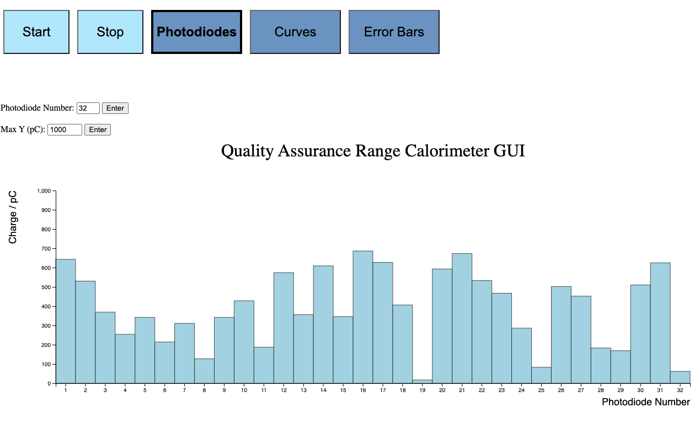
Web GUI
View live fit results in web GUI.
Detector control to be implemented in GUI.
DEVELOPED IN JAVASCRIPT BY FERN PANNELL

Slide 12
Future work
Further development of web-based GUI to allow data display and detector control without any specialised software on the user-end.
Improve scintillator composition and construction to optimise light output and stabilise cross-module calibration, further improving fit accuracy.
Deployment of fitting routines onto an FPGA to increase fitting speed.
Geant4 simulation to benchmark experimental results and constrain Birks’ constant.
Additional beam tests to further characterise detector performance with clinical and FLASH beams.

Slide 13
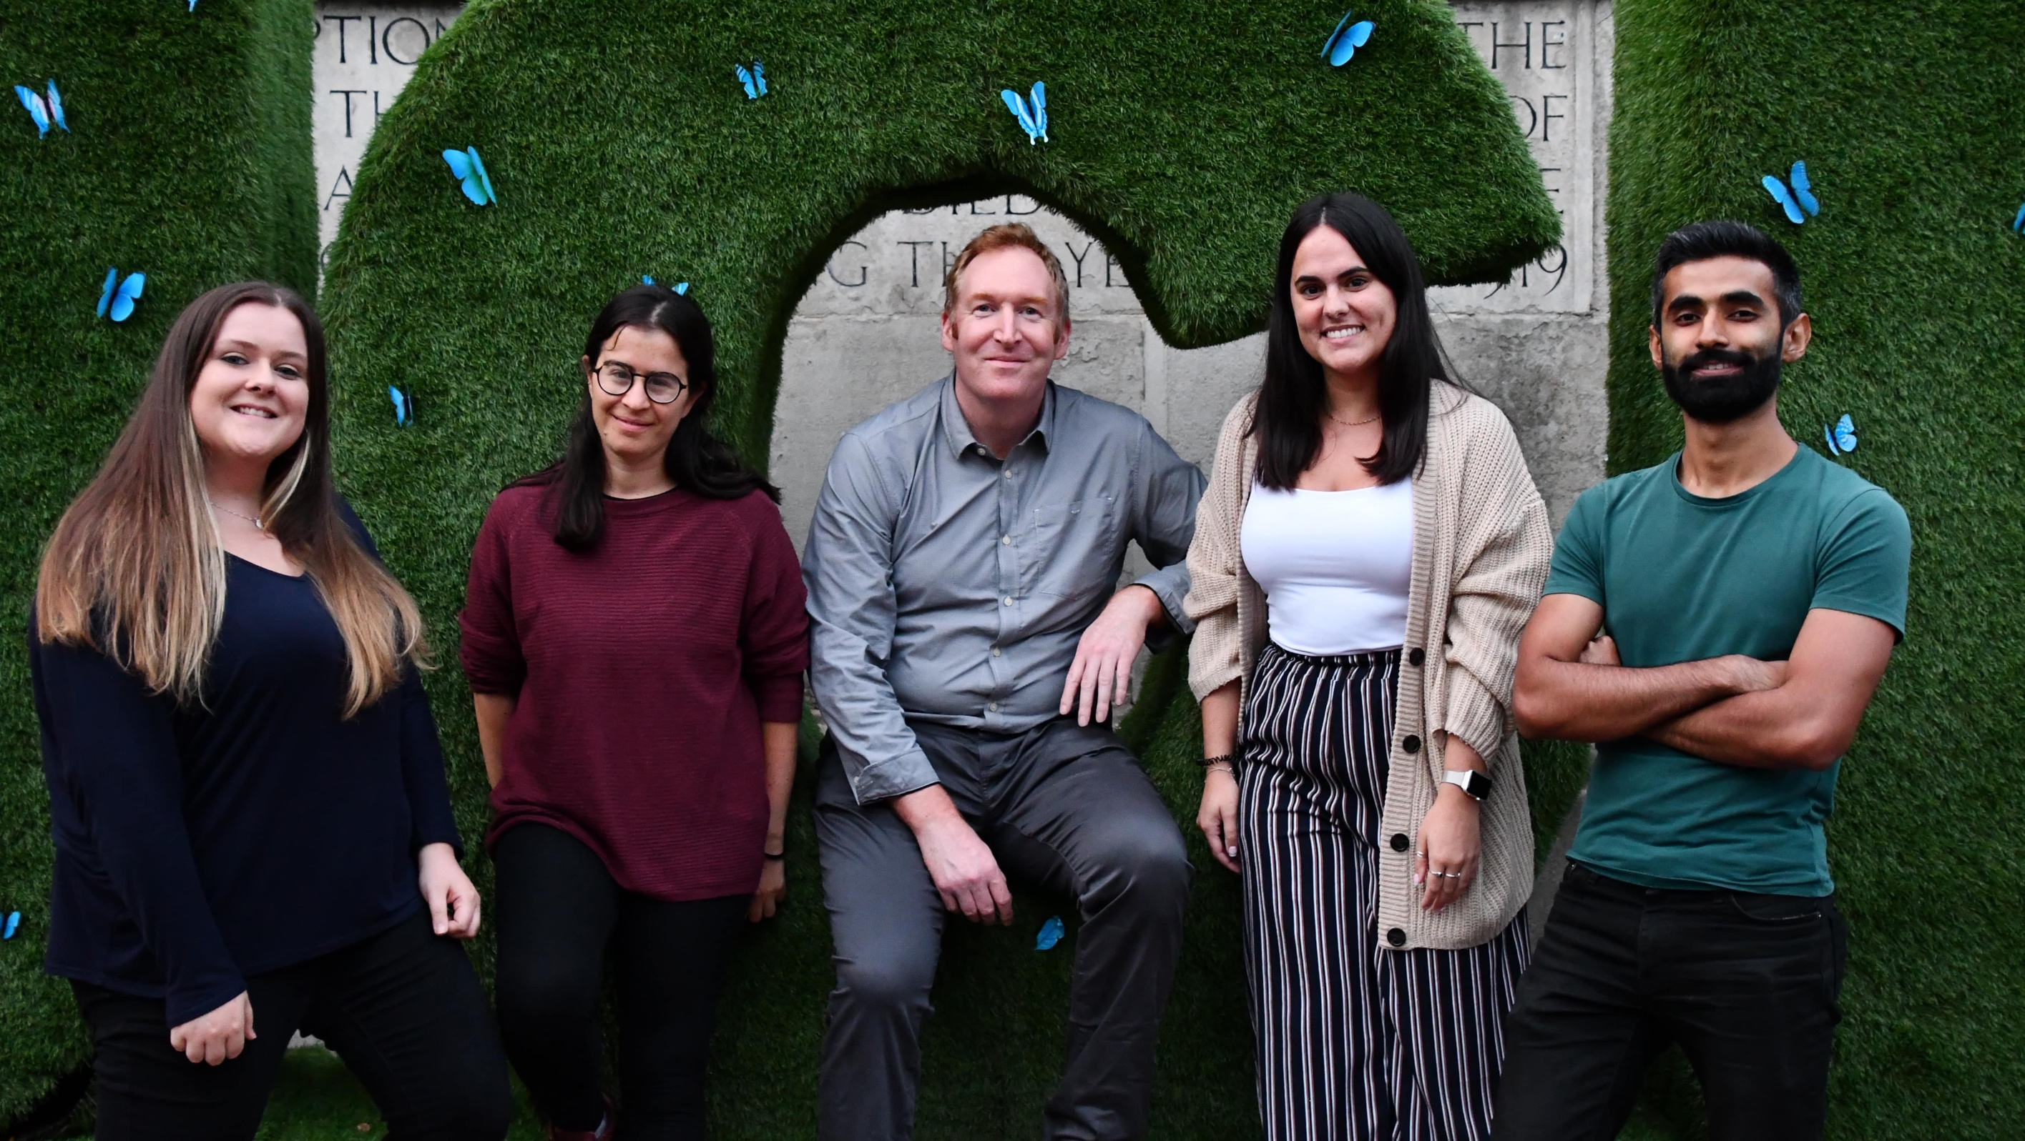

Thank you!
[1] L. Kelleter and S. Jolly. “A Mathematical Expression for Depth-Light Curves of Therapeutic Proton Beams in a Quenching Scintillator”. In: Medical Physics 47.5 (Feb. 2020), pp. 2300–2308. DOI: 10.1002/mp.14099
[2] S. Jolly et al. “Technical Challenges for FLASH Proton Therapy”. In Physica Medica 78 (2021). DOI: 10.1016/j.ejmp.2020.08.005

