Slide 1
The QuARC: A Quality Assurance Range Calorimeter for Proton Therapy
Simon Jolly, Saad Shaikh, Sonia Escribano, Raffaella Radogna, Fern Pannell, Connor Godden, Derek Attree
University College London

Slide 2
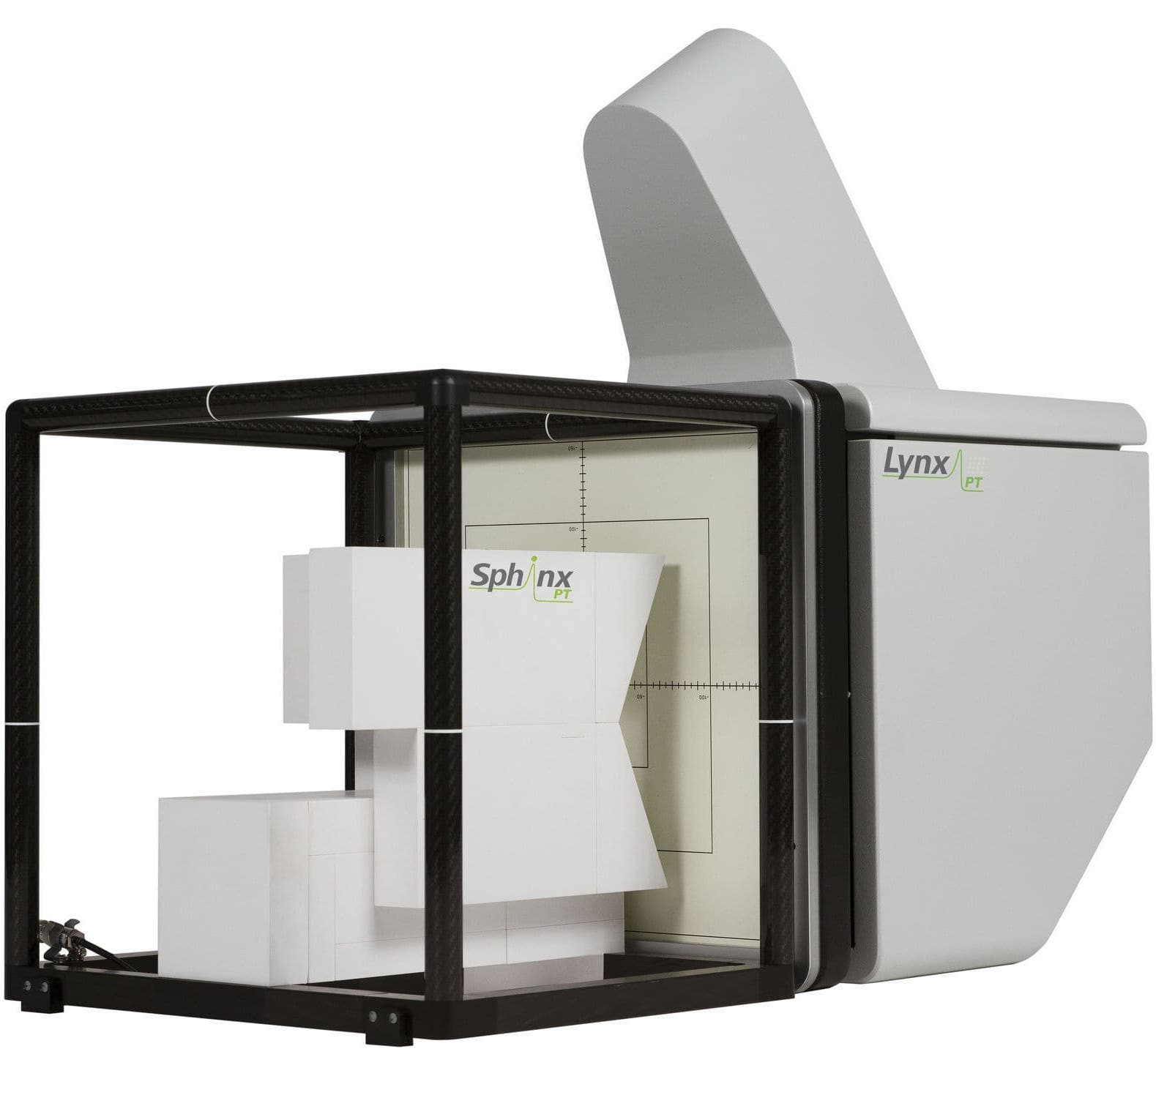
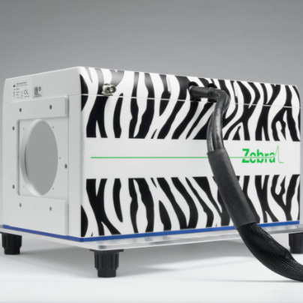
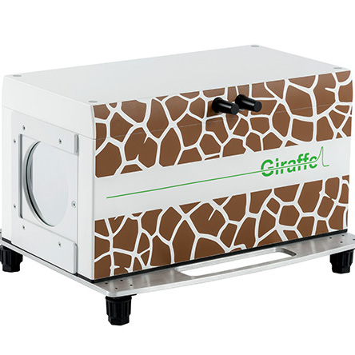
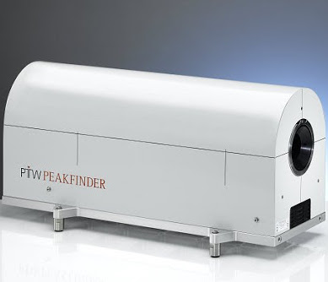
Range Quality Assurance: The Challenge
There are different approaches for measuring the range of protons in water for beam quality assurance:
  Slow
    Ionisation chamber in water tank/column (eg. PTW Peakfinder).
    Gold standard for measuring depth dose curve.
    If you want to use this for daily QA, good luck…
  Medium
    MLIC — Multi-Layer Ionisation Chamber (eg. IBA Zebra/Giraffe).
    Much faster depth-dose measurement than water tank.
    Not straightforward to set up and run; storage needs care.
    Beam passing through non-water equivalent material which is critical to measurement.
  Fast
    Measure spot size or dose after passing through known absorber (eg. IBA Lynx+Sphinx).
    Much quicker to set up; make measurement of many energies “simultaneously”.
    No actual measurement of range, just confirmation of previous measurement.
    Won’t see position-energy correlation.
We would like a detector that is:
  Able to make direct range measurements.
  Quick to set up: mountable to clinical nozzle.
  Robust: will survive a clinical environment.
  Easy to use: simple set up and interface.

Slide 3
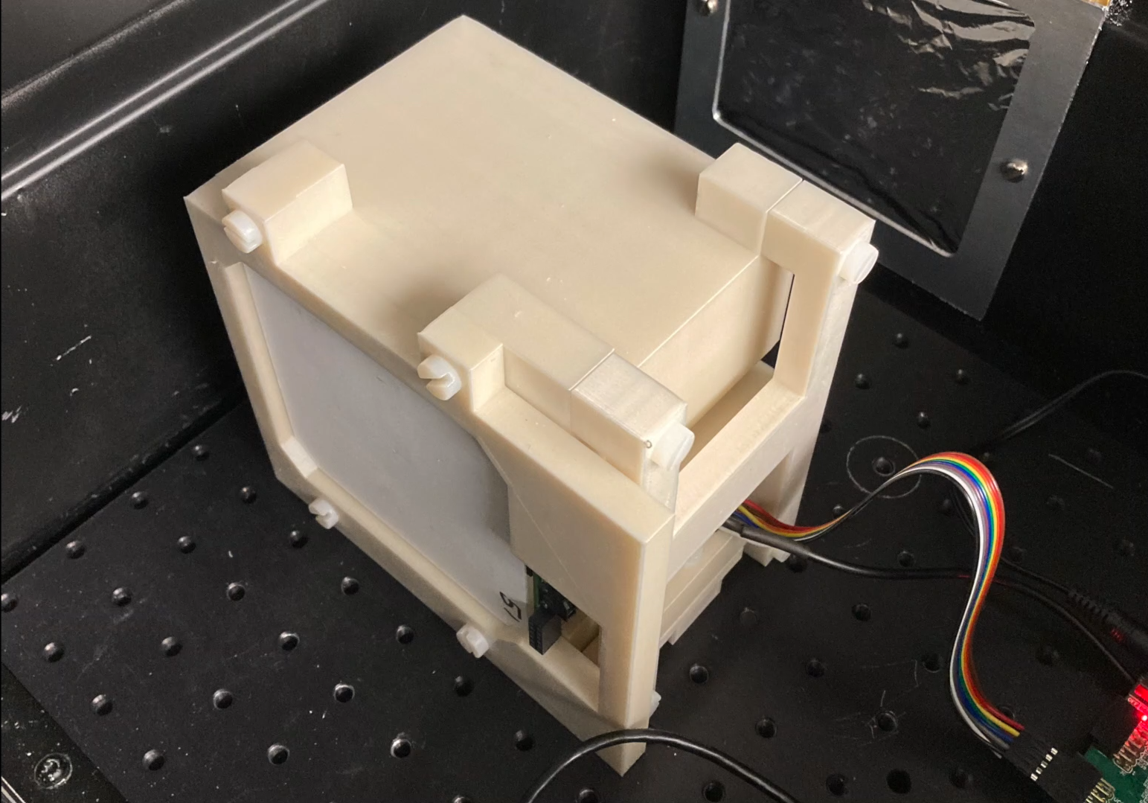
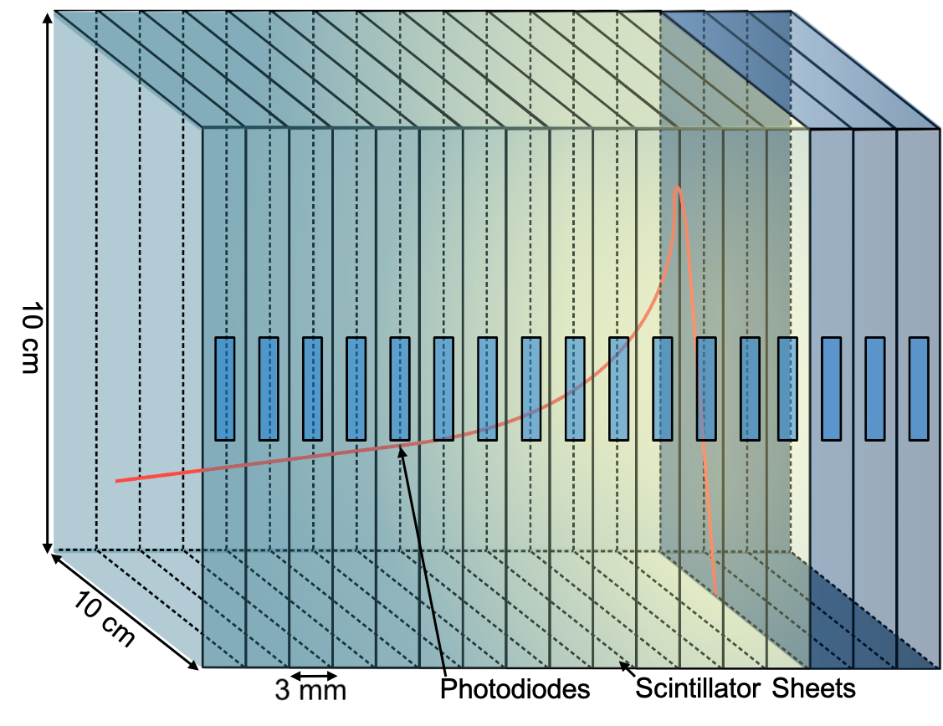
Enter the QuARC
The Quality Assurance Range Calorimeter (QuARC) constructed from plastic scintillator:
  Protons intercepted by a series of optically-isolated polystyrene scintillator sheets.
  Measure light output with photodiodes.
  Light output of each sheet nonlinear to dose, but quenching described by Birks’ Law:
    Fit data with analytical depth-light model.
    Reconstruct Bragg depth-dose curve and measure proton range.
  Photodiodes coupled to fast, modular electronics and an FPGA to read light levels at over 5 kHz.
  FPGA connects to on-board PC (Raspberry Pi) via USB.
  Connection to on-board PC via ethernet/WiFi.
Key benefits:
  Plastic scintillator inexpensive and water-equivalent.
  Range reconstructed with single beam delivery.
  Easy detector setup and no optical artefacts.

Slide 4
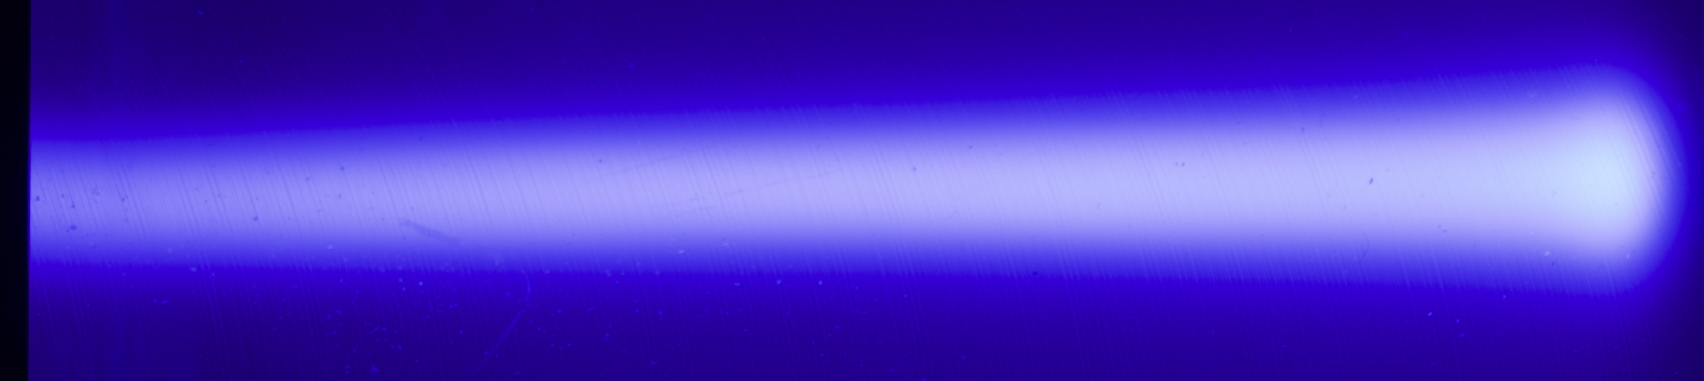
Why Not Just Use A Single Block??
It IS possible to measure the range with a single scintillator block. But…
Cameras are bulky and sensitive to radiation: photodiodes are not.
Fast range reconstruction impossible: need to import images with appropriate software and extract Bragg curve.
Optical effects mean transverse beam movement interpreted as changes in range.
Much smaller dynamic range with exposures of several seconds.
Nothing happens in real time…

Slide 5
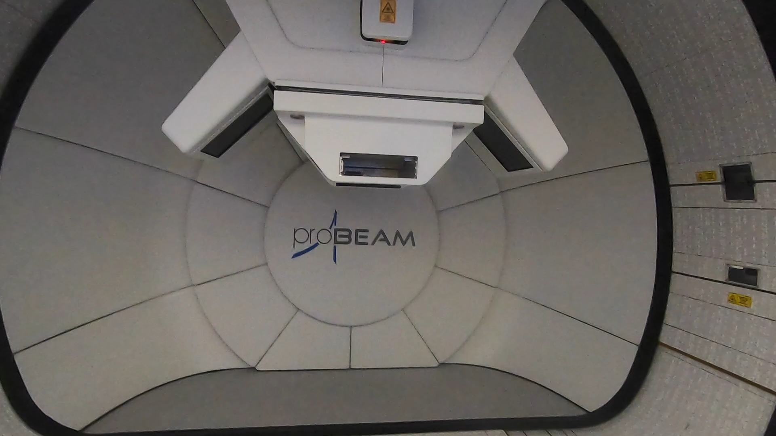
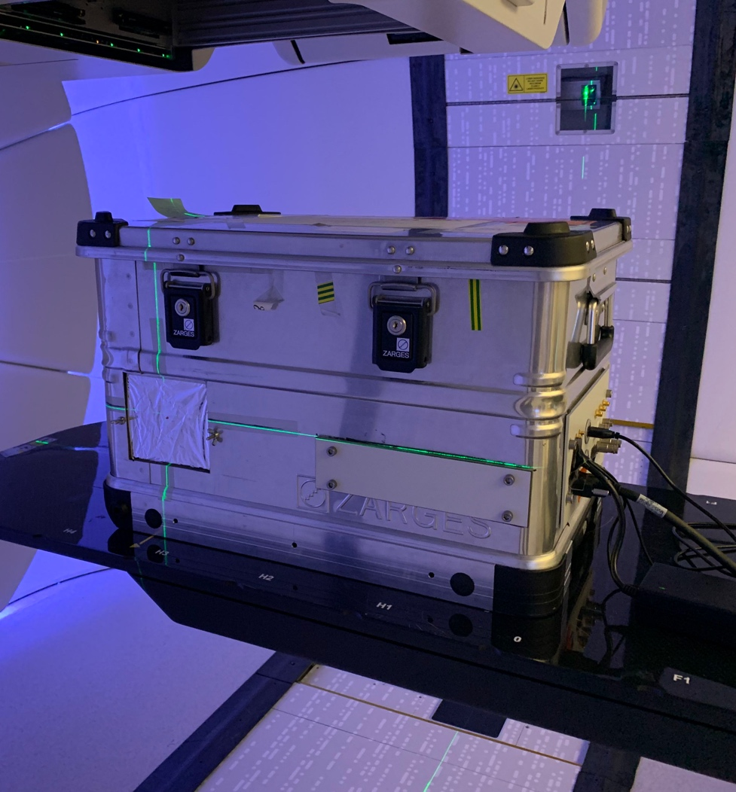
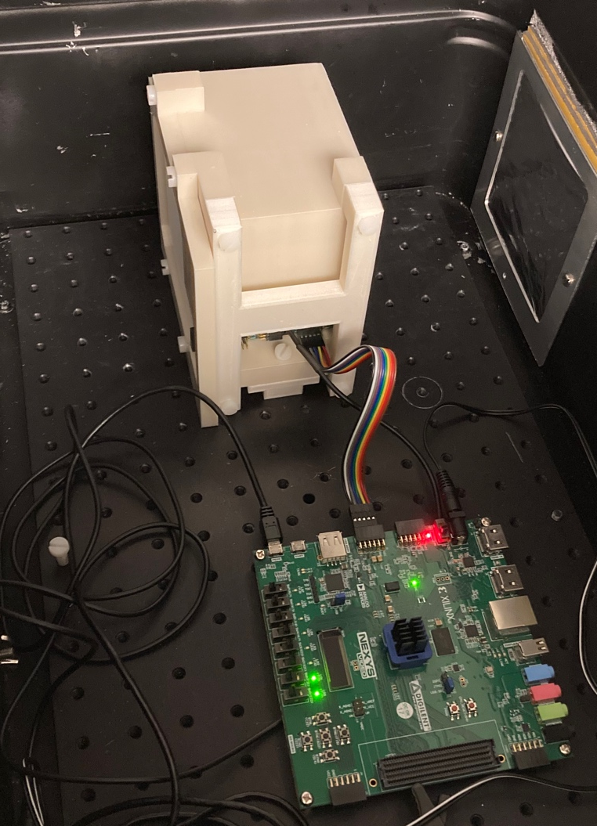
UCLH Beam Tests
Beam tests at UCLH 2021 and 2022 to evaluate photodiode performance with clinical beams.
Typically used one detector module (32 sheets, 96 mm total depth) to test pencil beam energies between 70–130 MeV.
Determine range reconstruction accuracy and demonstrate fast live range reconstruction capabilities.

Slide 6
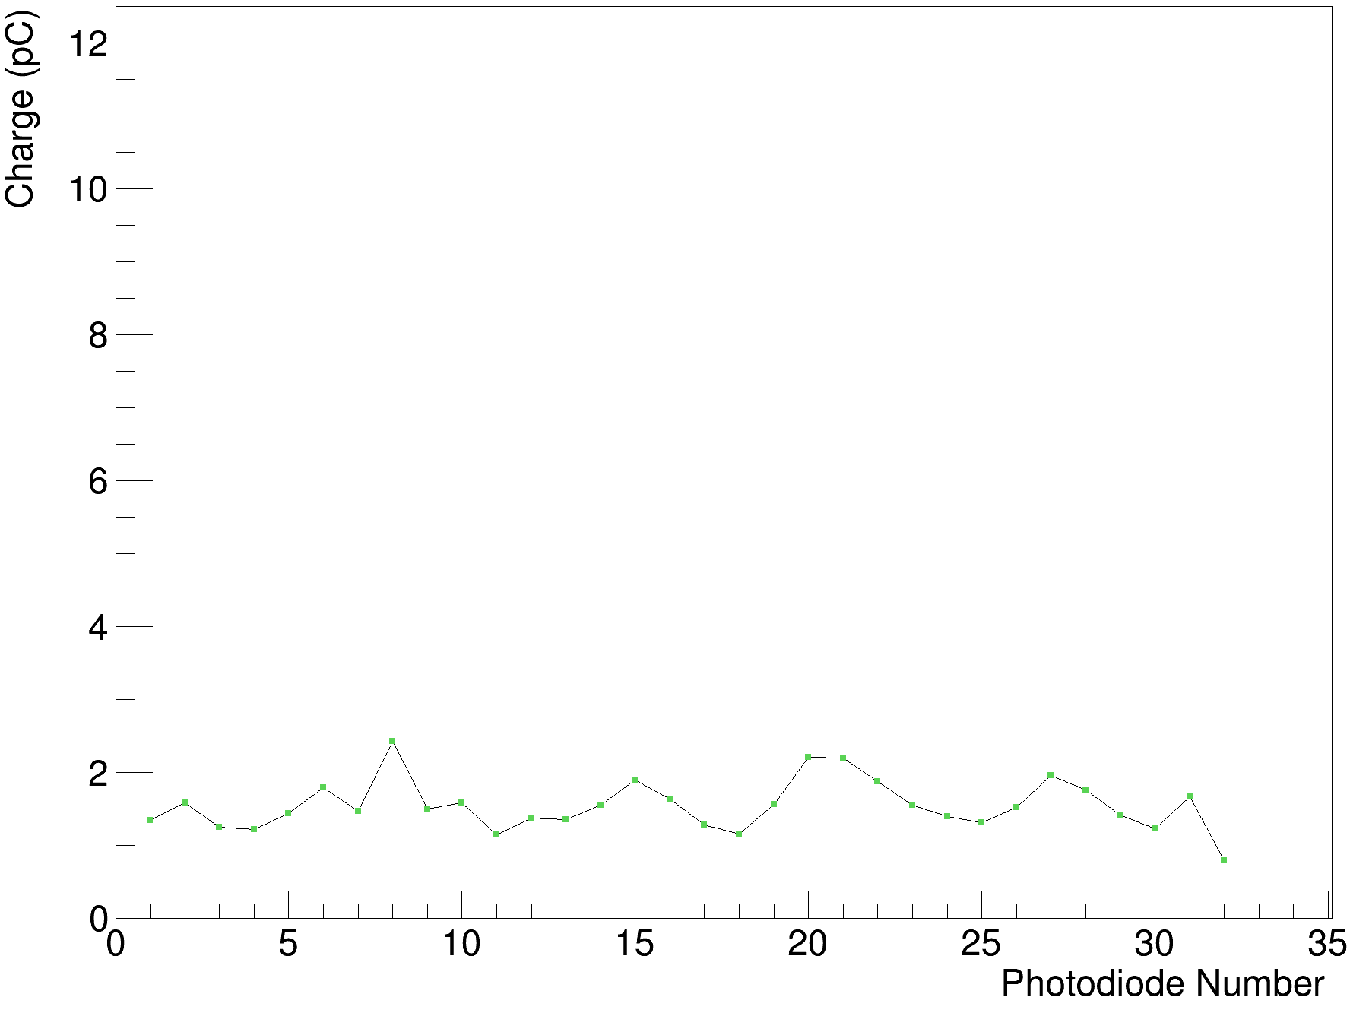
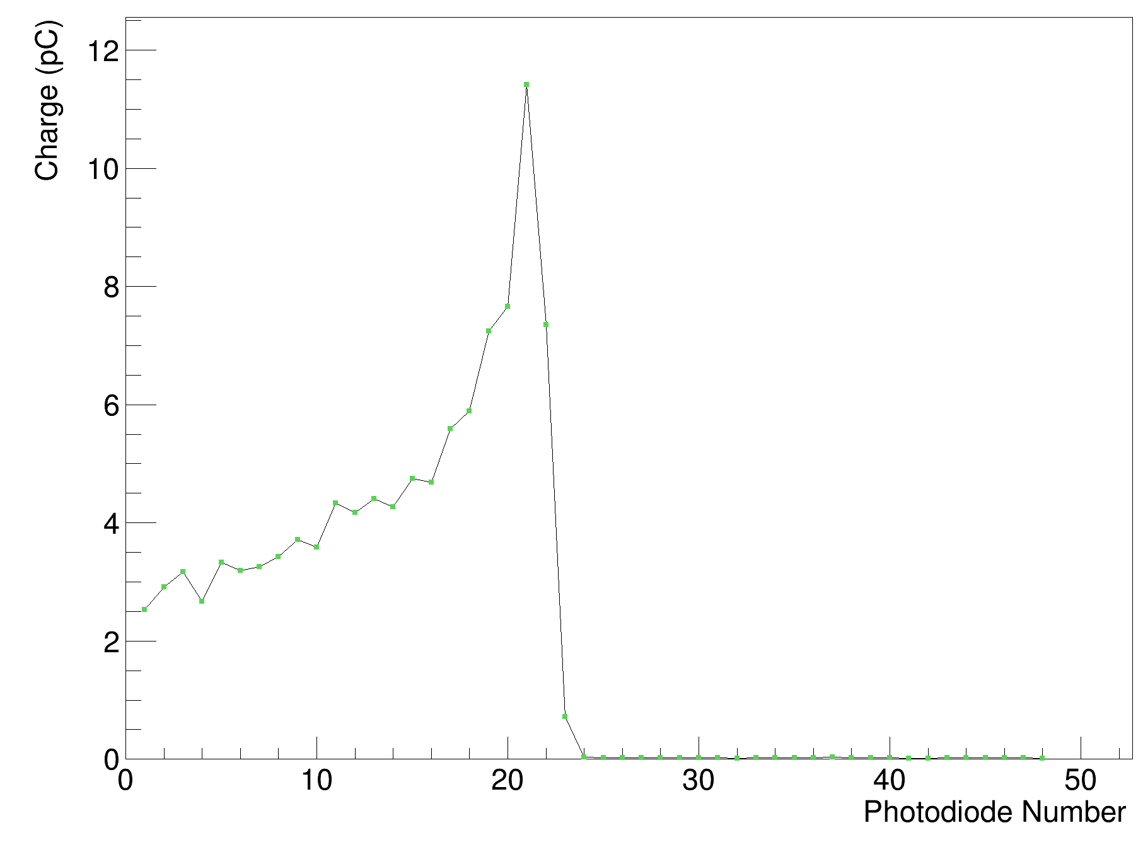
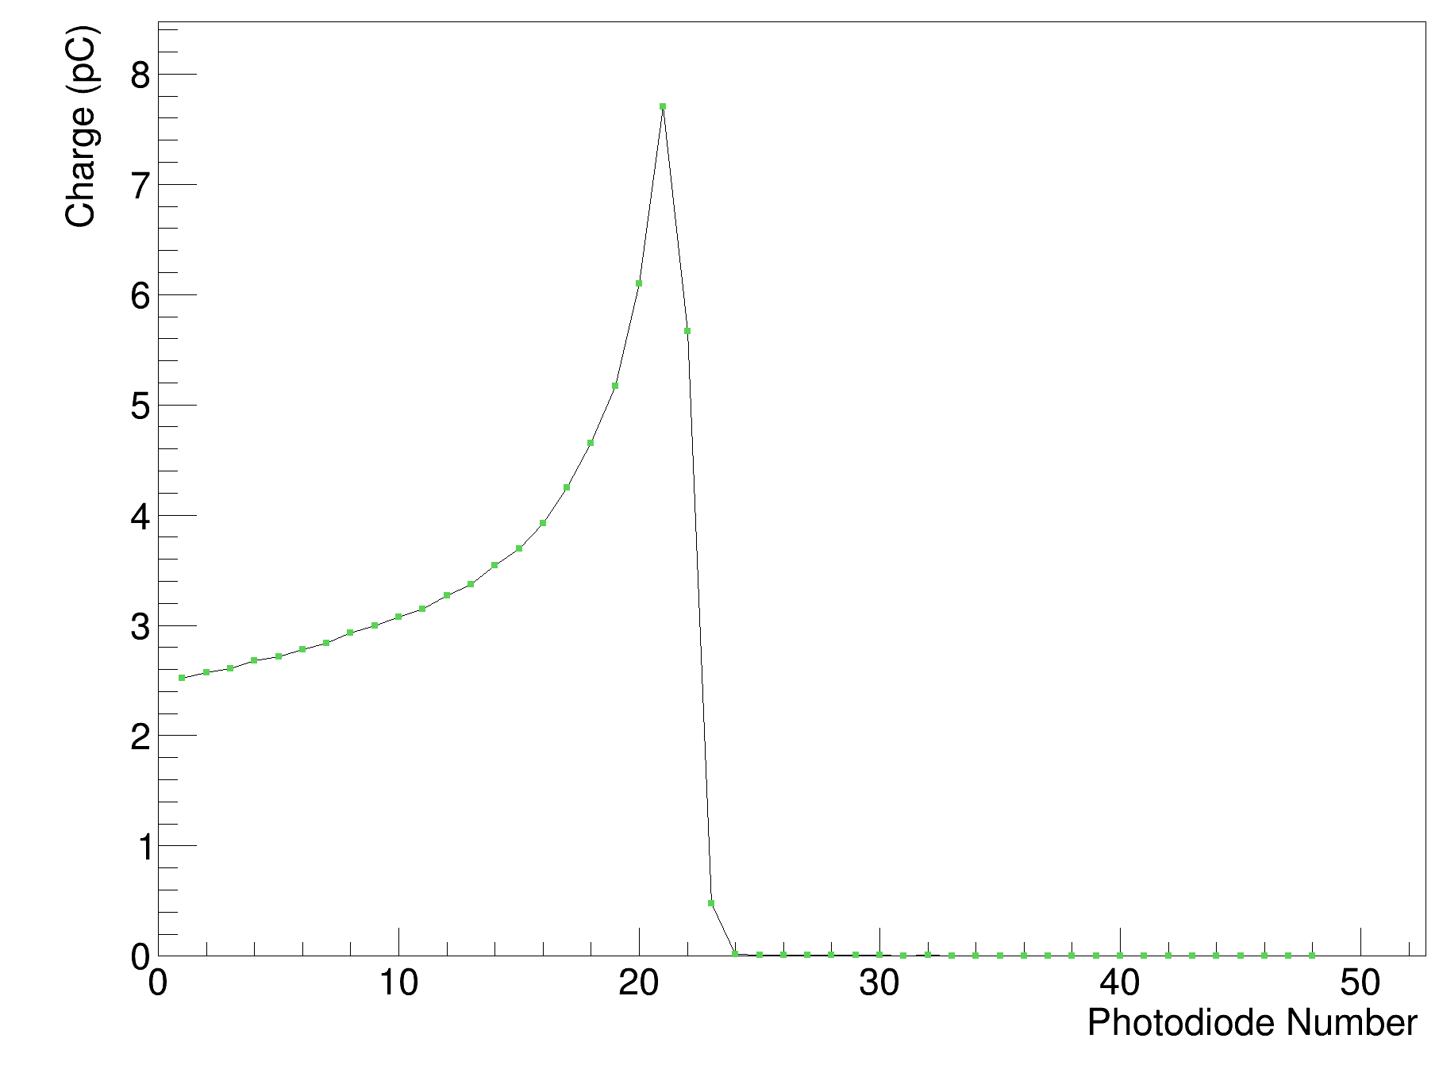
Calibration Process
Shoot through
Raw Data
Calibrated Data
Each scintillator layer has several variables:
  Light output of individual sheet.
  Coupling to photodiode.
  Response of photodiode.
Carry out “shoot-through” at >240 MeV for each module:
  Use ~50 mm WET upstream absorber: choose flattest part of Bragg curve.
  Shoot beam through in both directions: take out variations along curve.
Divide subsequent data measurements by this shoot through for calibrated output.

Slide 7
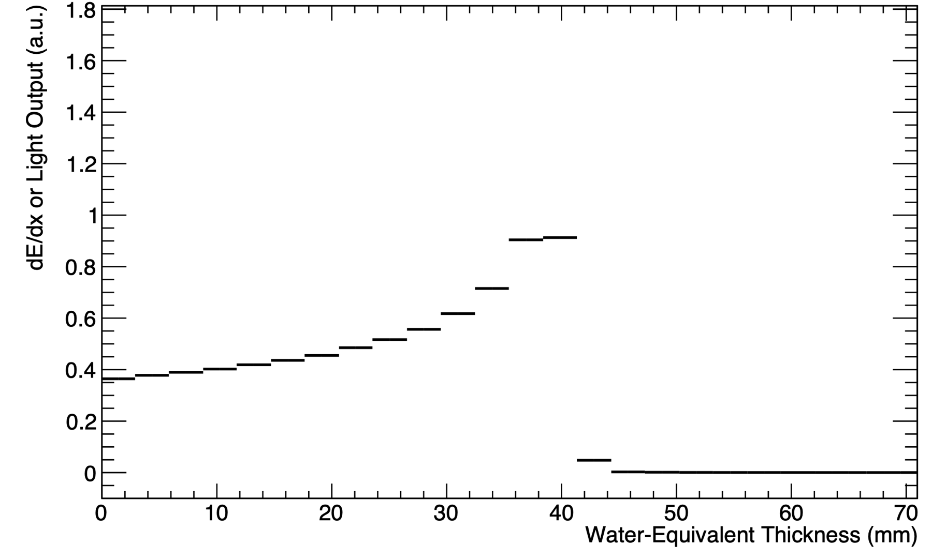
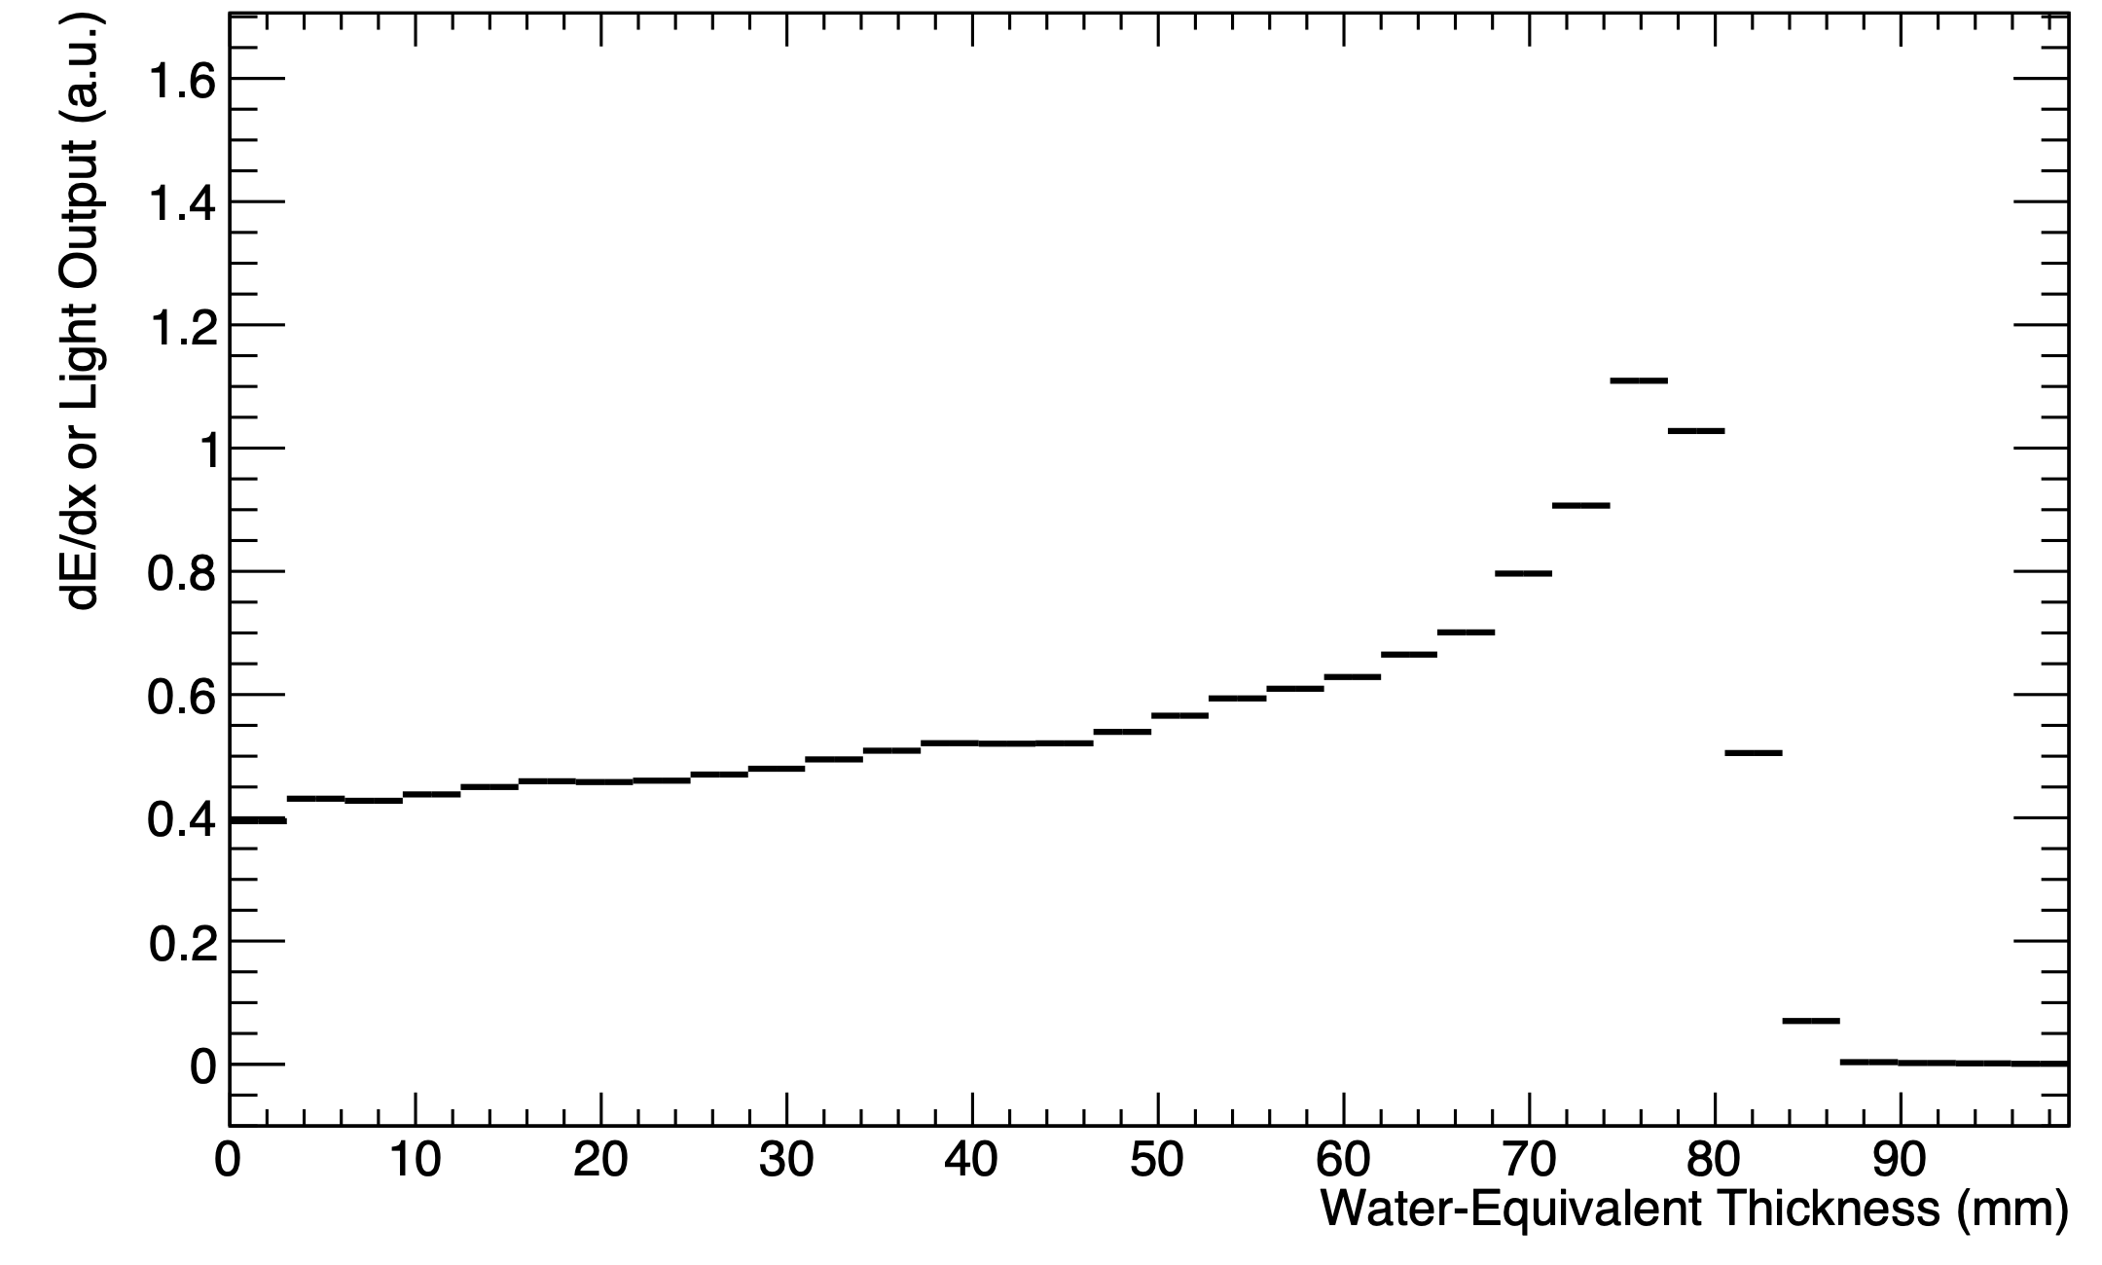
UCLH Beam Test Results
Legend:
  Black: Sheet Average Light Output
70 MeV
16/06/22
UNPUBLISHED DATA – DO NOT COPY OR DISTRIBUTE
130 MeV
01/09/22

Slide 8
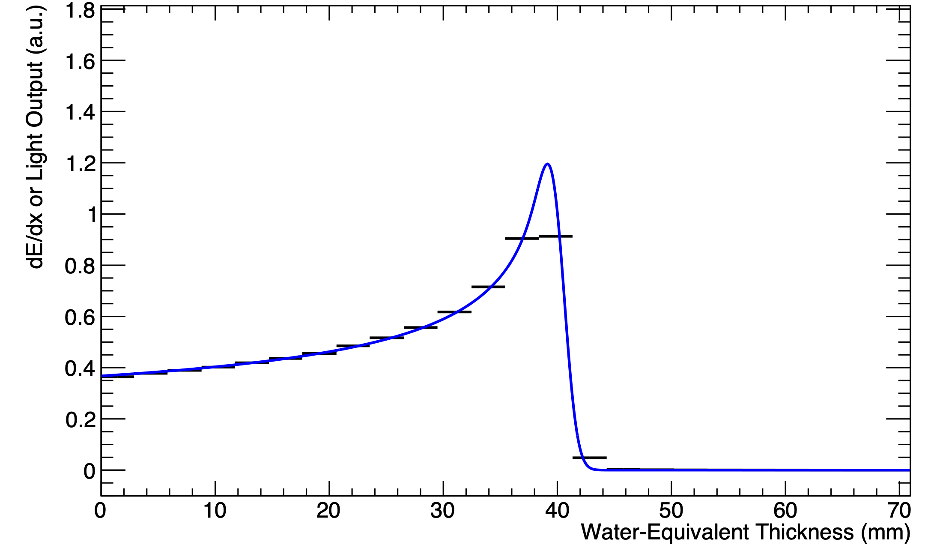
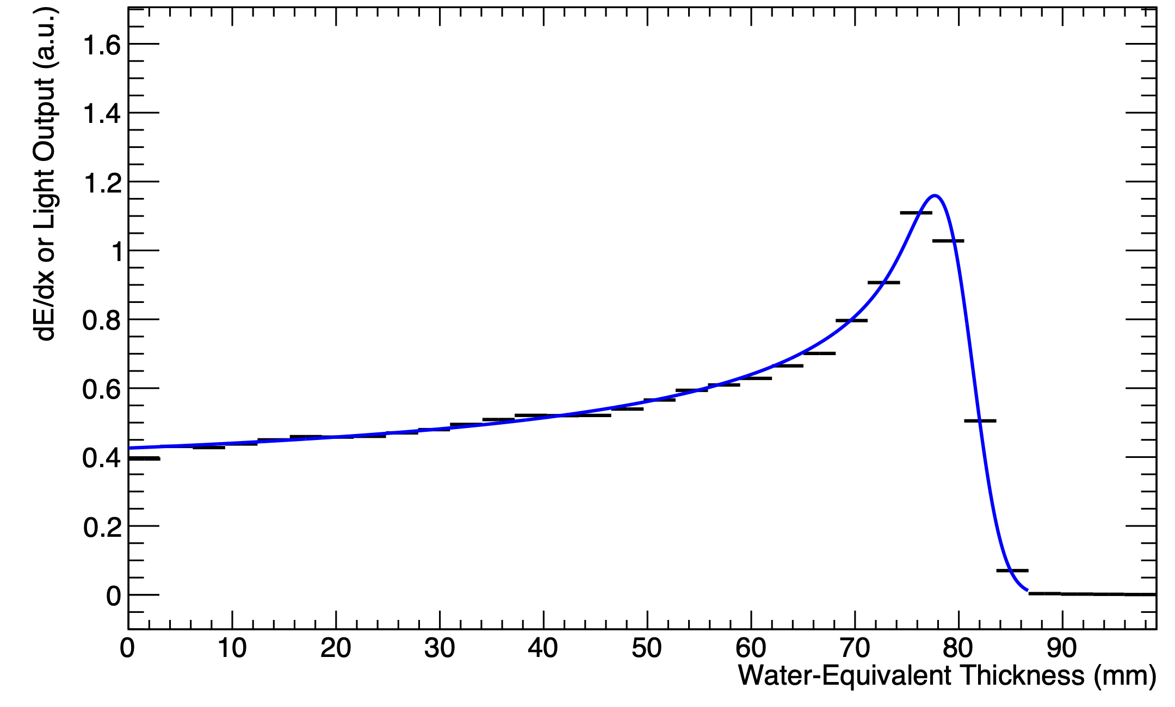
UCLH Beam Test Results
Legend:
  Black: Sheet Average Light Output
  Blue: Fitted Quenched Depth-Light Curve
70 MeV
16/06/22
UNPUBLISHED DATA – DO NOT COPY OR DISTRIBUTE
130 MeV
01/09/22

Slide 9
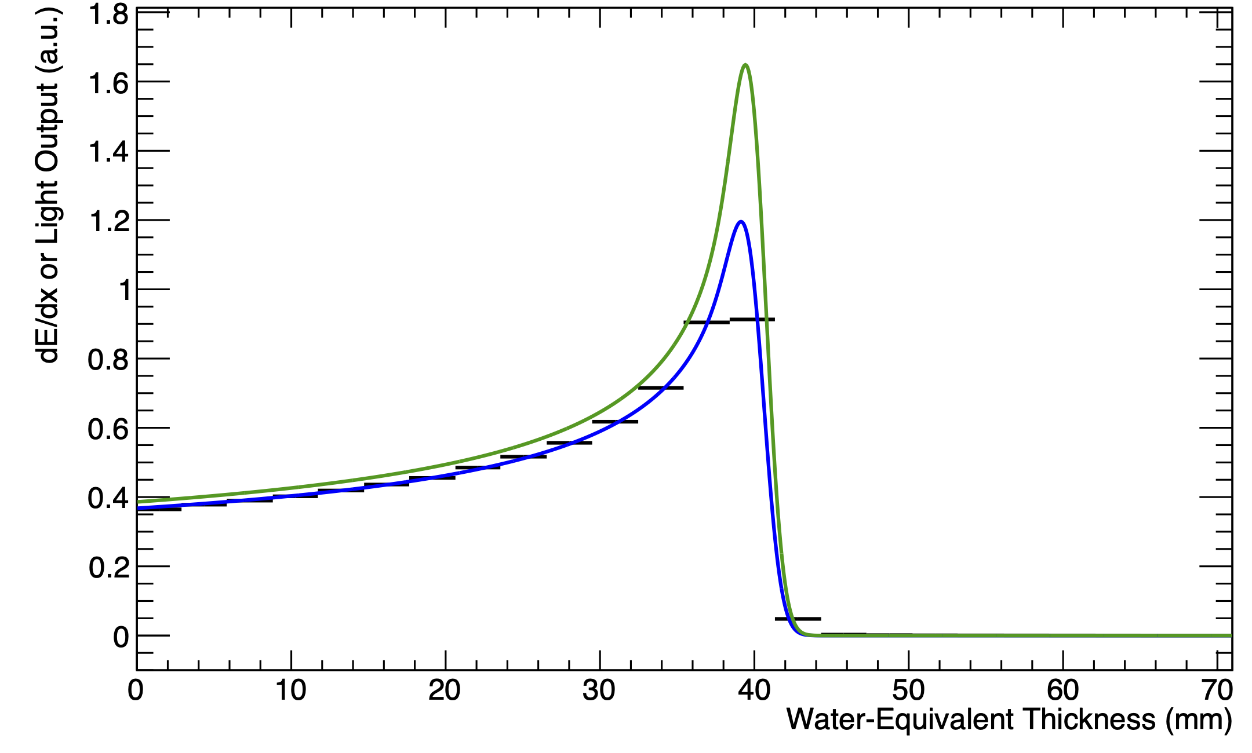
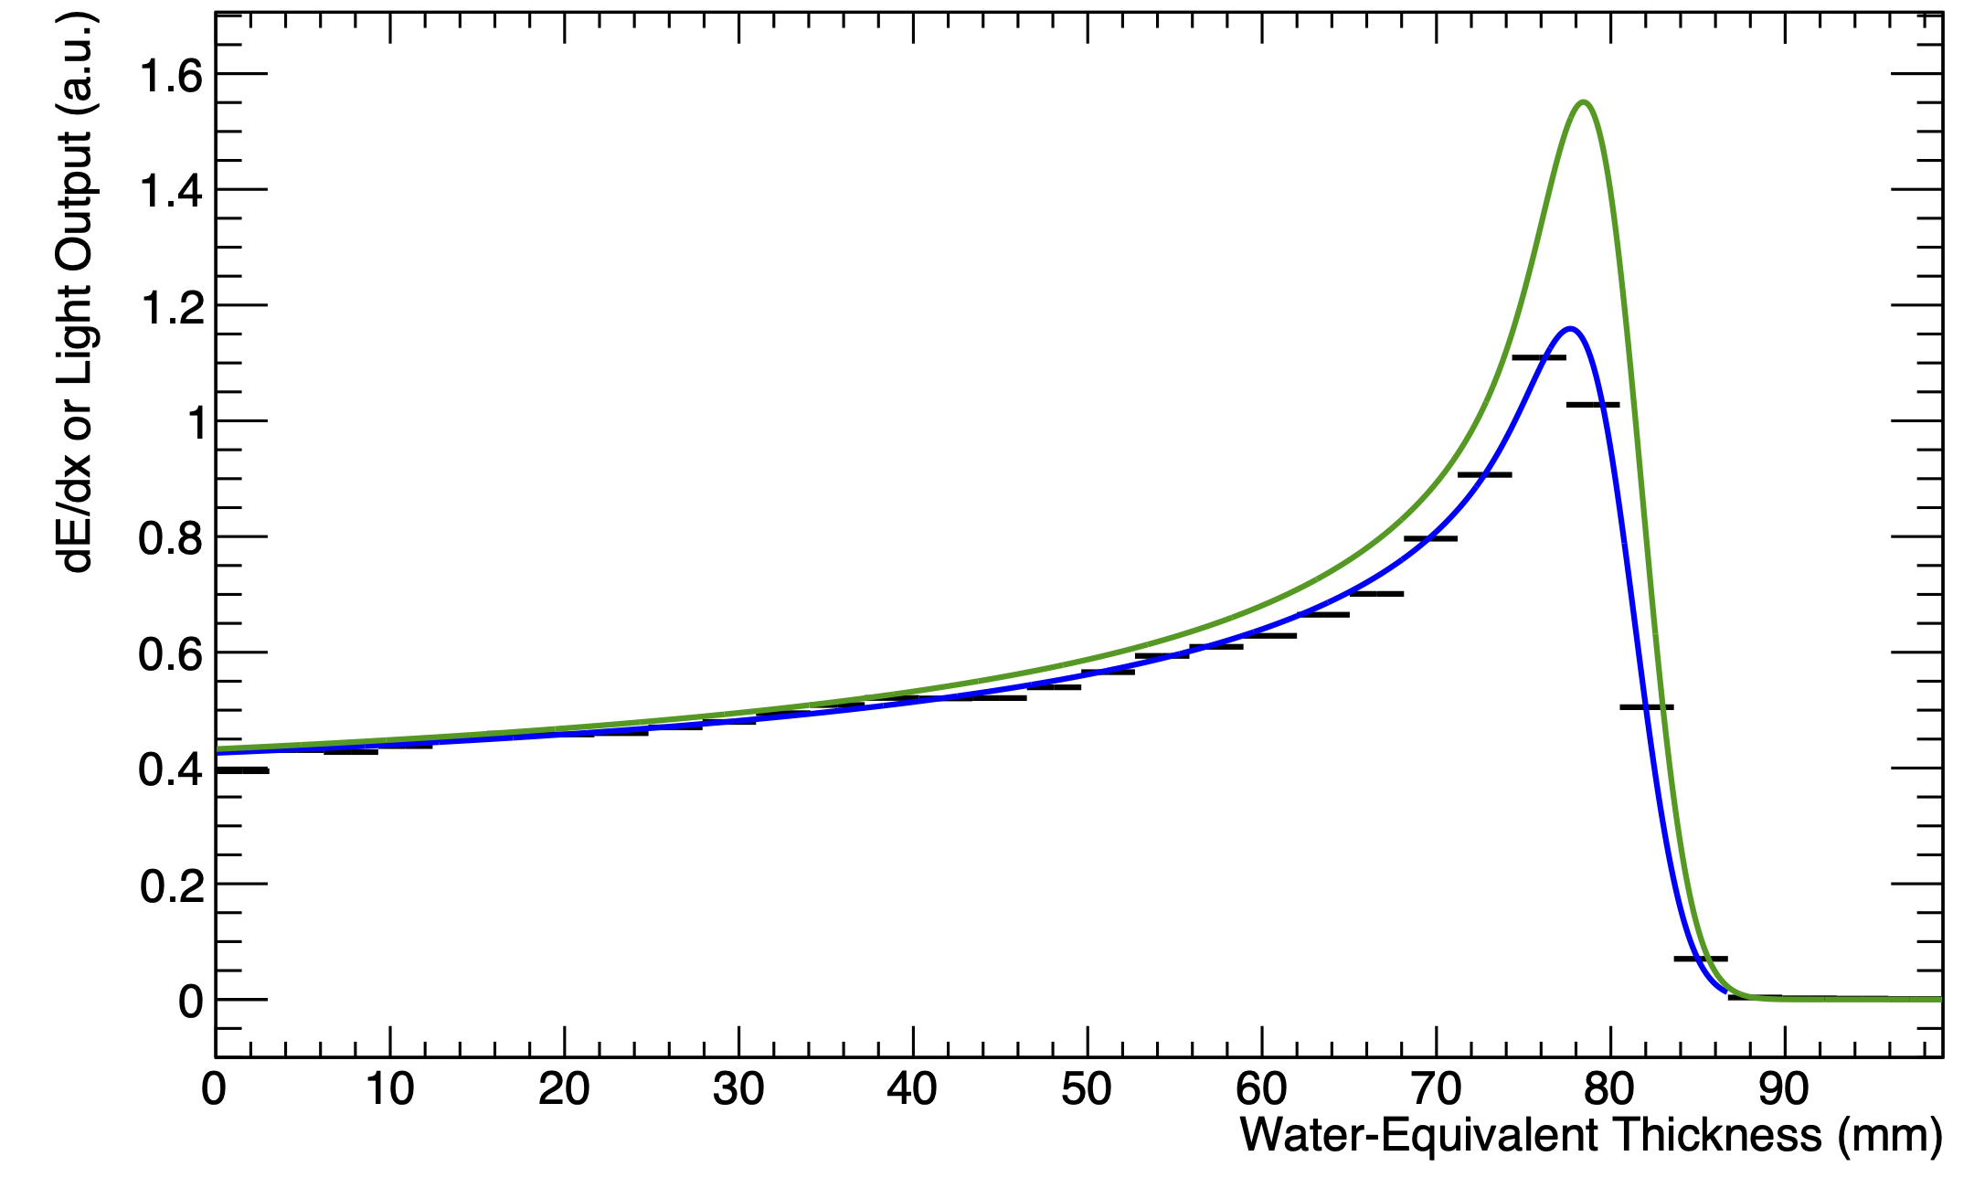
UCLH Beam Test Results
Legend:
  Black: Sheet Average Light Output
  Blue: Fitted Quenched Depth-Light Curve
  Green: Reconstructed Depth-Dose Curve
70 MeV
16/06/22
UNPUBLISHED DATA – DO NOT COPY OR DISTRIBUTE
130 MeV
01/09/22

Slide 10
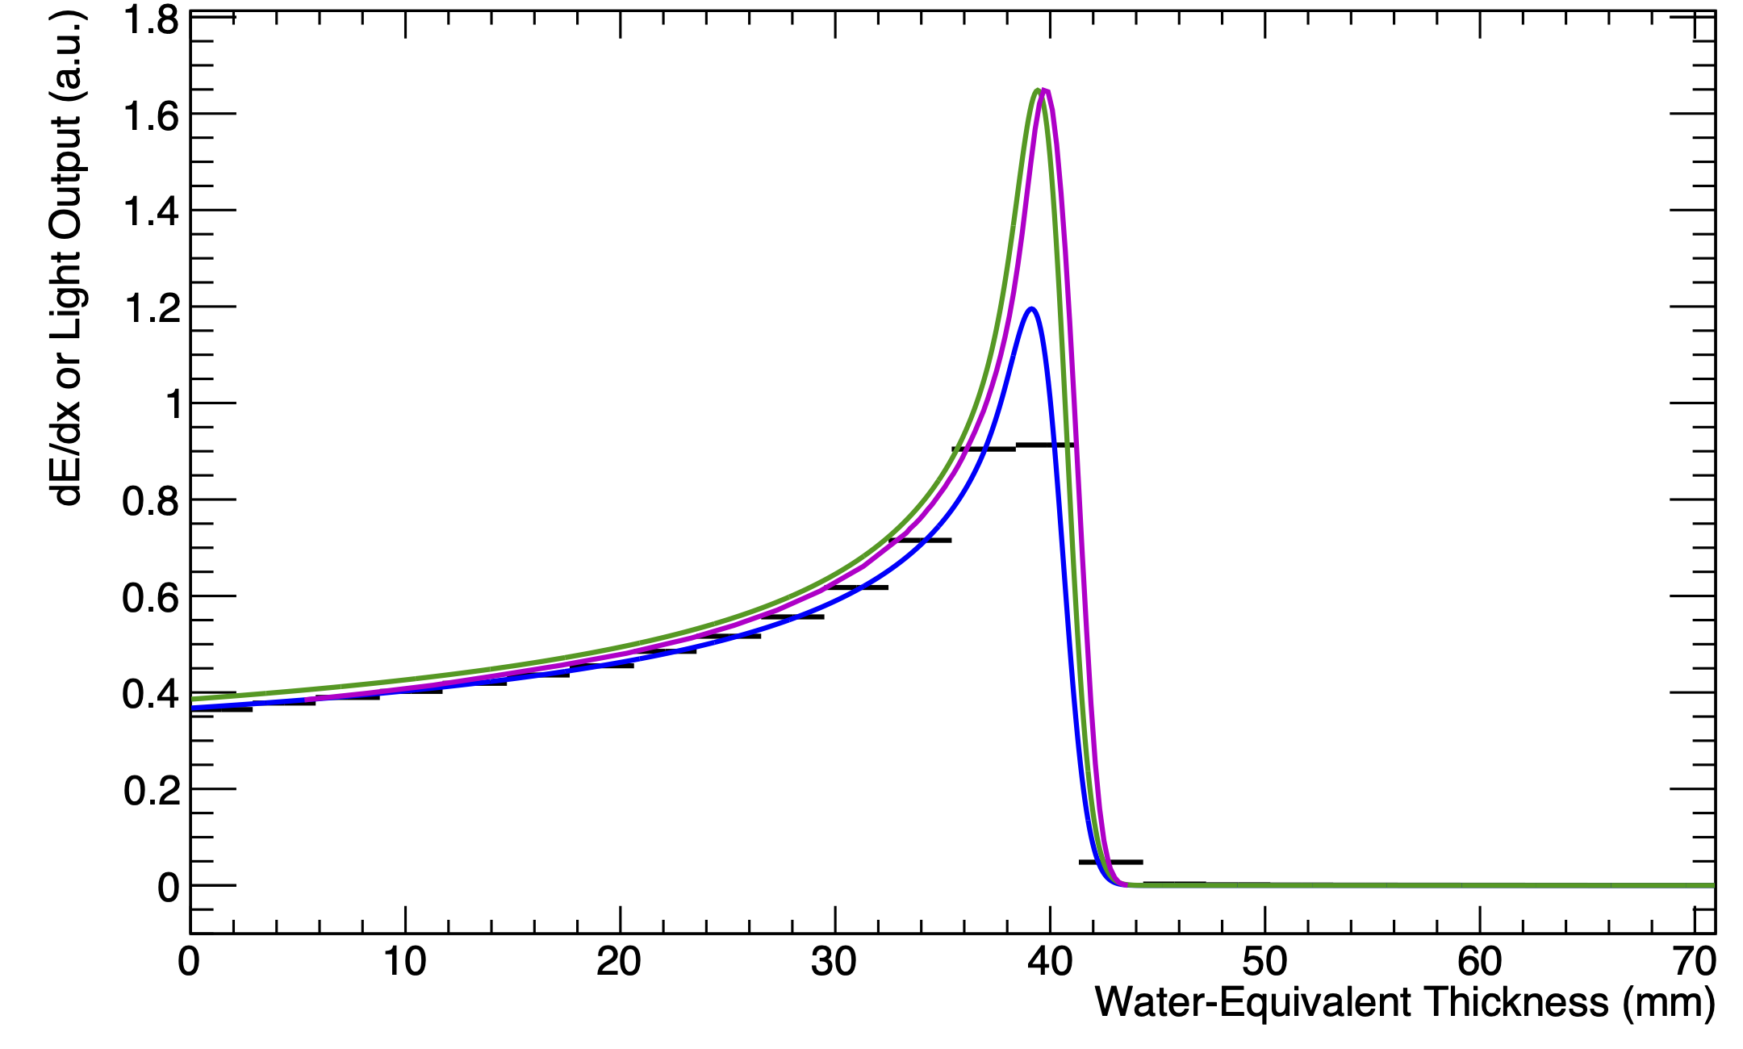
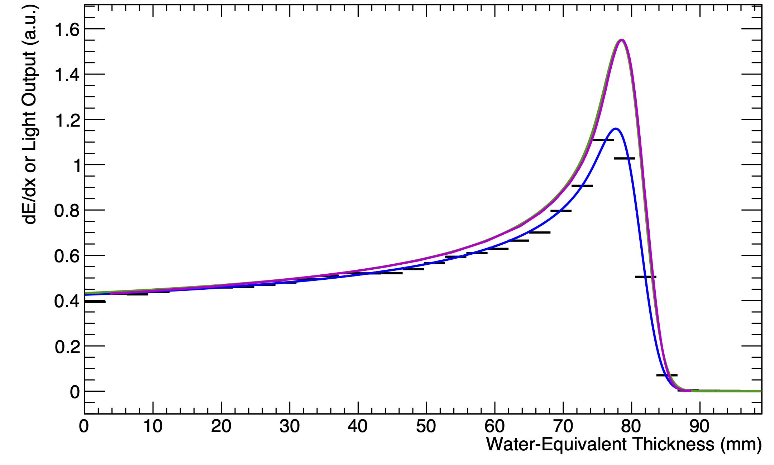
UCLH Beam Test Results
Legend:
  Black: Sheet Average Light Output
  Blue: Fitted Quenched Depth-Light Curve
  Green: Reconstructed Depth-Dose Curve
  Magenta: UCLH Reference Dose Curve
Captures shape of Bragg curve and range accurate within 0.5 mm.
  Disclaimer: depth calibration is ongoing!
70 MeV
16/06/22
UNPUBLISHED DATA – DO NOT COPY OR DISTRIBUTE
130 MeV
01/09/22

Slide 11
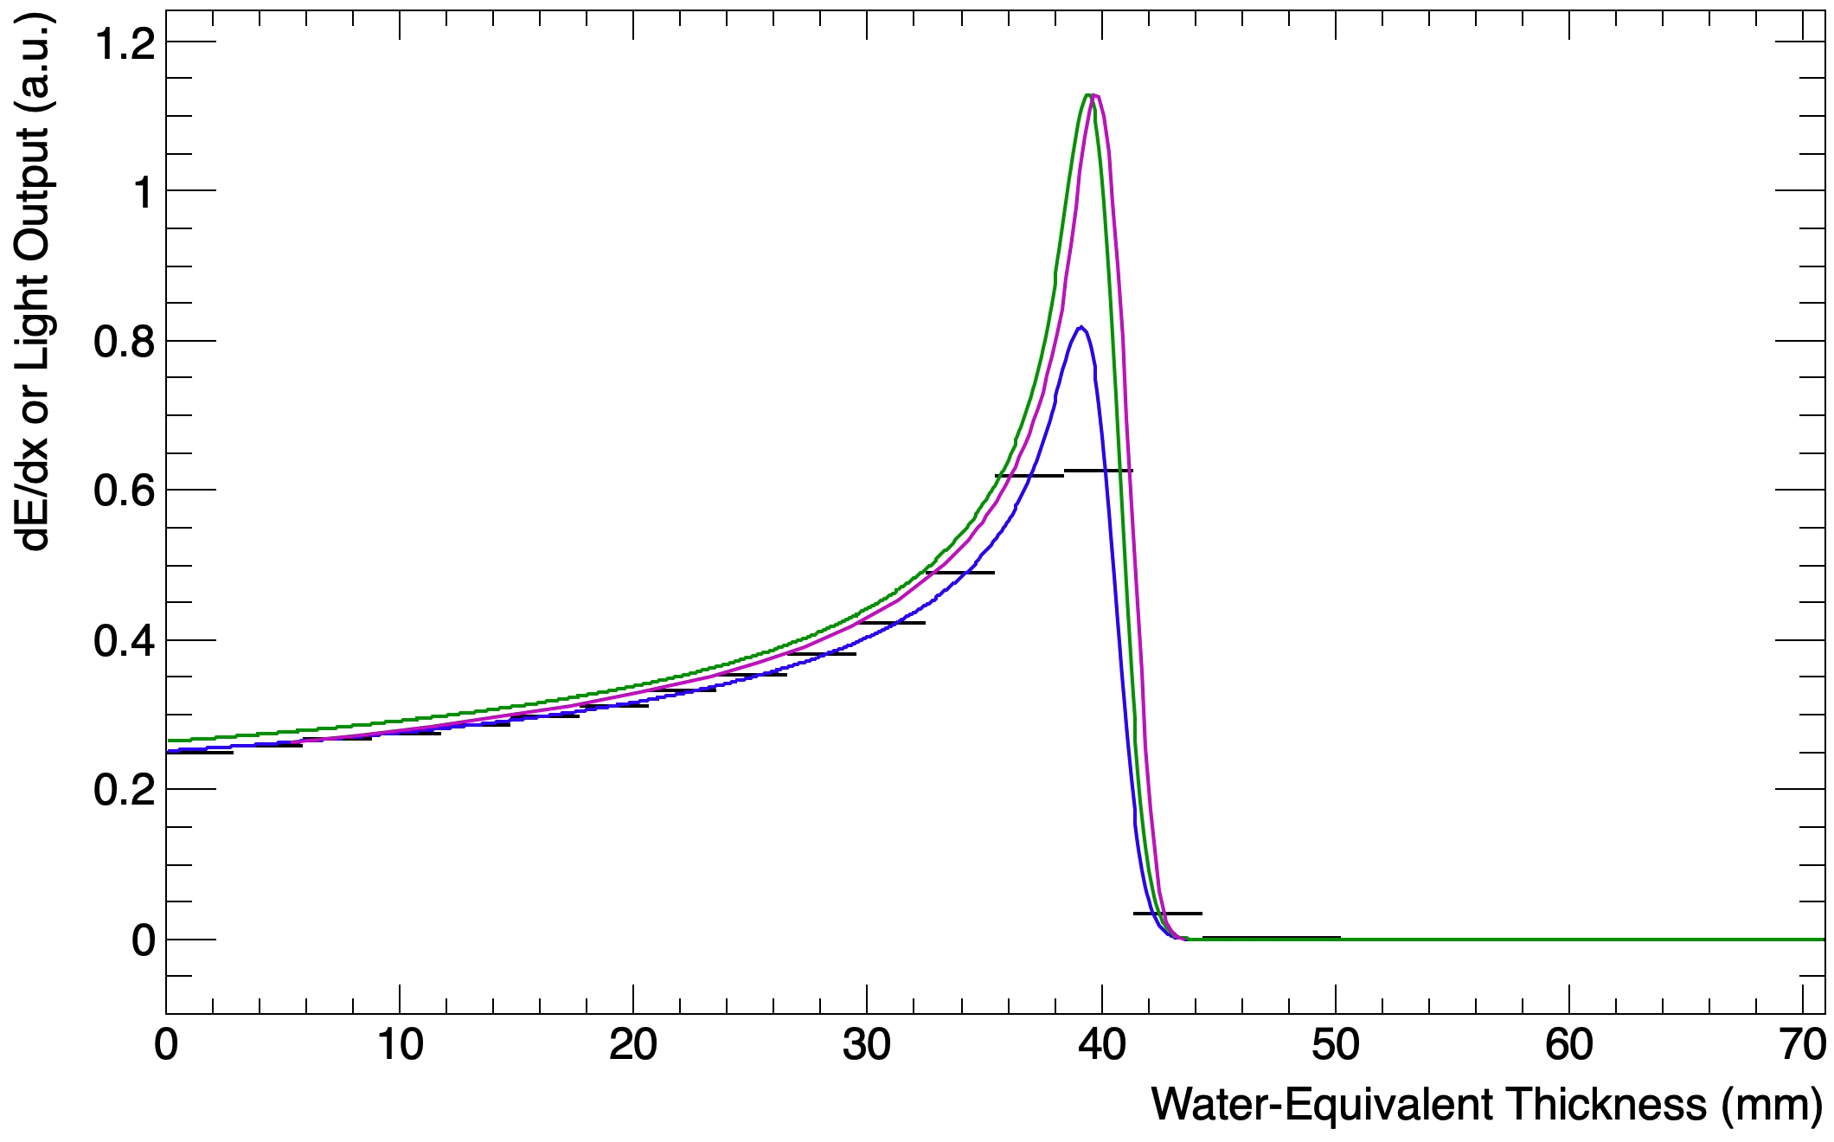
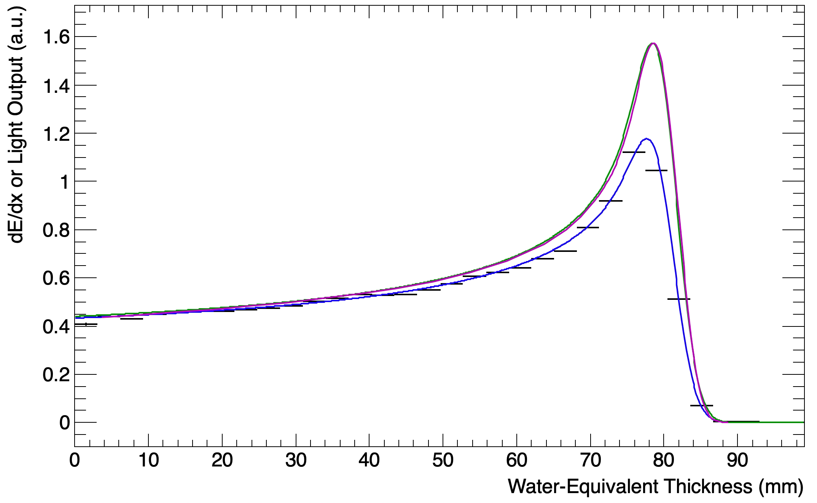
UCLH Beam Test Results
Legend:
  Black: Sheet Average Light Output
  Blue: Fitted Quenched Depth-Light Curve
  Green: Reconstructed Depth-Dose Curve
  Magenta: UCLH Reference Dose Curve
Captures shape of Bragg curve and range accurate within 0.5 mm.
  Disclaimer: depth calibration is ongoing!
Latest measurement accurate to 100 microns.
Real-time range reconstruction at 40 Hz.
70 MeV
16/06/22
UNPUBLISHED DATA – DO NOT COPY OR DISTRIBUTE
130 MeV
01/09/22

Slide 12
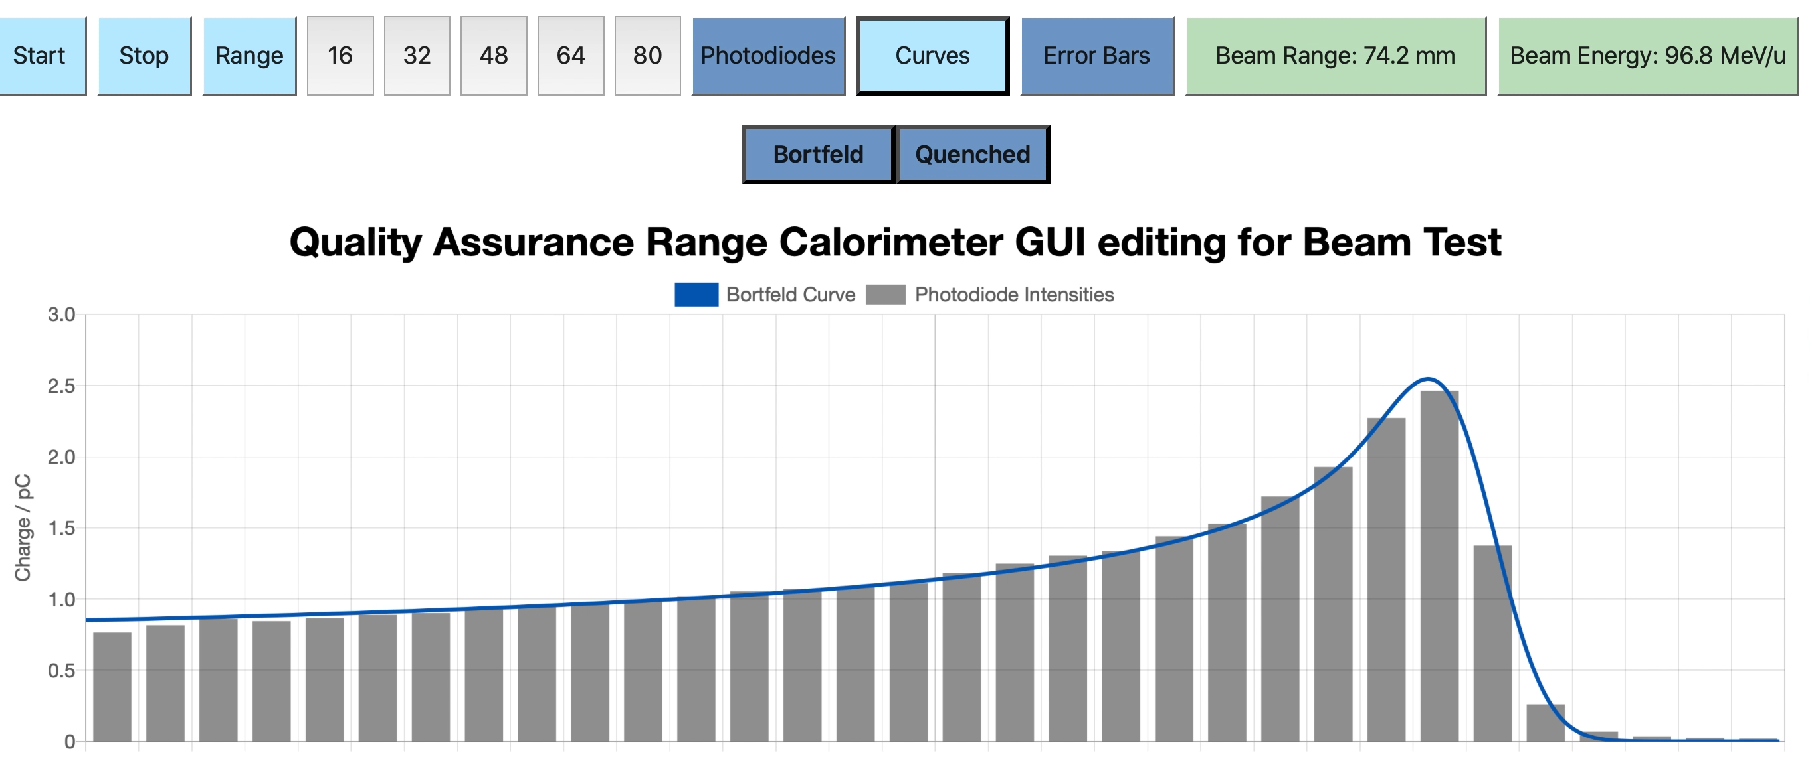
Web-Based GUI
FPGA transfers data to PC, which performs fit.
View live fit results in web GUI.
PC hosts webpage on LAN, to allow any device on network to access live display.
Detector control soon to be implemented in GUI.
DEVELOPED IN JAVASCRIPT BY FERN PANNELL
UNPUBLISHED DATA – DO NOT COPY OR DISTRIBUTE

Slide 13
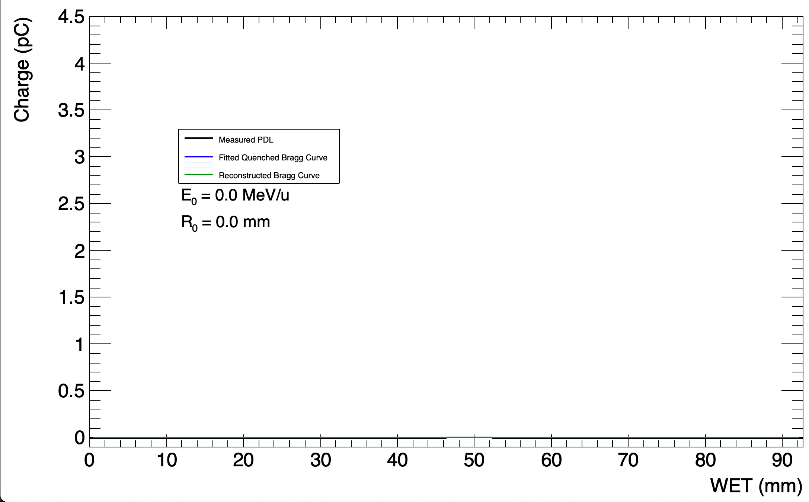
Live Fitting
RANGE-STEP “TREATMENT PLAN”
UNPUBLISHED DATA – DO NOT COPY OR DISTRIBUTE
Notes:
This allows you to perform range QA for all the energies on interest in one fell-swoop – you simply set up a treatment plan and then the fitting gives you range for each of the energies contained in the plan.

Slide 14
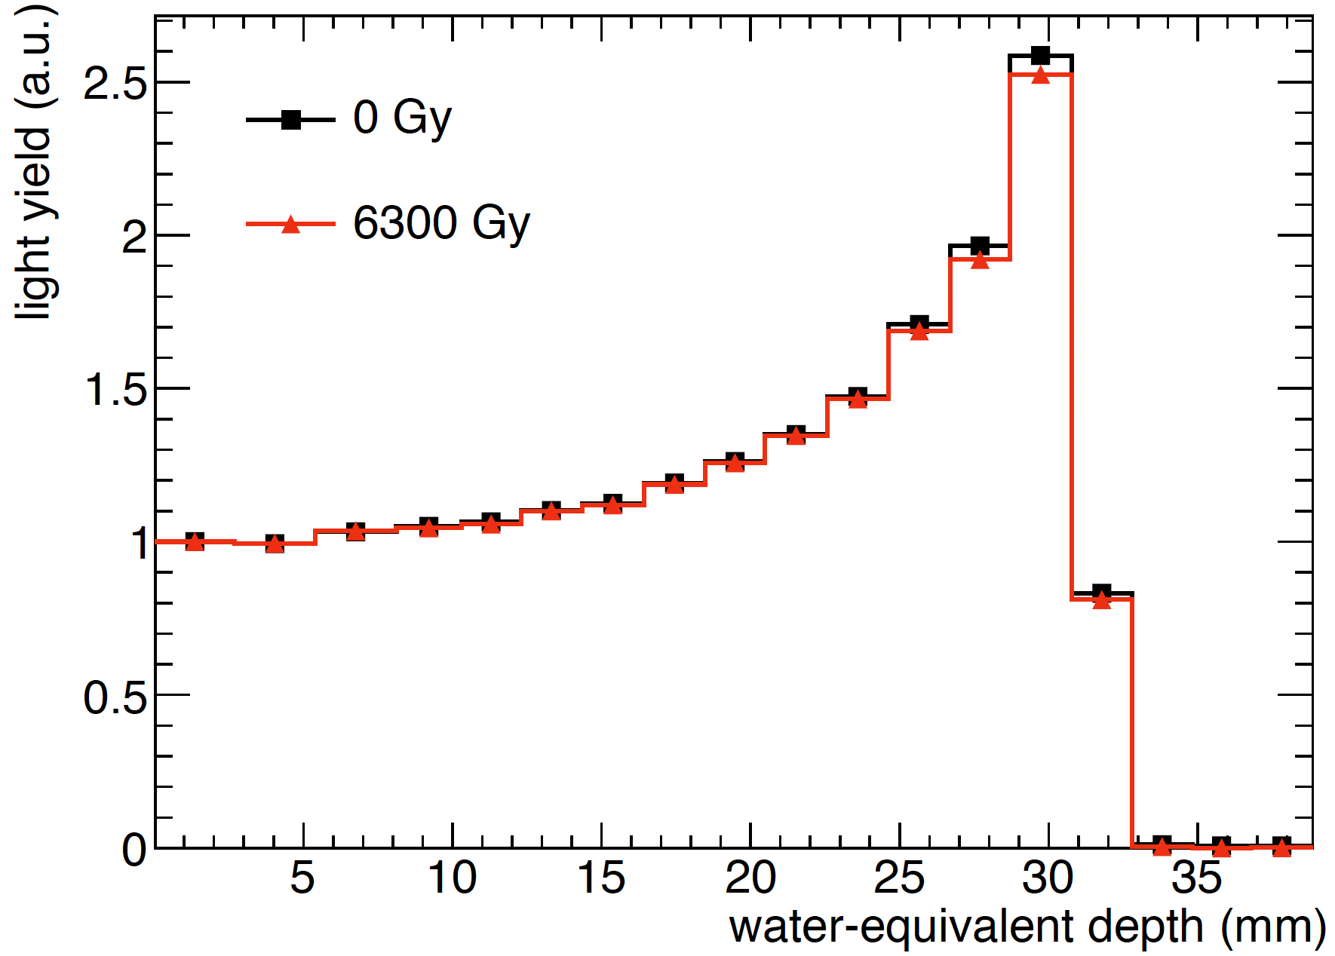
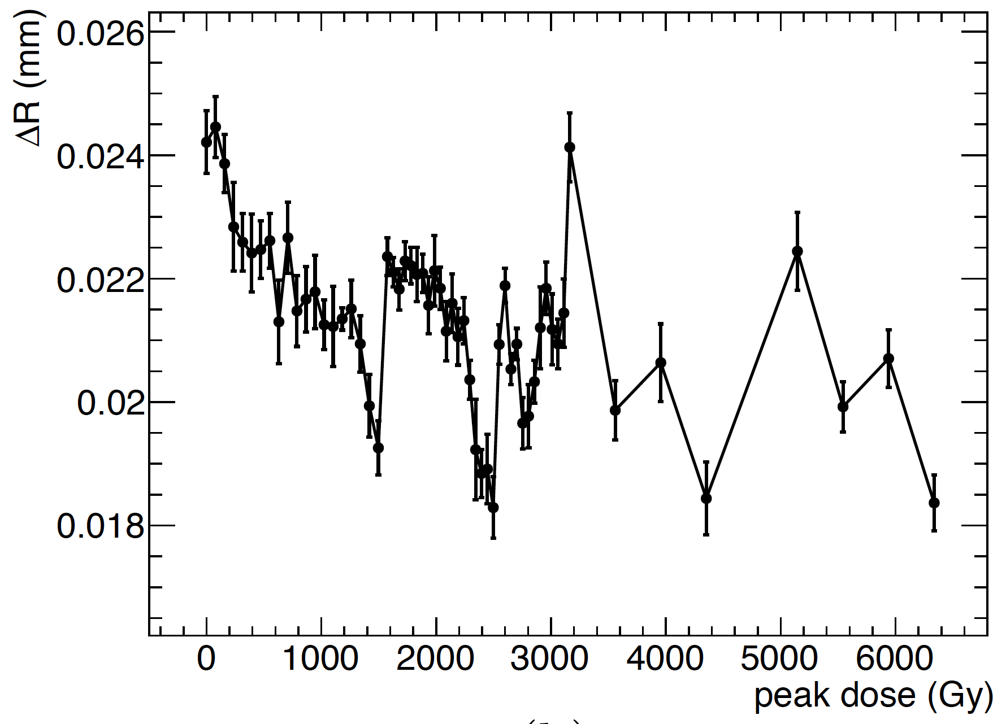
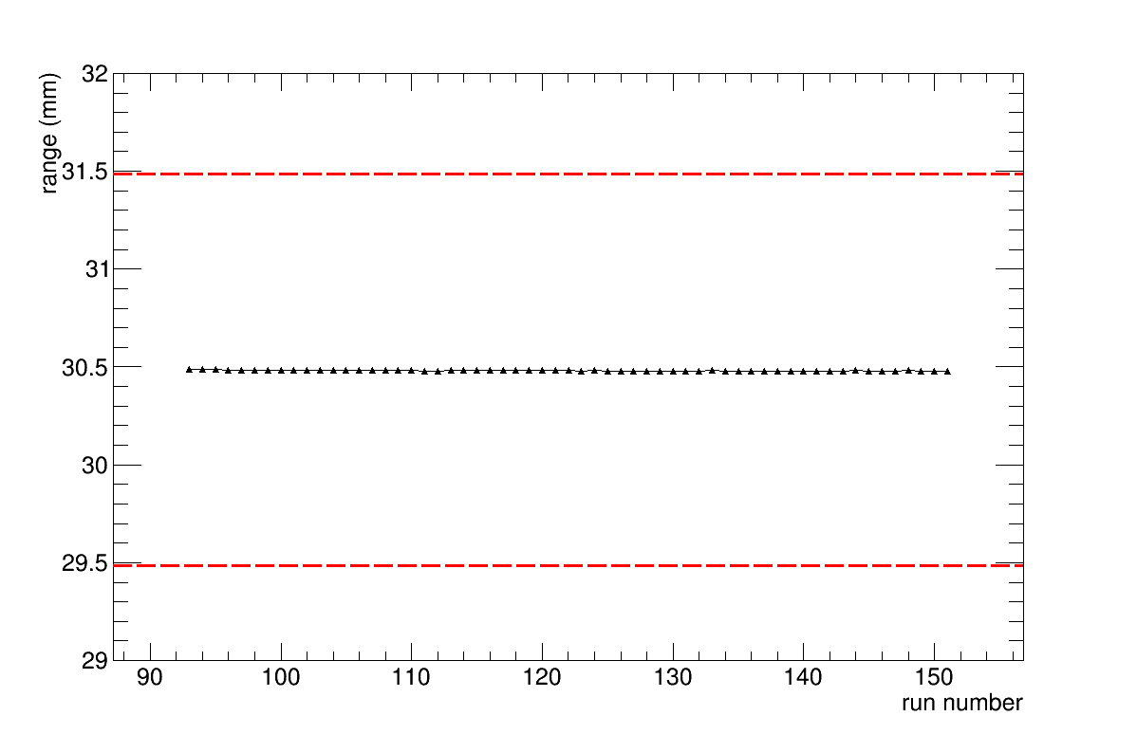
Clatterbridge Radiation Hardness Tests
Still able to reconstruct Bragg curve: measurement repeatable to around 10 microns…
Radiation hardness tests:
  Detector survived a year’s worth of dose: 6,300 Gy.
  Less than 5% reduction in peak light output.
  No change in range accuracy.
0 Gray
6000 Gray

Slide 15
SOBP Fitting
Can use Jette and Chen model to create SOBP from individual Bortfeld/Quenched Bortfeld curves.
  3 additional fitting parameters.
Measure and fit to SOBP curve – do not require individual Bragg curve measurements.
Data from April 15th 2019 beam test in Heidelberg with CMOS sensor detector prototype.
UNPUBLISHED DATA – DO NOT COPY OR DISTRIBUTE
Bortfeld SOBP model fit to reference
David Jette and Weimin Chen 2011 Phys. Med. Biol. 56 N131

Slide 16
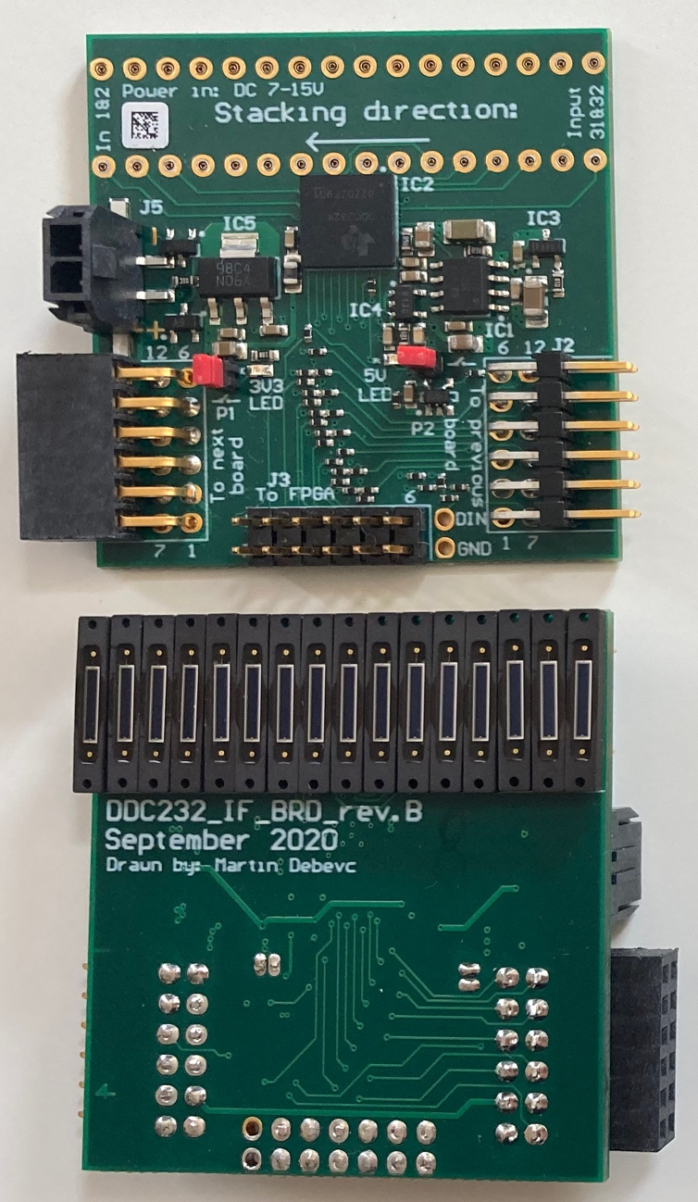
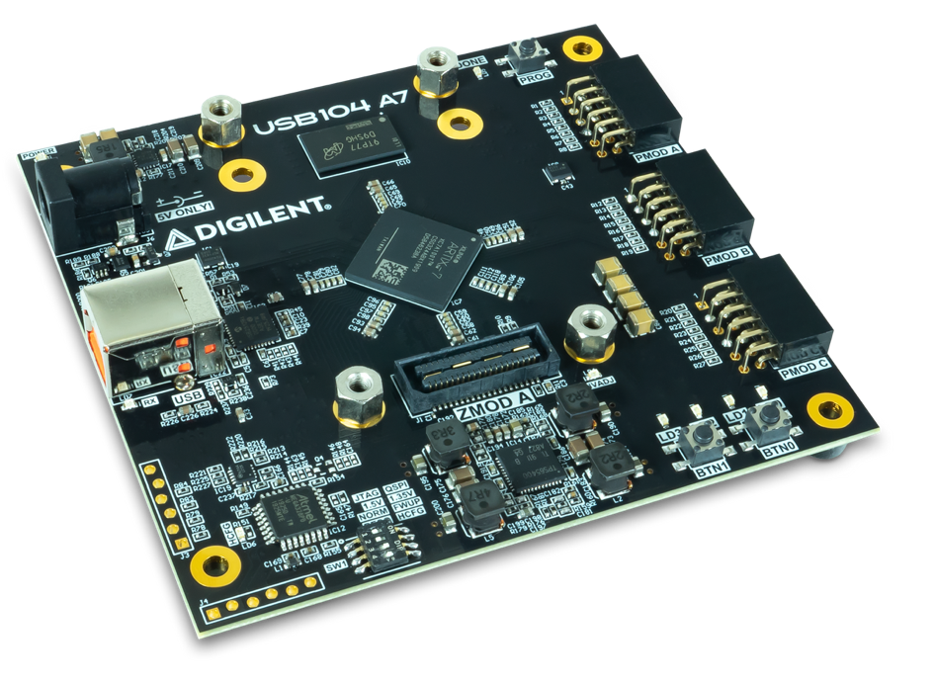
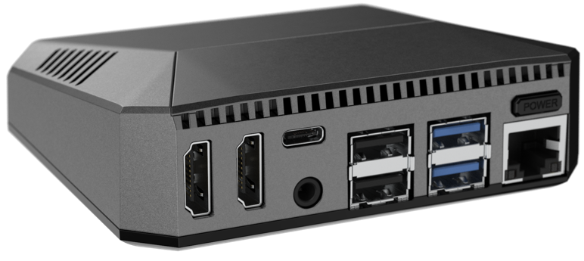
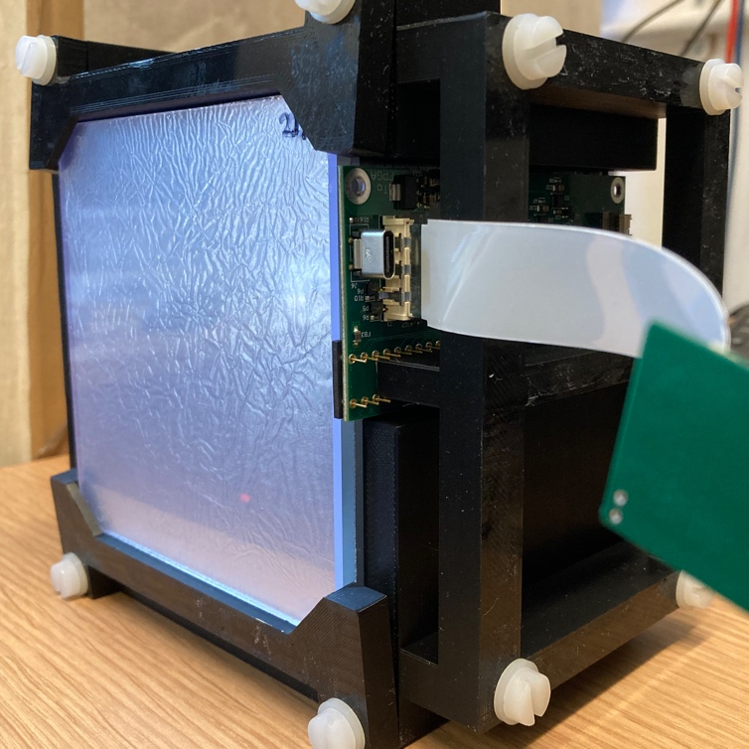
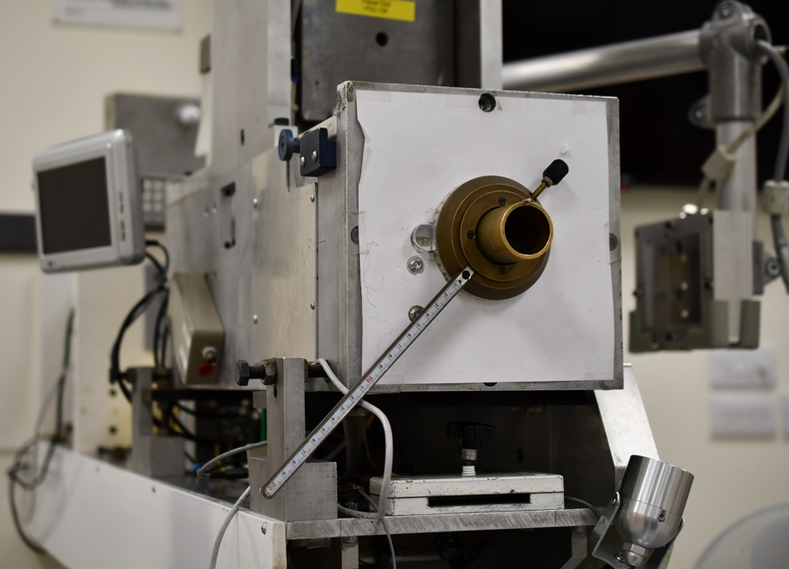
A QuARC For Clatterbridge
Compact version using 14 x 2.8 mm clear scintillator sheets (with mylar foil) coupled to single DDC232 board.
Use compact USB104 A7 FPGA for readout.
FPGA connected to Raspberry Pi 4 for DAQ, fitting and hosting of web GUI.
Result is a very small, lightweight, nozzle-mountable system for fast range QA!

Slide 17
Clatterbridge QuARC Version 1
Clatterbridge setup simpler than high energy:
  Only needs 14 scintillator sheets with single photodiode board and FPGA.
  Monoenergetic beam means live fitting only needed for PSQA SOBPs: beam QA simple.
  Power requirements lower: FPGA powered from Raspberry Pi.
Already complete:
  14-sheet stack in holder with photodiodes and electronics already tested and calibrated at UCLH.
  Full DAQ chain with Raspberry Pi tested and ready to go.
  FPGA firmware and low-level DAQ software development mature.
To do:
  3D print enclosure with nozzle mounts and patch panel (1 month).
  Update GUI to provide detector control (~3 months).
Cost to Clatterbridge: £0.

Slide 18
Clatterbridge QuARC Version 2
Research prototype needs upgrades for full clinical system:
  Reduce scintillator sheet thickness to 2.8 mm for optimum range reconstruction.
  Update electronics with low power USB-C interface (bus powered from Raspberry Pi) and 2.8 mm photodiode spacing.
  Optimise detector enclosure for robustness and mounting speed.
  Update GUI to Clatterbridge’s needs: include SOBP fitting for PSQA?
Cost to Claterbridge:
  Scintillator sheets: ~£3k per module.
  Electronics: FPGA (£300) + Raspberry Pi (£100) per module.
  Front end electronics (Cosylab): ~£20k? One-off.
  Clinical device certification…

Slide 19
What We Will Provide Free Of Charge
Complete working prototype of detector.
Installation, setup and training.
GUI development to tailor detector to clinical needs.
Development of clinical system:
  Electronics development costs additional.
  Component costs need covering (we don’t have spares…).
Ongoing improvements to all software parts of system.
Training for local users to set up, maintain and repair: Liverpool University?
Support for clinical lifetime of detector (or until I get fired from UCL…).

Slide 20
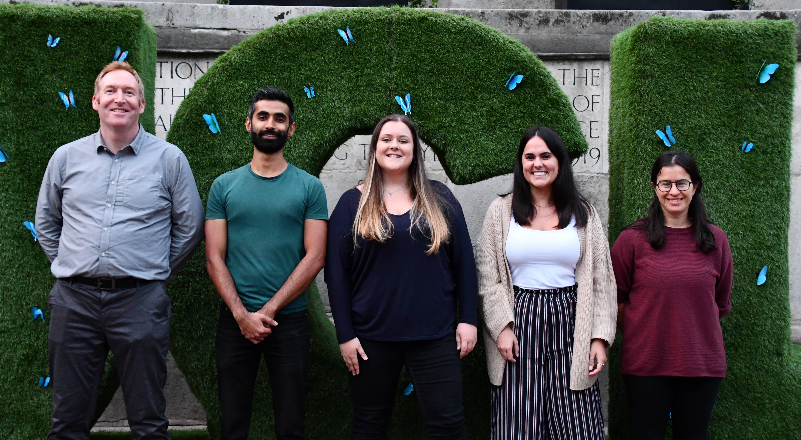
Thank You From The UCL Team

