Slide 1
FLASH Radiotherapy: New Paradigm New Challenges
Simon Jolly, Saad Shaikh
(University College London)
Raffaella Radogna (University of Bari)

Slide 2
Abstract
Proton beam therapy (PBT) is a more advanced form of radiotherapy that allows dose to be delivered more precisely, sparing healthy tissue. In recent years there has been increasing interest in a new high dose rate form of radiotherapy called FLASH. In FLASH radiotherapy, extremely high dose rates above 40 Gy/s and delivery times below 100 ms have shown exceptional reduction in damage to healthy tissue with similar tumour control to standard radiotherapy. In addition, such short delivery times have the potential to eliminate dose delivery inaccuracy related to patient movement during treatment. Research is currently underway to develop the first clinical systems capable of delivering therapeutic beams at FLASH rates with protons, electrons and photons.
Two key challenges exist in the development of FLASH PBT:
The development of accelerator systems fast enough to deliver spot-scanned PBT beams within a suitably short time frame to elicit the FLASH effect;
The improvement of diagnostic and Quality Assurance (QA) detectors capable of making dosimetric measurements at FLASH rates.
A background to PBT and the advantages over conventional radiotherapy is presented. A brief history of FLASH radiotherapy is given with a focus on progress in delivering FLASH PBT. The challenges in both accelerator and diagnostics development are outlined. Finally, the UCL QuARC project to develop a FLASH-ready QA detector for fast proton range measurements is described, with experimental results of the first clinical tests of the prototype detector system.

Slide 3
Cancer Treatment With Radiotherapy
Cell death occurs through DNA damage:
Single strand breaks: healthy cell can self repair.
Double strand breaks: self-repair much more difficult.
Optimise clustering of breaks with targeted radiation intensity.
With enough damage, apoptosis takes over…

Slide 4
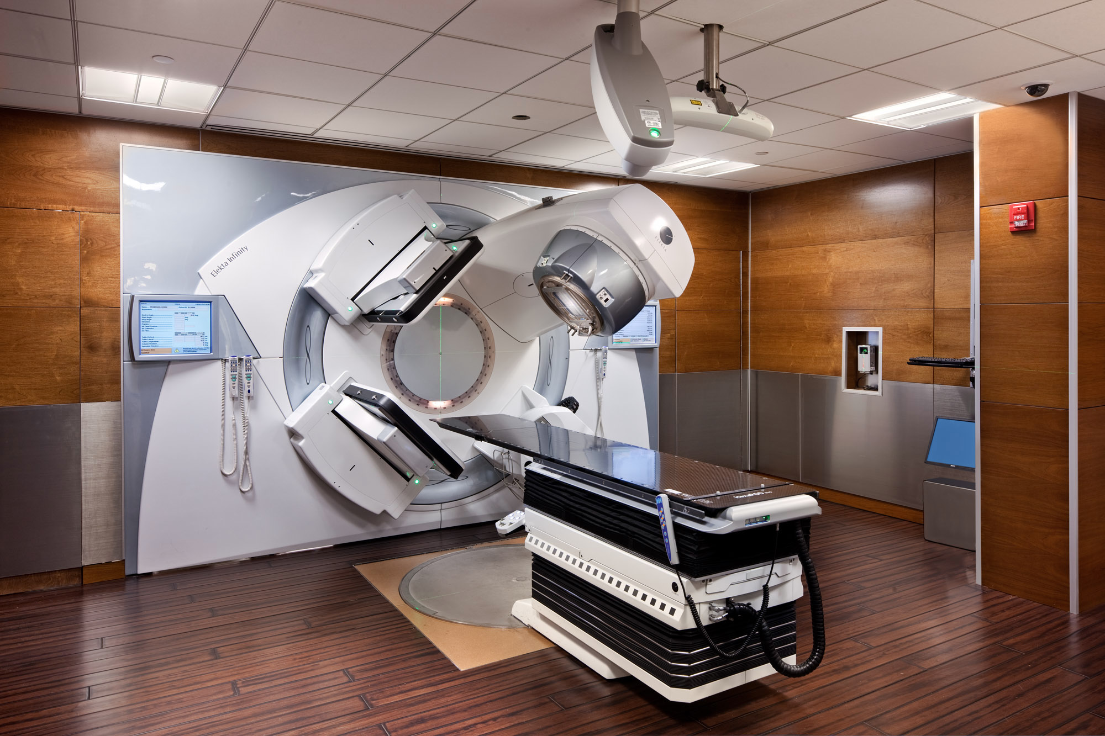
Radiotherapy Treatment Room
http://thefarbercenter.com/blog/wp-content/uploads/2011/10/linac-room.jpg

Slide 5
Radiotherapy Treatment Room
http://thefarbercenter.com/blog/wp-content/uploads/2011/10/linac-room.jpg

Slide 6
Particle Dose Distribution
Unlike X-rays, charged particles stop!
Electrons, being lighter, scatter and spread out.
Protons deposit most dose at the end of their path: the Bragg Peak.

Slide 7
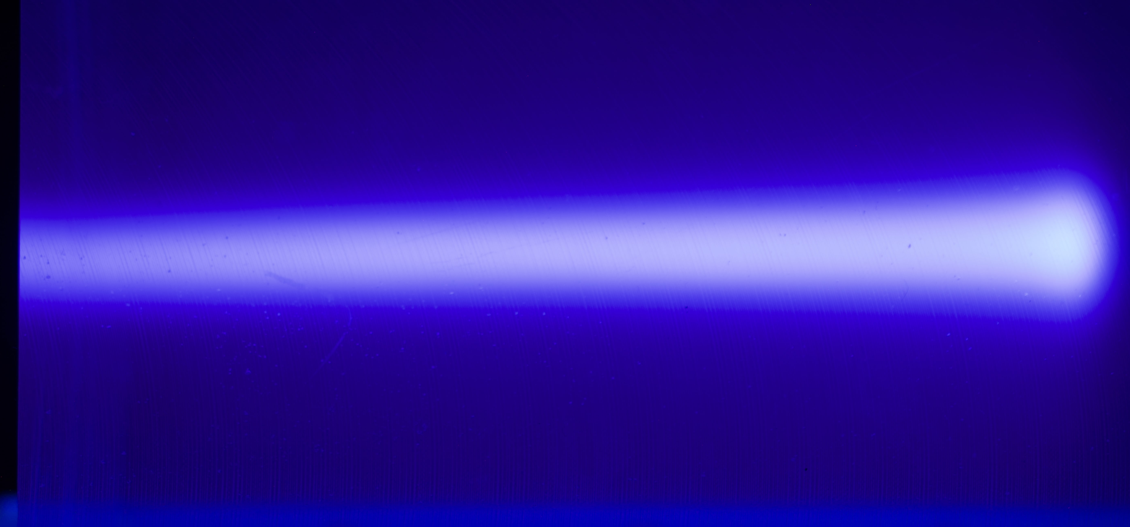
A Real Bragg Peak!

Slide 8
Non Small Cell Lung Cancer: Dose Comparison
IMRT
PBT
Zhang X, Li Y, Pan X, et al.
Int J Radiat Oncol Biol Phys. (2010); 77 (2): 357–366
DOI: 10.1016/j.ijrobp.2009.04.028

Slide 9
Treating in a FLASH…
Whatever the modality, aim for maximum Tumour Control Probablity (TCP) and minimum Normal Tissue Complication Probablity (NTCP).
In the last decade, attempts have been made to treat with the same dose in very short times:
Normal treatment: >1 min.
FLASH treatment: <100 ms.
Ultra-high dose rate:
Reduction of the normal tissue complications (NTCP).
Same tumour control level (TCP).
Less side effects, or higher dose for better chance of cure.
FLASH is a healthy tissue effect: dose to tumour doesn’t change.
Acceptable dose still within a range.
Treating so fast is challenging…

Slide 10

First Patient Treatment with FLASH-radiotherapy
Background: When compared to conventional radiotherapy (RT) in pre-clinical studies, FLASH-RT was shown to reproducibly spare normal tissues, while preserving the anti-tumor activity. This marked increase of the differential effect between normal tissues and tumors prompted its clinical translation. In this context, we present here the treatment of a first patient with FLASH-RT.
Material & Methods: A 75-year-old patient presented with a multiresistant CD30+ T-cell cutaneous lymphoma disseminated throughout the whole skin surface. Localized skin RT has been previously used over 110 times for various ulcerative and/or painful cutaneous lesions progressing despite systemic treatments. However, the tolerance of these RT was generally poor, and it was hypothesized that FLASH-RT could offer an equivalent tumor control probability, while being less toxic for the skin. This treatment was given to a 3.5-cm diameter skin tumor with a 5.6-MeV linac specifically designed for FLASH-RT. The prescribed dose to the PTV was 15 Gy, in 90 ms. Redundant dosimetric measurements were performed with GafChromic films and alanine, to check the consistency between the prescribed and the delivered doses.
Results: At 3 weeks, i.e. at the peak of the reactions, a grade 1 epithelitis (CTCAE v 5.0) along with a transient grade 1 oedema (CTCAE v5.0) in soft tissues surrounding the tumor were observed. Clinical examination was consistent with the optical coherence tomography showing no decrease of the thickness of the epidermis and no disruption at the basal membrane with limited increase of the vascularization. In parallel, the tumor response was rapid, complete, and durable with a short follow-up of 5 months. These observations, both on normal skin and on the tumor, were promising and prompt to further clinical evaluation of FLASH-RT.
Conclusion: This first FLASH-RT treatment was feasible and safe with a favorable outcome both on normal skin and the tumor.
Day 0
3 weeks
(max. of skin reactions)
5 months
human Patient:
lymphoma on skin
FLASH-RT:
10 pulses (of 1 μs duration) in 90 ms
with 1.5 Gy/pulse
Bourhis et al., Radiother. Oncol. (2019)
DOI: 10.1016/j.radonc.2019.06.019

Slide 11
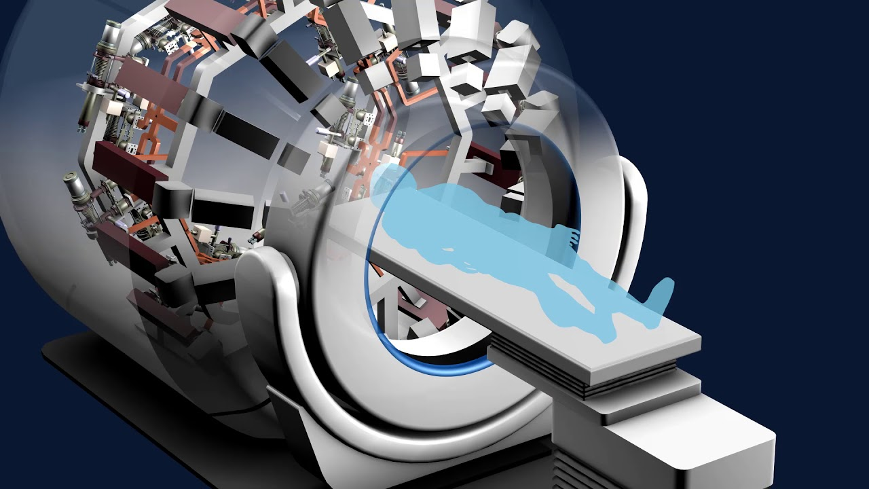
FLASH Technologies
3 particle types for FLASH:
Photons:
Most well-established treatment modality.
First clinical experiment successful with photons.
No clinical high current linacs: melt X-ray target…
Will require very different treatment modality.
Electrons:
High current linacs readily available.
Easiest particle to produce and control.
Never been used clinically.
Pre-clinical systems still under development (Very High Energy Electron radiotherapy).
Protons (+ Ions):
Best dose distribution.
Probably fastest route to clinical system.
Higher current needed (particularly for synchrotrons).
Shoot-through? Then why use protons…?
Scanning VERY challenging.
New dosimetry technology needed…

Slide 12
FLASH PBT Spot Scanning Requirements
Standard clinical spec for PBT system:
2 Gy/l/min to cubic 1 litre water volume.
Situated 10–20 cm deep in larger water volume.
Requires 2x10¹¹ protons ≃ 30 nC.
34 layers; 50x50 spots per layer; 2 mm spot spacing; 85,000 spots.
Must deliver same spec ie. same number of protons in <100 ms:
30 nC in 100 ms = 300 nA average current to patient.
Peak current will be higher since beam needs to be switched off between spots and energy layers.
Spot scanning extremely challenging for magnets!
Normal dwell time per spot 5–20 ms.
100 ms total delivery means ~3 ms total per layer:
~1 ms to deliver all spots in single layer.
~1 ms to adjust energy.
~1 ms free time…
2,500 spots per layer means 400 ns per spot: 200 ns per spot; 200 ns switching.
Have to be able to deliver and monitor at this speed…
All beamline magnets must be able to adjust and settle in ~1 ms: about 1,000-fold increase over current systems.
Steering magnets in nozzle must be able to steer beam 2 mm in 200–400 ns at isocentre:
5–10 m/ms: very fast!
PSI gantry max speed is 2 cm/ms.
S. Jolly et al., “Technical Challenges for FLASH Proton Therapy”, Physica Medica, 78, 71-82 (2020).
DOI: 10.1016/j.ejmp.2020.08.005

Slide 13
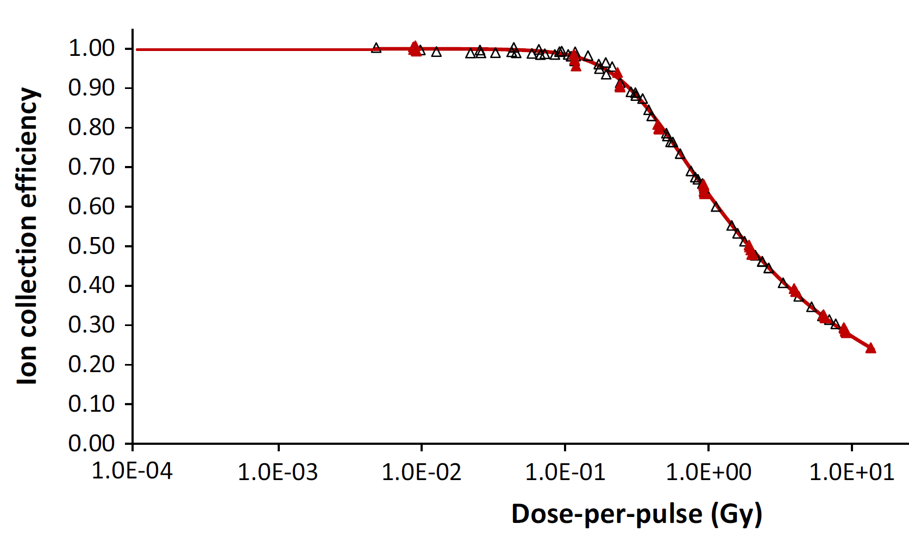
FLASH PBT Dosimetry Requirements
If you thought magnet scanning was tough…
Current clinical systems “trickle fill” each spot:
Current delivered to single spot until dose within tolerance.
System then moves to delivering next spot.
Ion chambers — our gold standard for dose monitoring and measurement — will not work quickly enough:
Recombination time of ions too slow.
Charge collection efficiency falls at high currents.
Will need new technology: scintillators?
Dosimetry also provides vital safety aspect:
Prevent under or over-dosing to patient.
Avoid unwanted exposure.
Personal Protection System needs to be able to shut off beam 1,000 times more quickly.
Error in dosimetry:
FLASH effect due to this error?
Too much dose to patient.
No online monitoring of scanned dose.
No effective patient safety…
Typical performance of ionization chambers
(here Advanced Markus chamber)
Losses due to ion recombination increase with increasing dose per pulse
conventional
(< 0.3 mGy/pulse)
Petersson et al., Med Phys 44 (2017) 1157
DOI: 10.1002/mp.12111
charge collection efficiency
FFF
(< 2 mGy/pulse)
IORT
(> 20 mGy/pulse)
FLASH
(> 0.6 Gy/pulse)
New treatment modality requires new dosimetric tools:
No existing Quality Assurance detectors for FLASH rates.
Need new technological advances to meet challenges.
Scintillators don’t give absolute dose (light variation with time) but can give relative dose and fast…

Slide 14
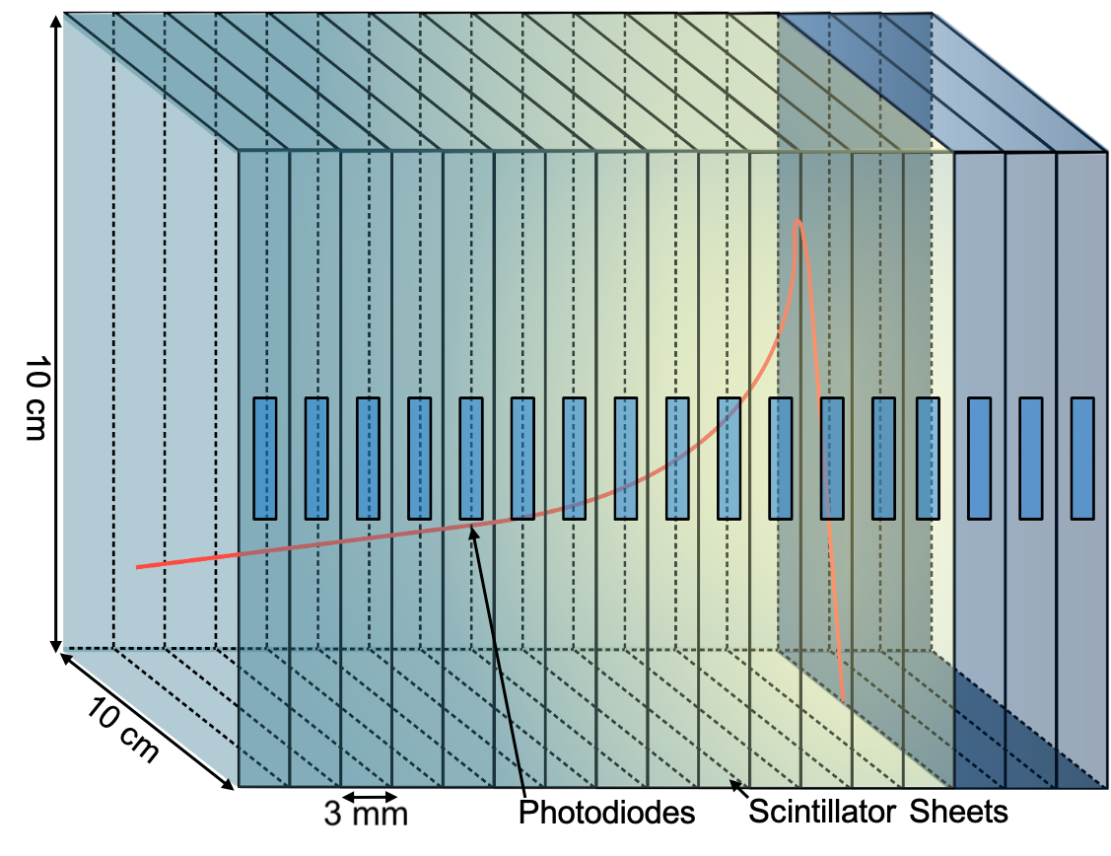
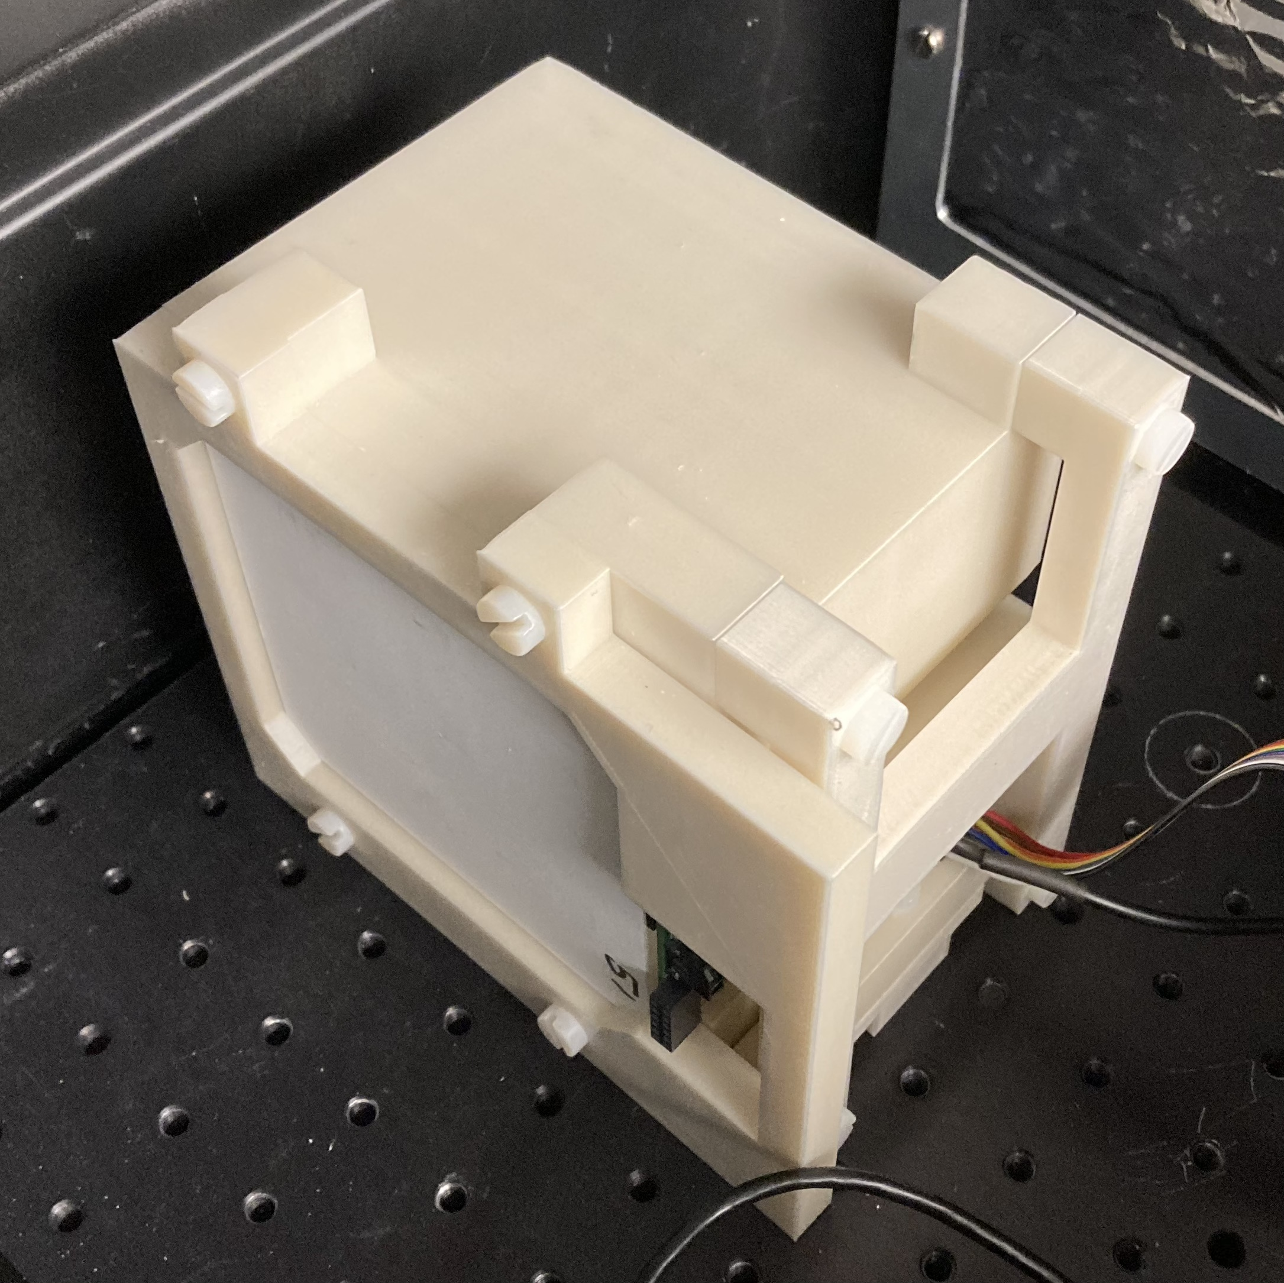
QuARC — Quality Assurance Range Calorimeter
Proton range is a very important parameter!
Measure proton range using a series of optically-isolated polystyrene scintillator sheets.
Light output of each sheet proportional to proton energy deposition, with some quenching effects.
Measure depth-light curve & reconstruct Bragg depth-dose curve to measure proton range.
Key benefits:
Plastic scintillator inexpensive and water-equivalent.
Range reconstructed with single beam delivery.
Easy detector setup and no optical artefacts.
L. Kelleter, S. Jolly, Med. Phys 25 (5), 2300–2308 (2020).
DOI: 10.1002/mp.14099

Slide 15
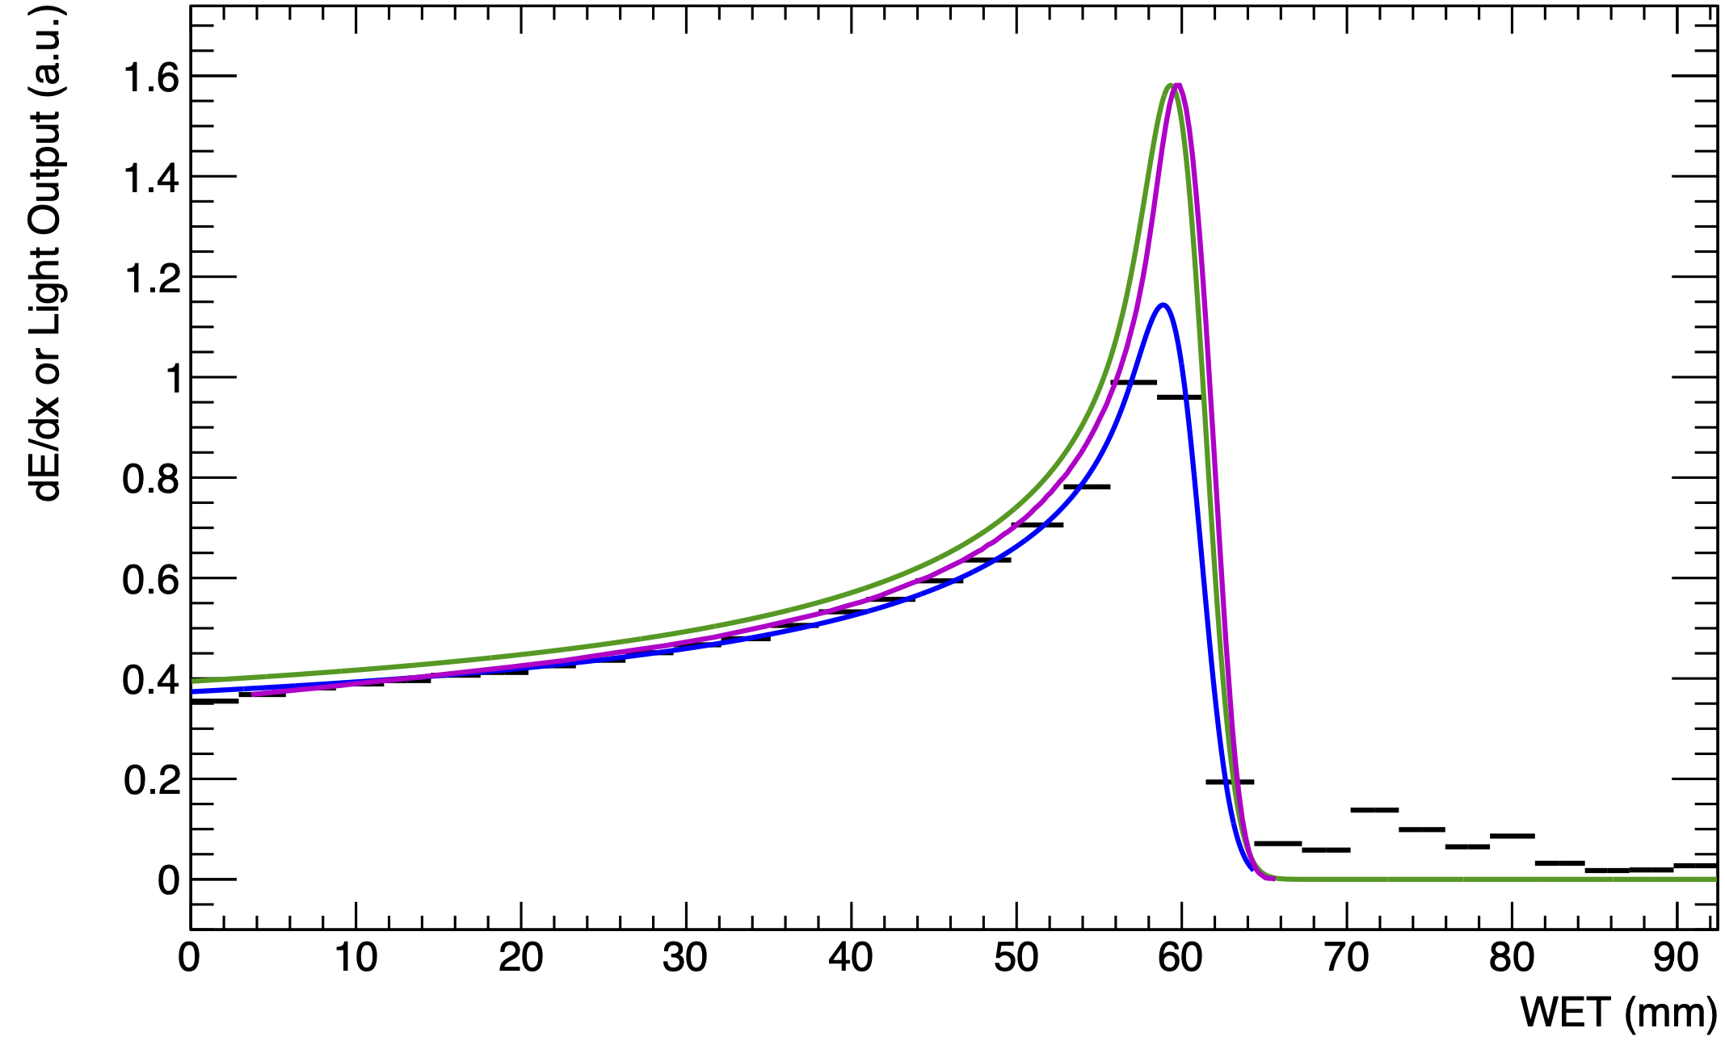
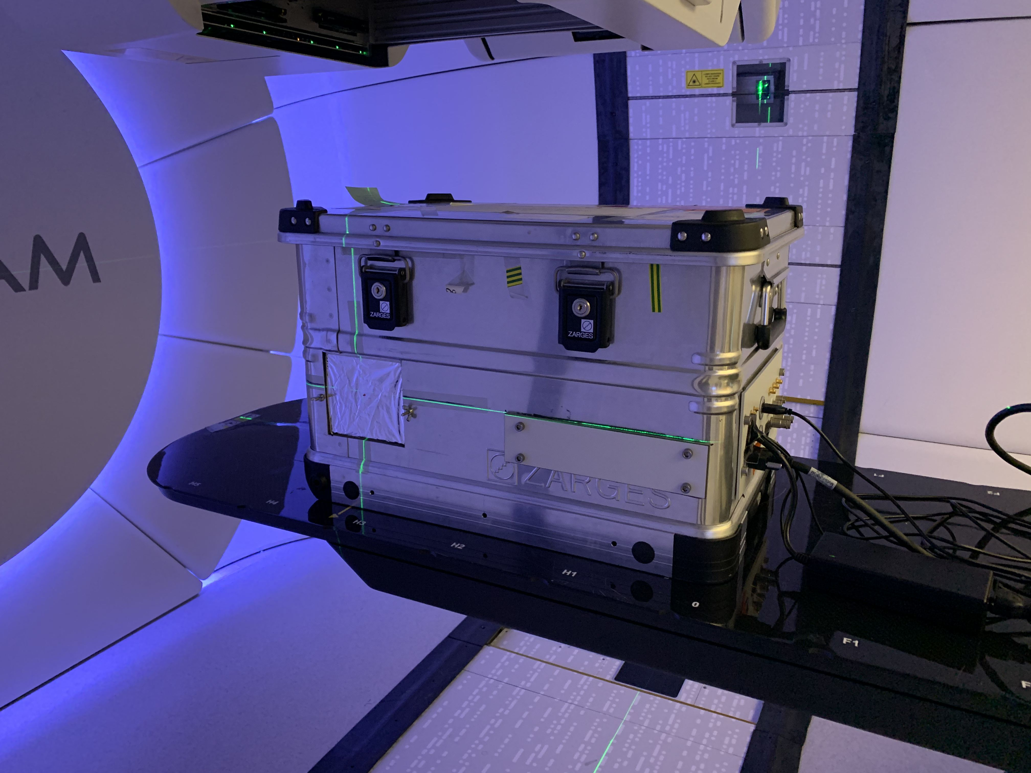
UCLH Beam Test Results
Clinical proton beam at 90 MeV:
Black: Sheet Average Light Output
Blue: Fitted Quenched Depth-Light Curve
Green: Reconstructed Depth-Dose Curve
Magenta: UCLH Reference Dose Curve
Good quality of fits, however, tend to underestimate range by about 0.5 mm.
Reconstructed range well despite poor signal-to-noise ratio.
Only using 1% of total headroom.
Real-time range reconstruction!
6 kHz data-rate, 40 Hz range fitting.
90 MeV
UNPUBLISHED DATA – DO NOT COPY OR DISTRIBUTE
L. Kelleter, S. Jolly et al., Phys. Med. Biol. 65 165001 (2020).
DOI: 10.1088/1361-6560/ab9415

Slide 16
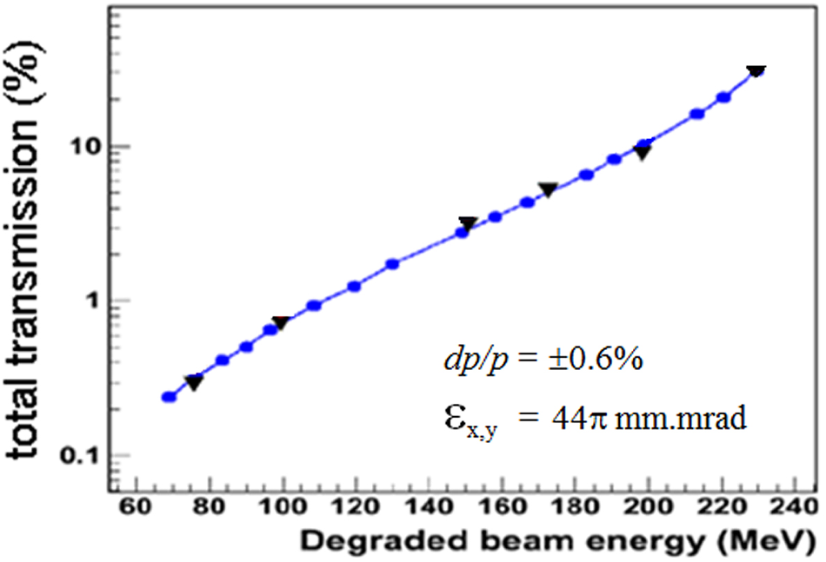
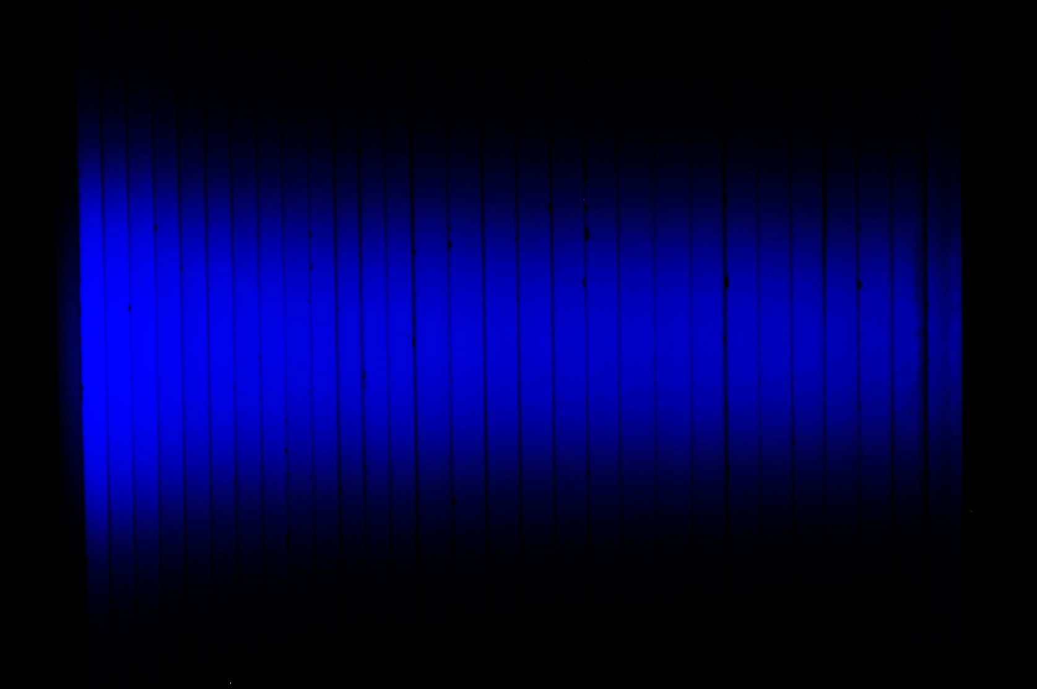
Scaling To FLASH
Dose-rate for FLASH not yet fully determined:
Most estimates around 40 Gy/s.
Corresponds to a current of 600 nA to the patient.
Current detectors used for QA fail at this level.
However, scintillation light output scales linearly with dose-rate.
Measurements made with clinical beam at UCLH with 300 nA cyclotron current.
Approx. 1% transmission ratio to treatment room.
Expect 600/(300*1%) = 200 factor increase in light.

Slide 17

Conclusions
FLASH therapy giving very promising results in early pre-clinical trials.
FLASH mechanism not well understood: related to oxygen? FLASH sparing reduced with hypoxia?
FLASH proton therapy will require changes in treatment modality:
Can we still “trickle fill” or do we need a priori knowledge of proton number per spot?
Can we steer beam fast enough or do we need to go back to older technology? Pin filters effective compromise?
Dosimetry challenges significant: can’t treat if we don’t know dose!
Will need new QA tools to ensure treatment is safe.
Scintillators provide one possible route: there will be others!
Thank you to Andreas Schüller of UHDPulse network: coordinating the dosimetry development effort.
http://uhdpulse-empir.eu/

Slide 18
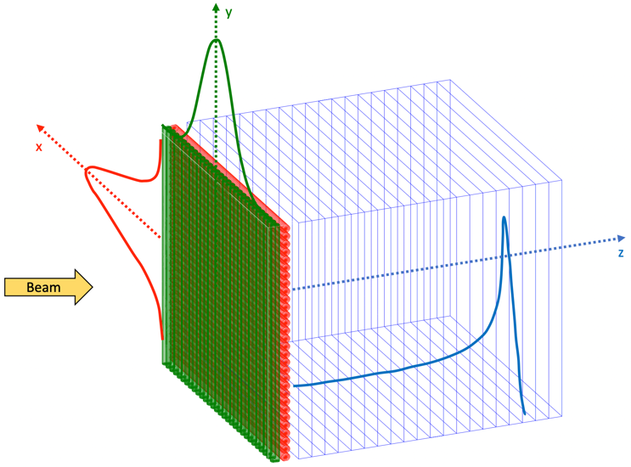
The QuADProBe (Just Funded!)
The Quality Assurance Detector for Proton Beam Therapy (QuADProBe) will enable 3D spot measurements:
Spot size and position is measured with 2 x 1D scintillating fibre arrays.
Range measured with QuARC.
Builds on well-established technology:
Scintillating fibre profile monitor already demonstrated at Heidelberg.
QuARC programme already well-established at UCL.
Very little basic detector R&D required:
Scintillating fibre array already demonstrated at Heidelberg.
Main challenges are mechanical and DAQ integration.

