Slide 1
Progress 18th - 25th January

Slide 2
Scintillation Error adaptation
Adapting the files:
Comment out the following lines which are responsible for optical photon processes:
Line 37 from exampleB1.cc:
physicsList->RegisterPhysics(new G4OpticalPhysics());
Line 149 from plotHisto.cc:
hist5->Draw("HIST");
The following line has also been commented out to take out a plot that will not be used currently:
photons->Draw("same");

Slide 3
Recompiling the files
If changes have been made to the plotHisto.cc, recompile:
$ g++ -o plotHisto ../plotHisto.cc `root-config --cflags --glibs` -O3
If changes have been made to any other sources files or header files, recompile:
$ cmake -DCMAKE_PREFIX_PATH=/Users/username/Applications/GEANT4/geant4-v11.0.3-install/lib/Geant4-11.0.3/ ../'
An alias has been made and saved in the .zshrc file
alias g4cmake='cmake -DCMAKE_PREFIX_PATH=/Users/username/Applications/GEANT4/geant4-v11.0.3-install/lib/Geant4-11.0.3/ ../'
If changes have been made to the macro file (run.mac), the files don’t have to be recompiled; just run the simulation with the macro file:
$ ./exampleB1 run.mac

Slide 4
Changing beam settings using the macro file
Produce a histogram with the chosen parameters/settings executing the line:
$ ./plotHisto output0.root true
In the build folder of the simulation
For a beam with Gaussian straggling:
/gps/ene/type Gauss
For this distribution of the beam’s energy, the sigma value can be changed:
/gps/ene/sigma [energy value] MeV
For a mono-energetic beam:
/gps/ene/type/ Mono
The macro file can be used to change the energy of the beam:
/gps/ene/mono [energy value] MeV
The number of particles in the run is changed with:
/run/beamOn [number of particles]
The progress of the run can be show using the function:
/run/printProgress [number of particles]
To do a point-like source:
/gps/pos/type Beam is changed to /gps/pos/type Point

Slide 5
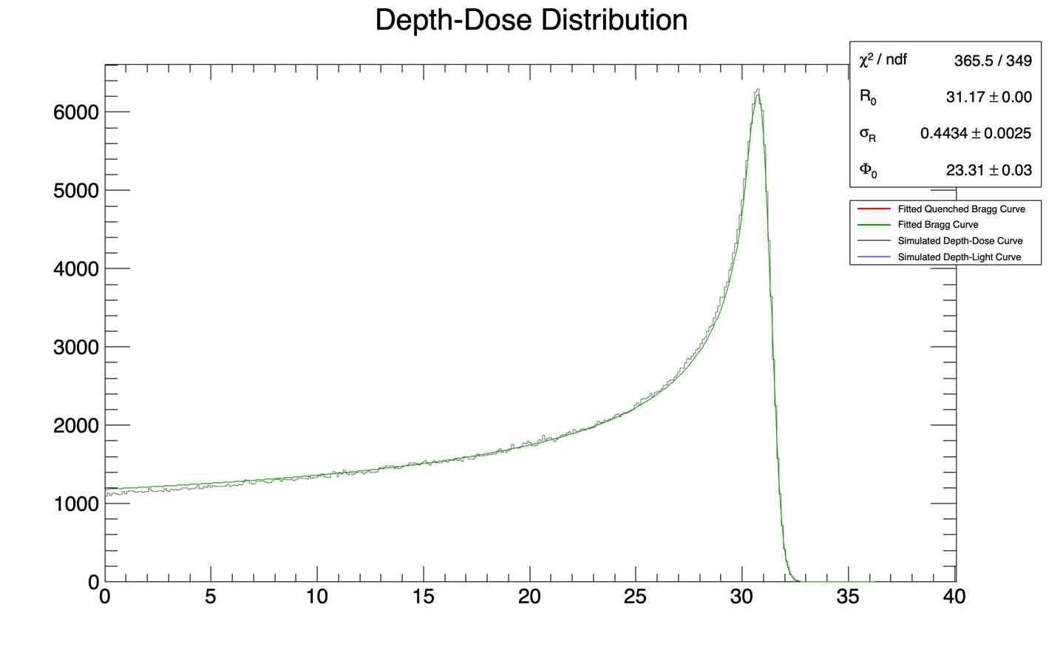
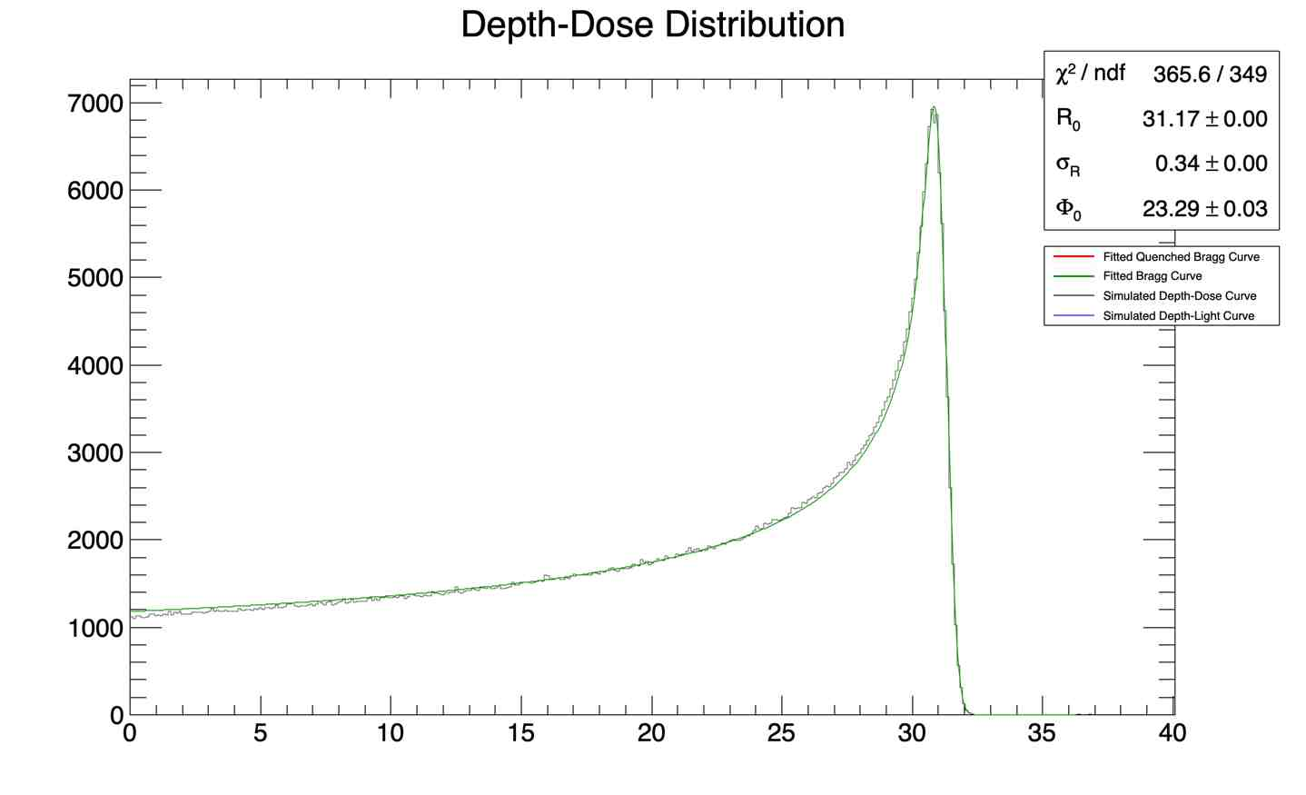
Gaussian straggling vs mono-energetic beam
/gps/ene/type Gauss
/gps/ene/mono 60 MeV
/gps/ene/sigma 0.3 MeV
/run/beamOn 10000
/gps/ene/type Mono
/gps/ene/mono 60 MeV
/run/beamOn 10000

Slide 6
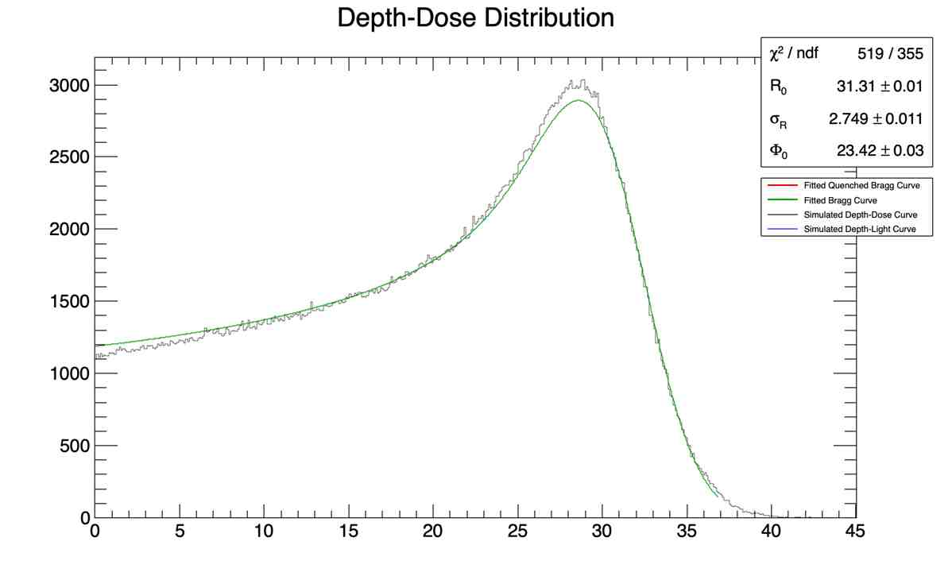
Beam energy: small spread vs large spread
/gps/ene/type Gauss
/gps/ene/mono 60 MeV
/gps/ene/sigma 0.3 MeV
/run/beamOn 10000
/gps/ene/type Gauss
/gps/ene/mono 60 MeV
/gps/ene/sigma 3 MeV
/run/beamOn 10000

Slide 7
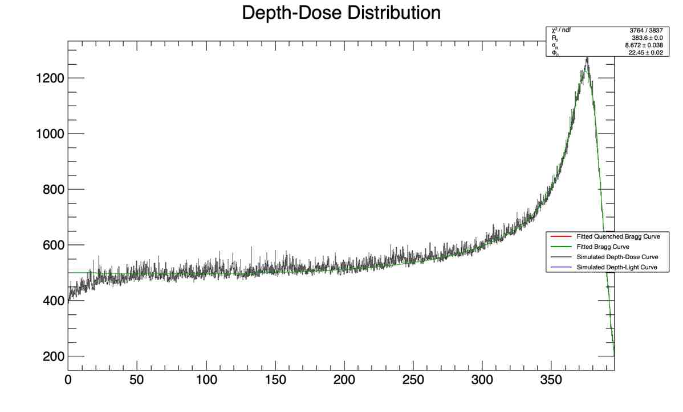
Low energy beam vs High energy beam
/gps/ene/type Gauss
/gps/ene/mono 60 MeV
/gps/ene/sigma 0.3 MeV
/run/beamOn 10000
/gps/ene/mono 250 MeV
/gps/ene/sigma 0.3 MeV
/run/beamOn 10000

Slide 8
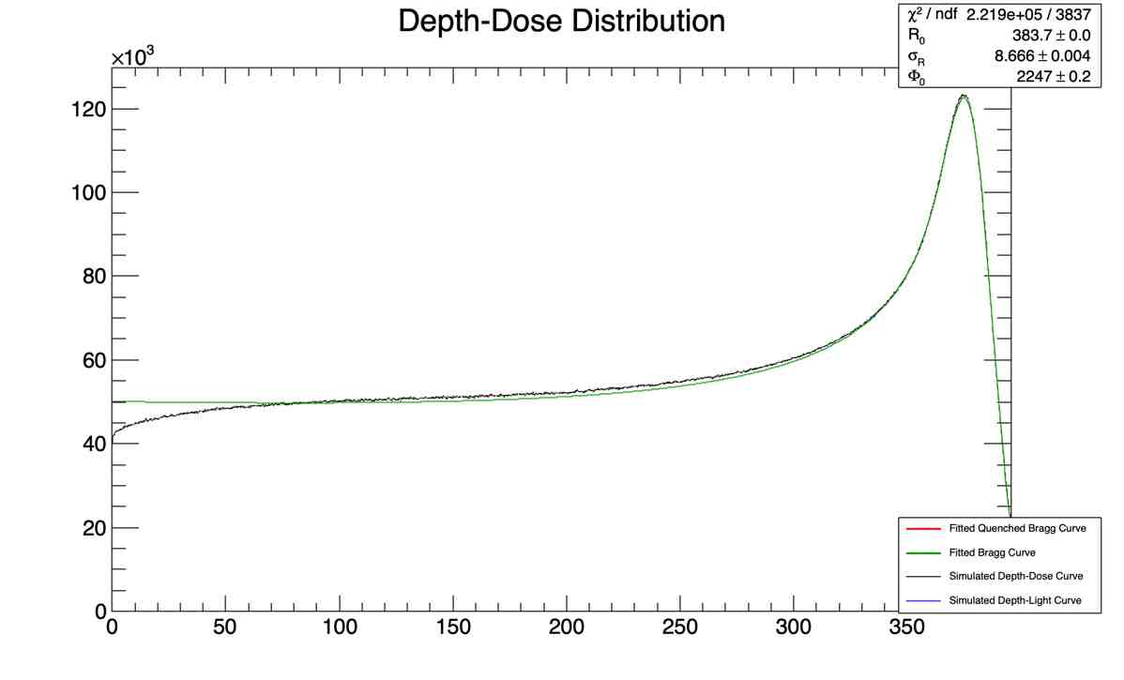
Does the curve get smoother with more particles?
/gps/ene/mono 250 MeV
/gps/ene/sigma 0.3 MeV
/run/beamOn 10000
/gps/ene/mono 250 MeV
/gps/ene/sigma 0.3 MeV
/run/beamOn 1000000

Slide 9
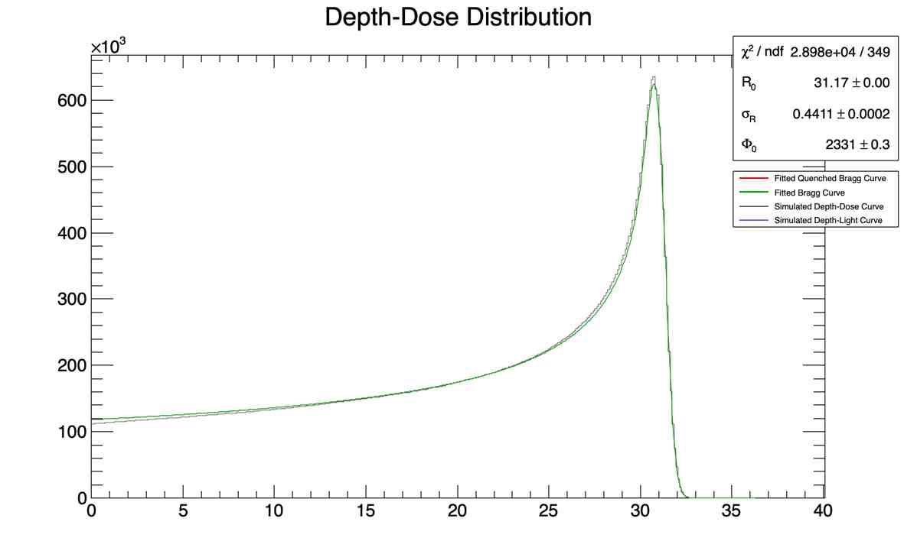
Small number of particles vs large
/gps/ene/type Gauss
/gps/ene/mono 60 MeV
/gps/ene/sigma 0.3 MeV
/run/beamOn 10000
/gps/ene/type Gauss
/gps/ene/mono 60 MeV
/gps/ene/sigma 0.3 MeV
/run/beamOn 1000000

Slide 10
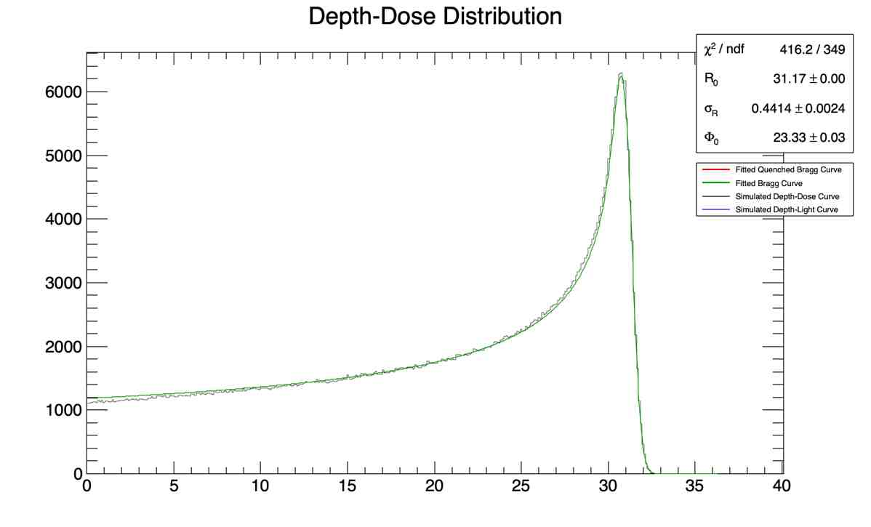
Non-point like source vs Point like source
# General particle source
# proton circle source
/gps/pos/shape Circle
/gps/pos/centre 0. 0. -19.2 cm
/gps/pos/radius 0. mm
/gps/pos/sigma_r 2. mm
/gps/particle proton
/gps/pos/type Beam
/gps/direction 0 0 1
# General particle source
# proton circle source
/gps/pos/shape Circle
/gps/particle proton
/gps/pos/type Point
/gps/direction 0 0 1

