Slide 1
Progress 25th January - 1st February

Slide 2
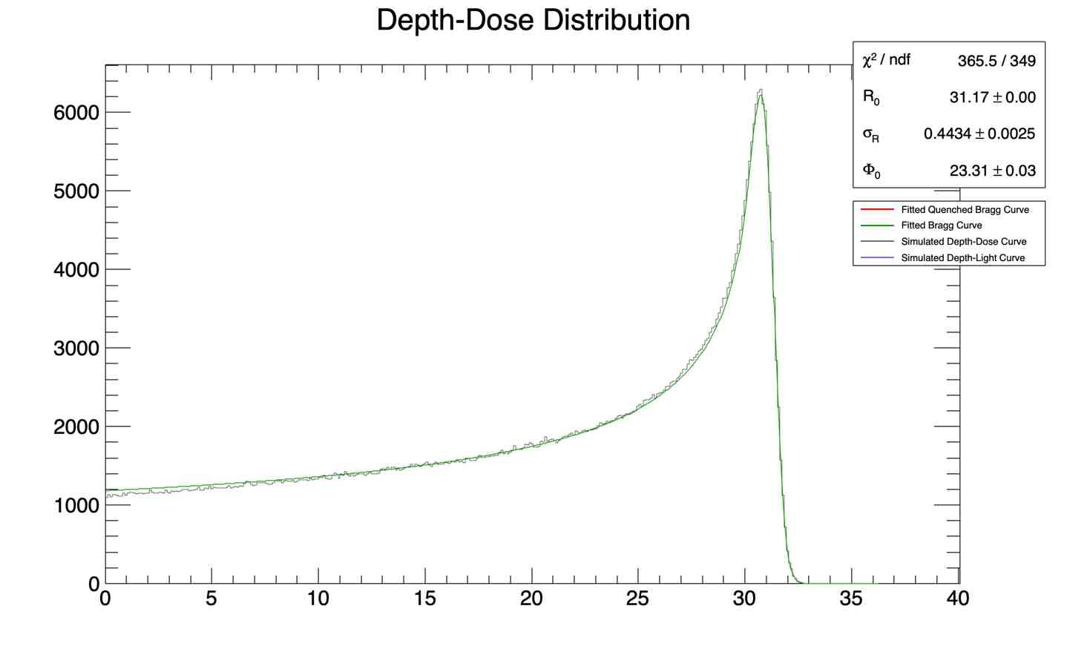
Context and Introduction - depth-dose curves
Dose Depth Curves - energy deposited in (mega) electronvolts along a distance (water-equivalent thickness in milimeters)
To generate depth-dose curve:
Modify the macro file to change the run parameters
Run the simulation with the macro file
Plot the histogram using a ROOT file

Slide 3
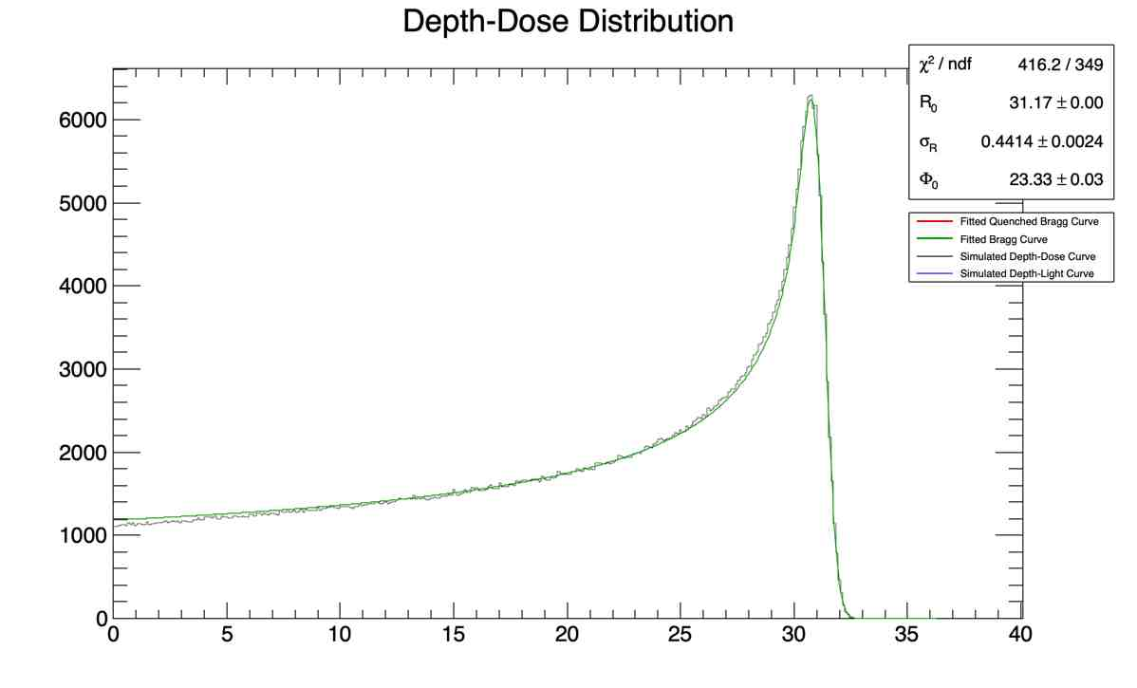
Non-point like source vs Point like source
# General particle source
# proton circle source
/gps/pos/shape Circle
/gps/pos/centre 0. 0. -19.2 cm
/gps/pos/radius 0. mm
/gps/pos/sigma_r 2. mm
/gps/particle proton
/gps/pos/type Beam
/gps/direction 0 0 1
# General particle source
# proton circle source
/gps/pos/shape Circle
/gps/particle proton
/gps/pos/type Point
/gps/direction 0 0 1

Slide 4
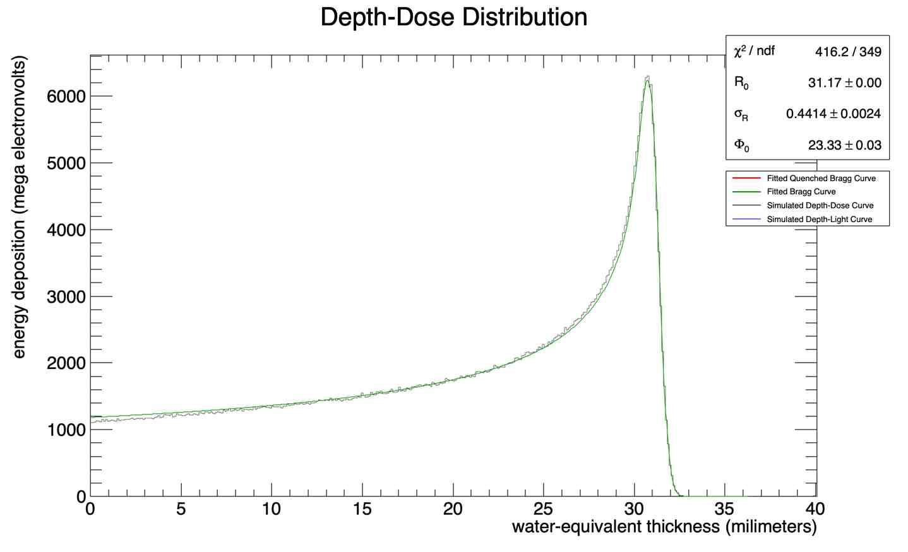
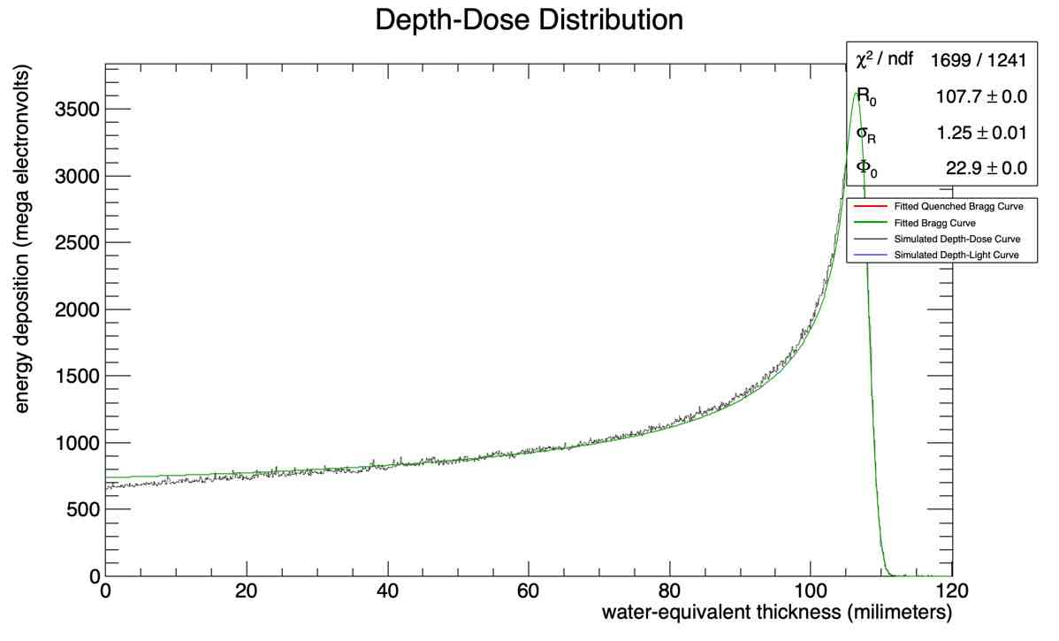
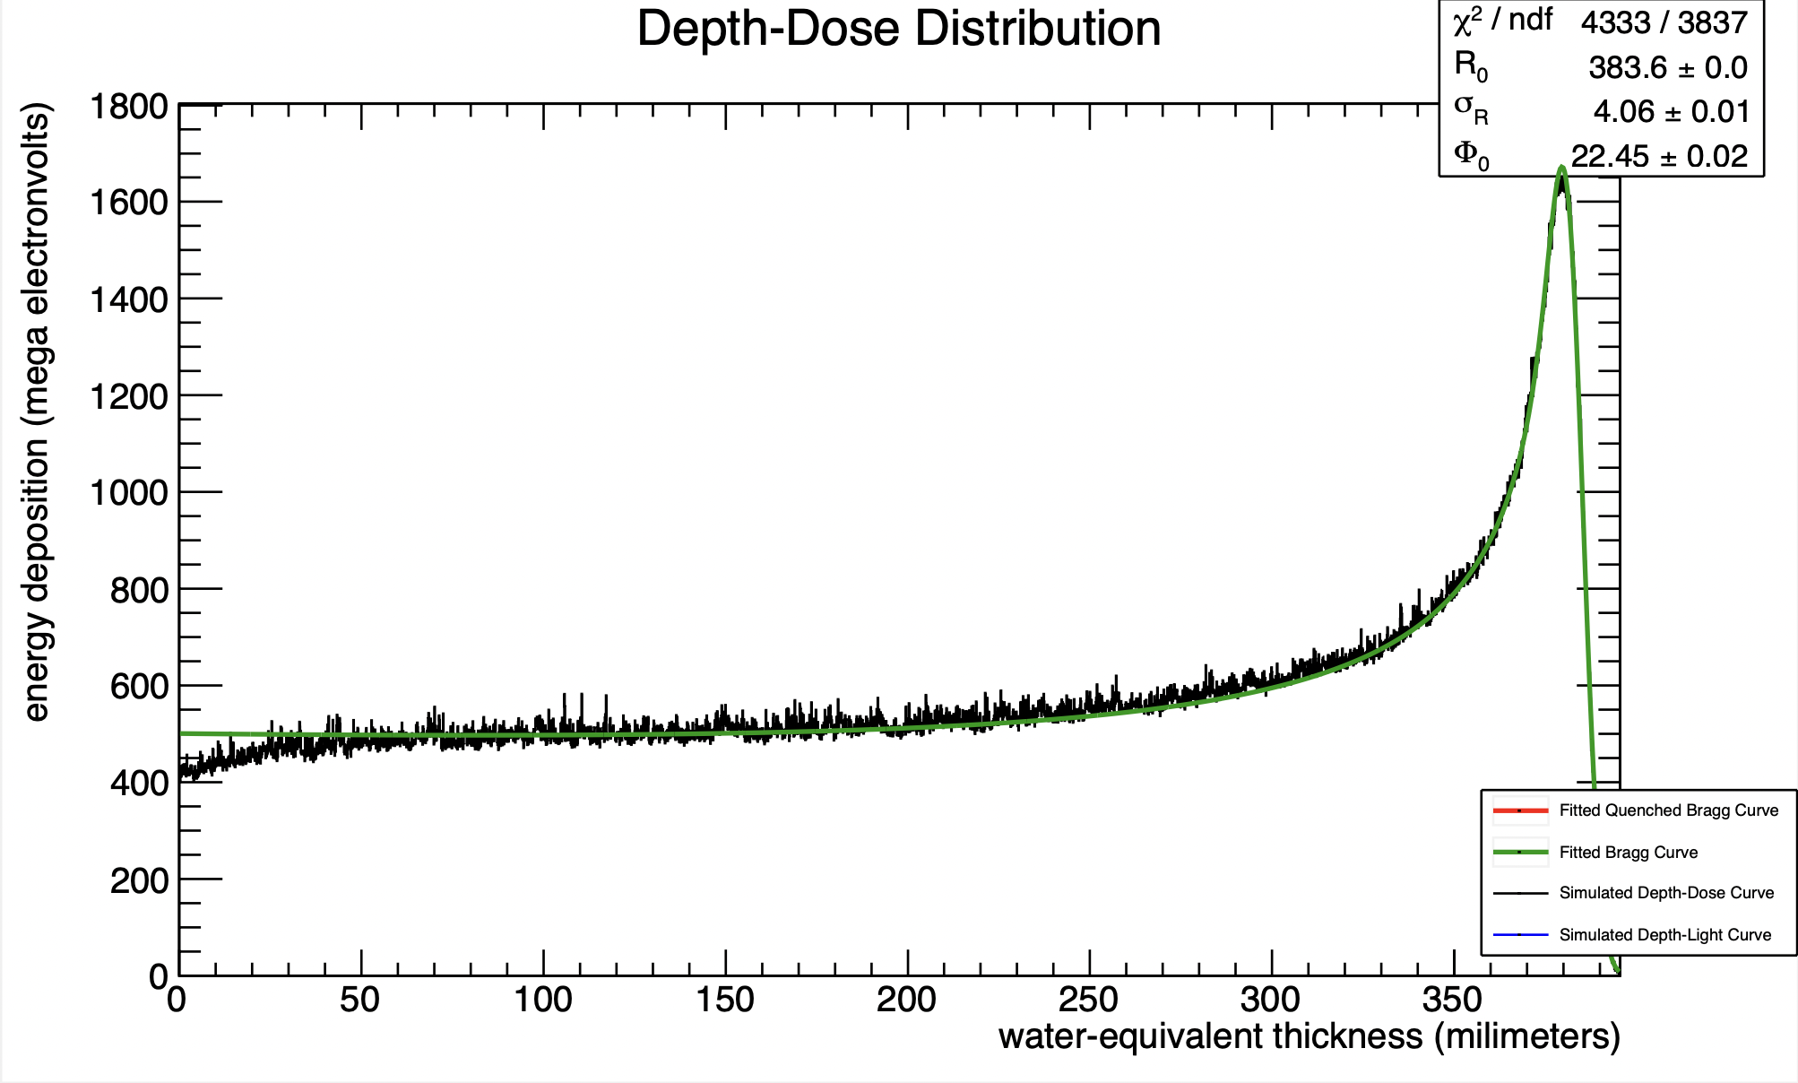
Point-like source at higher energies

Slide 5
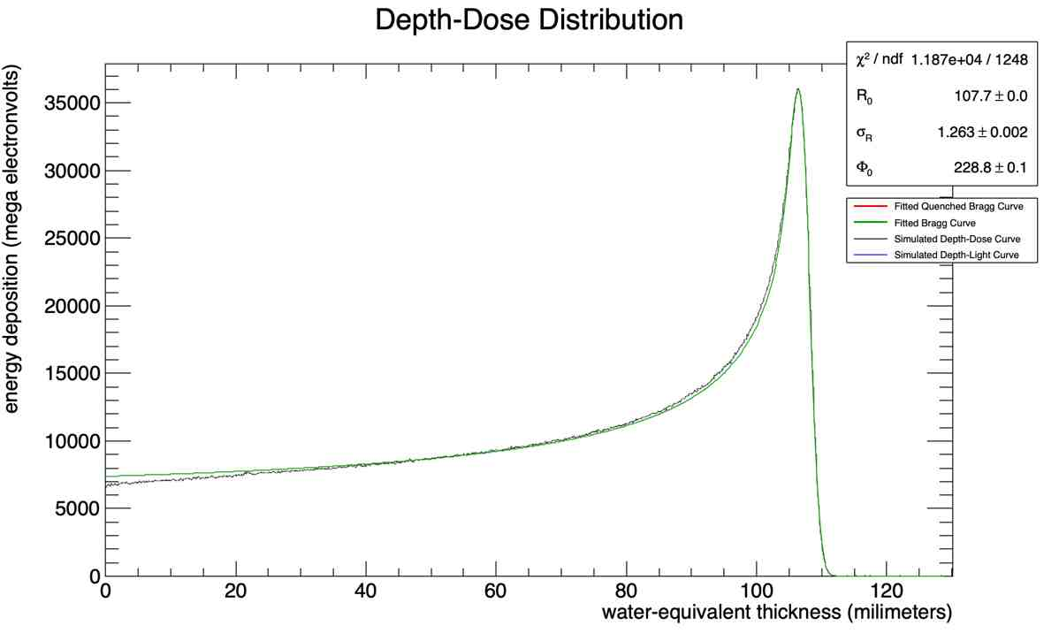
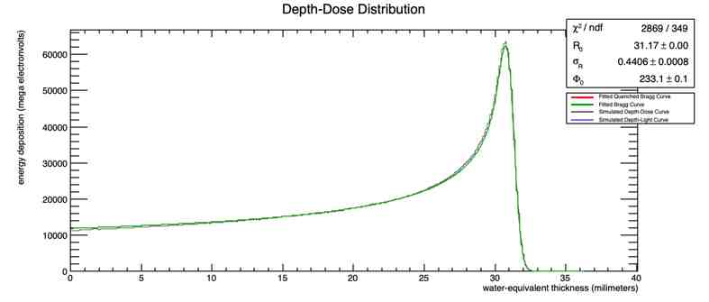
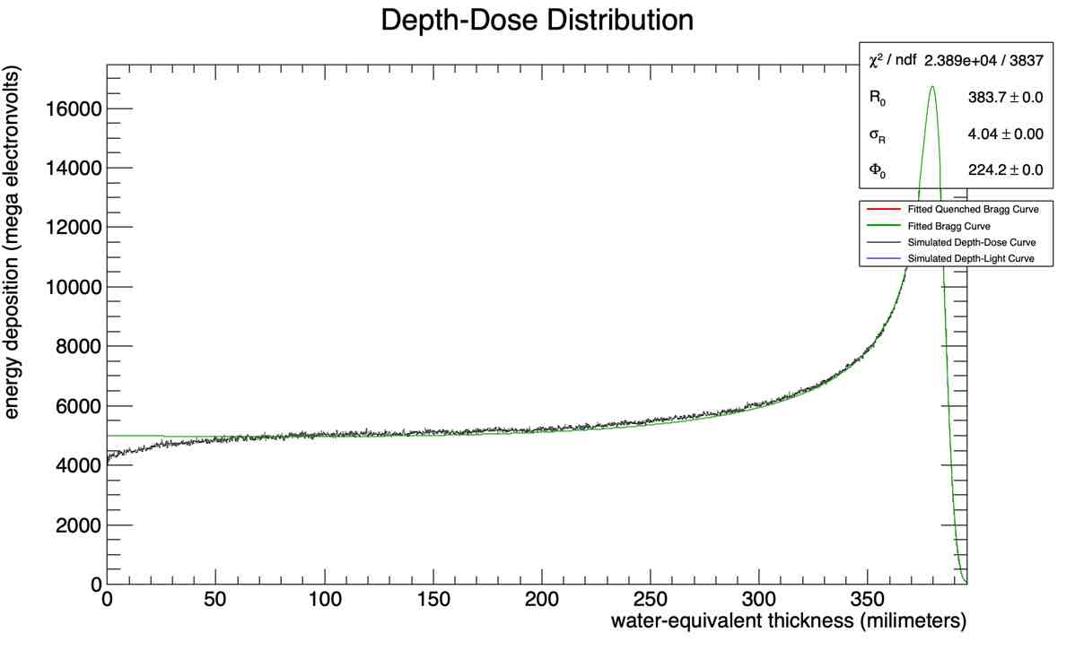
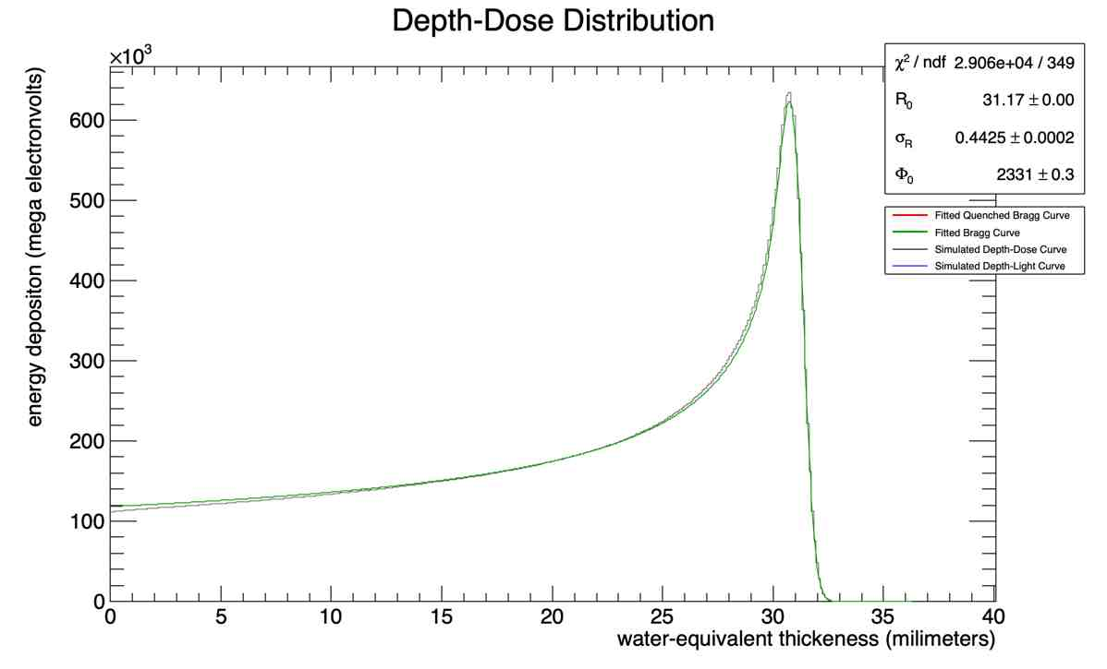
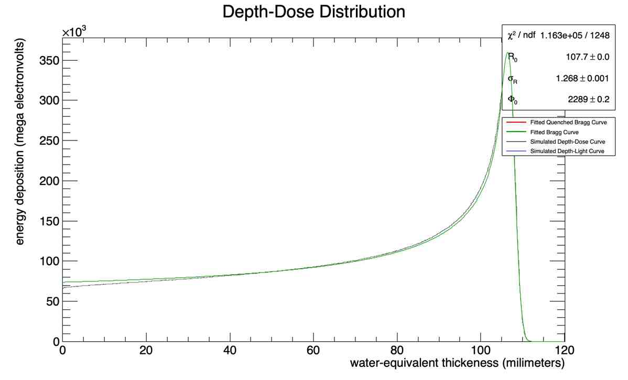
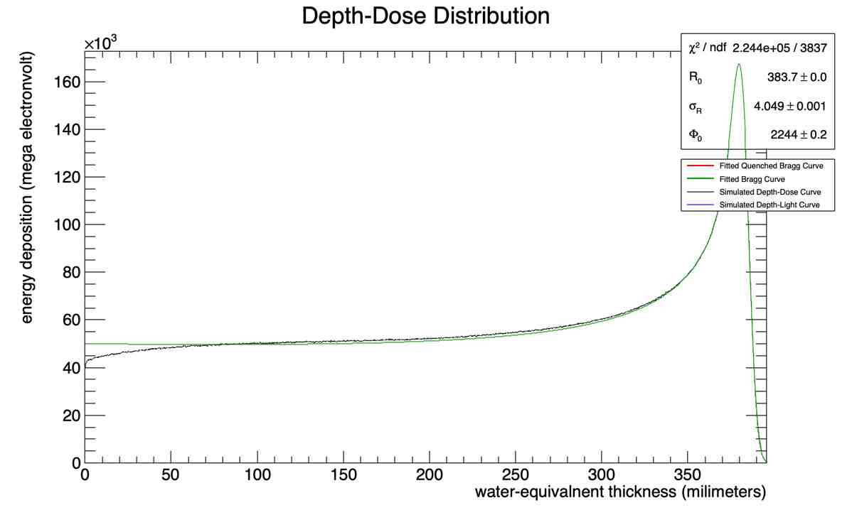
Point like source for higher energies and larger number of particles
Number of particles /energy in MeV | 60 | 120 | 250
10000
100000
1000000

Slide 6
Full error message
G4WT4 > --> Event 0 starts with initial seeds (13049039,61775110).
G4WT4 > G4VParticleChange::CheckIt : the true step length is negative !! Difference: 0.0387463[MeV]
G4WT4 > opticalphoton E=3.34861e-06 pos=-0.000520943, 0.00242823, -0.191418
G4WT4 > -----------------------------------------------
G4WT4 > G4ParticleChange Information
G4WT4 > -----------------------------------------------
G4WT4 > # of secondaries : 0
G4WT4 > -----------------------------------------------
G4WT4 > Energy Deposit (MeV): 0
G4WT4 > Non-ionizing Energy Deposit (MeV): 0
G4WT4 > Track Status : StopAndKill
G4WT4 > True Path Length (mm) : -0.0387
G4WT4 > Stepping Control : 0
G4WT4 > First step in volume
G4WT4 > Mass (GeV) : 0
G4WT4 > Charge (eplus) : 0
G4WT4 > MagneticMoment : 0
G4WT4 > = : 0*[e hbar]/[2 m]
G4WT4 > Position - x (mm) : -0.521
G4WT4 > Position - y (mm) : 2.43
G4WT4 > Position - z (mm) : -191
G4WT4 > Time (ns) : -0.000178
G4WT4 > Proper Time (ns) : 0
G4WT4 > Momentum Direct - x : -0.243
G4WT4 > Momentum Direct - y : 0.113
G4WT4 > Momentum Direct - z : -0.963
G4WT4 > Kinetic Energy (MeV): 3.35e-06
G4WT4 > Velocity (/c) : 0.725
G4WT4 > Polarization - x : -0.634
G4WT4 > Polarization - y : 0.733
G4WT4 > Polarization - z : 0.246
G4WT4 >
-------- EEEE ------- G4Exception-START -------- EEEE -------
*** G4Exception : TRACK001
issued by : G4VParticleChange::CheckIt()
Step length and/or energy deposit was illegal
*** Event Must Be Aborted ***
G4WT4 > G4Track (0x142653ea8) - track ID = 2, parent ID = 1
G4WT4 > Particle type : opticalphoton - creator process : Scintillation, creator model : Undefined
G4WT4 > Kinetic energy : 3.34861 eV - Momentum direction : (-0.242935,0.113321,-0.963401)
G4WT4 > Step length : -38.7463 um - total energy deposit : 0 eV
G4WT4 > Pre-step point : (-0.530356,2.43262,-191.455) - Physical volume : Sheet (Scintillator)
G4WT4 > - defined by : not available
G4WT4 > Post-step point : (-0.520943,2.42823,-191.418) - Physical volume : Sheet (Scintillator)
G4WT4 > - defined by : OpWLS - step status : 4
G4WT4 > *** Note: Step information might not be properly updated.
G4WT4 >
-------- EEEE -------- G4Exception-END --------- EEEE -------

Slide 7
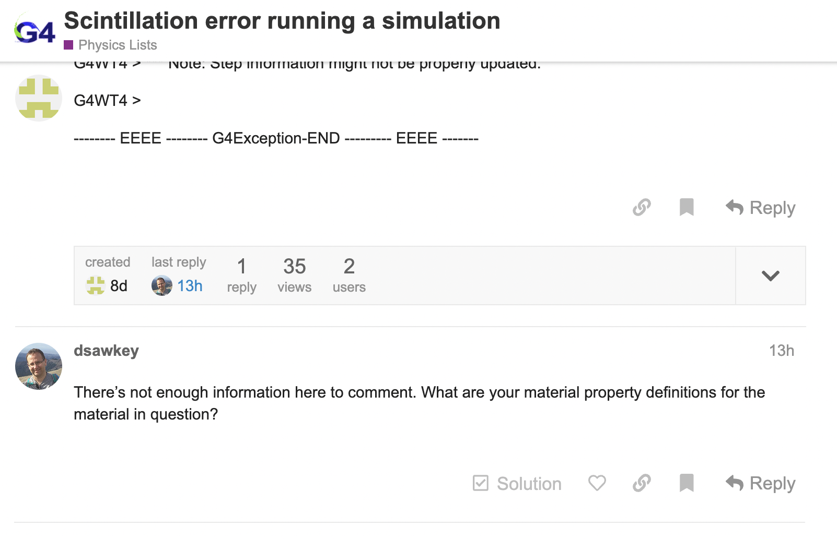
Geant4 forum responses

Slide 8
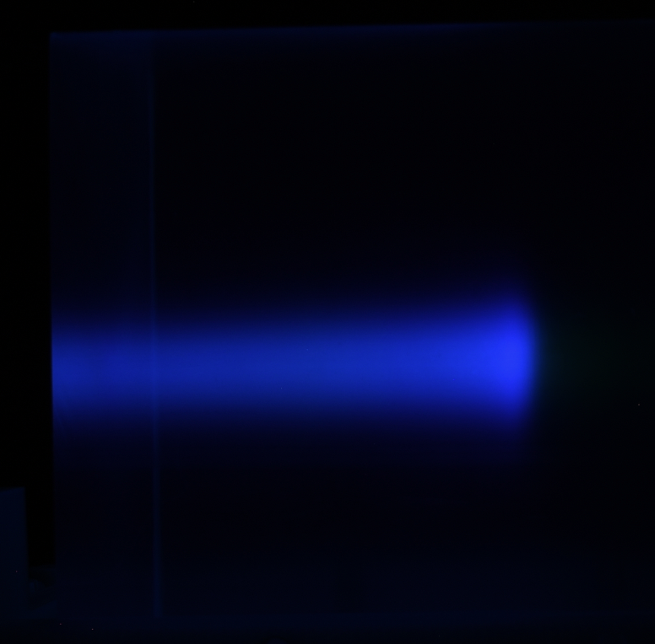
Image analysis outline:
Simple sum each column to get the total pixel count
Subtract the background image
Measure the brightness of the total pixel count of each column
Geometric analysis: convert the x-axis from pixel column number to physical thickness in water equivalent thickness
Image analysis in Python - research:
How to adjust for the geometric effects of the images?
How do we measure the brightness of a pixel?

