Slide 1
Progress 1st Feb-8th Feb

Slide 2
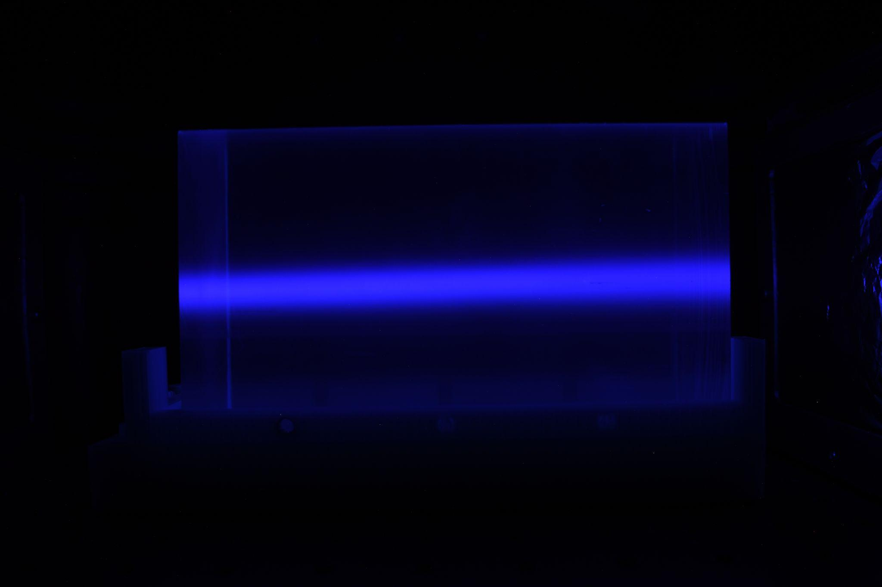
Image Analysis

Slide 3
Measuring Brightness using RBG values
Method 1 - measuring the image brightness using only the blue channel
Method 2 - measuring the image brightness value using all three colour channels
Method 3 - measuring the image brightness using all three colour channels (simplified)

Slide 4
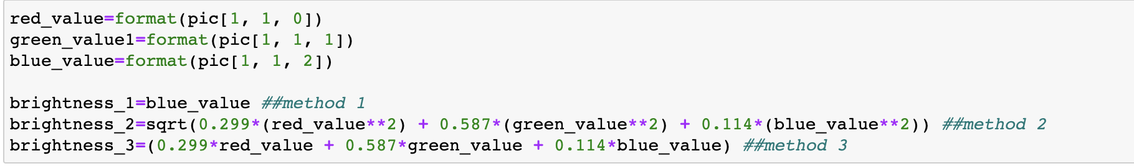
Measuring the Brightness of an Individual Pixel

Slide 5
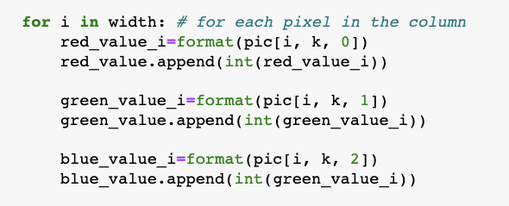
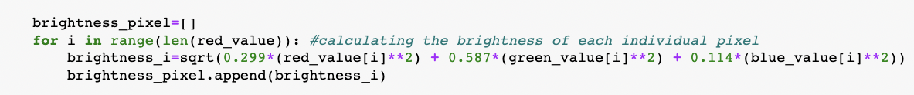
Measuring the Brightness of a Whole Column
The output: an array of pixel brightness values for the whole column

Slide 6
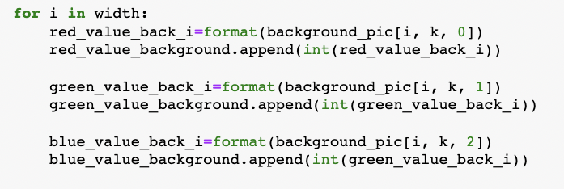
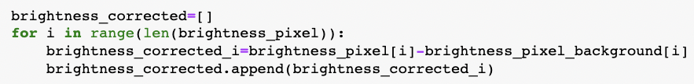
Accounting for background
The output: an array of background pixel brightness values for the whole column

Slide 7

Measuring the Brightness SUM of a Whole Column
The output: a single value - the sum of individual pixel brightness values

Slide 8
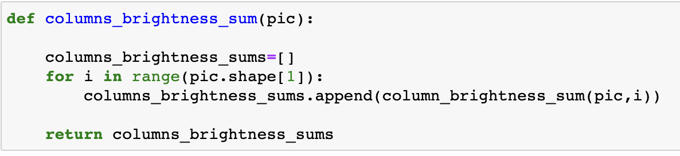
The Brightness Value for each Column in the Picture

Slide 9
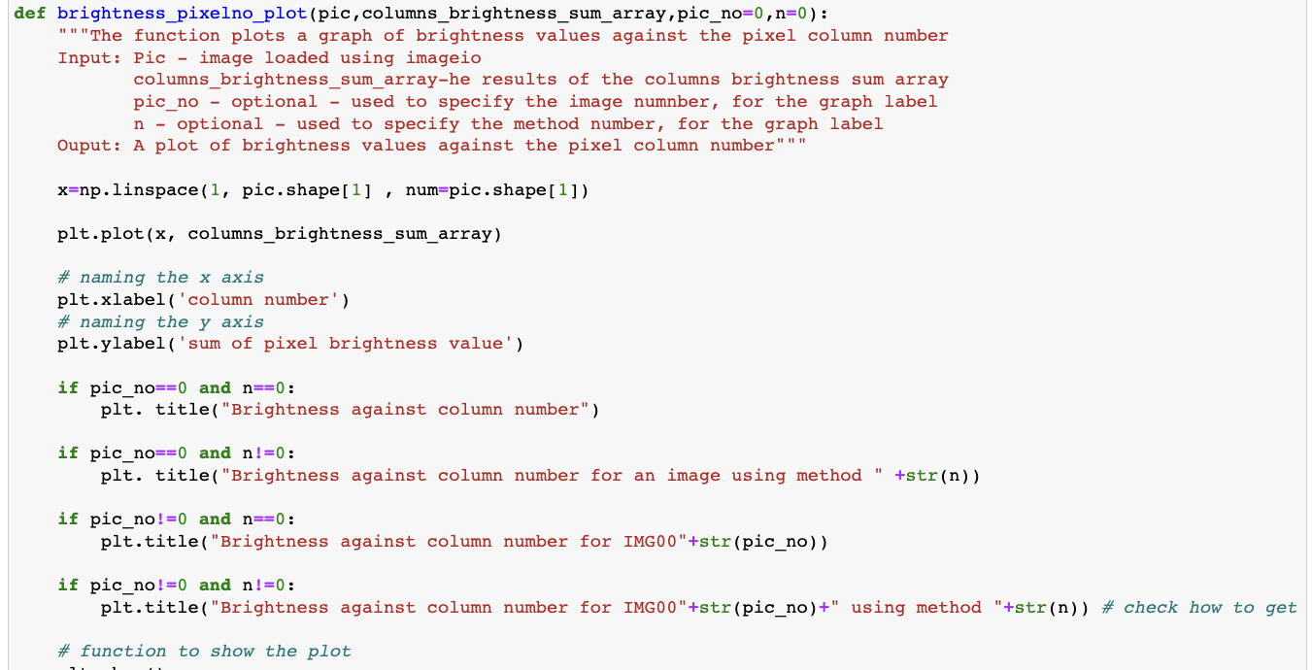
Producing a plot

Slide 10
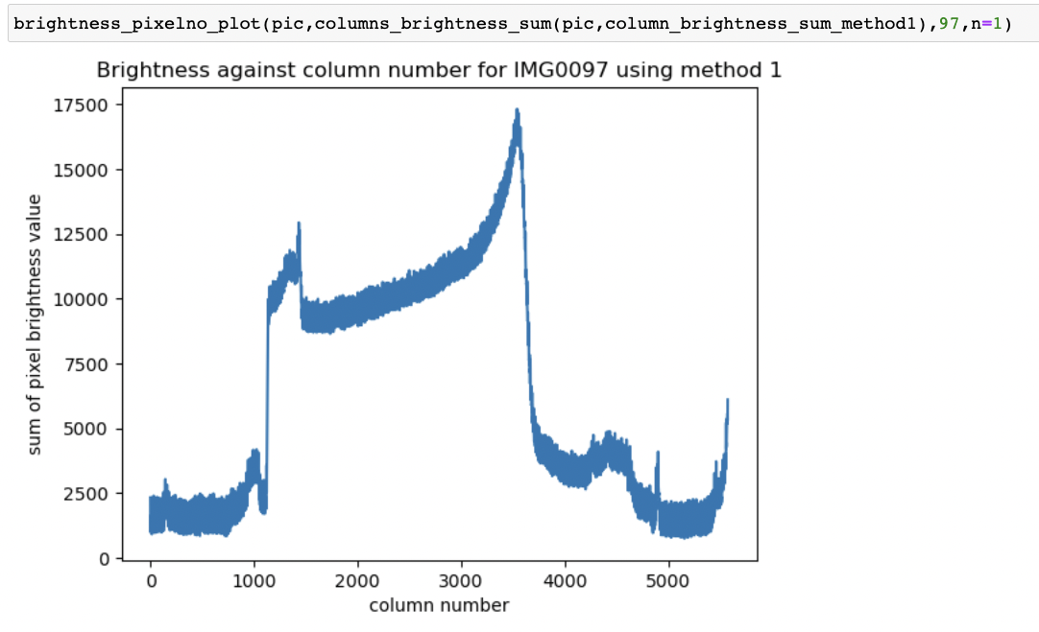
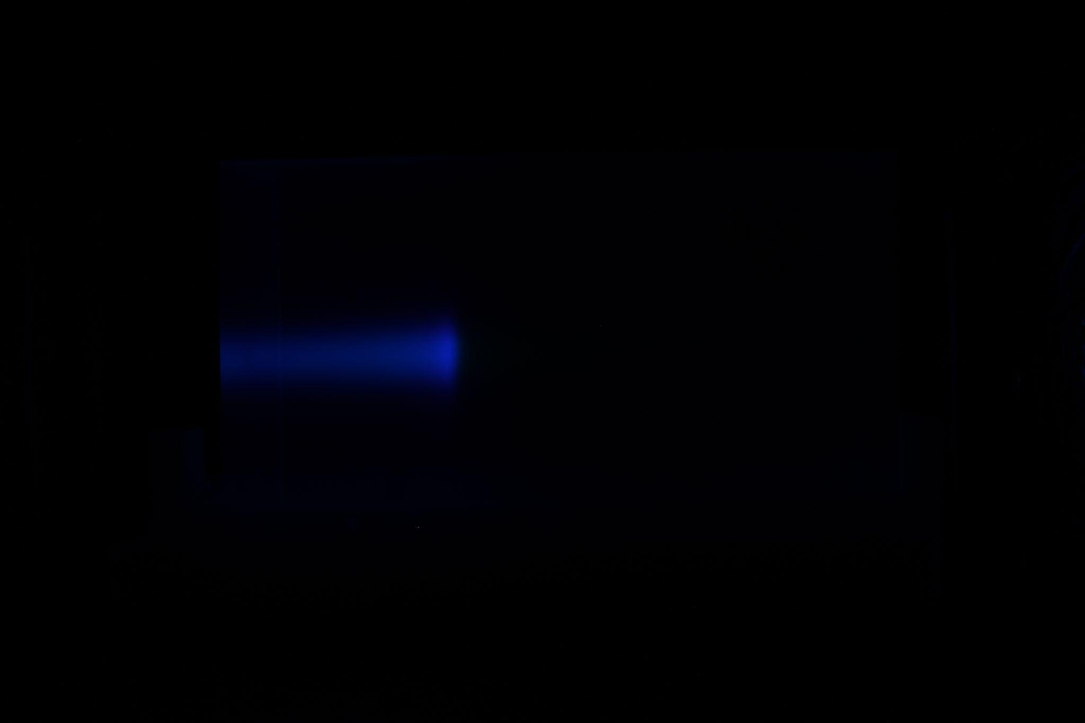
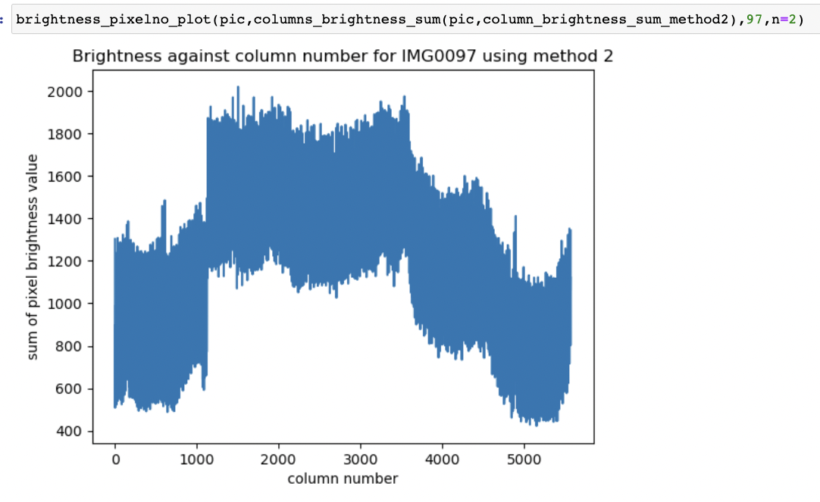
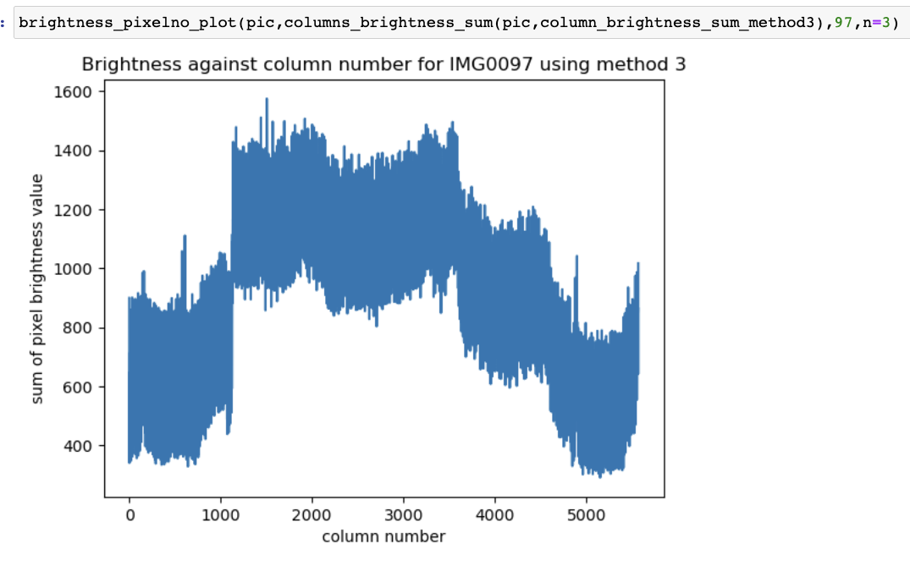
Method comparison, background not accounted for

Slide 11
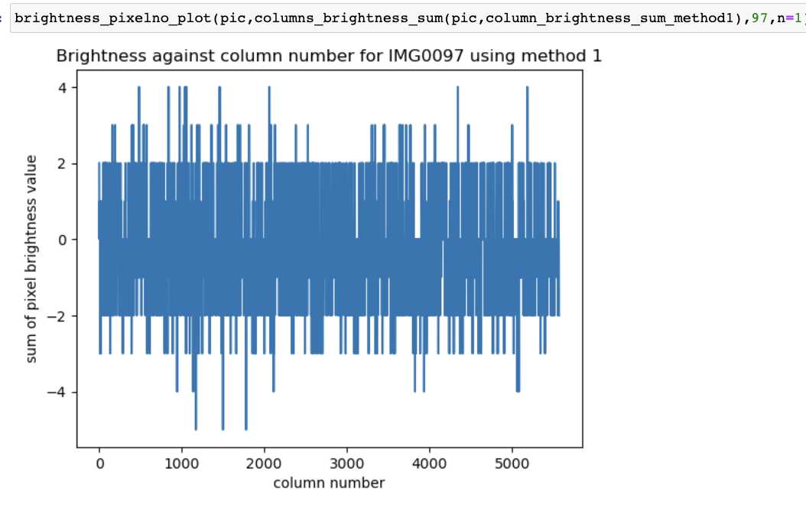
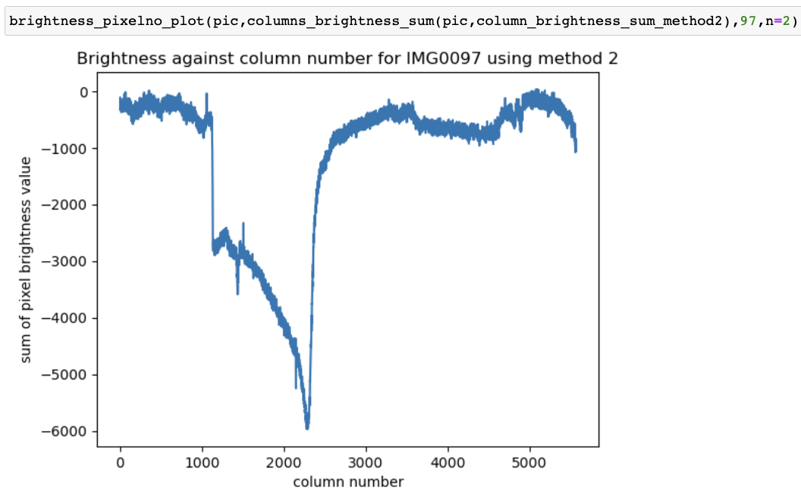
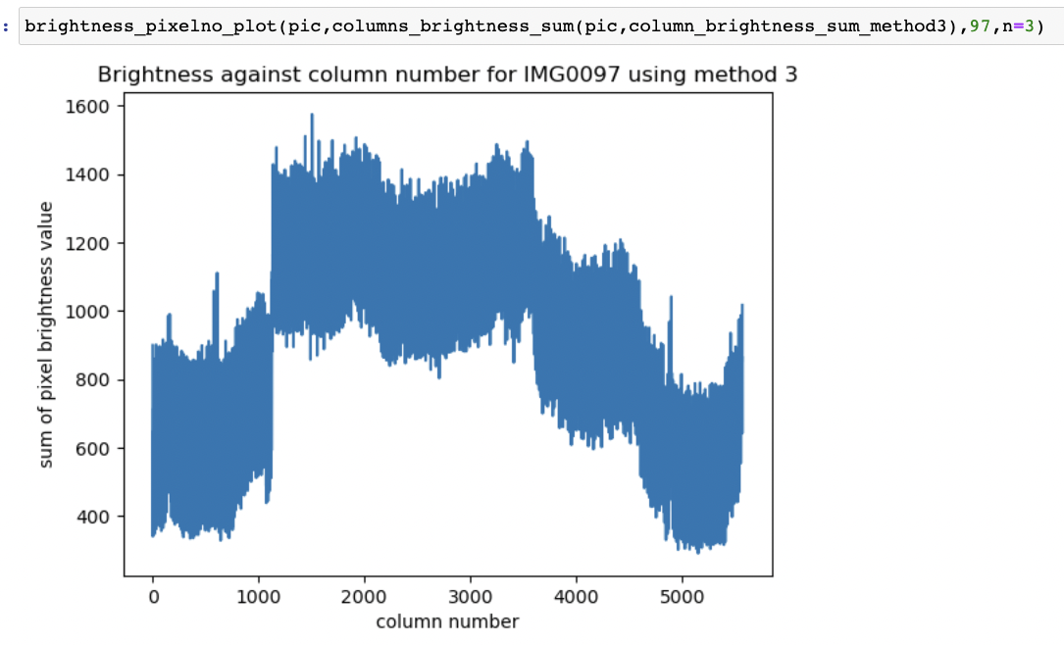
Method comparison, background accounted for

Slide 12
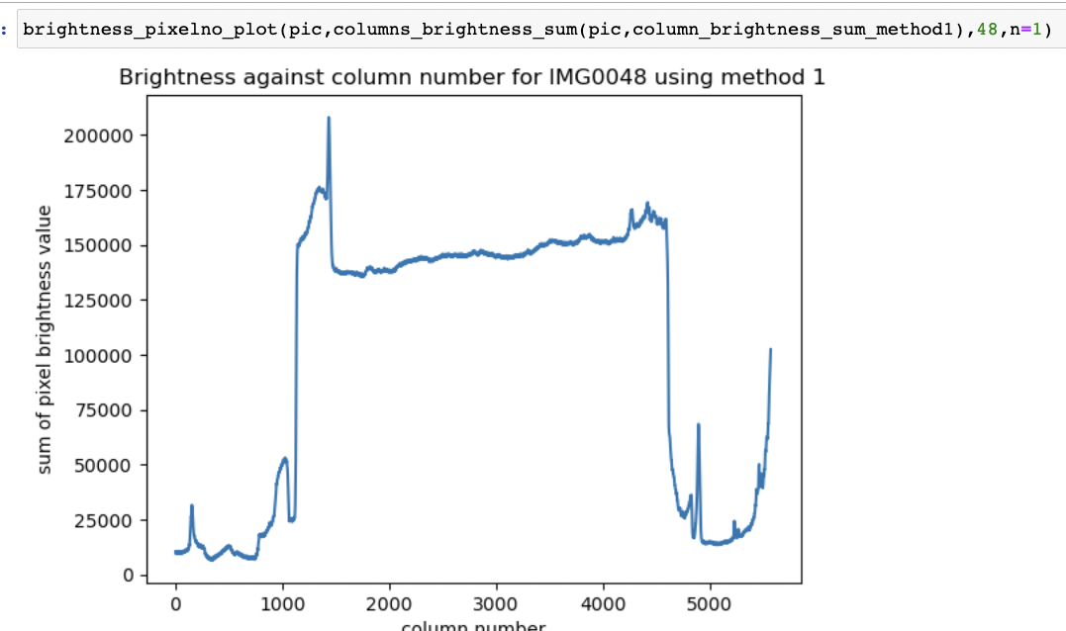
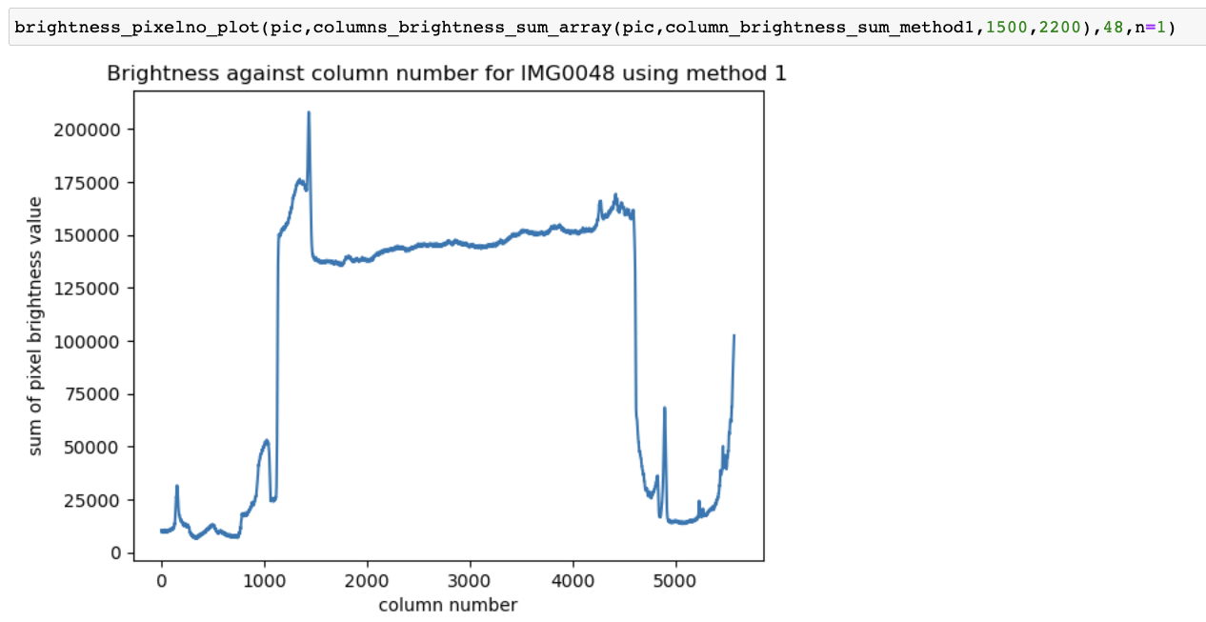
Restricting the range (background not accounted for)

