Slide 1
Progress 8th-15th February

Slide 2
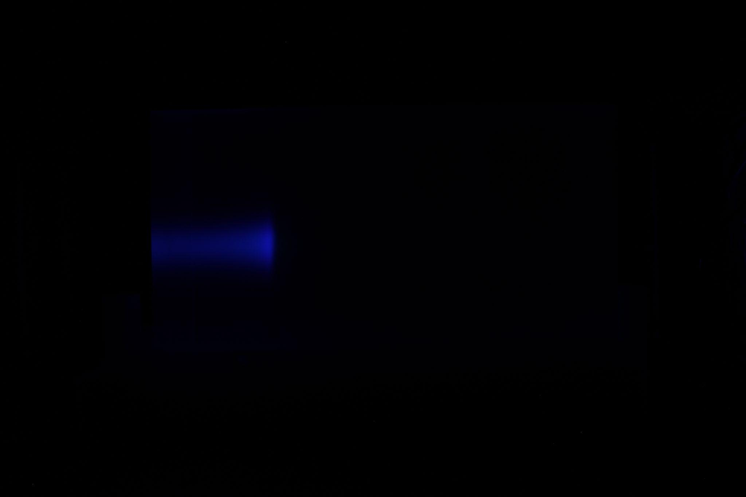
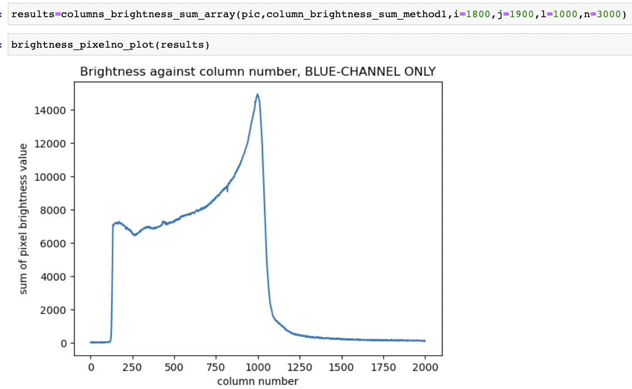
Image Analysis - introduction
Beam test images are analysed to obtain experimental data. Images are analysed in Python to obtain a brightness value for individual pixels.
The sum of the pixel brightness for an entire image column of is obtained; this is used to construct a depth-dose curve (brightness value against column number plot shown on the following slide). The schematic on the following slide shows the steps of image analysis, including how the image is pre-processed using width and height restrictions.

Slide 3
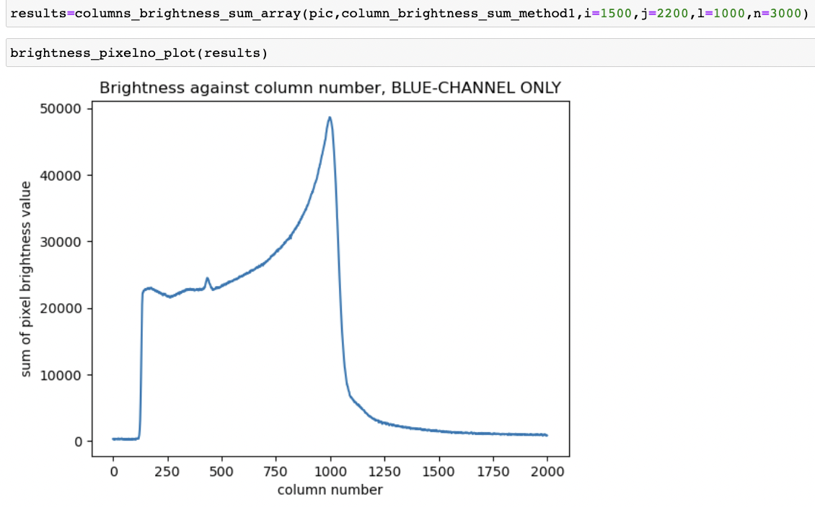
Image Analysis, continued

Slide 4
(0,0)
(pic.shape[1],0)
parameters i and j are used to control the height or the columns
(n,i)
(l,i)
parameters n and l are used to control the width of the image
(n,j)
(l,j)
(0,pic.shape[0])
(pic.shape[1],pic.shape[0])

Slide 5
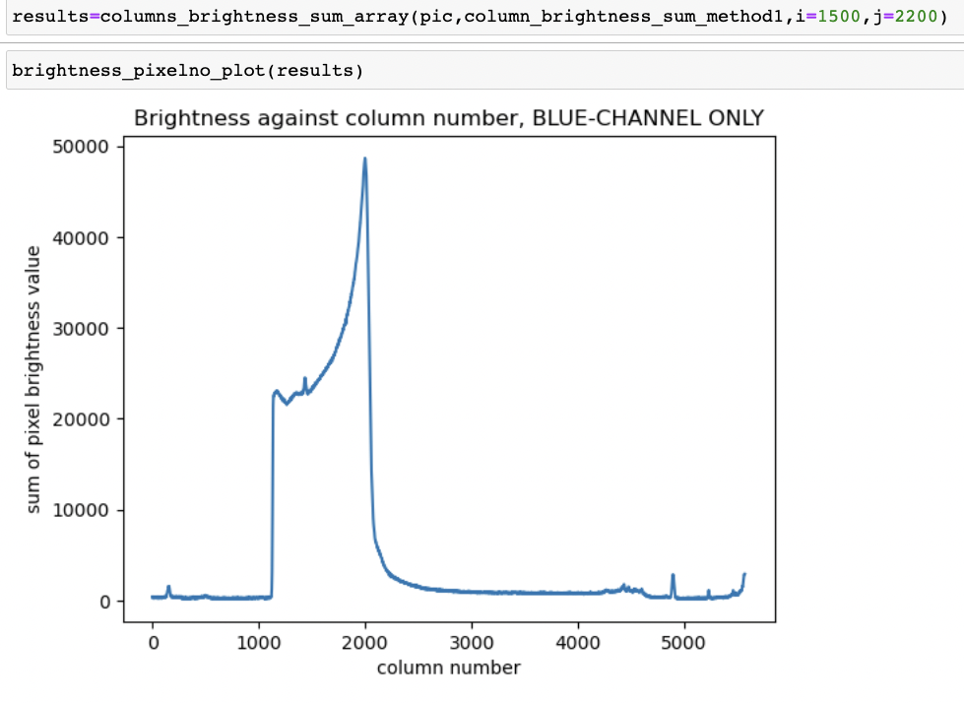
Implementing height and width restrictions
Note here: column number 0 is actually the value l

Slide 6
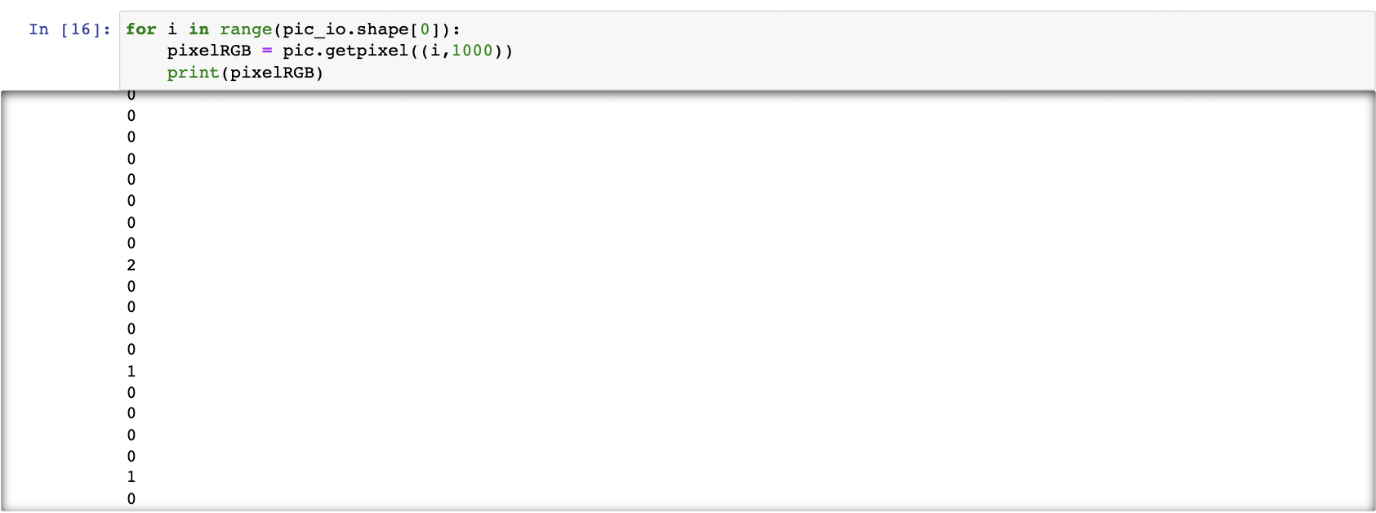
Greyscale in PILLOW
The image analysis Python module, PILLOW, will not be used to convert the images to greyscale as the values which are being obtained are not precise enough for the purpose.

Slide 7
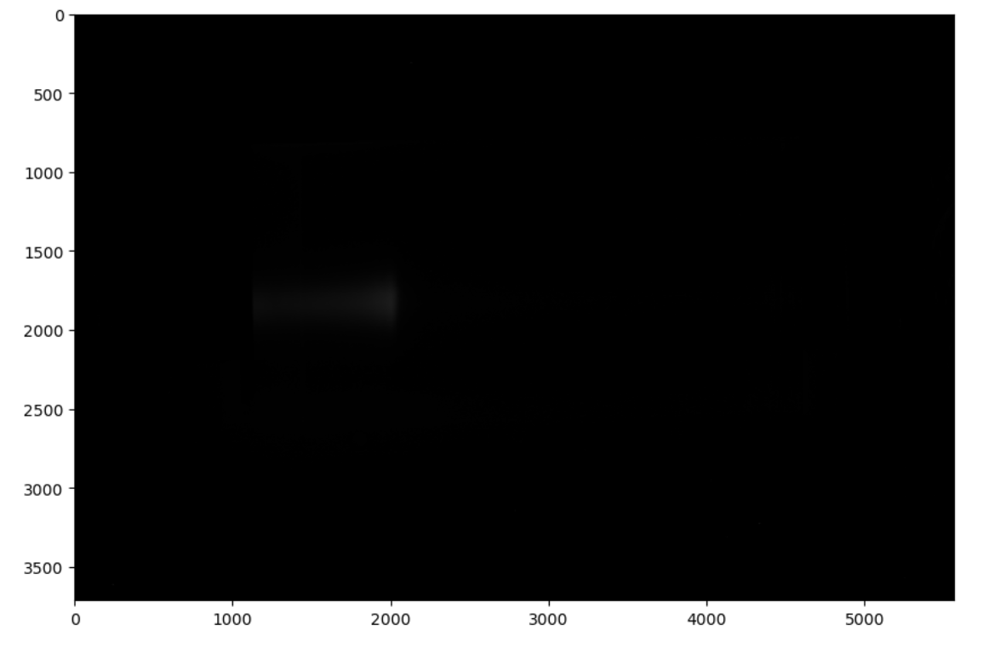
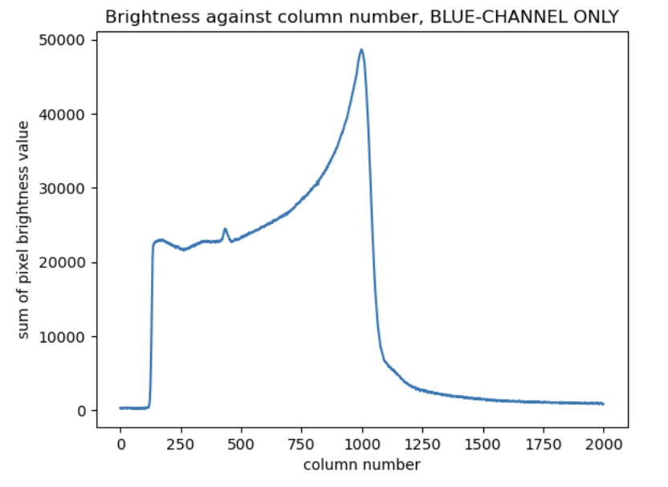
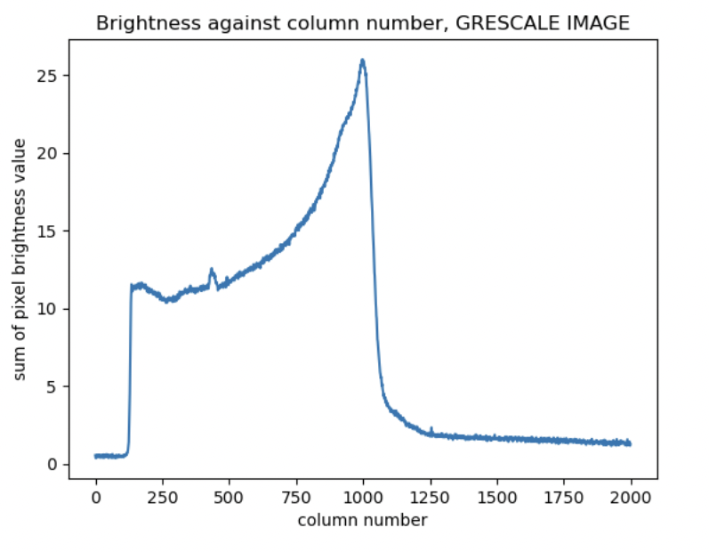
Comparison of curves generated using blue-channel only vs greyscale image

Slide 8
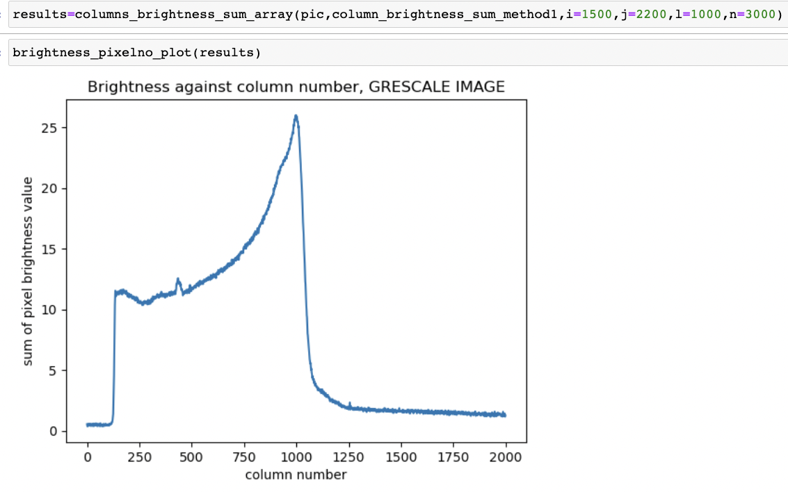
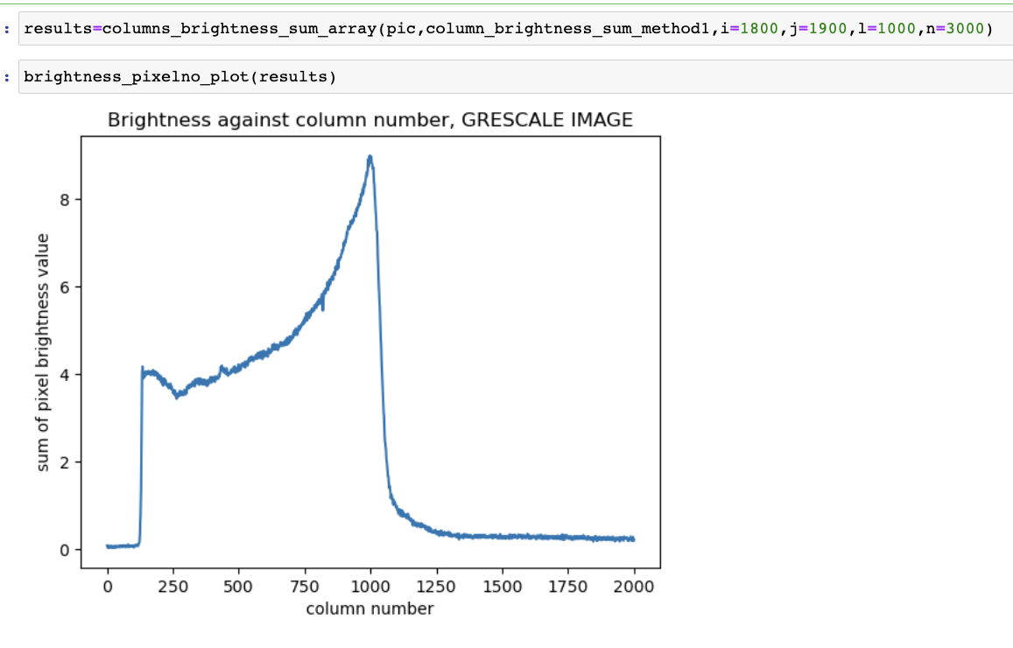
Blue channel only, increasing width and height restrictions
greyscale, increasing width and height restrictions

Slide 9
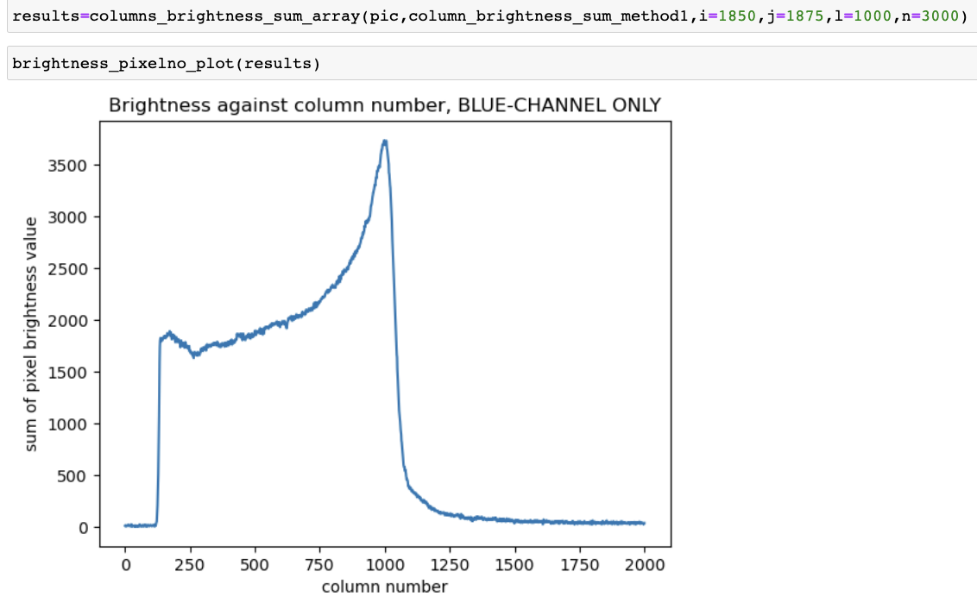

Slide 10
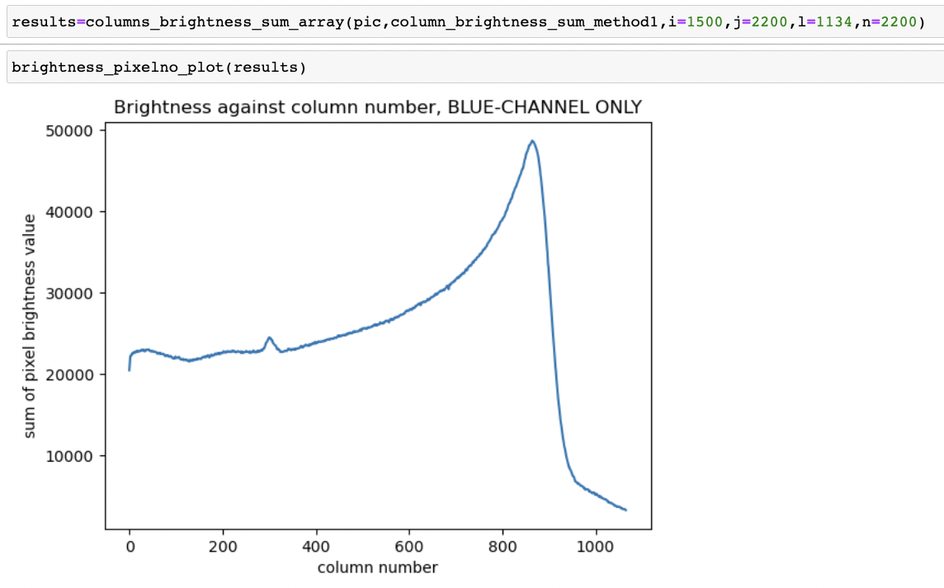
Blue channel only - (approximately) scintillator block only

Slide 11
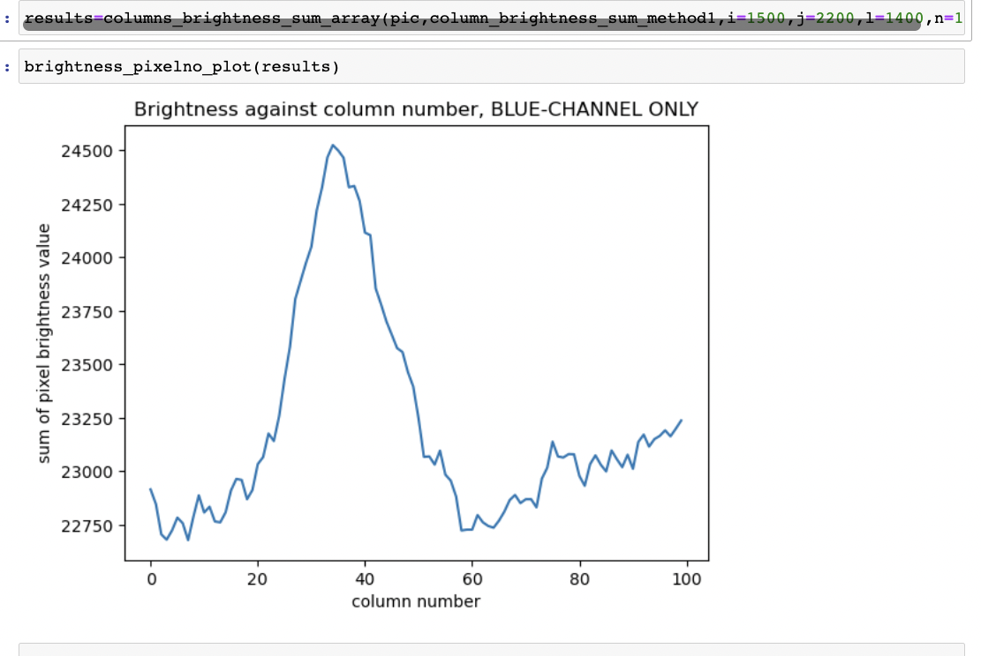
A zoom in on anomalous results

Slide 12
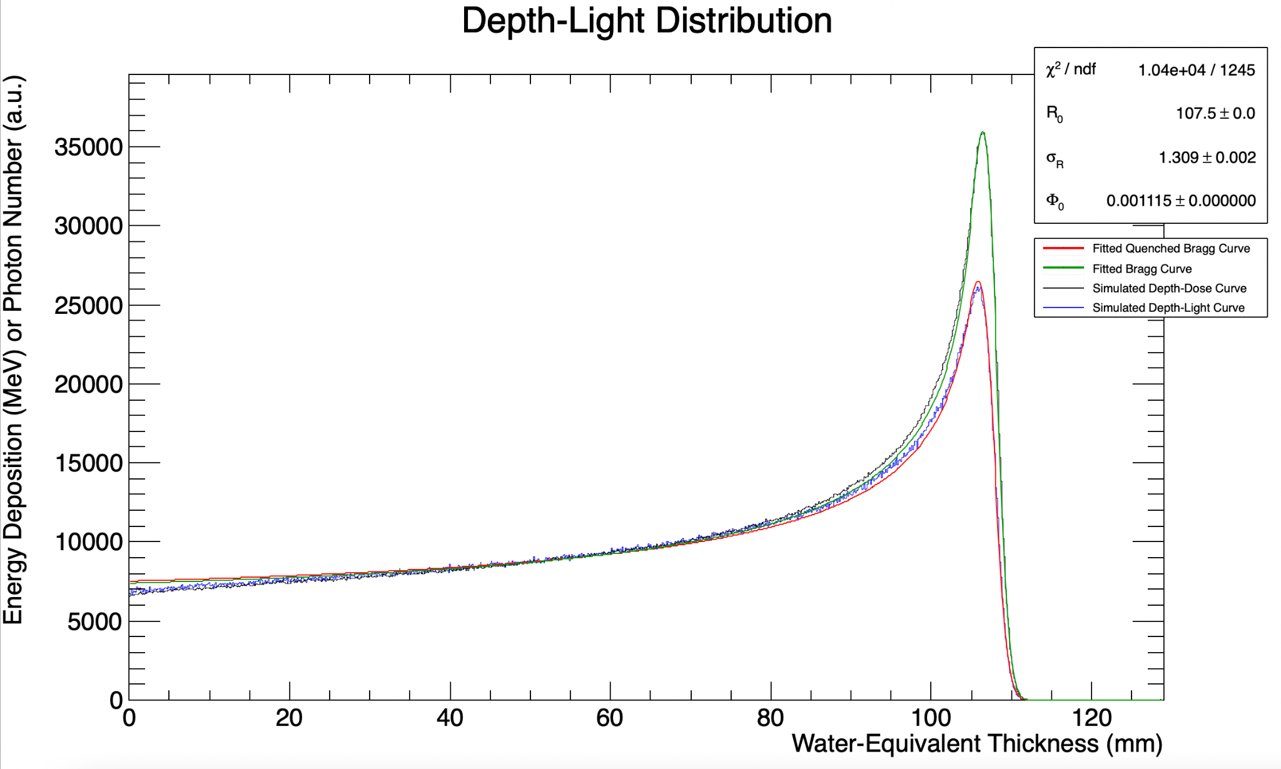

Slide 13
Next Steps
How to deal with optical artefacts?
Assign physical thickness to pixel height and width (using data in LengthCalibration folder) and multiply by 1.03 (approx.) to convert to water-equivalent thickness.
Export curve data for each beam energy image
Do a Kelleter curve fit to the image data
Run G4 simulation + Kelleter fit for each beam energy image

