Slide 1
QuARC: A Quality Assurance Range Calorimeter for Proton Therapy
DEPARTMENT OF PHYSICS AND ASTRONOMY
University of Bristol
Wednesday 8th February 2023
Sonia Escribano-Rodriguez¹, Saad Shaikh¹, Raffaella Radogna², Simon Jolly¹
¹University College London, Physics & Astronomy, London, United Kingdom
²University of Bari, Physics, Bari, Italy

Slide 2
Overview
Proton Therapy
Challenges in PT
QuARC
Analytical model
Experimental results
Clinical application
Geant4 Simulation
Future work

Slide 3
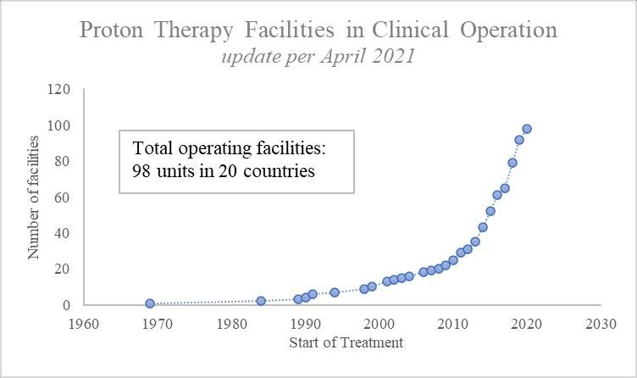
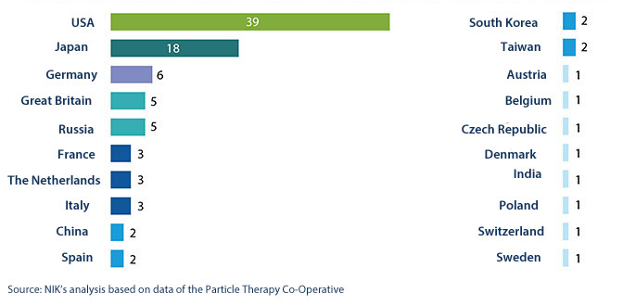
Proton therapy
Proton Therapy (PT) is a modality of radiotherapy that utilises proton beams with energies between 70 MeV and 250 MeV to irradiate cancerous structures.
(F Aliyah et al 2021 IOP Conf. Ser.: Earth Environ. Sci. 927 012042)
1

Slide 4
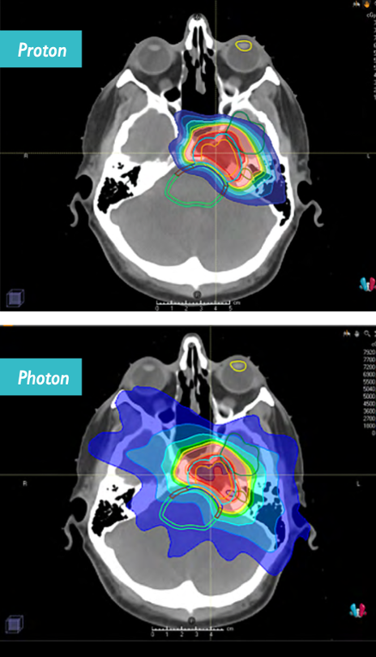
Proton therapy
PT offers a highly localised depth-dose distribution, reducing the damage to healthy tissues nearby. Specially indicated for:
Paediatric tumours
Tumours close to critical structures
Depth tumours
(Johns Hopkins Medicine)
2

Slide 5

Proton therapy
Better dose conformation due to the finite energy loss of the protons. The energy deposition is characterised by the Bethe-Bloch formula
$$−\frac{dE}{dx}=4πN_{A}r_{c}^{2}m_{e}c^{2}\frac{Z}{A}\frac{z^{2}}{β^{2}}\left[\ln\left(\frac{2m_{e}c^{2}{γ^{2}β}^{2}}{I}\right)−β^{2}−\frac{δ}{2}−\frac{C}{Z}\right]$$
3

Slide 6
Proton therapy
Better dose conformation due to the finite energy loss of the protons. The energy deposition is characterised by the Bethe-Bloch formula
$$−\frac{dE}{dx}=4πN_{A}r_{c}^{2}m_{e}c^{2}\frac{Z}{A}\frac{z^{2}}{β^{2}}\left[\ln\left(\frac{2m_{e}c^{2}{γ^{2}β}^{2}}{I}\right)−β^{2}−\frac{δ}{2}−\frac{C}{Z}\right]$$
3

Slide 7
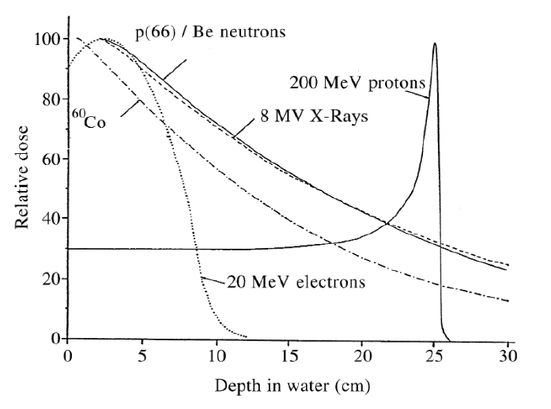
Proton therapy
Better dose conformation due to the finite energy loss of the protons. The energy deposition is characterised by the Bethe-Bloch formula
$$−\frac{dE}{dx}=4πN_{A}r_{c}^{2}m_{e}c^{2}\frac{Z}{A}\frac{z^{2}}{β^{2}}\left[\ln\left(\frac{2m_{e}c^{2}{γ^{2}β}^{2}}{I}\right)−β^{2}−\frac{δ}{2}−\frac{C}{Z}\right]$$
3
(R. Orecchia, A. Zurlo, A. Loasses et al. 1996. Eur. J. Cancer, volume 34)

Slide 8
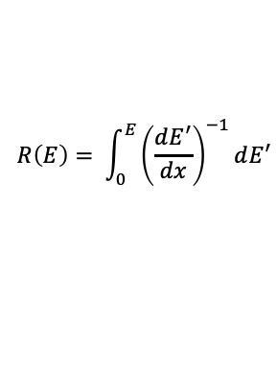
Proton therapy
Better dose conformation due to the finite energy loss of the protons. The energy deposition is characterised by the Bethe-Bloch formula
$$−\frac{dE}{dx}=4πN_{A}r_{c}^{2}m_{e}c^{2}\frac{Z}{A}\frac{z^{2}}{β^{2}}\left[\ln\left(\frac{2m_{e}c^{2}{γ^{2}β}^{2}}{I}\right)−β^{2}−\frac{δ}{2}−\frac{C}{Z}\right]$$
$$R\left(E\right)= \int_{0}^{E}{{\left(\frac{dE^{′}}{dx}\right)}^{−1}dE^{′}}$$
3
(R. Orecchia, A. Zurlo, A. Loasses et al. 1996. Eur. J. Cancer, volume 34)

Slide 9
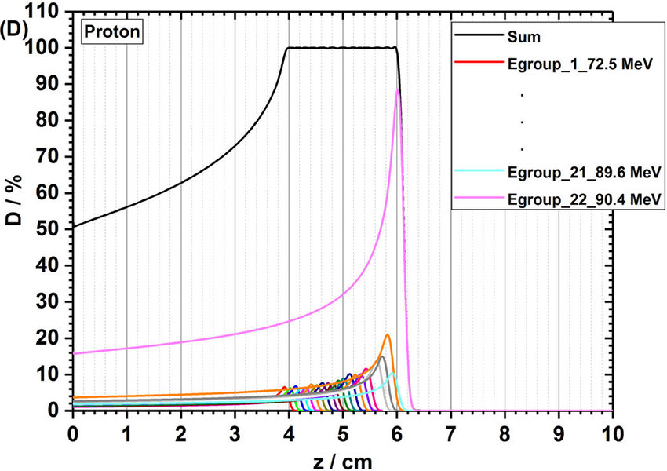
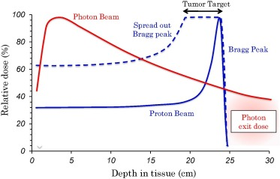
Proton therapy
To cover the whole tumoral region a spread-out Bragg peak (SOBP) is created by combining beams with different energies.
(Geng C, Gates D, Bronk L, Ma D and Guan F. 2018 Phys Med.51:13-21)
4

Slide 10
FLASH Proton therapy
FLASH radiotherapy is a novel technique that offers ultra-high dose-rate. While the chemical and biological mechanisms of the FLASH effect are undefined, early preclinical evidence suggests FLASH radiotherapy offers additional healthy tissue sparing effects with complete dose delivery in less than 100 ms.
For FLASH proton therapy this corresponds to average currents of at least 600 nA to the patient, compared to current clinical standard of 1–10 nA [1].
5

Slide 11
Proton therapy: challenges
Knowing precisely the proton range is a technical challenge, and the range uncertainties prevent taking full advantage of PT benefits.
To ensure accurate dose delivery, daily QA measurements are required. The properties are usually measured with a commercial ionisation-chamber.
- Time-consuming (up to 1h) → compromise between speed and accuracy.
- Current detectors used for QA cannot cope with the requirements of FLASH PT.
6

Slide 12
Clinical devices are time consuming and can’t cope with the requirements for FLASH proton therapy, which exposes the need for a device capable of working at FLASH and regular rates in a quicker way.
Develop a detector to make fast, accurate measurements of proton range
QuARC: Quality Assurance Range Calorimeter
7

Slide 13
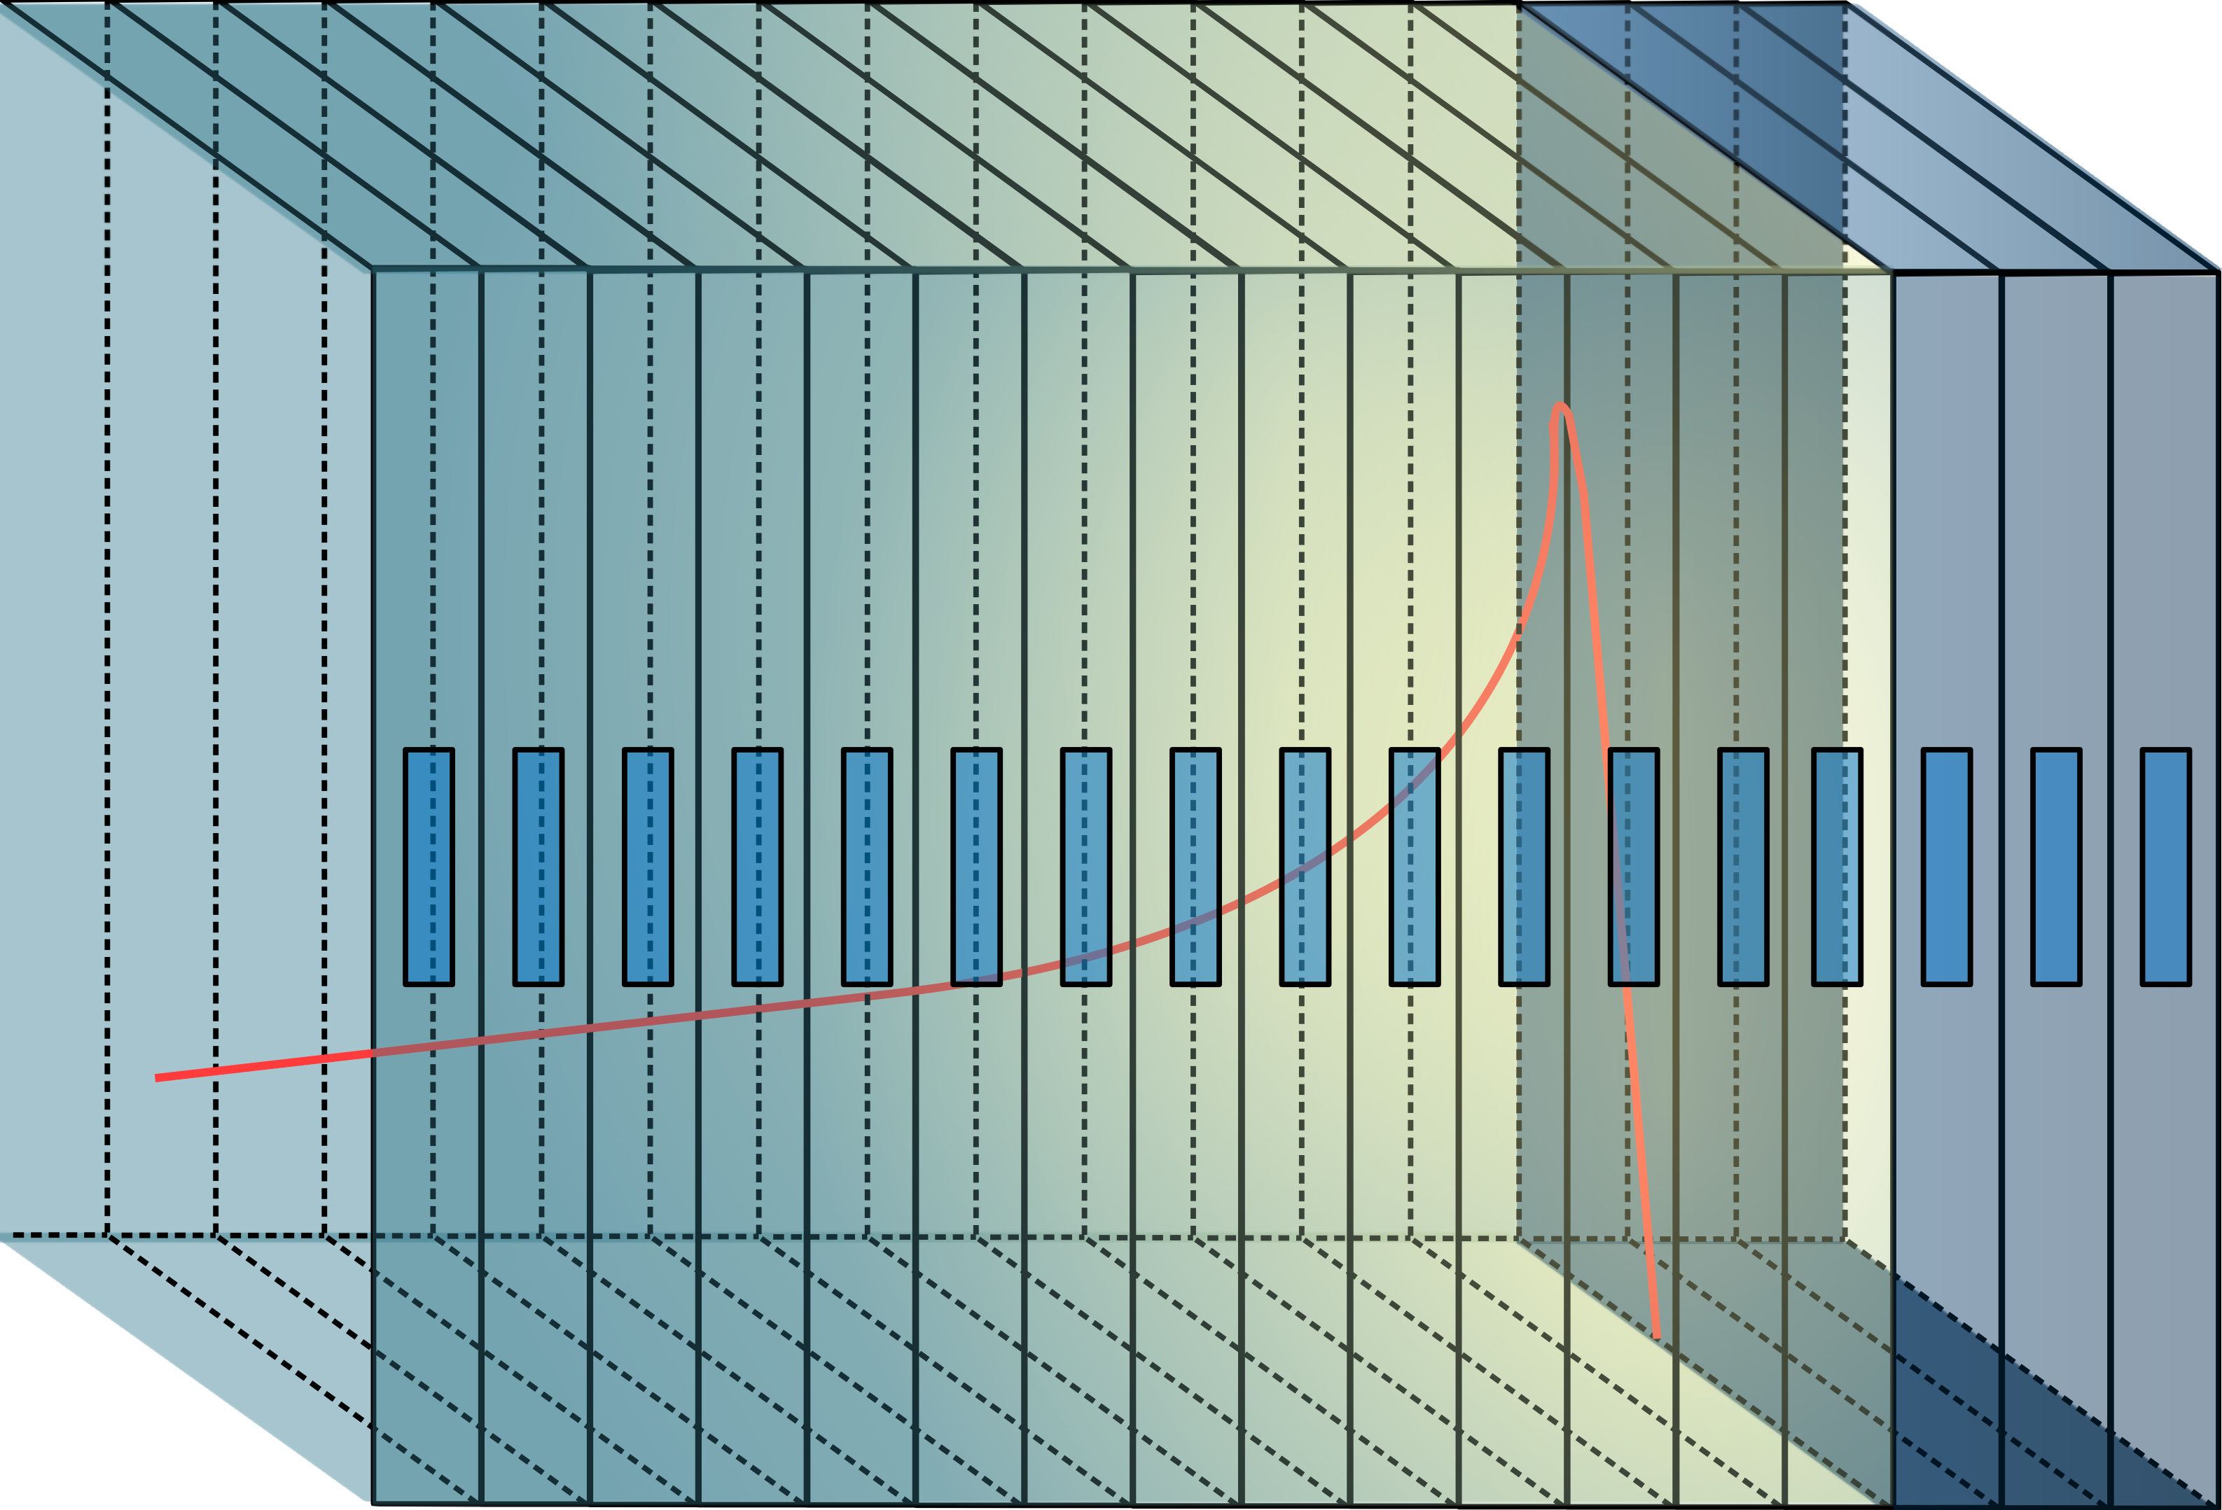

QuARC
Optically-isolated polystyrene scintillator sheets of 105 mm x 105 mm x 3 mm.
Segmented design: each sheet is coupled to a photodiode to measure light output, so each layer is individually sampled.
$$ρ=1.03 g/cm^{3}$$
8

Slide 14
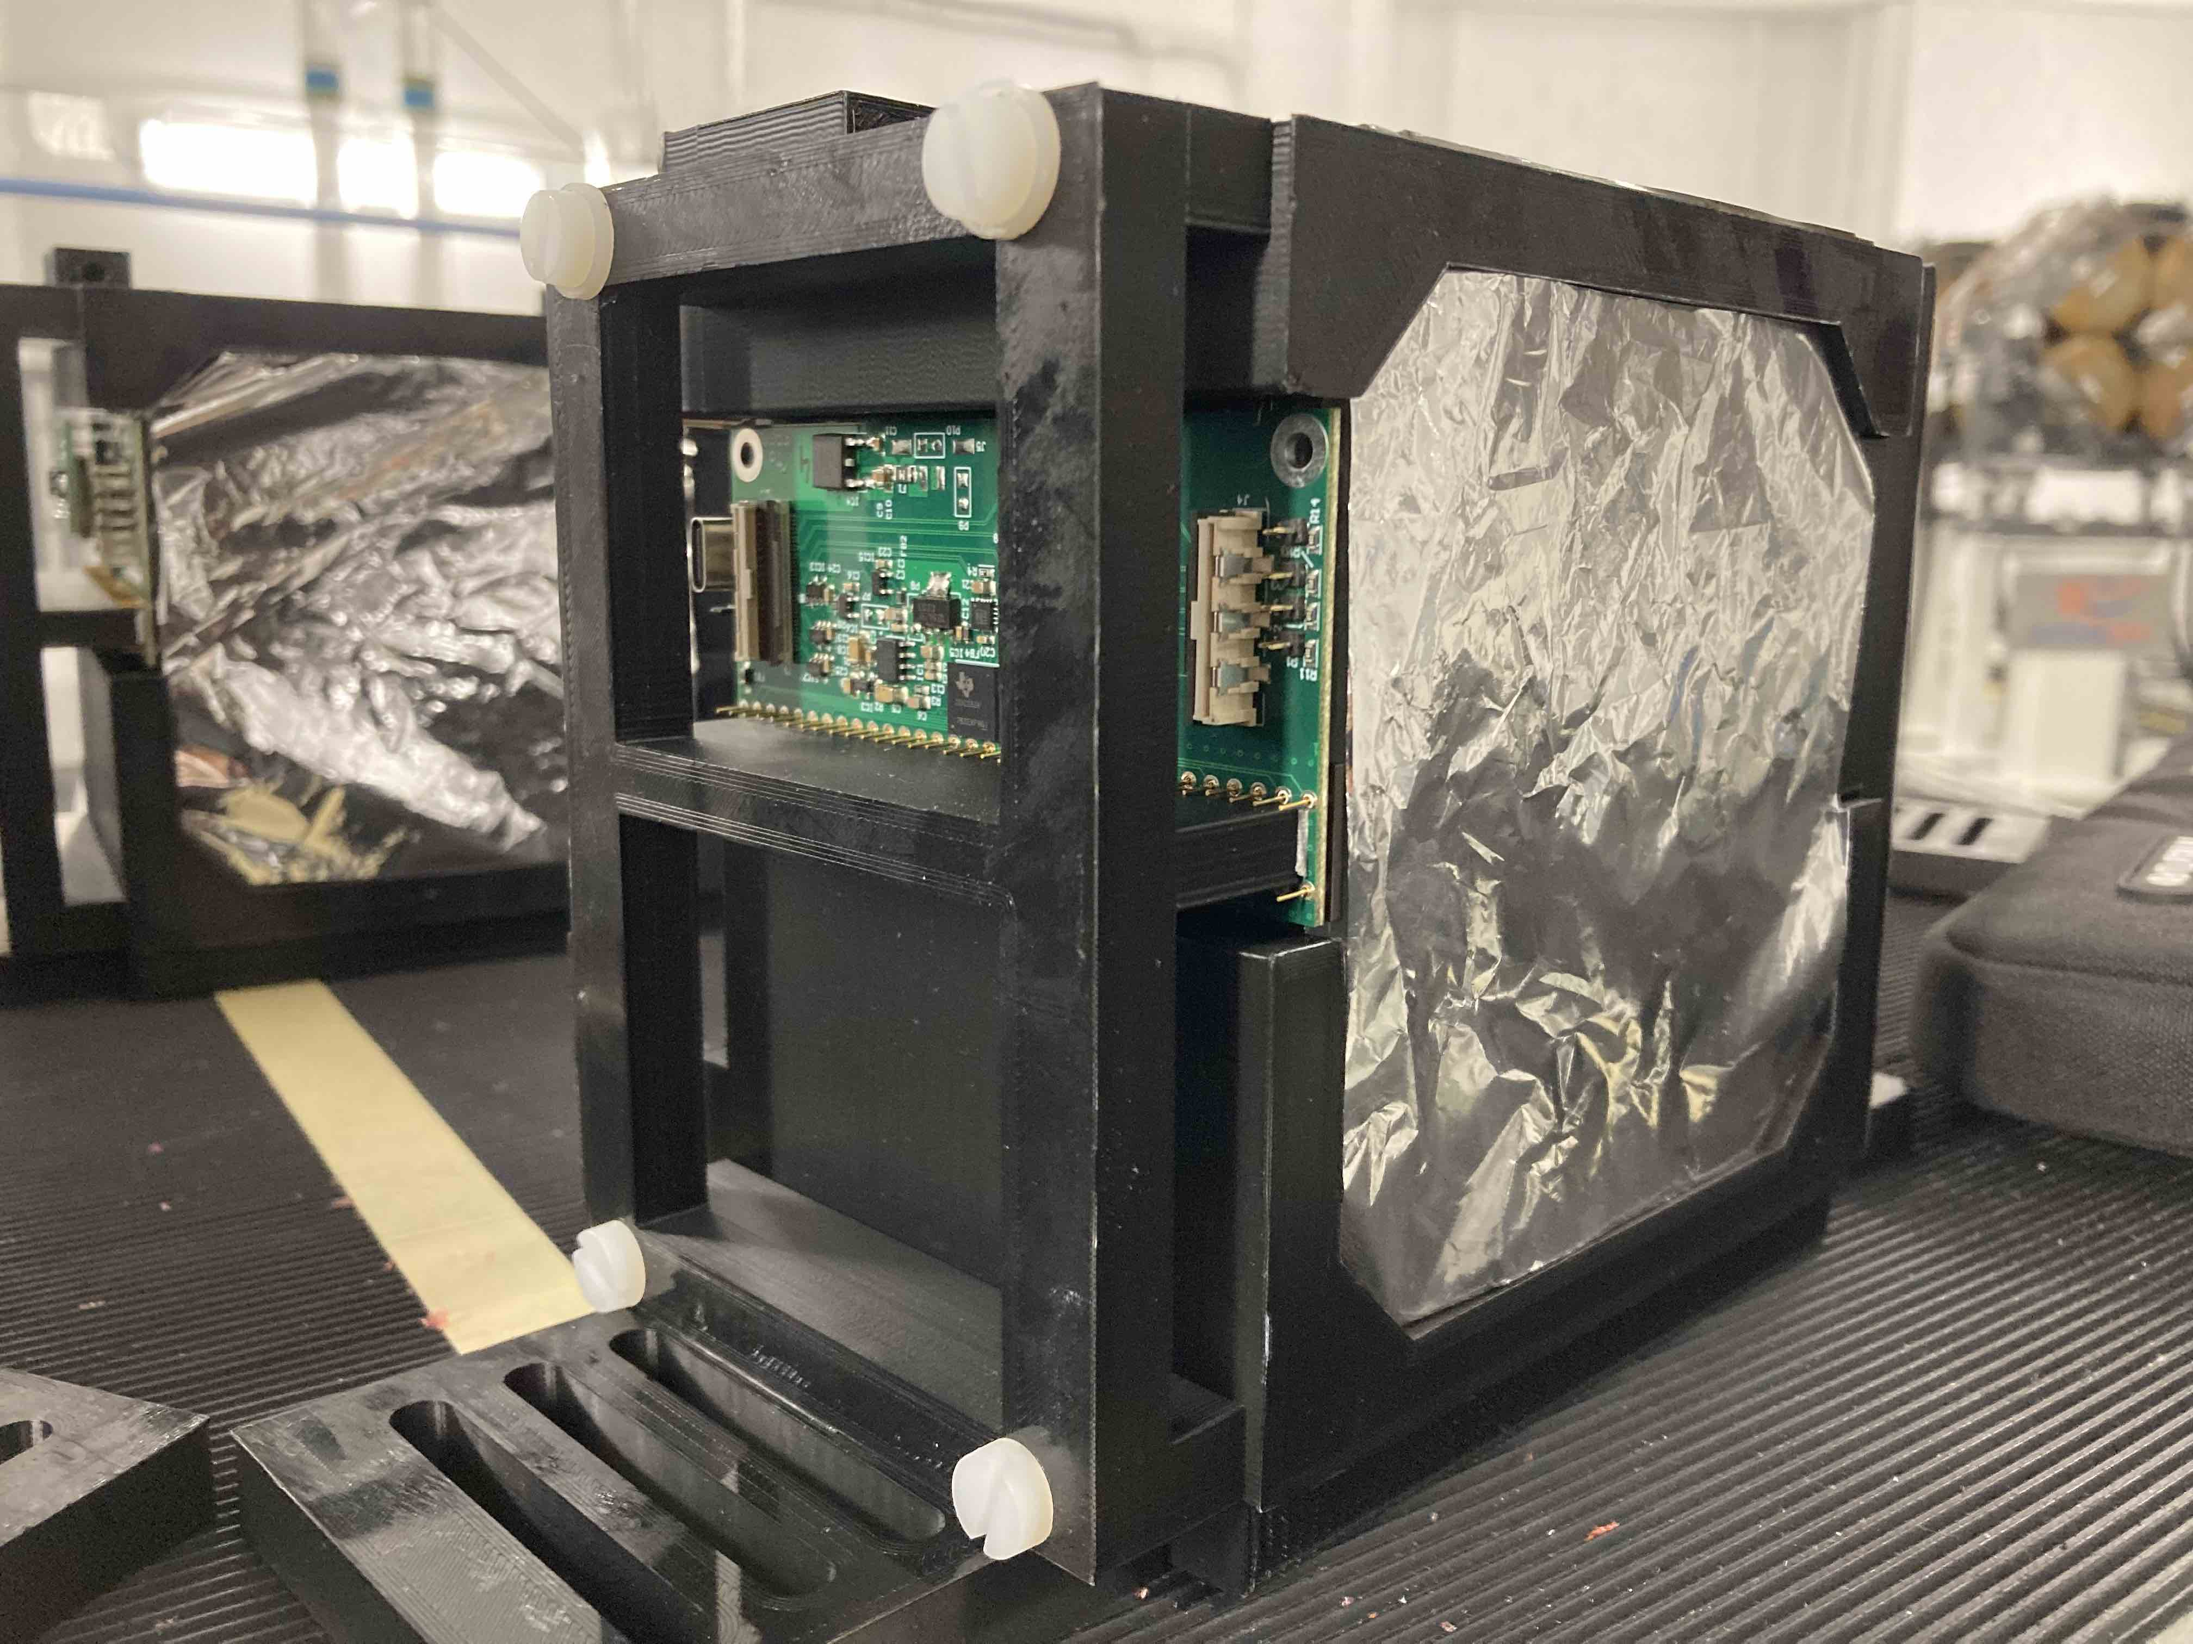
QuARC
Photodiodes coupled to modular ADC converters, read-out by an FPGA.
The scintillator sheets are housed in a custom plastic 3D-printed holder in groups of 32 sheets.
9

Slide 15
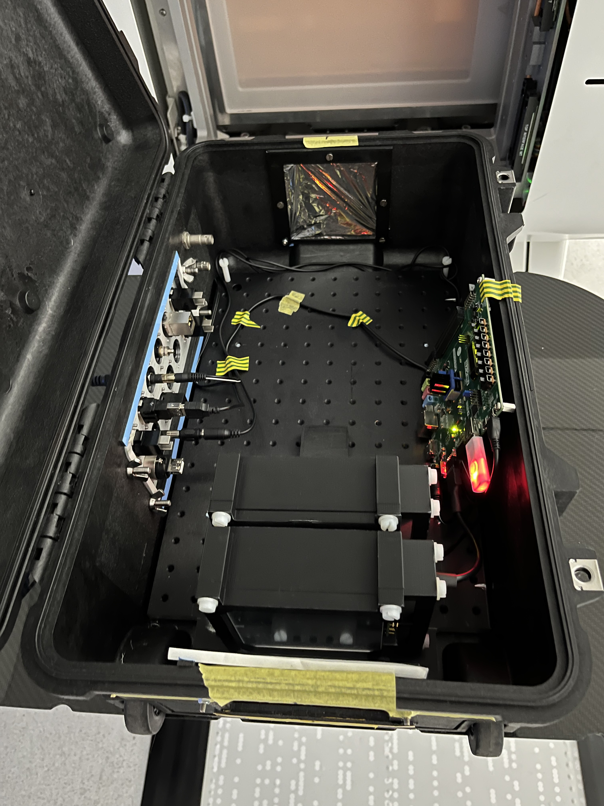
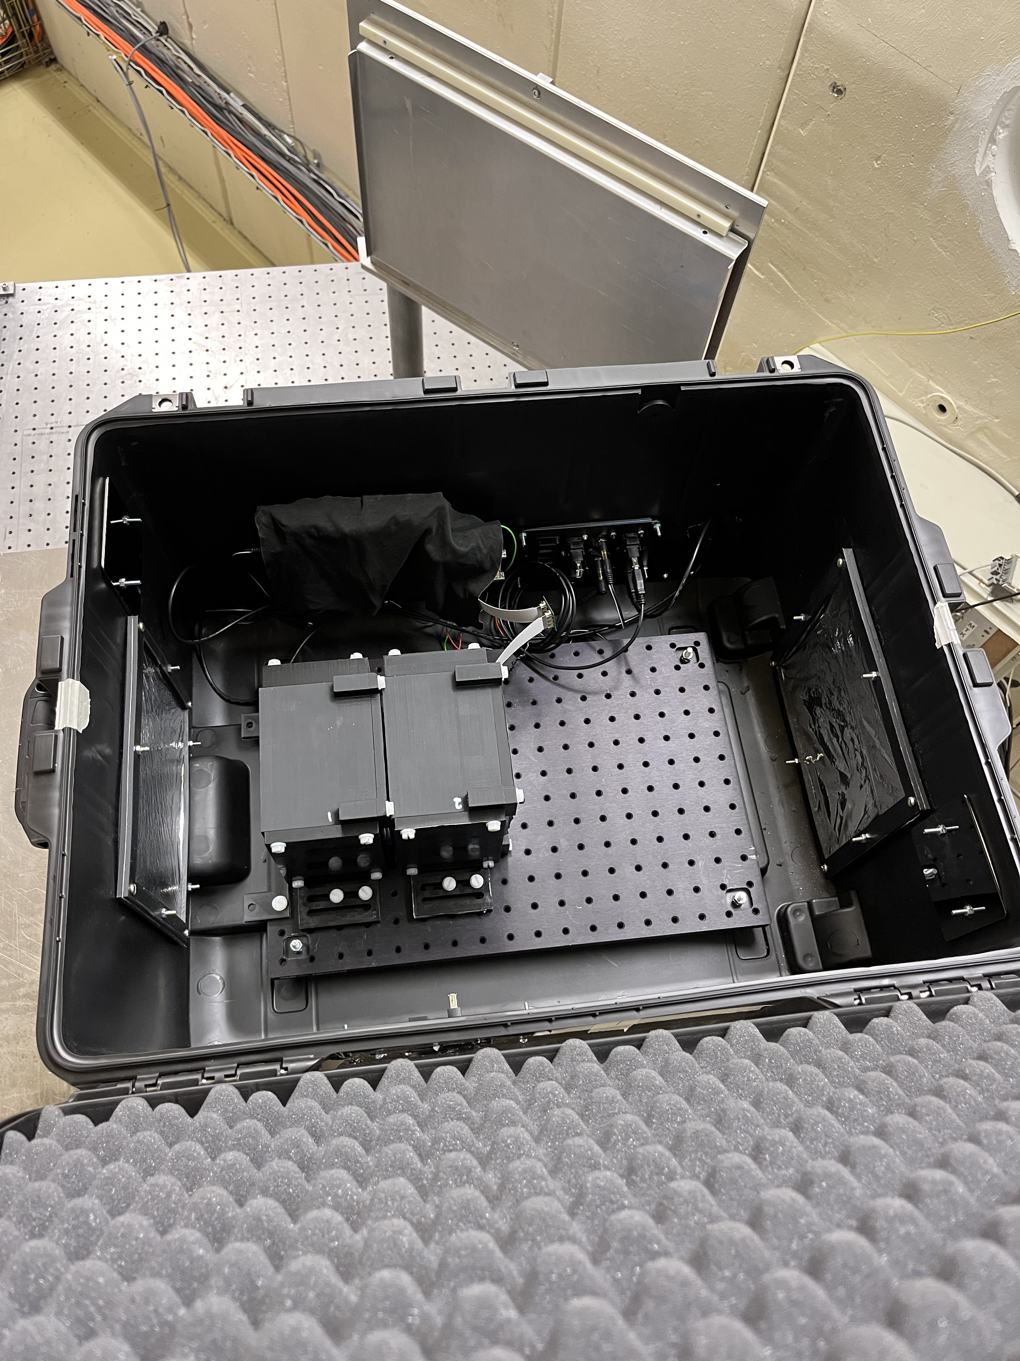
QuARC
The scintillator modules are placed in a light-tight case, with two mylar windows for beam entrance.
10

Slide 16
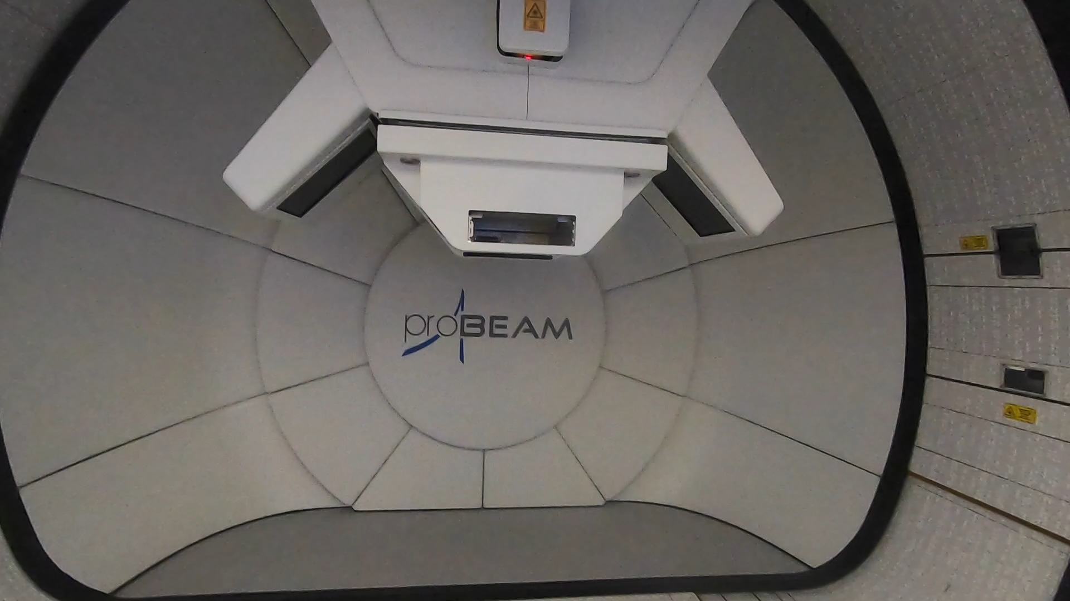
QuARC set up
11

Slide 17
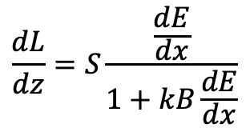
QuARC model
Bortfeld analytical approximation of a Bragg Curve
The light output of the scintillator is subject to quenching effects → non-linear response in the scintillation light output to absorbed dose.
Birks’ law for light quenching
The aim is to develop a model that describes the depth-light curve in a quenching scintillator and allow the extraction of information about the beam range.
$$\frac{dL}{dz}=S\frac{\frac{dE}{dx}}{1+kB\frac{dE}{dx}}$$
12

Slide 18
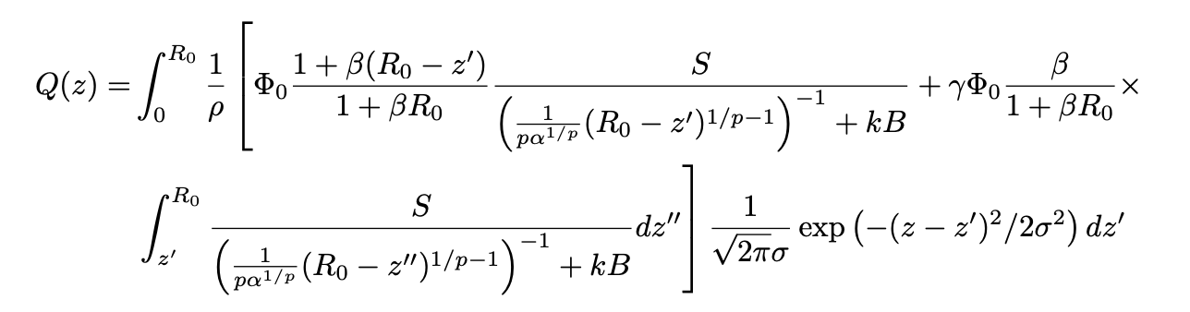
QuARC model
Analytical model deployed to fit depth-light curve obtained by the PD to reconstruct Bragg curve and recover proton range in real-time [2]. The model combines Bortfeld’s description of the Bragg curve with Birks’ empirical law describing scintillator light quenching as a function of LET.
13

Slide 19
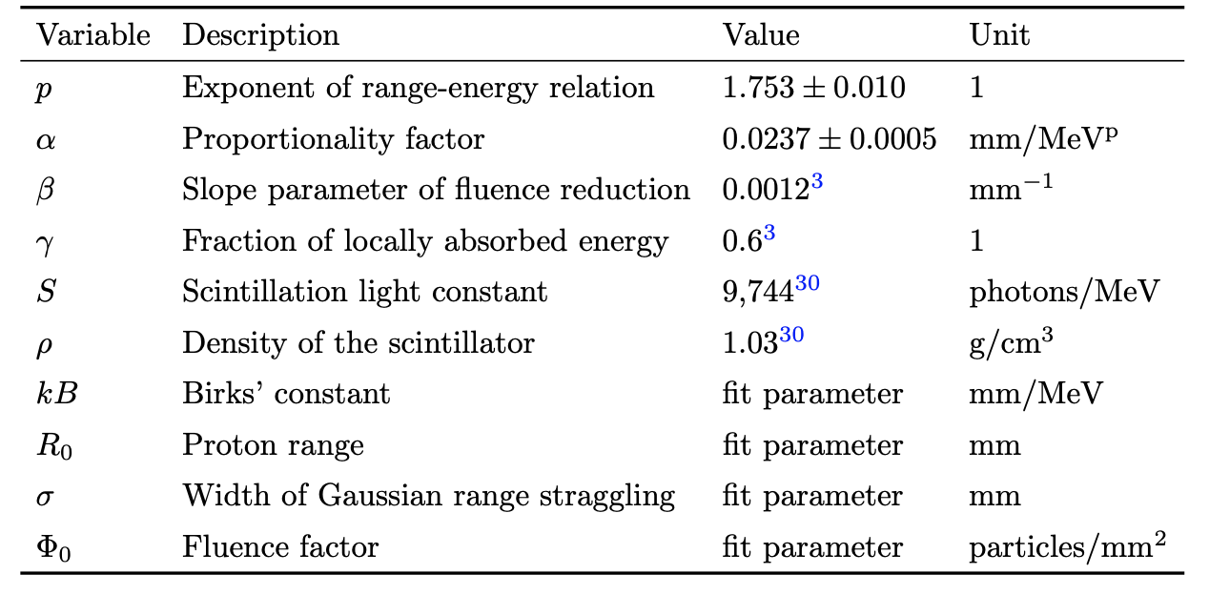
QuARC model
4-fit-parameter model [2].
14

Slide 20
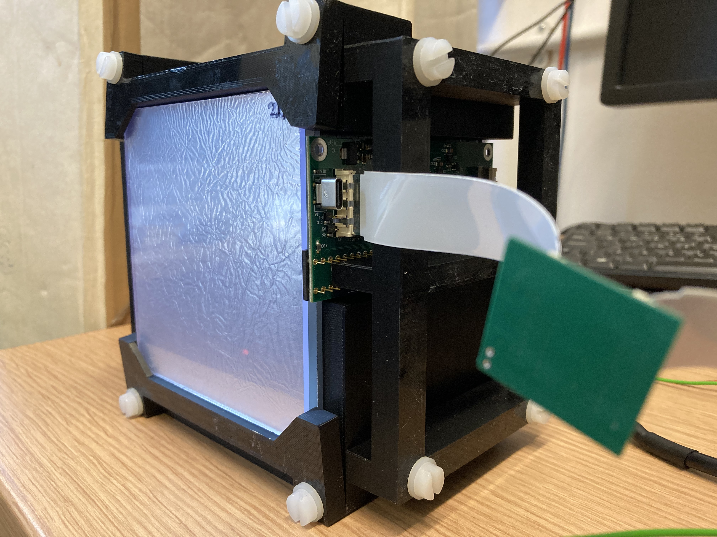
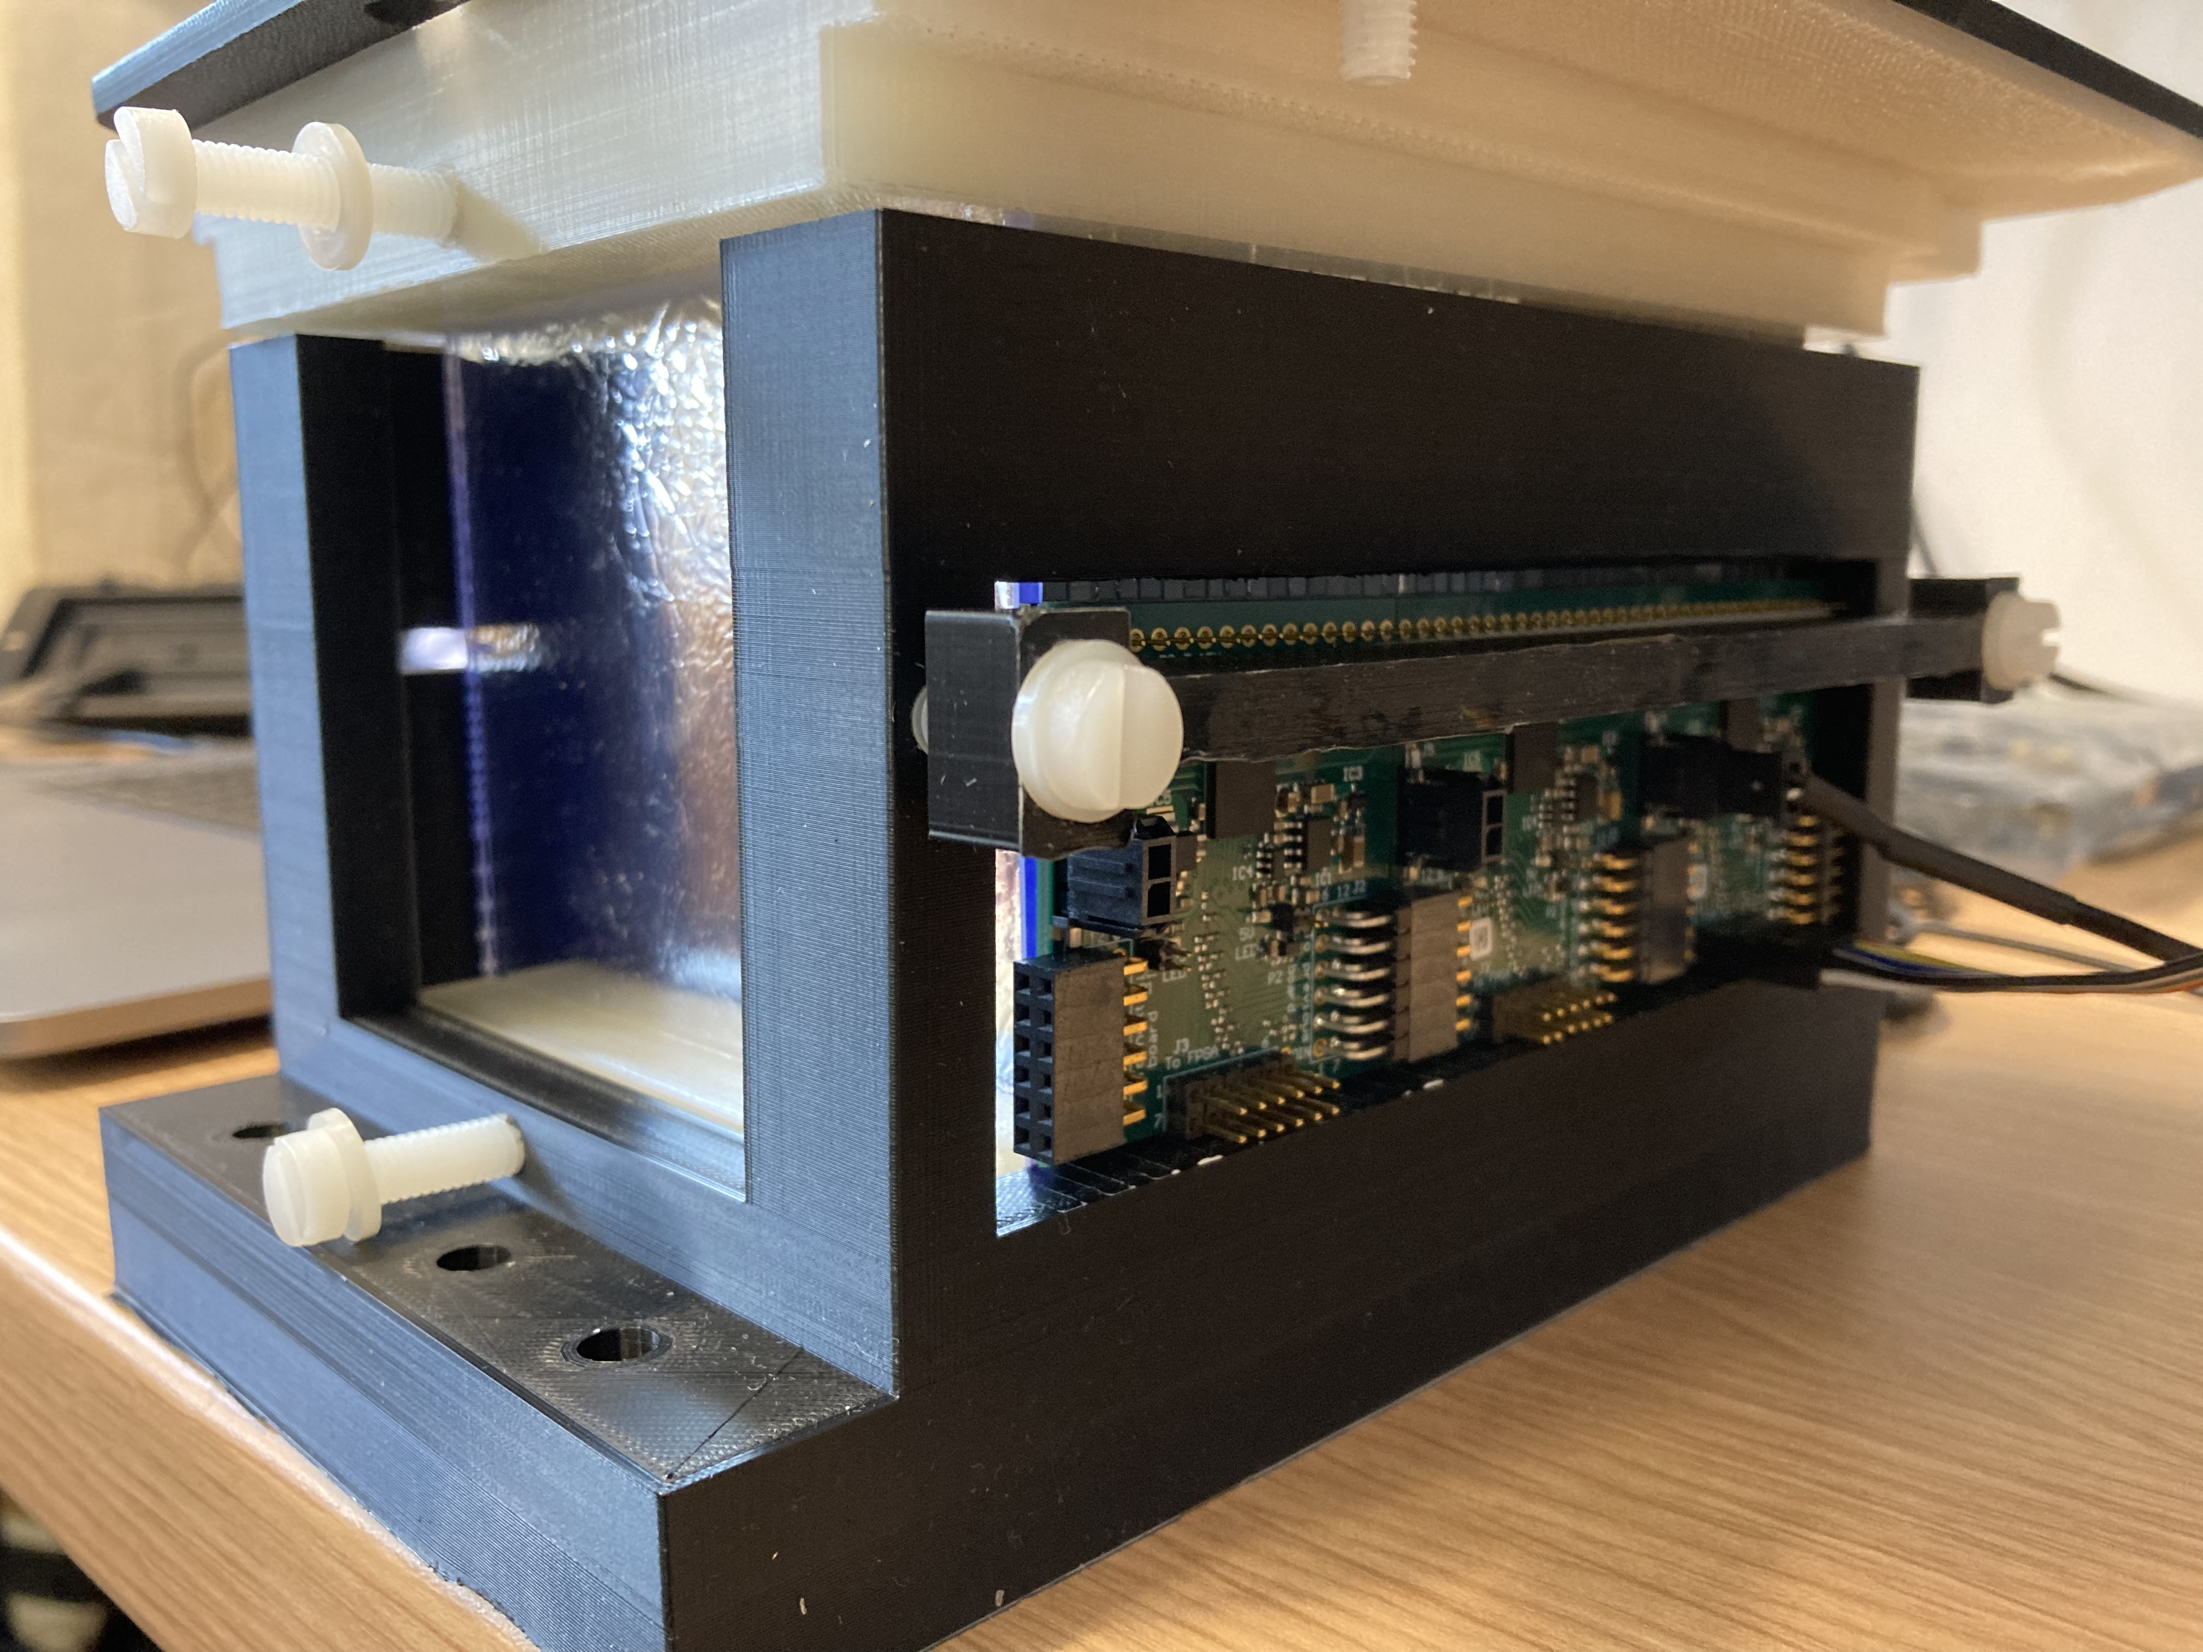
UCLH experiment
3 modules tested
Beam energies 70-150 MeV
White & clear sheets
Clear sheets only
15

Slide 21
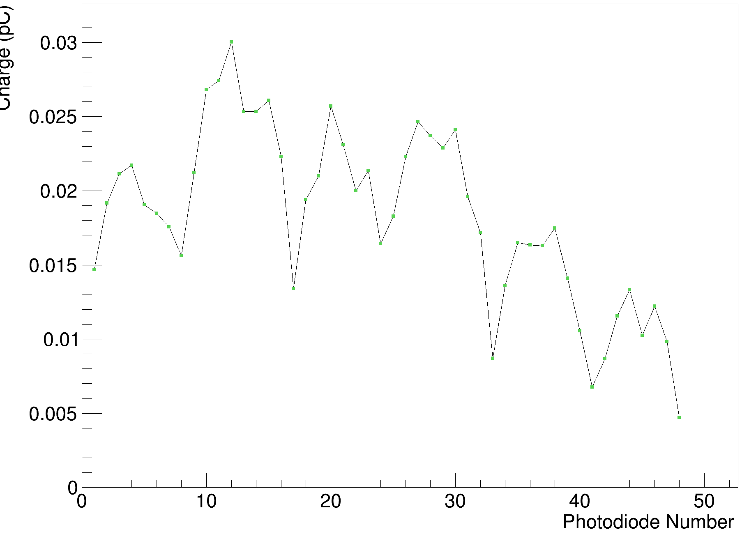
UCLH experiment
Initial background measurements for future subtraction.
16

Slide 22
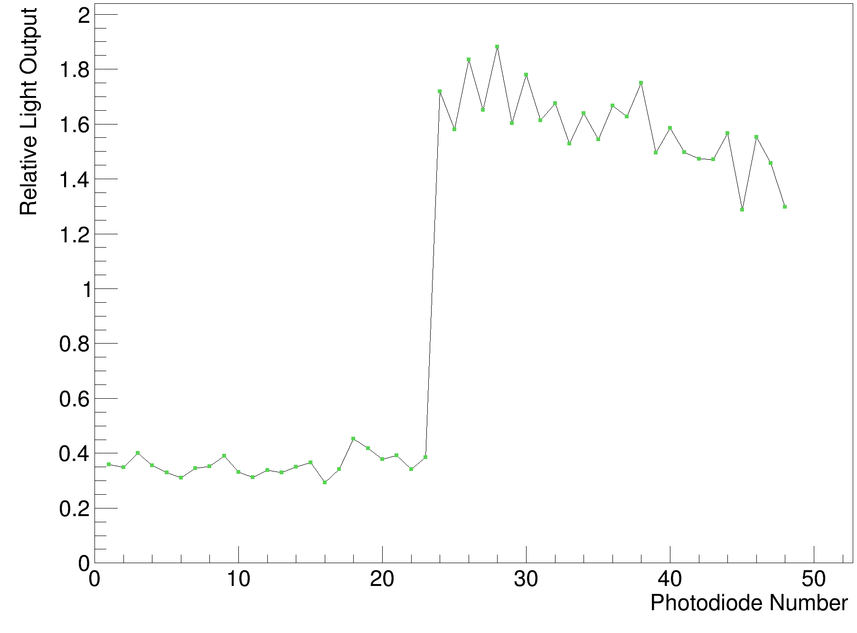
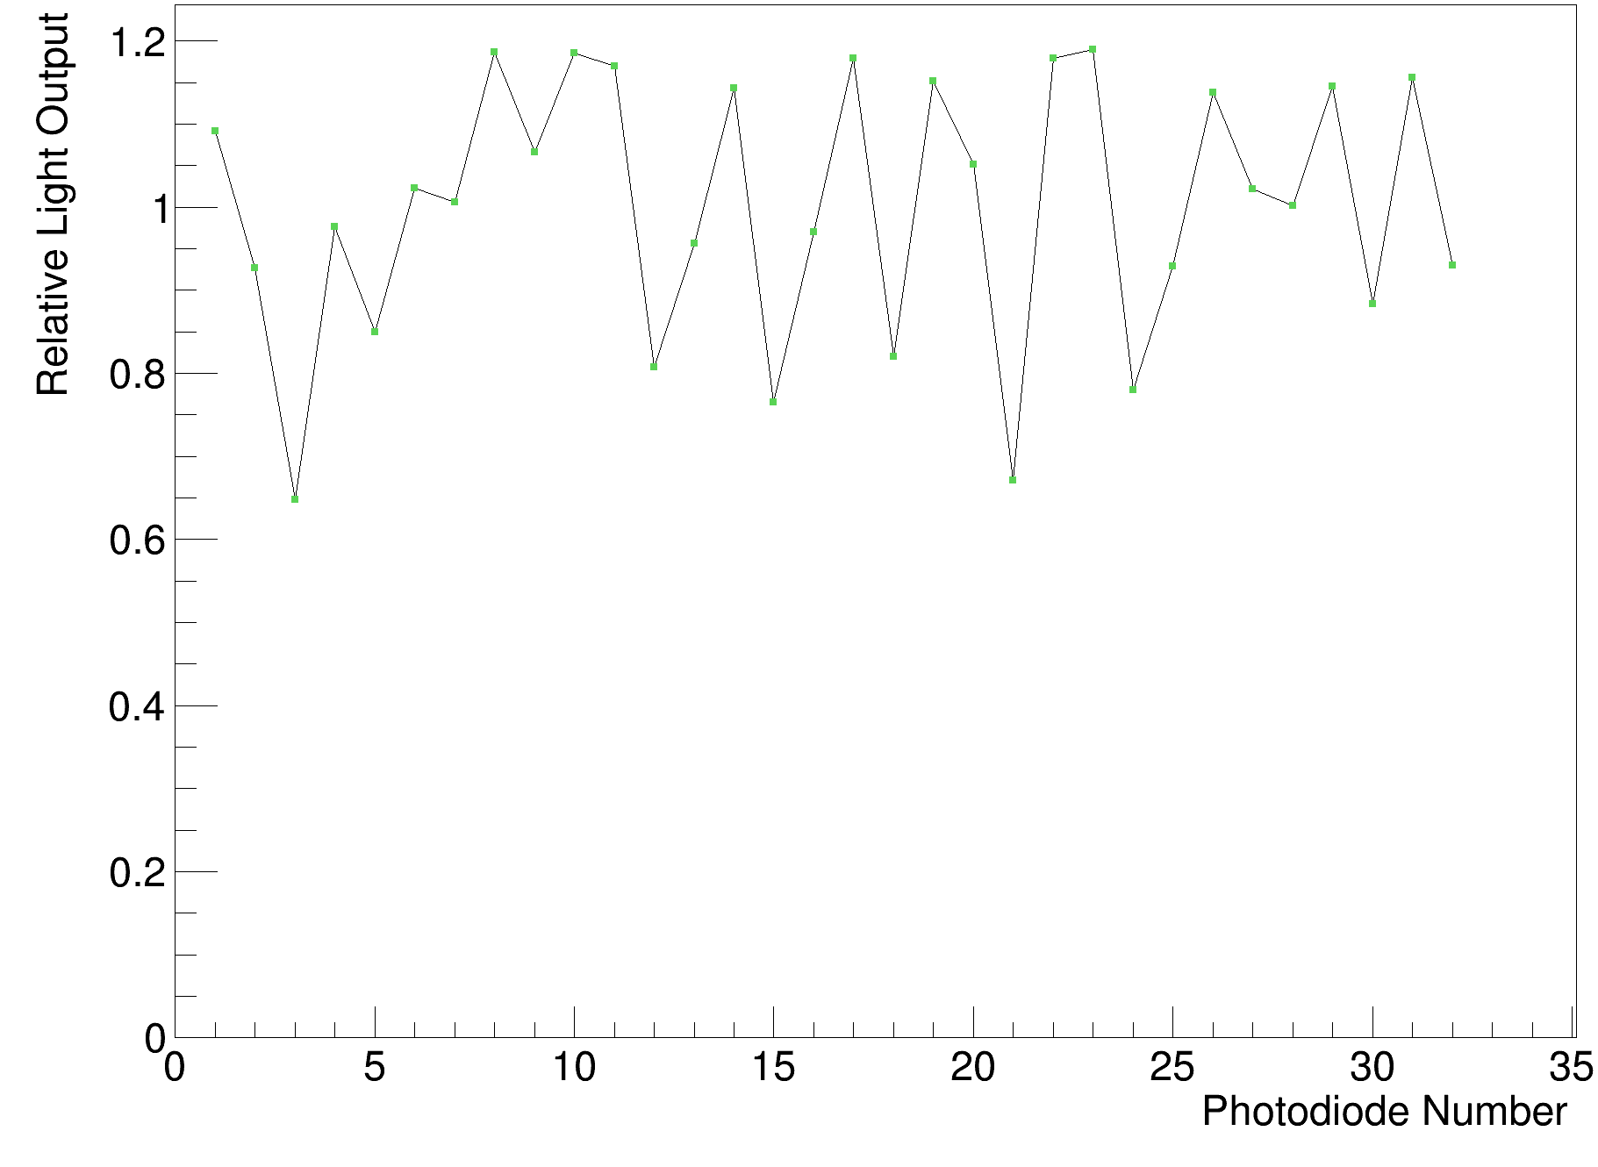
UCLH experiment
Calibration is required with a shoot-through measurement to acknowledge the differences in light output between the sheets (130 MeV).
White & clear sheets
Clear sheets only
17

Slide 23
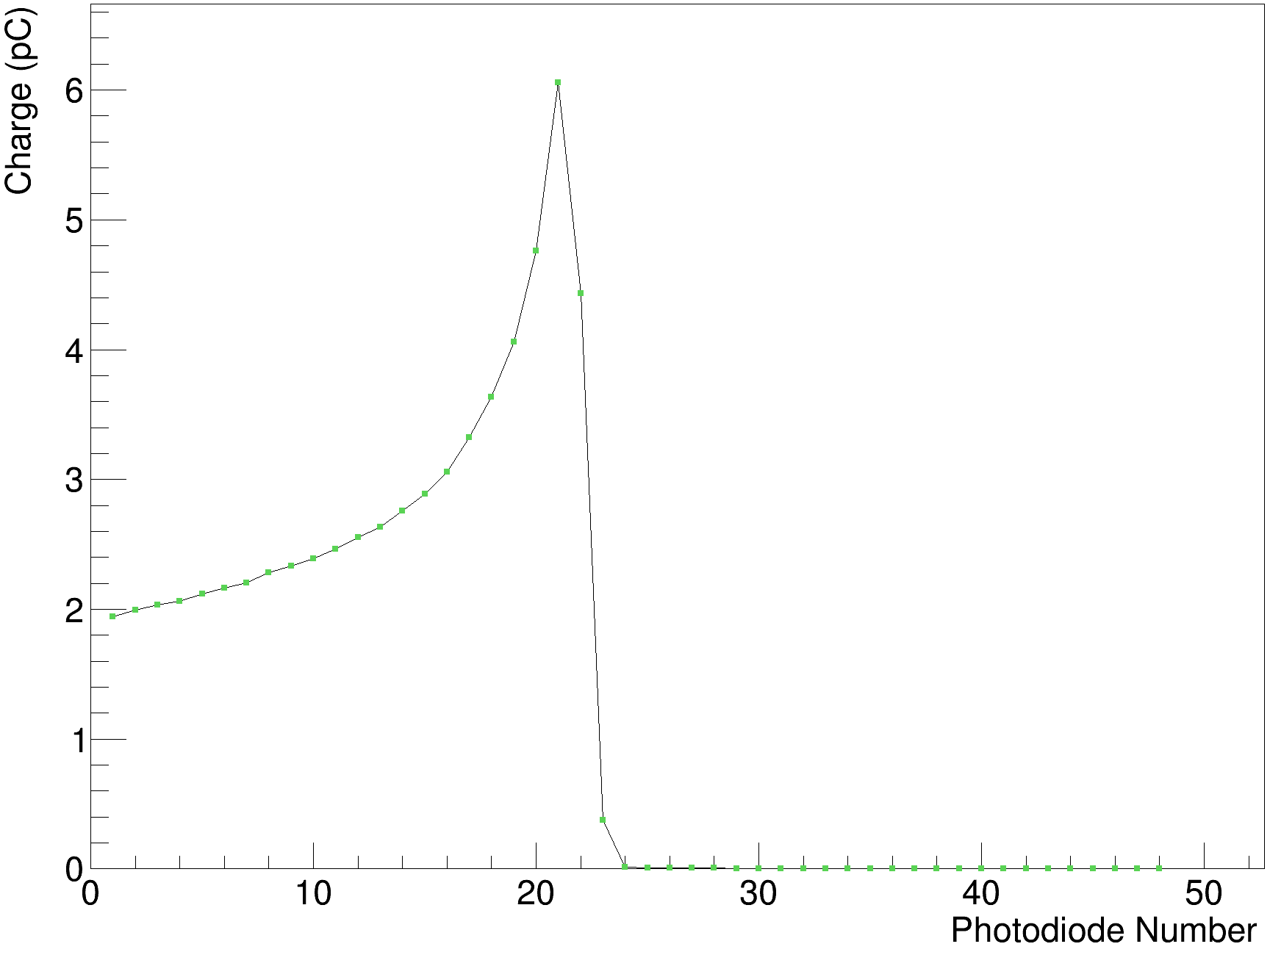
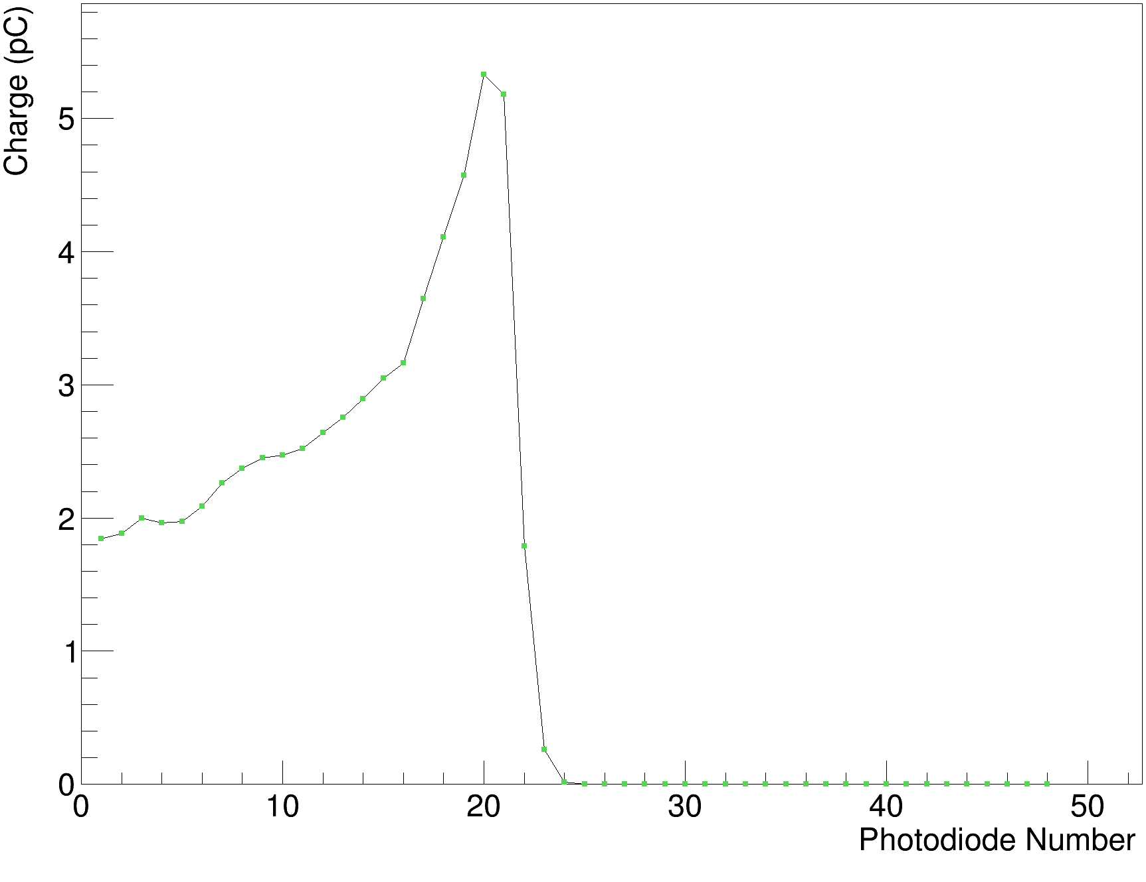
UCLH experiment
Initial calibrated data for a 90 MeV beam
Clear sheets only
White sheets only
18

Slide 24
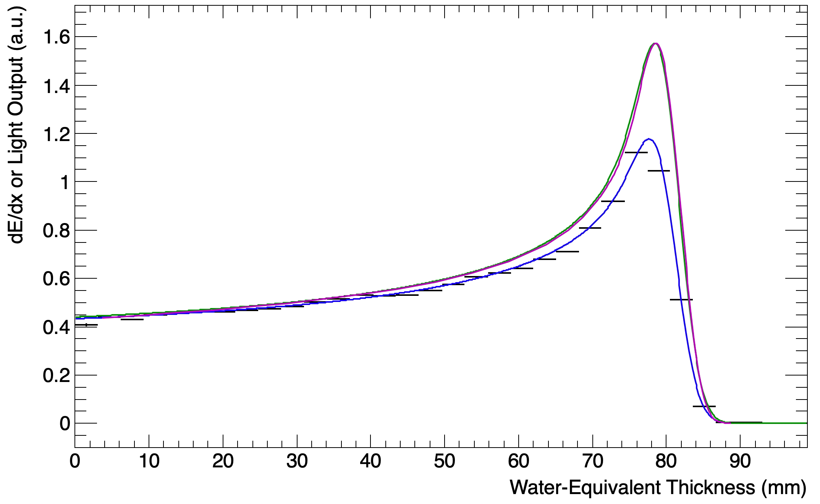
UCLH experiment II
130 MeV
Accurate to 0.1 mm in only 10 mins – including setup time
  Black: Sheet Average Light Output
  Blue: Fitted Quenched Depth-Light Curve
  Green: Reconstructed Depth-Dose Curve
  Magenta: UCLH Reference Dose Curve
19

Slide 25
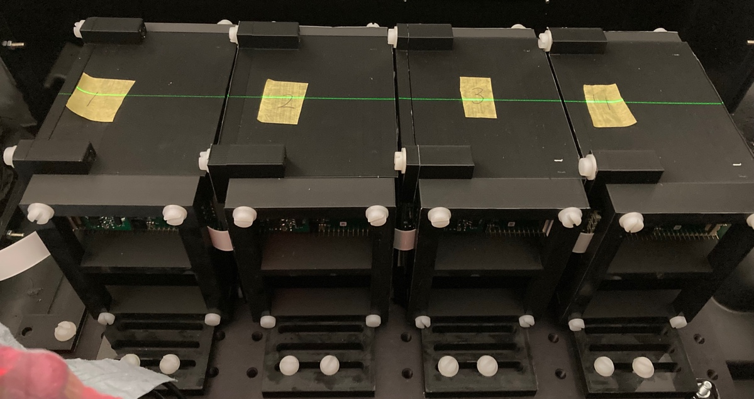
The Christie experiment
Testing 4 modules (32 x 3mm sheets each) with clinical and FLASH currents.
Beam energies between 70 and 245 MeV.
20

Slide 26
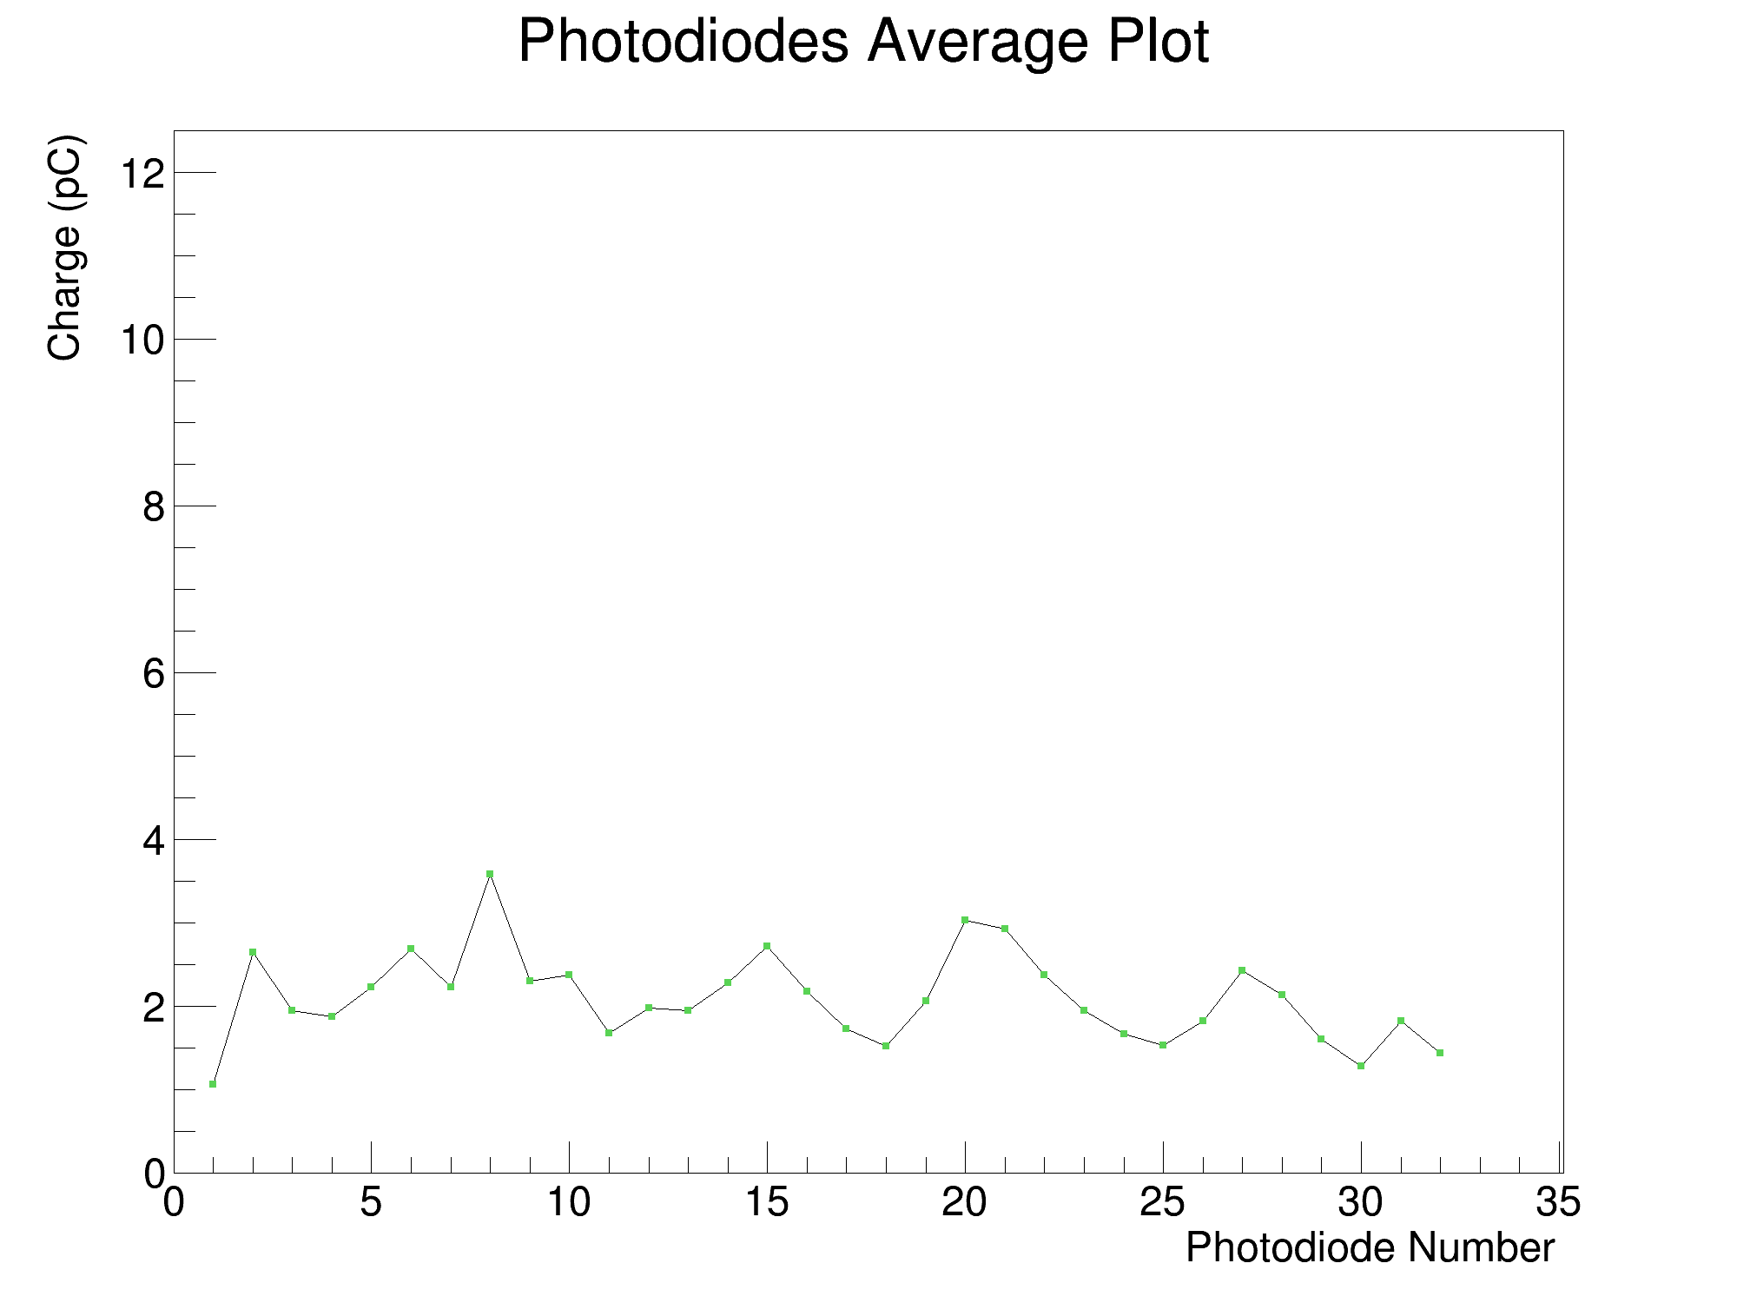
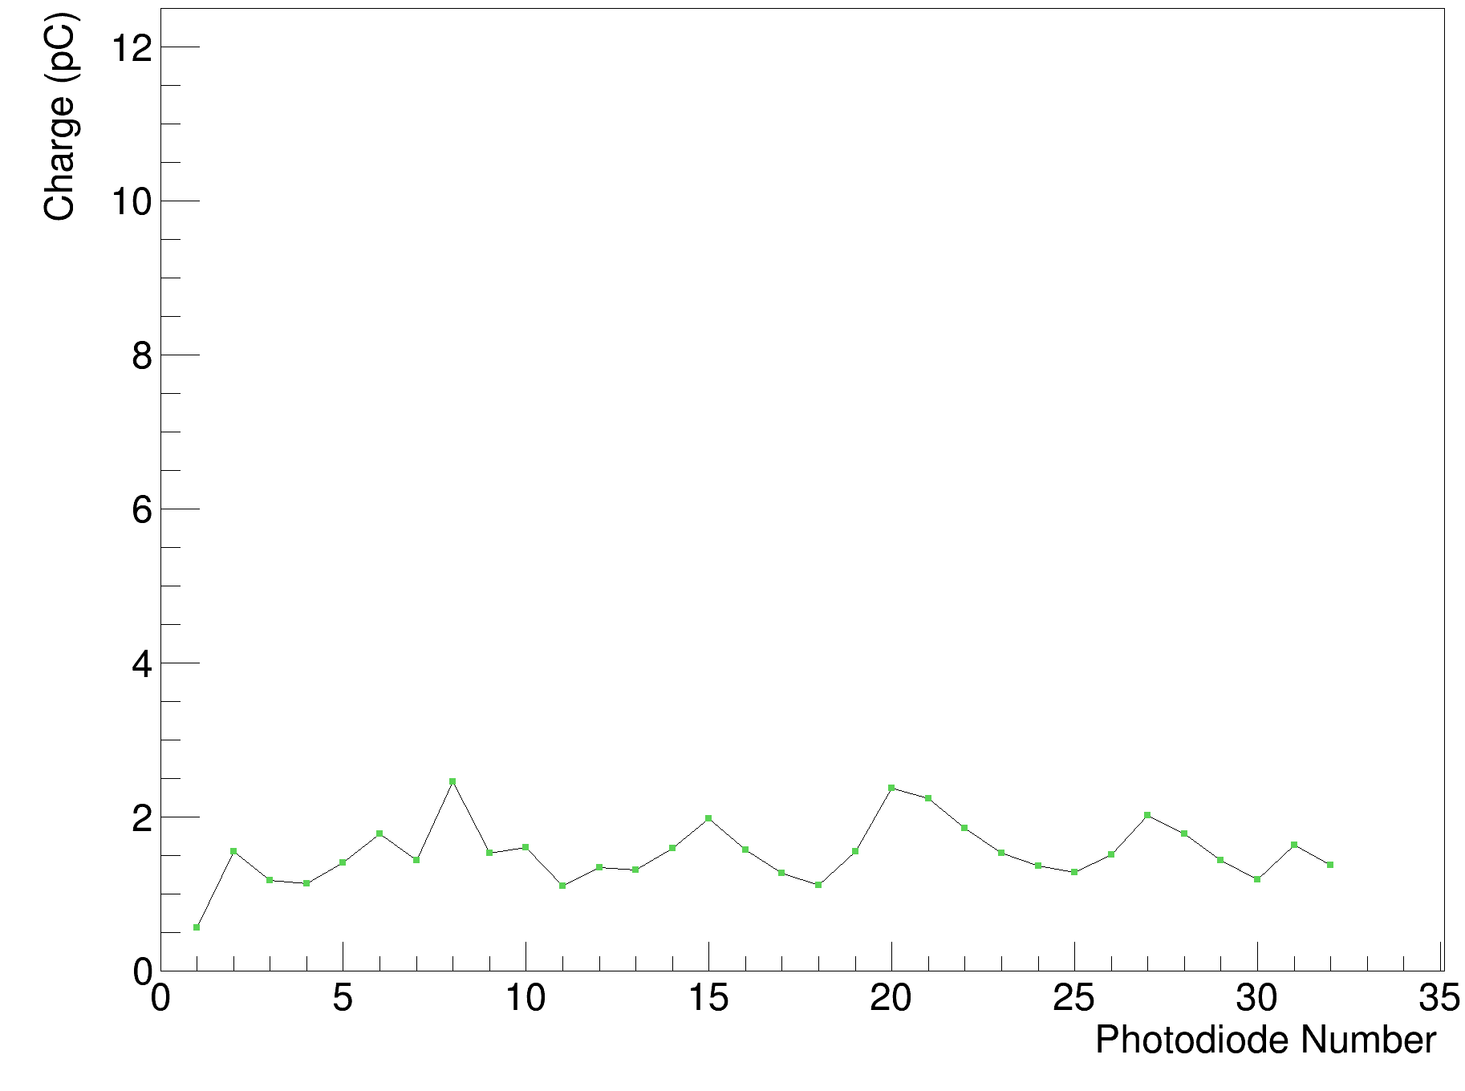
The Christie experiment
Initial calibration is required with a shoot-through measurement.
245 MeV, front
245 MeV, back
21

Slide 27
The Christie experiment
Comparison of the integrated photodiode charge for clinical and FLASH currents for a 245 MeV proton beam. The normalised calibration ratio shows that the light output is within 1% of each other.
22

Slide 28
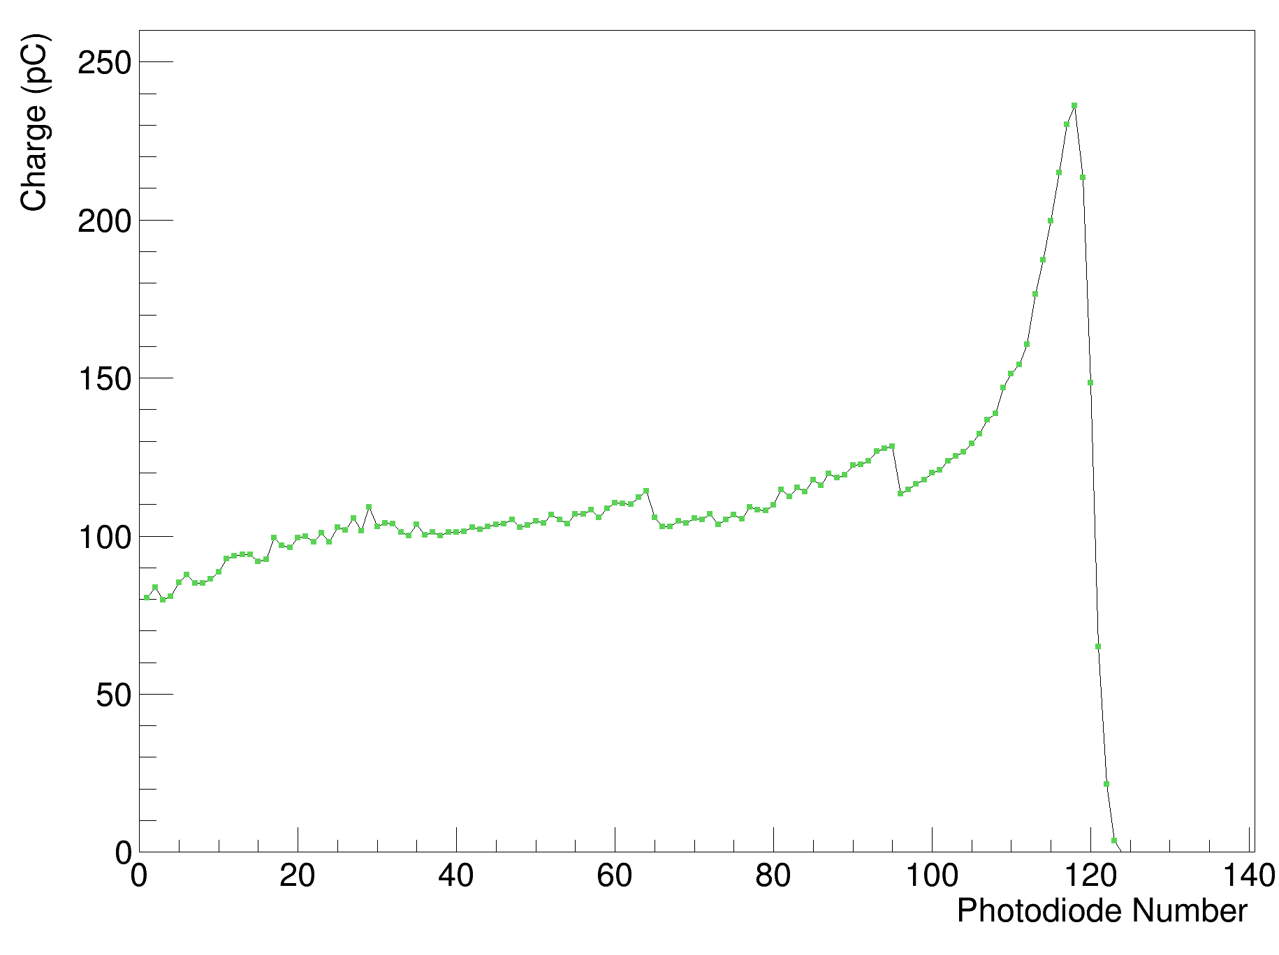
The Christie experiment
FLASH measurements at 245 MeV: initial data.
23

Slide 29
Christie Beam Test: Results
24

Slide 30
Christie Beam Test: Results
24

Slide 31
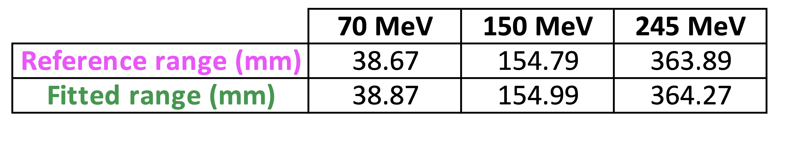
Christie Beam Test: Results
24

Slide 32
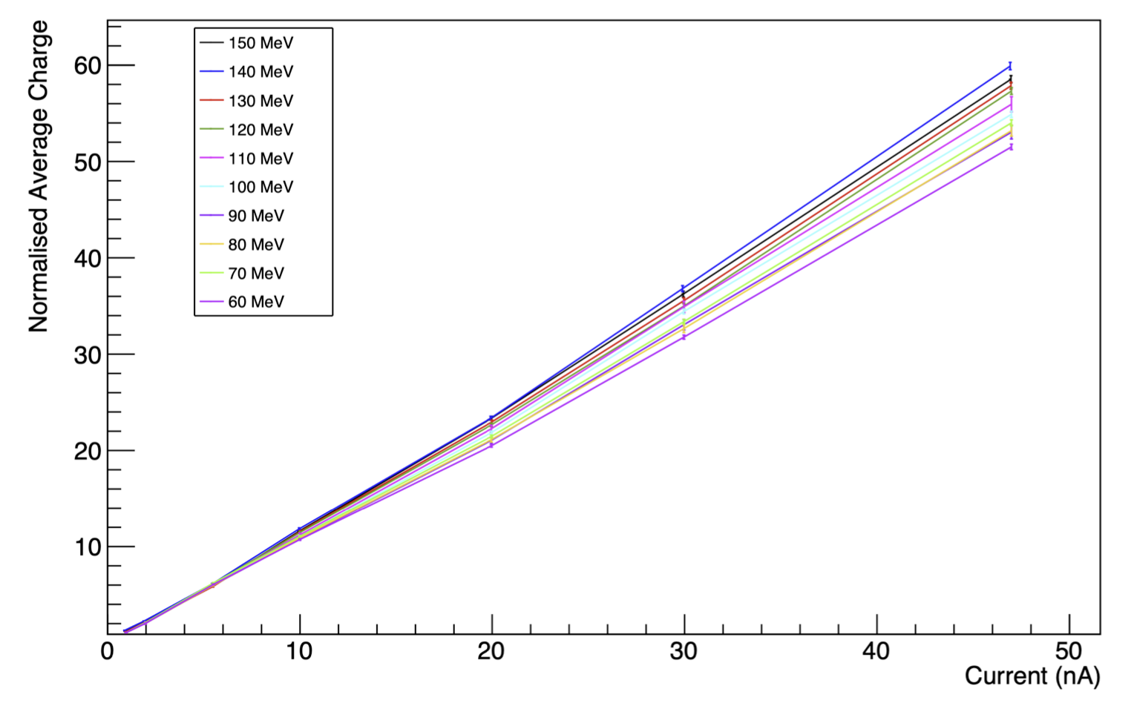
PARTREC experiment
Not a clinical facility, but used to push the detector to its limit in terms of beam current and light output.
Scintillator light output scales linearly with dose-rate.
PRELIMINARY RESULTS
25

Slide 33
Clinical application
A compact version of the QuARC has been designed for the Clatterbridge proton therapy centre in Liverpool, UK, as part of an upgrade to their clinical control system.
The detector will have a compact computing solution on-board to both perform data-acquisition and fitting.
Clinical devices provide the software to obtain the range value without the need for any coding/analysis during the measurement → GUI.
26

Slide 34
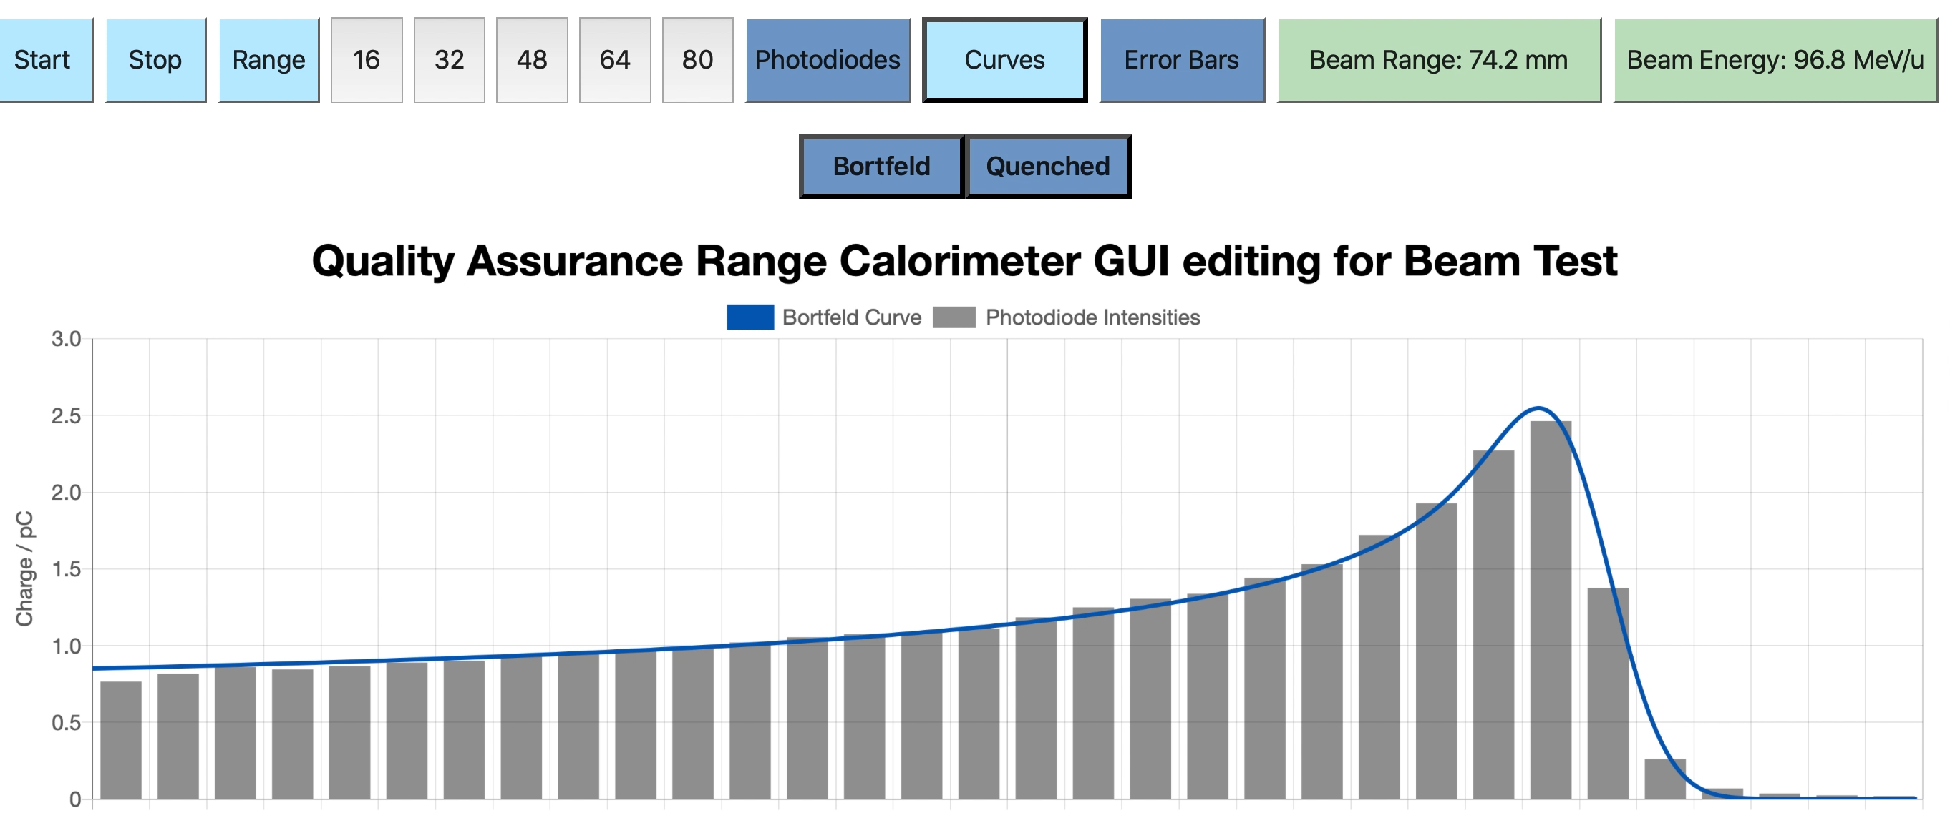
Web GUI
Clinical devices provide the software to obtain the range value without the need for any coding/analysis during the measurement
View live fit results in web from any device.
DEVELOPED IN JAVASCRIPT BY FERN PANNELL
27

Slide 35
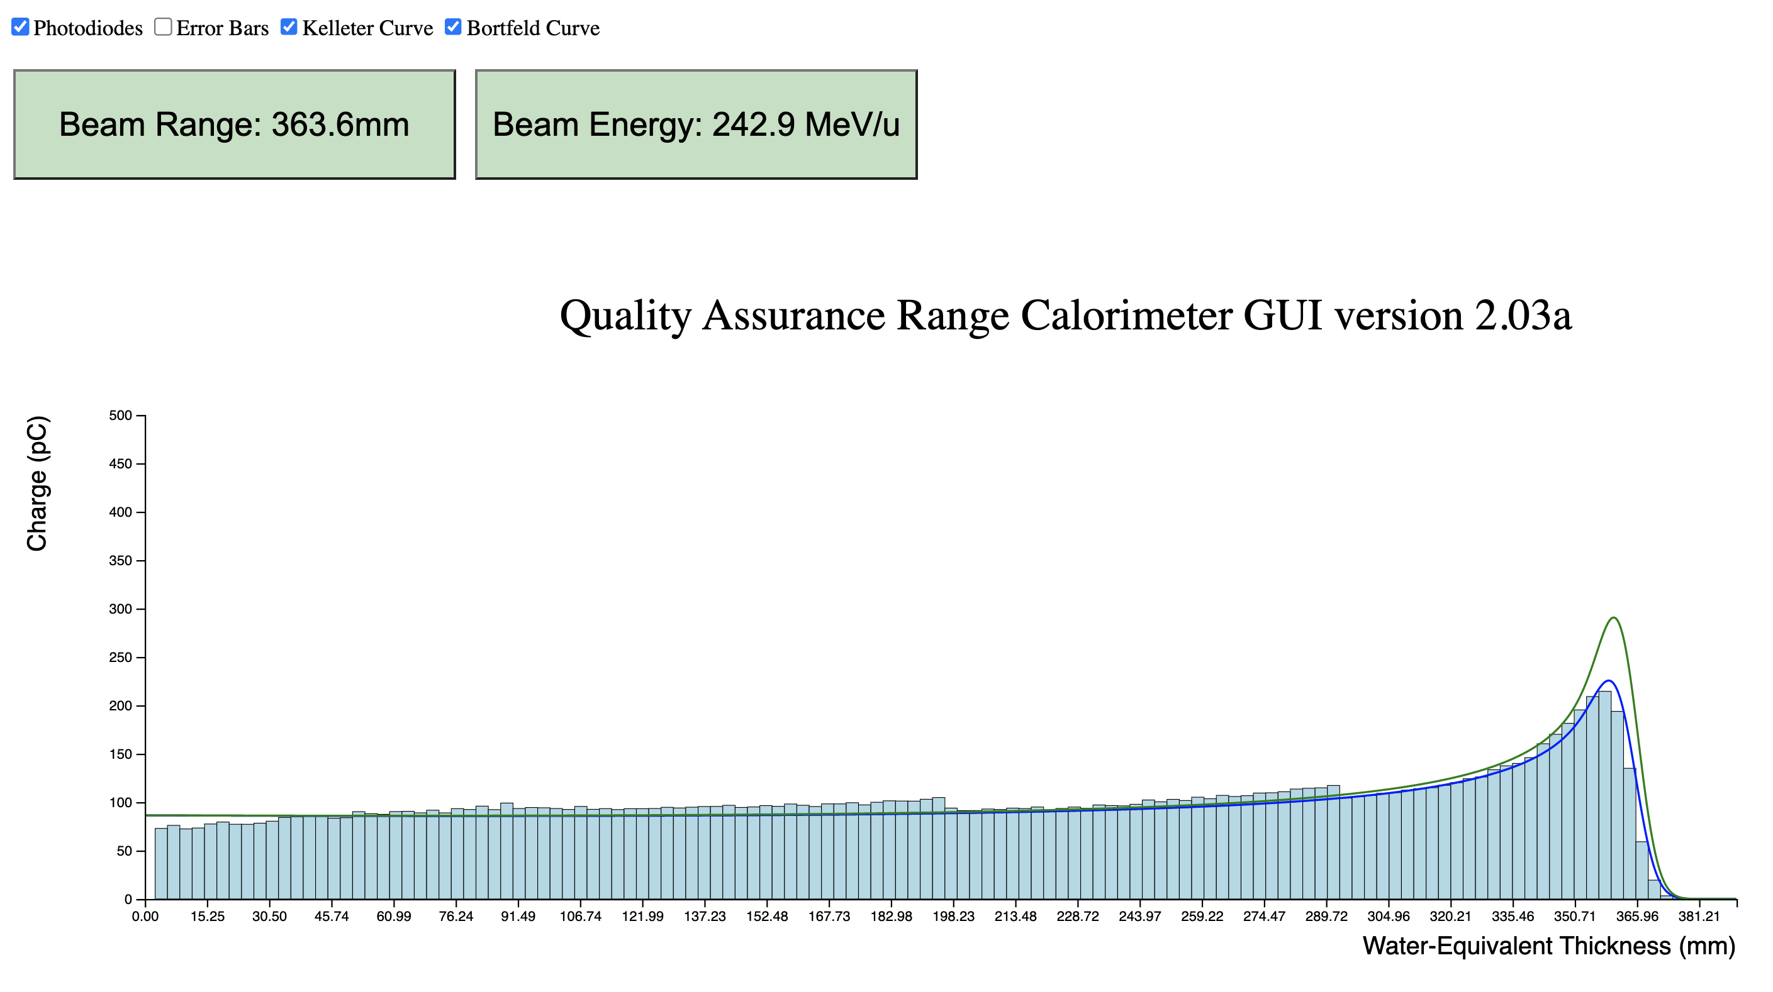
Web GUI
View live fit results in web GUI + conversion to WET.
Detector control to be implemented.
28

Slide 36
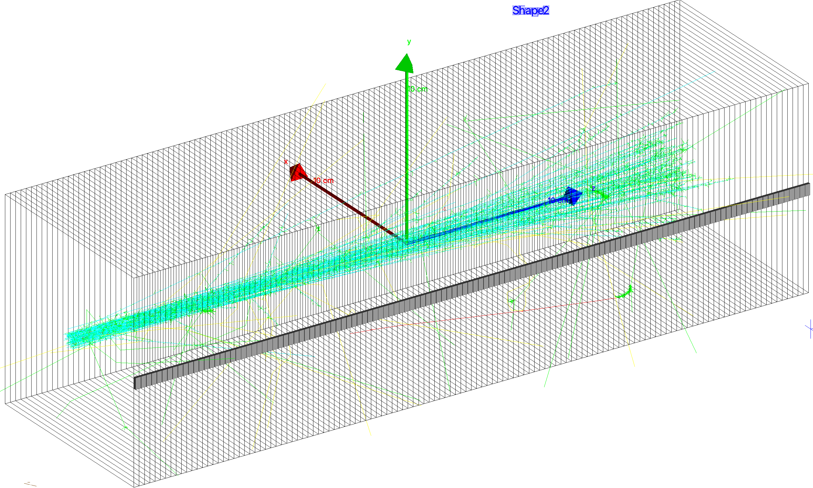
Geant4 Simulation
Compare simulated results with experimental data.
Investigate Birks’ constant values.
29

Slide 37
Future work
Further development of web-based GUI to allow data display and detector control without any specialised software on the user-end.
Improve scintillator composition and construction to optimise light output.
Deployment of fitting routines onto an FPGA to increase fitting speed.
Geant4 simulation to benchmark experimental results and constrain Birks’ constant.
Additional beam tests to further characterise detector performance with clinical and FLASH beams.
30

Slide 38






Acknowledgements

Slide 39
Thank you!
[1] S. Jolly et al. “Technical Challenges for FLASH Proton Therapy”. In Physica Medica 78 (2021). DOI: 10.1016/j.ejmp.2020.08.005
[2] L. Kelleter and S. Jolly. “A Mathematical Expression for Depth-Light Curves of Therapeutic Proton Beams in a Quenching Scintillator”. In: Medical Physics 47.5 (Feb. 2020), pp. 2300–2308. DOI: 10.1002/mp.14099

