Slide 1
FLASH Range QA Measurements with the Quality Assurance Range Calorimeter (QuARC)
DEPARTMENT OF PHYSICS AND ASTRONOMY
61st Annual PTCOG Conference
Saad Shaikh, Sonia Escribano-Rodriguez¹, Raffaella Radogna, Connor Godden, Derek Attree, Samuel Manger, Karen Kirkby, Marc-Jan Van Goethem, Alexander Gerbershagen, Simon Jolly
¹sonia.escribano@ucl.ac.uk

Slide 2
No financial disclosures

Slide 3
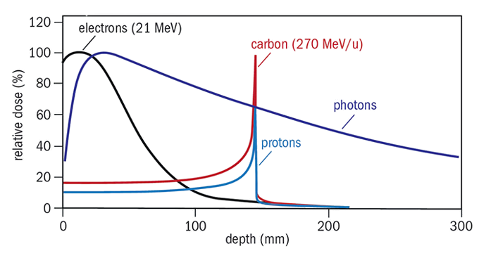
Proton therapy
Highly localized depth-dose distribution.
Range uncertainties prevent taking full advantage: accurate beam range quality assurance (QA) is essential → QA can be time consuming.
FLASH PT can offer additional healthy tissue sparing → Current QA detectors can not cope with FLASH rates (~40 Gy/s and 600 nA to the patient [1]).
1

Slide 4
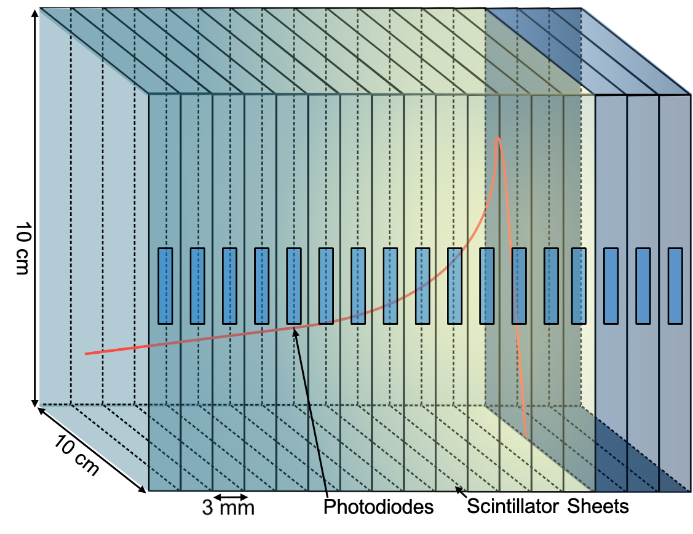
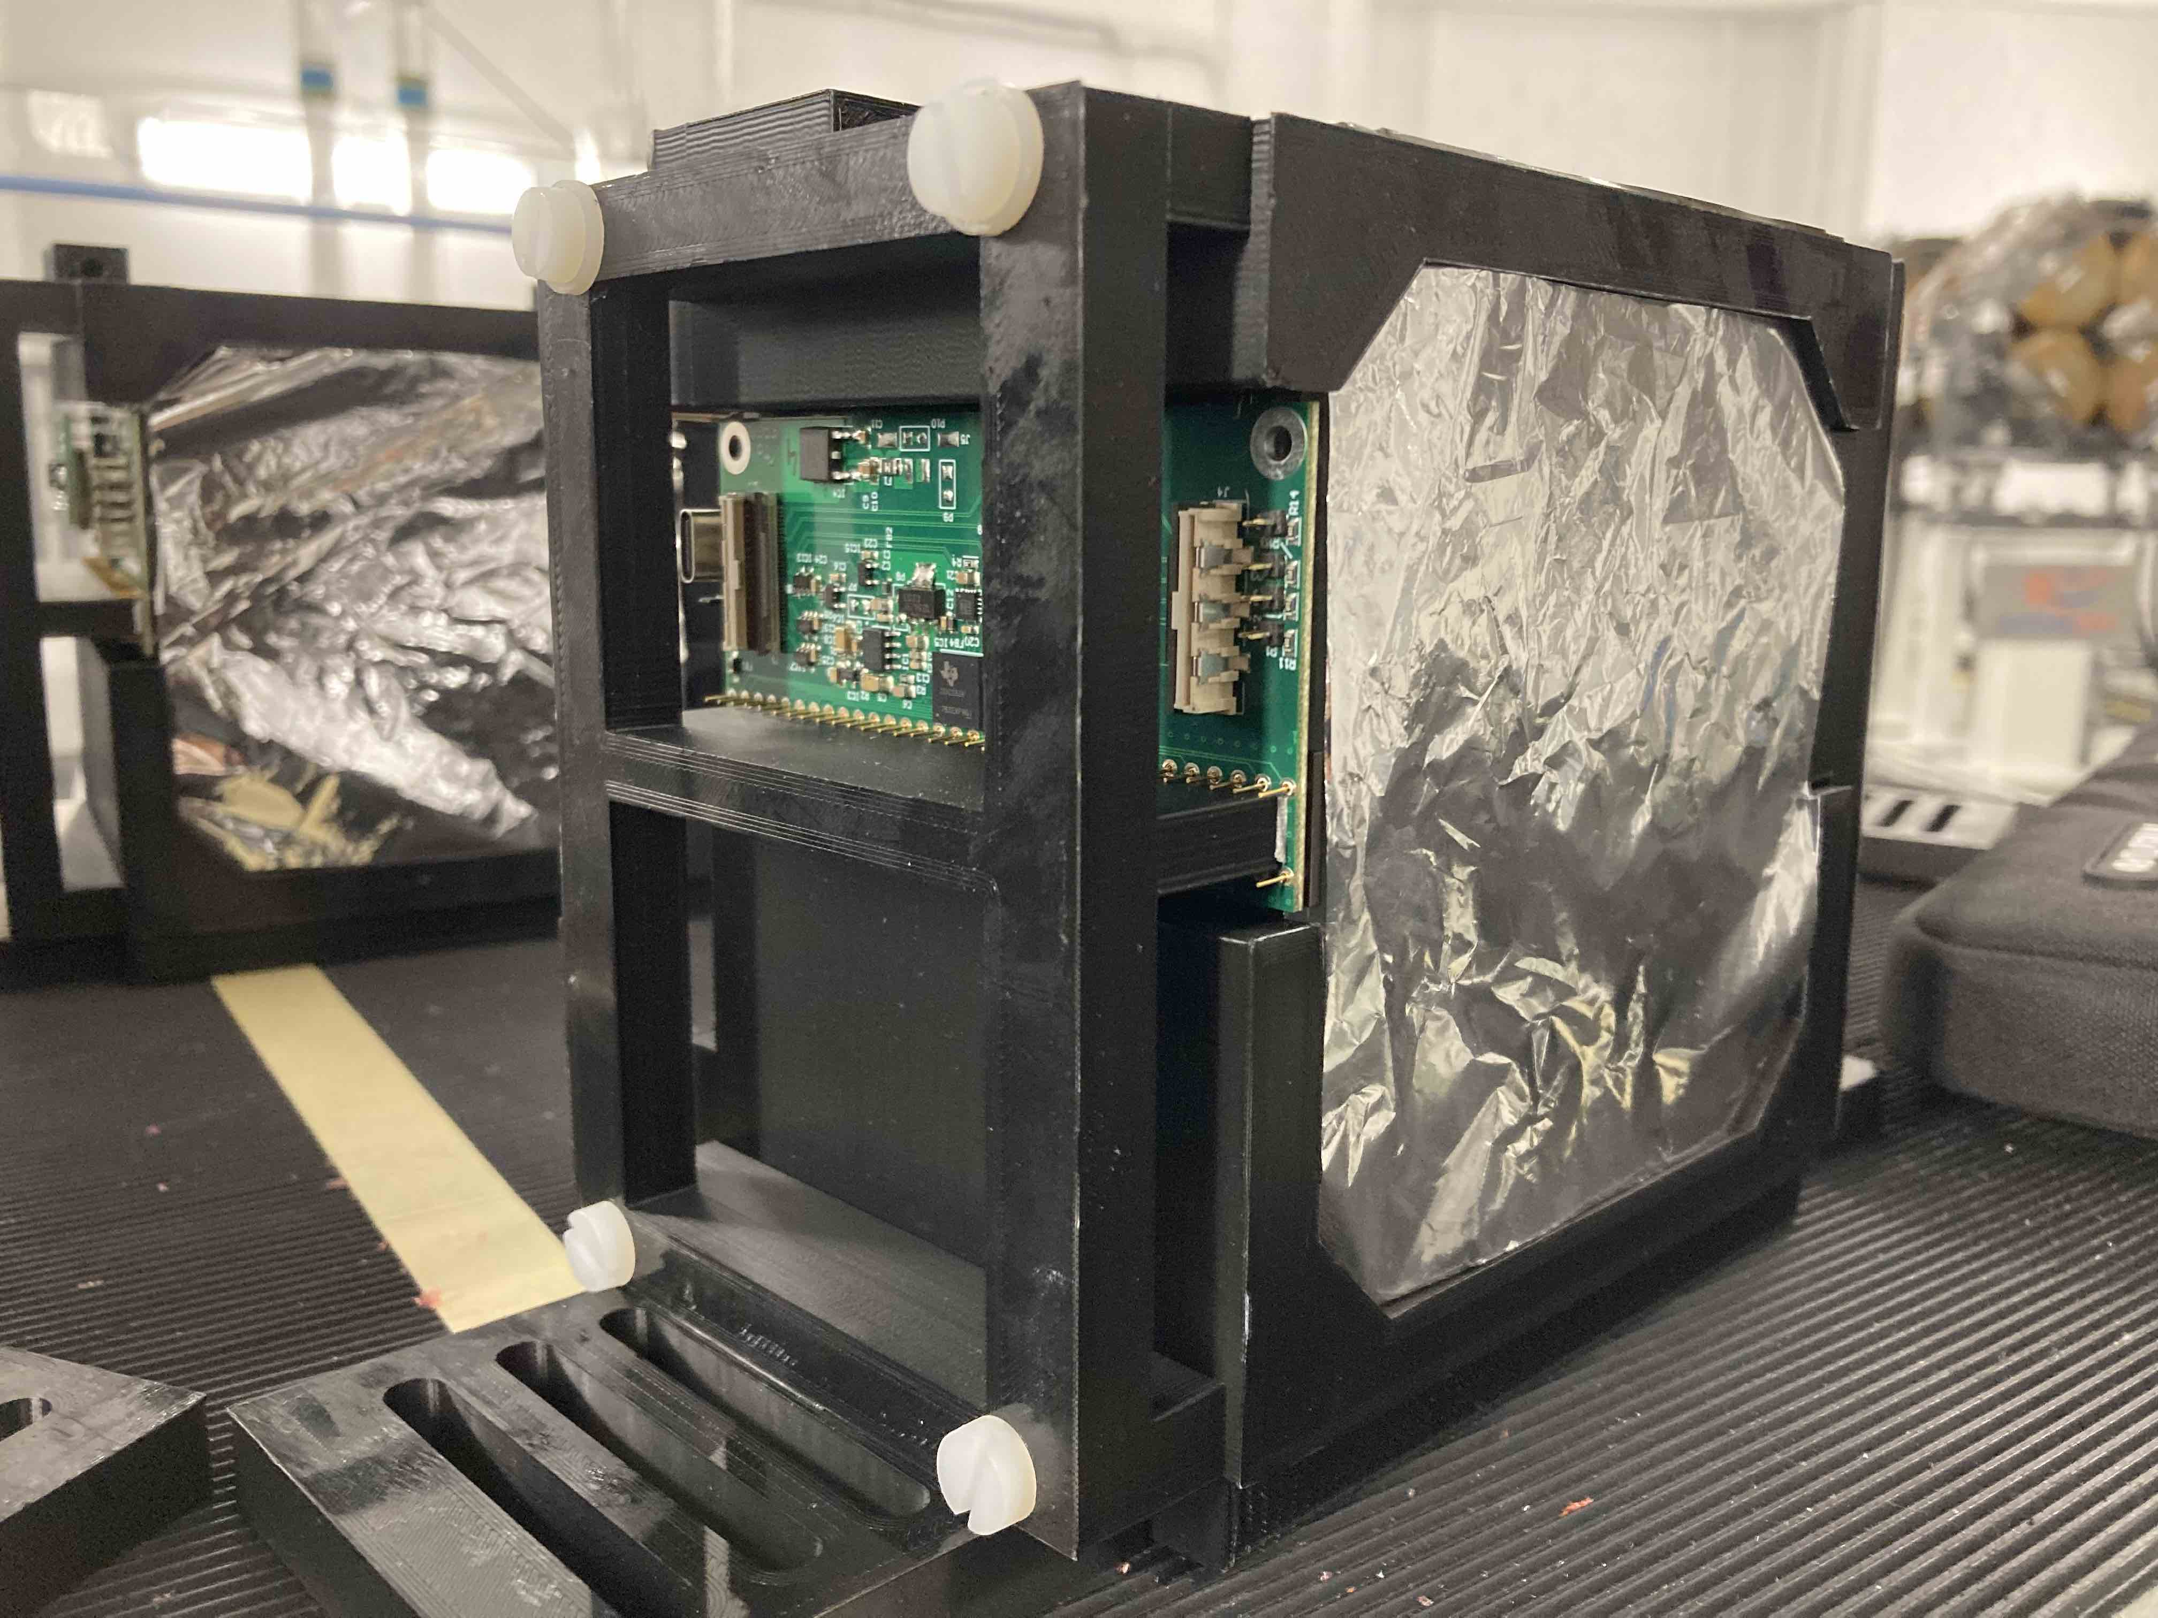
Quality Assurance Range Calorimeter (QuARC)
Optically-isolated polystyrene scintillator sheets in a segmented design.
Photodiodes coupled to fast, modular electronics and an FPGA to read light levels at 6 kHz.
Light output nonlinear to LET due to quenching effects described by Birks’ law.
- Fit light output using analytical depth-light model [2].
2

Slide 5
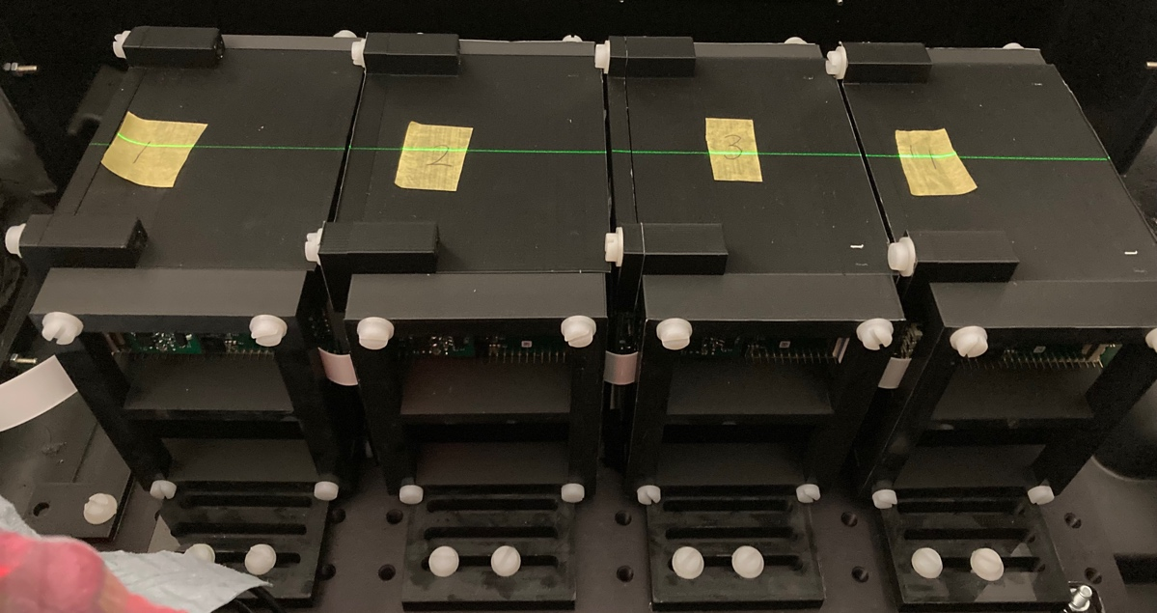
The Christie Beam Test
Four 32-sheet detector modules (40 cm WET) to test energies between 70 and 245 MeV at clinical current.
245 MeV FLASH beam available at 800 nA ion-source current (approx. 7% transmisssio.
3

Slide 6
The Christie Beam Test: Results
150 MeV
[2]
70 MeV
4

Slide 7
The Christie Beam Test: Results
150 MeV
245 MeV
[2]
[2]
70 MeV
4

Slide 8
The Christie Beam Test: Results
150 MeV
245 MeV
[2]
[2]
70 MeV
4

Slide 9
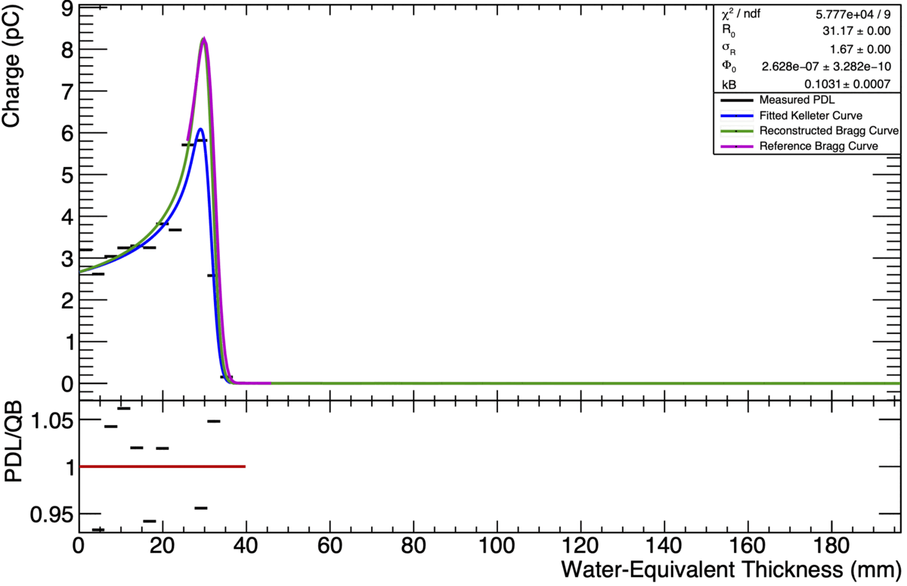
PARTREC Beam Test
Tested currents up to 50 nA and energies up to 150 MeV.
Push the detector to its limit in terms of beam current/scintillator light output.
2 detector modules tested.
5

Slide 10
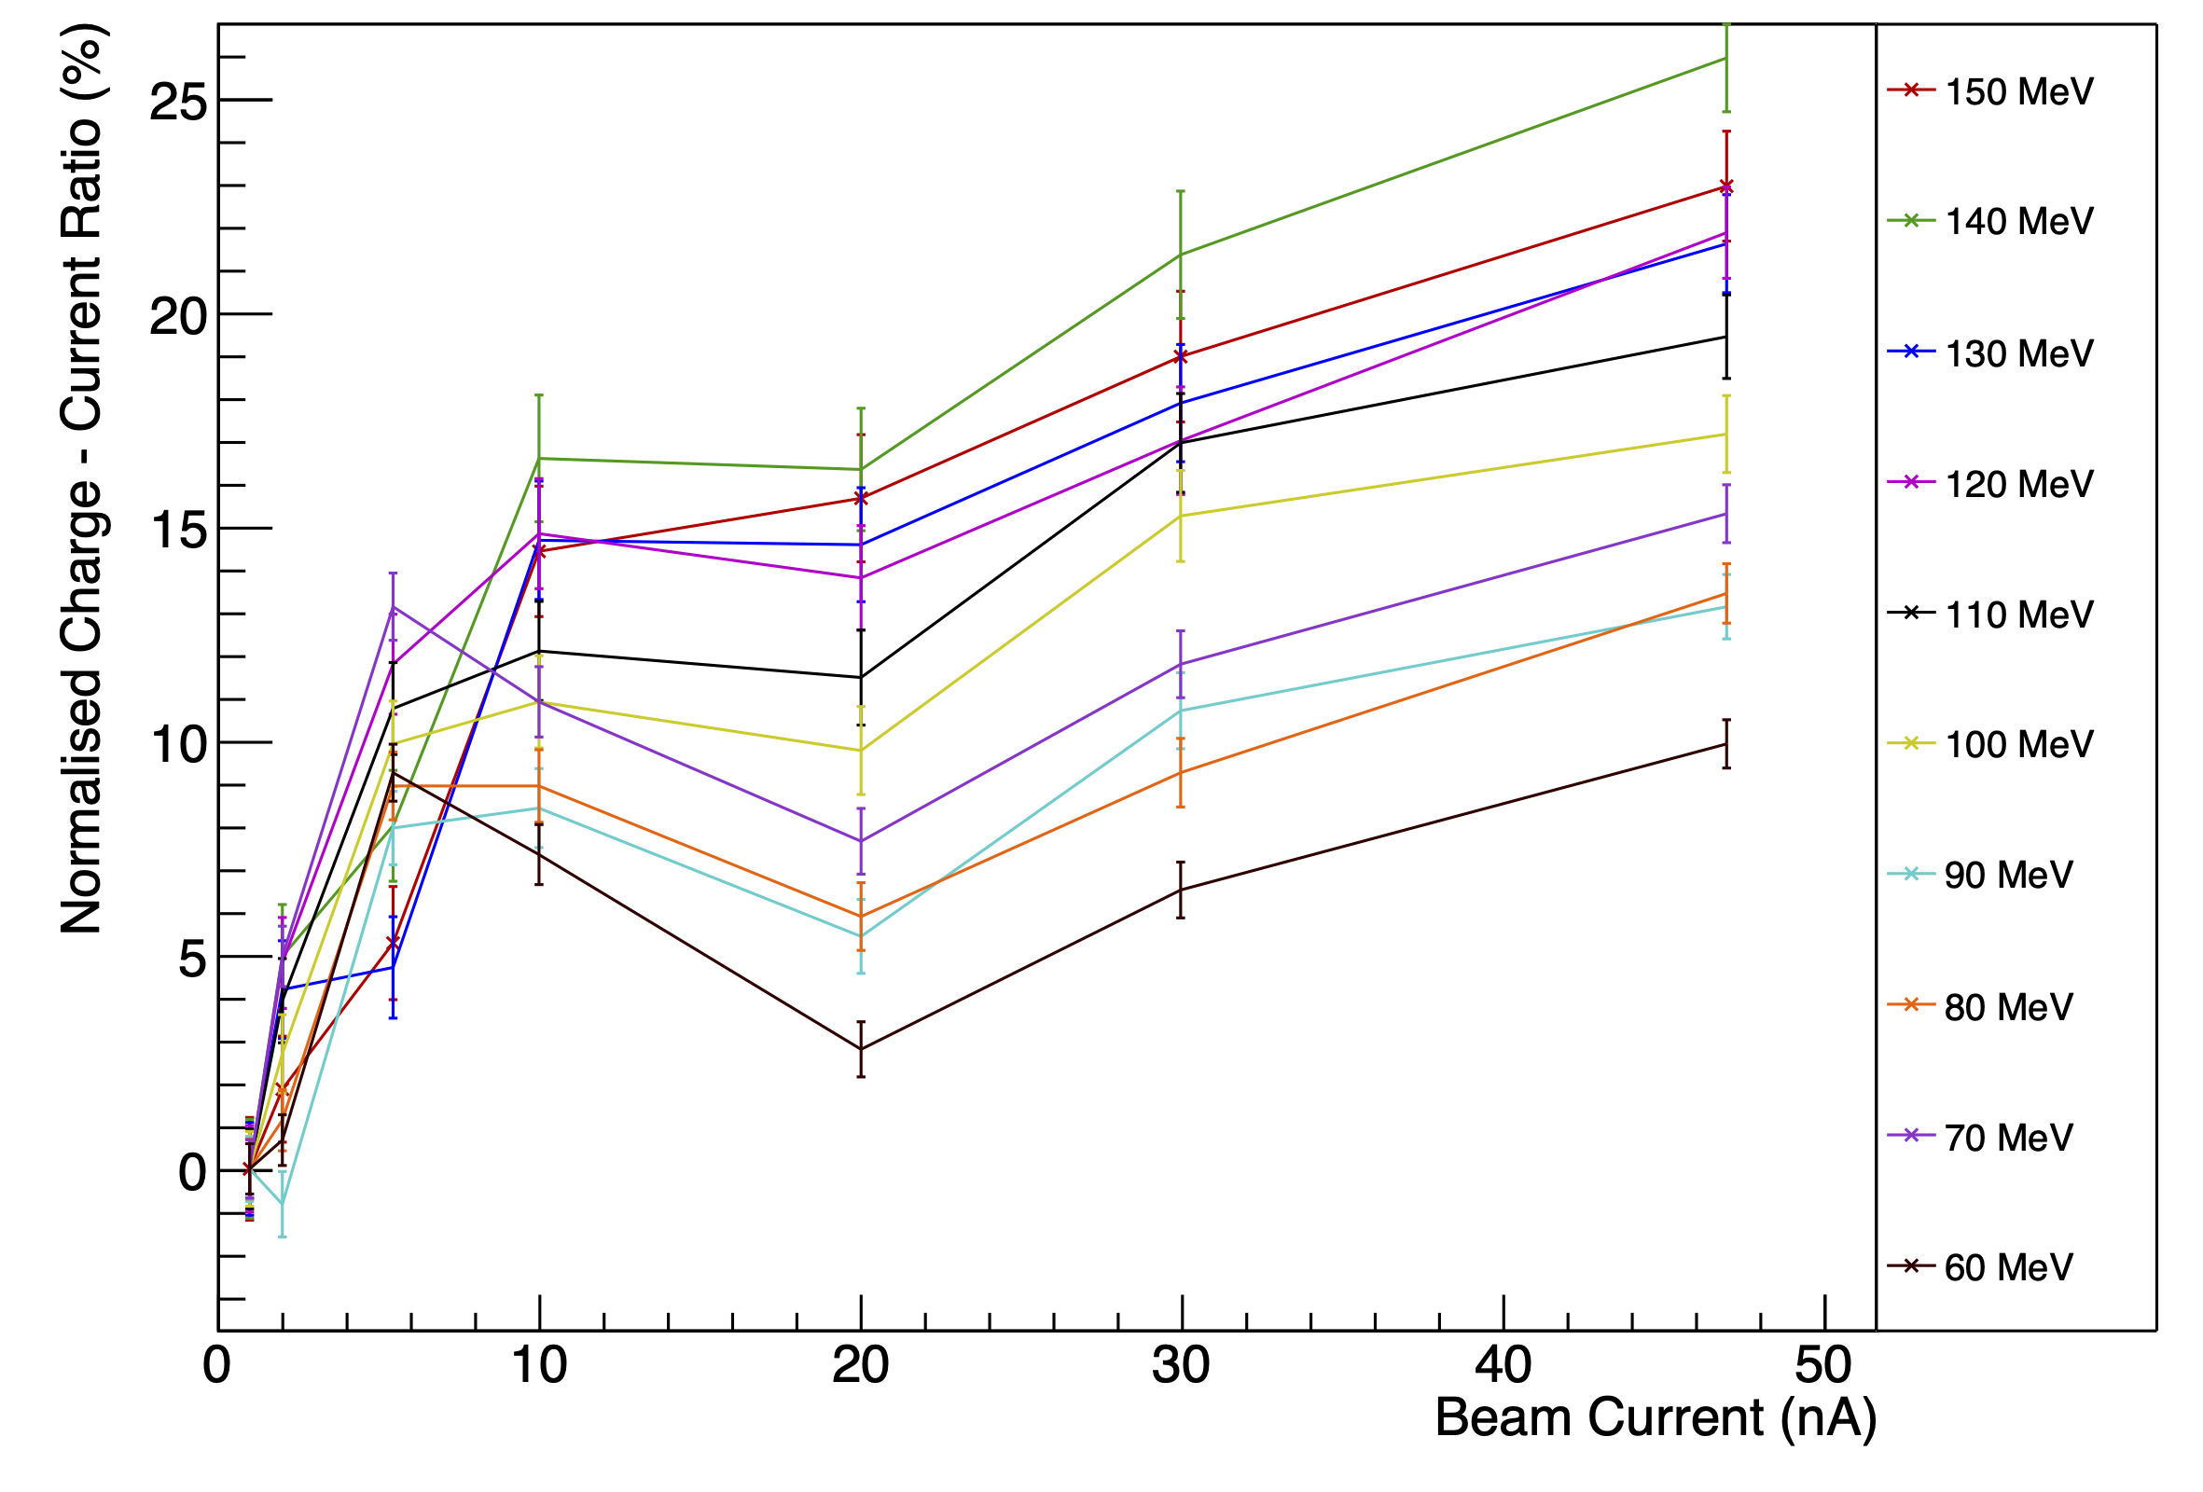
PARTREC Beam Test
Tested currents up to 50 nA and energies up to 150 MeV.
Push the detector to its limit in terms of beam current/scintillator light output.
2 detector modules tested.
PRELIMINARY RESULTS
5

Slide 11
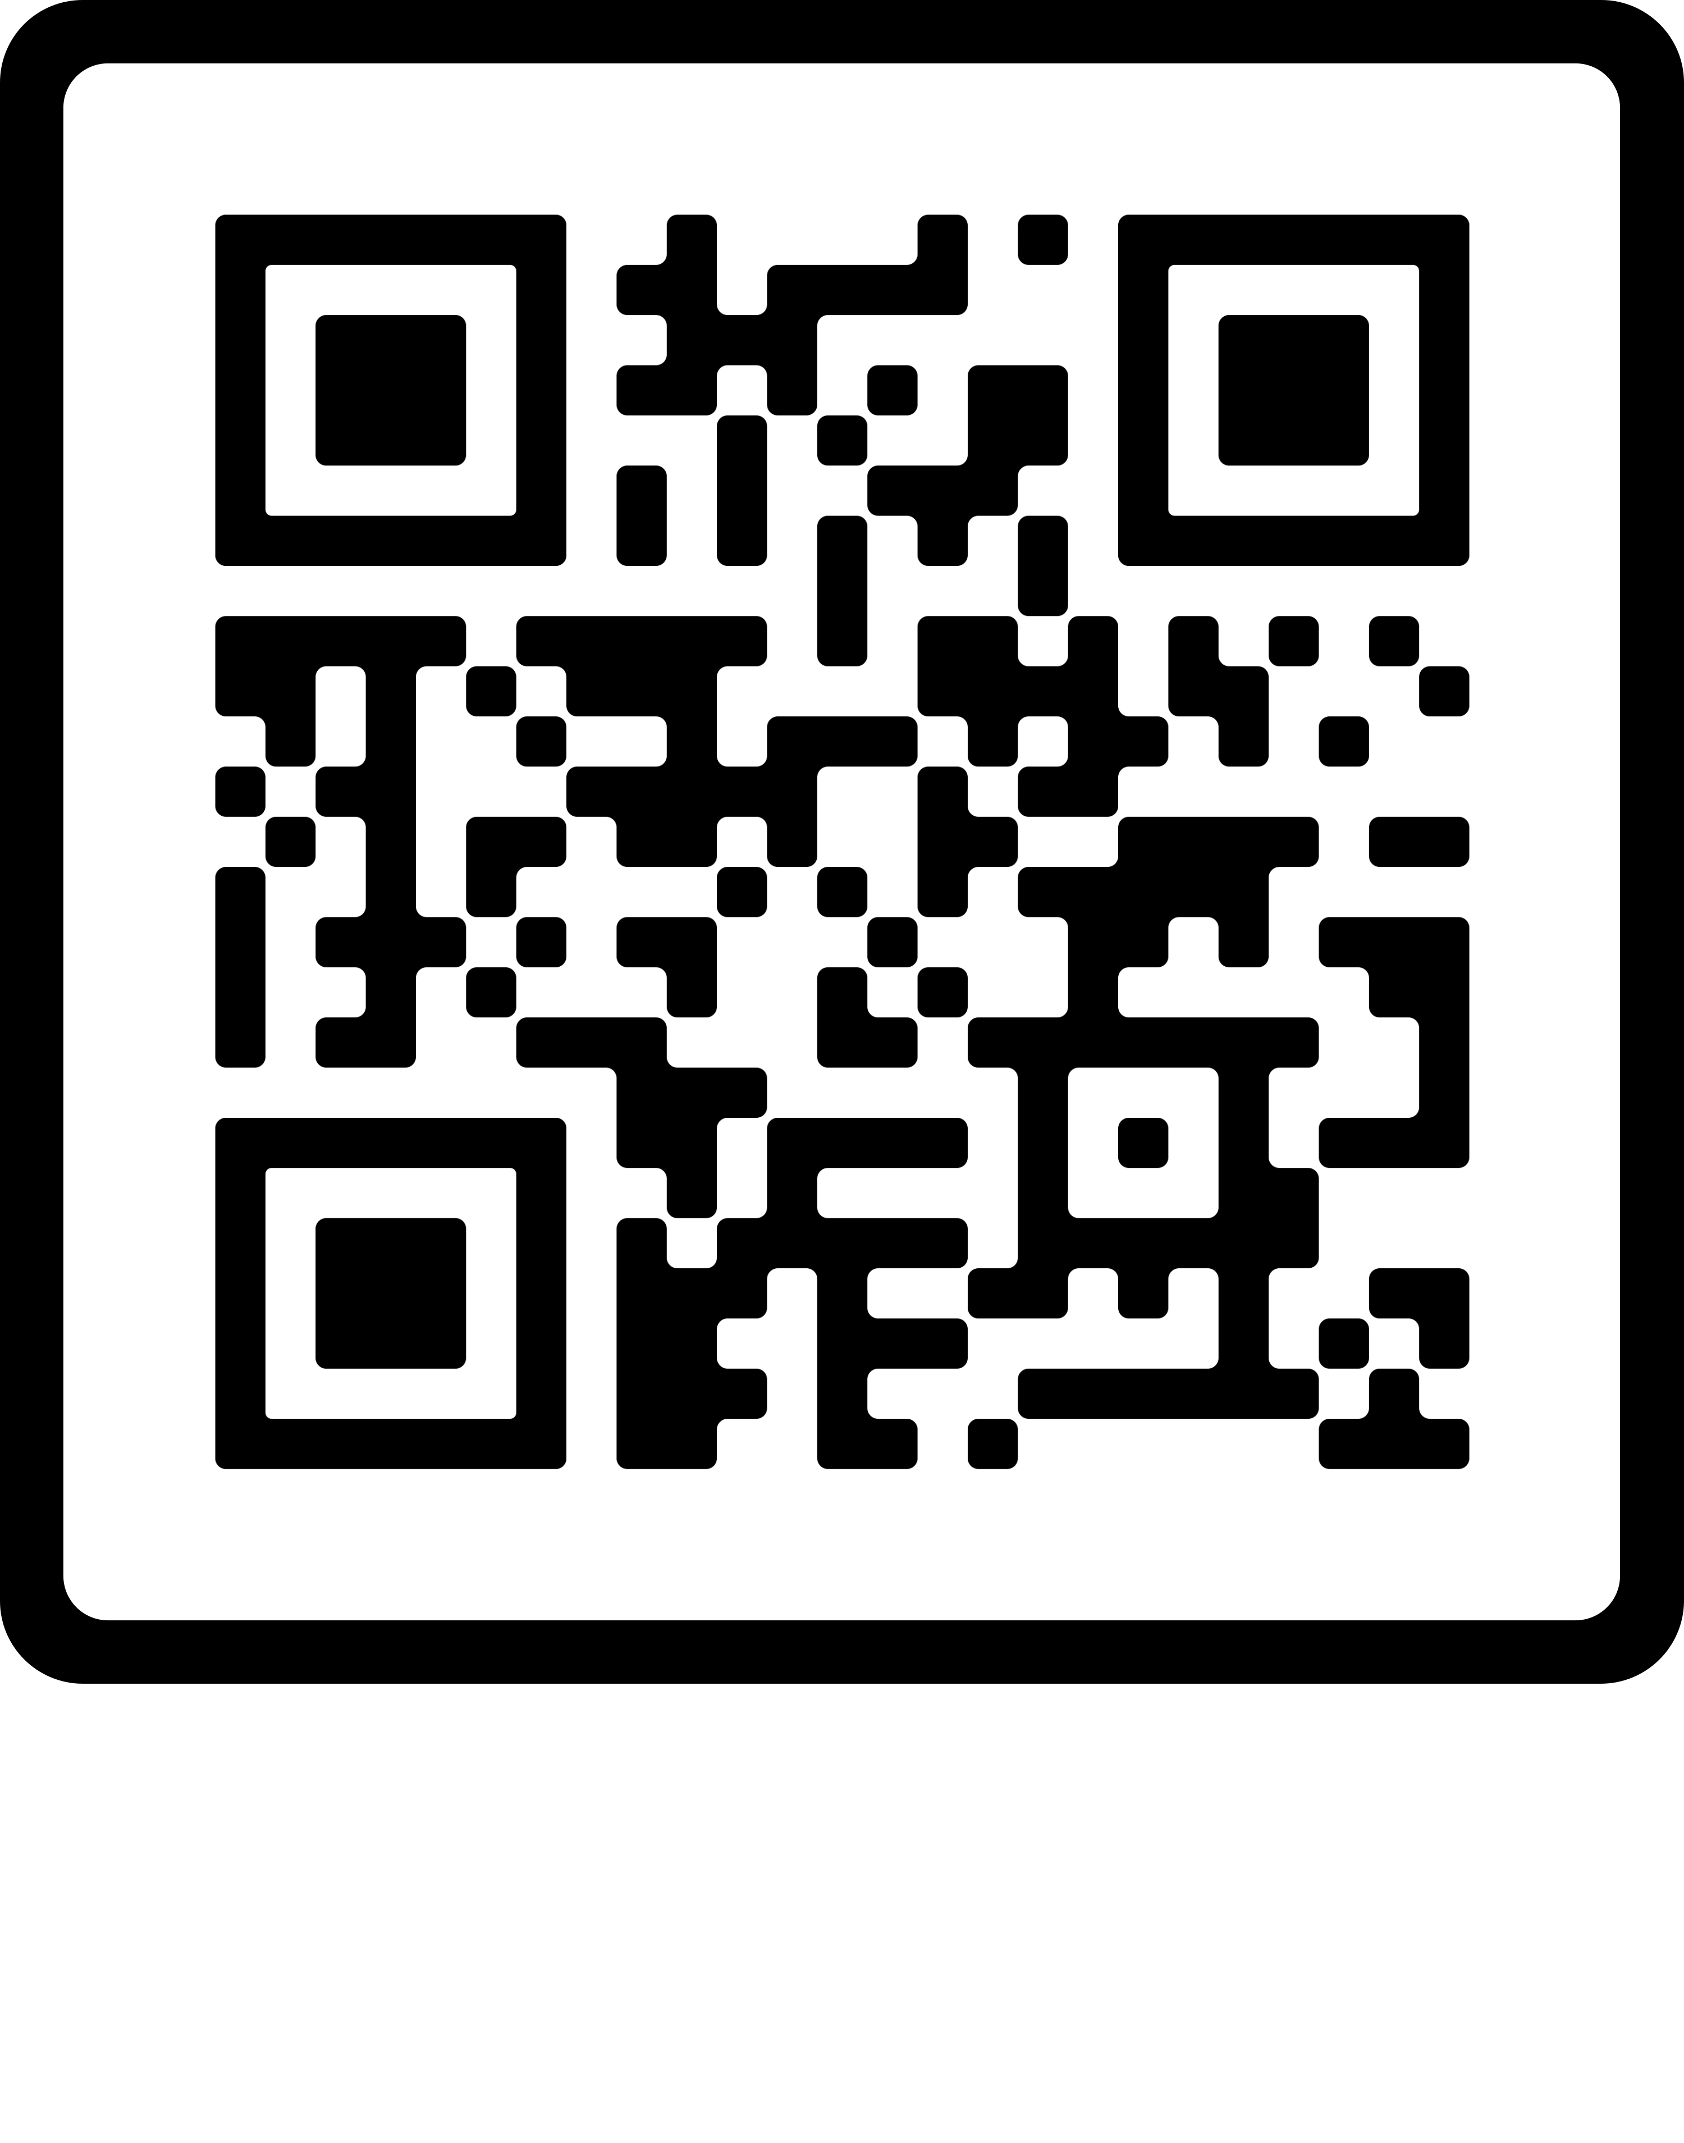
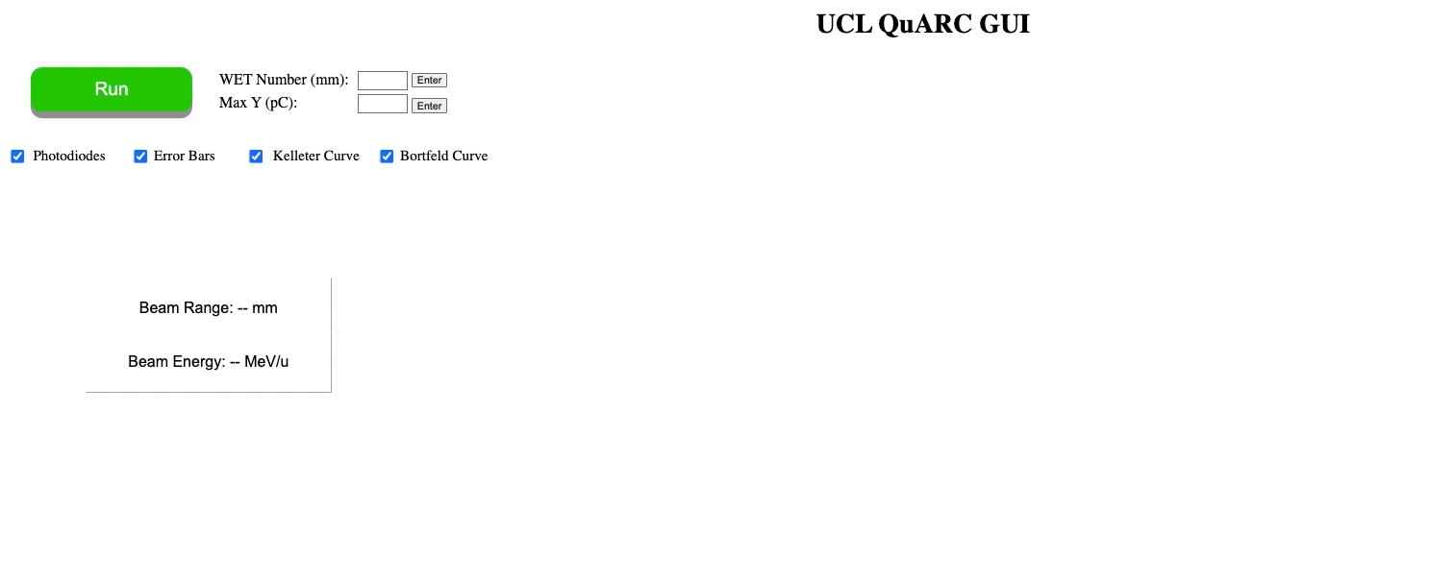
Web GUI
- View live fit results in web GUI.
6

Slide 12
Conclusions and future work
Detector able to reconstruct proton ranges at clinical currents between 70-245 MeV with an accuracy of 0.4 mm.
Detector can handle up to 50 nA of nozzle current. Non-linearities in charge observed but range consistent.
Further development of web-based GUI to allow detector control.
Improve scintillator composition and construction to optimise light output.
Geant4 simulation to benchmark experimental results and constrain Birks’ constant.
Additional beam tests to optimise light output and characterise detector performance with clinical and FLASH beams.
7

Slide 13





Acknowledgements

Slide 14
Thank you!
P168: A compact detector for eye therapy quality assurance at the Clatterbridge Cancer Centre
[1] S. Jolly et al. “Technical Challenges for FLASH Proton Therapy”. In Physica Medica 78 (2021). DOI: 10.1016/j.ejmp.2020.08.005
[2] L. Kelleter and S. Jolly. “A Mathematical Expression for Depth-Light Curves of Therapeutic Proton Beams in a Quenching Scintillator”. In: Medical Physics 47.5 (Feb. 2020), pp. 2300–2308. DOI: 10.1002/mp.14099

