Slide 1
Meeting with Nuvia
DEPARTMENT OF PHYSICS AND ASTRONOMY
2nd November 2023, London
Saad Shaikh, Sonia Escribano-Rodriguez¹, Raffaella Radogna, Connor Godden, Derek Attree, Samuel Manger, Karen Kirkby, Marc-Jan Van Goethem, Alexander Gerbershagen, Simon Jolly
¹sonia.escribano@ucl.ac.uk

Slide 2
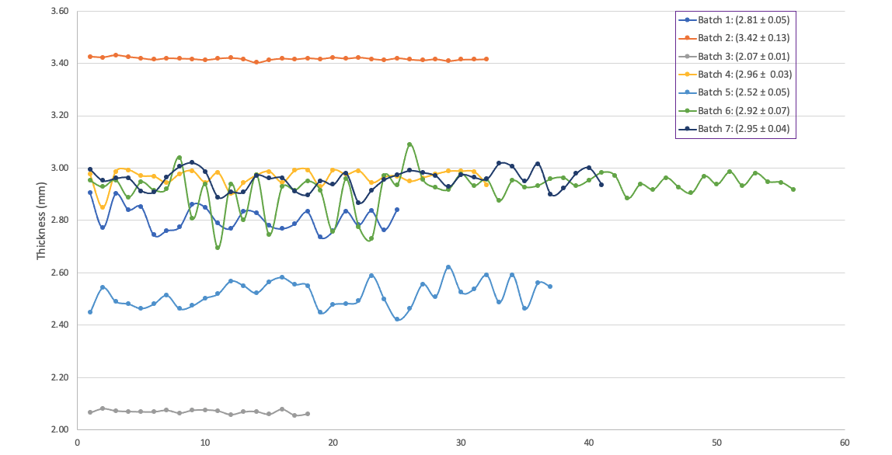
Sheet thickness should be 3.0mm.

Slide 3
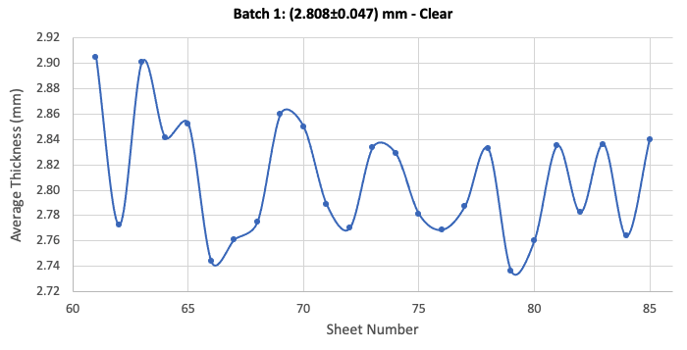
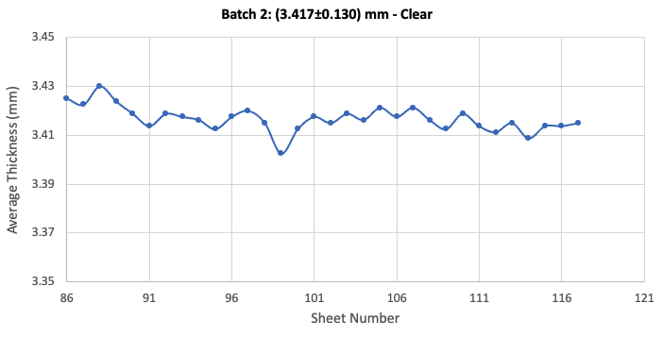
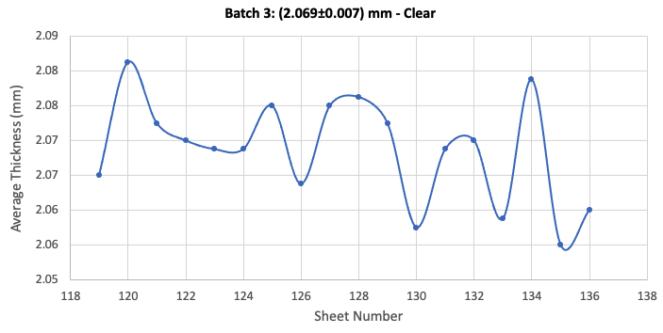
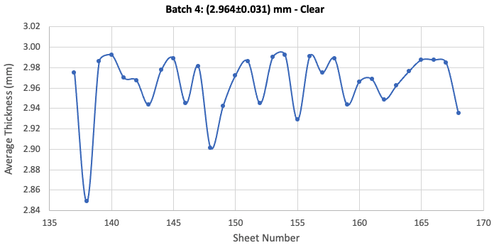

Slide 4
Experiment 16th June 2022
Sheets were 3.4mm thick instead of 3mm. Due to PD separation the sheets had to be compensated with a 2mm thick sheet every two.
2

Slide 5
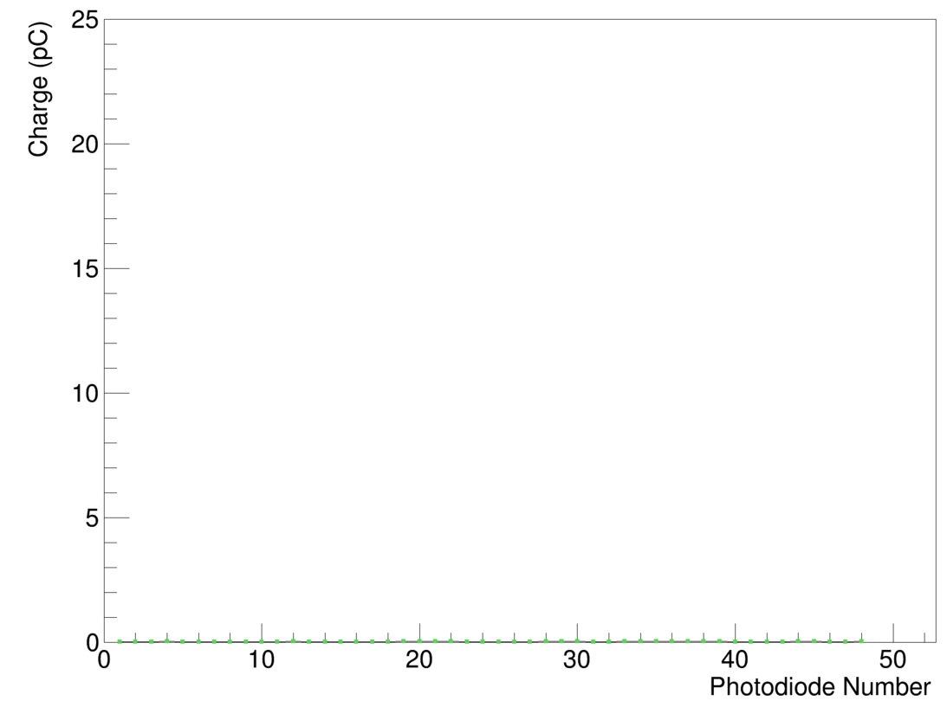
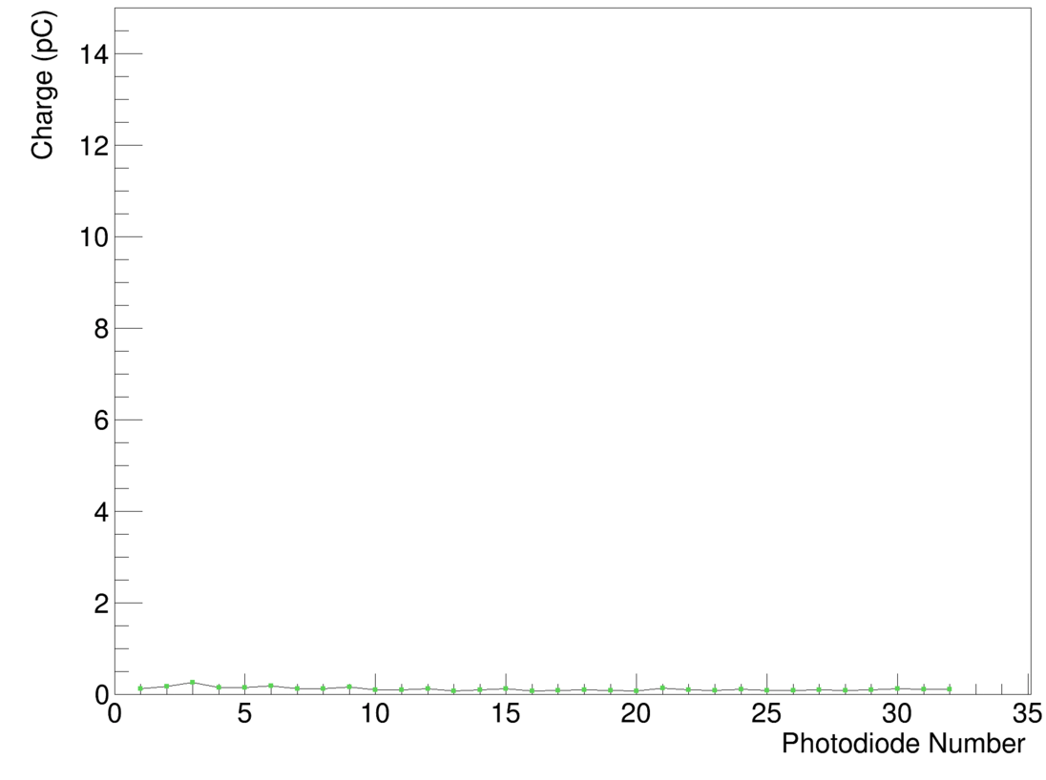
Cross-talk measurements
Thickness of the sheets really affects the light cross-talk
Rev B: 0.78% cross-talk
Rev C: 2 thick + 1 thin -> 5.11% cross-talk
2

Slide 6
Fit Results
The increase in cross-talk light leads to inconsistent fits
Rev B
Rev C
2

Slide 7
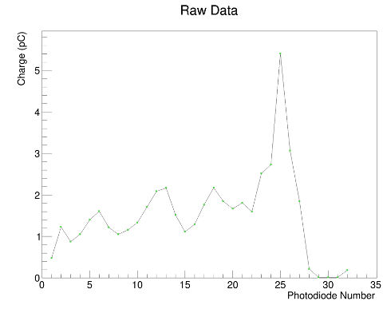
Experiment 1st September 2022
Correct thickness, but light output lower than expected: about 40% down on the set of sheets that average 2.86mm. It also looks like there is a fair amount of variation in light output between sheets.
2

Slide 8
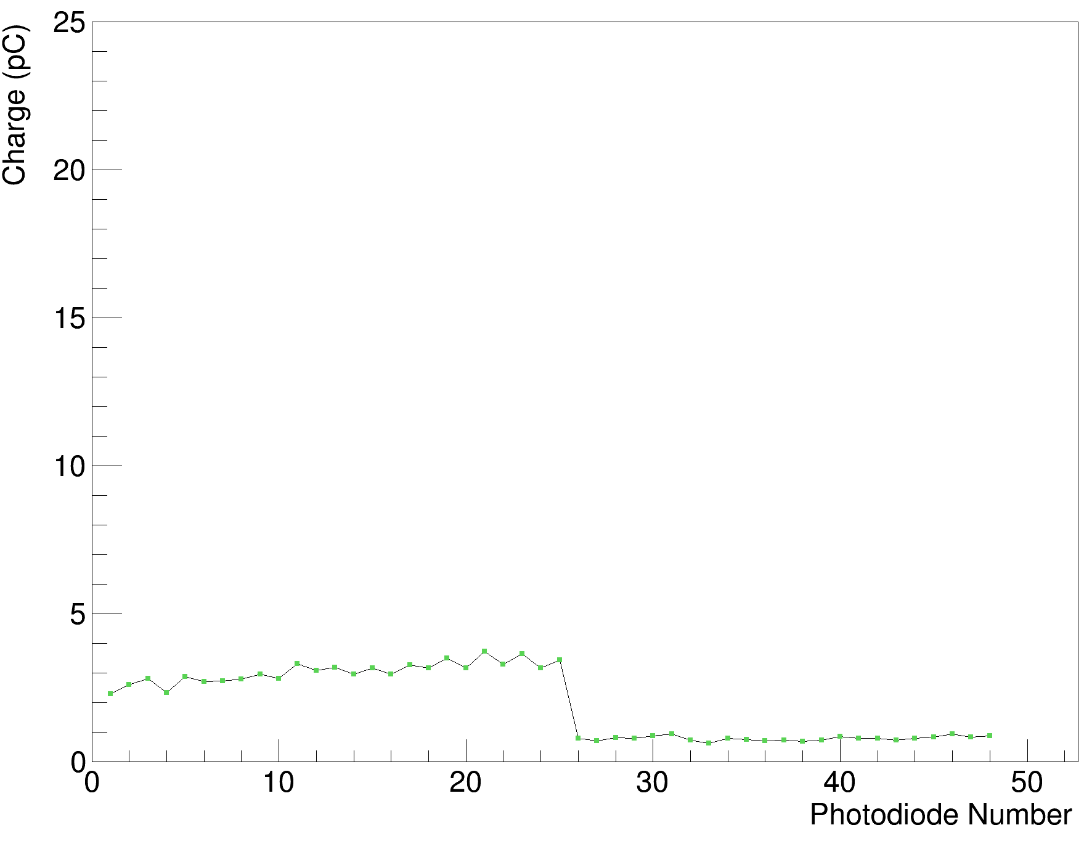
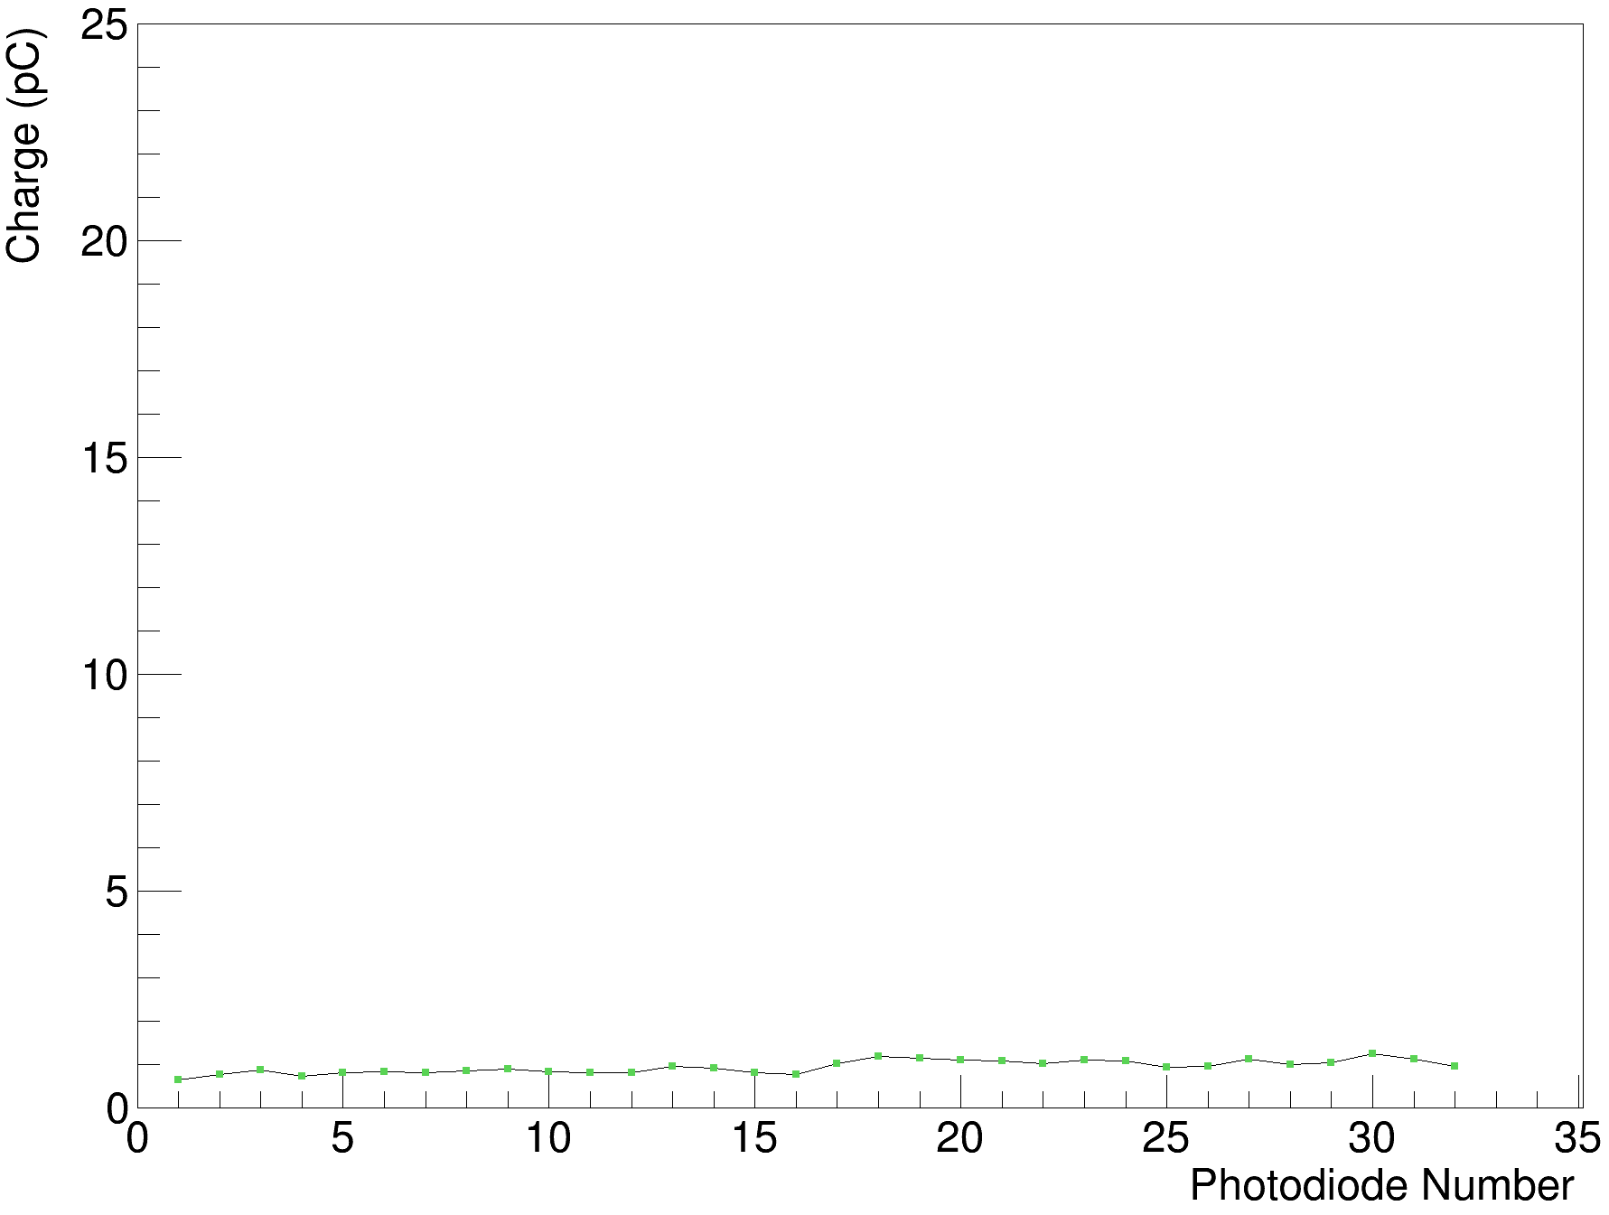

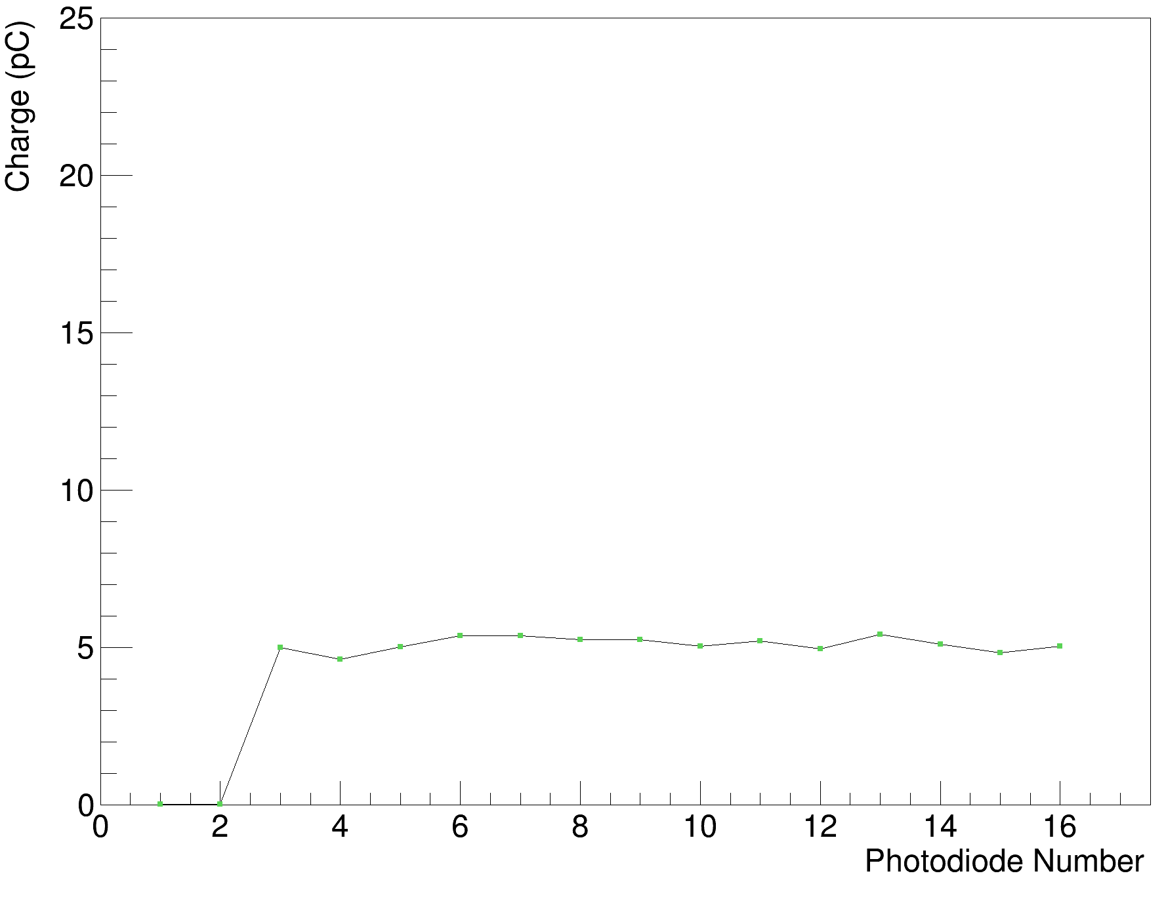
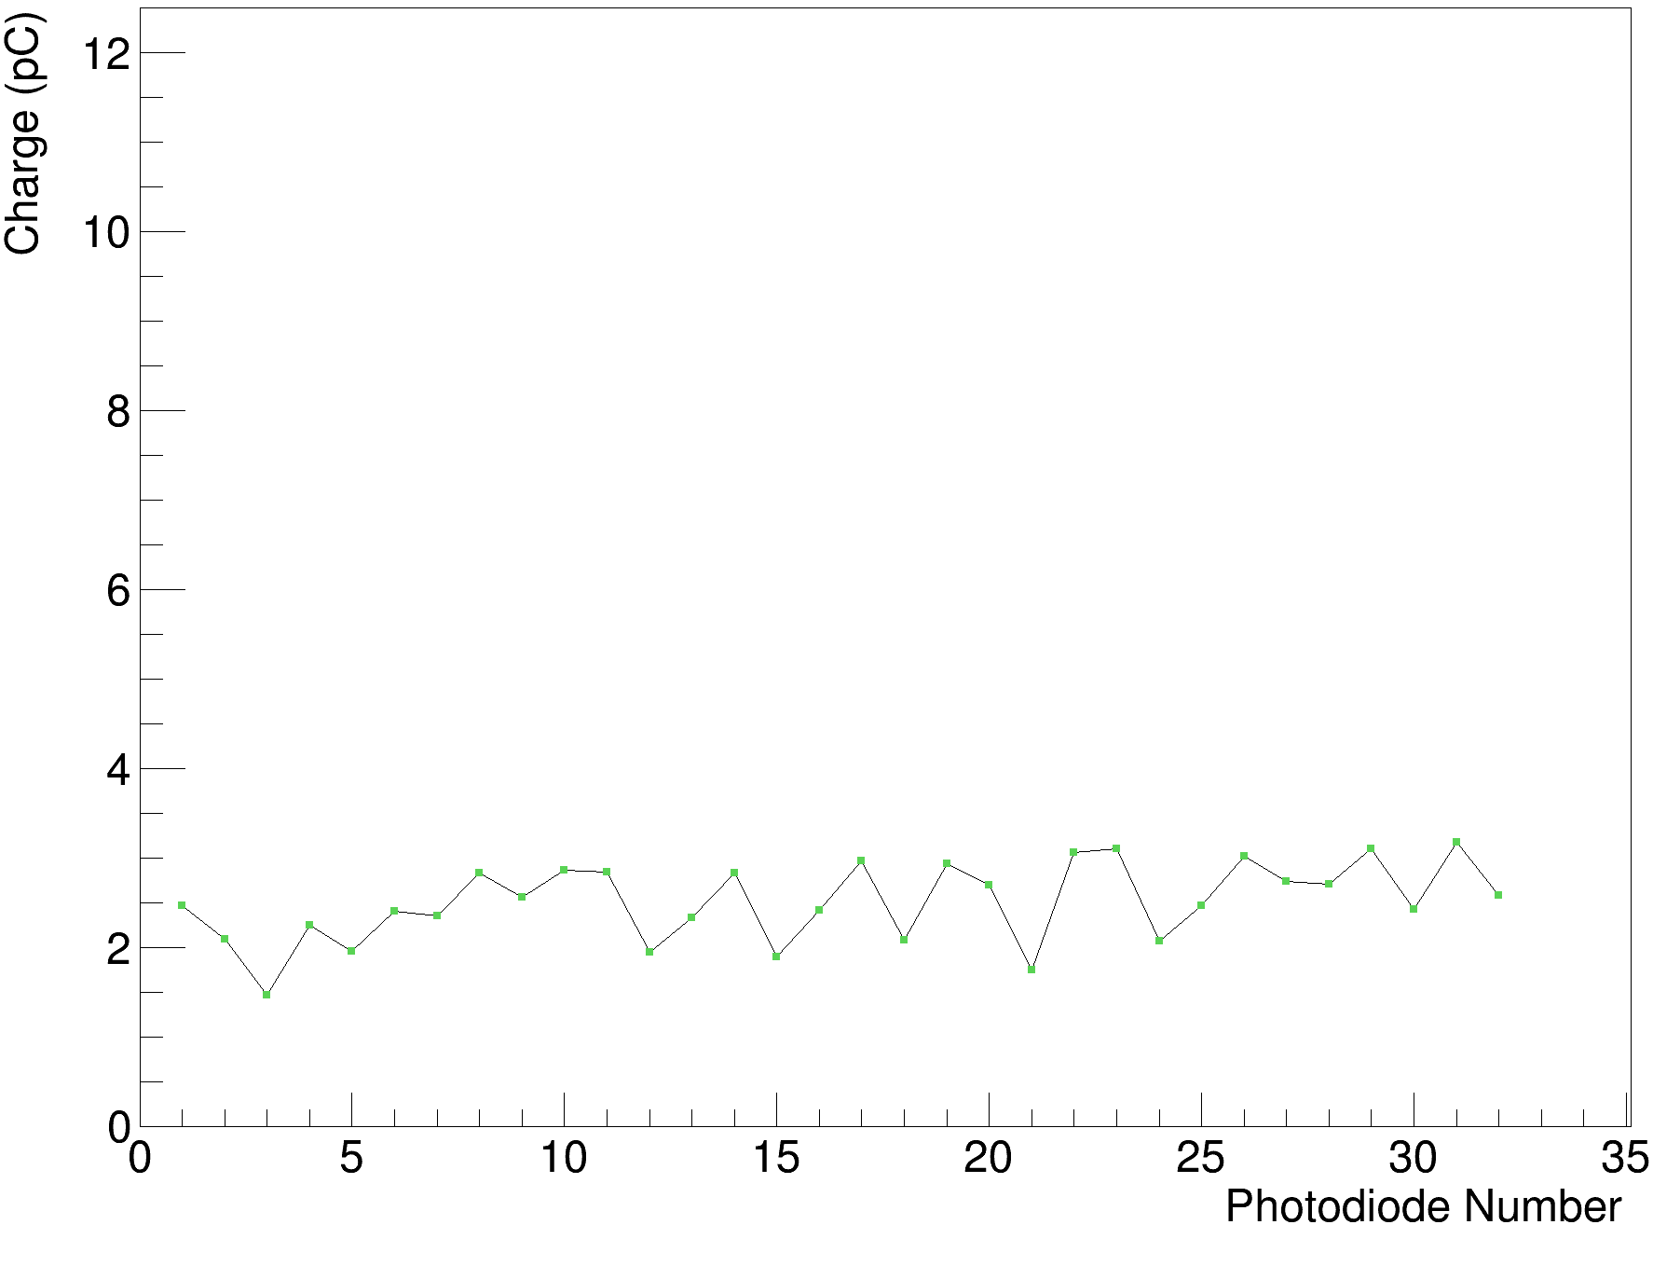
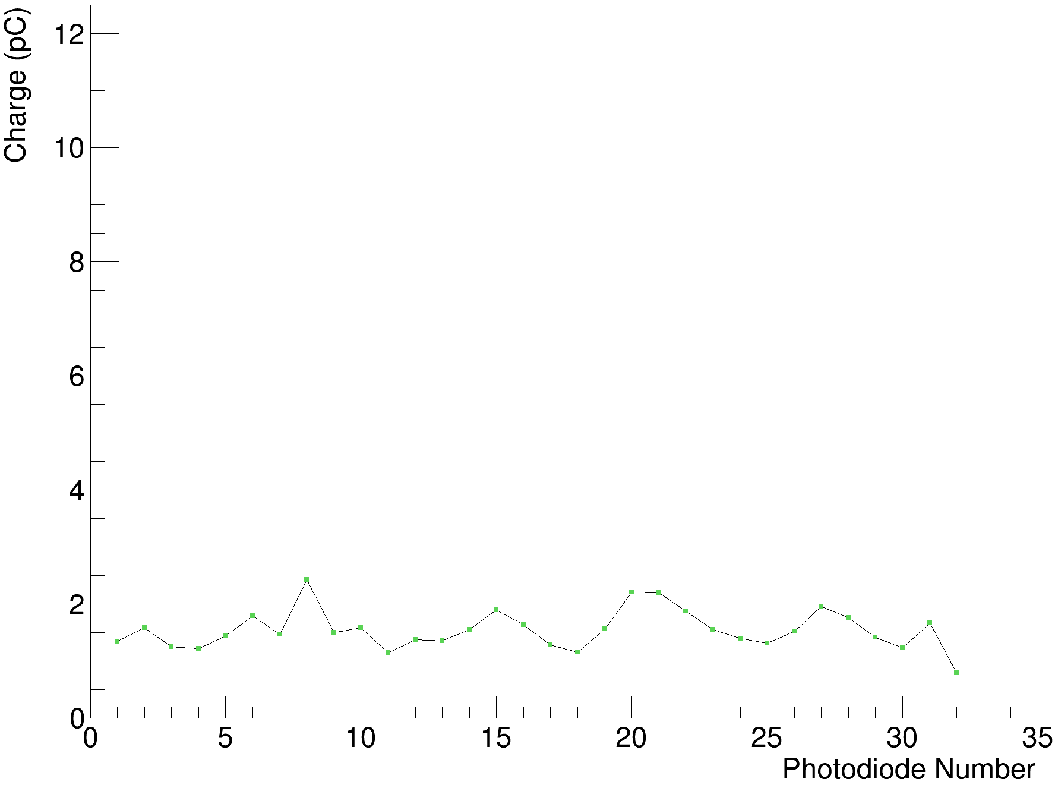
Light comparisons
Rev. B Clear Polished & White Painted
Rev. B White Painted
Rev. B Black Painted
Shoot through comparisons
Rev. B Clear Polished
Rev. B Clear Polished
Rev. C Clear Polished
(misaligned photodiodes)
Rev. D Clear Opaque
Rev. C Clear Polished
(misaligned photodiodes)
Rev. D Clear Opaque
1

