Slide 1
FLASH Range QA Measurements with the Quality Assurance Range Calorimeter (QuARC)
DEPARTMENT OF PHYSICS AND ASTRONOMY
4th Ion Imaging Workshop, London
Saad Shaikh, Sonia Escribano-Rodriguez¹, Raffaella Radogna, Connor Godden, Derek Attree, Samuel Manger, Karen Kirkby, Marc-Jan Van Goethem, Alexander Gerbershagen, Simon Jolly
¹sonia.escribano@ucl.ac.uk

Slide 2
FLASH Radiotherapy
- FLASH Radiotherapy, is a novel approach of RT using ultra-high dose rate (>40 Gy/s for a total irradiation time <100 ms [1]).
1

Slide 3
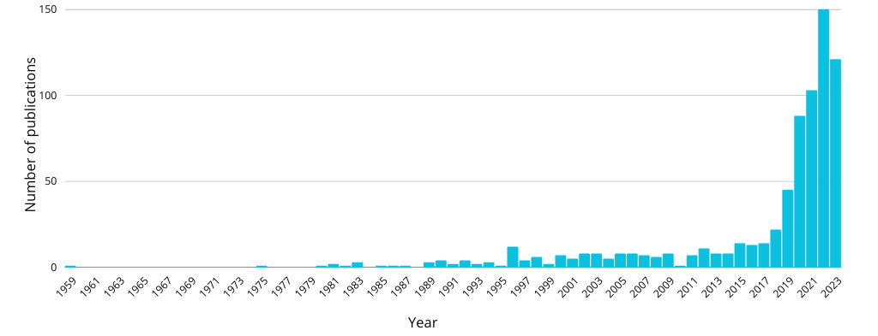
FLASH Radiotherapy
- FLASH Radiotherapy, is a novel approach of RT using ultra-high dose rate (>40 Gy/s for a total irradiation time <100 ms [1]).
- Gained interest in the past 5 years.
1

Slide 4
FLASH Radiotherapy
- FLASH RT can offer additional healthy tissue sparing while maintaining the damage to the tumoural cells.
2

Slide 5
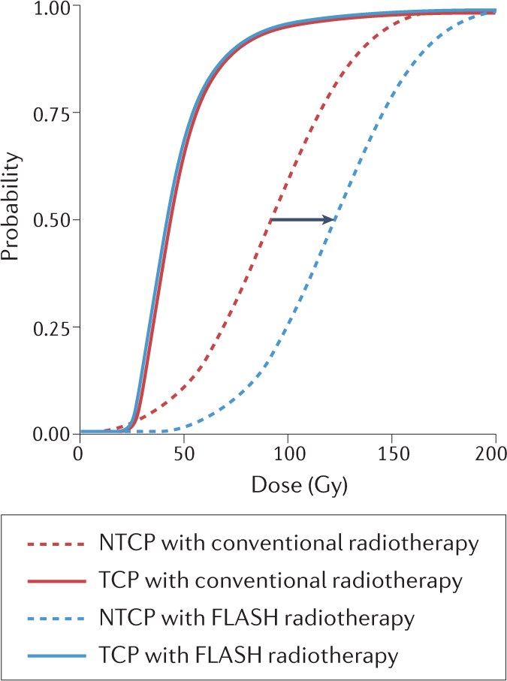
FLASH Radiotherapy
- FLASH RT can offer additional healthy tissue sparing while maintaining the damage to the tumoural cells.
NTCP = Normal Tissue Complication Probability
TCP = Tumour Control Probability
2
Vozenin, Bourhis and Durante Nat Rev Clin Oncol. (2022)

Slide 6
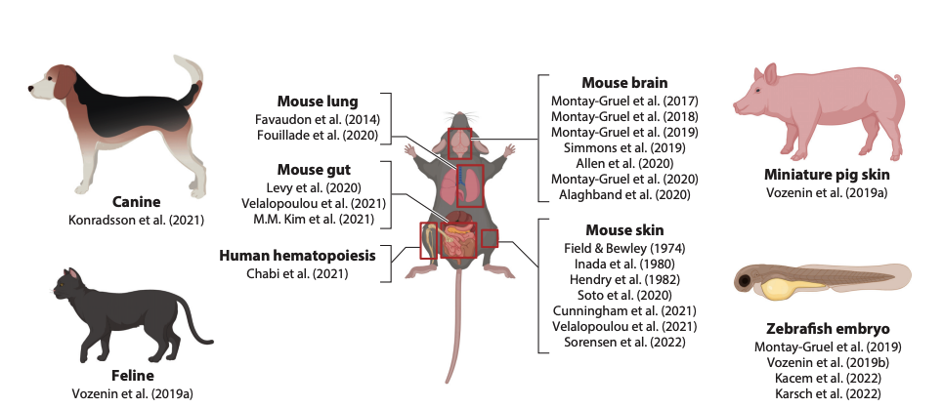
FLASH Radiotherapy
- Limited understanding of the mechanisms but broad experimental evidence.
Adapted from Limoli, Vozenin, Annu. Rev. Cancer Biol. (2023)
3

Slide 7
FLASH Radiotherapy
- Limited understanding of the mechanisms but broad experimental evidence.
Adapted from Limoli, Vozenin, Annu. Rev. Cancer Biol. (2023)
3

Slide 8
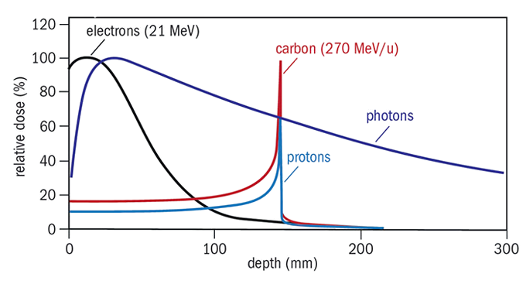
FLASH Proton therapy
PT offers highly localized depth-dose distribution.
Range uncertainties prevent taking full advantage: accurate beam range quality assurance (QA) is essential.
Current QA detectors can not cope with FLASH rates: ~600 nA in FLASH compared to 1 nA in traditional RT [1].
4

Slide 9
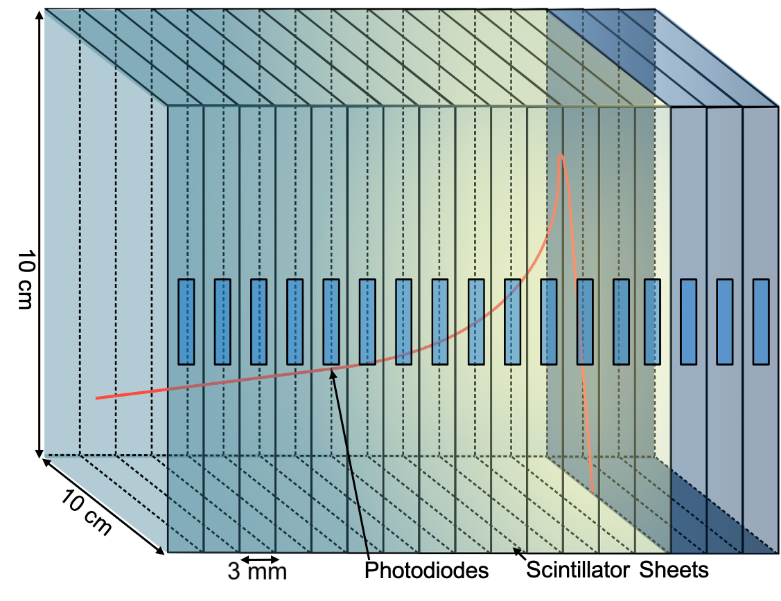
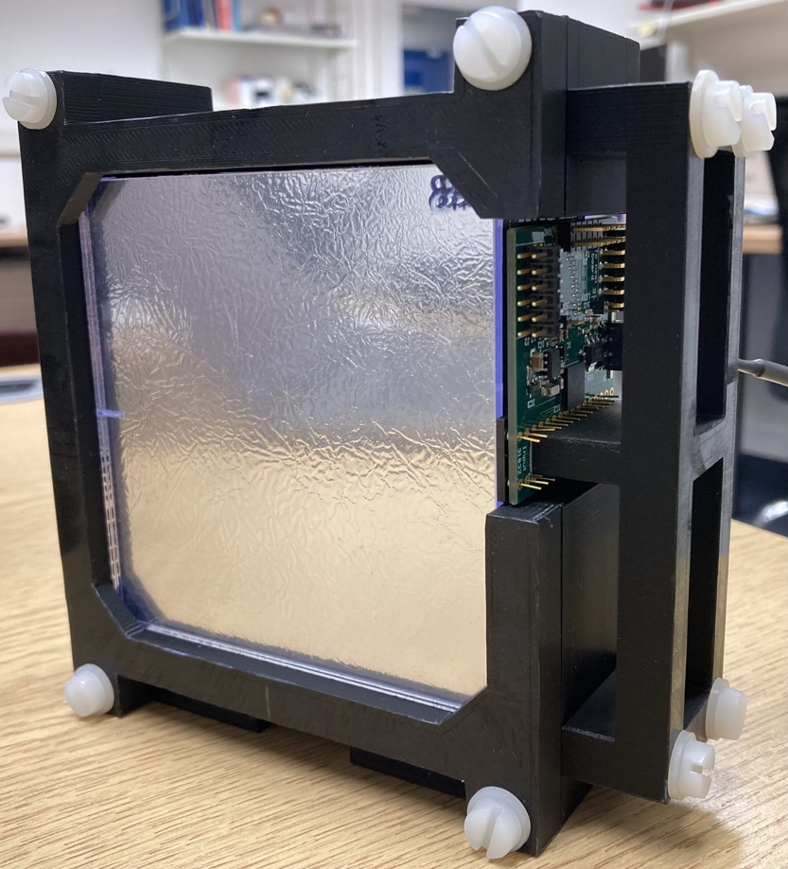
Quality Assurance Range Calorimeter (QuARC)
Optically-isolated polystyrene scintillator sheets in a segmented design.
Fit light output using analytical depth-light model to account for quenching [2].
5

Slide 10
Quality Assurance Range Calorimeter (QuARC)
Optically-isolated polystyrene scintillator sheets in a segmented design.
Fit light output using analytical depth-light model to account for quenching [2].
Two challenges: higher energies and higher current.
5

Slide 11
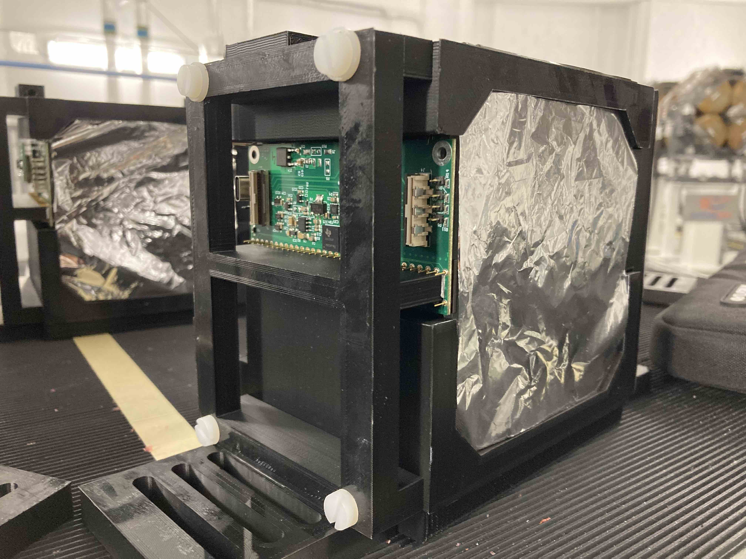
The Christie Beam Test
245 MeV FLASH beam available at 800 nA ion-source current (approx. 7% transmission).
6

Slide 12
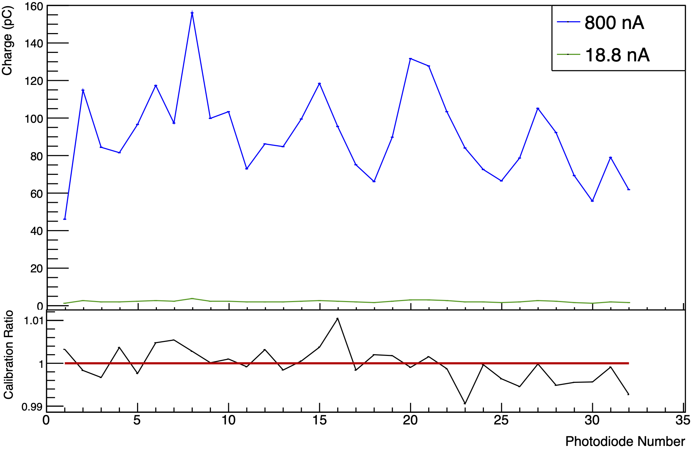
The Christie Beam Test
245 MeV FLASH beam available at 800 nA ion-source current (approx. 7% transmission).
6

Slide 13
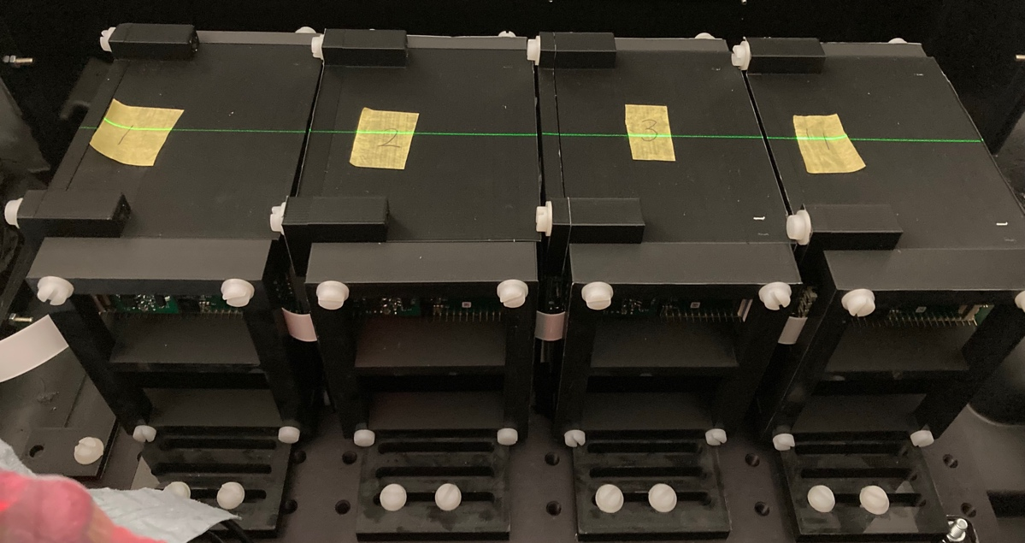
The Christie Beam Test
Four 32-sheet detector modules (40 cm WET) to test energies between 70 and 245 MeV at FLASH and clinical currents.
7

Slide 14
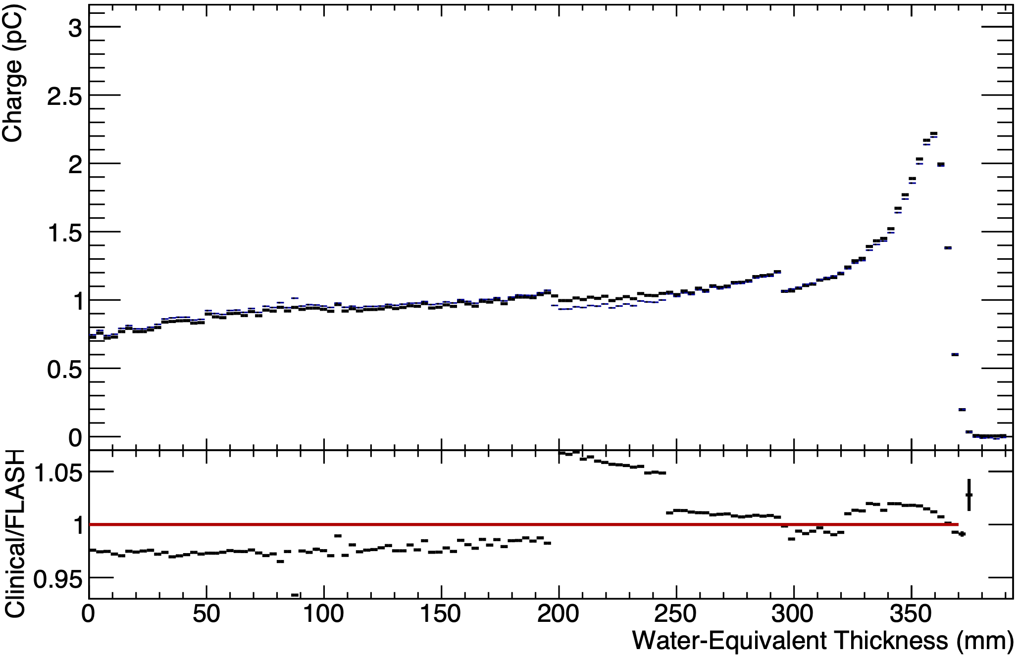
The Christie Beam Test
Four 32-sheet detector modules (40 cm WET) to test energies between 70 and 245 MeV at FLASH and clinical currents.
7

Slide 15
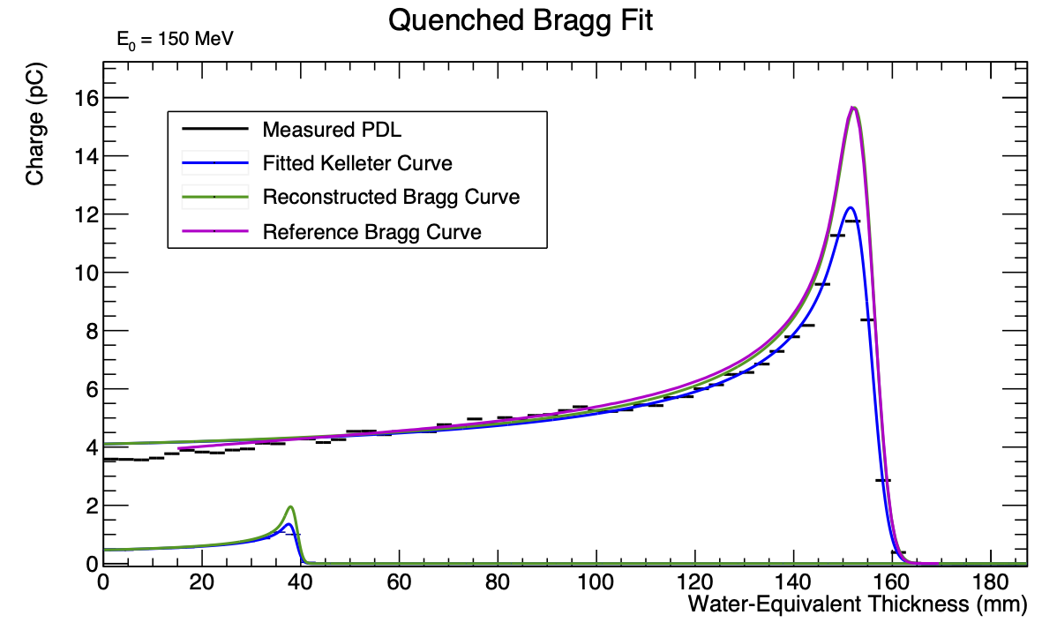
The Christie Beam Test
150 MeV
[2]
70 MeV
8

Slide 16
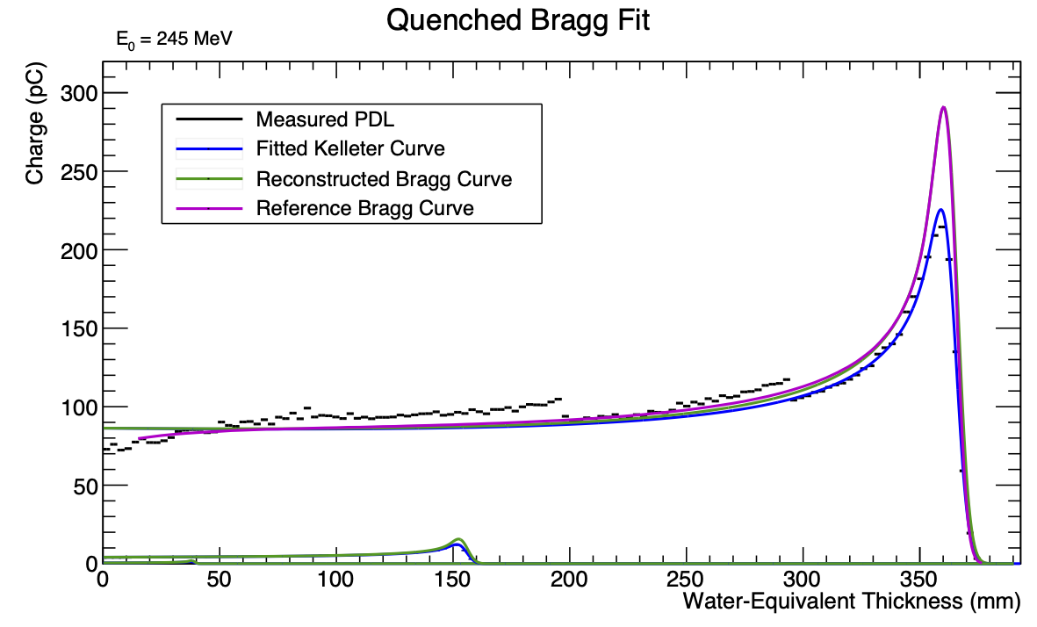
The Christie Beam Test
150 MeV
245 MeV
[2]
[2]
70 MeV
8

Slide 17
The Christie Beam Test
150 MeV
245 MeV
[2]
[2]
70 MeV
8

Slide 18
PARTREC Beam Test
Tested currents up to 50 nA and energies up to 150 MeV: 2 detector modules.
Push the detector to its limit in terms of beam current/scintillator light output.
9

Slide 19
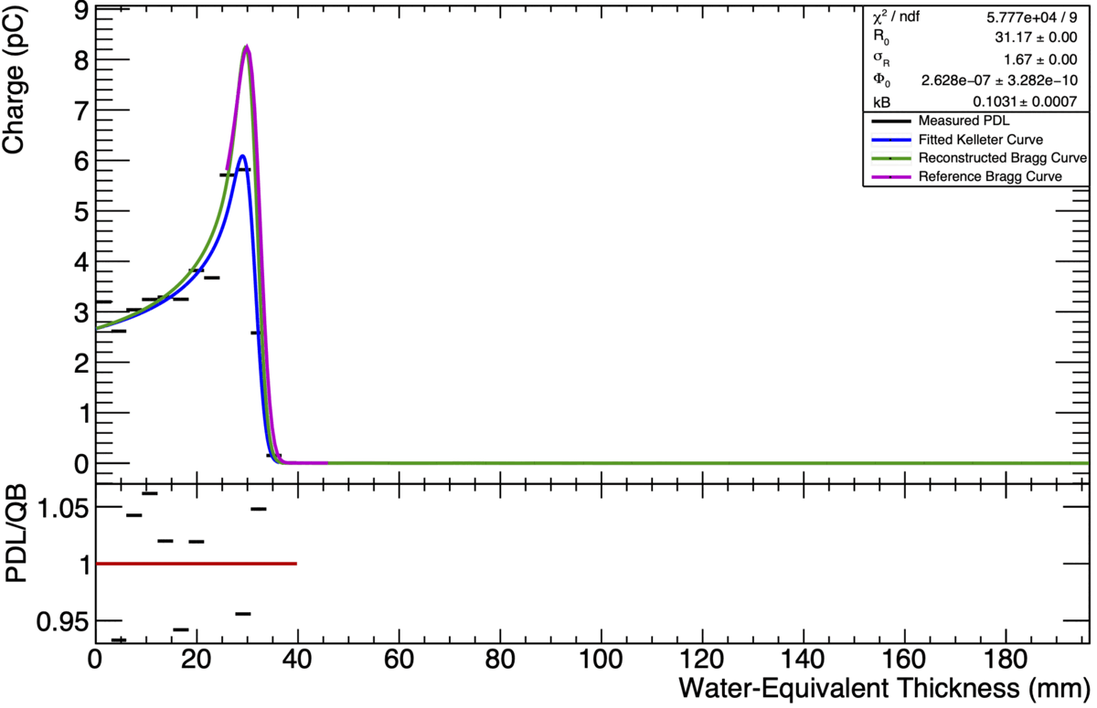
PARTREC Beam Test
Tested currents up to 50 nA and energies up to 150 MeV: 2 detector modules.
Push the detector to its limit in terms of beam current/scintillator light output.
9

Slide 20
Conclusions and future work
Detector able to reconstruct proton ranges at clinical currents between 70-245 MeV with an accuracy of 0.4 mm.
Detector can handle up to 50 nA of nozzle current. Range consistent in FLASH and clinical currents.
Improve scintillator composition and construction to optimise light output.
Additional beam tests to optimise light output and characterise detector performance with clinical and FLASH beams.
10

Slide 21
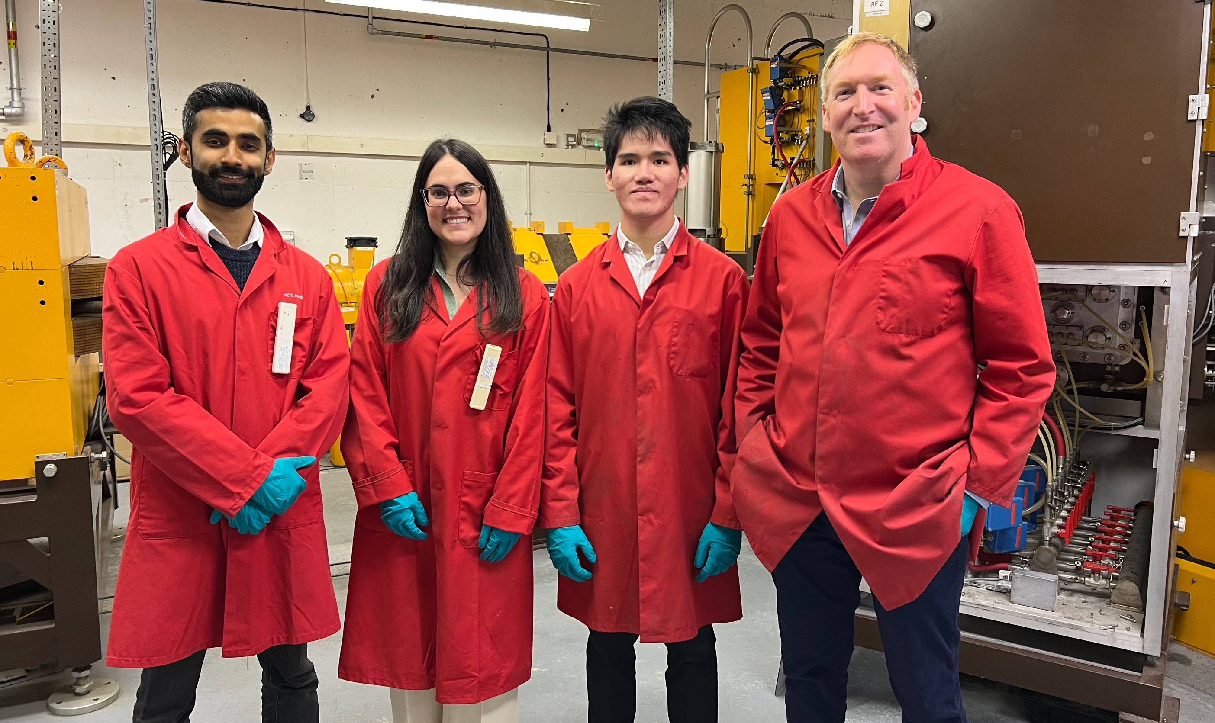

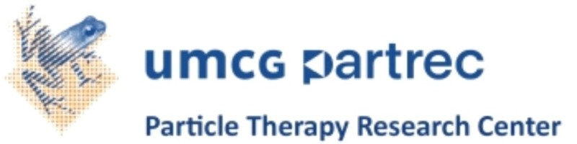


Acknowledgements

Slide 22
sonia.escribano@ucl.ac.uk
Thank you!
[1] S. Jolly et al. “Technical Challenges for FLASH Proton Therapy”. In Physica Medica 78 (2021). DOI: 10.1016/j.ejmp.2020.08.005
[2] L. Kelleter and S. Jolly. “A Mathematical Expression for Depth-Light Curves of Therapeutic Proton Beams in a Quenching Scintillator”. In: Medical Physics 47.5 (Feb. 2020), pp. 2300–2308. DOI: 10.1002/mp.14099

