Slide 1
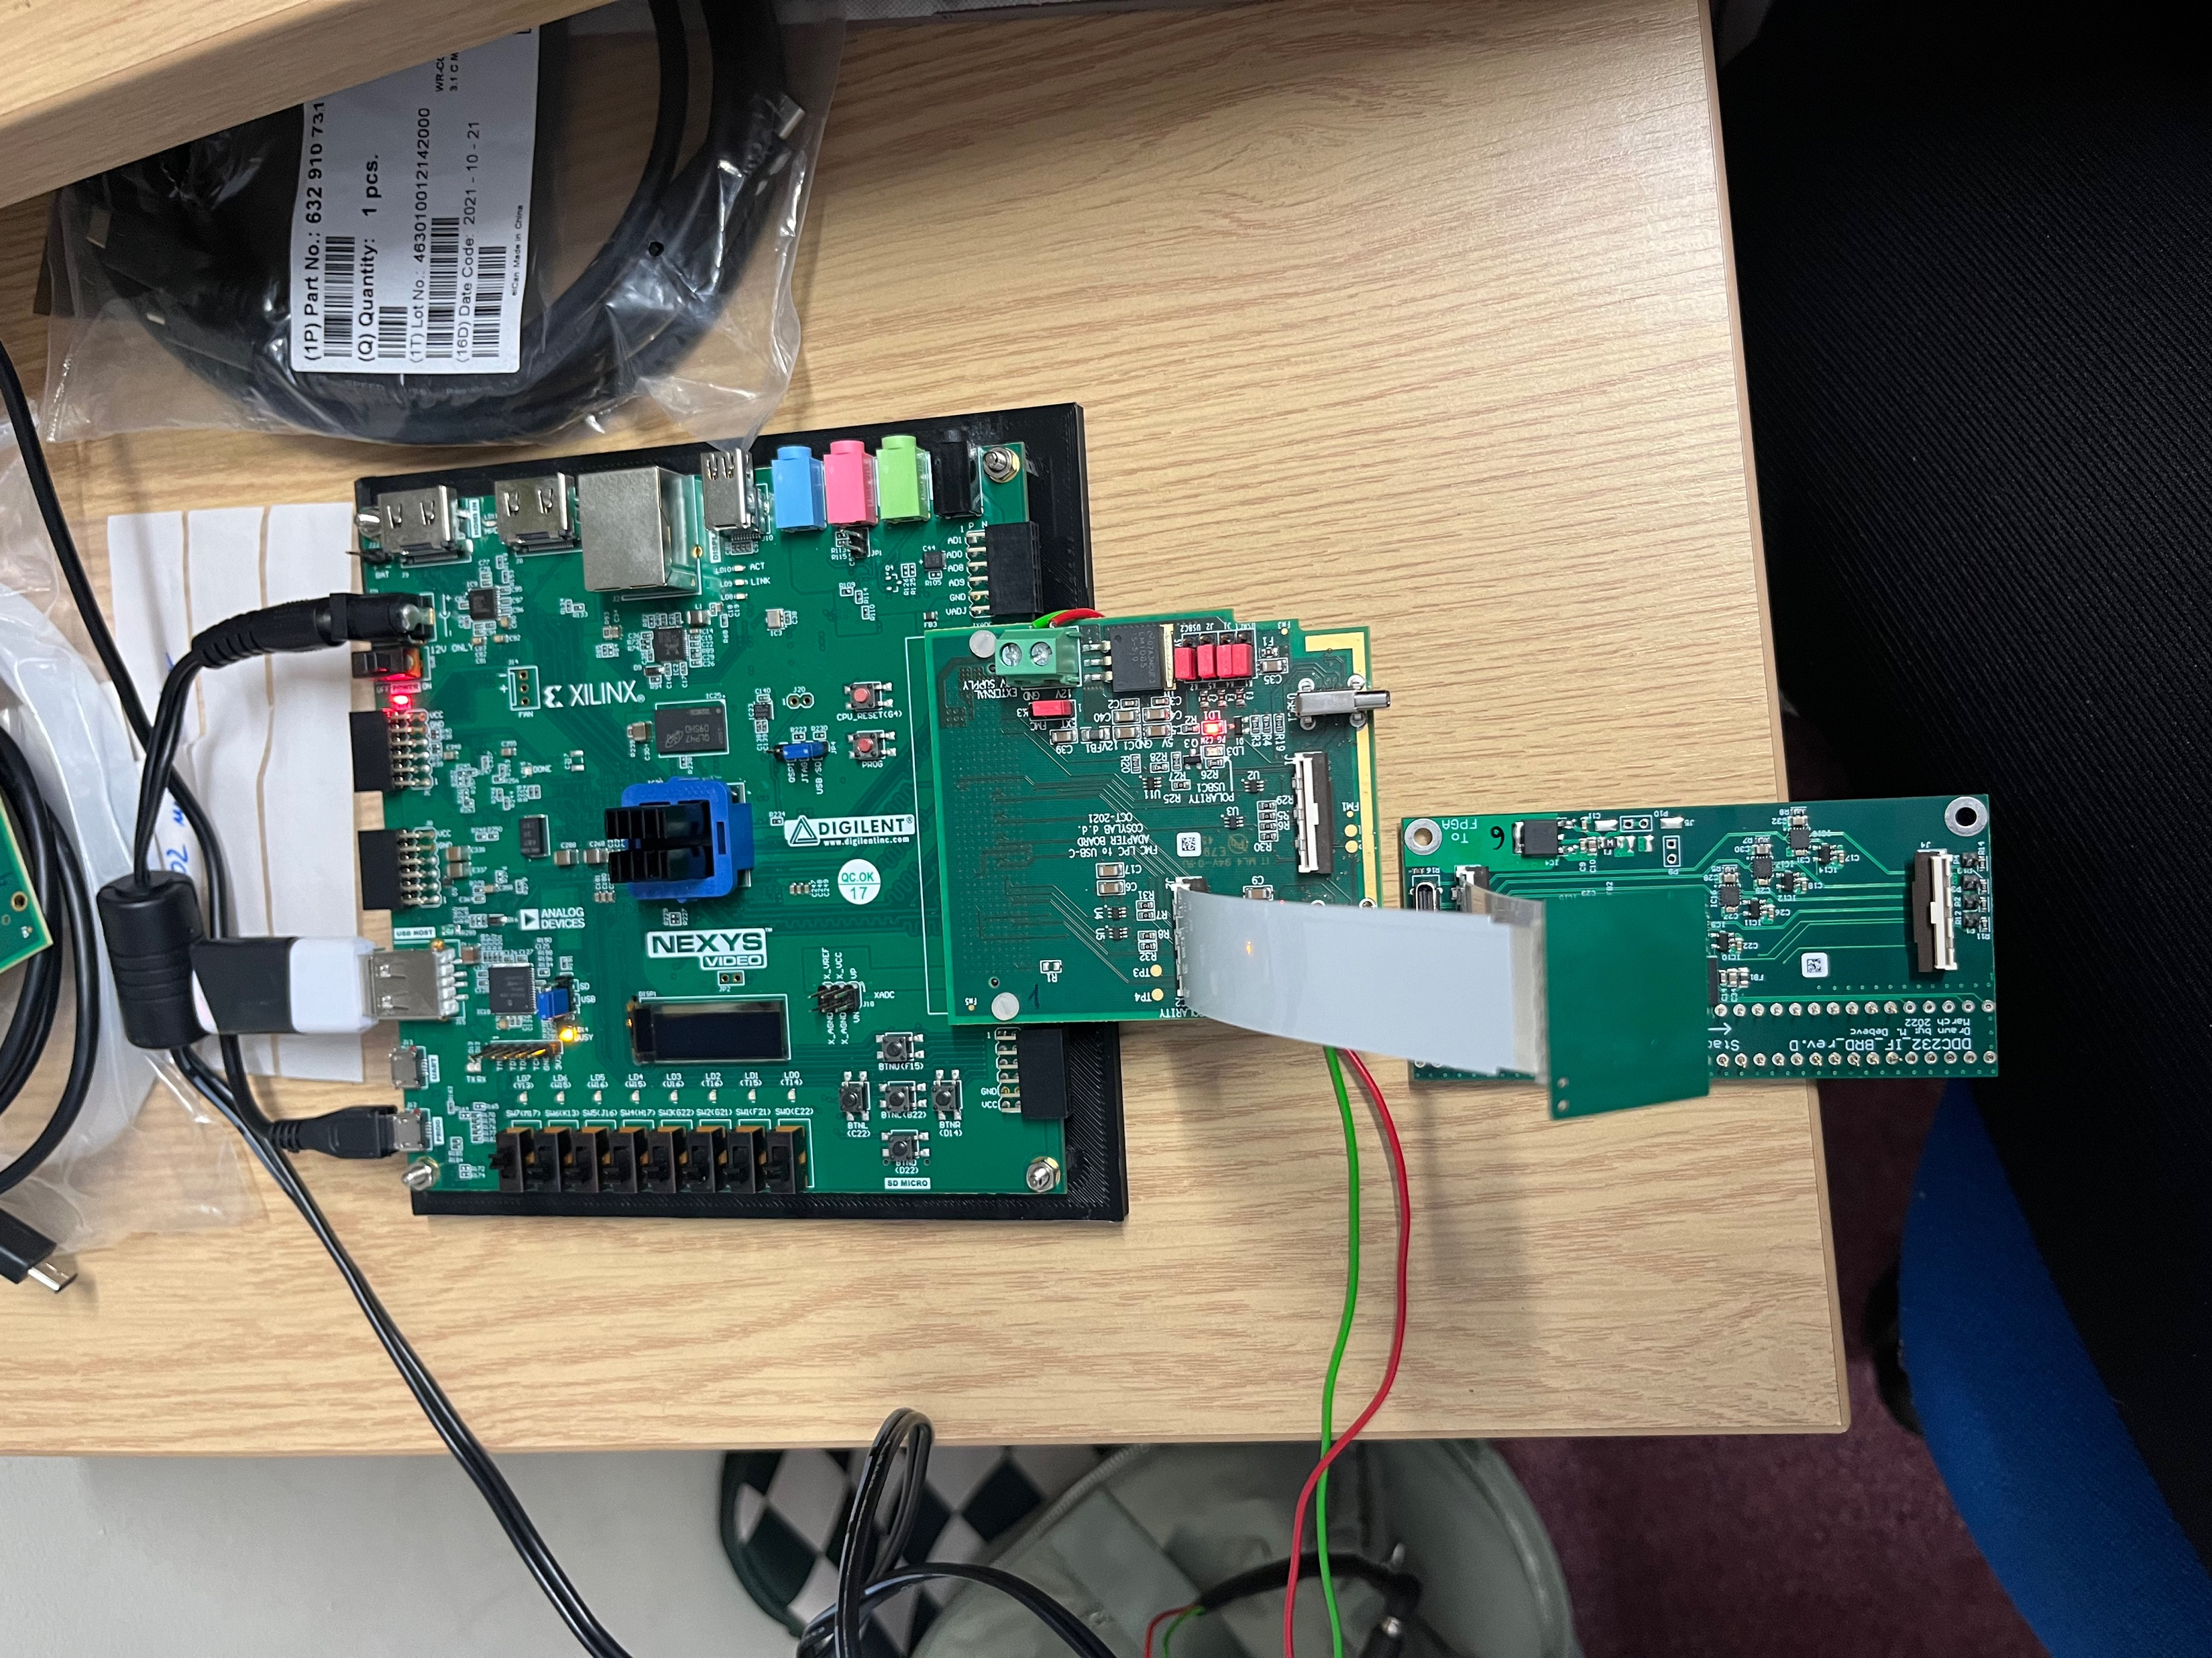
Debugging usb C

Slide 2
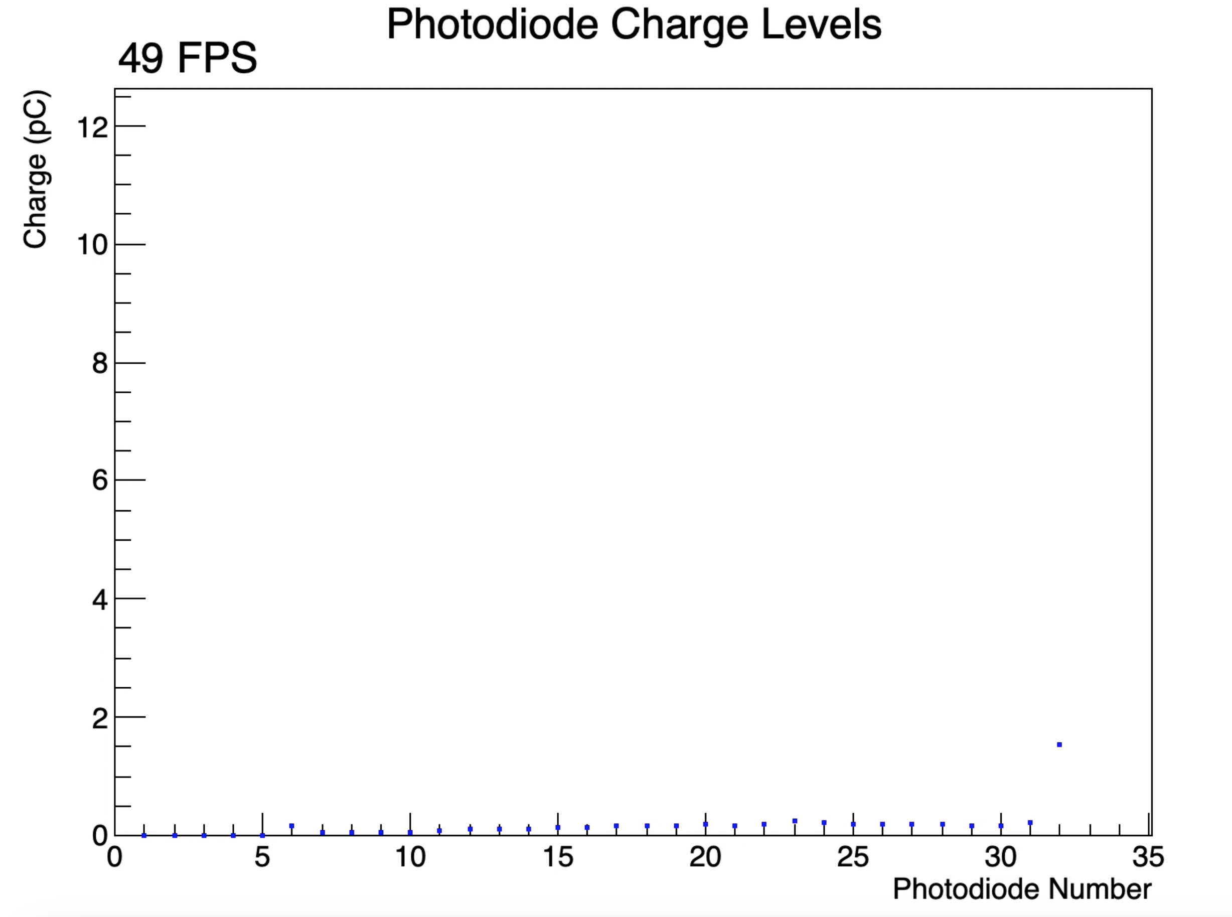
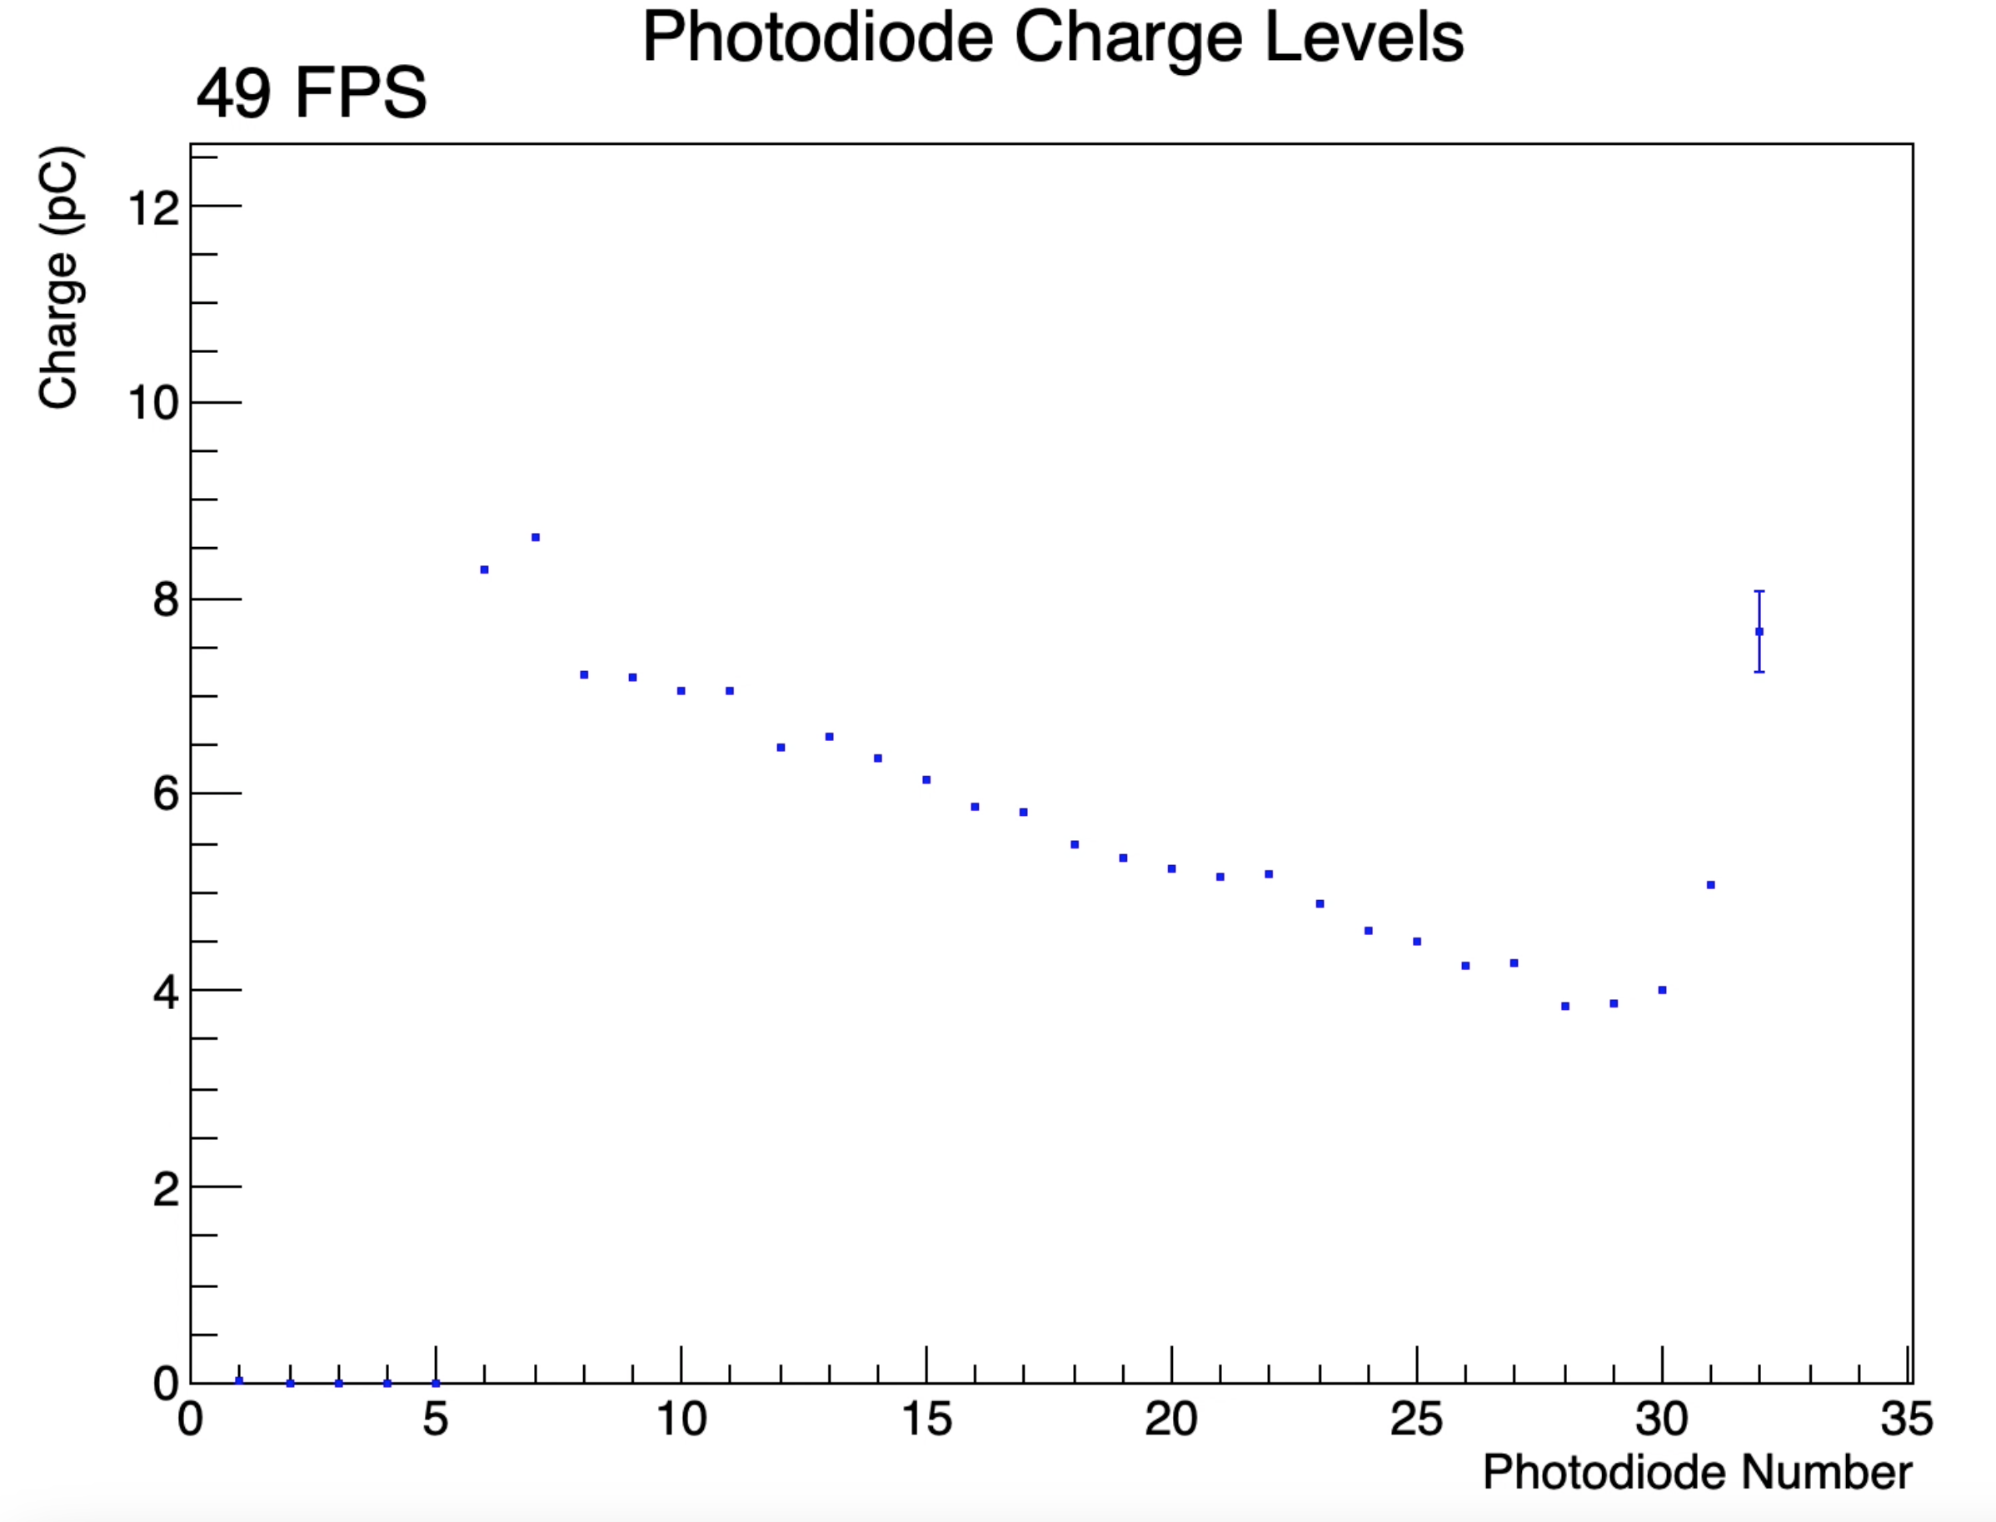
Debugging usb C: short molex
We start by using short molex cable: we have a steady + low signal
./prog.sh nexys 1 12.5 0 170 100000 50 true board1-long.txt revC false
PD facing down
PD facing up

Slide 3
Debugging usb C: short molex
We start by using short molex cable: we have a steady + low signal
./prog.sh nexys 1 12.5 0 170 100000 50 true board1-long.txt revC false

Slide 4
Debugging usb C: long molex cable
Switching the cable to a long molex our signal becomes a lot worse, unsteady and jumps a lot.
./prog.sh nexys 1 12.5 0 170 100000 50 true board1-long.txt revC false

Slide 5
Debugging usb C:
Previous tests were made with daughter board 1, the board that works with usbC is board4. We have checked with short and long molex and the results are the same as we obtained in board 1.

