Slide 1
QuARC Data Processing
Sonia Escribano Rodriguez
30th November 2023

Slide 2
Data Processing
The data processing has two different steps: first one is to calibrate the data (calibrate.py) and the second one is to fit the data (fit.cpp). Running the codes is done as follows:
Calibrating:
python3 calibrate.py 170 0 0 false 20230518 Run015.txt background.txt shootBack.txt shootFront.txt
Fitting:
g++ -o fitnew fit_new.cpp `root-config --cflags --glibs` -O3
./fitnew false 60 Clatterbridge 20230518 Run015.txt

Slide 3
Calibration process
Calibrate.py: subtracts background and calibrates data. The output file generated is called Run0xy_calibrated.txt and has the following format:
- Header information now includes PD position followed by the middle point of each of the PD (defined inside the code as a vector)
- One line per measurement acquired
- Averaged data + error at the end of the file.
Running time: ~5 seconds for 30k measurements with 1 module of 14PD.
~20 seconds for 30k measurements with 4 modules.

Slide 4
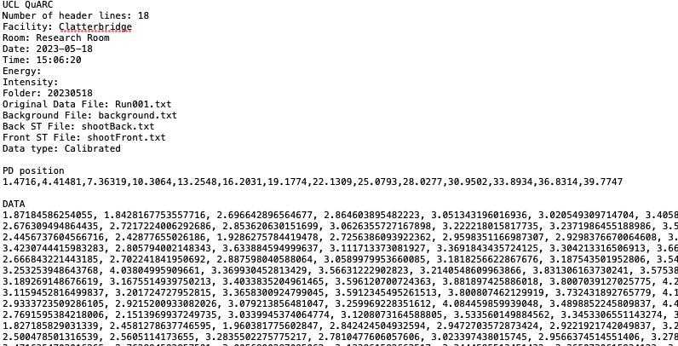
Calibrated files example
…

Slide 5
Fitting proccess
Fit.cpp: reads the file Run0xy_calibrated.txt and fits the data at an averaged frequency (Default = 25 Hz). Output file: Run0xy_fitted_zHz.txt
- Header information not modified
- One fitted measurement per averaged data at frequency f. Final measurement shows the total average value of the PD and the fit for this value.
- For SOBP only the averaged data is fitted, the rest has the same structure but fit curves are 0 and energy and range are -.
Running time:
~4 seconds for 30k measurements with 1 module (14PD) pristine BP
~7.5 seconds for 30k measurements with 14PD SOBP.
~60 seconds for 30k measurements with 4 modules.

Slide 6
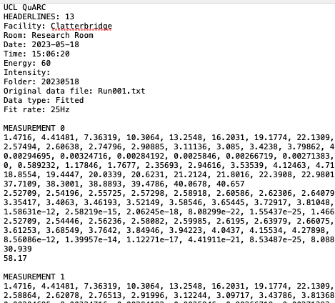
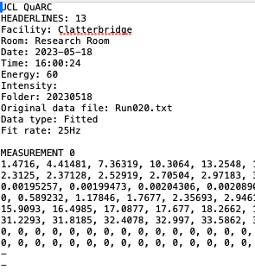
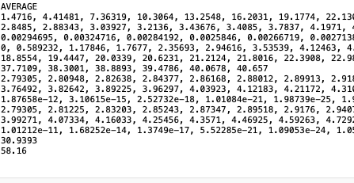
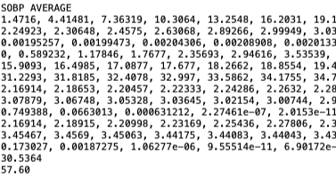
Fitting files: pristine BP
Fitting files: SOBP
…
…

Slide 7
Future work
- Changing the number of header lines does not affect the GUI visualisation, as this number is read automatically by the php code. However the final measurement, the averaged is NOT displayed in the screen (probably due to the way the shell script read lines).
- Individual calibrate and fit codes for each facility?
- Both codes need to be tidy up + add comments for other users.

