Slide 1


Proton Beam Therapy
DEPARTMENT OF PHYSICS AND ASTRONOMY
HEP Christmas Group Meeting 2023
Sonia Escribano, Febian Febian, Raffaella Radogna, Ruben Saakyan, Derek Attree, Connor Godden, Simon Jolly

Slide 2
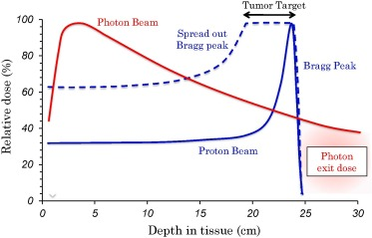
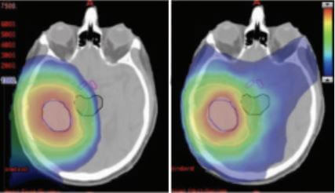
Proton beam therapy
Proton Beam Therapy (PBT) offers a highly localised depth-dose distribution, due to the well-defined range of protons in matter. Range uncertainties prevent taking full advantage of its benefits.

Slide 3
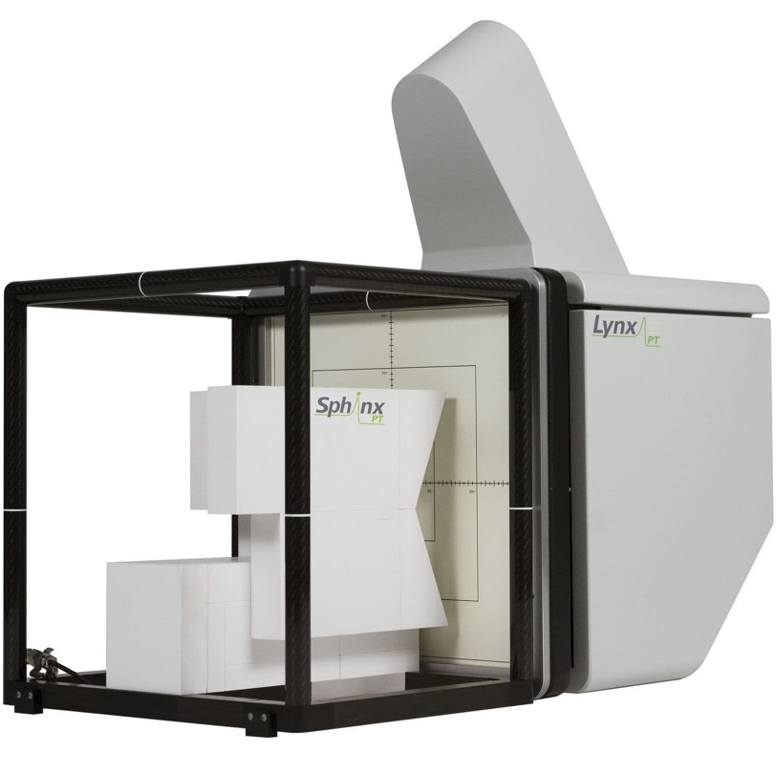
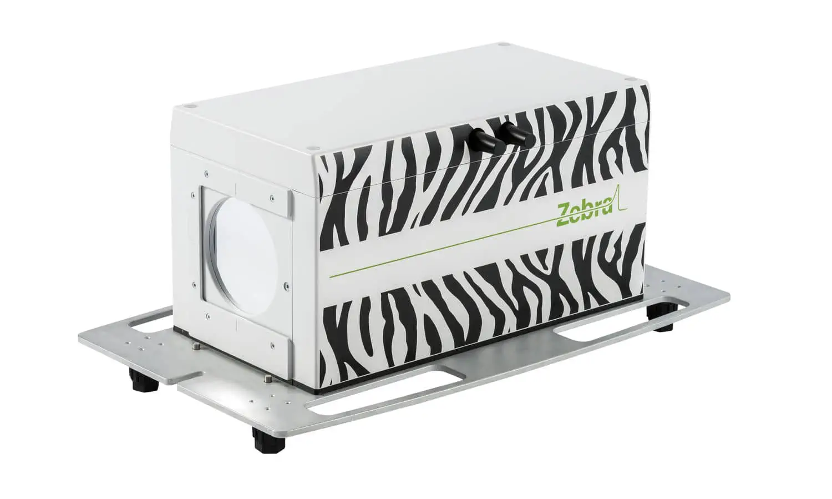
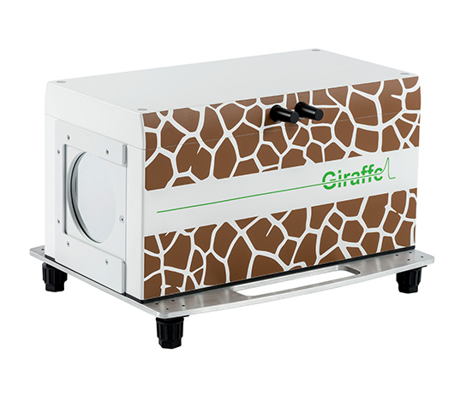
Daily Quality Assurance (QA)
To ensure accurate dose delivery in PBT, daily Quality Assurance (QA) measurements are required.
Measurements of beam range, absolute dose, spot position and size.
Current methods often compromise between speed and accuracy.
Develop a detector to make fast, accurate measurements of proton range.

Slide 4
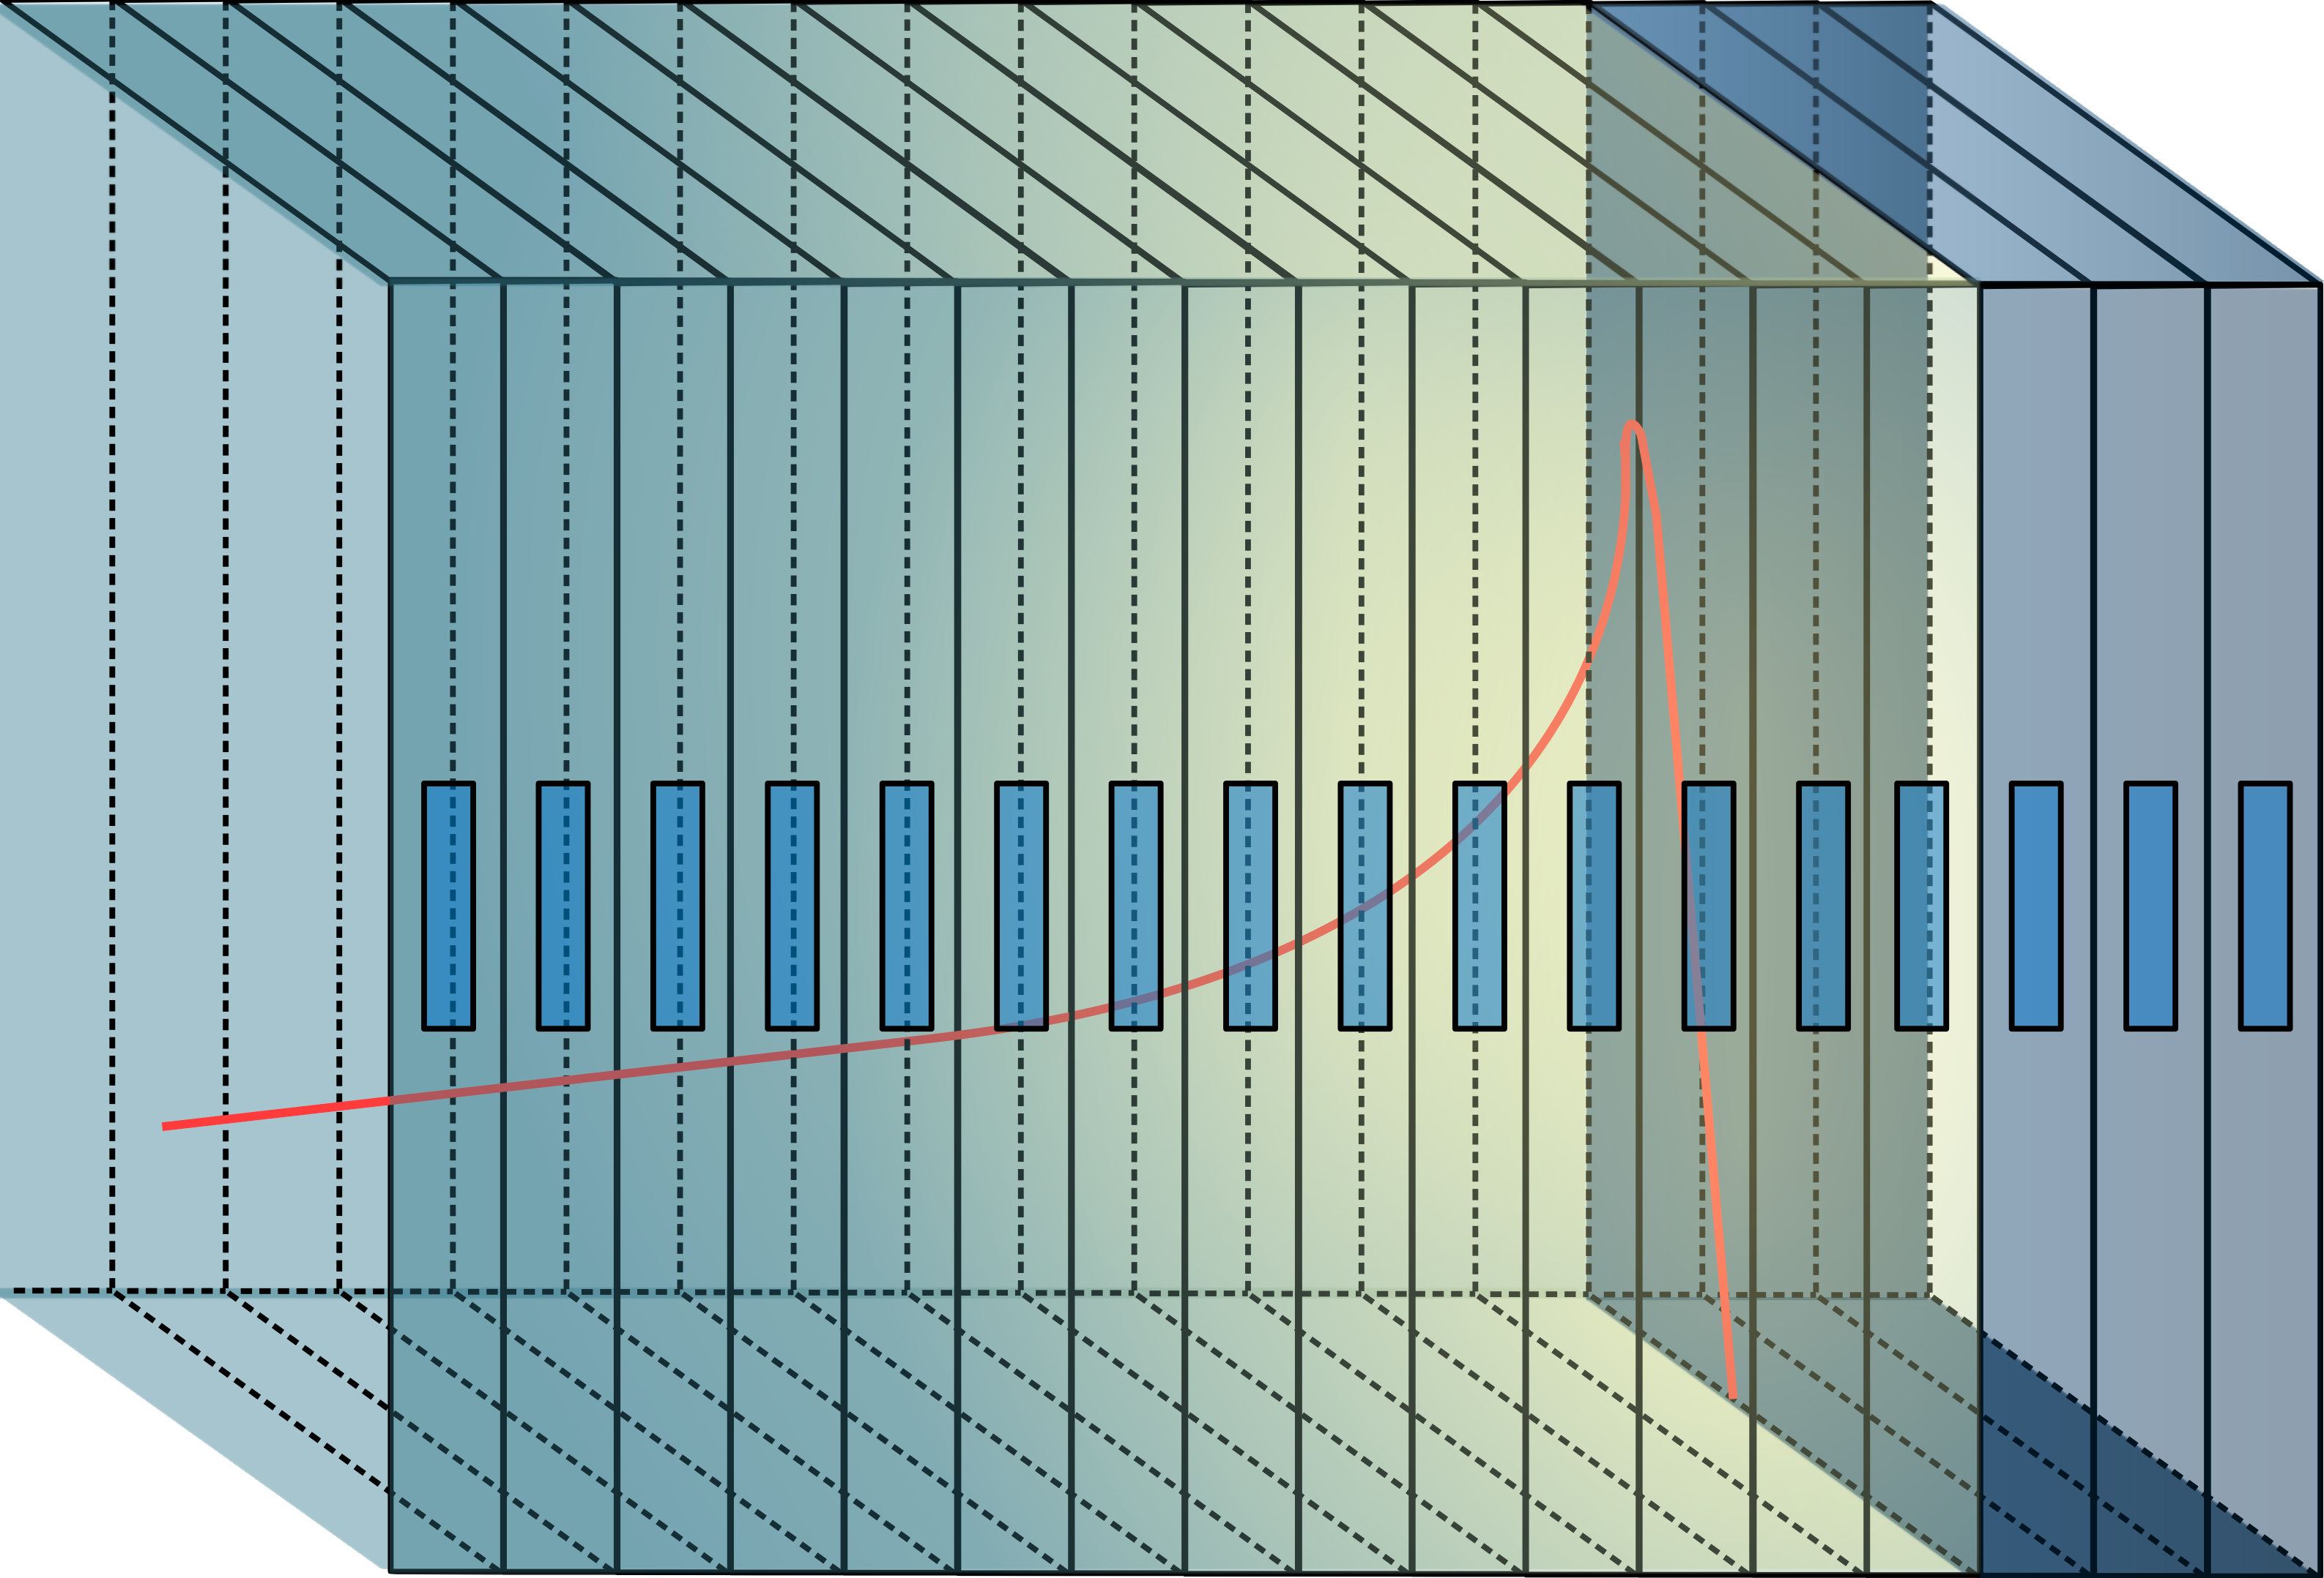
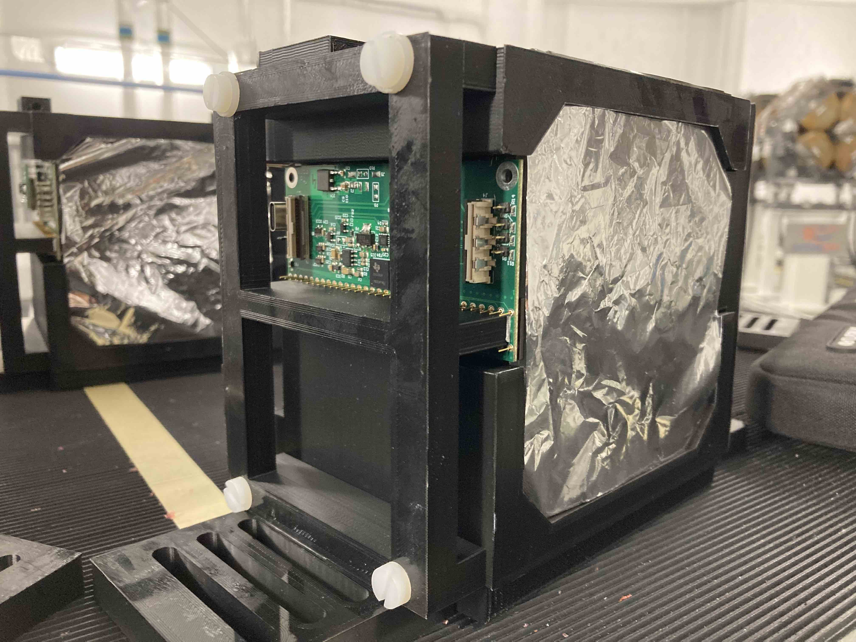
QuARC
QuARC = Quality Assurance Range Calorimeter
Optically isolated polystyrene scintillator sheets of 105 mm x 105 mm x 3 mm.
Each sheet is coupled to a photodiode. PD coupled to modular ADC converters, read-out by an FPGA.
Analytical model deployed to fit depth-light curve to reconstruct Bragg curve [1].

Slide 5
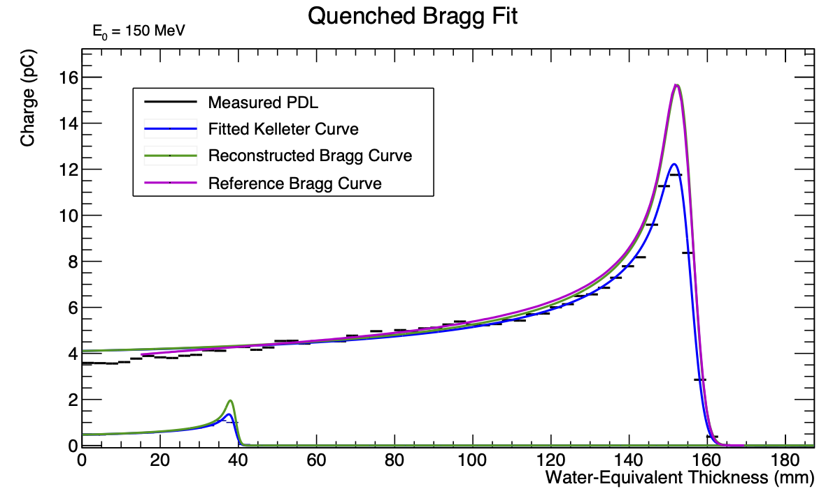
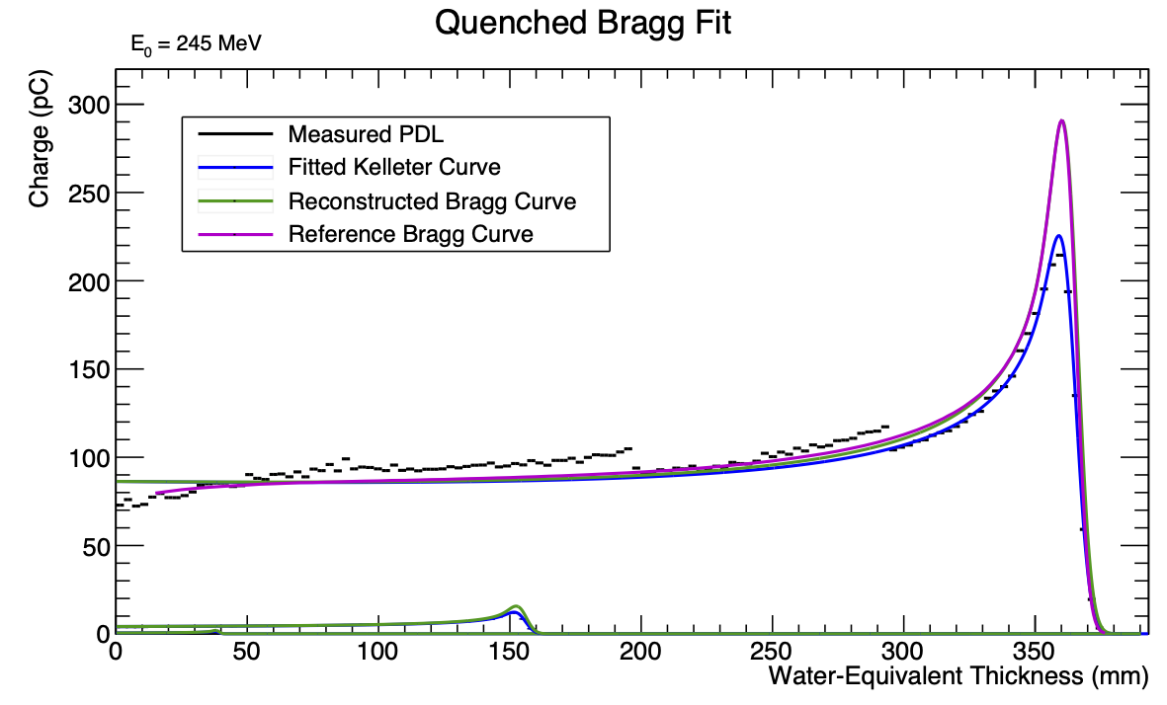
The Christie Beam Test
150 MeV
245 MeV
[1]
[1]
70 MeV
8

Slide 6
The Christie Beam Test
150 MeV
245 MeV
[2]
[2]
70 MeV
8

Slide 7
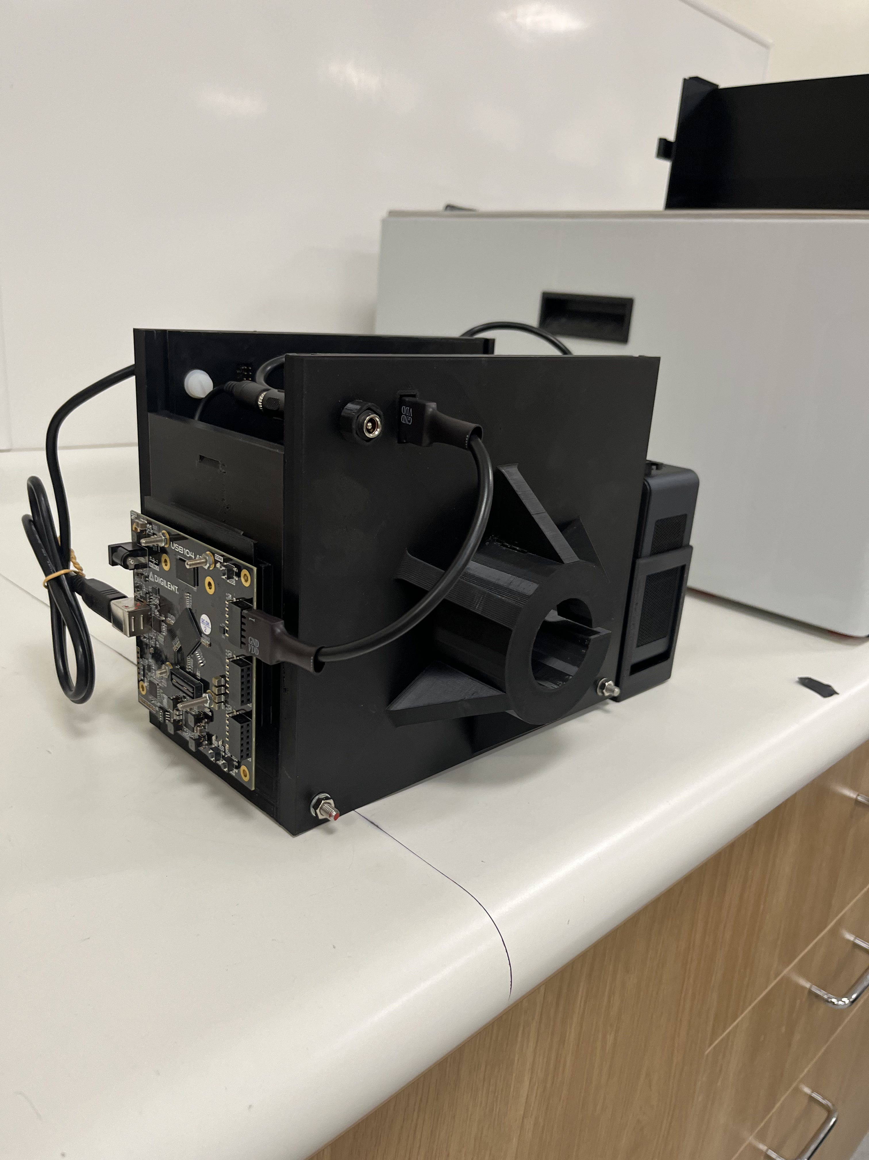
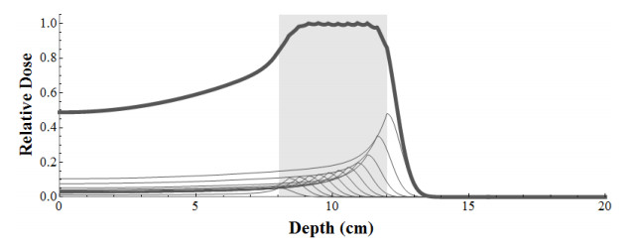
Compact QuARC for Clatterbridge
Eye tumours with 60 MeV proton beam
Spread-out Bragg peaks (SOBP)

Slide 8
Compact QuARC for Clatterbridge
Eye tumours with 60 MeV proton beam
Spread-out Bragg peaks (SOBP)

Slide 9
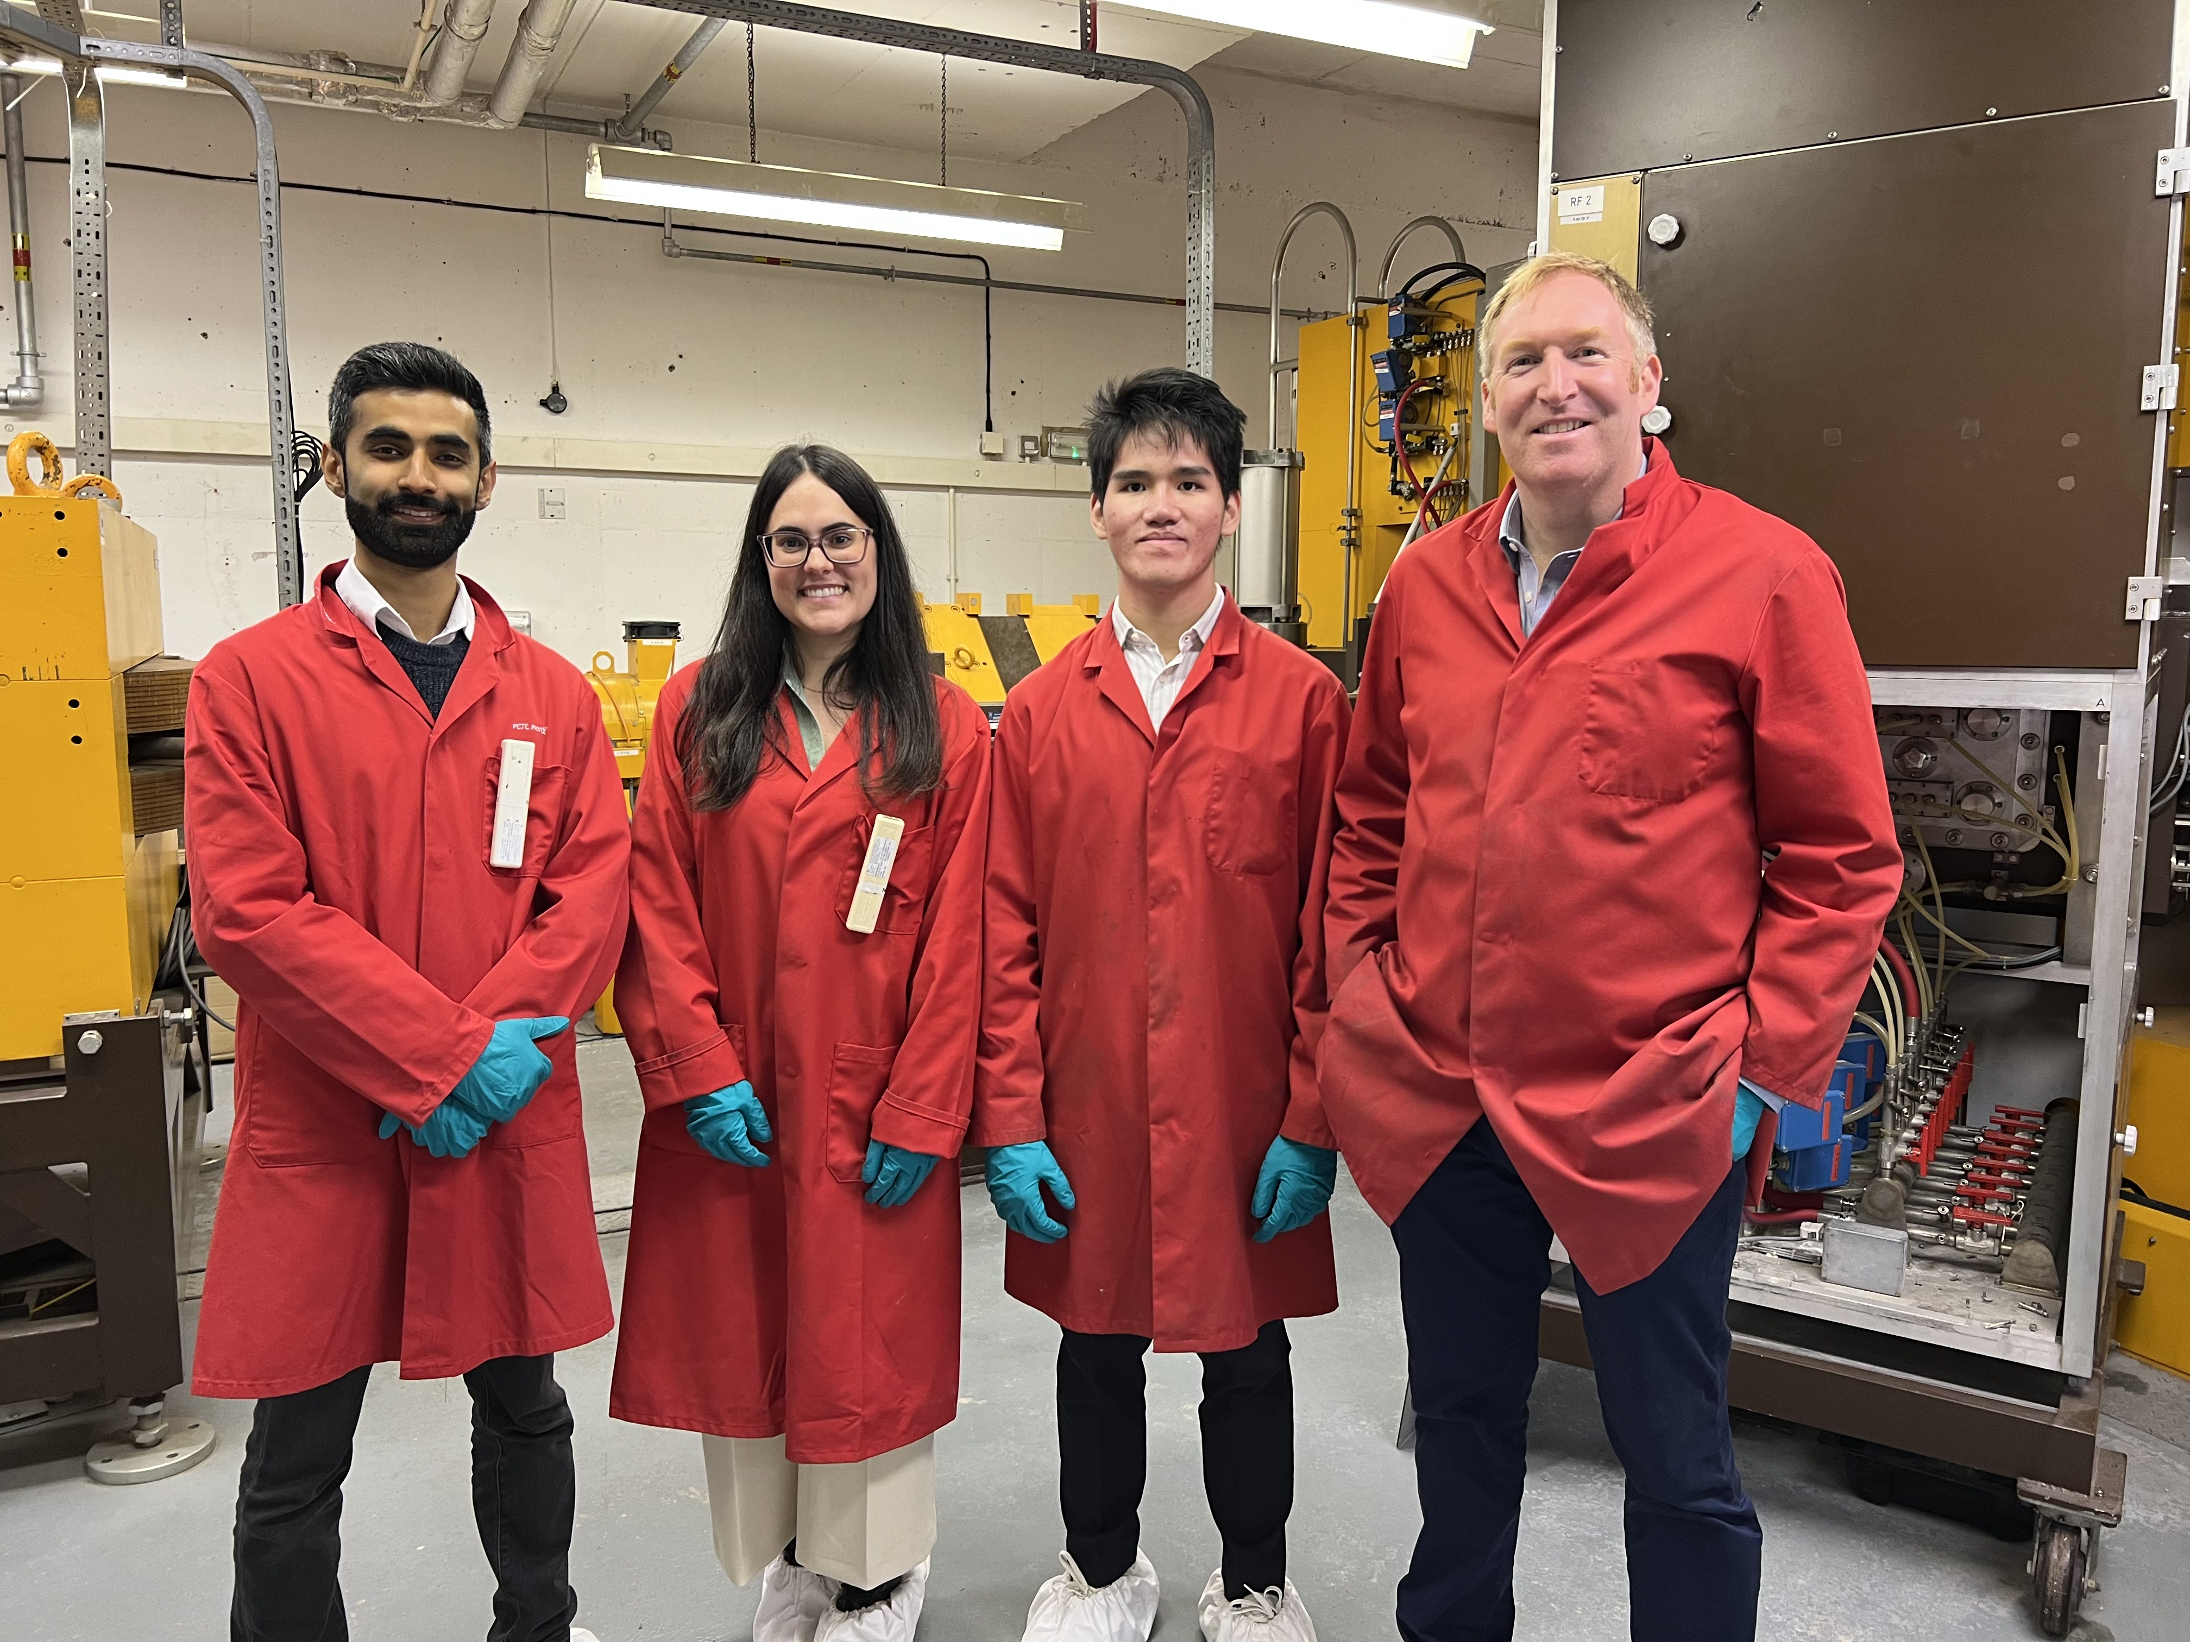
What’s new in the PBT group?

Slide 10
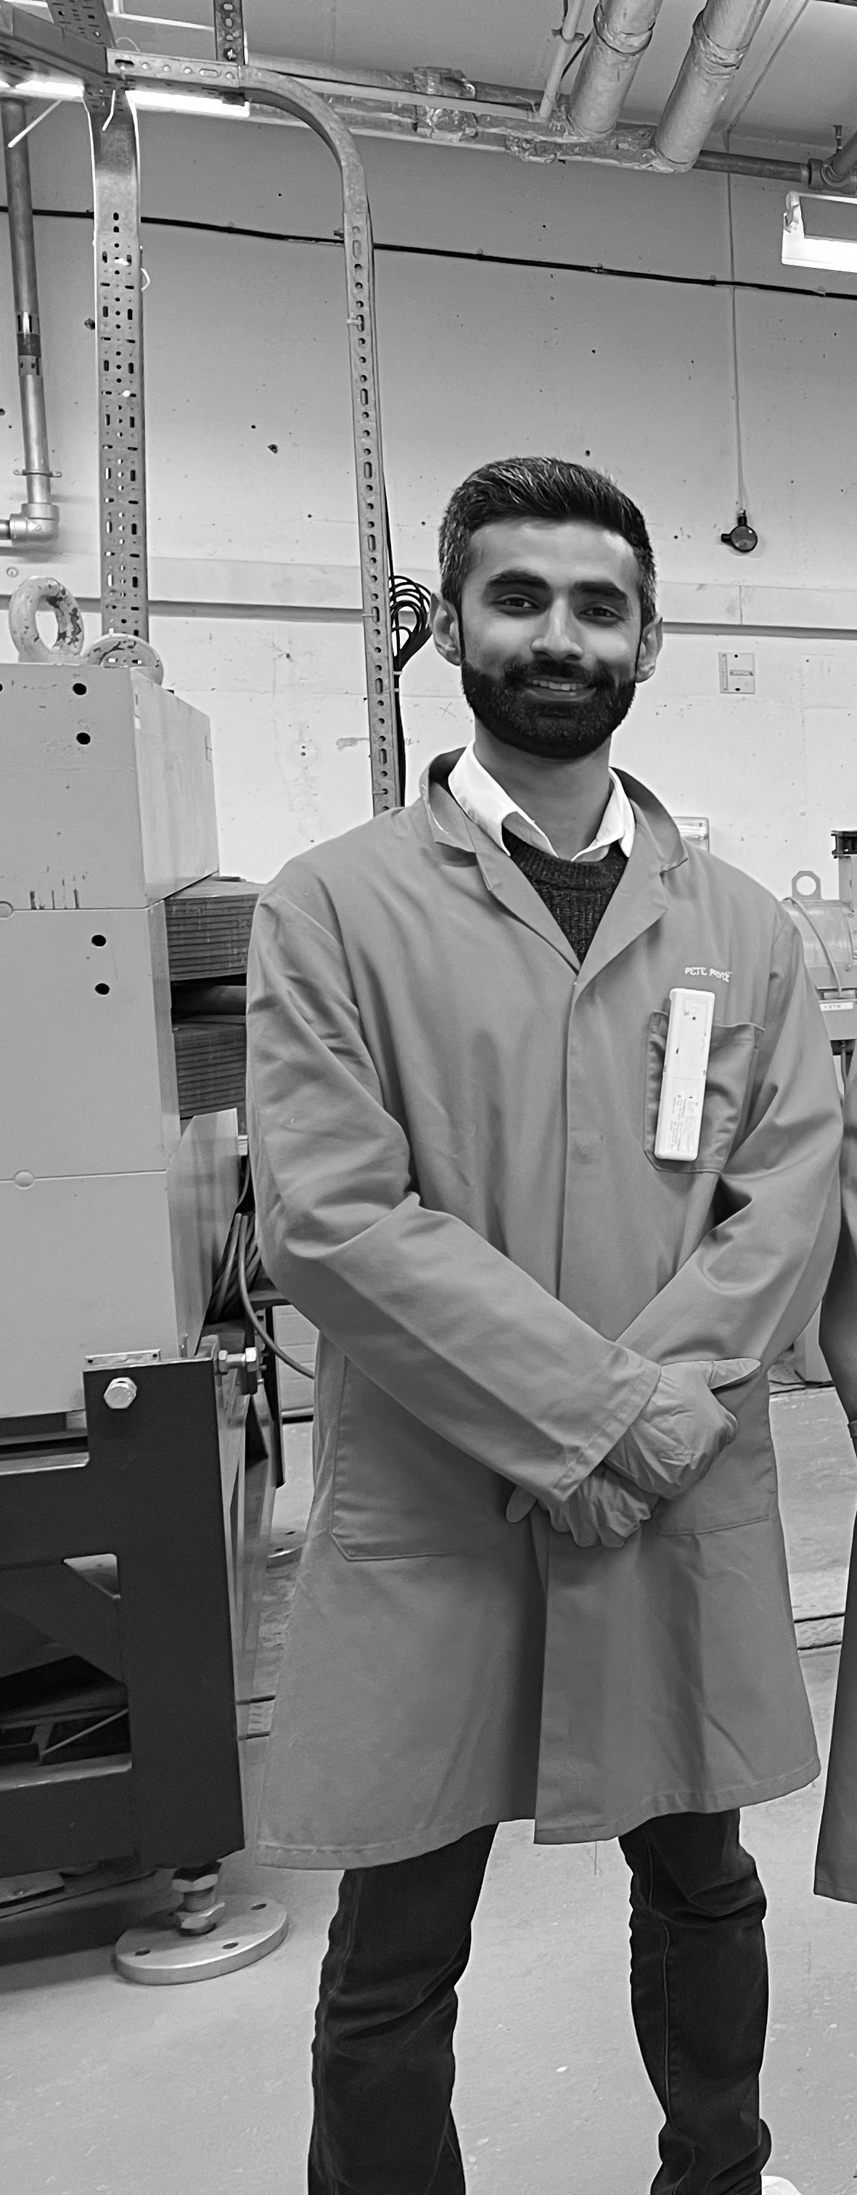
What’s new in the PBT group?

Slide 11
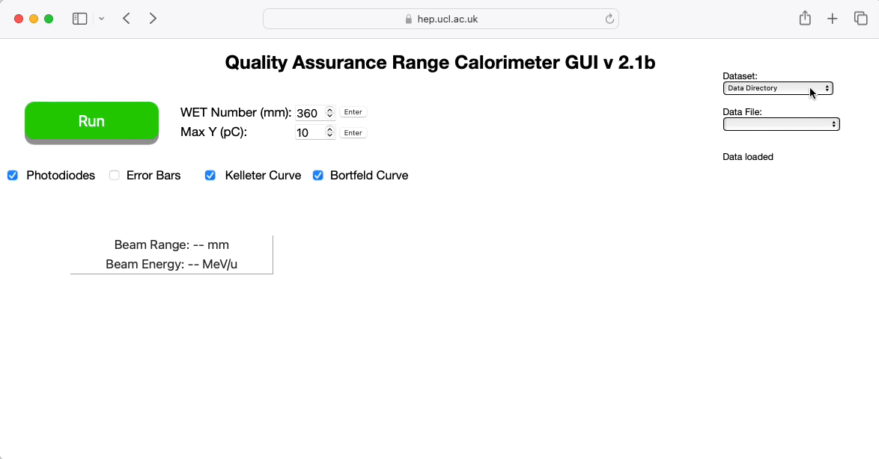
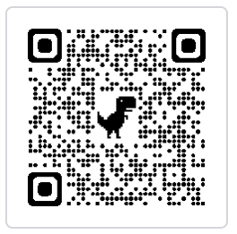
Web GUI
Select file and watch fitted results in “real time”.
Working on implementing DAQ from GUI.

Slide 12
What’s new in the PBT group?
QuADProBe: a device that combines range, spot size, spot position and absolute dose measurement all in one.

Slide 13



What’s new in the PBT group?
QuADProBe: a device that combines range, spot size, spot position and absolute dose measurement all in one.
+
+

Slide 14
What’s new in the PBT group?
QuADProBe: a device that combines range, spot size, spot position and absolute dose measurement in one device.
+
+
QuARC
(range)
Transmission calorimeter (absorbed dose)
Pixel detector (spot size and position)

Slide 15

Future work

Slide 16
New Year’s Resolutions
Future work
QuADProBe experiments @UCLH in February and May 2024
Improve scintillator composition to optimise light output and stabilise cross-module calibration, further improving fit accuracy.
Deployment of fitting routines onto an FPGA to increase fitting speed.
Web development to handle DAQ with GUI.
Additional beam tests to further characterise detector performance.

Slide 17

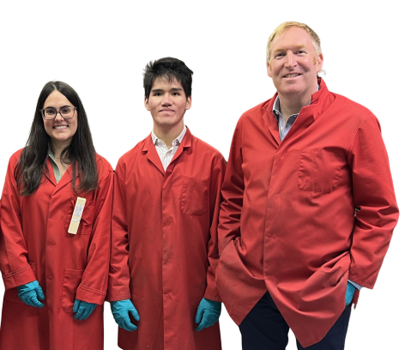


Thank you!
[1] L. Kelleter and S. Jolly. “A Mathematical Expression for Depth-Light Curves of Therapeutic Proton Beams in a Quenching Scintillator”. In: Medical Physics 47.5 (Feb. 2020), pp. 2300–2308. DOI: 10.1002/mp.14099

