Slide 1
Dose Delivery Verification for Proton Beam Therapy and Detectors
Simon Jolly
University College London

Slide 2
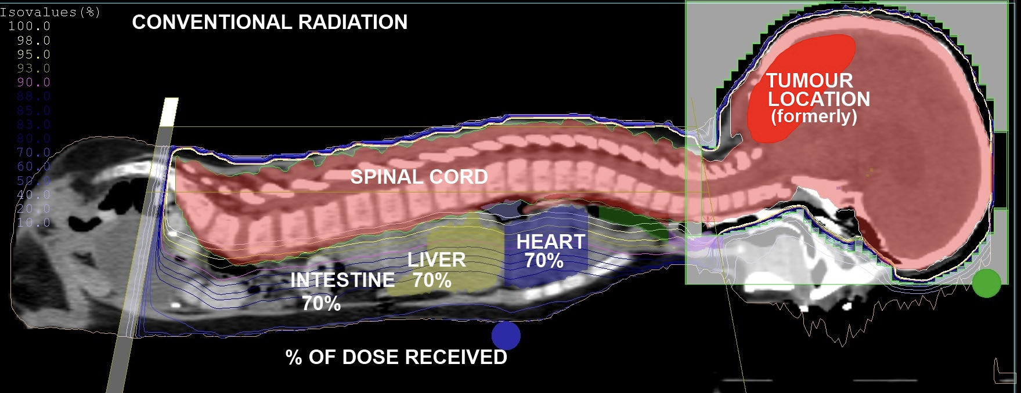
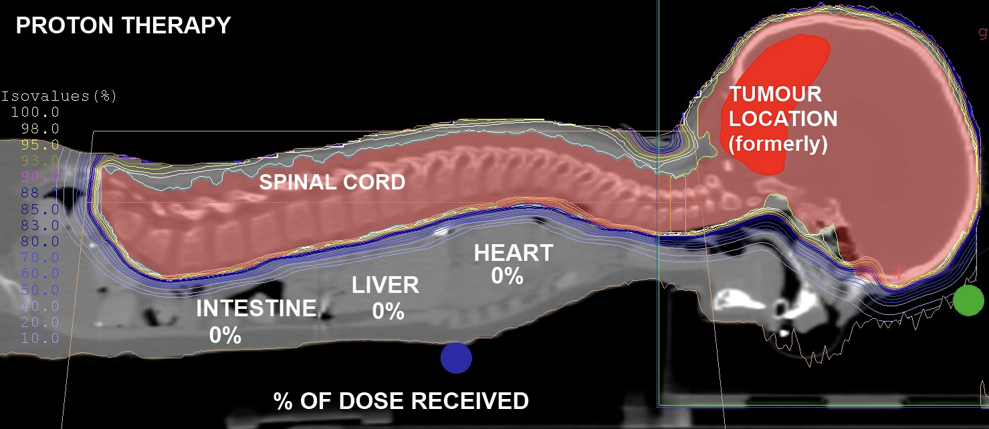
Proton Therapy: Dose Localisation
Ionising radiation damages DNA of tumour cells, causing cell death.
Superior dose conformity compared to conventional X-ray radiotherapy.
Range uncertainties prevent taking full advantage of dose localisation benefits.
Clinic must perform daily beam Quality Assurance (QA).

Slide 3
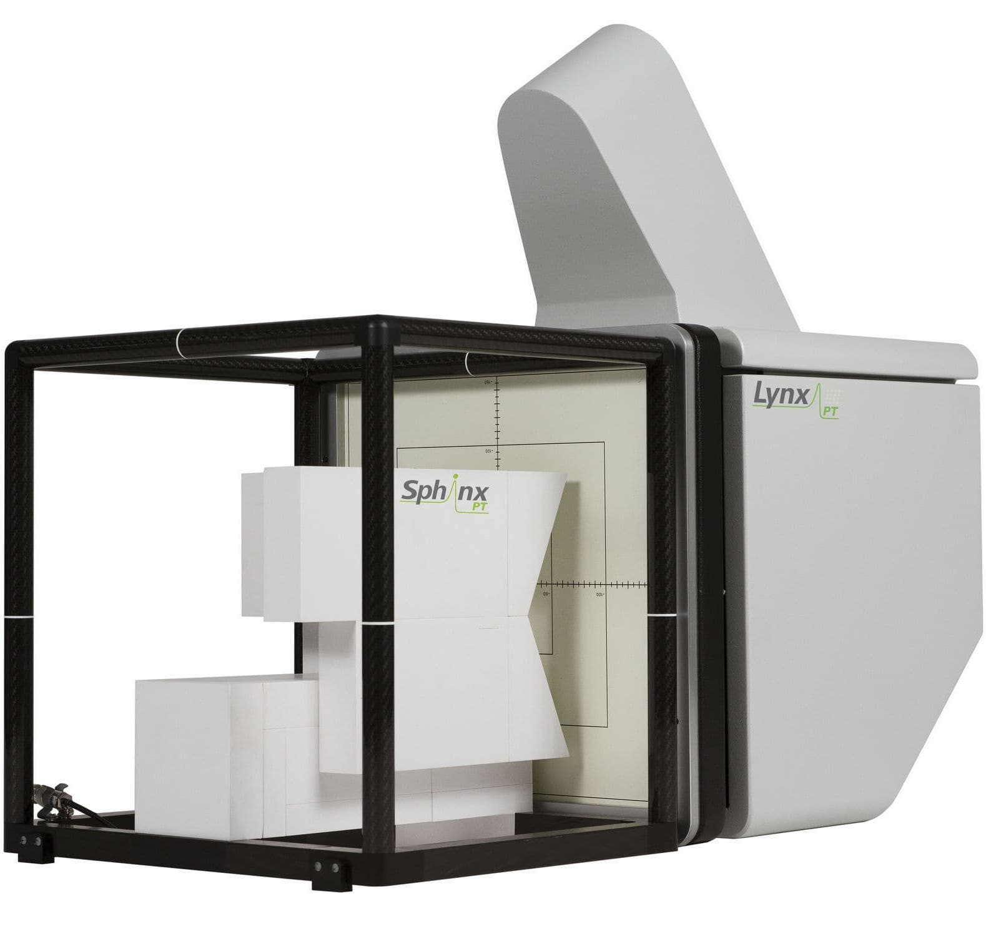
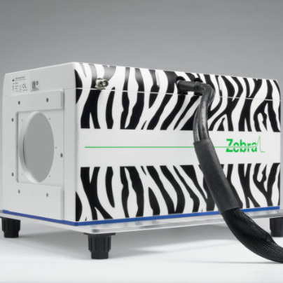
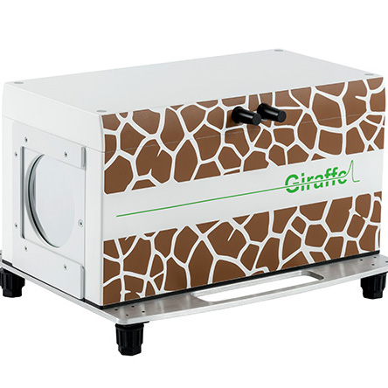
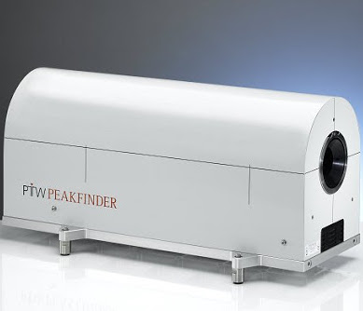
Daily Quality Assurance (QA)
Daily QA requires measurement of beam range, spot position and spot size.
Range measured in water-equivalent material for a selection of beam energies.
  Water chosen as proxy for human tissue.
Typically measured using layers of ionisation chambers in a water tank, requiring repeated beam delivery.
Current methods often compromise between speed and accuracy.
Develop a detector to make fast, accurate measurements of proton range.

Slide 4
Range Quality Assurance: The Challenge
There are different approaches for measuring the range of protons in water for beam quality assurance:
  Slow
    Ionisation chamber in water tank/column (eg. PTW Peakfinder).
    Gold standard for measuring depth dose curve.
    If you want to use this for daily QA, good luck…
  Medium
    MLIC — Multi-Layer Ionisation Chamber (eg. IBA Zebra/Giraffe).
    Much faster depth-dose measurement than water tank.
    Not straightforward to set up and run; storage needs care.
    Beam passing through non-water equivalent material which is critical to measurement.
  Fast
    Measure spot size or dose after passing through known absorber (eg. IBA Lynx+Sphinx).
    Much quicker to set up; make measurement of many energies “simultaneously”.
    No actual measurement of range, just confirmation of previous measurement.
    Won’t see position-energy correlation.
We would like a detector that is:
  Able to make direct range measurements for multiple energies.
  Quick to set up and easy to use.
  Robust: doesn’t mind being clouted…
  Mountable to gantry nozzle to enable measurements at any angle.

Slide 5
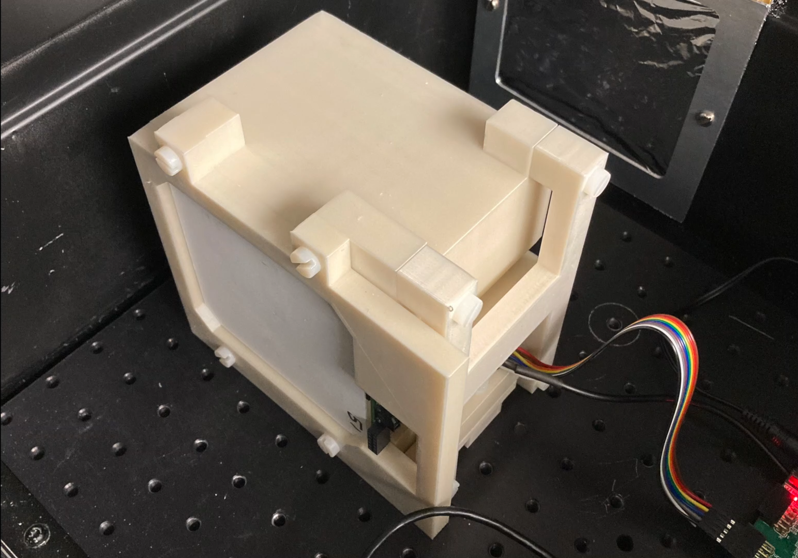
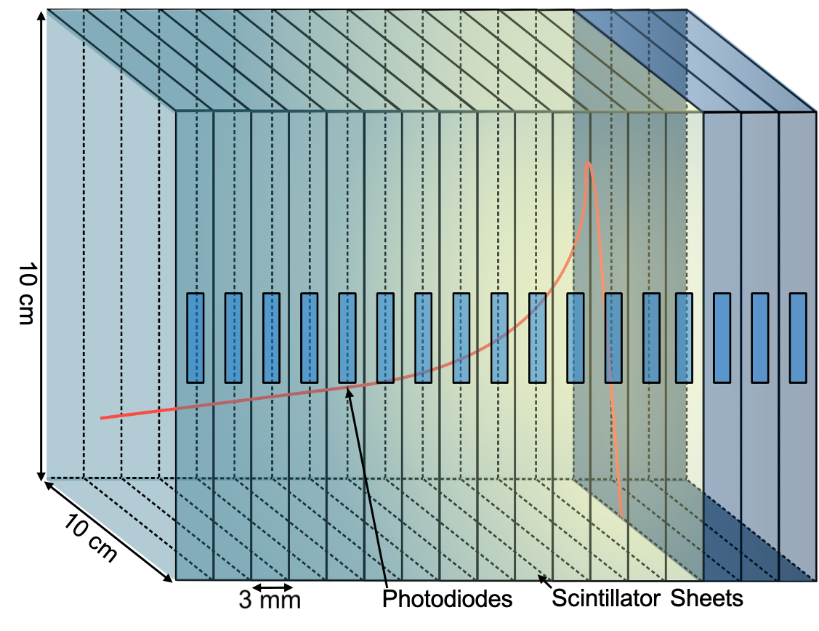
Enter the QuARC
The Quality Assurance Range Calorimeter (QuARC) constructed from plastic scintillator:
  Protons intercepted by a series of optically-isolated polystyrene scintillator sheets.
  Measure light output with photodiodes.
  Light output of each sheet nonlinear to dose, but quenching described by Birks’ Law:
    Fit data with analytical depth-light model.
    Reconstruct Bragg depth-dose curve and measure proton range.
  Photodiodes coupled to fast, modular electronics and an FPGA to read light levels at over 5 kHz.
  FPGA connects to on-board PC (Raspberry Pi) via USB.
  Connection to on-board PC via ethernet/WiFi.
Key benefits:
  Plastic scintillator inexpensive and water-equivalent.
  Range reconstructed with single beam delivery.
  Easy detector setup and no optical artefacts.

Slide 6
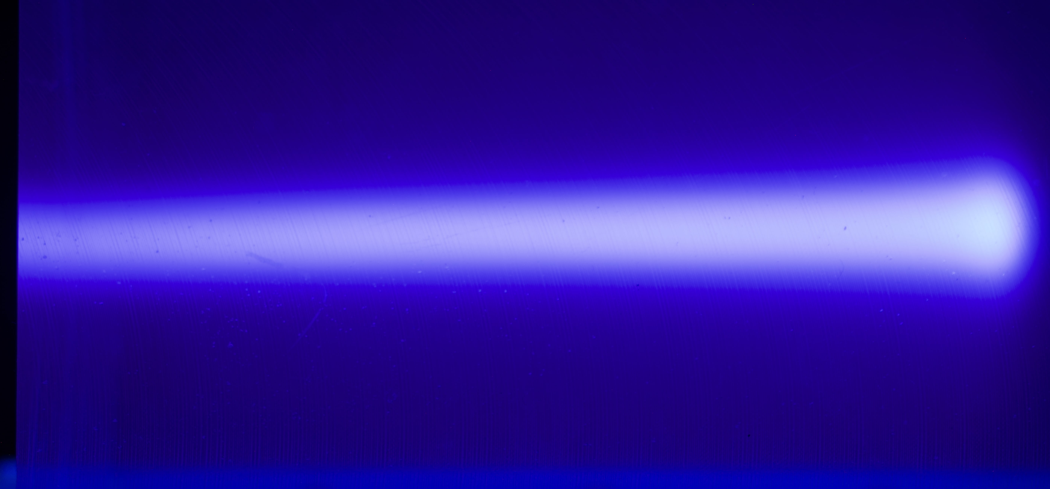
A Real Bragg Peak!

Slide 7
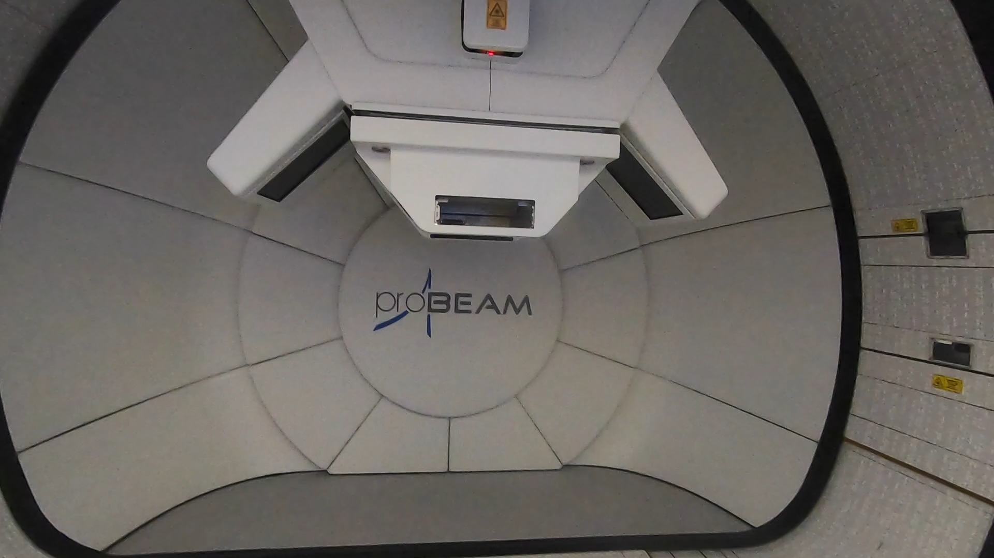
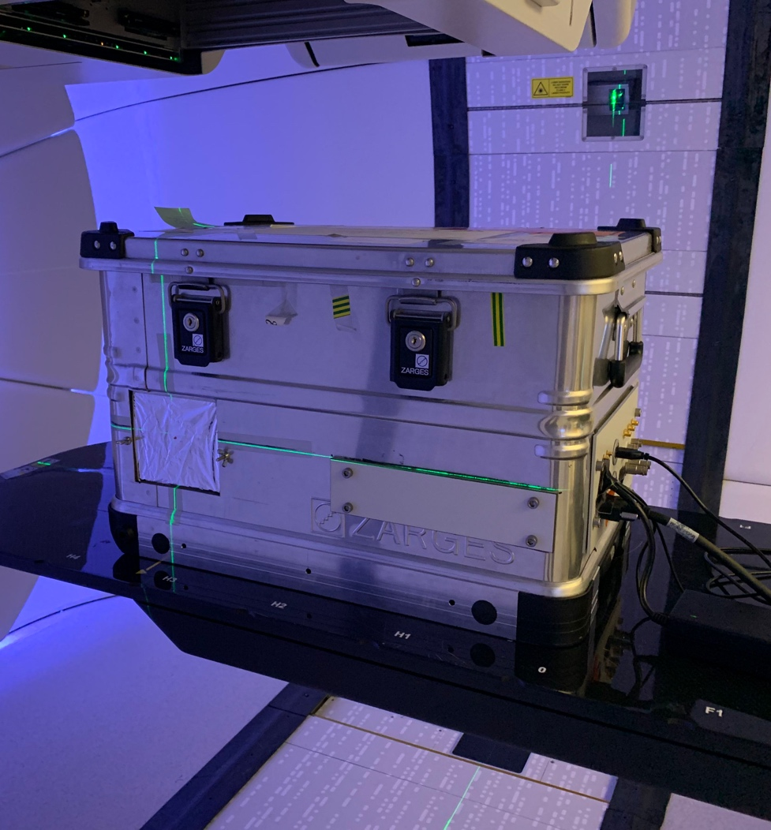
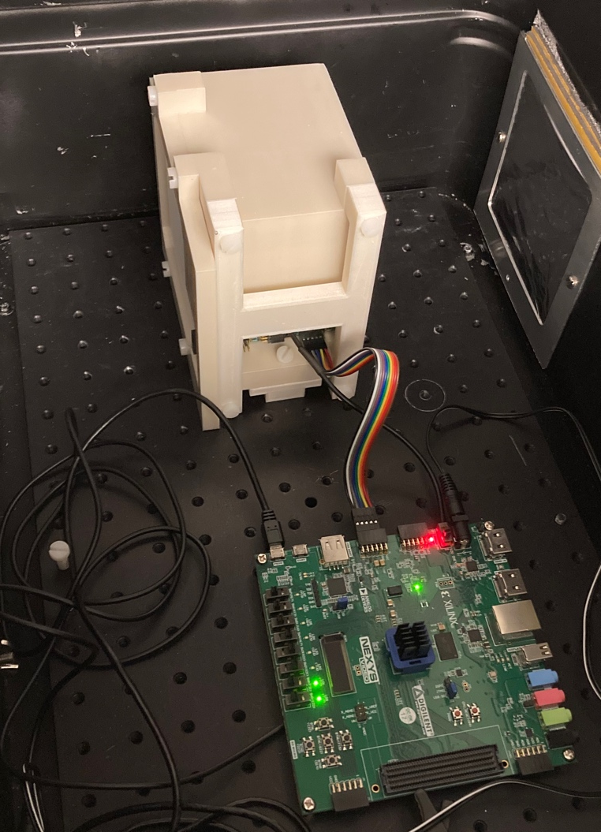
UCLH Beam Tests
Beam tests at UCLH on 16th Jun and 1st Sep 2022 to evaluate photodiode performance with clinical beams.
Typically used one detector module (32 sheets, 96 mm total depth) to test pencil beam energies between 70–130 MeV.
Determine range reconstruction accuracy and demonstrate fast live range reconstruction capabilities.

Slide 8
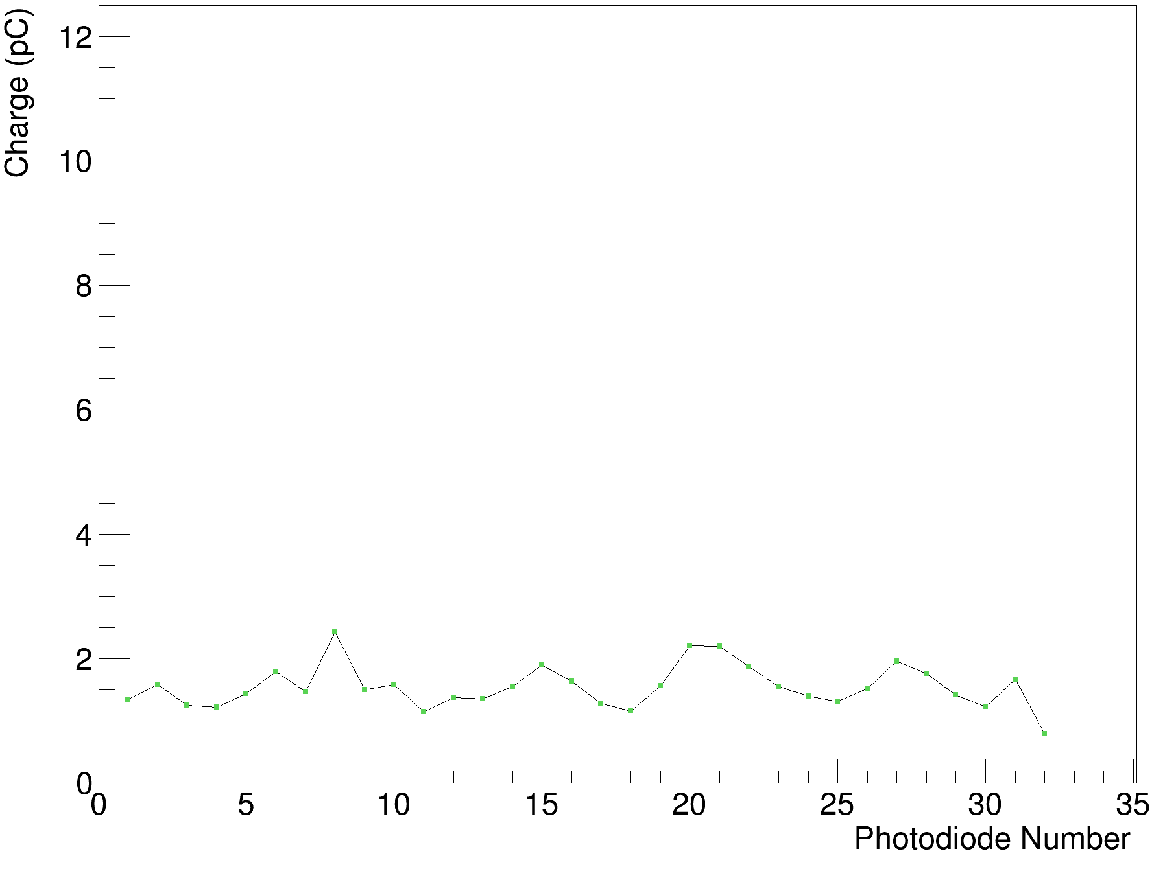
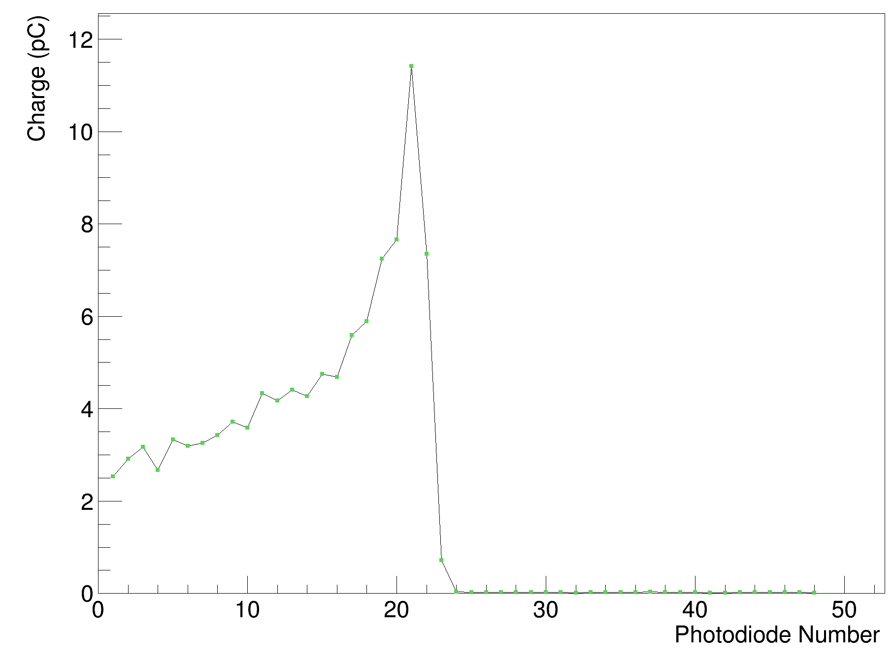
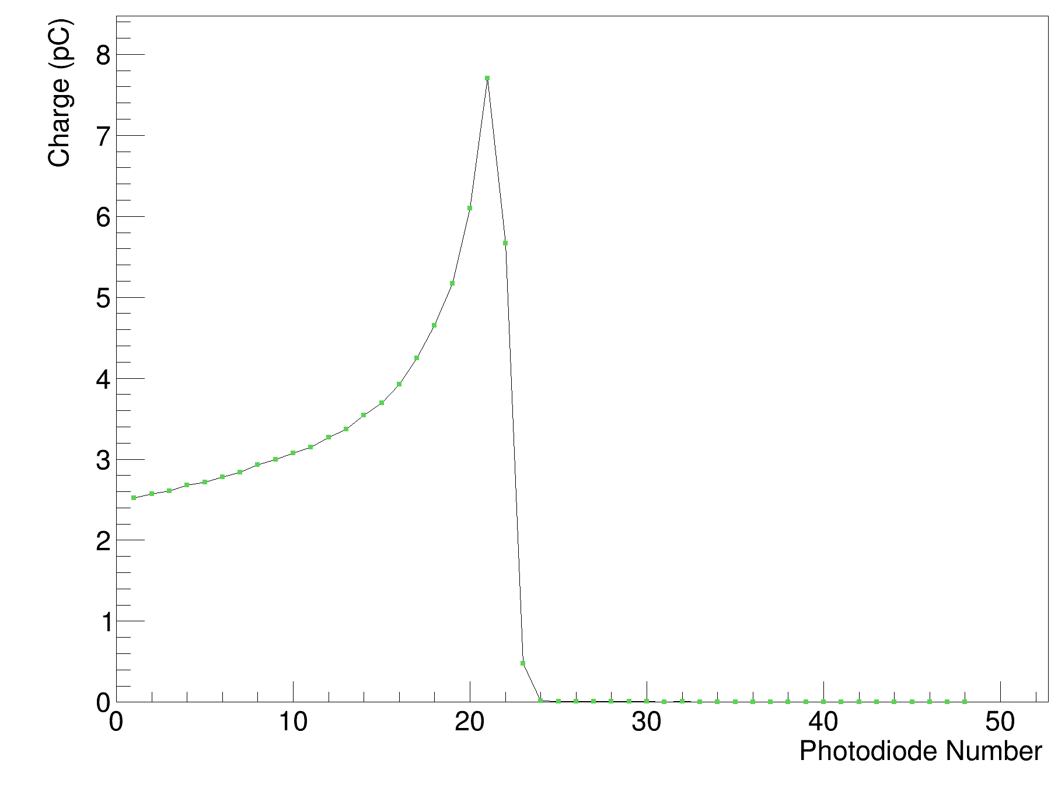
Calibration Process
Shoot through
Raw Data
Calibrated Data
Each scintillator layer has several variables:
  Light output of individual sheet.
  Coupling to photodiode.
  Response of photodiode.
Carry out “shoot-through” at >240 MeV for each module:
  Use ~50 mm WET upstream absorber: choose flattest part of Bragg curve.
  Shoot beam through in both directions: take out variations along curve.
Divide subsequent data measurements by this shoot through for calibrated output.

Slide 9
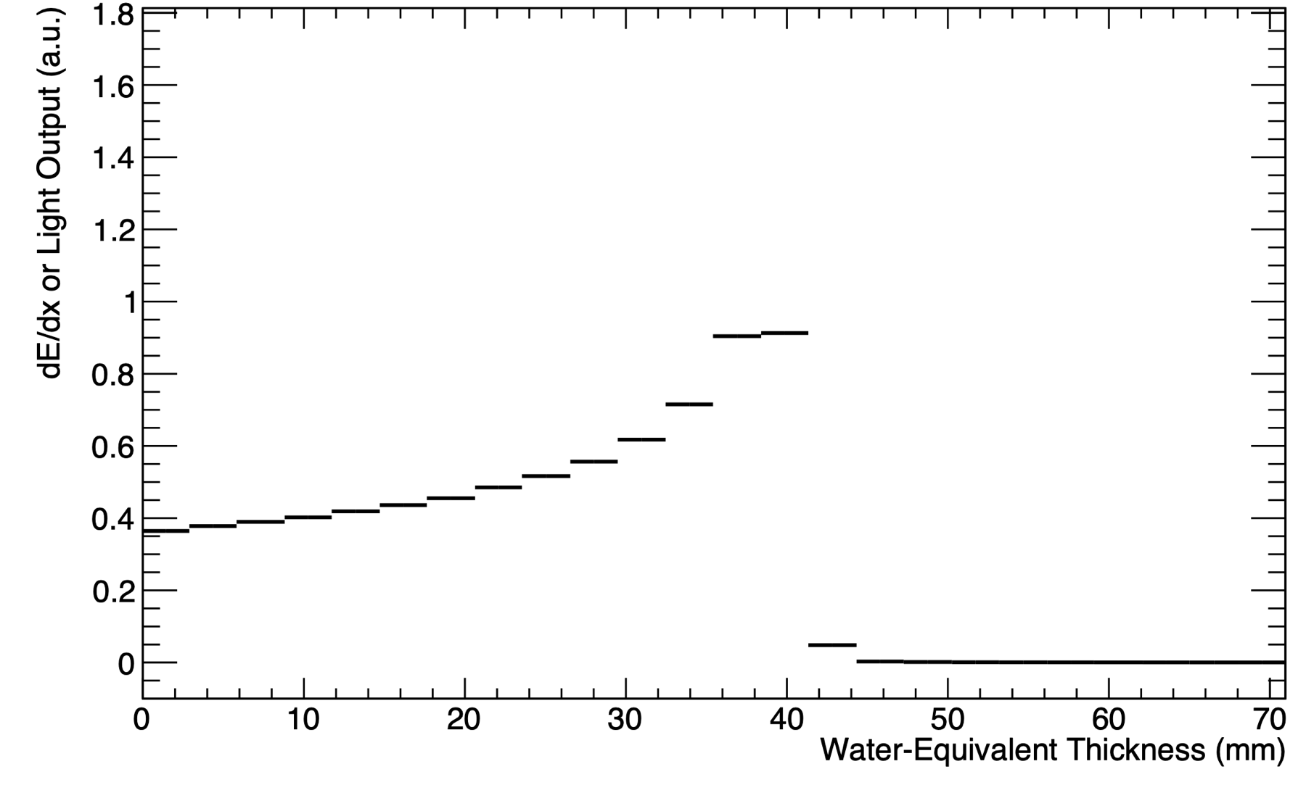
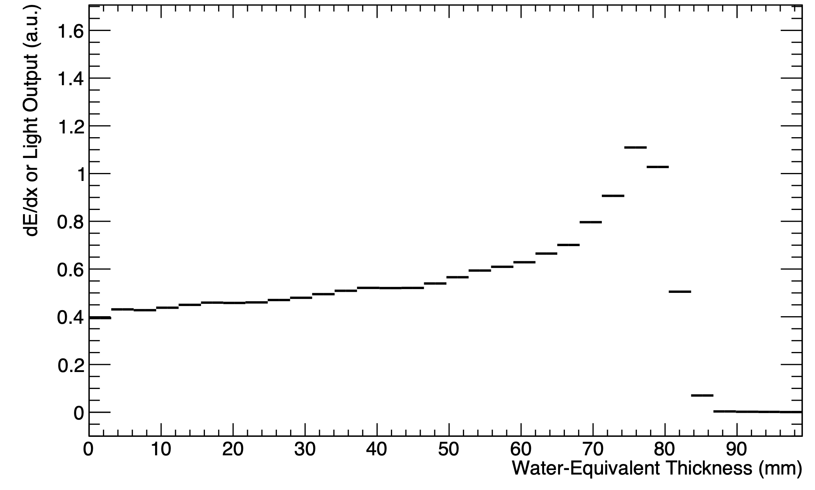
UCLH Beam Test Results
Legend:
  Black: Sheet Average Light Output
70 MeV
16/06/22
UNPUBLISHED DATA – DO NOT COPY OR DISTRIBUTE
130 MeV
01/09/22

Slide 10
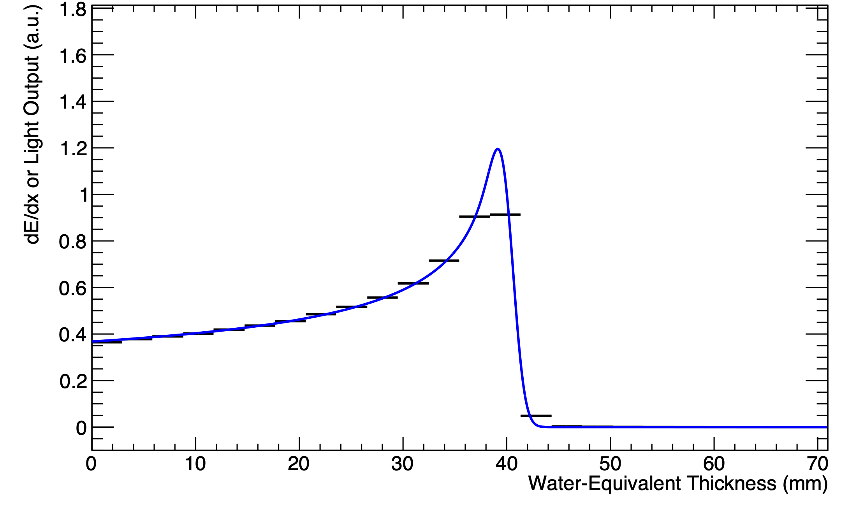
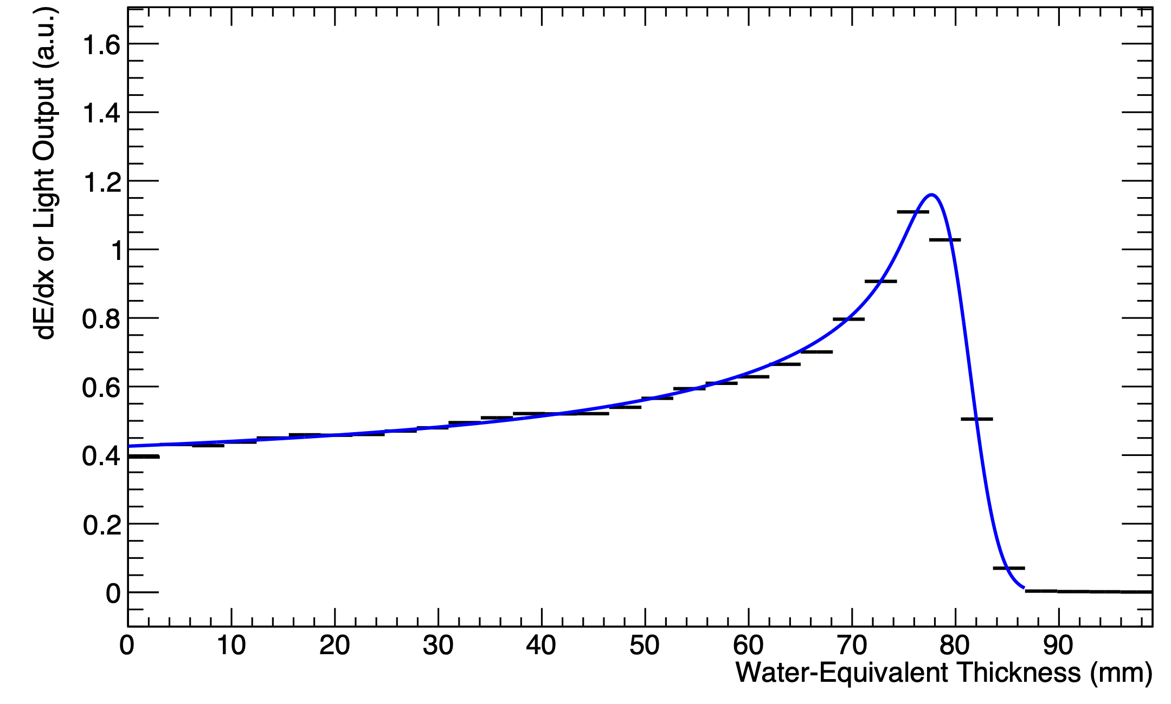
UCLH Beam Test Results
Legend:
  Black: Sheet Average Light Output
  Blue: Fitted Quenched Depth-Light Curve
70 MeV
16/06/22
UNPUBLISHED DATA – DO NOT COPY OR DISTRIBUTE
130 MeV
01/09/22

Slide 11
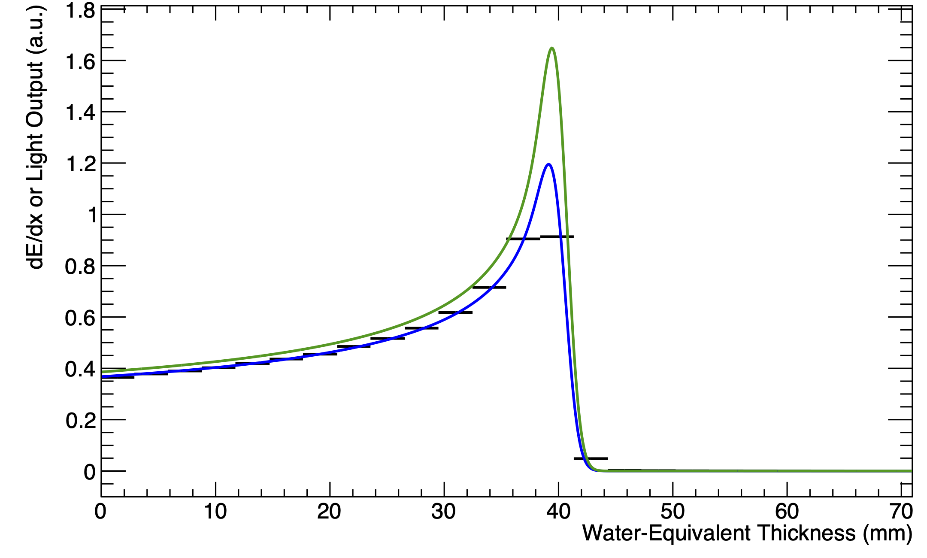
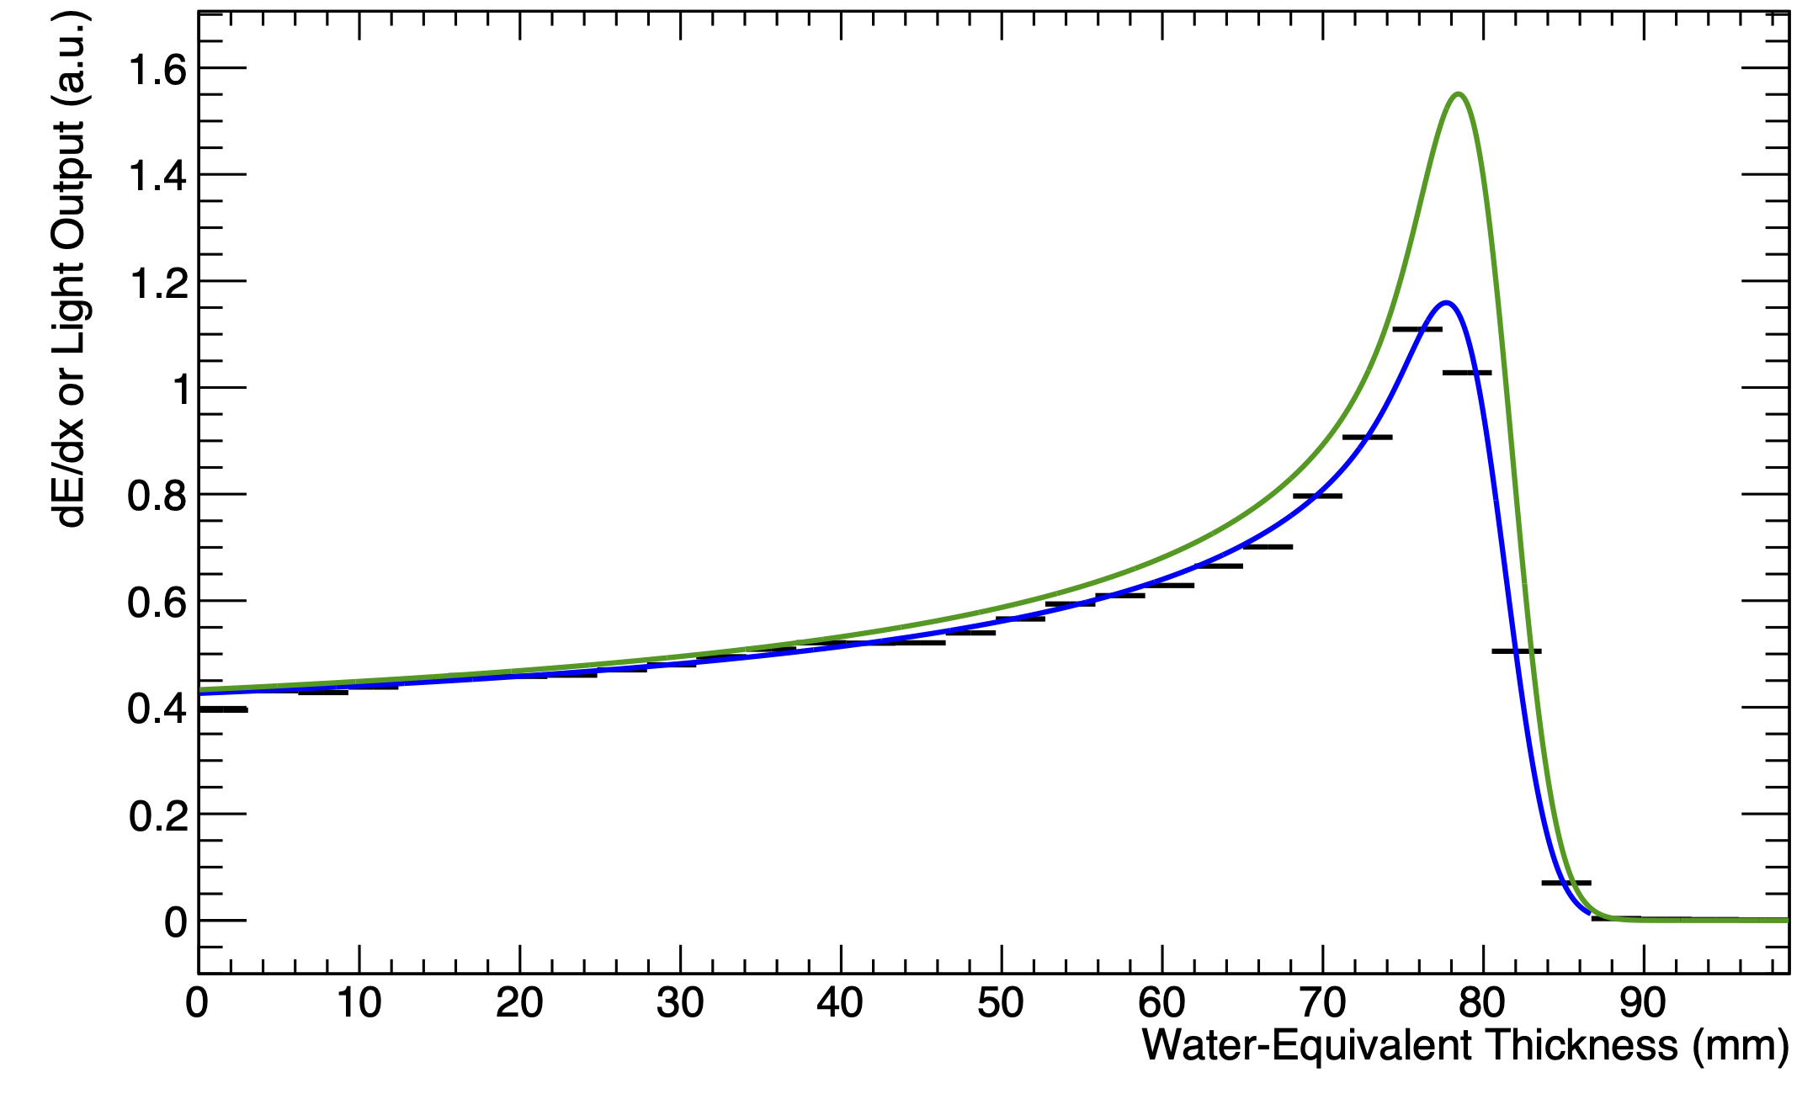
UCLH Beam Test Results
Legend:
  Black: Sheet Average Light Output
  Blue: Fitted Quenched Depth-Light Curve
  Green: Reconstructed Depth-Dose Curve
70 MeV
16/06/22
UNPUBLISHED DATA – DO NOT COPY OR DISTRIBUTE
130 MeV
01/09/22

Slide 12
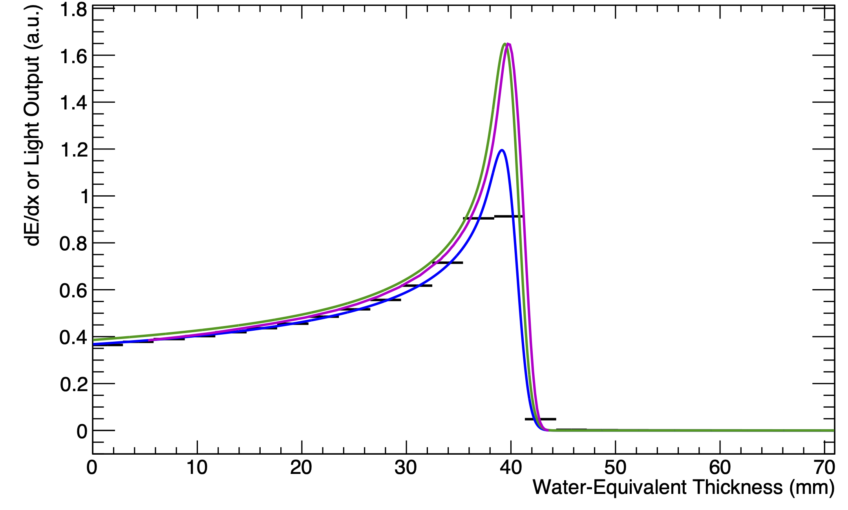
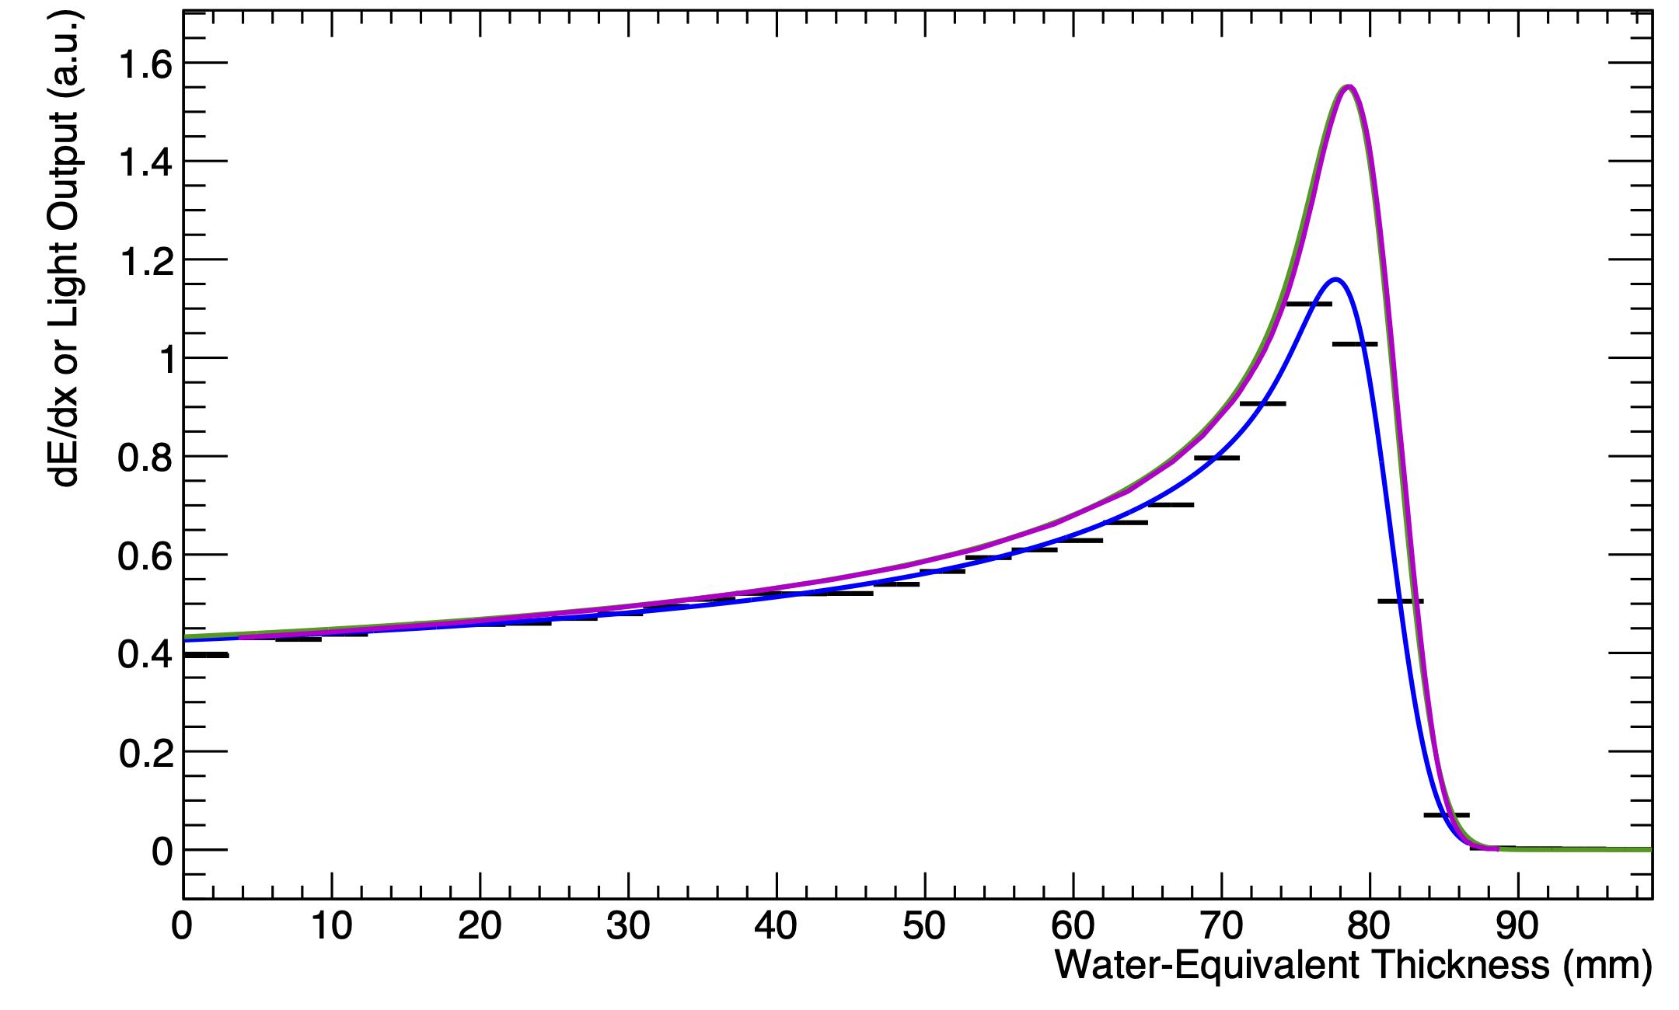
UCLH Beam Test Results
Legend:
  Black: Sheet Average Light Output
  Blue: Fitted Quenched Depth-Light Curve
  Green: Reconstructed Depth-Dose Curve
  Magenta: UCLH Reference Dose Curve
Captures shape of Bragg curve and range accurate within 0.5 mm.
  Disclaimer: depth calibration is ongoing!
70 MeV
16/06/22
UNPUBLISHED DATA – DO NOT COPY OR DISTRIBUTE
130 MeV
01/09/22

Slide 13
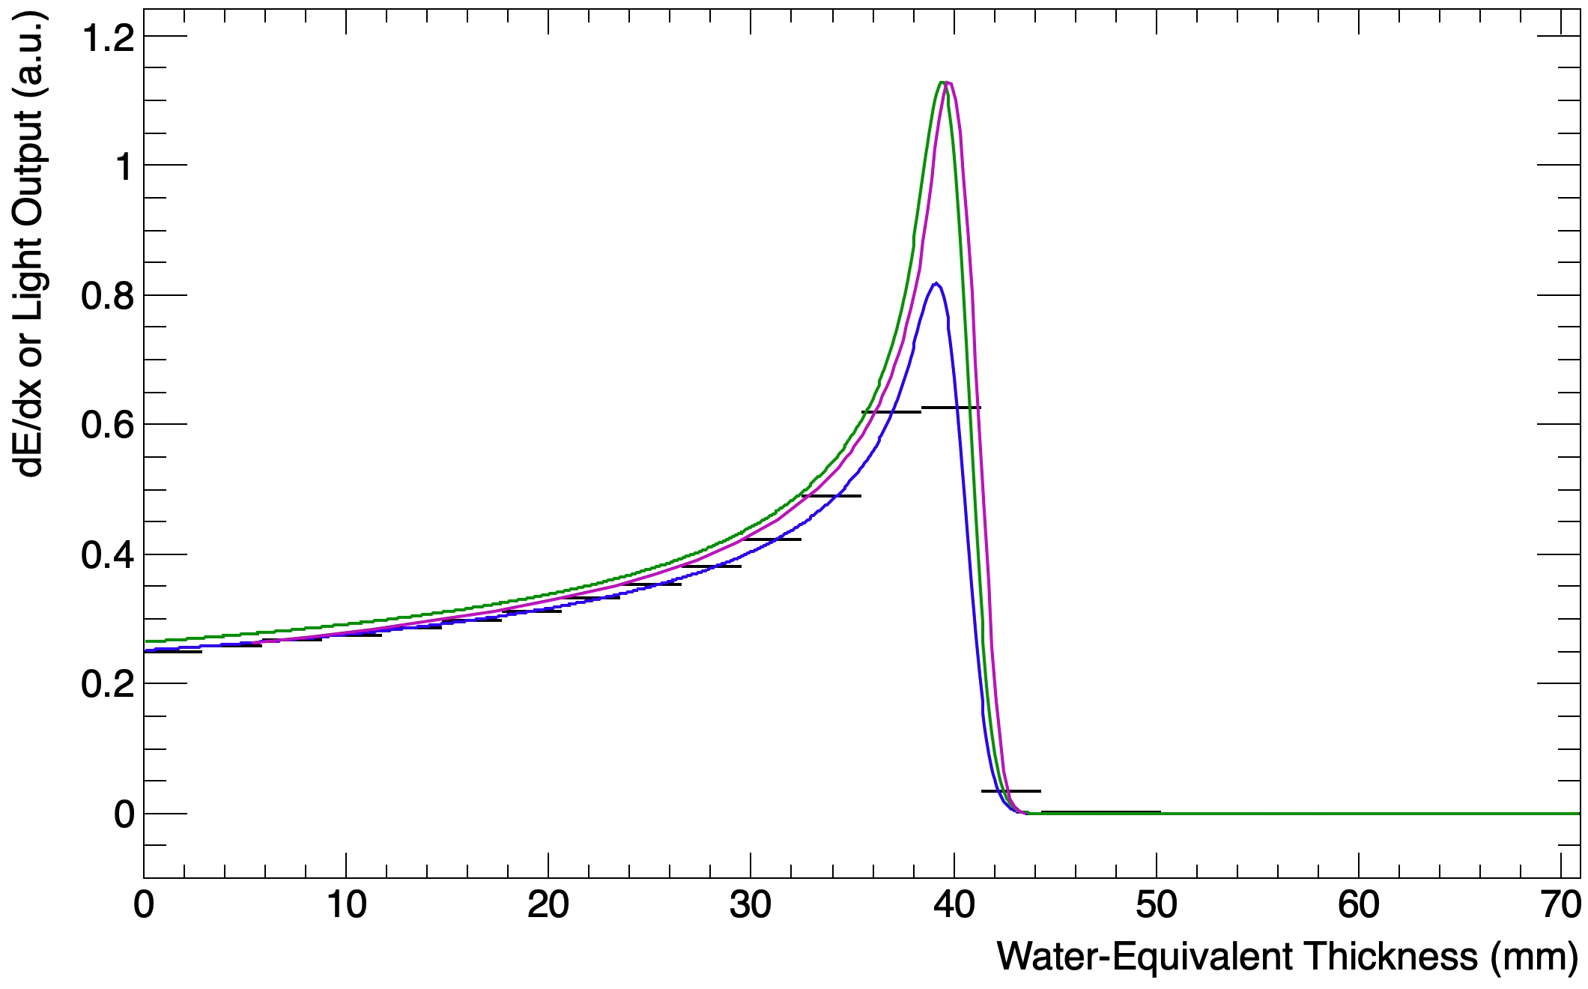
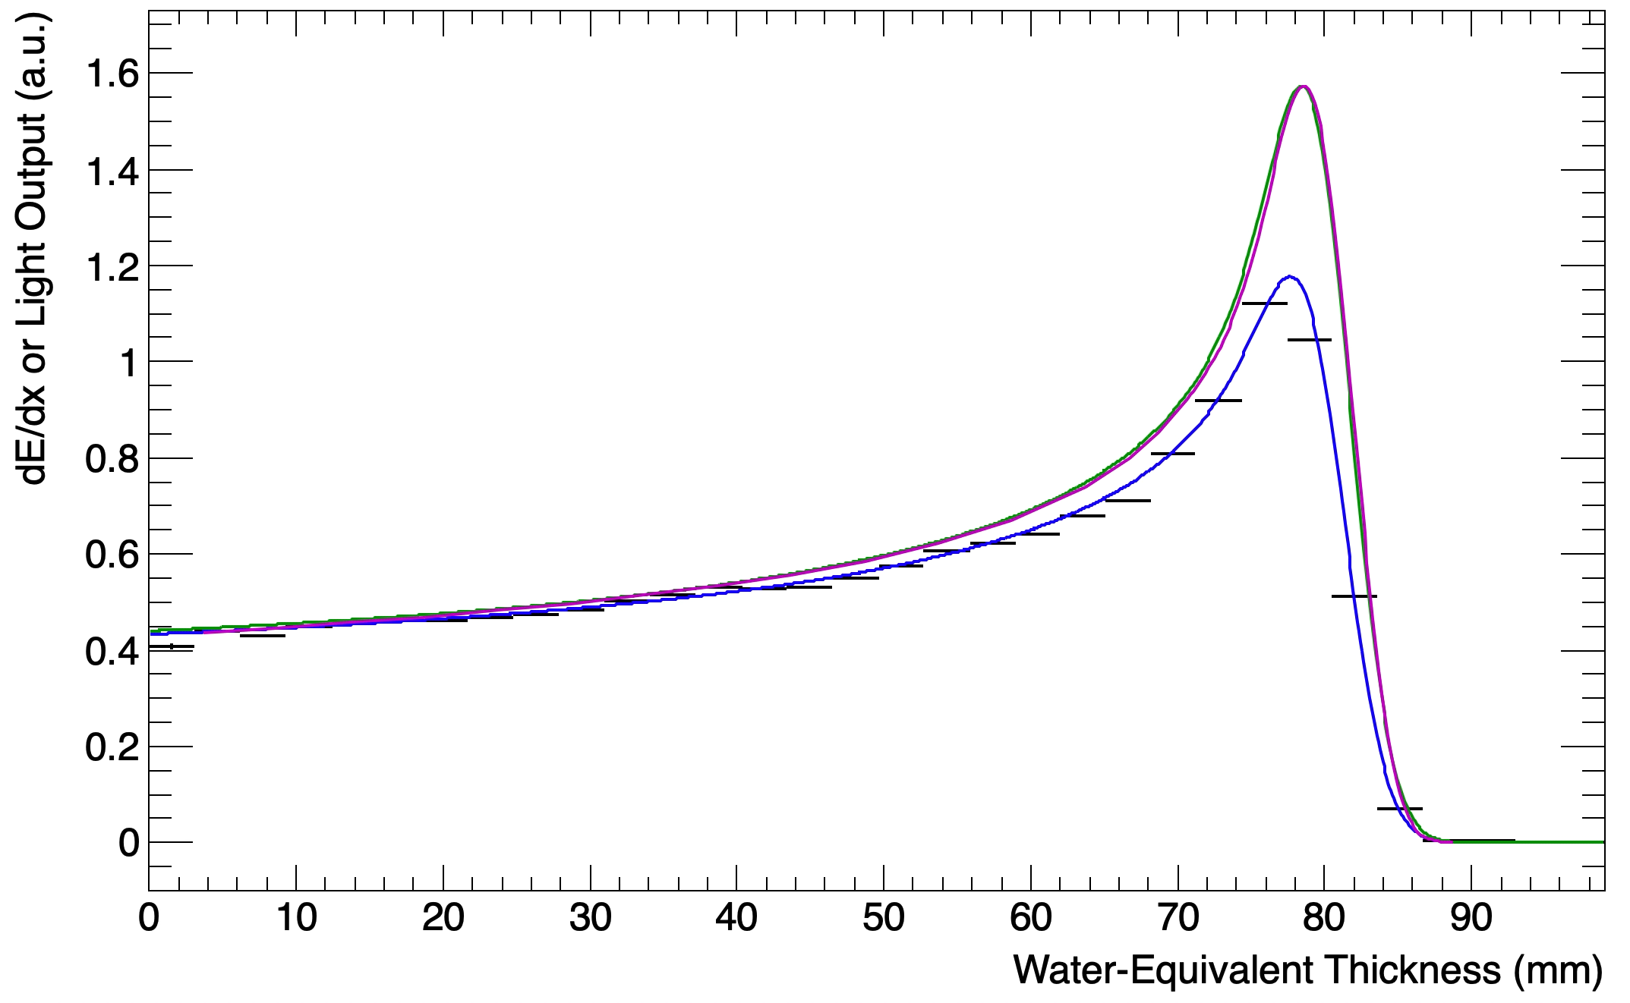
UCLH Beam Test Results
Legend:
  Black: Sheet Average Light Output
  Blue: Fitted Quenched Depth-Light Curve
  Green: Reconstructed Depth-Dose Curve
  Magenta: UCLH Reference Dose Curve
Captures shape of Bragg curve and range accurate within 0.5 mm.
  Disclaimer: depth calibration is ongoing!
Latest measurement accurate to 100 microns.
Real-time range reconstruction at 40 Hz.
70 MeV
16/06/22
UNPUBLISHED DATA – DO NOT COPY OR DISTRIBUTE
130 MeV
01/09/22

Slide 14
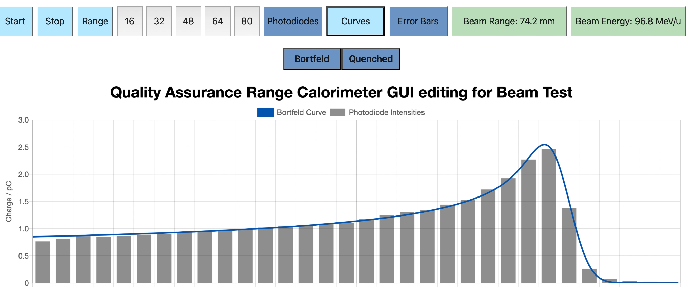
Web-Based GUI
FPGA transfers data to PC, which performs fit.
View live fit results in web GUI.
PC hosts webpage on LAN, to allow any device on network to access live display.
Detector control soon to be implemented in GUI.
DEVELOPED IN JAVASCRIPT BY FERN PANNELL
UNPUBLISHED DATA – DO NOT COPY OR DISTRIBUTE

Slide 15
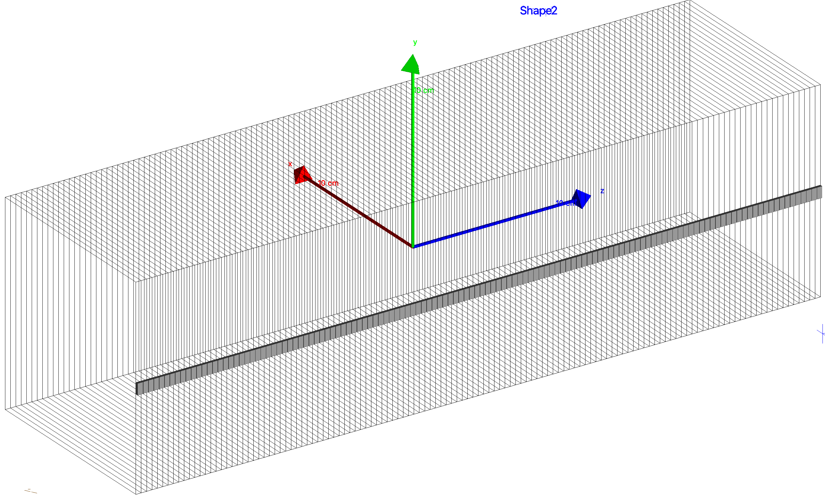
Detector Simulations
Detector simulated in Geant4.
Simple construction with layers corresponding to plastic scintillator sheets.
Include photodiodes and characterize light capture in small area.

Slide 16
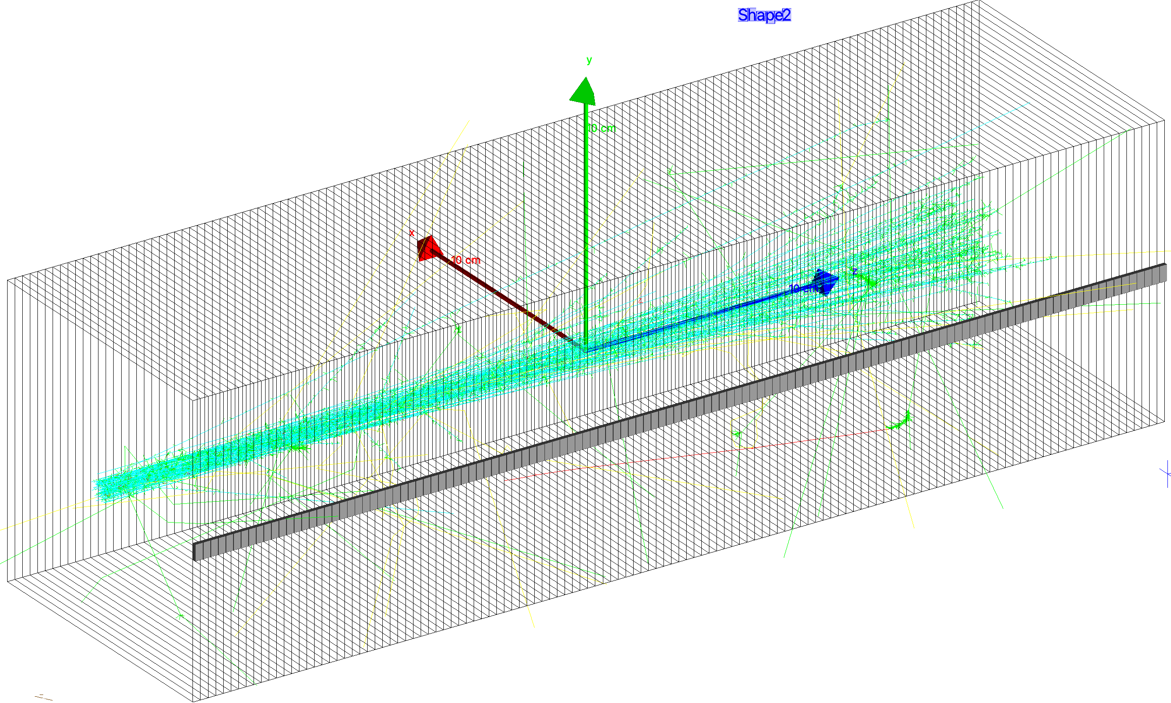
Detector Simulations (2)
Normally simulate a million protons in a few minutes.
Use realistic initial beam parameters.
Protons: cyan.
Photons: green.
Neutrons: yellow.
Electrons: blue.
Positrons: red.

Slide 17
Simulation Results
Simulations still only rudimentary: most detector development carried out without them!
Good match between simulated and measured depth dose curves.
Will need to improve so we can characterize light capture: issues with off-axis beams.

Slide 18
Conclusions
We have a working detector!
Able to make measurements down to ~100 microns with 3 mm sheets.
Still working on refining curve fitting and reconstruction, particularly for live fit.
Live fitting on FPGA: watch this space…
Detector simulations still evolving: not had time/manpower to develop comprehensive simulations but will need to in order to resolve some measurement artifacts (off-axis beams).

Slide 19
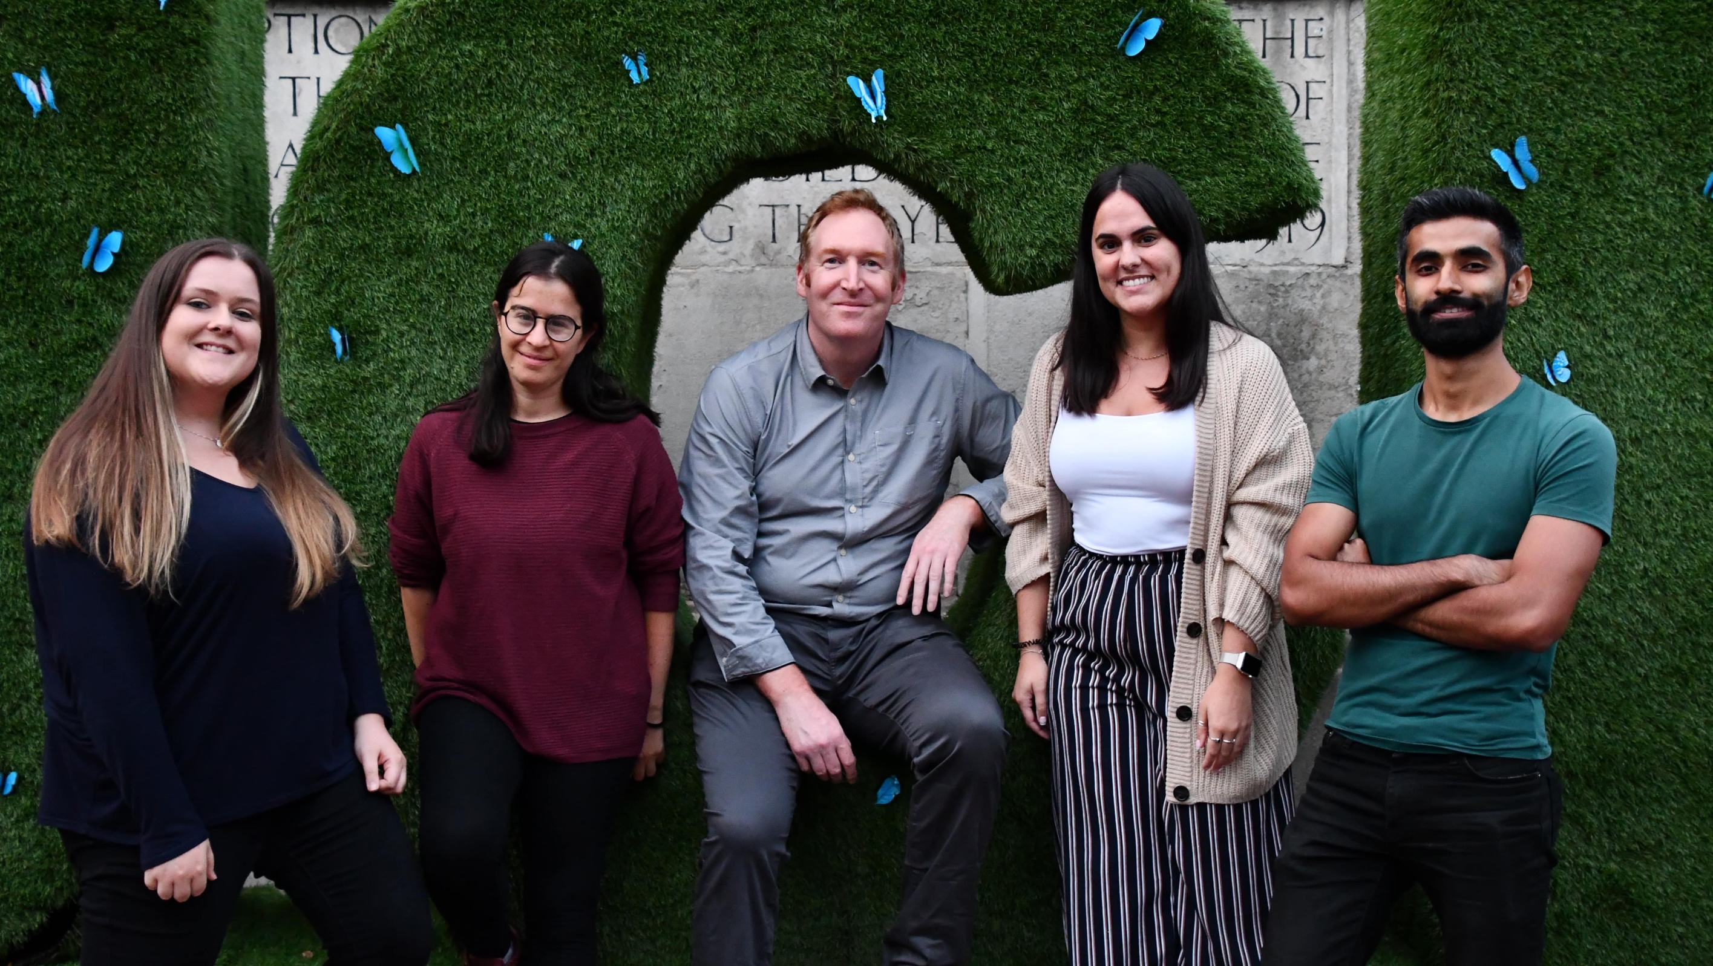
Thank You!
https://www.hep.ucl.ac.uk/pbt/QuarcBuildAndTest.mp4

