Slide 1

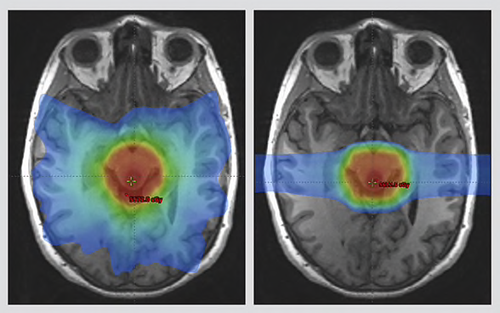
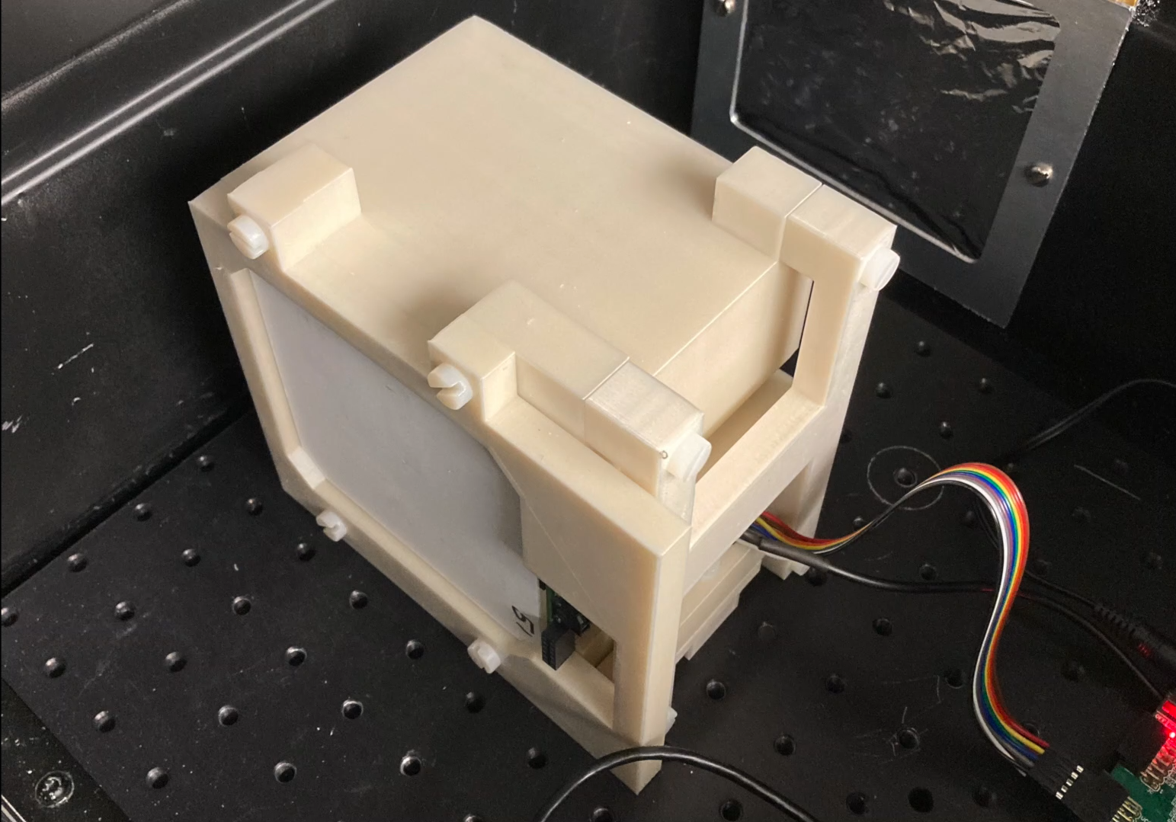
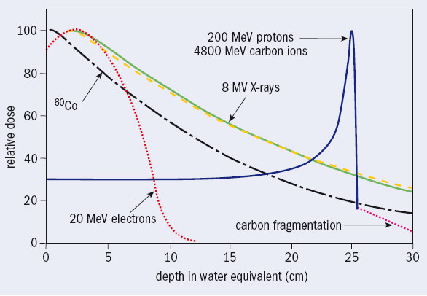
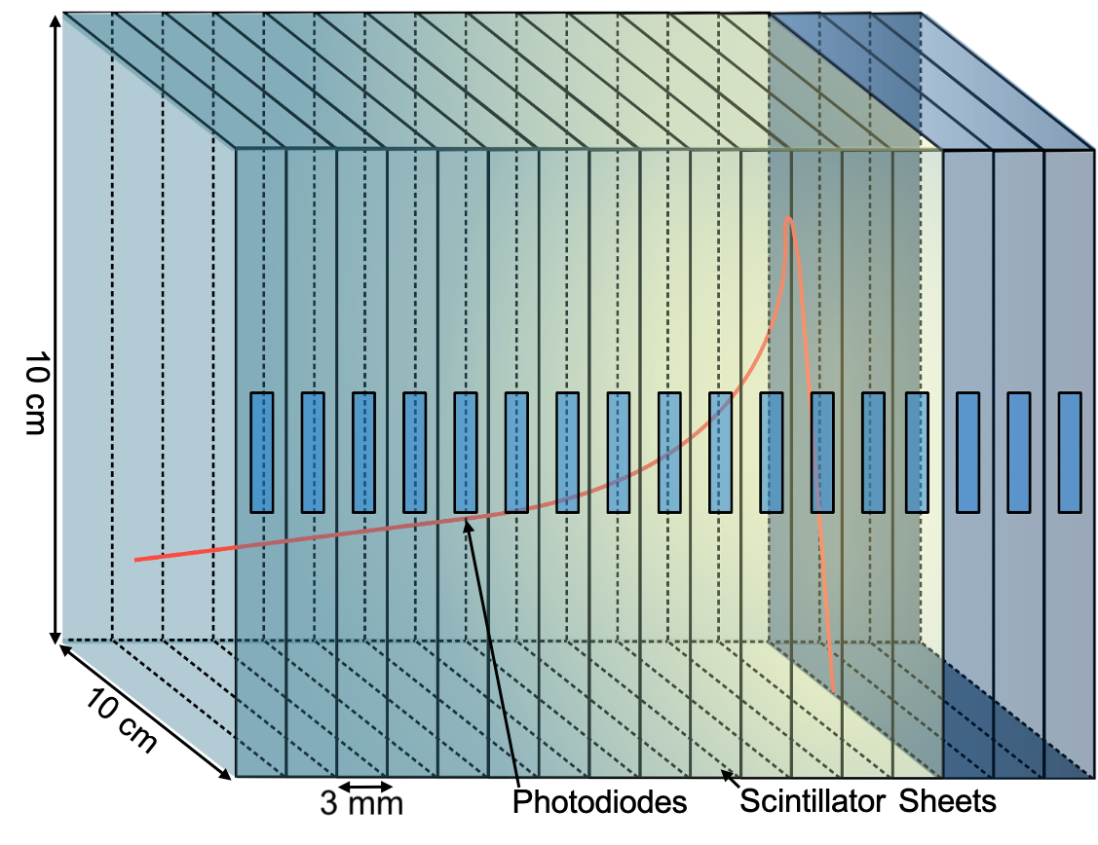
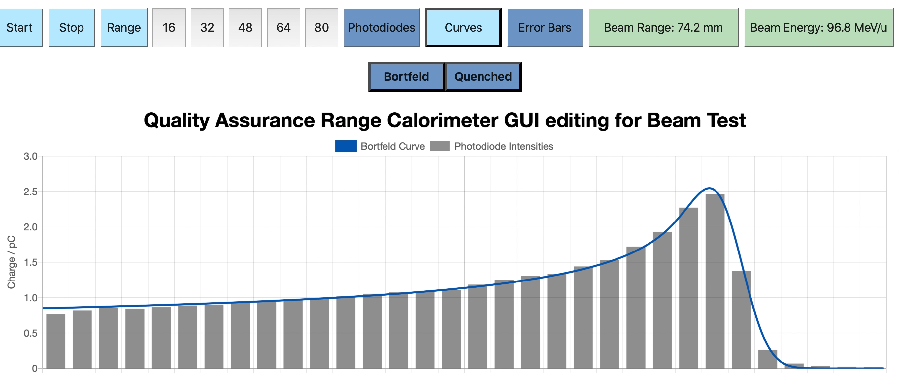
Proton Beam Therapy: HEP In Action
Protons
The Quality Assurance Range Calorimeter (QuARC) measures proton range in plastic scintillator.
Controlled by Raspberry Pi and FPGA with web-based GUI.
PhD Project:
  Fit Bragg curve on FPGA.
  Extend to heavier ions: Helium, Carbon, Oxygen.
  Use Machine Learning to optimize fast fitting of Bragg curves.
  Add beam spot measurement for full 3D reconstruction.
  Install in a hospital…
X-rays
Proton therapy gives more accurate does than photons. But where…?

