Slide 1
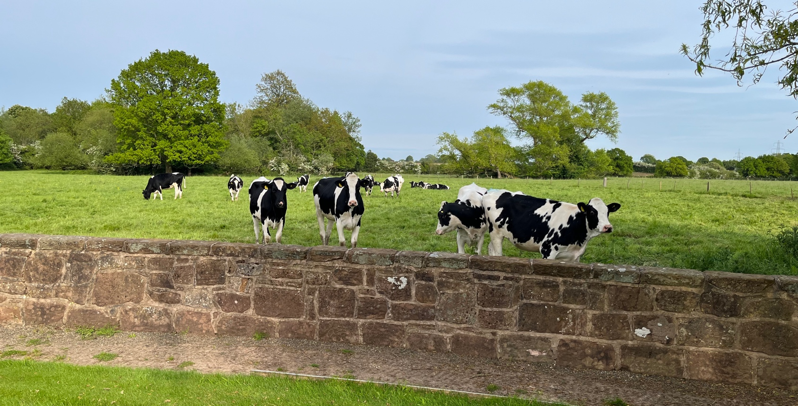
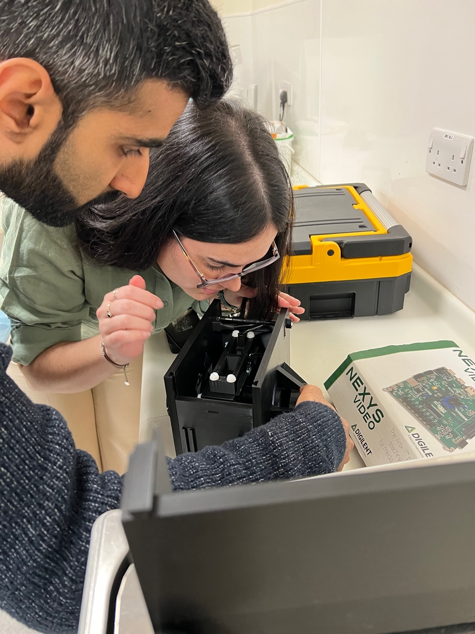
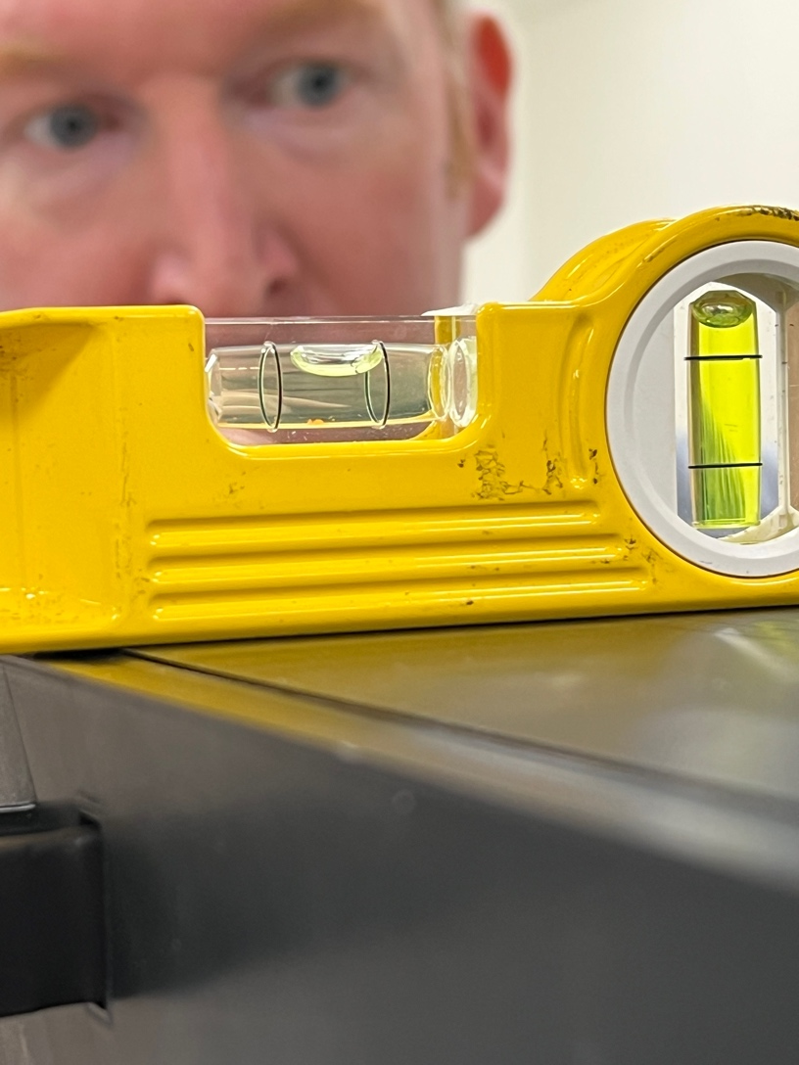
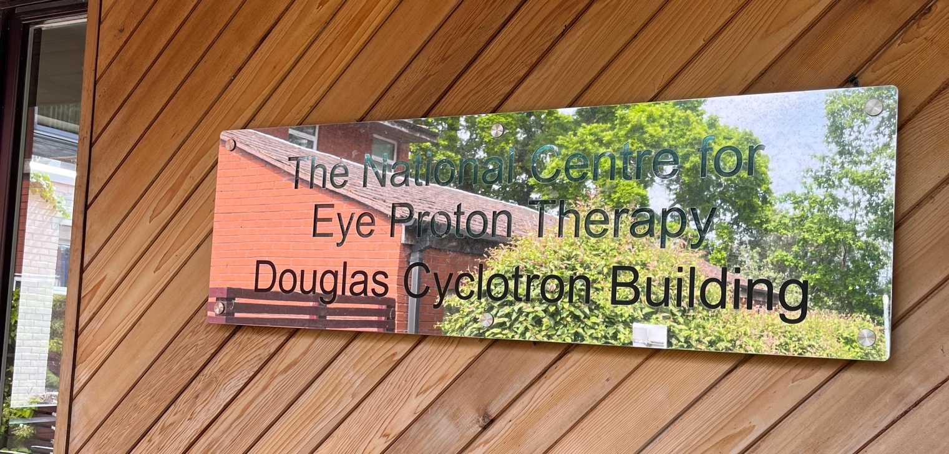
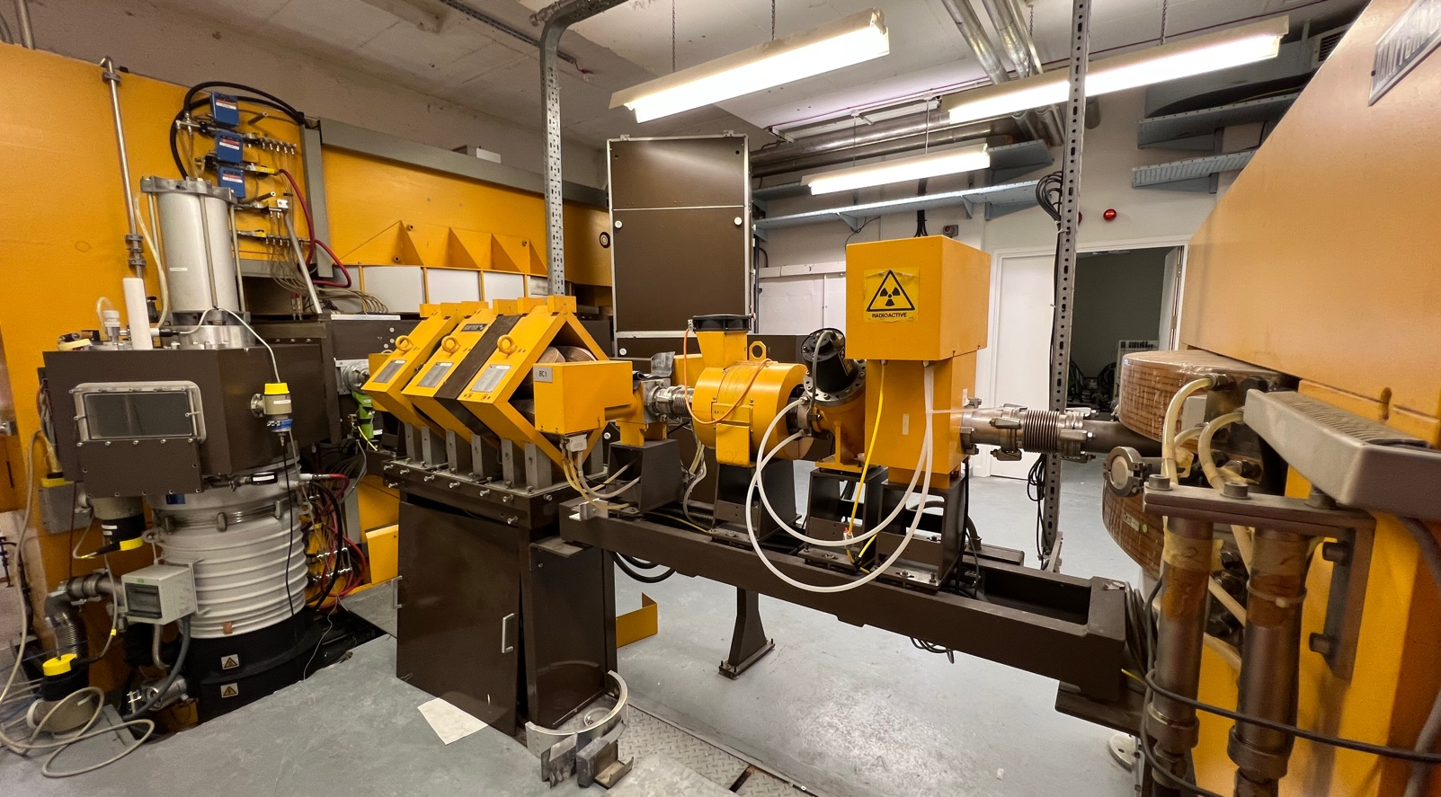
Clatterbridge Analysis
18th May 2023 Experiment

Slide 2
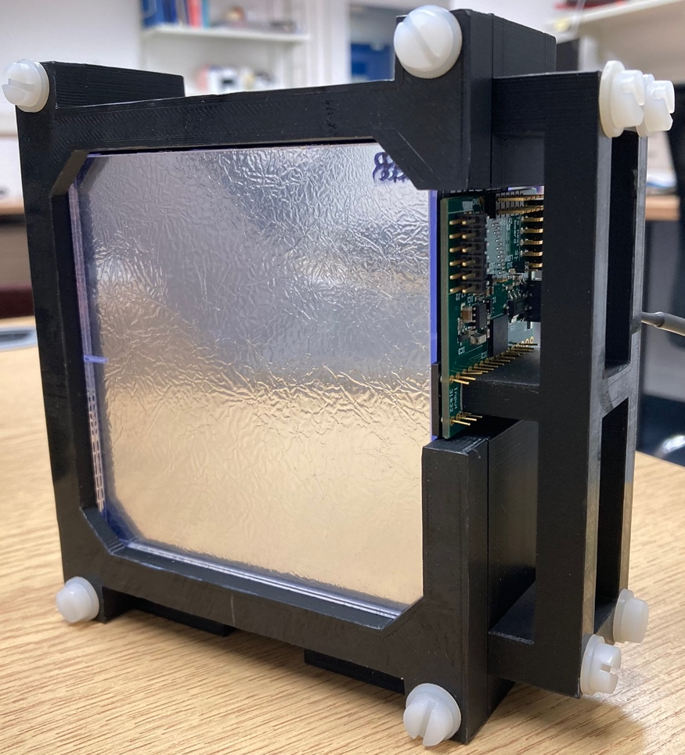
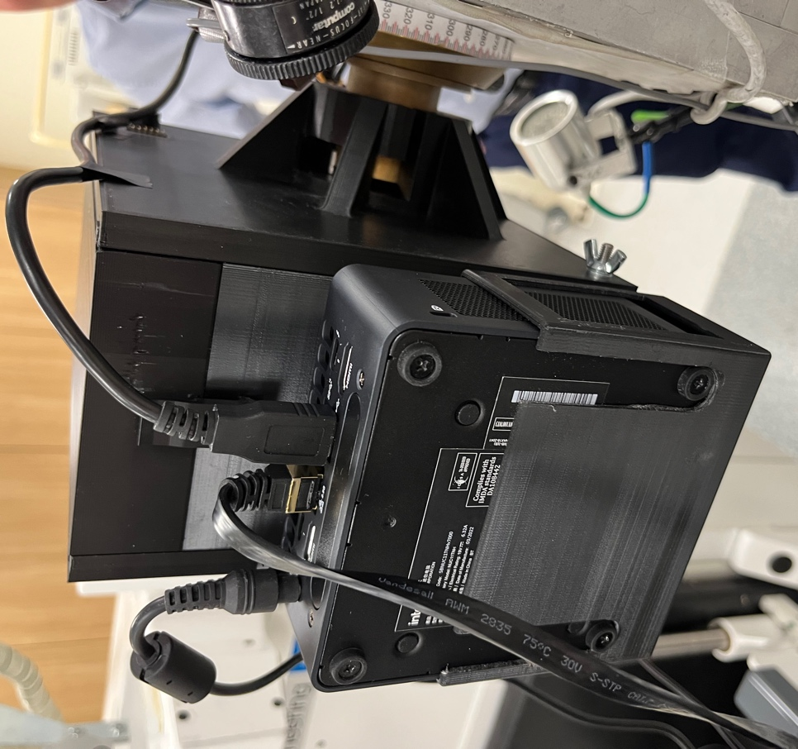
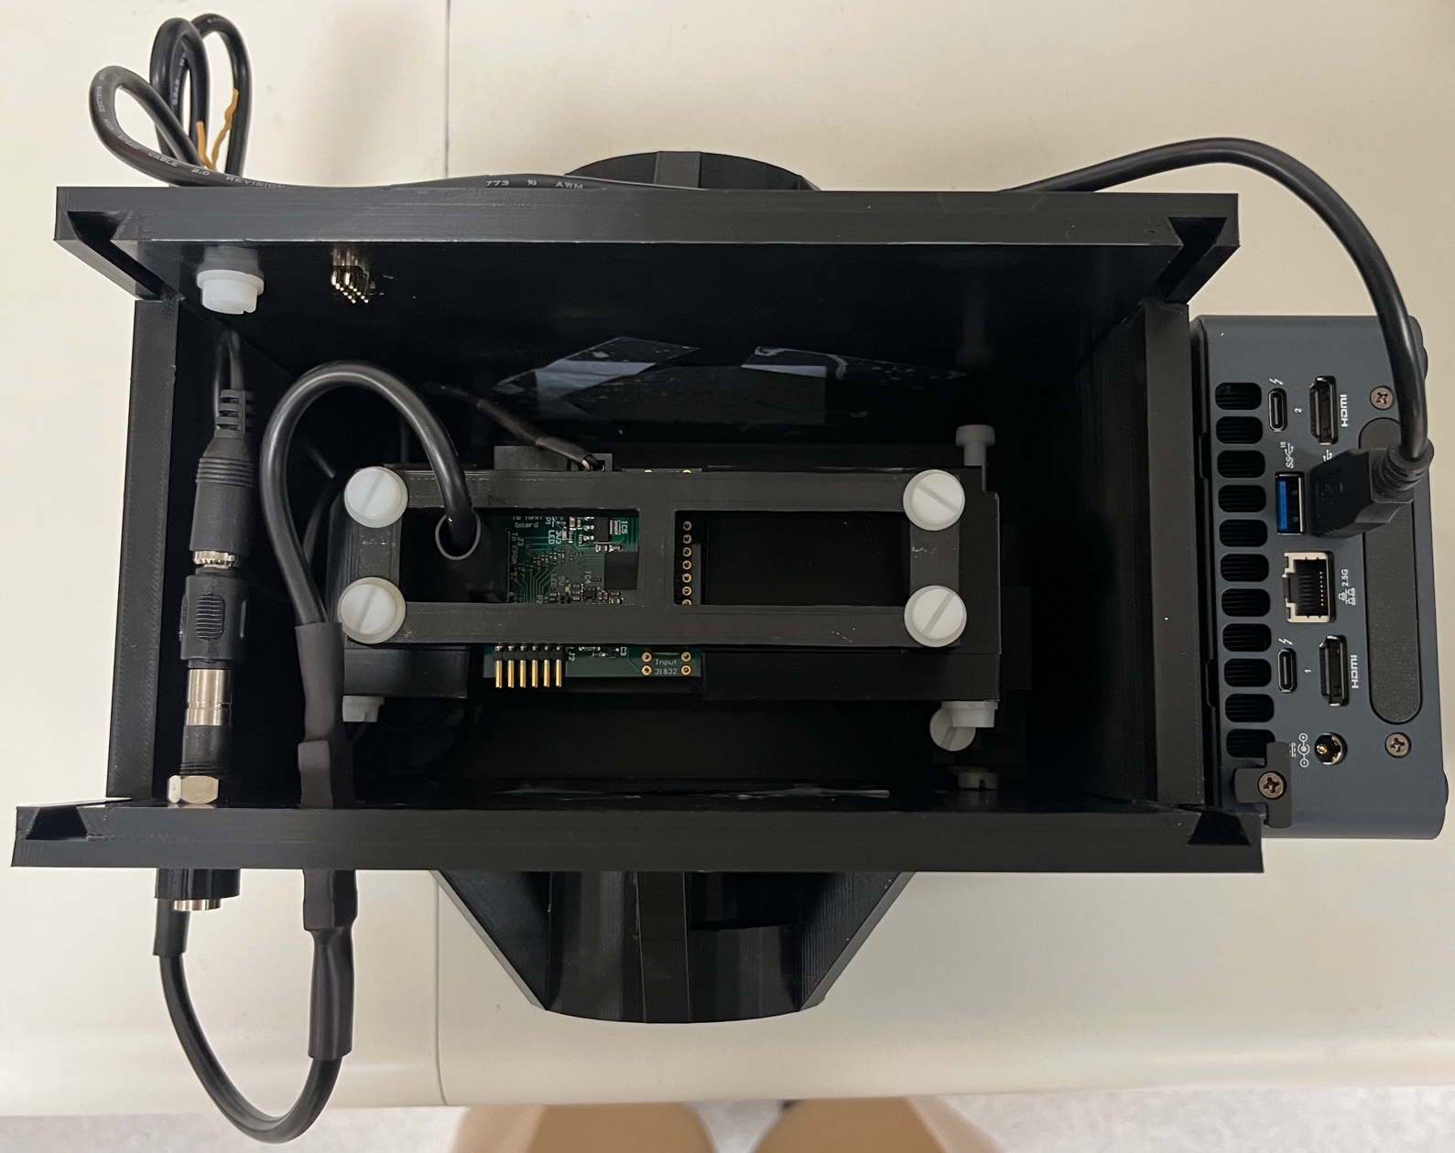
Setup
Single module, 14-sheet DDC232 Rev. B prototype
  Clear, polished scintillator sheets
  Average sheet thickness: 2.85 mm
  2 inputs left unplugged.
Compact USB104 FPGA board for readout with Intel NUC PC.
3D-printed detector enclosure mounted onto beam nozzle.

Slide 3
Experiment Plan
Pristine Bragg peak measurements at 60 MeV.
Bragg peak measurements with 1-10 mm absorber (1 mm steps) and 10-20 mm (2 mm steps).
  Investigate sensitivity of range reconstruction (with very few data points)
Spread-out Bragg Peak measurements (assorted plans).
  Test SOBP fitting!
Note: calibration shoot-through measurements taken at UCLH 1st September 2022.

Slide 4
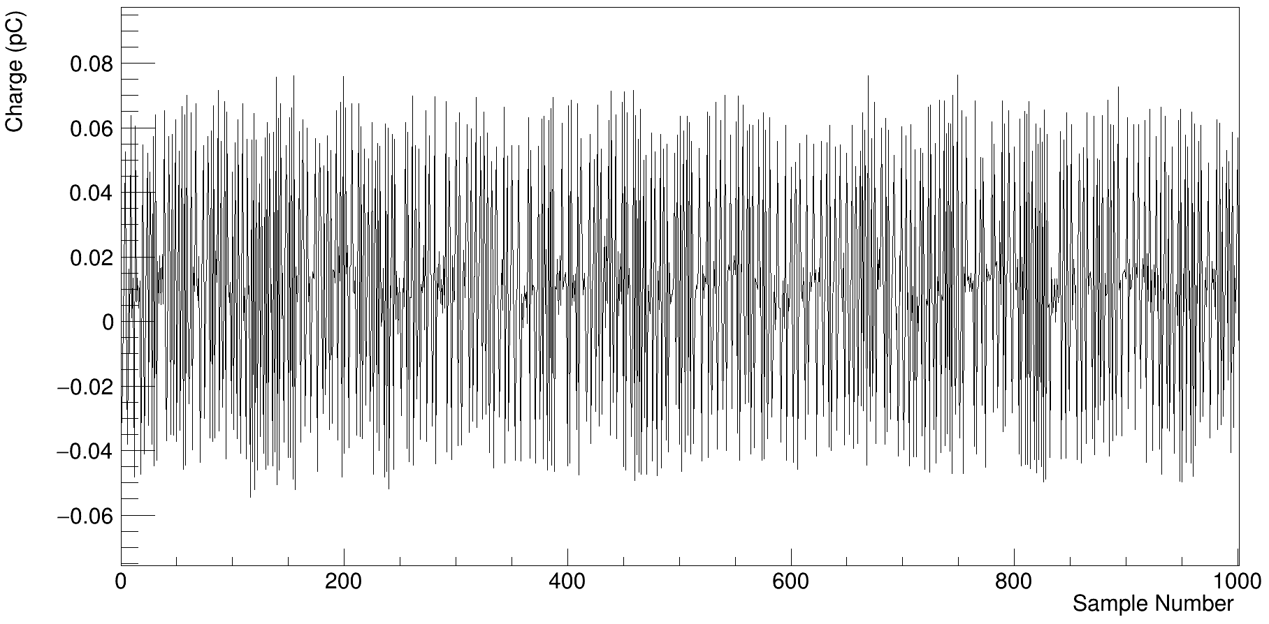
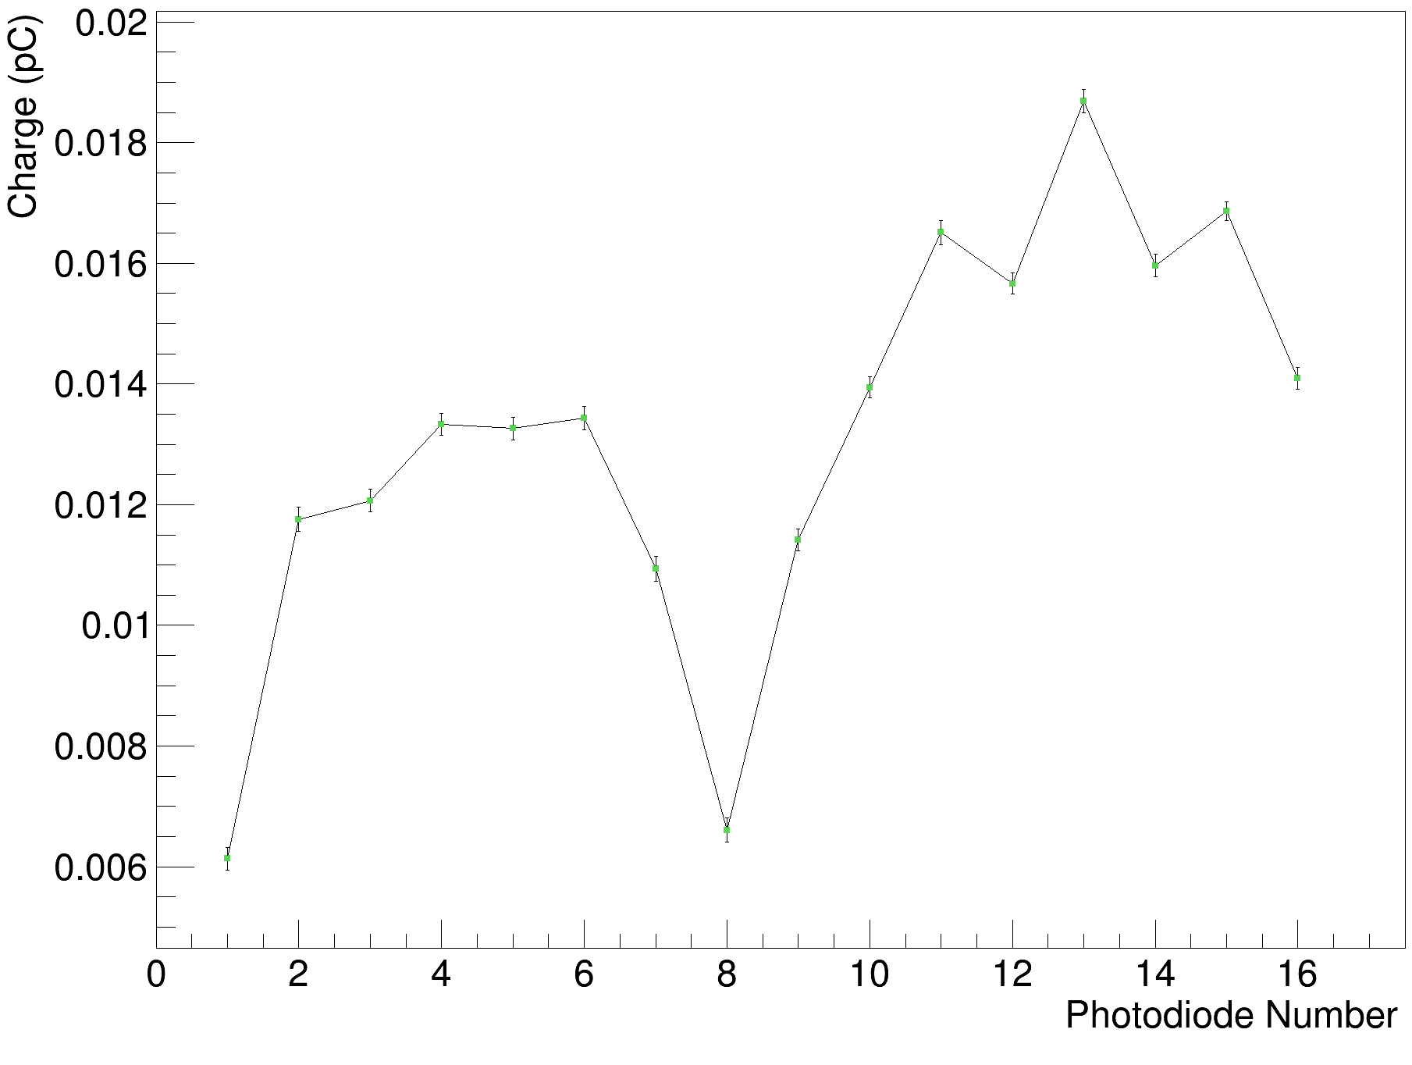
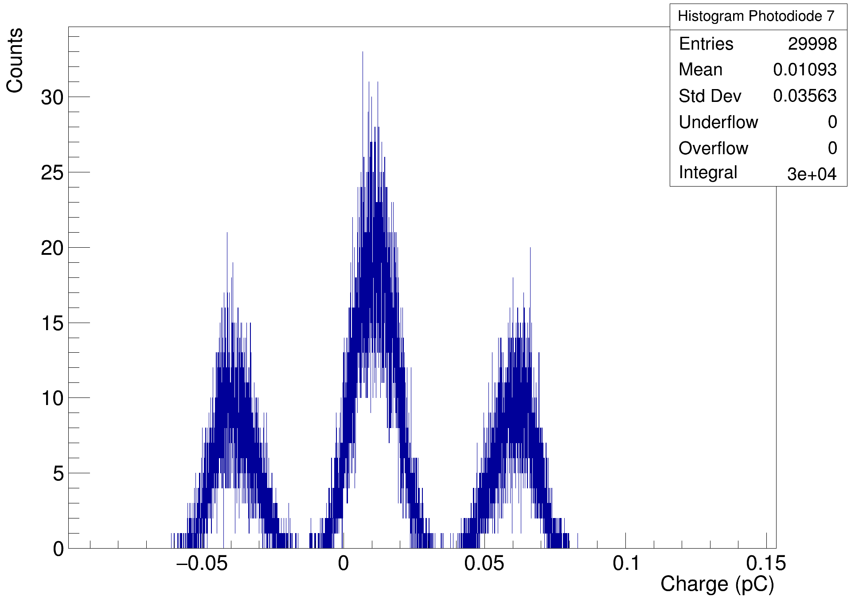
Background Measurements

Slide 5
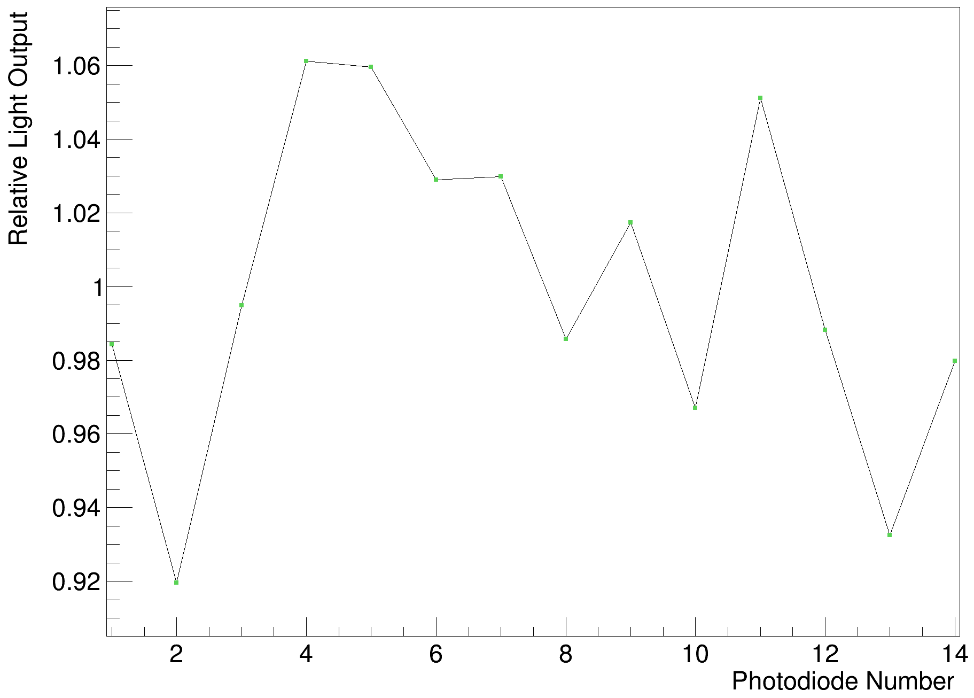
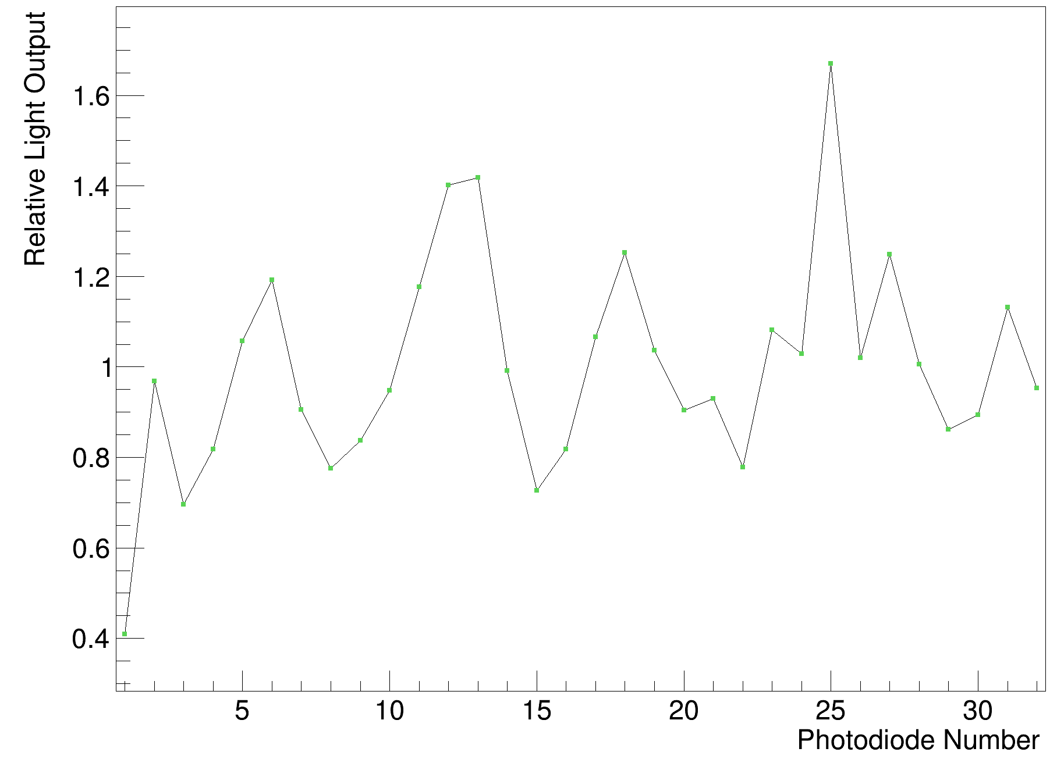
UCLH Calibration Measurements
Clatterbridge Module (polished sheets)
Rev. D Stack 1 (unpolished sheets)
Far less variation with polished sheets!

Slide 6
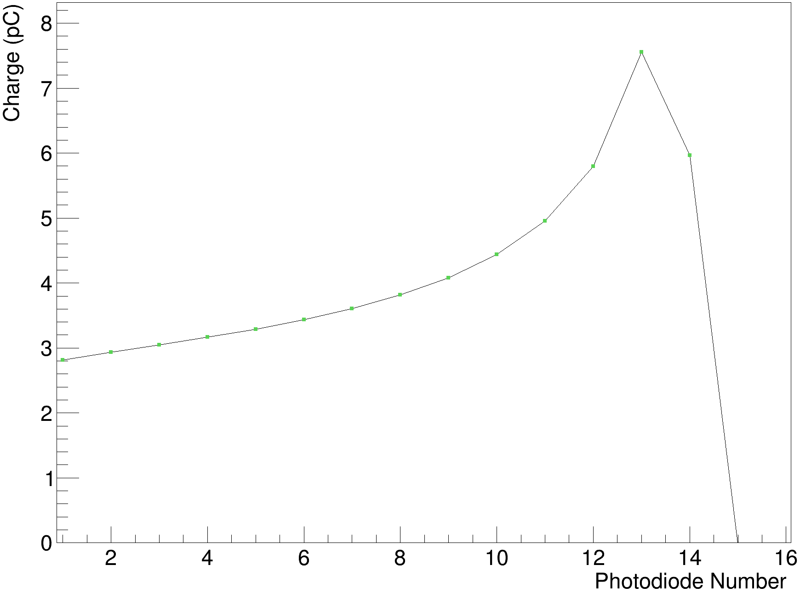
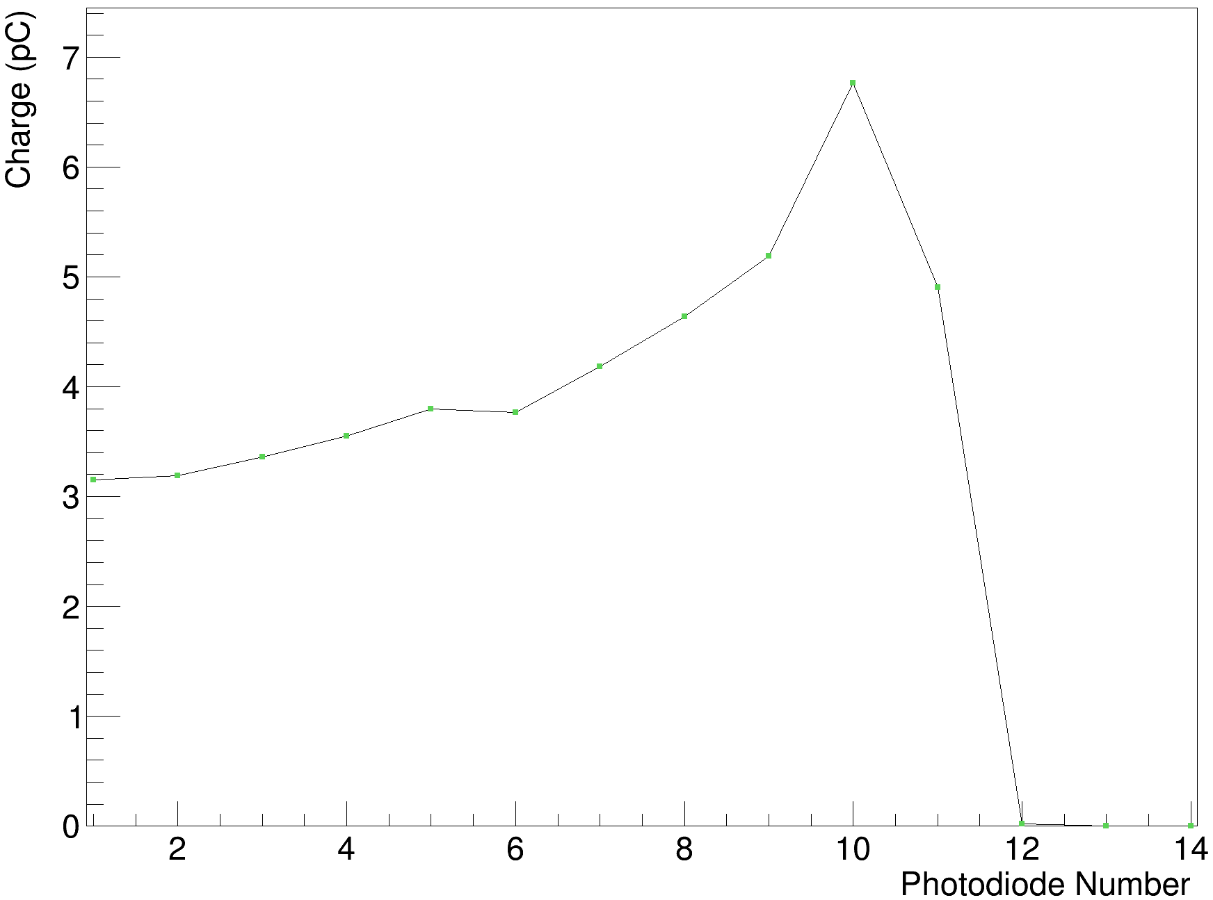
Calibrated Curve Comparison
UCLH 70 MeV (September 2022)
Clatterbridge 60 MeV (May 2023)
Slightly worse calibrated results (unsurprisingly)

Slide 7
Range Reconstruction (Pristine 60 MeV)
Reference Range:
29.3 mm (eye tissue)
29.3 mm x 1.05 =
30.77 mm (WET)
RSP = 1.034(?)
2 MU/s approx.

Slide 8
Range Reconstruction (Absorber)
Given position of Bragg peak (could be between sheets) and relatively few data points, can recover artificially sharp Bragg peaks.
Alternative approach: given stability of fit results in 4 runs of 60 MeV, could try to fix kB and sigma.
  True values of kB and sigma not currently known
Test whether letting parameters be free (potentially unphysical) gives better ranges.

Slide 9
Fixed vs. Free Sigma & kB
Chosen fixed values:
Sigma = 0.7125
kB = 0.1327
Average of pristine 60 MeV measurements.
Free parameter fits consistently accurate to ± 0.2 mm

Slide 10
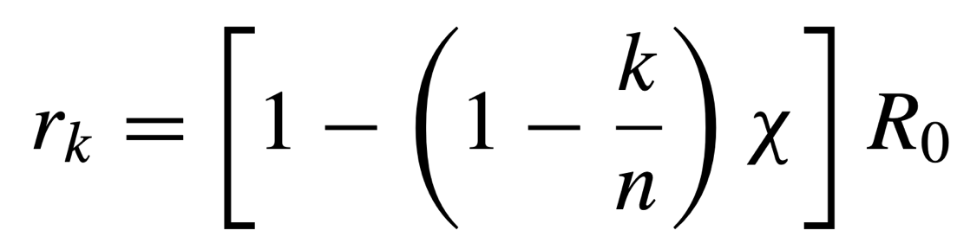
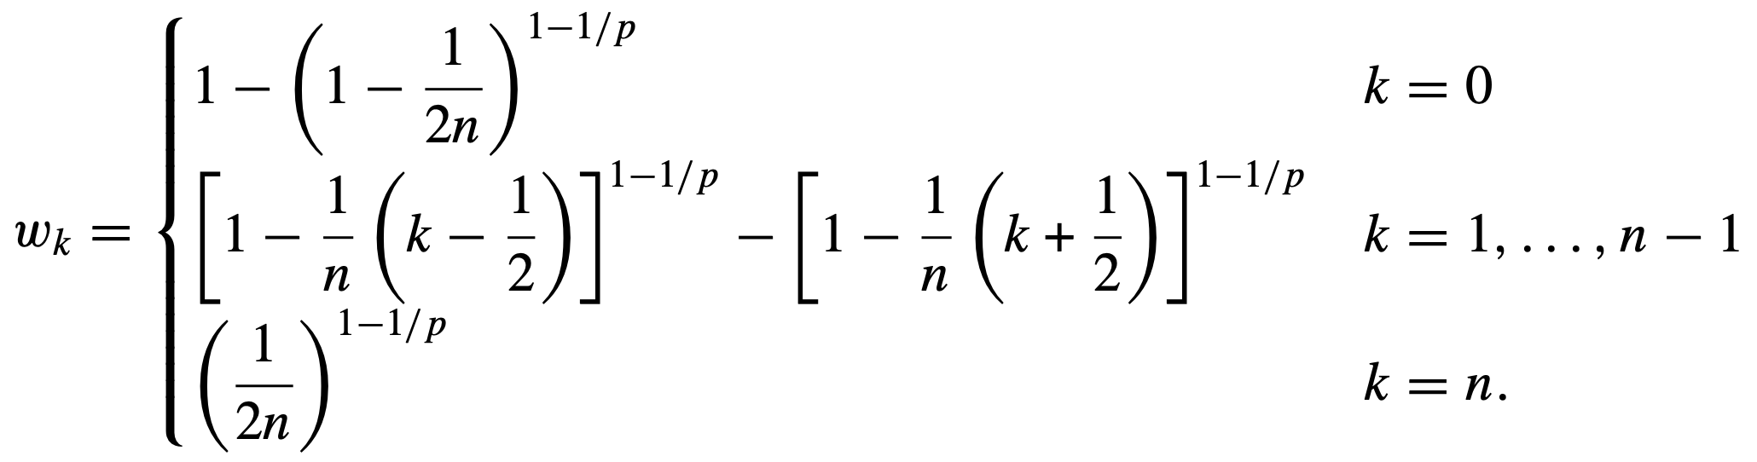
Spread-Out Bragg Peak Fitting
Analogous extension to the Kelleter model as Jette and Chen did with the Bortfeld model: https://doi.org/10.1088/0031-9155/56/11/N01
Combine n (quenched) Bragg curves to produce an SOBP where the range of the k^{th} curve, r_{k}, is calculated using:
And each Bragg curve’s weight, w_{k}, is:
2 new free parameters in fit:
χ = ratio of SOBP range/width (0.5-1)
p = exponent in Bragg-Kleeman range-energy relation
p needs to be free to address tilt in recovered SOBP.

Slide 11
SOBP Ref: 292/92
Range: 28.8 mm
Modulation: 14.1 mm
(eye tissue)
Range: 30.24 mm
Modulation: 14.81 mm
(WET)

Slide 12
SOBP Ref: 132/19
Range: 27.3 mm
Modulation: 27.3 mm
(eye tissue)
Range: 28.67 mm
Modulation: 28.67 mm
(WET)

Slide 13
SOBP Ref: 769/02
Range: 29.3 mm
Modulation: 29.3 mm
(eye tissue)
Range: 30.77 mm
Modulation: 30.77 mm
(WET)

Slide 14
SOBP Ref: 172/91
Range: 23.9 mm
Modulation: 16.5 mm
(eye tissue)
Range: 25.1 mm
Modulation: 17.33 mm
(WET)

Slide 15
SOBP Ref: 770/02
Range: 5.6 mm
Modulation: 5.6 mm
(eye tissue)
Range: 5.88 mm
Modulation: 5.88 mm
(WET)

Slide 16
Conclusions
Calibration from UCLH doesn’t quite hold up in comparison to measurements made at UCLH.
  Calibration curve of clear, polished sheets shows less than ±10% variation sheet-to-sheet compared to ±60% with Rev. D module.
Range reconstruction appears to be quite accurate:
  60 MeV beam accurate to 0.15 mm to reference.
  Sensitive to 1 mm changes in absorber WET, accurate to ±0.2 mm.
  Fixing sigma and kB offers better looking Bragg curves, at the expense of range accuracy. Could be improved with real values of these quantities.
Remarks about SOBP fitting:
  Need to be a little more careful in constraining parameter ranges (not a bad thing).
  Value of kB struggles in cases where there isn’t a ramp-up (χ = 1).
  Sigma can also be challenging (snaps to lower limit in some cases).
  P requires some adjustment after fit to remove tilt, typically 10% increase. This is likely made worse by quenching!
  Better for initial range estimation to use 50% of peak light output due to proximal light output being quenched less than around the actual range.

