Slide 1
DEPARTMENT OF PHYSICS & ASTRONOMY
QuARC – A Quality Assurance Range Calorimeter for Proton Therapy
Saad Shaikh
PhD Thesis

Slide 2
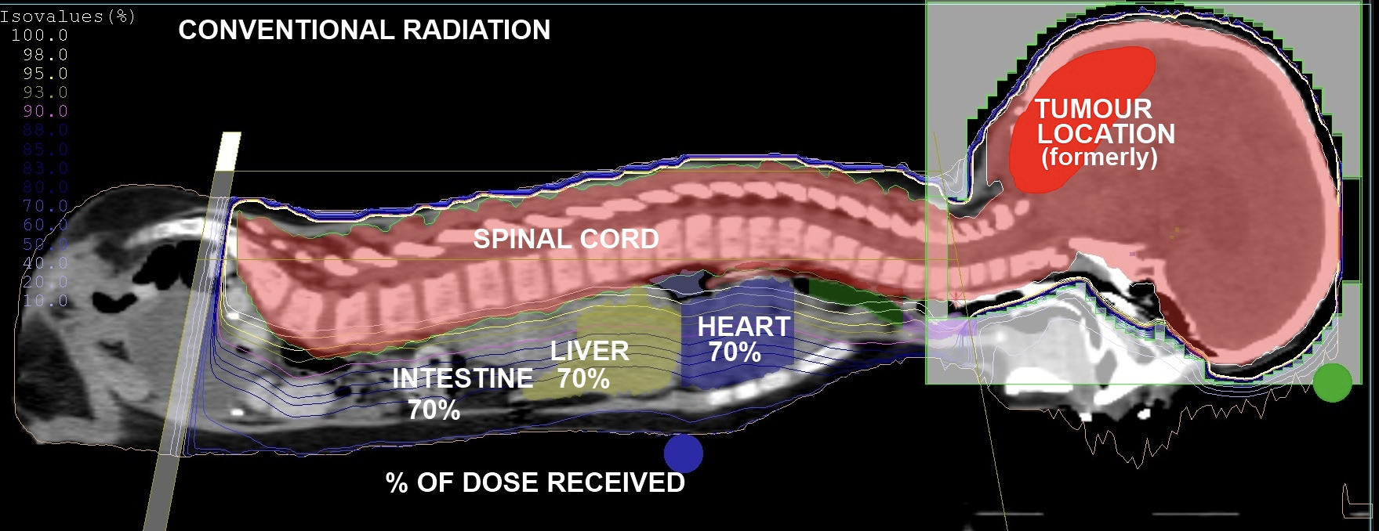
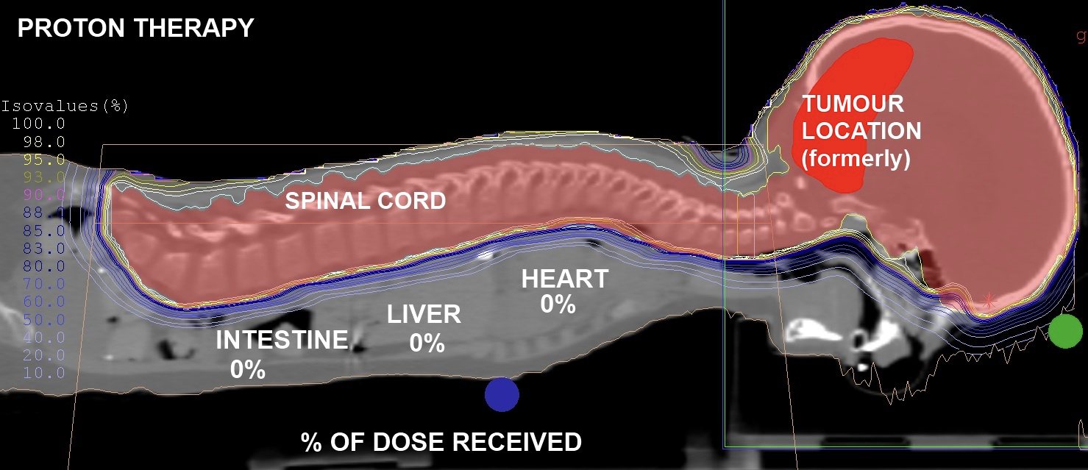
Proton Therapy
Ionising radiation damages DNA of tumour cells, causing cell death.
Superior dose conformity compared to conventional X-ray radiotherapy.
Range uncertainties prevent taking full advantage of dose localisation benefits.
Clinic must perform daily beam Quality Assurance (QA).

Slide 3
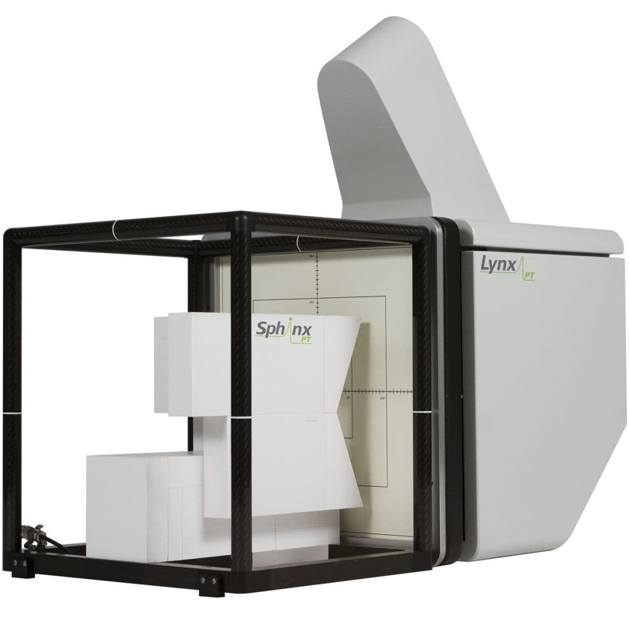
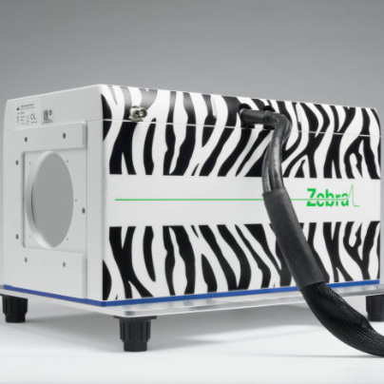
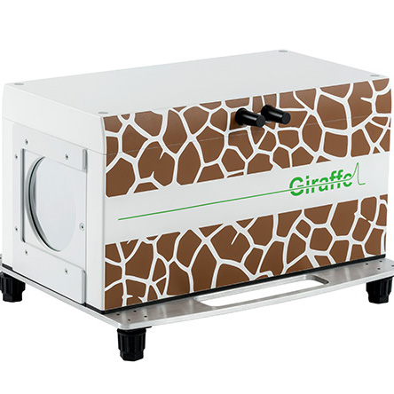
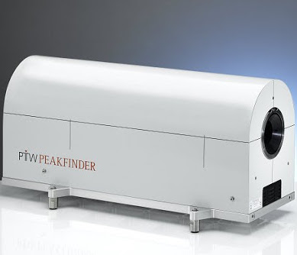
Daily Quality Assurance (QA)
Daily QA requires measurement of beam range, spot position and spot size.
Range measured in water-equivalent material for a selection of beam energies.
  Water chosen as proxy for human tissue.
Typically measured using layers of ionisation chambers in a water tank, requiring repeated beam delivery.
Current methods often compromise between speed and accuracy.
Develop a detector to make fast, accurate measurements of proton range.

Slide 4
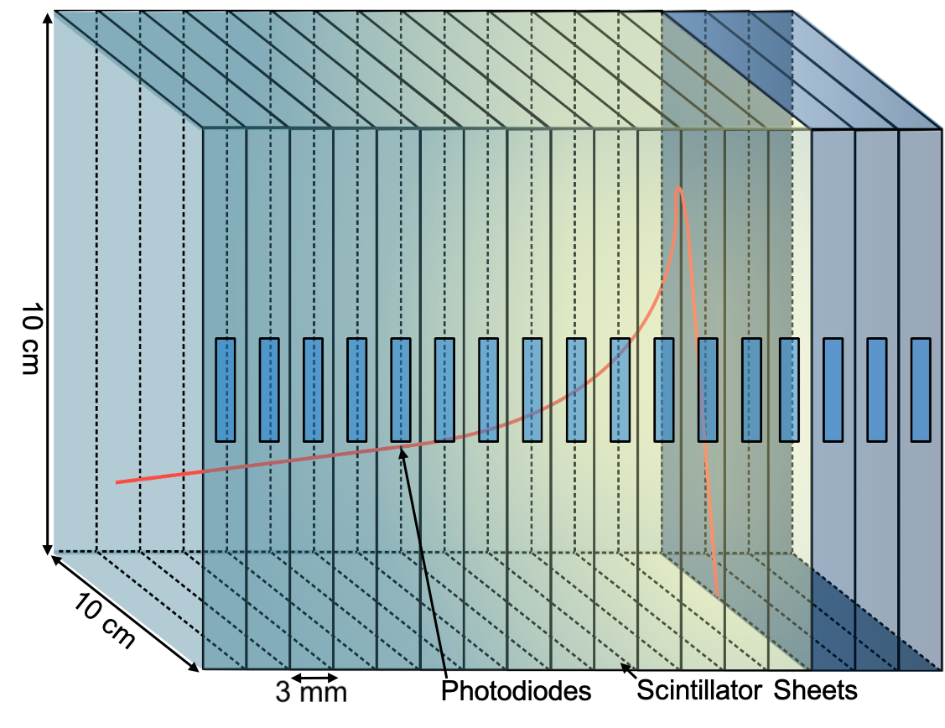
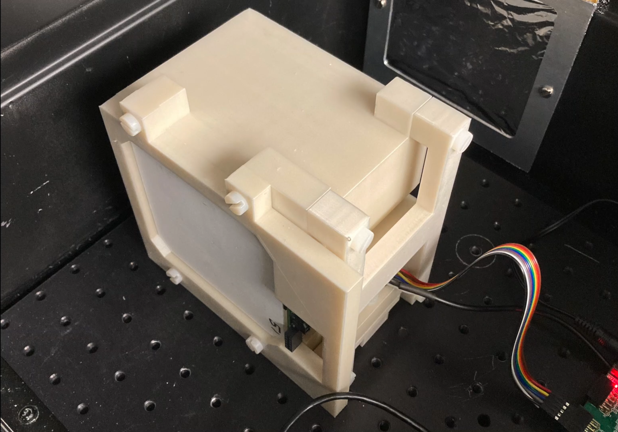
QuARC – Overview
Measure proton range using a series of optically-isolated polystyrene scintillator sheets.
Light output of each sheet nonlinear to dose, but quenching described by Birks’ Law:
  Fit data with analytical depth-light model [1].
  Reconstruct Bragg depth-dose curve and measure proton range.
Photodiodes coupled to fast, modular electronics and an FPGA to read light levels at over 5 kHz.
Key benefits:
  Plastic scintillator inexpensive and water-equivalent.
  Range reconstructed with single beam delivery.
  Easy detector setup and no optical artefacts.
Notes:
The goal here is to reconstruct the proton depth-dose distribution. Now, the problem with scintillators is that the light output is non-linear with dose: this is called scintillation light quenching. However, this quenching is described empirically by Birks’ Law.
So, we get around this problem by fitting the data with a version of Bortfeld's Bragg model that accounts for quenching effects using Birks' law.
We can then remove the quenching corrections to recover the original dose-depth curve, which gives us the proton range.

Slide 5
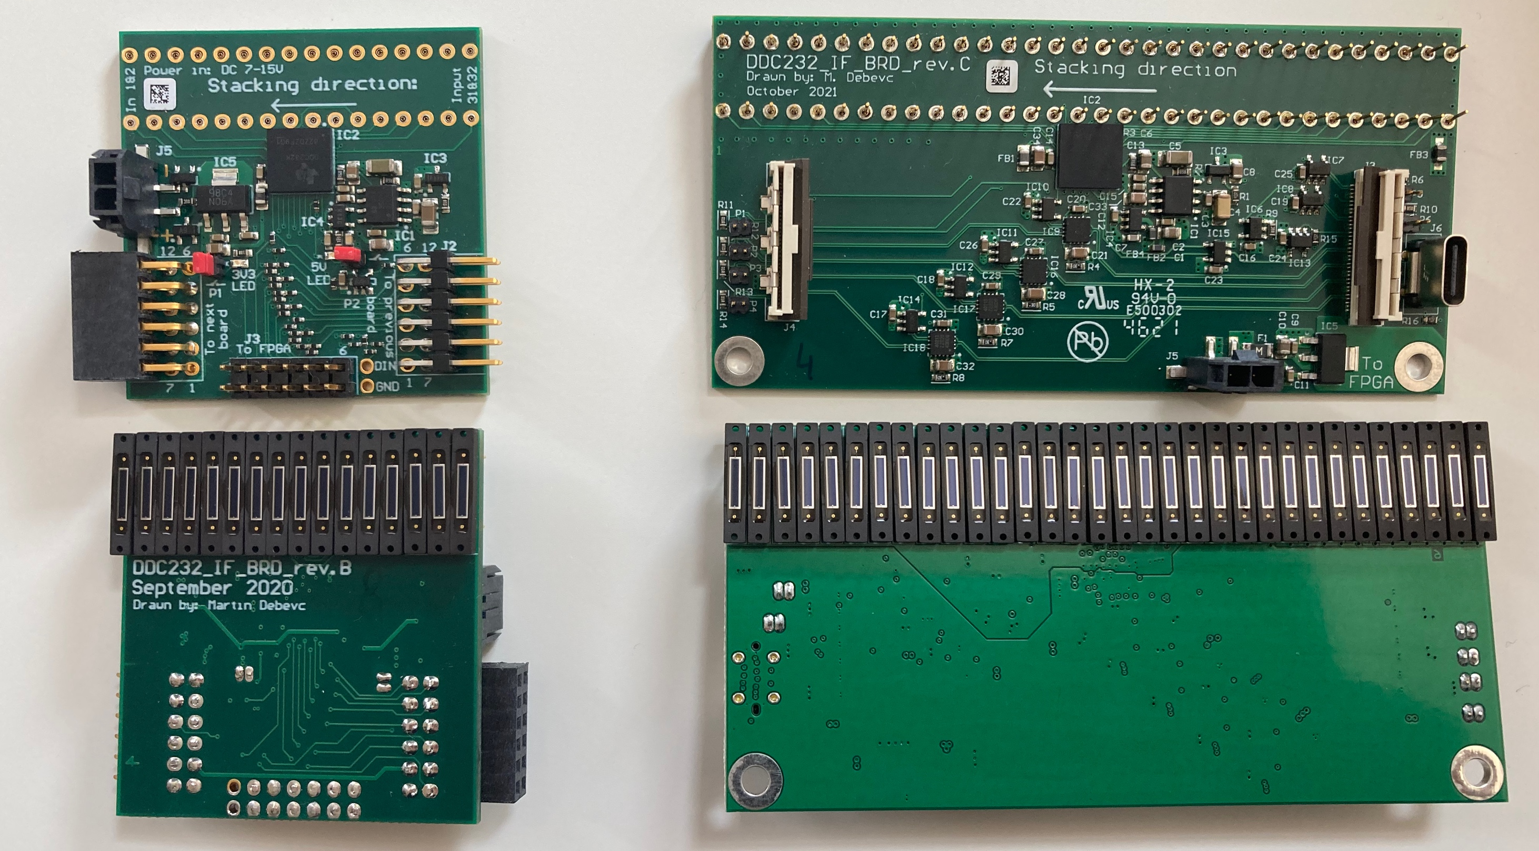
Analogue Front-End
Rev B. Board (left)
16 diodes per board, 2.86 mm spacing
Photodiode charge split across 2 DDC232 inputs
Connection via PMOD to FPGA
Single-ended signalling
Rev C./D. Board (right)
32 diodes per board, 3.0 mm spacing
Connection via USB-C to daughter board
Differential-pair signallin.

Slide 6
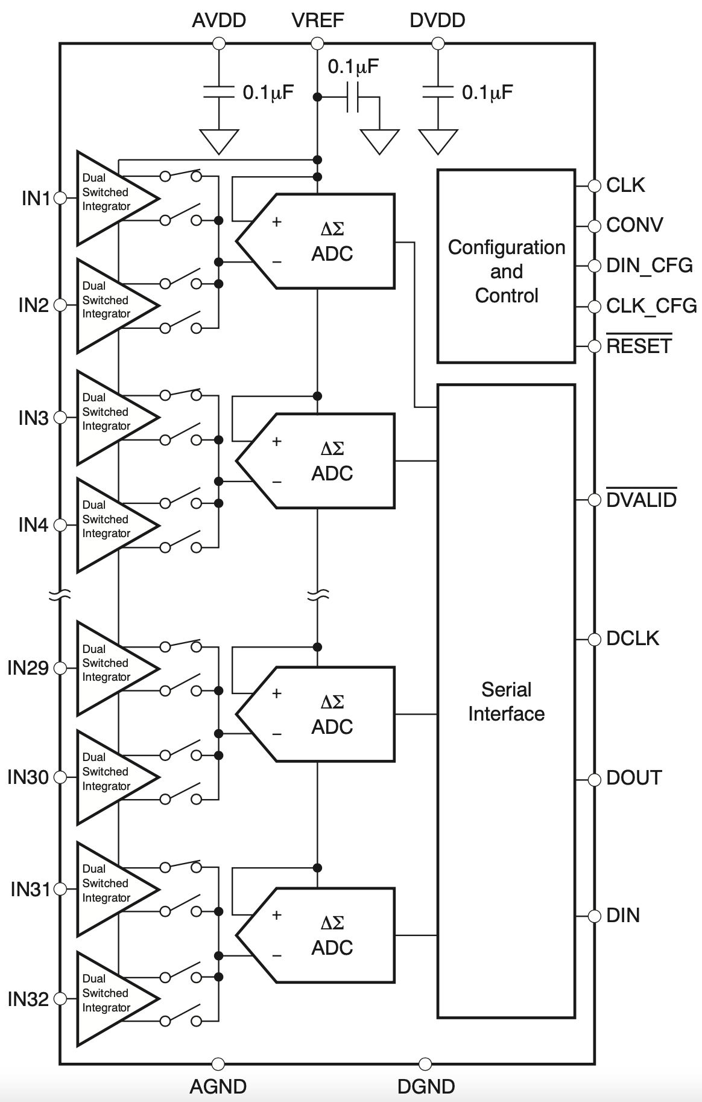
VHDL FPGA Design
ADC configured: FPGA sends 12 bits to set dynamic range, precision etc.
ADC sends 640-bit read-back pattern – used to check everything is OK.
Integration begins: each 170 μs cycle gives a photodiode measurement.
Measurement stored in FIFO on FPGA.
FPGA sends measurement to PC using FTDI chip.

Slide 7
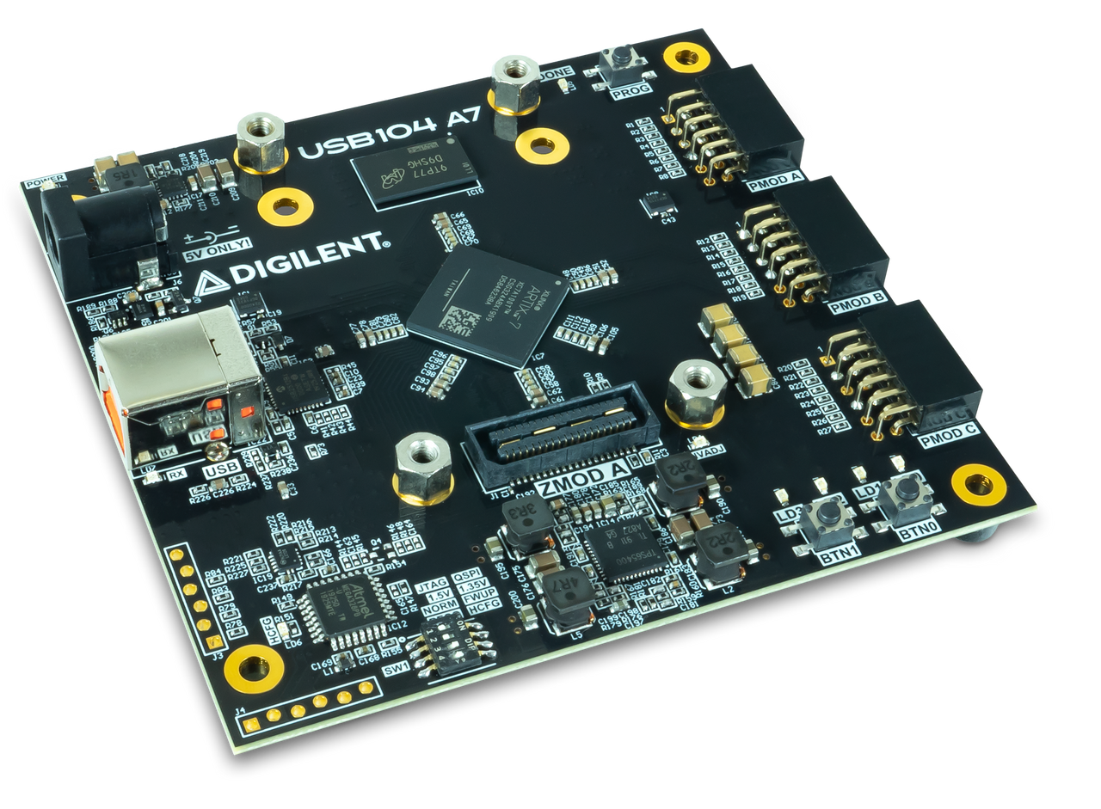
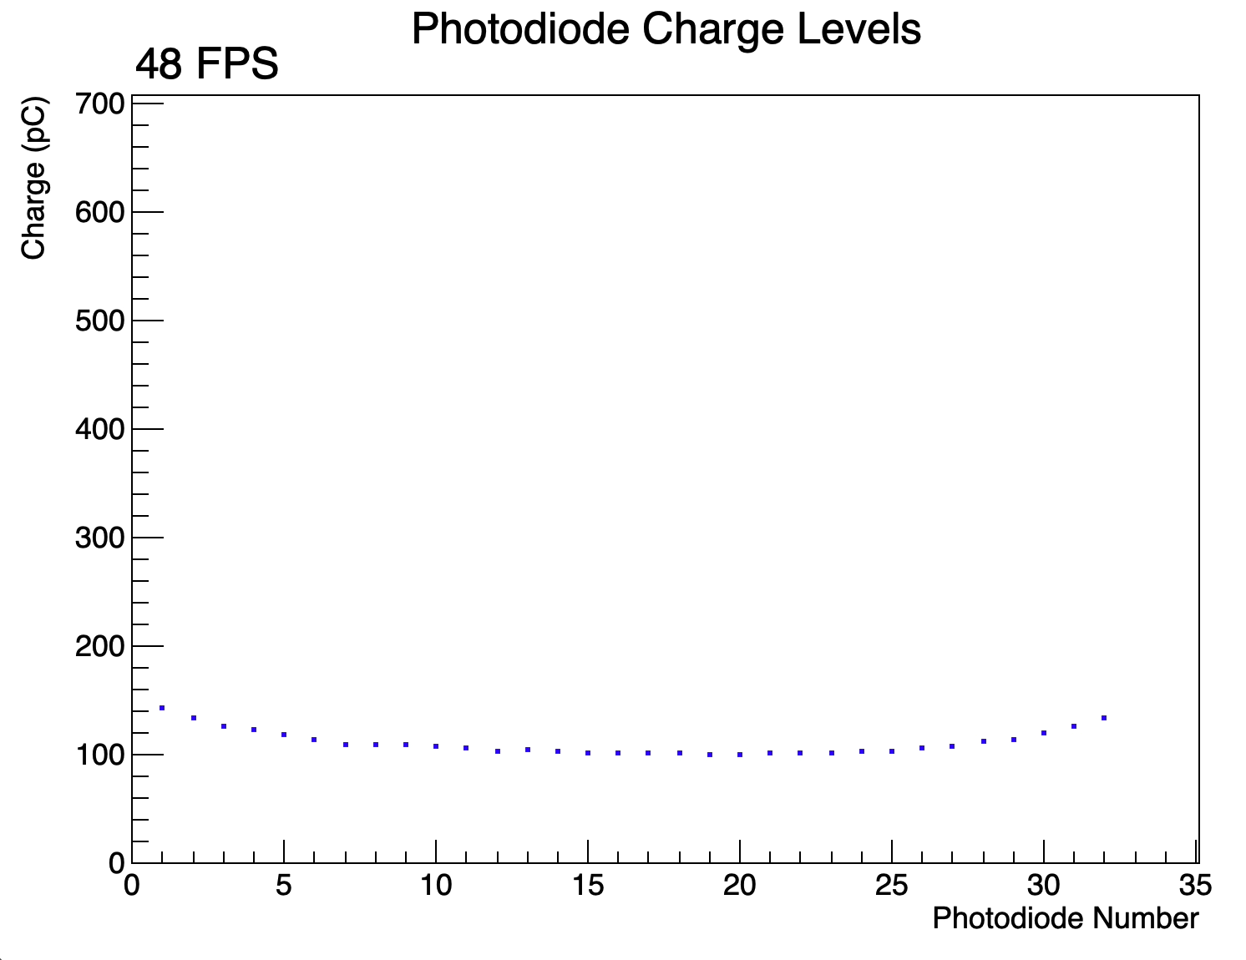
C++ Data Acquisition
C++ script using libFTDI libraries interfaces PC (MacOS, Linux) and FPGA over USB.
PC sends data to FPGA to set integration time, full-scale range, number of DDC232 boards and measurements to read.
Script stores raw data in hexadecimal format and performs rolling average at user-specified rate for live display of light levels.
Live display and function fitting using ROOT.

Slide 8
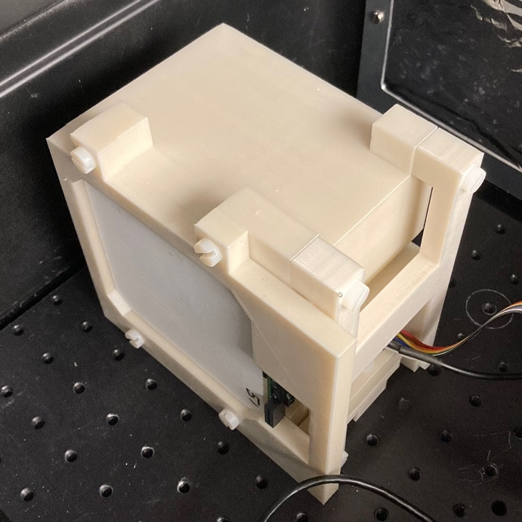
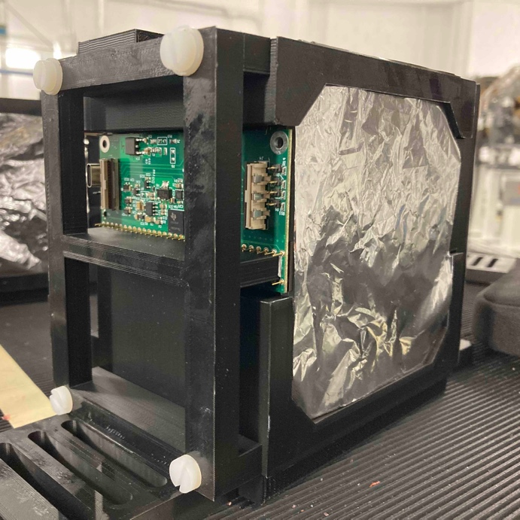
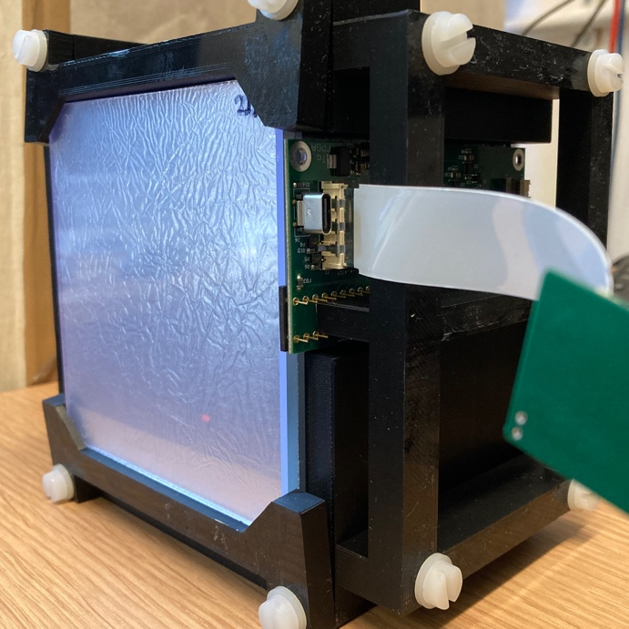
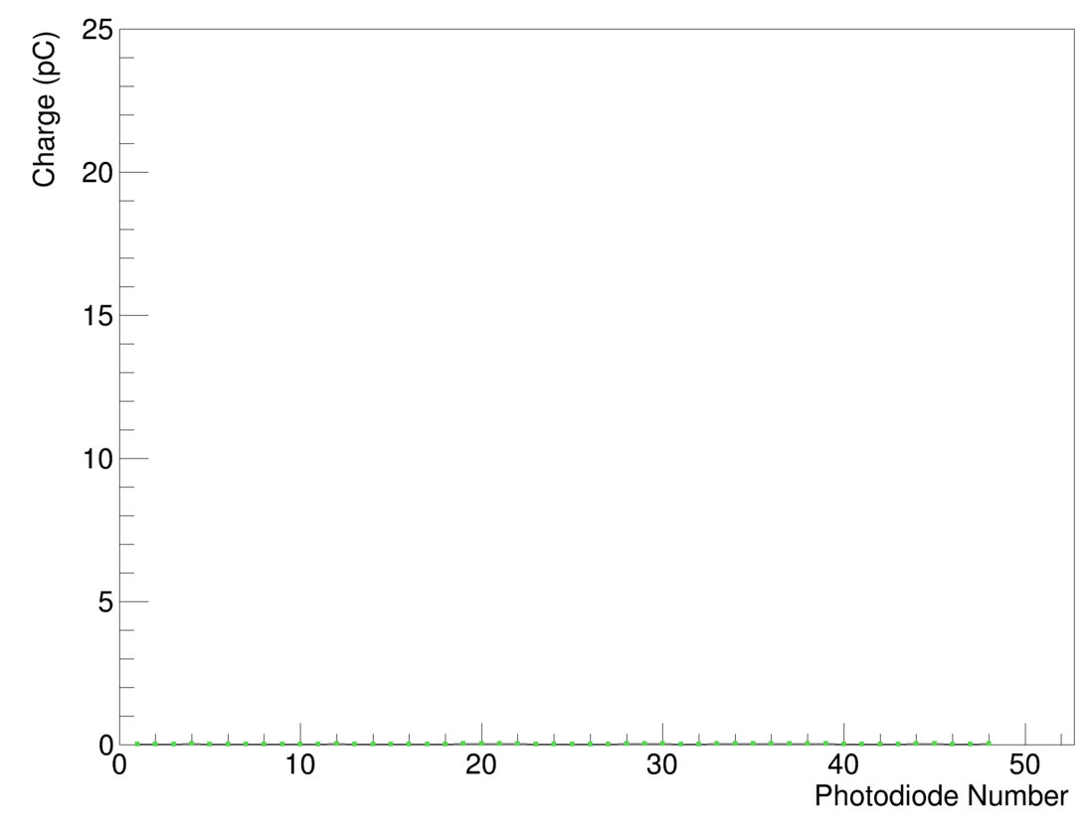
Detector Assembly
Detector modules typically contain 32 scintillator sheets housed in a 3D-printed enclosure.
Analogue front-end boards directly coupled to scintillator without optical gel.
Many different prototypes assembled for beam tests.
Optimised scintillator optical isolation to use Mylar foil and avoid painting of scintillator.
Average crosstalk: 0.78%

Slide 9
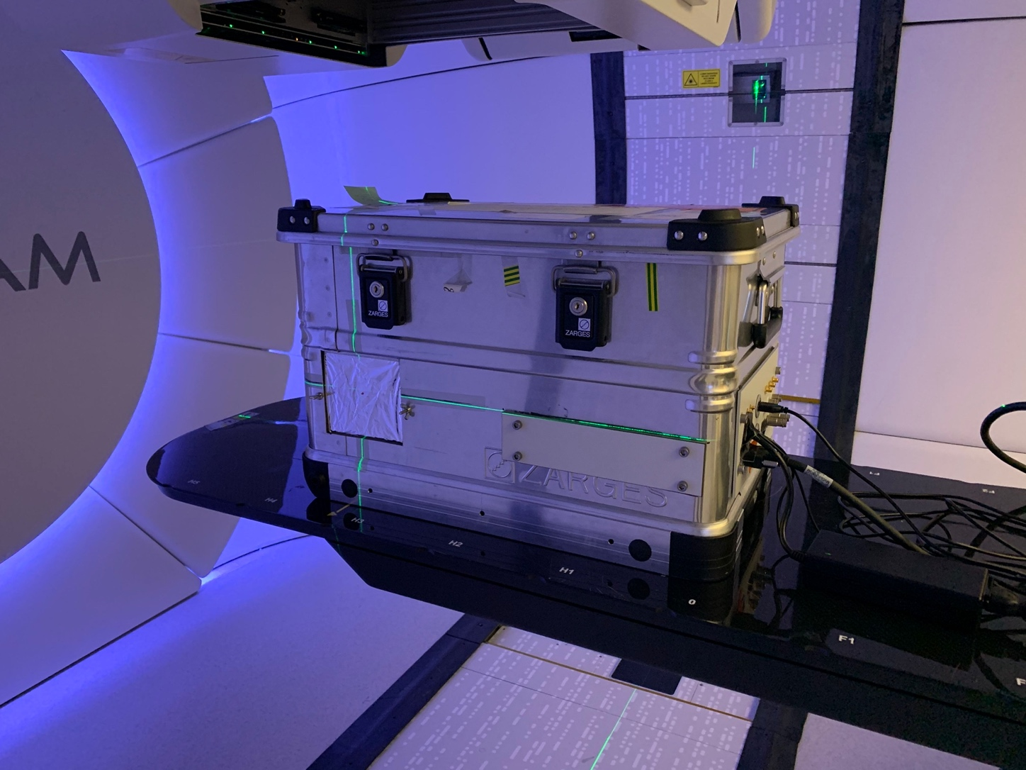
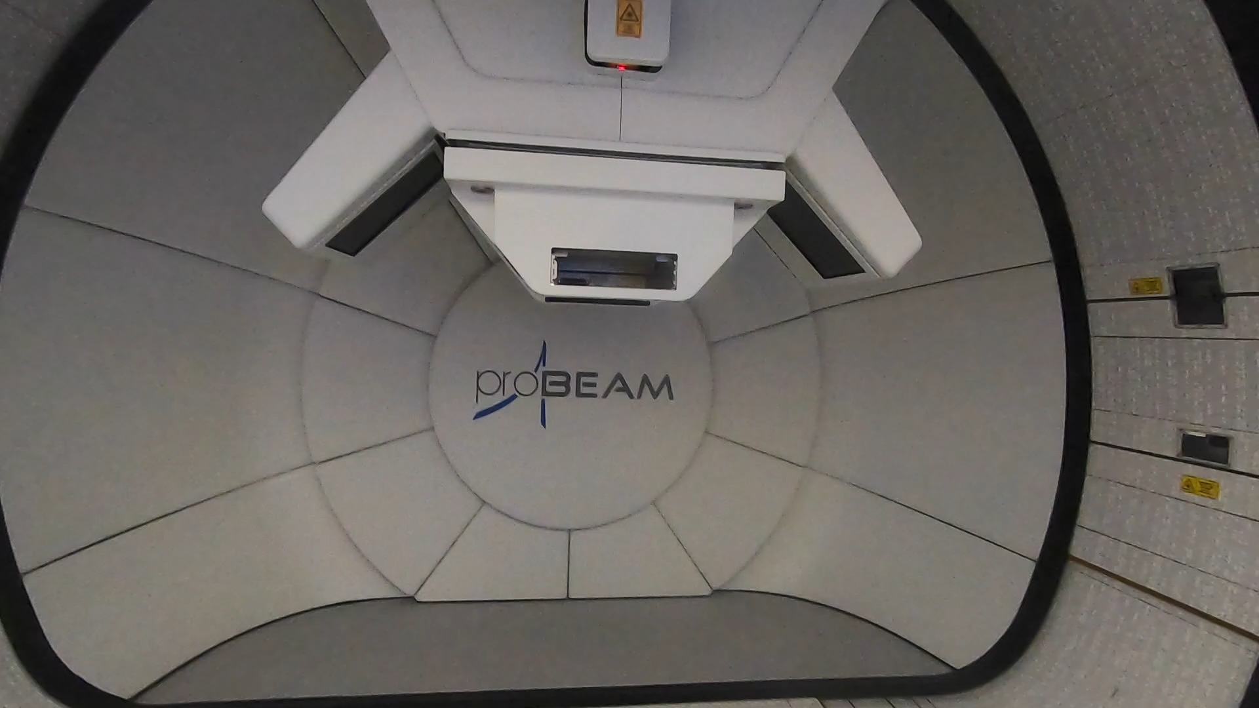
UCLH Beam Tests
4 beam tests at UCLH to evaluate performance at clinical rates with beam energies between 70-130 MeV.
Determine range reconstruction accuracy and demonstrate fast live range reconstruction capabilities.
Prototypes differing in mechanical setup, scintillator composition and electronics.
Optimise detector setup and identify issues.

Slide 10
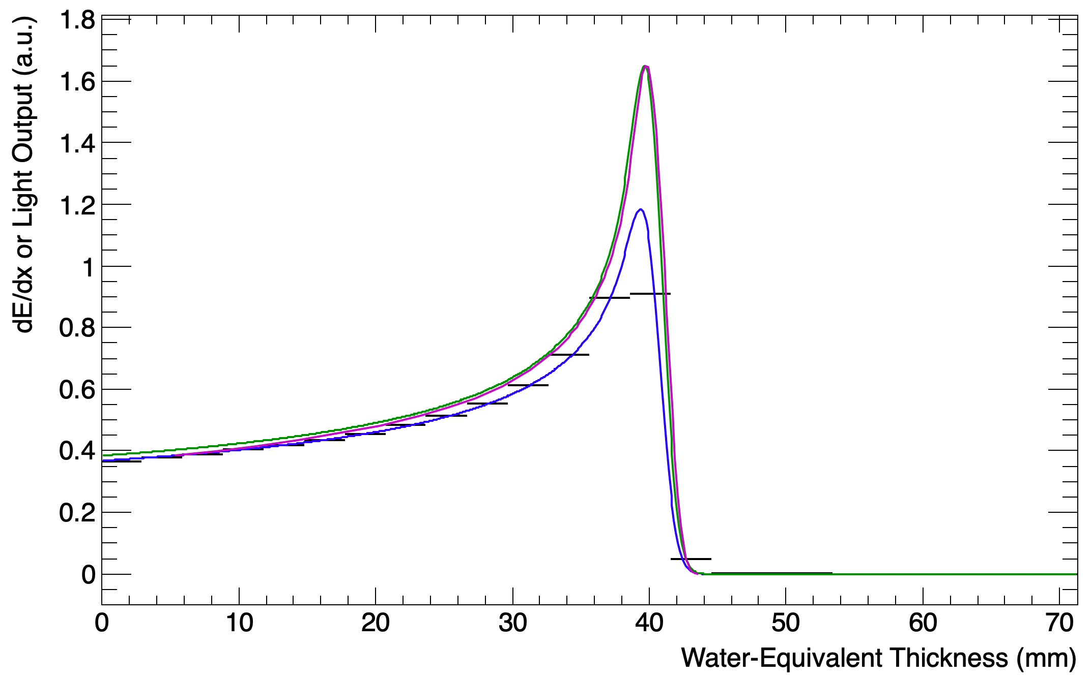
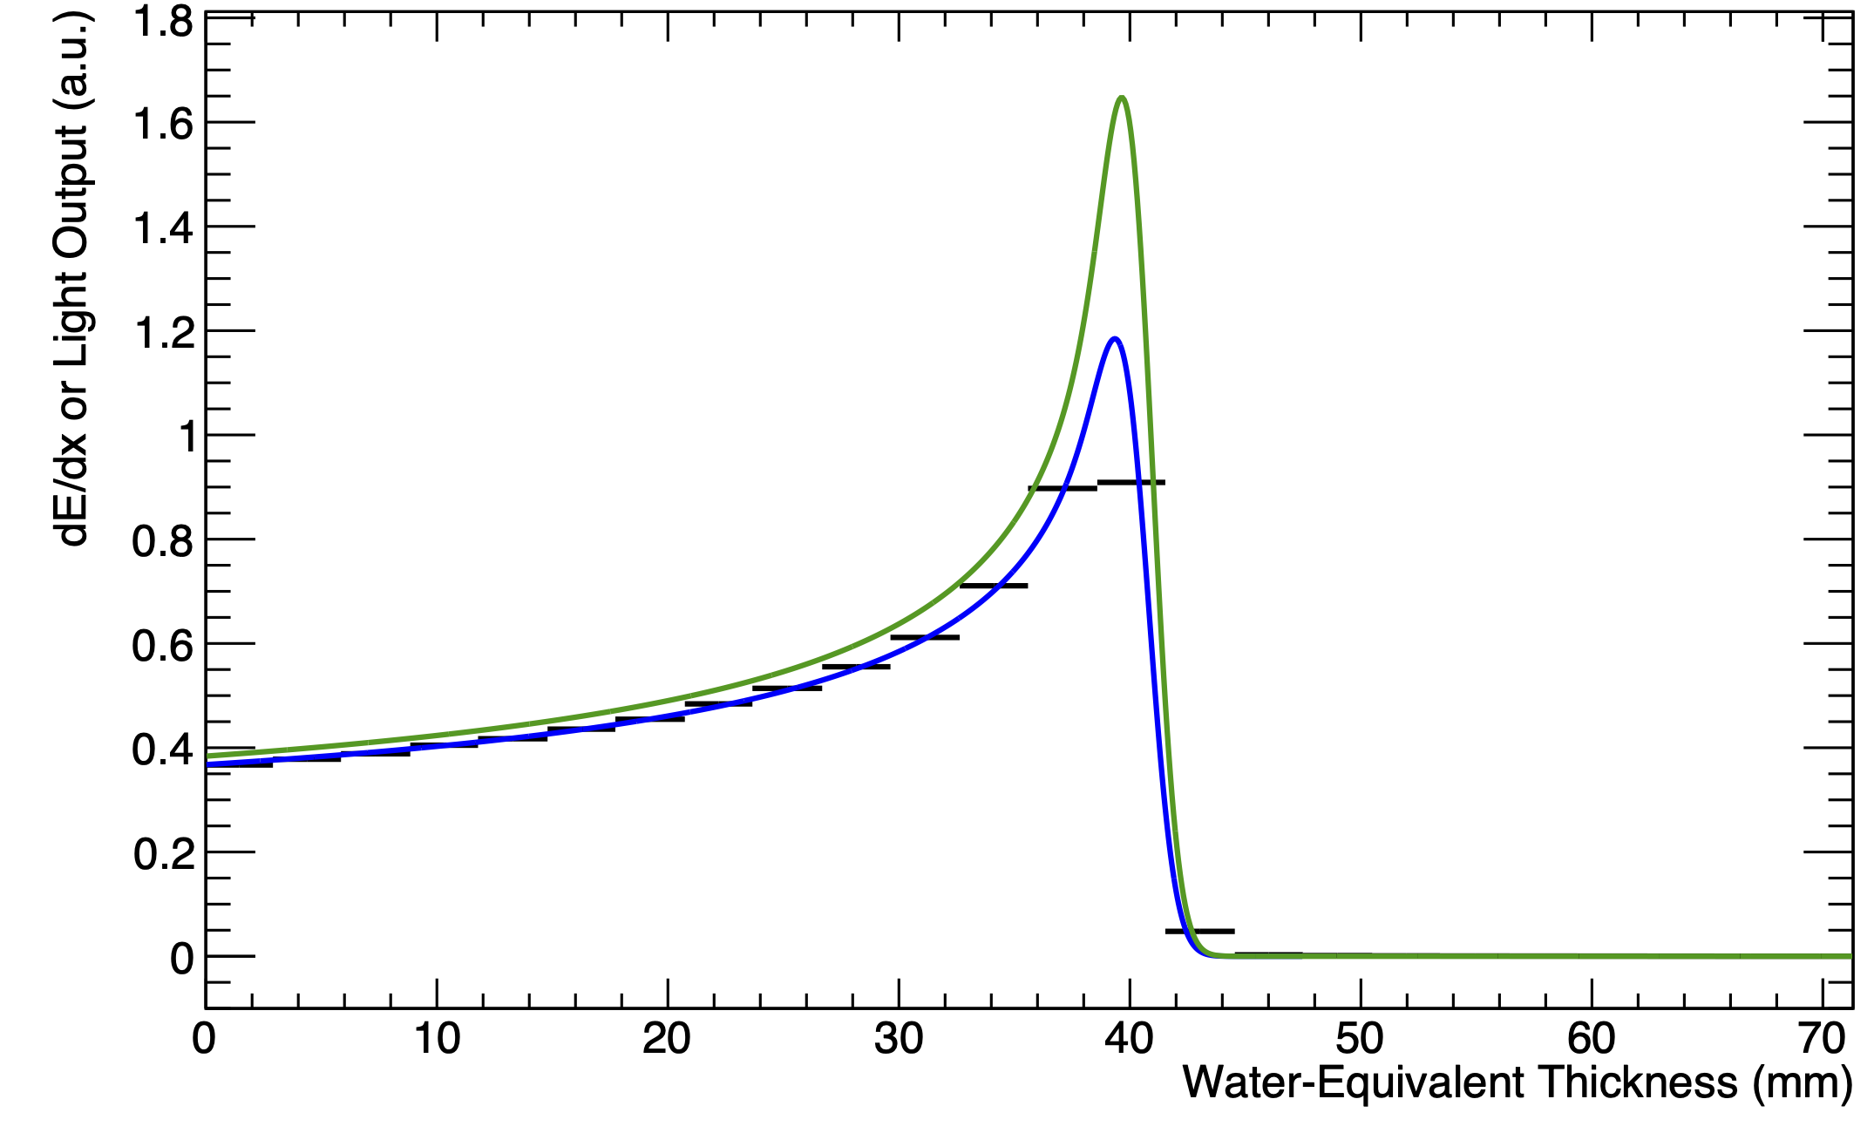
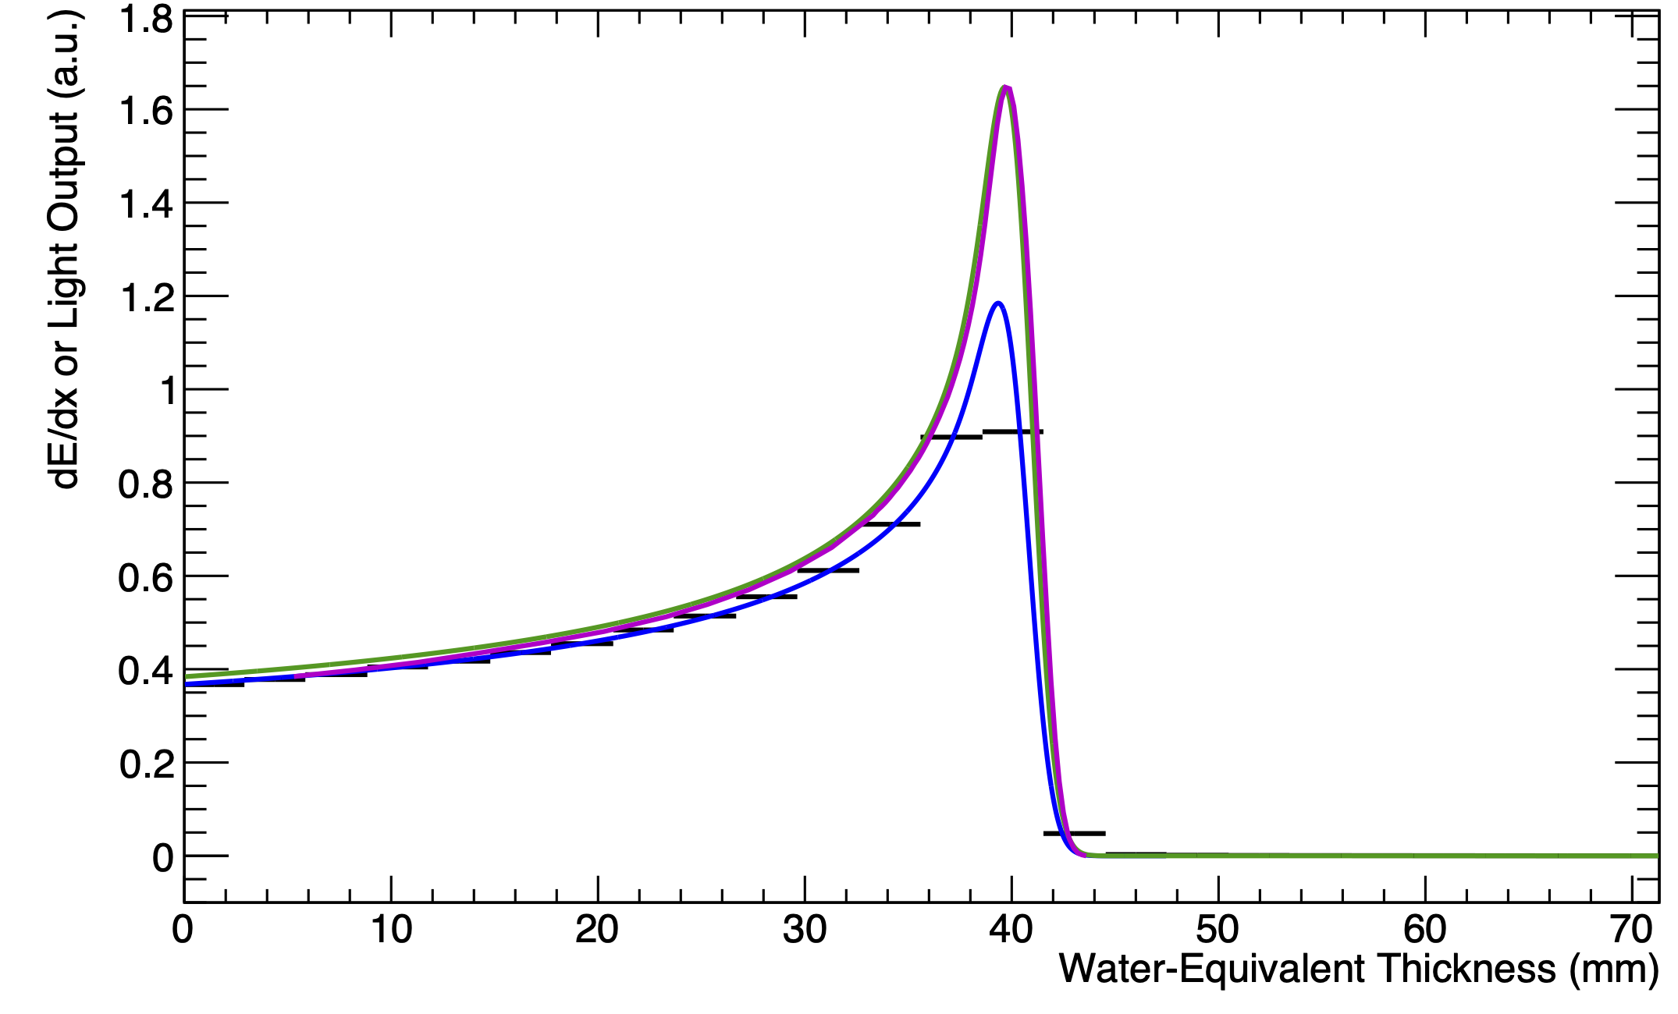
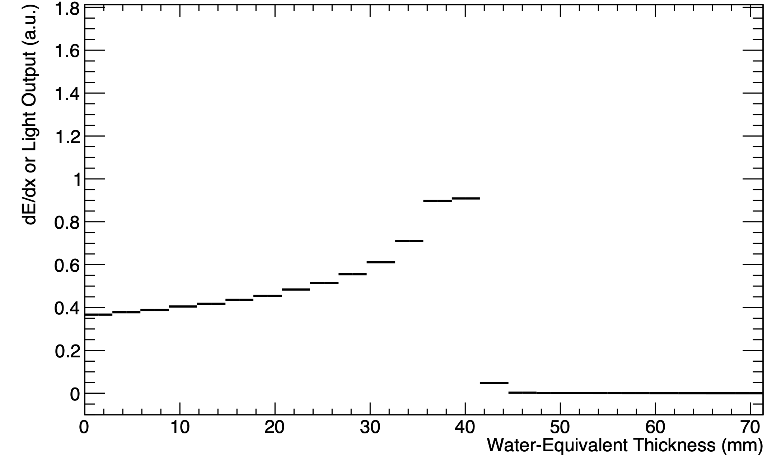
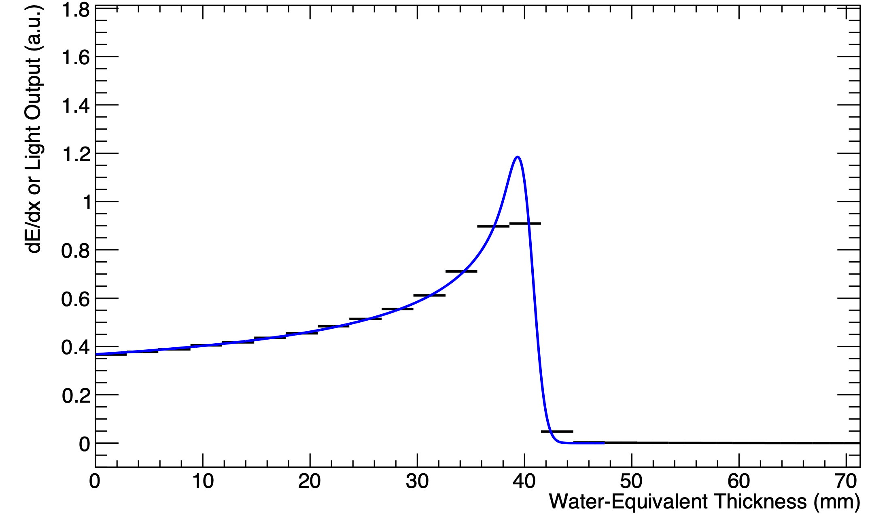
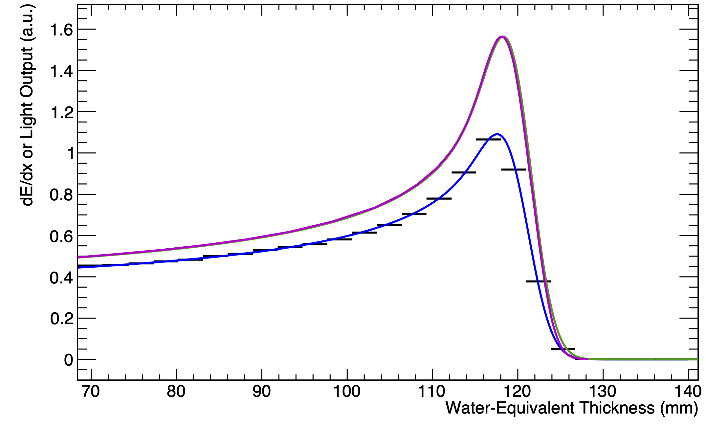
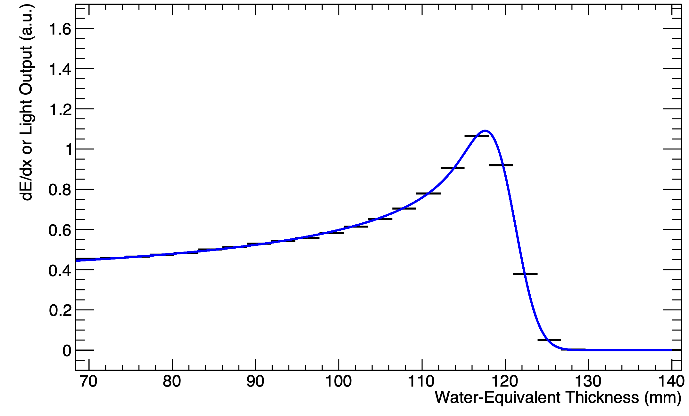
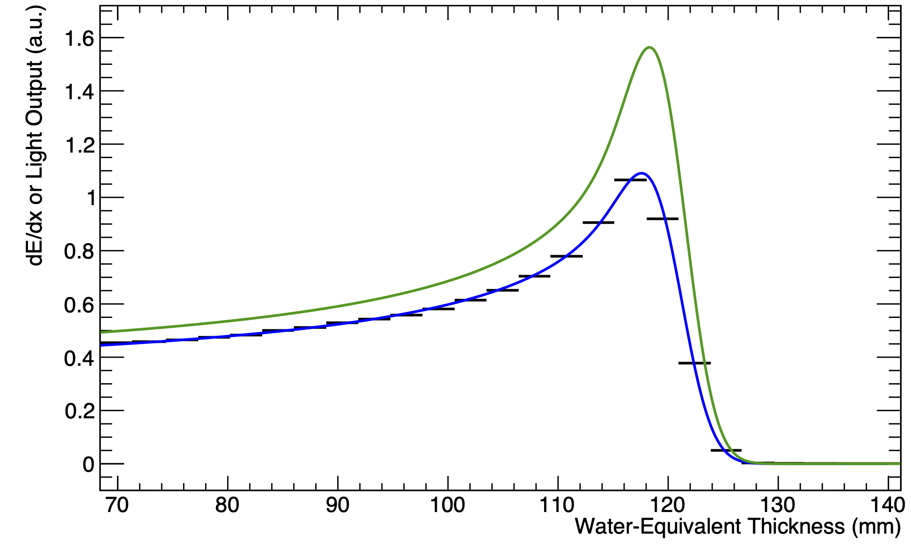
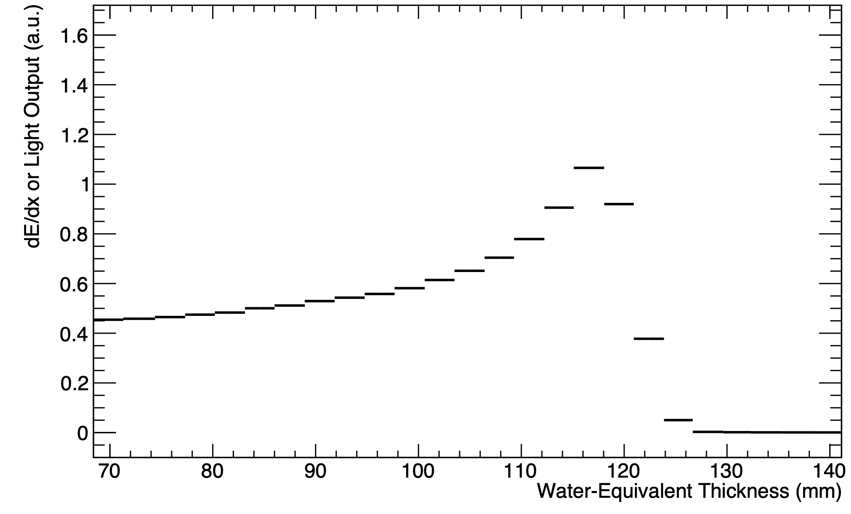
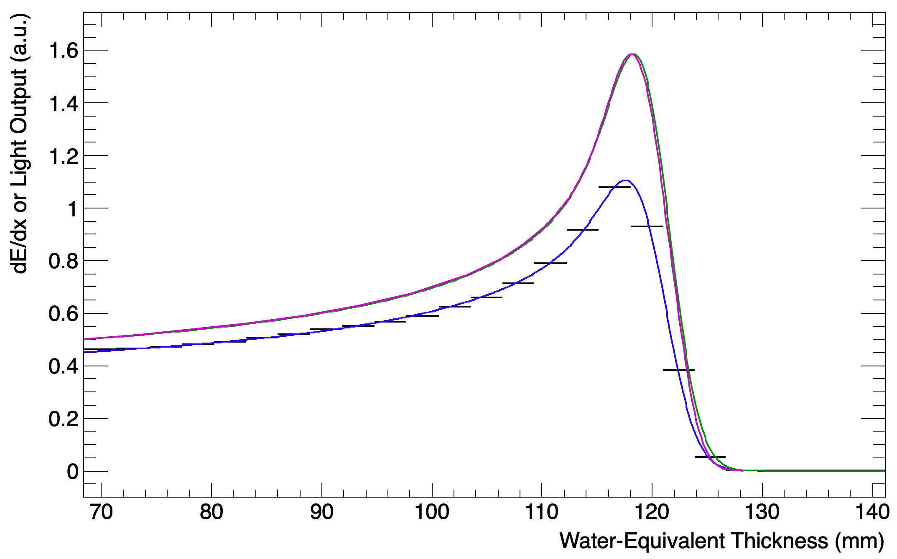
Results
70 MeV
Legend:
  Black: Sheet Average Light Output
  Blue: Fitted Quenched Depth-Light Curve
  Green: Reconstructed Depth-Dose Curve
  Magenta: UCLH Reference Dose Curve
Capture shape of Bragg curve with range accurate within 0.5 mm.
Large headroom available!
Optimised scintillator composition and optical isolation method.
Identified issues with range dependence on beam spot position.
UNPUBLISHED DATA – DO NOT COPY OR DISTRIBUTE
130 MeV

Slide 11
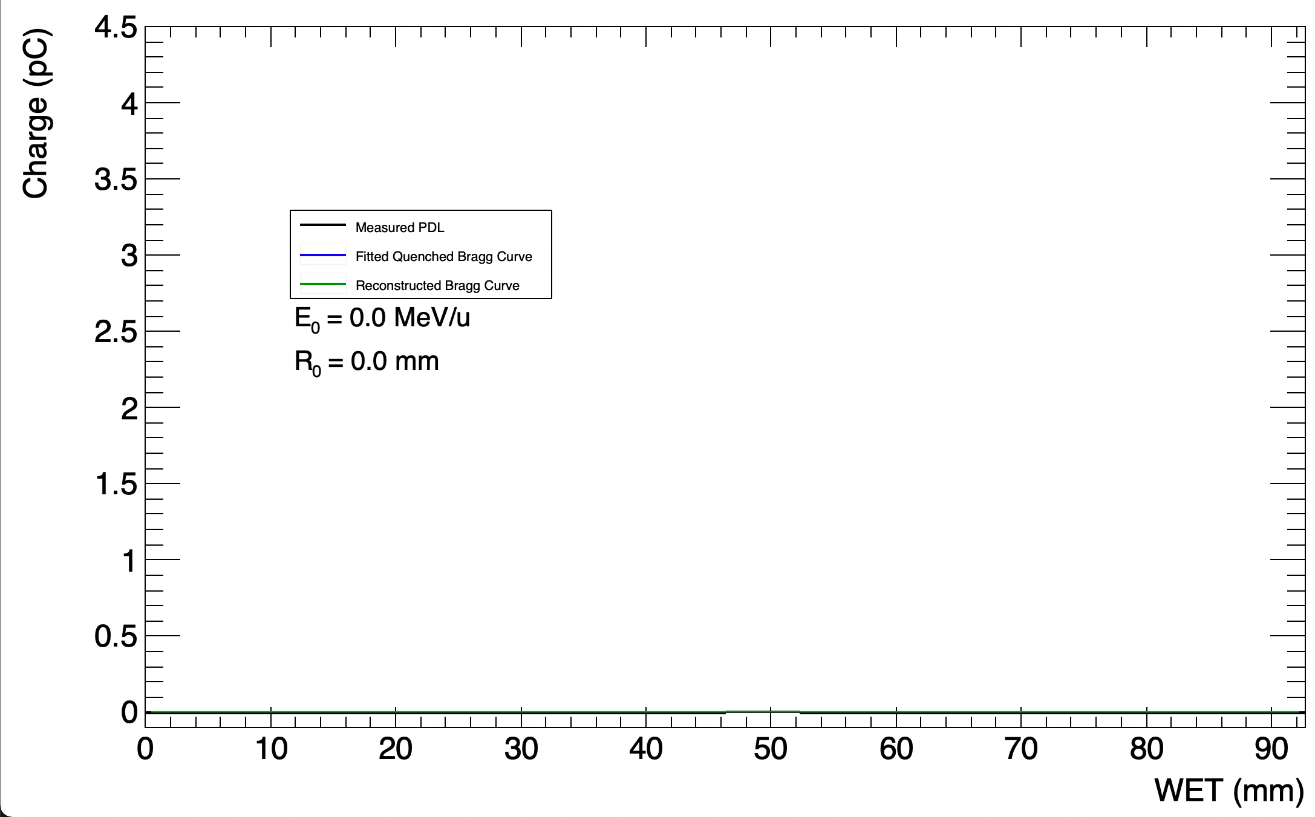
Live Fitting
RANGE-STEP “TREATMENT PLAN”
UNPUBLISHED DATA – DO NOT COPY OR DISTRIBUTE
Notes:
This allows you to perform range QA for all the energies on interest in one fell-swoop – you simply set up a treatment plan and then the fitting gives you range for each of the energies contained in the plan.

Slide 12
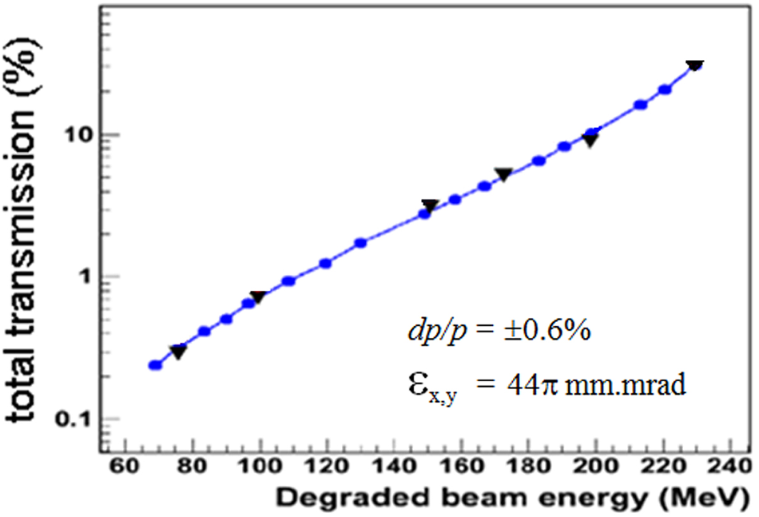
FLASH Proton Therapy
New frontier for proton therapy treatment delivery.
Pre-clinical evidence suggest treating at very high dose-rates (or beam current) can better spare healthy tissue.
Dose-rate for FLASH not yet fully determined – most estimates around 40 Gy/s [3].
  Corresponds to a current of 600 nA to the patient. Around 200 times increase!
Current detectors used for QA fail at this level.
However, scintillation light output should scale linearly with dose-rate.

Slide 13
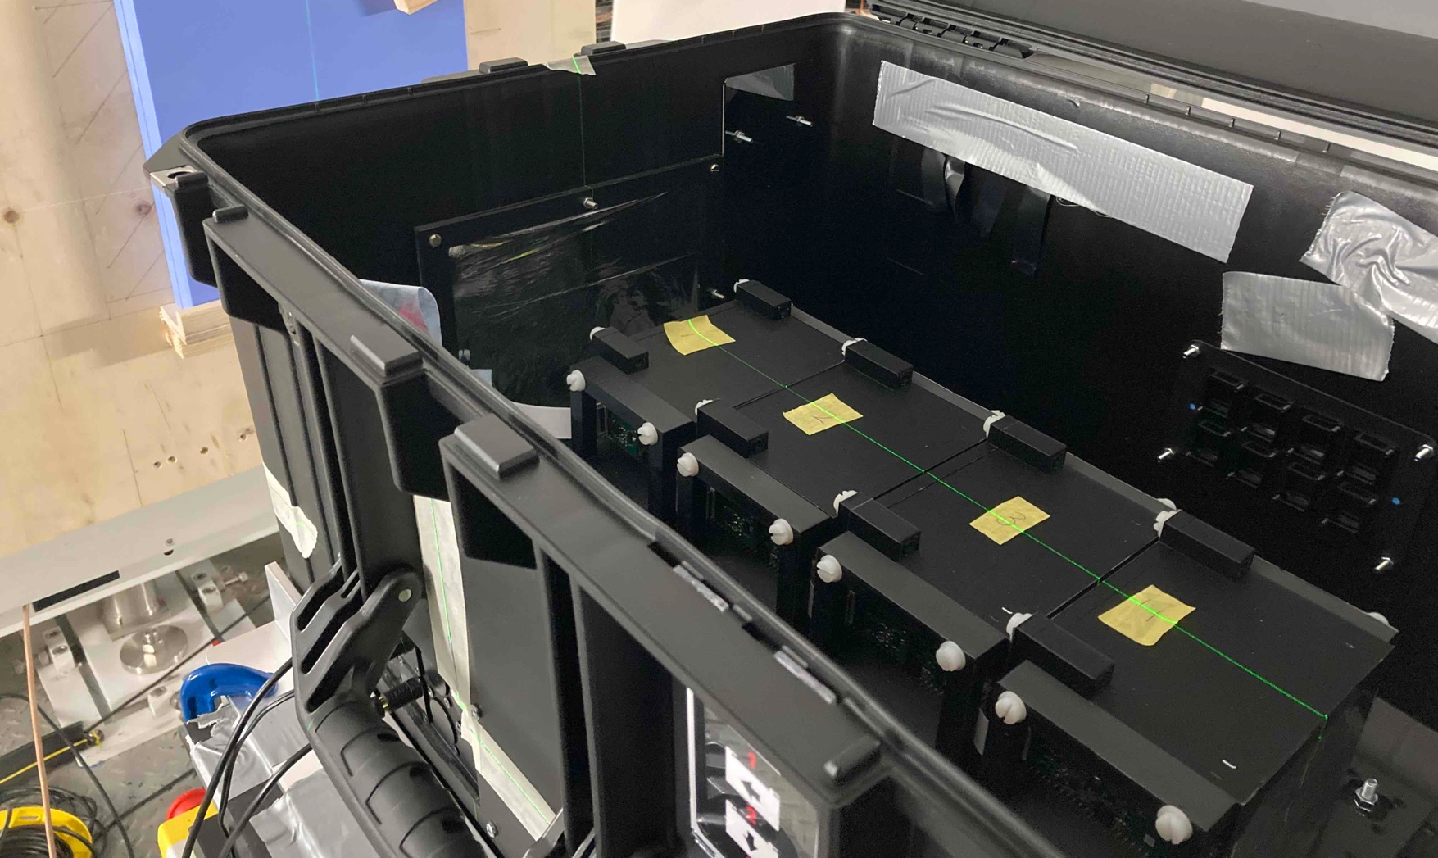
The Christie Beam Test
Used 4 32-sheet detector modules in a chain to evaluate performance across full clinical energy range and at FLASH dose rate.
Reconstructed range accurate to within 0.5 mm at clinical rates.
Detector able to measure beam nozzle currents of up to 50 nA.
Some non-linearity in light output observed, but range generally stable.
Sub-optimal detector light output due to unpolished scintillator sheets.

Slide 14
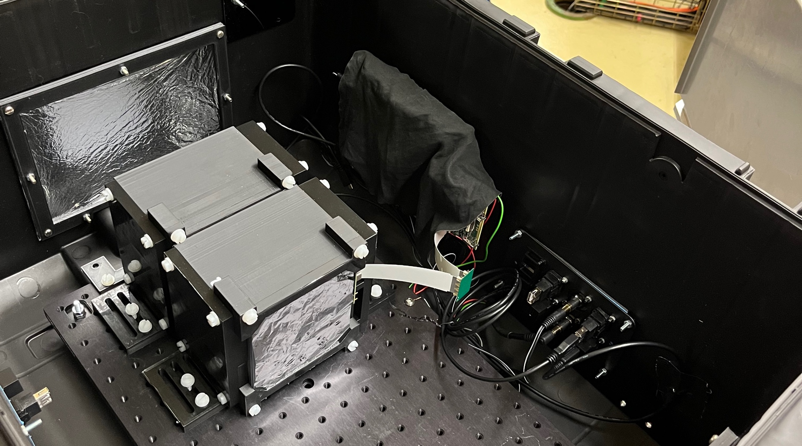
PARTREC Beam Test
Deeper investigation into light output dependence on dose-rate with beam energies between 60–150 MeV.
Confirmed maximum measurable current for detector at around 50 nA.
Further non-linearities measured in light output.
Convoluted with worse beam shape at lower energies (aluminium beam degrader) and inefficient light collection.

Slide 15
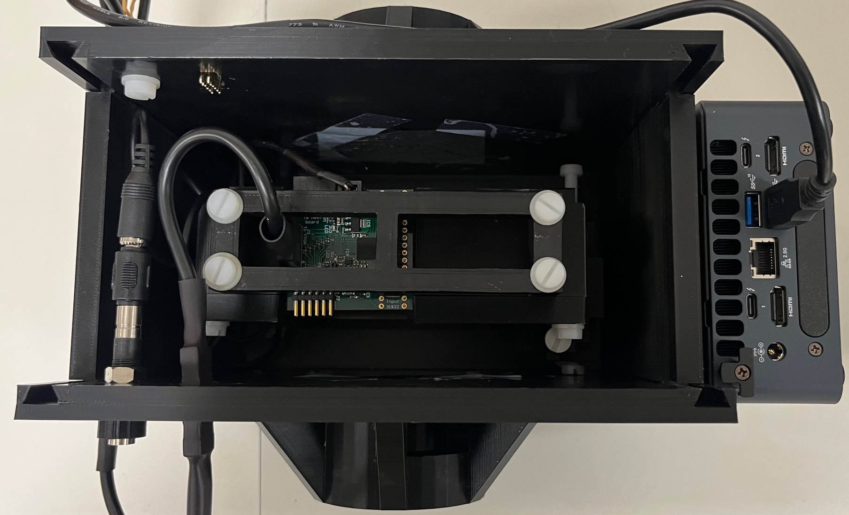
Clatterbridge Beam Test
Specialised compact version of the QuARC for range QA at 60 MeV.
Technical demonstration of full detector setup mounted onto nozzle.
Perform range measurements of pristine and spread-out Bragg peaks.
Test limitations of relatively coarse spatial resolution.
Detector able to reconstruct range accurate to 0.2 mm!

Slide 16
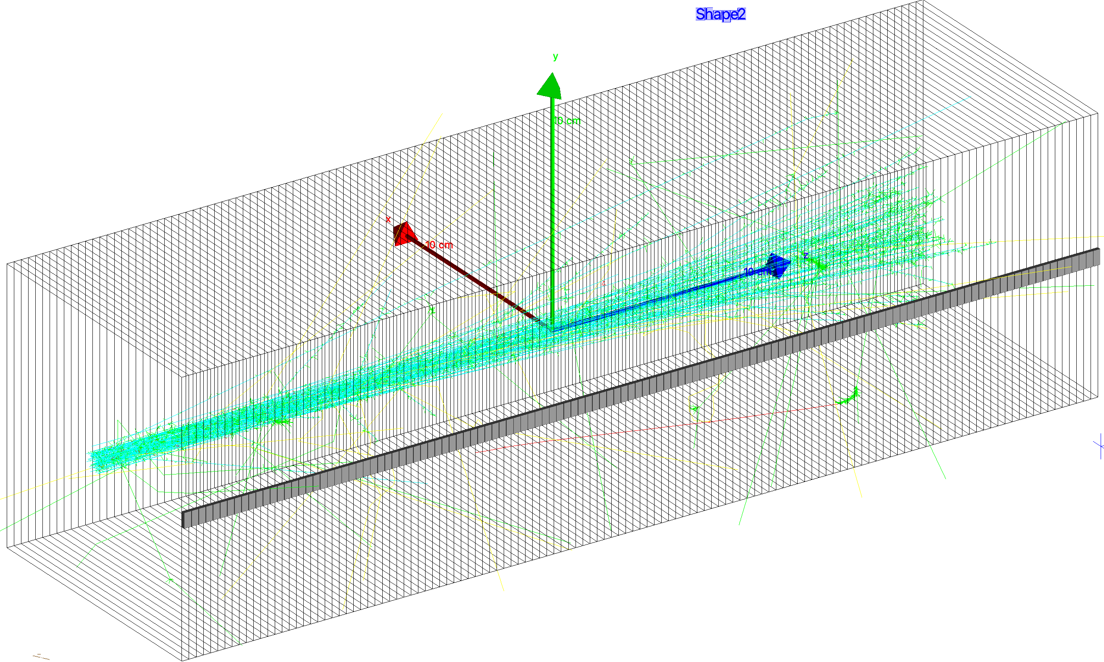
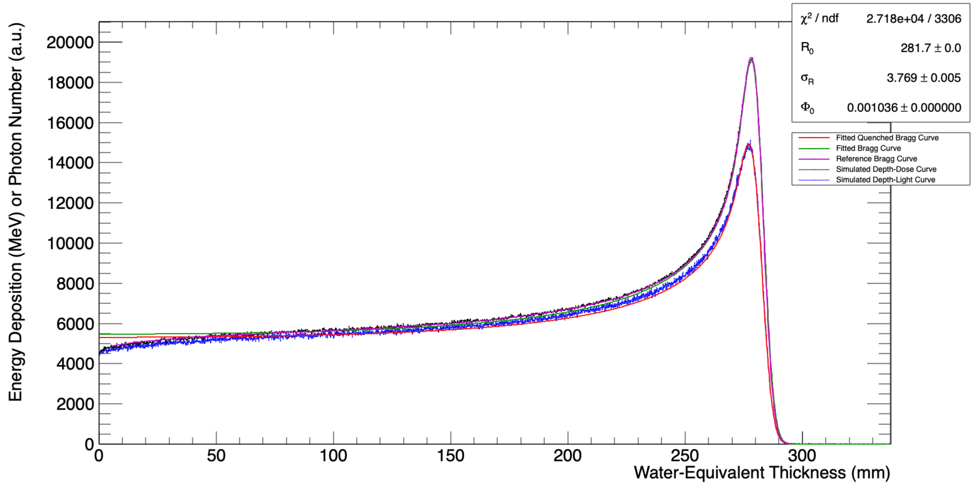
Geant4 Simulation
Preliminary investigation into simulation of detector geometry using Geant4.
Developed multi-threaded simulation from scratch to measure depth-light and depth-dose information, at high and low spatial resolutions.
Compared to reference data.
Lots of future work possible!

Slide 17
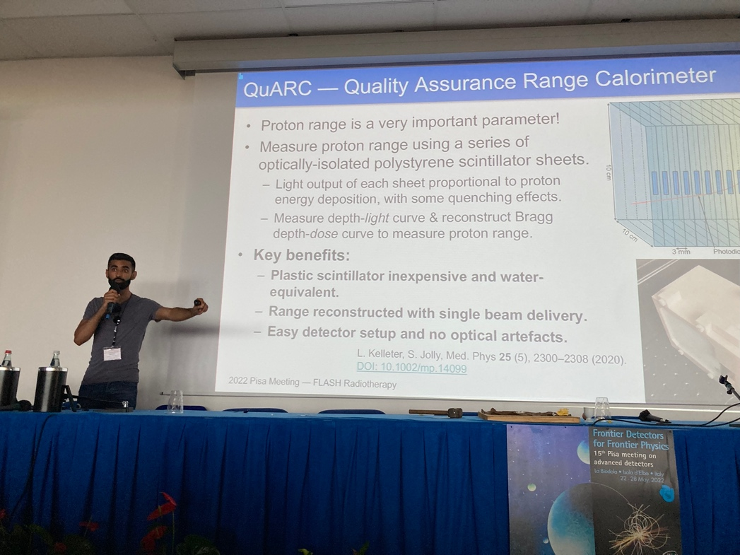
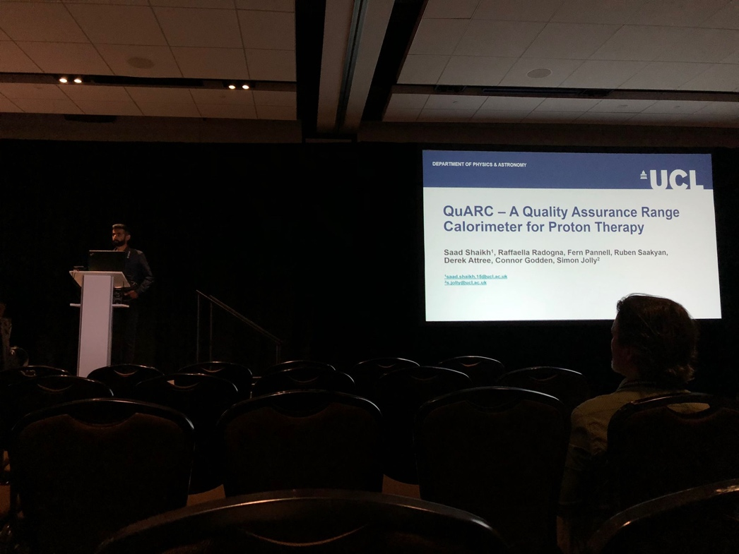
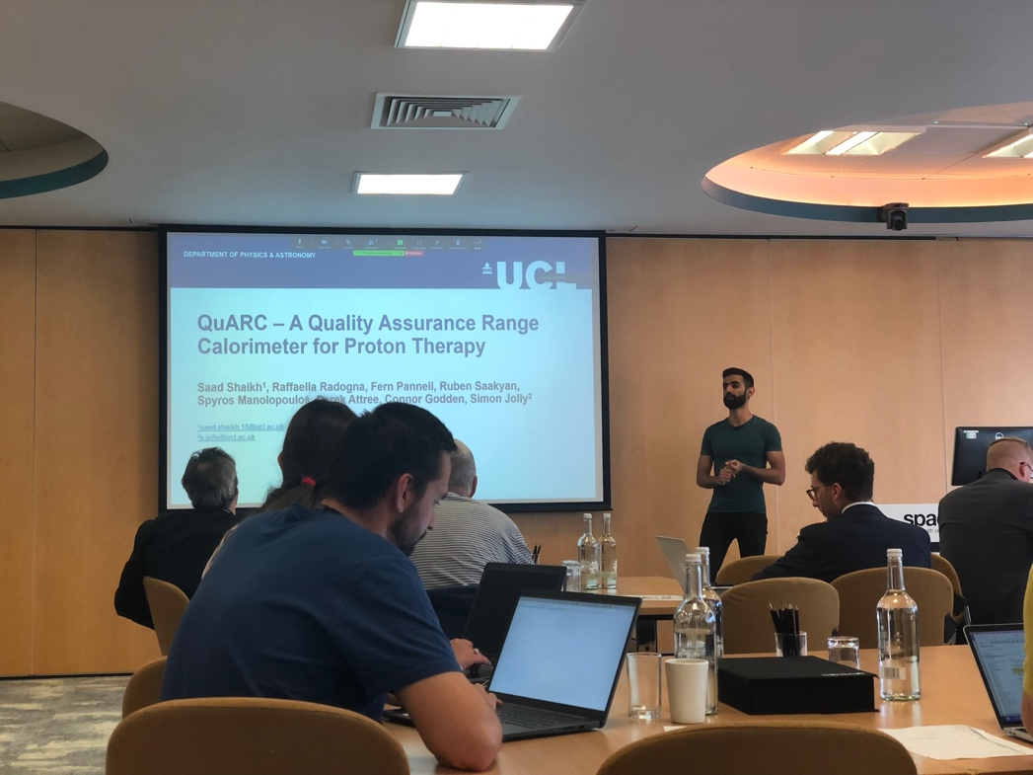
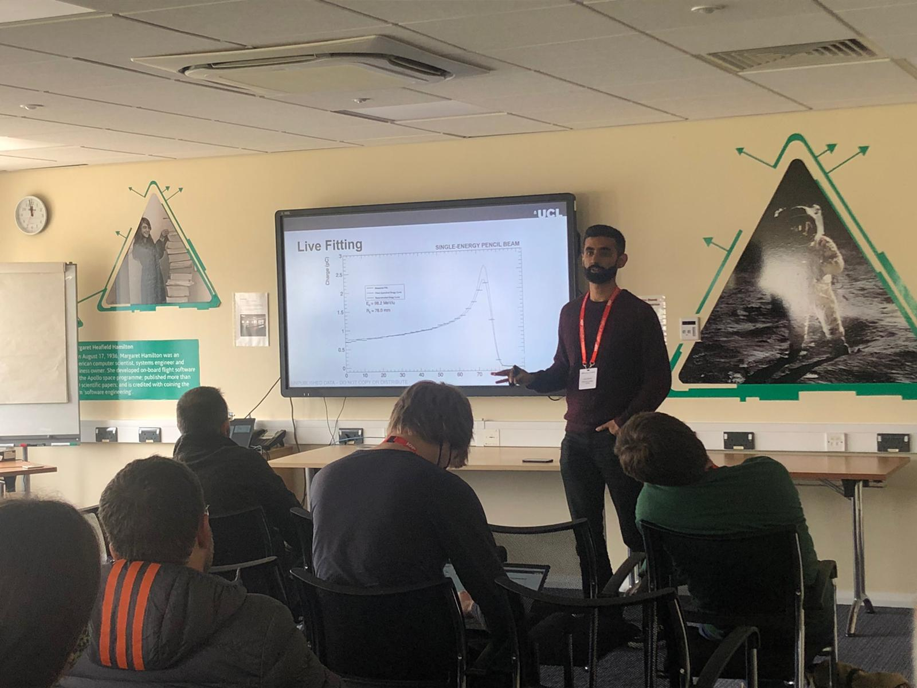
Summary
Developed a QA device that can perform real-time measurements of proton range to sub-mm precision at clinical and FLASH dose-rates.
Key role in detector design/assembly, front-end development and data analysis.
Aspects of this work presented at 9 international conferences/workshops.
Two first-author papers currently being prepared from Clatterbridge and Christie/PARTREC beam tests.

Slide 18
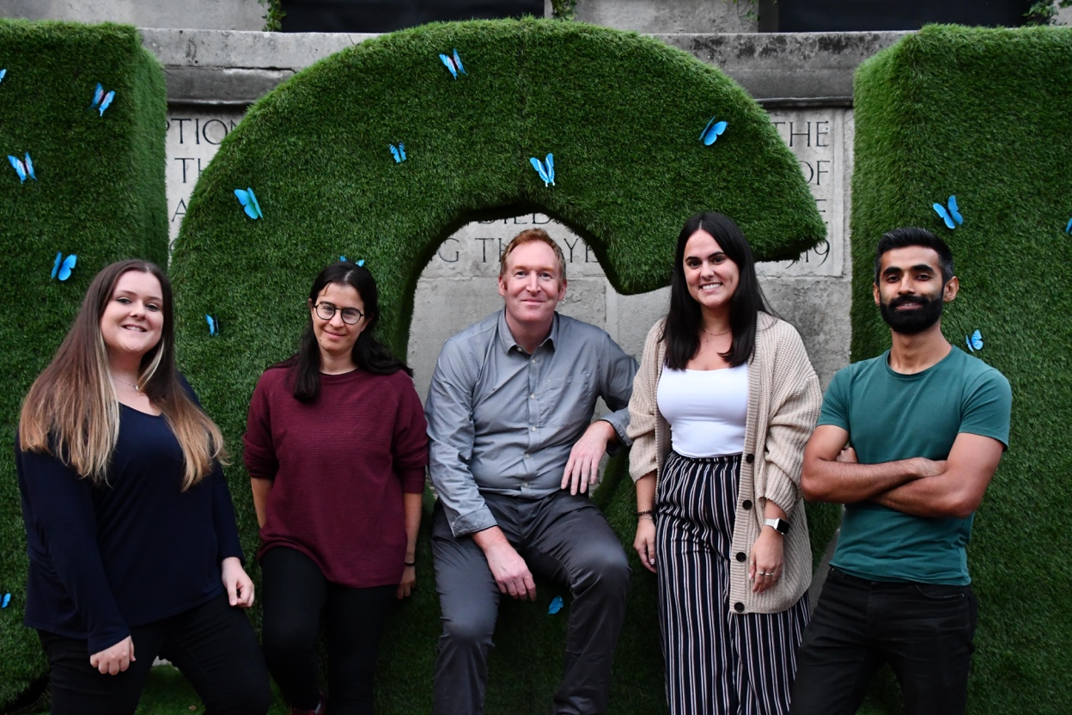
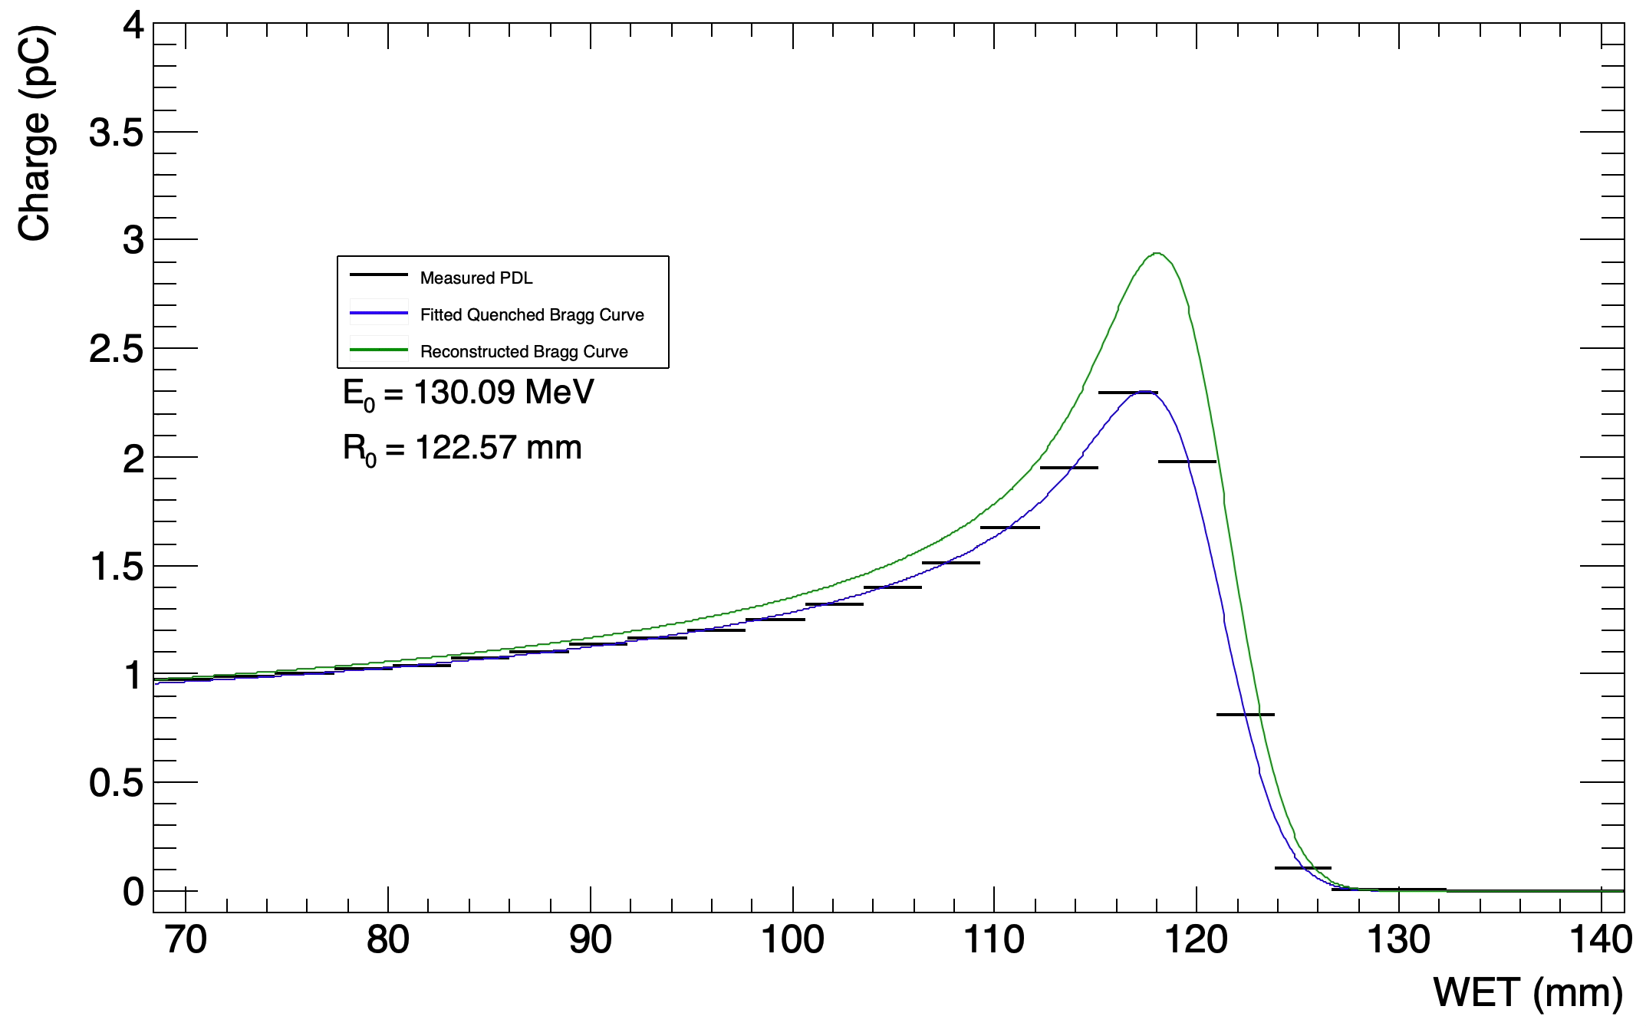
Thank you for listening!
Questions?
https://www.hep.ucl.ac.uk/pbt/QuarcBuildAndTest.mp4
References:
L. Kelleter and S. Jolly. “A Mathematical Expression for Depth-Light Curves of Therapeutic Proton Beams in a Quenching Scintillator”. In: Medical Physics 47.5 (Feb. 2020), pp. 2300–2308. DOI: 10.1002/mp.14099
L. Kelleter et al. “A Scintillator-based Range Telescope for Particle Therapy”. In: Physics in Medicine & Biology 65.16 (Aug. 2020). DOI: 10.1088/1361-6560/ab9415.
S. Jolly et al. “Technical Challenges for FLASH Proton Therapy”. In Physica Medica 78 (2021). DOI: 10.1016/j.ejmp.2020.08.005

