Slide 1
DEPARTMENT OF PHYSICS & ASTRONOMY
Proton Beam Therapy
HEP Group Day 2023
Saad Shaikh¹, Sonia Escribano, Raffaella Radogna, Ruben Saakyan, Connor Godden, Simon Jolly²
¹saad.shaikh@ucl.ac.uk
²s.jolly@ucl.ac.uk

Slide 2
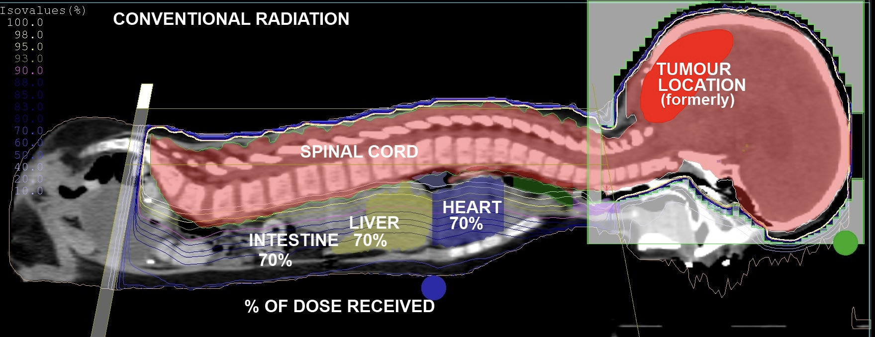
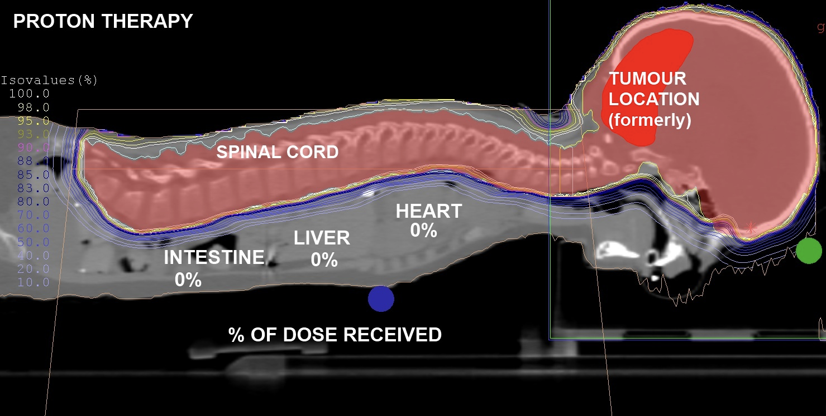
Proton Therapy
Ionising radiation damages DNA of tumour cells, causing cell death.
Superior dose conformity compared to conventional X-ray radiotherapy.
Range uncertainties prevent taking full advantage of dose localisation benefits.
Clinic must perform daily beam Quality Assurance (QA).

Slide 3
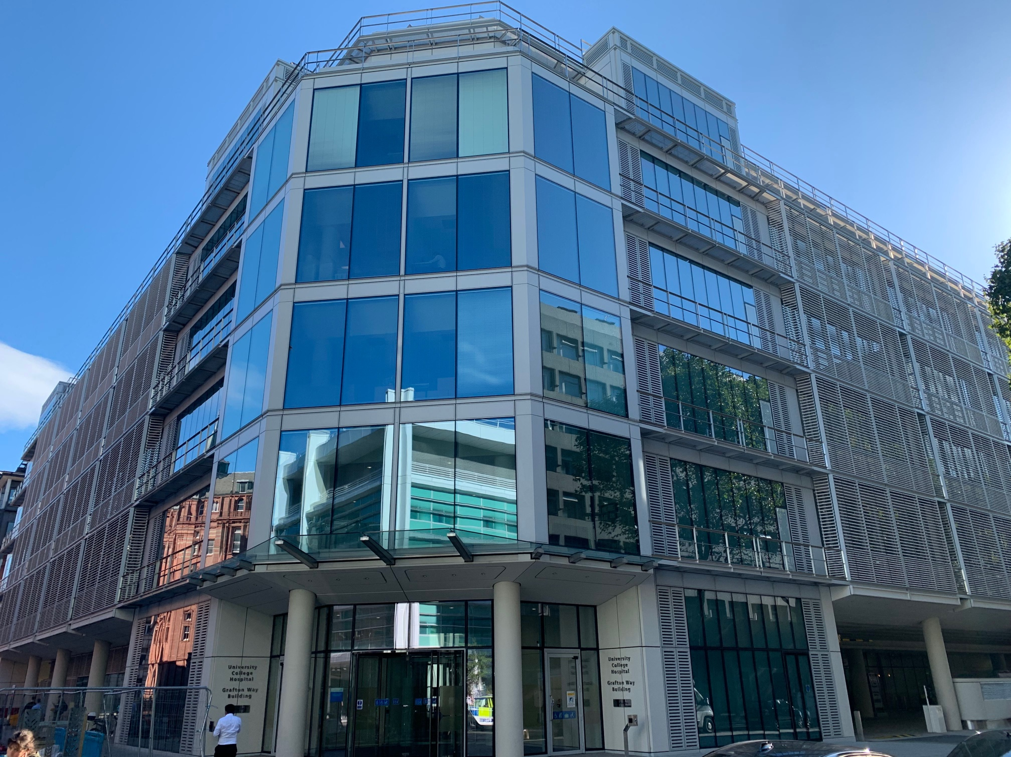
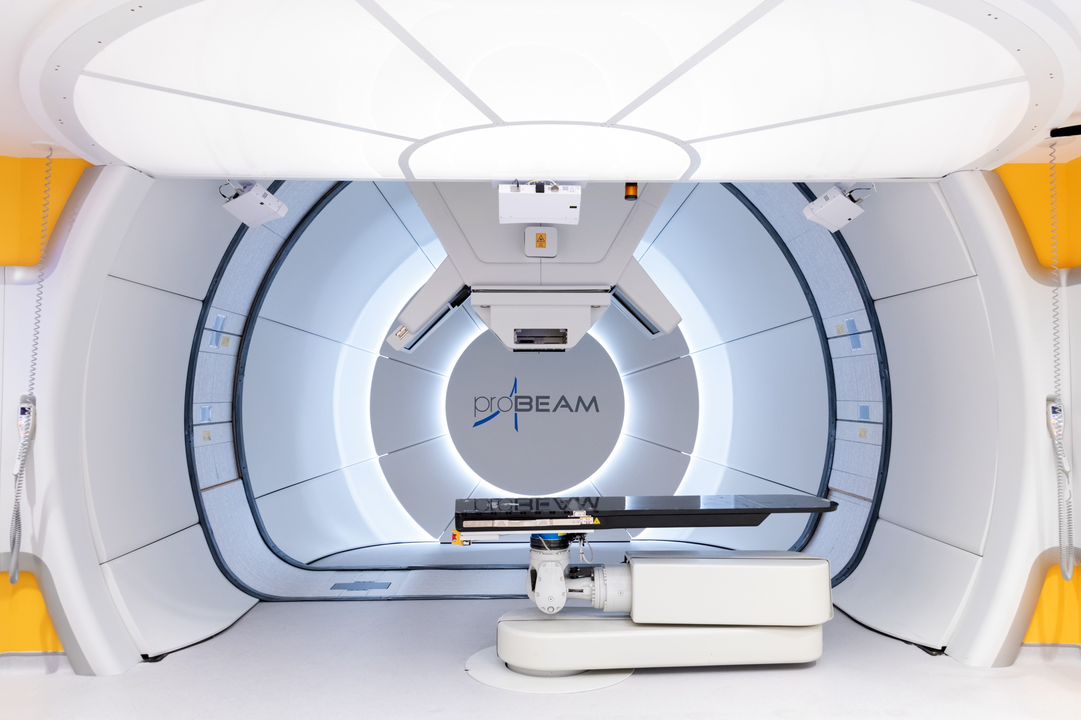
UCLH Proton Therapy

Slide 4
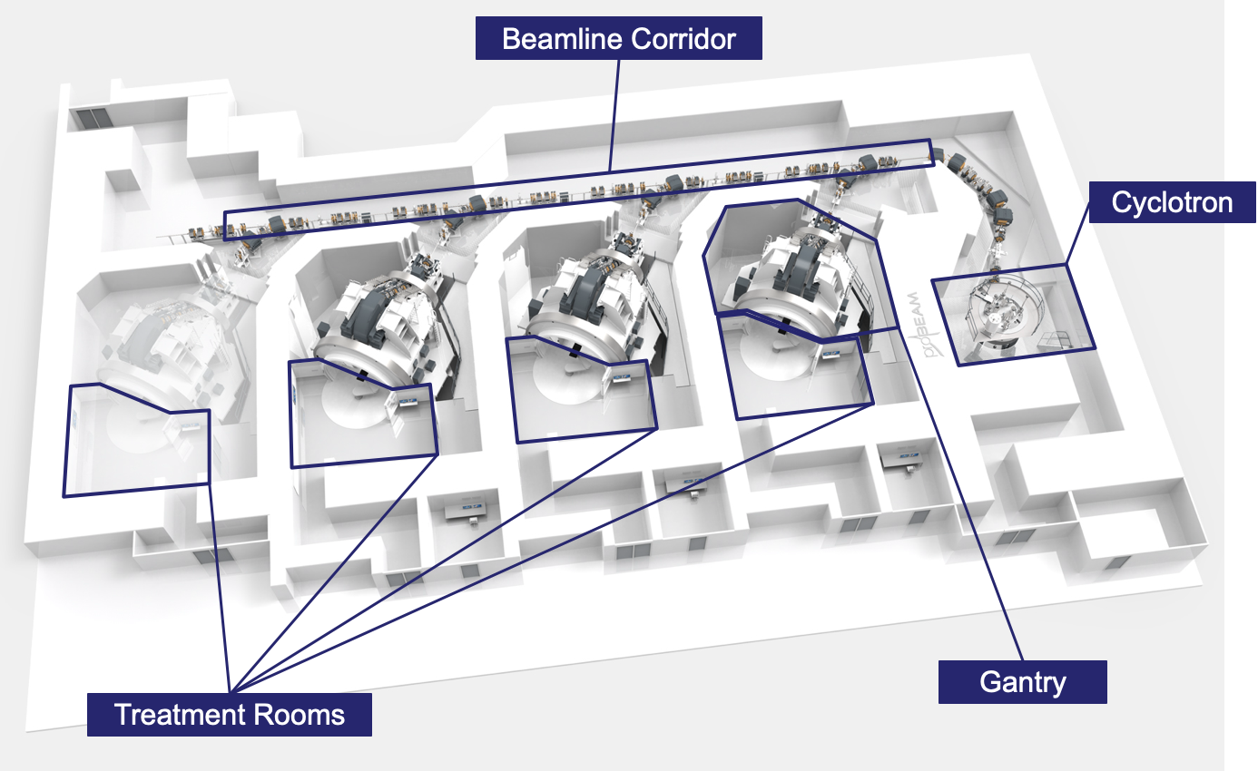
UCLH Proton Therapy
Images courtesy Varian Inc. (not for reproduction)

Slide 5
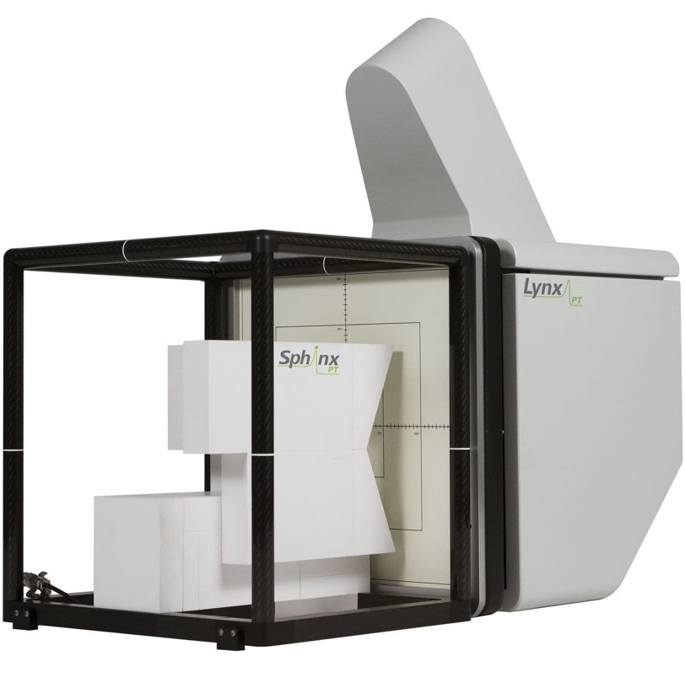
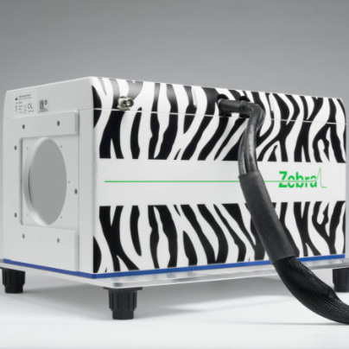
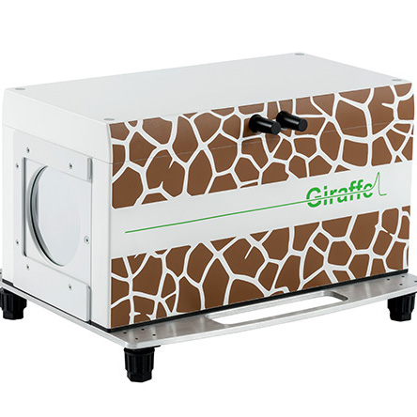
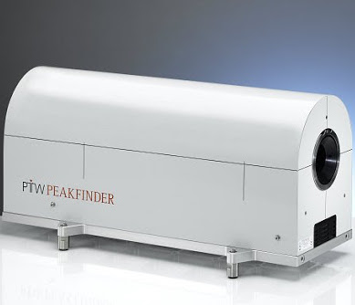
Daily Quality Assurance (QA)
Daily QA requires measurement of beam range, absolute dose, spot position and size.
Range measured in water-equivalent material for a selection of beam energies.
  Water chosen as proxy for human tissue.
Typically measured using layers of ionisation chambers in a water tank, often requiring repeated beam delivery.
Current methods often compromise between speed and accuracy.
Develop a detector to make fast, accurate measurements of proton range.

Slide 6
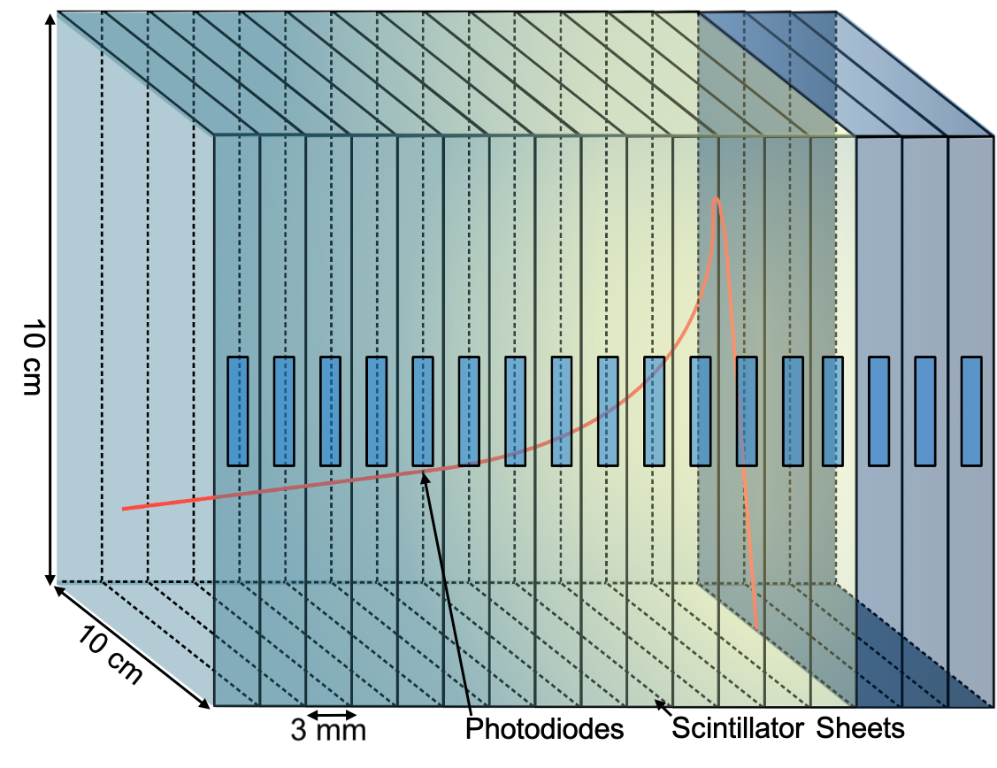
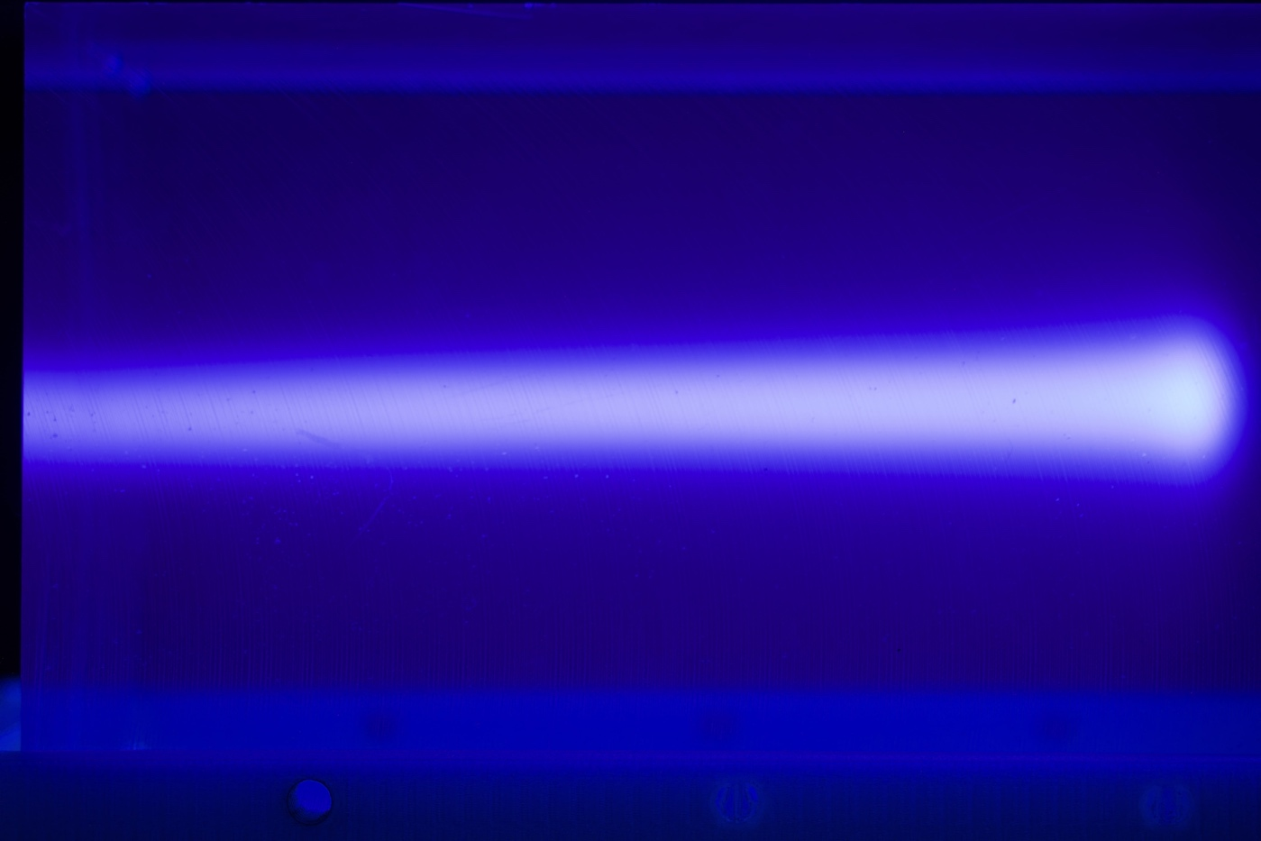
QuARC Detector Principle
Need to measure proton depth-dose relation to find proton range.
Detector is a series of optically-isolated polystyrene scintillator sheets.
  Protons cause the emission of scintillation light.
  Segmented design allows sampling of light in each layer.
Light output of each sheet nonlinear to dose, but quenching described by Birks’ Law:
  Fit data with analytical depth-light model.
  Set quenching to zero to reconstruct Bragg depth-dose curve and measure proton range.
L. Kelleter and S. Jolly. “A Mathematical Expression for Depth-Light Curves of Therapeutic Proton Beams in a Quenching Scintillator”. DOI: 10.1002/mp.14099
L. Kelleter et al. “A Scintillator-based Range Telescope for Particle Therapy”. DOI: 10.1088/1361-6560/ab9415.

Slide 7
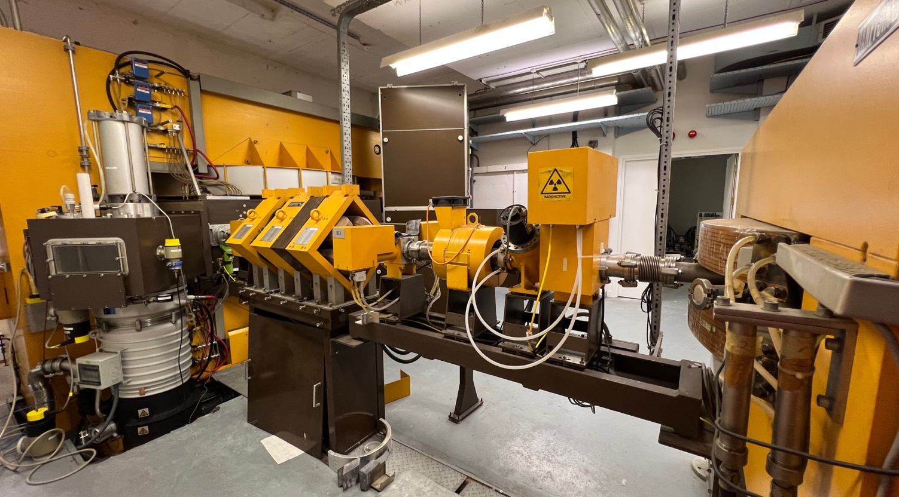
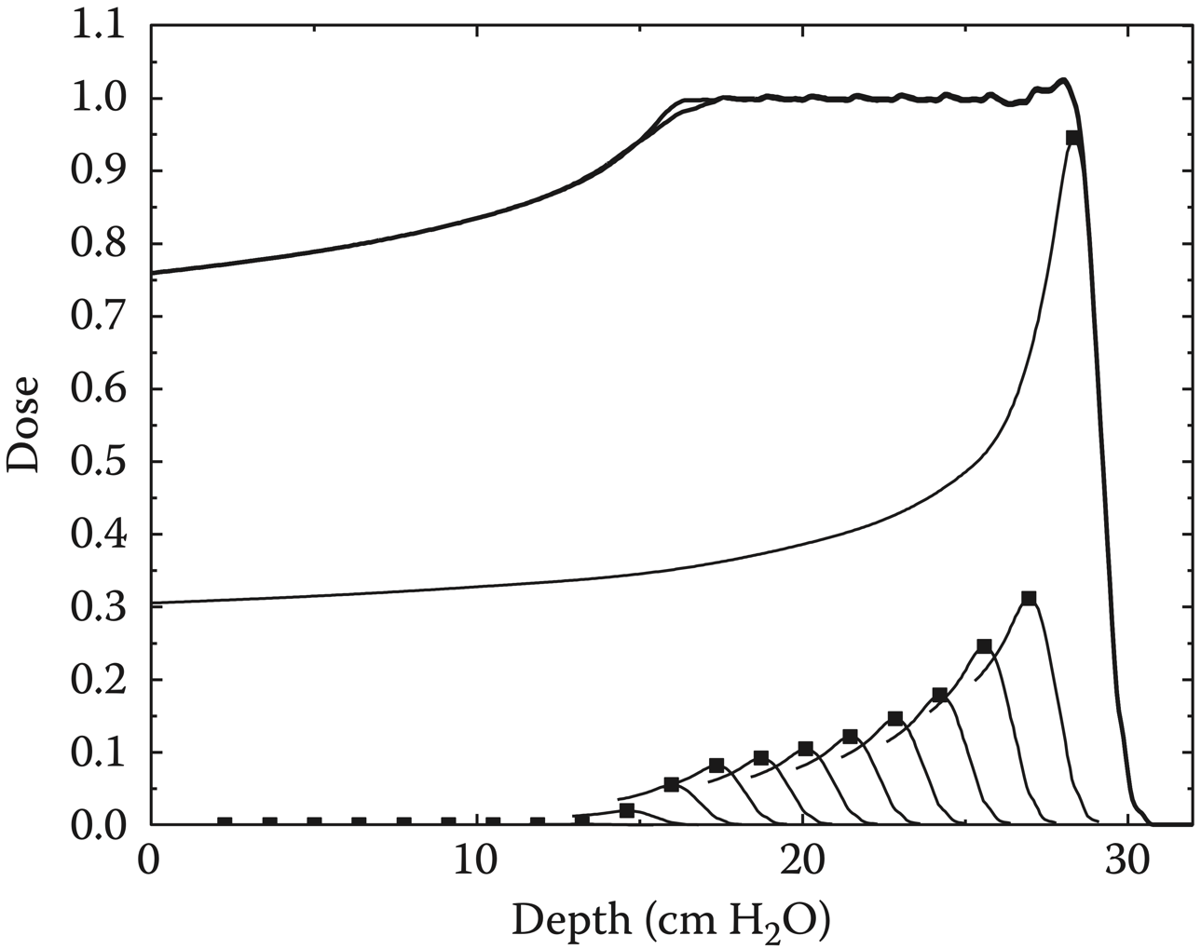
Compact QuARC for Clatterbridge
Clatterbridge Cancer Centre treats eye tumours with a 60 MeV proton beam.
  Operating since 1989!
  Low-end of clinical energy regime (60-250 MeV).
Uses passive scattering to create spread-out Bragg peaks (SOBPs): uniform region of dose.
  Superimpose multiple pristine Bragg peaks.
Developing a compact version of the QuARC for range QA of pristine and SOBPs.
Performed beam test in May 2022…

Slide 8
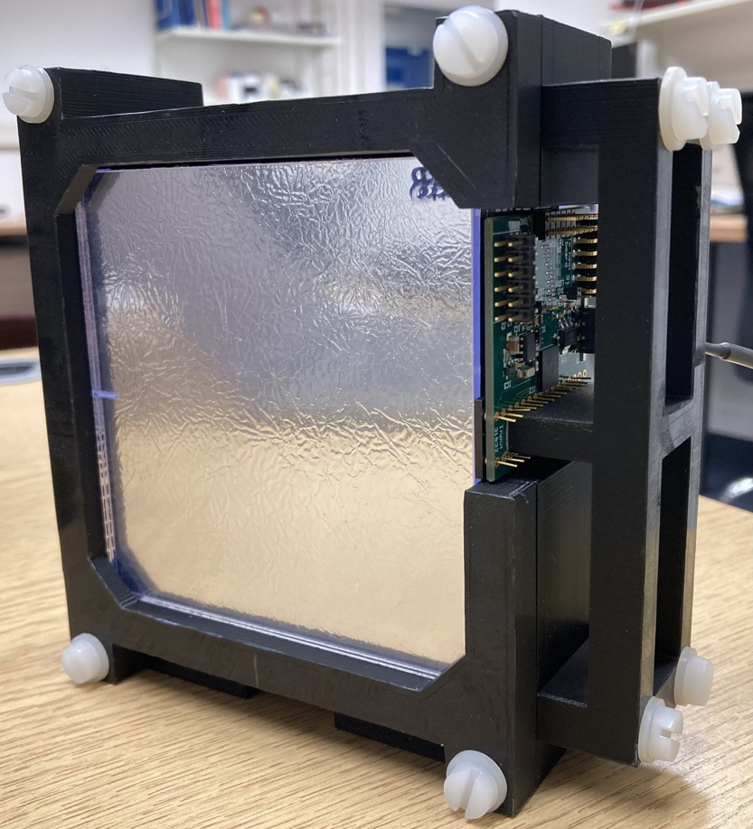
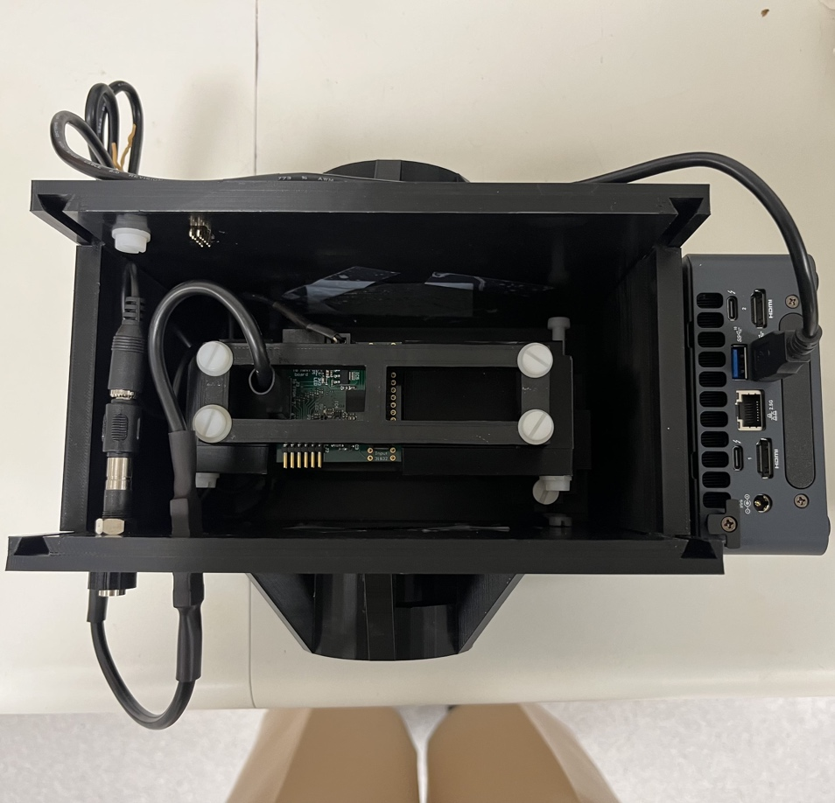
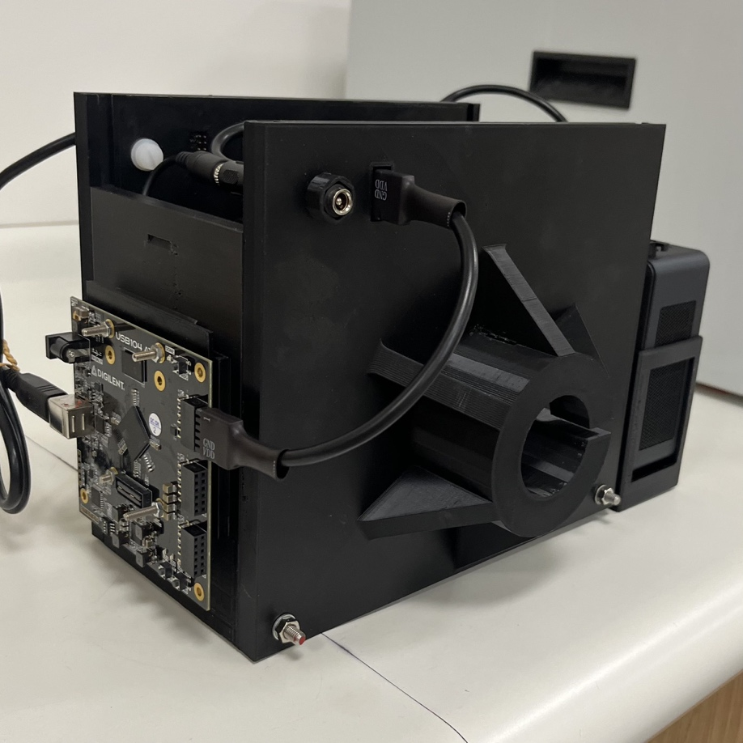
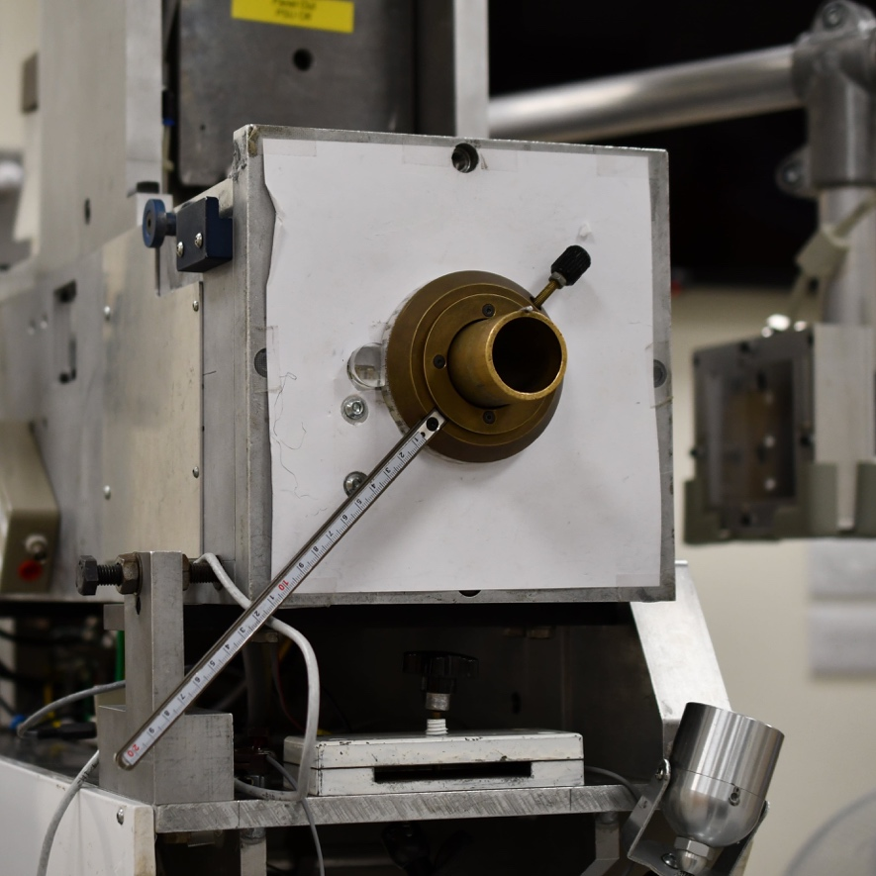
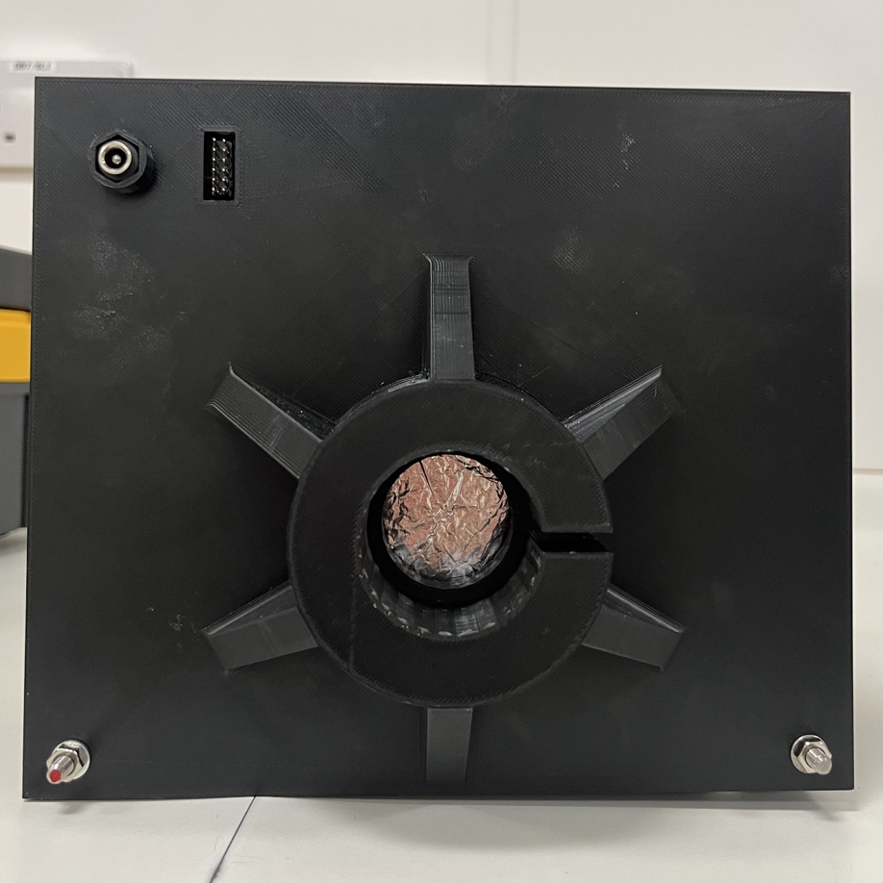
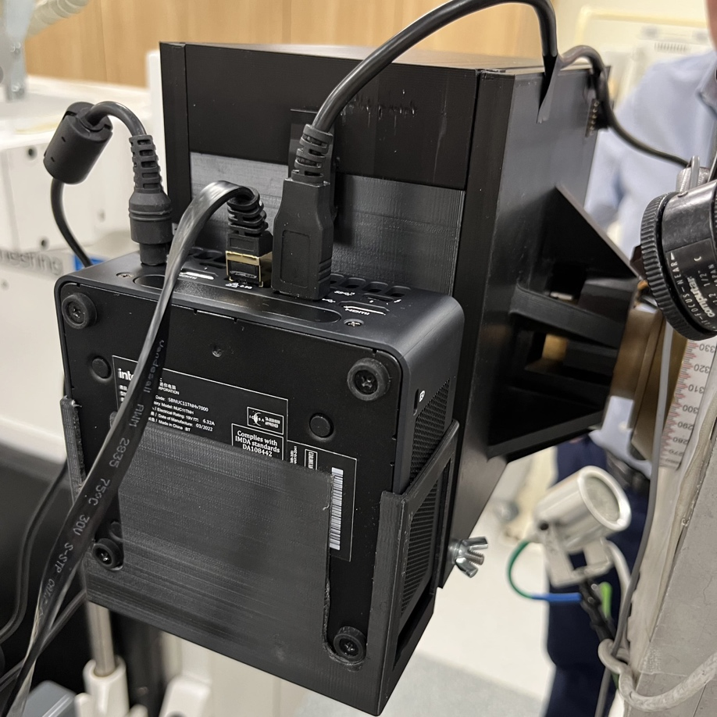
Beam Test at Clatterbridge
14-sheet detector module in 3D-printed enclosure.
Photodiode ADC measure light at 6 kHz.
Compact FPGA and PC mounted onto enclosure.
Detector enclosure mounts onto beam nozzle!

Slide 9
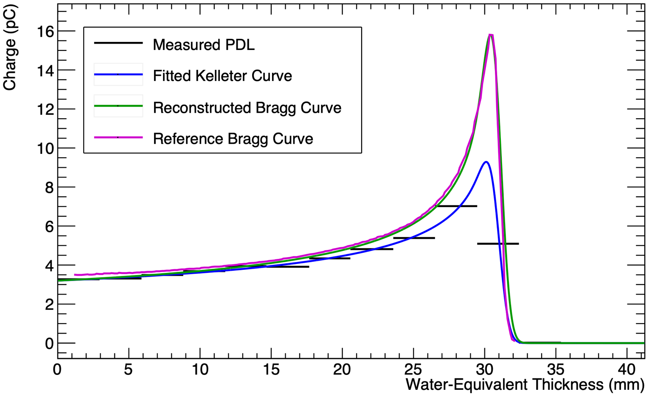
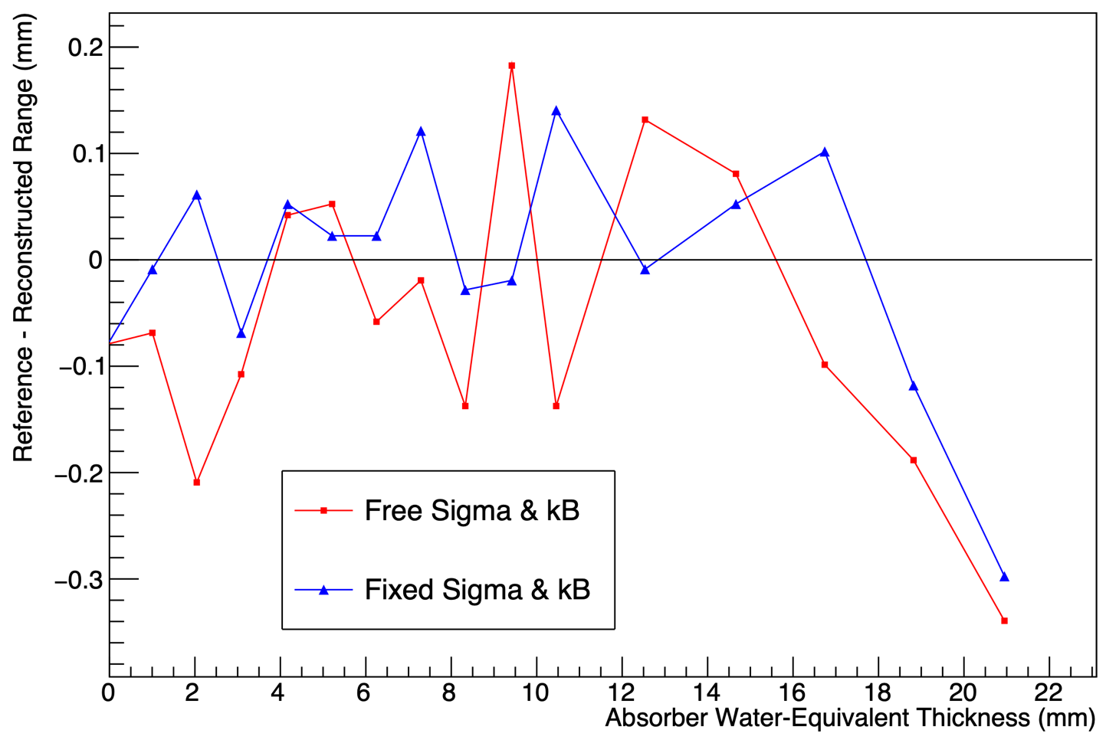
Pristine Beam Range Accuracy
Test range accuracy with 60 MeV proton beam and with increasing amounts of material absorber.
Legend:
  Black: Sheet Average Light Output
  Blue: Fitted Quenched Depth-Light Curve
  Green: Reconstructed Depth-Dose Curve
  Magenta: UCLH Reference Dose Curve
Detector accurate to 0.2 mm and sensitive to 1 mm changes in beam range!

Slide 10
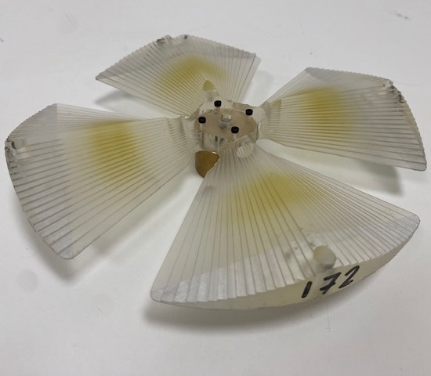
Spread-out Bragg Peak Fitting
SOBPs delivered using range modulator wheels
Developed new analytical framework to fit quenched spread-out Bragg Peaks.
Range accurate to 0.2 mm.
Required some gentle massaging of fit to get the correct tilt on the plateau.
  Made complicated by different amounts of quenching!
Framework was overall a success and a powerful feature of the QuARC.
D. Jette and W. Chen. “Creating a Spread-out Bragg Peak in Proton Beams”. DOI: 10.1088/0031-9155/56/11/N01.

Slide 11

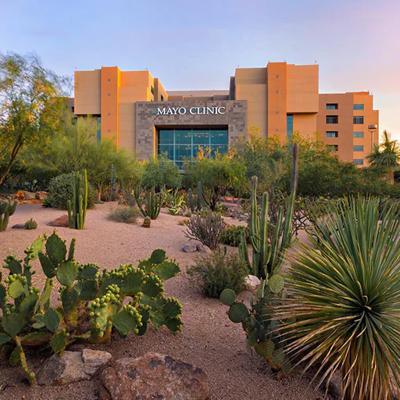
To The Future…
Passed my viva last week!
Preparing papers for Phys. Med. Biol.:
  Spread-Out Bragg Peak Range QA Measurements at the Clatterbridge Cancer Centre.
  FLASH Range QA Measurements using the Quality Assurance Range Calorimeter
Starting a postdoc at Mayo Clinic, Phoenix, Arizona in November for 1 year.
Hopefully will return to UCL (Medical Physics)
Thank you for everything!

Slide 12
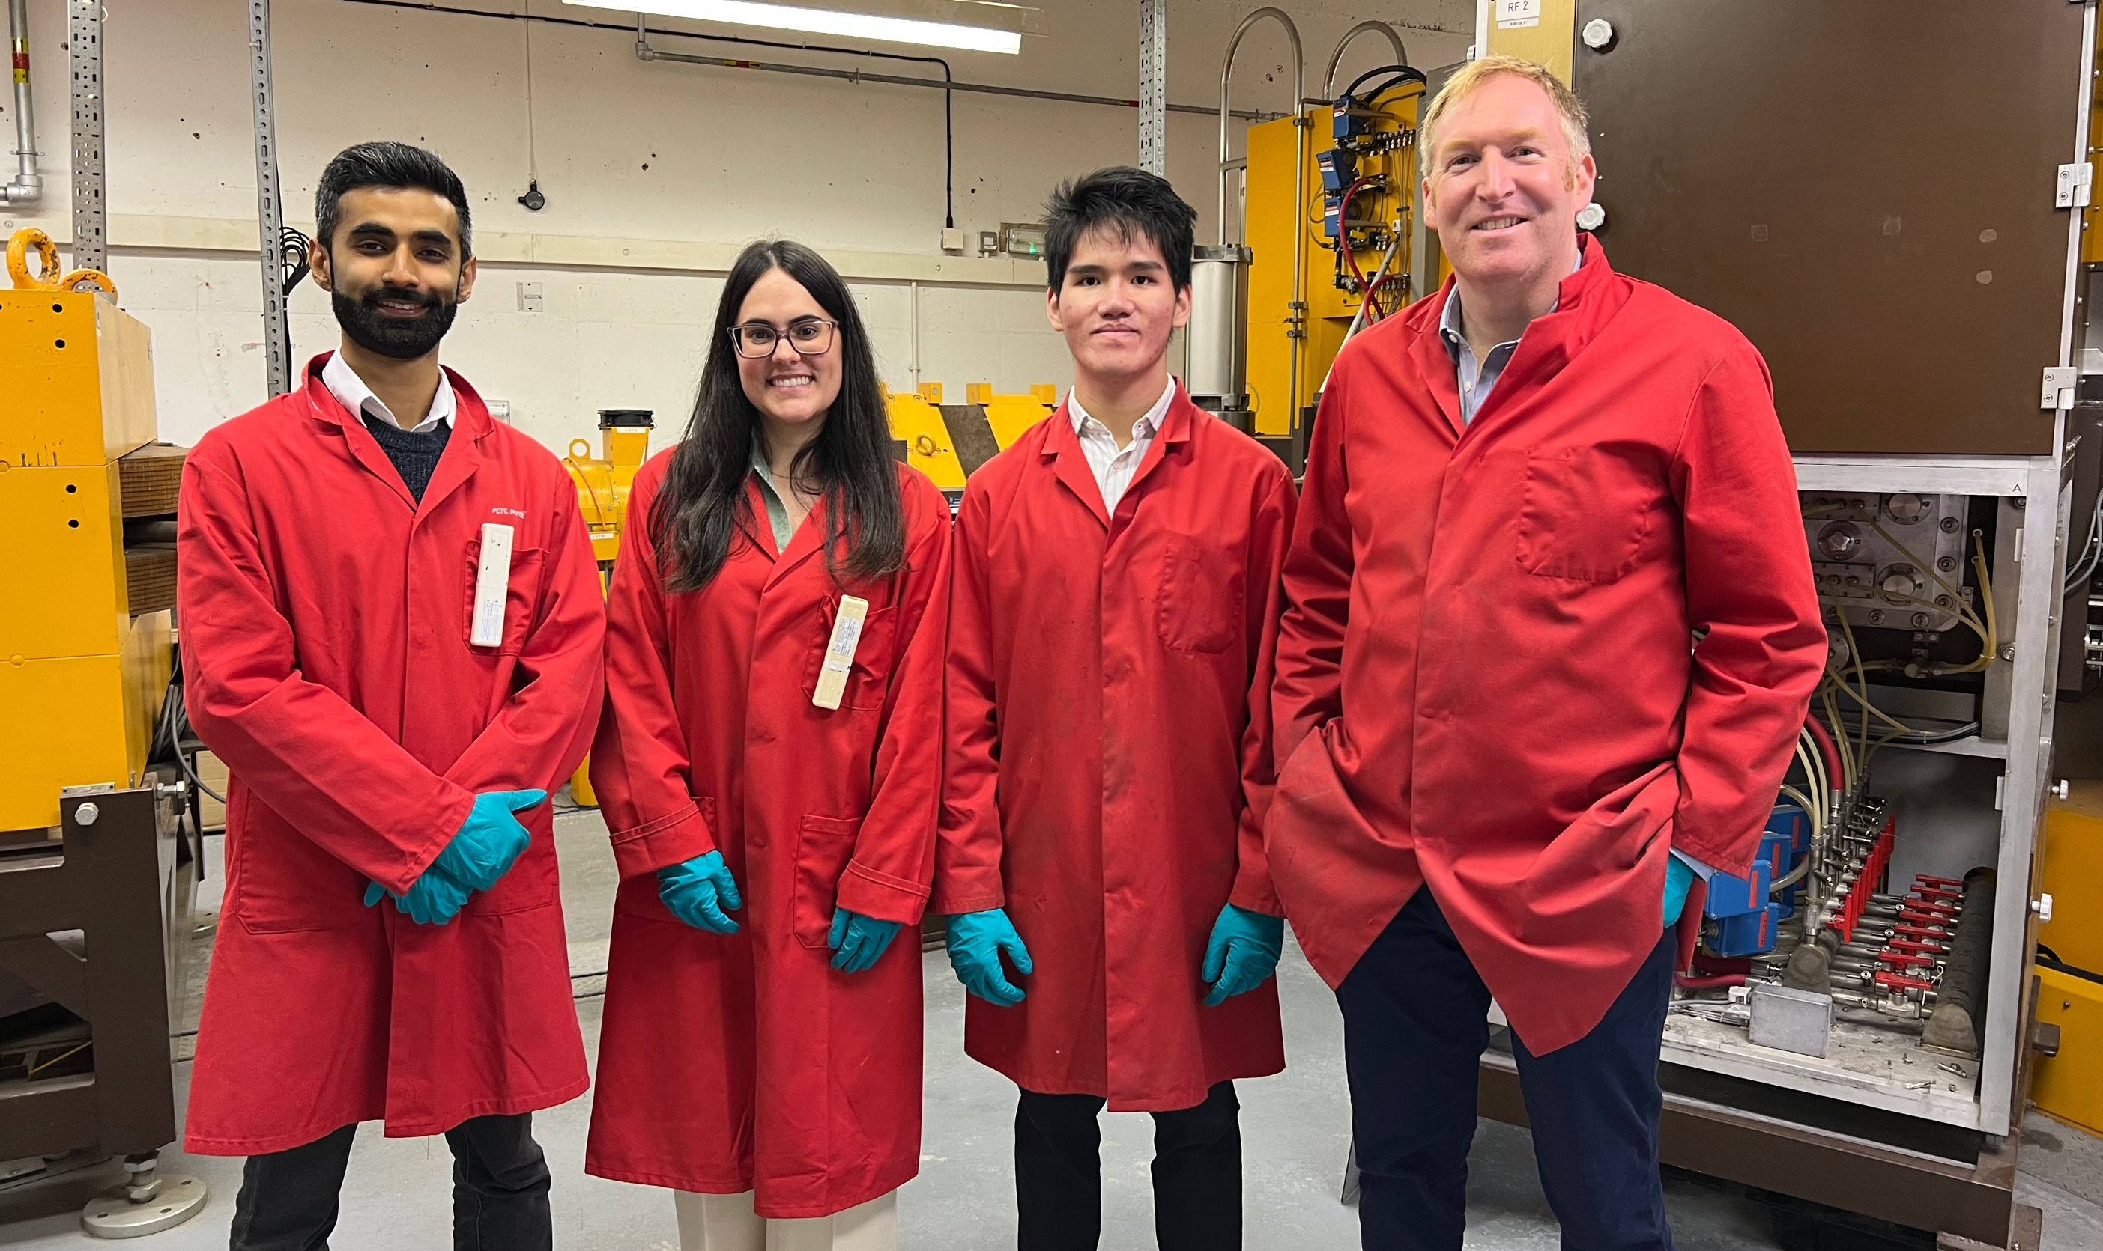
Thank you!
Questions?
saad.shaikh@ucl.ac.uk

