Slide 1
FPGA Development and Zmod daughter board #1
PBT Group 02/10/2024

Slide 2
Design Goals Zmod Board
Firstly, Why we need the board?
  To interfaced between FPGA and DDC232 board, Capturing Data and communicating to the Computer interfaced.
Reduce the noise pickup.
Reduce the power consumption.
Improve the signal distribution from board to board.
Make all interconnections USB-C.
Modify the design such that it can be powered by a (boosted) 5V USB bus supply or an equivalent high current external power supply connected to the ZMOD board.
Produce a second layout with identical circuit design by staggered photodiode layout to couple to 1.5mm-thick scintillator sheets.

Slide 3
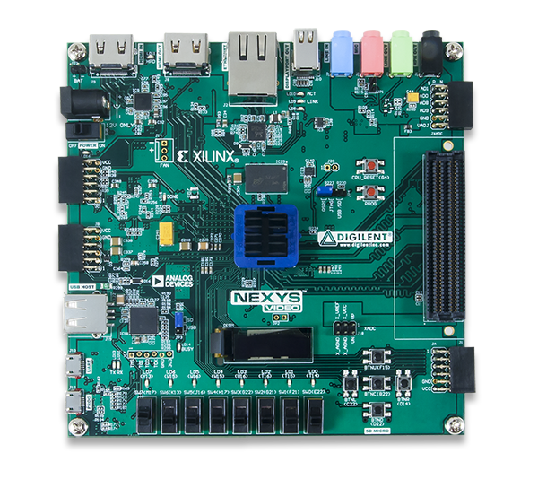
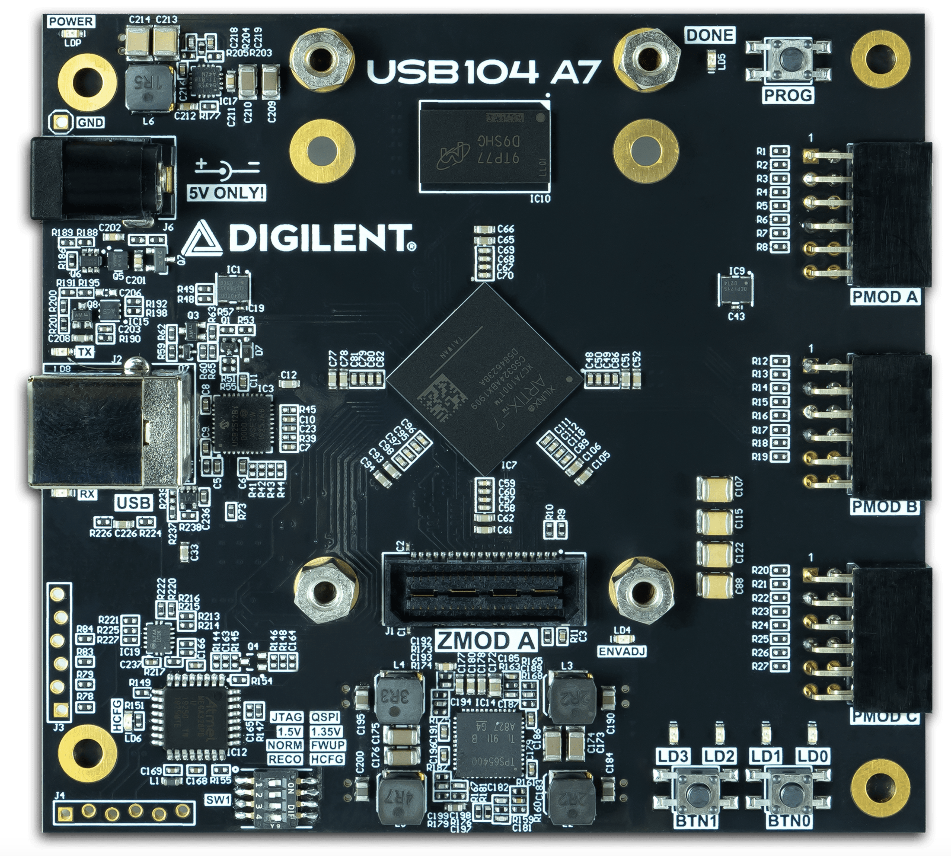
FPGA board Migration
Nexys Video FMC port.
Ref Manual:
https://digilent.com/reference/programmable-logic/nexys-video/reference-manual
USB104 A7 Zmod port Syzygy.
Ref Manual: https://digilent.com/reference/programmable-logic/usb104a7/reference-manual

Slide 4
Why we do this?
Advantage of Zmod Port (USB-104) over FMC port(Nexys video)
  Lower Cost: Zmod modules are typically more cost-effective compared to FMC modules, making them suitable for budget-sensitive projects.
  Compact Size: Zmod connectors and modules are smaller and more compact than FMC, allowing for more flexibility (Assembly wise) in smaller FPGA boards.
  Simplified Interface: Zmod uses a simpler I/O interface compared to FMC, which can ease the development process.
  High-Speed Serial Interfaces: Although FMC supports high-speed data transfer, Zmod can still provide adequate performance for many mid-speed applications at a lower complexity level.
  Bus Power: Could run everything with 5V USB Bus power.

Slide 5
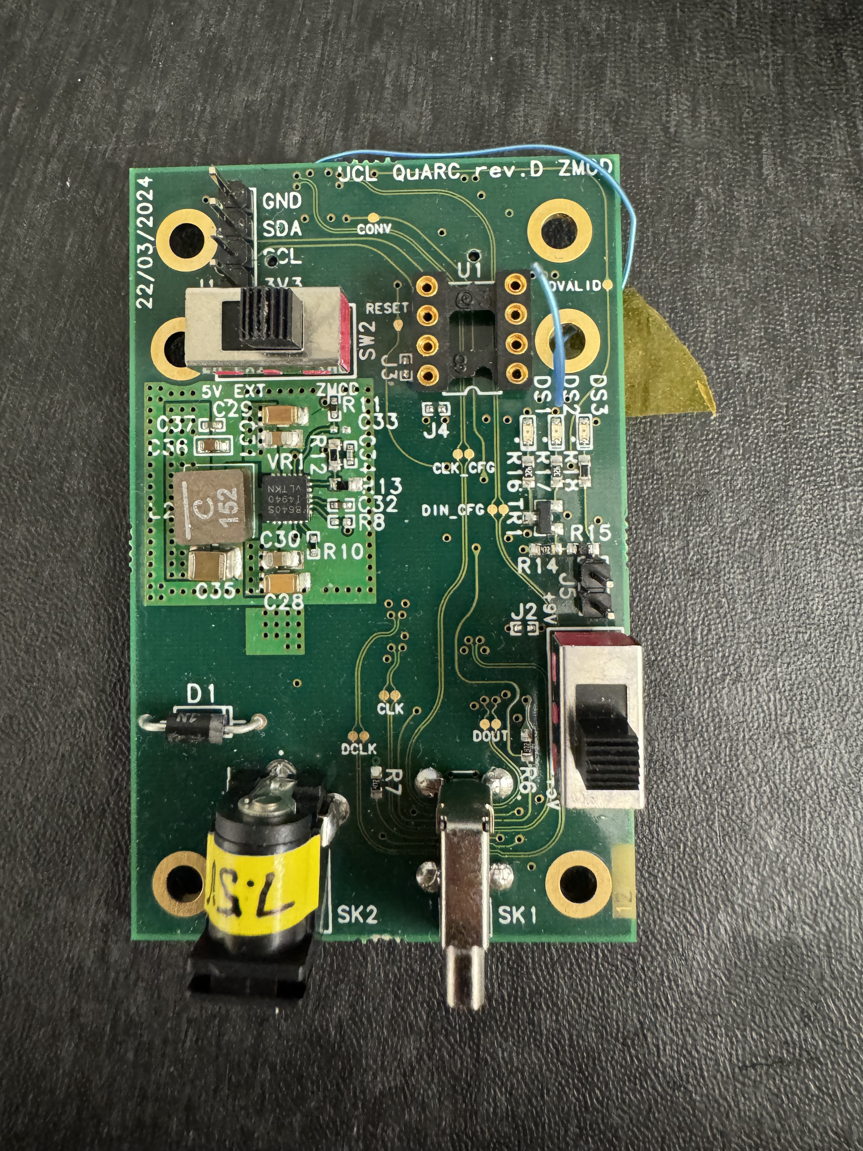
New custom zmod daughterboard needed
First Prototype developed by Pete Hastings from Oxford University Electronics group. Was first proposed in 5 May 2024 and prototype was first introduced in 22nd July 2024(?TBC)

Slide 6
Issue Encounter
The newly developed board does not has the MCU (Microcontroller unit) to act as an I2C (inter Integrated Circuit) - a communication protocol that allows multiple integrated circuits (ICs) to communicate with each other over a short distance using just two wires: a serial data line (SDA) and a serial clock line (SCL).
There has been an issue with pin connector mapping from USB-C. some of the differential pairs are mislabelled with the plus and minus the wrong way round. – This one has been noted for the next revision board (Discussion between Simon and Pete directly via email)

Slide 7
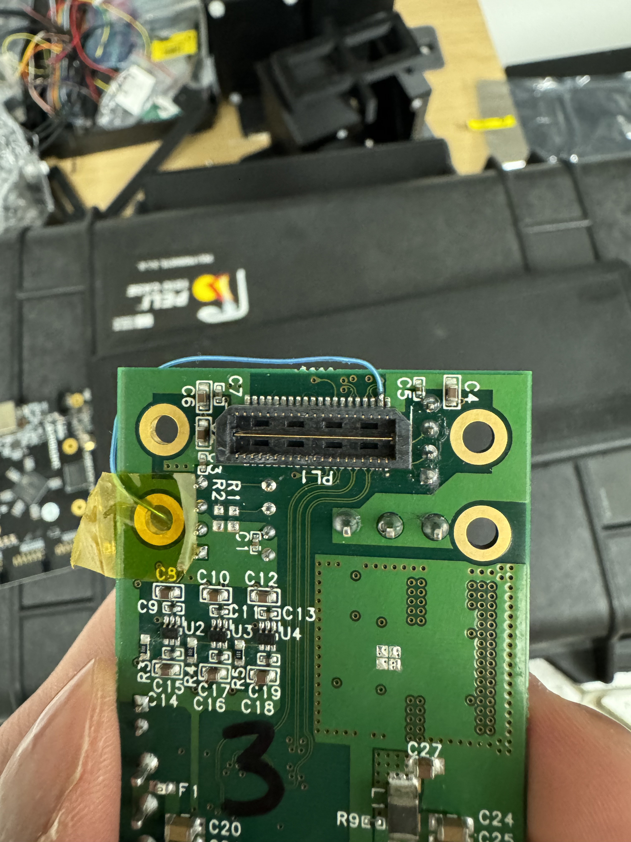
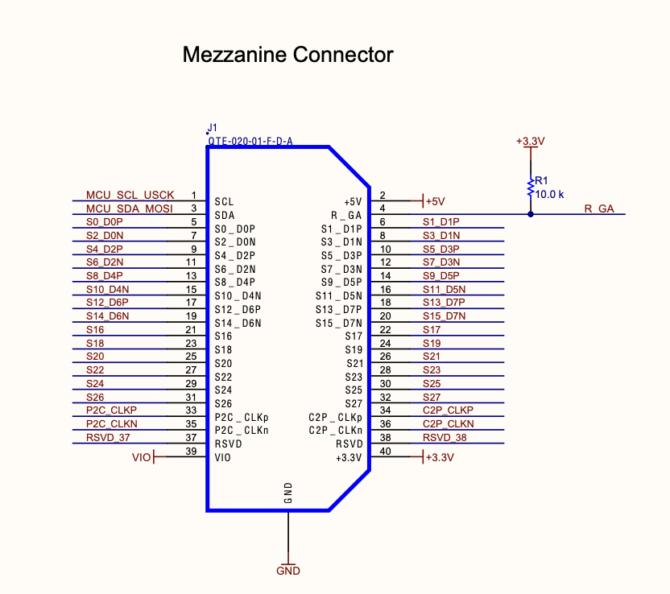
Troubleshooting
Solder a cable to Pin 4 – R GA accountable to set the V adjust (regulating voltage for IO pins in the daughterboard setting up the address for I2C communication from FPGA)
(it doesn’t want to communicate unless the VIO is compatible with Daughter board and FPGA logic gates)
The rest of the zmod pins are accessible from the component highlighted by white in the bottom left pic

Slide 8
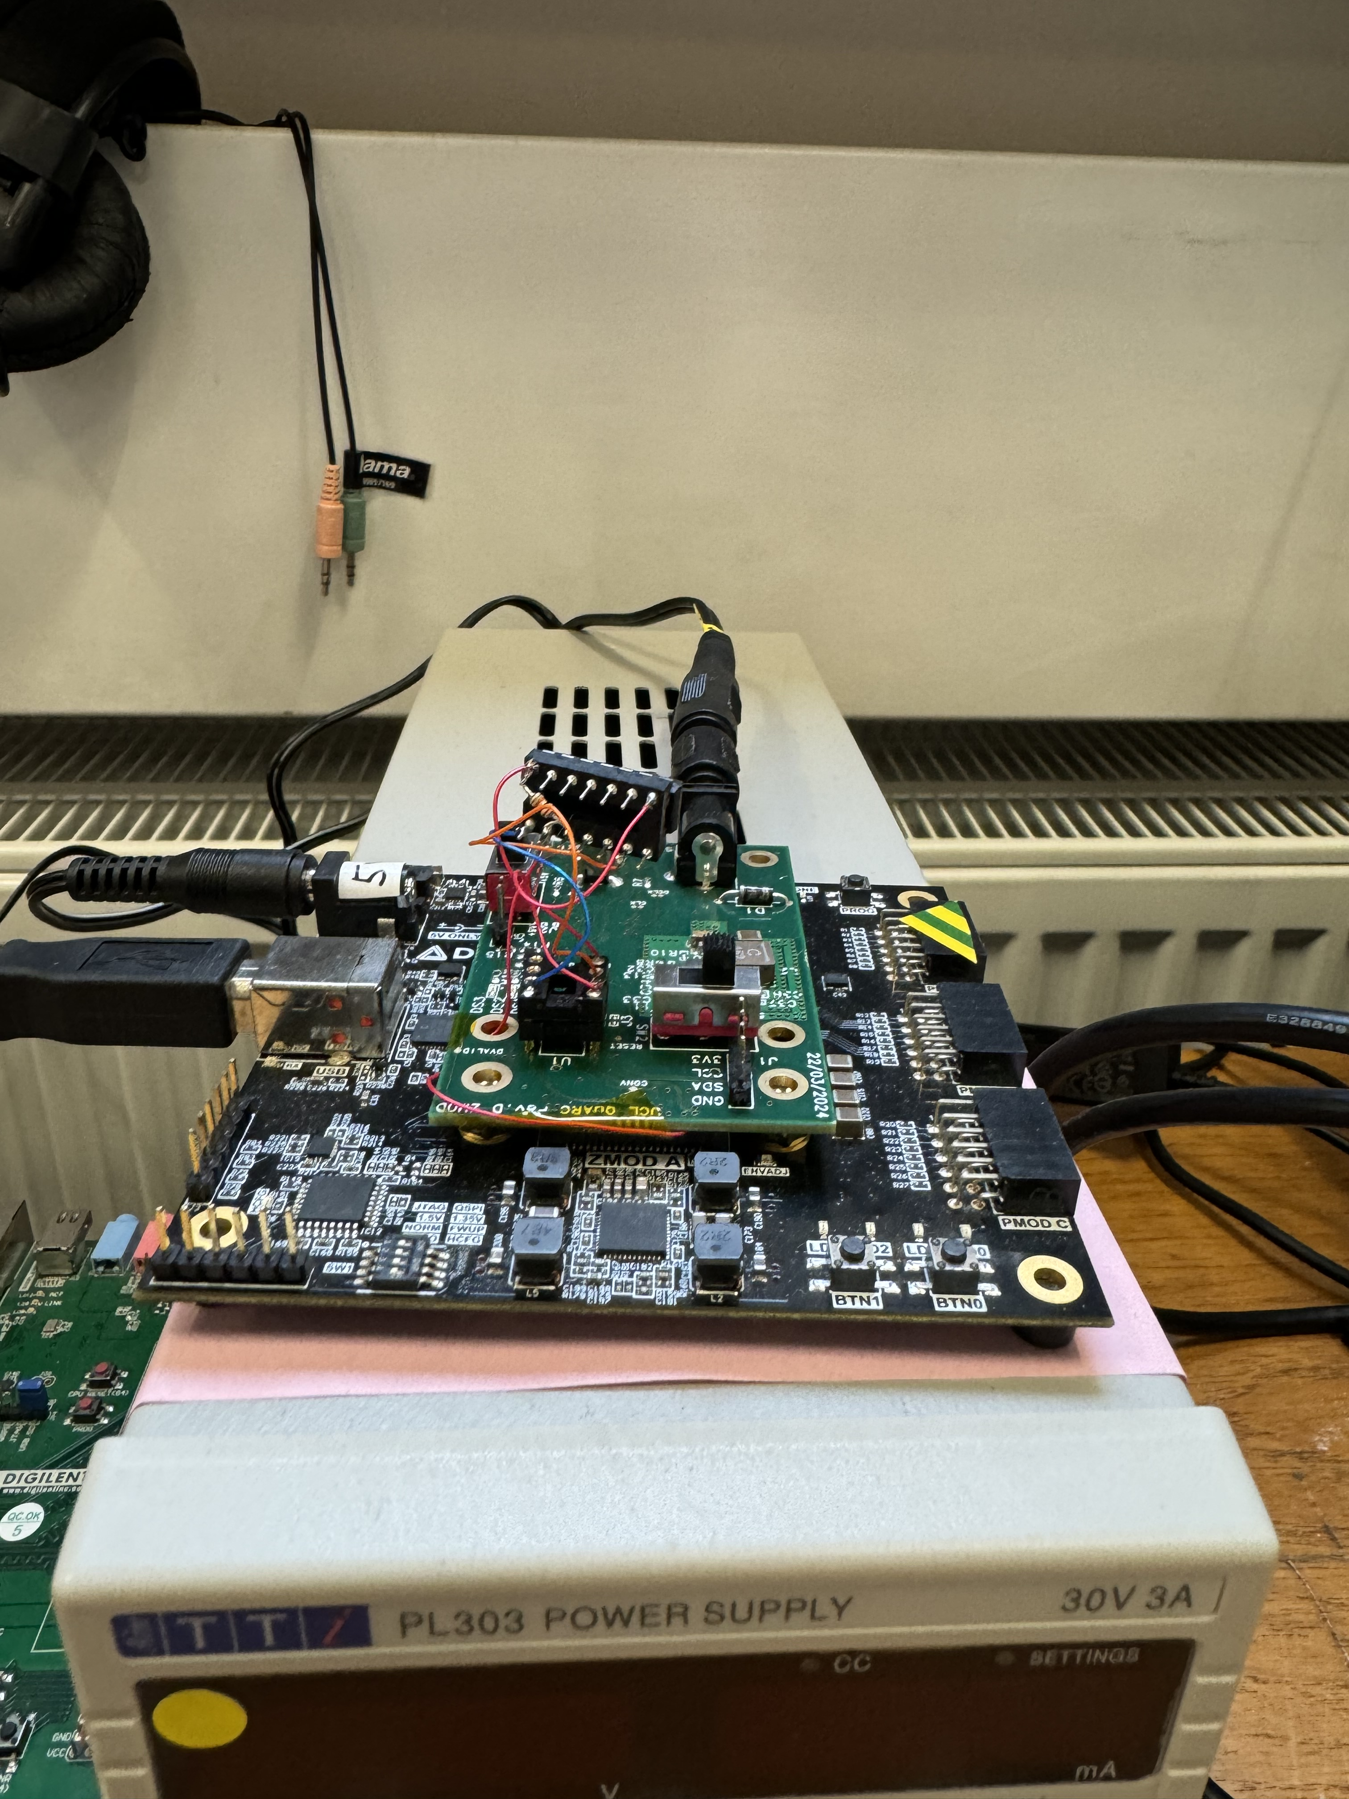
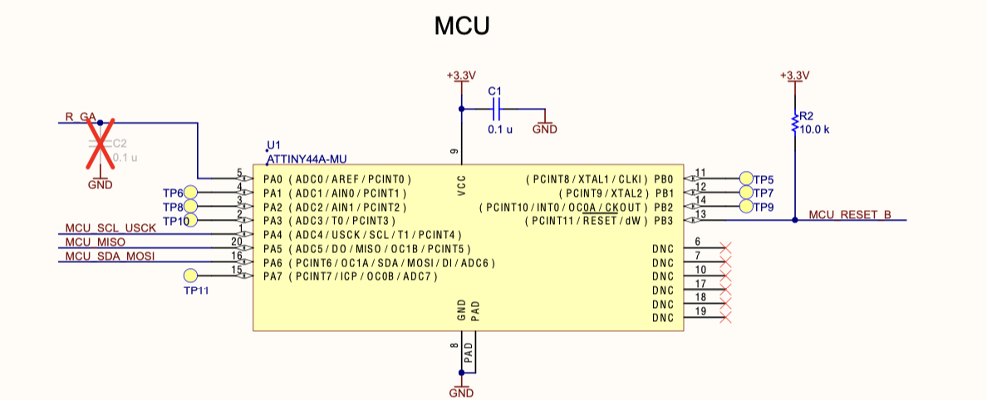
Troubleshooting
Utilising the soldered cable, bypass the zmod port and connected to the external MCU component (16pins).
It responsible for I2C and act as the EEPROM giving the personality to the board, gives address and IO connection. Inserting the right parameter to EEPROM allowing development on the board.
EEPROM (Electrically Erasable Programmable Read-Only Memory) is a type of non-volatile memory used in electronics to store small amounts of data that must be preserved when power is removed. Unlike regular ROM, EEPROM can be erased and reprogrammed electronically, allowing for data updates without removing the chip from a circuit. It is often used for storing configuration settings, calibration data, or other system parameters that may need to be changed during device operation.

