Slide 1
USBC Port Labelling
ZMOD Daughterboard rev#2
11/12/2024

Slide 2
Outline
Background: Before proceeding to printing PCB, review on the electronic design is conducted.
After checking the DDC232 Design (which I just find recently sinking in a long email) there seems to be a USB-C pins translation mismatch.
  No big deal as it’s just the matter of assigning the pins in FPGA (It remains functioning) but it could create confusion if needs to be referred later.

Slide 3
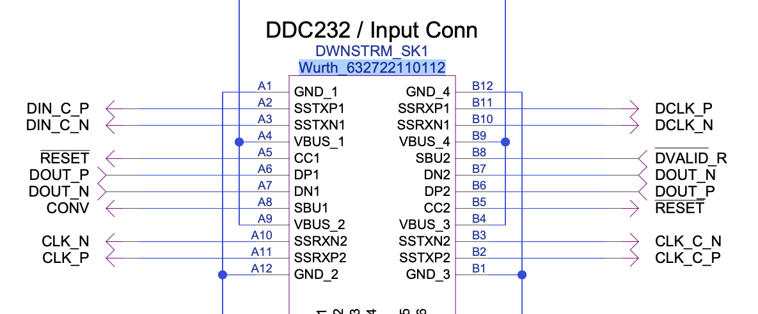
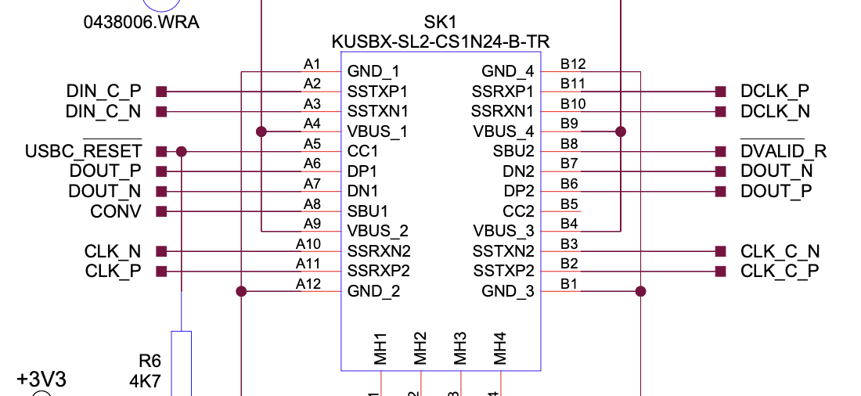
Pete’s Design Labelling
Matching Translation label (A2-A2, A3-A3) – is not achievable??
If the cable orientation and port match, A2 – A2, The other side will be A11
If the cable orientation and port is A2 – B2, the other side will be B11 (like Marko Example)
ZMOD Board USBC Port Pin

Slide 4
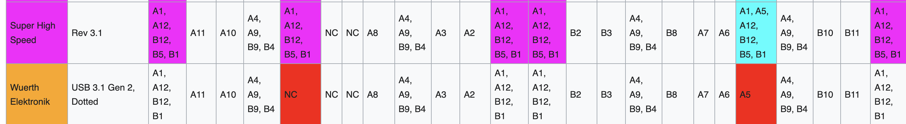
Refer to USB-C Cables Tables

Slide 5
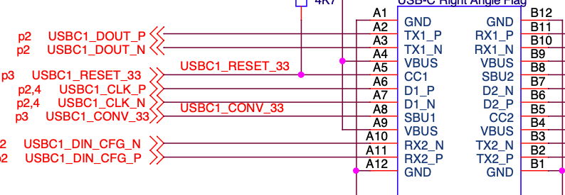
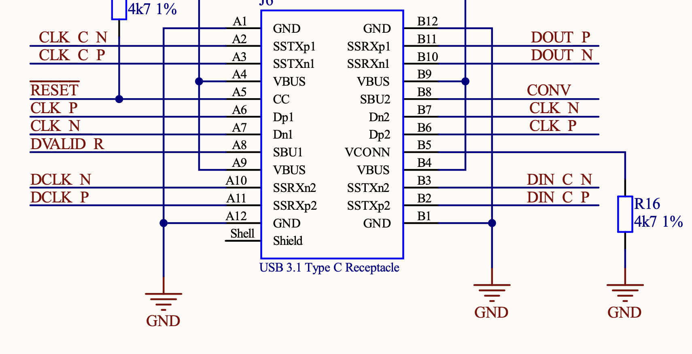




Example Marko Design
FMC Daughterboard
DDC232 Board
Design shows USB-C Port Pins
A2 and A3 translates to B11 and B10 – means the cable connected to A2 and A3 Port pins on FMC is equal to B2, B3 cable pins which – on the DDC232 board equals to B11, B10 respectively.
Similarly for A10, A11 DIN CFG.
A5 (CC Pins Reset) translates to A5 in DDC as well – A5 port – B5 Cable – A5 Other side.

Slide 6
Proposed new labelling for ZMOD
Matching to the DDC232 Port input as it has been printed
DCLK_P
DIN_C_P
DCLK_N
DIN_C_N
RESET
CONV
DOUT_P
DOUT_N
DOUT_N
DOUT_P
DVALID_R
CLK_C_N
CLK_N
CLK_C_P
CLK_P
Regarding CC pins, I would say, the ZMOD Daughterboard CC2 pin remains floating is not a problem.

