Slide 1
USB-C Cable Tests Conclusion and First DaQ Attempt
17/01/2024

Slide 2
Outline
USB-C Test Conclusion
Background
Cable Category
Data Acquisition notes and set-up
Apple Mac M2 Chips
Outcomes
Other
Jumper Board to Jumper Board translational Pin

Slide 3
Background
Based on previous results and trials, only a certain USB-C cable provided by the manufacturer of the board (CosyLab) works.
That’s why many USB-C cable are tested to find out the properties of each cable
However, the results are not the best either (noisy and some not responsive to a certain Photodiodes)
Potentially due to the digitization cut-off and the different in length of the cables compare to short molex
Hence, Using a shorter USB-C cable should works the samely as the short molex cable in DaQ
Otherwise, FPGA coding needs to be modified to adjust the length of the cable

Slide 4
USB-C Cable Conclusion
The colour code on “Cable Make” Column shows the Grouping of the same properties/behaviour cable

Slide 5
USB-C Cable Conclusion
Generally, the Magenta colored one is the most popular type regulating in the market. (4/11 cable tested)
Characteristic: either one of the CC pin (A5/B5 depends on the polarity) is grounded
Marko (Cosylab Recommended one) is just found once in the market. The other 3 is recommended right away by CosyLab
Characteristic: There is no connection in CC pin A5 and Connection on CC pin B5 is one way to CC pin A5
The blue colored one: (doesn’t seem to suit in our application due to missing feature)
Characteristics: Both CC pin is grounded.

Slide 6
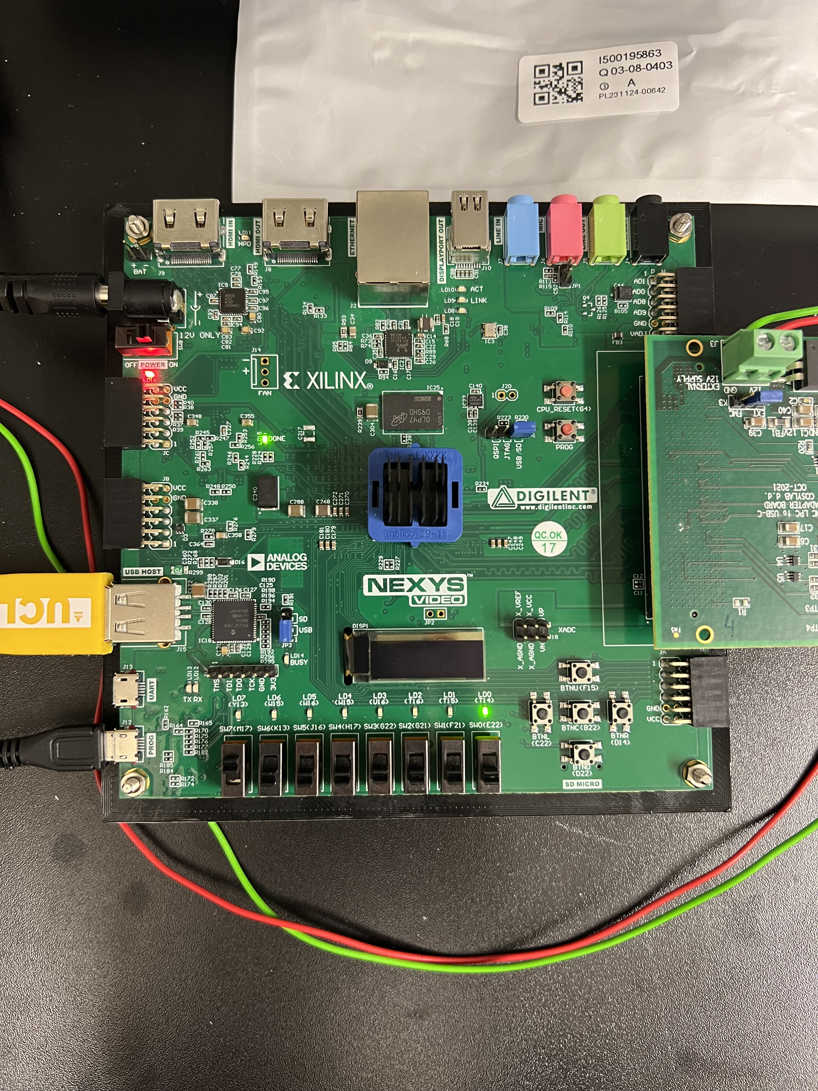
DaQ Setup
Nexys FPGA needs to be configured using USB (transferring the RevD_USBC.bit) all the time after turning off the FPGA.
It started blinking orange LED4 (LHS pic)
When its reading the file, it shows constant LDI4 on (LHS pic)
When it’s ready to capture data, it shows 2 green LED (LDI5 and LD0)(RHS Pics)
Tried running on blinking orange results:
libFTDI initialised!
FTDI device opened!
Set mode to synchronous FIFO
Assigning FSR... setting 12.5pC... successful.
Assigning integration time... failed. Error code: -1 usb bulk write failed

Slide 7
Installing root
Needed to compile liveplot.cpp and DaQ process
Using Package Manager:
Macport:
Sudo Port Install root6
Brew (requires full Xcode App):
Brew install root

Slide 8
DaQ on Mac M2 (Apple Silicon Chips)
It works!
Some Troubleshooting:
Use sudo g++ -L/opt/local/lib -I/opt/local/include/libftdi1 -lftdi1 -std=c++17 FTDI.cpp -o FTDI

Slide 9
DaQ Attempt
Connection from FPGA microUSB to Laptop directly to USB-B port (Intel Mac):
Using MultiCompPro Short USB-C Cable:
1801000000000000000000000000000000000000000000000000000000000030F066012480F690551801000000000000000000000000000000000000000000000000000000000030F066012480F69055
Using Wuerth Elektronik Long Cable:
1C0080000000000000000000000000000000000000000000000000000000001878320192407B582A9C00800000000000000000000000000000000000000000000000000000000018782300A0407B5878
Using Baolongking Short USB-C Cable:
1801000000000000000000000000000000000000000000000000000000000030F066012480F690551801000000000000000000000000000000000000000000000000000000000030F066012480F69055

Slide 10
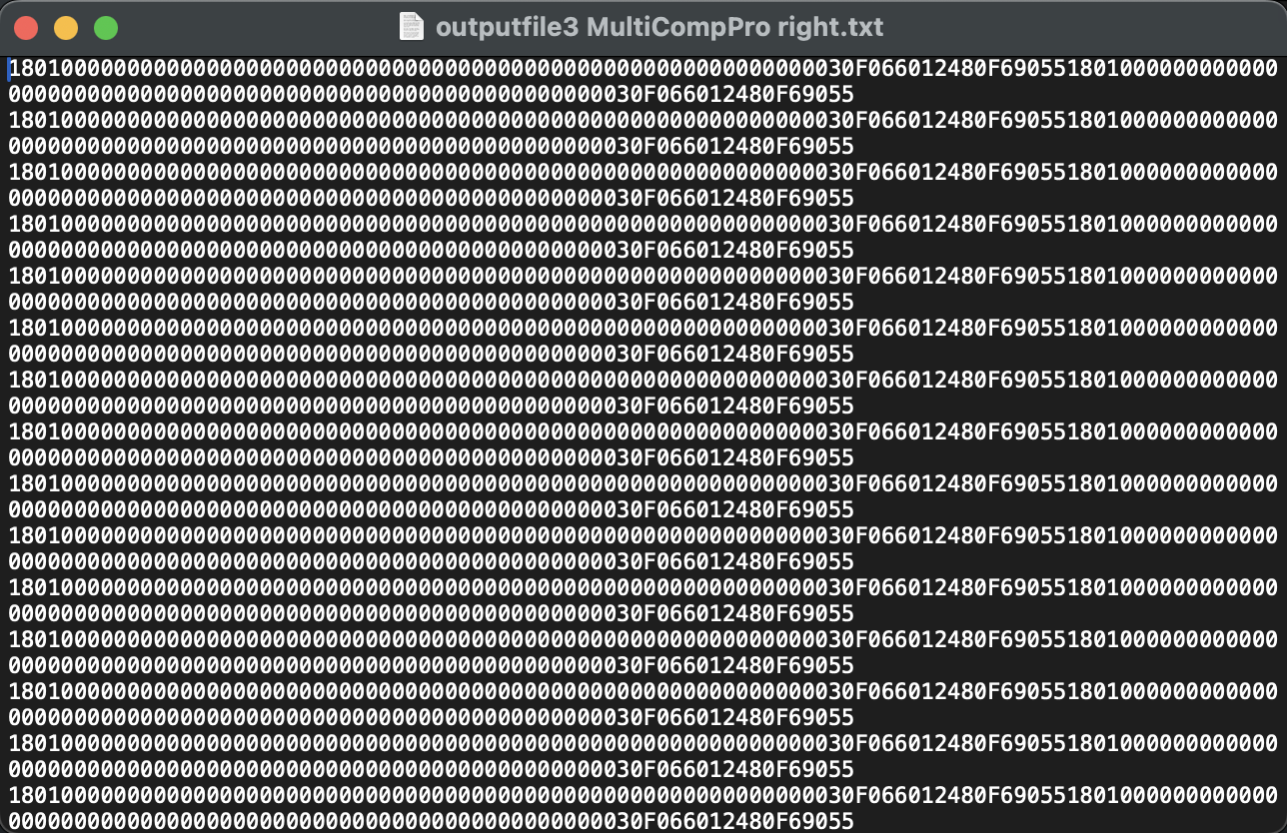
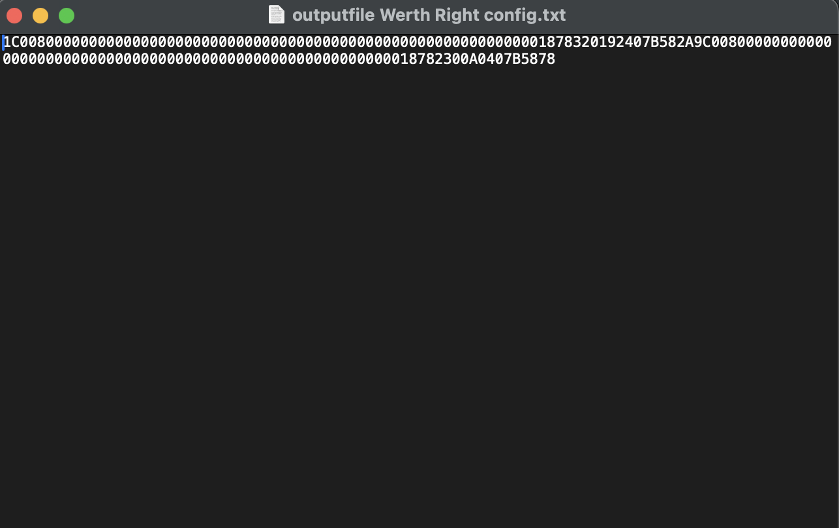
DaQ Attempt
Using MultiCompPro Short USB-C Cable: (not sure why, Can’t generate Liveplot results yet due to this)
Using Wuerth USB-C Cable:

Slide 11
DaQ Attempt
Connection from FPGA microUSB to Laptop directly to USB-B port (Intel Mac):
Using MultiCompPro Short USB-C Cable:
1801000000000000000000000000000000000000000000000000000000000030F066012480F690551801000000000000000000000000000000000000000000000000000000000030F066012480F69055
Connection from FPGA microUSB to Mac Port Adapter to Mac USB-C Port (Apple M2):
Using MultiCompPro Short USB-C Cable:
1811000000000000000000000000000000000000000000000000000000000030F066012480F690551811000000000000000000000000000000000000000000000000000000000030F066012480F69055
Same result obtained from long cable MicroUSB FPGA direct to USB-C port on Mac

Slide 12
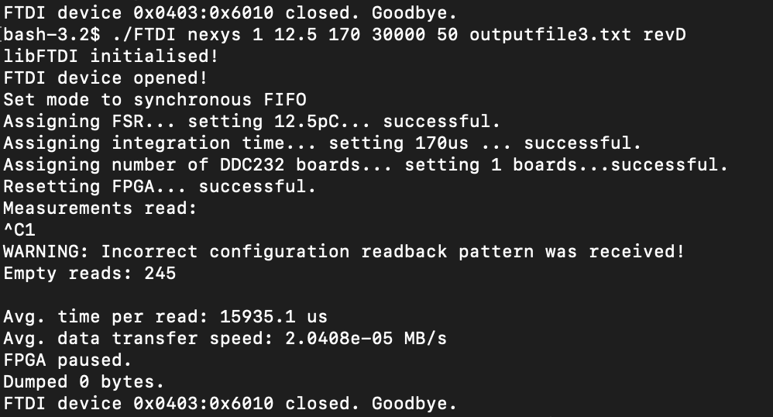
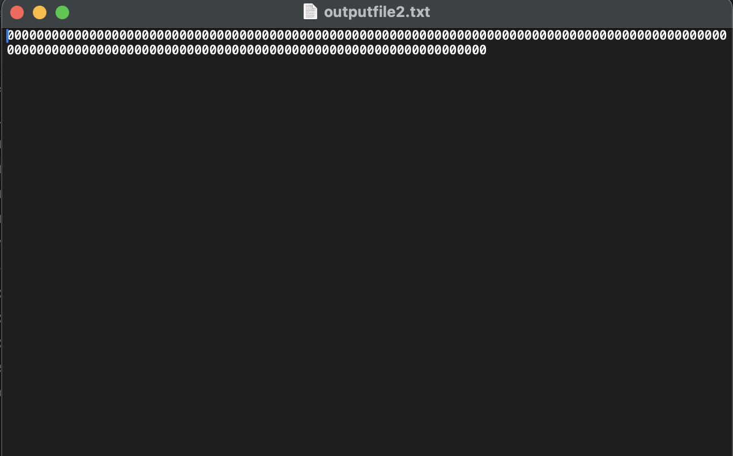
DaQ Attempt
the connection from FPGA microUSB to Laptop directly to USB-B port (Intel Mac):
If the FMC to DDC board USB-C connection is flipped:

Slide 13
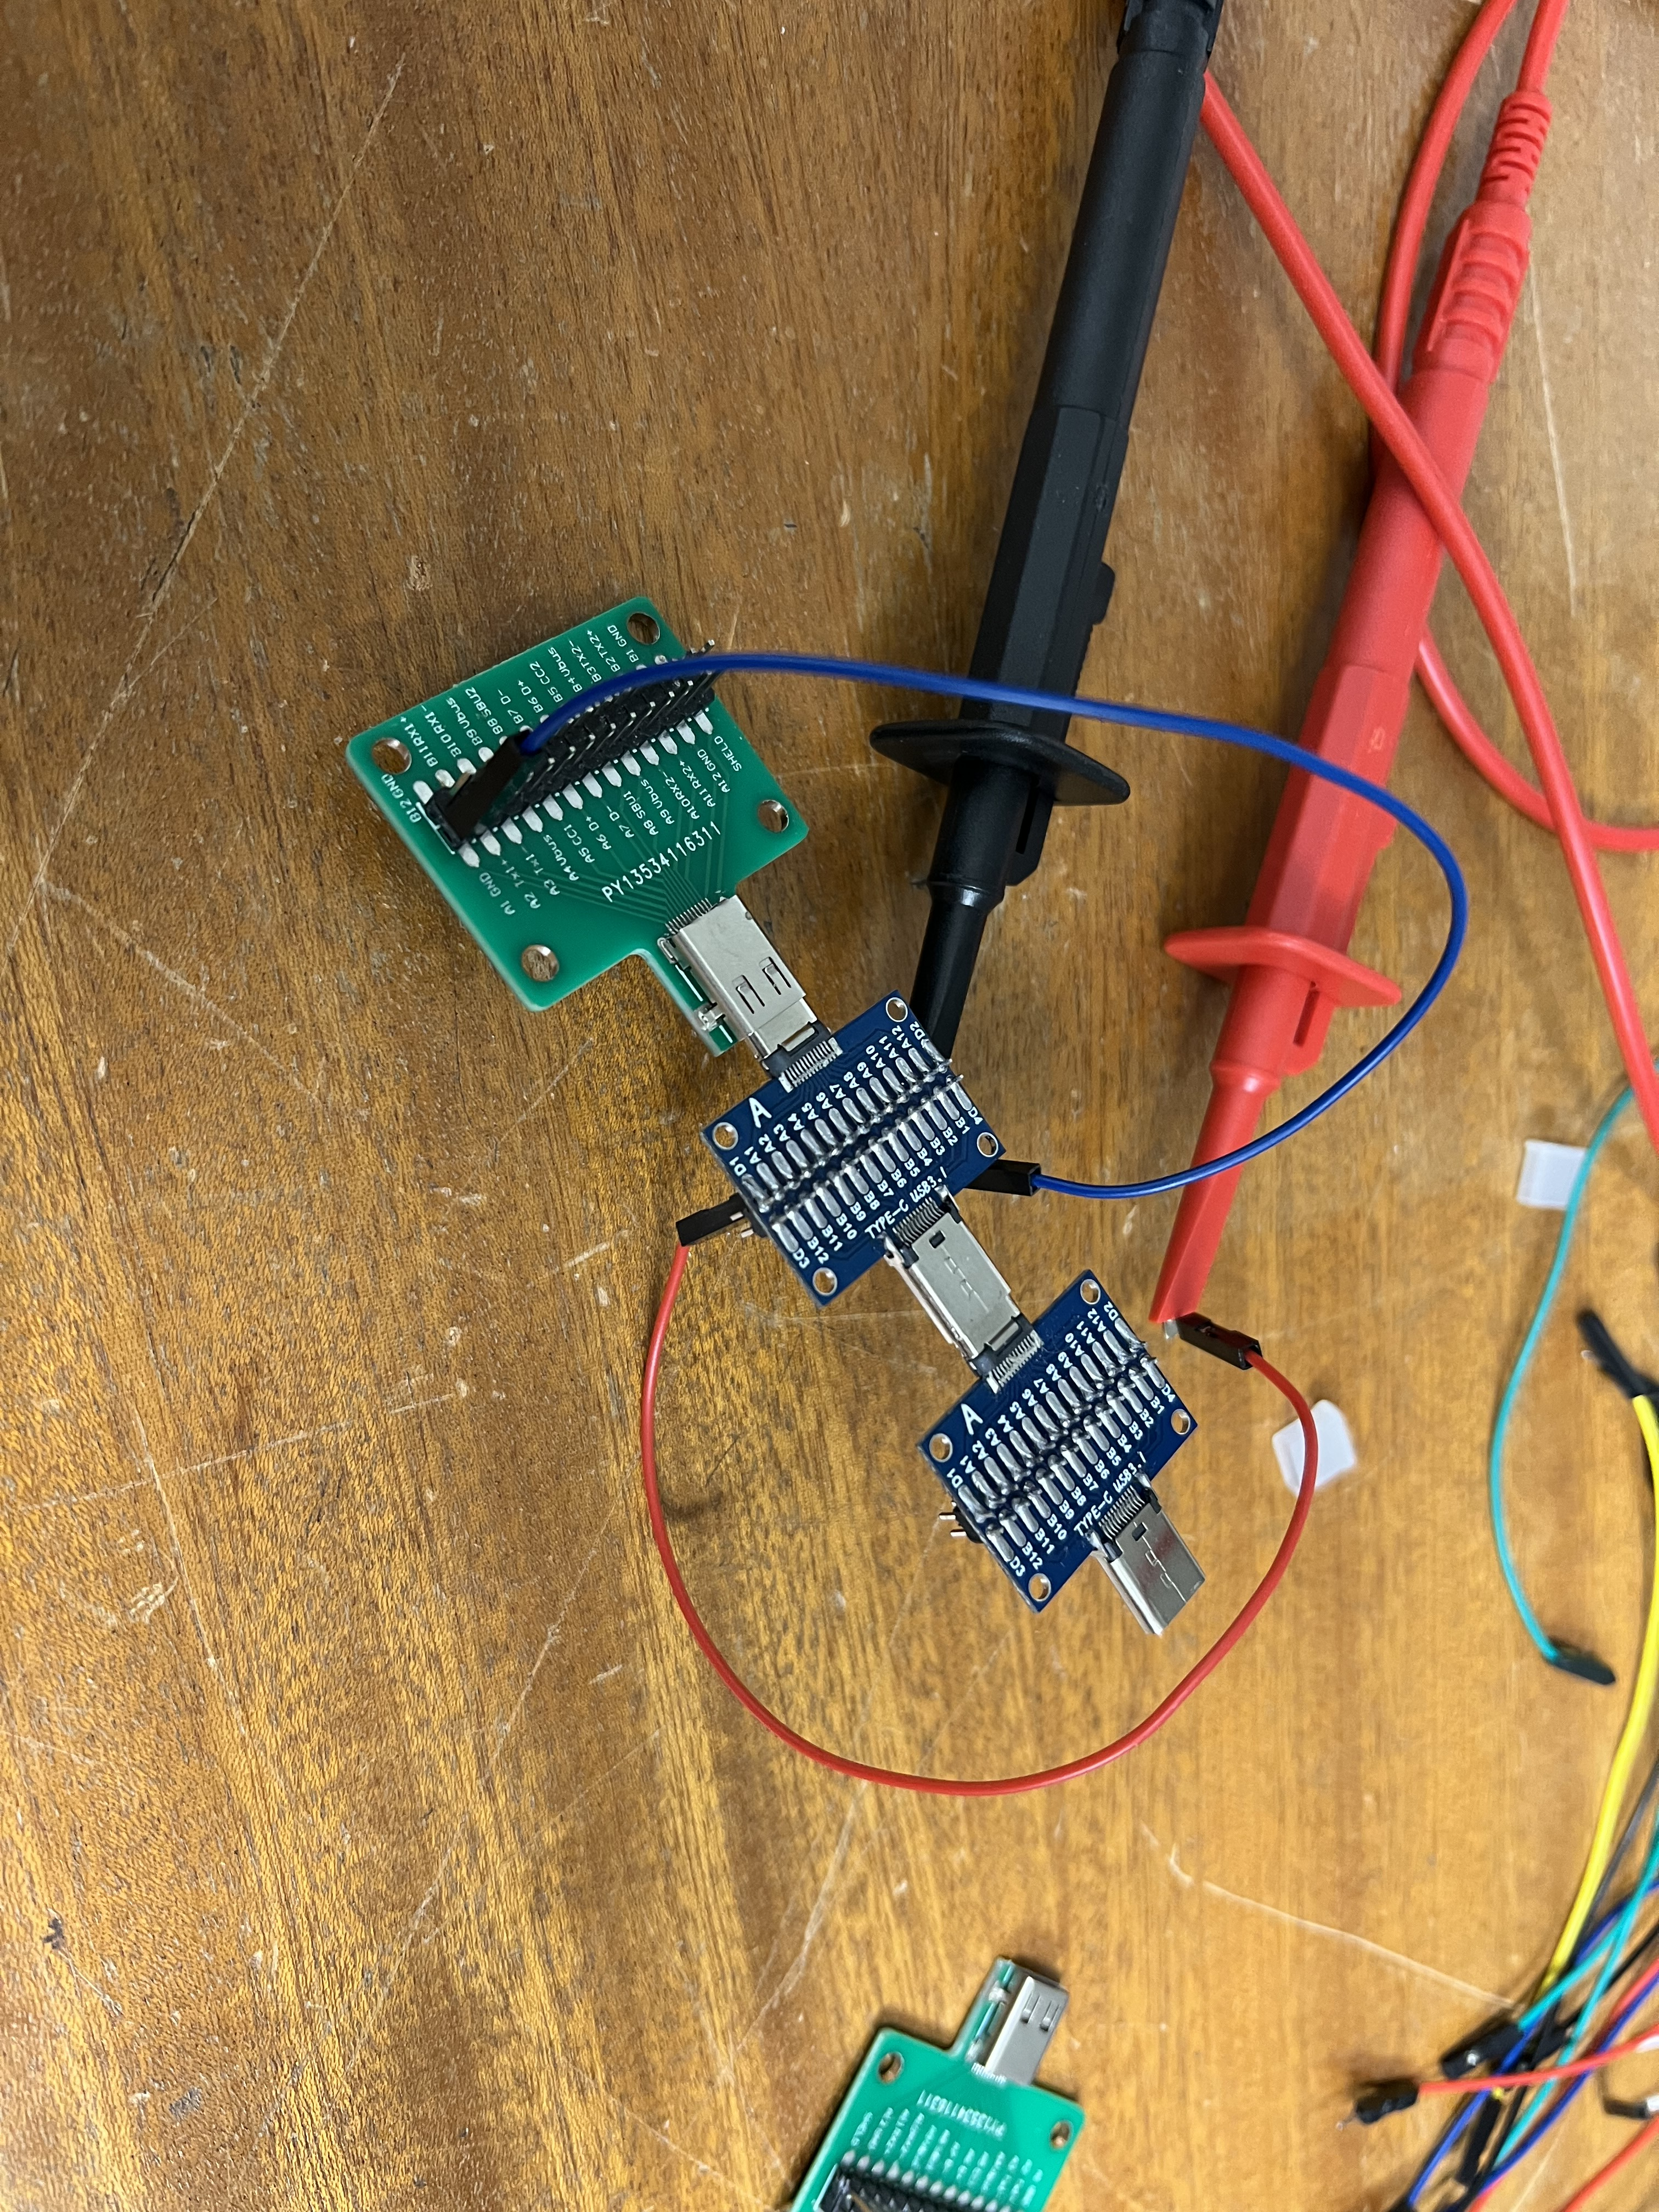
Jumper board translation
Why do we care?
We might need to jumper the connection of the USB-C cable pin from FMC Board to DDCBoard to utilize effectively
The configuration in the left top side picture resulting a mismatch of translation:
A1 pin on green jumper board – B1 on blue board
B1 on LHS blue board – B1 on RHS blue board
The configuration in the left Bottom side picture resulting a direct translation:
A1 pin on green jumper board – A1 on blue board
Therefore, it’s just a polarity issue, worth considering and keep in mind.

