Slide 1
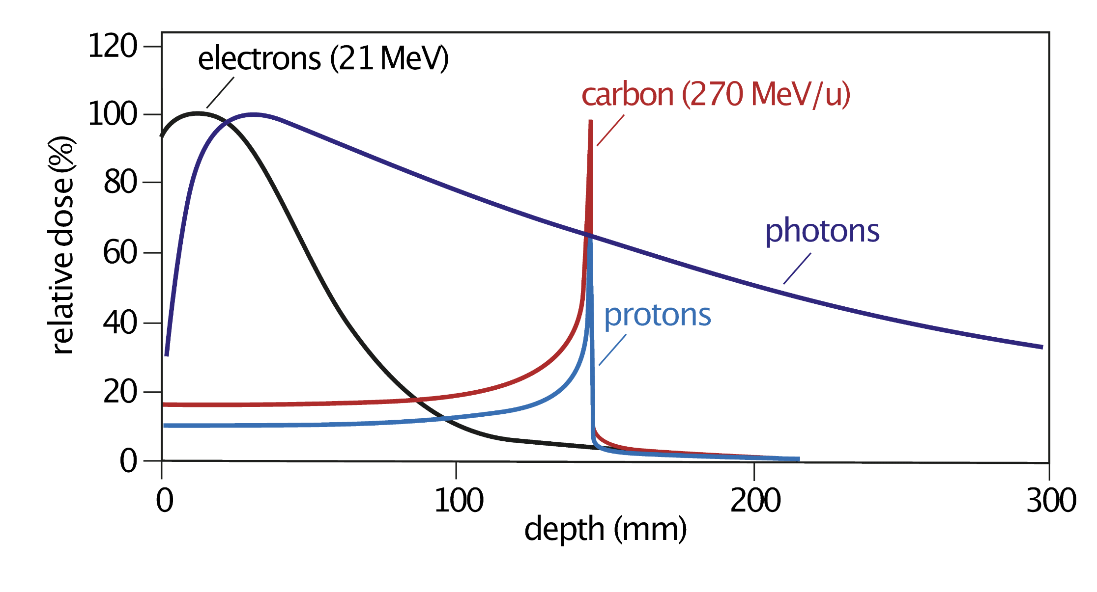
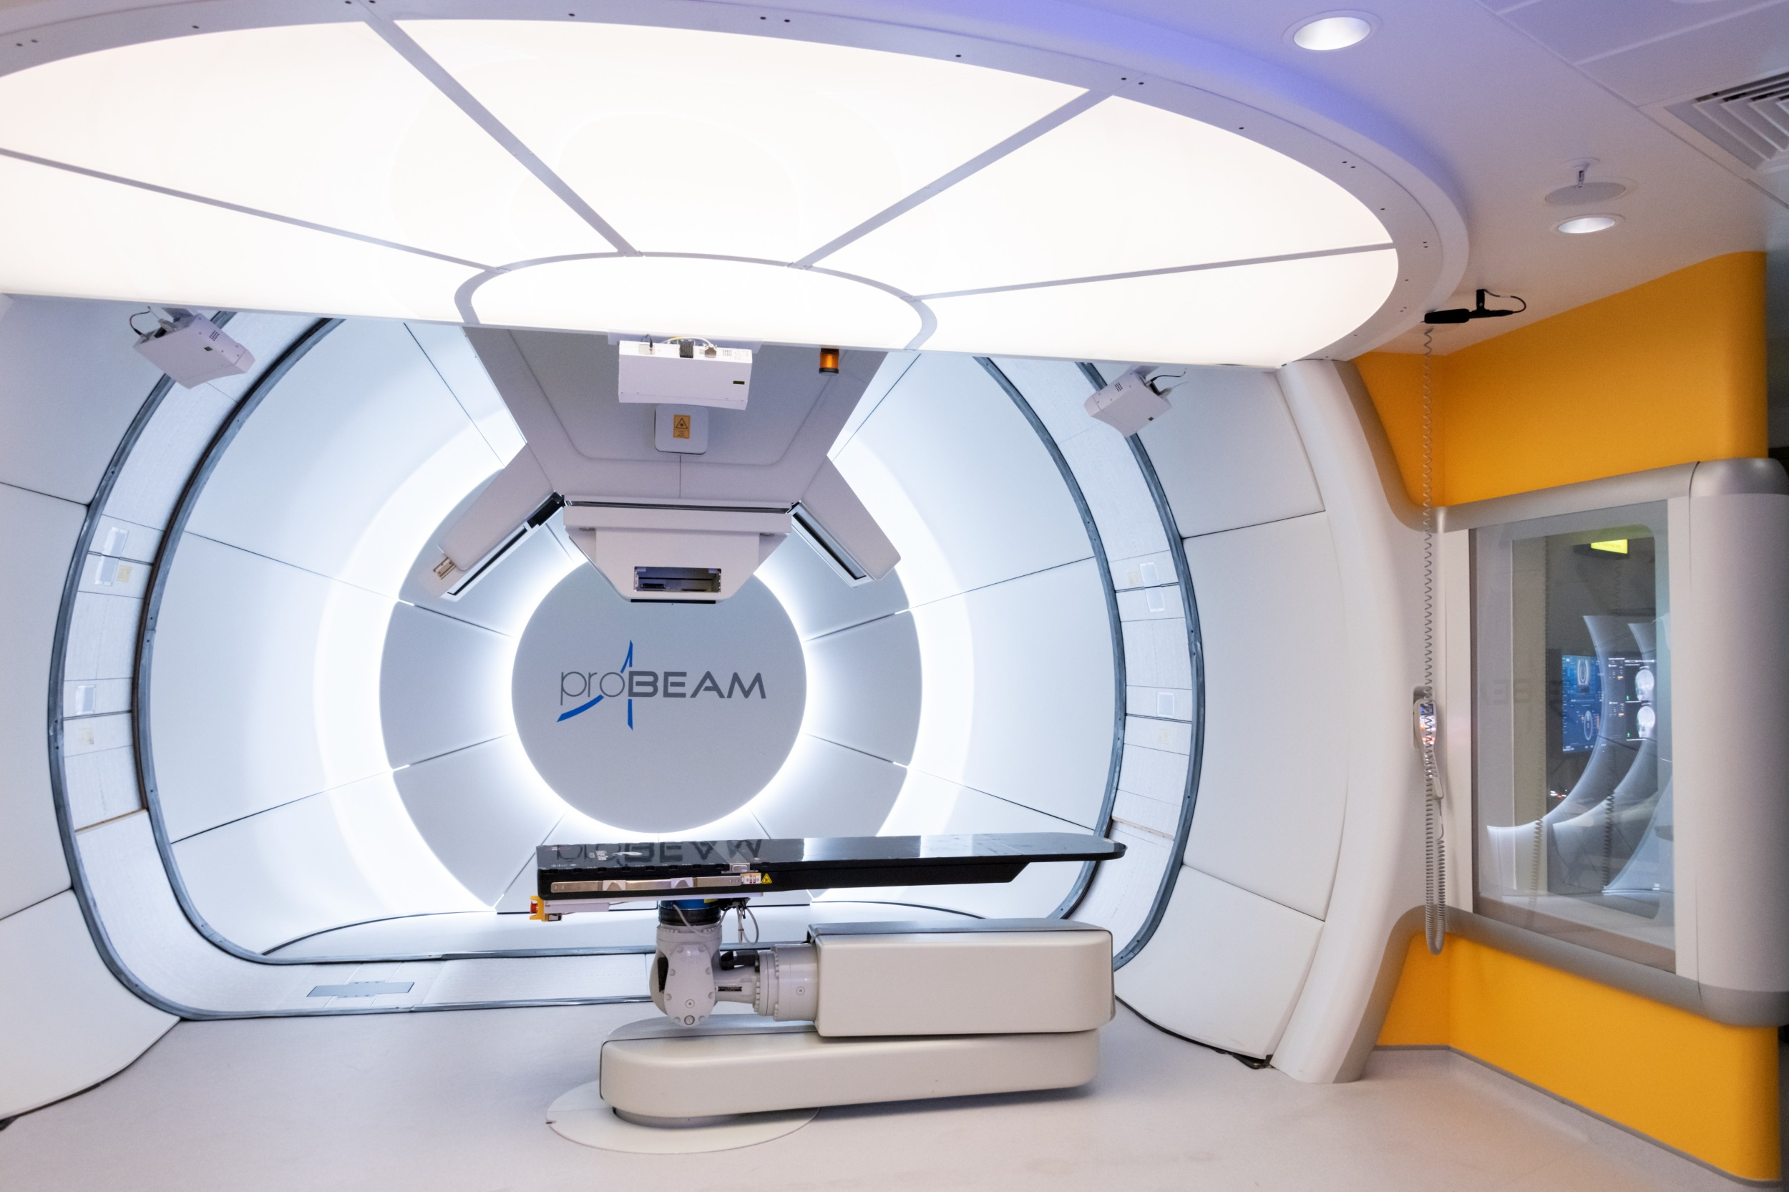
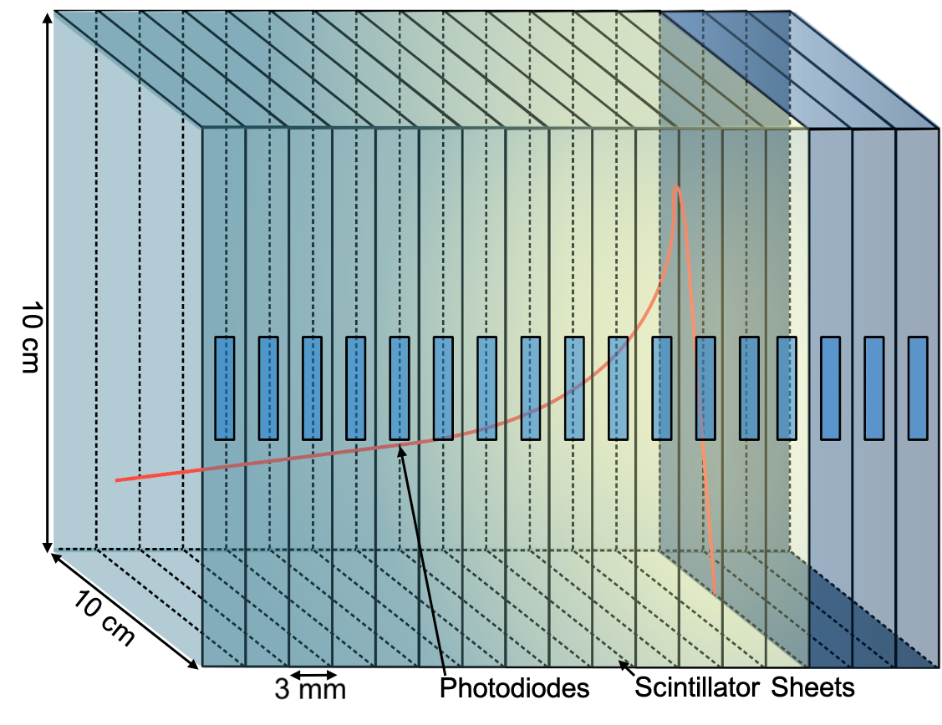
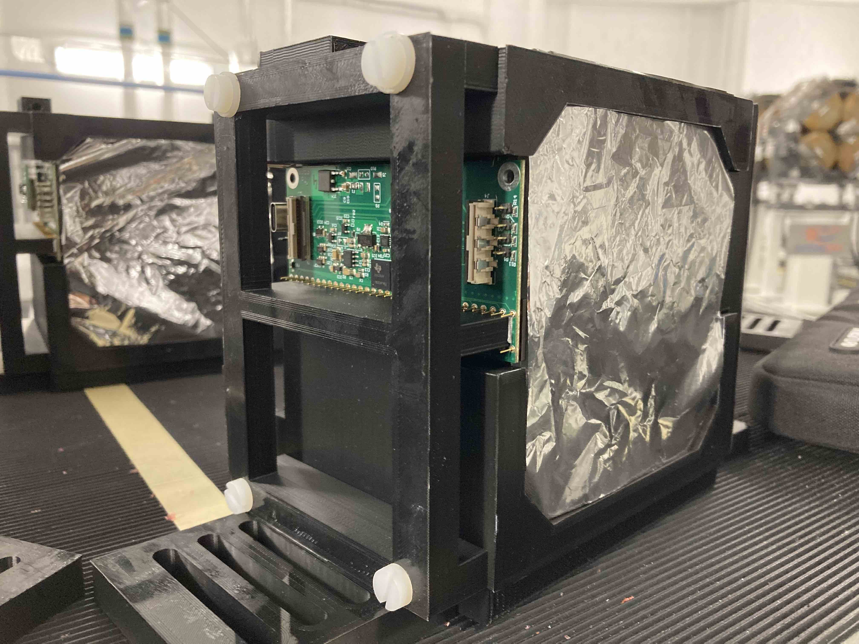
FPGA Optimisation and Machine Learning in Proton Beam Therapy Quality Assurance Device
Physics and Astronomy Department
Bragg Peak
Source: CERN
Source: UCLH NHS
UCLH Proton Beam Therapy facility
Source: Escribano – Rodriguez (2023)

Slide 2
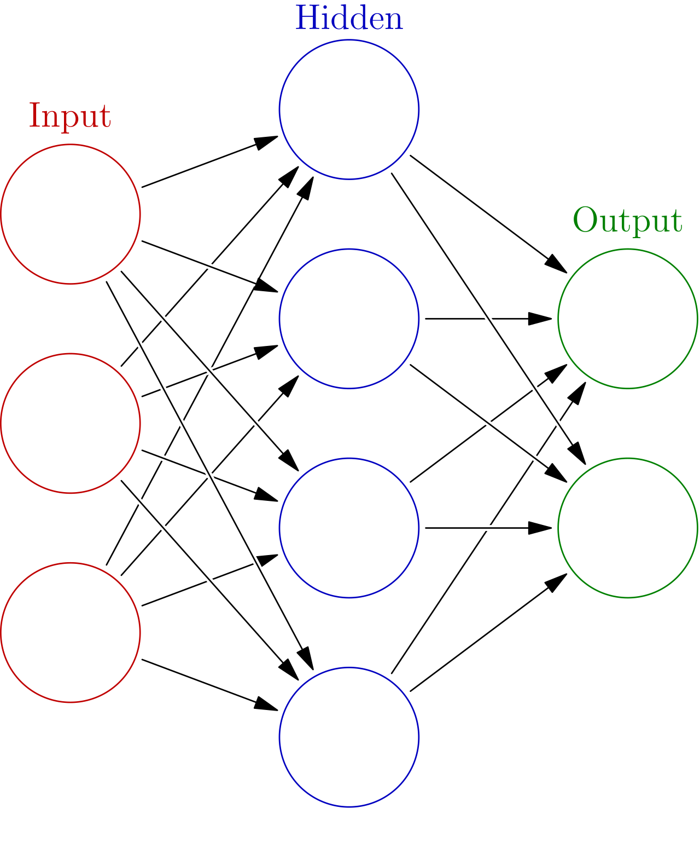
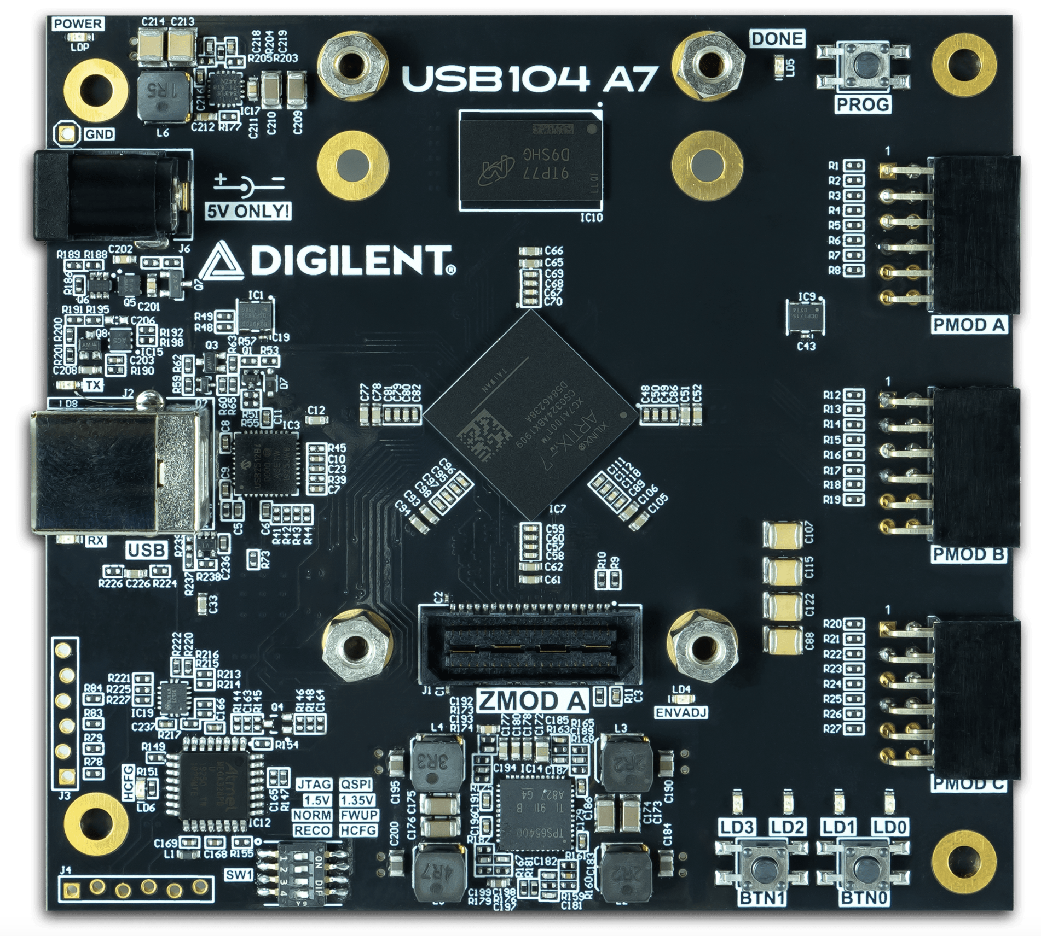
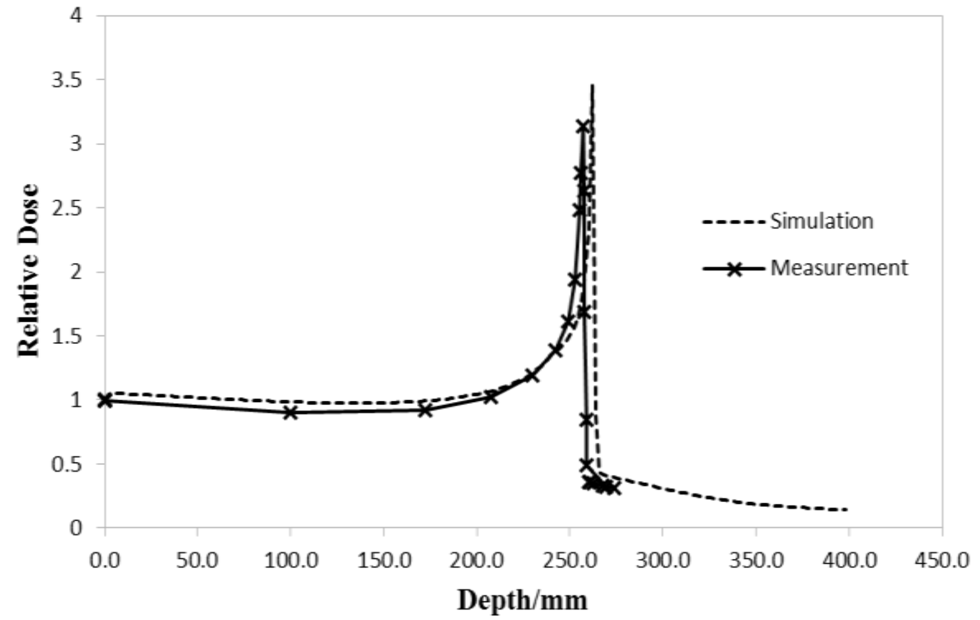
FPGA Optimisation and Machine Learning
Source: Escribano – Rodriguez & Sheikh (2023)
150 MeV
70 MeV
Carbon Ions
Monte Carlo
AI Model
Source: Digilent
Source: Keat (2017) – ResearchGates/330824578
Notes:
We interface the device using FPGA,

