Slide 1
ZMOD Daughterboard Rev#2
Updates, 27/11/2024

Slide 2
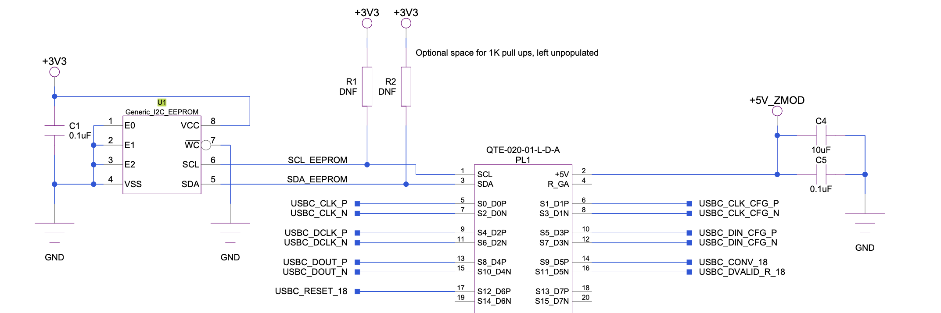
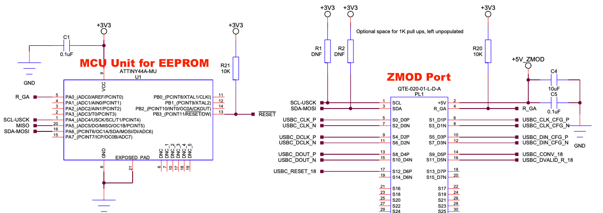
Rev#1
Rev#2

Slide 3
Changes
Generic I2C EEPROM Component in Rev#1 to use ATTiny44A-PU
  Generic only handles connection but not enabling I2C and SPI (Serial Peripheral Interface) - a communication protocol that allows multiple integrated circuits (ICs) to communicate with each other over a short distance using just two wires: a serial data line (SDA) and a serial clock line (SCL).
  SCL USCK (Universal Synchronous Clock), SDA from ATTiny44A-PU, MOSI(Master Out Slave In) and MISO Master In Slave Out) – Bi directional data transfer from master and slave device.

Slide 4
R_GA (Resistor Ground Assist): Reference resistor (pull-down resistor) provides reference voltage for all components to communicate (determines current flowing when line is low (I2C using MOSFET – like switch))
  This provides I2C address (The I2C address of each pod is determined by a resistor divider formed between the carrier and the pod. A pulldown resistor R_GA is connected to each port on the carrier. Each port uses a unique resistor value. On the pod, a 10-kΩ pullup resistor is connected from R_GA to +3.3V. The R_GA net is connected to one of the pMCU ADC input pins, and the resulting voltage is used to determine the I2C address of the pod)
In the design, “DNF” indicates Do Not Fit, it’s there in design but not to be printed out. (for further design purposes, no need to change the design)

Slide 5
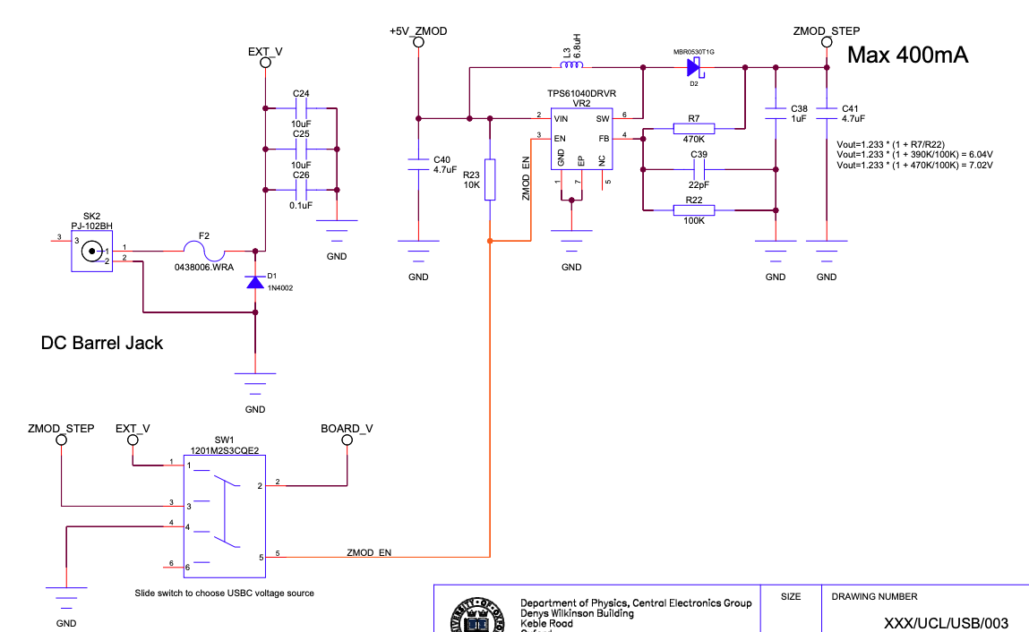
TPS6104 Voltage Booster, step up 5V to 7V using Common value resistor,
Switch to take supply from Ext_V/ZMOD_V at the same time disabling V booster when not beeded

Slide 6
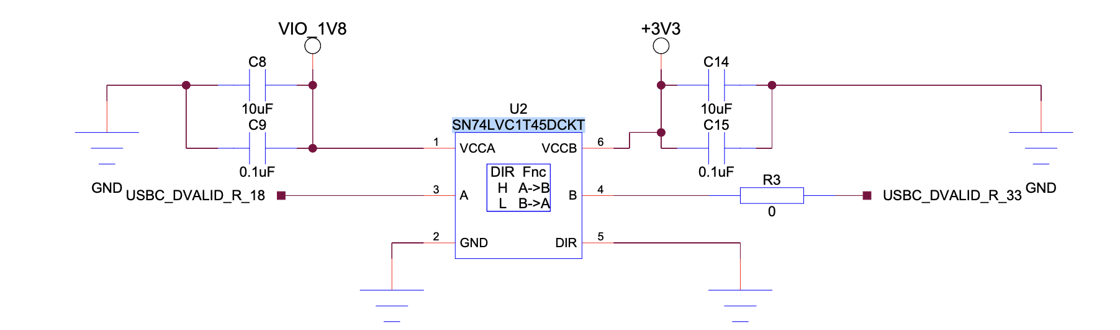
Level Shifters
SN74LVC is a single-bit bidirectional voltage level translator, It allows signal translation between two voltage domains, enabling proper communication between components operating at different voltage levels.
Dir (direction control) is grounded means low, VCCB translate to VCCA (3.3V to 1.8V)

Slide 7
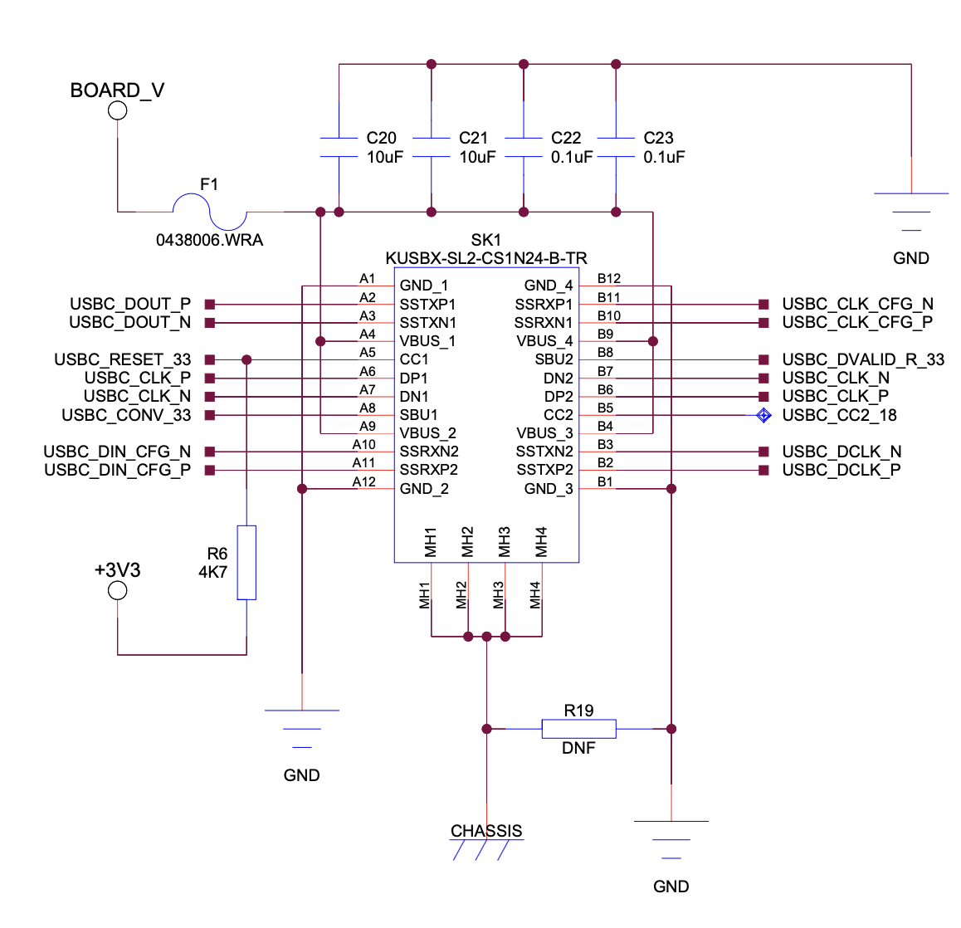
USBC Port
Takes V, from Board_V value (ZMOD_STEP or ext_V)
MH (Mounting Hole) Chassis is metal enclosure or framework of the electronic device. It can also be part of the case or housing for the product, often used for mechanical protection and grounding.
Dvalid R_33 is connected from USBC port to DDC,
Dvalid R_18 is connected from Zmod to FPGA (this requires the level shifters)

Slide 8
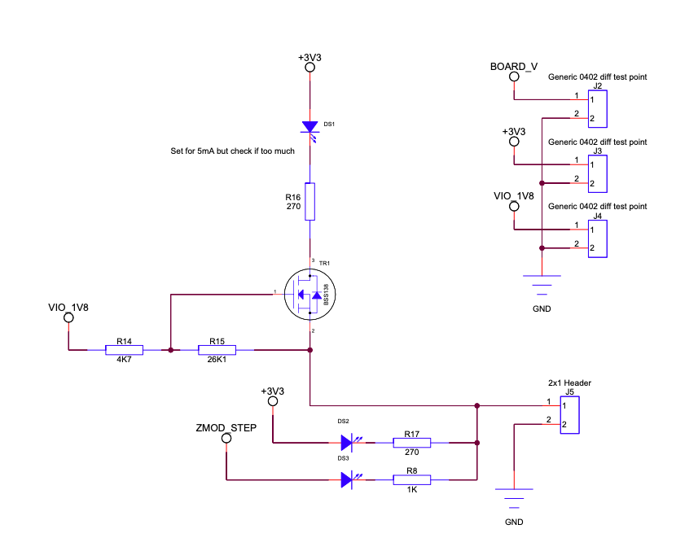
LED for power debugging process. To check the power supply using jumper pin. Meaning that it left floating when not necessary to not incur any unnecessary noises.

Slide 9
Notes
Why Capacitors connected to power supply:
  Prevention of voltage spikes of the supply, preventing damage to the board it connected to
  Decoupling noise from power supply ripple, board receive clean DC voltage
  Energy storage, ensuring smooth transition when turn on and off.
QFN (Quad Flat no-Lead) and DIS(Dual in line package)?
  The IC pins, under the components or extend outside (QFN smaller and more compact) – QFN needs to be printed in to the PCB, DIS can be manually soldered

