Slide 1
Raspberry Pi 5: Setting Up + Initial Tests
Sonia Escribano Rodriguez
26/01/2024

Slide 2
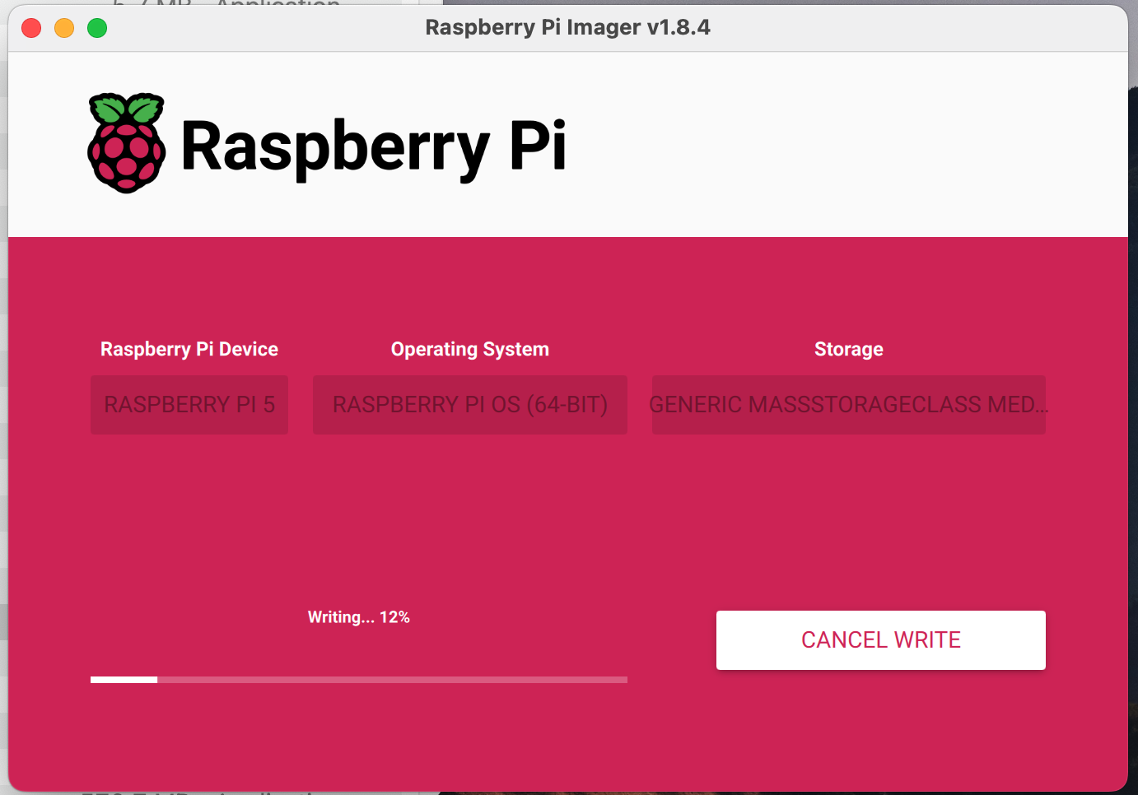
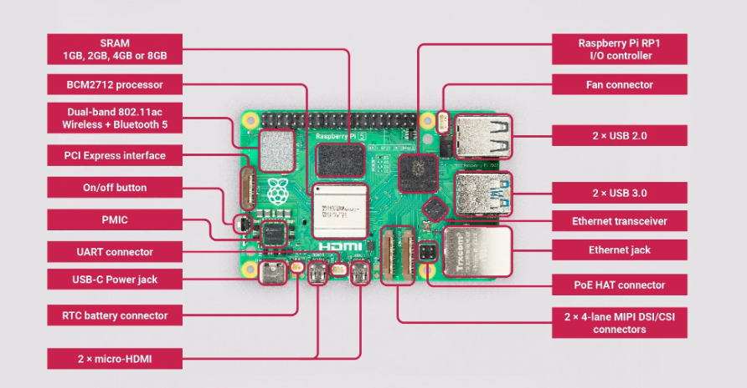
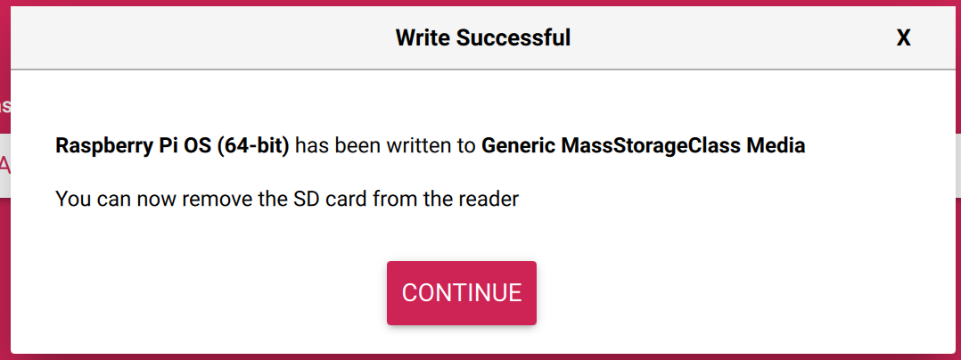
Installing OS with raspberry pi imager
When it is first turned on we get an error message: failed to open sdcard device. If we use the sdcard from pi4 it shows that the installed OS is not supported for pi5, so we get a new sdcard and install system using raspberry pi imager.
https://www.raspberrypi.com/documentation/computers/getting-started.html#raspberry-pi-imager

Slide 3
Installing FTDI
Following instructions from wiki we have some issue with Python version (we now need to use python3 instead of just python)
https://www.hep.ucl.ac.uk/pbt/wiki/Proton_Calorimetry/Equipment/ZyboZ7_DDC232#Compiling_and_Running_FTDI_Code
Installation process:
sudo apt-get install build-essential git-core cmake doxygen
sudo apt-get install libusb-1.0 libconfuse-dev swig python3-dev libboost-all-dev
mkdir libftdi
cd libftdi
git clone git://developer.intra2net.com/libftdi
mv libftdi src
mkdir build
cd build
cmake -DCMAKE_INSTALL_PREFIX="/usr" ../src
sudo make install -j4

Slide 4
Compiling FTDI code
Copying the PhotodiodeCode folder code from pi4 into pi5. We face some compilation issues: installation libraries are different, so the code needs to be compiled as follows
This gives the warning on the right but creates the executable

Slide 5
DAQ: acquisition with nexys
- 1st test: acquiring 100k measurements, no visualisation. The average time per read is 223us (higher than 170us from the NUC, but lower than the 270us from pi4)
./FTDI nexys 1 350 170 10000 50 test.txt revB
- 2nd test: acquiring 100k measurements, with visualisation. We need to compile liveplot, but to do so we have to install root before. The installation is slightly different than it is with Raspbian, details of the process can be found here:
https://www.hep.ucl.ac.uk/pbt/wiki/Software/ROOT#Local_Installation_on_Raspbian
We can then compile livePlot script + acquire and visualise data with prog.sh
g++ -o livePlot2 livePlot.cpp `root-config --cflags --glibs` -O3 -Wno-psabi
./prog.sh nexys 1 12.5 0 170 100000 50 true testplotMac.txt revC true

Slide 6
Connecting to pi5 via ssh
Initially the ethernet cable did not seem to connect to the network, and was showing no IP address. We need to contact HEP support so they can add the Raspberry Pi 5 to the HEP laptop network. Once they do it the ethernet connection is working.
- IP obtained correctly when jusing ifconfig
- ssh not allowed. Check it it’s enabled from the configuration tool. In terminal:
sudo raspi-config -> System Interface -> Enable ssh
We now can ssh from MacBook to pi5 (they need to be connected to the same network!)

Slide 7
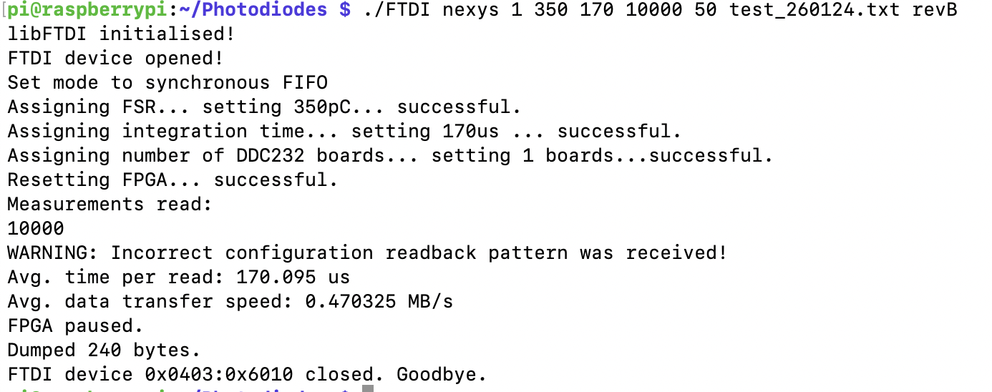
DAQ in pi5 from MacBook via ssh
- When sshing the average time per read is 170us. These are better times than we got direcly on pi5, which was 217us.

Slide 8
DAQ + Plot in pi5 from MacBook via ssh
- Plotting data directly on pi5 is a bit slow but we do not have the freezing issues we had on the pi4. Avg time per read = 217us.
- Plotting data via ssh shows a much quicker update of the graph and the average time per read is 170us.
./prog.sh nexys 1 12.5 0 170 100000 50 true testplotMac.txt revC true

Slide 9
DAQ with plot: FPS comparison
DAQ running on pi direcly only 4 FPS.
DAQ running on pi5, ssh from MacBook (22FPS)
DAQ running on MacBook (35 FPS)

Slide 10
DAQ: acquisition with usb104
FTDI is working but we can’t acquire data with the usb104 board, issue when running the code that does not occur if we use nexys board for the command line. What could be the issue?? Running the same command with the laptop everything works ok
- using usb104 + usb104 in code we get a cannot open FTDI device -4
- using usb104 + nexys in code we get error usb bulk -1 (expected due to inconsistency)
- using nexys+nexys everything works correctly
Compilation gives a deprecation issue with ftdi_usb_purge_buffers but works ok, so the error we are having is not a compiling issue.

Slide 11
DAQ: acquisition with usb104
Looking at FTDI code the line where the -4 comes from is the following. This line remains the same in both codes, so probably is because one of the header files.
Looking at ftdi.h, we observe two differences between them (left pi5, right macbook). Even after commenting these the result is the same, so it’s something else.

Slide 12
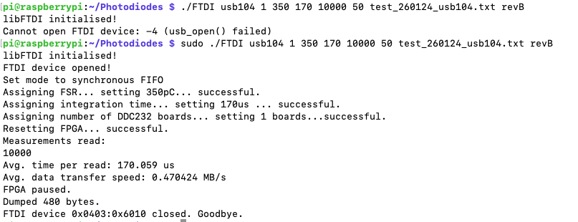
DAQ: acquisition with usb104
If we use usb104 we get an error because we have to use the sudo command for FTDI!!! Not necessary for ./prog.sh

Slide 13
DAQ: acquisition + plot with usb104
Live plot, with a flash pointing at the PD, shows that DAQ is working. Maximum value reached is 27 FPS.
DAQ running on pi5, ssh from MacBook (27FPS)
DAQ running on MacBook (49 FPS)

Slide 14
Conclusions
The previous DAQ has been obtained with the PDboard 6 + daughter board with short ribbon cables + nexys board connected to pi5 via usb and then with the usb104 + Clatterbridge prototype with usb cable.
The results suggest that using pi5 on its own does not meet our requirements but pi5 + ssh from MacBook is a good option for DAQ with acquisition times of 170us.
Live visualisation via ssh shows good results, but number of FPS is reduced in comparison to acquiring directly with MacBook (22 vs 35 FPS for nexys, 27 vs 49 for usb104). Acquiring directly on pi is slower, 4FPS for nexys and 8 FPS for usb104.
Pi5 can be used to acquire data as it shows good results with both boards.

