Slide 1
GUI v2.3
Sonia Escribano-Rodriguez
March 2024

Slide 2
GUI v2.2: next steps
Simplify code + comment it + Document everything in wiki
Use measurement time instead of number? Comment on tINT?
Header lines needed?
Fitting of data: just average? In the same file? Error?
Plot live data? New htmls?

Slide 3
GUI v2.3: run time
Use measurement time instead of number of measurements.
$$n_{meas}=\frac{t_{acq}}{t_{INT}}$$

Slide 4
GUI v2.3: tINT
- tINT > 170us. If value is lower error message is shown and value is automatically set to 170us.
Maximum limit?

Slide 5
Axis: auto-adjustment based on data
Before we had a preset value of x and Y based on the facility. Now the value is based on the data that is being read:
Issue with WET! Not perfect
Values over 50
empty

Slide 6
Axis: auto-adjustment based on data
Issue with x>50 the yaxis unzooms, and plot seems empty. Why?

Slide 7
Axis: auto-adjustment based on data
Issue with x>50 the yaxis unzooms, and plot seems empty. Why? Update both functions at the same time by creating a new function.
This does not work. Could it be because setPhotodiodes is 16? And 16*3=49, so up to this works? -> To test this idea setPD=20, and this should work until 20*3=60. Now plot is not visible

Slide 8
Axis: auto-adjustment based on data
To test this idea setPD=20, and this should work until 20*3=60. Now plot is not visible.
If we setPhotodiodes <16 we get the same error.
setPhotodiodes>16 we do not see anything unless we type maxY first
setPhotodiodes does not need to be adjusted! This is only for fitting data and Pduncalibrated. We only need to adjust setWET from actual data and/or when box is updated and everything works good.

Slide 9
DAQ: live data visualisation from GUI
Before we start visualising data we need to modify the js to only plot fits and display the Ebeam and Erange if the values exist, otherwise we get an error and visualisation is never possible (we don’t have all the data).
The final run will have fitted results, so we can’t simply delete those lines. If condition to establish that if it’s an empty line it will ignore it, and if not it will plot it in the same way we did in previous versions.
→ Future issue: how do we do the fitting of the final run only?

Slide 10
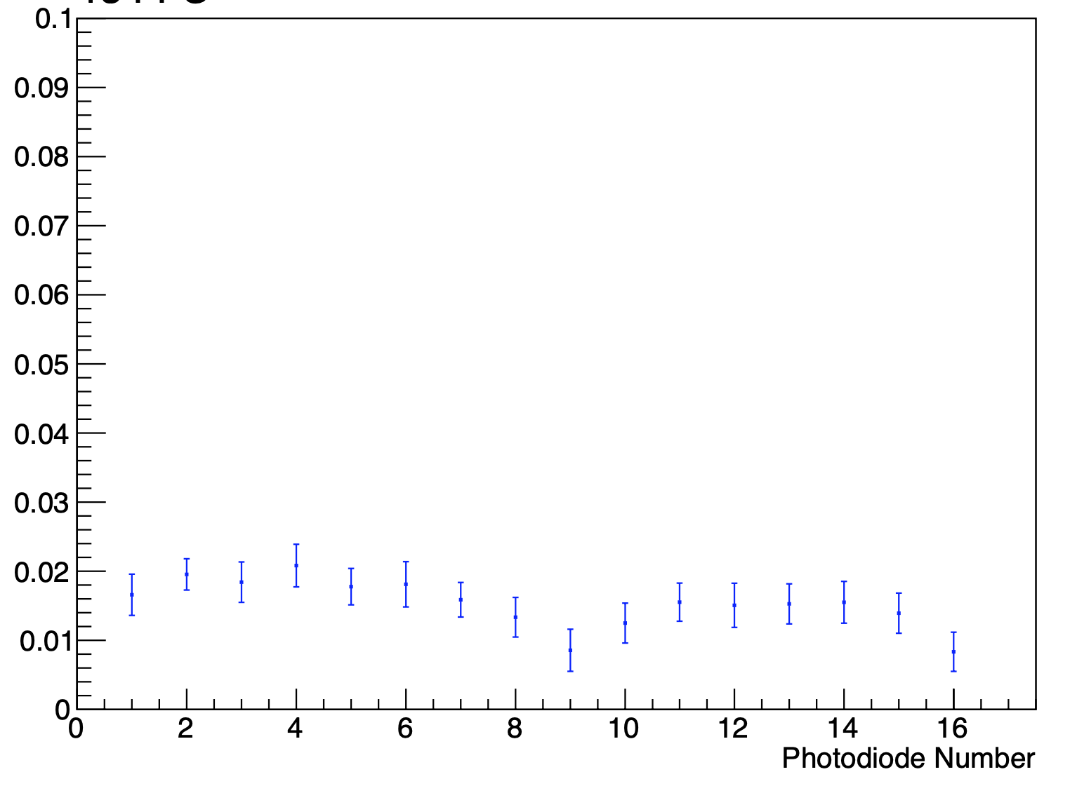
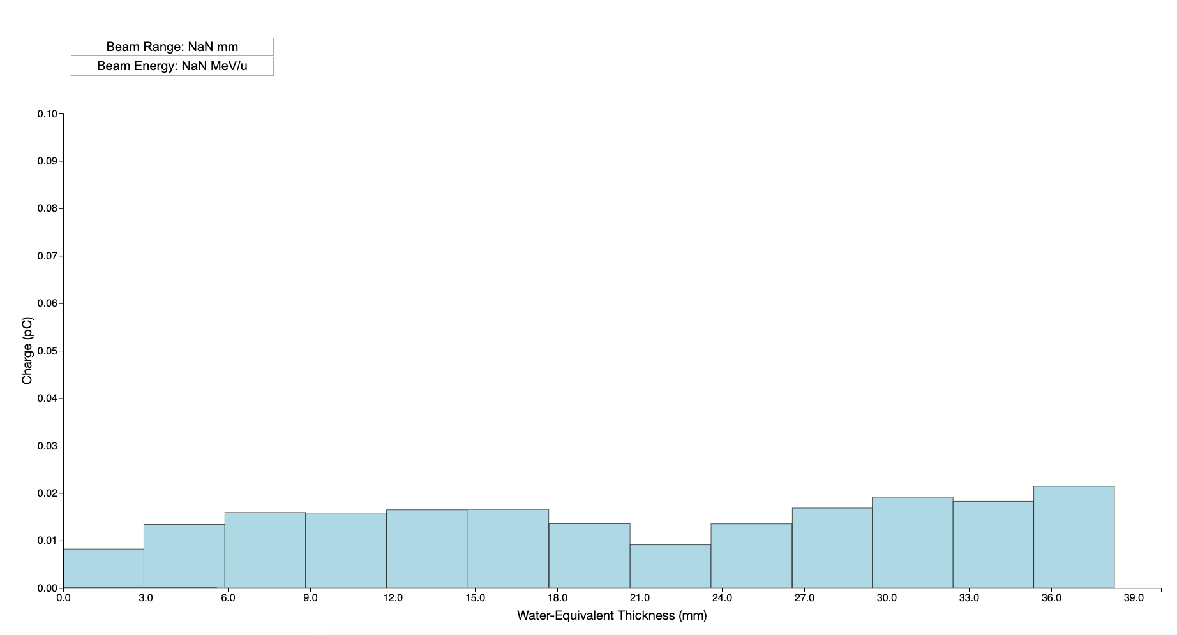
DAQ: live data visualisation from GUI
Saad’s livePlot

Slide 11
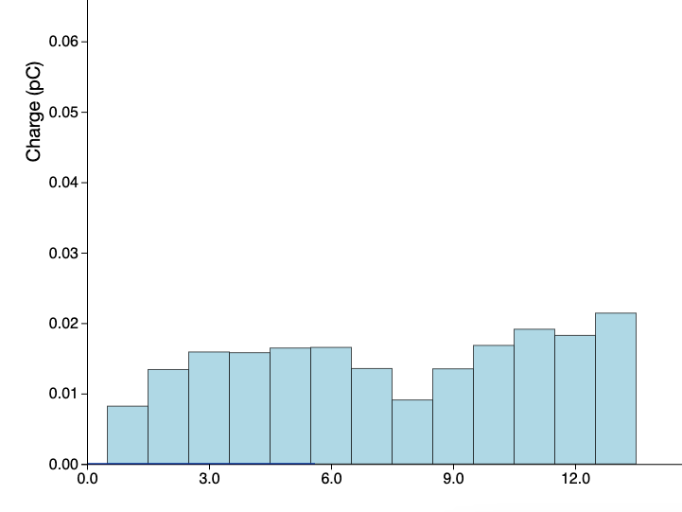
Live data visualisation: change our xaxis to Pdnum instead of position to determine if what we are visualising agrees correctly with cpp and ROOT visualisation.
Two disconnected PD but 3 missing! Not plotted at all, but we need to consider side for code
Test calibration code with Clattebridge data. Are all points generated?

Slide 12
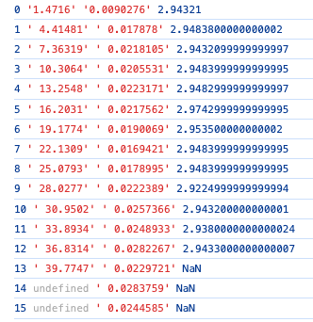
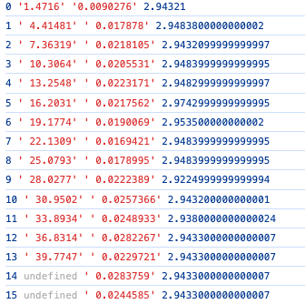
Live data visualisation: looking at calibrated file there are 14xPDpositions and 16 photodiodeData (y). Why in our plot one of the xPD positions disappears? The last one precisely? Looking at bandwidth seems like last one (i=13) is not calculated, as next value does not exist. Using condition that is = to previous one we get good results.
console.log(i, xPDposition[i], photodiodeData[i],bandwidths[i])

Slide 13
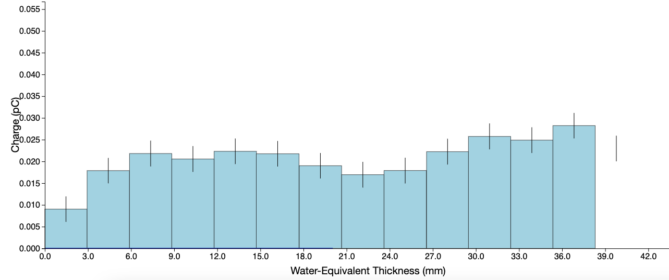
If we look at the error bars they are plotted, so the issue is in the plotting and not in the numeric data. ErroBars are based on xPDposition, while the bars are based on photodiodeData. We need to correct this to keep consistency between the two, however the redefinition of bars does not fix the problem.

Slide 14
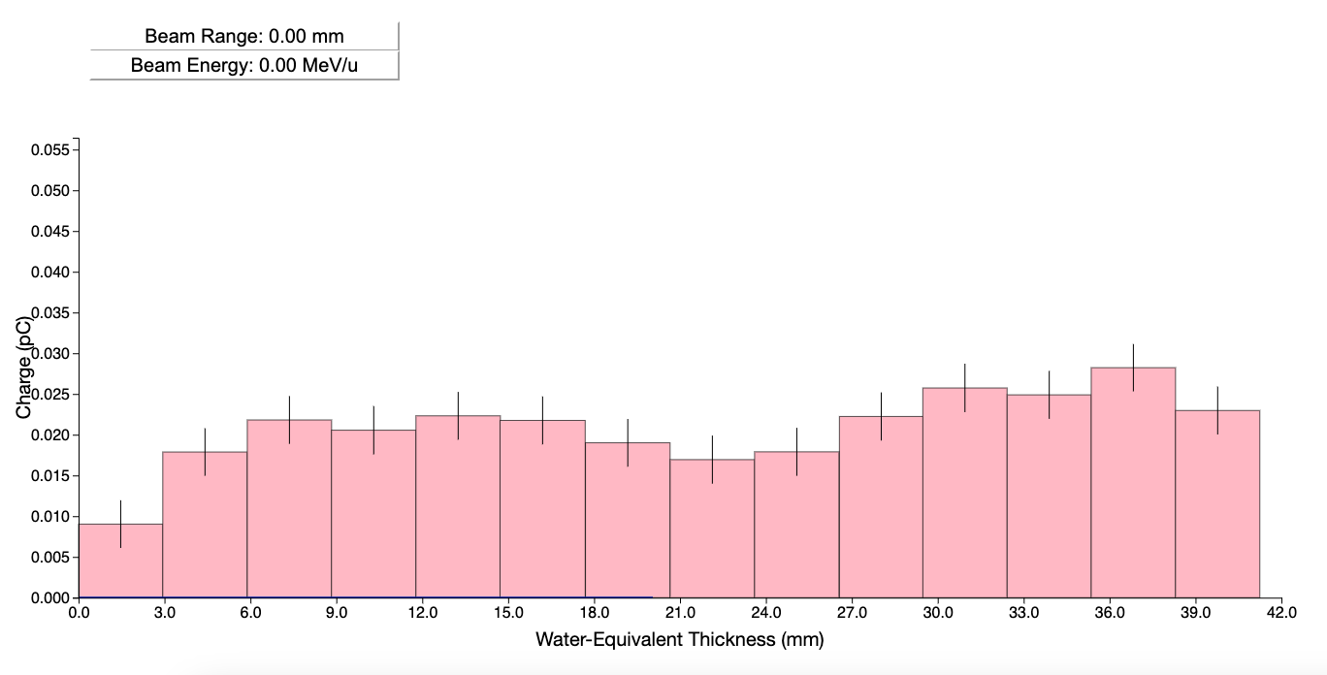
We need to setPhotodiodes = 14, otherwise it reads the NaN and gives an error and the last numerical value can’t be shown. We also need to add a special condition for it’s width, as it can’t be calculated based on the next bar (we use previous bar value). Once our scintillator has uniform thickness this won’t be an issue.
Maybe read PD num from file once it’s generated ok?
Separate the data update from the code that adds elements to the SVG DAQ2 is now the original code.

Slide 15
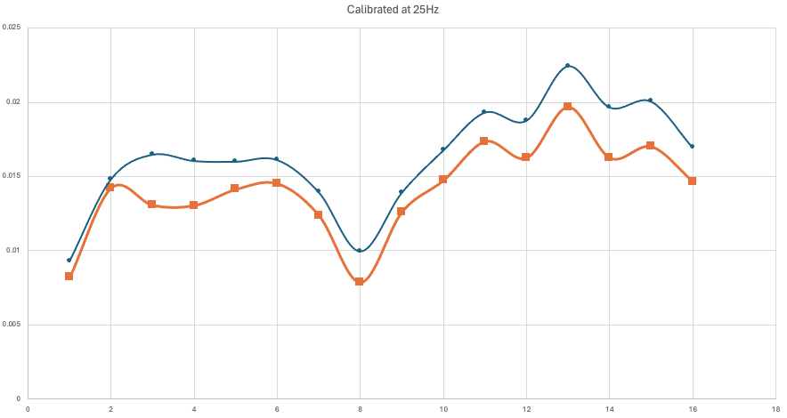
When we look at live data the graph does not update. Is it because the values are very small due to calibration and the difference between averaged is not visible? -> Removing calibration mantains the issue Looking at 0*calibrated data at 25Hz we do see a difference between the different measurements, so we should observe this in GUI as well.
Here we have 16 points, need to figure on which side we have the two extra ones.
The issue was that the output_GUI.txt file was not closed in the right place, so it never updated after 1st measuement

Slide 16
Graph appears and disappears, based on what? If all terms are there is always plotted? NO, so it is not a number issue but a plot thing.

Slide 17
Checking DAQ.js to see where the issue is:
Static file shows no issues, maybe it is updated too quickly??
The following line removes the whole svg, including axis and everything. Only want to remove the plot inside, bars?
d3.select('svg').selectAll('*').remove();
Check updating interval frequency first!
Up to here the latest GUI version from pi has been copied to /unix/www/html/pbt/PDdisplay/escribano/pi5

Slide 18
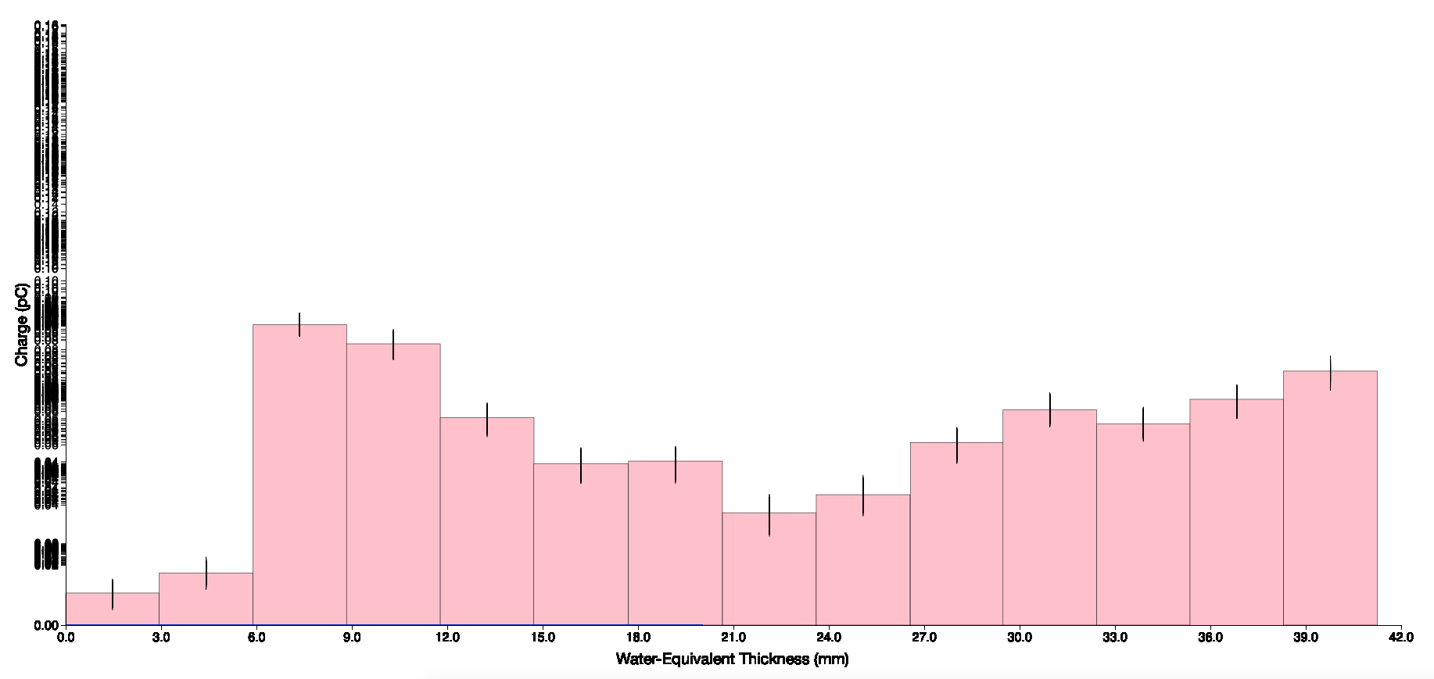
Updating interval frequency does not affect.
If we remove d3.select('svg').selectAll('*').remove(); the y-axis overwrites continuously. We don’t see an update as bars are plotted on top of each other and no longer visible. Maybe remove yaxis only?

Slide 19
Issue: need to update the graph efficiently without flickering/visual glitches.
Update Bars Instead of Redrawing: Instead of removing all elements from the SVG and redrawing them every time new data is parsed, we can update only the existing bars.
To recreate the graph every time new data was parsed, we only need the createGraph() function. However, because our rate is high continuously recreating the graph leads to glitches. We need to define an additional function, called updateGraph(). In this way we have two separate functions: one that the creates the graph initially a (createGraph) and one that updates it constantly with new data. This separation allows for more efficient updating.
createGraph() function to initialize the graph and draw the initial data, and then create a new function called updateGraph() to handle updating the graph with new data

Slide 20
Live visualisation of PD is now working!!!!!!
Automated axis does not work anymore
Error bars!
Beam legends

Slide 21
Live visualisation of PD with errors is now working: error multiplied by factor 5 for visualisation
Automated axis and Beam legends

Slide 22
ErrorBars need to be redefined similarly to bars. Also, the output_GUI.txt file we read from the error is a constant value and we need to modify this. For now we use 3% of the PD value, in the future we need to change this in the code
g++ -o calibrateSonia_fit calibrateSonia_fit.cpp `root-config --cflags --glibs` -O3
The rest of the elements need to be redefined and adjusted based on the new two individual functions for data plotting and updating.

Slide 23
All the elements are working now!!
Small delay between clicking button and start of visualisation. Is it because of DAQ or because of js?
Y-Axis updates automatically if we do not set a value. This could be useful if suddenly there is a big increase or drop, but at the same time it could not. Should we fixed it based on 1st measurement? But then if 1st measurement is bad?

Slide 24
Visualising the two options by removing lid and seeing how plot changes, then putting lid on again.
Option 1: y-Axis adjusts automatically for every meas
Option 2: y-Axis adjusted for the first value only (simulated+flash)
OPTION 1 is much better, and changes in light output are still visible. No need for clinicians to readjust values.

Slide 25
GUI v2.3: Cache issues
W: Monday 11th March 2024
Everything works correctly except the small delay when plotting data (sometimes it happens sometimes it does not) and the start/stop button.
Also, today sometimes the graph was not updated at all but data was being acquired. Seems to be the same cache issue that we had in other versions, because when we erase cache is always plotted correctly.
Browser Cache: Browsers cache resources by default to improve performance and reduce server load. Leading to outdated data being displayed.
a) Cache-Control Meta Tags: For HTML files -> Added some lines.
b) Cache-Control in AJAX Requests: paparse does not cache data so this does not apply top our case.
We can select in tools not to cache this webpage ever and that fixes the updating issue!!It’s always plotted correctly.

Slide 26
GUI v2.3: Cache issues
Can’t clear cache from js or HTML, but we can invalidate cache for specific page
Cache-Control Meta Tags: In the HTML we instruct the browser not to cache the webpage or its resources.
<meta http-equiv = 'cache-control' content = 'no-cache’>
<meta http-equiv = 'expires' content = '0’>
<meta http-equiv = 'pragma' content = 'no-cache’
b) ensuring that js is always loaded without relying on the browser's cache
<script>
// Append a timestamp to the URL of DAQ.js to ensure it's always unique
var script = document.createElement('script');
script.src = 'DAQ.js?' + new Date().getTime();
document.head.appendChild(script);
</script>

Slide 27
GUI v2.3: Cache issues
Once the main cache issue is fixed, we see that there is a small delay between clicking button and start of live visualisation. Is it because of DAQ or because of js?
If we tail –f outputGUI.txt it starts updating automatically, so the delay is on the GUI side, not on DAQ.
There is still a bit of a delay at the beginning: maybe due to older versions of file that is being plotted (output_GUI.txt)?? If we automatically delete this file before starting our code will this fix the issue?

Slide 28
Cache issues v2.3
Delay due to plotting previous output_GUI.txt file. Previous run was with lid open (high counts on 3rd photodiode) and this run is with lid close. There is a delay of ~3s from start of the acquisition.

Slide 29
Cache issues v2.3
Previous run was with lid open but file output_GUI.txt has been deleted. Now there isn’t a delay on the plot. executeFTDI.sh needs to be modified to remove this file before starting DAQ to avoid any possible delay issues.
http://10.97.249.16/DAQ_clean.html
Chrome still has some cache issues

Slide 30
Stop button
Everytime is clicked acquisition starts, even when button says stop. We need to make sure that when txt=stop and it’s clicked the shell script is interrupted. End of run show measure again?
When clicking stop a new run is acquired, when it should stop the previous one. Also when run is done, button should change automatically.

Slide 31
Start/Stop button issues
1. When button shows we click on stop button, it acquires data: plot is not updated but data files are generated. Add conditional to the execution of php script to limit the acquisition to the times where the button shows word measure and it’s clicked.
2. When run finishes button still shows stop, when it should show measure to start again -> Adding a new condition to the word that’s being read, and simulating a click after that time. Sometimes autoclick takes longer (next slide)
3. If stop button is clicked while acquiring data, plot is no longer produced but data keeps being acquired. How can we kill the shell process from php?? -> Tested with xhr.abort but did not work. Check during meeting with Simon

Slide 32
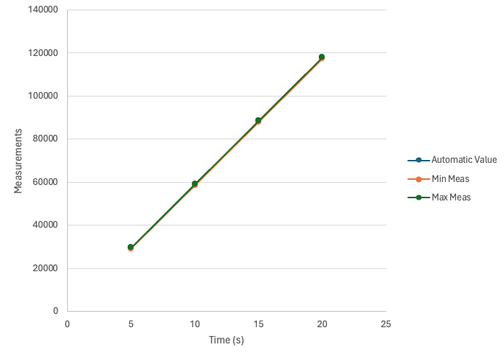
Start/Stop button issue 2
Simulating a click after running time: sometimes autoclick takes longer. Due to 1 cs limit, every time has an interval of 587 measurement so a small delay could occur.
This should not have a very notorious impact based on the numbers, but on real time we observe that there are the following delays between end of plot and autoclick of the button:
5s run: 0s delay
10s run 1s delay
15s run: 2s delay
20s run: 3s delay
50s run: 7s delay
DAQ runs quicker than expected. Autoclick of button corresponds to real set time. How is this possible?

Slide 33
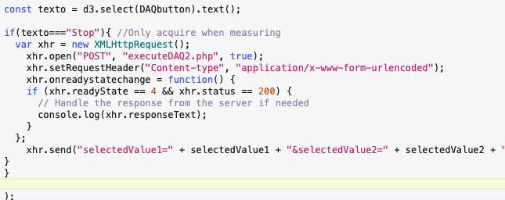
Start/Stop button issues
When button shows stop and we click on it, it acquires data again but plot is not updated. We need to stop the shell script when button says stop.
Can't directly kill the PHP script from your JavaScript code because PHP runs on the server side and JavaScript runs on the client side. However, you can send a signal to the PHP script to stop executing.

Slide 34
Future steps v2.3
This version is saved on pi5. Saved as version 2.2 by mistake
Cache issues (things have improved but not 100% fixed)
Killing the shell script from php to stop DAQ when button is clicked, how?
Status messages for user?
Reverse button does not work. Need to determine which direction is which and modify the C++ code to write data to file correctly.
Error bars
Organise files + comment codes -> New folder with just necessary files
Update GUI with all info
Fitting of last measurement
UCL Network: http://192.168.4.73/DAQ_clean.html UCL Wifi: http://10.97.249.16/DAQ_clean.html
Home: http://192.168.0.23/DAQ_clean.html

