Slide 1





The QuADProBe: A Quality Assurance Detector for Proton Beam Therapy
Simon Jolly
University College London

Slide 2
Beam Quality Assurance
4 key quantities to verify in particle therapy beam QA:
  Absolute dose
  Spot size
  Spot position
  Range (for a specified energy)
Ideally measure all these quantities for all these quantites:
  Spot size, range and dose for all positions AND gantry angles.
  A bit time consuming for daily QA…
Can you make a simultaneous measurement with suitable accuracy to speed up the process?
Can you do it with a single “QA plan”?
  Create treatment plan with all necessary parameters.
  Mount detector to nozzle and let plan run for full QA.

Slide 3
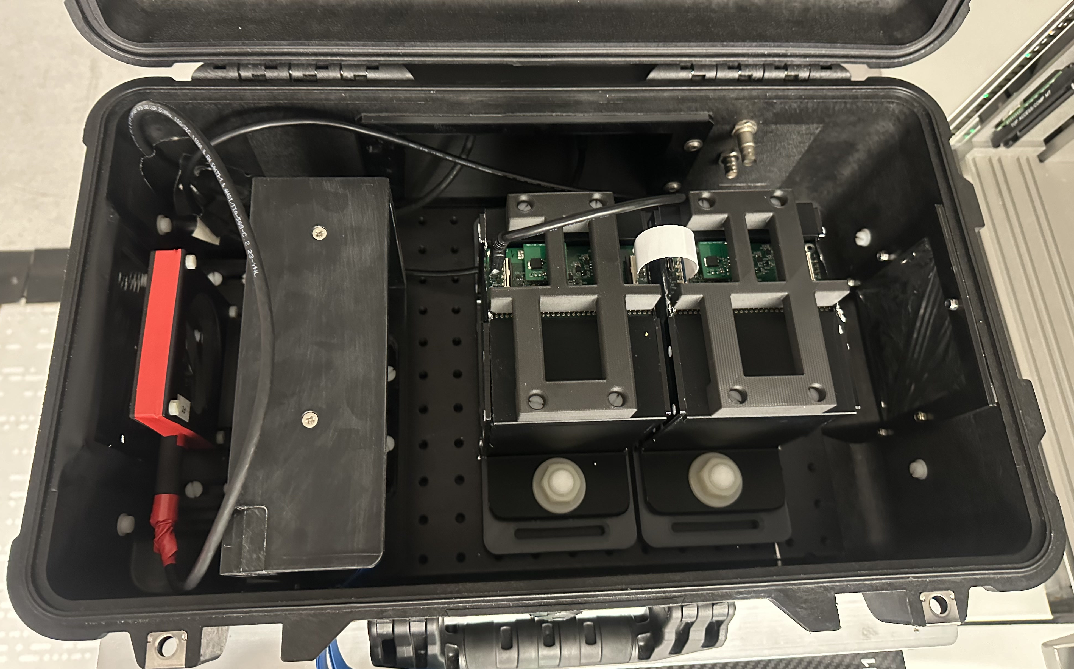
Enter: The QuADProBe
Absolute Dose: NPL Transmission Calorimeter (TC)
Water Equivalent Range: UCL QuARC Range Telescope
Protons
Spot Size + Position: Birmingham CMOS Pixel Sensor
Enclosure: Peli 1510 flight case with patch panel

Slide 4
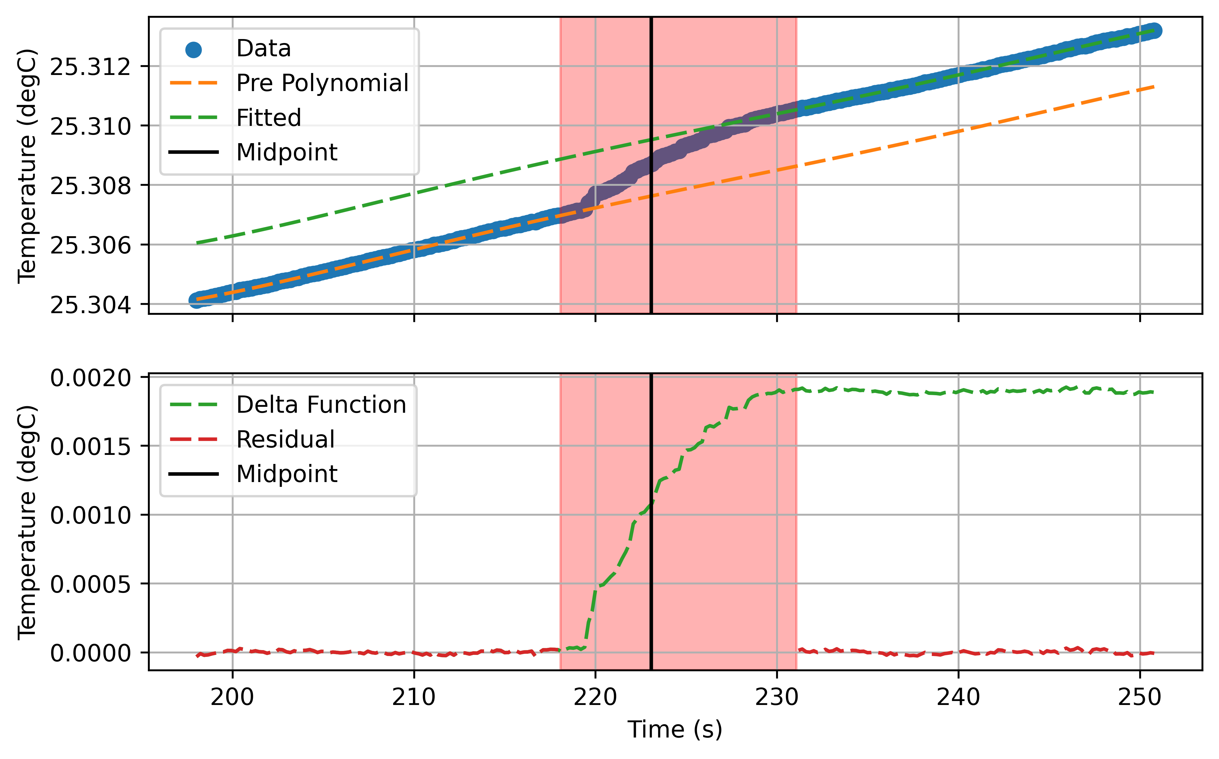
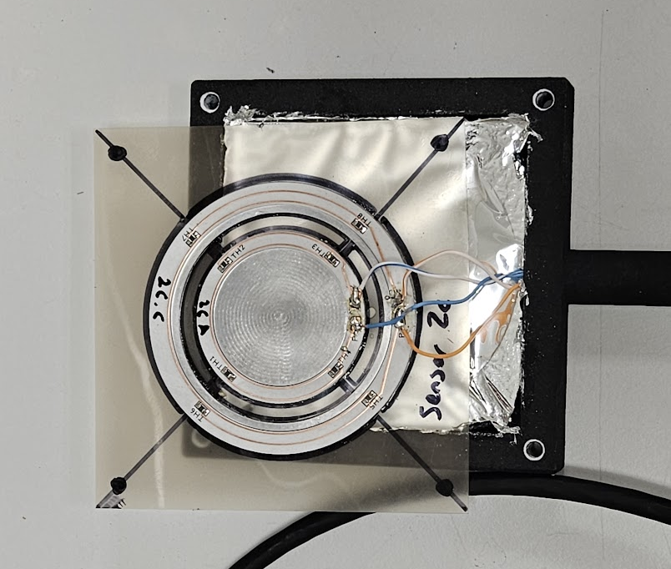
The NPL Transmission Calorimeter (TC)
A thin aluminium core with embedded thermistors
  45 mm diameter
  0.6 mm thickness, approximately 1.2 mm WET
  High performance 7 W/mK thermal conductivity dielectric PCB connecting thermistors
Twin core design:
  Primary core to measure radiation-induced temperature change
  Secondary core to compensate for ambient temperature fluctuations
Results:
  Linear response with dose in 3 x 3 x 3 cm³ cube
  Measures 1.96 ± 0.04 mK for 10 Gy delivery
  Performance evaluated at different dose rates and different energies

Slide 5
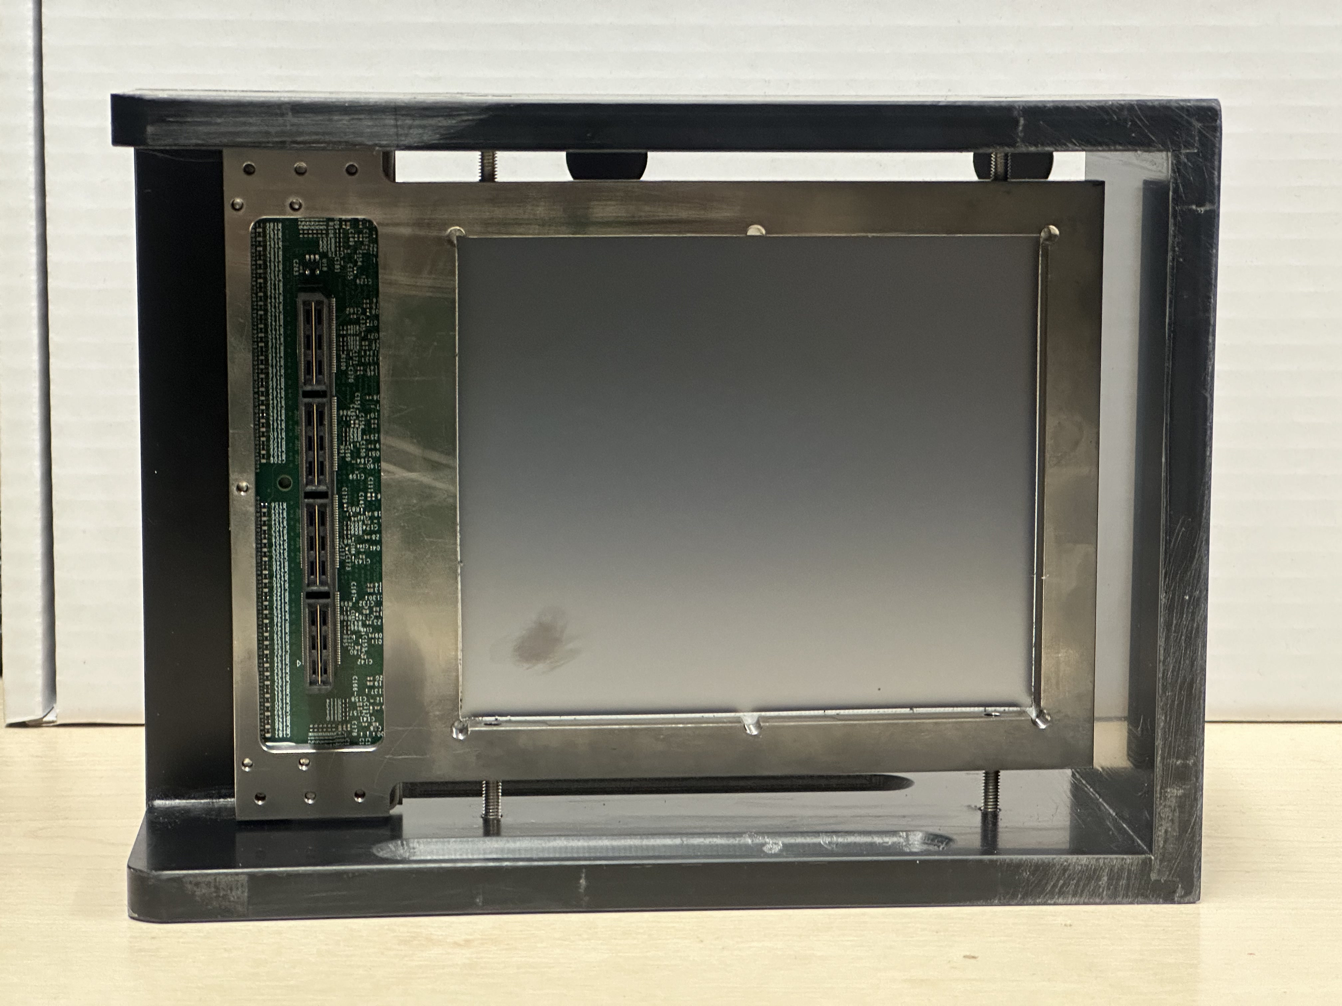
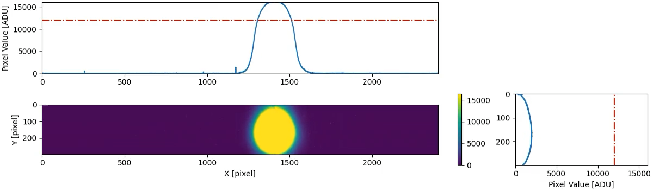
The Birmingham CMOS Pixel Sensor
2D large format CMOS pixel sensor LASSENA:
  Developed at RAL (UK) X-ray imaging; marketed by Nordson
  2,400 x 2,800 pixels each 50x50 µm²
  12 x 14 cm² active area
  Readout along one side to allow tiling of sensors over a 24x(Nx12) cm² area
  Active thickness of 8 um silicon plus 700 um of support silicon.
  34 fps full frame readout via a rolling shutter (28 ms integration time).
NIMA 2022: 10.1016/j.nima.2022.166703
Jinst 2023: 10.1088/1748-0221/18/03/P03014

Slide 6
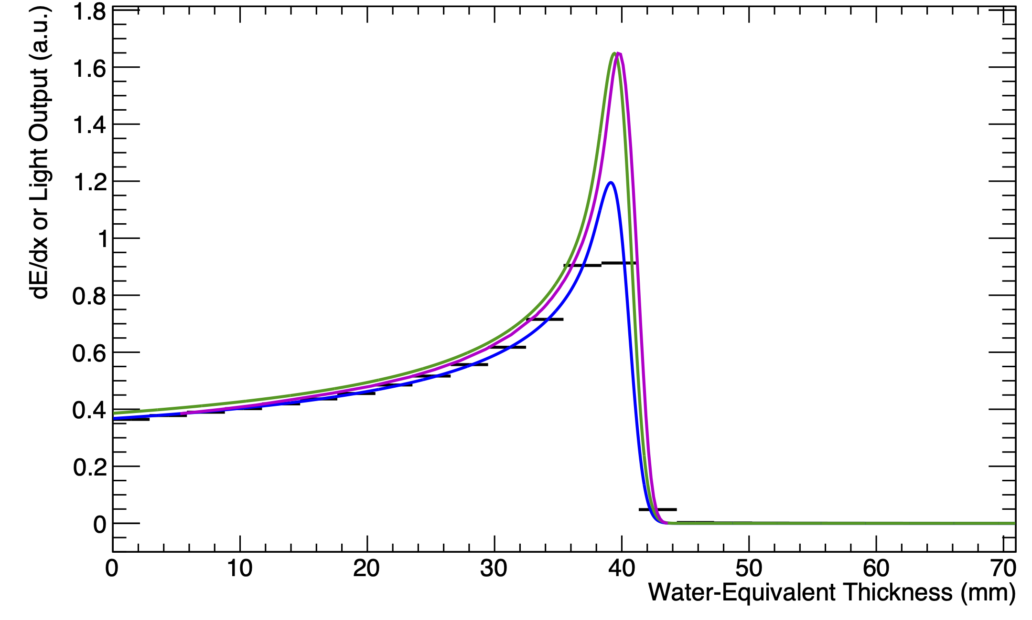
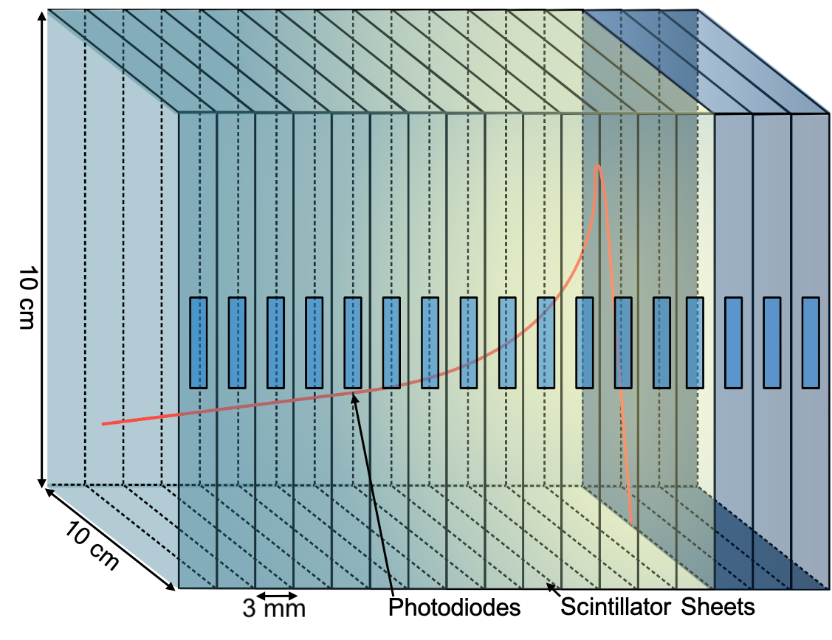
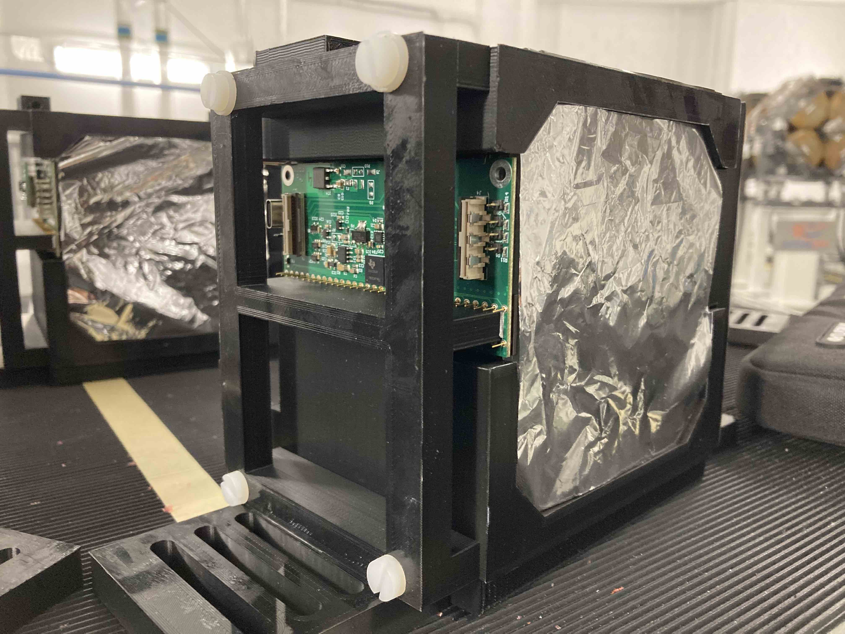
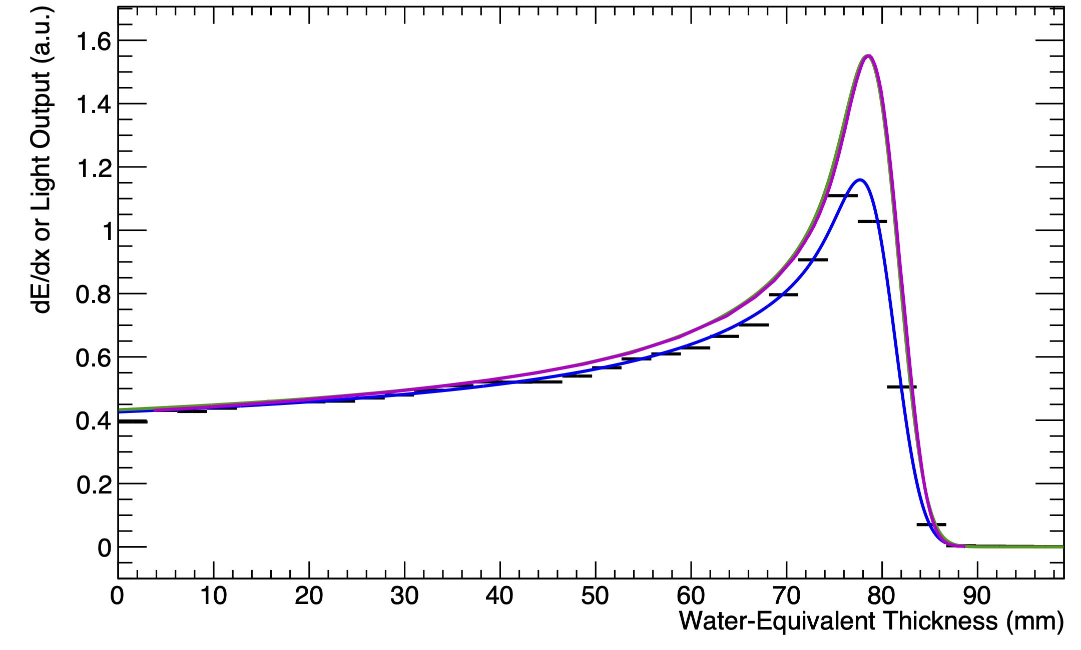
The UCL QuARC
The Quality Assurance Range Calorimeter (QuARC) constructed from plastic scintillator:
  Protons intercepted by a series of optically-isolated polystyrene scintillator sheets.
  Measure light output with photodiodes.
  Light output of each sheet nonlinear to dose, but quenching described by Birks’ Law:
    Fit data with analytical depth-light model.
    Reconstruct Bragg depth-dose curve and measure proton range.
  Photodiodes coupled to fast, modular electronics and an FPGA to read light levels at over 5 kHz.
  FPGA connects to on-board PC (Raspberry Pi) via USB.
  On-board DAQ runs web server: connect over network for full data viewing and control.
Sheet Average Light Output
Fitted Quenched Depth-Light Curve
Reconstructed Depth-Dose Curve
UCLH Reference Dose Curve
70 MeV
16/06/22
130 MeV
01/09/22

Slide 7
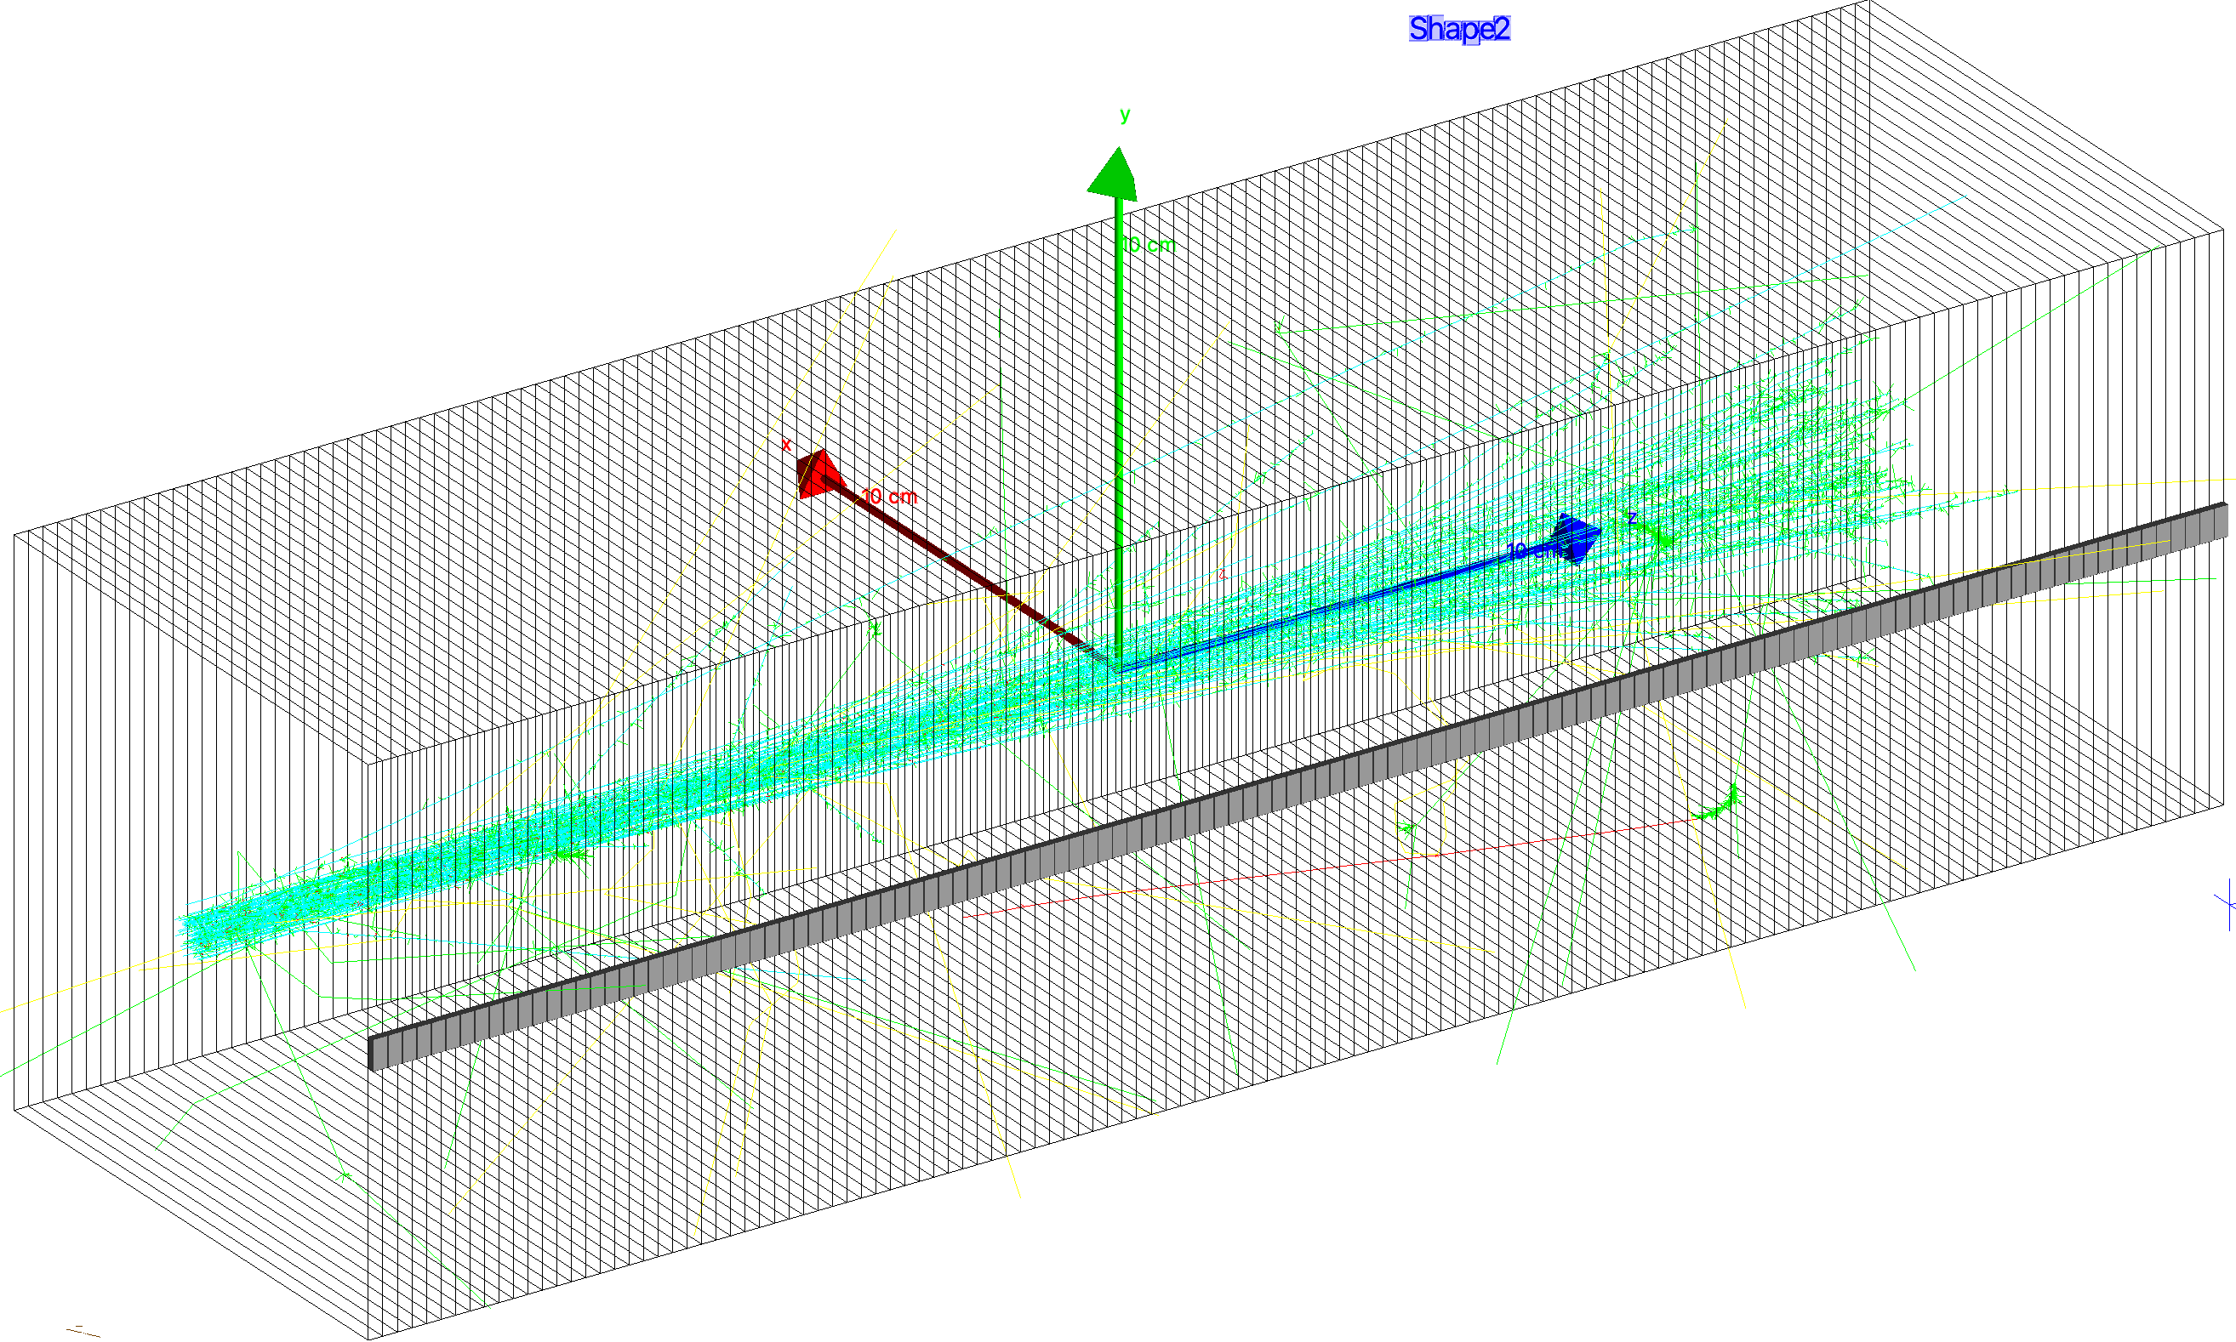
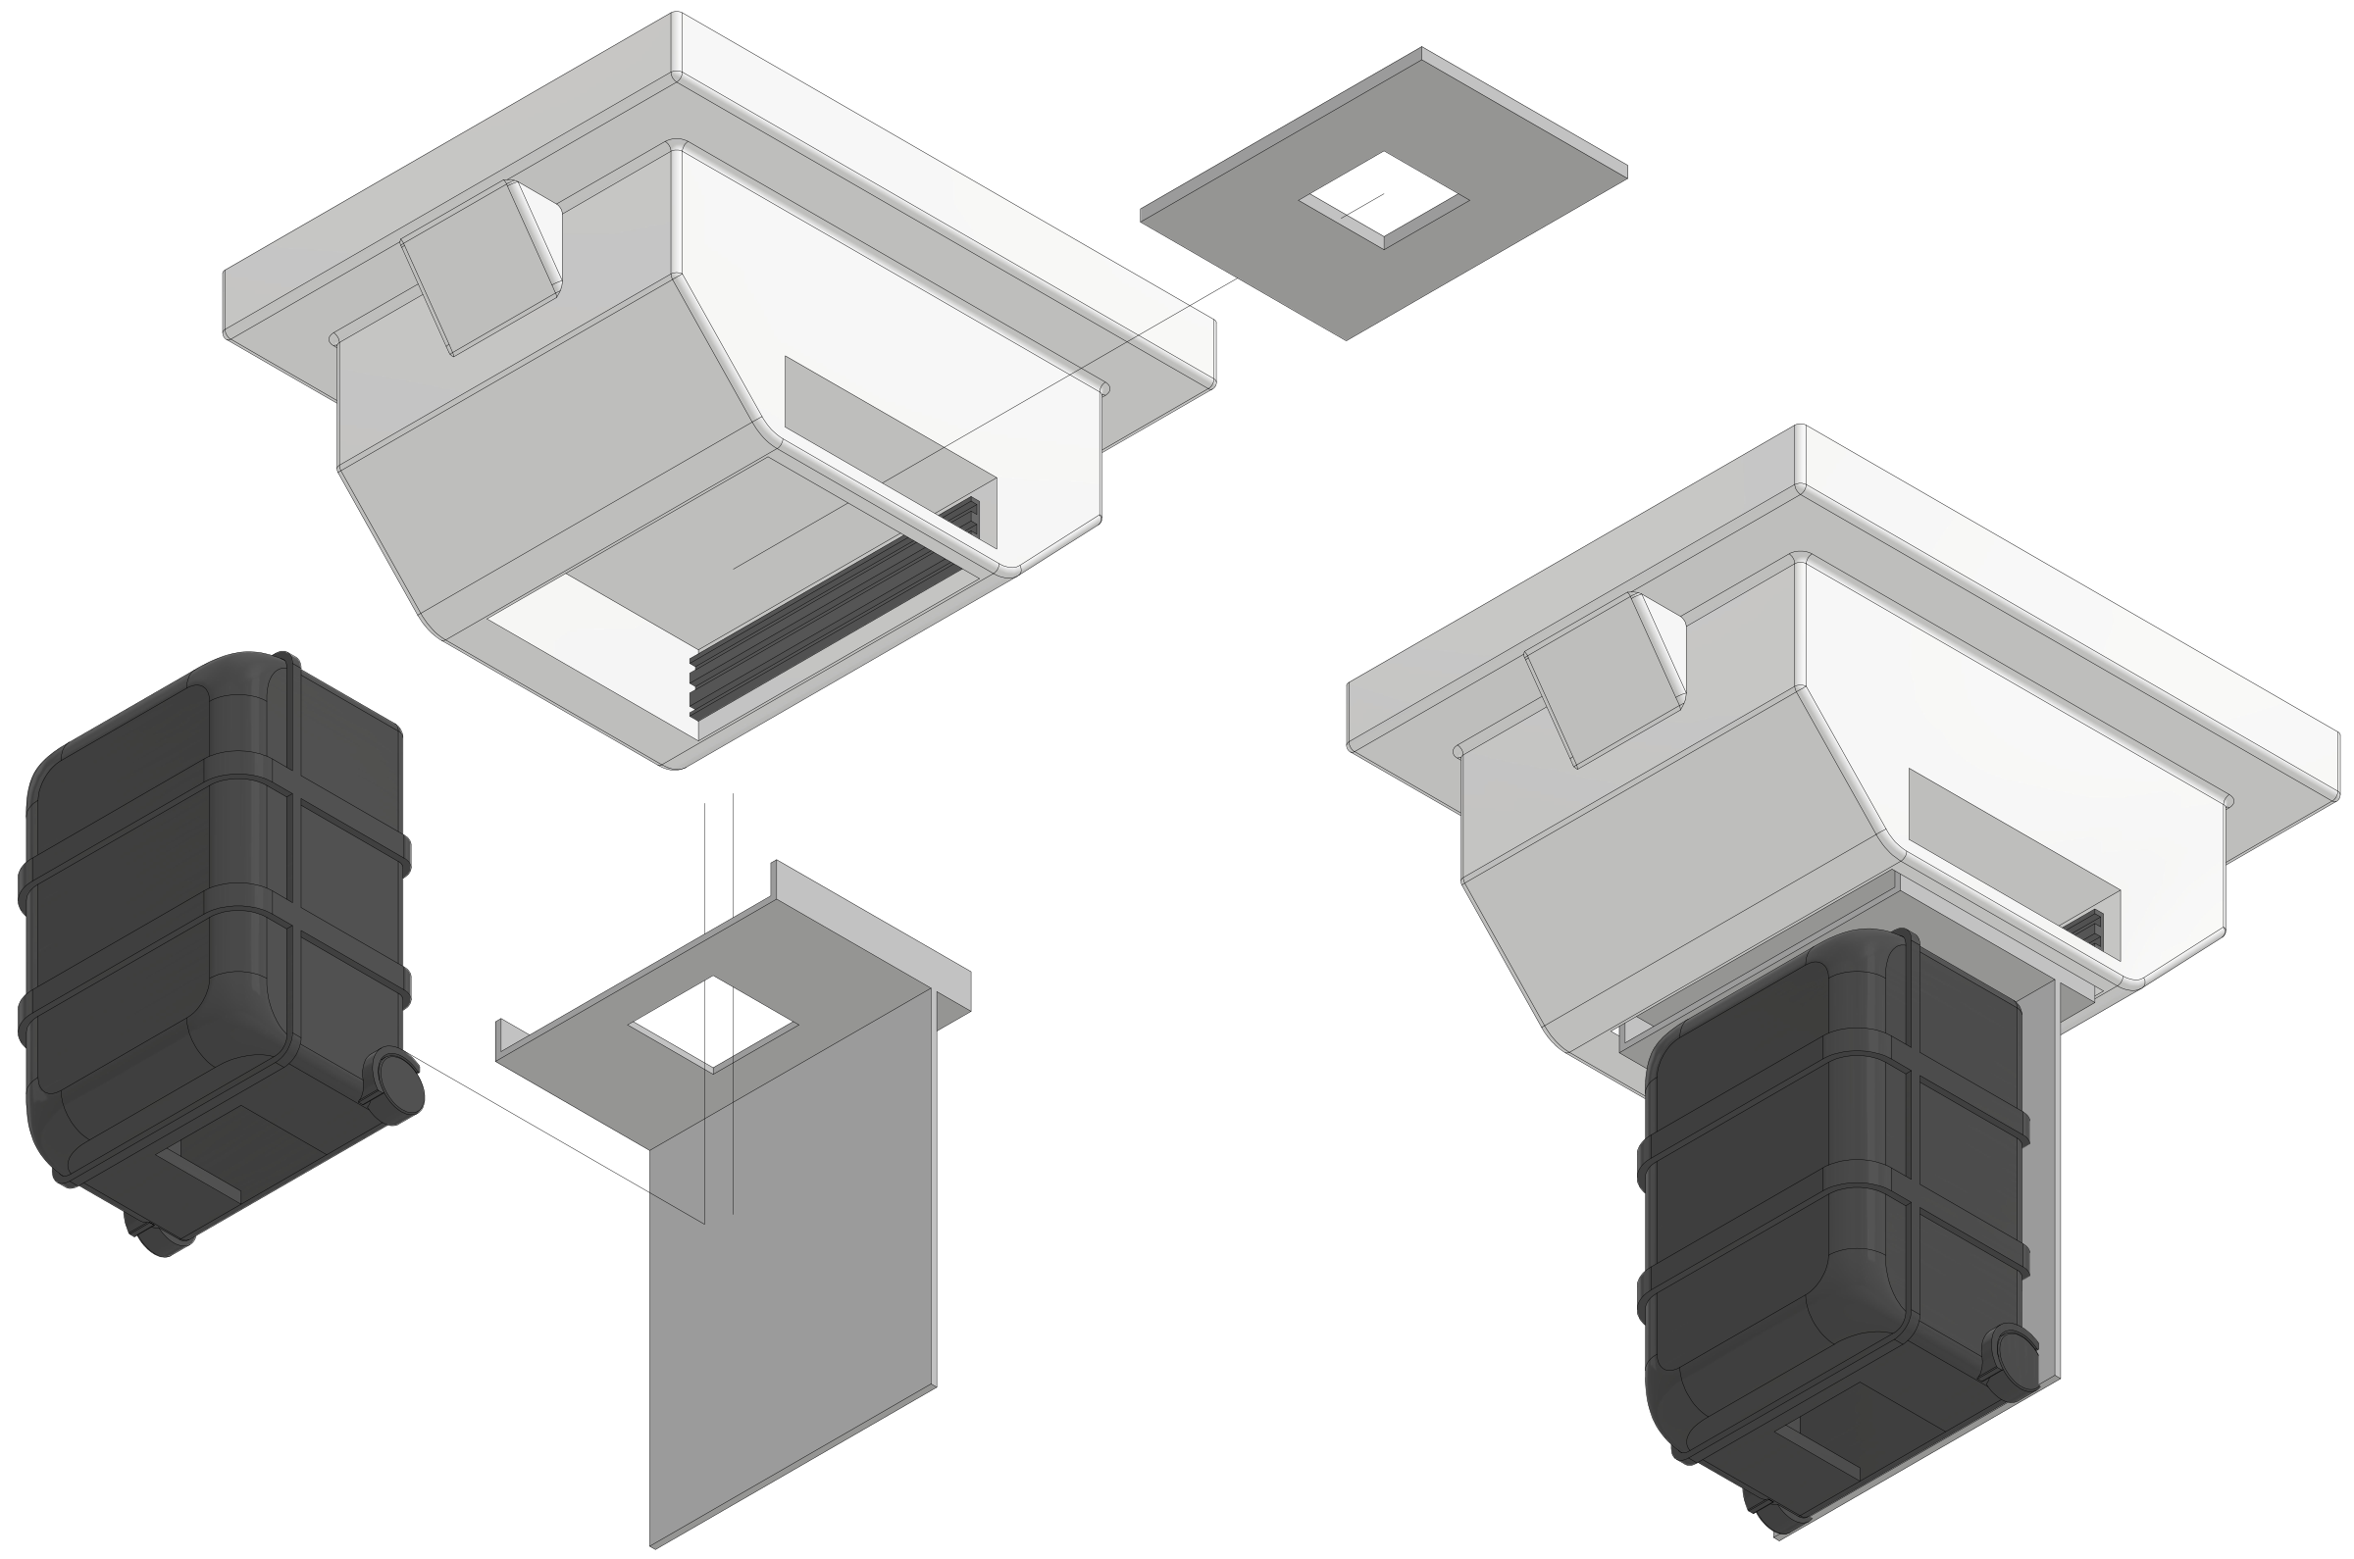
From Beam QA to Patient Specific QA
What does this have to do with PSQA?
  Measure all 4(/6) parameters simultaneously
  Reconstruct volumetric dose deposition per spot.
  Reconstruct complete plan volumetric dose spot-by-spot.
Is this a valid method of PSQA?
  Is 3D volumetric dose reconstruction in simulation clinically acceptable?
  Optimal volume for PSQA?
  How else would it be done for log file QA?
Issues:
  Speed: at least 1–10 kHz
  Timing integration between systems
  Nozzle mounting

Slide 8
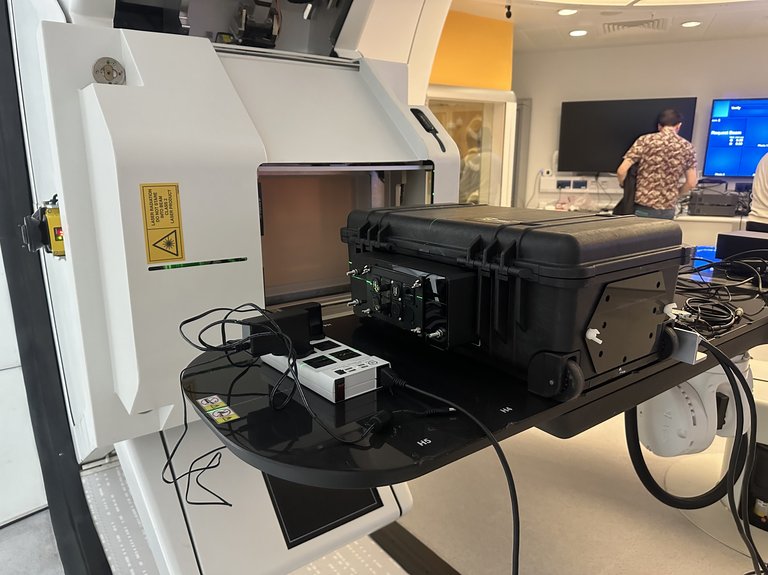
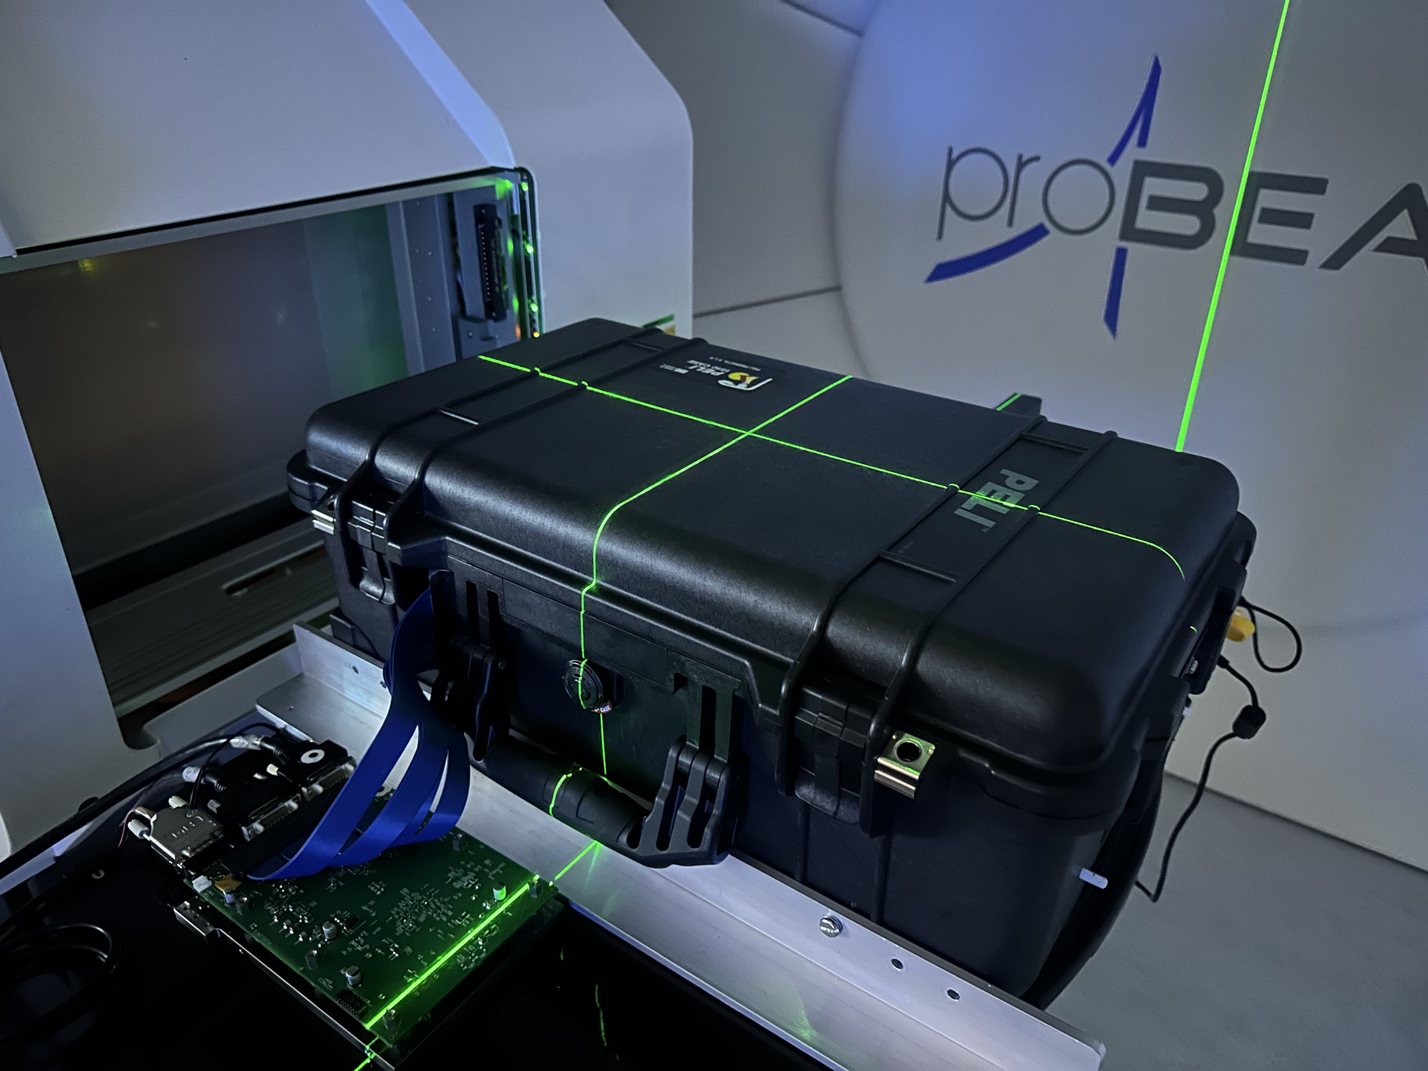
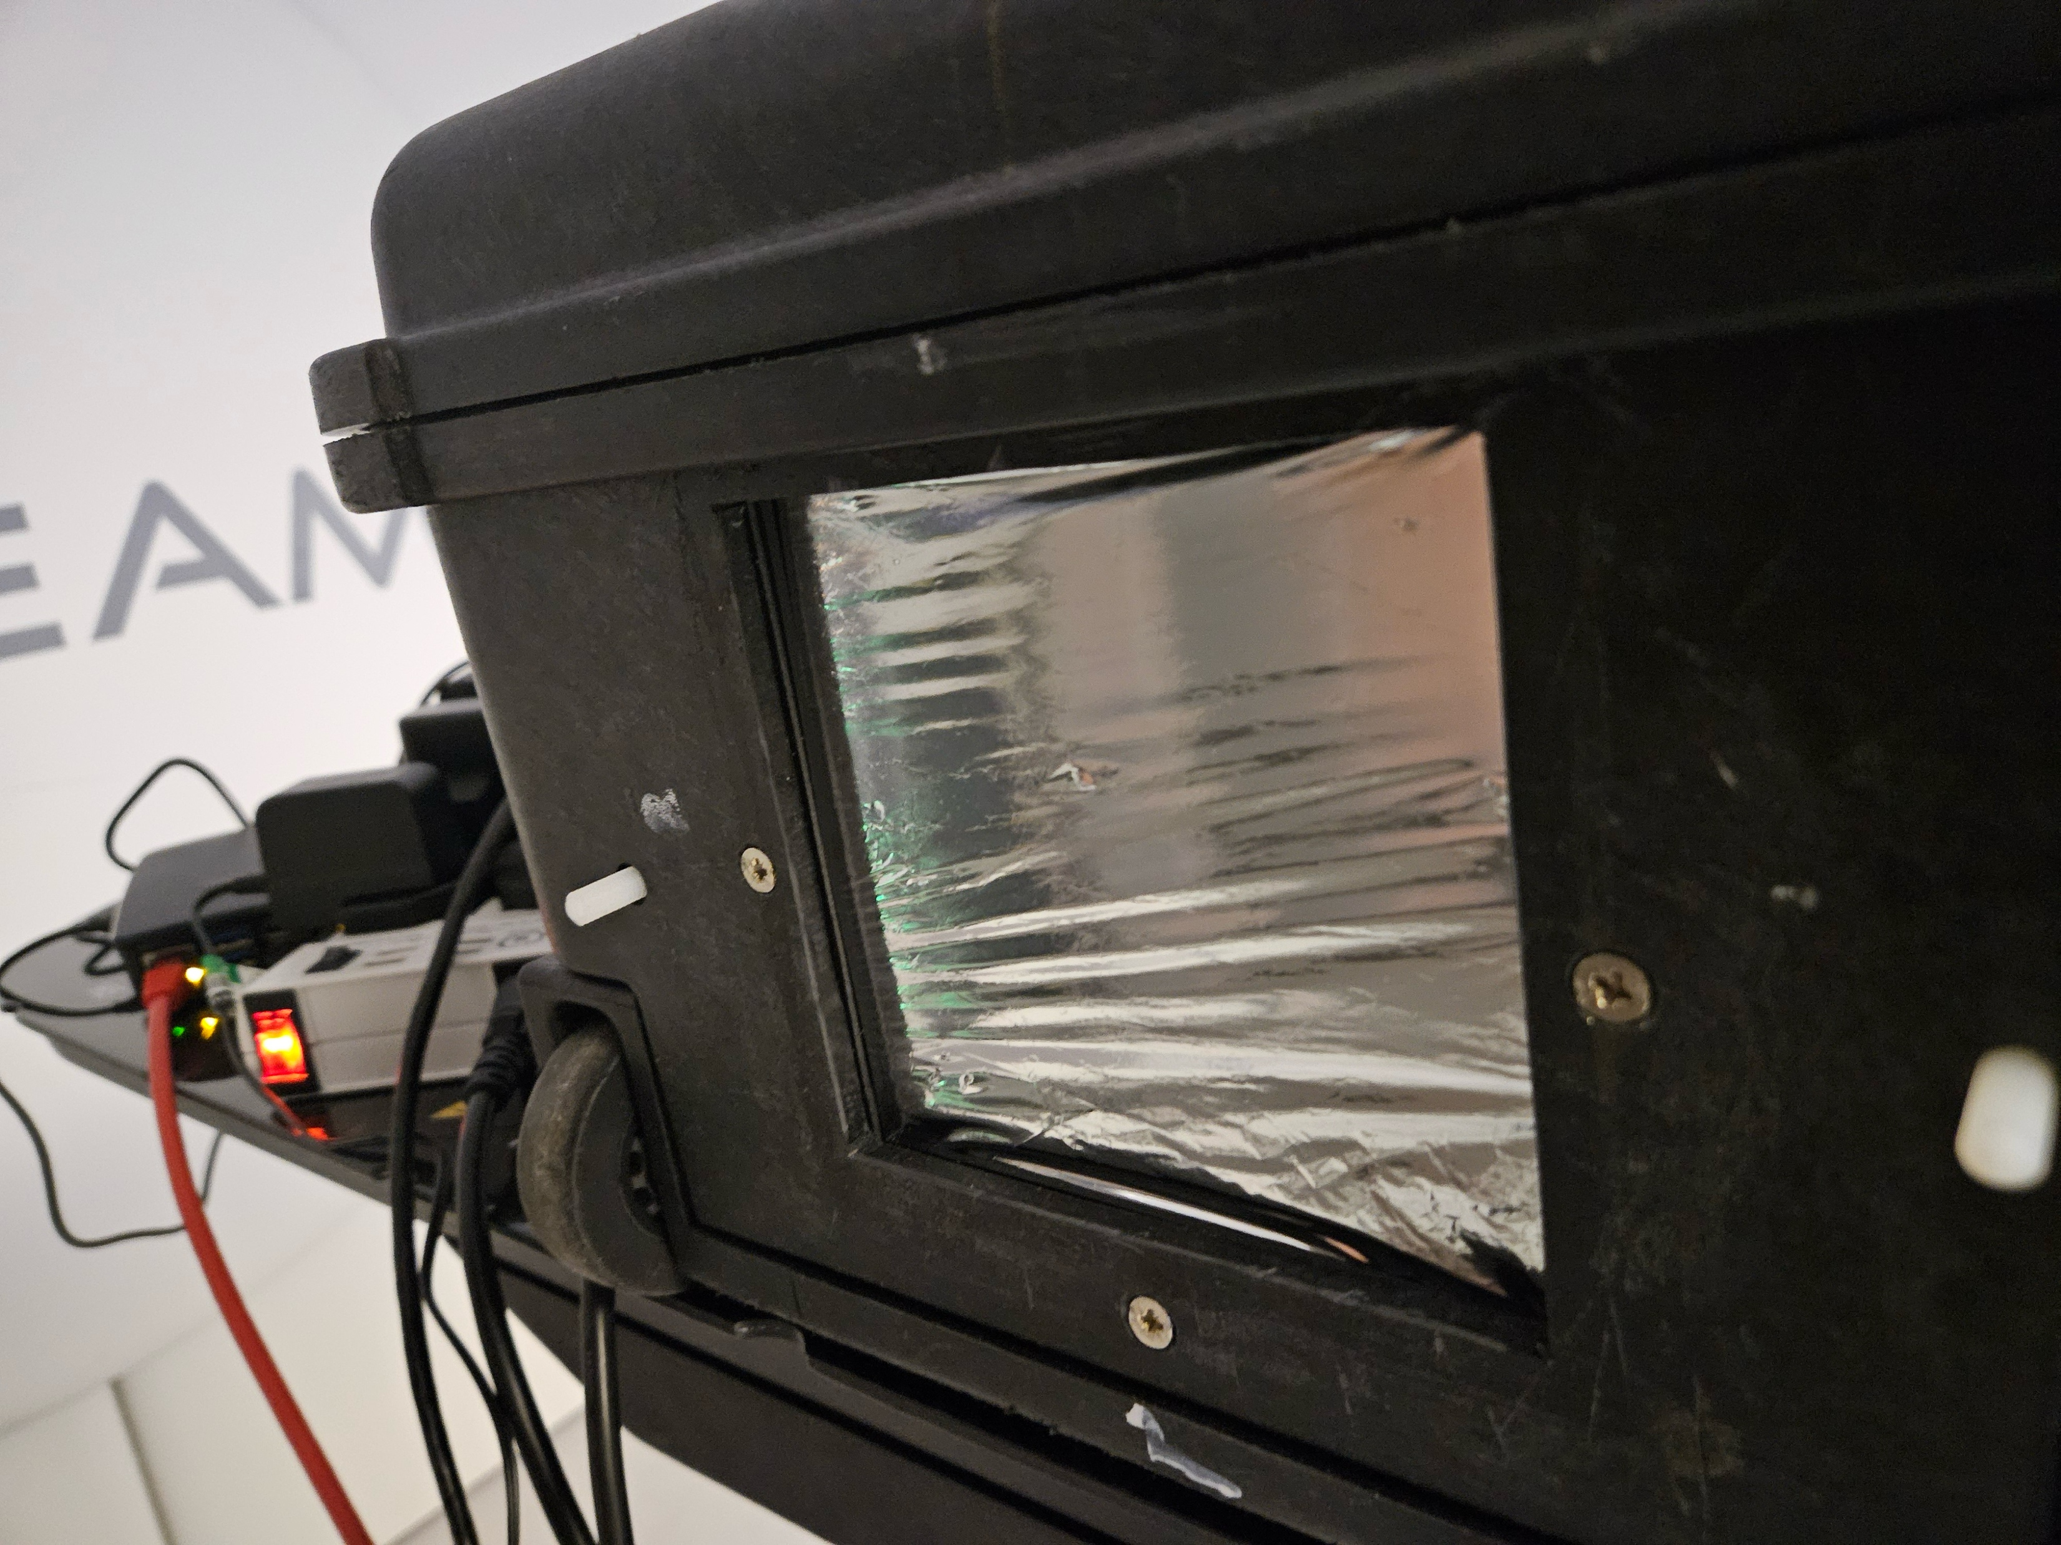
UCLH Beam Tests
Two nights of tests at UCLH
4 QA treatment plans to test:
  3 x 3 x 3 and 5 x 5 x 5 box fields
  Single spot SOBP
  “Slice” field to test pixel sensor readout.
Some teething problems:
  Noisy readout from QuARC
  Dead pixels/areas on pixel sensor
  Couch position interlock
  Different gantry room for each night

Slide 9
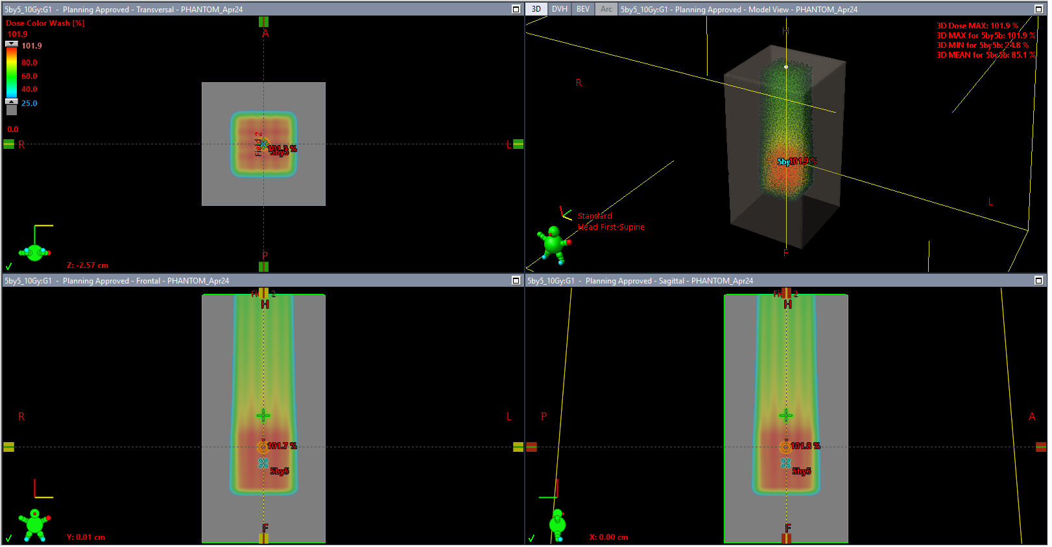
UCLH 5 x 5 x 5 Box Field Plan

Slide 10
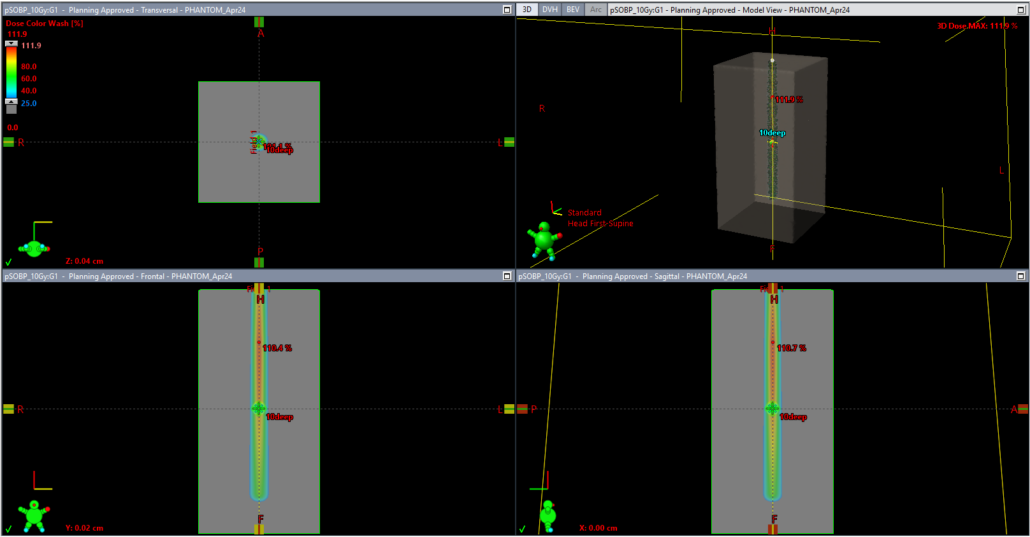
UCLH Single Spot SOBP Plan

Slide 11
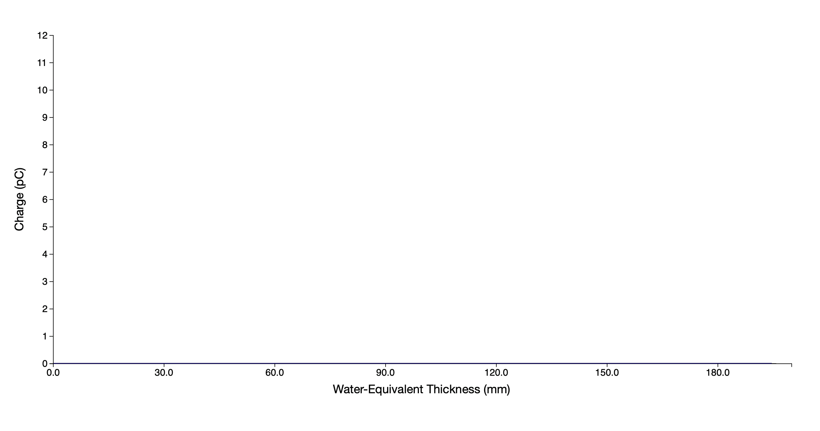
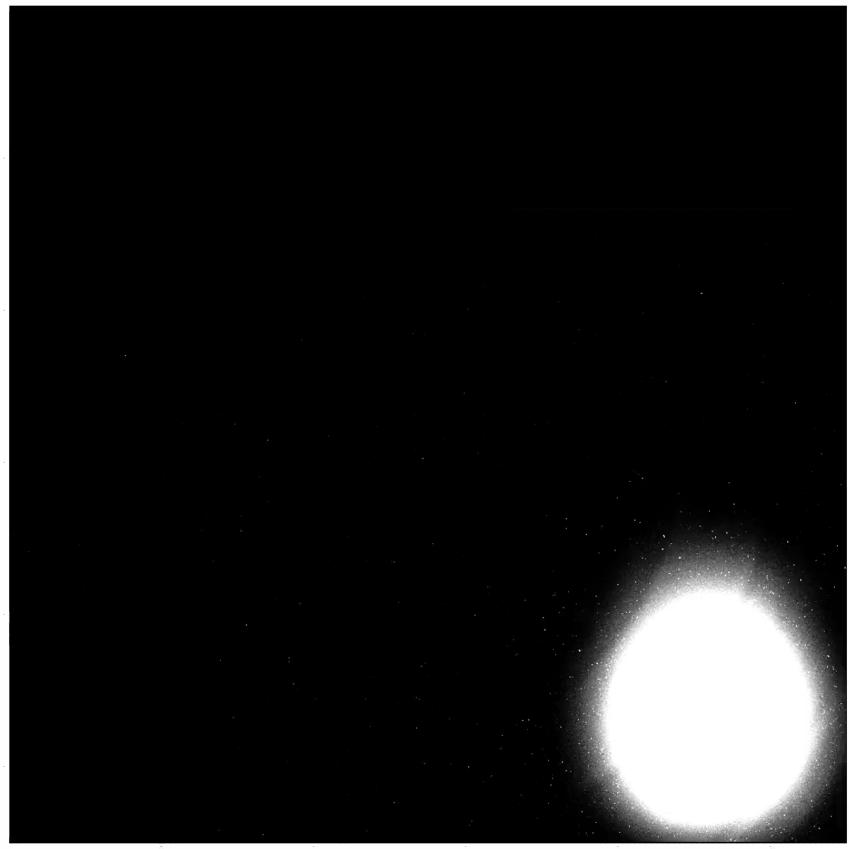
UCLH Beam Test Results (Preliminary)
Pixel Sensor
QuARC

Slide 12
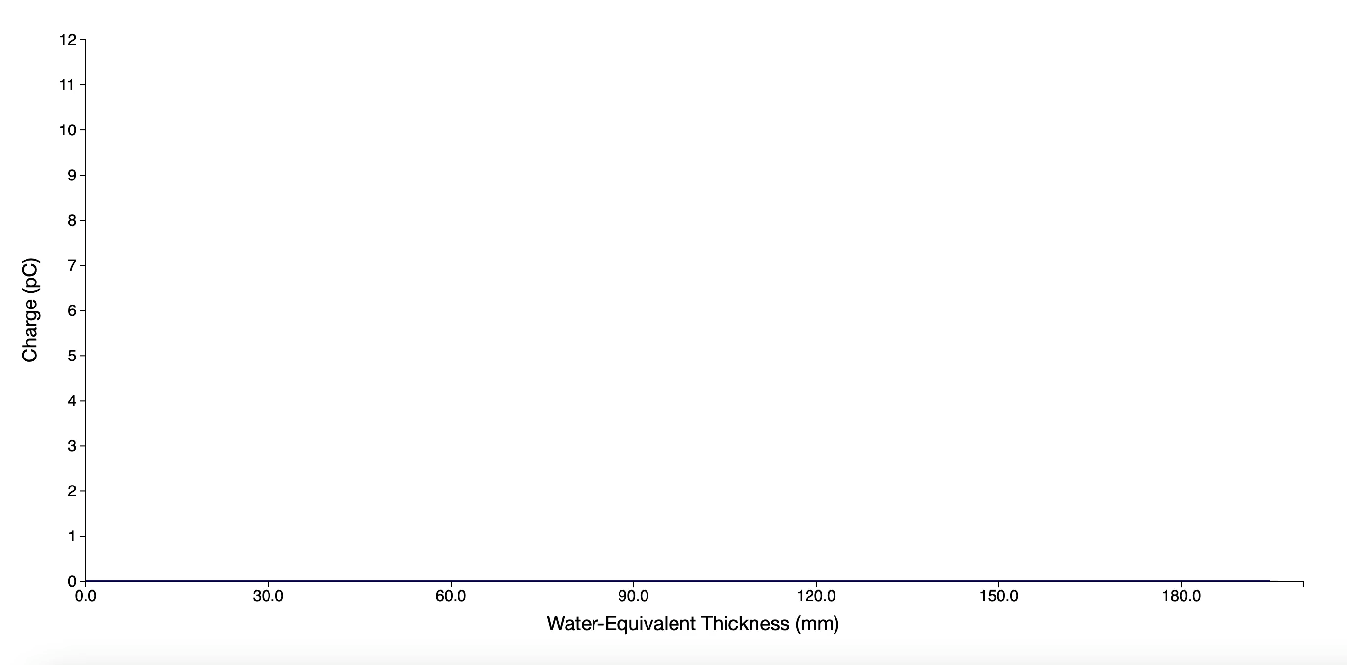
UCLH Beam Test Results (Preliminary)
Pixel Sensor
QuARC

Slide 13


Funny Eggs: UCLH Spot Profile Comparison
Pixel Sensor
Gantry 1
Gantry 3

Slide 14
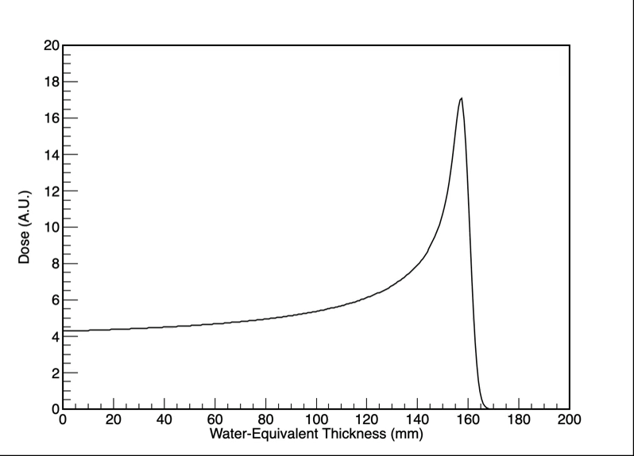
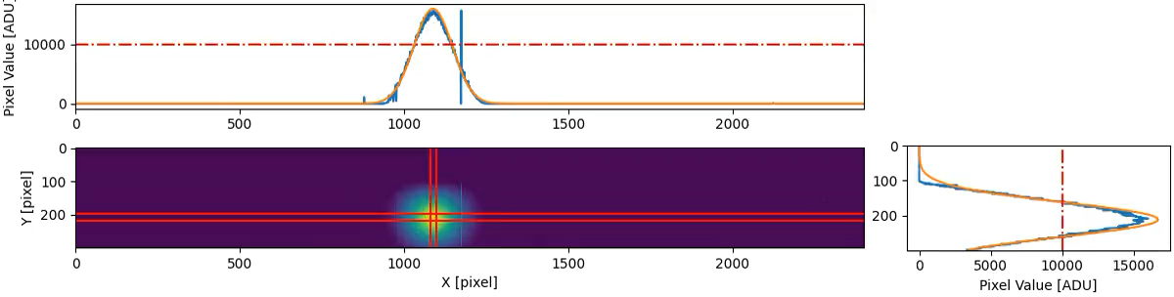
Combined Data Output

Slide 15
Issues
All detectors are showing their age…
QuARC:
  Needs improved electronics and scintillator sheets to resolve “noisy” channels.
  May need dual-sided readout for off-axis measurement.
Pixel sensor:
  Many dead pixels and channels.
  Readout saturates at higher currents.
  Rate limited to 34 fps full/300 fps predictive.
  Readout electronics bulky frame grabber
Transmission Calorimeter:
  Limited spatial area.
  Large difference in WET between central region and holder.
No timing correlation between detectors.
Not yet nozzle-mounted: bypass interlocks?

Slide 16


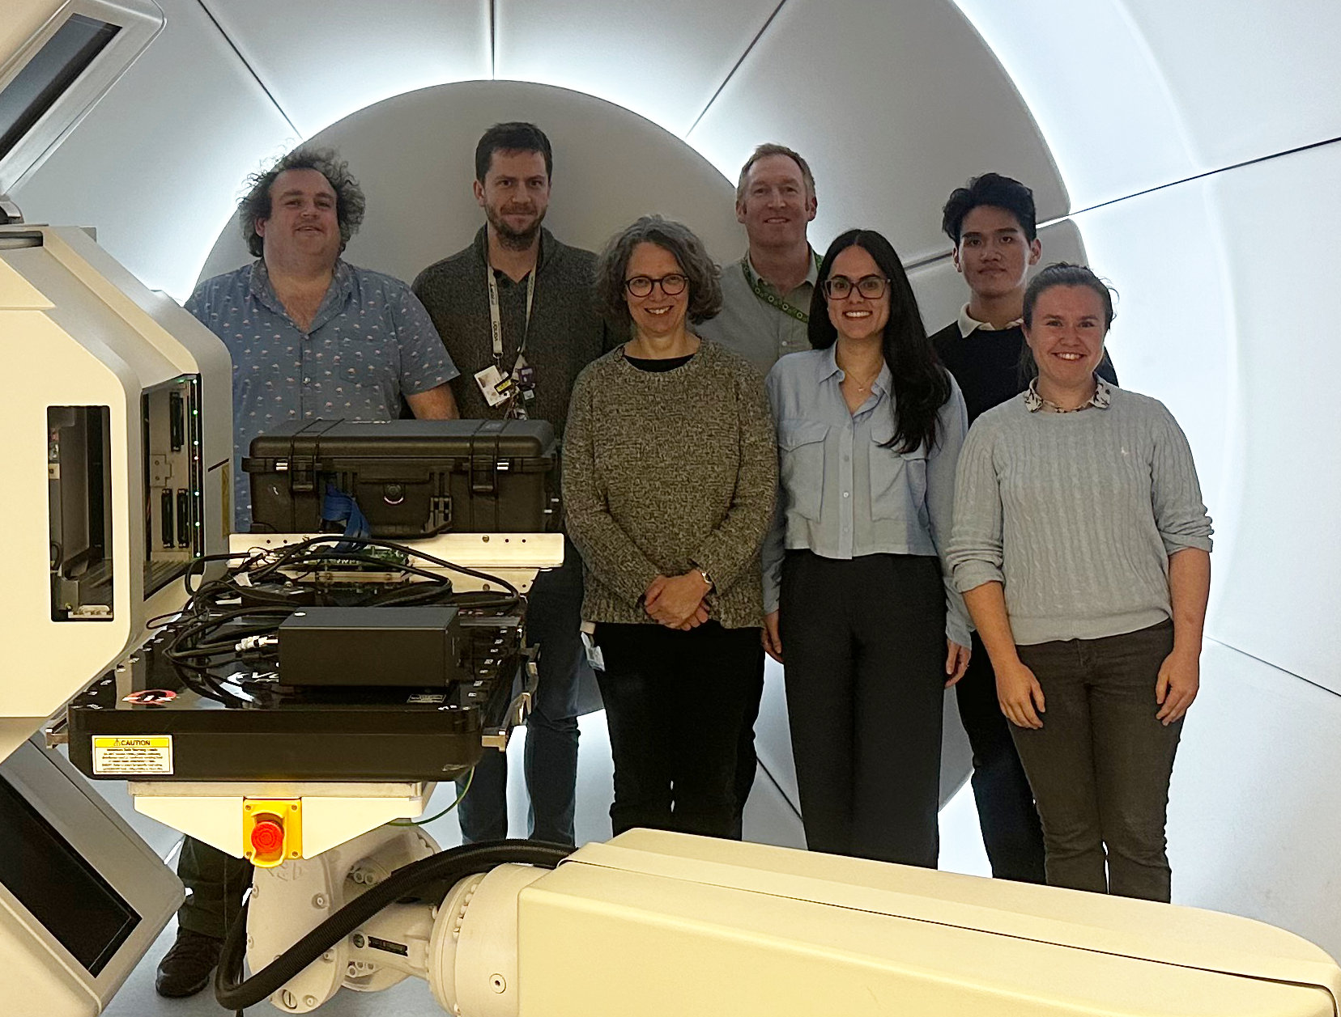

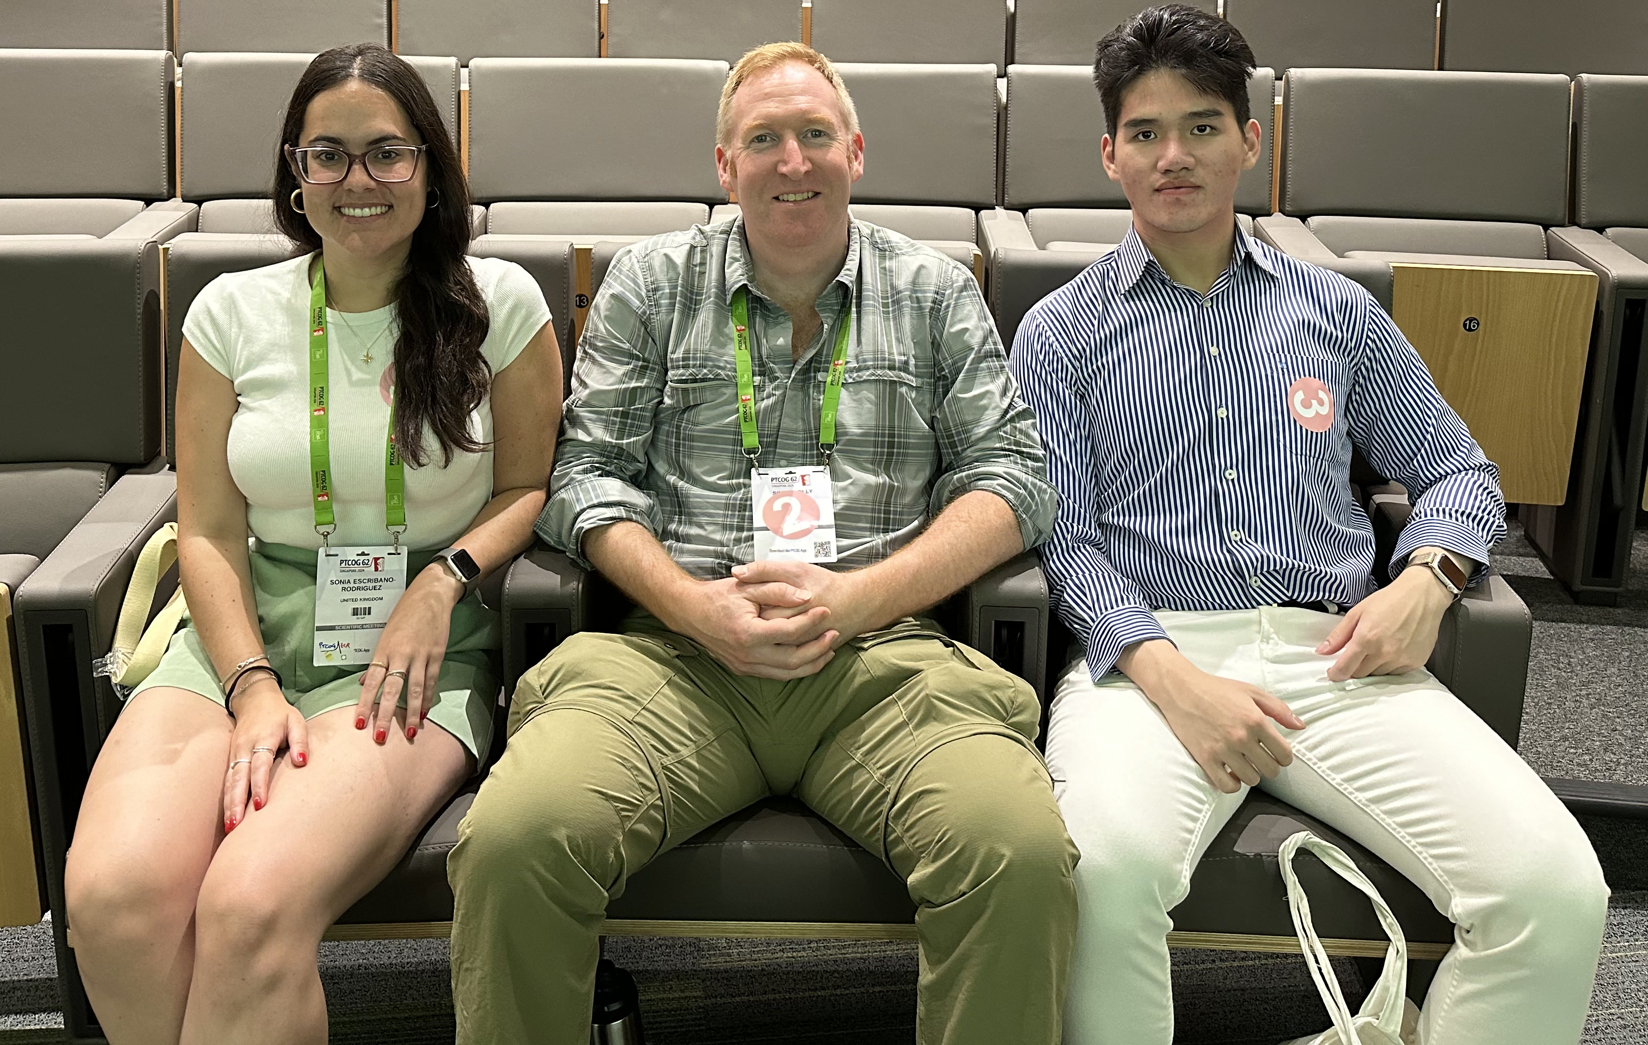
Acknowledgements
Simon Jolly
Sonia Escribano Rodriguez
Connor Godden
Harry Barnett
Matt Warren
Febian
Saad Shaikh
Fern Pannell
Sam Flynn
Nigel Lee
Russell Thomas
Colin Baker
Alison Warry
Andrew Gosling
Lee Harrison-Carey
Andrew Poynter
Rafaella Radogna
Tony Price
Catherine Burne
Phil Allport

