Slide 1
Upright Treatment/Fixed Beamlines/Compact Facilities: Machine Design Challenges
Simon Jolly
University College London

Slide 2

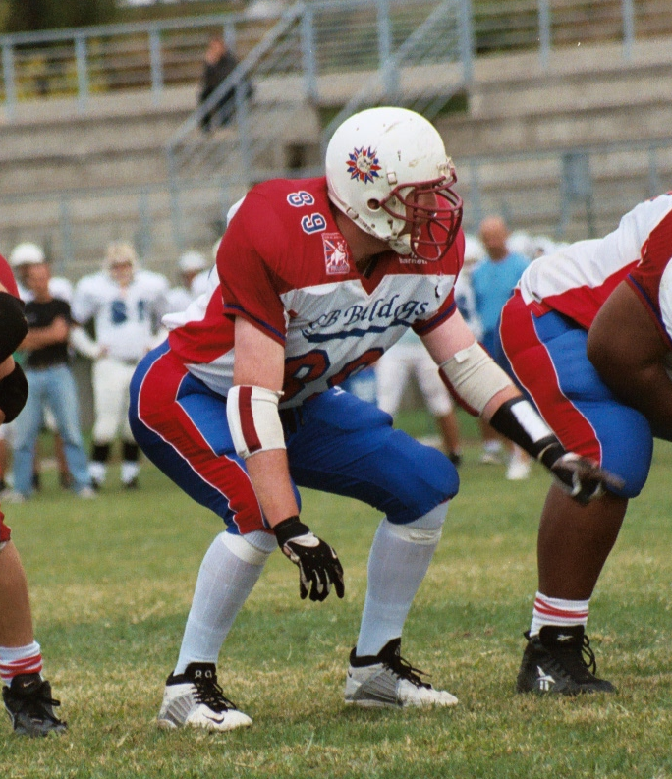
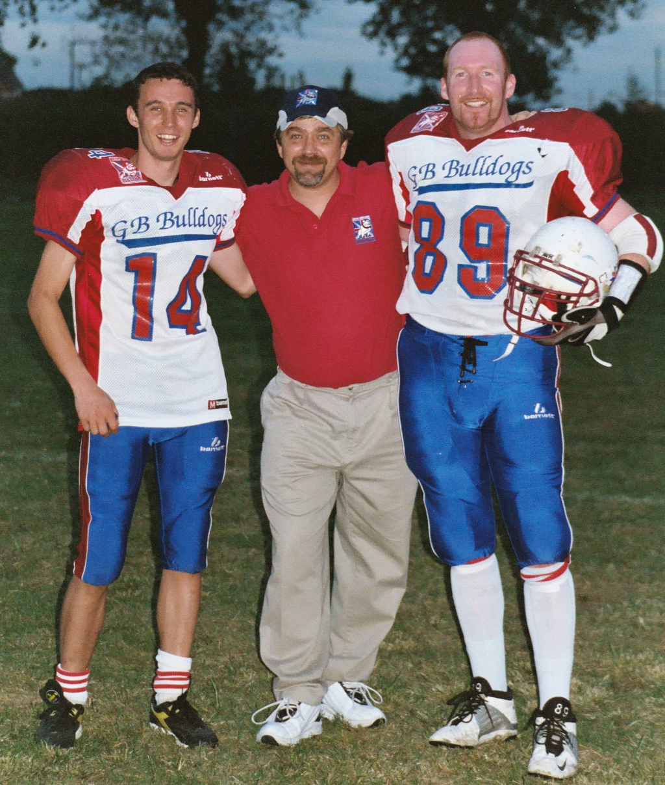
Problems, Not Solutions…

Slide 3

AI: Not Always The Right Solution…

Slide 4

AI: Not Always The Right Solution…

Slide 5
Similar, But Not The Same
What does “Gantry-less” mean?
Fixed beamline
Compact footprint+single floor (protons)
Upright treatment
Fixed beamlines optimise simplicity:
Mechanically simpler with easier installation.
Usually use FODO lattice for beam optics.
Oldest systems scattering only: no scanning magnets.
Compact systems optimise footprint:
Protons in photon space?
Removal of magnetic beamline (Mevion) helps compactness but gives less control over beam.
More stringent shielding if accelerator close to patient.
Upright patient positioning optimises treatment:
Some indications better treated upright than supine.
Makes fixed beamlines more feasible: at expense of proton-specific indications…?

Slide 6
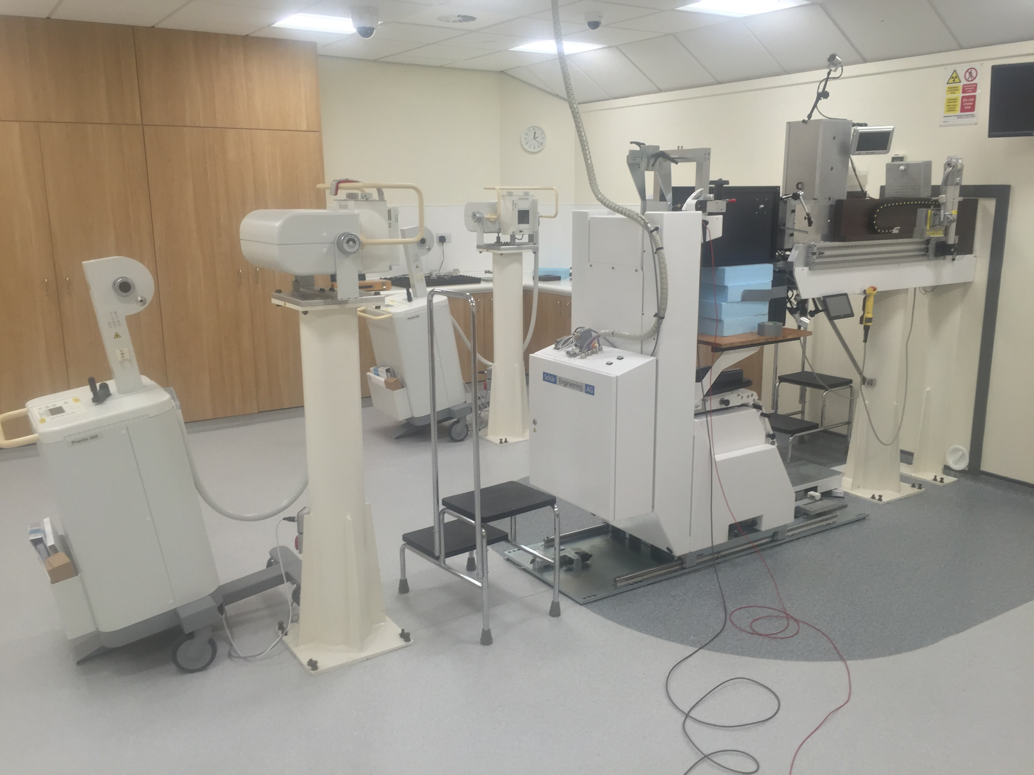
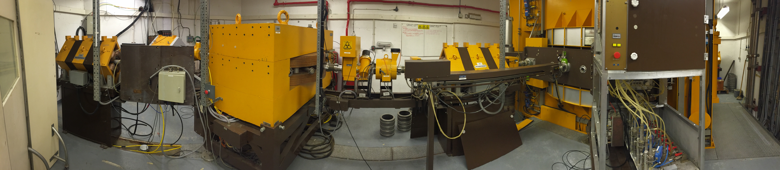
Compact Vs. Fixed Beam

