Slide 1





The QuADProBe: A Comprehensive Quality Assurance System for Machine and Patient Specific Quality Assurance
Simon Jolly
University College London

Slide 2
Disclosures
I’m a high energy physicist.
I’m socially awkward.
I haven’t had a COVID vaccine.
I’m difficult to work with.
Research funded in part by UK STFC and EPSRC research councils; EU Marie Curie network “Optimisation of Medical Accelerators”.
UCL research collaboration with Nuvia CZ for scintillator development.
No conflicts of interest to disclose.

Slide 3
Abstract
Background
  The clinical pressure to maximise patient throughput and increase efficiency in PBT means an increased focus on methods of decreasing the setup and measurement time for beam-based Quality Assurance (QA). This includes not only machine QA - where the focus is on making beam QA measurements both faster and more comprehensive - but also Patient Specific QA, which can be a significant load on staff and machine time better utilised elsewhere.
Methods
  The Quality Assurance Detector for Proton Beam Therapy - the QuADProBe - is currently under development to integrate the various beam QA measurements into a single combined detector capable of making simultaneous measurements of absolute dose, beam position, spot size and shape and range in water across the full range of clinical energies at both clinical and FLASH dose rates. The transmission calorimeter developed at NPL offers dose measurements with consistent repeatability with less than 2% (k=1) SEOM. A Monolithic Active Pixel Sensor (MAPS) developed at the University of Birmingham measures beam spot size and position with sub-millimetre accuracy. Finally, the UCL plastic scintillator-based Quality Assurance Range Calorimeter (QuARC) allows sub-millimetre measurements of Water Equivalent Path Length up to 250 MeV.
Results
  These are combined into a single nozzle-mounted enclosure with single onboard PC-based data acquisition (DAQ) system providing full detector monitoring and control through a simple web interface. The nozzle-mounted enclosure greatly simplifies setup and enables measurements at all gantry angles without adjustment to the detector setup. The web-based DAQ user interface enables detector control with any computer, tablet or mobile device connected to the same network as the QuADProBe.
Conclusions
  We present QuADProBe measurements carried out at the UCLH PBT centre, covering both single energy pristine Bragg curves at a range of energies and positions, and a series of box fields, including treatment plans with multiple gantry angles. These demonstrate the feasibility of making all beam QA measurements simultaneously. Since measurements are made in real time, the QuADProBe reduces single PSQA measurements to the time taken for treatment delivery - on the order of a few minutes - since rescanning and detector adjustment is not required.

Slide 4
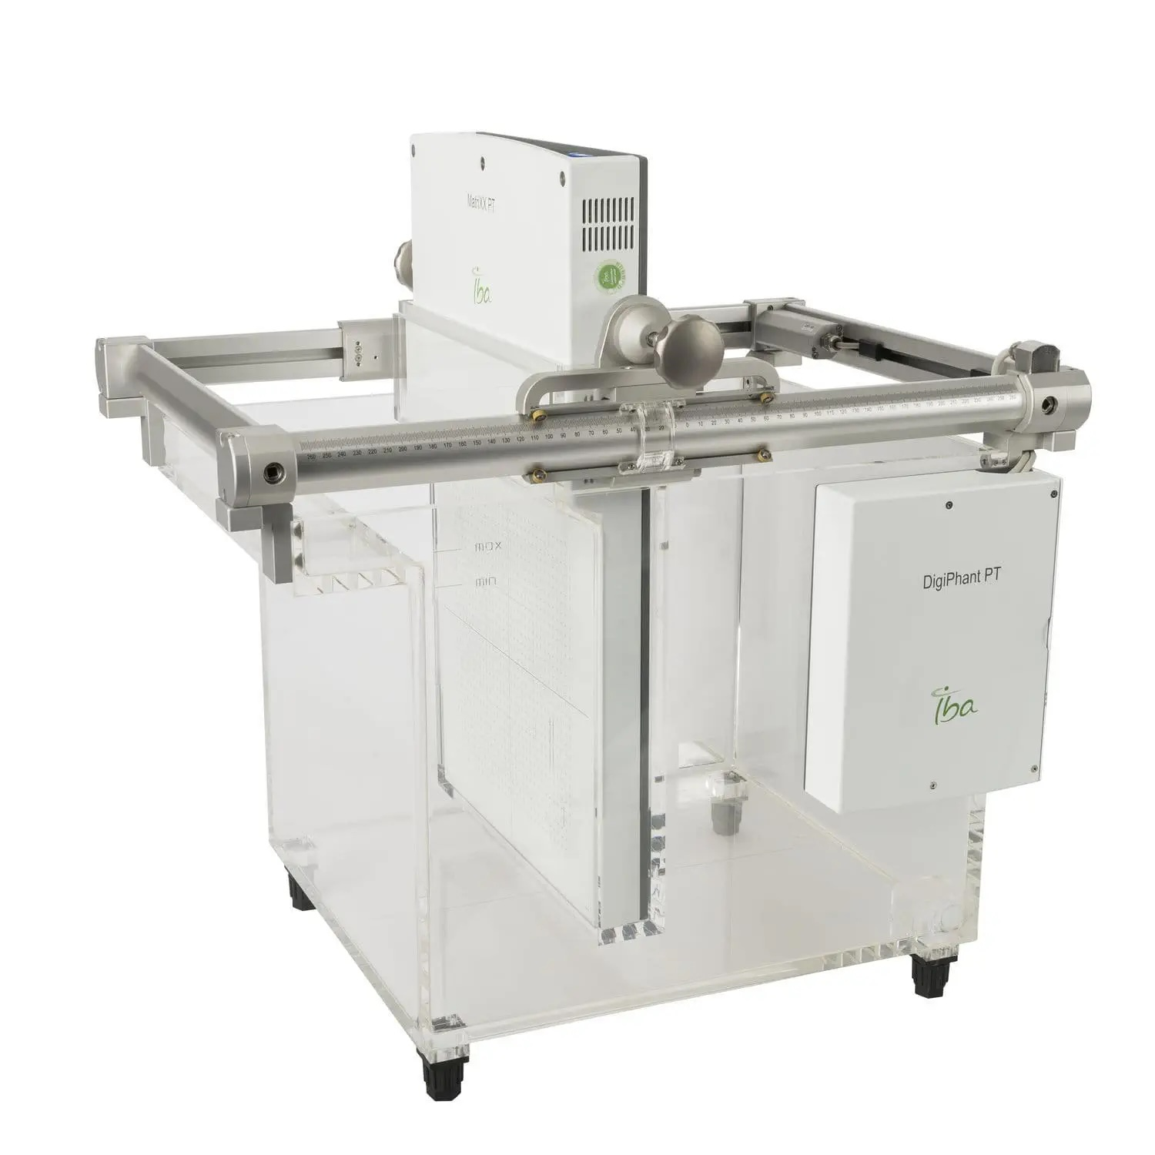
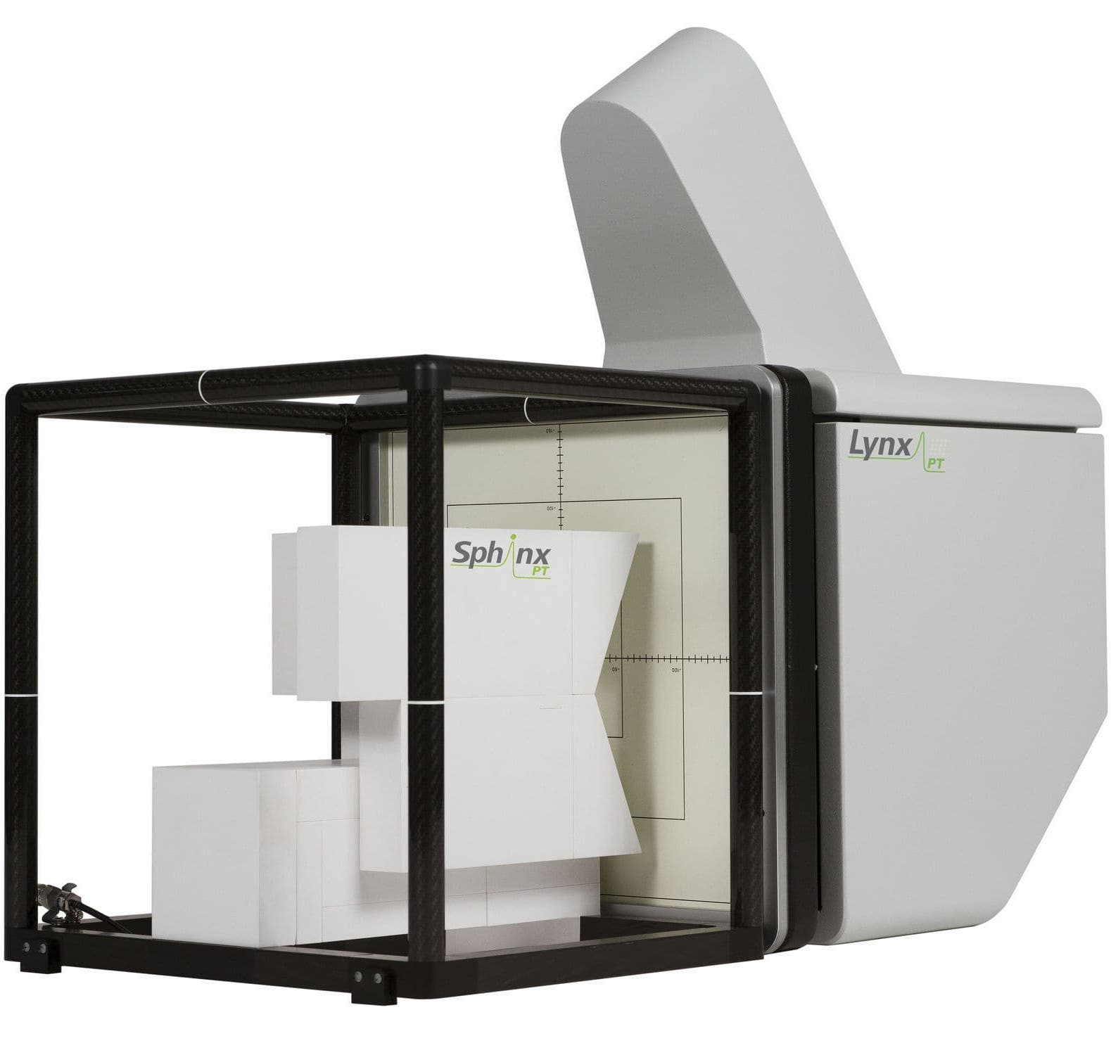
PBT Beam & Patient Quality Assurance
Beam QA verifies 4 properties:
  Absolute dose
  Spot size (X & Y)
  Spot position (X & Y)
  Range (to water)
Measurement frequency determines how fast/comprehensive it is:
  Ideally measure all properties at all positions/energies
  Too much for daily QA!
  Limit to verification of a few properties
  Make compromises eg. spot size after known absorber
Patient QA less frequent but more comprehensive:
  Need to verify volumetric dose to water for full treatment plan
  Includes multiple gantry angles
Need to compromise for speed:
  Sample only at specific locations
  Single gantry angle
If we can measure all properties at all positions/energies and all gantry angles, we can do better
Measure all properties simultaneously with separate detectors
Reconstruct in simulation

Slide 5
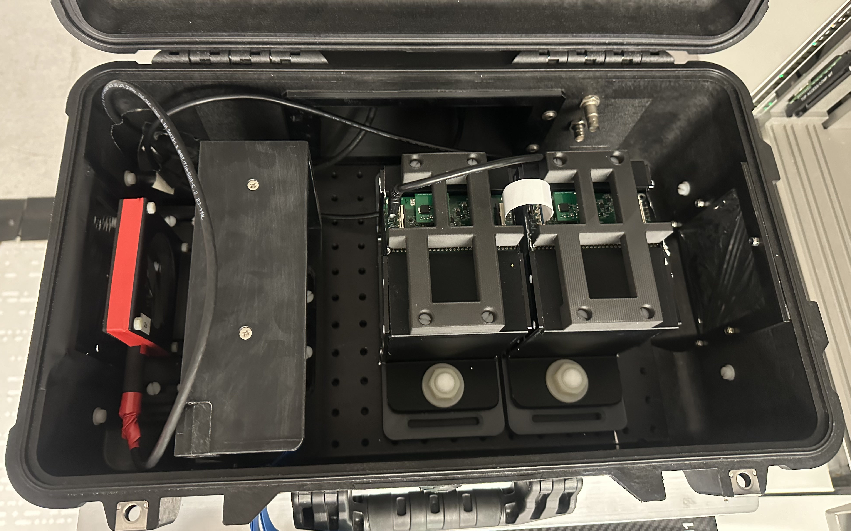
Enter: The QuADProBe
Absolute Dose: NPL Transmission Calorimeter (TC)
Water Equivalent Range: UCL QuARC Range Telescope
Protons
Spot Size + Position: Birmingham CMOS Pixel Sensor
Enclosure: Peli 1510 flight case with patch panel

Slide 6
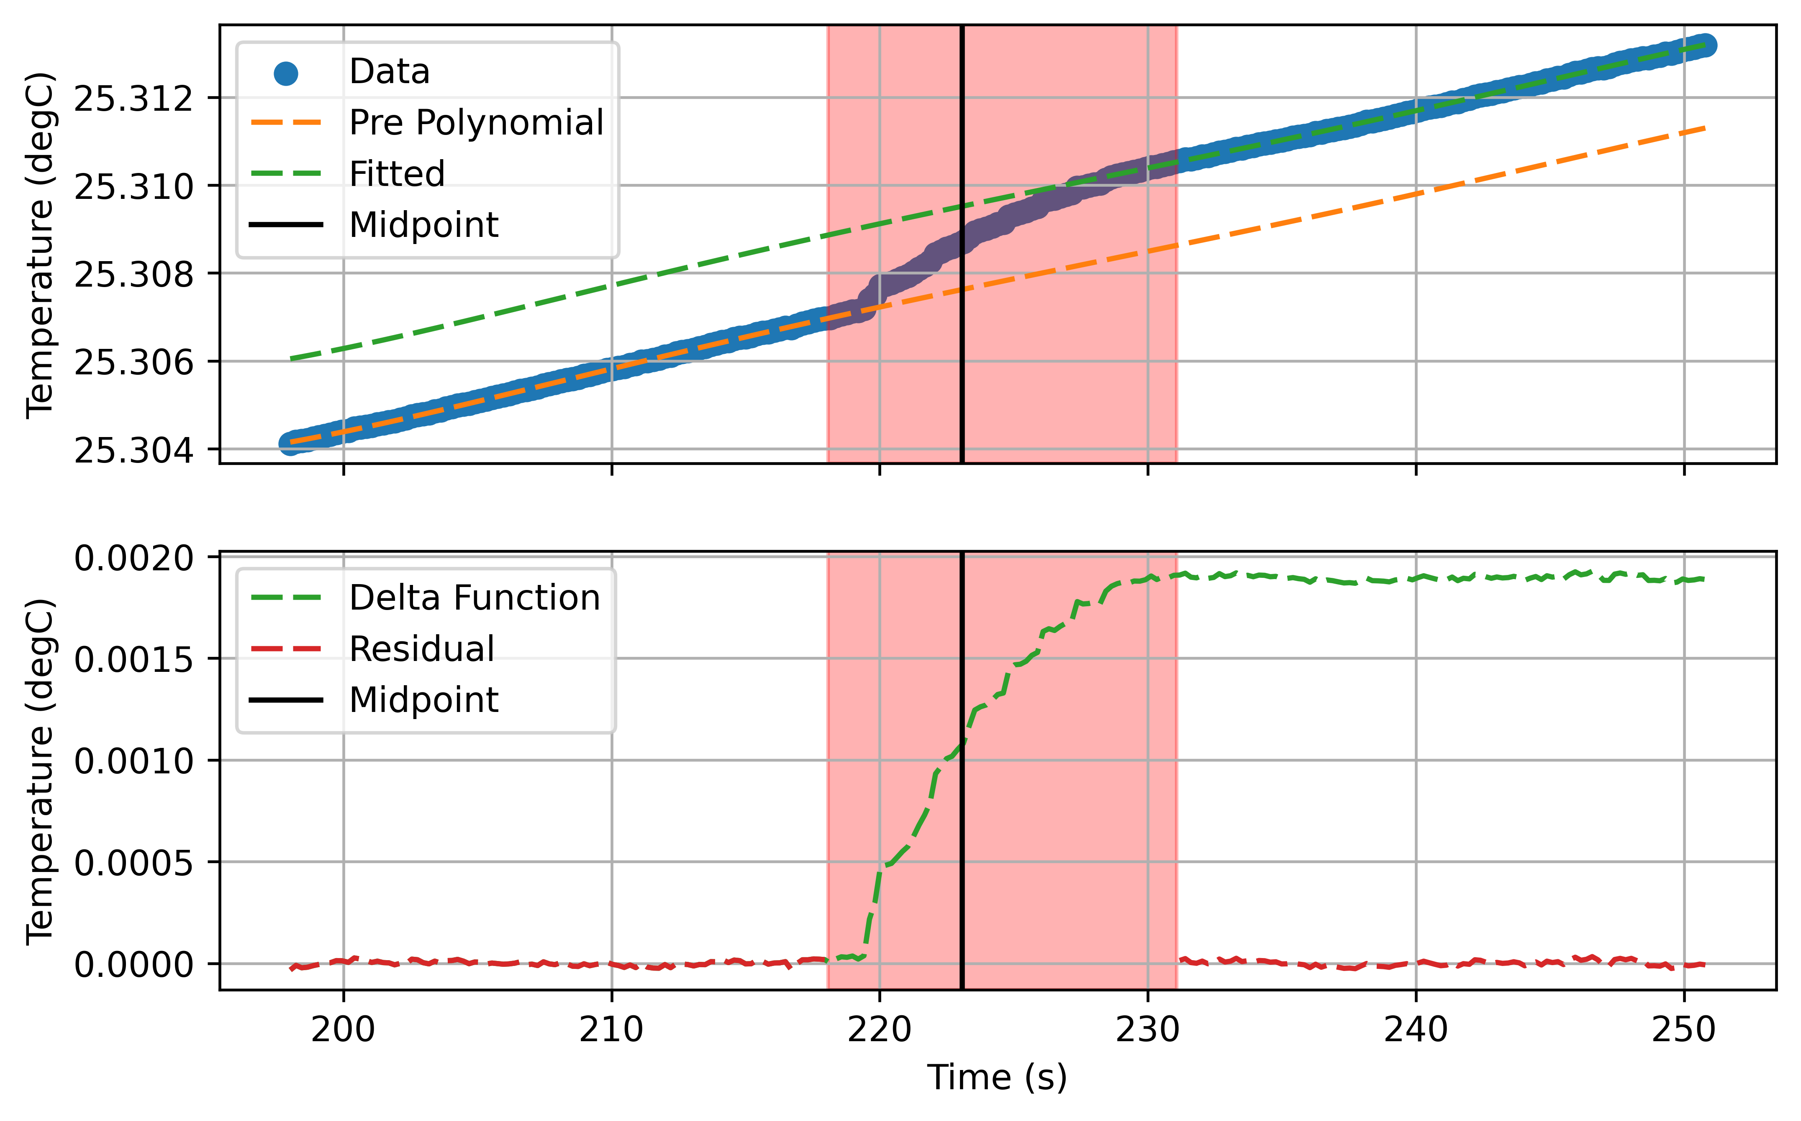
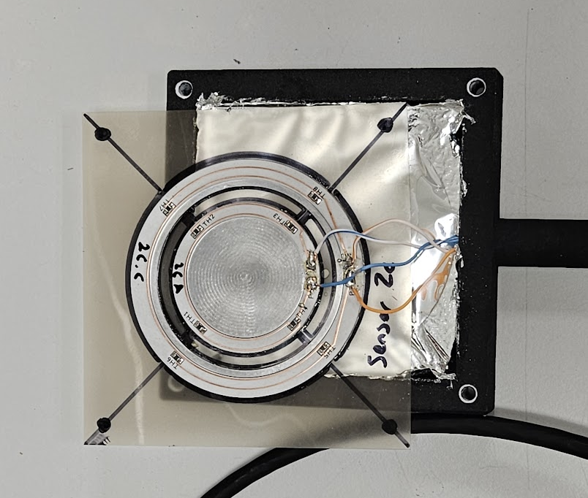
The NPL Transmission Calorimeter (TC)
A thin aluminium core with embedded thermistors
  45 mm diameter
  0.6 mm thickness, approximately 1.2 mm WET
  High performance 7 W/mK thermal conductivity dielectric PCB connecting thermistors
Twin core design:
  Primary core to measure radiation-induced temperature change
  Secondary core to compensate for ambient temperature fluctuations
Results:
  Linear response with dose in 3 x 3 x 3 cm³ cube
  Measures 1.96 ± 0.04 mK for 10 Gy delivery
  Performance evaluated at different dose rates and different energies

Slide 7
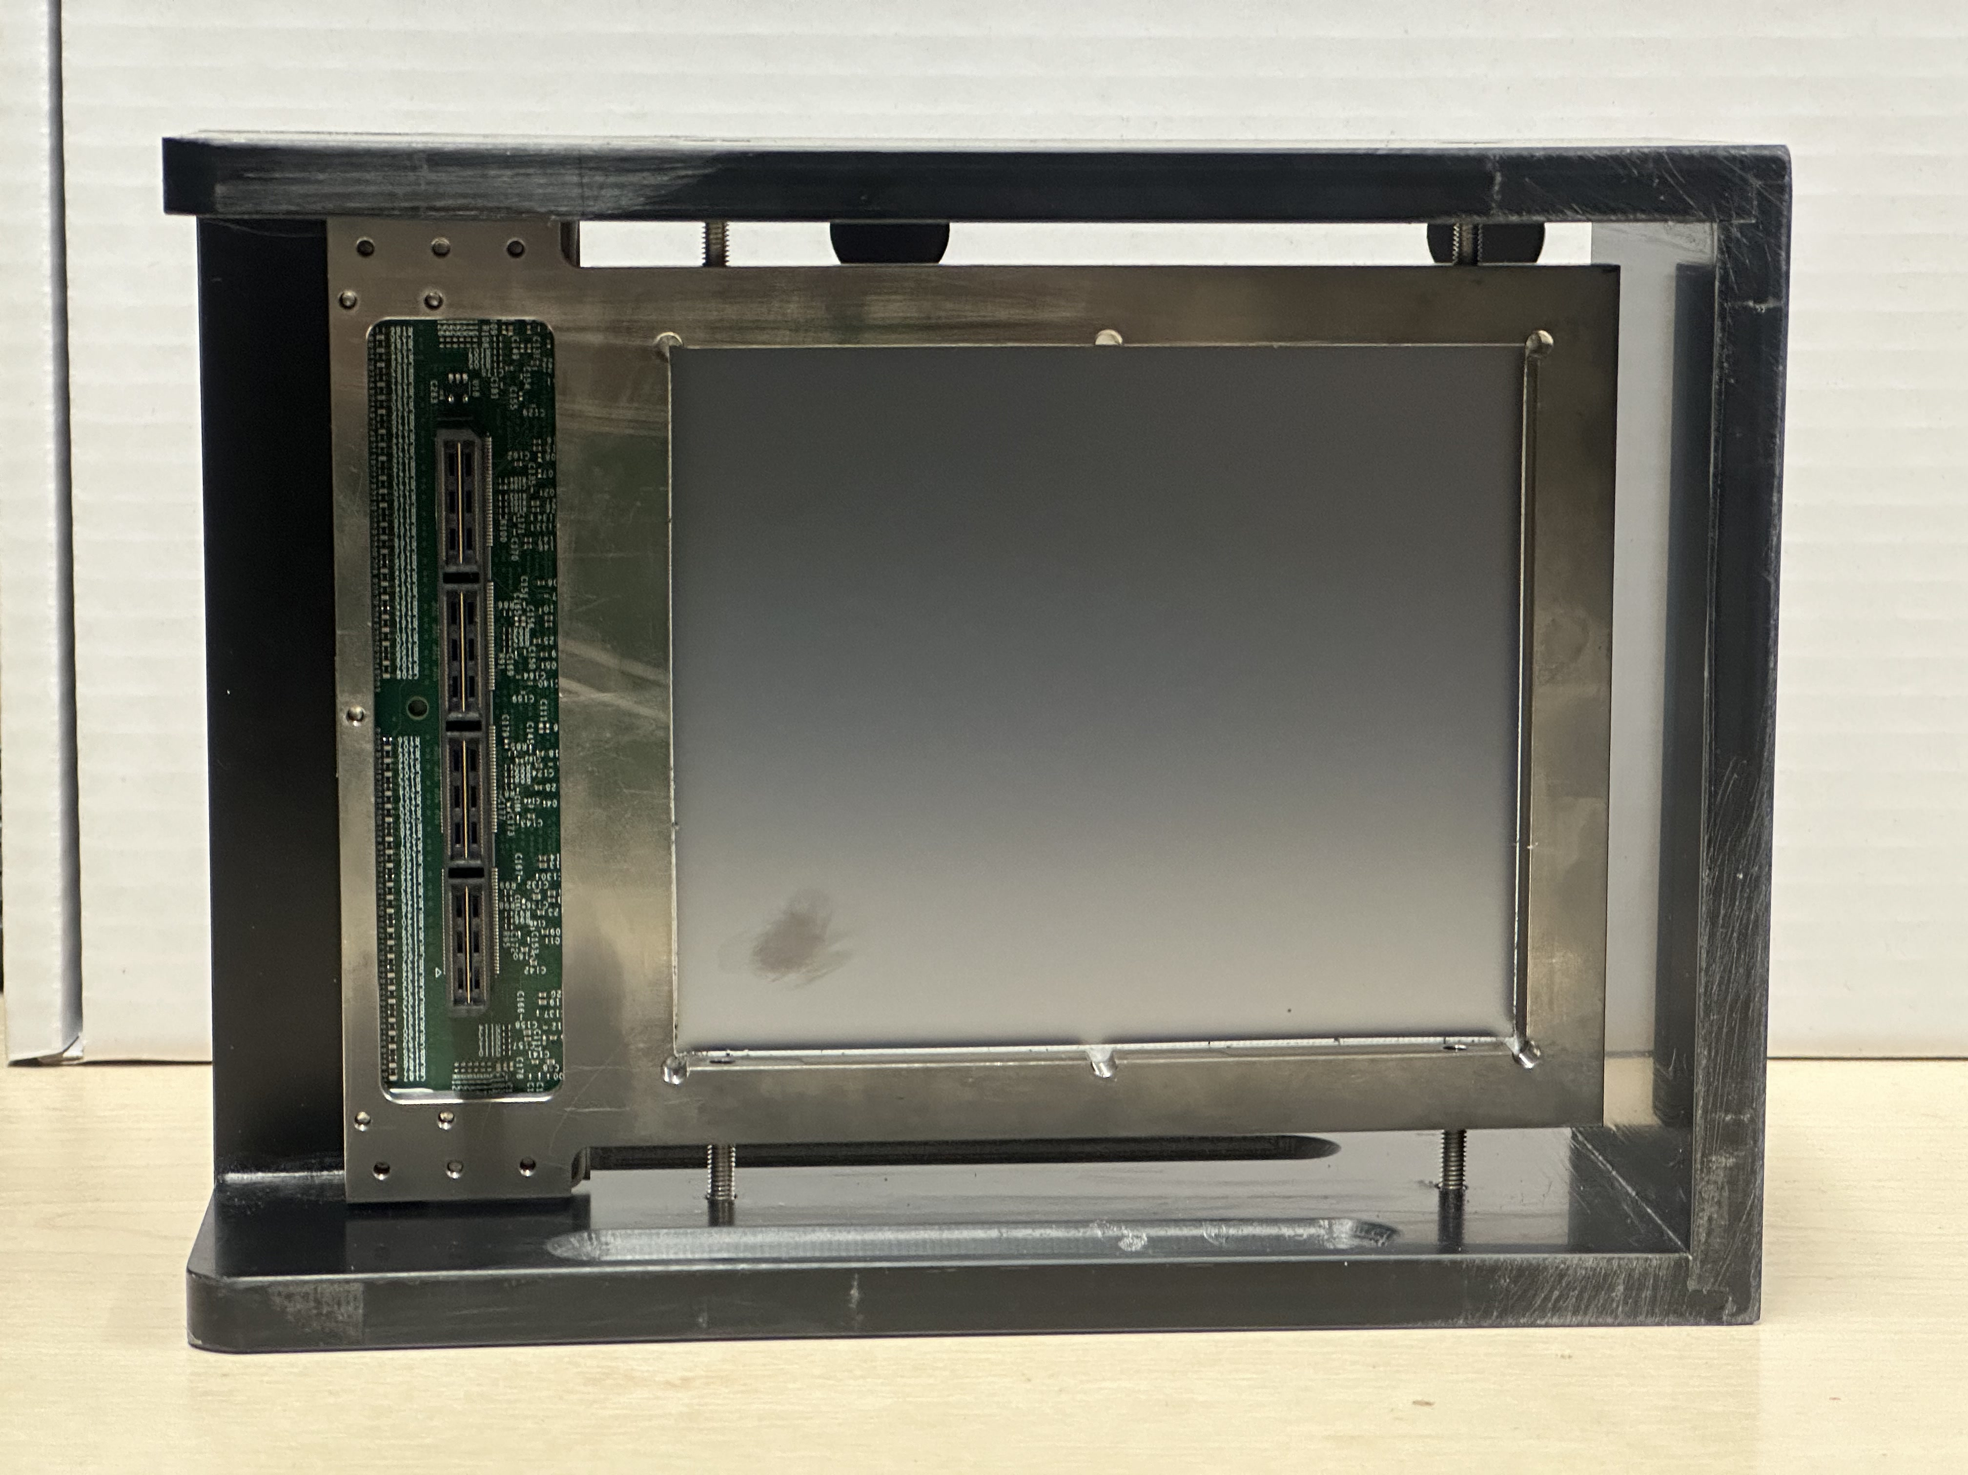
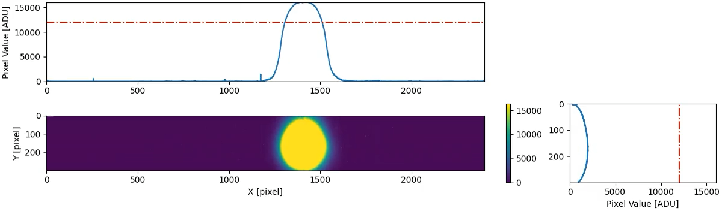
The Birmingham CMOS Pixel Sensor
2D large format CMOS pixel sensor LASSENA:
  Developed at RAL (UK) X-ray imaging; marketed by Nordson
  2,400 x 2,800 pixels each 50x50 µm²
  12 x 14 cm² active area
  Readout along one side to allow tiling of sensors over a 24x(Nx12) cm² area
  Active thickness of 8 um silicon plus 700 um of support silicon.
  34 fps full frame readout via a rolling shutter (28 ms integration time).
NIMA 2022: 10.1016/j.nima.2022.166703
Jinst 2023: 10.1088/1748-0221/18/03/P03014

Slide 8
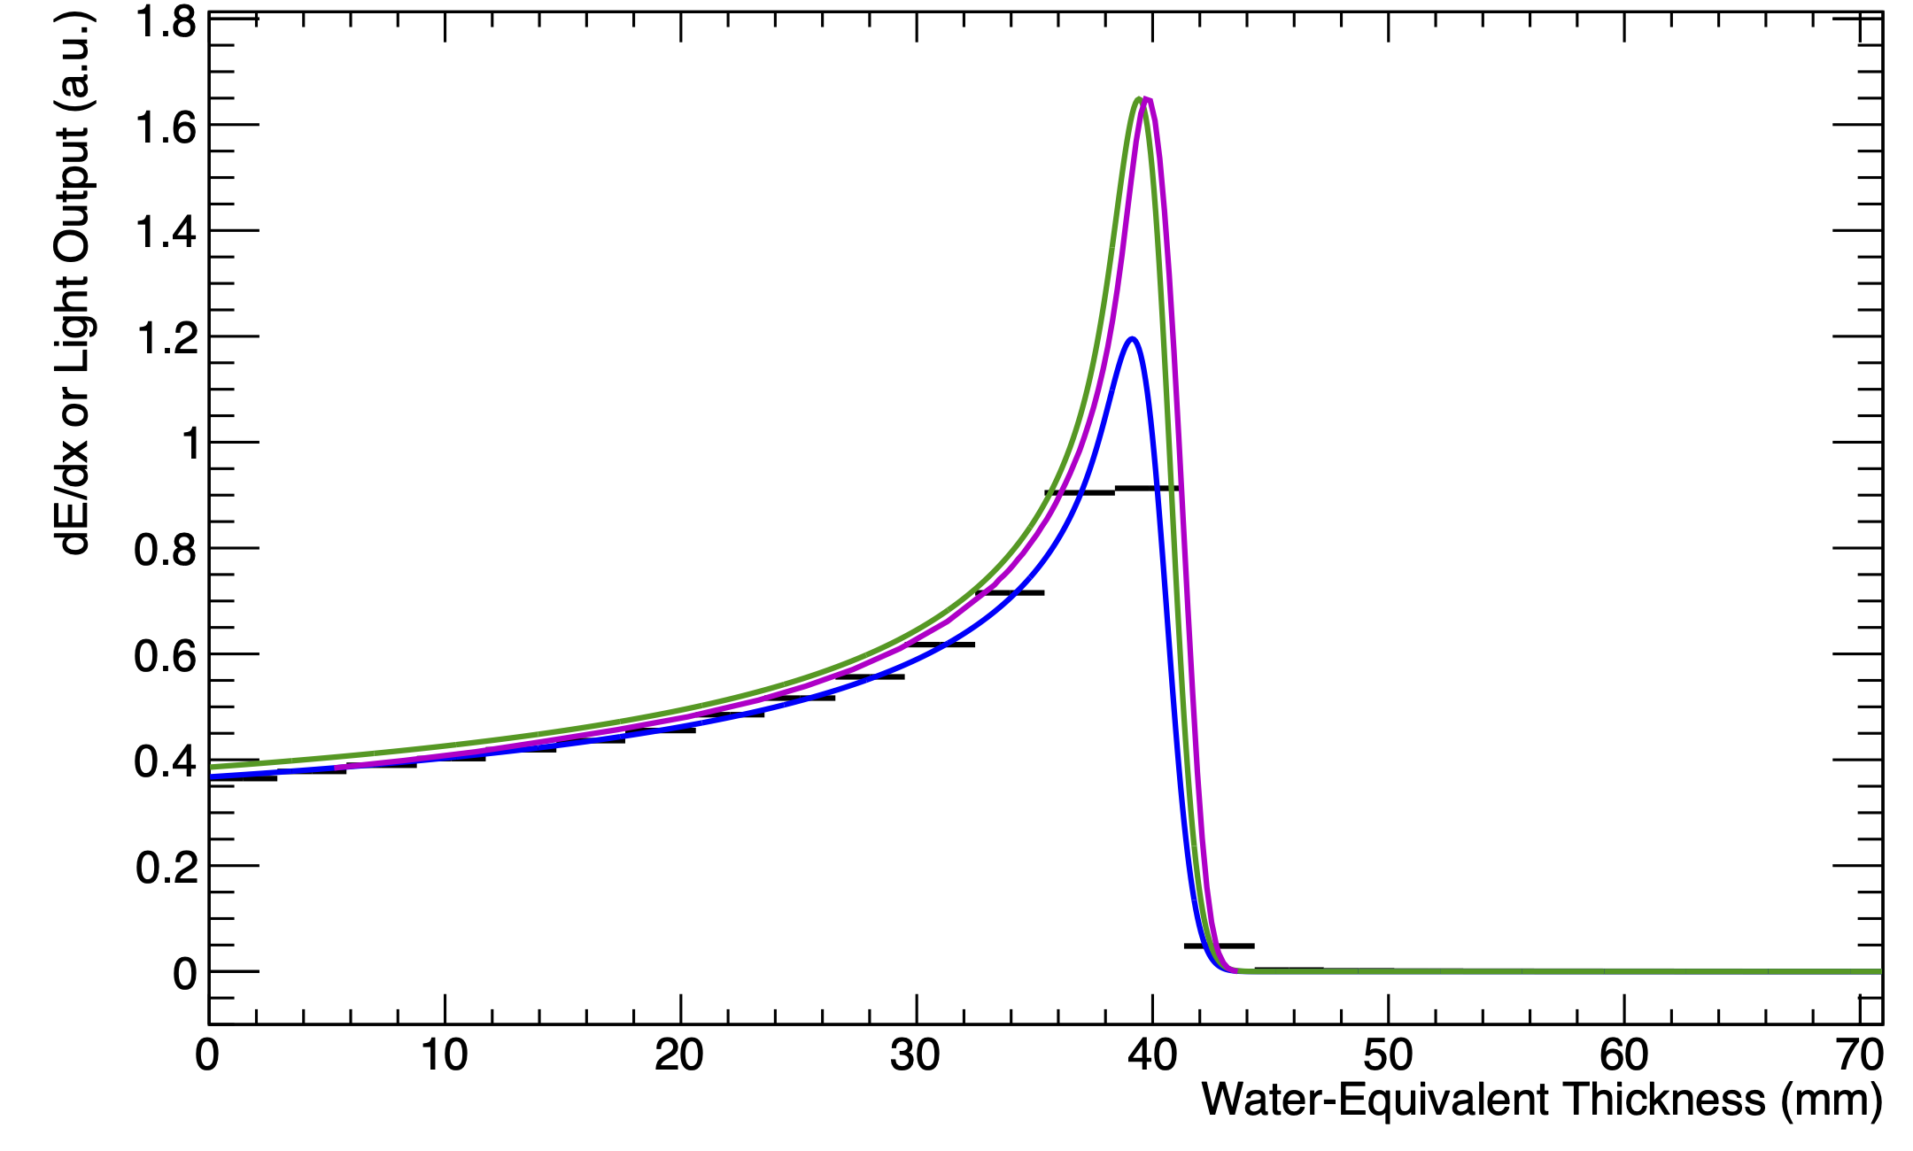
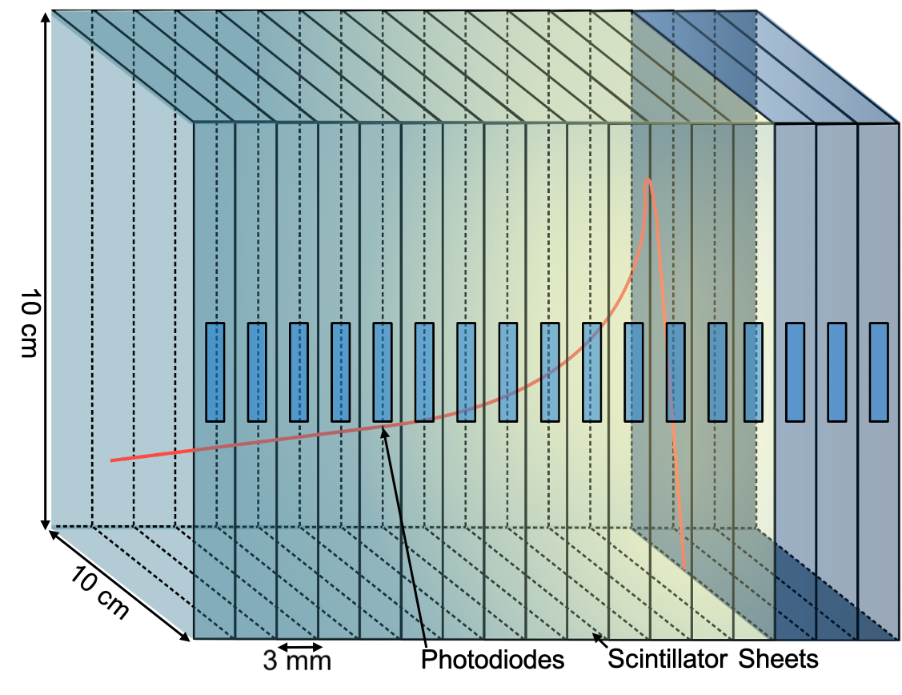
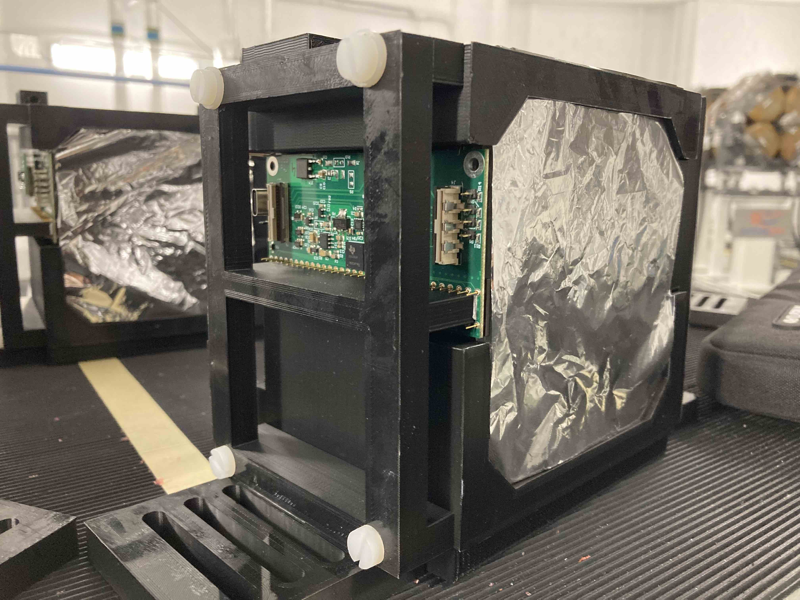
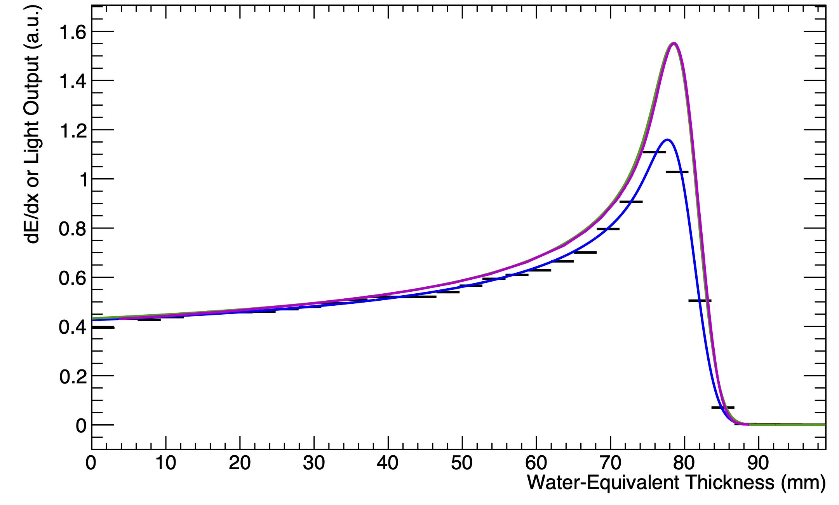
The UCL QuARC
The Quality Assurance Range Calorimeter (QuARC) constructed from plastic scintillator:
  Protons intercepted by a series of optically-isolated polystyrene scintillator sheets.
  Measure light output with photodiodes.
  Light output of each sheet nonlinear to dose, but quenching described by Birks’ Law:
    Fit data with analytical depth-light model.
    Reconstruct Bragg depth-dose curve and measure proton range.
  Photodiodes coupled to fast, modular electronics and an FPGA to read light levels at over 5 kHz.
  FPGA connects to on-board PC (Raspberry Pi) via USB.
  On-board DAQ runs web server: connect over network for full data viewing and control.
Sheet Average Light Output
Fitted Quenched Depth-Light Curve
Reconstructed Depth-Dose Curve
UCLH Reference Dose Curve
70 MeV
16/06/22
130 MeV
01/09/22

Slide 9
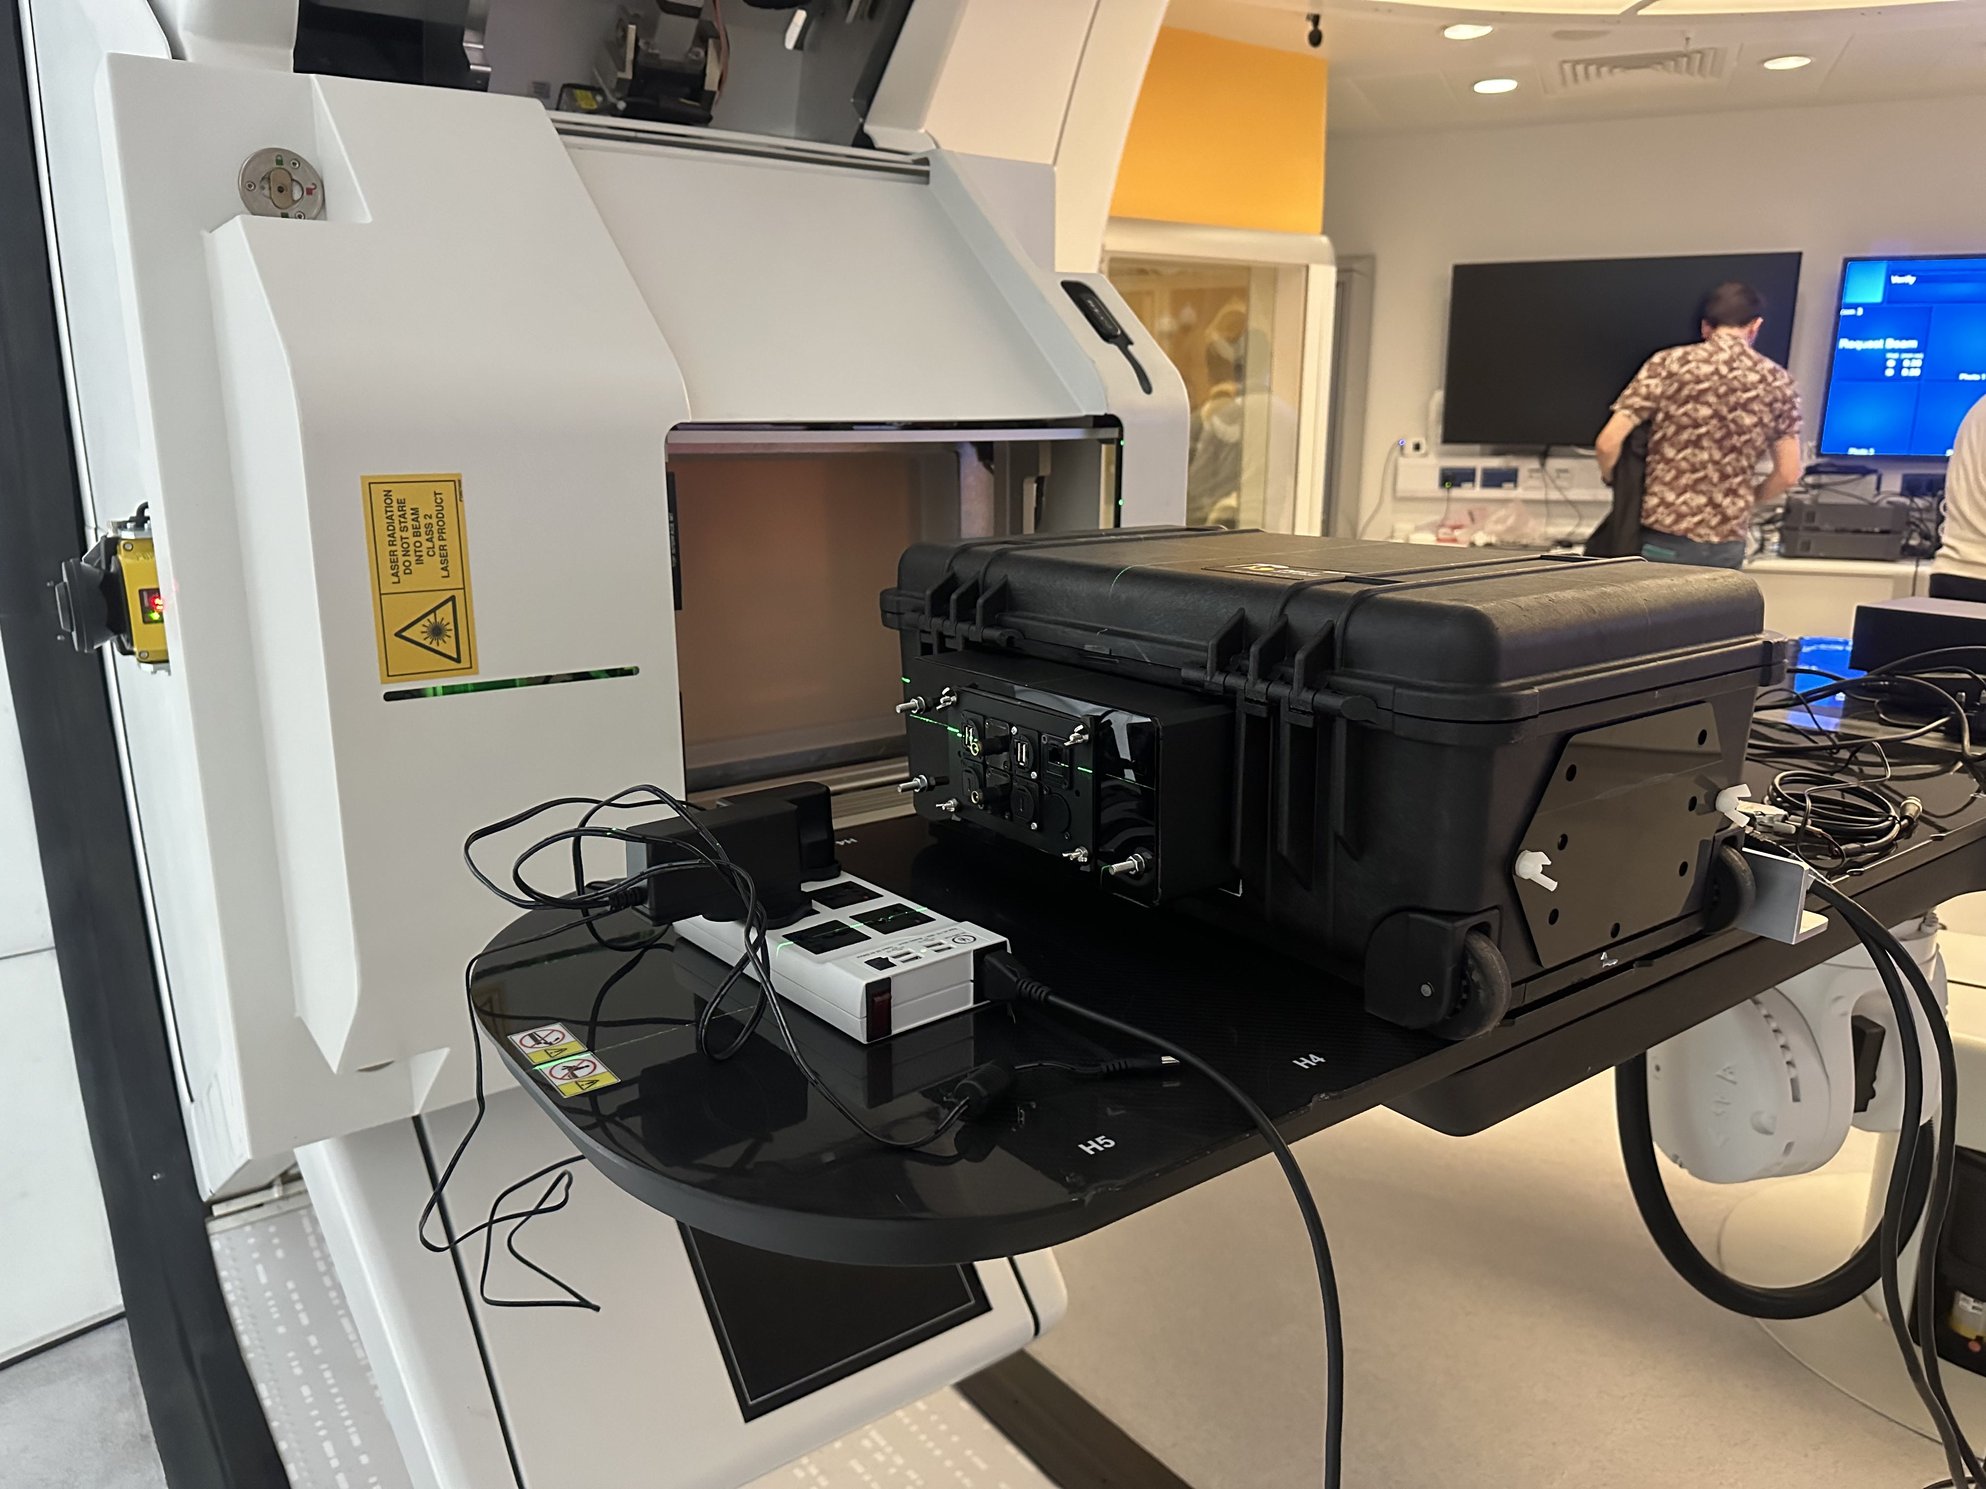
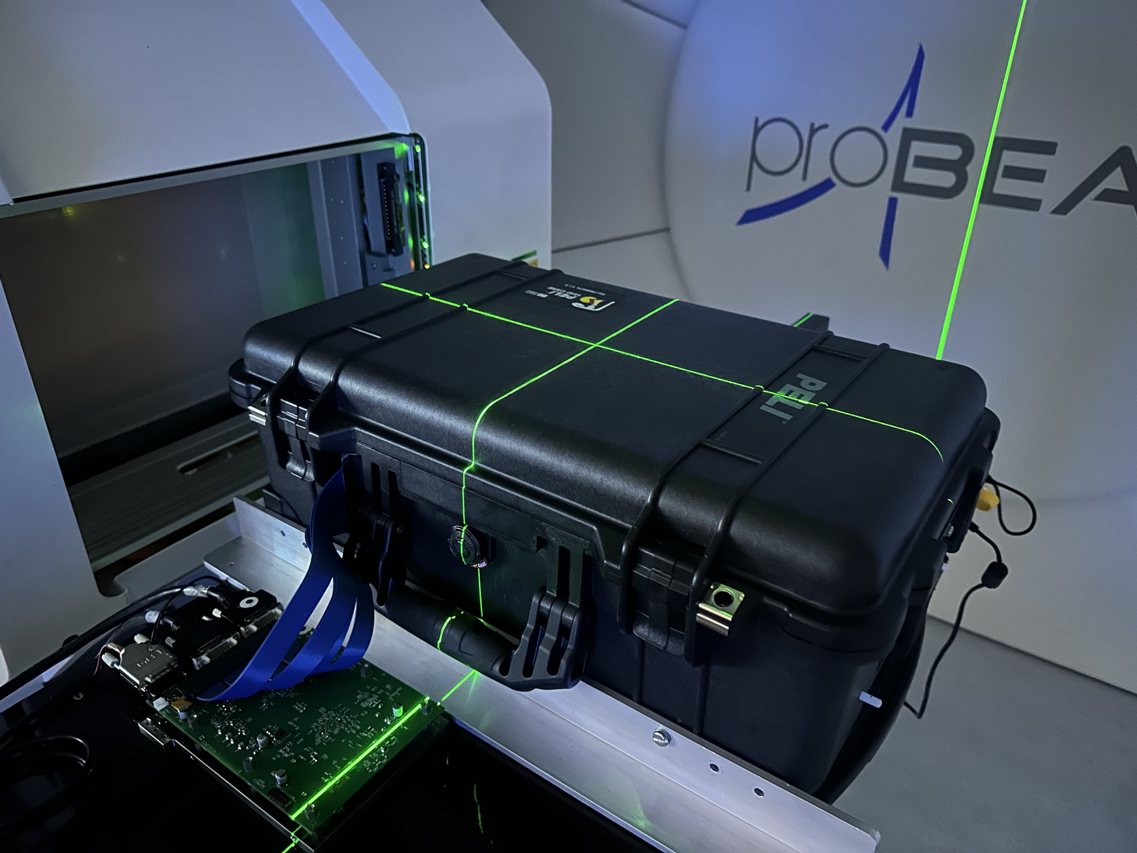
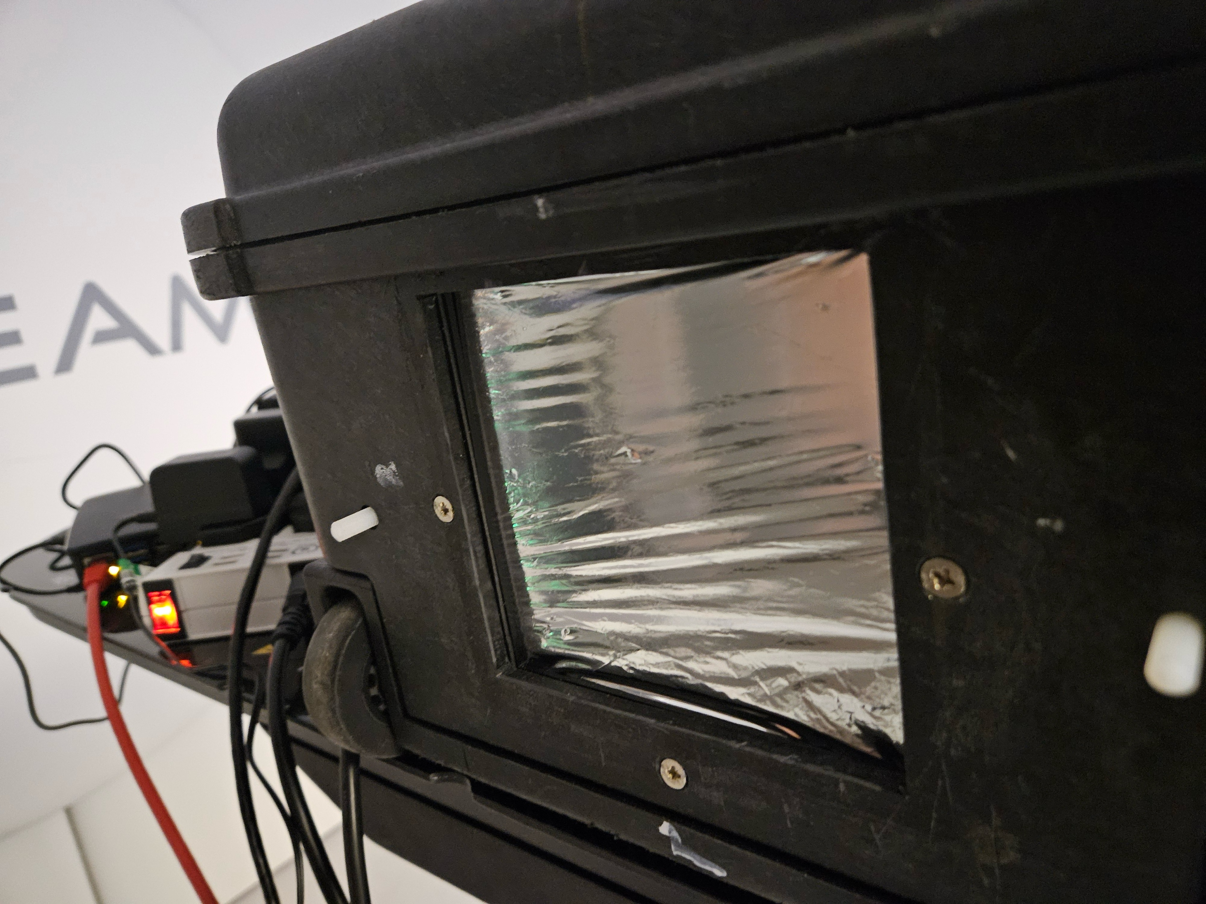
UCLH Beam Tests
Two nights of tests at UCLH
4 QA treatment plans to test:
  3 x 3 x 3 and 5 x 5 x 5 box fields
  Single spot SOBP
  “Slice” field to test pixel sensor readout.
Some teething problems:
  Noisy readout from QuARC
  Dead pixels/areas on pixel sensor
  Couch position interlock
  Different gantry room for each night

Slide 10
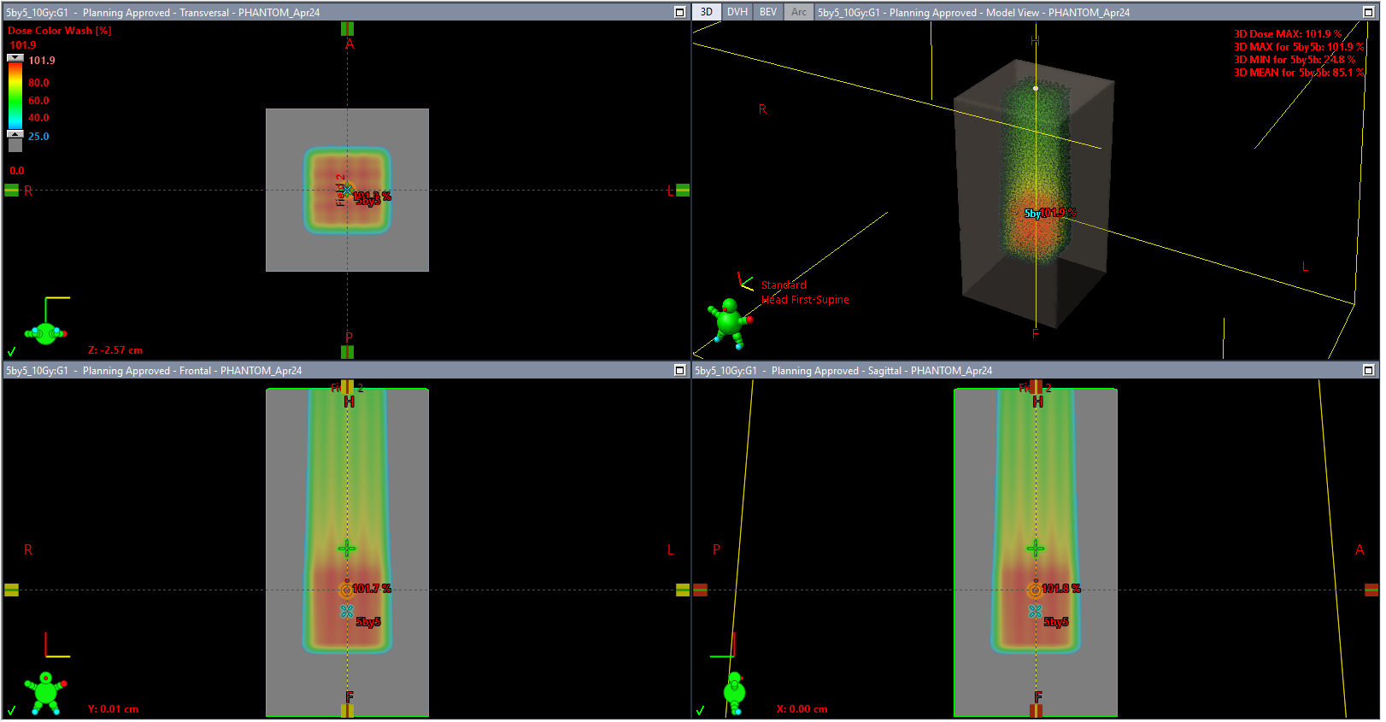
UCLH 5 x 5 x 5 Box Field Plan

Slide 11
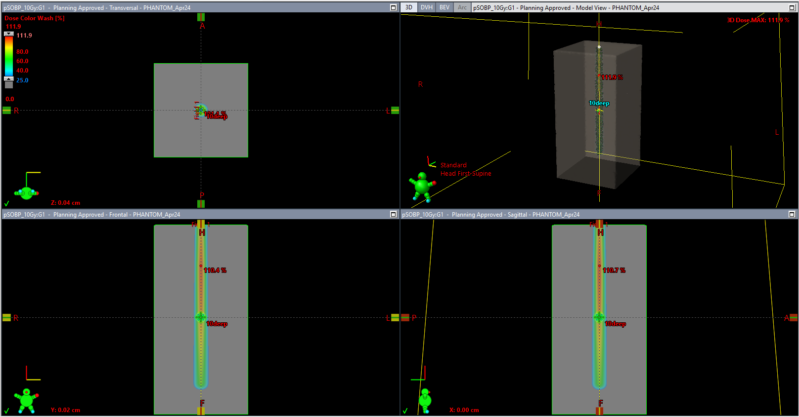
UCLH Single Spot SOBP Plan

Slide 12
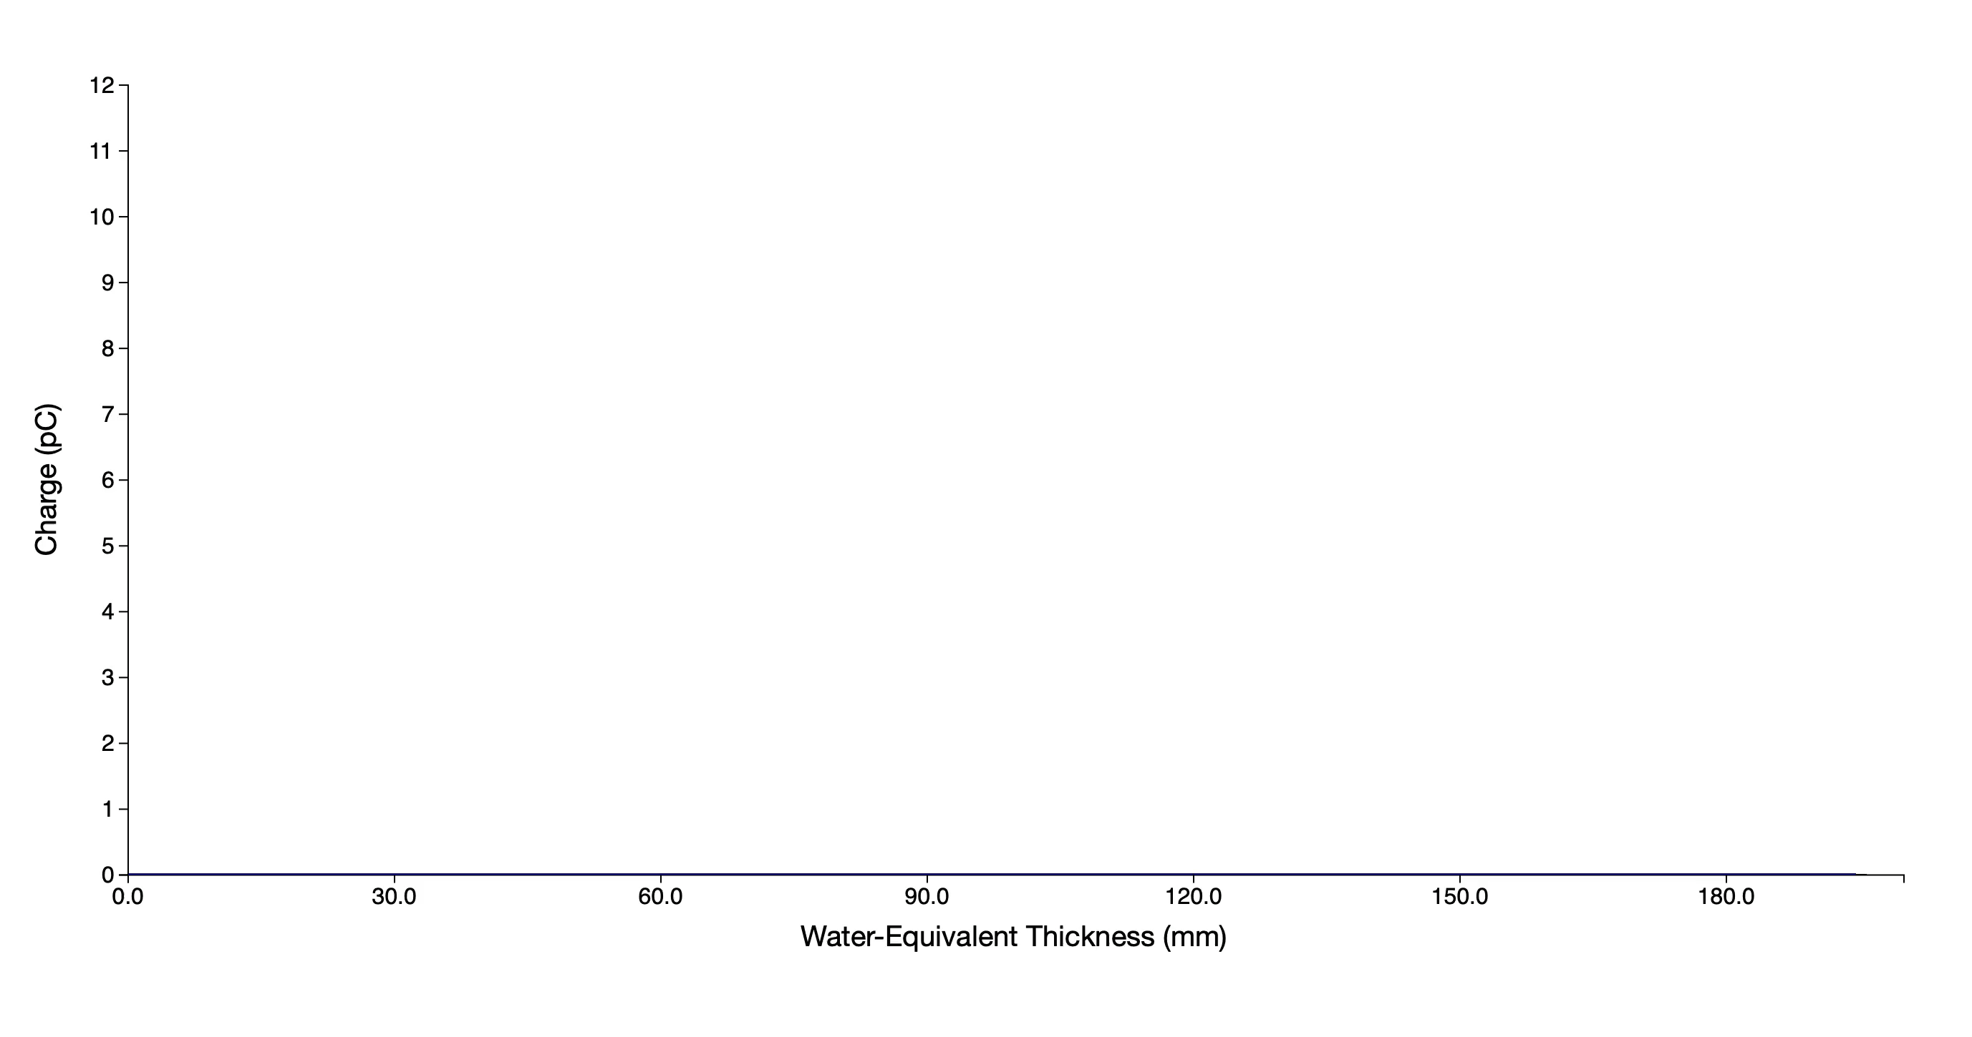
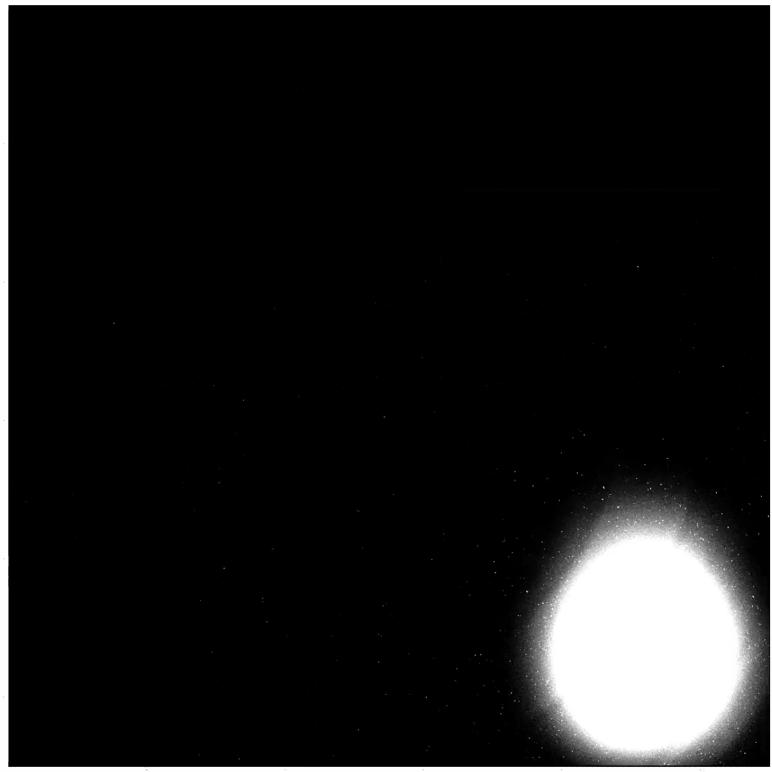
UCLH Beam Test Results (Preliminary)
Pixel Sensor
QuARC

Slide 13
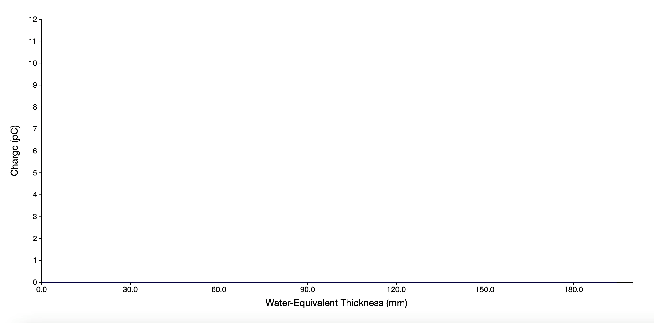
UCLH Beam Test Results (Preliminary)
Pixel Sensor
QuARC

Slide 14
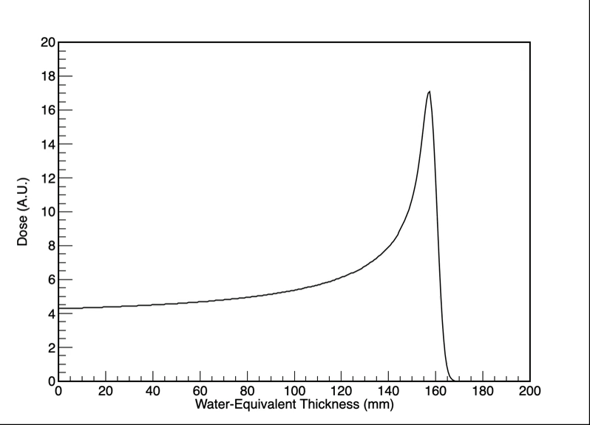
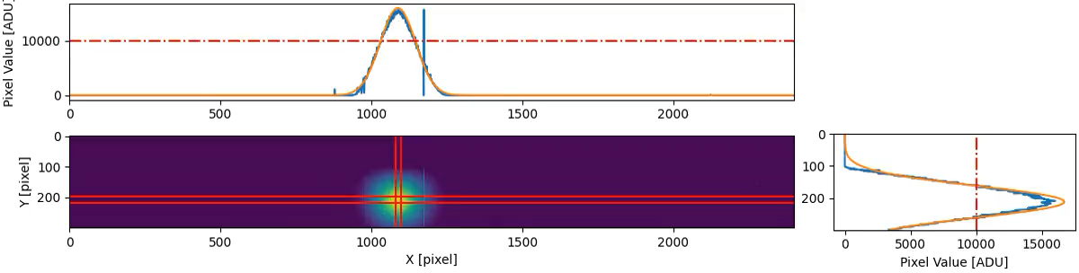
Combined Data Output

Slide 15
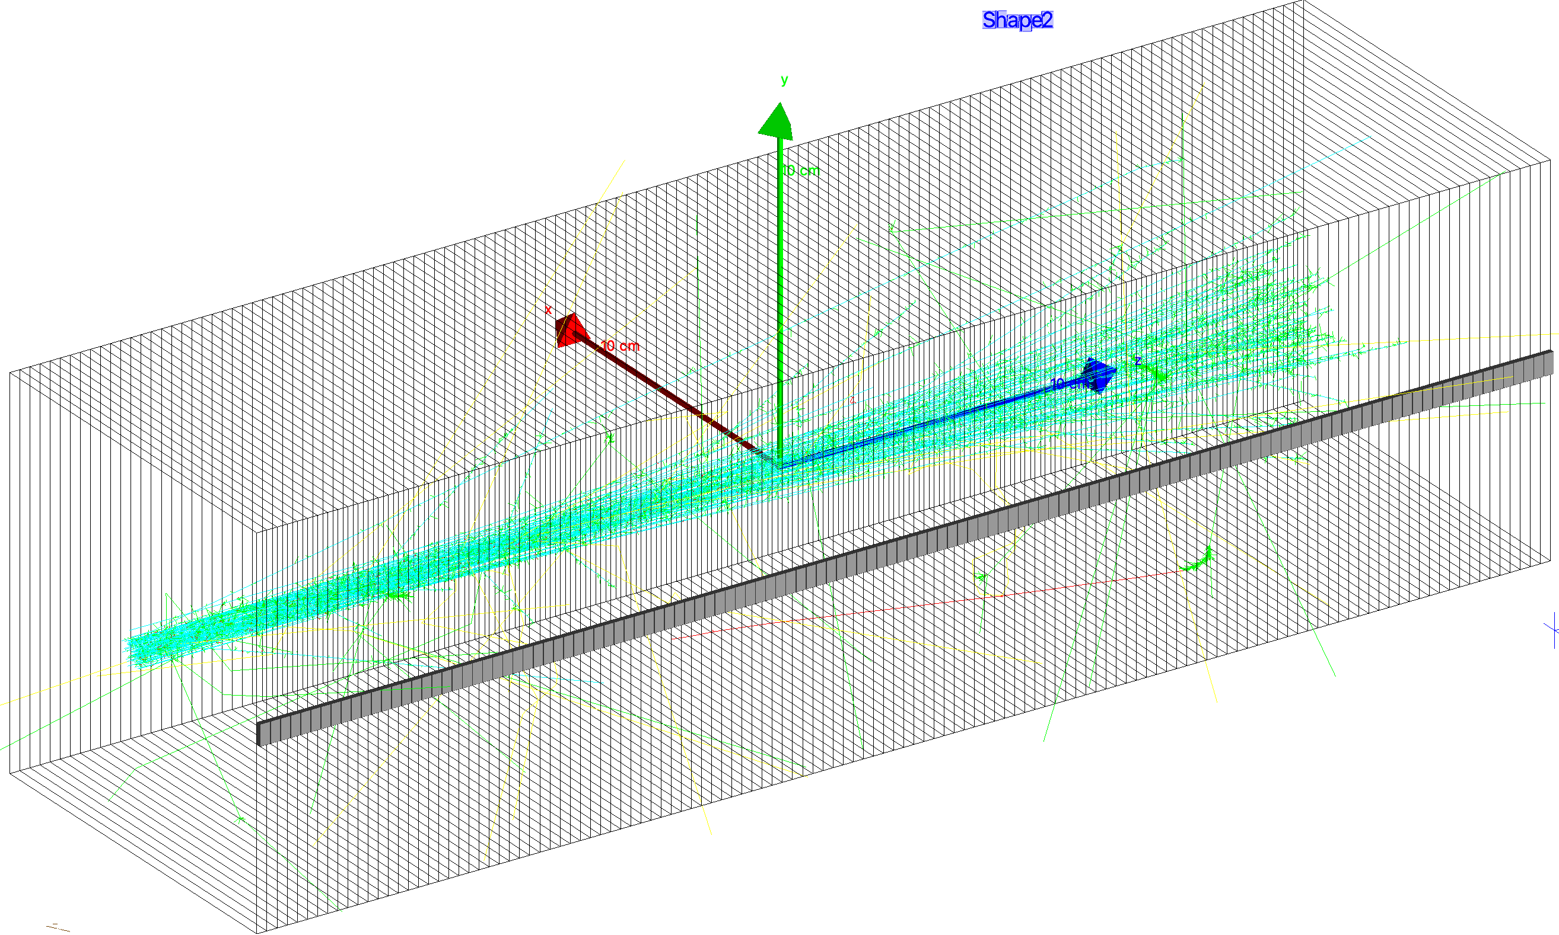
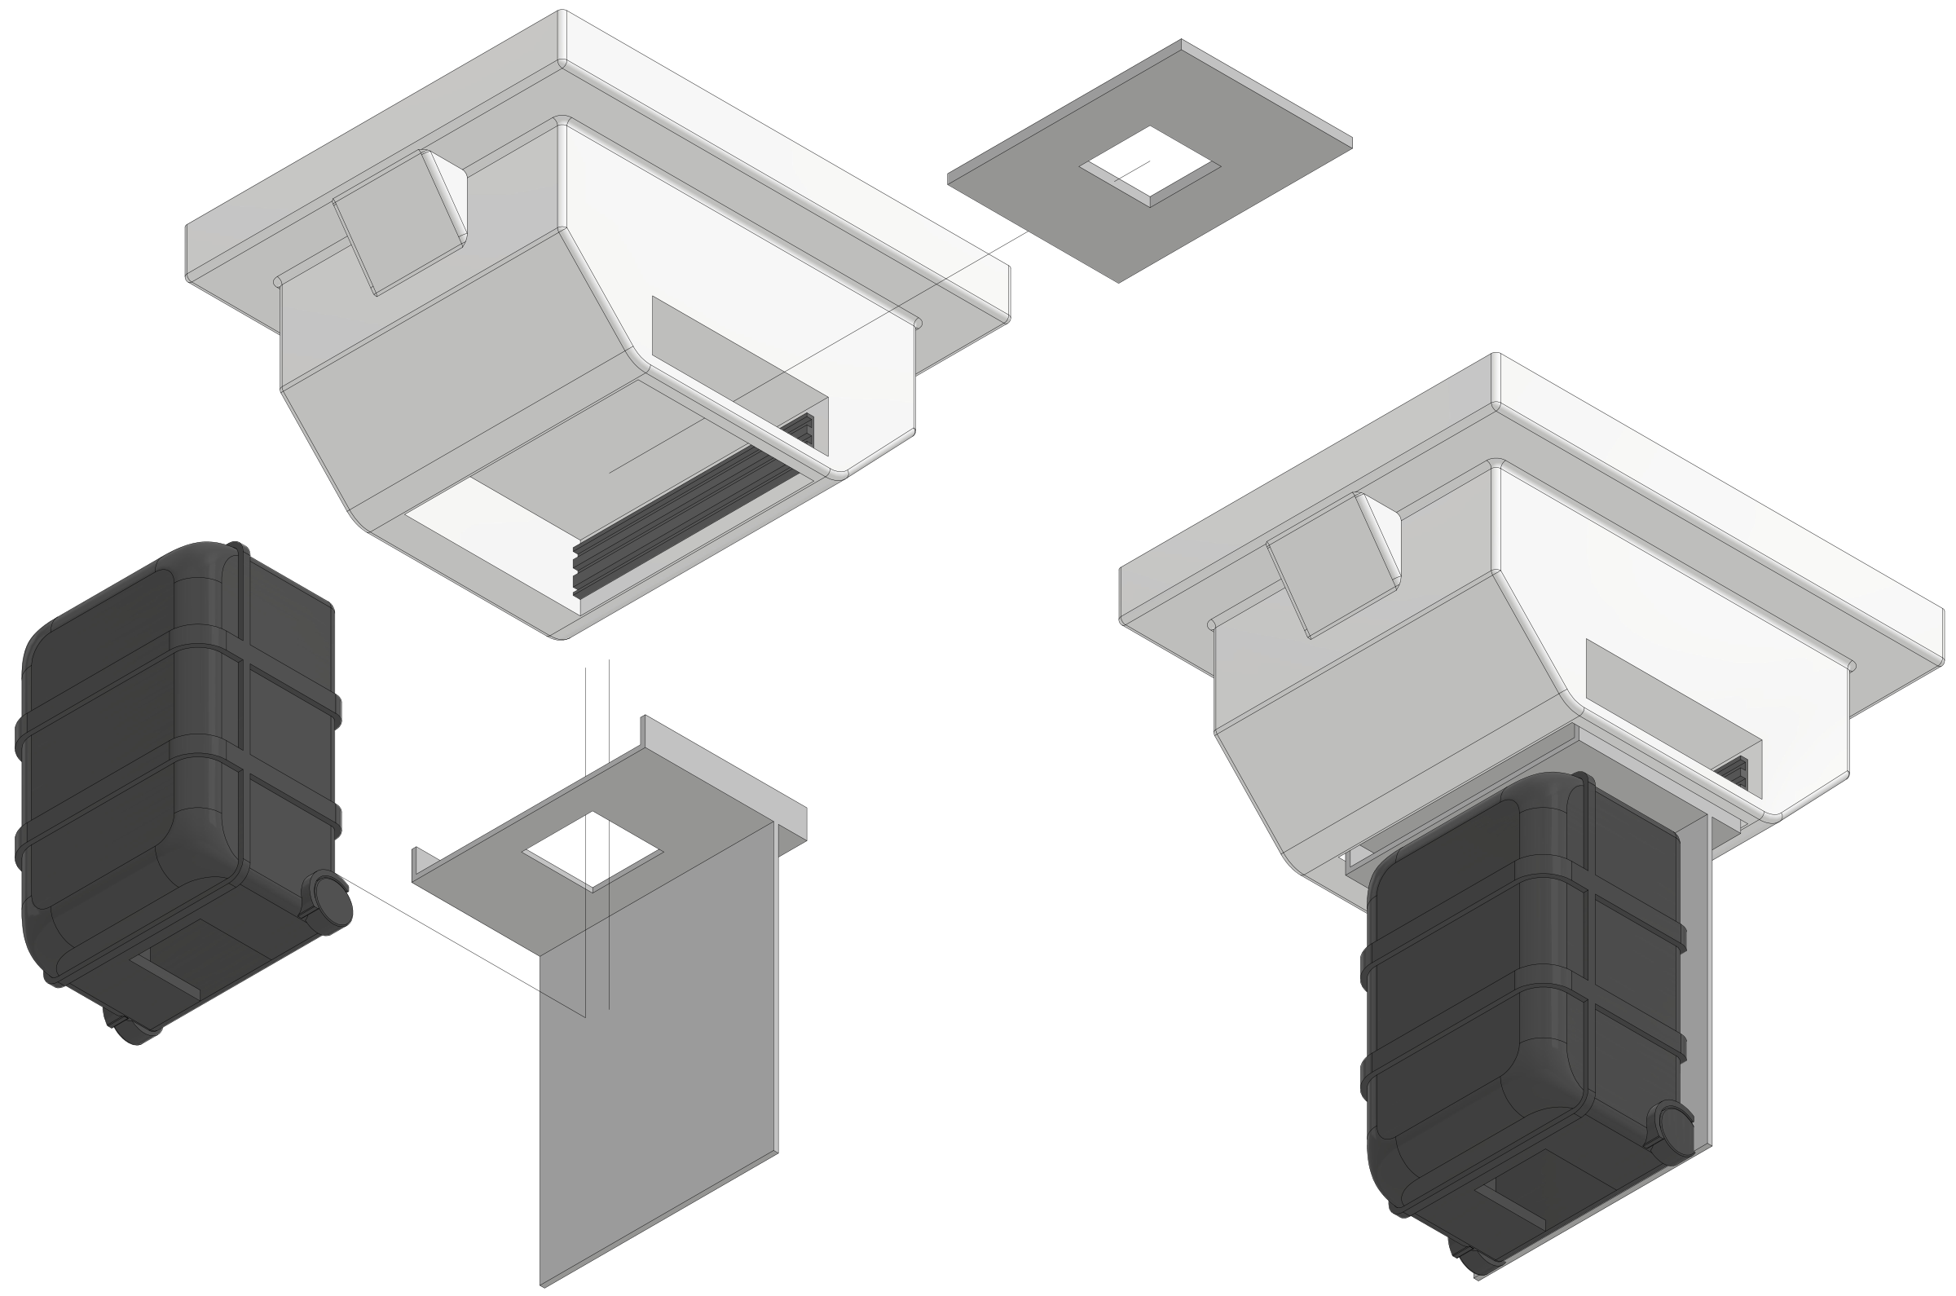
Conclusions
Taking simultaneous measurements of all key parameters is possible!
Prototype detector needs refinement but demonstrated principle.
Questions for the community:
  Is 3D volumetric dose reconstruction in simulation clinically acceptable?
  Optimal volume for PSQA?
Next steps:
  Integrated DAQ.
  Faster readout.
  Nozzle mount.
  Realistic treatment plans.

Slide 16


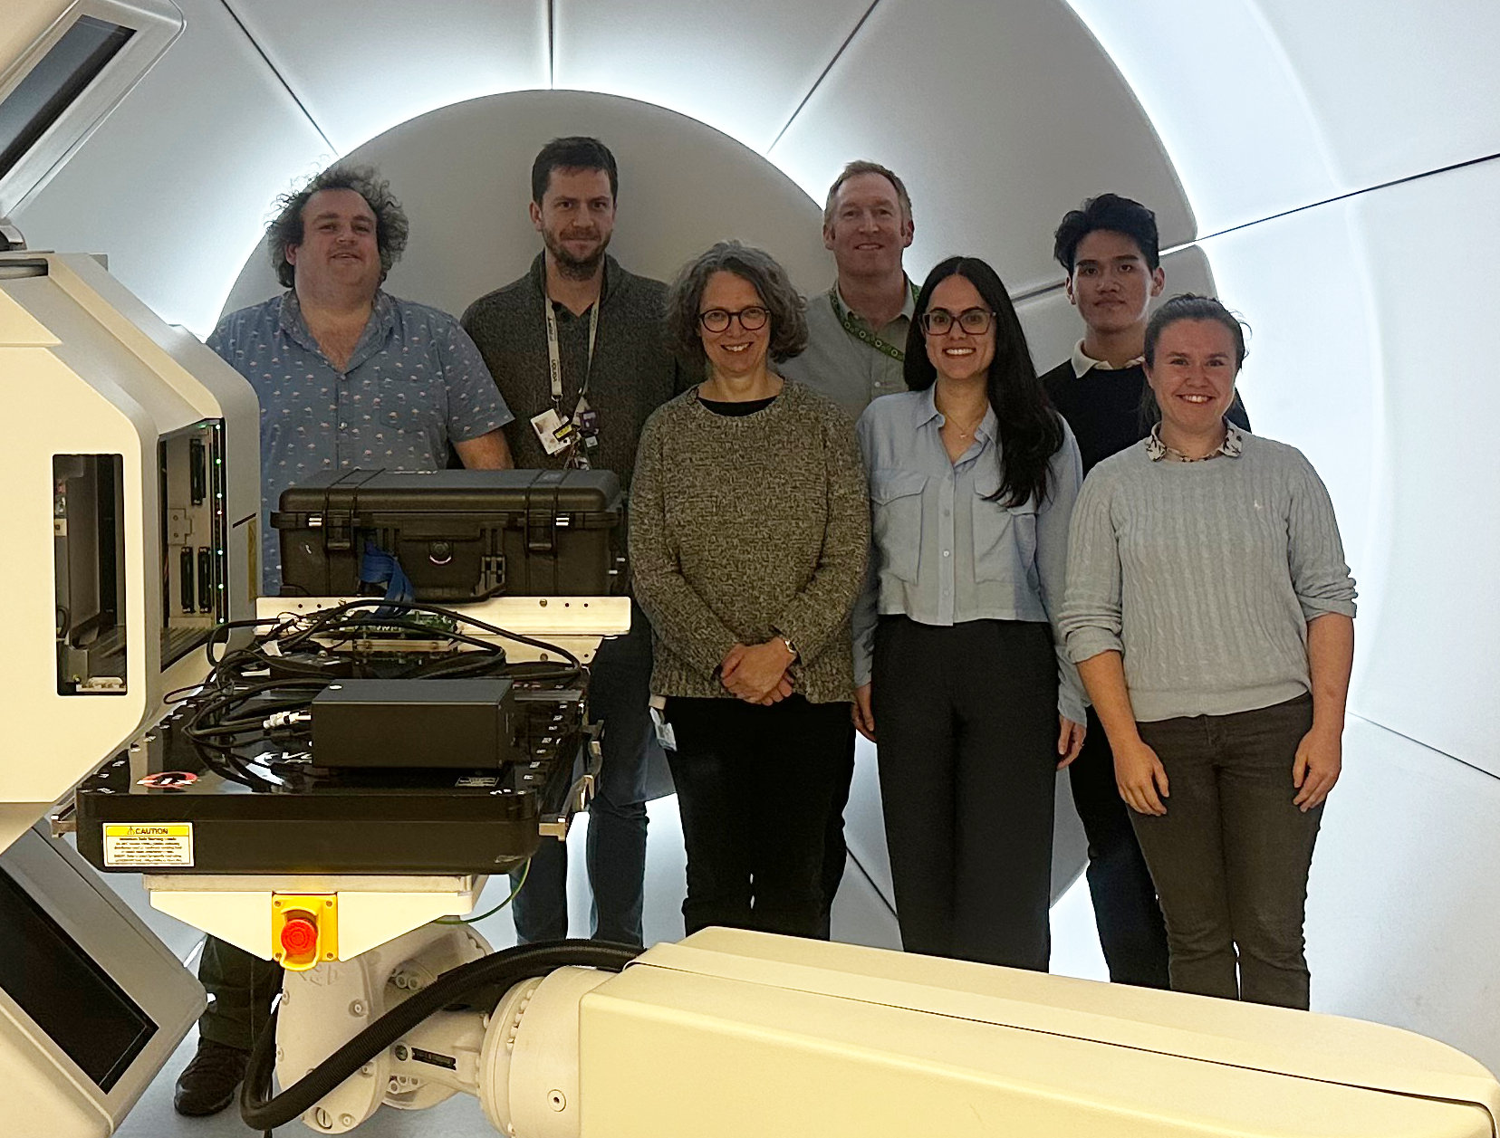

Acknowledgements
Simon Jolly
Sonia Escribano Rodriguez
Harry Barnett
Connor Godden
Matt Warren
Febian
Saad Shaikh
Fern Pannell
Sam Flynn
Nigel Lee
Russell Thomas
Colin Baker
Alison Warry
Andrew Gosling
Lee Harrison-Carey
Andrew Poynter
Rafaella Radogna
Tony Price
Catherine Burne
Phil Allport

