Slide 1
LASSENA Detector

Slide 2
Parameters
12x14cm2
10um Si sensitive region
735um Si substrate for support
Al frame with hole bored out so only silicon is seen by the beam
Full frame readout ~35 frames per second
Saturates at clinical conditions
Can Region of Interest to speed it up. 2cm strip = 230 fps
Beam current x7 before saturation

Slide 3
Previous UCLH tests
Have performed beam current calibrations
Publications showing the results are in PMB
Have monitored a brain scan using moving ROI
Requires double beam delivery. One saturated to calculate positions, second with a preprogrammes ROI which "tracks" the beam
Tests in 2022 had dropped frames due to data rates but Sam Flynn fixed this with a new data structure.
Can find beam position and width. As well as spots 1mm offset from scan on purpose.
Ready to test again!

Slide 4
Some pictures
We had a large perspex sheet machined to hold the sensor
This sheet is to be inserted into the range shifter slot and allow sensor to be mounted in the snout
Previous tests were at isocentre and isocentre – 50cm (closer to snout)
Repeated pattern of 4mm diameter holes allows sensor to be moved

Slide 5
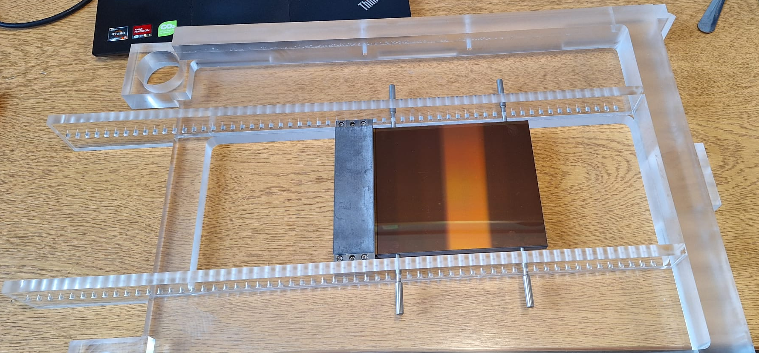

Slide 6
Dimensions

Slide 8
Required connections
Large flat blue ribbon cables from daughter board to sensor
Black connector is 10x90mm
Two camera link cables from daughter board to camera board
9 pin link for power to daughter board
Camera board to PC via usb-c thunderbolt optical cable. 50 m in length so directly controlled from the control room

Slide 9
Box Field
Green box represents ROI
ROI moves towards and away from Lead shield (left of picture)
Can change ROI fairly quickly
Should aim to do box scan scross the ROI then move the ROI and scan again
So....
Pick and ROI
Deliver spots up and down (in the image)
Move to new ROI
Repeat 2

