Slide 1
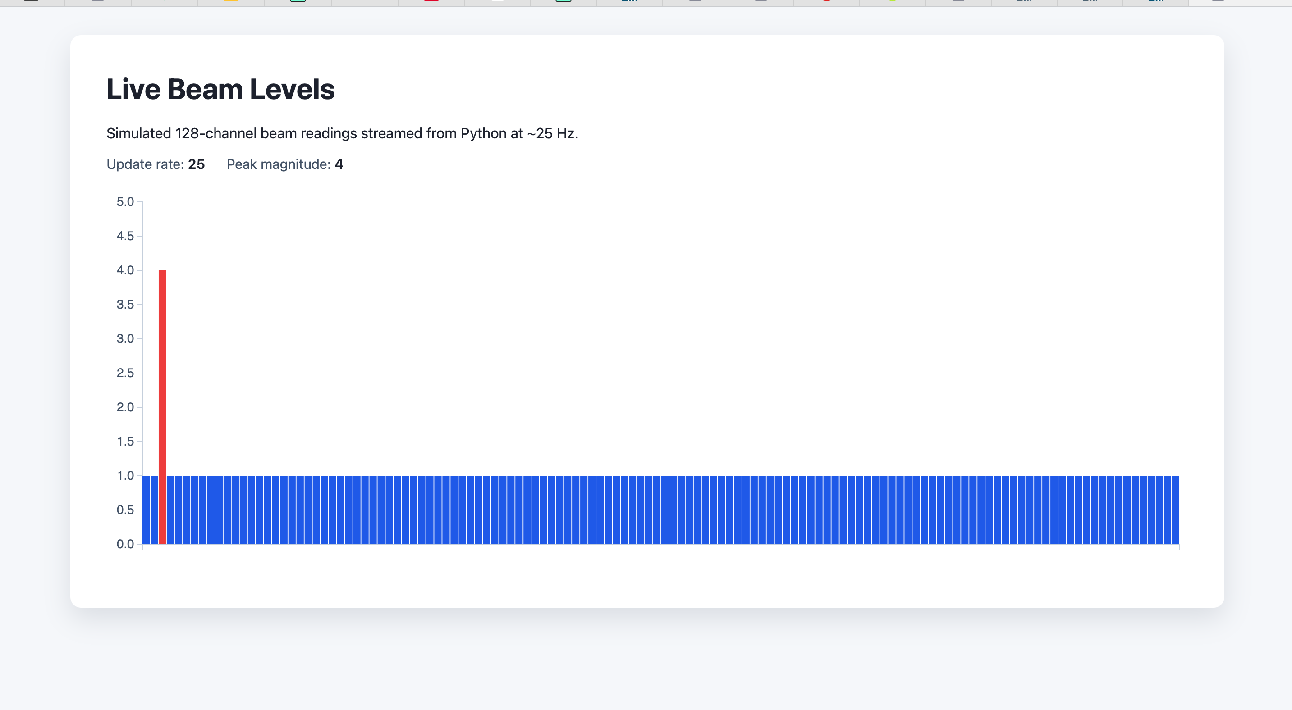
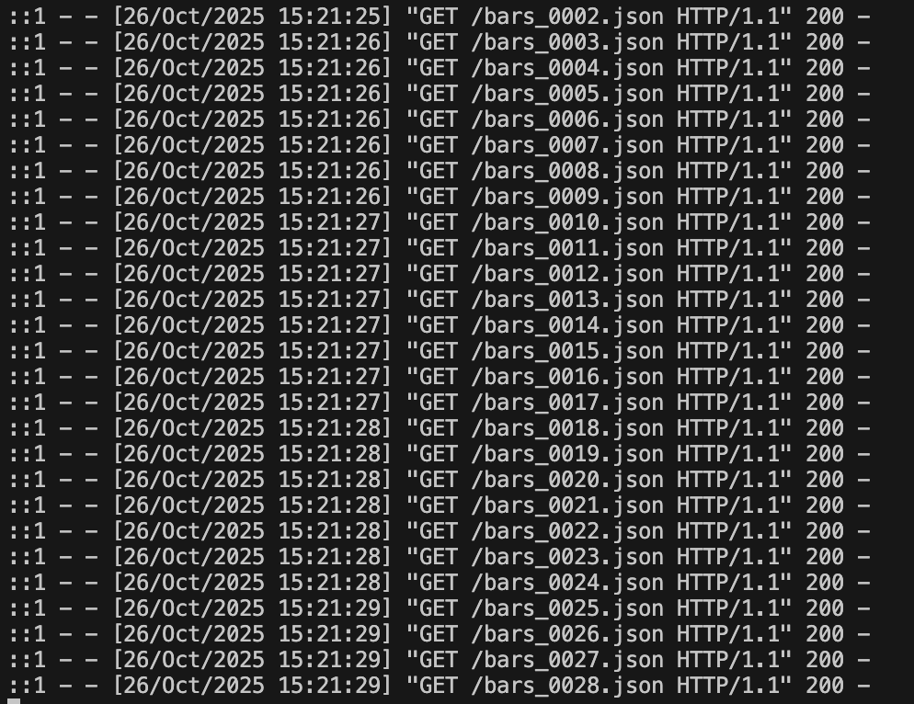
Developing a Graphical User Interface for a Proton Beam Therapy Detector
Supervisor: Prof Simon Jolly, HEP PBT Group UCL
MSci Student: Danial Saeed
Notes:
Here is a debut presentation which aims to communicate what I understand to be:
the main motivations,
Plans regarding deadlines
Progress on project code (learning so far)

Slide 2
Aims
Background project demonstration
Literature review structure
  Gantt chart
Code updates. Achieved a d3.js run python hosted webpage visualizer of json data at ~25Hz *.
    *- still investigating. Also more confident in code aspects than before

Slide 3
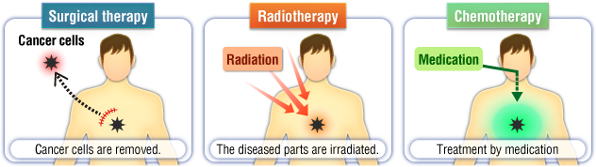
Cancer and its treatment
Uncontrollable division during a failure of cell apoptosis
Best treatment is surgical removal among surgery, chemotherapy and radiation therapy
Surgery requires specific requirement that location and spread of cancerous growth needs to be accessible
~40% of cancer is mainly treated via radiotherapy
[1]

Slide 4
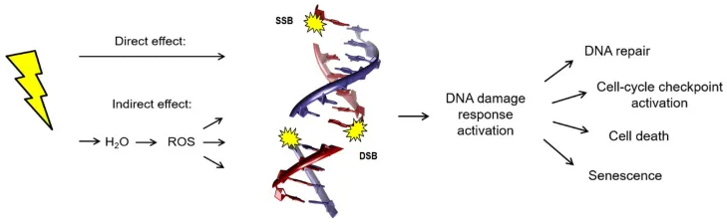
Radiotherapy – radiation oncology
We target cancer cells and cause cell death via damage to DNA
Single Strand and Double Stranded Breaks causes repair mechanisms to enter cell death
X-rays: photon treatment that deposits energy over a range that depends on the energy of the beam
This means both the tumour and healthy cells are subject to it..
[2]

Slide 5
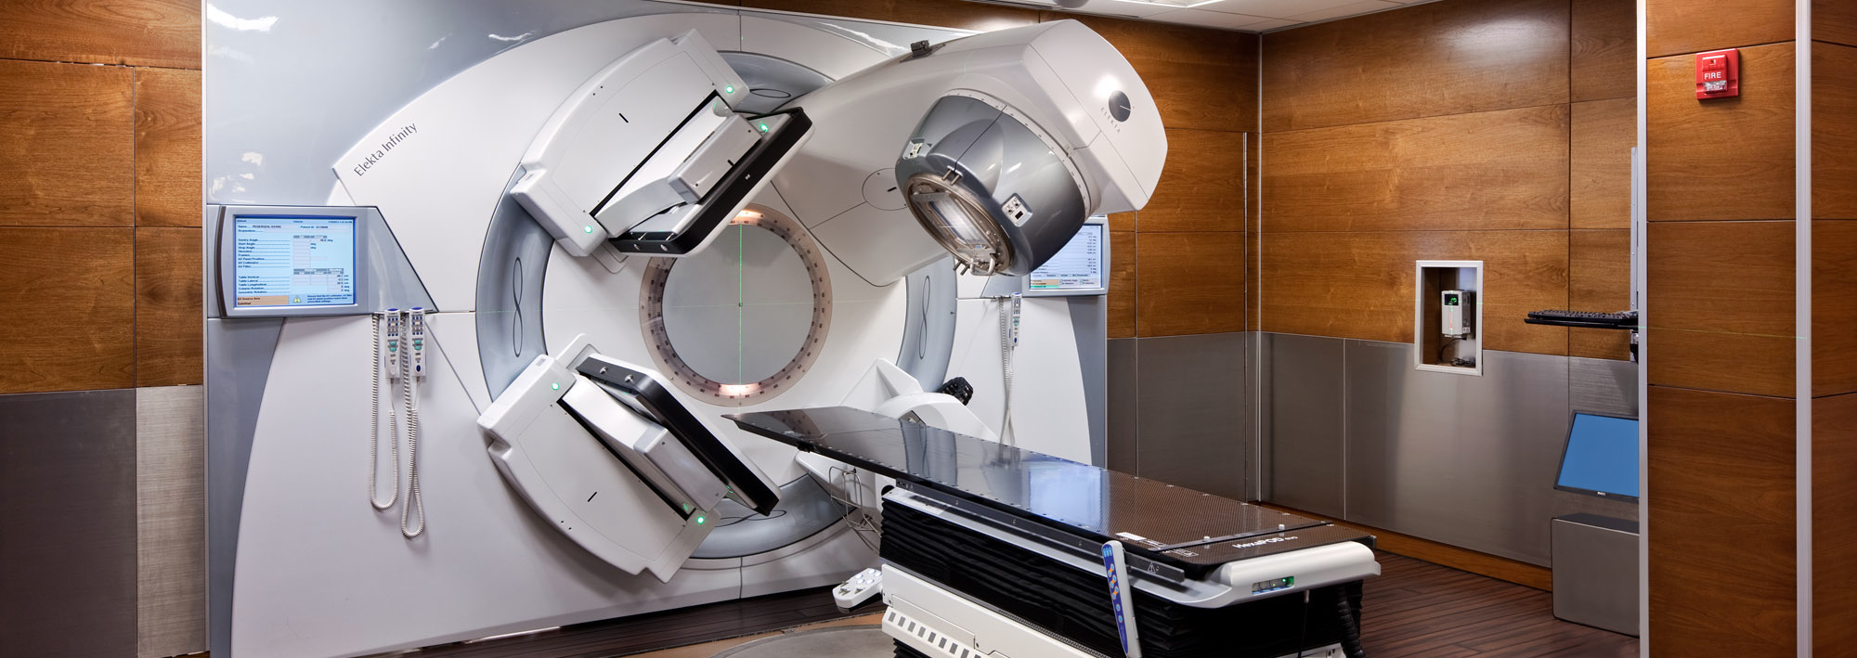
Treatment apparatus– Gantry & Nozzle
Gantry machinery rotates 360° about patient allowing Nozzle to deliver radiation
rotation allows for radiation from all angles to produce a cumulative central treatment
[3]

Slide 6
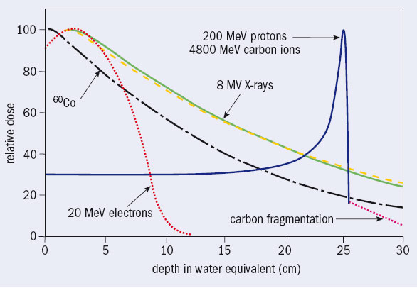
Radiation also applies to healthy tissue
Yellow line x-ray dosage, high at entry and continues past the tumor.
Dose dealt to healthy tissue is called ‘Low Dose Bath’
Blue line proton beam. They deposit most of their energy in a sharp peak called the Bragg peak.
Reduced Low Dose Bath, PBT is hence superior for treatment where dose needs to be at a minimum
High Precision also poses great risk; sharp Bragg peak needs perfect control of the beam…
[4]

Slide 7
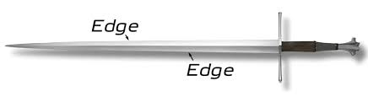
Quality Assurance:
Bragg peak position poses challenge: even mm error in precision means
Current QA involves patient specific quality assurance that requires many hours, none that are live and separate from the beam machinery
We must independently measure:
  Dose (How much radiation?)
  Range (depth beam reaches)
  Spot position (on X/Y)
  Spot size (radius of beam)

Slide 8
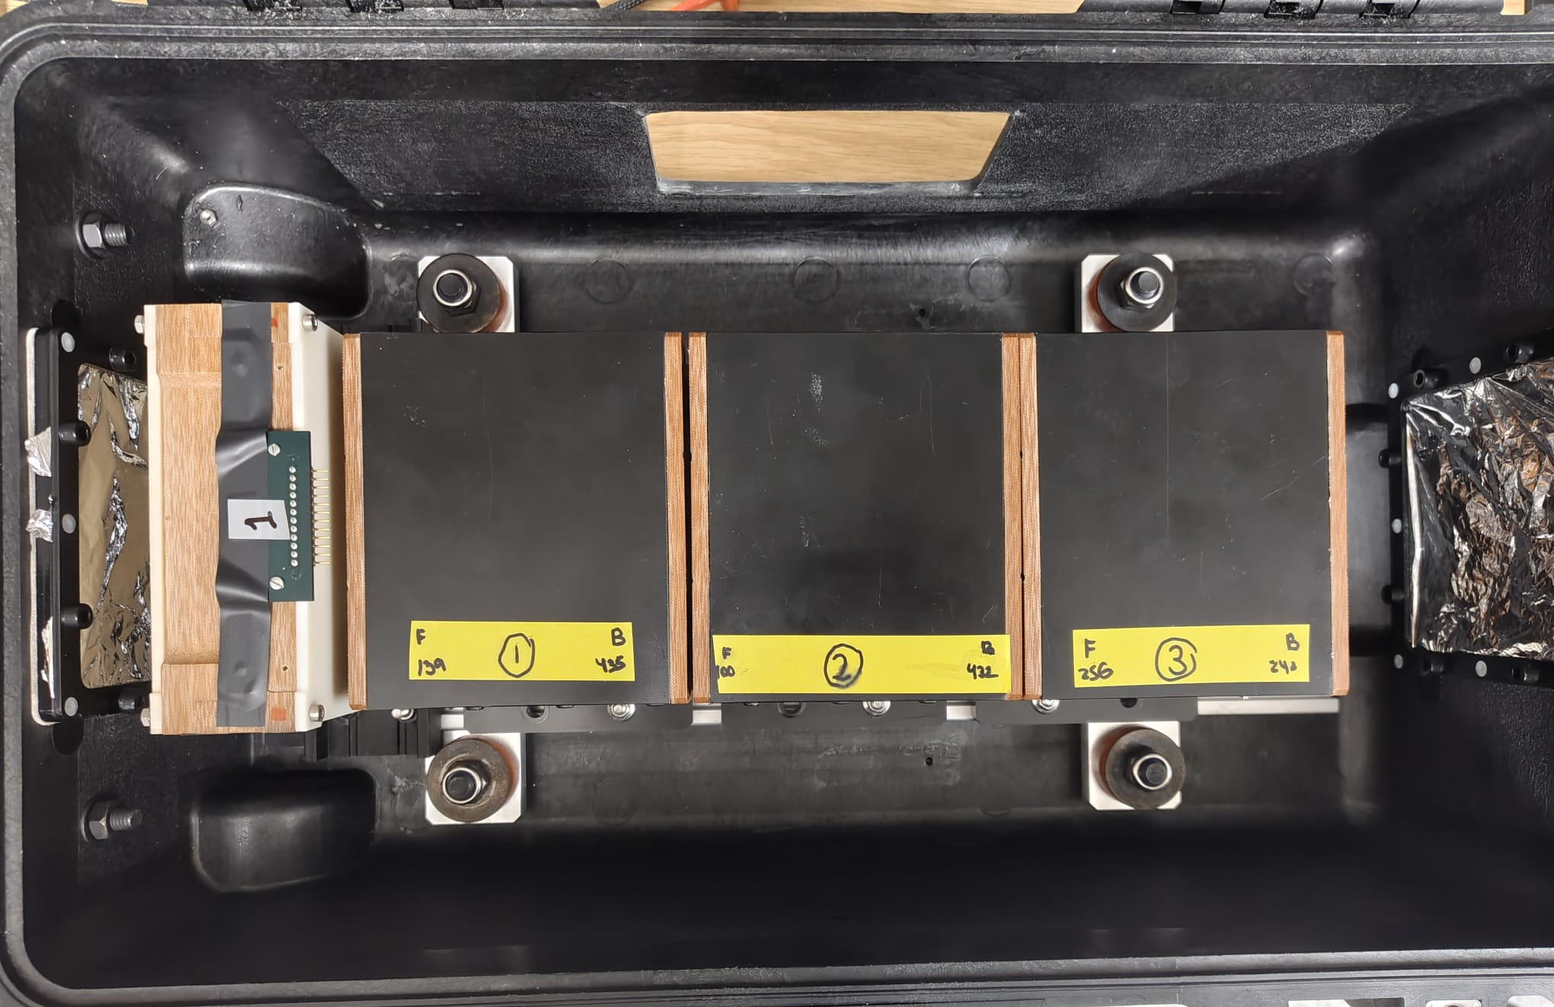
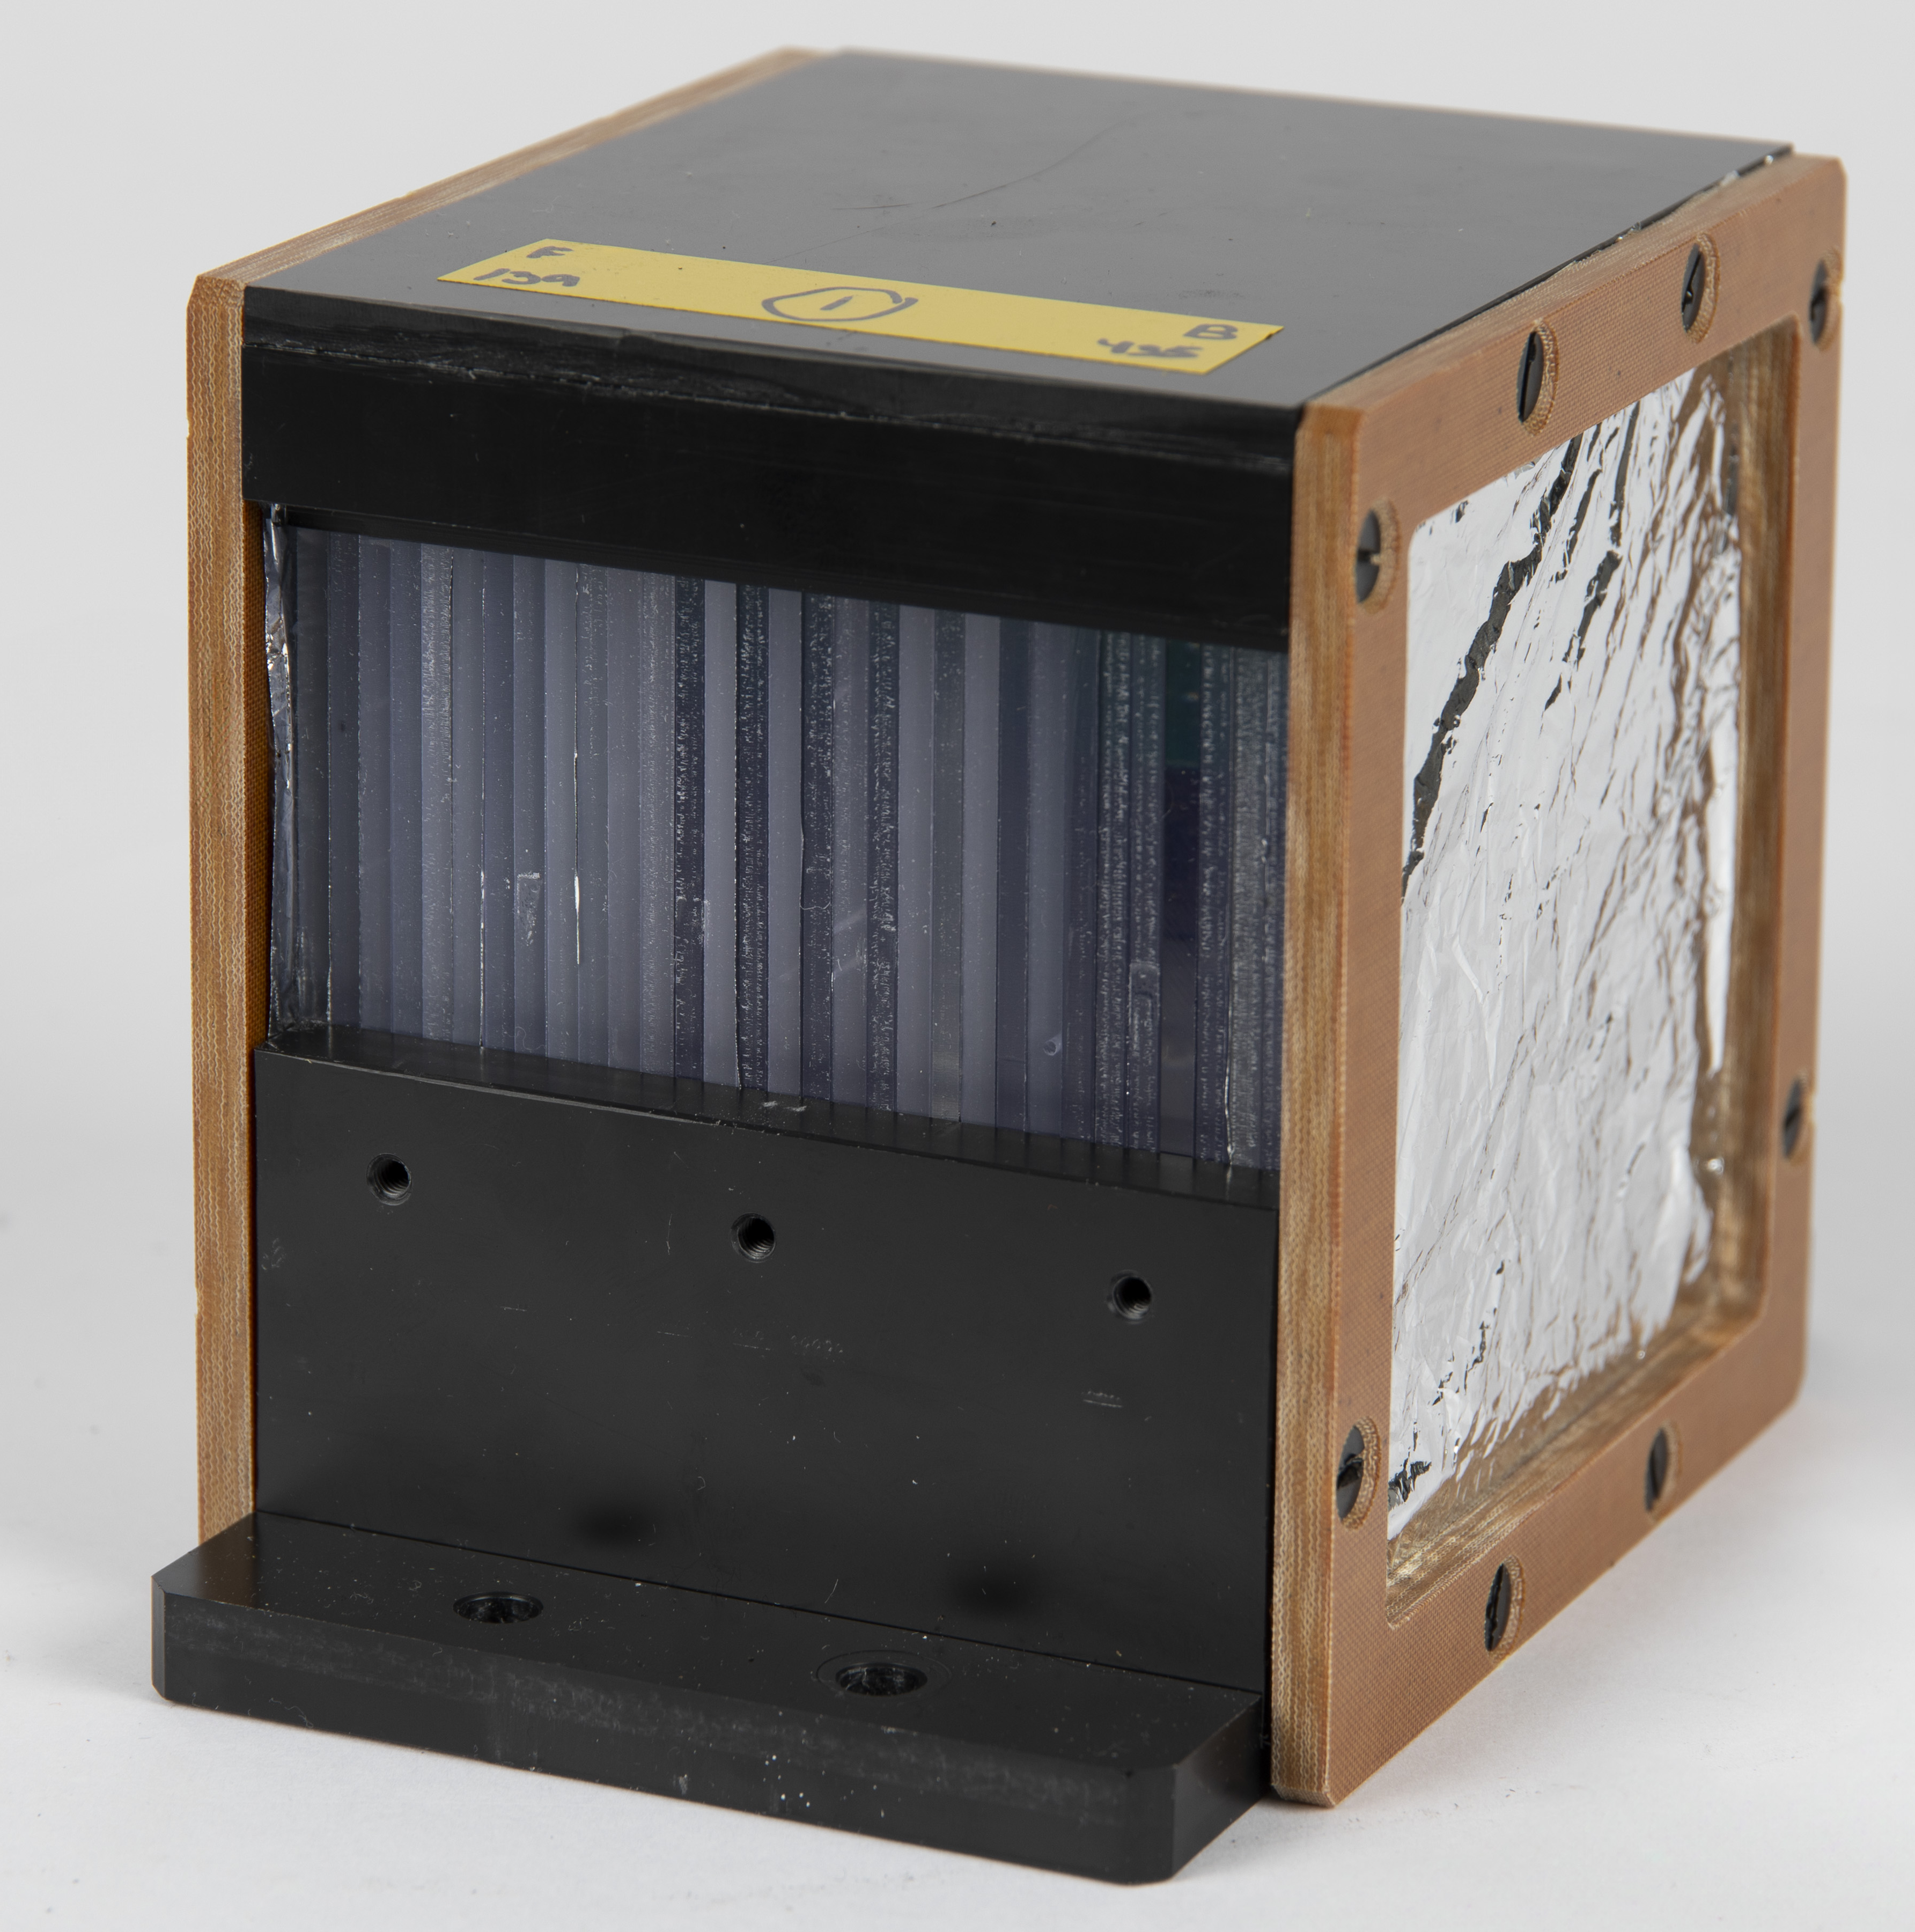
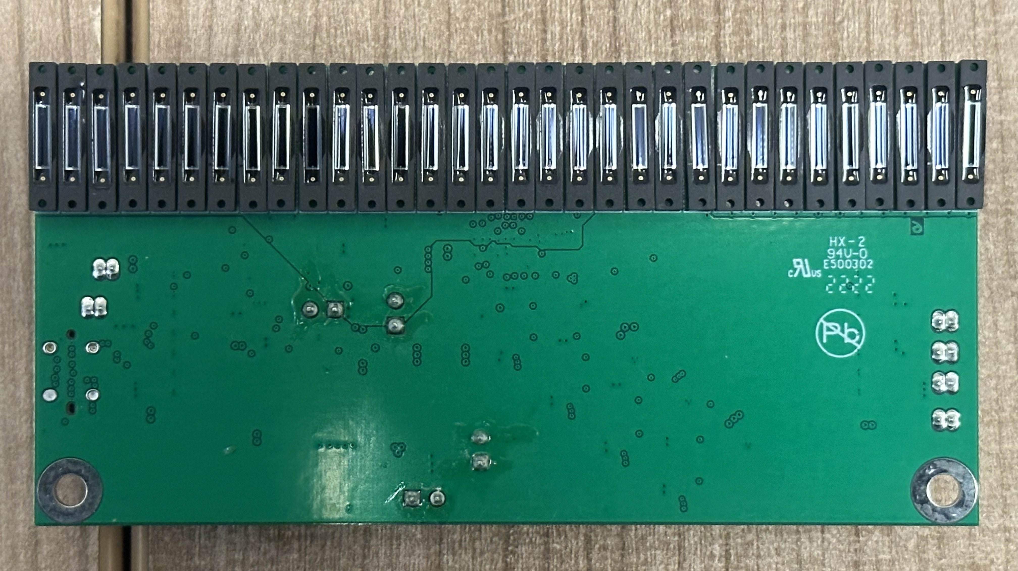
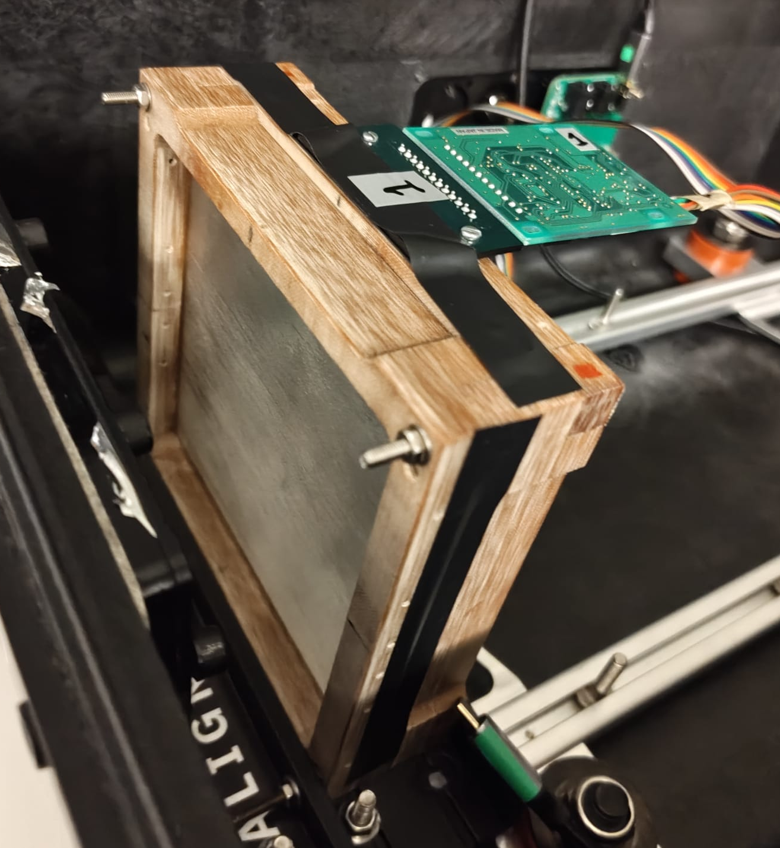
QuADProBe
QuARC
Dose &Range Diagnostics
SciFi
Tracker
Spot Size and Position Diagnostics

Slide 9
The QuARC- Quality Assurance Range Calorimeter
  Group produced detector to independently measure Proton beam range.
  Stack of Scintillator sheets which photo-luminesce as beam passes
  Green PCB housing Photodiodes send light signals to FPGA which converts it to signal at high speed.
  Raspberry Pi then writes this to a JSON file.
  Have diodes on all 4 sides of the scintillator is also a goal
Slide Source: J Bateman, UCL HEP: Proton Beam Therapy

Slide 10
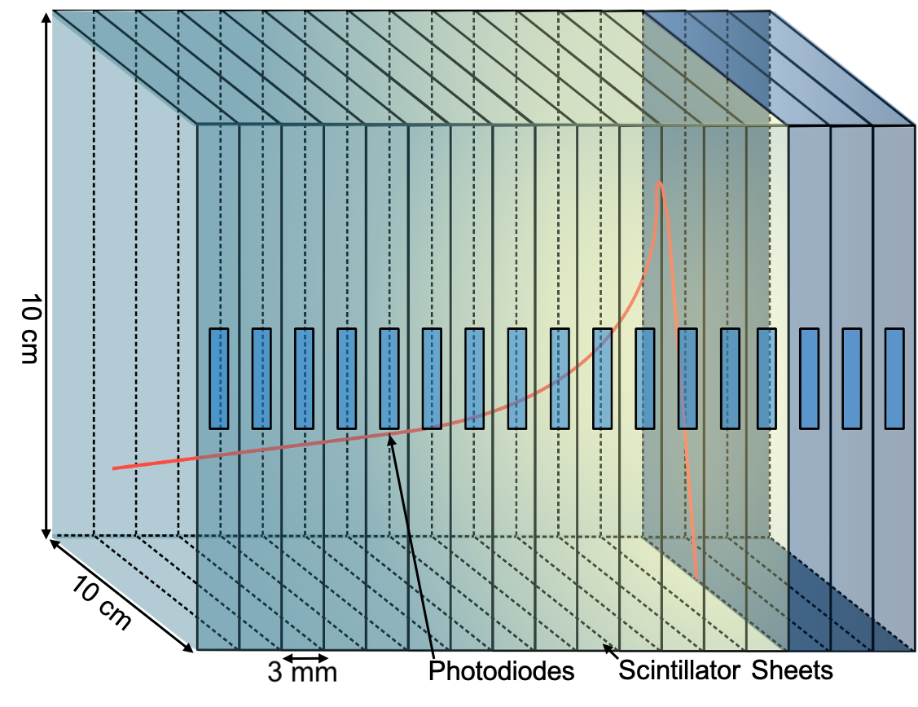
Project Objective: Live Graphical Bragg Peak Monitoring via Detector
QuARC solves a physics problem but creates a data stream that needs to be interpreted!
Raw data on the Raspberry pi is useless after the beam has already been administered, it needs to be recorded live
Quality Assurance requires an interface from hardware to human
The Quadprobe then provides information on spot size and position so overall we have fast, live, independent and mobile QA!!
[5]

Slide 11
Current Tasks
Literature Review
Gantt Chart
Code:
    Familiarize myself with JSON files, creating, reading and writing
    Via Python open and read python files and plot (not time dependent as won’t be used in final project)
    Via D3.js and .html files host a python webserver to visually display (W/O Flask)

Slide 12
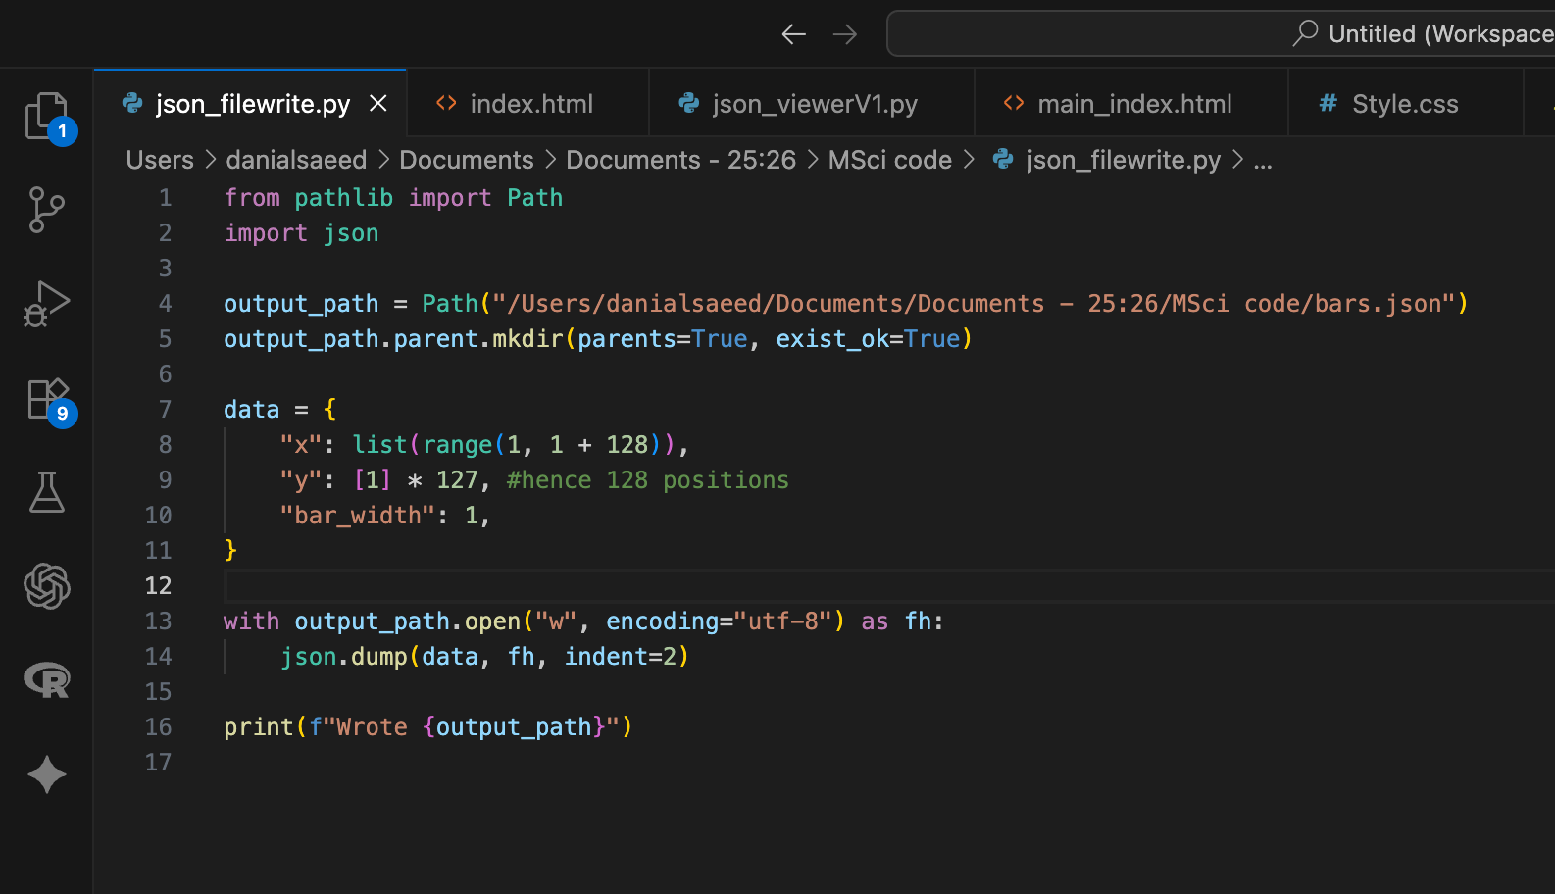
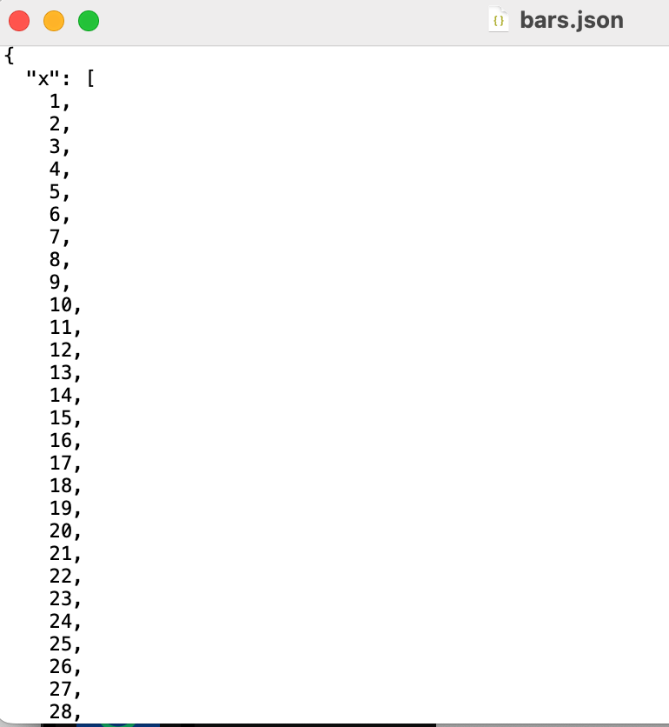
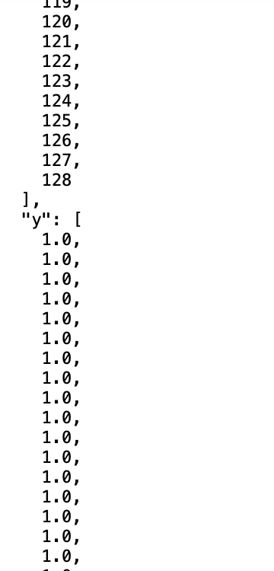
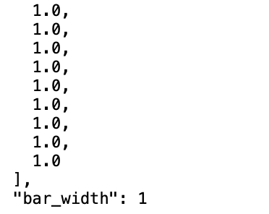
Writing a JSON
Via Python:
Code creates a file that writes an array of x positions 1-128 with corresponding y values of 1, as well as a bar width value

Slide 13
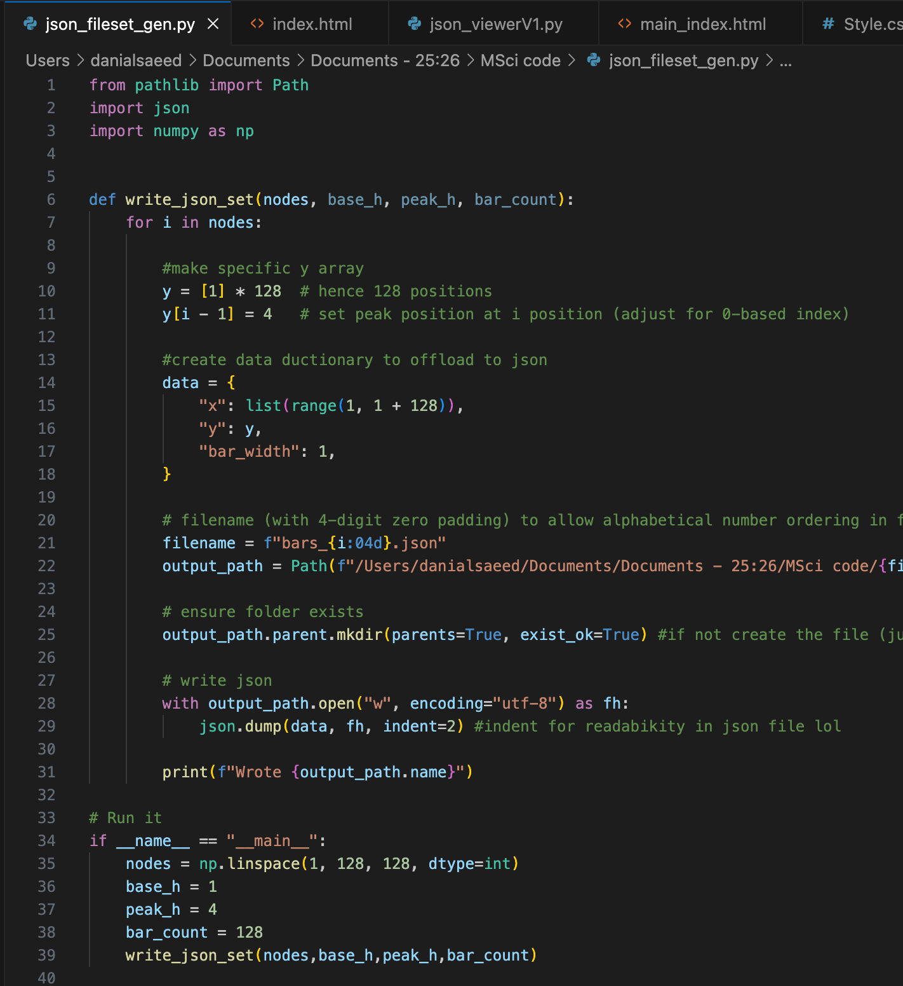
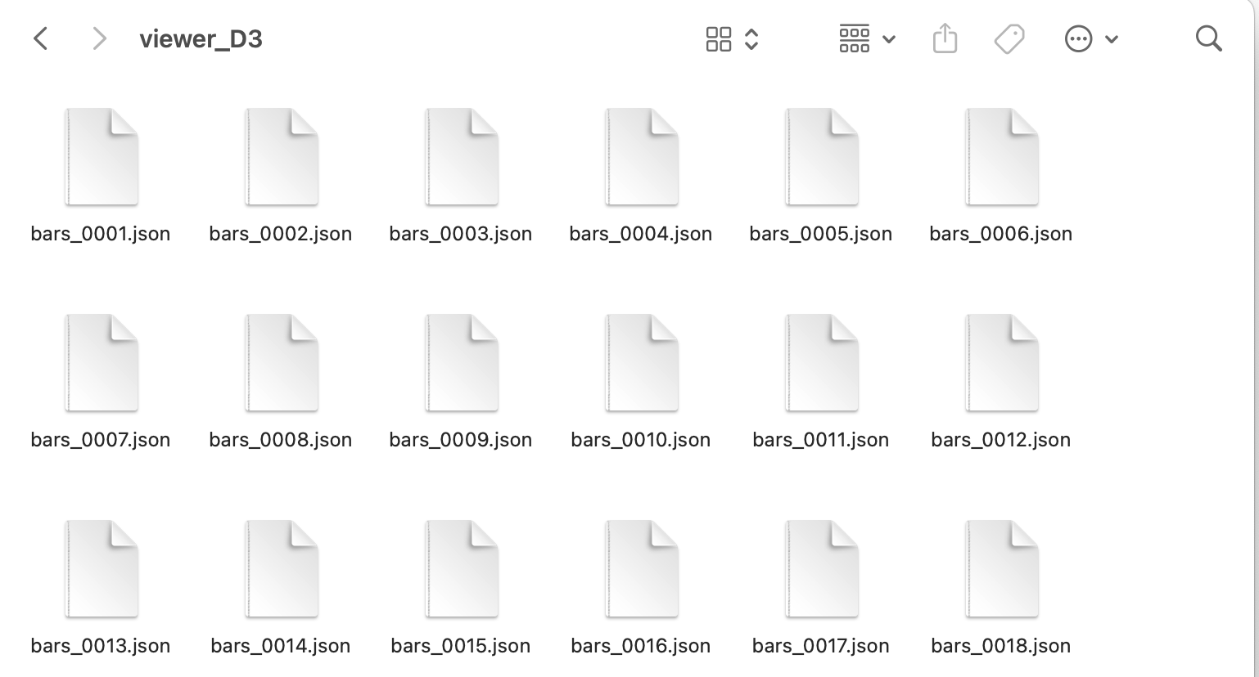
Simulate JSON set
Code now to create 128 files all with an alternating y index value of a peak height…
So at x=1 y=4 for file 0001
will be used to now develop the skills to open and display Json files at speed.
Emulate the Raspbery Pi serving Json files to code, where code needs to read and display reliably at 25Hz

Slide 14
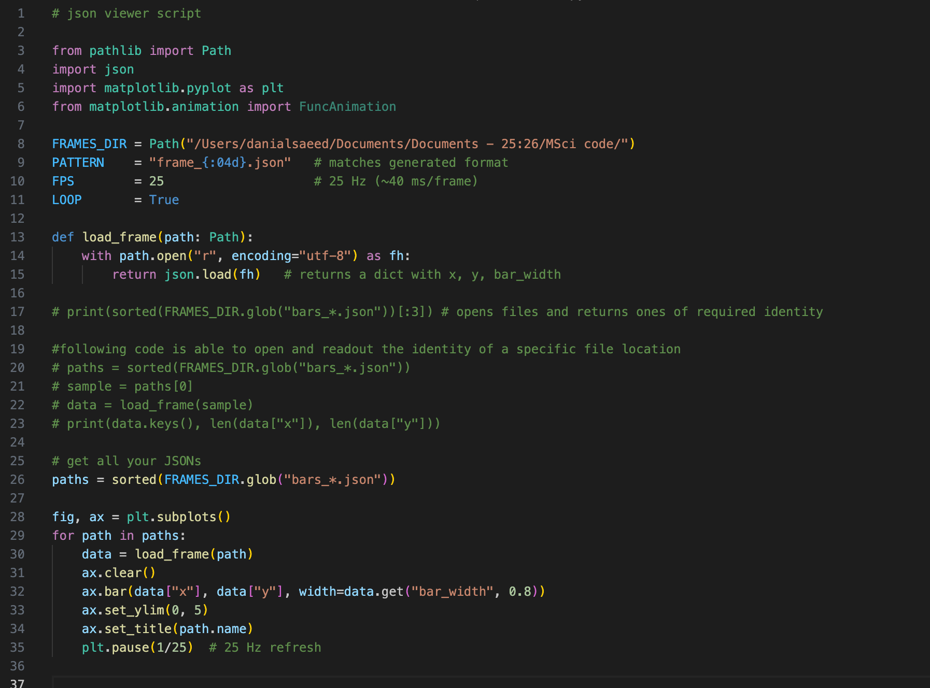
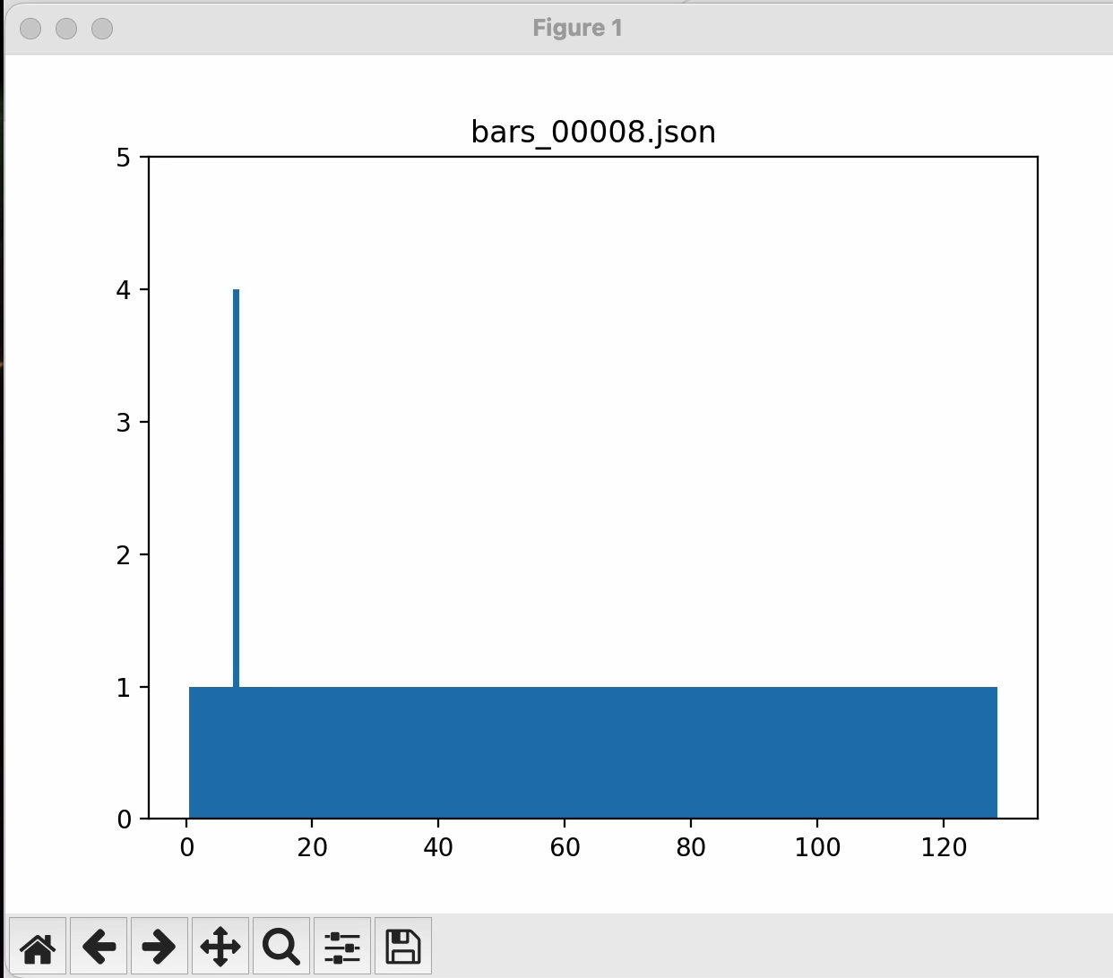
Visualizing the JSON Set via Python
Python code to open JSON’s in loop
And thus, plot it via python also

Slide 15
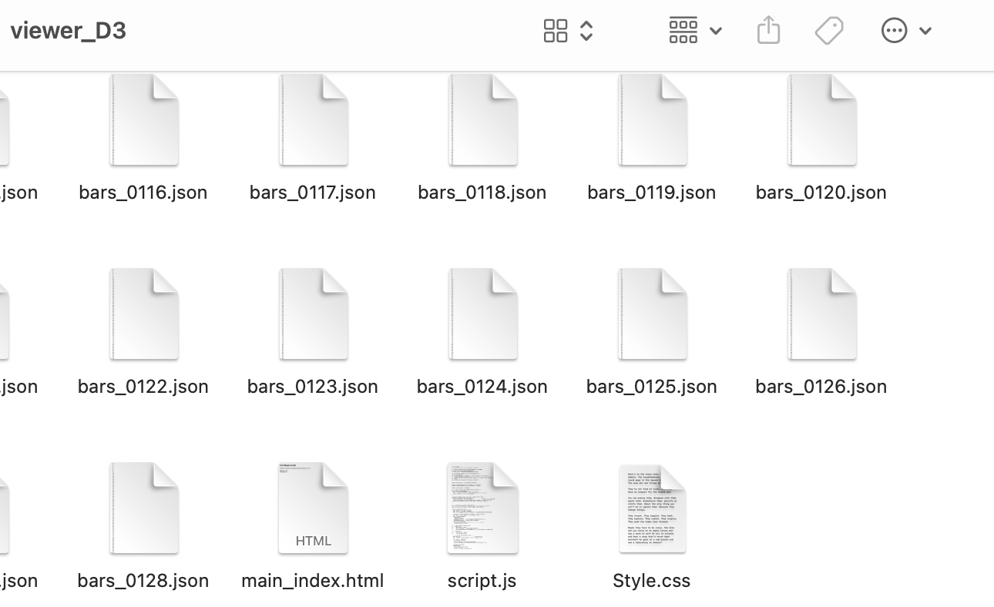
Converting to a GUI Web-base
Collated files to viewer_D3 folder
Script.js contains Javascript code
Main_index.html contains outer shell for website
Style.css contains stylistic pointers for graph rendering and bar characteristics

Slide 16
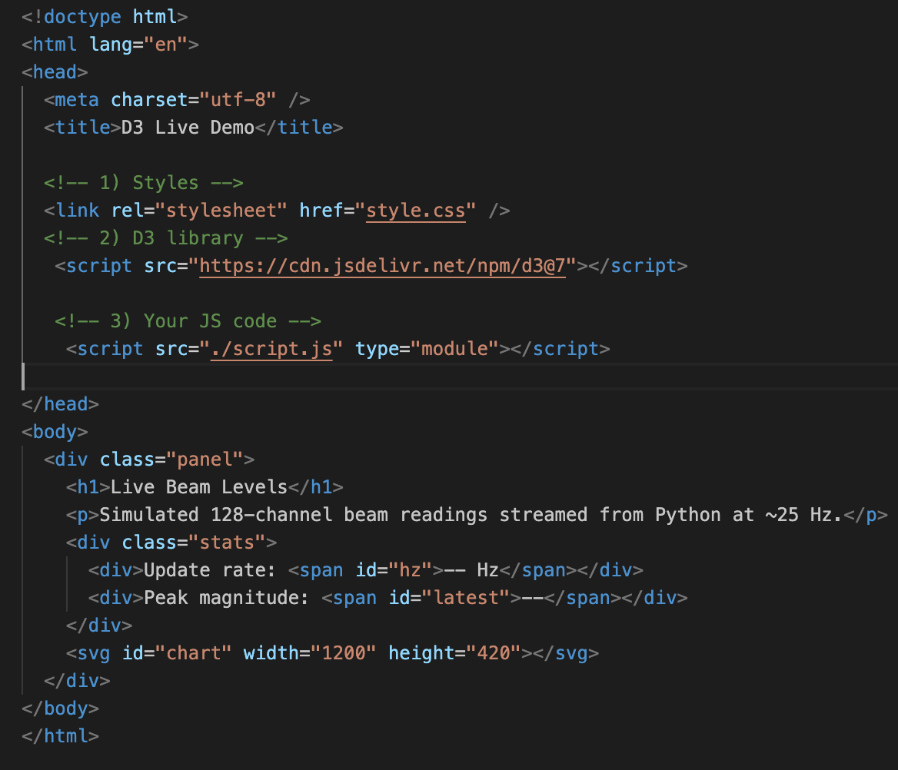
Main_Index.html
Html skeleton
D3.js code will feed and send values for
  Update rate being <span id=“hz”>…
  Peak magnitude : <span id=”latest”>…
  <svg id="chart" width="1200" height="420"></svg> to direct where D3 will draw a bar chart
Html defines where things appear
Working on learning html structure via
https://www.freecodecamp.org/learn/responsive-web-design/basic-html-and-html5/introduction-to-html5-elements

Slide 17
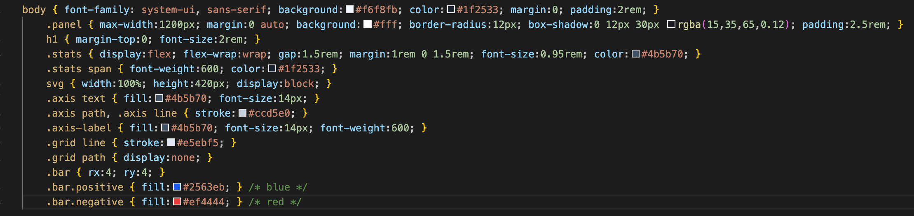
Style.css
This html code is also something I am working on tweaking in order to familiarize myself and learn.
I would like to ask how I can better improve the webpage when I display it so I can action this and in turn learn.

Slide 18
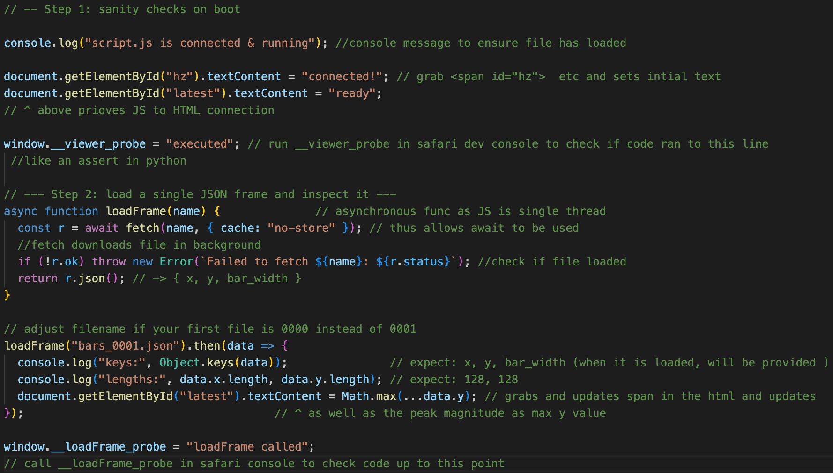
Script.js – sections 1&2
Step 1 contains file sanity checks
Step 2: contains a function to load a single function in which it makes a html request for a file and stores it.
{ cache: “no-store” } ensures a new copy of the file is always read even if the same file is read.
r is at first an object placeholder
Either returns a failed promise of a JSON and sends an error
Or: returns the response body, fulfills the promise and parses the JSON data

Slide 19
Zoom in of features of script sect 1 & 2
Async + Await: introduces non-blocking data loading - the browser keeps running while JSON files fetch in the background.
Fetch API: makes HTTP GET requests to load local files served by python -m http.server, with { cache:"no-store" } forcing a fresh copy each time.
Error handling: if (!r.ok) throws clear fetch errors - same principle as Python assert.
DOM updates: live-writes the update rate and peak value into <span> elements (hz, latest).
JSON parsing: converts Python-exported JSON into a JavaScript object { x, y, bar_width } ready for plotting.
Debugging checks: console.log() and the global probe confirm both data structure and code execution.
Modular design: isolates data-fetch logic from visualisation logic → makes Step 3 (D3 plotting) plug-and-play.

Slide 20
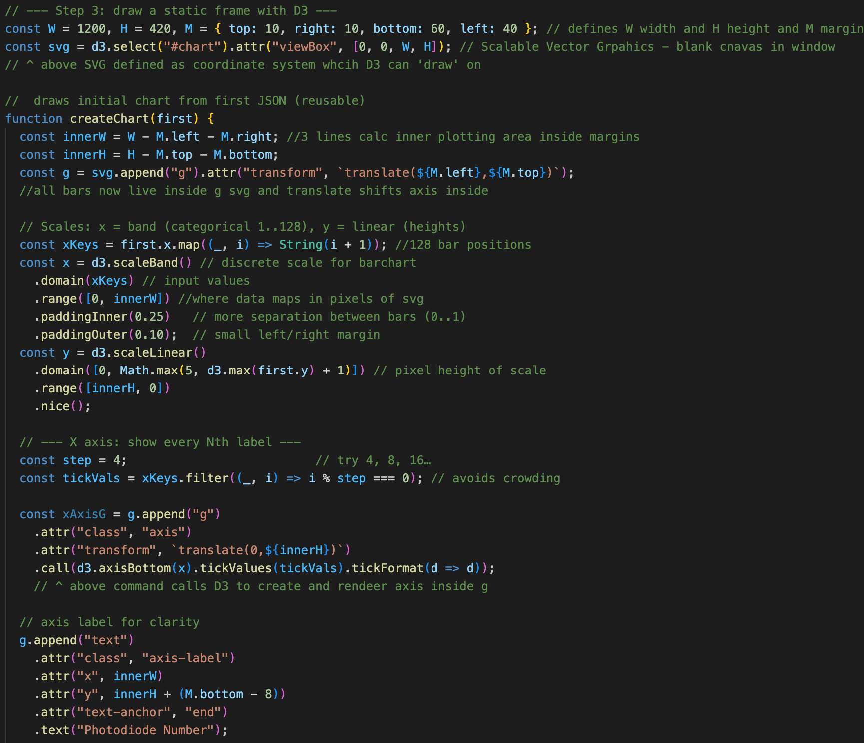
Script.js parts 3
Builds entire drawing space of bar chart inside <svg> drawing area. We create a static bar chart to establish what is going on
Via D3 Scales we map data to space
Add axes and add labels
It further..

Slide 21
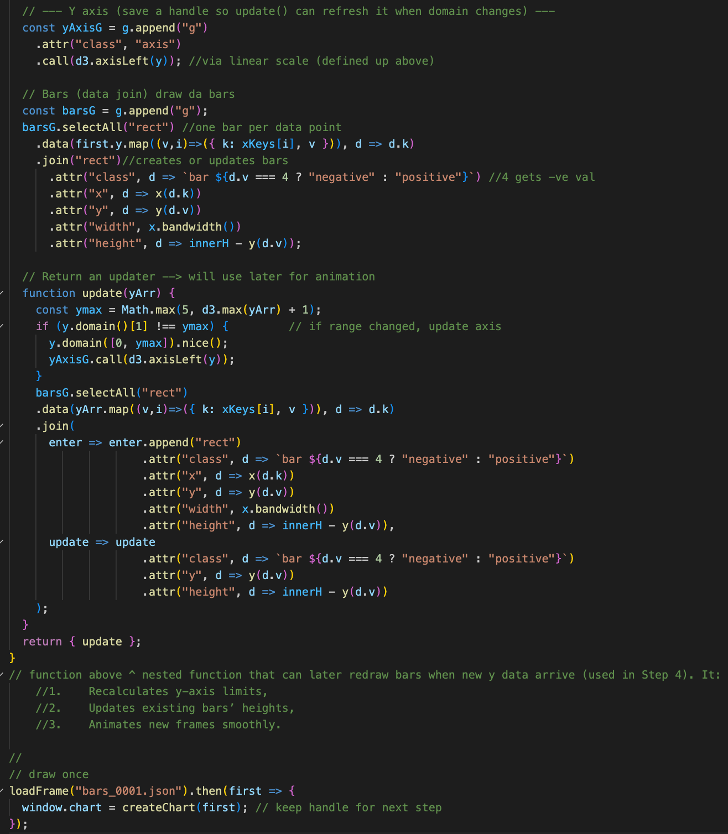
Section 3 cont
…Automatically sets:
X position, y position and height, x bar width
defines peak bar as having a negative value (for html style coloring)
Prep for animation via Update function:
Recomputes the y-axis scale if new data exceed old limits.
Redraws all bars with new heights (attr("height", …)).
Updates classes and colors.
Enables smooth live playback at 25 Hz. *

Slide 22
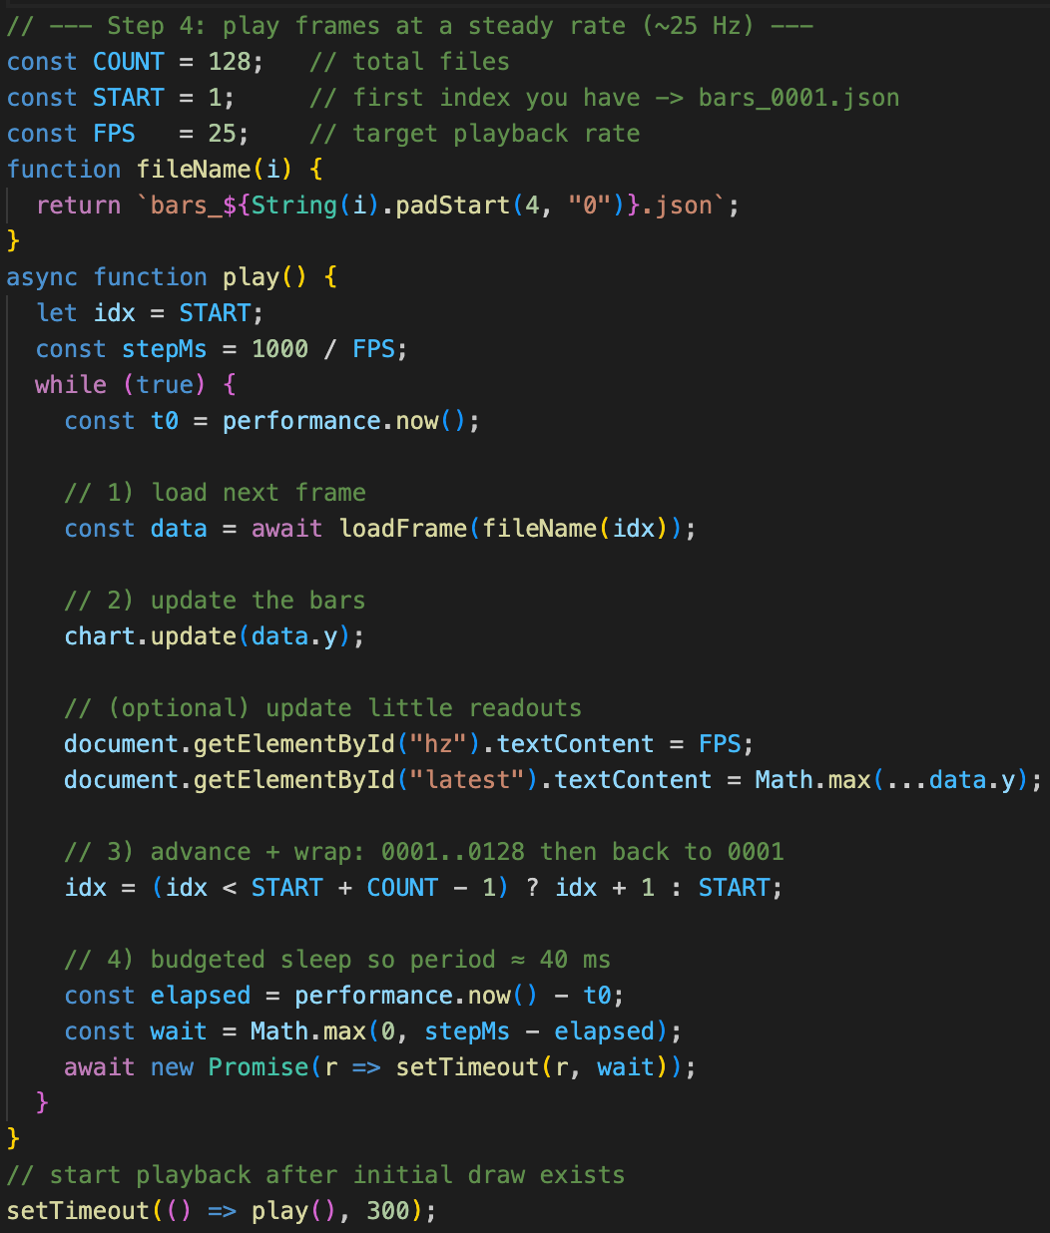
Section 4
High resolution timer to ms precision
Await waits until json is loaded, nothing occurs until then
Y frames updated
Main Issue:
display the “FPS” value which is the target. Not actual frame rate….
Rest of loop budgets time (stepMs = 40 ms) and sleeps the remainder, but if load + draw takes ≥ 40 ms, the loop slips. Thus, the static hz won’t reveal that.

Slide 23
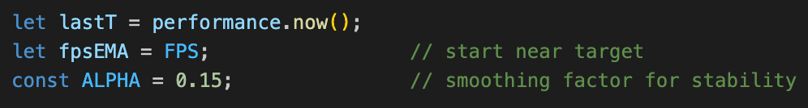
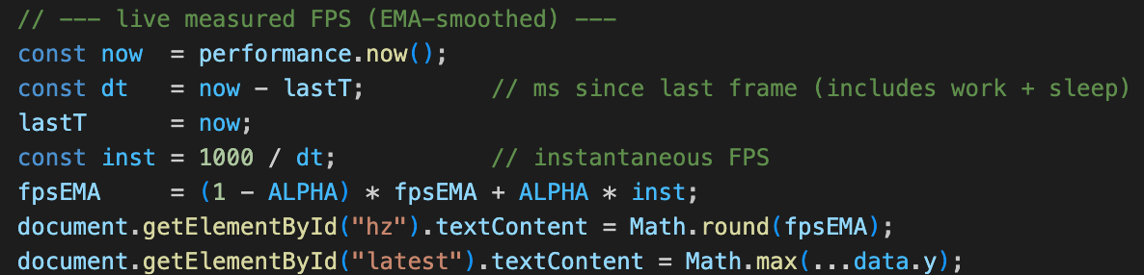
Section 4
High resolution timer to ms precision
The fix:
Await waits until json is loaded, nothing occurs until then
We add above 3 lines to measure real period
Y frames updated
Then replace the old(red) line with this code (left).

Slide 24
Dealing with the timing
measures the true frame interval (load + draw + wait) using performance.now(),
then converts that to instantaneous FPS.
An exponential moving average smooths short-term spikes,
so the displayed value reflects real playback rate stability rather than the fixed 25 Hz target.
This exposes timing drift or slow JSON loads that would otherwise stay hidden.

Slide 25
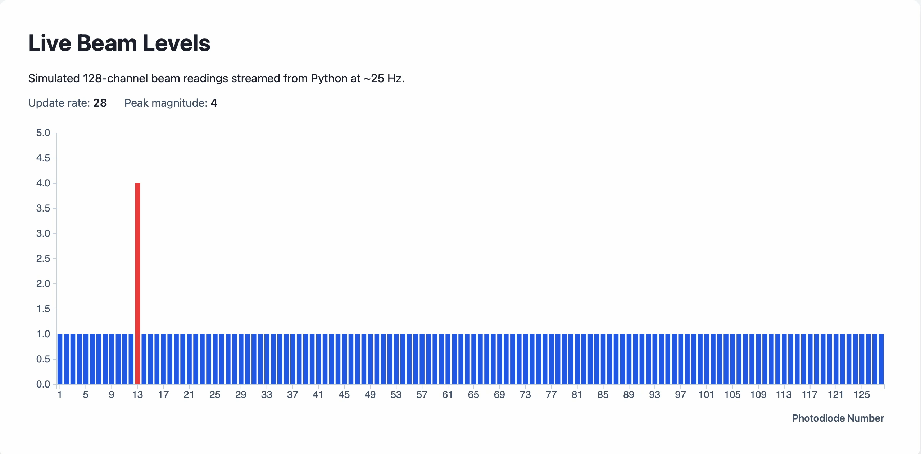
Current Website Function

Slide 26
ref
[1]-https://www.particle.or.jp/hirtjapan/en/what/difference.html
[2]- https://www.oncology.ox.ac.uk/research/research-groups/vallis-group
[3]- http://thefarbercenter.com/blog/wp-content/uploads/2011/10/linac-room.jpg
[4]- Jones, D. (1989, January). Particles Newsletter, No. 3. J. Sisterson, 89(4).
[5]-https://www.hep.ucl.ac.uk/pbt/wikiData/presentations/2024/SJ_PTCOG_QuADProBe_2024-06-12.pdf

