Slide 1
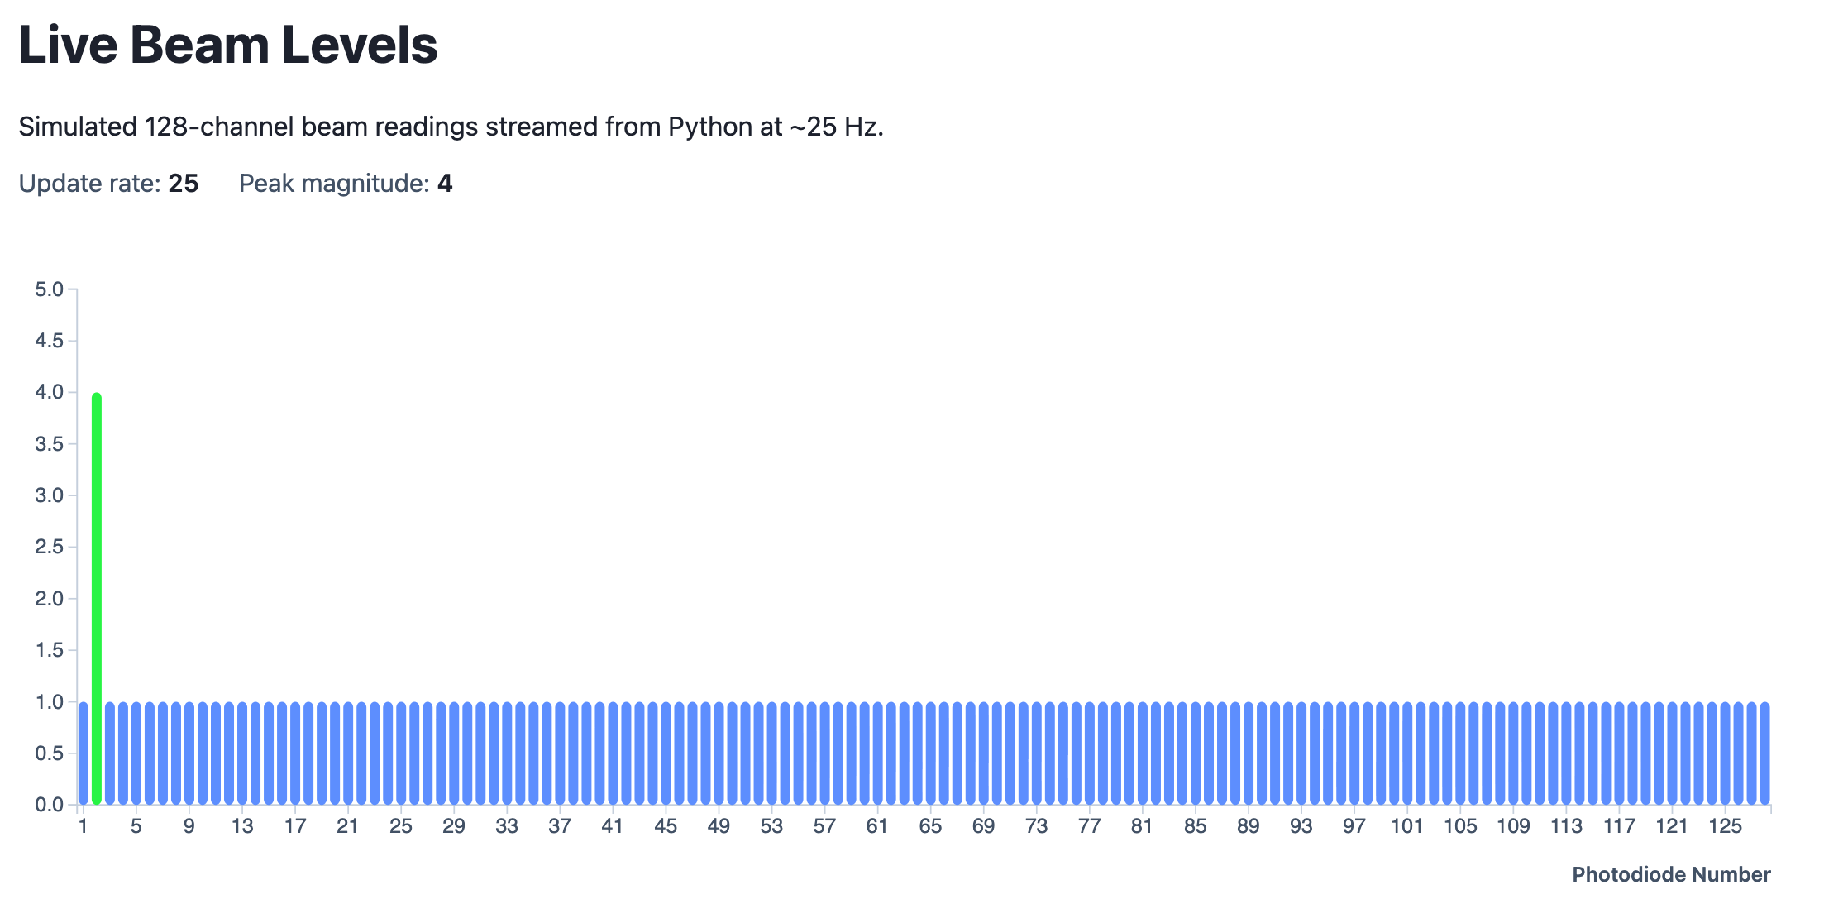
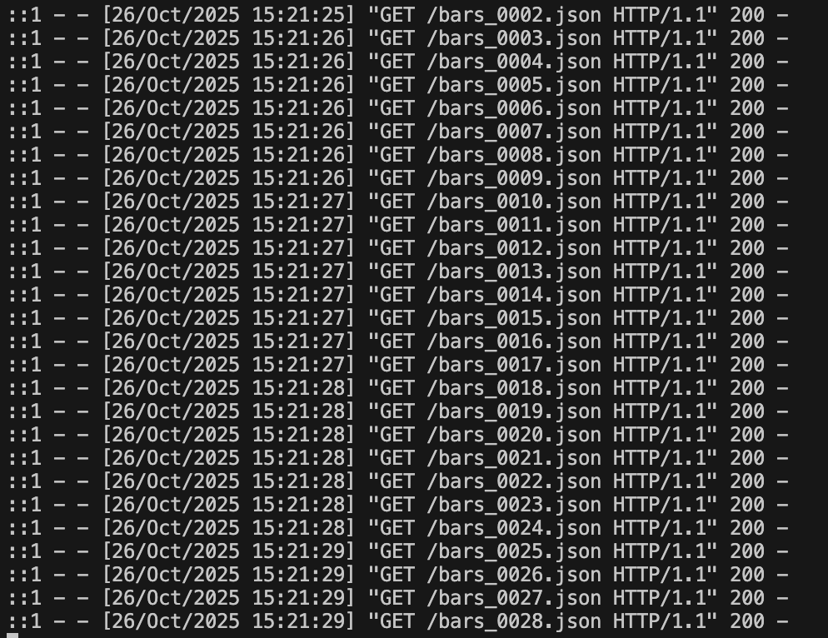
Developing a Graphical User Interface for a Proton Beam Therapy Detector
Supervisor: Prof Simon Jolly, HEP PBT Group UCL
MSci Student: Danial Saeed
Notes:
2nd presentation updates on code work primarily.

Slide 2
Current Tasks & Recent News
Code updates:
Shift from 128 static simulated data files to 1 unified file rewritten at constant 25Hz rate
Removal of visual smoothing on GUI update rate
Improved safe file writing
Installed the D3 library locally (no more internet link to library)

Slide 3
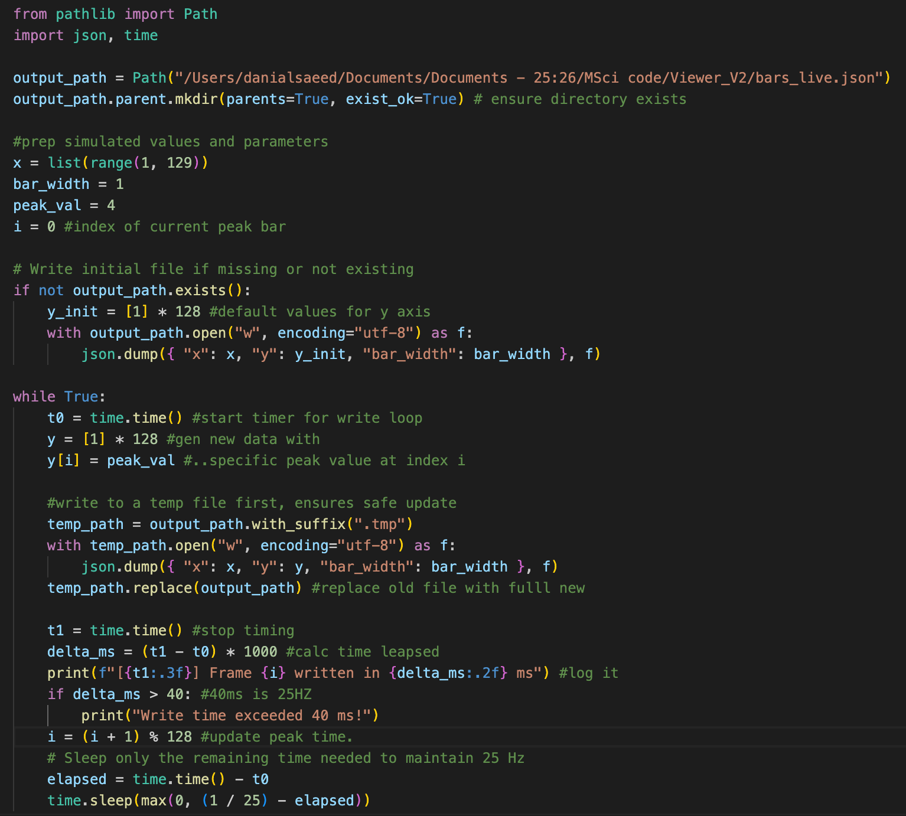
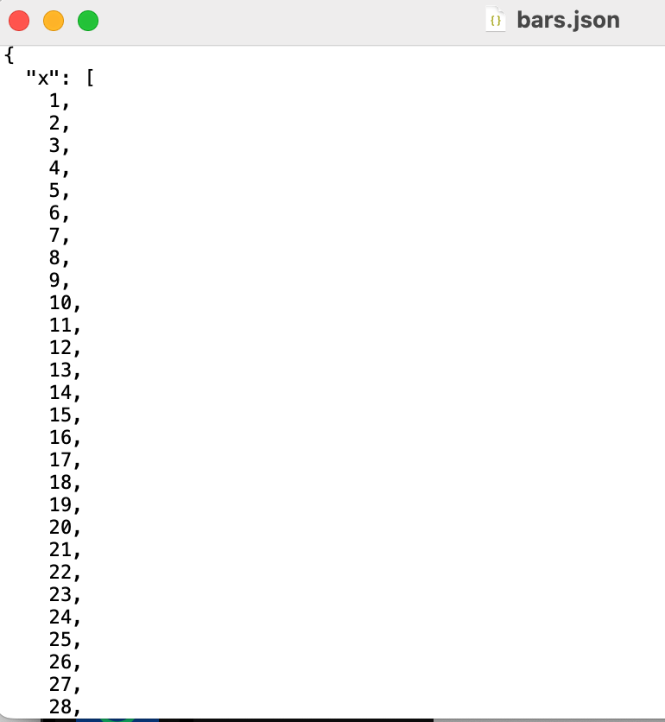
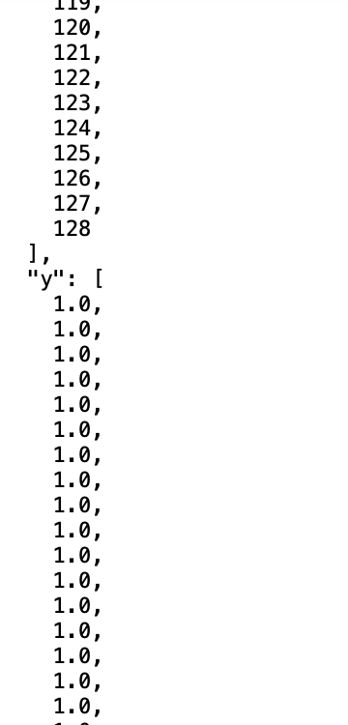
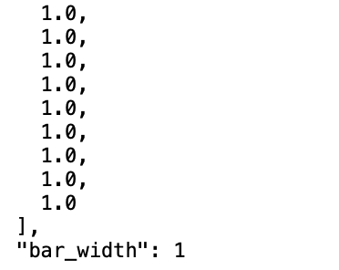
Simulated JSON data structure
Via Python:

Slide 4
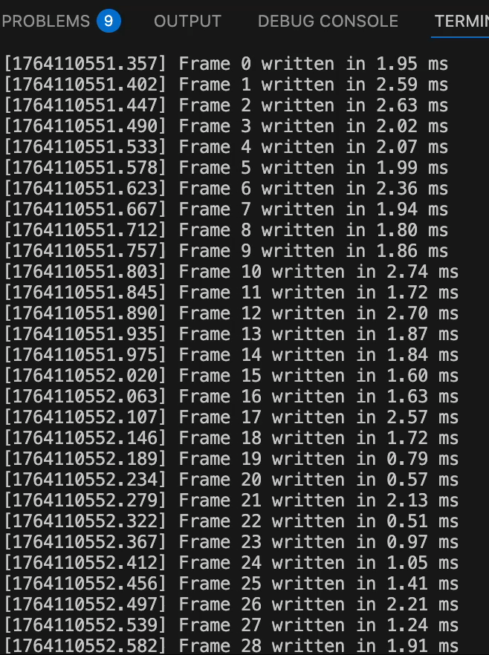
JSON set replaced
We can see the same file being rewritten,
And now the worry moves to whether it is rewritten consistently within the timeframe of 25 Hz
To investigate… a plotting code is generated

Slide 5
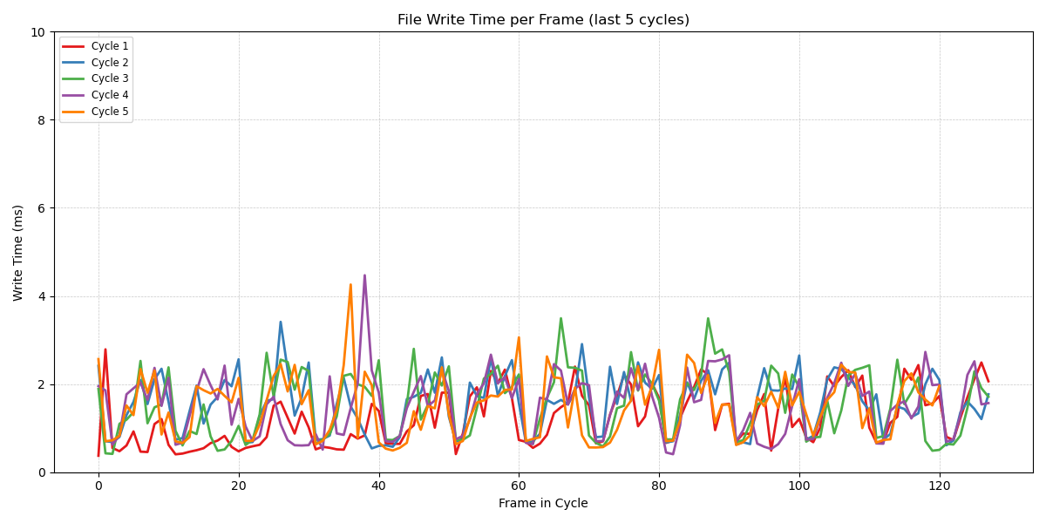
25 Hz limit is not challenged

Slide 6
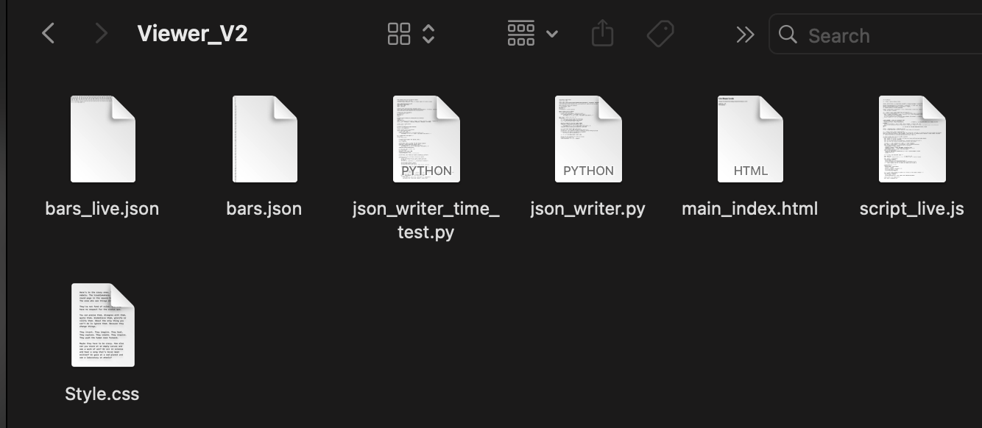




GUI Web-base
Collated files to New Viewer_V2 folder
New Script_live.js contains Javascript code
Main_index.html contains outer shell for website
Style.css contains stylistic pointers for graph rendering and bar characteristics (updated colours)
Bars_live.json file is now core to our workflow…

Slide 7
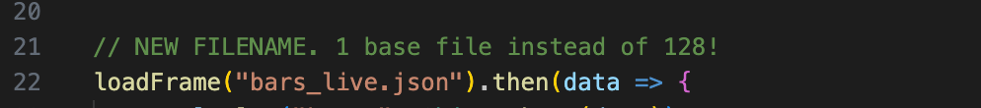
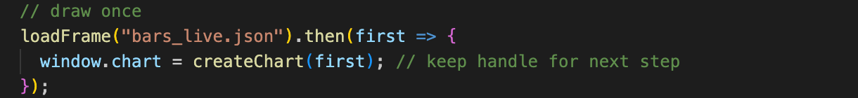
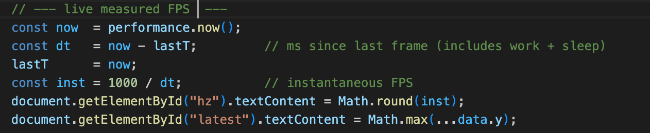
Small changes for new infrastructure
Switch to single live updating JSON file
Added display of max peak value
D3 chart now from new file
Accurate frame rate readout

Slide 8
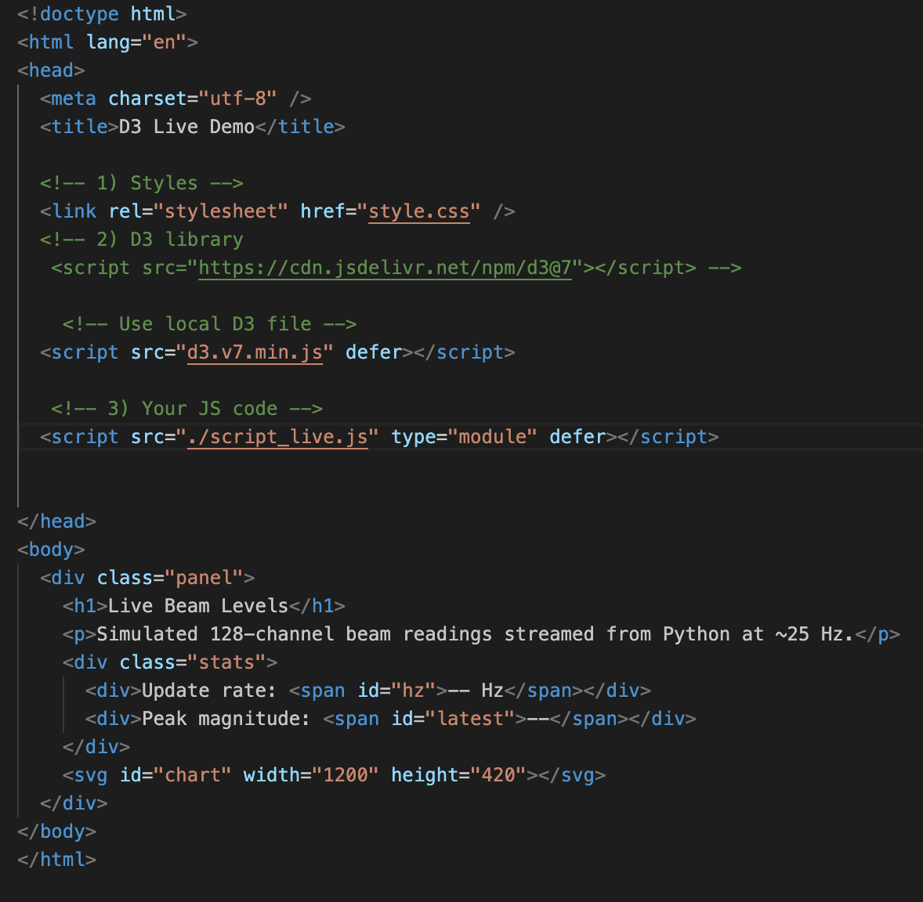
Main_Index.html
Html skeleton
Now = the D3.js file is locally stored, and called
defer ensures the JS loads after HTML is parsed, preventing early execution
Working on learning html structure via
https://www.freecodecamp.org/learn/responsive-web-design/basic-html-and-html5/introduction-to-html5-elements

Slide 9
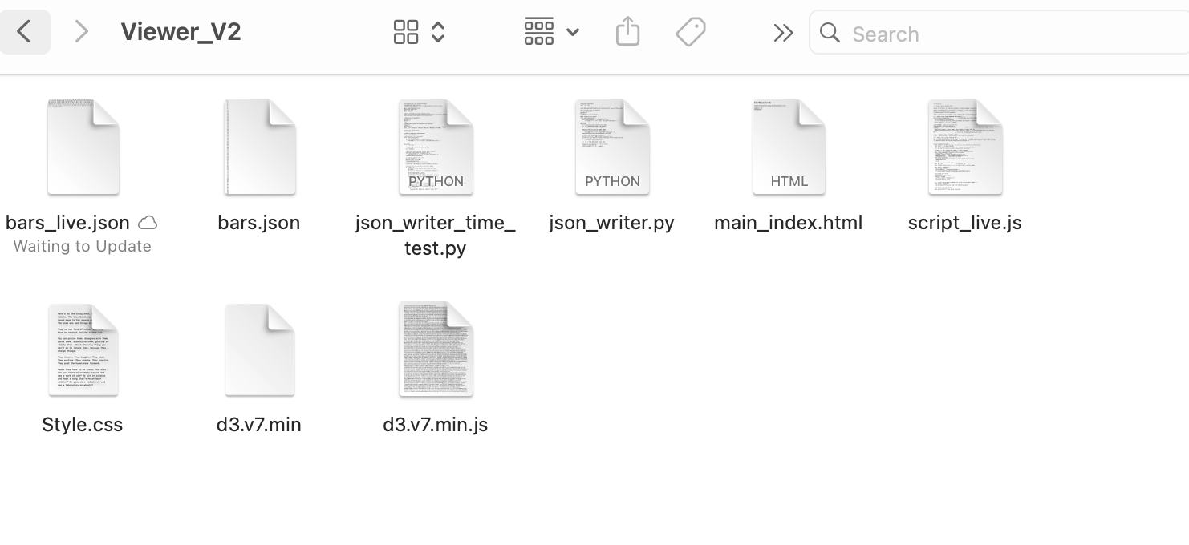

Shift to local D3.js library
Simple fix, open the linked library and download the webpage as a file.

Slide 10
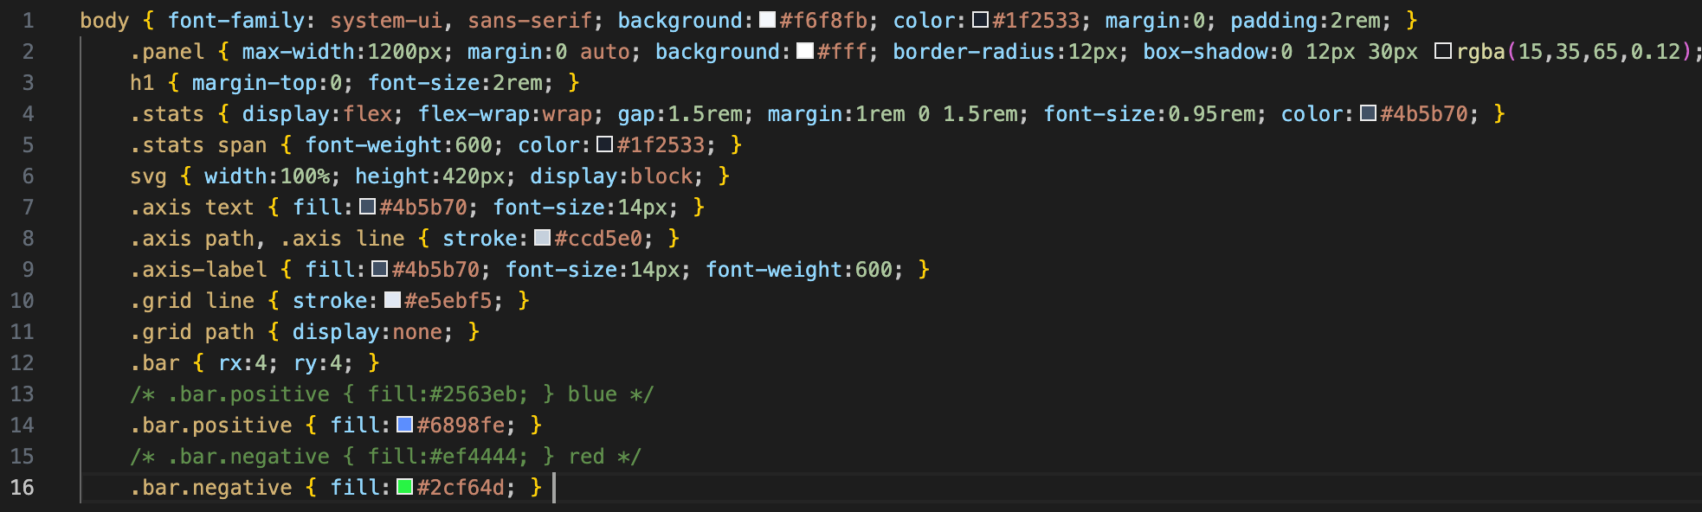
Style.css
Slowly tweaking this to familiarize myself with the capabilities

Slide 11
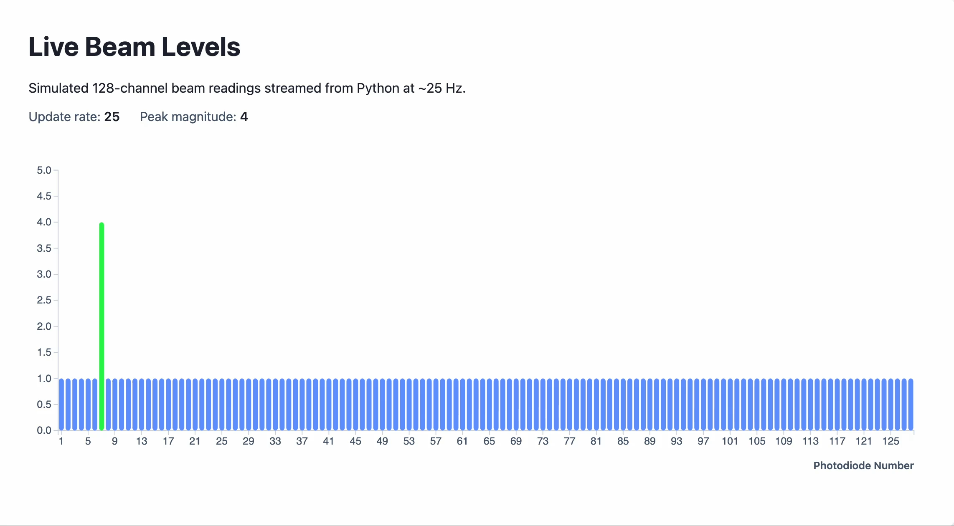
Current Website Function

Slide 12
Aims

Slide 13
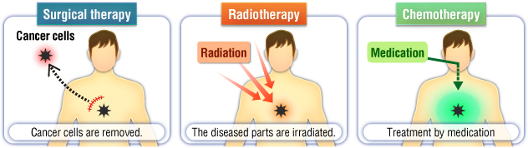
Cancer and its treatment
Uncontrollable division during a failure of cell apoptosis
Best treatment is surgical removal among surgery, chemotherapy and radiation therapy
Surgery requires specific requirement that location and spread of cancerous growth needs to be accessible
~40% of cancer is mainly treated via radiotherapy
[1]

Slide 14
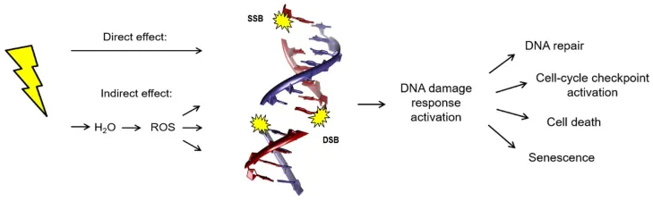
Radiotherapy – radiation oncology
We target cancer cells and cause cell death via damage to DNA
Single Strand and Double Stranded Breaks causes DNA damage response including senescence (permanent loss of division), apoptosis, or repair or checkpoint activation
X-rays: photon treatment that deposits energy over a range that depends on the energy of the beam
This means both the tumour and healthy cells are subject to it..
[2]

Slide 15
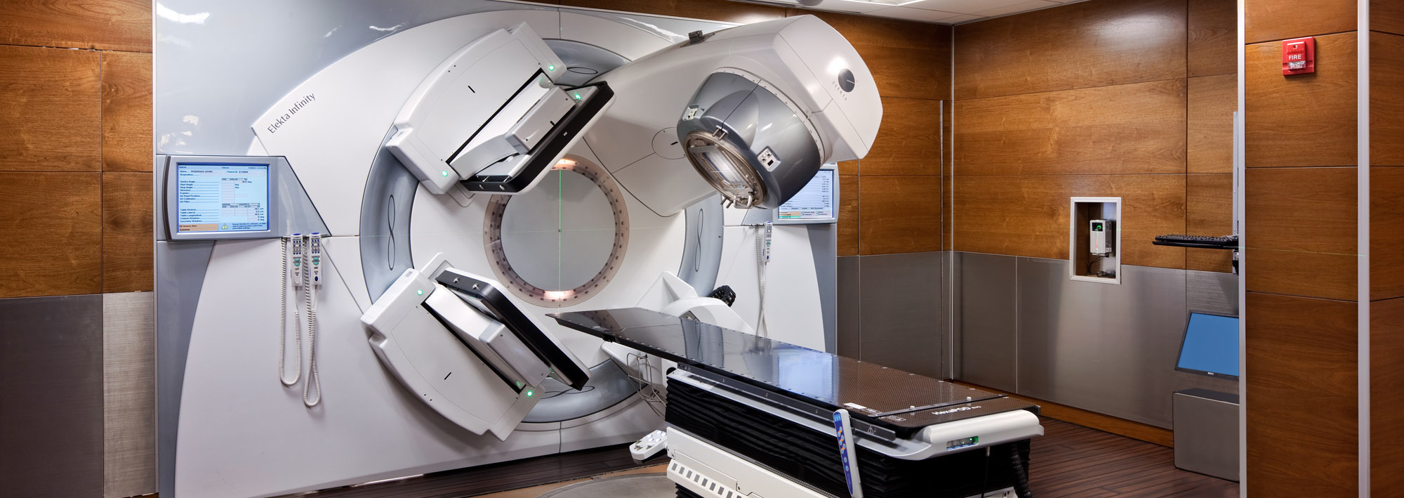
Treatment apparatus– Gantry & Nozzle
Gantry machinery rotates 360° about patient allowing Nozzle to deliver radiation
rotation allows for radiation from all angles to produce a cumulative central treatment
[3]

Slide 16
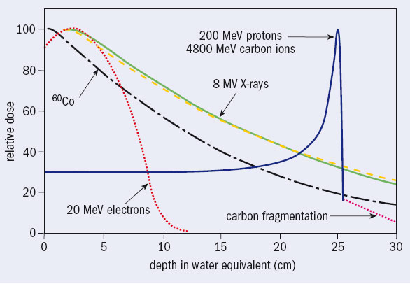
Radiation also applies to healthy tissue
Yellow line x-ray dosage, high at entry and continues past the tumor.
Dose dealt to healthy tissue is called ‘Low Dose Bath’
Blue line proton beam. They deposit most of their energy in a sharp peak called the Bragg peak.
Reduced Low Dose Bath, PBT is hence superior for treatment where dose needs to be at a minimum
High Precision also poses great risk; sharp Bragg peak needs perfect control of the beam…
[4]

Slide 17
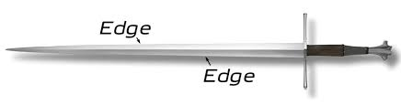
Quality Assurance:
Bragg peak position poses challenge: even mm error in precision means
Current QA involves patient specific quality assurance that requires many hours, none that are live and separate from the beam machinery
We must independently measure:
Dose (How much radiation?)
Range (depth beam reaches)
Spot position (on X/Y)
Spot size (radius of beam)

Slide 18
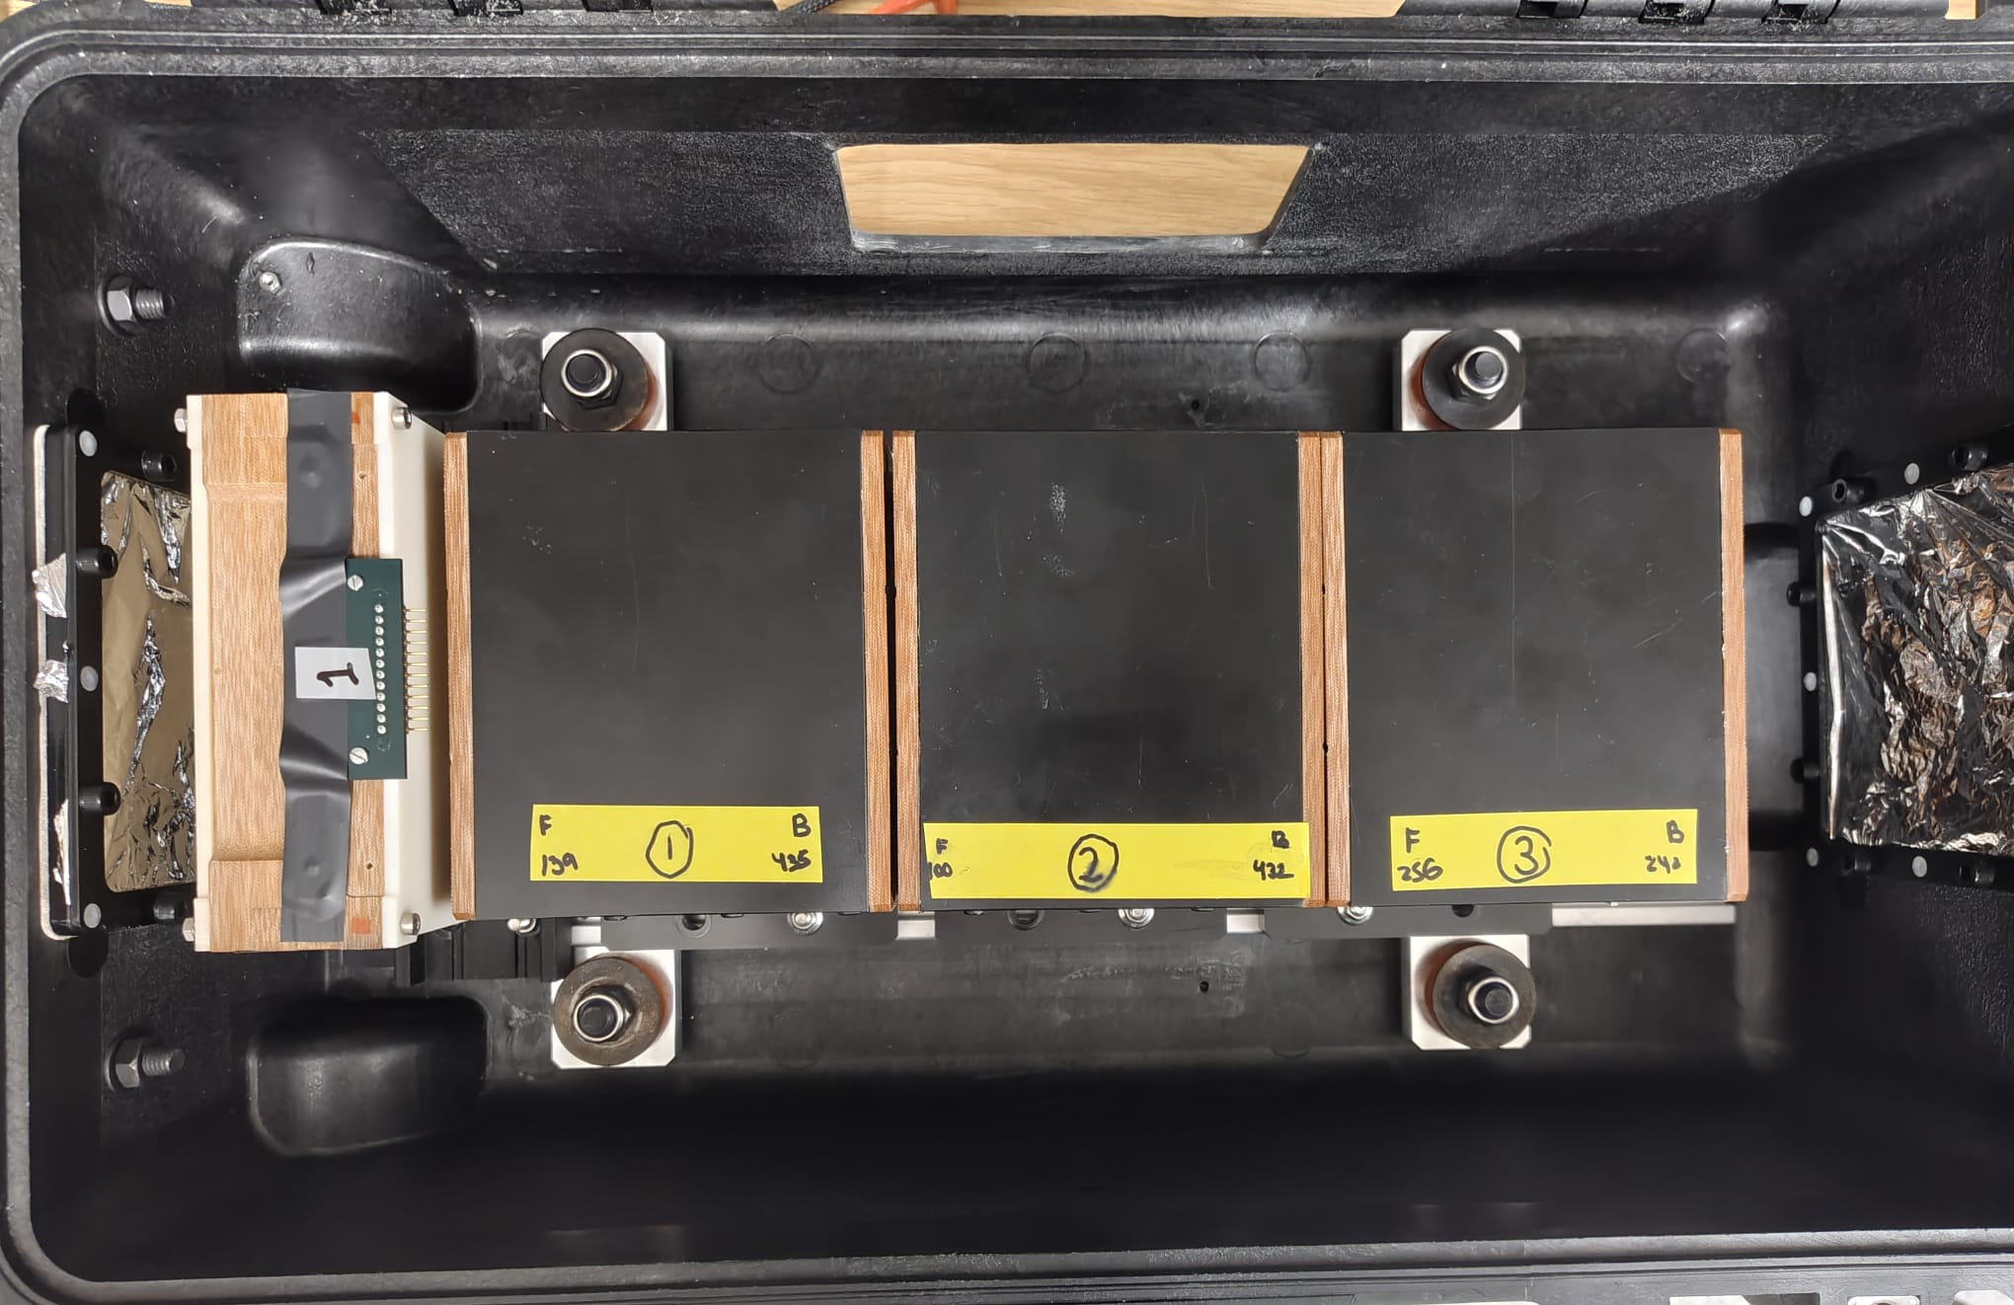
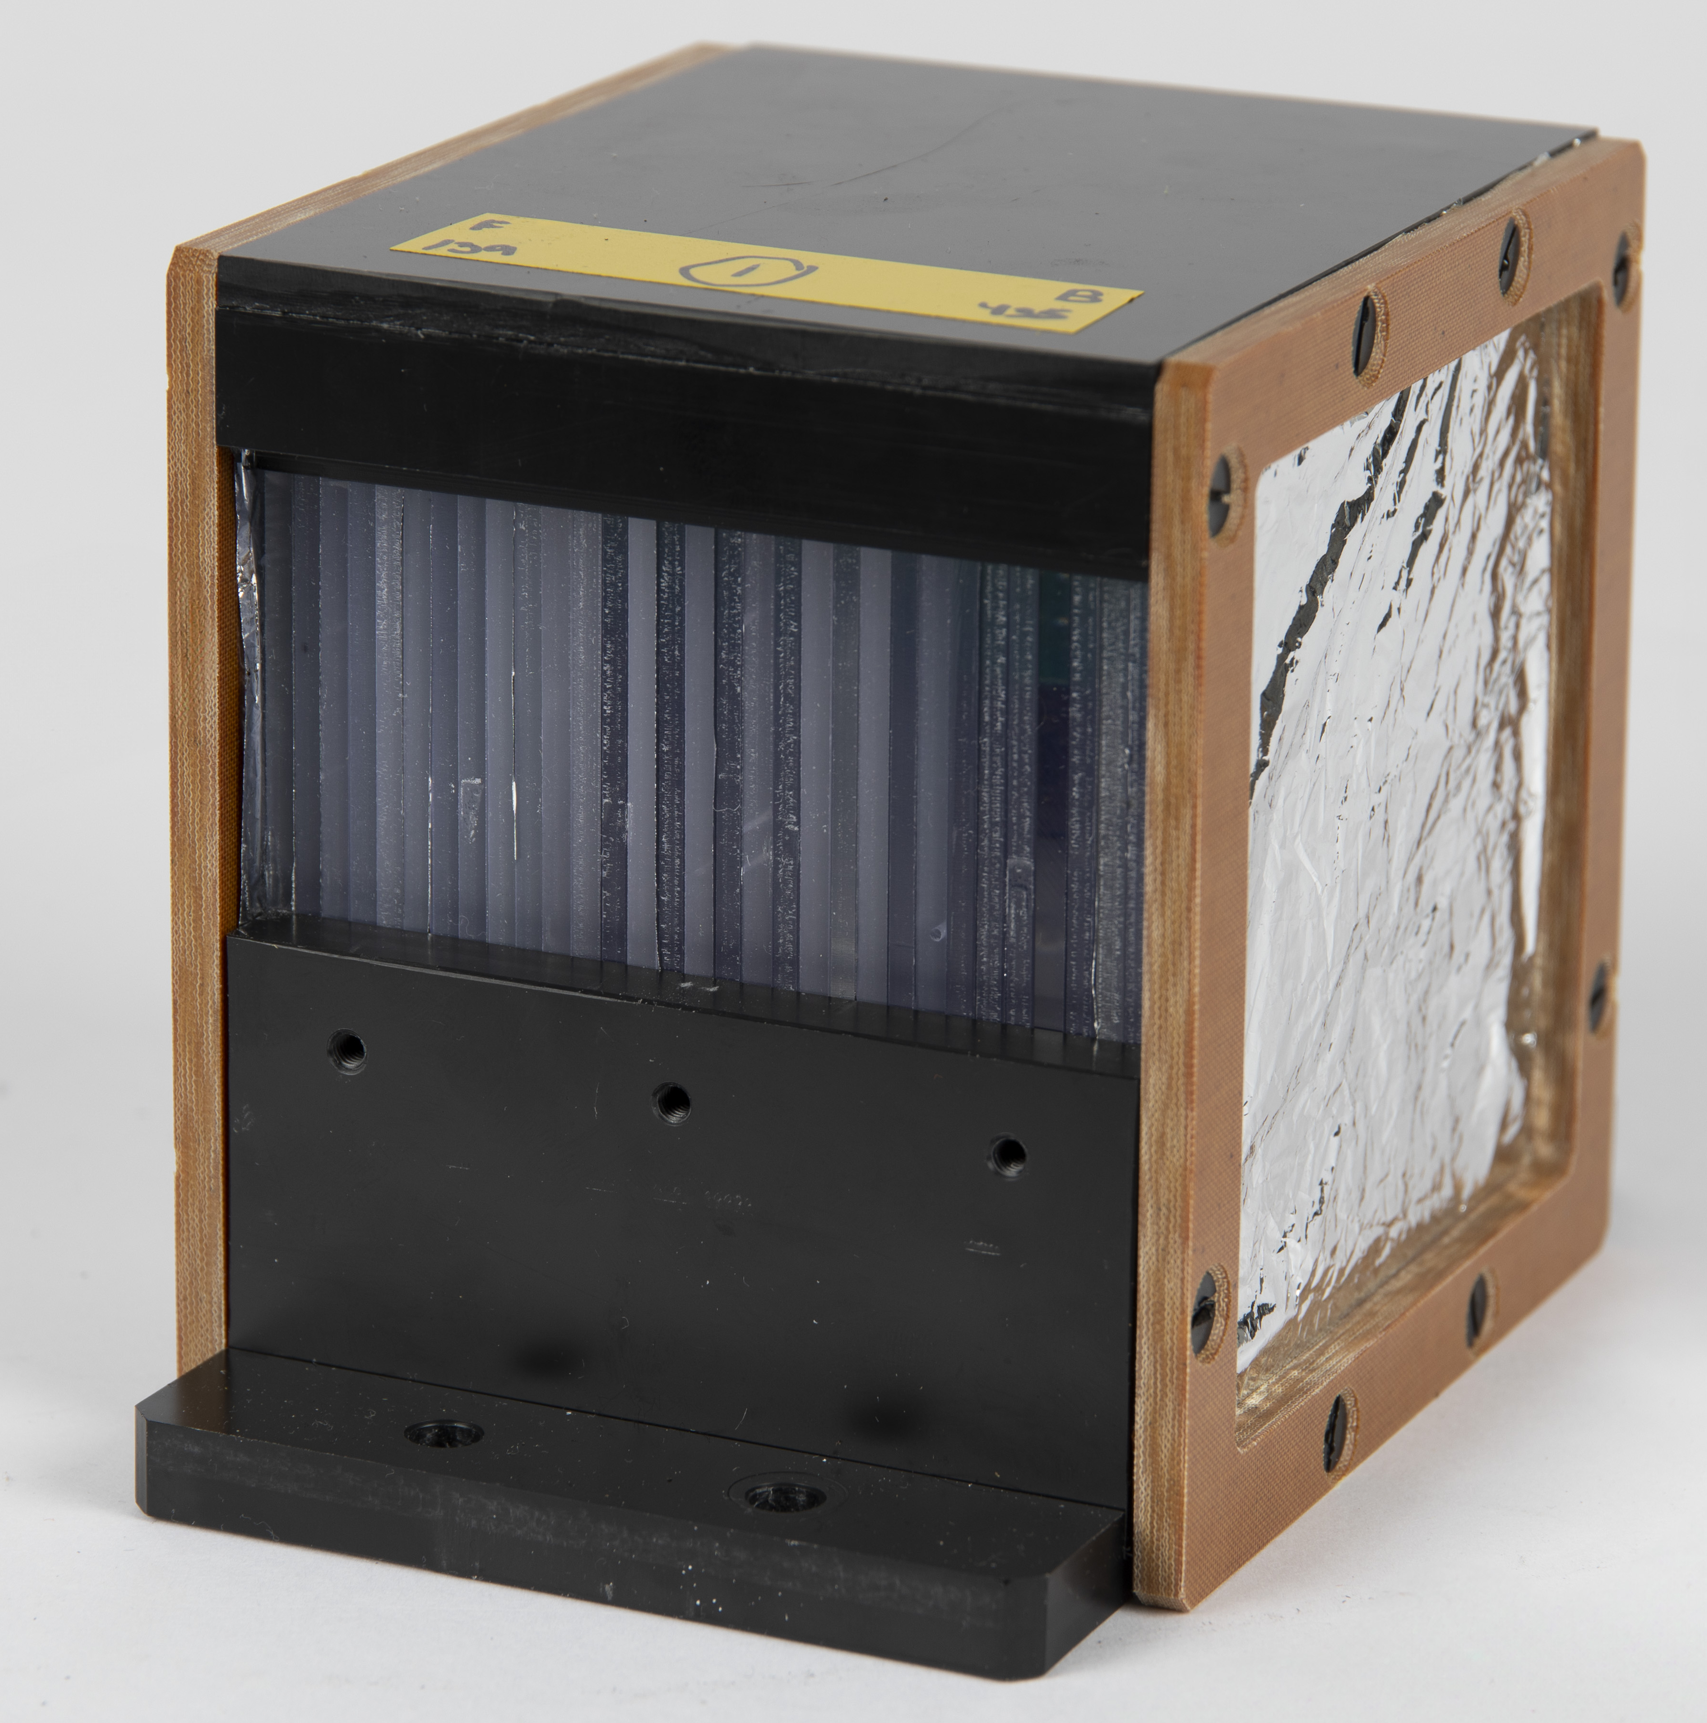
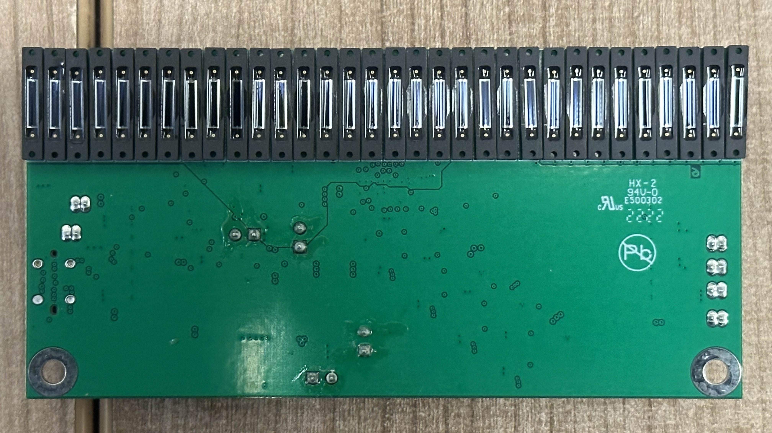
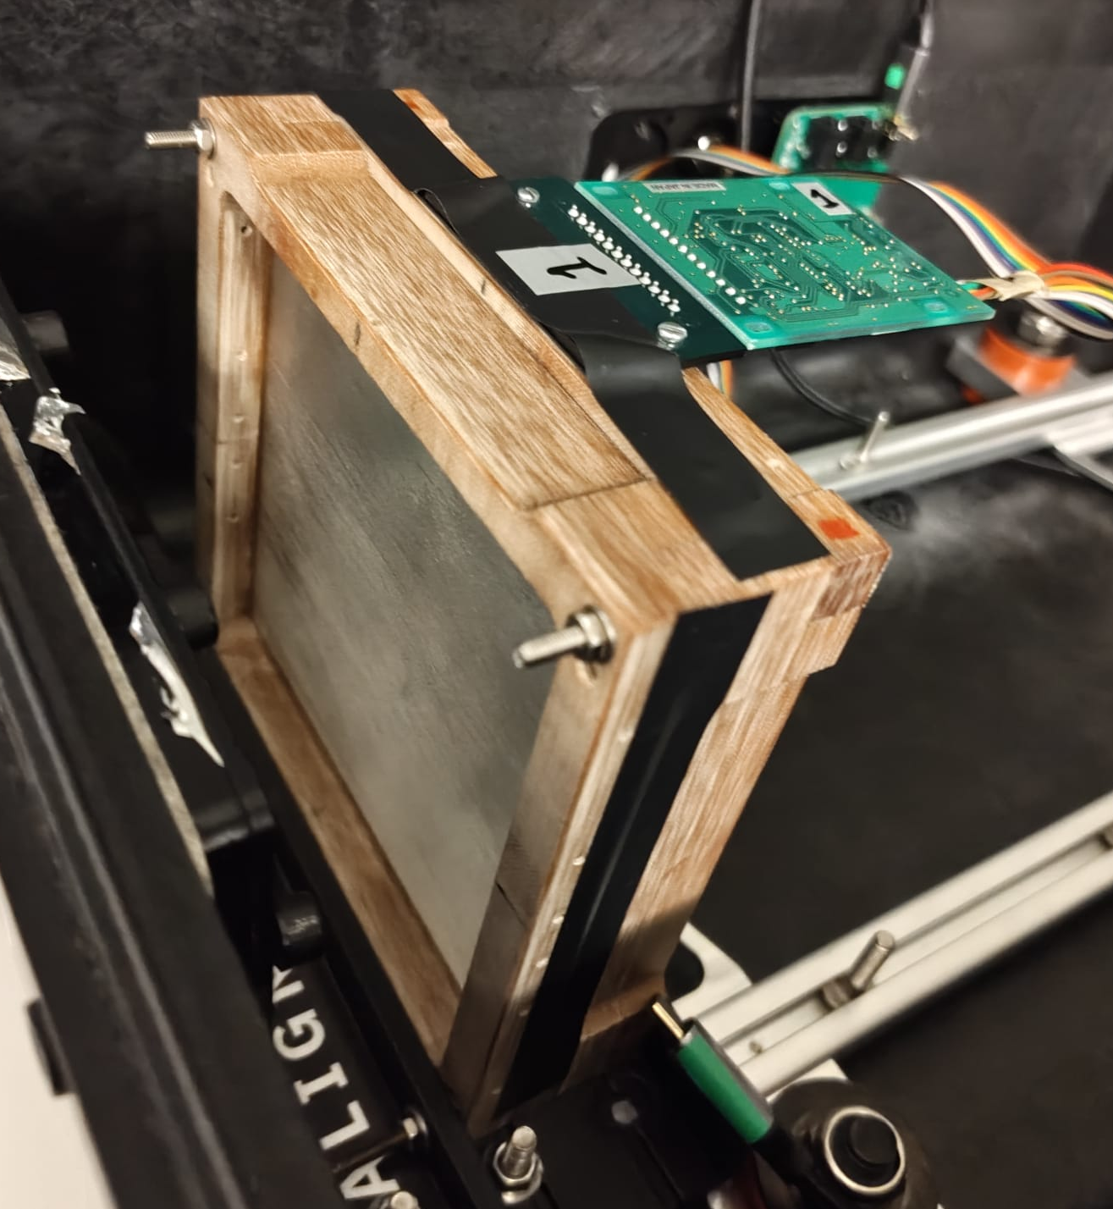
QuADProBe
QuARC
Dose &Range Diagnostics
SciFi
Tracker
Spot Size and Position Diagnostics

Slide 19
The QuARC- Quality Assurance Range Calorimeter
Group produced detector to independently measure Proton beam range.
Stack of Scintillator sheets which photo-luminesce as beam passes
Green PCB housing Photodiodes send light signals to FPGA which converts it to signal at high speed.
Raspberry Pi then writes this to a JSON file.
Have diodes on all 4 sides of the scintillator is also a goal
Slide Source: J Bateman, UCL HEP: Proton Beam Therapy

Slide 20
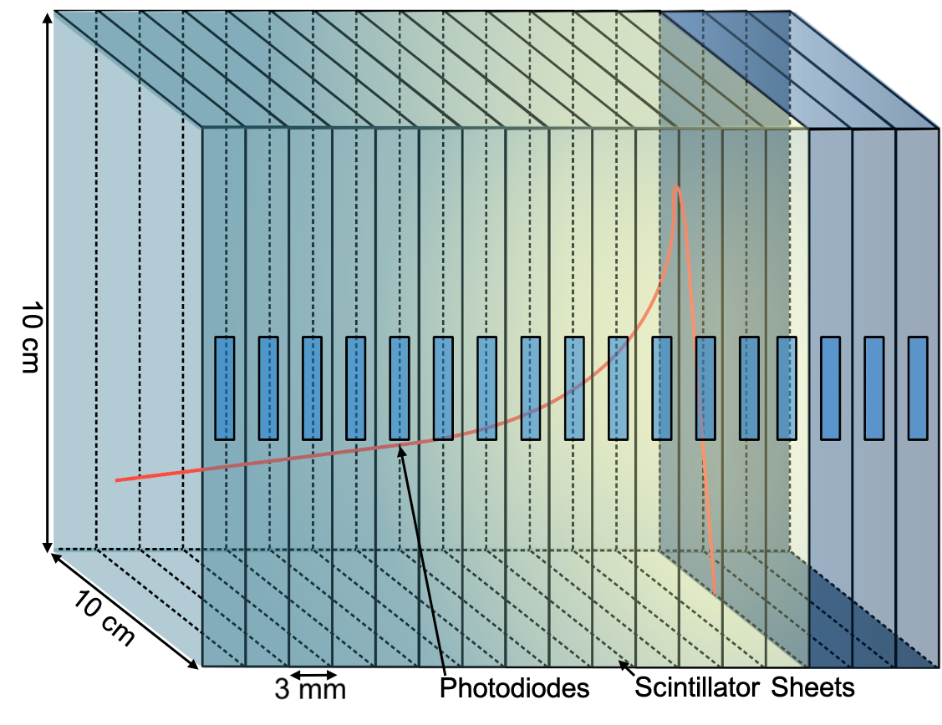
Project Objective: Live Graphical Bragg Peak Monitoring via Detector
QuARC solves a physics problem but creates a data stream that needs to be interpreted!
Raw data on the Raspberry pi is useless after the beam has already been administered, it needs to be recorded live
Quality Assurance requires an interface from hardware to human
The Quadprobe then provides information on spot size and position so overall we have fast, live, independent and mobile QA!!
[5]

Slide 21
ref
[1]-https://www.particle.or.jp/hirtjapan/en/what/difference.html
[2]- https://www.oncology.ox.ac.uk/research/research-groups/vallis-group
[3]- http://thefarbercenter.com/blog/wp-content/uploads/2011/10/linac-room.jpg
[4]- Jones, D. (1989, January). Particles Newsletter, No. 3. J. Sisterson, 89(4).
[5]-https://www.hep.ucl.ac.uk/pbt/wikiData/presentations/2024/SJ_PTCOG_QuADProBe_2024-06-12.pdf

