Slide 1
SciFi Heidelberg Design
06/08/2025

Slide 2
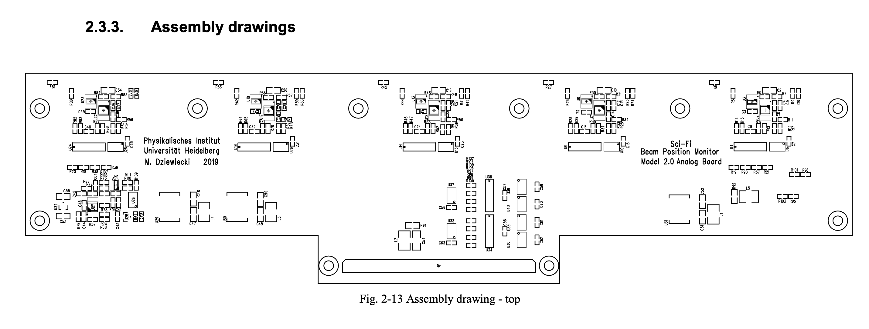






Assembly design

Slide 3
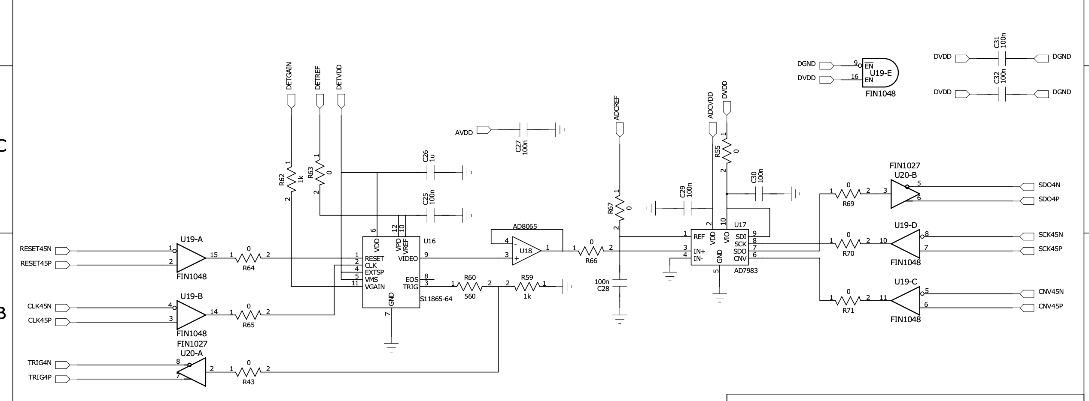
Schematic Diagram

Slide 4
ADC – AD7983
The AD7983 is a successive approximation register (SAR) ADC.
It converts an analog voltage into a 16-bit digital number.
It runs on a single power supply (VDD).
It starts sampling the analog input when the CNV (convert) signal goes from low to high (rising edge).
It samples the input voltage at pin IN+, referenced to IN− (used like a ground or differential pair).
The input voltage range is from 0 V to REF, where REF is an external reference voltage.
REF is independent of the supply voltage (VDD)—this means you can choose your own ADC range, giving flexibility and precision.

Slide 5
ADC Connection
REF (2.9V to 5V): Reference voltage for conversion. Decoupled to 100nf Capacitor for fast transient response from voltage supplied from ADCREF
IN- : Grounded
IN+: Video Signal (from photodiode that has gone through AD8065 op-amp for buffer)
VDD(2.4V-2.6V): Supply voltage for analog (to run the device). Decoupled to 100nf capacitor from voltage ADCVDD
VIO(1.71V to 5.5V): Voltage for digital power (like Vadj set same logic level. Options 1.8 2.5 3.3 and 5V). From DVDD decoupled to 100nf and connected to SDI (tells SDI SDO SCK and CONV to produce VIO signal that match the V use for MCU or FPGA (Avoid damaging pins))
SDI, SDO, SCK, CONV: SPI connection for signal read and write using LVDS.

Slide 6
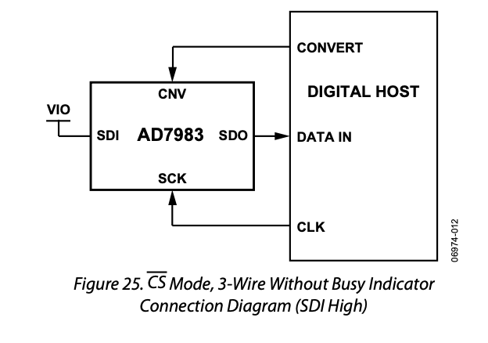
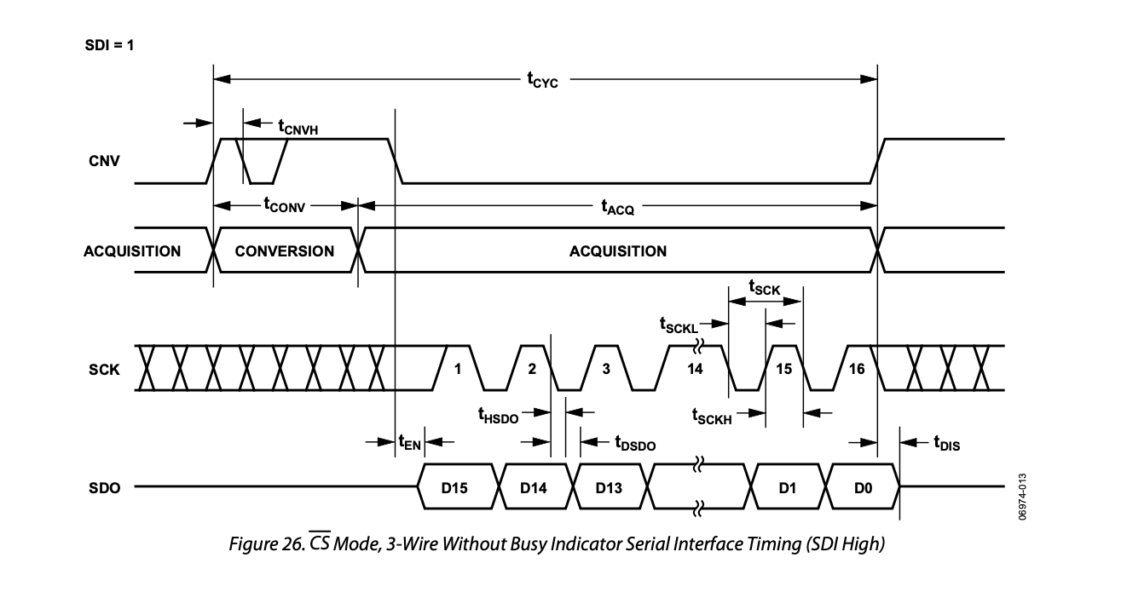
ADC Operation
From the design, it seems to be on CS (Chip Select) 3 wire configuration without busy indicator enabled.
On rising edge CONV, initiates conversion until its done irrespective of the state of CONV. Once it done it goes to standby mode and go to acquisition.
On Falling edge CONV, MSB gets readout from SDO. Consequent bits are read on falling edge of SCK. (Using rising edge is possible but slower).
SDO goes to HSMC pin directly i.e readout by FPGA.

Slide 7
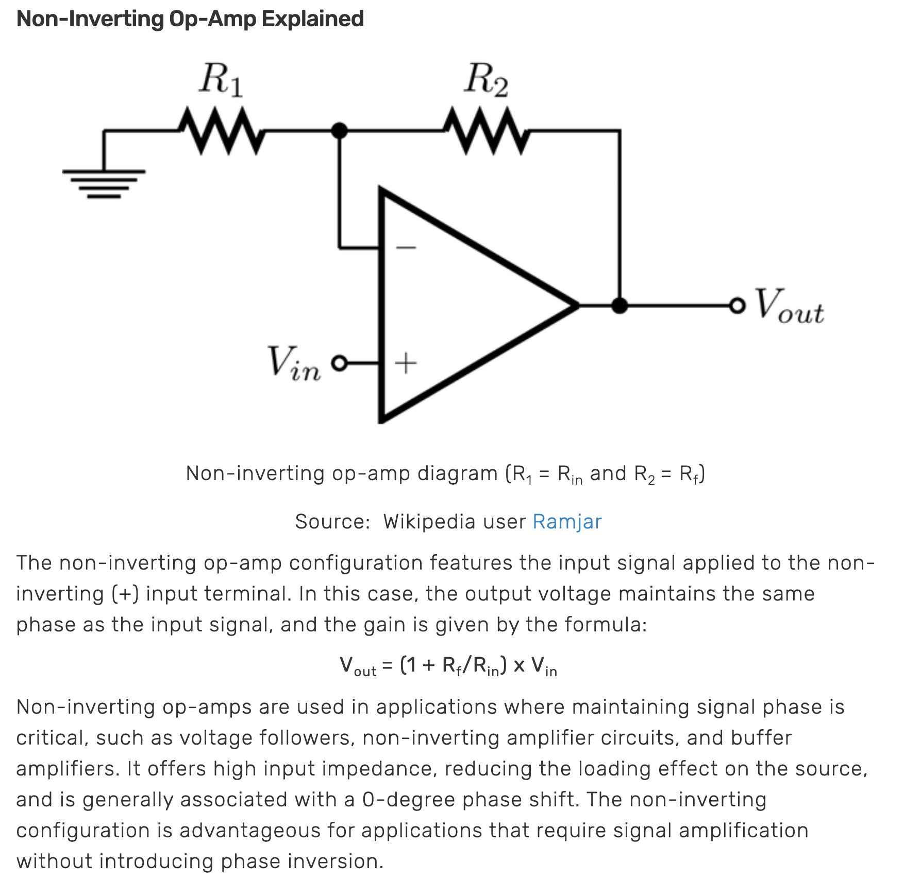
Non Inverting Op-amp – AD8065
AD8065 - A high-speed, low-distortion op-amp.
It likely serves as a buffer to drive the ADC input with low output impedance, ensuring accurate sampling.
signal buffer is an electronic circuit that passes a signal from input to output unchanged, but improves electrical performance.
The buffer protects the signal source and ensures the ADC sees a clean, stable voltage.

Slide 8
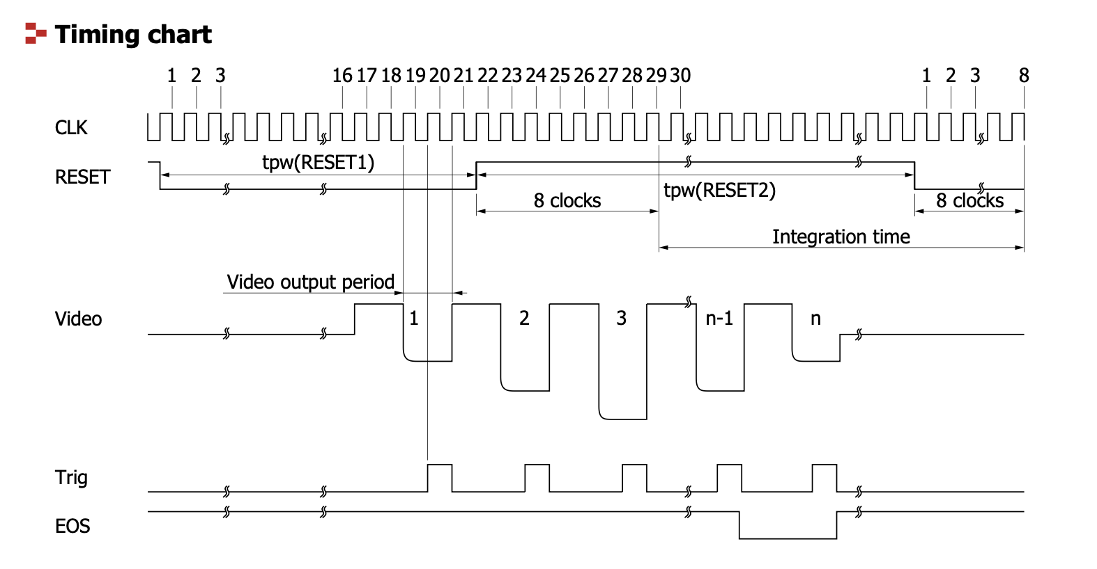
Photodiodes Array – S11865-64
Data Rate: 1MHz max
5v (upto 6V) power supply operation
0.8mm pitch * 64 channel (50.4mm in length)
Photodiode: 0.7mm width x 0.8mm height.
Sequential readout with a shift register
CLK: 40KHz to 4MHz
On rising edge of trigger, video output gets registered
Video output period is 2 CLK Cycle, Trigger is 1 CLK cycle.

Slide 9
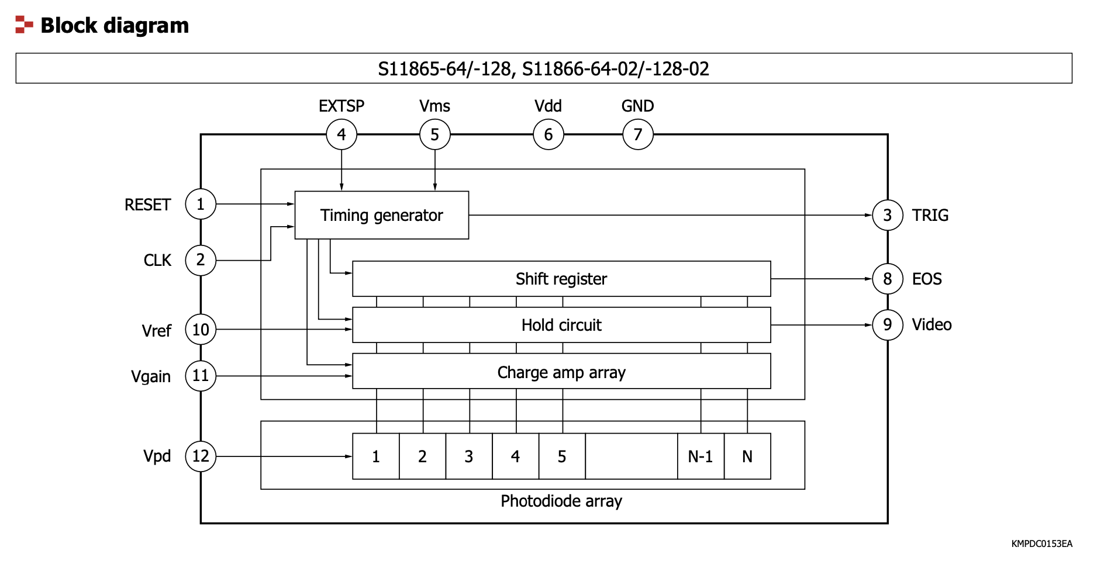
Operation
CLK, RESET generates Trigger for passing video out
VDD, VMS, EXTSP are connected to a single Vsupply DETVDD.
Vgain is connected to DETGAIN
VPD and VREF is connected to DETREF.
PD array is powered with VDD, generating analog signal that goes to Amplifier array. Translated with the same logic Vref, Video is send out to IN+ Buffer on rising edge Trigger.
Shift register for sequential readout is not used as EOS is not utilized in the design.

Slide 10


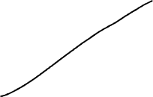
LVDS Driver – FIN1048
Convert single-ended digital signals into differential pairs, suitable for high-speed data transmission over longer distances or noisy environments.
Eliminating classic common-mode voltage noise: (out of phase signal case)
Noise – cancelled out
Clean signal

Slide 11
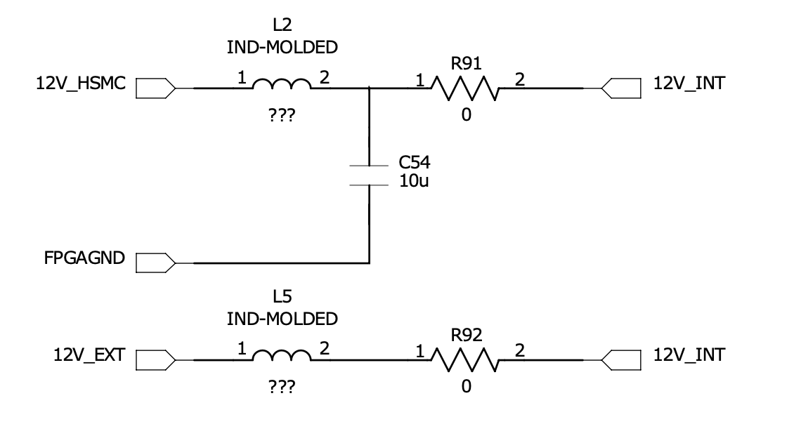
Power supply routing
2 options from external power supply or HSMC FPGA connection.
Both supply 12V.
Connected to LC Low pass filter prior to supplying voltage to peripherals.

Slide 12
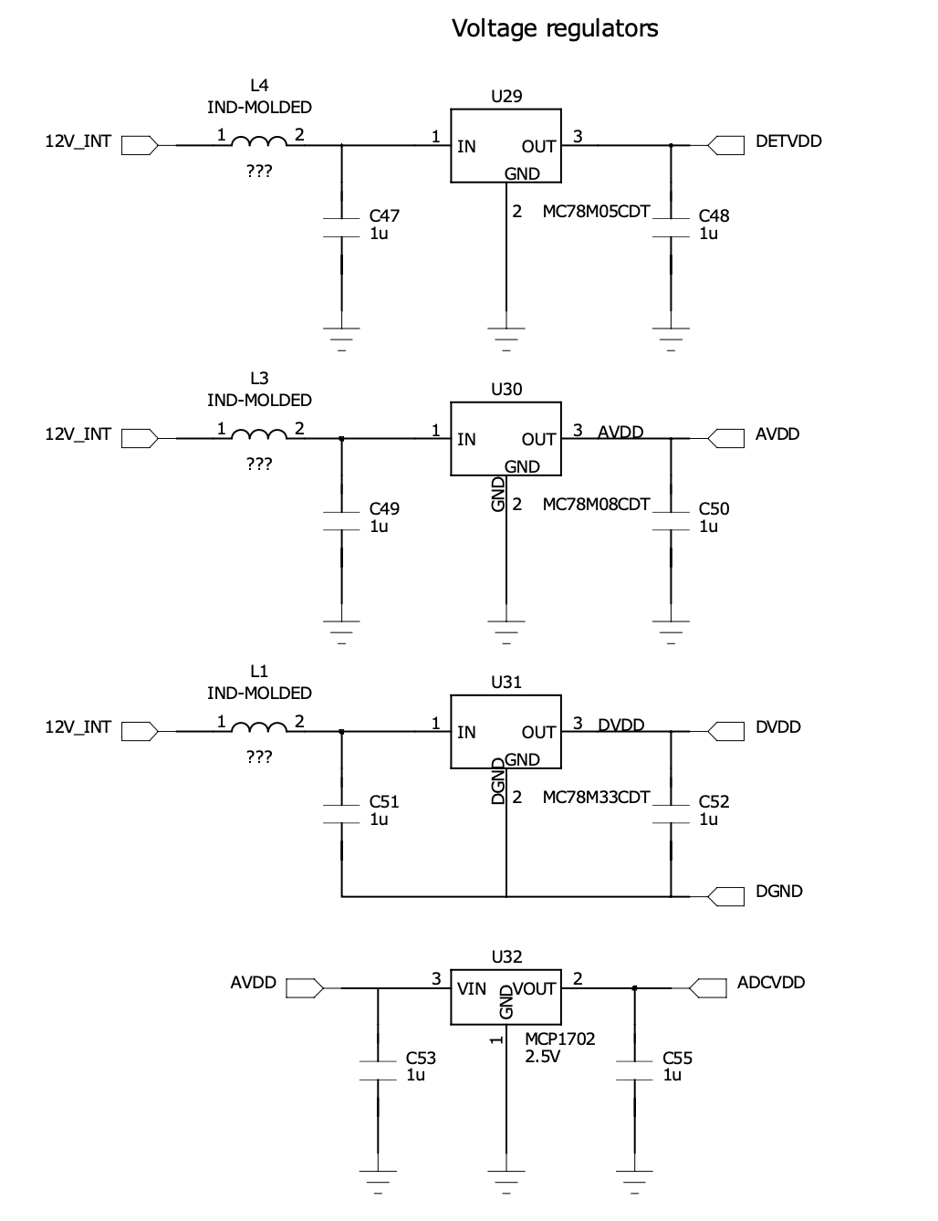
Power Signals
12V_INT is supplied to various different Voltage regulators to supply different level of voltage to different peripheral.
MC78M05CDT produces clean 5V from supply between 7V – 18V for DETVDD (photodiode array VDD, EXTSP VMS)
MC78M08CDT produces clean 8V from supply 10.5V-23V for AVDD. This then goes to MCP1702 to produce clean 2.5V ADCVDD
MC78M33CDT produces clean 3.3V for DVDD which is an input to ADC VIO. It serves as 3.3V logic level across communication from ADC to FPGA.

Slide 13
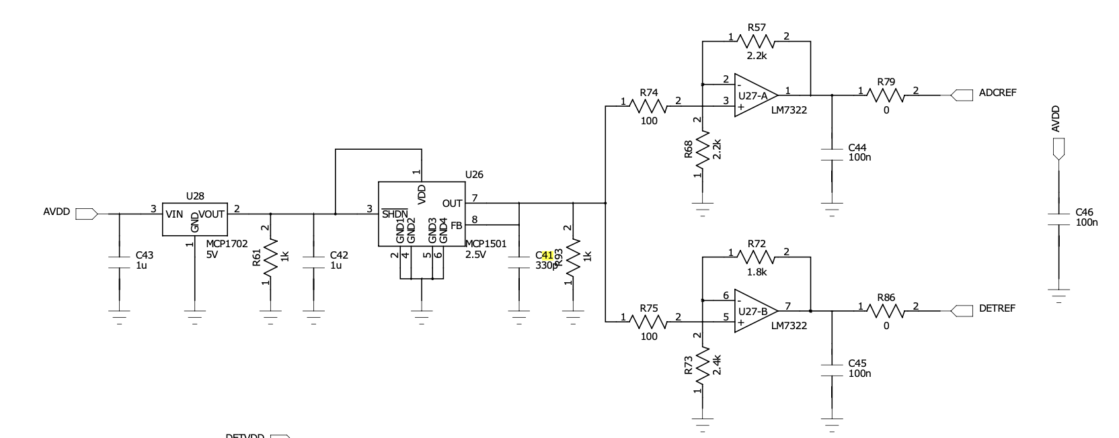
More power signals
AVDD is also used to generate ADCREF and DETREF.
AVDD first goes through 5V voltage regulator MCP1702-5V. Then it goes to buffer MCP1501-2.5V.
Then it goes to buffer opamp process. Both process gets 2.5V. Connected in Non-inverting configuration. Gain for ADCREF is 2x whereas DETREF is 1.75x. ADCREF is therefore 5V and DETREF is 4.4V.
The MCP1501 is a buffered voltage reference capable of sinking and sourcing 20 mA of current. The voltage reference is a low-drift band gap based reference

Slide 14
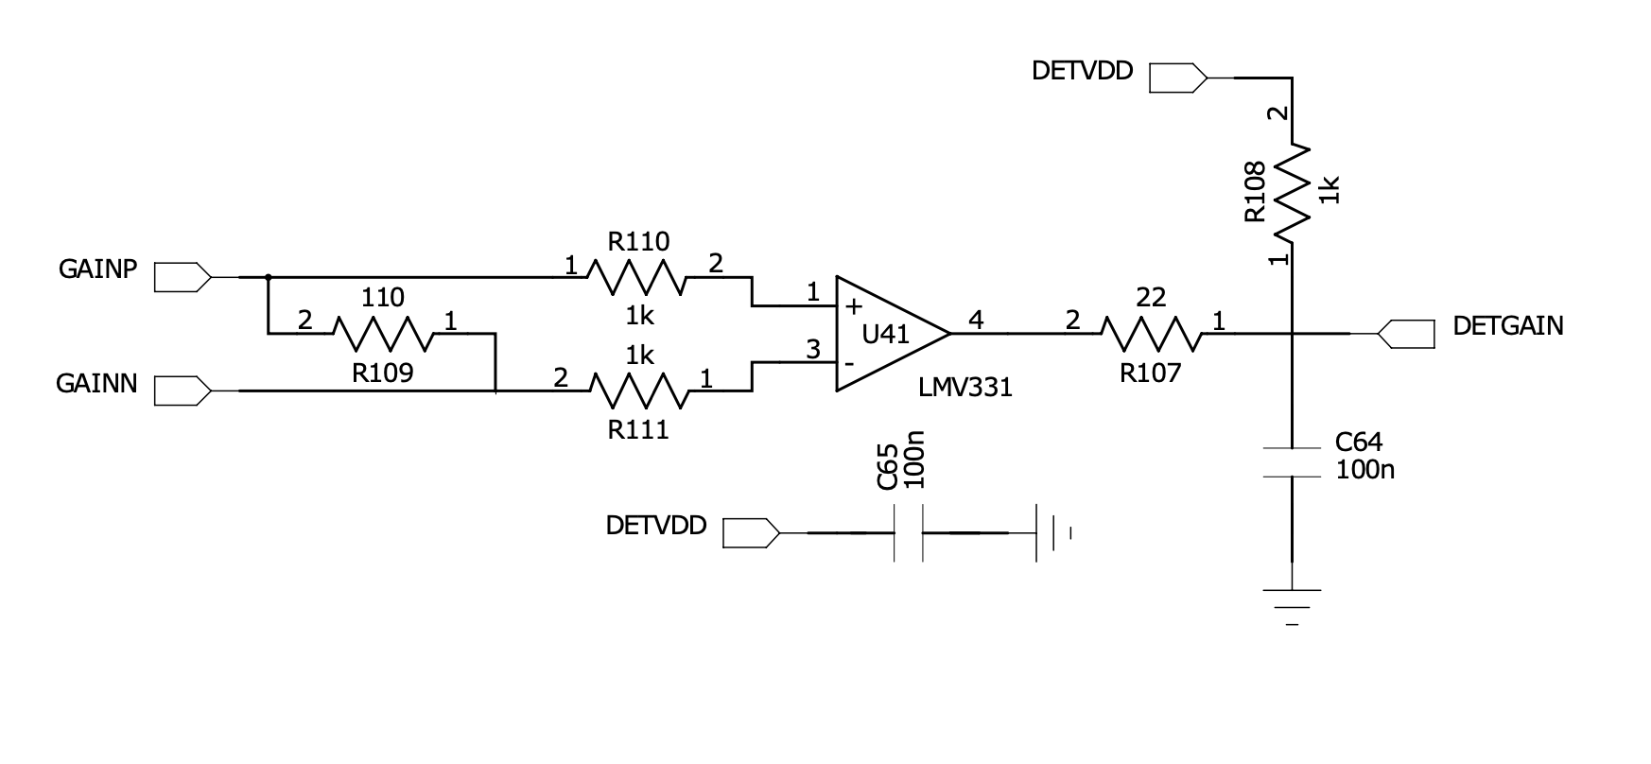
More power signals
For DETGAIN, Photodiode Amplifer array Gain -> using differential amplifier.
The voltage at the positive input of the op-amp is determined by GAINP and GAINN through a voltage divider.
The voltage at the negative input of the op-amp is a feedback path from the op-amp's output.
Gain In this specific case, A =(1000+110)/1000​≈0.9.
GAINP and GAINN is configurable from HSMC connection i.e. from FPGA.

Slide 15
Notes

Slide 16
ADC Operation Theory example
REF = 5.000 V (external precision reference)
VDD = 3.3 V (power supply for ADC, different from REF)
Resolution = 16 bits ⇒ 2¹⁶ = 65,536 levels (0 to 65,535)
LSB size (Least Significant Bit) = REF / 65,536 = 5 V / 65,536 ≈ 76.3 µV
So, every increase of ~76.3 µV in the input results in the digital output increasing by 1.
If IN+ = 1.9V and IN- = -0.6V, (Differential pairs) -> 2.5V / Vref * 65,536 = 32678 (0x8000 in hex)

Slide 17
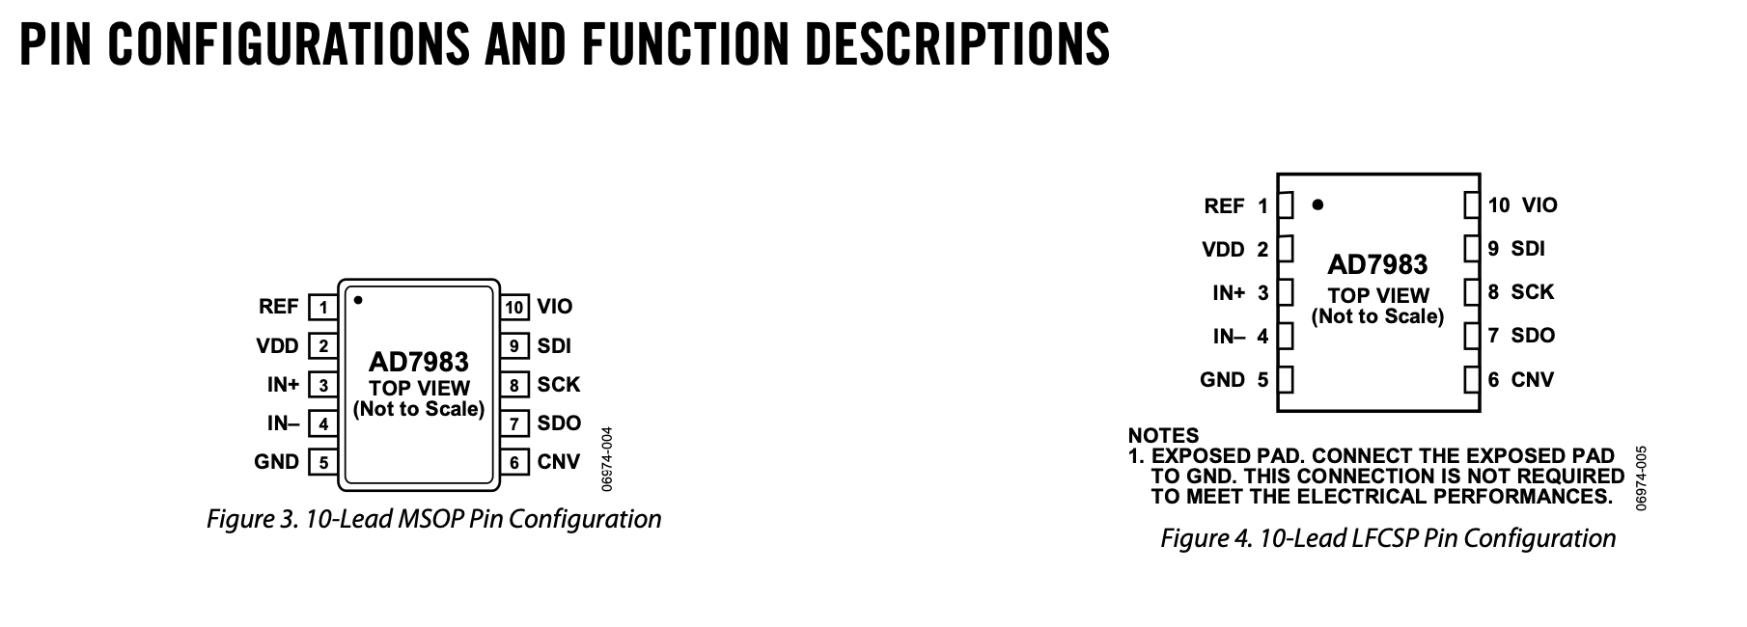
MSOP vs LFCSP
A 10-lead MSOP and a 10-lead LFCSP are both types of IC (integrated circuit) packages,
10-lead MSOP
  MSOP = Mini Small Outline Package
  It’s a small, rectangular surface-mount package.
  10-lead means it has 10 pins (5 on each side).
LFCSP = Lead Frame Chip Scale Package
  Also called QFN (Quad Flat No-lead) in some contexts.
  A leadless, surface-mount package.
  Pins are underneath or near the edges of the package.

Slide 18
Capacitor roles
Why Capacitors connected to supply:
  Prevention of voltage spikes of the supply, preventing damage to the board it connected to
  Decoupling noise from power supply ripple, board receive clean DC voltage
  Energy storage, ensuring smooth transition when turn on and off.

