Slide 1
USBC PD Board
22/09/2025

Slide 2
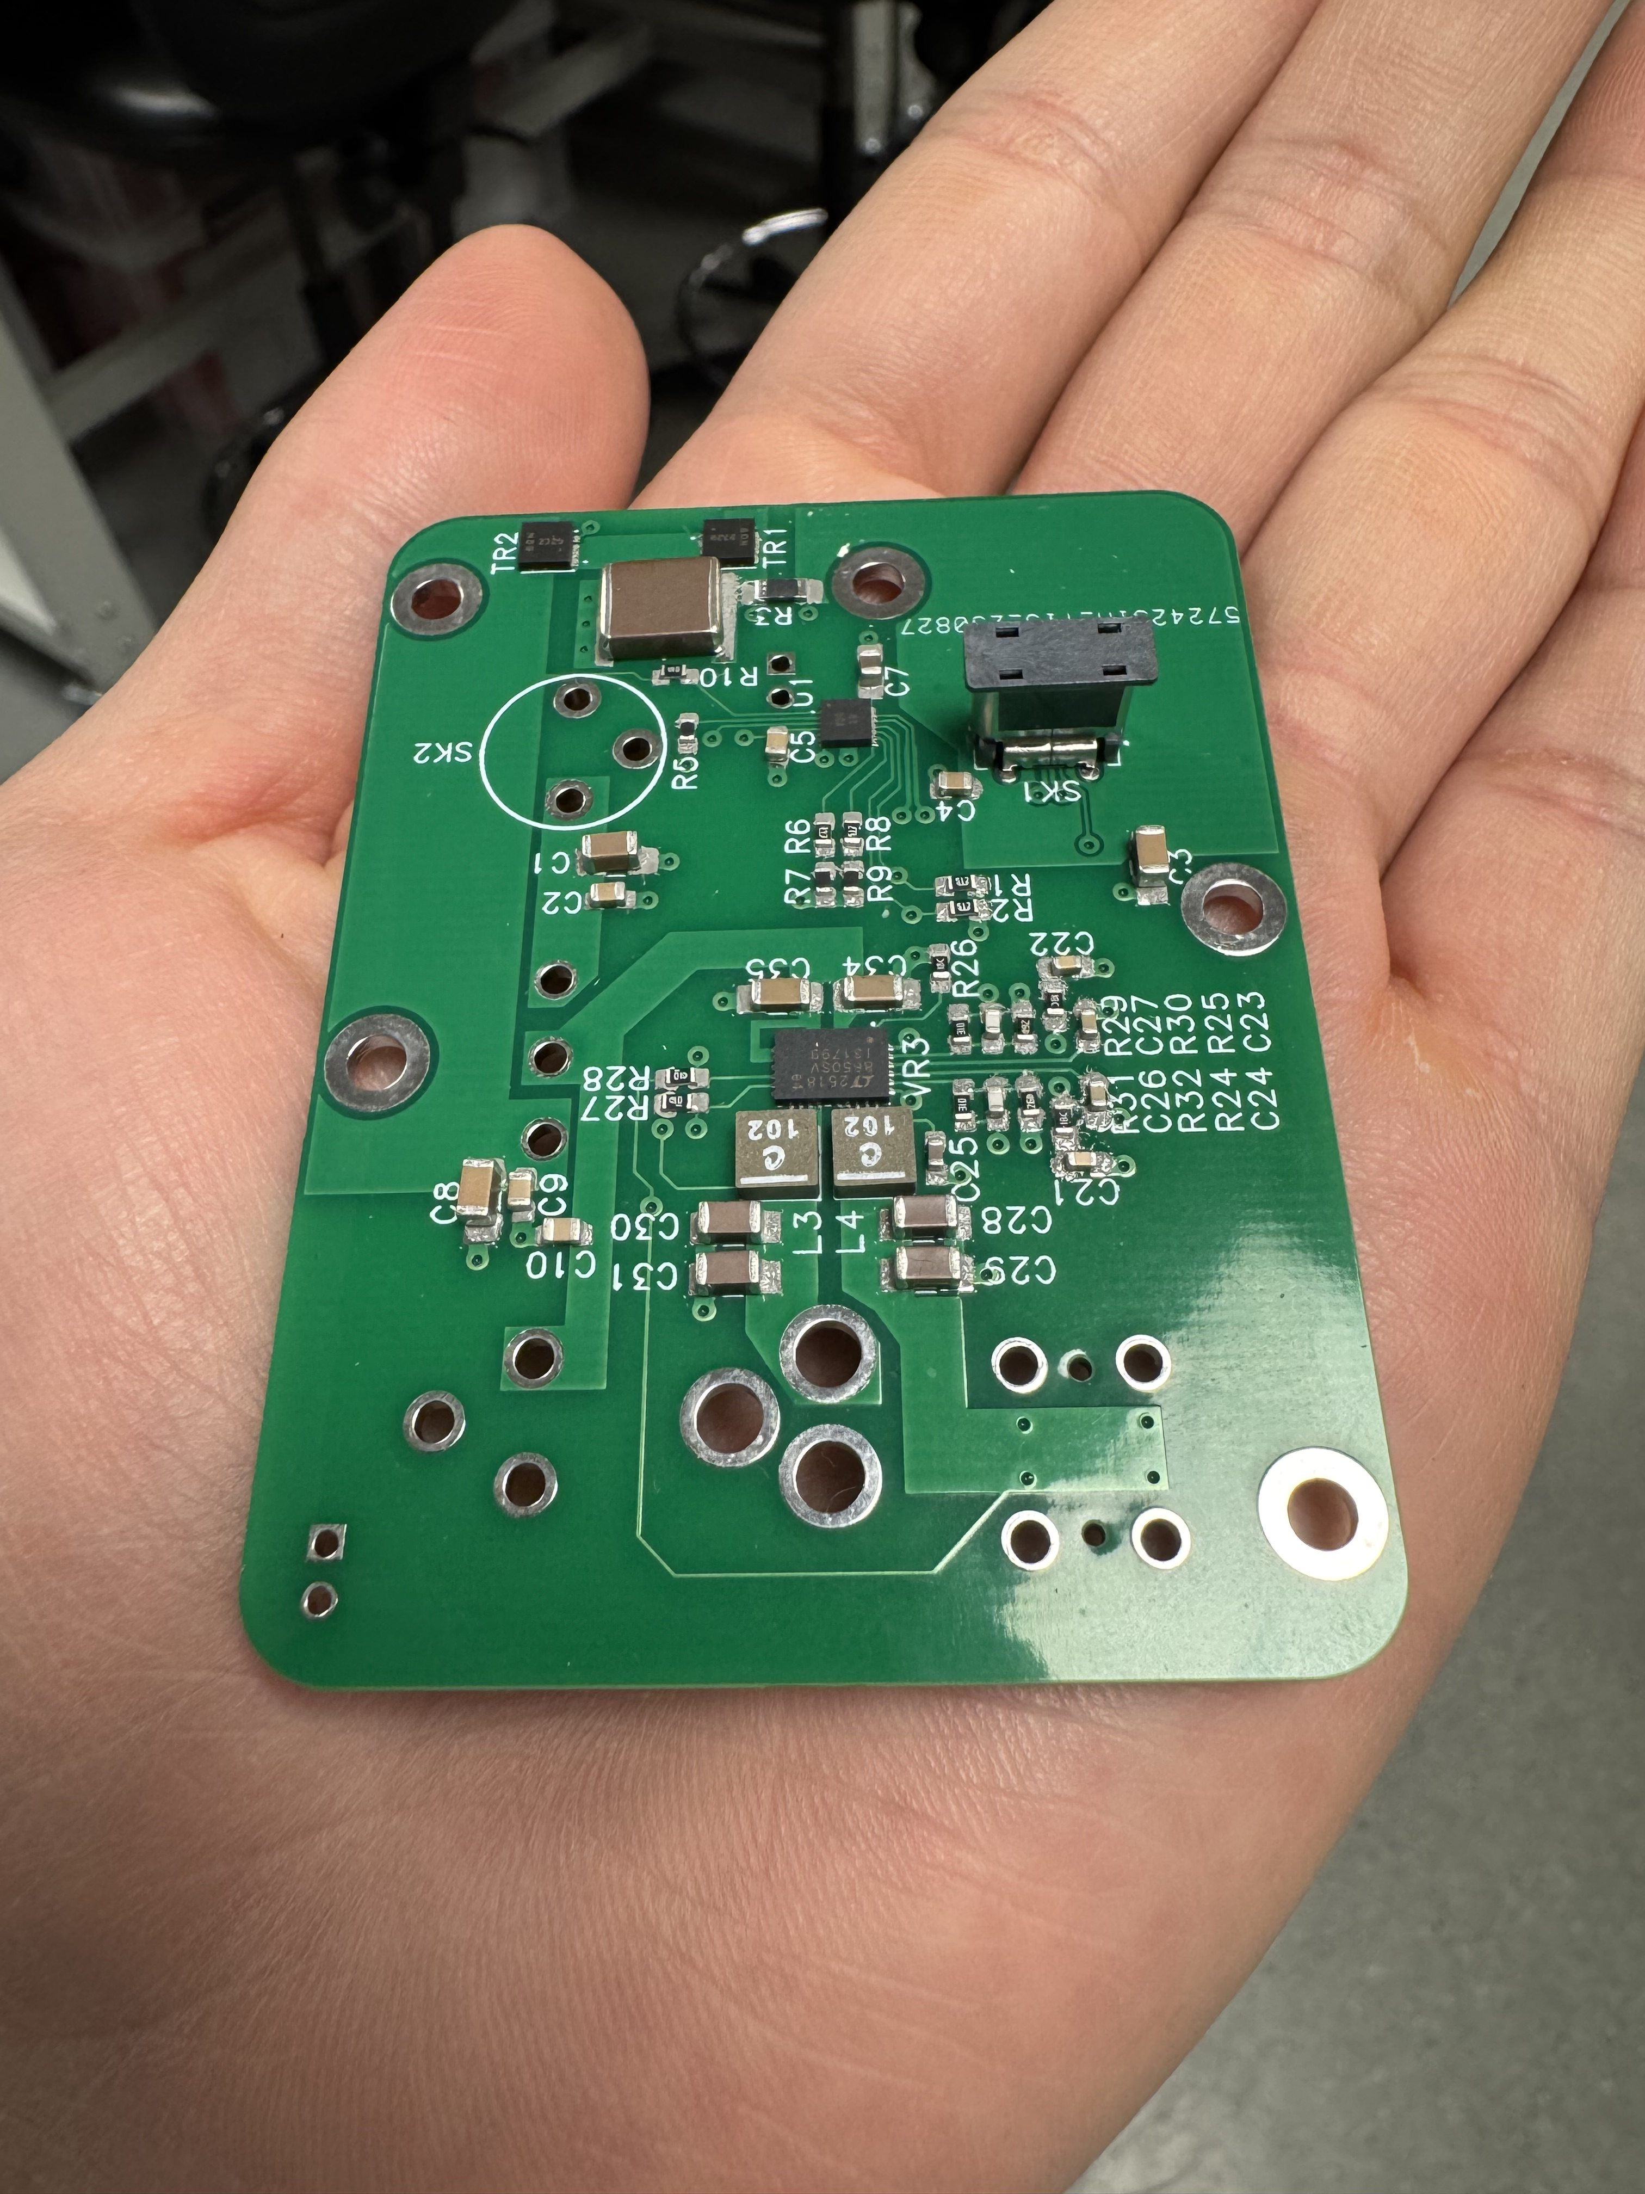
Background
USBC_PD board is designed to
  Reduce the cabling complexities within the detector.
  More stable supply across all devices without the need to renegotiates whenever a cable is being plugged or unplugged from the supply (minix case)
As per 26/09, 5 PCB boards have been assembled: 3 using the printed PCB provided from Pete (green coloured) and 2 using the hand crafted PCB at UCL (yellow-coppered coloured).
2 fully functional board. 1 functional but wrongly assembled, 1 busted out and 1 USBC port snap out

Slide 3
Timeline
06/08/25 – USBC PD board idea is proposed with some initial designs
15/08/25 - Design is finalized
28/08/25 – discuss things with EEE at UCL and further modified design from the original.
04/09/25 – BOM is listed and ready to purchased
12/09/25 – negatives purchased from microlitho
15/09/25 – 18 PCBs are ready to be populated
19/09/25 – all components arrived from Farnell, mouser
23/09/25 – first PCB board populated and tested
25/09/25 - 4 more PCB board populated and tested

Slide 4
Feature
Input Supply:
  USB-C: 100W (20V 5A must be exact otherwise negotiating failed)
  DC Barrel Jack: 20V 5A max, but for the board to function, 9V 3A min.
Switch to determine which input supply to use: either USBC or DC Barrel Jack
Output:
  USBC: 5.2V
  DC barrel: 5.2V
  DC barrel: input voltage rating

Slide 5
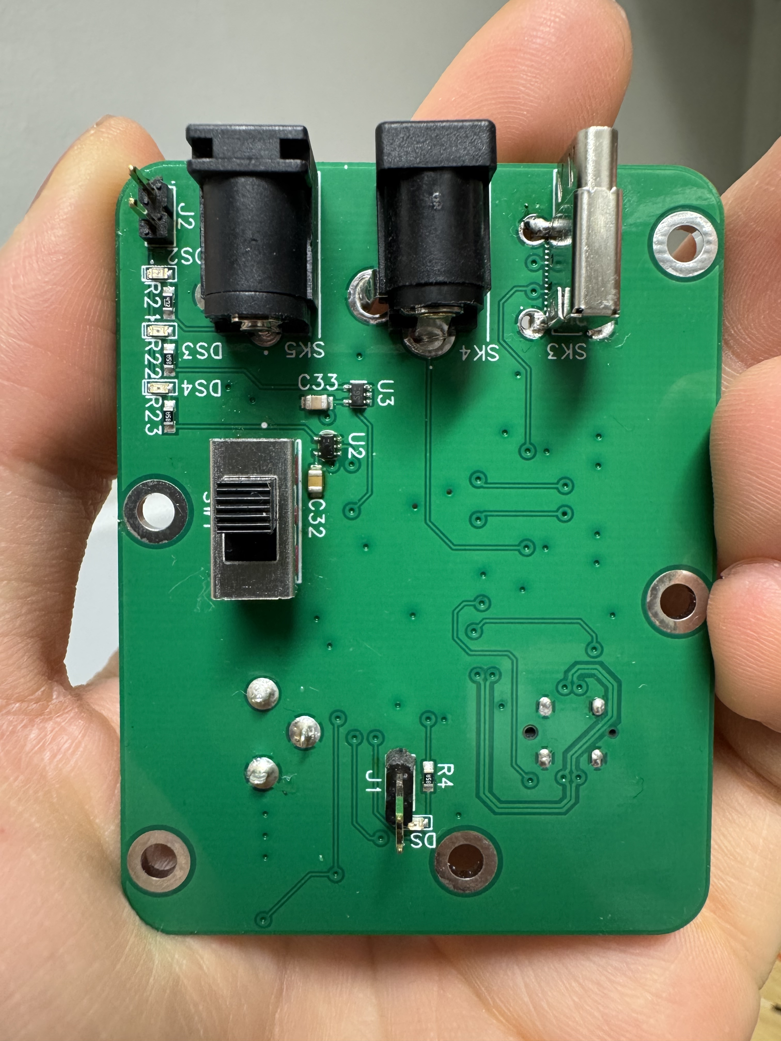
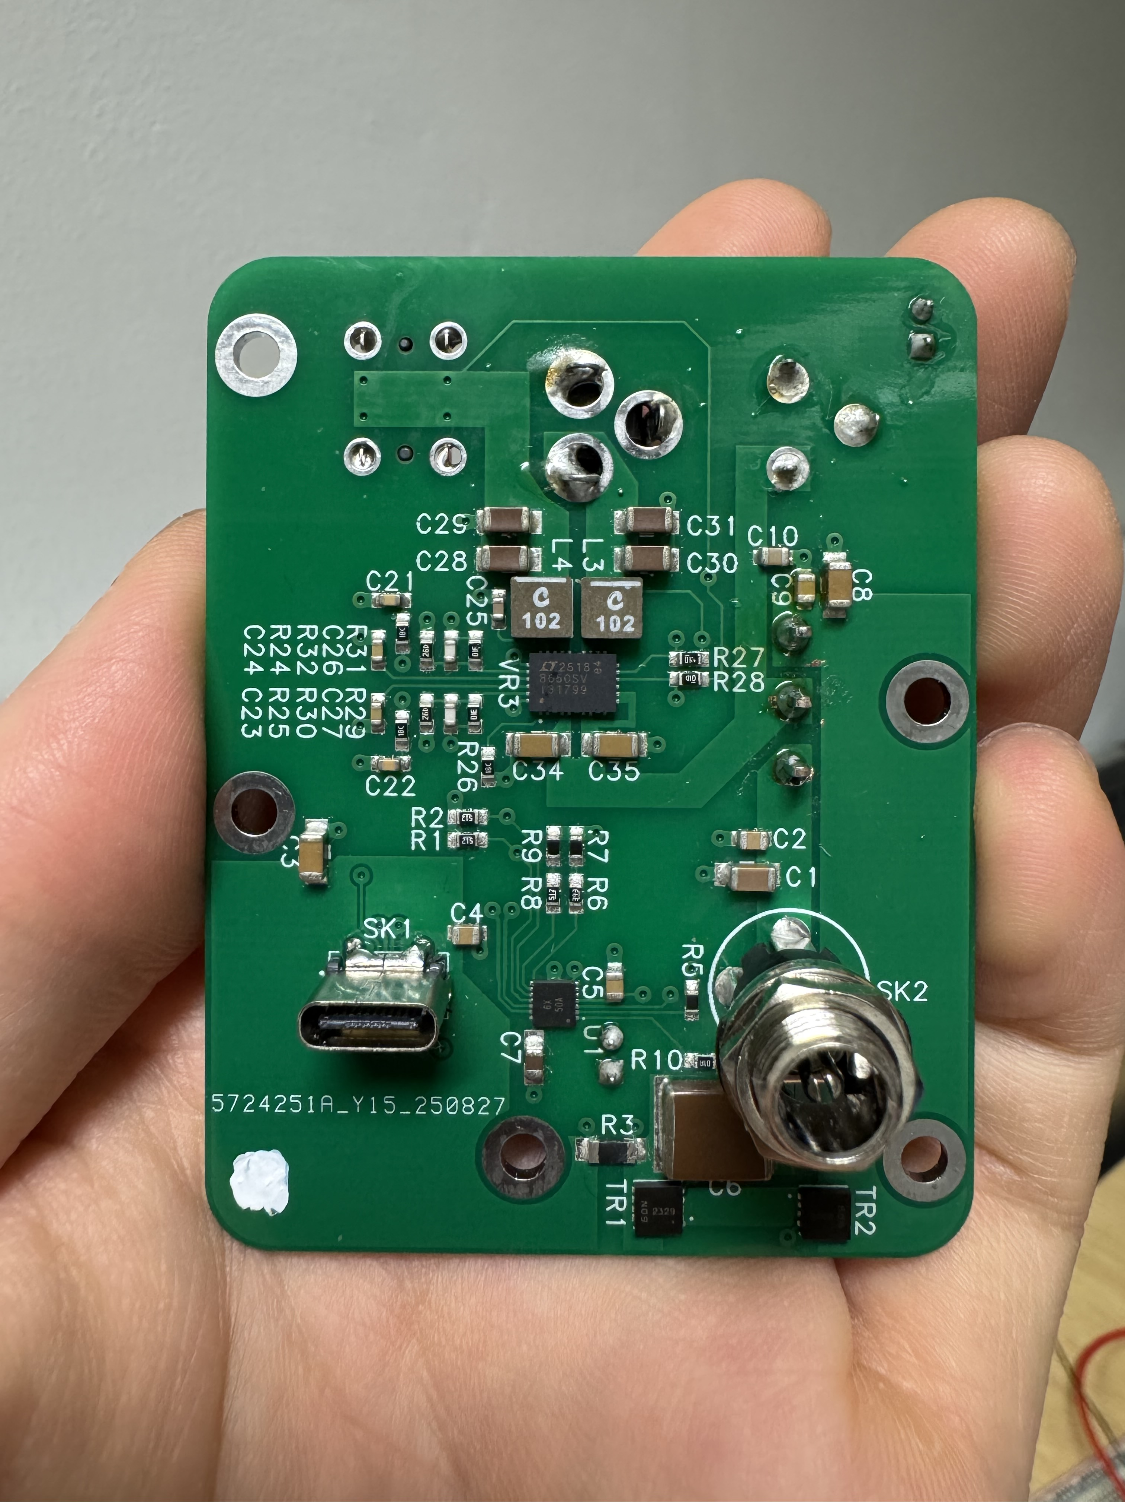
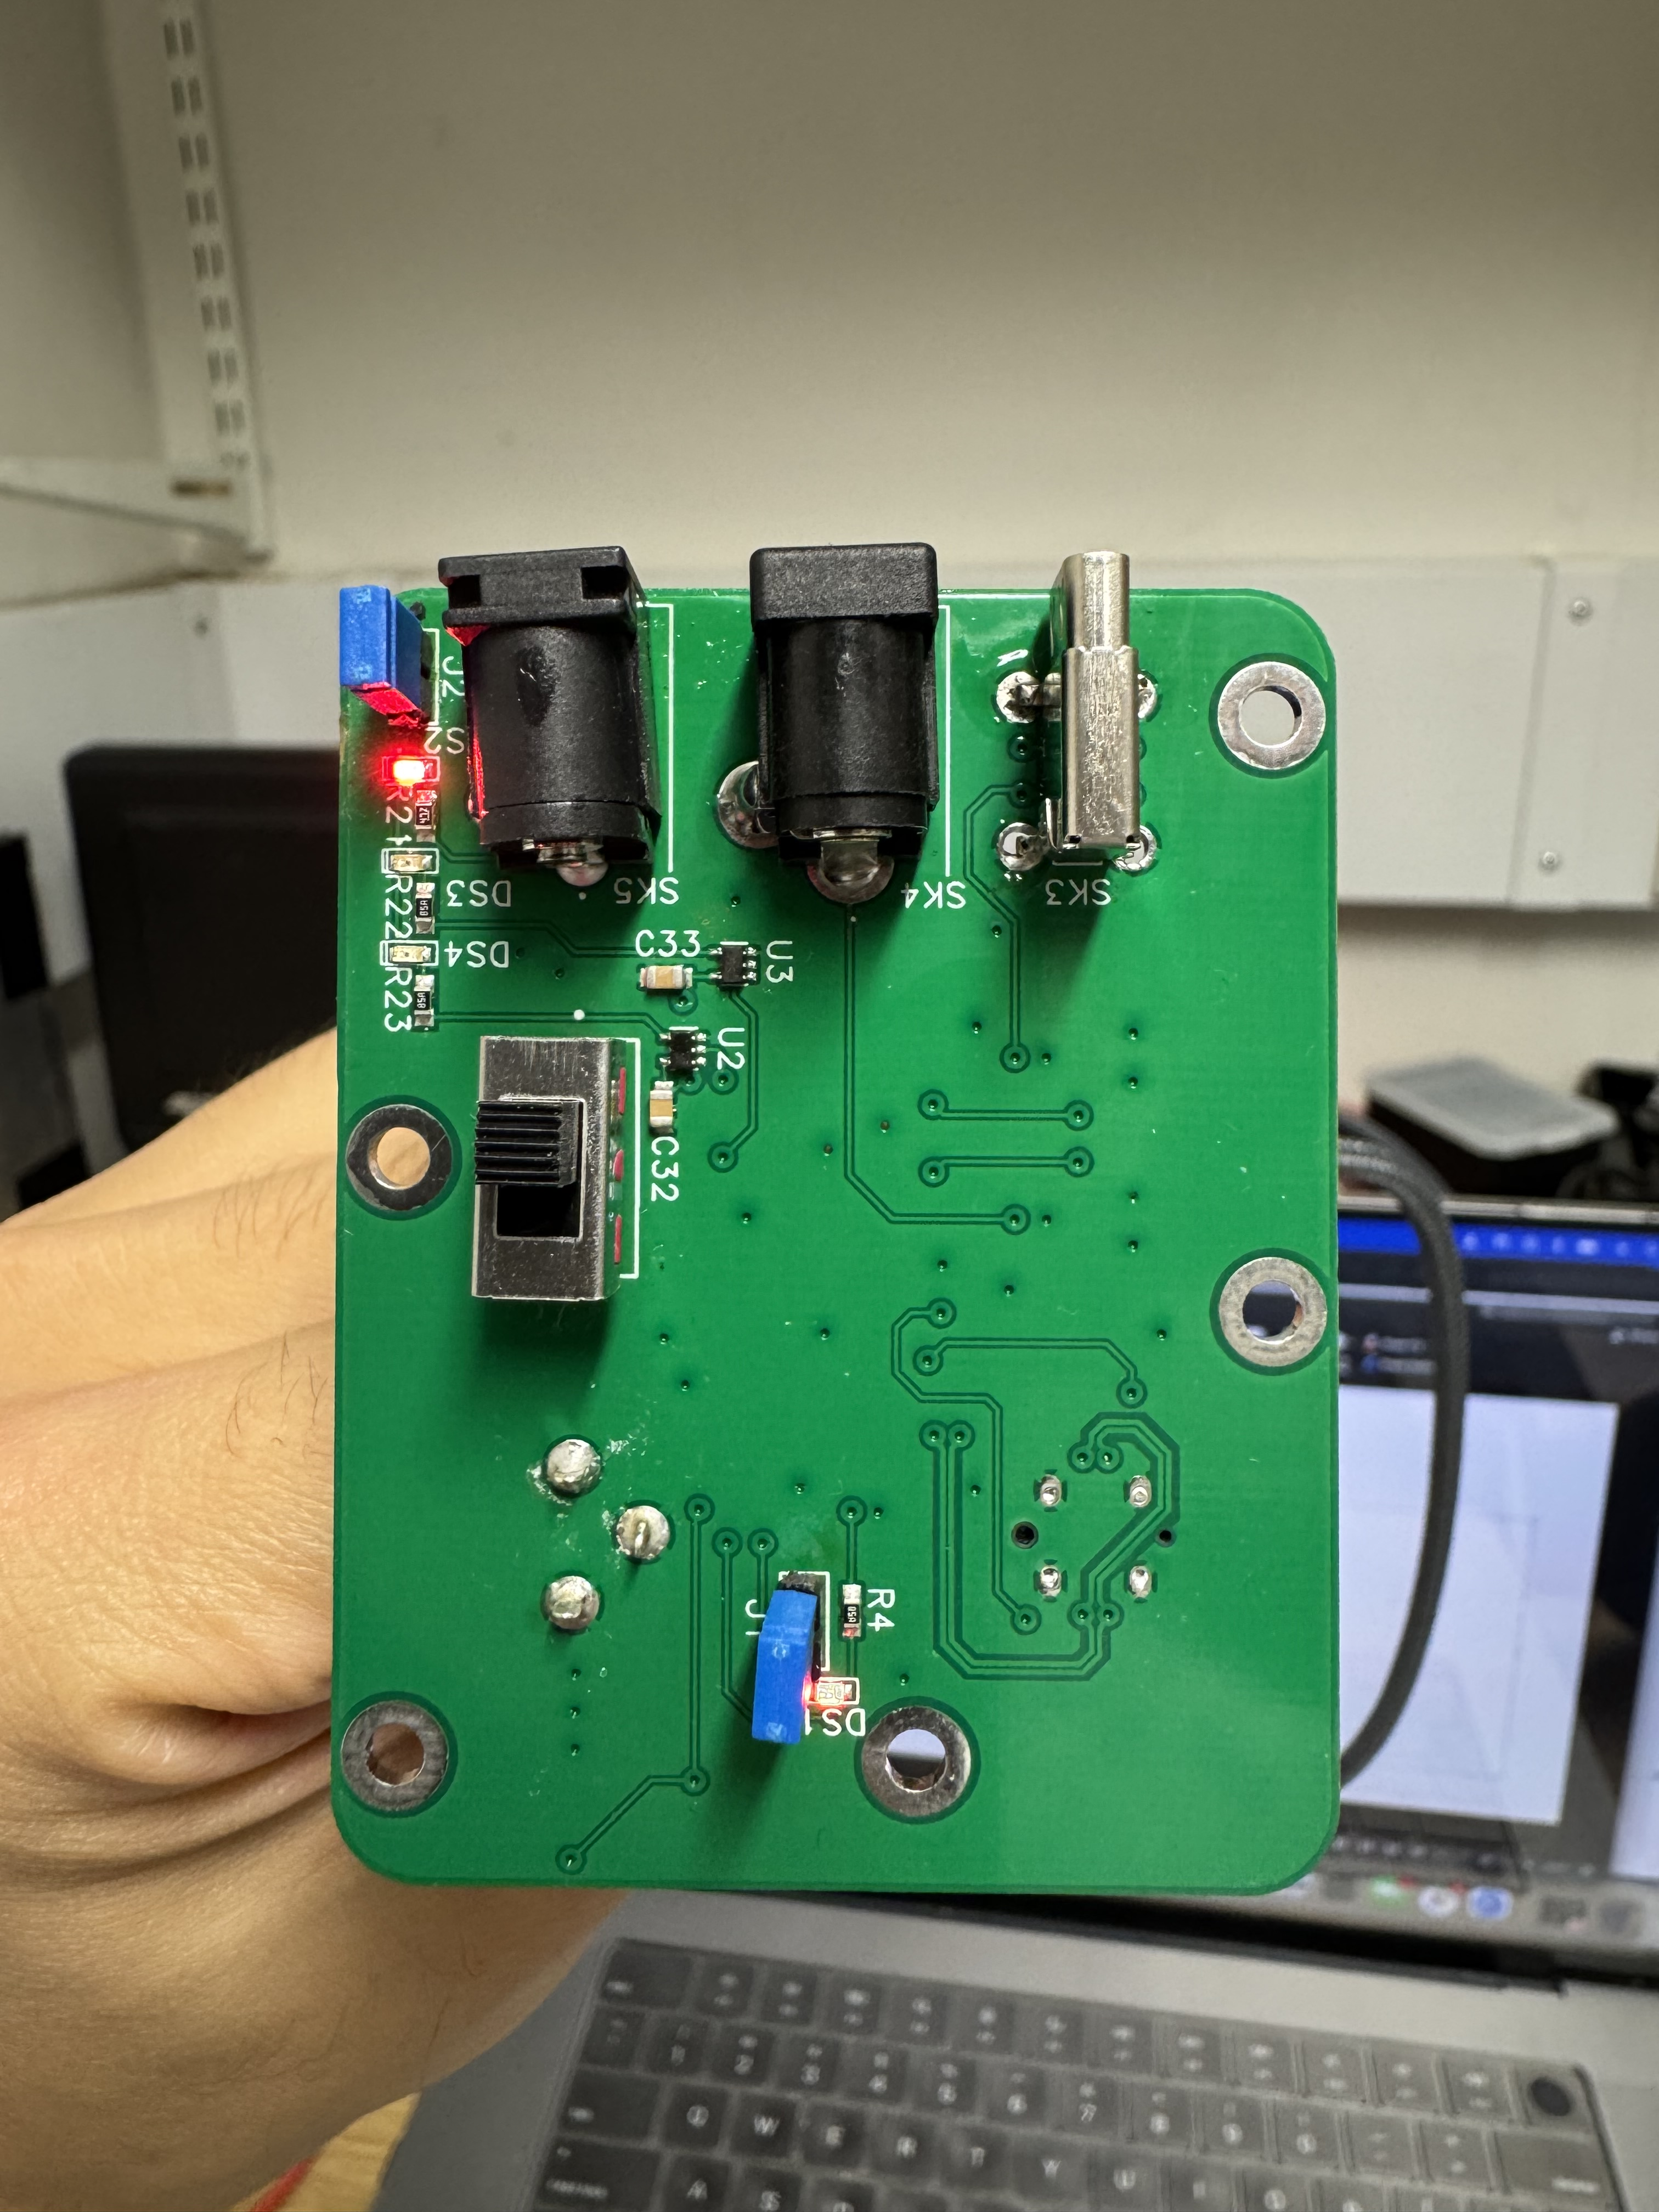
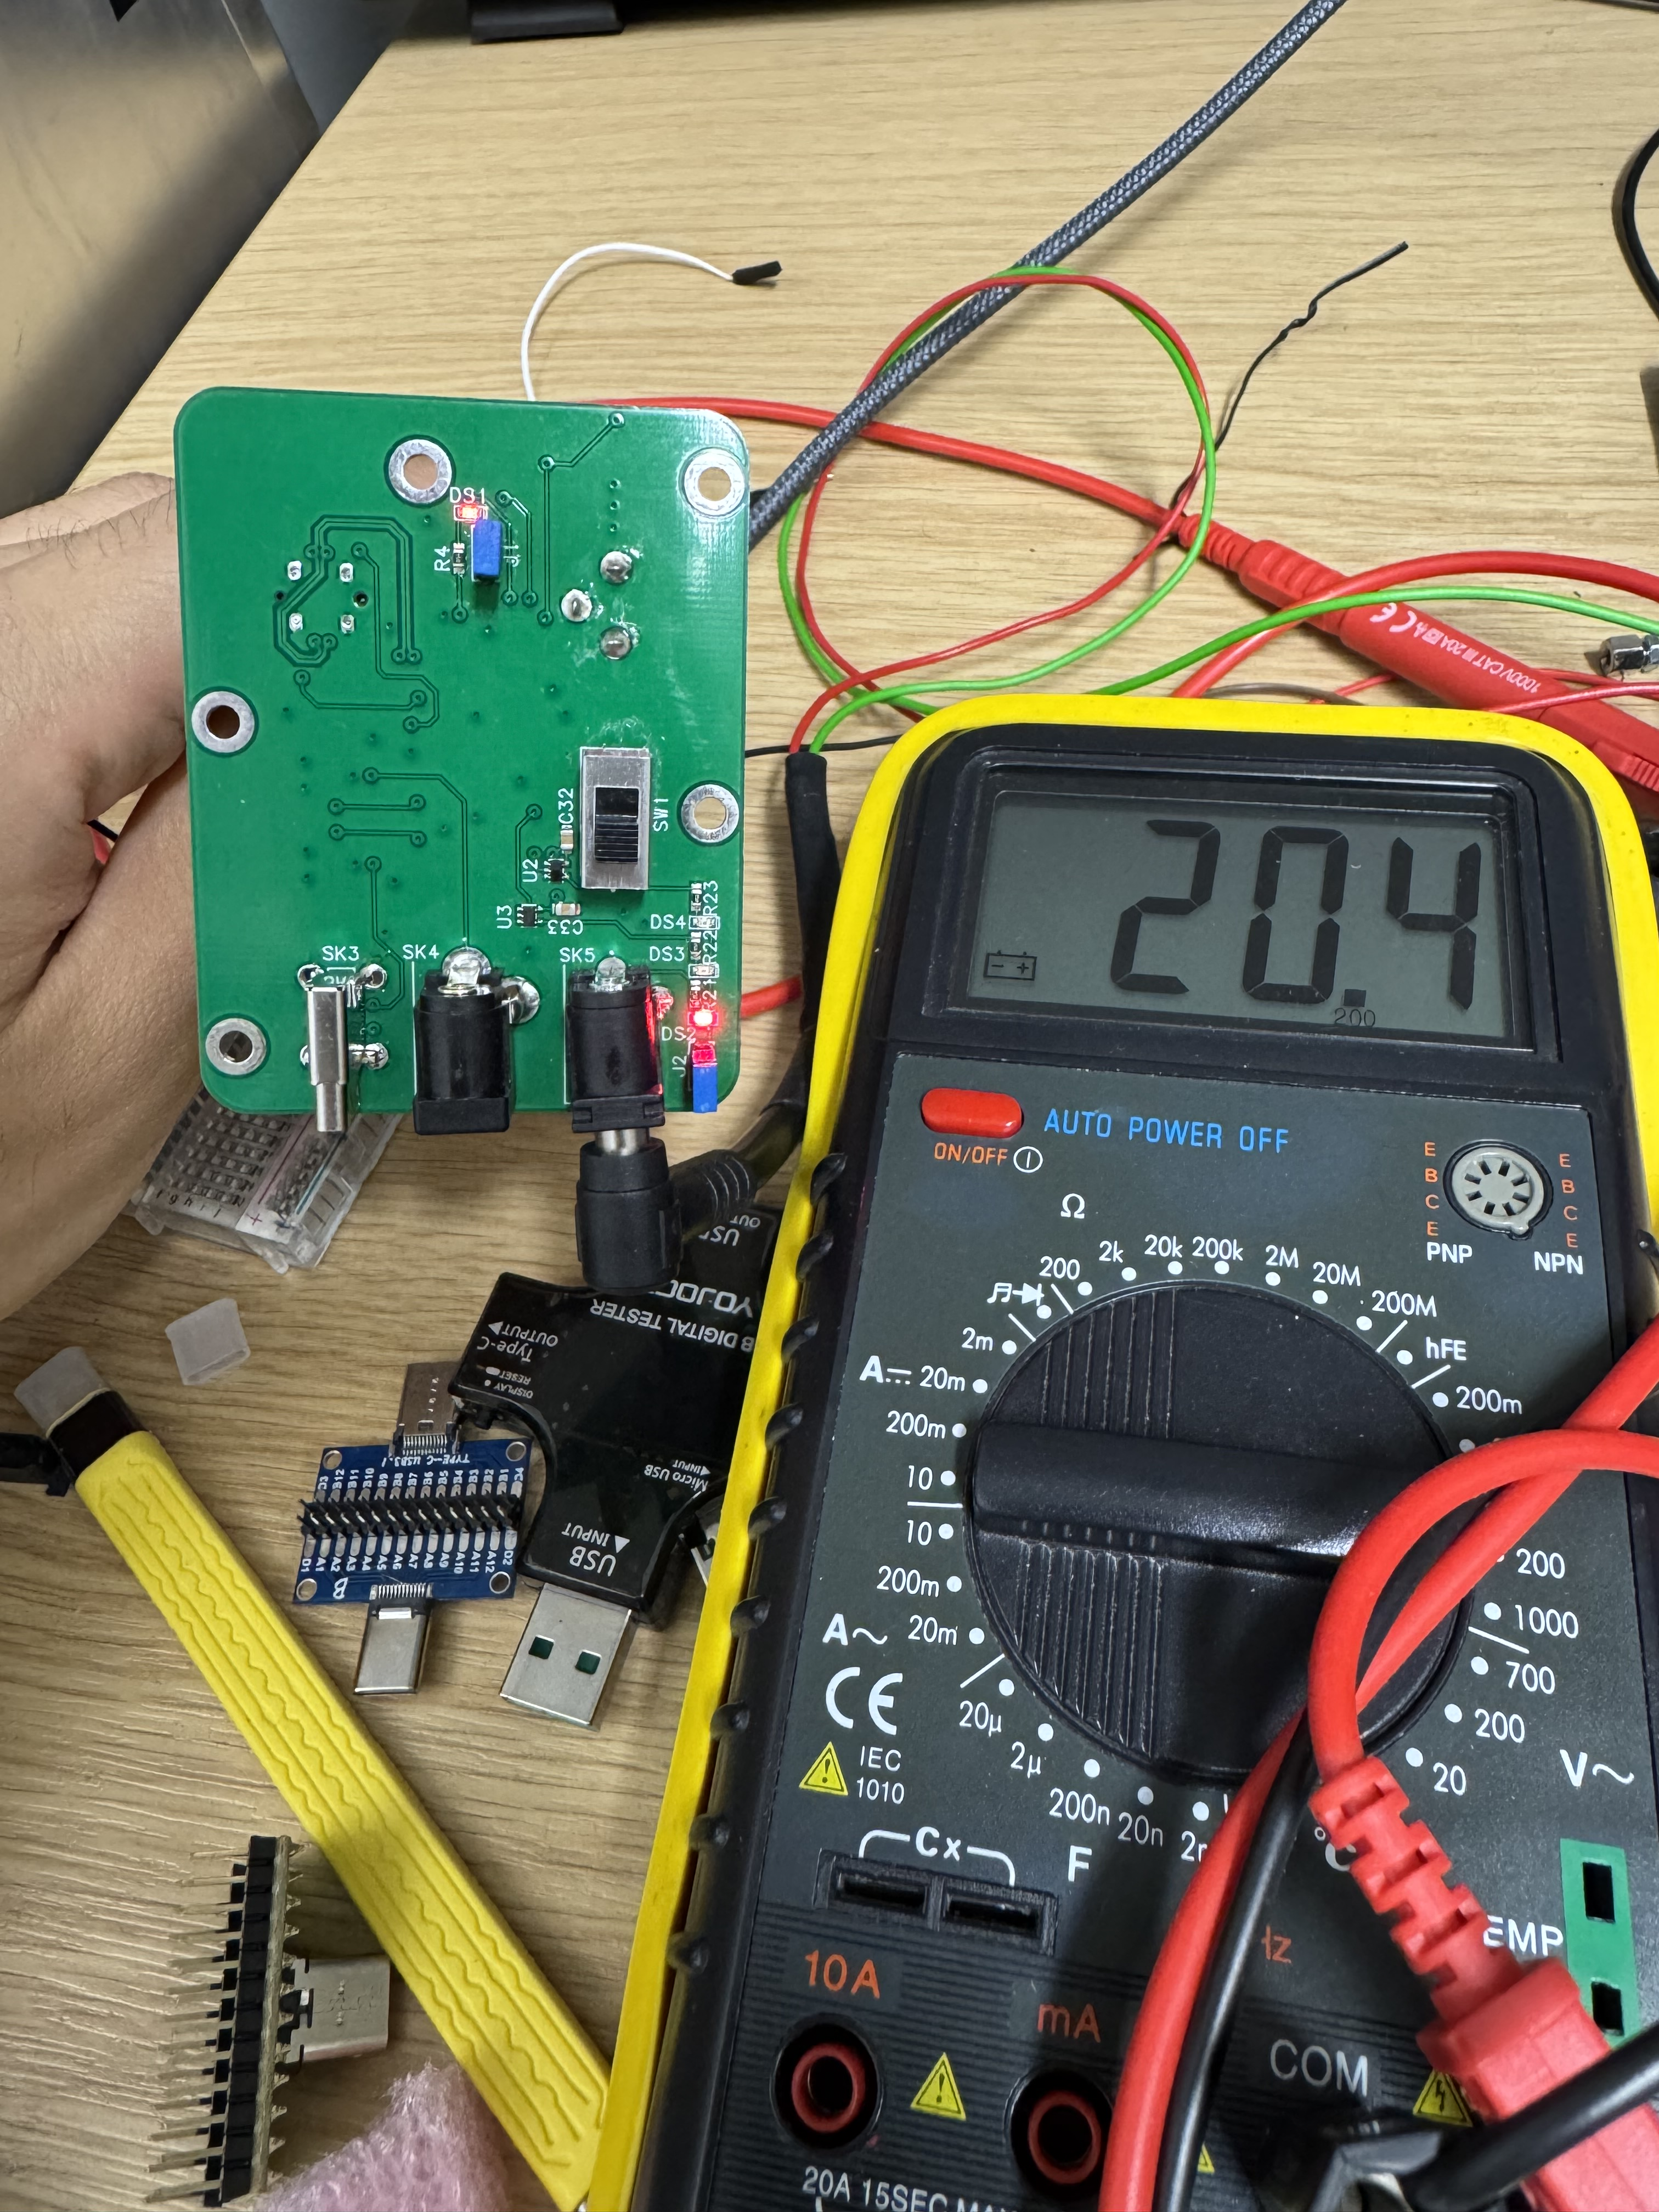
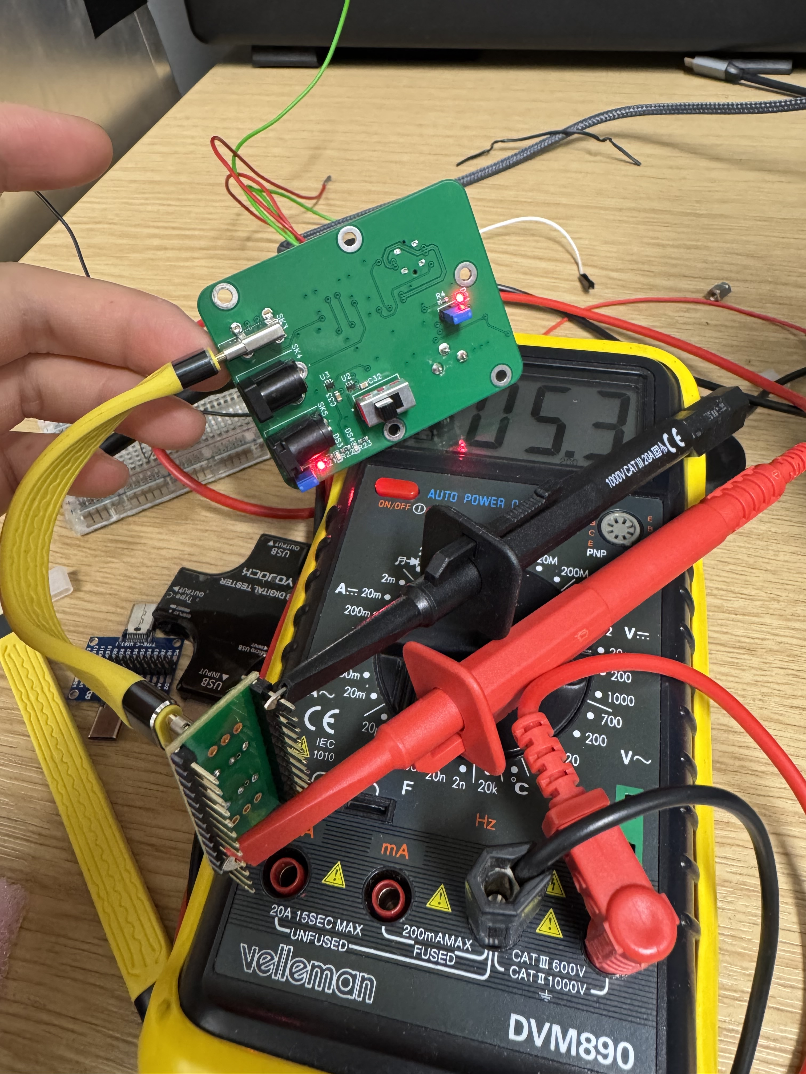
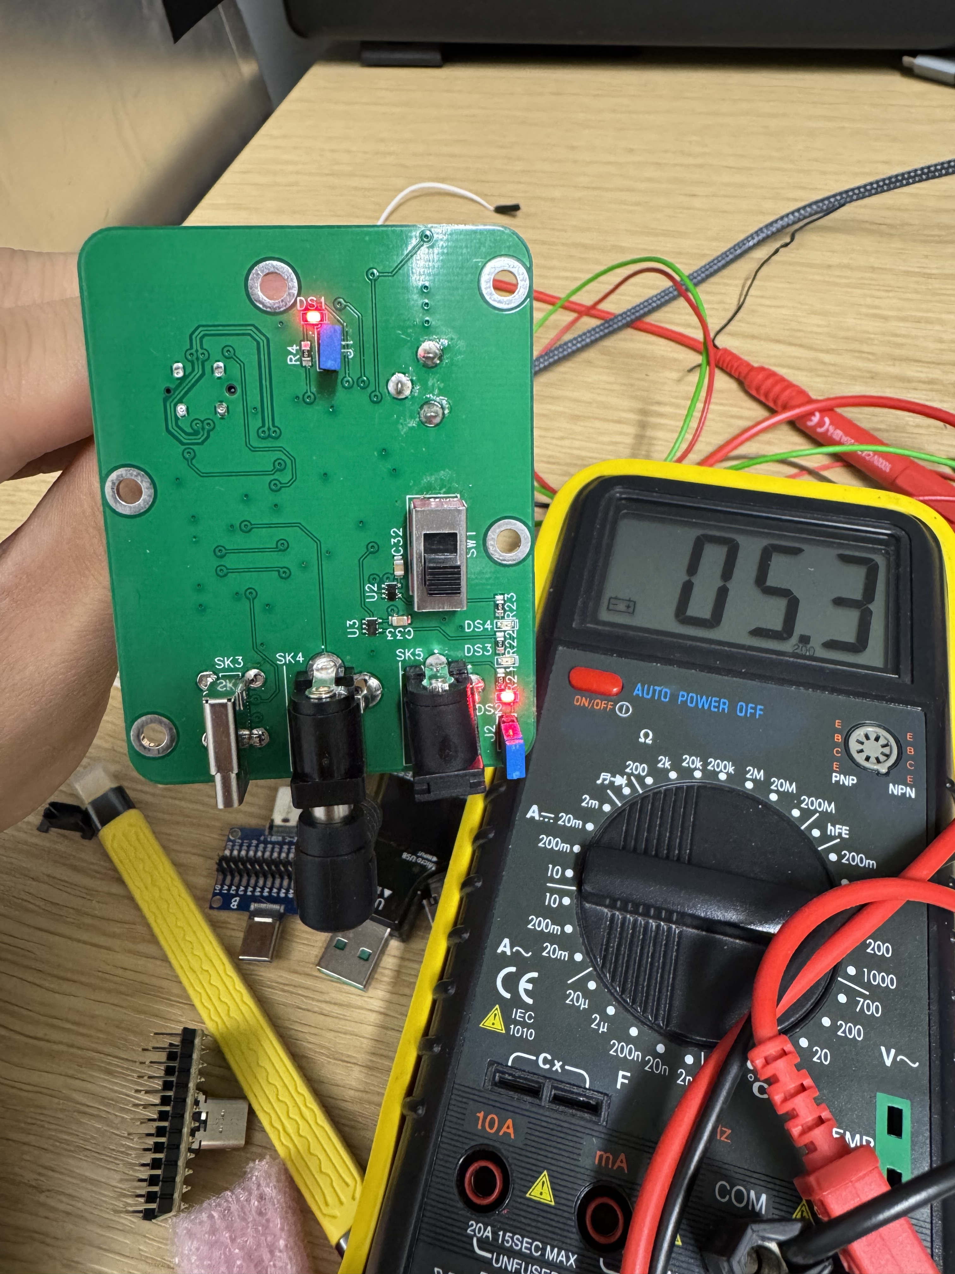
Boards picture
Final board looks and LED indicator
USBC PD Tested as expected

Slide 6
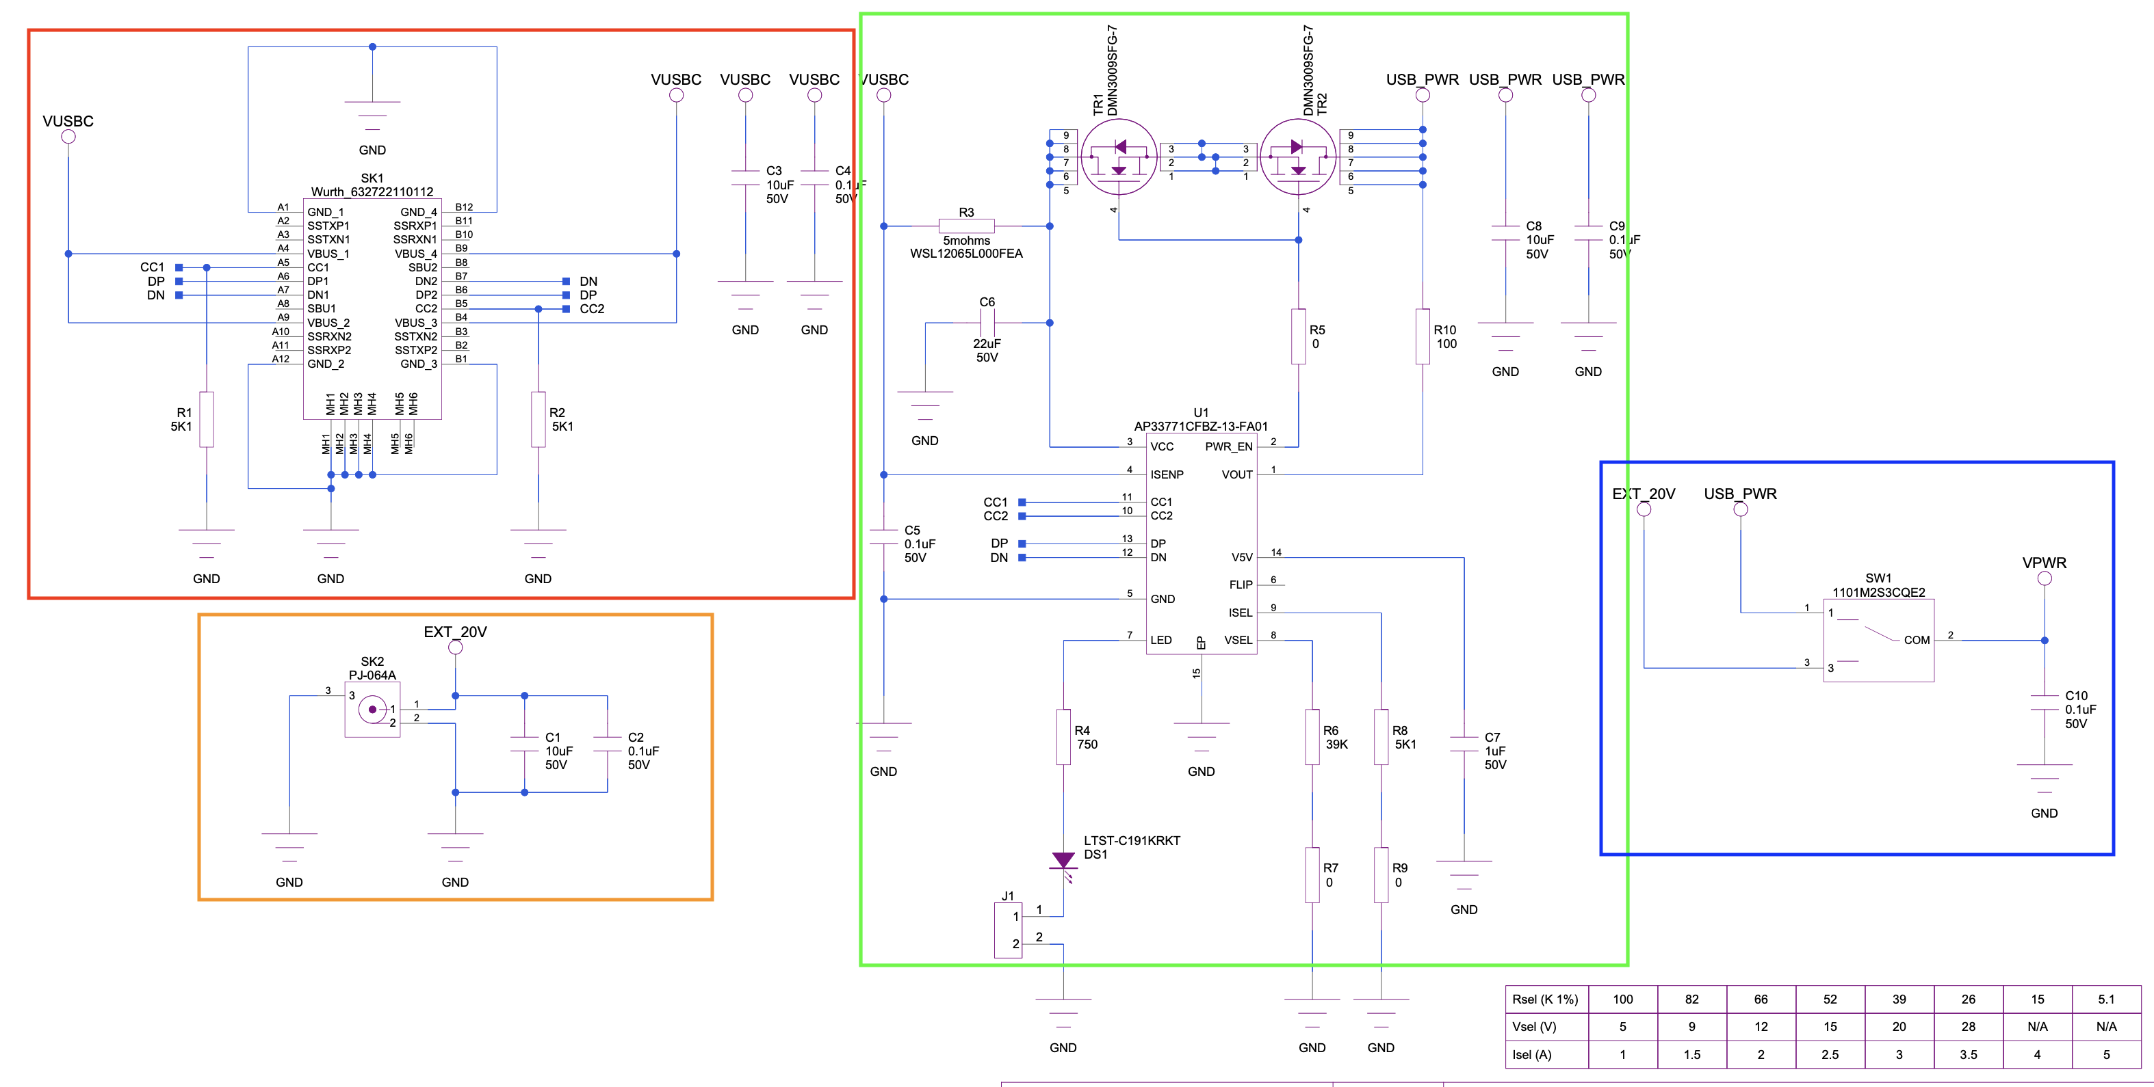
Design
Input USBC Connector, SK1, is connected to IC AP33771CFBZ, U1, which is USBC sink IC that deals with the power negotiation, Shown on the table the Rsel and Isel, is selected so that USBC connector negotiates 20V 5A.
U1 has a built in LED that indicates the negotiation status, if the LED remains on, means negotiating failed (mismatch V/I input).
If it successful, it will blink at a rate of once per 4s. When negotiation failed there will be no output (0V) at the output port.
The input DC barrel jack, SK2, is connected directly to the SW1. The voltage input from USBC power (USB_PWR) and DC barrel jack (EXT_20V) is selected by SW1, given output VPWR

Slide 7
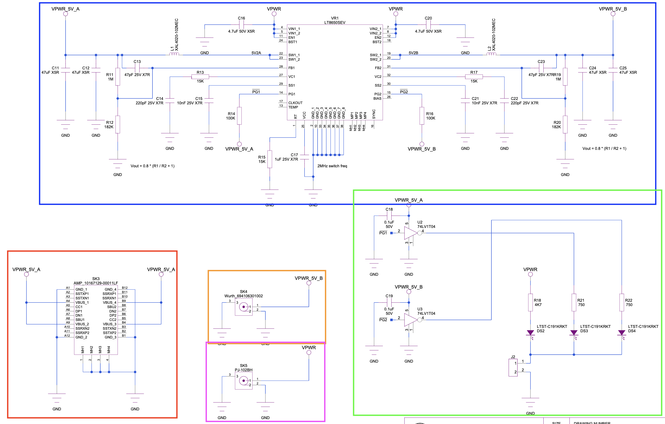
The blue box, IC LT8650 SE, It’s a step down voltage regulator that deal with producing the clean 5.2V output for both USBC and DC Barrel jack .
The output then being supplied out from USBC port SK3 and DC barrel jack SK4
The output VPWR is supplied out directly from SK5.
The green box shows the use of LED for debugging purposes. However, DS3 and DS4 which should indicates there is Voutput from SK3 and SK4, does not function.

Slide 8
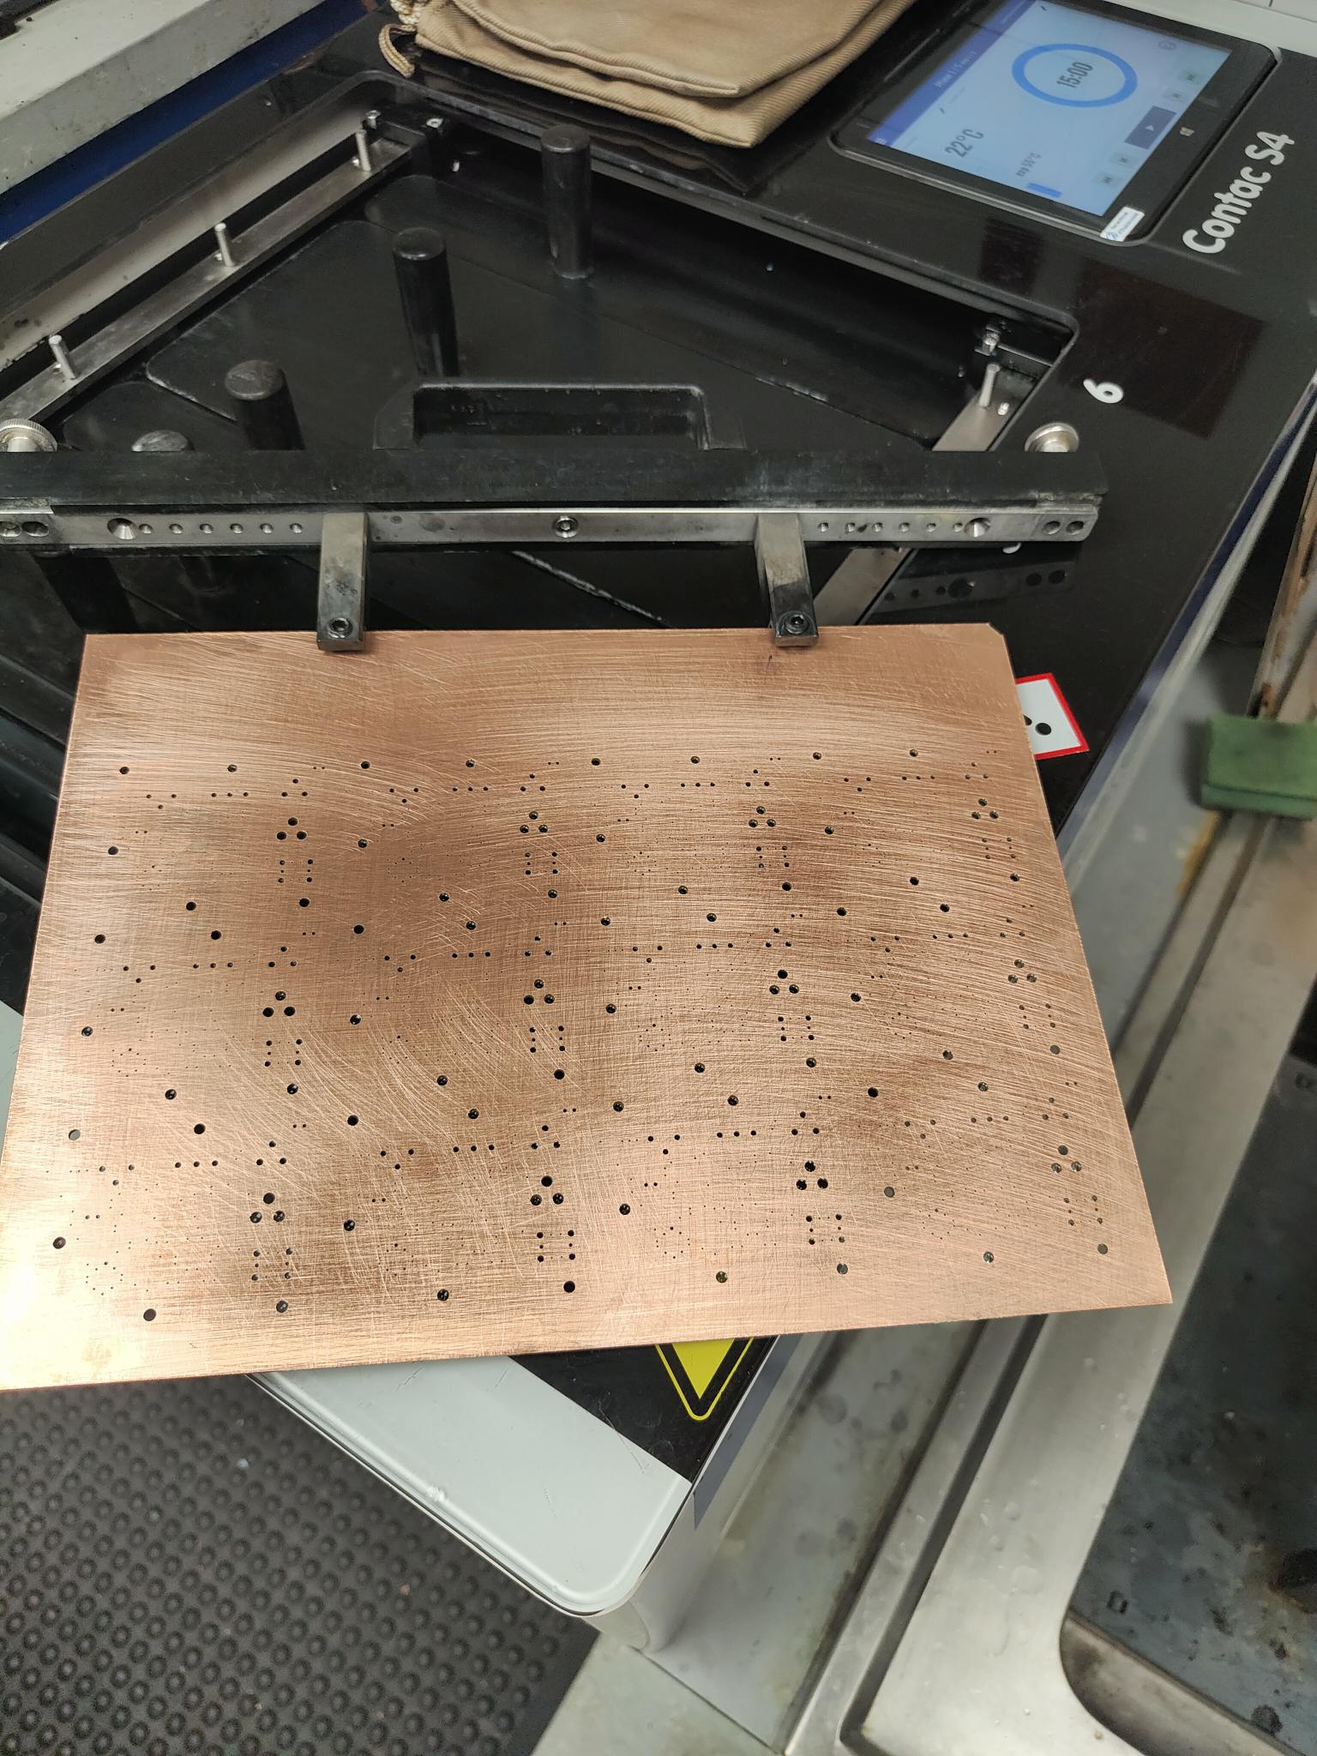
PCB Fabrication Process
Base Material: Start with FR4 board (fiberglass reinforced epoxy, copper-clad on one or both sides).
Cutting & Cleaning
  Cut the PCB to the designed for the PCB vias and holes.
  Clean the copper surface to remove oxidation, grease, and dust (chemical cleaning or scrubbing with water).
Carbonising (optional for vias / pads)
  Apply carbon ink to certain pads/vias if conductive carbon finish is required.
Plating: Ensure correct copper thickness (e.g., 1 oz/ft²), via electrolytic copper plating
Lamination / Photoresist Application
  Apply a photosensitive resist film (dry film or liquid).
  Ensures only desired copper remains after exposure and development.

Slide 9
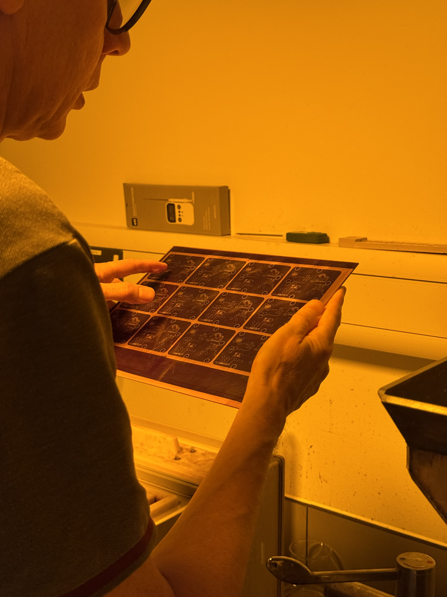
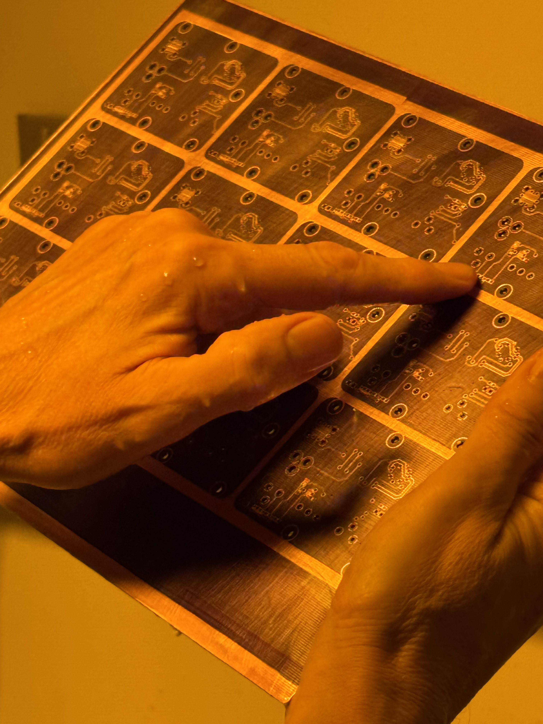
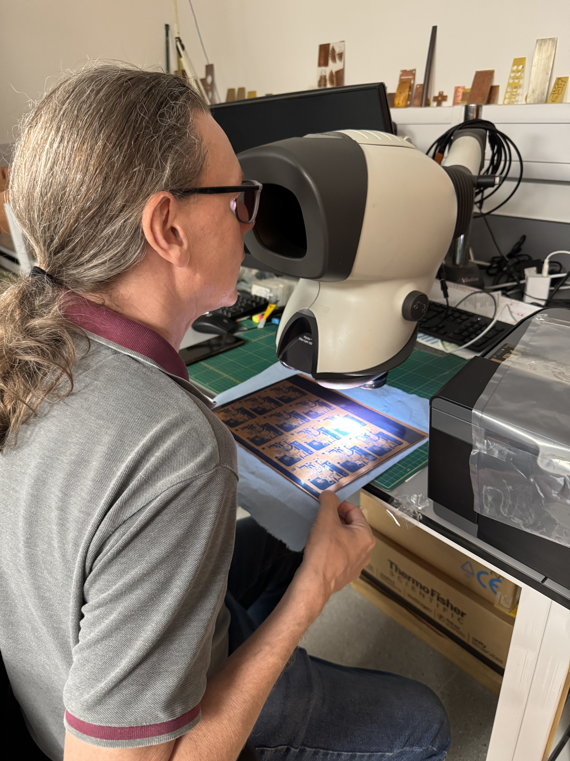
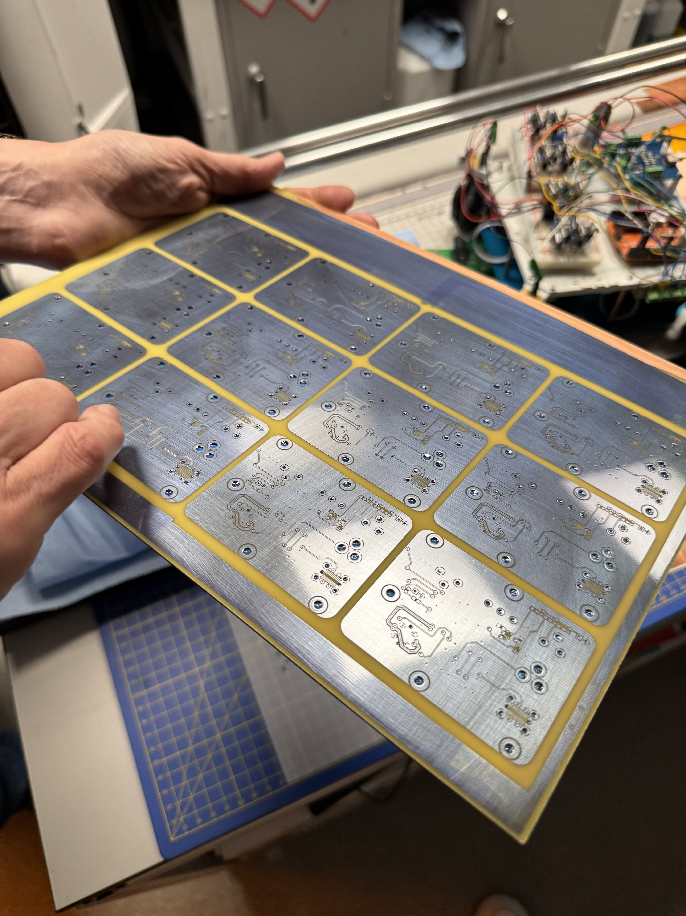
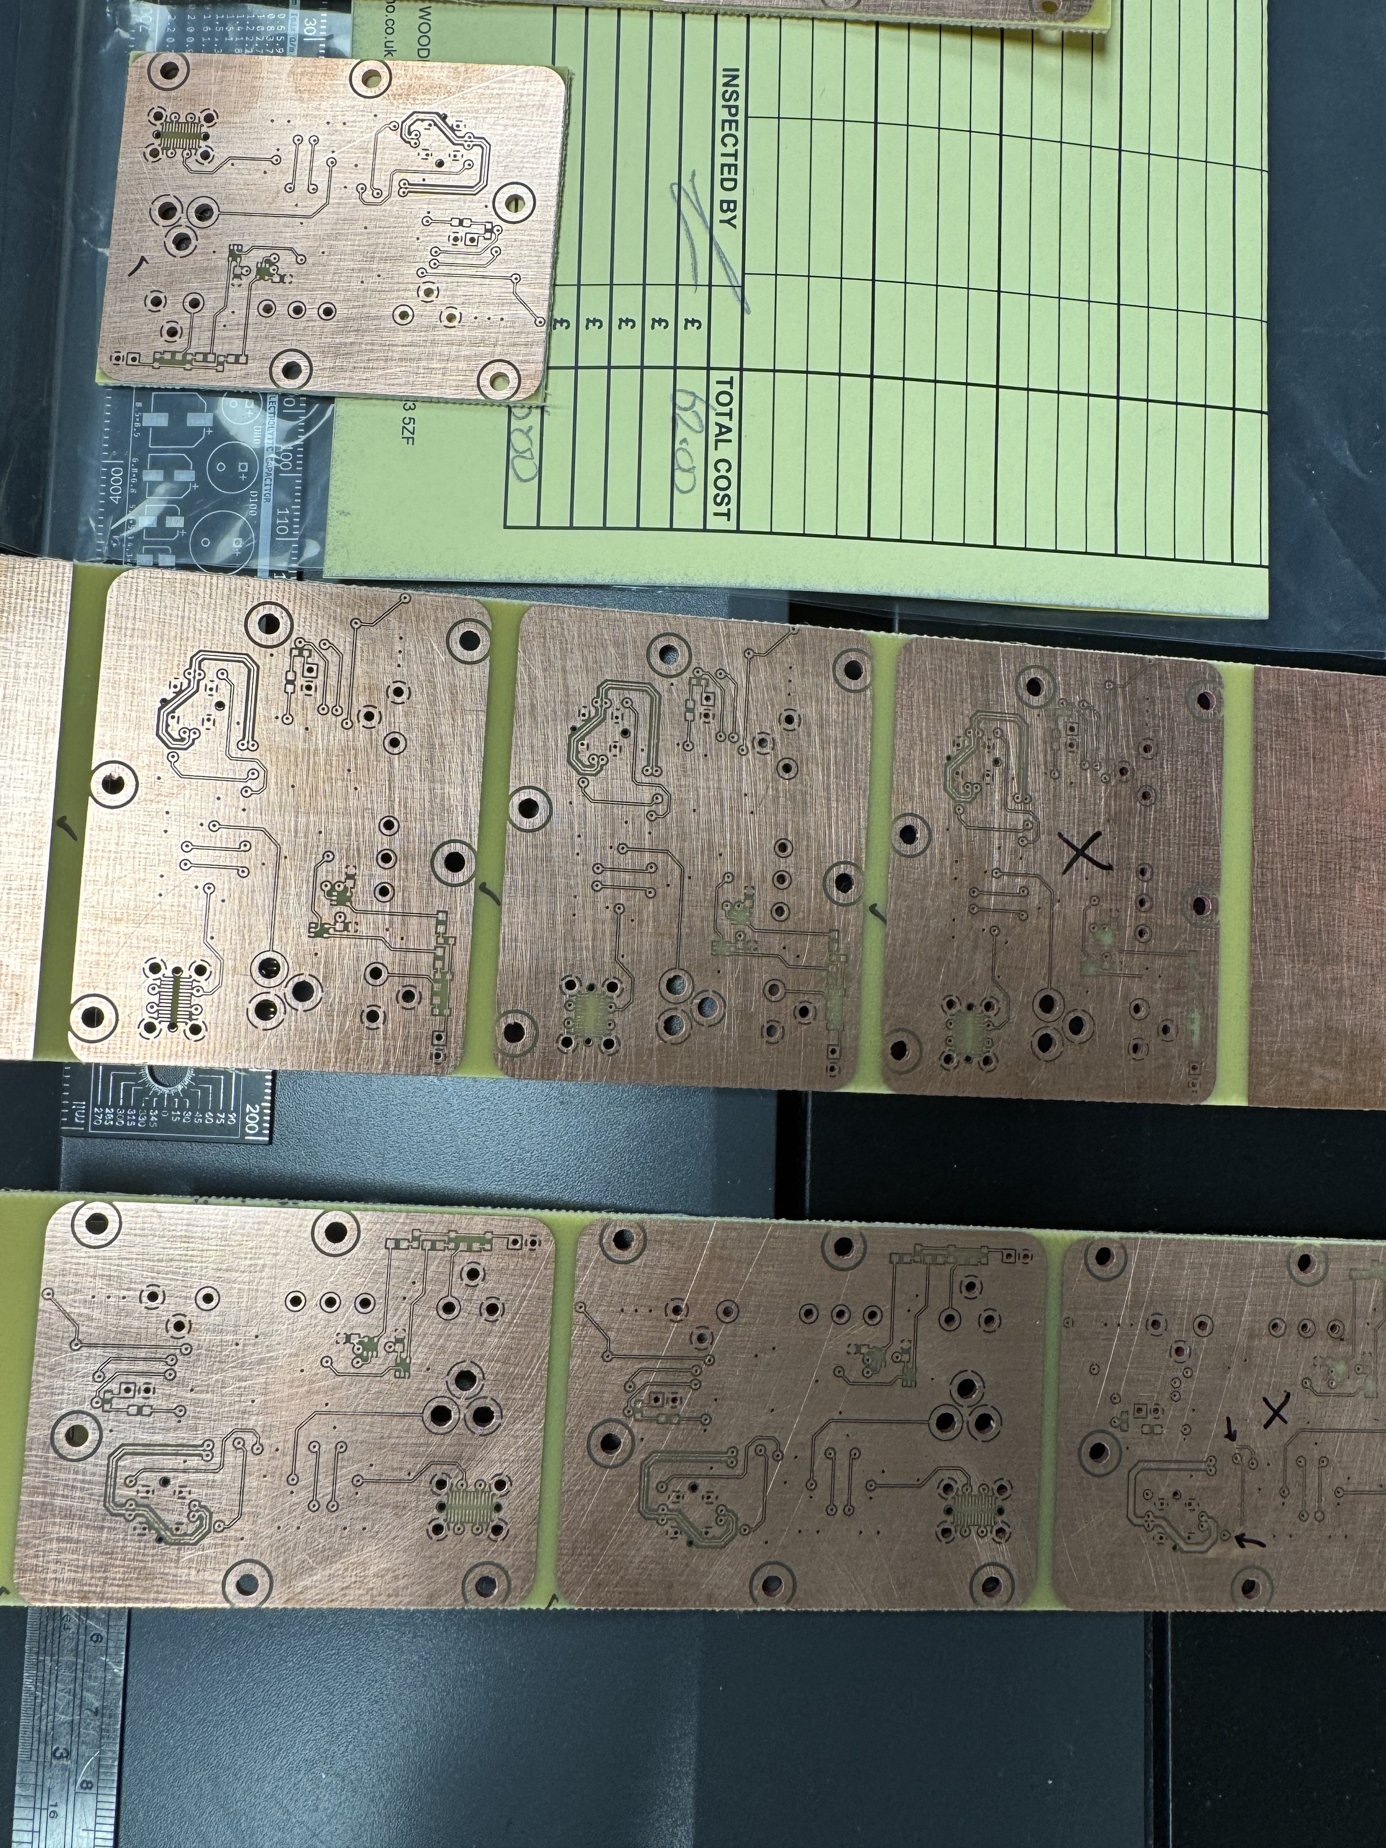
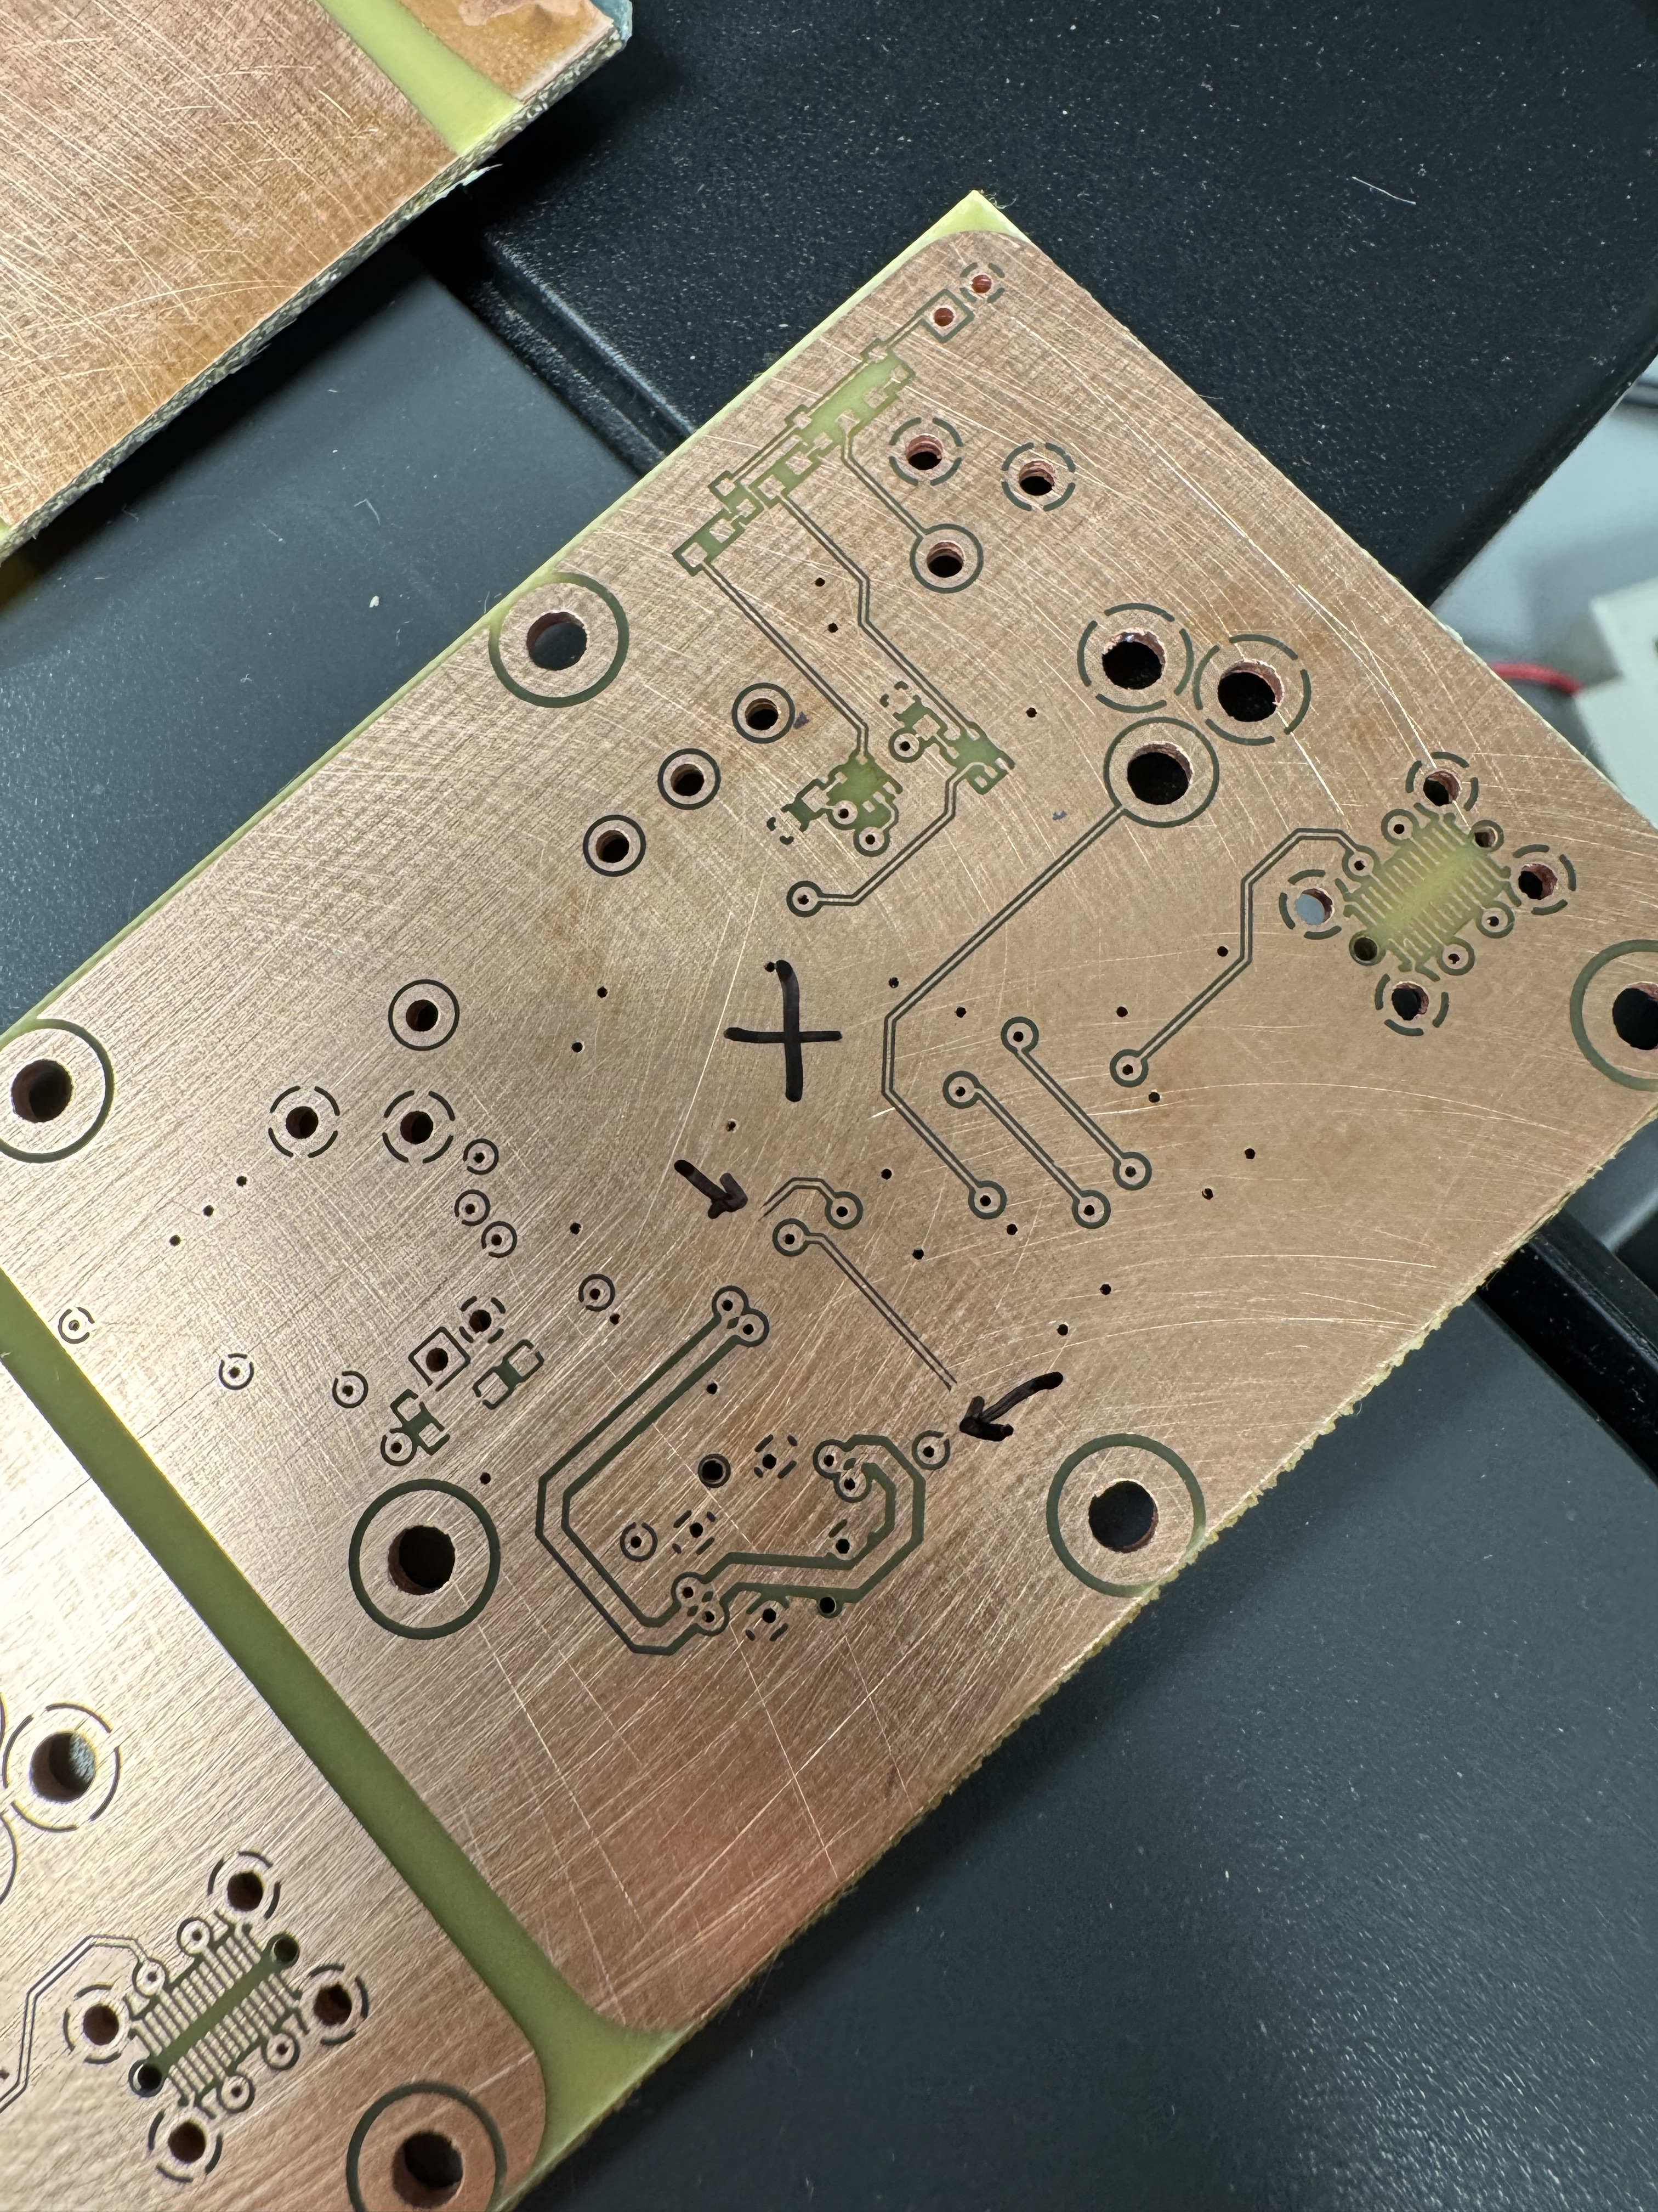
PCB Fabrication Process
Imaging with Negatives / Mask
  Use a photomask (negative) with the PCB trace design.
  UV light exposure hardens the resist on copper areas to be preserved.
  Developing removes unexposed resist, leaving copper traces protected.
Etching
  Immerse board in etchant (ferric chloride, ammonium persulfate, or alkaline etchant) to remove the copper
  Unprotected copper dissolves, leaving only circuit pattern
  Rinse thoroughly after etching. Ensure they are dry
  If Copper remains, can manually etch using scalpel
Soak in heavy alkaline solution, to remove photoresist film.
  Once this done, can see whether the board is good or not
Oven Curing / Baking
  Boards are baked to remove moisture and harden coatings.
  Improves reliability before assembly.

Slide 10
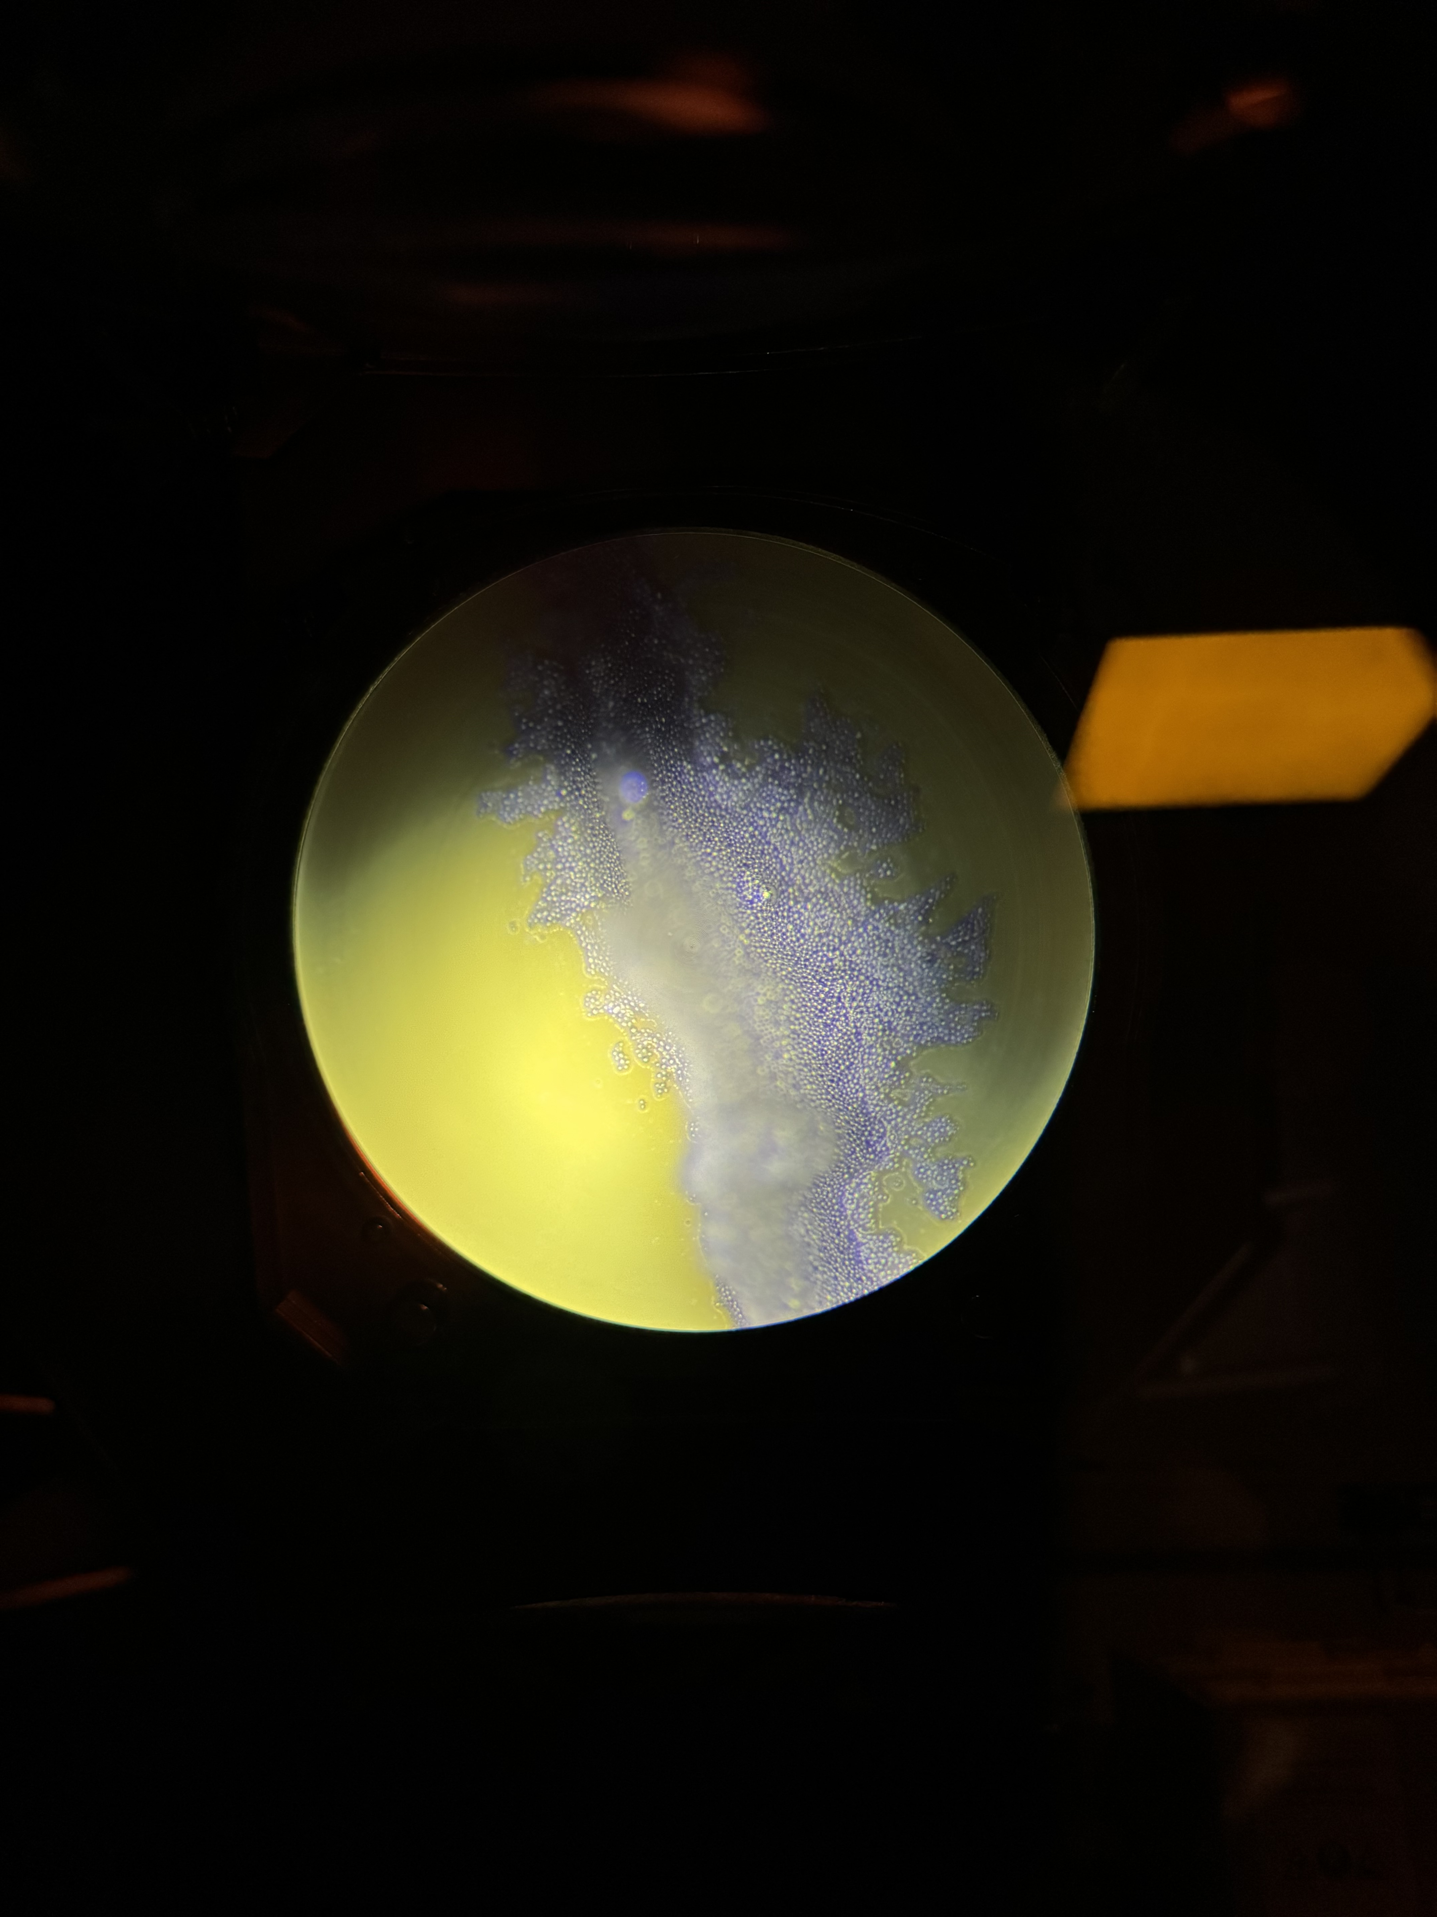
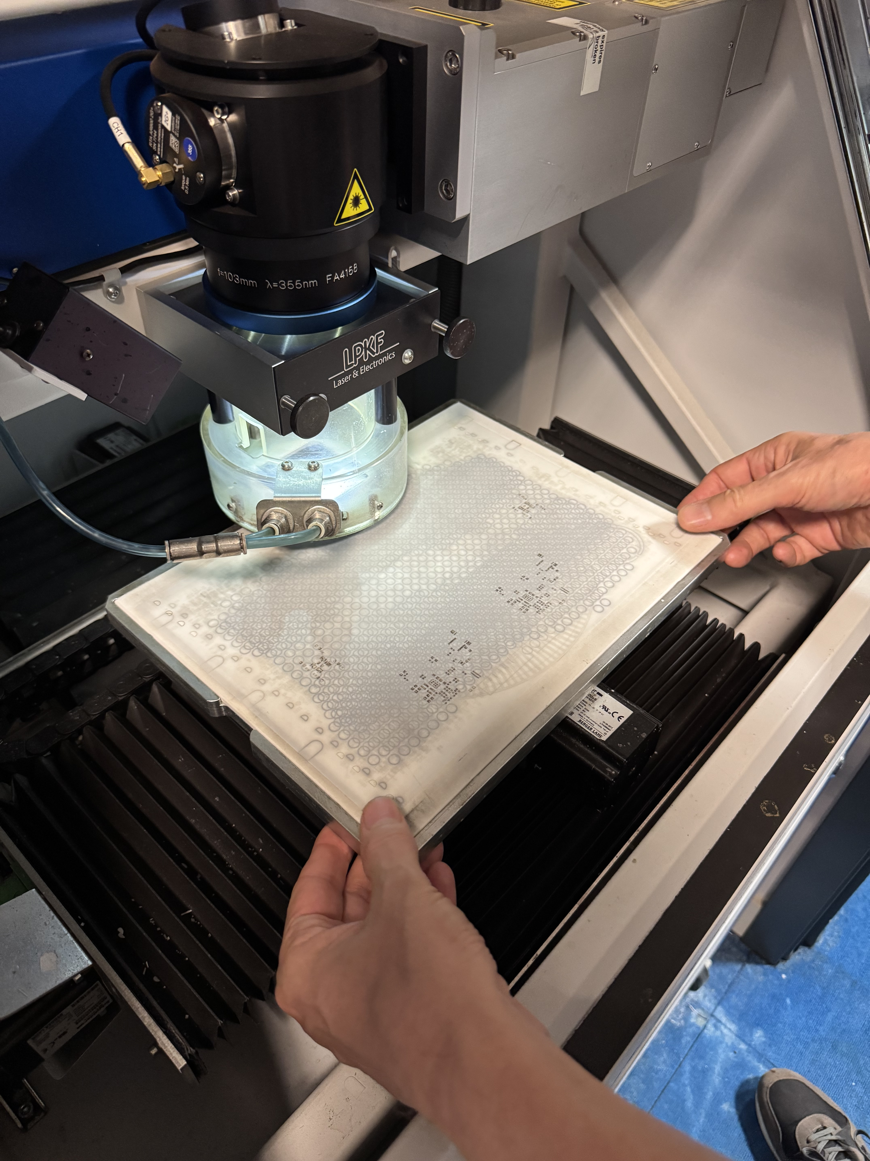
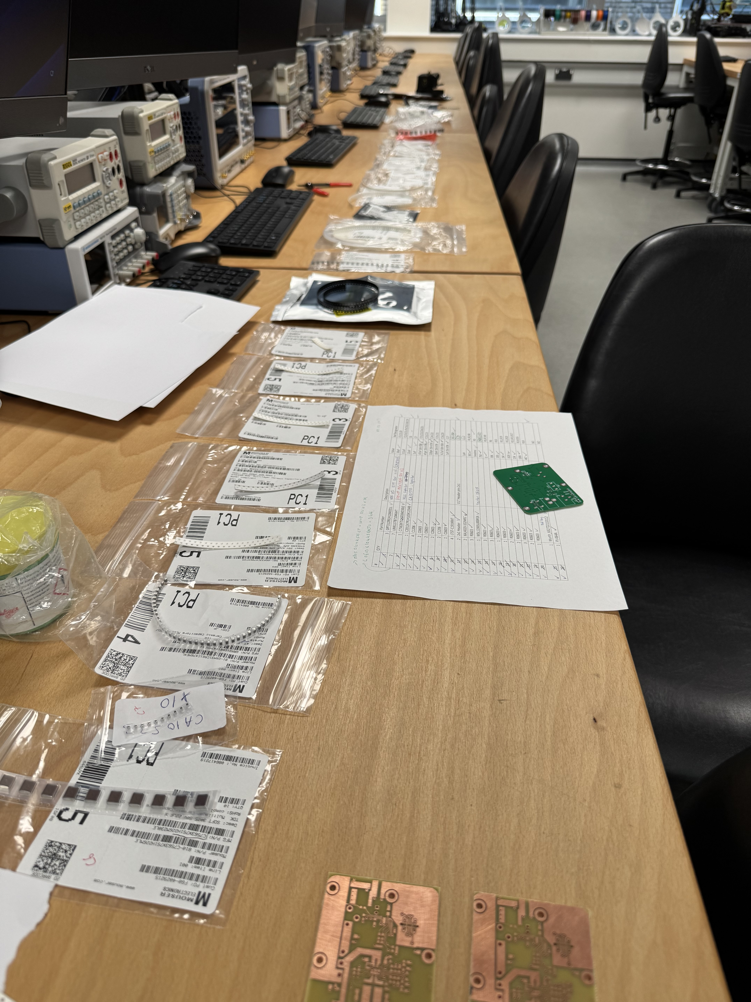
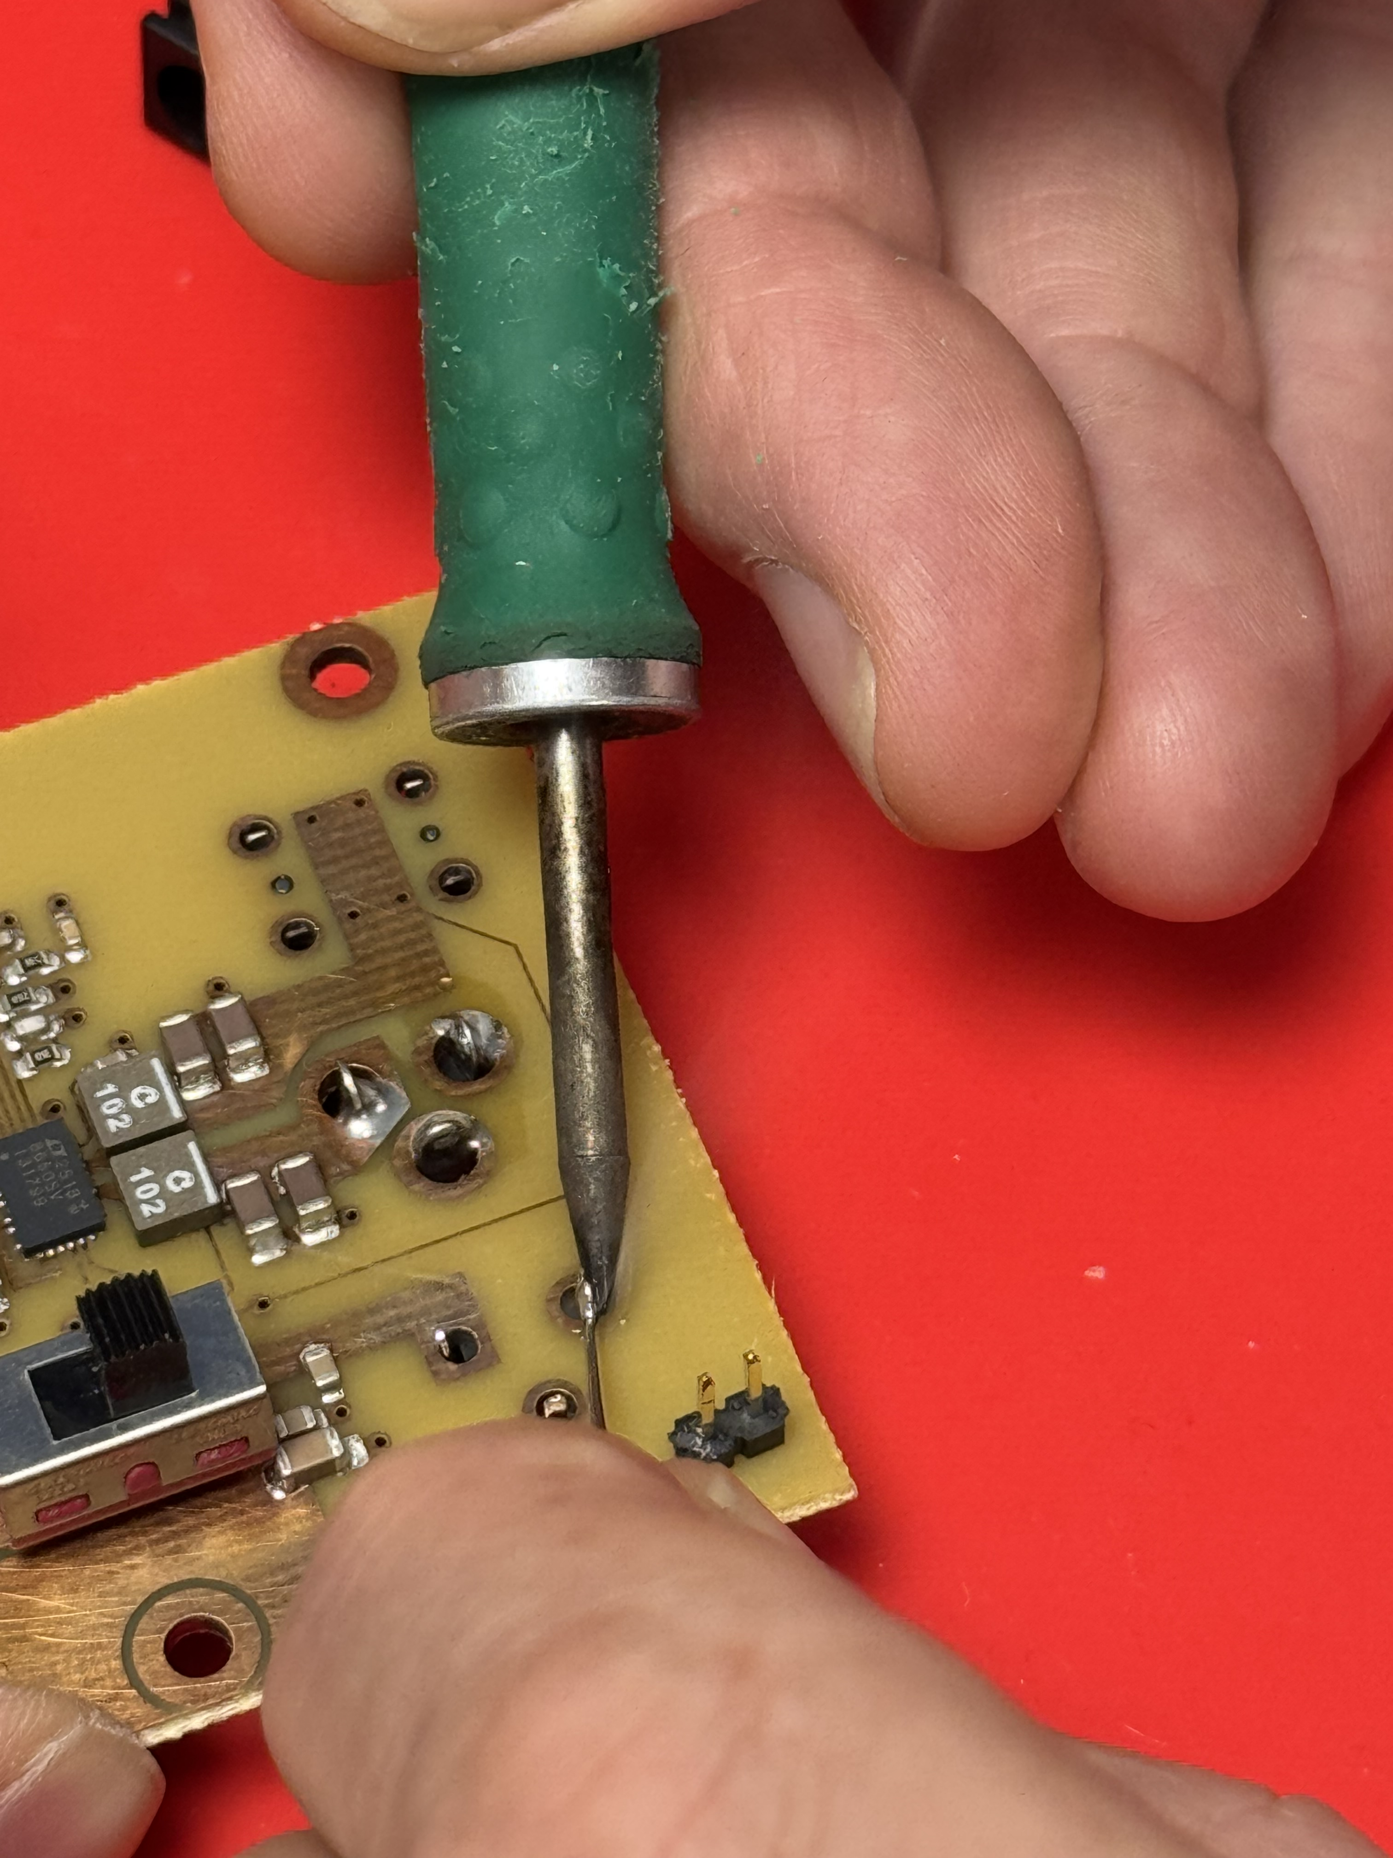
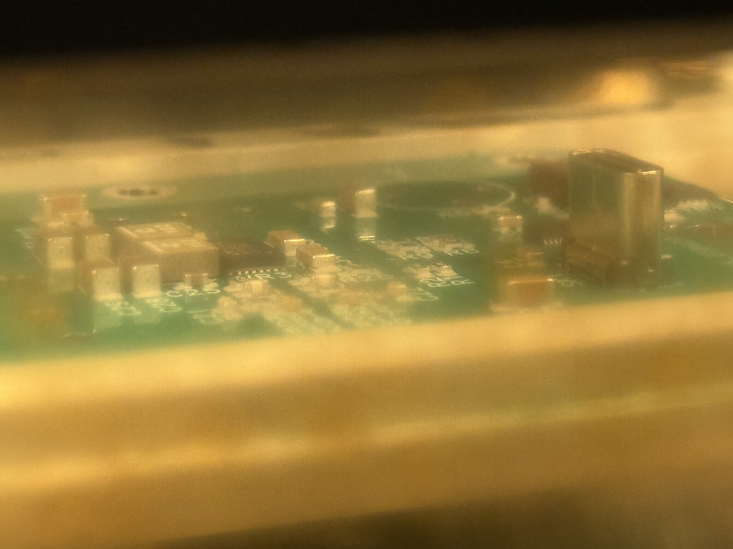
PCB Fabrication Process
Solder paste
Due diligence check connectivity (tedious things but recommended)
  Check ground and short circuit, vias to vias, trace to trace
Solder Mask & Silkscreen
  Apply solder mask (green, blue, etc.) to protect copper and prevent solder bridges.
  Add silkscreen (component labels, text, logos).
Component Population
  Place ICs, resistors, capacitors, connectors, etc. on designated pads.
  Automated pick-and-place or manual soldering.
Soldering & Assembly
  Reflow soldering (for SMT parts) or wave soldering (for through-hole).
  Ensures reliable electrical/mechanical connections.
Testing & Quality Control
  Electrical testing (continuity, shorts, impedance).
  Functional testing with programmed ICs.
Final Finishing
  Cutting/depanneling into individual boards.
  Apply protective coatings if needed.

Slide 11






Tips on PCB design
Utilise the space to its full potential
Also care about not only the electrically functioning but also mechanically strong and easy to assembled
In the case of free space, it could be use for “redundancy”. Such as weak USBC port, make it parallel to each other so in the case of 1 breaks, there is another hole that can be fitted.
Track size make it larger than 100micron, 300 micron would be good. Stronger and less prone to any stretch.
Connecting tracks to hole, widened the end.

Slide 12
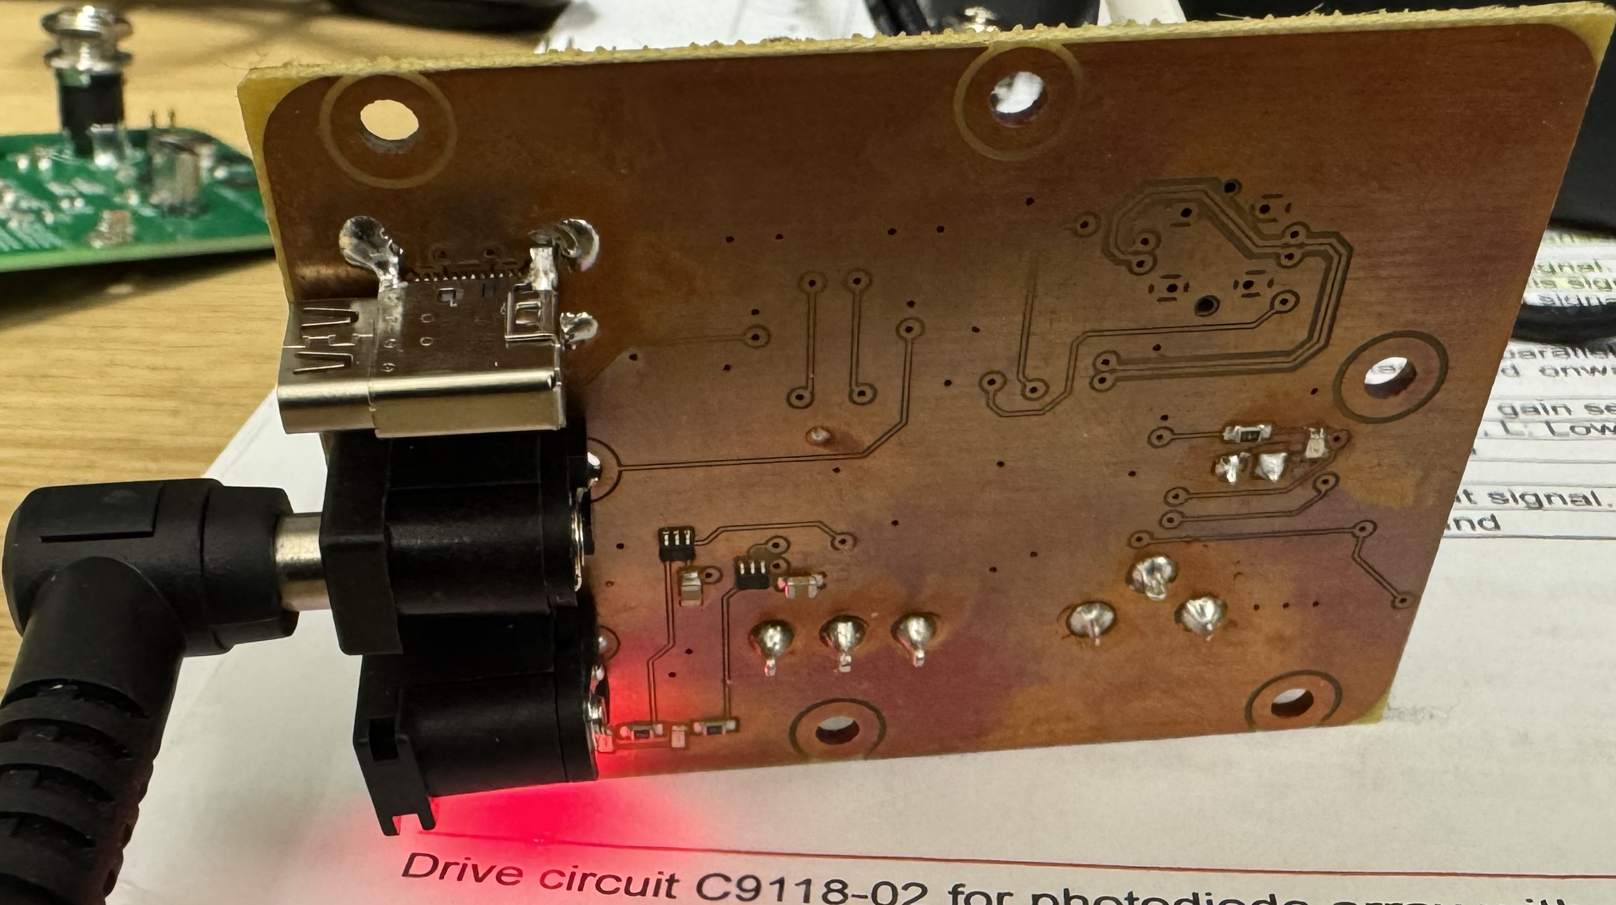
Testing conducted
Plug a DC Barrel Jack 12 V into SK2 (DC barrel port)
  Connect the SK3 to multimeter – 5.2V obtained
  Connect the SK4 to multimeter – 5.2V obtained
  Connect the SK5 to multimeter – 12.2V obtained
DC barrel port functioning as it intended to be.
However, when jumper cable is connected to J2, Only LED DS2 lights up whereas DS3 and DS4 are not. (Applied to all 5 boards)
When the switch, is set to the USBC side and back to the DC barrel jack side, DS3 and DS4 blinks very briefly. (This confirms there is no issue on the LED neither during assembly (orientation issue)) any reason why this is happening? (for next design consideration)

Slide 13
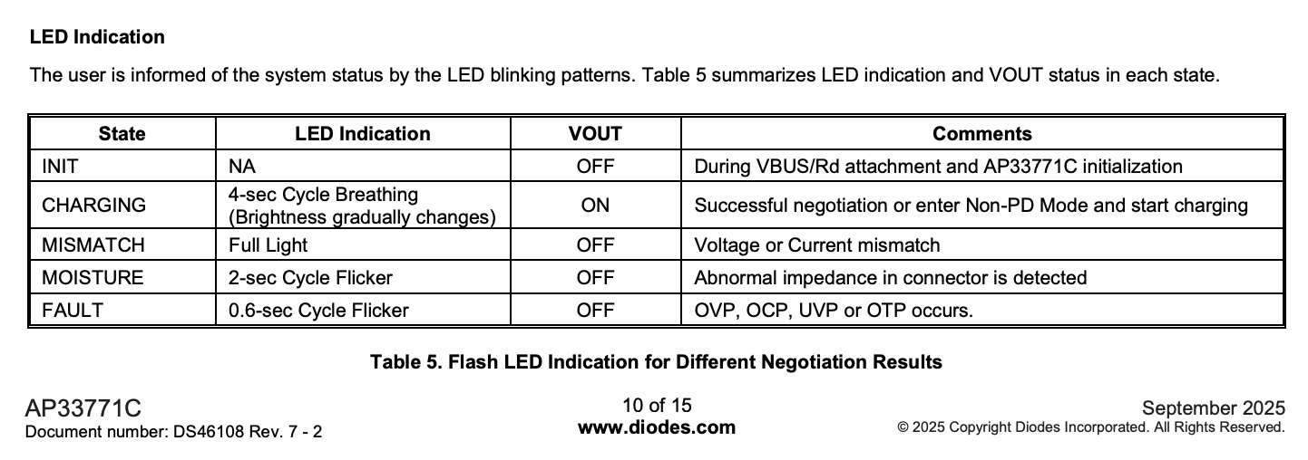
Testing conducted
Disconnected DC barrel jack, turn the switch to the USBC side, Connected USBC power supply (Apple 140W PSU) to SK1 (USBC Port)
  V output from SK3, SK4, SK5, are all 0V when tested using multimeter.
  It happens to all 5 boards that have been assembled
When jumper cable is connected to JS1, DS1 lights up fully(there is a slight delay of about 0.5s before it lights up after the jumper cable is connected).
  Based on the datasheet of AP33771C from diodes, Fully lights up LED indicating Voltage or current mismatch

Slide 14
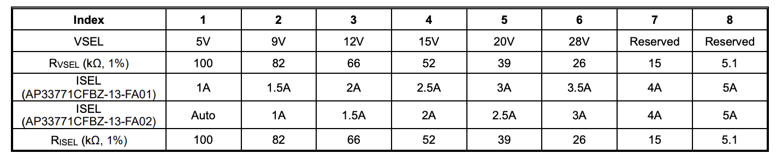
Testing Conducted
Supply from USBC port is 5.2V 3A despite there is 20.5V 5A options. (Tested using 140W apple power supply)
Plug another PSU with 20V 5A from minix to input USBC SK1
  Connect the SK3 to multimeter – 5.2V obtained
  Connect the SK4 to multimeter – 5.2V obtained
  Connect the SK5 to multimeter – 20.4V obtained

