Slide 1
Setting up PS KV260
29/10/2025

Slide 2
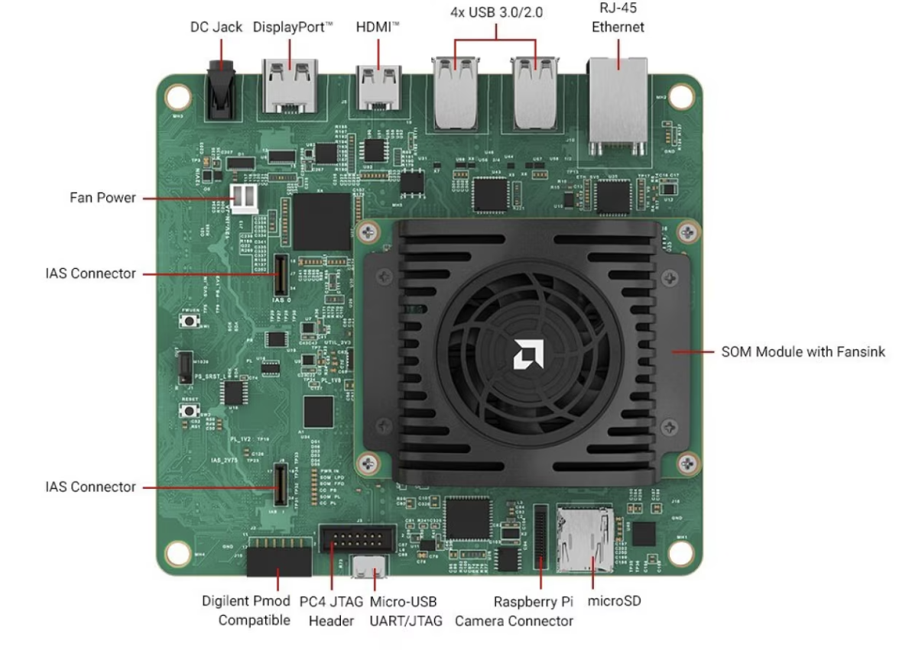
Background
Next stage of the development will be moving on to Kria K26 SoM chip (PS and PL in 1 chip), the board is currently under development.
Why? More compact, more powerful, more cost effective.
Allows integration of QuARC and Scintillating fiber without the need to increase more firmware aspects
First stage of getting familiar with K26 SOM Chips, is to play around with a development board KV260 and KR260 which also uses K26 SOM
This ppt file contains
Overview of the devices
Booting up with a supported OS: Ubuntu 22.04
Connecting to the device via Gnome Desktop, Serial Console, SSH
Copying Files using HDD or SCP
Initial setup, install Apache
Run DAQ using CLI
Compiling cpp source code

Slide 3
Specs of K26 Chip
Programmable logic:
256K system logic cells,
144 block RAMs,
64 UltraRAM blocks,
1.2K DSP slices.
CPU: Dual-core Arm Cortex-R5F at 600 MHz. (eq. intel atom z500 (2005 era))
GPU: Arm Mali-400 MP2 at 667 MHz. (eq NVIDIA GeForce 6100)
Kit Dimension: 119 × 140 × 36 mm

Slide 4
Memory
DDR Memory: 4 GB (4 x 512 Mb x 16 bit) [non-ECC]. (PC RAM)
Primary Boot Memory: 64MB QSPI (FPGA RAM) -> Nexys 16MB
Secondary Boot Memory SDHC card (PC Storage, external max 32GB)
2 different boot memory isolating firmware from the run-time OS and application.
On-chip memory: ~26.6 Mb SRAM (Caching Memory)
https://www.amd.com/en/products/system-on-modules/kria/k26/kv260-vision-starter-kit.html

Slide 5
Supported OS
Well Supported and recommended: Linux Ubuntu 22.04 LTS
Other:
Ubuntu 24.04
PetaLinux 21.01
PetaLinux 22.01
From forum, people do mention it’s probably possible to interface other ubuntu/petalinux version, but no support from Xilinx and requires debootstrap (building limited version of OS from scratch)
Worth checking app compatibility
If using this way (hope not), need to check and manage memory on your own.

Slide 6
Ubuntu 22.04
LTS (long term support) - Stable
GNOME version: enabled desktop looking feature.
4GB RAM is bare minimum to run this OS.
To setup:
https://xilinx.github.io/kria-apps-docs/kv260/2022.1/linux_boot/ubuntu_22_04/build/html/docs/sdcard.html#next-step

Slide 7
Then
Once booted with Linux, we have access to a terminal (via serial console or HDMI+keyboard)
Serial Console if we connect to host computer using terminal
HDMI+Keyboard, if we connect KV260 to monitor (GNOME Desktop ver)
Get the latest bit file and XSA file from the host PC.
Package it for Vitis or transfer it directly to the KV260.
(still investigating the FW booting system, and Vitis and custom Kernel)
(Need some hands on experiment to get idea validation and deeper understanding).

Slide 8
KV260 specific
Memory locking – not allowed for custom program outside of what has been provided?
“The Kria Starter Kits are shipped with a pre-loaded boot FW stored in the QSPI non-volatile memory device and a preset boot mode configuration of QSPI32.” (source)
“If you are developing on AMD released Starter Kits, the QSPI image is locked and the only section that should need an update is the Image A/B section along with the persistent registers. However, if you are developing your own carrier cards, the production SOM’s QSPI section is not locked. The entire QSPI can be customized to meet your boot firmware requirements for your production designs.” (source)

Slide 9
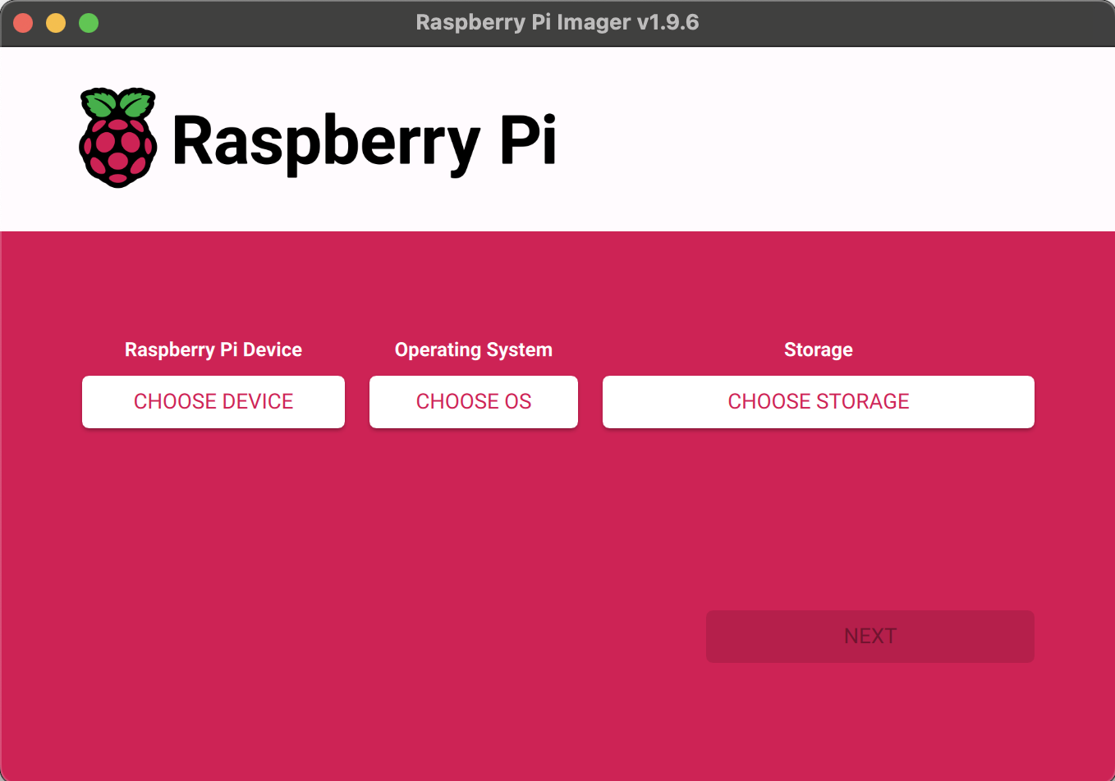
Boot Linux on Kria KV260
In host PC:
Install Ubuntu 22.04 LTS
Install raspberry pi imager
Prepare MicroSD card 16GB(used)/32GB
Open rasp pi imager, then Select rasp pi 5 (Device), select custom OS – Ubuntu 22.04 img.xz file (downloaded file), then select the external SD card.
Change settings – enable ssh, password authorisation

Slide 10
Gnome Desktop UI
There is no On/OFF button, once the barell jack 12V connected, it powers up and boot the linux up.
It might takes several minutes to boot up
Simply connecting HDMI to a monitor and keyboard and mouse altogether allowing the Gnome Desktop Interface
Login detail febian, protons2024
There is no internet connection unless its connected to internet port directly via ethernet cable conection.
Notes:
To check error log from running apache: sudo tail -n 20 /var/log/apache2/error.log

Slide 11
Serial Console UI
Run this in host PC terminal: (required connecting UART-USB connection to PC)
ls /dev/tty.* (to find out which port it is connected)
screen /dev/tty.usbserial-XFL1KP2HLD511 115200,cs8
Type febian
Then it will get prompted with password: protons24
This is running on terminal fully from host PC.
To exit
Exit to logout
Ctrl+a to initiate exit
Then \
Choose option y

Slide 12
Copying files using HDD
Connect the HDD to KV260
Connect serial console to it from host PC
Lsblk –o NAME,SIZE,MOUNTPOINT
First have to mount it (/dev/sda1) to a certain folder (mkdir is fine)
sudo mount /dev/sda1 external/
Once mounted, navigate to cd external/
Perform copy: cp external/filename.txt another/local/directory
Once done, sudo umount external

Slide 13
Ethernet connection
Can’t establish connection directly from PC – KV260 despite having specified the IP address for each end. (no route to host error) Required Router.
Turn off wifi in host PC is required otherwise it will goes via wifi not the connected router
Establish IP address for KV260
sudo nano /etc/dhcpcd.conf
interface eth0
static ip_address=192.168.1.2/24
KV260 image with rasppi 5 with name Febian
ssh febian@raspberrypi
Encounter error Host ID has changed, check .ssh/known_hosts, and remove any raspberrypi related SHA
Able to do file transfer using scp from host PC
scp Downloads/filename.txt febian@raspberrypi:/home/febian/Downloads/
Test connection (IP address might change)
ping 192.168.1.2 to KV260 (only works if static Ip is being set)
ping 192.168.8.1 to router
ping 192.168.8.122 KV260 on router

Slide 14
Downloading apache
Download using: sudo apt install apache2 (required internet)
Downloading it via host PC is not a very good option as the processing system architecture is different.
Other way, connect the KRIA directly to the ethernet port on the wall to get the internet directly running on the KRIA.
Using the Gnome UI, keyboard, and mouse to access its terminal directly
Unfortunately, it does not work either. (keeps stuck on connecting but does not taking it)
Tried connecting using 802.1x security using UCL account as ISD mentioned, does not works, connection time out
When 802.1x is enabled, ssh via LAN is not possible, don’t forget to disable it.
Tried connecting the dongle to usbc - usbb adapter, doesn’t get detected
It seems the KRIA must be registered to ISD to get the internet connections.
Notes:
IEEE 802.1x is a Network Access Control (NAC), consisting of 3 layer, supplicant (device trying to connect), Authentication layer, and Authentication server.
EAP/PEAP/TLS/MSCHAPV2, are all authentication layer.
EAP (Extensible Authentication Protocol: framework defines how devices and servers exchange credentials
PEAP (Protected EAP): EAP with encryption layer
MSCHAPv2: authentication protocol verifies username and password
Once connected successfully servers provides either IPv4 or IPv6 (internet protocol) to send and received traffic from the network. V4 vs v6 different bits format. V6 support more addresses.

Slide 15
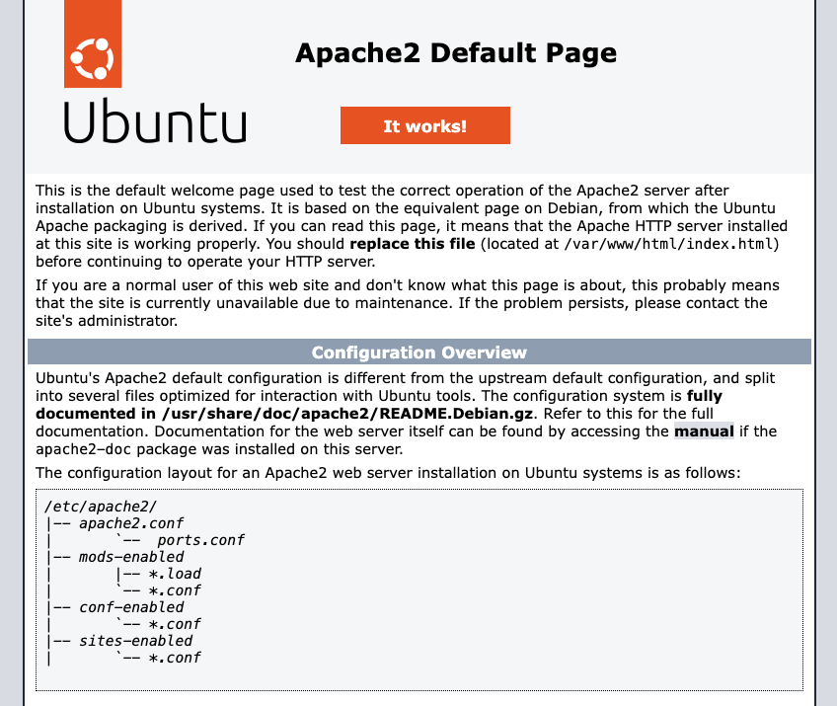
Installing Apache
Kria is now connected to the internet. Mac address of Kria is registered by Tony with the help of Simon.
Install apache using the package manager
Sudo apt update
Sudo apt install apache –y
Unfortunately, I have to re image the ubuntu22.04 from the beginning as apache build dependencies within the system, too many complicated unknown issue.
Apache installed is apache2 2.4.52-1 ubuntu4.16_arm64.deb
After successfully install, lovely html page appears.

Slide 16
Configure Apache on Kria
Edit 000-default.conf
sudo nano /etc/apache2/sites-available/000-default.conf
Add
<Directory /home/febian/mystuff>
Options Indexes FollowSymLinks
AllowOverride None
Require all granted
</Directory>
Change the DocumentRoot to /home/febian/mystuff
Ensure autoindex is enabled
Sudo a2enmod autoindex
Make the folder executable using: chmod +x /home/febian
Restart apache with: sudo systemctl restart apache2

Slide 17
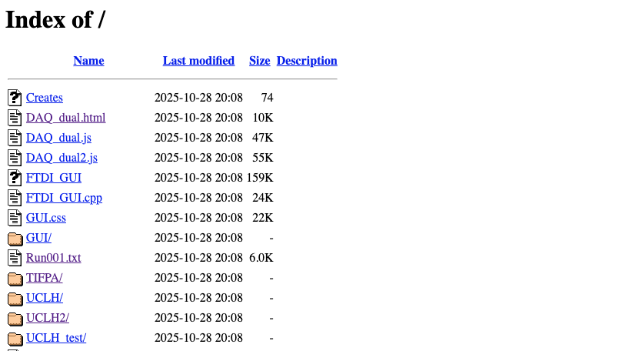
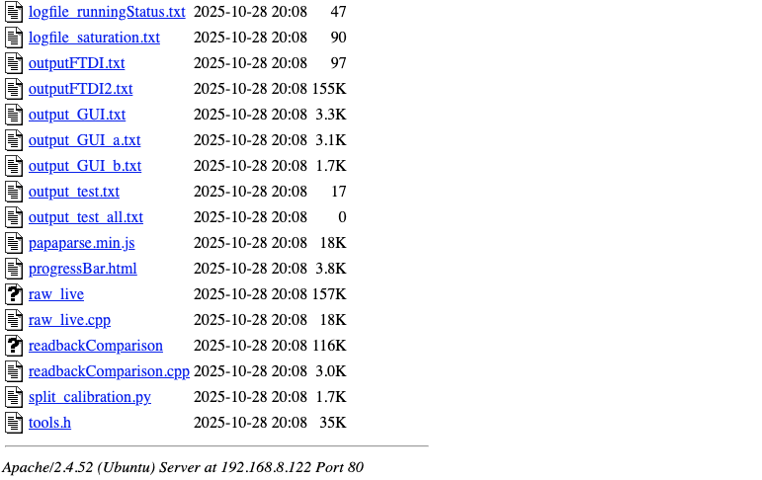
Looks nice!
Same way as it is in raspberrypi

Slide 18
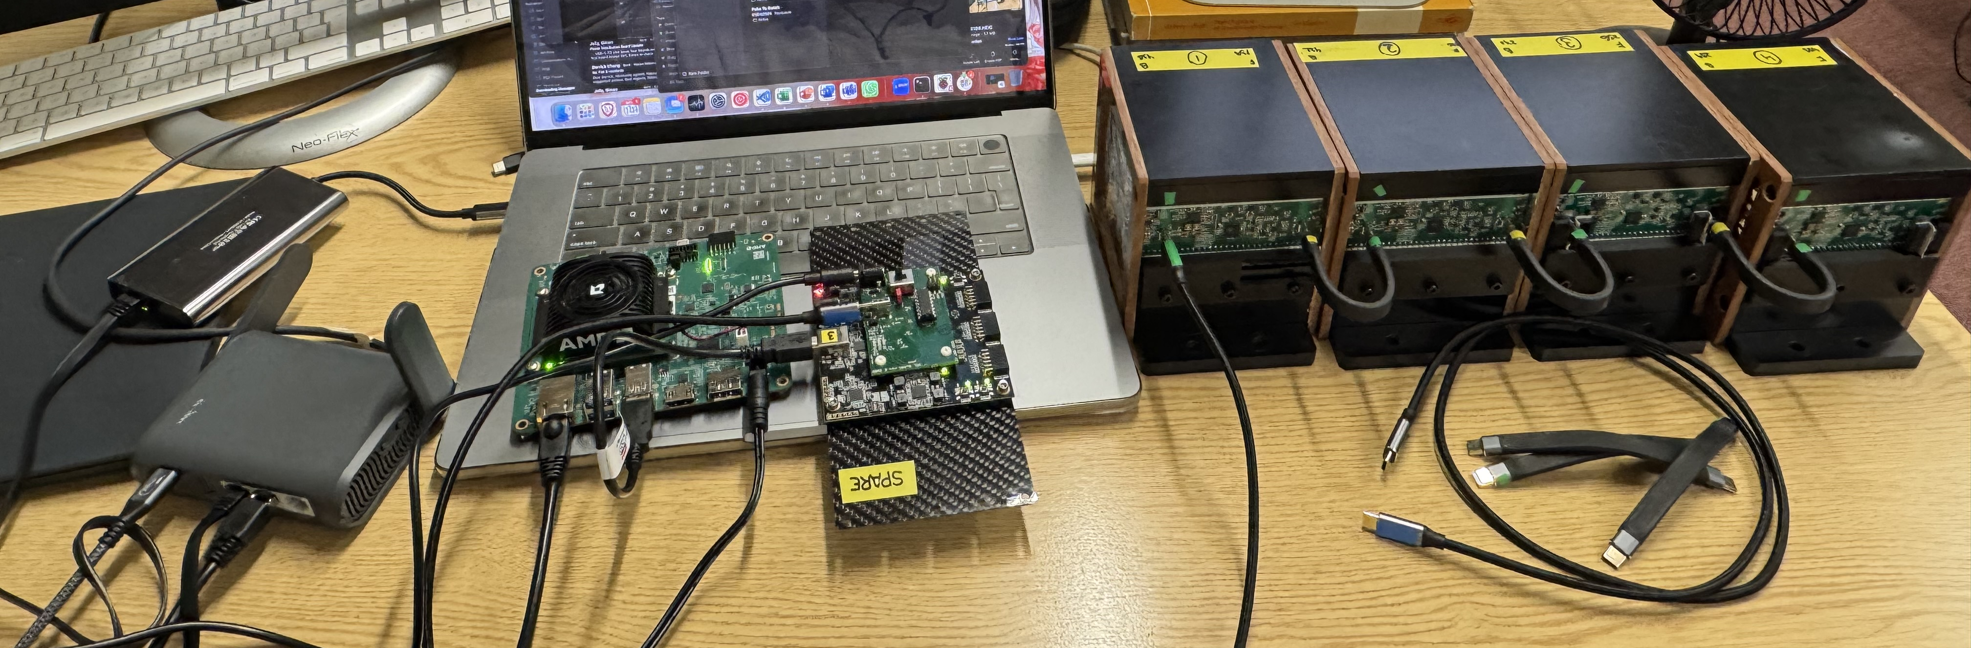
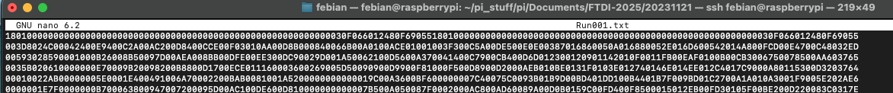
Run DAQ from KV260
Copied the entire content of the Pi to Kria directly (pi has about 23GB data, 64 GB data microSD for KV260 works)
Navigate to Documents/FTDI-2025/
Run the following command in terminal
sudo ./FTDI USB104ZMOD 1 12.5 170 10000 50 Run001.txt revD 2
Run well
The compiled FTDI cpp code save the file to 20231121 folder, name Run001-8 based on number of board used (txt file is saved on KV260)
Readback pattern is correct as expected
Tested with 1-8 board from using spare FPGA (as original one has passed away)

Slide 19
Run DAQ
Interfaced another Ubuntu 22.04 in another microSD namely kriapi
ssh febian@kriapi, pw: protons2024
Copy only Documents/FTDI-2025 folder
Tested with 1 board using the same syntax
Run fine, test pattern is all good, everything is expected, I thought there will be a dependencies error especially with libFTDI packages
Copy only the compile FTDI file
Error: Failed to open CSV file
Copied the CSV file from folder GUI
Run well as well

Slide 20
Compiling in KV260
g++ -L/home/febian/libftdi/build/src -I/home/febian/libftdi/src/src -std=c++17 -O3 -Wno-psabi FTDI.cpp -o FTDI -lftdi1
We are using a manually manage packages of libftdi.
-L/directory/.. – indicating the location of lftdi1
-I/directory/.. – indicating the location of ftdi.h
Copy tools.h into cwd
Compiled successfully
Tested with the compiled DAQ, run well
(it seems for Ubuntu 22.04 LTS Kria, g++ is already included)

