Slide 1
KV260 Apache - webdisplay

Slide 2
Preliminary Test
Load the Rasp Pi 512GB microSD directly
  Doesn’t boot up
    does not listed in the router clients
    With gnome desktop, no response
Kria Linux has embedded python packages already
  python --version
  Python 3.10.12 (stable version)
  Testing running hello world python script, works fine
Handy Syntax
  hostname -I
    It will tell the IP address of the pi in the router (192.168.8.122)

Slide 3
Downloading apache
Download using: sudo apt install apache2 (required internet)
Downloading it via host PC is not a very good option as the processing system architecture is different.
Other way, connect the KRIA directly to the ethernet port on the wall to get the internet directly running on the KRIA.
  Using the Gnome UI, keyboard, and mouse to access its terminal directly
  Unfortunately, it does not work either. (keeps stuck on connecting but does not taking it)
  Tried connecting using 802.1x security using UCL account as ISD mentioned, does not works, connection time out
    When 802.1x is enabled, ssh via LAN is not possible, don’t forget to disable it.
  Tried connecting the dongle to usbc - usbb adapter, doesn’t get detected
  It seems the KRIA must be registered to ISD to get the internet connections.
Notes:
IEEE 802.1x is a Network Access Control (NAC), consisting of 3 layer, supplicant (device trying to connect), Authentication layer, and Authentication server.
EAP/PEAP/TLS/MSCHAPV2, are all authentication layer.
EAP (Extensible Authentication Protocol: framework defines how devices and servers exchange credentials
PEAP (Protected EAP): EAP with encryption layer
MSCHAPv2: authentication protocol verifies username and password
Once connected successfully servers provides either IPv4 or IPv6 (internet protocol) to send and received traffic from the network. V4 vs v6 different bits format. V6 support more addresses.

Slide 4
SCP apache folder from Pi
Prepare this folder from pi
  /usr/sbin/apache2
  /etc/apache2/
  /usr/lib/apache2/
  /var/www/
  /usr/share/apache2/
Copy the folder to KRIA following this setup
  /home/febian/apache2/
    ── usr/
      sbin/apache2
      lib/apache2/
      share/apache2/
    etc/apache2/

Slide 5
To run the application
/home/febian/apache2/usr/sbin/apache2 –f /home/febian/apache2/etc/apache2/apache2.conf -d /home/febian/apache2/
  /home/Febian/ can be shortcut using $HOME/
Not so smooth, Errors incoming, in short this method does not work
Missing required library
  ldd /home/febian/apache2/usr/sbin/apache2
    libaprutil-1.so.0 => not found
    libapr-1.so.0 => not found
  Do similarly in Pi, and scp the library to KRIA under /home/user/apache2/usr/lib/
  Then, echo 'export LD_LIBRARY_PATH=$HOME/apache2/usr/lib:$LD_LIBRARY_PATH' >> ~/.bashrc
  source ~/.bashrc

Slide 6
More errors
Missing Setup Env Variables, re write in terminal by using:
  export APACHE_RUN_DIR=/home/user/apache2/run
  export APACHE_PID_FILE=/home/user/apache2/run/apache2.pid
  export APACHE_LOCK_DIR=/home/user/apache2/run/lock
  export APACHE_LOG_DIR=/home/user/apache2/logs
  export APACHE_CONFDIR=/home/user/apache2/etc/apache2
practically speaking, adjust the variable within envvars file
Adjust the User and Group, either in envvars or directly in apache2.conf

Slide 7
More errors
Next, error in loading the modules to run Apache
  Adjust all the used modules directory to have /home/Febian/apache2/…
  The required modules:
    loaded module access_compat_module from /home/febian/apache2/usr/lib/apache2/modules/mod_access_compat.so
    loaded module alias_module from /home/febian/apache2/usr/lib/apache2/modules/mod_alias.so
    loaded module auth_basic_module from /home/febian/apache2/usr/lib/apache2/modules/mod_auth_basic.so
    loaded module authn_core_module from /home/febian/apache2/usr/lib/apache2/modules/mod_authn_core.so
    loaded module authn_file_module from /home/febian/apache2/usr/lib/apache2/modules/mod_authn_file.so
    loaded module authz_core_module from /home/febian/apache2/usr/lib/apache2/modules/mod_authz_core.so
    loaded module authz_host_module from /home/febian/apache2/usr/lib/apache2/modules/mod_authz_host.so
    loaded module authz_user_module from /home/febian/apache2/usr/lib/apache2/modules/mod_authz_user.so
    loaded module autoindex_module from /home/febian/apache2/usr/lib/apache2/modules/mod_autoindex.so
    loaded module deflate_module from /home/febian/apache2/usr/lib/apache2/modules/mod_deflate.so
    loaded module dir_module from /home/febian/apache2/usr/lib/apache2/modules/mod_dir.so
    loaded module env_module from /home/febian/apache2/usr/lib/apache2/modules/mod_env.so
    loaded module filter_module from /home/febian/apache2/usr/lib/apache2/modules/mod_filter.so
    loaded module mime_module from /home/febian/apache2/usr/lib/apache2/modules/mod_mime.so
    loaded module mpm_prefork_module from /home/febian/apache2/usr/lib/apache2/modules/mod_mpm_prefork.so
    loaded module negotiation_module from /home/febian/apache2/usr/lib/apache2/modules/mod_negotiation.so
    loaded module php_module from /home/febian/apache2/usr/lib/apache2/modules/libphp8.2.so
    loaded module reqtimeout_module from /home/febian/apache2/usr/lib/apache2/modules/mod_reqtimeout.so
    loaded module setenvif_module from /home/febian/apache2/usr/lib/apache2/modules/mod_setenvif.so
    loaded module status_module from /home/febian/apache2/usr/lib/apache2/modules/mod_status.so

Slide 8
Apache Config files
Edit apache/sites-available/000-default.conf
  To correspond to a certain directory within KRIA
Enabling the conf file
  sudo a2ensite yoursite.conf
  sudo systemctl reload apache2
  Error: a2ensite: command not found
  Error: Failed to reload apache2.service: Unit apache2.service not found.
We can use,
  Disable the old one: rm apache2/etc/apache2/sites-enabled/000-default.conf
  Enabled the new one (symbolic link): ln -s apache2/etc/apache2/sites-available/000-default.conf apache2/etc/apache2/sites-enabled/000-default.conf
Notes:
(symbolic link also known as a soft link), which acts as a reference or pointer to another file or directory, the -s option must be used. Symbolic links can point to files or directories on different filesystems and are useful for creating shortcuts or organizing files without duplicating data.
Pros: convenience, accessible from easier directory, multiple reference without duplication, enable easier version control across multiple files
Cons: could be tricky to managed

Slide 9
More errors
make_sock: could not bind to address 0.0.0.0:80
  Required sudo mode
    Change the ports.conf file to port 8080 instead
    Change the site-available/*.conf to <VirtualHost *:8080
Could not reliably determine the server's fully qualified domain name, using 127.0.1.1. Set the 'ServerName' directive globally to suppress this message
  Set ServerName in apache2.conf file to 192.168.8.122
At last, the Apache run
  But when run from the hostPC, error 403 Forbidden page comes.

Slide 10
Troubleshoot
Make sure the folders are accessible
  Chmod +x the directory (allows the directory to be executable)
Make sure the documentroot is set to the right directory
  grep -R "DocumentRoot" ~/apache2/etc/apache2/sites-available
Make sure the apache config restriction is correct
  grep -R "Require" ~/apache2/etc/apache2/
  grep -R "Allow from" ~/apache2/etc/apache2/
  grep -R "Deny from" ~/apache2/etc/apache2/
  Change the require all denied to all granted
    nano ~/apache2/etc/apache2/mods-enabled/php8.2.conf
    nano ~/apache2/etc/apache2/mods-enabled/status.conf
    nano ~/apache2/etc/apache2/mods-enabled/info.conf

Slide 11
Troubleshoot
Run from the KRIA itself, using localhost:8080
Change the DocumentRoot to something else, checking whether its file permission issue
Re-run everything in sudo mode and direct copying to the corresponding directory in Kria.
  Setup apache2.service and apachectl script to run the server on the background
  Run it manually using sudo –E apache2
Despite all the trying, 403 Forbidden error still the case
  This could be highly likely caused by cross OS apache2 which resulting in library source file mismatches. It presents but read and compiled in a different way from how Debian would do.
  Modules incompatibility. Debian’s .so files may fail to load on Ubuntu, or Apache may skip them silently.

Slide 12
Displaying dir in host PC web
Using simple python web server
In Kria, cd to the directory that want to be shown to the web browser as the base. In terminal run
  cd pi_stuff/pi/
  python3 –m http.server 8000
    Output: Serving HTTP on 0.0.0.0 port 8000 ...
  Access to host PC web browser
    http://192.168.8.122:8000
  However in the meantime, the terminal is not accessible

Slide 13
Syntax explanation
python3 –m http.server 8000
  The -m option tells Python to: Run a module (from the standard library or installed packages) as a standalone program.
  http.server is a built-in web server module
    Serves files from the current directory
    Automatically generates a directory listing (like an FTP browser)
    Uses Python’s built-in socketserver to handle HTTP requests

Slide 14
Using Systemd
systemd is the "traffic controller" that starts and manages everything on your Linux system after it boots up. the init system and service manager
To automatically run the py module on the background when boot up.
  sudo nano /etc/systemd/system/fileserver.service
    The content of the script ->
  sudo systemctl daemon-reload
  sudo systemctl enable fileserver.service
  sudo systemctl start fileserver.service
  http://192.168.8.122:8000 can be accessed in hostpc web browser even when it’s not ssh
[Unit]
Description=Simple Python File Server
After=network.target
[Service]
User=febian
WorkingDirectory=/home/Febian/pi_stuff
ExecStart=/usr/bin/python3 -m http.server 8000
Restart=always
[Install]
WantedBy=multi-user.target

Slide 15
More about systemd
When you power on your Raspberry Pi or Ubuntu PC:
  The kernel loads first.
  Then the kernel starts PID 1, which is systemd.
  systemd’s job is to:
    Start all essential background services (networking, logging, SSH, etc.)
    Manage processes (start, stop, restart, monitor)
    Handle dependencies between services (e.g. “start networking before web server”)
    Manage system states (boot, shutdown, suspend, etc.)
    Provide unified logging via journald
So systemd = process manager + service manager + event coordinator.
Using sudo systemctl to control the services
  start, stop, restart, status, enable(start automatically on boot), disable, list-units --type =service

Slide 16
Taking DAQ with the GUI
From the web browser, 192.168.8.122:8000, open GUI/DAQ_dual.html
Render the html design well, but does not acquiring data
  it keeps mentioning no device connected despite successfully acquiring data via ssh terminal
  It is expected as the nature of http.server of python module serves as a nicely interfaced for sharing folder/files
  Still need Apache

Slide 17
Http.server vs Apache
Feature | Python http.server | Apache2
Purpose | Quick file sharing or testing | Production-ready web server
Installation | Comes with Python, no install needed | Must be installed (sudo apt install apache2)
Configuration | Minimal (port, directory) | Complex, supports virtual hosts, modules, SSL
Performance | Low, single-threaded | High, multi-threaded/multi-process, handles many concurrent users
Security | Minimal (no HTTPS, no auth) | Advanced (SSL, authentication, access control)
Dynamic Content | Only static files; needs frameworks like Flask/Django for apps | Supports dynamic content via PHP, WSGI (Python), Perl, etc.
Use Case | LAN file sharing, testing, learning | Hosting websites, web apps, production environments
Ease of Use | Extremely easy (one-liner) | Requires setup and configuration
Logging | Minimal console output | Full logging system (access/error logs)
Scalability | Very limited | Can serve thousands of simultaneous users

Slide 18
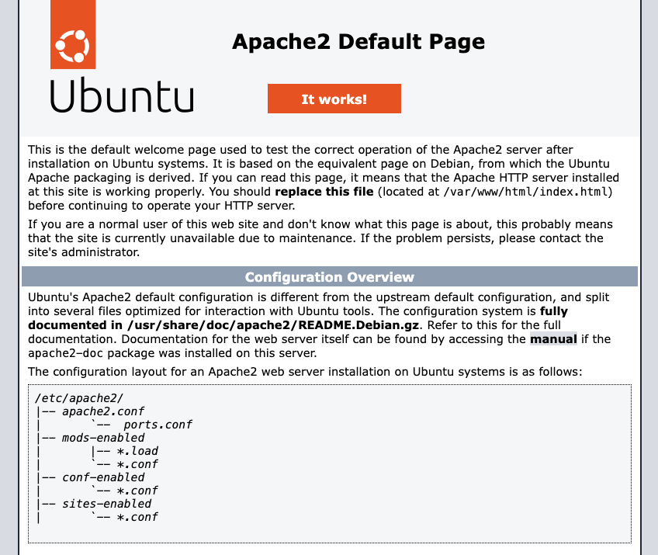
Apache journey continues
Kria is now connected to the internet. Mac address of Kria is registered by Tony with the help of Simon.
Install apache using the package manager
  Sudo apt update
  Sudo apt install apache –y
  Unfortunately, I have to re image the ubuntu22.04 from the beginning as apache build dependencies within the system, too many complicated unknown issue.
  Apache installed is apache2 2.4.52-1 ubuntu4.16_arm64.deb
  After successfully install, lovely html page appears.

Slide 19
Configure Apache on Kria
Edit 000-default.conf
  sudo nano /etc/apache2/sites-available/000-default.conf
  Add
    <Directory /home/febian/mystuff>
    Options Indexes FollowSymLinks
    AllowOverride None
    Require all granted
    </Directory>
  Change the DocumentRoot to /home/febian/mystuff
Ensure autoindex is enabled
  Sudo a2enmod autoindex
Make the folder executable using: chmod +x /home/febian
Restart apache with: sudo systemctl restart apache2

Slide 20
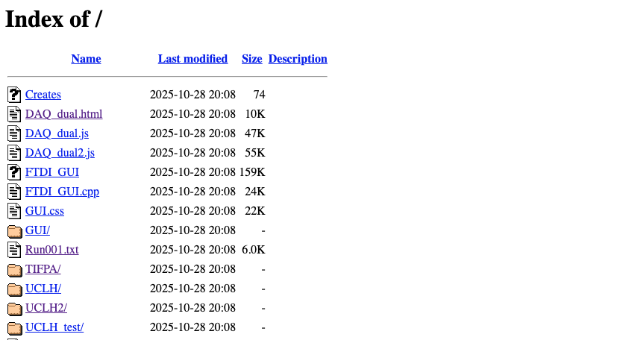
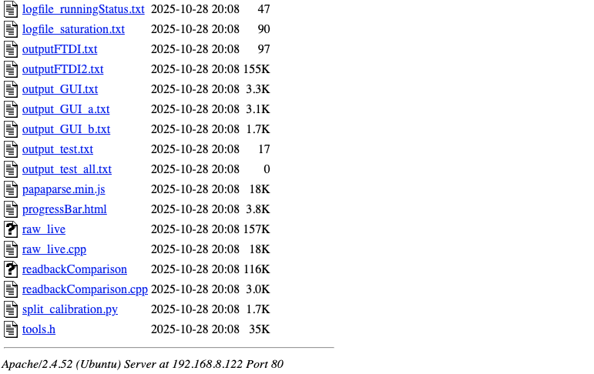
Looks nice!
Same way as it is in raspberrypi

Slide 21
DAQ with DAQ_dual.html
Does not work
  Keeps saying device not connected
  Tested with FTDI folder, runs fine
I thought it could be a naming convention issue
  Reimage another sd card for KRIA with name pi@raspberrypi
  Setup the apache exactly as how the raspberrypi is setup
  Put the folder exactly as how it is in raspberrypi
    Directory looks like /home/pi/GUI/v3.6
  Device not connected error still
I thought it could be that its not executable
  Chmod 755 /home/pi/GUI/v3.6/DAQ_dual.html

Slide 22
DAQ_dual.html troubleshoot
Maybe it required php library
  sudo apt install php libapache2-mod-php
  sudo systemctl restart apache2
  Error remains
Add more files to chmod executable
  chmod 644 *.php
  chmod 755 directories
  Error remains
Create a simple web_app to dynamically display text files when a button is clicked
  Run just fine indicating no rendering issue

Slide 23
DAQ_dual.html troubleshoot
Apparently Executable is not enough as it needs to write as well
  sudo chown -R pi:www-data /home/pi/GUI/v3.6
  sudo chmod -R 777 /home/pi/GUI/v3.6
  sudo chown pi:www-data /home/pi/GUI/v3.6/executeFTDI.sh
  sudo chmod 777 /home/pi/GUI/v3.6/executeFTDI.sh
  sudo chown pi:www-data /home/pi/GUI/v3.6/FTDI_GUI
  sudo chmod 777 /home/pi/GUI/v3.6/FTDI_GUI
  sudo chown pi:www-data /home/pi/GUI/v3.6/raw_live
  sudo chmod 777 /home/pi/GUI/v3.6/raw_live
Device still not connected, apache user must be in dialout
  sudo usermod -a -G dialout www-data
  Reconnect the USB connection

Slide 24
More about CHMOD and CHOWN
CHMOD is change mode whereas CHOWN is change owner
  chmod 755 file
chmod +x script.sh
  that makes “script.sh” executable.
sudo chown alice:staff file
  makes “alice” the owner, and “staff” the group.
who | can do what
owner | read, write, execute
group | read, execute
others | read, execute
permission | value
r (read) | 4
w (write) | 2
x (execute) | 1

Slide 25
DAQ_dual.html troubleshoot
sudo: a terminal is required to read the password; either use the -S option to read from standard input or configure an askpass helper
sudo: a password is required
  sudo nano /etc/sudoers.d/ftdi
  www-data ALL=(ALL) NOPASSWD: /home/pi/GUI/v3.6/executeFTDI.sh, /home/pi/GUI/v3.6/FTDI_GUI, /home/pi/GUI/v3.6/raw_live
PHP Warning: Undefined array key "selectedValue8" in /home/pi/GUI/v3.6/executeDAQ.php on line 17, referer: http://192.168.8.200/DAQ_dual.html
  Edit the executeDAQ.php, remove the selectedValue8 from line 17 and line 25. (This value is not being utilised anywhere yet)

Slide 26
Troubleshoot
D3 library used is d3.v4.13.0 which is already inside the cwd.
  D3 library is JS library and compatible with both Debian and ubuntu OS no problem
Obtained DAQ successfully saved. Status message is all good, status box is all good. Expected behaviour to the pi version, No live display shown
  One thing to confirm, yes the directory name matters a lot. Under the php, exec_shell(directory) is defined manually to /home/pi/GUI/v3.6

Slide 27
Further Testing/Troubleshoot
Notice that the timing mechanism in Kria is not running when its off.
  I believe pi was like this as well I remembered Sonia mention.
  Connected to internet is needed to get updated date and time.
Notice Missing Root Library which is required for Live_display
  Copy the root-6.30.02 folder from rasp pi to Kria (tried to extract it using the tar.gz does not work, missing files)
  Add this to bash.rc: source /home/pi/root-6.30.02/build/bin/thisroot.sh
  source ~/.bashrc
  Test using root-config –version :should see 6.30.02
  Recompile: g++ -o raw_live raw_live.cpp `root-config --cflags --glibs` -O3
DAQ_dual.html runs well on kria KV260

Slide 28
PS fresh install requirements conclusion
Rasp pi imager ubuntu 22.04 on microSD card from hostPC
  Name user is pi, name of the device raspberrypi.local
  Enable ssh using password
Open Kria, ssh to it using pi@192.168.8.xxx
Run: sudo apt install apache2 (slides 37)
Run: sudo apt install php libapache2-mod-php (slides 41)
Fix the config files for apache (slides 38)
Copy the root-6.30.02 folder to /home/pi (slides 46)
Copy the file GUI/v3.6/ to /home/pi
Chmod chown the folders (slides 42)

