Slide 1
PS/PL Connectivity
26/11/2025

Slide 2
Background
Explore how PS side could program the PL side of KV260
Designing the VHDL Block Designs

Slide 3
fpgautil
Examples:
(Load Full Bitstream using Overlay)
fpgautil -b top.bin -o can.dtbo
(Load Partial Bitstream through the sysfs interface)
fpgautil -b top.bin -f Partial
(Load Authenticated Bitstream through the sysfs interface)
fpgautil -b top.bin -f Full -s AuthDDR
(Load Parital Encrypted Userkey Bitstream using Overlay)
fpgautil -b top.bin -o pl.dtbo -f Partial -s EnUsrKey -k <32byte key value>
(Read PL Configuration Registers)
fpgautil -b top.bin -r
fpgautil: FPGA Utility for Loading/reading PL Configuration in zynqMP
Usage: fpgautil -b <bin file path> -o <dtbo file path>
Options: -b <binfile> (Bin file path)
-o <dtbofile> (DTBO file path)
-f <flags> Optional: <Bitstream type flags>
f := <Full | Partial >
Default: <Full>
-s <secure flags> Optional: <Secure flags>
s := <AuthDDR | AuthOCM | EnUsrKey | EnDevKey | AuthEnUsrKeyDDR | AuthEnUsrK>
-k <AesKey> Optional: <AES User Key>
-r <Readback> Optional: <file name>
Default: By default Read back contents will be stored in readback.bin file
-t Optional: <Readback Type>
0 - Configuration Register readback
1 - Configuration Data Frames readback
Default: 0 (Configuration register readback)
-R Optional: Remove overlay from a live tree

Slide 4
xmutil
usage: xmutil [-h]
{boardid,bootfw_status,bootfw_update,getpkgs,listapps,loadapp,unloadapp,xlnx_platformstats,ddrqos,axiqos,pwrctl,desktop_disable,desktop_enable,dp_unbind,dp_bind}
bootfw_status: Prints Qspi MFG version and date info along with persistent state values.
bootfw_update: Updates the primary boot device with a new BOOT.BIN in the inactive partition (either A or B).
listapps: Queries on target FW resource manager daemon of pre-built app bitstreams available on the platform and provides summary to CLI.
loadapp: Loads requested application configuration bitstream to programmable logic if the device is available.
unloadapp: Removes application bitstream. (Takes slot number, default 0)

Slide 5
PL/PS Communication update
After reading Erdem source and confirmation from Marvin (KIT), another attempt to load bin file from PS side to PL side is successful
Generate bin file from bitstream by enabling bin file generation from the settings on the top bar. (the previous bin file is to generate memory config file, hence they are different)
Copied the bin file to the PS side.
Load bin file by using
Sudo fpgautil –b ./directory/binfile.bin –f Full
Time taken to load BIN is 134.000000 Milli Seconds
BIN FILE loaded through FPGA manager successfully
Bin file is then loaded to the FPGA side and functioning.
When this happen, if the command is run within PS using GNOME Desktop, it will make the keyboard and mouse unresponsive. Meaning after programming the PL, the desktop gets disabled. Using SSH, runs perfectly fine.

Slide 6
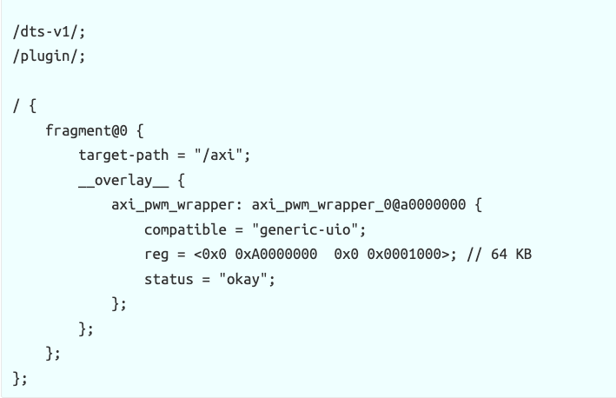
Device Tree Overlay for Ubuntu
Create file namely axi_pwm.dts with the content in the image (uncompiled)
Then convert it into dtbo using device tree compiler (dtc)
dtc -@ -I dts -O dtb -o axi_pwm.dtbo axi_pwm.dts
Then apply the overlay:
sudo fpgautil -o axi_pwm.dtbo
More on this guide

Slide 7
PMOD KV260 Pin config
PMOD Pin
PMOD pin 1: PACKAGE_PIN H12
PMOD pin 2: PACKAGE_PIN B10
PMOD pin 3: PACKAGE_PIN E10
PMOD pin 4: PACKAGE_PIN E12
PMOD pin 5: PACKAGE_PIN D10
PMOD pin 6: PACKAGE_PIN D11
PMOD pin 7: PACKAGE_PIN C11
PMOD pin 8: PACKAGE_PIN B11
kv260 constraints file base.xdc

Slide 8
Steps to PL/PS connectivity
Create VIVADO design with those (Pmod or Rpi GPIO), you can follow "Board Connections" for Pmod or GPIO at VIVADO Block Design. Now, generate .BIN file and XSA.
Create device tree from XSA using XSCT. You will get DTSI file here.
Create DTBO using device tree compiler in Linux (Ubuntu Host PC).
Rename .BIN and DTBO as kr260-gpio.BIN, kr260-gpio.DTBO. Copy .BIN, DTBO and shell.json into Kria-Ubuntu Image inside "/lib/firmware/xilinx" with new directory like "kr260-gpio".
Run sudo xmutil listapps, you must able to see "kr260-gpio" firmware over there.
Now you can unload app and load "kr260-gpio" firmware. As ubuntu desktop is not needed for this gpio control, you can disable the ubuntu desktop using xmutil command.
At Kria-Ubuntu terminal, now you will able to see gpio over the sysfs/class/gpio.
You can either manually toggle specific gpio (set direction of GPIO and tee value) or you can write user app for toggling.
(Following this tutorial)

Slide 9
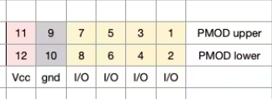
1. Create Vivado Design
Need to use Block Design functionality containing clock design and Zynq Ultrascale + MPSoC then the general one
Use the automated connection feature to assist.
Validate Block Design
Create HDL wrapper – generate a VHDL file from the BD
Add constraint (PMOD pin config for KV/KR260)
Generate Bin file from generate bitstream feature
Output at/<Vivado project>/<Vivado project>.runs/impl_1/
Generate XSA from File – Export Hardware – include bitstream

Slide 10
2. Generate DTSI from XSA file
Required xsct (Xilinx software command line tool) interface from vitis SDK (not HLS) - required install full vitis+vivado+vitisHLS
Kria boards requires Vitis 2022.1, meaning Vivado 2022.1 as well. In HostPC, install Vitis 2022.1 (This is what is recommended in docs and project tutorial, haven’t tried using the old version, not enough space to install vitis 2022.2 on top of vivado 2022.2, re-install required disk 145GB)
Once installed, goes to CMD on windows, then source xsct
C:\Xilinx\Vitis\2022.1\bin\xsct
Then run command, hsi::open_hw_design design_1_wrapper.xsa
Remember to cd C:/Xilinx/xsa (otherwise it can’t open as it tries to create temporary file with C: of which windows not allowed file/foldername to contain :

Slide 11
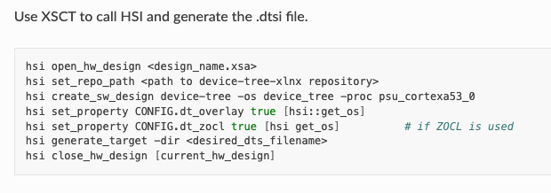
2. Generate DTSI from XSA file
Git clone Xilinx repo to a directory in host pc
Please download the same version to the vivado version i.e xlnx_rel_v2022.1
In windows, just install zip file from the repo.
hsi set_repo_path C:/Users/Protons/Documents/device-tree-xlnx
Then run hsi create_sw_design device-tree –os device_tree –proc psu_cortexa53_0
Then, run this to update config
hsi set_property CONFIG.dt_overlay true [hsi::get_os]
hsi set_property CONFIG.dt_zocl true [hsi::get_os]
Run hsi generate_target –dir C:/Xilinx/xsa
Source: here

Slide 12
3. Creating DTBO
Generating the device tree blob
scp pl.dtsi to kria PS
dtc -@ -I dts -O dtb -o pl.dtbo pl.dtsi
4. Rename .BIN and DTBO as kv260-gpio.BIN, kv260-gpio.DTBO. Copy .BIN, DTBO and shell.json into Kria-Ubuntu Image inside "/lib/firmware/xilinx" with new directory like "kv260-gpio".
Rename using mv pl.dtbo kv260-gpio.dtbo
Sudo mkdir in /lib/firmware/Xilinx
Sudo cp the files
5. Run step 5 and 6, listapps does not shows the kv260-gpio apps

Slide 13
What’s the issue???
Shell.json issue?
k26-starter-kit app shell.json content is the same as well
{ " shell_type" : “XRT_FLAT", "num_slots": "1" }
Make sure the " the right double quotation mark used <- this is the issue
Naming file .bin vs .BIN? .bit.bin name?
nope
Readable issue? Nope (tried 777 as well)
sudo chmod 644 /lib/firmware/xilinx/kv260-gpio/*
sudo chown root:root /lib/firmware/xilinx/kv260-gpio/*
Reboot the Kria? still nope
Wrong HW design? Exported xsa design was made from Vivado 2022.2?
KV260 issue?

Slide 14
Redesign HW using Vivado 2022.1
Encounter error, unable to generate clk_wiz IP
Error: TCL error create_gui procedure for BD Cell ‘system_clk_wiz_0_0’. Expected floating-point-number but got “unable to get value from speedsfile for keyword MM”
Need to reinstall the vivado, including support to custom board, tick SoC which supported Zynq Ultrascale+. (required 164.7GB storage, managed to free up to 164.9GB)
Either way this is useful.

Slide 15
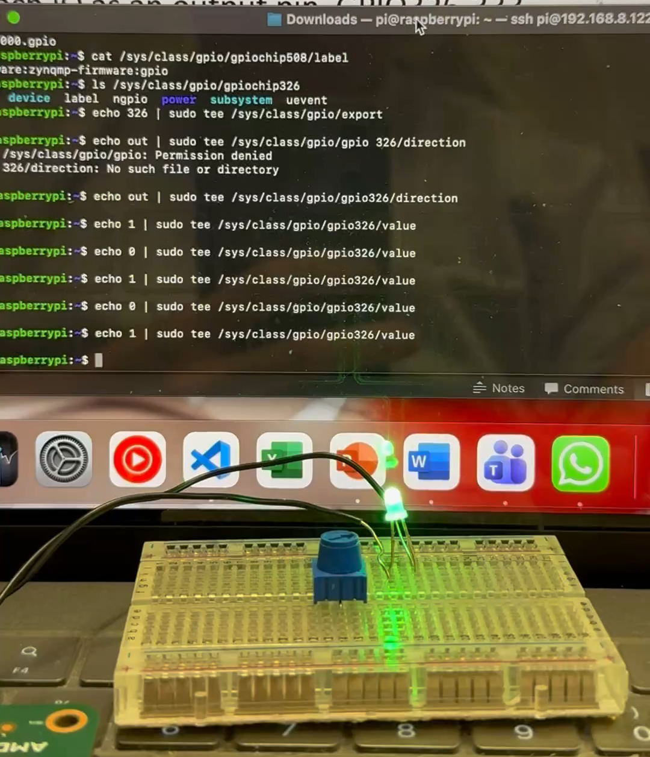
GPIO
Proceed to: ls /sys/class/gpio/
cat /sys/class/gpio/gpiochip326/label
a0000000.gpio
Gpiochip334( Zynqmp_gpio) and gpiochip508 (firmware:zynqmp-firmware:gpio), no need to be bothered.
Export each IO as an output pin, GPIO326-333
echo 326 | sudo tee /sys/class/gpio/export
echo out | sudo tee /sys/class/gpio/gpio326/direction
Toggle value
echo 1 | sudo tee /sys/class/gpio/gpio326/value
LED turned on
When reboot, need to reload the app up and export each IO pin.

