Slide 1
Nuvia Scintillators (Injection Mold requirements) for the QuARC
PHYSICS, HEP
PROTON BEAM THERAPY

Slide 2
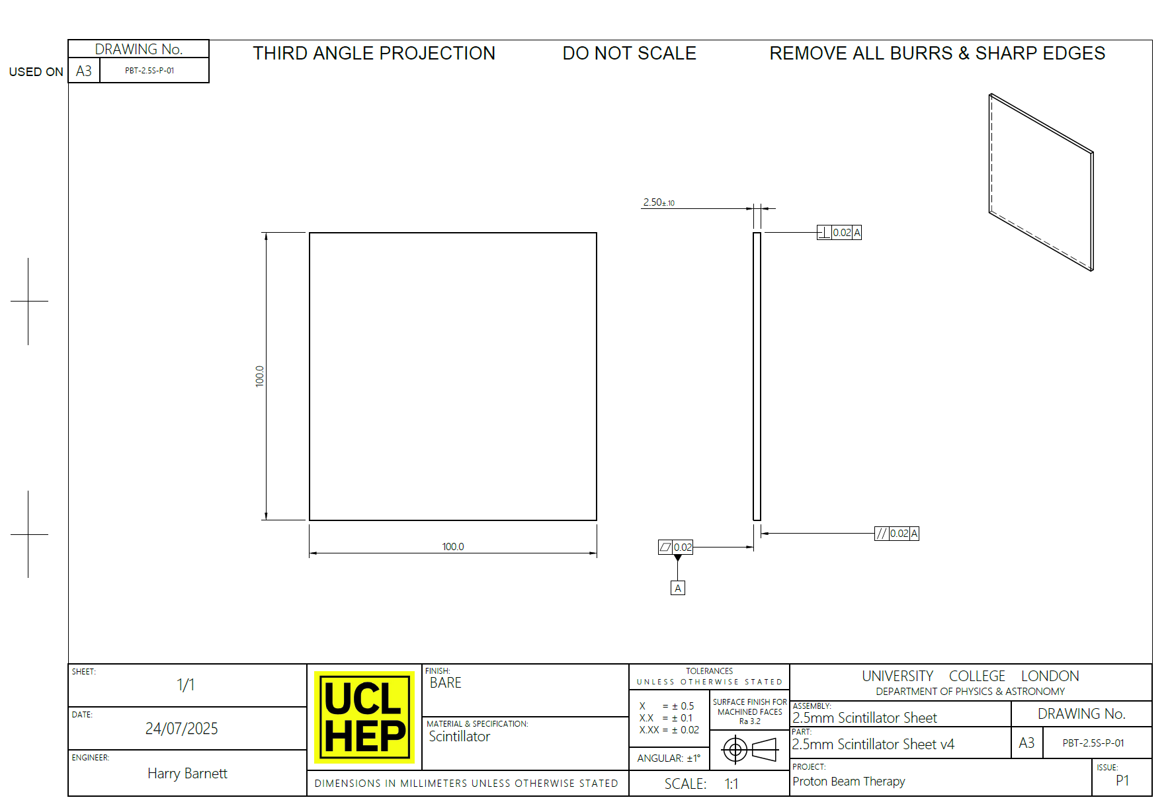
What we are aiming to Produce

Slide 3
Current Injection Molds 25/04/2025
100mm
100mm
100mm
100mm
Out of the current blanks we would only be able to machine 80mm x 80mm sheets

Slide 4
We’d like the Scintillator to be delivered in the following format.
IDEAL SIZES FROM NUVIA
130 - 140mm
130 - 140mm
130 - 140mm
130 - 140mm

Slide 5
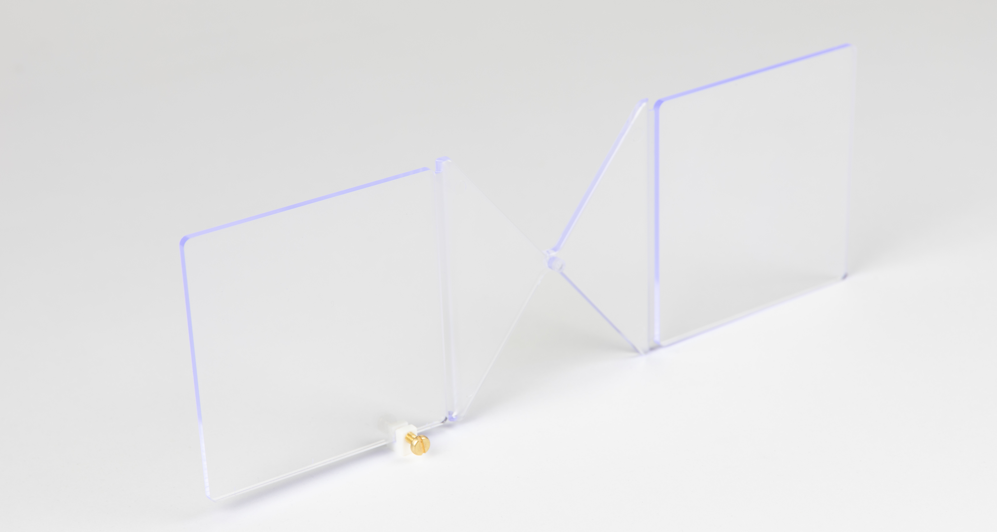
IDEAL SIZES FROM NUVIA
Thickness of 3.3 to 4mm

Slide 6
Ship us the blanks as shown with both sides connected

Slide 7
We will cut the 100 x 100mm out of the stock and face to 2.5mm in depth.

Slide 8
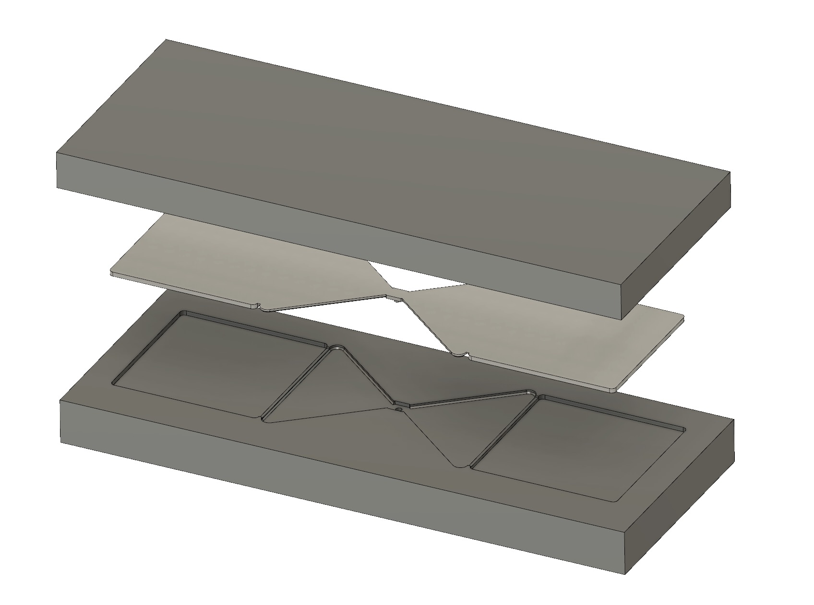
Reference Surface
Mold
Scintillator
"Flat" (reference) Surface
Mold
We'd like the "reference" surface to be as flat and optically clear as possible

Slide 9
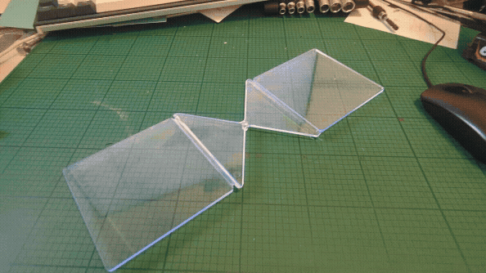
Reference Surface Cont.
Frist side shown is the "reference" surface, second is the surface we would machine

Slide 10
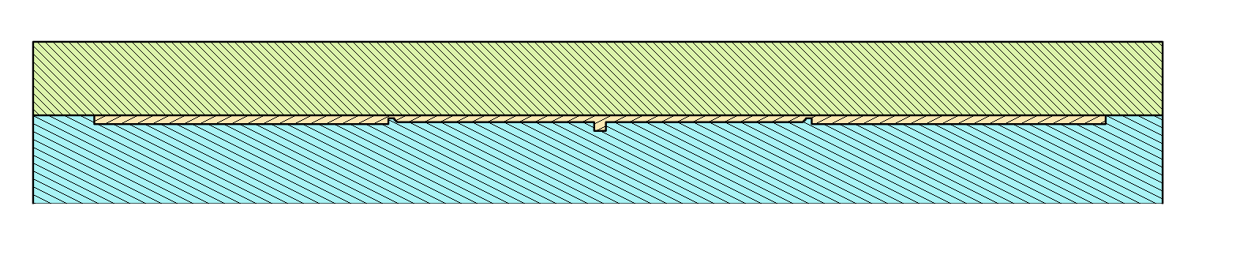
Reference Surface Cont.
Mold cut in half
Pour Point
"Flat" (reference) Surface

